Slide 1
CSCI 5822 Probabilistic Models of Human and Machine Learning
Mike Mozer
Department of Computer Science and Institute of Cognitive Science University of Colorado at Boulder

Slide 2
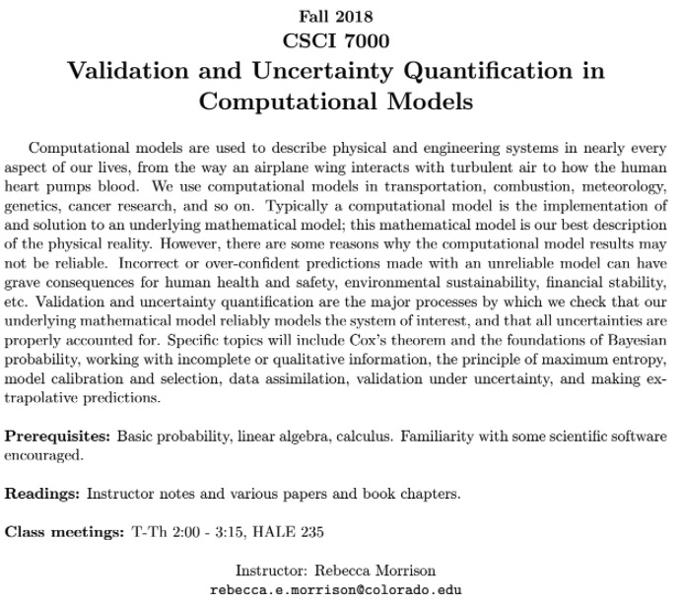
Fall Course

Slide 3
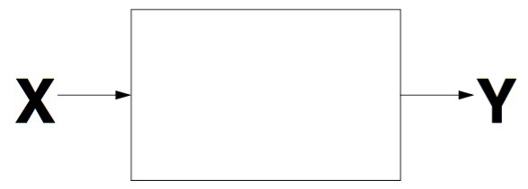
Gaussian Processes For Regression, Classification, and Prediction

Slide 4
How Do We Deal With Many Parameters, Little Data?
1. Regularization
e.g., smoothing, L1 penalty, drop out in neural nets, large K for K-nearest neighbor
2. Standard Bayesian approach
specify probability of data given weights, P(D|W)
specify weight priors given hyperparameter α, P(W|α)
find posterior over weights given data, P(W|D, α)
With little data, strong weight prior constrains inference
3. Gaussian processes
place a prior over functions directly rather than over model parameters, W

Slide 5
Problems That GPs Solve
Overfitting
In problems with limited data, the data themselves aren’t sufficient to constrain the model predictions
Uncertainty in prediction
Want to not only predict test values, but also estimate uncertainty in the predictions
Provide a convenient language for expressing domain knowledge
Prior is specified over function space
Intuitions are likely to be stronger in function space than parameter space
E.g., smoothness constraints on function, trends over time, etc.

Slide 6
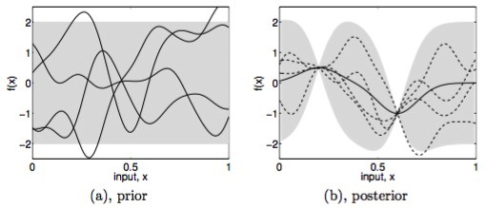
Intuition
Figures from Rasmussen & Williams (2006) Gaussian Processes for Machine Learning
Notes:
Prior: all smooth functions are allowed
Grey area: plausible value of f(x)
Observe 2 data points -> only allowed functions are those that are consistent with the data
End up with a posterior over functions. Kind of like throwing out all functions that don’t go through the data points.
Posterior uncertainty shrinks near observations. Why? smoothness of functions – points near the observations need to have values similar to those of the observations

Slide 7
Demo
http://chifeng.scripts.mit.edu/stuff/gp-demo/

Slide 8
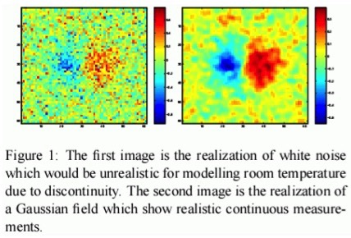
A Two-Dimensional Input Space
Notes:
Kriging / Shane’s work

Slide 9
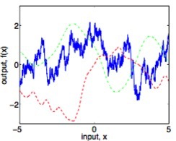
Important Ideas
Nonparametric model
complexity of model posterior can grow as more data are added
compare to polynomial regression
Prior determined by one or more smoothness parameters
We will learn these parameters from the data

Slide 10
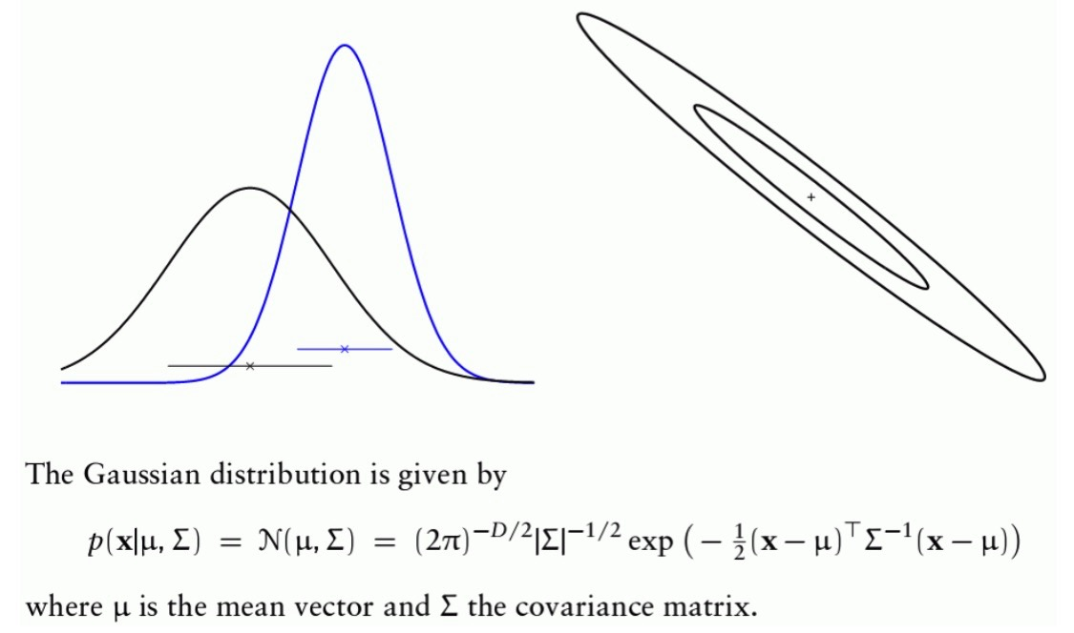
Gaussian Distributions: A Reminder
Figures stolen from Rasmussen NIPS 2006 tutorial

Slide 11
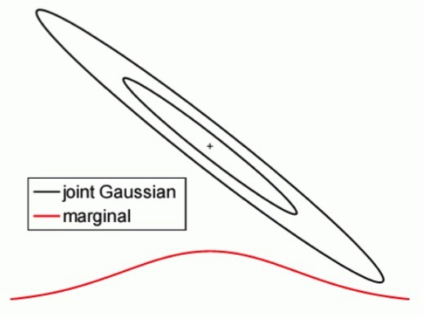
Gaussian Distributions: A Reminder
Marginals of multivariate Gaussians are Gaussian
Figure stolen from Rasmussen NIPS 2006 tutorial

Slide 12
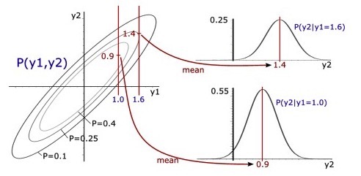
Gaussian Distributions: A Reminder
Conditionals of multivariate Gaussians are Gaussian

Slide 13
Stochastic Process
Generalization of a multivariate distribution to countably infinite number of dimensions
Collection of random variables G(x) indexed by x
E.g., Dirichlet process
x: parameters of mixture component
x: possible word or topic in topic models
Joint probability over any subset of values of x is Dirichlet
P(G(x₁), G(x₂), …, G(x_{k})) ~ Dirichlet(.)

Slide 14
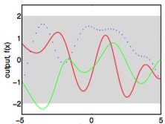
Gaussian Process
Infinite dimensional Gaussian distribution, F(x)
Draws from Gaussian Process are functions
f ~ GP(.)
notation
Switch
G0 -> F
G -> f
G(x) -> f(x)
f
x
Notes:
Notation switch: F instead of G, f(x) instead of G(x)

Slide 15
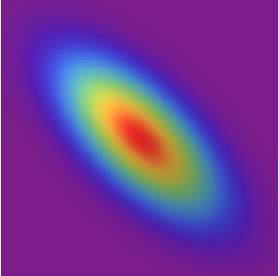
Gaussian Process
Joint probability over any subset of x is Gaussian
P(f(x₁), f(x₂), …, f(x_{k})) ~ Gaussian(.)
Consider relation between 2 points, x₁ and x₂
f(x₁) constrains the value of f(x₂)
f
x₁
x₂
x

Slide 16
Gaussian Process
How do points covary as a function of their distance?
f
f
x₁
x₂
x
x₁
x₂
x

Slide 17
From Gaussian Distribution To Gaussian Process
A multivariate Gaussian distribution is defined by a mean vector and a covariance matrix.
A Gaussian process is fully defined by a mean function and a covariance function
Example
squared exponential
covariance
l: length scale
Notes:
Gaussian distribution

Slide 18
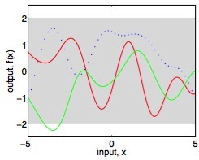
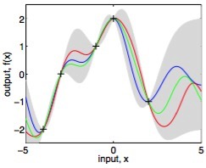
Inference
GP specifies a prior over functions, F(x)
Suppose we have a set of observations:
D = {(x₁,y₁), (x₂, y₂), (x₃, y₃), …, (x_{n}, y_{n})}
Bayesian approach
p(F|D) ~ p(D|F) p(F)
If data are noise free
P(D|F) = 0 if any
P(D|F) = 1 otherwise

Slide 19
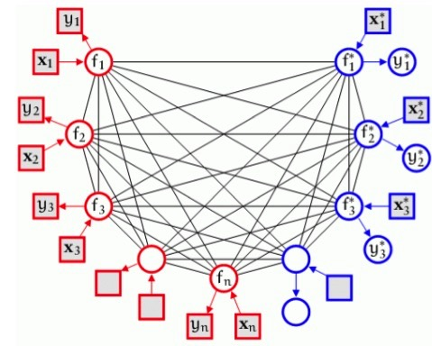
Graphical Model Depiction of Gaussian Process Inference
train
test
observed
unobserved
Notes:
square boxes are observed
Red = training data
Blue = test data

Slide 20


GP Prior
where
GP Posterior Predictive Distribution
Notes:
X: set of training points
X*: set of test points
all points need to be jointly Gaussian -- training and test
decompose covariance matrix into X and X*
Posterior makes a prediction for each value along with the _Gaussian_ uncertainty
Analytical form because GP prior + gaussian likelihoods -> Gaussian process posterior
Marginalize to get Gaussian posterior over set of points

Slide 21

Observation Noise
What if
Covariance function becomes
Posterior predictive distribution becomes

Slide 22
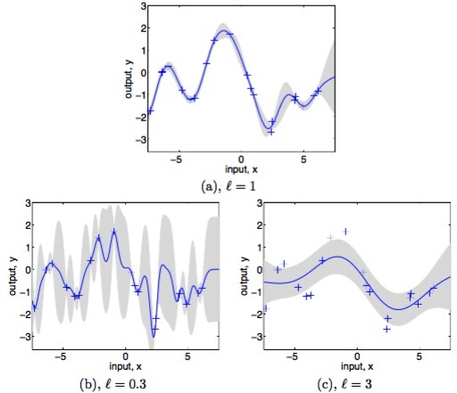
What About The Length Scale?
Notes:
Note: uncertainty grows rapidly with distance from data points with short length scale

Slide 23
Full-Blown Squared-Exponential Covariance Function Has Three Parameters
How do we determine parameters?
Prior knowledge
Maximum likelihood
Bayesian inference
Potentially many other free parameters
e.g., mean function
Notes:
QUIZ: what will sigma_f do?
sigma_f determines range of y values, e.g., all values in [-1, +1] vs. all values in [-100, +100]
Bayesian inference is nice because you can impose prior on parameters, but it’s typically very expensive

Slide 24
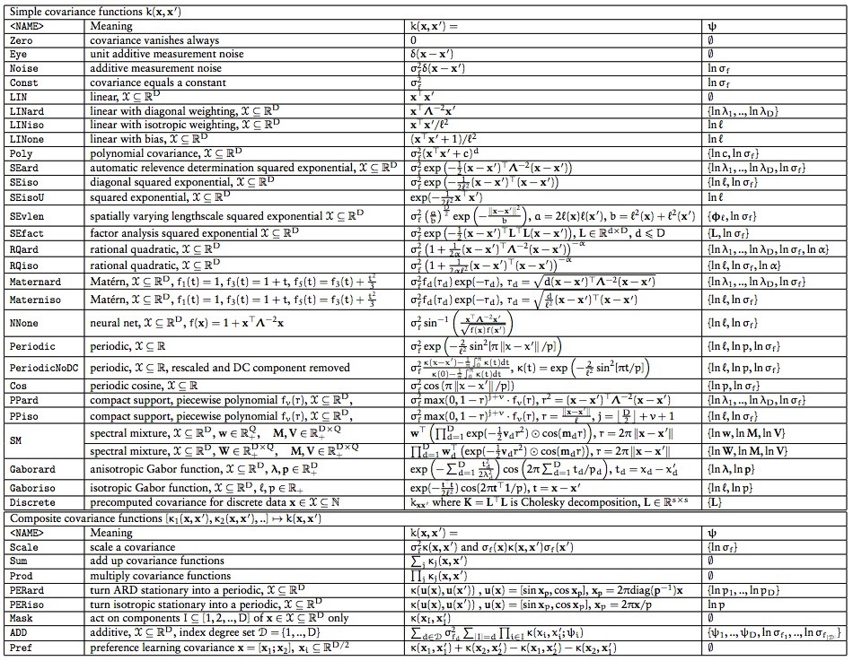
Many Forms For Covariance Function
From GPML toolbox

Slide 25
Many Forms For Likelihood Function
What is likelihood function?
noise free case we discussed
noisy observation case we discussed
With these likelihoods, inference is exact
Gaussian process is conjugate prior of Gaussian likelihood
(Works for noisy observations because noise is incorporated into covariance function.)

Slide 26
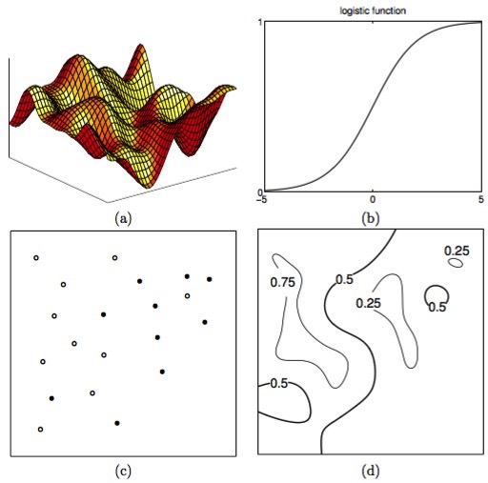
Customizing Likelihood Function To Problem
Suppose that instead of real valued observations y, observations are binary {0, 1}, e.g., class labels

Slide 27
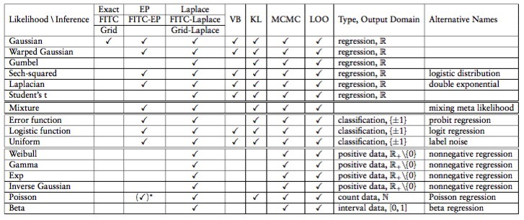
Many Approximate Inference Techniques For GPs
Choice depends on likelihood function
From GPML toolbox

Slide 28
What Do GPs Buy Us?
Choice of covariance and mean functions seem a good way to incorporate prior knowledge
e.g., periodic covariance function
As with all Bayesian methods, greatest benefit is when problem is data limited
Predictions with error bars
An elegant way of doing global optimization…

