Slide 1
Working Effectively with People in Government on Open Source Projects
http://jden.us/talk-2014-osbridge
CC-BY jden

Slide 2
why government?
Notes:
Governments have a lot of users
Governments have an obligation to serve everybody – it’s a great place to put your skills to work around accessibility and user-centered design
They have a lot of fun data
They directly affect our daily lives
When civic hackers and governments work together, we accomplish more than either could do alone

Slide 3
jason denizac
instigator / web developer
Notes:
i have a background in public policy, and like many of you, i spend an inordinate amount of time on the internet

Slide 4

cfa
Notes:
. i'm also currently a Fellow at Code for America, a non-profit which works to bring commmunities and governments together by design and technology. I'll share some things I've learned at Code for America as well as previously, but in this talk I'm speaking for myself, not for Code for America. And for the sake of full disclosure, the application period for next year's Fellowship class is currently open, and if you're thinking about applying, I'd be happy to speak with you more after

Slide 5
civic hacking
Notes:
I'm going to be using a term you may or may not have heard before - civic hacking & civic hacker. I want to define what I mean by this.

Slide 6
hack
Notes:
a hack is any improvement on an existing system. it may not have been designed or envisioned originally, but it's a change that makes life better for someone.
I hold a fundamentally positive definition of "hack" and "to hack"

Slide 7
systems are fundamentally hackable
Notes:
A hacker holds a world view that systems are fundamentally hackable, that is, amenable to change. hackers keep an eye out for things which could be made better.
A civic hacker, then, is someone who sees cities and communities as just another system to hack.

Slide 8
“civic hacker”
Notes:
a civic hacker doesn't have to have any particular skill set, and a hack doesn't have to be particularly out of the ordinary. active, engaged citizens, then, could be seen as civic hackers. the key to being a hacker, in my definition, is the attitude, the inclination to want to participate in making things better.

Slide 9
you might already be a civic hacker
Notes:
you might be a civic hacker if, when you see a problem, you work to fix it, instead of just complaining about it

Slide 10
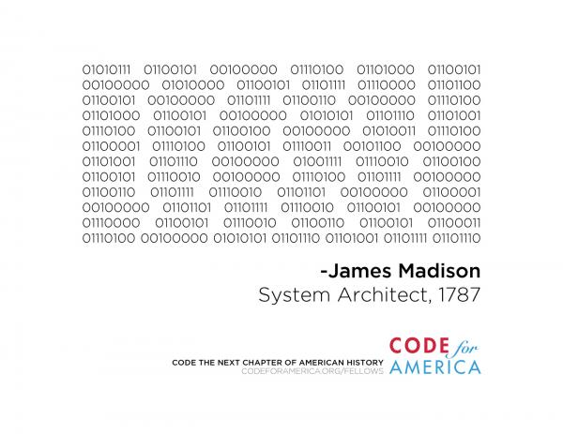

Slide 11
I. hacking with humility
still ahead: II. what the hall?
Notes:
so this is really two talks in one. the first part i'm calling "hack with humility,” which is mostly about communication and awareness. The second part will be called “what the hall?” and we’ll address the bureaucracy head-on

Slide 12
why hack?
Notes:
we want to make things better
there are a lot of things which could be better
for me, it starts with the phrase “life’s not fair”
well, why not?
so in all of my work, an underlying theme is I want to make things a little more fair.

Slide 13
why be humble?
Notes:
we, the attendees of this conference and conferences like this, posses an impressive array of skills and technical mastery. we can do things it seems those around us can’t.
it’s easy to get stuck being impressed with our own skills and knowledge and solid logic
it’s all in our heads. if we want to do good, we have to play well with others.
we are all profoundly ignorant, and we would do well to listen to others

Slide 14
how might we be humble?
Notes:
know and appreciate others’ work
be open to new ideas and suggestions

Slide 15
how might we be humble?
- inclusivity
Notes:
know and appreciate others’ work
be open to new ideas and suggestions

Slide 16
“routing around the damage”
Notes:
have you ever heard that the best solution to a problem is just not to have that problem?
this is secession, breaking away. while this can be a valid strategy in some cases, such as building redundant networks, it’s not to be taken lightly in group interaction
it’s a power play, and end-run. you might get to ship faster, but you’ll be starting frm scratch next time and you’re not likely to make many allies

Slide 17
no one likes to be called damaged goods

Slide 18
“if you want to go fast, go alone. If you want to go far, go together”
- oganizery aphorism

Slide 19
how might we be humble?
inclusivity
communication
Notes:
know and appreciate others’ work
be open to new ideas and suggestions

Slide 20
communicate!
Notes:
communicate your goals, your needs, and your wants
be open to new suggestions about how to actually get there

Slide 21
no ego
Notes:
- this isn’t a talk about logical fallacies or communications anti-patterns.
has anyone read “crucial conversations”?
I want to credit Isaac Schuleter of npm, inc for introducing me to another book called non-violent communication.

Slide 22
when I see $observation I feel $emotion because I need $need could you please $request
- Isaac Schuleter, slide 31, http://bit.ly/1pchusv
Notes:
- here’s that book as a madlib. this slide is lifted directly from Isaacs’ presentation at NodeconfEU last year. Notice that this pattern focuses on making your own internal thought process clear and using it as the rationale to ask for a change in behavior from someone else.
- What it doesn’t do it assign blame or motives, and it doesn’t put words in people’s mouths

Slide 23
speak plainly
Notes:
this means in non-technical language. every group ends up with some jargon; make a conscious effort to avoid introducing your own and to offer explanations when you otherwise can’t avoid it
be willing to translate technical language coming from other places that your group might encounter
help adapt technical definitions to what is meaningful in a new context
others often will not speak plainly, and you can always ask clarifying questions

Slide 24
existing words
Notes:
in a group you’ll come across a lot of things, including existing words
as a rule, don’t try to redefine or replace existing words, even if it sounds strange or wrong to you
unless it’s something critical. then raise it as an issue and propose a change in terminology with your reasoning
sometimes it matters. often it’s just pedantic and derailing

Slide 25
negotiation
Notes:
this is *not* about just getting your way
negotiation is about finding shared value and reaching consensus

Slide 26
negotiation: prepare
Notes:
this is a skill where planning and talking it out ahead of time is really crucial- get a buddy or a mentor to go over your plan with you
don’t let the other party derail you – always go in knowing your alternaives. what’s the cost to you of walking away? what’s the cost to them?

Slide 27
negotiation: be open
Notes:
it’s not about tricks or being heavy handed.
understand the other person's objectives, understand and communicate your own objectives. don't be coy or dishonest. raise possible objections or deal-breakers proactively and in good faith to see if a mutually-agreeable solution can be met.

Slide 28
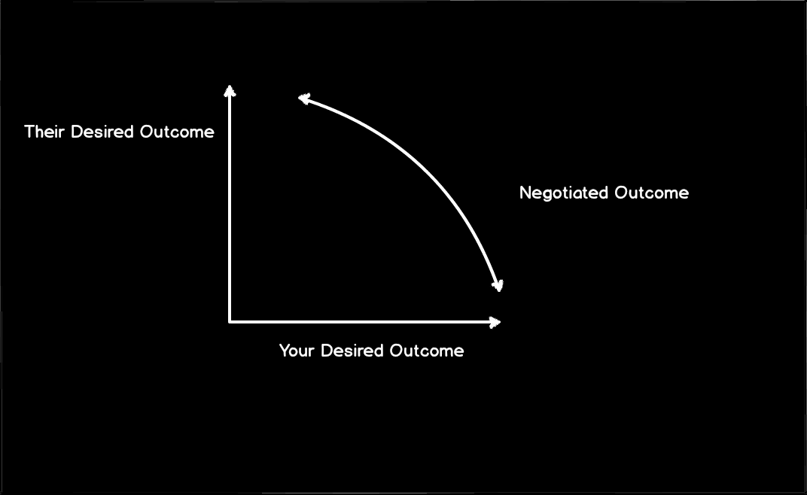
Notes:
let’s look at a visual model.
the vertical axis is the range of the other party’s desired outcomes
the horizontal axis is your desired outcomes.
anywhere in the middle, let’s say is a possible agreement

Slide 29
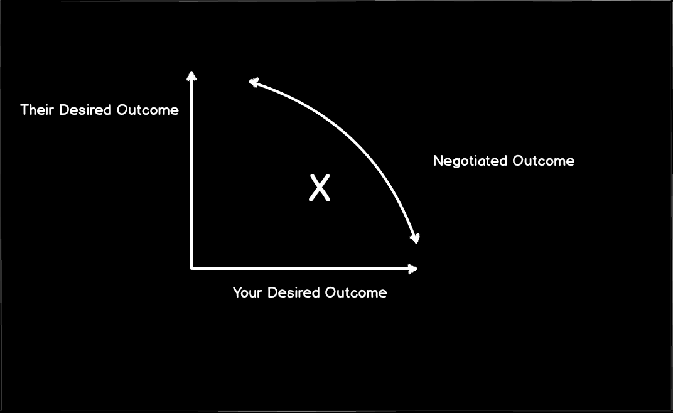
Notes:
imagine that this x is the first thing we asked for. we go in, tell them what we want, and they more or less come back and say okay.
we’re done, right?
we “got to yes!”

Slide 30
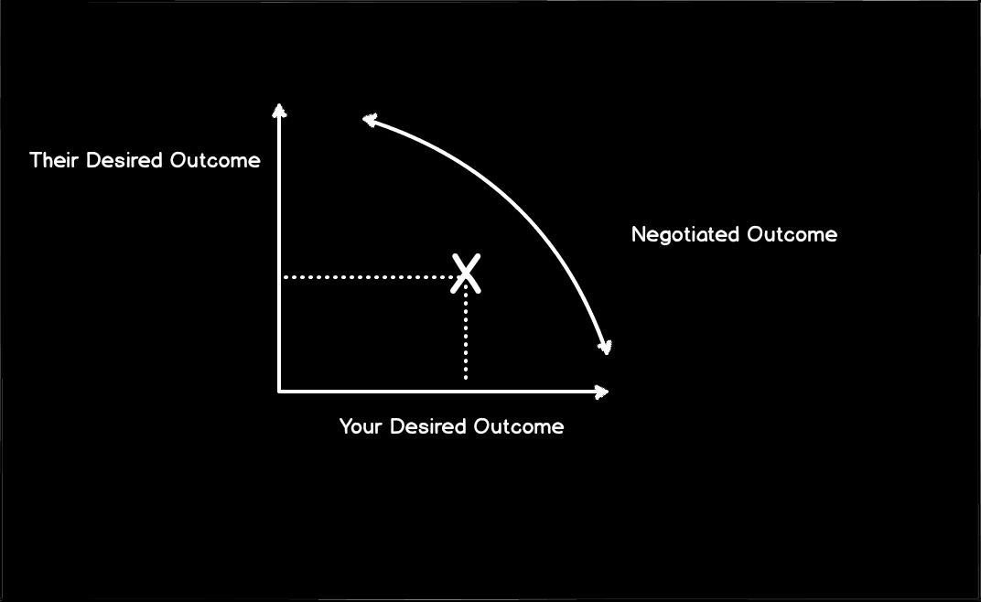
Notes:
let’s see. we got better than halfway towards getting what we want, and a little under half way for what they want.

Slide 31
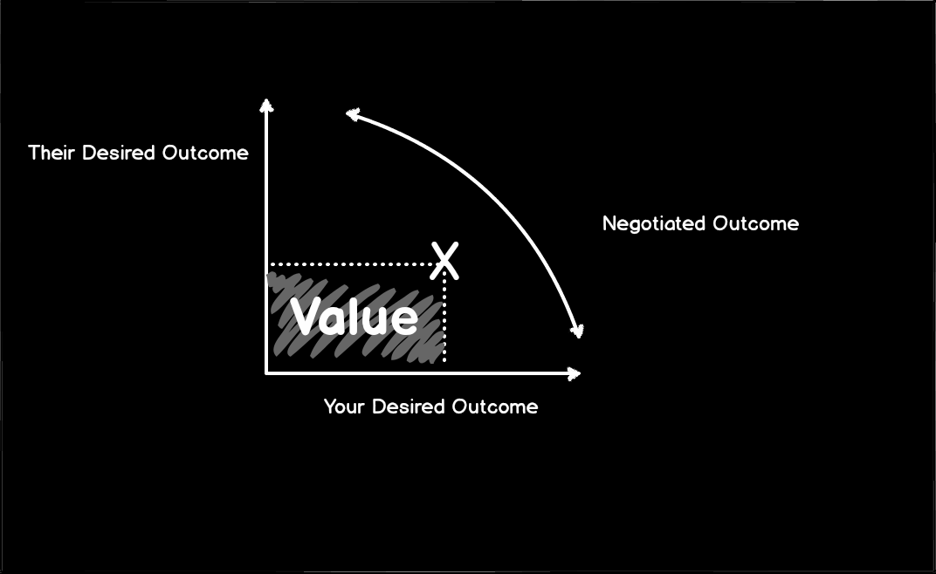
Notes:
this area out to here is the value that we were able to negotiate in this deal

Slide 32
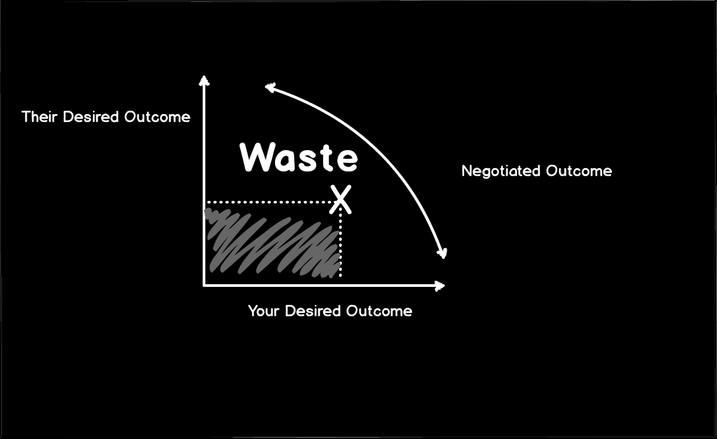
Notes:
- but all of this area outside under this curve is waste! we left stuff on the table
we even left off some value that was more favorable to both parties!
how might we communicate within a negotiation to capture more of that value and minimize waste?

Slide 33
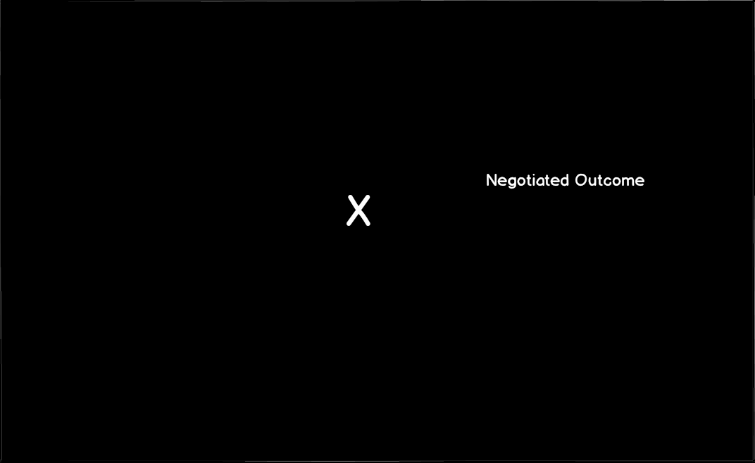
Notes:
of course, we don’t always have clear visibility of the axes of the decision space. it can feel like a shot in the dark.
we can start by being clear about our own desired outcomes and disclosing those to the other party.

Slide 34
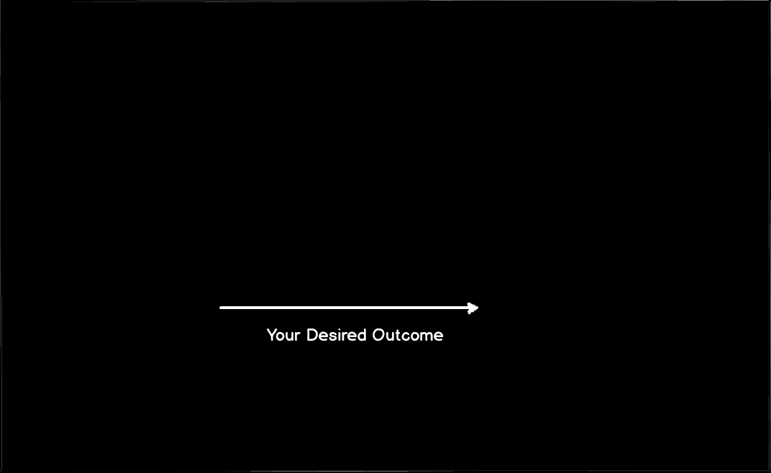
Notes:
from here, we can make tentative proposals and ask questions to learn more about the outcome axis desired by the other party.
again, the key is to be transparent about your motivations, confident in your requests, and honest in how you frame the negotiation

Slide 35
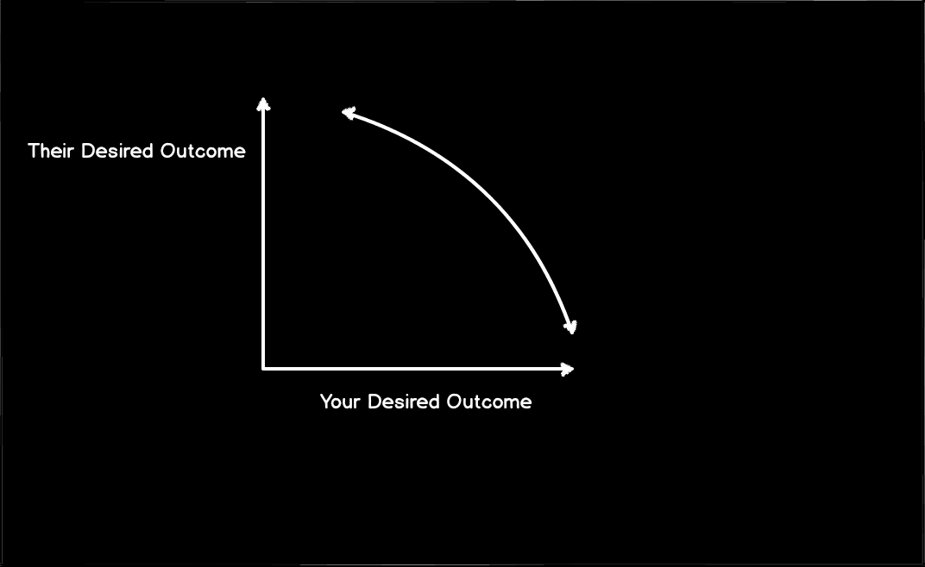
Notes:
when the landscape is clearer, we can be more straightforward about the tradeoffs, build trust, and help everyone be more happy with the outcomes and – potentially – more willing to compromise and reach a consensus
this bit about negotiation is based on the assumptions that your interactions with people are a repeat game – that is, relationship-based rather than transactional-based. this is a good assumption, especially when working in fixed geographic communities.

Slide 36
build trust
Notes:
negotiating fairly and communicating openly and honestly builds trust. this makes it easier to work over time towards larger and more ambitious goals. shared work experience also builds trust. but this all is hard work. thinking critically, is this all just early optimization? is this another example of waterfall processes and big design up front?

Slide 37
delivery as a strategy
Notes:
open source is well suited to continuous delivery. when decisions are made and rationale is documented in the open, and code and design changes are discussed and reviewed in public, we can move more quickly and ship more frequently. delivering smaller chunks more often is a good way to turn a single-project engagement into a relationship-based interaction. this can build trust by showing reliability and commitment on your part, but it can also create more interest and engagement from your other stakeholders by helping them become more comfortable with uncertainty inherent in many technology projects, and with the inherent feeling of lack of control. shipping in small and documented increments can help close the loop between cause and effect in a project’s development and help other stakeholders feel in control.

Slide 38
share credit
Notes:
everyone wants to look good. find opportunities to acknowledge contributions from non-technical stakeholders and learn from their expertise. this is all part of being humble and is good for the health and emotional well-being of the project team.

Slide 39
II. what the hall?
bureaucracy is hard to spell but it’s not a bad word
Notes:
in part 1 we talked about being humble in service to the project team. it could really be applied to all sorts of open source projects and general coalition-based organzing
what’s special about governments? when you think about environments where you find hacking and creativity, government bureaucracies might not be the first places which come to mind

Slide 40
“we’re from the government and we’re here to help”
Notes:
government employees are people too!
despite stereotypes of lazy or corrupt officials, people in the government are fundamentally smart, well-meaning, and dedicated public servants who operate within a specific structure. let’s explore some of the organizational psychology, incentive structures, and management approaches in government.

Slide 41
follow the $
Notes:
follow the variable. the most important piece of policy in any government is the annual budget. this determines what money gets spent and how; which projects are started, expanded, or killed. reading the budget reveals a government’s priorities.
budgets also set the annual pulse of the government. just as you might time interactions with the press around their deadlines and publishing schedules, it helps to be aware of the timing of the annual budget cycle.
department heads especially are preoccupied in the months leading up to the budget setting process. if the project you’re working on needs money to be appropriated, it’s super important to prepare ahead of time. if it’s smaller in scope and you just need some time from government officials, this might be a harder time to get ahold of them. plan accordingly.

Slide 42
elections
Notes:
elections, especially changes in administration (that is, the mayor or city manager), have a big influence on the priorities and ambitions of department heads.
during a heated election – or in an unpopular administration – people will be less willing to take risks.
towards the end of an administration, people will be less willing to take on new projects no matter how safe.
and at the beginning of a new administration, new ideas – as long as they match up with the publically stated priorities – may be more likely to gain traction
regardless of the timing, matching projects you want to pursue with others’ priorities makes it more likely people will pay attention and return your calls and emails.

Slide 43
appointed? classified?
know who you’re working with
Notes:
in governments, people are generally either appointed by a political process or hired into a classified position with a generically defined job description. as you might imagine, this affects their motivations. appointees generally have much more leeway, and serve at the pleasure of whoever appointed them. their tenure often matches that of the elected administration.
classified employees are the front-line employees who make an agency work. they work in well-defined positions and are most often career-track. they may have seen many administrations and many different policy directions. they may be less likely to get on board if they think you’ll make their job harder without any tangible benefit to them, or they may simply think you’re a flash in the pan and can outlast you.
but classified employees also offer staying power – if you can involve them and make them happy, you can tap into the actual operations of a government angecy and potentially have a much bigger – and more long-lasting – change with your project.
any project that wants to make the front-line citizen experience better will probably involve front-line agency employees.
classified refers to the job descriptions. these are rigidly defined and may restrict the ability of employees to take on new tasks. “not in my job description” may be a source of frustration to a hacker used to taking on everything, but it’s a protection to employees to keep them from getting assigned too much additional work without being compensated for it.
employee pay in bureaucracies is determined by a formula to prevent graft, corruption, and illegal political discrimination.

Slide 44
keep following the $
procurement and purchasing
Notes:
a lot of the frustration you might feel in government technology projects comes from the way governments buy goods and services.
again, for reasons of preventing graft, fraud, and abuse of public funds, purchasing is controlled through a series of well-defined procedures and rules.
unfortunately, these rules don’t exactly match up with how software – especially open source software – is built.
it’s also one of the reasons many government employees don’t have experience interacting with open source project teams. vendor contracts are often structured in ways that create very siloed development.

Slide 45
operations & sustainability
Notes:
identify and address operational challenges around your project. where will the app run? who will maintain it? will city IT be involved? who will be responsible and accountable for security and privacy issues around your app?
address these proactively.

Slide 46
context is key
Notes:
Who are the people and groups in your community who care about this issue? Who would benefit from the proposed changes? Who might be disadvantaged or hurt by them? Who has already been doing work in this area? What has been tried in the past? A good afternoon of research can give you a great basis for talking in an informed manner about your project and its context, and can also lead you to improving your idea or avoiding a lot of duplicated or wasted effort.
it's also a good idea to RTFM and read the source. In government, this is the law and regulations. You don't have to be a lawyer to understand what's being said. Fortunately, most states and other governments make their laws and rules available online. Having some knowledge of the existing rules and regulations can go a long way in demonstrating your level of interest to partners in government (and other organizations!) - even if it's just enough to be able to ask an intelligent question or two. It shows you've done research and you understand some of the basic operating parameters and constraints.

Slide 47
Thank you
Questions, comments, feedback
@_ jden (that’s an underscore) / jason@denizac.org
Slides, etc
http://jden.us/talk-2014-osbridge

