Slide 1
Object-Oriented Programming in Java
Introduction
Notes:
For further information, or if you want to give feedback about this course, please contact:
john.denny@gmail.com

Slide 2
About the Course
An intensive 5-day introduction to Object-Oriented programming in Java, aimed primarily at programmers experienced in another language who need to develop applications in Java
how?
Through slides, discussions, exercises, and projects

Slide 3
Course Objectives
At the end of the course, students should understand object-oriented concepts and be able to:
think, design and program in an object-oriented way
develop Java applications to solve real-world problems
build code that is effective, reliable and re-usable¹
enjoy programming in Java!
Notes:
The purpose of this course is to help students become effective Java developers. The syntax of the language is easy; writing object-oriented code is not too difficult, but thinking in an object-oriented way can be a challenge. Once you can do that, you are on the road to creating effective applications in Java. Good programming style is creative, effective and enjoyable - so enjoy it!

Slide 4
Course Content
General characteristics of Java
Java Language Constructs
Object-Oriented Programming (classes, encapsulation, inheritance, polymorphism, objects)
Java Language, Part 2 (threads, interfaces, exception, generics, enums)
Using the libraries (Collections, input/output, Graphical User Interfaces with Swing, networking with Sockets, database access with JDBC)
Looking ahead

Slide 5
Course Timetable (roughly speaking)
Monday Java Introduction
Java Language
Object-Oriented Programming
Tuesday OOP (continued)
Classes Part 2
Exceptions and Assertions
Wednesday Language Part2
Core Libraries
Collections And Generics
Enums
Thursday Swing
Streams
Junit
Threads
Friday JDBC
Sockets

Slide 6
Characteristics of Java
Originally developed by Sun Microsystems, now Oracle
Similar in syntax to C++
Object-oriented; structured; generic; reflective¹
Platform independent²
Secure
Networked
Huge library of standard software
Notes:
Note 1:
structured: in simple terms a program that uses decisions, sequences and loops rather than “go to”s.
generic: where code is written independently of the data types; types are specified as needed; see later module Generics
reflective: the ability to examine and modify the structure and behavior of an object at runtime, e.g.
String myString;
Method[] methods = myString.getClass().getMethods()
This could be used, for example, to provide a generic graphical user interface that would allow a user to interact with any object that was posted over a network.
Note 2: The same Java source can be compiled on any type of computer or any operating system that has a Java Development Kit (JDK) and produce exactly the same byte code (executable form of the program). The same byte code will run in the same way on any hardware or operating system that has a Java Runtime Environment (JRE).

Slide 7
Java Program - 1
demo.Example
(see notes)
public class Example {
int quantity;
String name;
double cost;
public String getName() {
return name;
}
public double getPrice() {
return Two.calculatePrice(
quantity, cost);
}
}
class Two {
static double profit = 1.4;
public static double calculatePrice(
int num, double cost) {
return cost * num * profit;
}
}
source file - text
classes: one or
more per file
at most one
public class
per file
Notes:
each class contains methods (an object-oriented term; in other languages, known also as function, subroutine, operation etc.) and variables;
methods and variables can only be defined within a class;
one and only one of the classes in the file must be declared public;
the name of the source file must be the name of the public class, with the extension .java
the public class often has a public method called main; this is the entry point for the application when it is run from the command line.

Slide 8
Java Program - 2
demo.Example
public class Example {
int quantity;
String name;
double cost;
public String getName() {
return name;
}
public double getPrice() {
return Two.calculatePrice(
quantity, cost);
}
}
instance variables
class
methods

Slide 9
HelloJava Program
first.HelloJava
(see notes)
public class HelloJava {
public static void main(String[] args) {
System.out.println("Hello Java World");
}
}
Result written to the Console (standard output):
Console
Hello Java World
Notes:
Notes
The simplest task you can perform in Java is a statement; a statement is terminated by a semicolon. In this application, there is only one statement, println(), which prints a line of text on the screen. By convention, methods are referred to in documents by putting empty round brackets after the name; within the application there may be text inside the brackets.
A series of statements is known as a compound statement, or block, which can be placed wherever a single statement can. A compound statement is surrounded by braces: {}.
The layout of a statement is unimportant. A statement can be contained on a single line, or may span several lines. Generally, different words and symbols are separated by white-space, which is any number of spaces, tabs and new-lines. All the code in this handout conforms to one of the common conventions used, to make the code more readable.
Comments may be inserted into the code, and are ignored by the compiler. Comments may begin with two forward slashes, and terminated by the next new-line, or may be any number of lines between the symbols /* and */, e.g.
System.out.println("Hello Joe"); // comment to end of line
or
/* this is a comment, which may span
several lines */
Compiling a Java source file produces a file for each class; the file name is the class name with .class as the extension; in the above example, the compiler will generate file HelloStudent.class

Slide 10
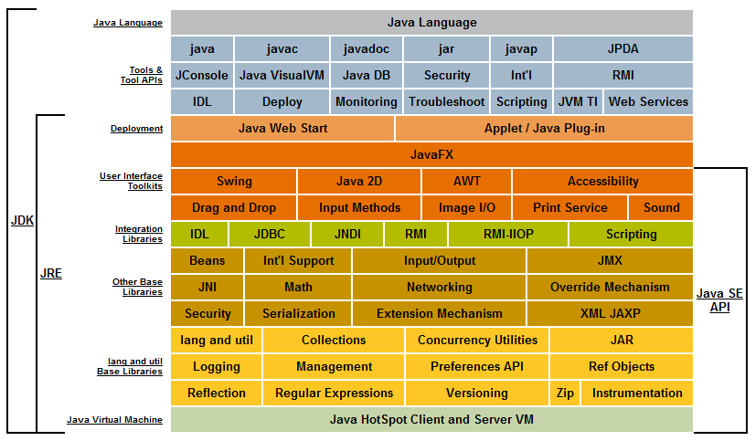
Java Conceptual Diagram
scary!
Notes:
see http://docs.oracle.com/javase/7/docs/

Slide 11
An Enterprise Application
Java EE Application Server
Directory service
Web client
Web Container
Servlets
EJB Container
RDBMS
Applet
JSP
Session EJBs
Entity EJBs
CORBA
Client
application
Java app
Message queue
JAX-
WS
RMI
JTA
JDBC
JMS
JMX
JAAS
JNDI
Web service
looking ahead a few steps

Slide 12
Summary so far
Java is:
Simple
Object oriented
Distributed
Multithreaded
Dynamic
Architecture neutral
Portable
High performance
Robust
Secure
Demos:
demo.Example
first.HelloJava
Exercises:
Compiling and Running Java
in a Windows DOS Shell
Getting Started in Eclipse

