Slide 1
Object-Oriented Programming in Java
Building a Graphical User Interface Using Swing

Slide 2
Module Content
Creating Components
Positioning Components
Handling User Events

Slide 3
Swing: Introduction
Swing used to create a Graphical User Interface (GUI)
Consists of:
set of GUI components, e.g. various types of button, text field, dialog box, menu
Model-View-Controller design pattern
undo and redo
drag and drop
event handling
Part of Java Foundation Classes (JFC) which also includes:
Internationalization
Pluggable look-and-feel
Java 2D graphics
Accessibility

Slide 4
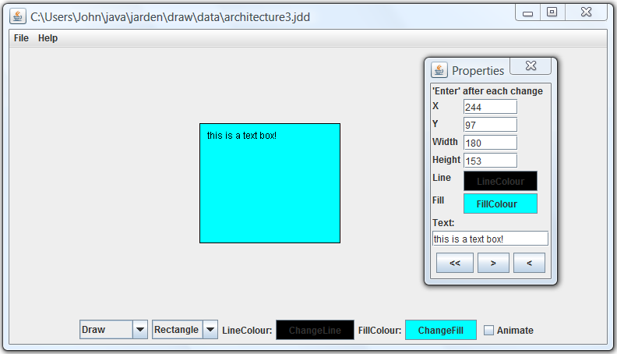
Swing: Demo
jarden.draw.DrawingGUI, built using Swing
if you ask nicely, your instructor
will give you a demo

Slide 5
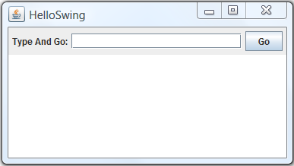
HelloSwing
Main sections of this program:
create GUI components (widgets)
define their layout
respond to user actions (gestures)

Slide 6
HelloSwing: create components
demo.swing.HelloSwing
JFrame frame = new JFrame("HelloSwing");
JLabel textLabel = new JLabel("Type And Go:");
textField = new JTextField(20);
messageArea = new JTextArea(10, 20);
JButton goButton = new JButton("Go");
JFrame
JTextField
JButton
JLabel
JTextArea

Slide 7
HelloSwing: set layout of components
demo.swing.HelloSwing
Container container = frame.getContentPane();
JPanel controlPanel = new JPanel();
container.add(controlPanel, BorderLayout.NORTH);
container.add(messageArea, BorderLayout.CENTER);
controlPanel.add(textLabel);
controlPanel.add(textField);
controlPanel.add(goButton);
JtextField, Jlabel and Jbutton
all in controlPanel
JPanel is a
container for
components,
to control
their layout
(positioning)
container has
controlPanel in
North and
messageArea
in Center

Slide 8
Layout Managers: FlowLayout
This is the default layout manager for panels
Components can be centred (default), or justified left or right
As components are added, wrap round as necessary
first
component
first
component
time-line
first
component
first
component
second
component
first
component
second
component
third
component
forth
component

Slide 9
Layout Managers: BorderLayout
This is the default layout manager for frames
North – width stretches to fit container;
height determined by contents
West – width
determined by
contents; height
stretches to fit
container
Center – width
and height
stretch to fit
container
East – width
determined by
contents; height
stretches to fit
container
South – width stretches to fit container;
height determined by contents
See demo.swing.Layouts for demo of
these and other layout managers

Slide 10
HelloSwing: handle button click
demo.swing.HelloSwing
public class HelloSwing implements ActionListener {
...
public HelloSwing() {
...
goButton.addActionListener(this);
...
}
...
public void actionPerformed(ActionEvent event) {
messageArea.append(textField.getText());
}
HelloSwing IS-A
ActionListener
when user clicks button,
call actionPerformed
Q: what if there are multiple buttons?

Slide 11
Handle events from multiple components
use different ActionListeners...
goButton.addActionListener(listenerA);
stopButton.addActionListener(listenerB);
...or use ActionEvent to determine source of event
public void actionPerformed(ActionEvent event) {
if (event.getSource() == goButton) {...
if (event.getActionCommand().equals("Go")) {...
}
or
by default, actionCommand
of a button is its label

Slide 12
HelloSwing: handle frame events
Application could have multiple frames, so need to tell Swing what to do when this frame is closed; we've gone for exit application
demo.swing.HelloSwing
public HelloSwing() {
...
frame.setDefaultCloseOperation(JFrame.EXIT_ON_CLOSE);
frame.setVisible(true);
...
}
start event handling thread

Slide 13
Swing: Summary
Three main aspects of Swing GUI
  create components
  position using layout managers
  handle events
Many more features: see Oracle Swing Tutorial
See also RadioSwing and ListSwing in package demo.swing
Demo: package demo.swing
Exercises: Graphical User Interfaces
Using Swing

