Slide 1
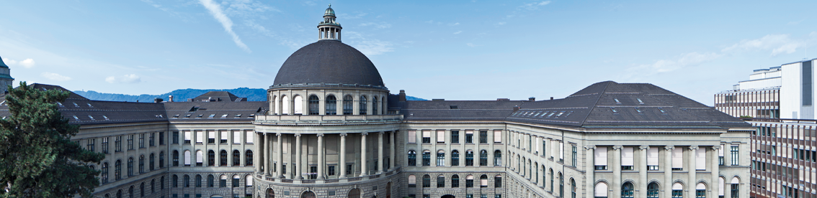
SwissCheese: Sentiment Classification using an Ensemble of CNNs and Distant Supervision
Jan Deriu¹, Maurice Gonzenbach¹, Fatih Uzdilli³, Aurelien Lucchi ^{1,} Valeria De Luca ^{2,} Martin Jaggi ¹
¹ Data Analytics Laboratory , ETH Zurich; ² Computer Vision Laboratory , ETH Zurich; ³ Institut für angewandte Informations­technologie , ZHAW

Slide 2
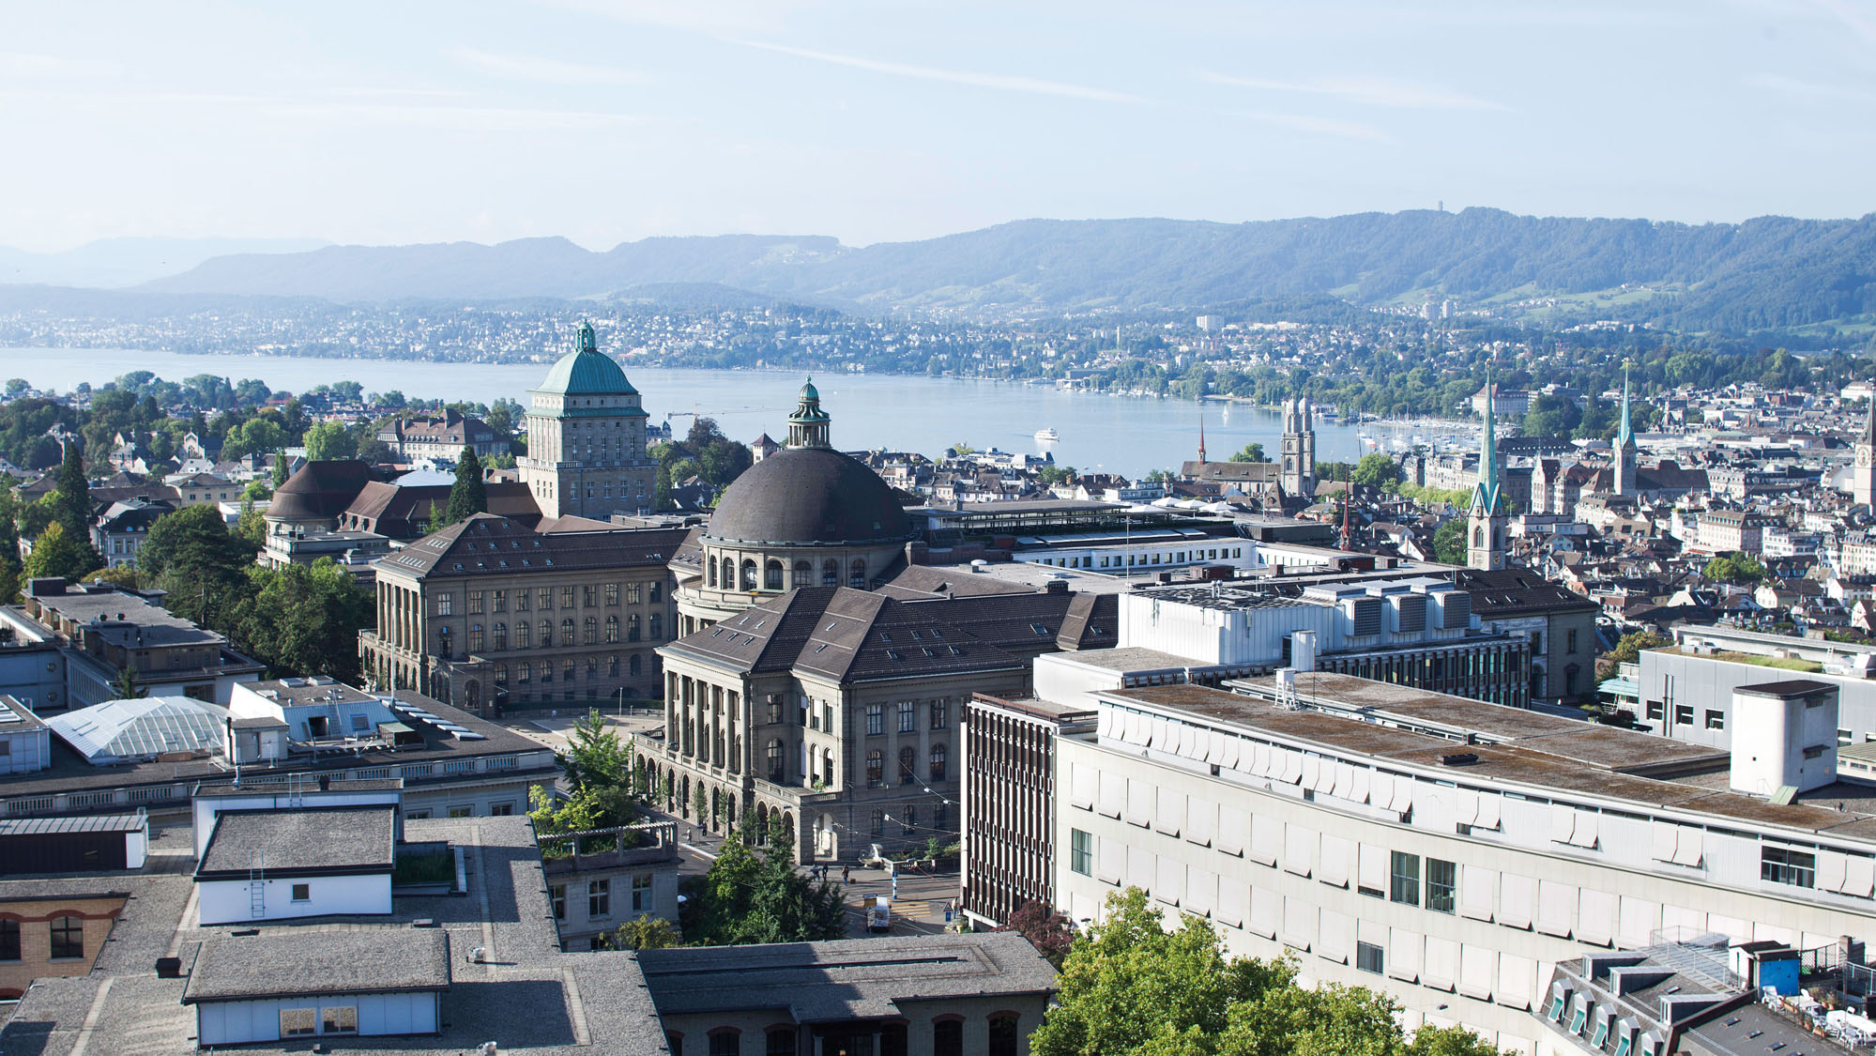

Slide 4
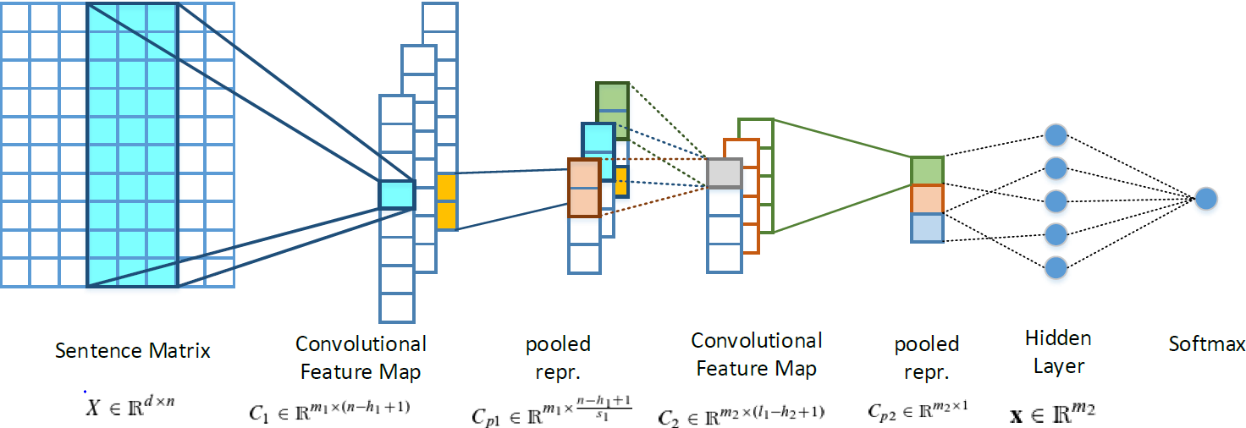
2 Layer Convolutional Neural Network

Slide 5

Technical Details
 | System 1 | System 2
Number of Kernels | 200 | 200
Filter Lengths | h₁=6, h₂=3 | h₁=6, h₂=4
Pooling&Striding Lenght | p=6, st=3 | p=3, st=3
Activation Function | relu | relu
Optimization: AdaDelta with $ρ=0.95, ε=1e^{−6}$
Regularization: System 1: No Regularization, No Dropout
System 2: L2 Regularization, No Dropout

Slide 6
3 Phase Training
Word Embeddings
System 1: Word2Vec on 200M tweets
System 2: GloVe on 90M tweets
Distant Phase
System 1: 90M tweets
Supervised Phase
Both Systems: 18K tweets provided by SemEval
System 2: 60M tweets
Sentiment inferred by the smileys inside a tweet

Slide 7
Impact of High Quality Word Embeddings

Slide 8
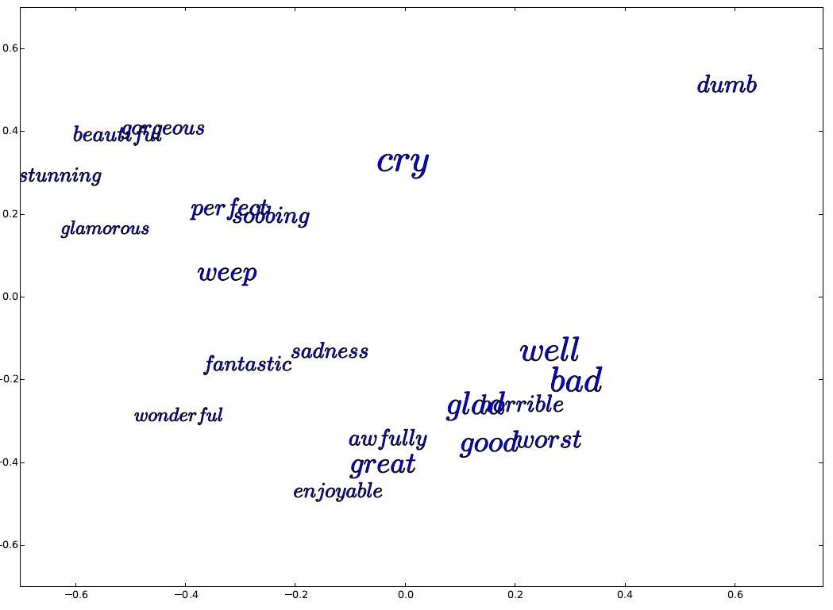
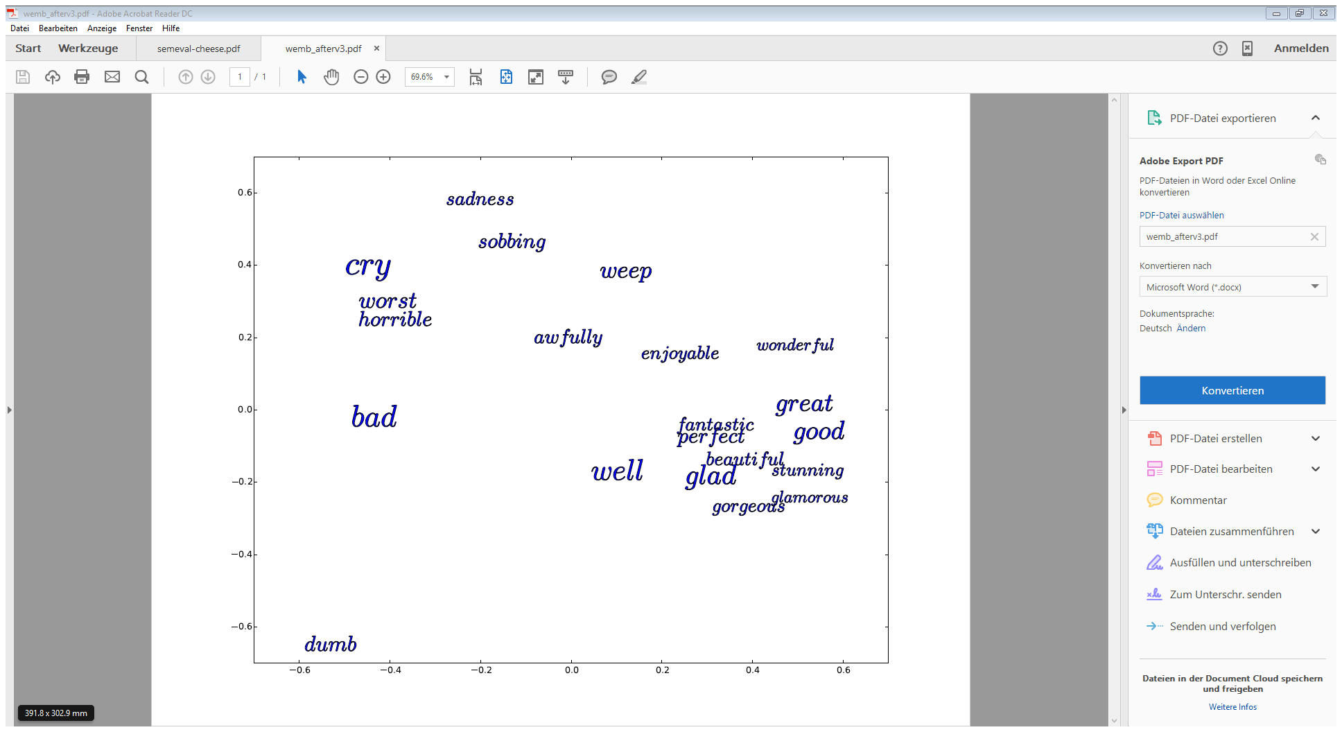
Word Embeddings update after the Distant Phase
Before the Distant Phase
After the Distant Phase

Slide 9
Impact of the Number of Tweets during the Distant Phase

Slide 10
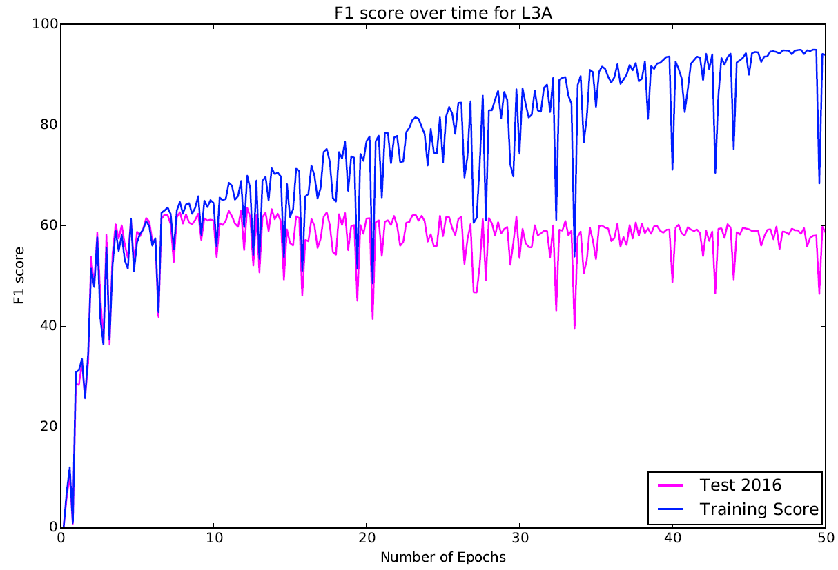
Meta Classifier
Supervised Phase: Shows a lot of variance
Goal: Increase Robustness
Solution: Use Meta Classifier
System 1: Trained for different number of epochs
System 2: Trained until it reached good scores on all validation sets

Slide 11
Results
 | S1a | S1b | S1c | S1d | S1e | S1f | S2 | FS
Test2016 | 60.47 | 62.73 | 61.89 | 60.58 | 57.19 | 62.2 | 62.36 | 63.30
Test2015 | 64.26 | 65.80 | 64.80 | 64.20 | 61.02 | 66.7 | 66.63 | 67.05
Test2014 | 73.98 | 74.6 | 75.70 | 74.15 | 69.12 | 72.00 | 72.45 | 71.55
Test2013 | 71.52 | 70.1 | 70.9 | 71.50 | 67.00 | 68.00 | 70.05 | 70.01

Slide 12
Contact information and credits
ETH Zurich
Organisational unit
Street address
Postcode City
www.ethz.ch/en.html
Publisher: Organisational unit of ETH Zurich
Design: Designer Name
Images: Credit (slide xx), Credit (slide xx)
© ETH Zurich, December 2013

