Slide 1

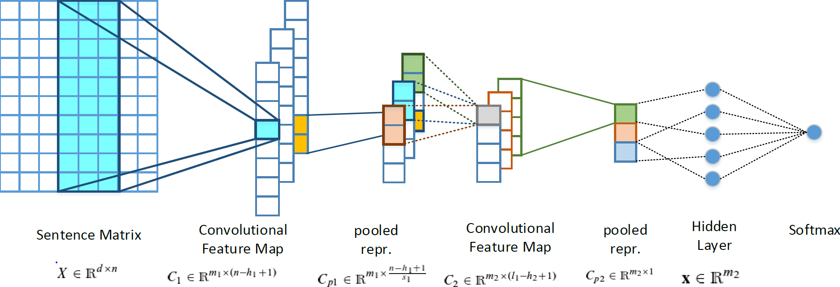
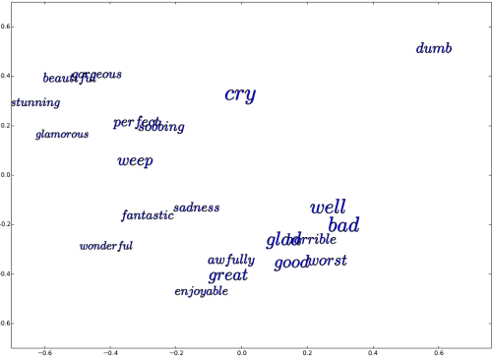
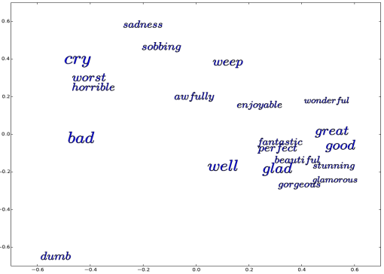
SwissCheese: Sentiment Classification using an Ensemble of Convolutional Neural Networks and Distant Supervision
Jan Deriu¹, Maurice Gonzenbach¹, Fatih Uzdilli³, Aurelien Lucchi ^{1,} Valeria De Luca ^{2,} Martin Jaggi ¹
¹ Data Analytics Laboratory , ETH Zurich; ² Computer Vision Laboratory , ETH Zurich; ³ Institut für angewandte Informations­technologie , ZHAW
CNN 2Layer Architecture
3 Step Training
Number of Tweets in the Distant Phase
Word Embeddings
S1: word2vec with 200M tweets
S2: GloVe with 90M tweets
Distant Phase
S1: 90M tweets
S2: 60M tweets
Supervised Phase
Both: 18K provided training data
Time: 3-4 days
Time: 10-15 hours
Time: up to 1h
Importance of high-quality
Word Embeddings
Word Embeddings
Update
Meta Classifier
Results
Supervised Phase: High Variance in F1-score over # epochs
Goal: Increase Robustness
Solution: Train a Random Forest on the outputs of the various systems
S1: Trained for different number of epochs (a-f)
S2: Trained until it reached good average scores among validation sets
 | Test 2016 | Test 2015 | Test 2014 | Test 2013
S1a | 60.47 | 64.26 | 73.98 | 71.52
S1b | 62.73 | 65.80 | 74.60 | 70.10
S1c | 61.89 | 64.80 | 75.70 | 70.90
S1d | 60.58 | 64.20 | 74.15 | 71.50
S1e | 57.19 | 61.02 | 69.12 | 67.00
S1f | 62.20 | 66.70 | 72.00 | 68.00
S2 | 62.36 | 66.63 | 72.45 | 70.05
FS | 63.30 | 67.05 | 71.55 | 70.01
Before Distant Supervised Phase
Technical Details
Number of Kernels: Both: 200
Filter Lengths: S1: h₁=6, h₂=3 S2: h₁=6, h₂=4
Pooling Length S1: w₁=6, st₂=2 S2: w₁=3, st₂=3
Optimization: AdaDelta, S1: no regularization S2: L2 regularization
After Distant Supervised Phase

