Slide 1
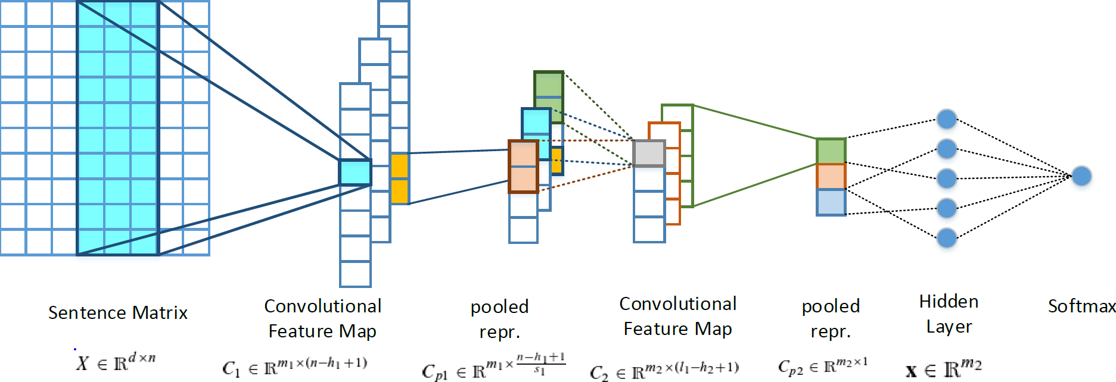
SwissCheese: Sentiment Classification using an Ensemble of Convolutional Neural Networks and Distant Supervision
Jan Deriu¹, Maurice Gonzenbach¹, Fatih Uzdilli³, Aurelien Lucchi ^{1,} Valeria De Luca ^{2,} Martin Jaggi ¹
¹ Data Analytics Laboratory , ETH Zurich; ² Computer Vision Laboratory , ETH Zurich; ³ Institut für angewandte Informations­technologie , ZHAW
CNN 2Layer Architecture
3 Step Training
Word Embeddings
S1: word2vec with 200M tweets
S2: GloVe with 90M tweets
Distant Phase
S1: 90M tweets
S2: 60M tweets
Supervised Phase
Both: 18K provided training data
Meta Classifier
Results
Supervised Phase: High Variance in F1-score over # epochs
Goal: Increase Robustness
Solution: Train a Random Forest on the outputs of the various systems
S1: Trained for different number of epochs (a-f)
S2: Trained until it reached good average scores among validation sets
 | S1a | S1b | S1c | S1d | S1e | S1f | S2 | FS
Test2016 | 60.47 | 62.73 | 61.89 | 60.58 | 57.19 | 62.20 | 62.36 | 63.30
Test2015 | 64.26 | 65.80 | 64.80 | 64.20 | 61.02 | 66.70 | 66.63 | 67.05
Test2014 | 73.98 | 74.60 | 75.70 | 74.15 | 69.12 | 72.00 | 72.45 | 71.55
Test2013 | 71.52 | 70.10 | 70.90 | 71.50 | 67.00 | 68.00 | 70.05 | 70.01
LiveJournal2014 | 73.86 | 70.57 | 72.54 | 74.00 | 71.32 | 68.00 | 70.86 | 69.51
Sarcasm2014 | 57.84 | 52.04 | 51.50 | 57.84 | 62.00 | 57.30 | 62.74 | 56.63

