Slide 1
Theory and Algorithms for Formal Verification Linear Temporal Logic
Spring 2022: CSCI 699
Instructor: Jyo Deshmukh

Slide 2
Outline
LTL Syntax and Semantics
LTL with past
LTL Examples
LTL Equivalences
Automata-based model checking for LTL
LTL to GNBA
Complexity of LTL model checking
LTL satisfiability

Slide 3
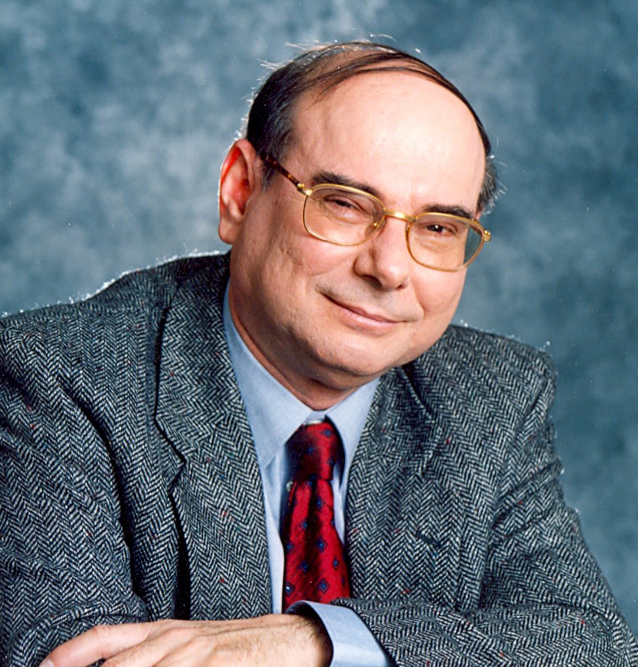
Temporal Logic
(Propositional) Temporal Logic (literally logic of time): specify finite and infinite sequences of Boolean propositions using logical formulae
Grew out of philosophy (tense logic and modal logic)
Amir Pnueli in 1977 used a form of temporal logic for expressing specifications of reactive systems
Won the 1996 Turing Award
Now part of PSL (property specification language, an IEEE standard used in the EDA industry)
Increasingly popular in Robotics, Reinforcement Learning domain to express high-level task objectives
1941-2009

Slide 4
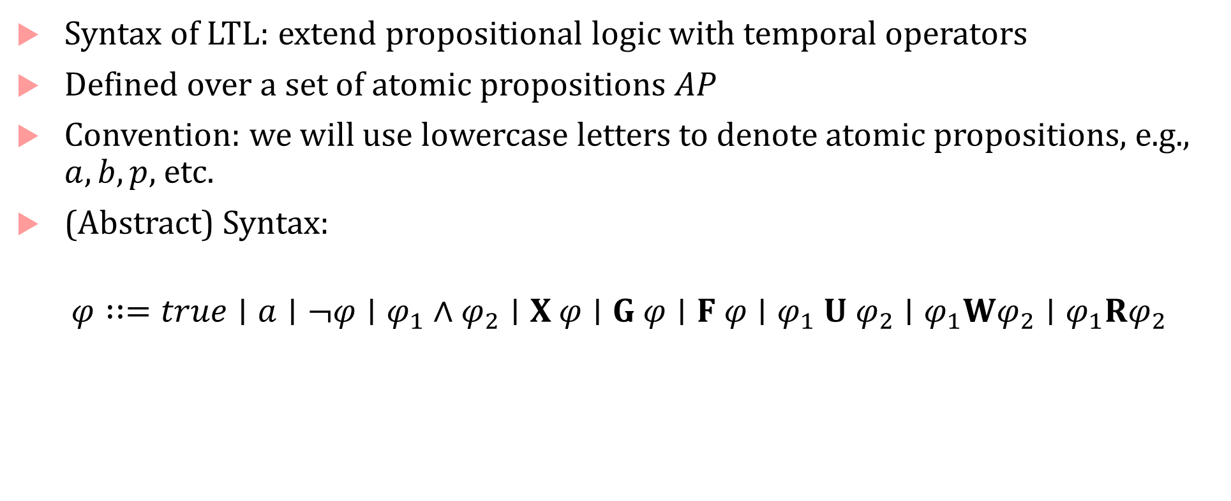
LTL Syntax
Syntax of LTL: extend propositional logic with temporal operators
Defined over a set of atomic propositions $AP$
Convention: we will use lowercase letters to denote atomic propositions, e.g., $a,b,p,$ etc.
(Abstract) Syntax:
$$φ∷=true∣a∣¬φ∣φ_{1}∧φ_{2}∣X φ∣G φ∣F φ∣φ_{1} U φ_{2}∣φ_{1}Wφ_{2}∣φ_{1}Rφ_{2}$$

Slide 5
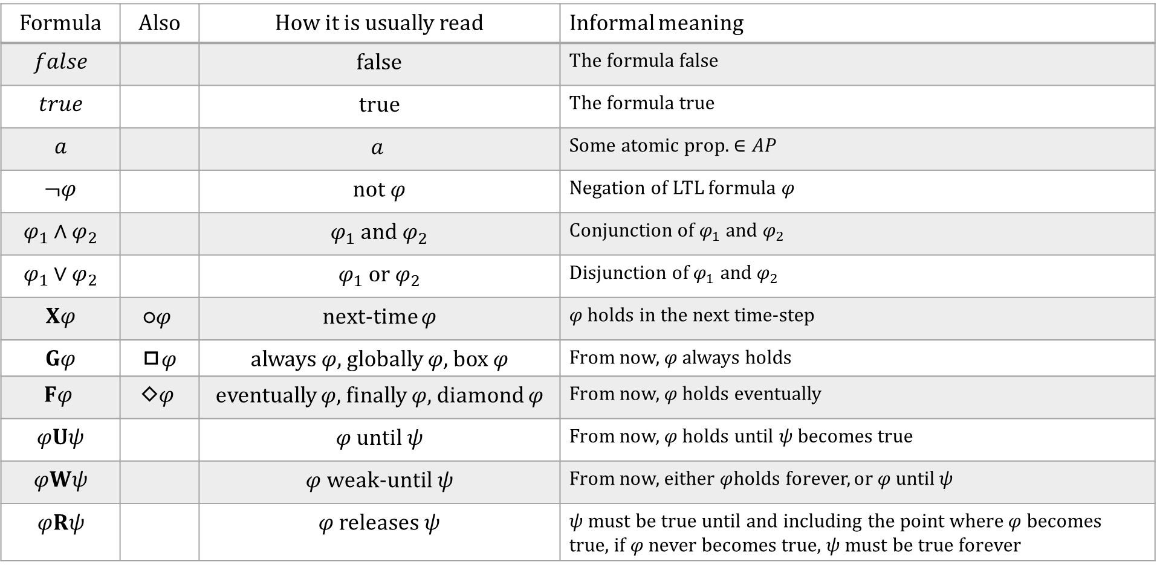
Syntax : English descriptions
Formula | Also | How it is usually read | Informal meaning
$$false$$ |  | false | The formula false
$$true$$ |  | true | The formula true
$$a$$ |  | $$a$$ | Some atomic prop. $∈AP$
$$¬φ$$ |  | not $φ$ | Negation of LTL formula $φ$
$$φ_{1}∧φ_{2}$$ |  | $φ_{1}$ and $φ_{2}$ | Conjunction of $φ_{1}$ and $φ_{2}$
$$φ_{1}∨φ_{2}$$ |  | $φ_{1}$ or $φ_{2}$ | Disjunction of $φ_{1}$ and $φ_{2}$
$$Xφ$$ | $$\text{○}φ$$ | next-time $φ$ | $φ$ holds in the next time-step
$$Gφ$$ | ◻$φ$ | always $φ,$globally $φ$, box $φ$ | From now, $φ$ always holds
$$Fφ$$ | $$\text{◇}φ$$ | eventually $φ$, finally $φ$, diamond $φ$ | From now, $φ$ holds eventually
$$φUψ$$ |  | $φ$ until$ψ$ | From now, $φ$ holds until $ψ$ becomes true
$$φWψ$$ |  | $φ$weak-until$ψ$ | From now, either $φ$holds forever, or $φ$ until$ψ$
$$φRψ$$ |  | $φ$ releases$ψ$ | $ψ$ must be true until and including the point where $φ$ becomes true, if $φ$ never becomes true, $ψ$ must be true forever

Slide 6
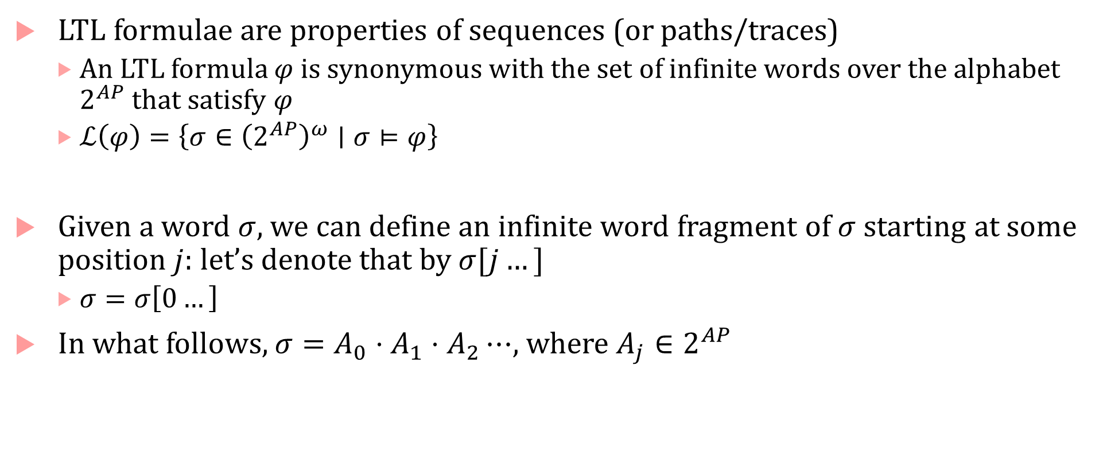
Infinite words and infinite word fragments
LTL formulae are properties of sequences (or paths/traces)
An LTL formula $φ$ is synonymous with the set of infinite words over the alphabet $2^{AP}$ that satisfy $φ$
$ℒ\left(φ\right)=\left\{σ∈{\left(2^{AP}\right)}^{ω}∣σ⊨φ\right\}$
Given a word $σ$, we can define an infinite word fragment of $σ$ starting at some position $j$: let’s denote that by $σ[j…]$
$σ=σ\left[0…\right]$
In what follows, $σ=A_{0}⋅A_{1}⋅A_{2}⋯$, where $A_{j}∈2^{AP}$

Slide 7
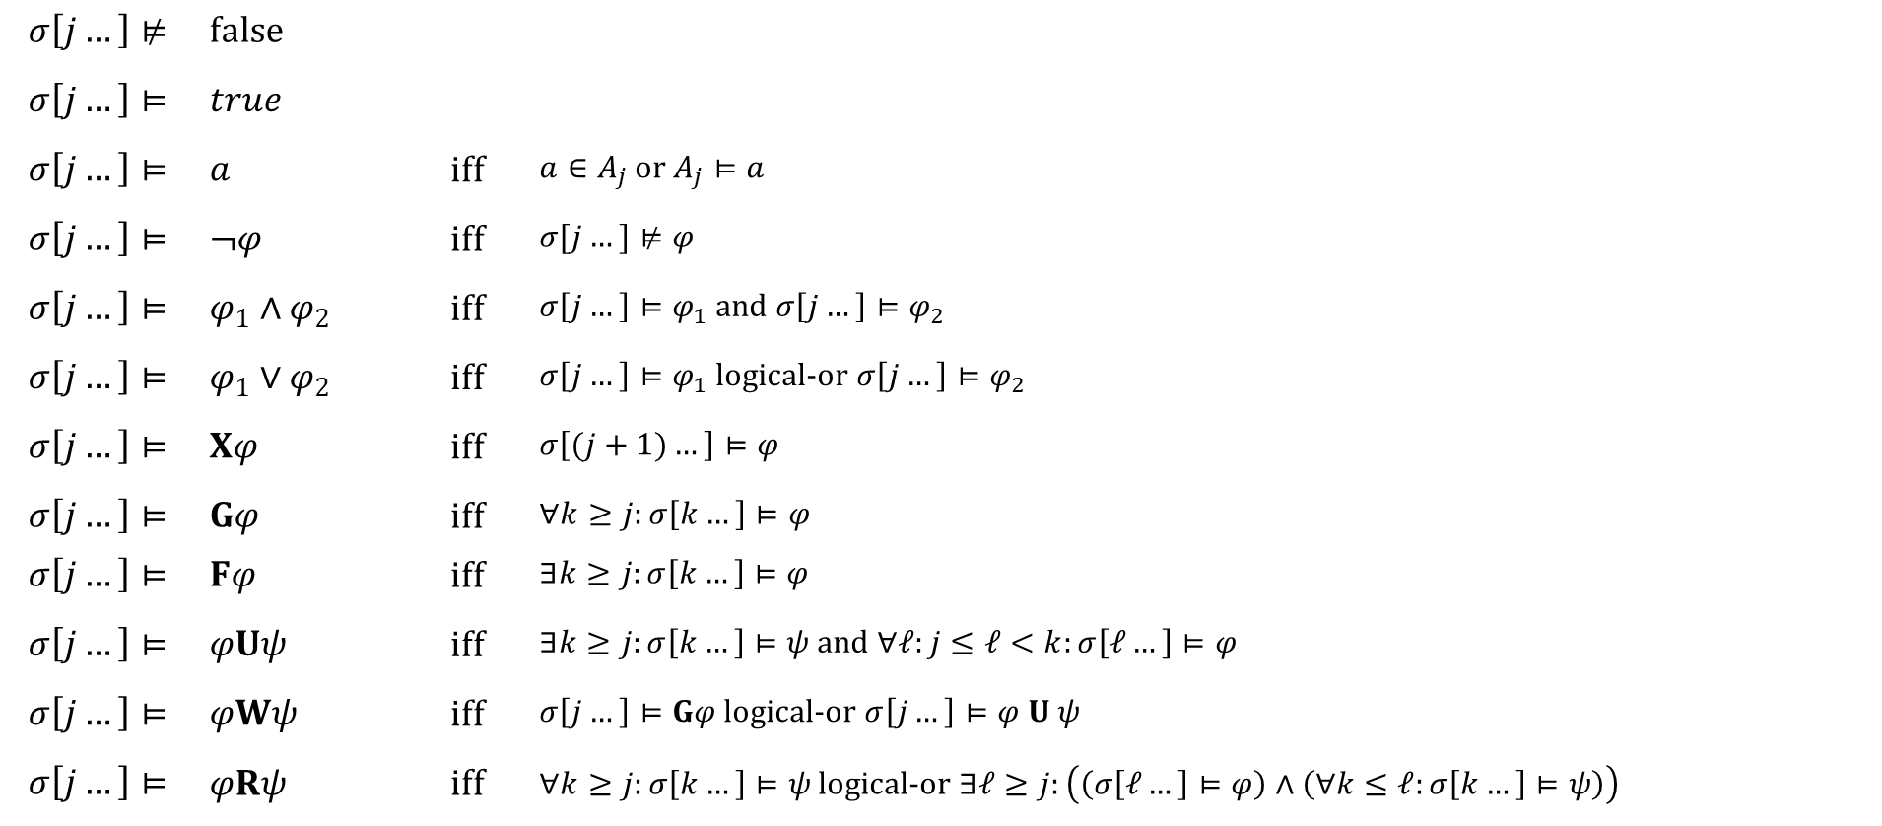
Formal semantics of LTL
$$σ\left[j…\right]⊭$$ | $$false$$
$$σ\left[j…\right]⊨$$ | $$true$$
$$σ\left[j…\right]⊨$$ | $$a$$ | iff | $a∈A_{j}$ or $A_{j}⊨a$
$$σ\left[j…\right]⊨$$ | $$¬φ$$ | iff | $$σ[j…]⊭φ$$
$$σ\left[j…\right]⊨$$ | $$φ_{1}∧φ_{2}$$ | iff | $σ\left[j…\right]⊨φ_{1}$ and $σ\left[j…\right]⊨φ_{2}$
$$σ\left[j…\right]⊨$$ | $$φ_{1}∨φ_{2}$$ | iff | $σ\left[j…\right]⊨φ_{1}$ logical-or $σ\left[j…\right]⊨φ_{2}$
$$σ\left[j…\right]⊨$$ | $$Xφ$$ | iff | $$σ\left[(j+1)…\right]⊨φ$$
$$σ\left[j…\right]⊨$$ | $$Gφ$$ | iff | $∀k≥j:σ\left[k…\right]⊨φ$
$$σ\left[j…\right]⊨$$ | $$Fφ$$ | iff | $∃k≥j:σ\left[k…\right]⊨φ$
$$σ\left[j…\right]⊨$$ | $$φUψ$$ | iff | $∃k≥j:σ\left[k…\right]⊨ψ$ and $∀ℓ:j≤ℓ<k:σ\left[ℓ…\right]⊨φ$
$$σ\left[j…\right]⊨$$ | $$φWψ$$ | iff | $σ\left[j…\right]⊨Gφ$ logical-or $σ\left[j…\right]⊨φ U ψ$
$$σ\left[j…\right]⊨$$ | $$φRψ$$ | iff | $∀k≥j:σ\left[k…\right]⊨ψ$ logical-or $∃ℓ≥j:\left(\left(σ\left[ℓ…\right]⊨φ\right)∧\left(∀k≤ℓ:σ\left[k…\right]⊨ψ\right)\right)$

