Slide 1
Theory and Algorithms for Formal Verification Labelled Transition Systems
Spring 2022: CSCI 699
Instructor: Jyo Deshmukh

Slide 2
Overview
Labeled Transition Systems: Notations, Terminology
Kripke structures
Modeling Concurrent Systems [BK: Chapter 2, Alur Chapters 2,4]
Asynchronous and Synchronous Communication
Equivalences and Abstractions [BK: Chapter 7]

Slide 3
Transition Systems
Any computation can be represented as a transition system
Variables can be discrete-valued or continuous-valued
Time can be logical, discrete, or continuous (dense)
Transition system representation models a computation (program) as a directed graph
Nodes are configurations or states of the system
Edges model state changes or system transitions
Labelled transition systems (LTSs) :
Transitions have names (drawn from a finite or infinite set of labels)
There is a finite (or infinite) set of atomic propositions
States are labeled with some subset of the set of atomic propositions

Slide 4
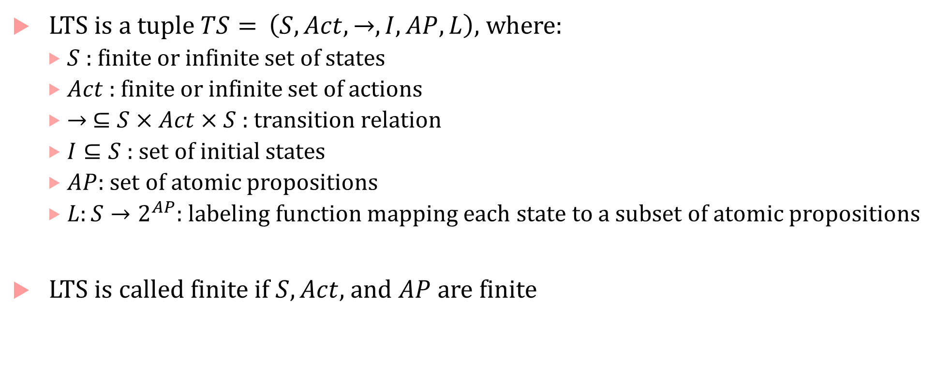
LTS formal definition
LTS is a tuple $TS=$ $\left(S, Act, →, I, AP, L\right)$, where:
$S$ : finite or infinite set of states
$Act$ : finite or infinite set of actions
$→ ⊆S×Act×S$ : transition relation
$I⊆S$ : set of initial states
$AP$: set of atomic propositions
$L:S→2^{AP}$: labeling function mapping each state to a subset of atomic propositions
LTS is called finite if $S, Act,$ and $AP$ are finite

Slide 5
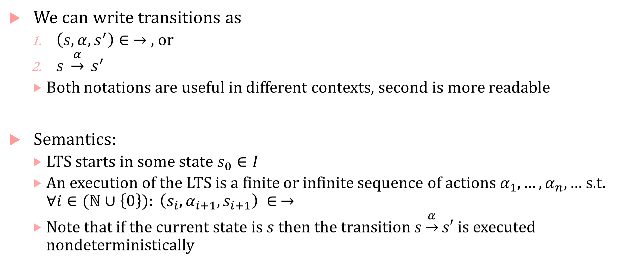
Transitions
We can write transitions as
$\left(s,α,s^{′}\right)∈ →$ , or
$s \underset{→}{α} s^{′}$
Both notations are useful in different contexts, second is more readable
Semantics:
LTS starts in some state $s_{0}∈I$
An execution of the LTS is a finite or infinite sequence of actions $α_{1},…, α_{n},…$ s.t. $∀i∈(ℕ∪\left\{0\right\}): \left(s_{i},α_{i+1}, s_{i+1}\right) ∈ →$
Note that if the current state is $s$ then the transition $s\underset{→}{α}s′$ is executed nondeterministically

Slide 6
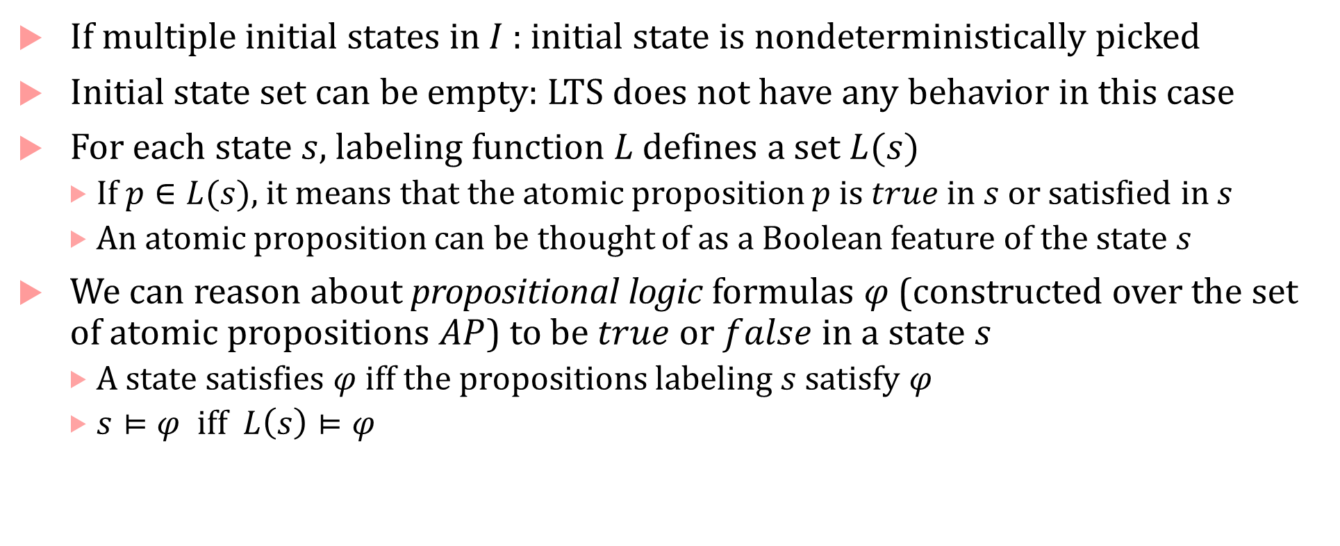
Initial states & Atomic propositions
If multiple initial states in $I$: initial state is nondeterministically picked
Initial state set can be empty: LTS does not have any behavior in this case
For each state $s$, labeling function $L$ defines a set $L(s)$
If $p∈L(s)$, it means that the atomic proposition $p$ is $true$ in $s$ or satisfied in $s$
An atomic proposition can be thought of as a Boolean feature of the state $s$
We can reason about propositional logic formulas $φ$ (constructed over the set of atomic propositions $AP$) to be $true$ or $false$in a state $s$
A state satisfies $φ$ iff the propositions labeling $s$ satisfy $φ$
$s⊨φ$ iff $L\left(s\right)⊨φ$

Slide 7



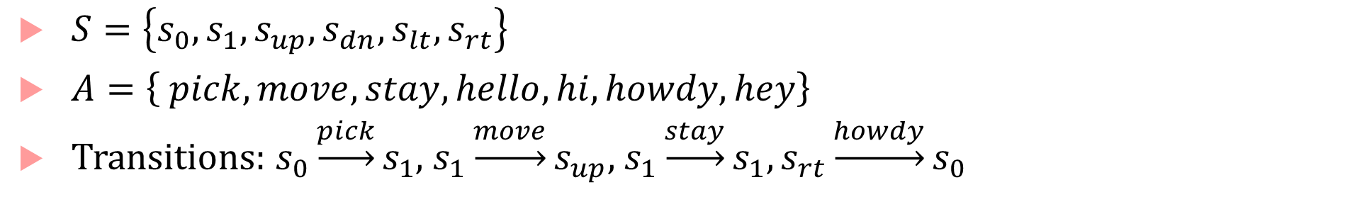



Example of LTS
$$s_{0}$$
hello
hey
pick
stay
$$s_{up}$$
move
$$s_{1}$$
move
$$s_{dn}$$
hi
move
move
howdy
$$s_{lt}$$
$$s_{rt}$$
$S=\left\{s_{0},s_{1},s_{up},s_{dn},s_{lt},s_{rt}\right\}$
$A=\left\{ pick, move,stay, hello,hi,howdy,hey\right\}$
Transitions: $s_{0}\underset{→}{pick}s_{1}$, $s_{1}\underset{→}{move}s_{up}$, $s_{1}\underset{→}{stay}s_{1}, s_{rt}\underset{→}{howdy}s_{0}$

Slide 8
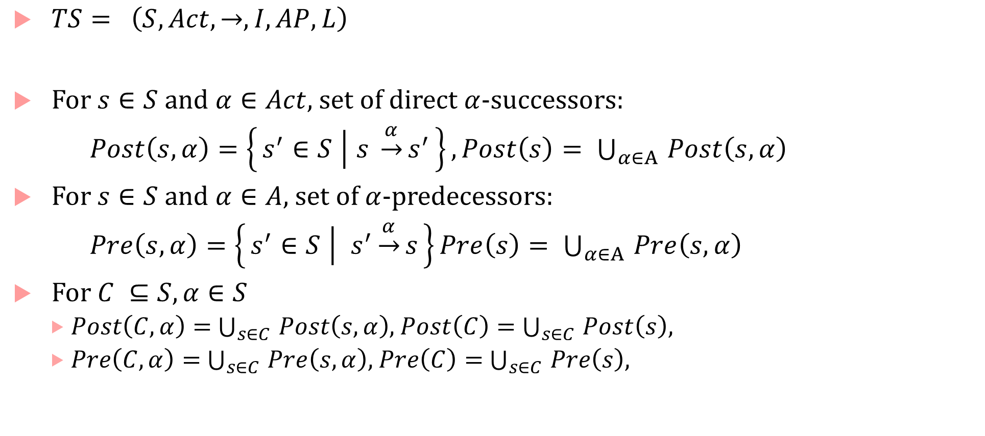
Successors and Predecessors
$TS= \left(S, Act, →, I, AP, L\right)$
For $s∈S$ and $α∈Act$, set of direct $α$-successors:
$Post\left(s,α\right)=\left\{s^{′}∈S ∣ s \underset{→}{α}s^{′}\right\}, Post\left(s\right)= \bigcup_{α∈A }{Post\left(s,α\right)}$
For $s∈S$ and $α∈A$, set of $α$-predecessors:
$Pre\left(s,α\right)=\left\{s^{′}∈S ∣ s^{′}\underset{→}{α}s\right\}Pre\left(s\right)= \bigcup_{α∈A }{Pre\left(s,α\right)}$
For $C ⊆S, α∈S$
$Post\left(C,α\right)=$ $\bigcup_{s∈C }{Post\left(s,α\right)}$, $Post\left(C\right)=$ $\bigcup_{s∈C }{Post\left(s\right)}$,
$Pre\left(C,α\right)=$ $\bigcup_{s∈C }{Pre\left(s,α\right)}$, $Pre\left(C\right)=$ $\bigcup_{s∈C }{Pre\left(s\right)}$,

Slide 9
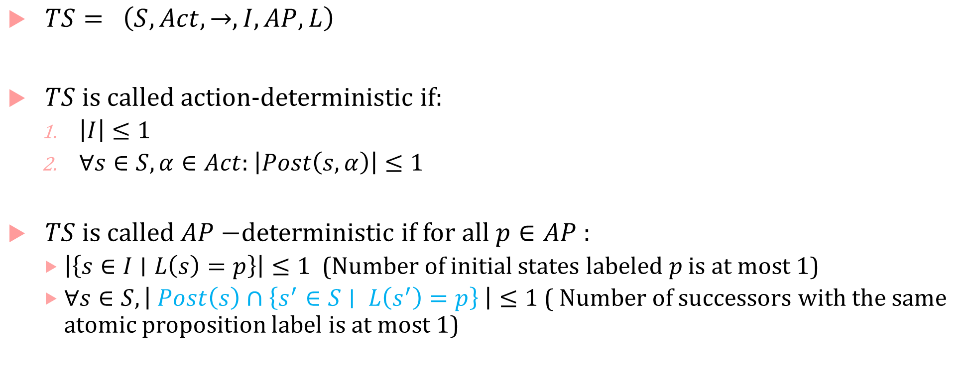
Deterministic Transition System
$TS= \left(S, Act, →, I, AP, L\right)$
$TS$ is called action-deterministic if:
$\left|I\right|≤1$
$∀s∈S,α∈Act$: $\left|Post\left(s,α\right)\right|≤1$
$TS$ is called $AP−$deterministic if for all $p∈AP$:
$\left|\left\{s∈I∣L\left(s\right)=p\right\}\right|≤1$ (Number of initial states labeled $p$ is at most 1)
$∀s∈S, \left| Post\left(s\right)∩\left\{s^{′}∈S∣ L\left(s^{′}\right)=p\right\} \right|≤1$ ( Number of successors with the same atomic proposition label is at most 1)

Slide 10
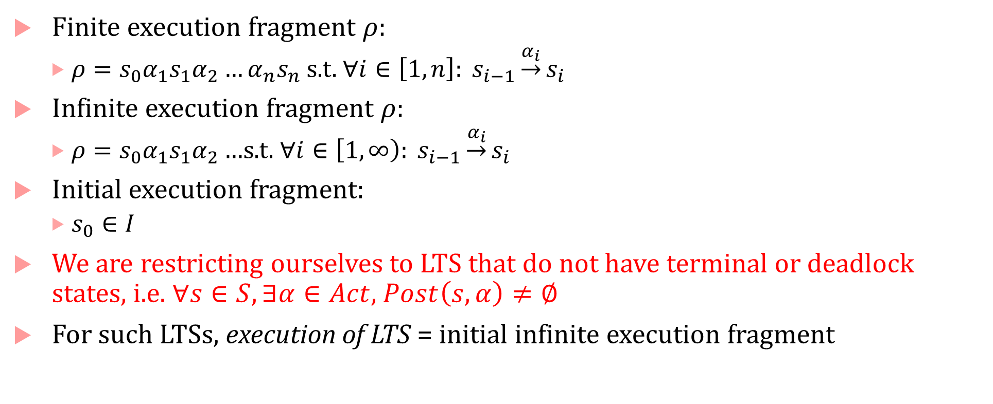
Executions
Finite execution fragment $ρ$:
$ρ=s_{0}α_{1}s_{1}α_{2}…α_{n}s_{n}$ s.t. $∀i∈\left[1,n\right]: s_{i−1}\underset{→}{α_{i}}s_{i}$
Infinite execution fragment $ρ$:
$ρ=s_{0}α_{1}s_{1}α_{2}…$s.t. $∀i∈\left[1,∞\right): s_{i−1}\underset{→}{α_{i}}s_{i}$
Initial execution fragment:
$s_{0}∈I$
We are restricting ourselves to LTS that do not have terminal or deadlock states, i.e. $∀s∈S,∃α∈Act$, $Post\left(s,α\right)≠∅$
For such LTSs, execution of LTS = initial infinite execution fragment

Slide 11



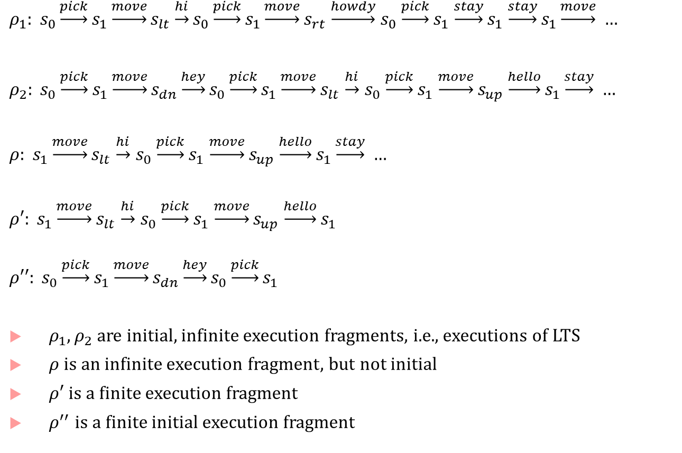



Execution example
$ρ_{1}: s_{0}\underset{→}{pick}s_{1}\underset{→}{move}s_{lt}\underset{→}{hi}s_{0}\underset{→}{pick}s_{1}\underset{→}{move}s_{rt}$ $\underset{→}{howdy}$ $s_{0}$ $\underset{→}{pick}s_{1}$ $\underset{→}{stay}s_{1}$ $\underset{→}{stay}s_{1}\underset{→}{move} …$
$ρ_{2}: s_{0}\underset{→}{pick}s_{1}\underset{→}{move}s_{dn}\underset{→}{hey}s_{0}\underset{→}{pick}s_{1}\underset{→}{move}s_{lt}$ $\underset{→}{hi}$ $s_{0}$ $\underset{→}{pick}s_{1}$ $\underset{→}{move}s_{up}$ $\underset{→}{hello}s_{1}\underset{→}{stay} …$
$ρ: s_{1}\underset{→}{move}s_{lt}$ $\underset{→}{hi}$ $s_{0}$ $\underset{→}{pick}s_{1}$ $\underset{→}{move}s_{up}$ $\underset{→}{hello}s_{1}\underset{→}{stay} …$
$ρ′: s_{1}\underset{→}{move}s_{lt}$ $\underset{→}{hi}$ $s_{0}$ $\underset{→}{pick}s_{1}$ $\underset{→}{move}s_{up}$ $\underset{→}{hello}s_{1}$
$$ρ′′: s_{0}\underset{→}{pick}s_{1}\underset{→}{move}s_{dn}\underset{→}{hey}s_{0}\underset{→}{pick}s_{1}$$
$ρ_{1},ρ_{2}$ are initial, infinite execution fragments, i.e., executions of LTS
$ρ$ is an infinite execution fragment, but not initial
$ρ′$ is a finite execution fragment
$ρ^{′′}$ is a finite initial execution fragment
$$s_{0}$$
hello
hey
pick
stay
$$s_{up}$$
move
$$s_{1}$$
move
$$s_{dn}$$
hi
move
move
howdy
$$s_{lt}$$
$$s_{rt}$$

Slide 12



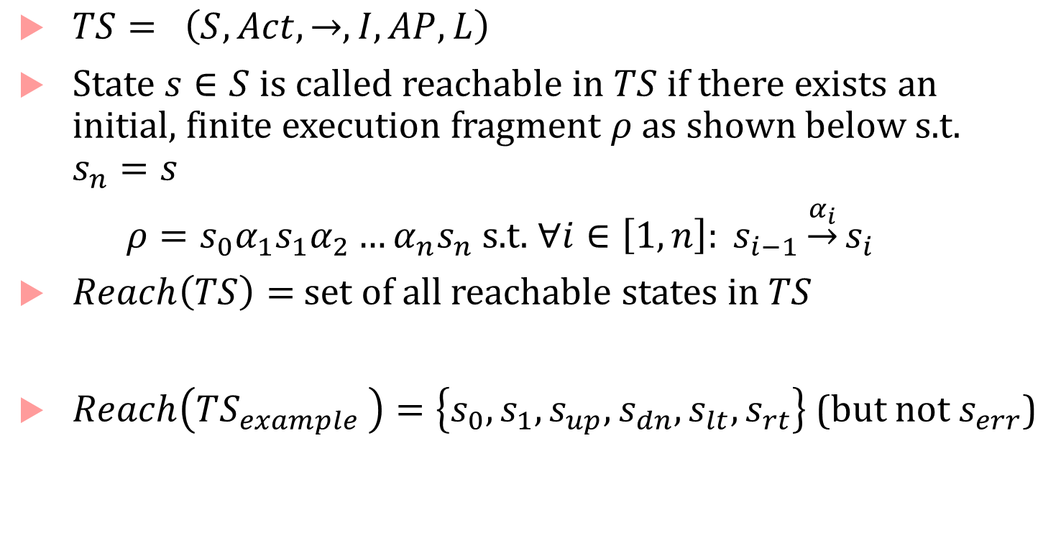





Reachable States
$TS= \left(S, Act, →, I, AP, L\right)$
State $s∈S$ is called reachable in $TS$ if there exists an initial, finite execution fragment $ρ$ as shown below s.t. $s_{n}=s$
$ρ=s_{0}α_{1}s_{1}α_{2}…α_{n}s_{n}$ s.t. $∀i∈\left[1,n\right]: s_{i−1}\underset{→}{α_{i}}s_{i}$
$Reach\left(TS\right)=$ set of all reachable states in $TS$
$Reach\left(TS_{example }\right)=\left\{s_{0},s_{1},s_{up},s_{dn},s_{lt},s_{rt}\right\}$ (but not $s_{err}$)
$$TS_{example}$$
$$s_{0}$$
hello
hey
pick
stay
$$s_{up}$$
move
$$s_{1}$$
move
$$s_{dn}$$
hi
move
move
howdy
$$s_{lt}$$
$$s_{rt}$$
$$s_{err}$$

Slide 13
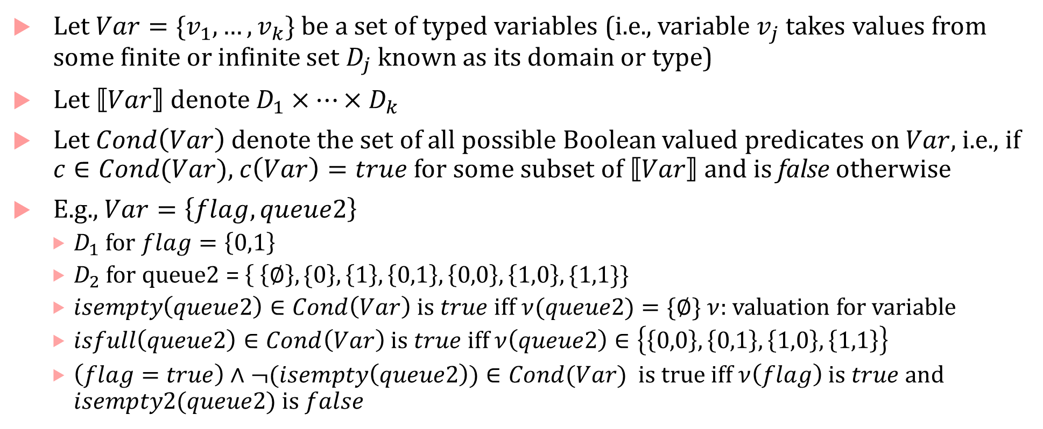
Modeling Programs using LTSs
Let $Var=\{v_{1},…, v_{k}\}$ be a set of typed variables (i.e., variable $v_{j}$ takes values from some finite or infinite set $D_{j}$ known as its domain or type)
Let $⟦Var⟧$ denote $D_{1}×…×D_{k}$
Let $Cond\left(Var\right)$ denote the set of all possible Boolean valued predicates on $Var$, i.e., if $c∈Cond(Var)$, $c\left(Var\right)=true$ for some subset of $⟦Var⟧$ and is false otherwise
E.g., $Var=\left\{flag, queue2\right\}$
$D_{1}$ for $flag=\left\{0,1\right\}$
$D_{2}$ for queue2 = $\left\{ \left\{∅\right\}, \{0\right\},\left\{1\right\}, \left\{0,1\right\},\left\{0,0\right\},\left\{1,0\right\},\{1,1\}\}$
$isempty\left(queue2\right)∈Cond\left(Var\right)$ is $true$ iff $ν(queue2)=\{∅\}$ $ν$: valuation for variable
$isfull\left(queue2\right)∈Cond\left(Var\right)$ is $true$iff $ν\left(queue2\right)∈\left\{\left\{0,0\right\},\left\{0,1\right\},\left\{1,0\right\},\left\{1,1\right\}\right\}$
$\left(flag=true\right)∧¬(isempty\left(queue2\right))∈Cond(Var)$ is true iff $ν\left(flag\right)$ is $true$ and $isempty2(queue2)$ is $false$

Slide 14
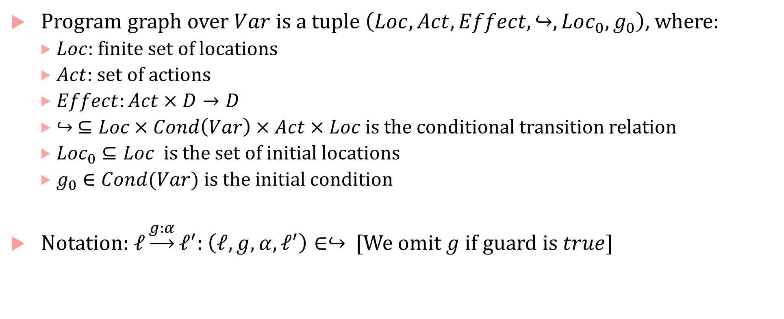
Program graphs
Program graph over $Var$ is a tuple $\left(Loc, Act, Effect, ↪,Loc_{0},g_{0}\right)$, where:
$Loc$: finite set of locations
$Act$: set of actions
$Effect:Act×D→D$
$↪ ⊆Loc×Cond\left(Var\right)×Act×Loc$ is the conditional transition relation
$Loc_{0}⊆Loc$ is the set of initial locations
$g_{0}∈Cond(Var)$ is the initial condition
Notation: $ℓ\underset{→}{g:α}ℓ^{′}$: $\left(ℓ,g,α, ℓ^{′}\right)∈↪$ [We omit $g$ if guard is $true$]

Slide 15
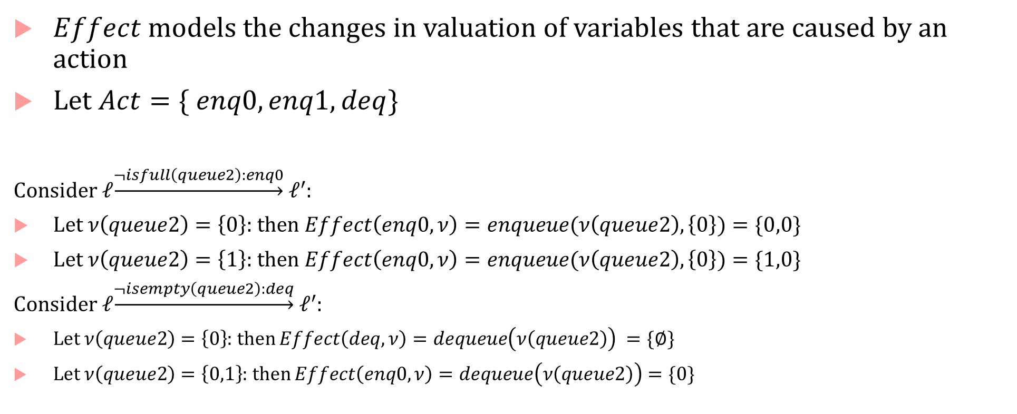
Effect and (e)valuation
$Effect$ models the changes in valuation of variables that are caused by an action
Let $Act=\{ enq0, enq1, deq\}$
Consider $ℓ\underset{→}{¬isfull\left(queue2\right):enq0} ℓ^{′}$:
Let $ν\left(queue2\right)=\left\{0\right\}$: then $Effect\left(enq0,ν\right)=enqueue(ν\left(queue2\right),\left\{0\right\})=\{0,0\}$
Let $ν\left(queue2\right)=\left\{1\right\}$: then $Effect\left(enq0,ν\right)=enqueue(ν\left(queue2\right),\left\{0\right\})=\{1,0\}$
Consider $ℓ\underset{→}{¬isempty\left(queue2\right):deq} ℓ^{′}$:
Let $ν\left(queue2\right)=\left\{0\right\}$: then $Effect\left(deq,ν\right)=dequeue\left(ν\left(queue2\right)\right) =\{∅\}$
Let $ν\left(queue2\right)=\left\{0,1\right\}$: then $Effect\left(enq0,ν\right)=dequeue\left(ν\left(queue2\right)\right)=\{0\}$

Slide 16
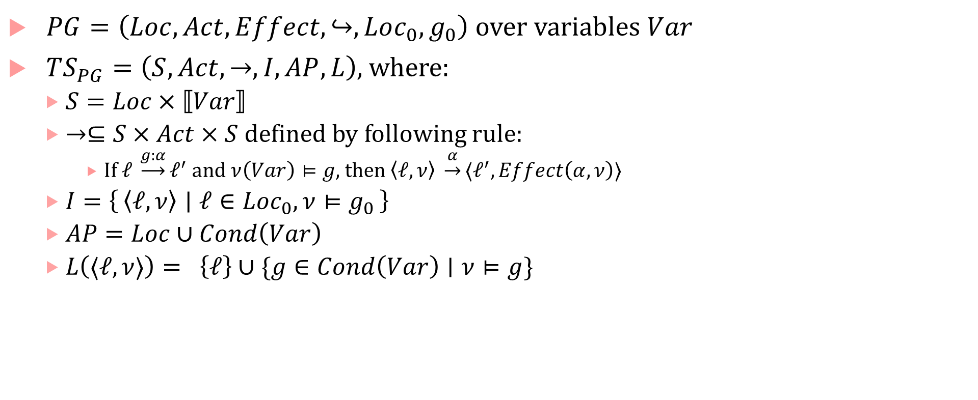
LTS semantics of a program graph
$PG=\left(Loc, Act, Effect, ↪,Loc_{0},g_{0}\right)$ over variables $Var$
$TS_{PG}=\left(S,Act, →, I, AP, L\right)$, where:
$S=Loc×⟦Var⟧$
$→⊆S×Act×S$ defined by following rule:
If $ℓ \underset{→}{g:α}ℓ^{′}$ and $ν\left(Var\right)⊨g$, then $\left\langle ℓ, ν\right\rangle \underset{→}{α}⟨ℓ^{′}, Effect\left(α, ν\right)⟩$
$I=\left\{\left\langle ℓ, ν\right\rangle ∣ ℓ∈Loc_{0}, ν⊨g_{0}\right\}$
$AP=Loc∪Cond\left(Var\right)$
$L\left(⟨ℓ,ν⟩\right)= \left\{ℓ\right\}∪\{g∈Cond\left(Var\right)∣ν⊨g\}$

Slide 17
LTS can model almost any computation
Sequential hardware circuits
Registers get new values every tick (depends on old values, input values, the circuit function)
States = valuations of registers and input variables
Actions = just one action “clock tick”
Transition relation = transitions between circuit states
Labels : truth values of any chosen “named wire” in the circuit (e.g., input, register, output, etc.)
Dynamical Systems
States are valuations of state variables of the system (can be continuous or discrete)
Actions can be taken by an external agent/controller
Transitions defined by the system dynamics (can be continuous or discrete)
Propositions defined by predicates on state variables, Labels = truth values of propositions for each state

Slide 18
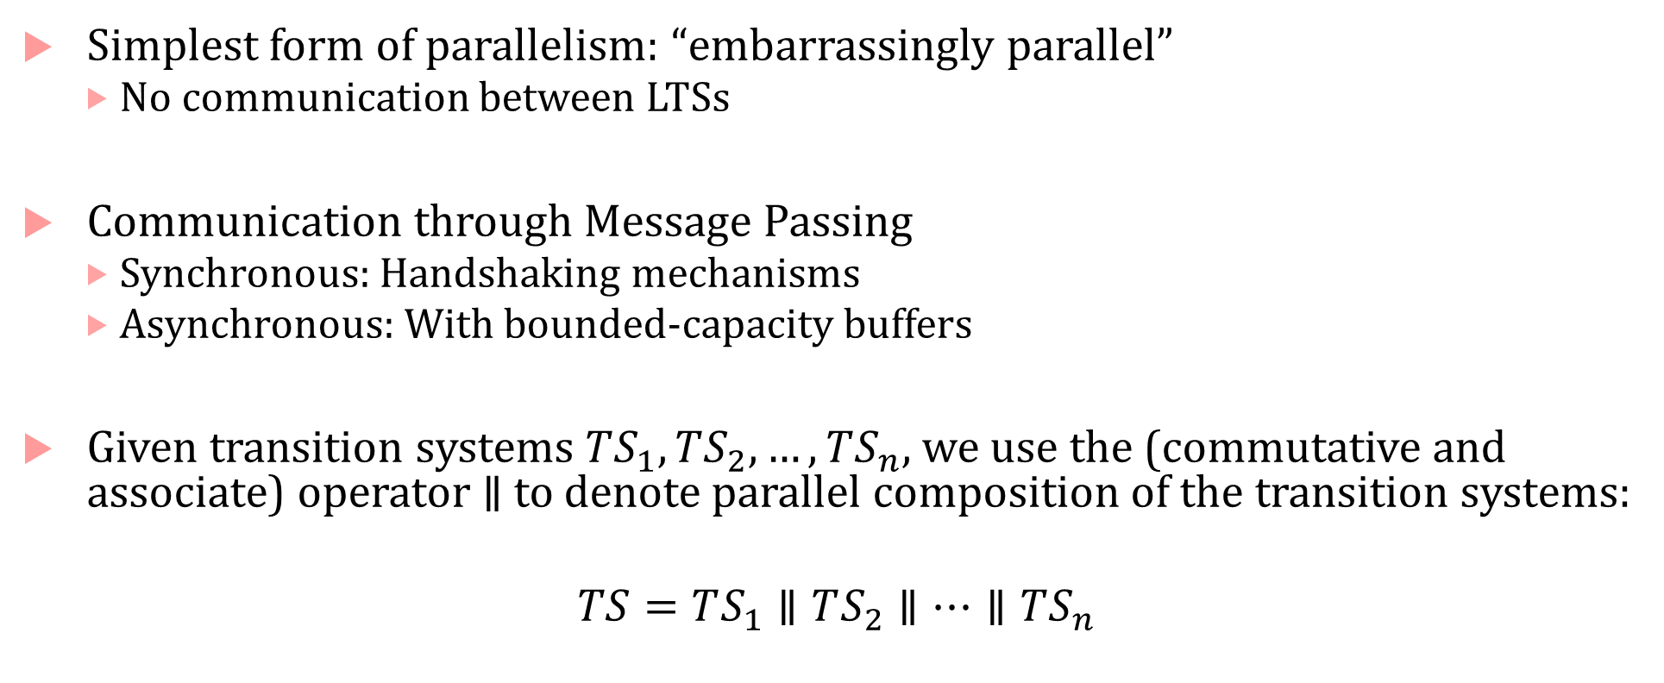
Concurrency/Parallelism and Communication
Simplest form of parallelism: “embarrassingly parallel”
No communication between LTSs
Communication through Message Passing
Synchronous: Handshaking mechanisms
Asynchronous: With bounded-capacity buffers
Given transition systems $TS_{1},TS_{2},…, TS_{n}$, we use the (commutative and associate) operator $∥$ to denote parallel composition of the transition systems:
$$TS=TS_{1}∥TS_{2}∥…∥TS_{n}$$

Slide 19

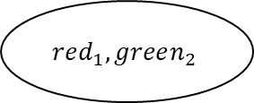
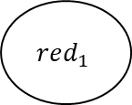
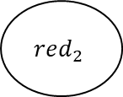
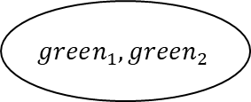
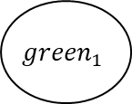

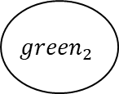
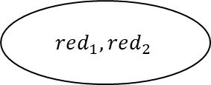





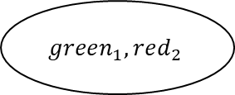
Interleaved model of concurrency
Interleaving: No explicit assumption on the order in which individual actions of transition systems can execute
$$red_{1}$$
$$red_{2}$$
$$red_{1},red_{2}$$
$$2$$
$$1$$
$$1$$
$$1$$
$$2$$
$$2$$
$$2$$
$$1$$
$$red_{1},green_{2}$$
$$green_{1},red_{2}$$
$${green}_{1}$$
$${green}_{2}$$
$$1$$
$$2$$
$$1$$
$$green_{1},green_{2}$$
$$2$$
$$TS_{1}$$
$$TS_{2}$$

Slide 20
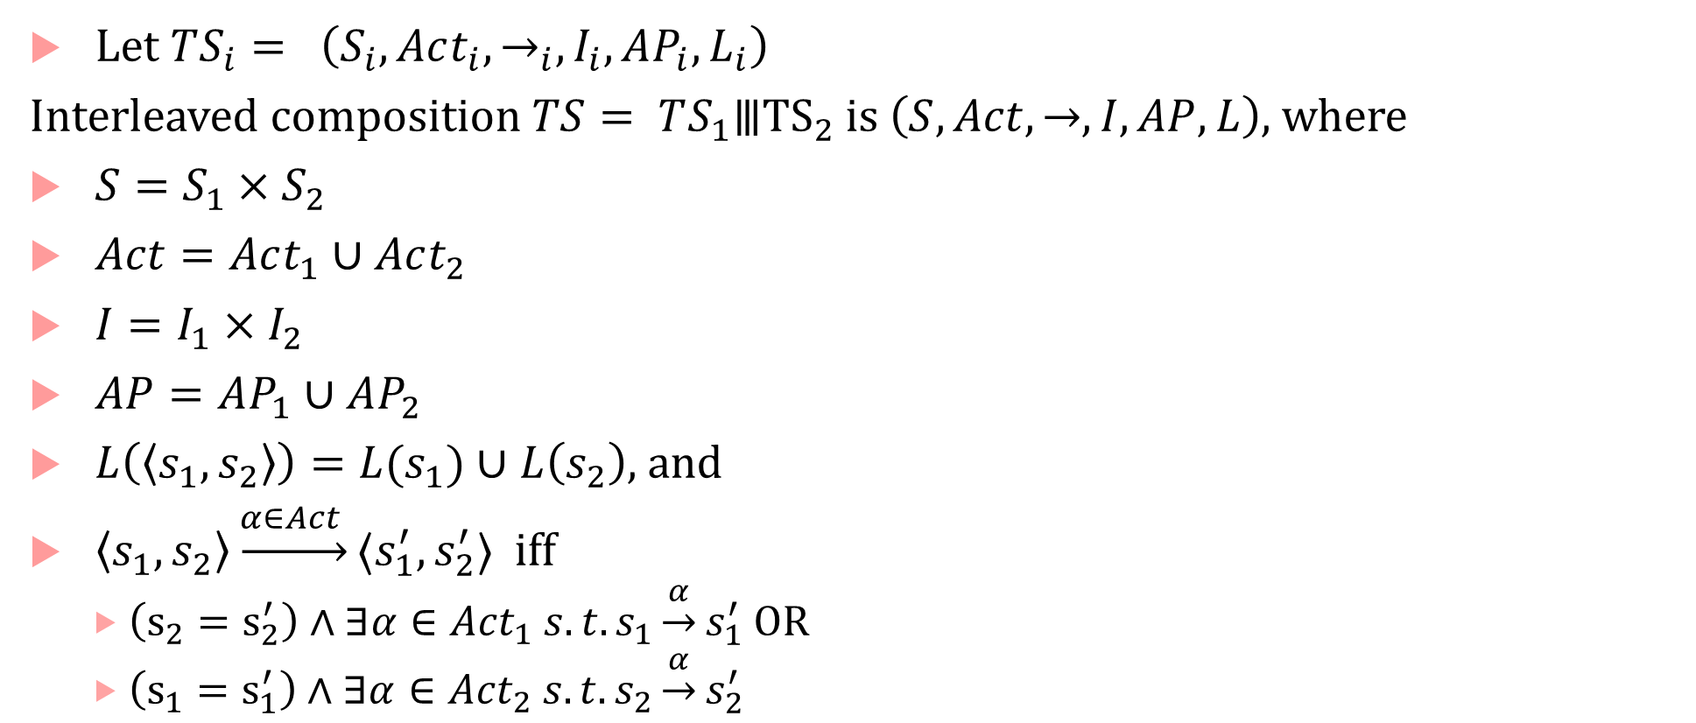
Interleaved composition
Let $TS_{i}= \left(S_{i}, Act_{i}, →_{i}, I_{i}, AP_{i}, L_{i}\right)$
Interleaved composition $TS= TS_{1}⦀{TS}_{2}$ is $\left(S, Act, →, I, AP, L\right)$, where
$S=S_{1}×S_{2}$
$Act=Act_{1}∪Act_{2}$
$I=I_{1}×I_{2}$
$AP=AP_{1}∪AP_{2}$
$L\left(\left\langle s_{1},s_{2}\right\rangle \right)=L(s_{1})∪L\left(s_{2}\right)$, and
$\left\langle s_{1},s_{2}\right\rangle \underset{→}{α∈Act }⟨s_{1}^{′},s_{2}^{′}⟩$ iff
$\left(s_{2}=s_{2}^{′}\right)∧∃α∈{Act}_{1} s.t. s_{1}\underset{→}{α}s_{1}^{′}$ OR
$\left(s_{1}=s_{1}^{′}\right)∧∃α∈{Act}_{2} s.t. s_{2}\underset{→}{α}s_{2}^{′}$

Slide 21
Interleaved LTS
LTS states nondeterministically choose which action to execute ($1$ or $2$)
$$red_{1}$$
$$red_{2}$$
$$red_{1},red_{2}$$
$$2$$
$$1$$
$$1$$
$$1$$
$$2$$
$$2$$
$$2$$
$$1$$
$$red_{1},green_{2}$$
$$green_{1},red_{2}$$
$${green}_{1}$$
$${green}_{2}$$
$$1$$
$$2$$
$$1$$
$$green_{1},green_{2}$$
$$2$$
$$TS_{1}$$
$$TS_{2}$$

Slide 22
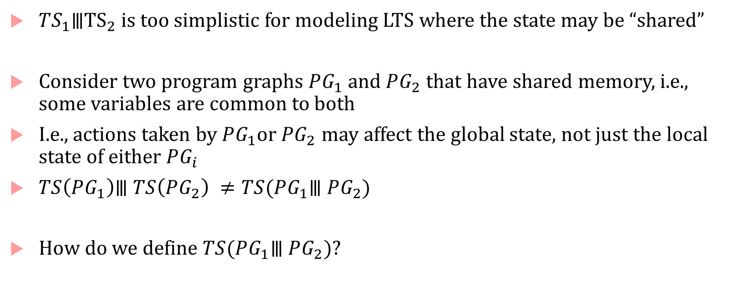
Shared memory/Asynchronous Message Passing
$TS_{1}⦀{TS}_{2}$ is too simplistic for modeling LTS where the state may be “shared”
Consider two program graphs $PG_{1}$ and $PG_{2}$ that have shared memory, i.e., some variables are common to both
I.e., actions taken by $PG_{1}$or $PG_{2}$ may affect the global state, not just the local state of either $PG_{i}$
$TS\left(PG_{1}\right)⦀ TS\left(PG_{2}\right) ≠TS(PG_{1}⦀ PG_{2})$
How do we define $TS(PG_{1}⦀ PG_{2})$?

Slide 23
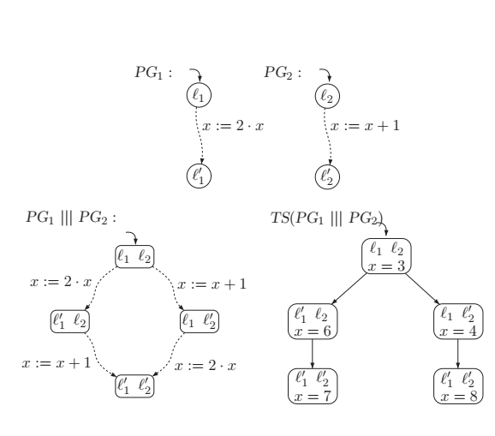
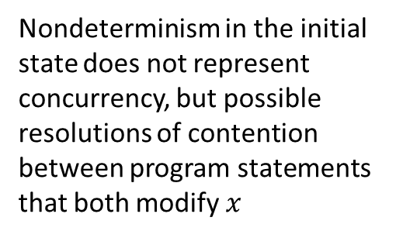
Interleaved Program Graphs
Nondeterminism in the initial state does not represent concurrency, but possible resolutions of contention between program statements that both modify $x$

Slide 24


Interleaving of program graphs
$PG_{i}=\left(Loc_{i}, Act,_{i} Effect_{i}, ↪_{i},Loc_{0,i},g_{0,i}\right)$ over variables $Var_{i}$
Interleaved program graph $PG=PG_{1}⦀ PG_{2}$ defined as:
$(Loc_{1}×Loc_{2}, Act_{1}⨄Act_{2},Effect,↪,Loc_{0,1}×Loc_{0,2}, g_{0,1}∧g_{0,2})$, where:

Slide 25
Mutual Exclusion

Slide 26
Handshaking or Synchronous Rendezvous

Slide 27
Synchronous Parallelism

Slide 28
Synchronous Product

Slide 29
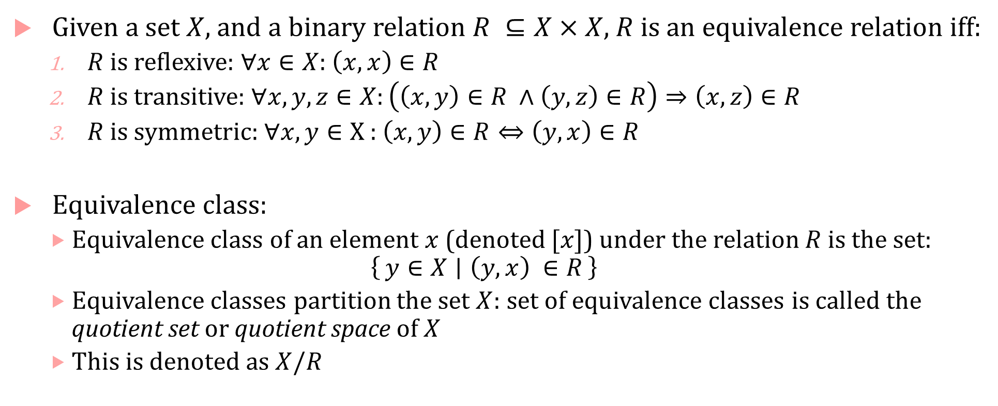
Equivalence Relation & Equivalence Classes
Given a set $X$, and a binary relation $R ⊆X×X$, $R$ is an equivalence relation iff:
$R$ is reflexive: $∀x∈X$: $\left(x,x\right)∈R$
$R$ is transitive: $∀x,y,z∈X:\left(\left(x,y\right)∈R ∧\left(y,z\right)∈R\right)⇒\left(x,z\right)∈R$
$R$ is symmetric: $∀x,y∈X$: $\left(x,y\right)∈R⇔\left(y,x\right)∈R$
Equivalence class:
Equivalence class of an element $x$ (denoted $[x]$) under the relation $R$is the set:
$$\left\{y∈X ∣ \left(y,x\right) ∈R\right\}$$
Equivalence classes partition the set $X$: set of equivalence classes is called the quotient set or quotient space of $X$
This is denoted as $X/R$

Slide 30
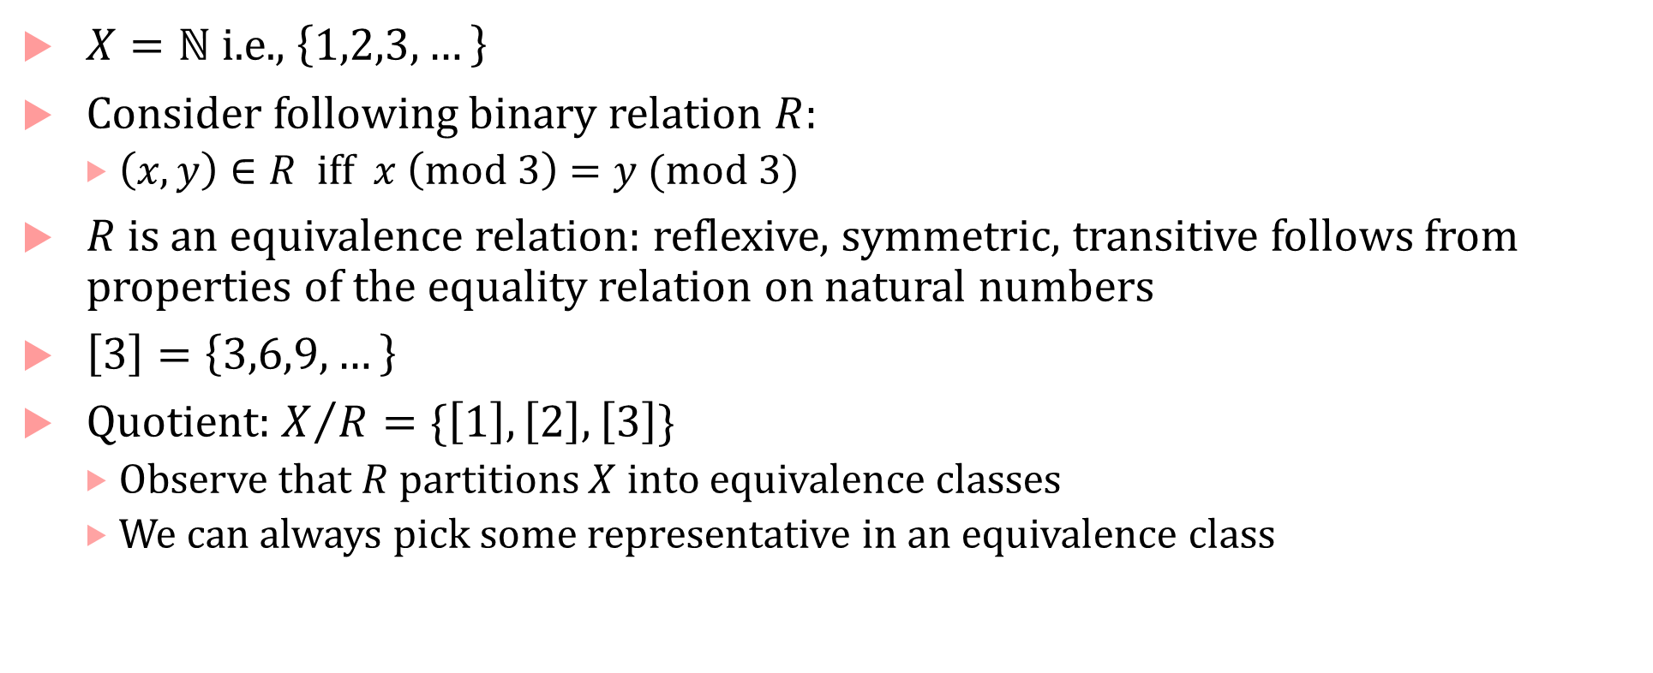
Equivalence & Quotient examples
$X=ℕ$ i.e., $\left\{1,2,3,…\right\}$
Consider following binary relation $R$:
$\left(x,y\right)∈R$ iff $x \left(mod 3\right)=y (mod 3)$
$R$ is an equivalence relation: reflexive, symmetric, transitive follows from properties of the equality relation on natural numbers
$\left[3\right]=\left\{3,6,9,…\right\}$
Quotient: $X/R=\{\left[1\right],\left[2\right],\left[3\right]\}$
Observe that $R$ partitions $X$ into equivalence classes
We can always pick some representative in an equivalence class

Slide 31
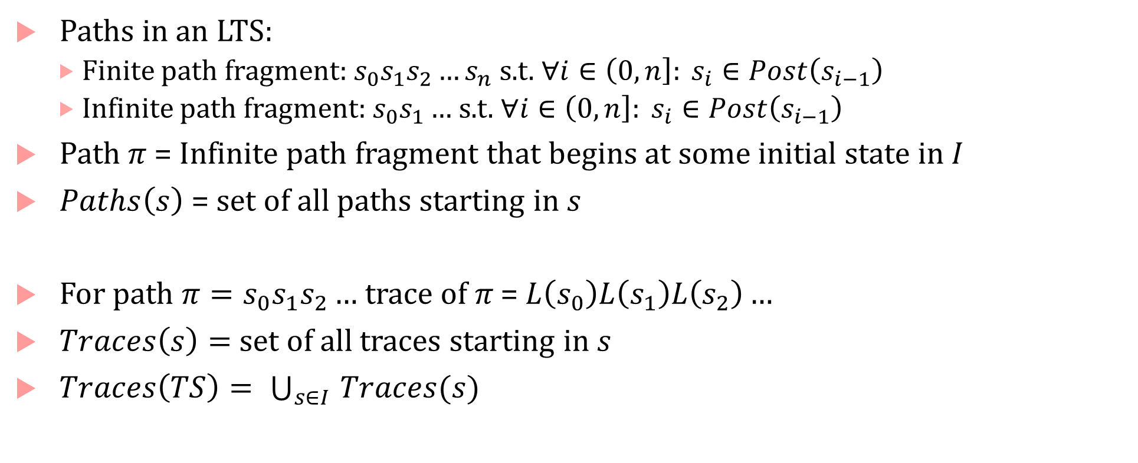
Paths and Traces in an LTS
Paths in an LTS:
Finite path fragment: $s_{0}s_{1}s_{2}…s_{n}$ s.t. $∀i∈\left(0,n\right]: s_{i}∈Post\left(s_{i−1}\right)$
Infinite path fragment: $s_{0}s_{1}…$s.t. $∀i∈\left(0,n\right]: s_{i}∈Post\left(s_{i−1}\right)$
Path $π$= Infinite path fragment that begins at some initial state in $I$
$Paths\left(s\right)$ = set of all paths starting in $s$
For path $π=s_{0}s_{1}s_{2}…$ trace of $π$ = $L\left(s_{0}\right)L\left(s_{1}\right)L\left(s_{2}\right)…$
$Traces\left(s\right)=$ set of all traces starting in $s$
$Traces\left(TS\right)= \bigcup_{s∈I }{Traces(s)}$

Slide 32
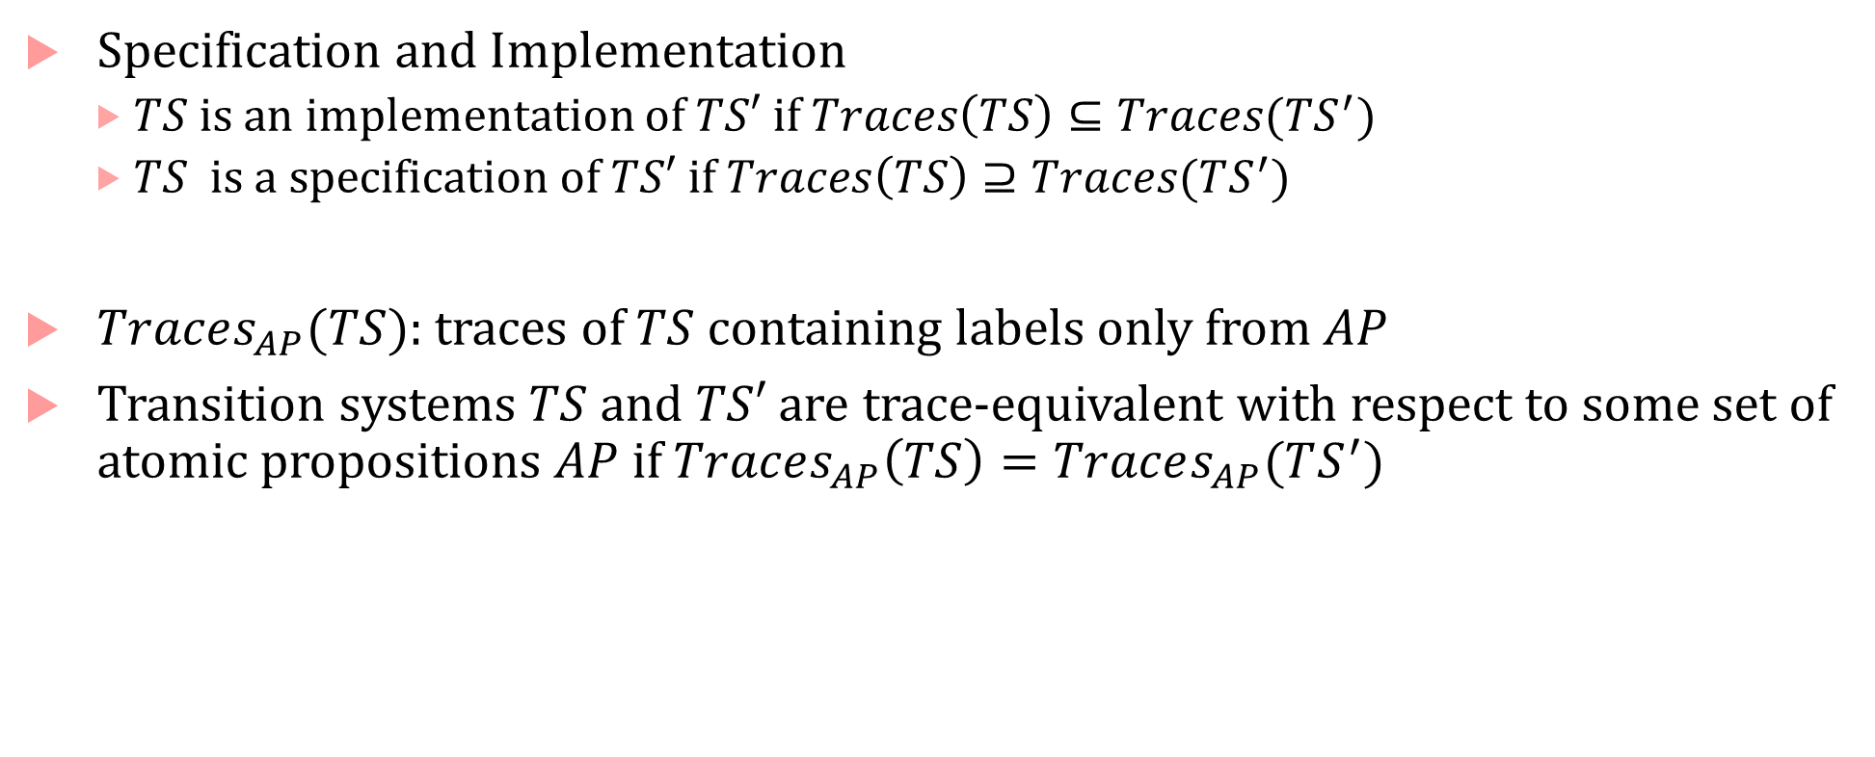
Trace Inclusion and Equivalence
Specification and Implementation
$TS$ is an implementation of $TS′$ if $Traces\left(TS\right)⊆Traces(TS^{′})$
$TS$ is a specification of $TS′$ if $Traces\left(TS\right)⊇Traces(TS^{′})$
$Traces_{AP}(TS)$: traces of $TS$containing labels only from $AP$
Transition systems $TS$ and $TS′$ are trace-equivalent with respect to some set of atomic propositions $AP$if $Traces_{AP}\left(TS\right)=Traces_{AP}(TS^{′})$

Slide 33
Bisimulation Relation

Slide 34
Bisimulation is an equivalence relation

Slide 35
Bisimulation Relation between states of an LTS

Slide 36
Bisimulation Quotient

Slide 37
Action-based Bisimulation

Slide 38
Partition Refinement: computing bisimulation quotients

Slide 39
Partition Refinement: computing bisimulation quotients

Slide 40
Partition Refinement: computing bisimulation quotients

Slide 41
Partition Refinement: computing bisimulation quotients

Slide 42
Time complexity

Slide 43
Simulation Pre-Order

Slide 44
Abstraction Function

Slide 45
Abstract LTS

Slide 46
Simulation Equivalence

Slide 47
Simulation Quotient

Slide 48
Comparing simulation and bisimulation equivalence

Slide 49
Stuttering Equivalence

Slide 50
Stuttering Bisimulation

