Slide 1
Introduction to Formal Verification/Reasoning
Fall 2018: CSCI 699
Instructor: Jyo Deshmukh
Course materials: http://www-bcf.usc.edu/~jdeshmuk/teaching/cs699-fm-for-cps/index.html

Slide 2
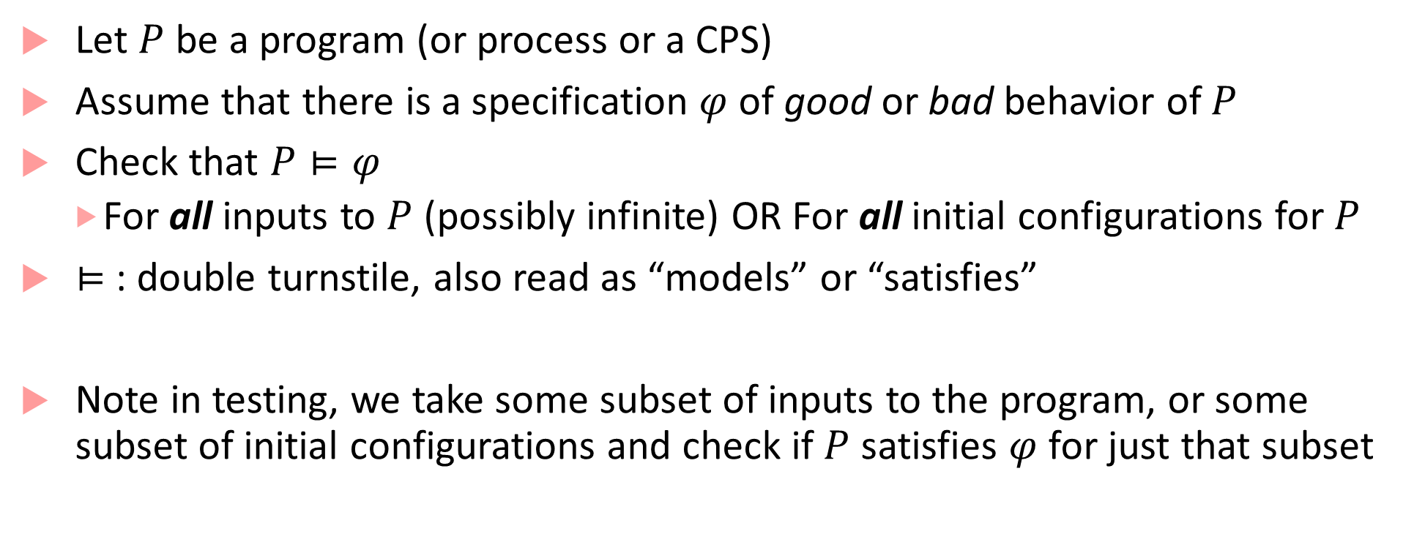
Formal Verification: Problem Definition
Let $P$ be a program (or process or a CPS)
Assume that there is a specification $φ$ of good or bad behavior of $P$
Check that $P⊨φ$
For all inputs to $P$ (possibly infinite) OR For all initial configurations for $P$
$⊨$ : double turnstile, also read as “models” or “satisfies”
Note in testing, we take some subset of inputs to the program, or some subset of initial configurations and check if $P$ satisfies $φ$ for just that subset

Slide 3
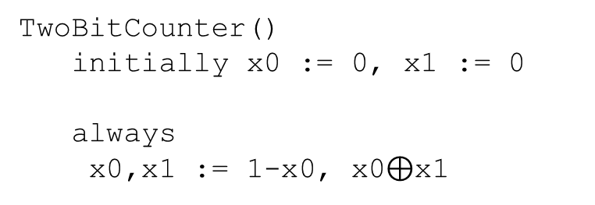
State-based modeling of programs
At any point in program execution, its state is everything that constitutes the configuration of the program
Program counter, values of all variables, etc.
Any program can be viewed as a system that defines a transition system over a set of states
TwoBitCounter()
initially x0 := 0, x1 := 0
always
x0,x1 := 1-x0, x0$⊕$x1
00
01
10
11

Slide 4
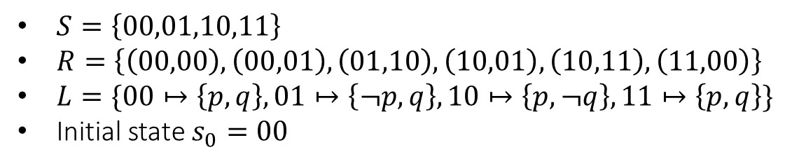

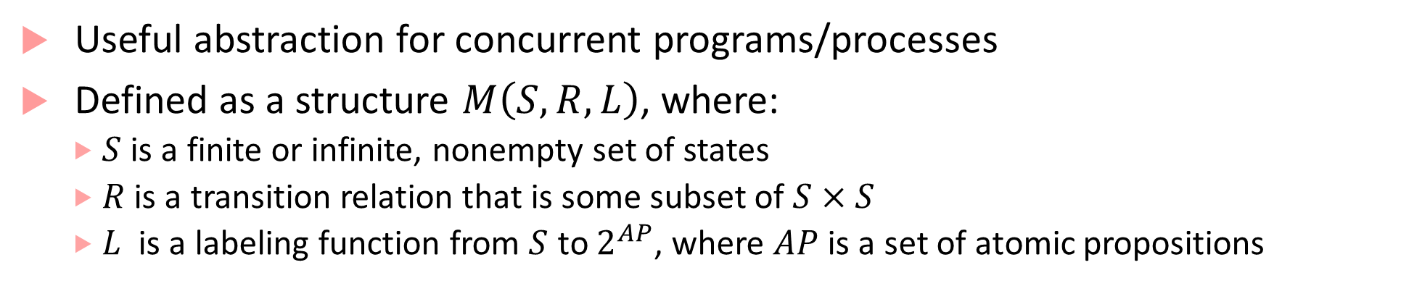



Kripke structure
Useful abstraction for concurrent programs/processes
Defined as a structure $M\left(S,R,L\right)$, where:
$S$ is a finite or infinite, nonempty set of states
$R$ is a transition relation that is some subset of $S×S$
$L$ is a labeling function from $S$ to $2^{AP}$, where $AP$ is a set of atomic propositions
$$p,q$$
$$¬p,q$$
$$p,¬q$$
$$p,q$$
$S=\left\{00,01,10,11\right\}$
$R=\left\{\left(00,00\right),\left(00,01\right), \left(01,10\right), \left(10,01\right), \left(10,11\right), \left(11,00\right)\right\}$
$L=\{00↦\left\{p,q\right\}, 01↦\left\{¬p,q\right\}, 10↦\left\{p,¬q\right\}, 11↦\left\{p,q\right\}\}$
Initial state $s_{0}=00$
00
01
10
11

Slide 5

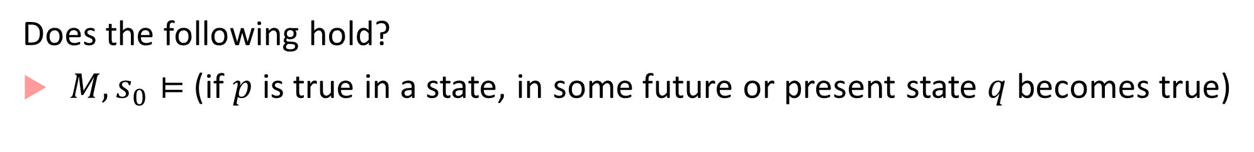



Verification question
Does the following hold?
$M,s_{0}⊨$ (if $p$ is true in a state, in some future or present state $q$ becomes true)
$$p,q$$
$$¬p,q$$
$$p,¬q$$
$$p,q$$
00
01
10
11

Slide 6

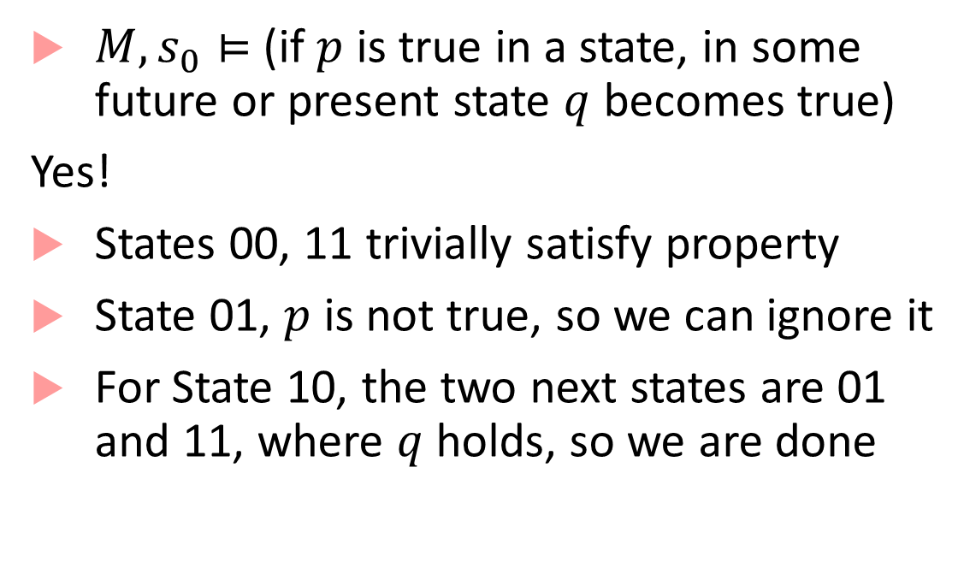



Verification question
$M,s_{0}⊨$ (if $p$ is true in a state, in some future or present state $q$ becomes true)
Yes!
States 00, 11 trivially satisfy property
State 01, $p$ is not true, so we can ignore it
For State 10, the two next states are 01 and 11, where $q$ holds, so we are done
$$p,q$$
$$¬p,q$$
$$p,¬q$$
$$p,q$$
00
01
10
11

Slide 7
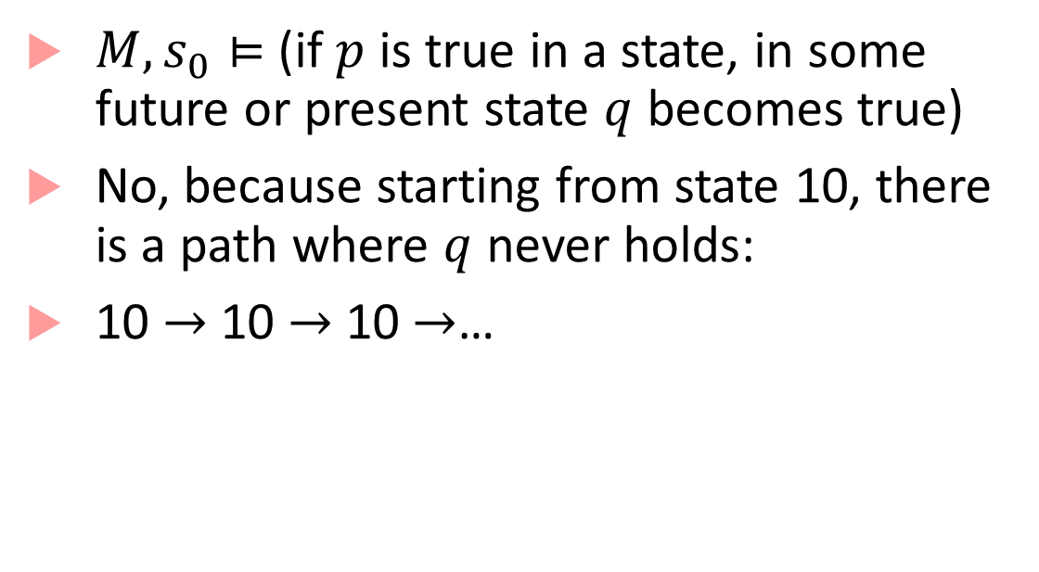
Verification question
$M,s_{0}⊨$ (if $p$ is true in a state, in some future or present state $q$ becomes true)
No, because starting from state 10, there is a path where $q$ never holds:
10 $→$ 10 $→$10 $→$…
$$p,q$$
$$¬p,q$$
$$p,¬q$$
$$p,q$$
00
01
10
11

Slide 8
Key Problems: Specifications and Model Checking
Can we express the property of interest in some machine-checkable (and unambiguous form)?
Yes, using Temporal Logic, automata, etc.
Given a Kripke structure/transition system, can we check if a given property holds for it algorithmically?
Yes, using a set of algorithms collectively known as model checking
Kripke structure is the “model” of the program
Model is also a term from logic: given a logical formula, a structure demonstrating satisfiability of the formula is called a model
We are checking if a given program can be the model for a given logical formula

Slide 9
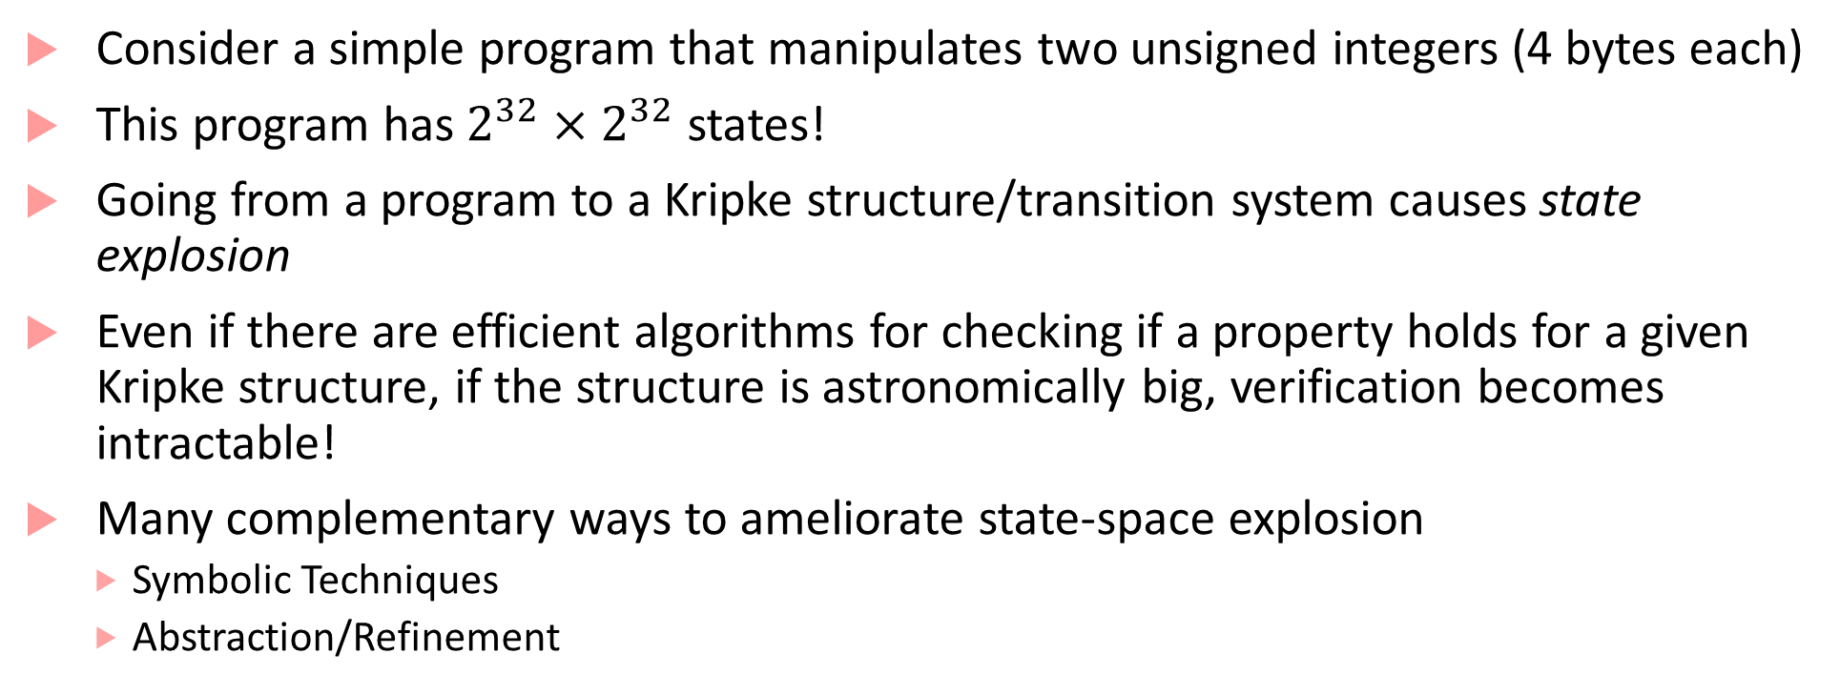
Challenges: State Explosion
Consider a simple program that manipulates two unsigned integers (4 bytes each)
This program has $2^{32}×2^{32}$ states!
Going from a program to a Kripke structure/transition system causes state explosion
Even if there are efficient algorithms for checking if a property holds for a given Kripke structure, if the structure is astronomically big, verification becomes intractable!
Many complementary ways to ameliorate state-space explosion
Symbolic Techniques
Abstraction/Refinement

Slide 10
Symbolic techniques
Main idea: Do not construct Kripke structure for program explicitly, but develop a symbolic representation for the transition system corresponding to the program
In Boolean programs (hardware verification): with the use of Binary Decision Diagrams and propositional SAT
In software programs: with the use of constraint solvers and SAT modulo theories (SMT solvers)
Symbolic model checking algorithms then perform verification with the help of constraint solving/SAT
We will learn the details in some of the papers we explore

Slide 11
Abstraction/Refinement
Main idea: Remove some detail from the program to create an abstraction of the program
Abstract program is typically much smaller than the actual program, and is an over-approximation: the abstract program will contain strictly more behaviors than the concrete program (because some detail was removed)
Run analysis algorithms on the smaller abstract program
If the abstract program satisfies the spec, we are done (if less detailed behaviors satisfy the spec, more detailed behaviors will also satisfy it).
If abstract program does not satisfy the spec, it may be a false positive: we then use refinement to improve the quality of abstraction

Slide 12


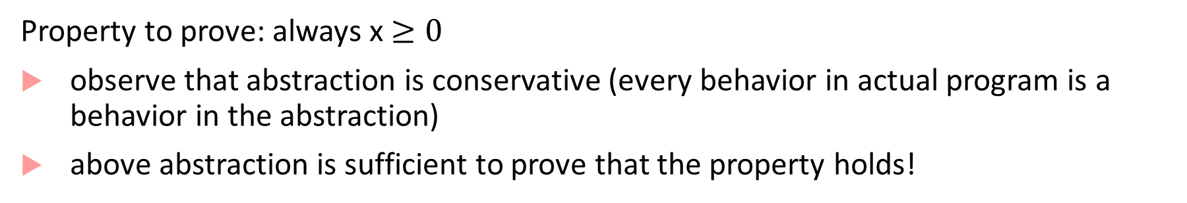
Example of abstraction
int x = 1000;
while (x > 0)
do
x := x-1;
od
halt
Concrete state
1000
Abstract state
999
Abstract transition
2
1
x$>$0
x$=$0
Property to prove: always x $≥0$
observe that abstraction is conservative (every behavior in actual program is a behavior in the abstraction)
above abstraction is sufficient to prove that the property holds!

Slide 13


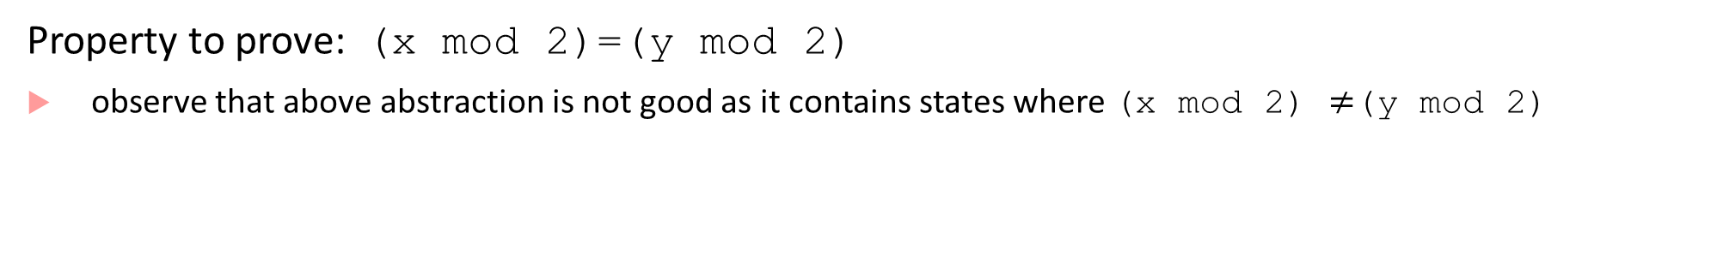
Need for refinement
int x = 1000;
int y = 0;
while (x > 0)
do
x,y := x-1, (y+1) mod 2;
od
halt
Concrete state for y
Concrete state for x
0
,
1000
Abstract state
1
,
1000
Abstract transition
0
,
0
1
,
0
0
,
1
1
,
1
x$>$0
x$=$0
Property to prove: (x mod 2)=(y mod 2)
observe that above abstraction is not good as it contains states where (x mod 2) $≠$(y mod 2)

Slide 14


Refinement example
int x = 1000;
while (x > 0)
do
x := x-1;
od
halt
x$>$0
x%2=0,y=0
x%2=1,y=1
Concrete state
1000
999
Old
Abstract state
998
997
0
New
Abstract state
2
1
Old Abstract transition
x$=$0,y=0
Property to prove: (x mod 2)=(y mod 2)
“refine” or split state into two new states, and add transitions between new states and surviving old states
Abstraction is now rich enough to prove required property

Slide 15




Refinement fails
int x = 1000;
while (x > 0)
do
x := x-1;
od
halt
Concrete state
1000
499
Old
Abstract state
999
498
New
Abstract state
500
1
x$>$=500
Old Abstract transition
x$>$0
500>x$>$0
x$=$0
Property to prove: if x>=500 , then eventually x<500
“refine” or split state into two new states, and add transitions between new states and surviving old states
Abstraction still not rich enough, need a ranking function to show that the system eventually exits state x>=500
New abstract transition

Slide 16
General challenges for abstraction/refinement
How do you compute program abstractions automatically?
How do you do the abstraction-refinement process efficiently?
Many types of abstractions explored in the community
Predicate Abstraction (use specific Boolean predicates to abstract the program)
Partial order reduction for concurrent programs (remove interleaved executions that do not have bearing on the property)
Symmetry reduction (exploit system symmetry)
Using abstract interpretation: interpret program as a transformer over some abstract domains (e.g. intervals, signed vs. unsigned sets, etc.), and use SMT solvers
CounterExample Guided Abstraction Refinement (CEGAR) by Clarke et al is a popular technique used for automating abstraction refinement process

Slide 17
CPS modeling
Model-Based Development (MBD) popular paradigm for developing software, typically uses three kinds of models:
Plant Model: Encapsulates physical processes to be controlled/regulated/ monitored by software
May be modeled using differential or algebraic equations
Typically models continuous-time evolution of continuous-valued physical quantities
Environment Model: Captures anything that cannot be controlled and is external to the system
Controller Model: Encapsulates the software component that continuously senses the plant and the environment and reacts to it

Slide 18
Typical closed-loop model
Plant Model
Environment
Controller
Actuators
System Dynamics
Sensors

Slide 19
Typical closed-loop model: issues in FV
Typically Stateful, Continuously evolving component with limited visibility of state, and possible stochasticity
Plant Model
Environment
Controller
Actuators
System Dynamics
Sensors
Stochastic or Nondeterministic assumptions on real-valued, real-time quantities
Stateful or Stateless Reactive, Real-Time Software Program

Slide 20
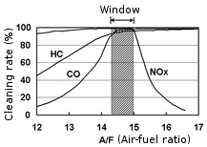
Case studies for verification
Catalytic converters reduce HC, CO2, and NOx emissions efficiency optimally when A/F ratio is at stoichiometric value
Objective: Control A/F to within 5% of nominal value
How do we model?
Plant: models internal air and fuel delivery dynamics
Controller: Proportional + Integral controller to regulate A/F ratio
Environment: Driver requests for torque

Slide 21


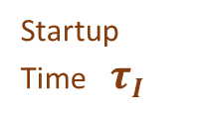




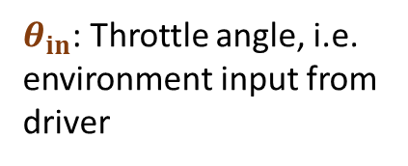
Controller: Modeled as a Hybrid Automaton
startup
$$λ_{ref}=14.7$$
No Feedback Control
Only feedforward estimator
Startup Time $τI$
Feedback Control
+ Feedforward estimator
normal
$$λ_{ref}=14.7$$
$θ_{in}$: Throttle angle, i.e. environment input from driver
$$θ_{in}≥{70}^{o}$$
$$θ_{in}≤{50}^{o}$$
sensor failure
power
$$λ_{ref}=14.7$$
$$_{ref}^{power}=12.5$$

Slide 22
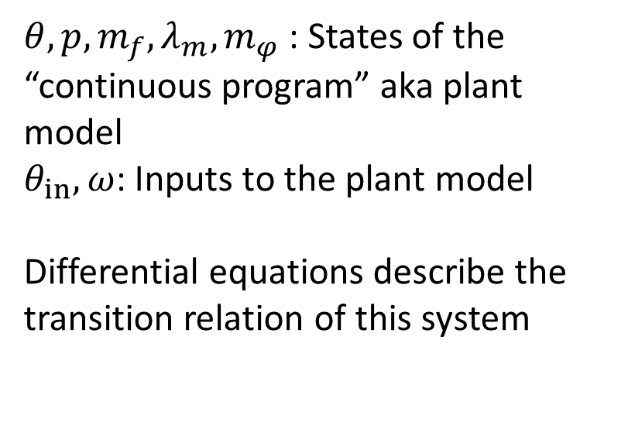
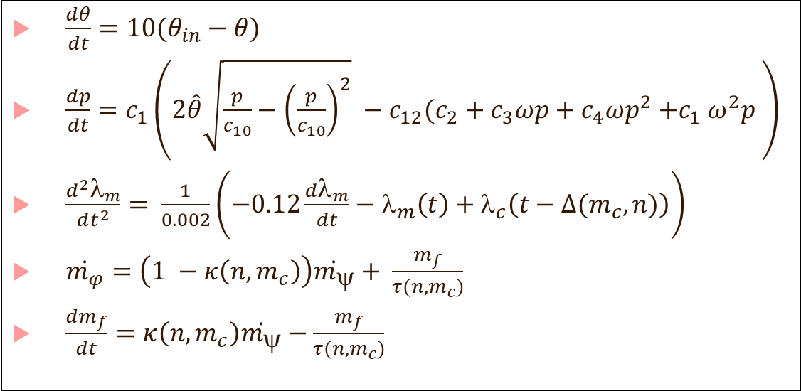
Plant: Modeled as Differential Equations
$\frac{dθ}{dt}=10(θ_{in}−θ)$
$\frac{dp}{dt}=c_{1}\left(2\hat{θ}\sqrt{\frac{p}{c_{10}}−{\left(\frac{p}{c_{10}}\right)}^{2}} −c_{12}(c_{2}+c_{3}ωp+c_{4}ωp^{2}{+c}_{1}ω^{2}p \right)$
$\frac{d^{2}λ_{m}}{dt^{2}}= \frac{1}{0.002}\left(−0.12\frac{dλ_{m}}{dt}−λ_{m}\left(t\right)+λ_{c}\left(t−∆(m_{c}, n)\right)\right)$
$\dot{m_{φ}}=\left(1 −κ\left(n,m_{c}\right)\right)\dot{m_{ψ}}+ \frac{m_{f}}{τ(n, m_{c})}$
$\frac{dm_{f}}{dt}=κ\left(n,m_{c}\right)\dot{m_{ψ}}−\frac{m_{f}}{τ(n, m_{c})}$
$θ,p,m_{f},λ_{m},m_{φ}$ : States of the “continuous program” aka plant model
$θ_{in},ω$: Inputs to the plant model
Differential equations describe the transition relation of this system

Slide 23
Verification challenge for closed-loop CPS models
State variables are real-valued: set of states may not be countable!
Models do not evolve in discrete time-steps: evolve continuously in time
Transitions are thus not finite in number or discrete in length, but continuous
Properties of interest in CPSs may involve real-time specifications (e.g. the A/F ratio is within 10% of reference within 2 seconds)
CPSs typically have an uncertain environment (e.g. user may nondeterministically change throttle angle), and we may also use stochastic assumptions (e.g. user alternating between wide-open throttle and fully closed throttle may be statistically less likely)

Slide 24
Some concepts you may need through this course
Some terms that may appear in papers: Reachability analysis, Bisimulation/Simulation Relations, Equivalence relations, Quotient structures, Product construction, Emptiness checking, Language equivalence, Undecidability, Under/Over-Approximations, ODEs, Initial Value Problem, Numerical solutions to ODEs, etc.
May be good to review these terms (independently or see me in office hours)
Think of this as a course that will connect the worlds of software verification and CPS verification: we will borrow techniques from either world to improve the state-of-the-art in the other world

Slide 25
Bibliography
Clarke, Edmund, Orna Grumberg, Somesh Jha, Yuan Lu, and Helmut Veith. "Counterexample-guided abstraction refinement for symbolic model checking." Journal of the ACM (JACM) 50, no. 5 (2003): 752-794.
Huth, Michael, and Mark Ryan. Logic in Computer Science: Modelling and reasoning about systems. Cambridge university press, 2004.
Peled, Doron. "Ten years of partial order reduction." In International Conference on Computer Aided Verification, pp. 17-28. Springer, Berlin, Heidelberg, 1998.
Emerson, E. Allen, and Richard J. Trefler. "From asymmetry to full symmetry: New techniques for symmetry reduction in model checking." In Advanced Research Working Conference on Correct Hardware Design and Verification Methods, pp. 142-157. Springer, Berlin, Heidelberg, 1999.
Ball, Thomas, Rupak Majumdar, Todd Millstein, and Sriram K. Rajamani. "Automatic predicate abstraction of C programs." In ACM SIGPLAN Notices, vol. 36, no. 5, pp. 203-213. ACM, 2001.
Graf, Susanne, and Hassen Saïdi. "Construction of abstract state graphs with PVS." In International Conference on Computer Aided Verification, pp. 72-83. Springer, Berlin, Heidelberg, 1997.
Cousot, Patrick, and Radhia Cousot. "Abstract interpretation: a unified lattice model for static analysis of programs by construction or approximation of fixpoints." In Proceedings of the 4th ACM SIGACT-SIGPLAN symposium on Principles of programming languages, pp. 238-252. ACM, 1977.

