Slide 1


Autonomous Cyber-Physical Systems: Course Introduction
Fall 2026: CS 513
Instructor: Jyo Deshmukh
Course website: https://shorturl.at/gNE3n
Course materials: https://shorturl.at/xq7xX

Slide 2

Who am I?
Associate Professor in CS & ECE
Co-Director, USC Center of Autonomy and AI
Lab Director : CPS-VIDA
Previously:
Principal Research Engineer, Toyota R&D [Verification/Safety for CPS]
Post-doctoral Scholar, Upenn [More Formal verification]
Ph.D. University of Texas at Austin [Formal Verification]

Slide 3
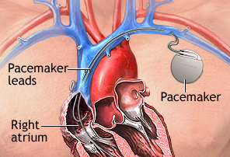
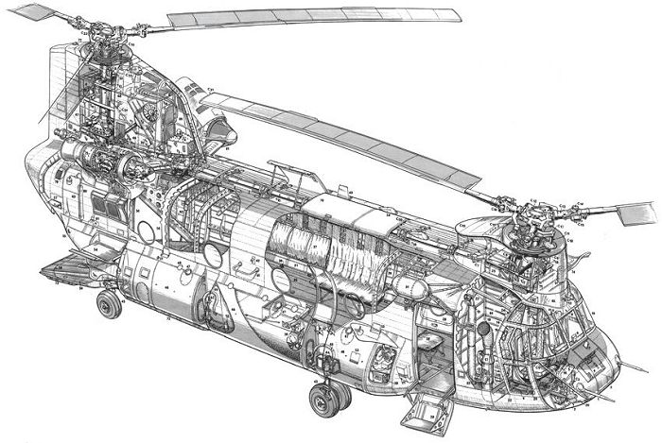
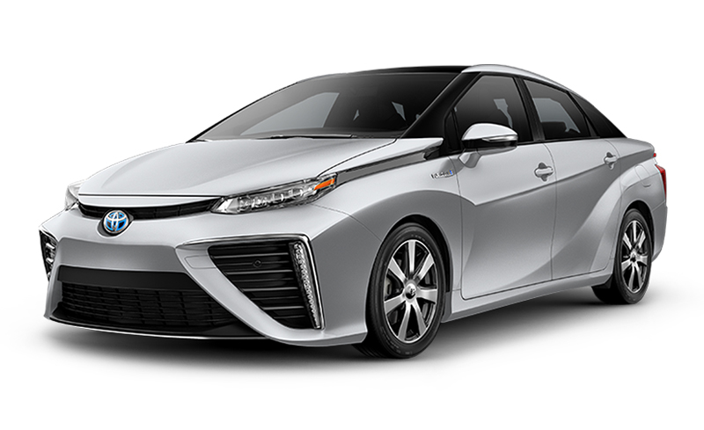
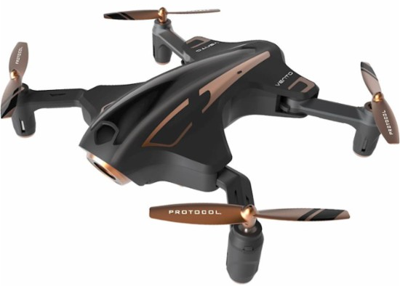
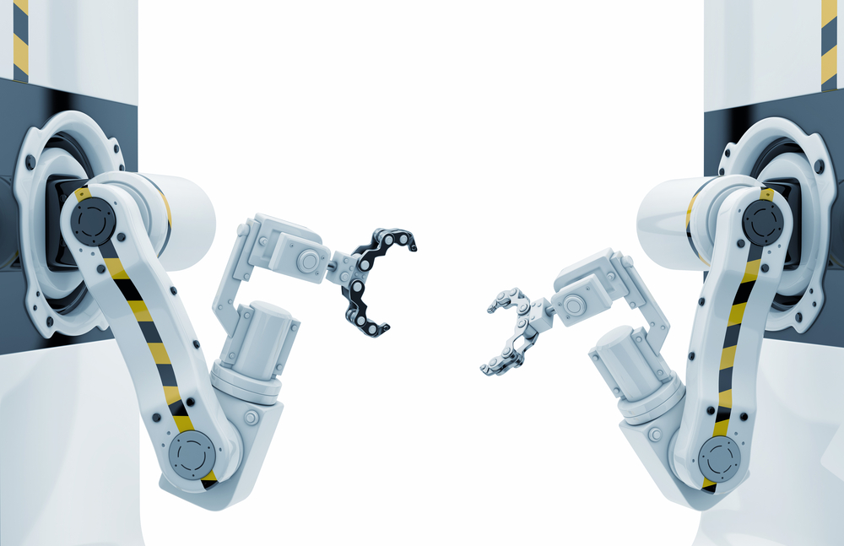
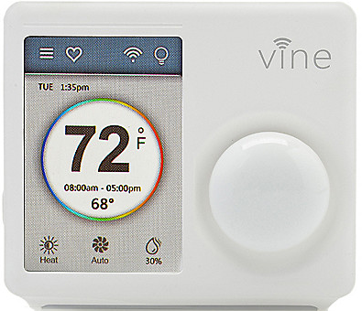
Cyber-Physical Systems
[All images from Google image search]

Slide 4
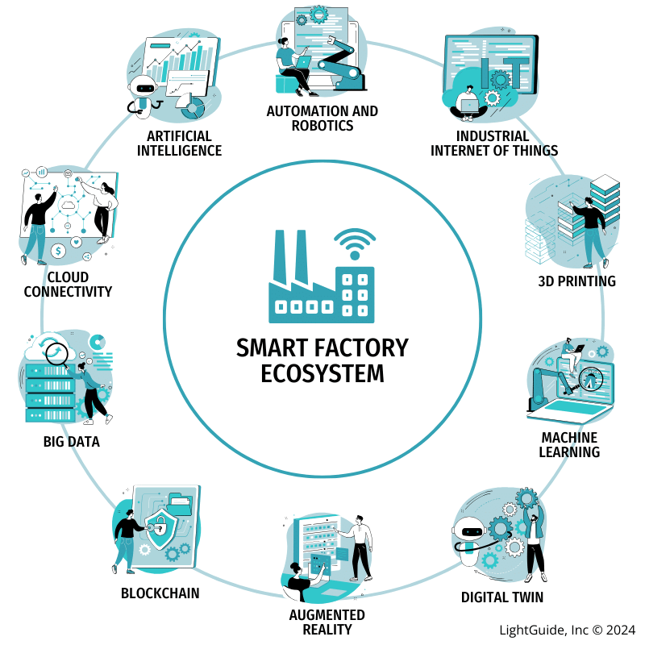
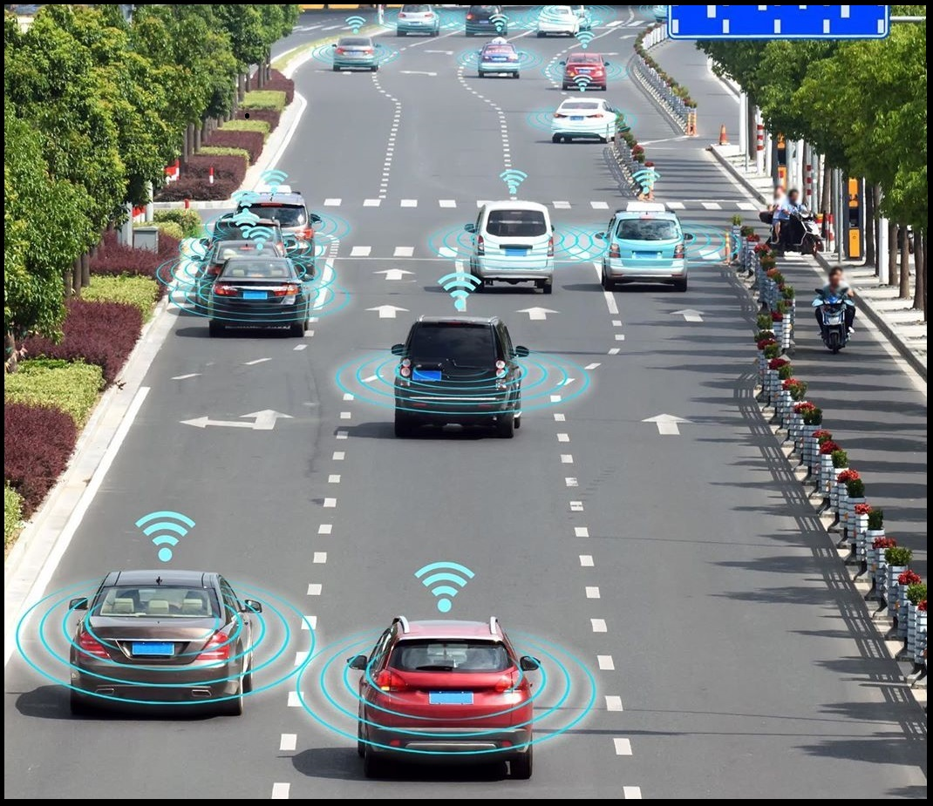
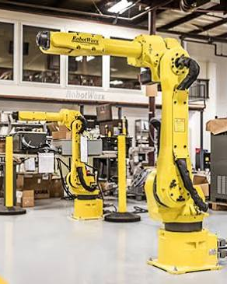
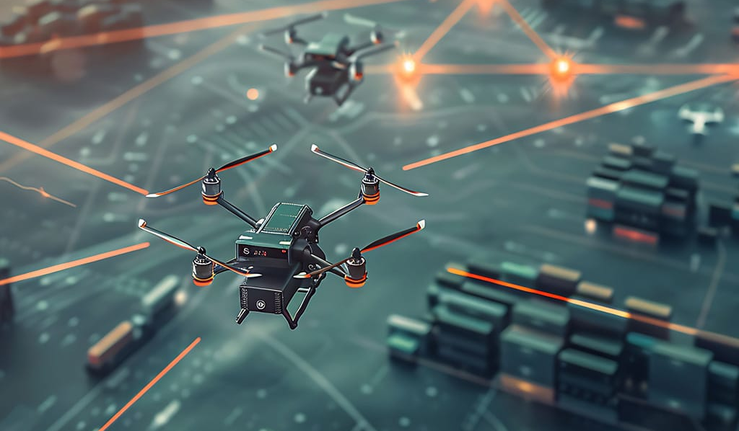
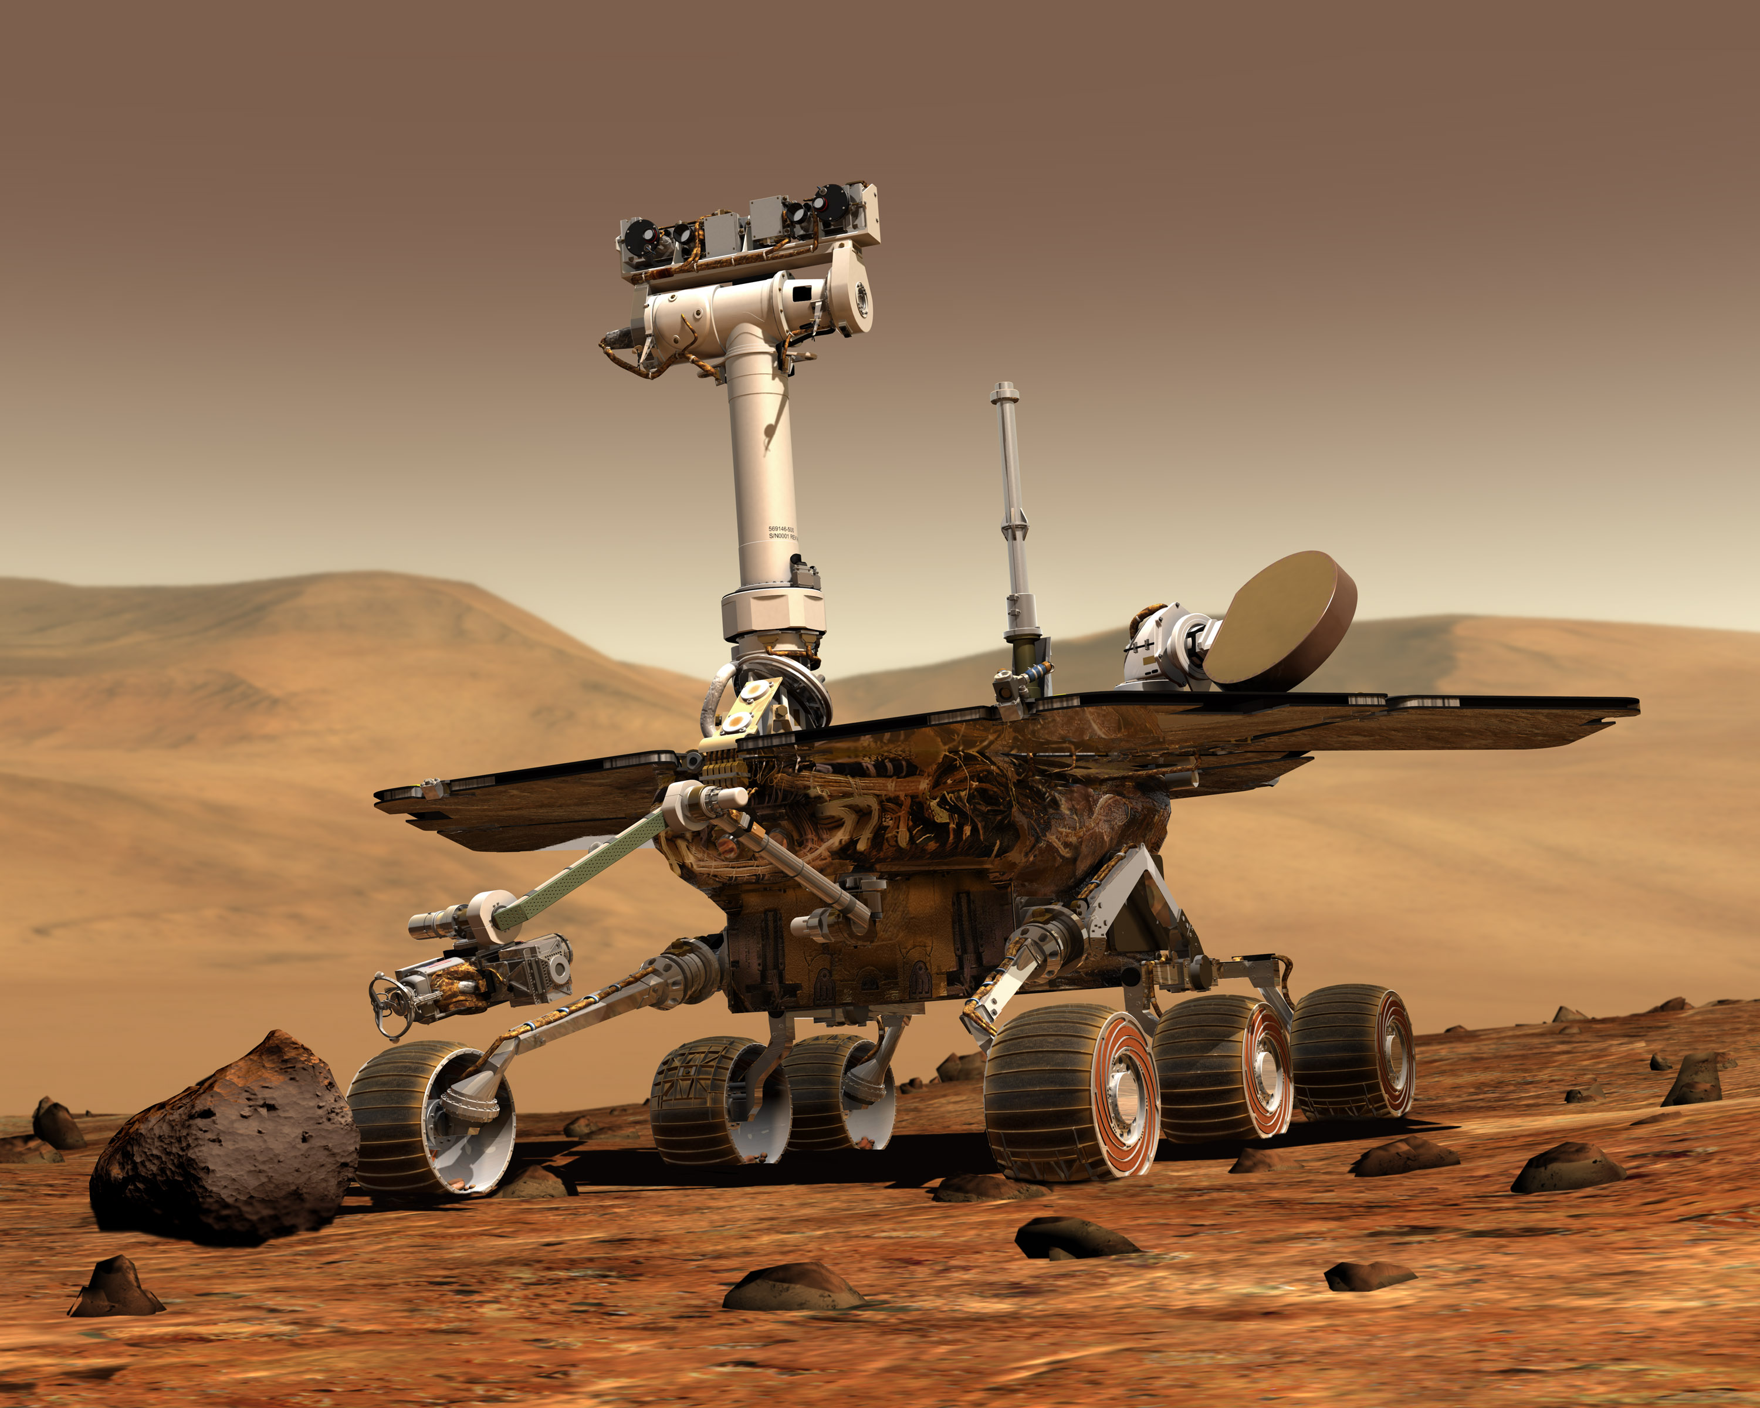
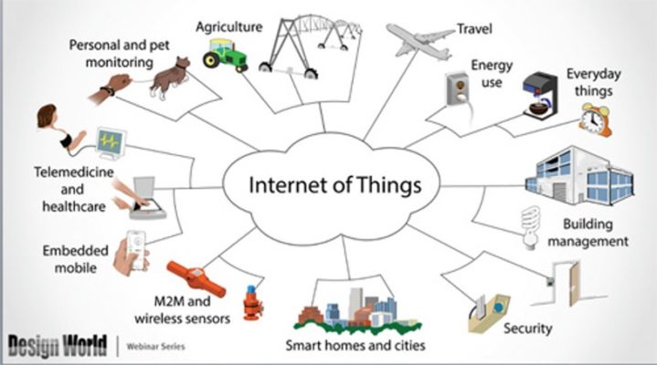
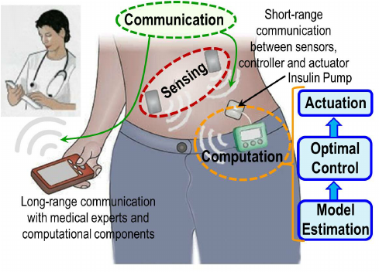
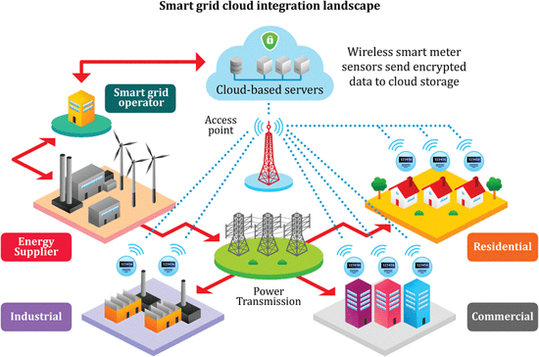
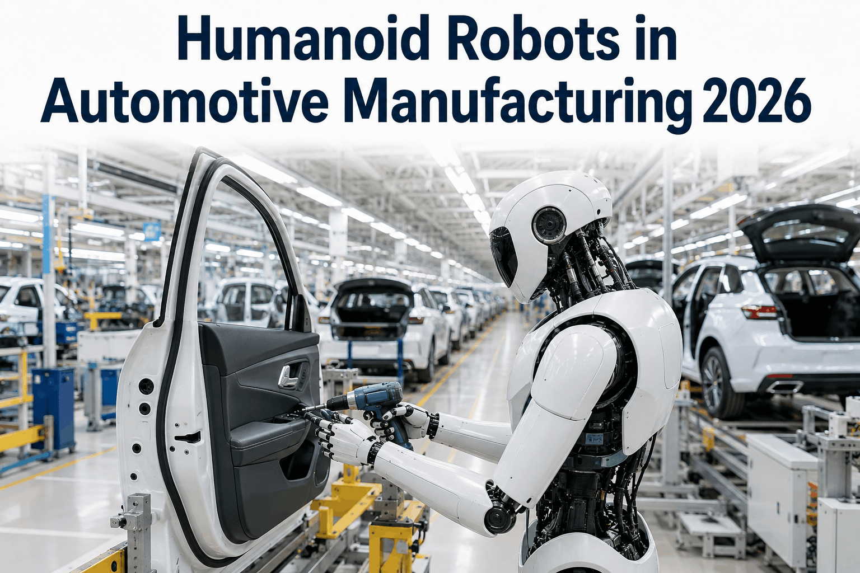
Cyber-Physical Systems + Autonomy

Slide 5
What is a Cyber-Physical System?
Different ways to answer this question!
Wikipedia: A Cyber-Physical system (CPS) is a mechanism controlled or monitored by software algorithms.
NSF: engineered systems built from, and depending upon, the seamless integration of algorithms and physical components
From a historical perspective CPS combines elements of cybernetics, mechatronics, control theory, process science, embedded systems, distributed control, and more recently communication.

Slide 6
What’s an autonomous CPS?
Autonomous: without the need for human intervention or control
Autonomous CPS = CPS with no human operator!
Semi-autonomous: CPS with autonomy under specific conditions but requiring a human operator otherwise.
Today, several CPS examples are semi-autonomous, and getting to fully autonomous

Slide 7
One view of a CPS
Actuators
Physical component
Sensors
Environment/Plant
Communication Network
Controller
(Some embedded code)

Slide 8
Course Objectives
Gain basic familiarity with CPS topics
Computational models
Control algorithms
Ingredients for autonomy
Challenge Problems/Case studies
Model-Based Software Development Paradigm for CPS
Developing models for physical components + software + communication
Software Engineering: Writing checkable requirements and tests
Software testing for CPS
Learn autonomous software stack through case studies in autonomy

Slide 9
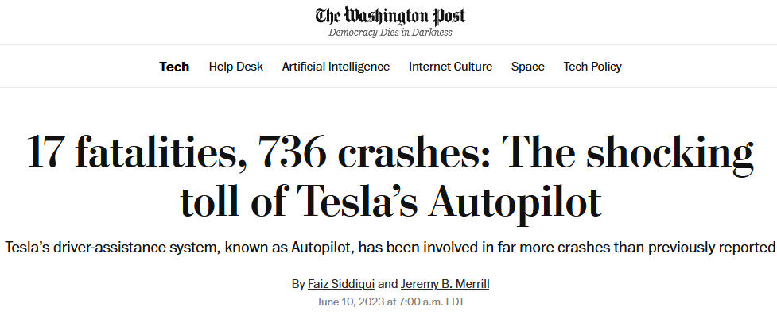
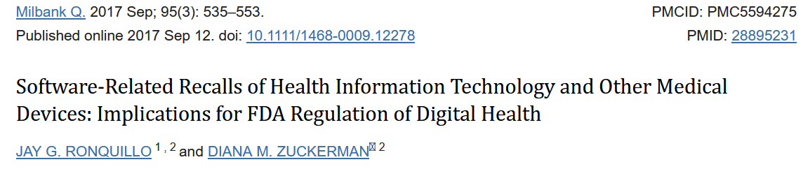
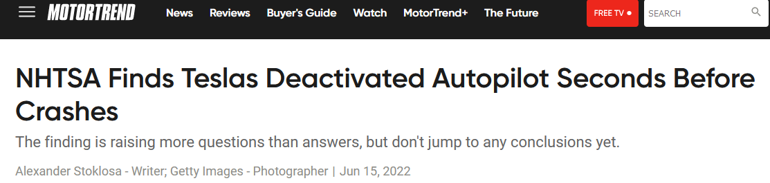
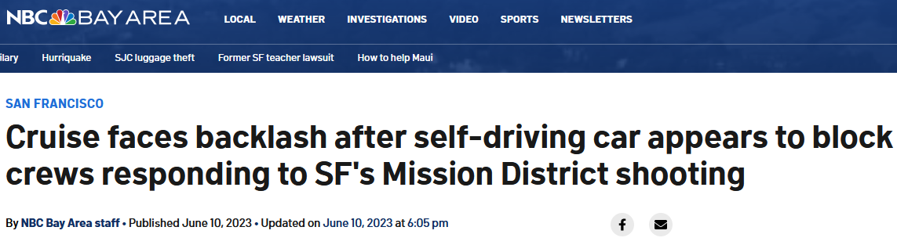
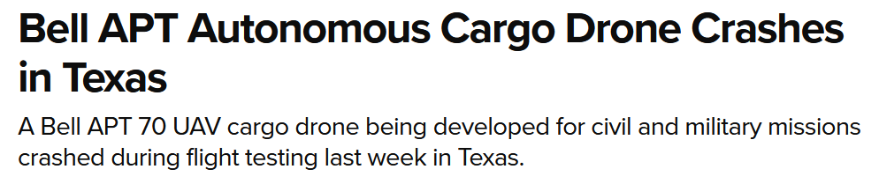
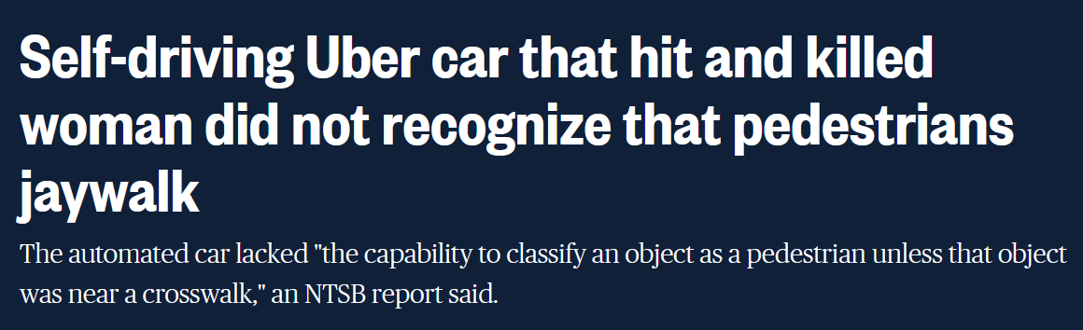
Key theme of the course: Safe Autonomy
ACPS are safety-critical, and/or mission-critical with huge implications on human health, well-being, economy, etc.

Slide 10
Course Overview
Part I: Model-based Design
Synchronous, Asynchronous, Dynamical, Hybrid Models of Computation
Basics of Linear Control, Nonlinear Control, Model-Predictive Control
Part II: Specifications and Safety
Temporal Logic, Test Generation/Falsification, Verification
Part III: Ingredients of Autonomy (Data-Driven Design)
Basics of modern perception, planning, decision-making, reinforcement learning

Slide 11
Course structure
All course material, course calendar is available here: https://shorturl.at/xq7xX
Course Homepage:
https://shorturl.at/gNE3n

Slide 12
How will we evaluate ourselves?
3 Written Homework Assignments
Focus on theory
2 Mini-Projects
Learn how to code the controller for a self-driving car subsystem
Learn how to use a vision-based perception module as a sensor
Class Project

Slide 13
Homework assignments/Mini-projects are group assignments
We will randomly assign you a group (of 2 – in the worst case 3)
You are responsible for coordinating with your group members
If your group members do not show up, are not doing the work, are using too much Claude, … -- please contact the instructor/TAs ahead of time
Each group member gets the same grade otherwise
Each homework assignment will have a different random group
Both mini-projects will have the same group

Slide 14
Class Project
Details at: https://shorturl.at/Irhxy
Purpose:
Exercise in Model-based Design, Specification, Testing + Modern AI for Autonomy
Write formal requirements
Generate tests/proofs using verification/falsification/test generation
Show the application of formal reasoning
Expected outcome:
Design autonomy for something interesting
Demonstrate that it works
Show a test/verification/assurance strategy

Slide 15
Project Clusters
C1 Multi-agent systems
Multi-UAV or Swarm Systems (homogeneous agents)
Heterogeneous Multi-UAV Systems
UAV + UGV coordination
UAV + UUV systems
C2 Flying Robots + UAM
Vision-based Policies (e.g. using foundation models) + more…
Flying manipulators
eVTOLS + Urban Air Mobility
C3 Space Robotics
Multi-agent extra-terrestrial missions
Rovers with different morphologies
Docking Systems
Space Debris Cleanup
C4 Autonomous Driving
Scenario Generation + Coverage
Long-Horizon Scenarios
Automatic edge case generation
V2X or V2V System
Autonomous Truck Platooning
C5 Medical CPS
Deep Brain Stimulation
AI-assisted prosthetics
C6 Smart Infrastructure
Smart Grid, Smart Cities
Develop large-scale distributed CPS
Study problems arising from scalability and uncertainty
Transportation Systems
C8 Foundations
Neuro-Symbolic Reasoning
Reasoning about Latent spaces
Robustness of Design Processes in Autonomy
Verifying Foundation Models
Reinforcement Learning, Multi-agent Reinforcement Learning
C7 CPS security
Vulnerability Detection
Attack Mitigation
Adversarial Sensing/Actuation Attacks

Slide 16
Example Projects
Design an eVTOL to follow a specific route plan (specified formally), Drone manipulators, Autonomous Racecars, Racing drones
Vehicle model and controller to automatically change lanes through stochastically generated vehicular/pedestrian/bicycle traffic
Transportation system to study effect of deploying autonomous systems
Drone swarm to perform complicated long-horizon missions (with guarantees)
Coordination between multiple robot arms or arm + ground robot
Steering VLA/World Models to satisfy formal specifications, Learning specifications from demonstrations

Slide 17
Projects that will earn a low grade
Anything to do with automatic parking, flying one drone, simple extensions to Carla
Unless it is a drone carrying your car in a drone-friendly parking lot
Projects that take an existing github repo, and demo that it works
And not much else …
Projects that have only a machine learning focus (RL, MARL, without talking about safety)
Projects that have no component of test generation/specifications/ assurance etc.
Projects that seem doable by < 5 people

Slide 18
Projects that will earn a high grade
Experimenting with new simulators, new frameworks + serious design effort
Projects that incorporate non-trivial specifications (everybody does reach-avoid)
Projects that work on novel CPS applications
Robust, working demos
Project reports that could be polished for a conference publication
(e.g. CPS-IoT Week, ESWeek, CAV, ICRA, RSS, IROS, AAMAS, ICAPS + AI/ML/CV confs etc.)
Theoretical work on foundations
Light Theoretical work + Solid empirical results

Slide 19
Project Timeline
Project teams
Identify team members by September 7
Project pitch by September 21
Project check-in:
Project presentations on 12/1
5-minute pre-recorded videos uploaded by November 30
In-person attendance on 12/1 will get extra credit
Final Project Deliverable on 12/10
15-page project report (details on next slide)

Slide 20
Grading and Evaluation Breakdown
Assignments: 40% (10+15+10)
Mini-Projects: 30% (15x2)
Project: 25%
Final Video : 5%
Final Report : 20%
Class participation: 5%
Q&A, Project engagement, Office hours, …

Slide 21
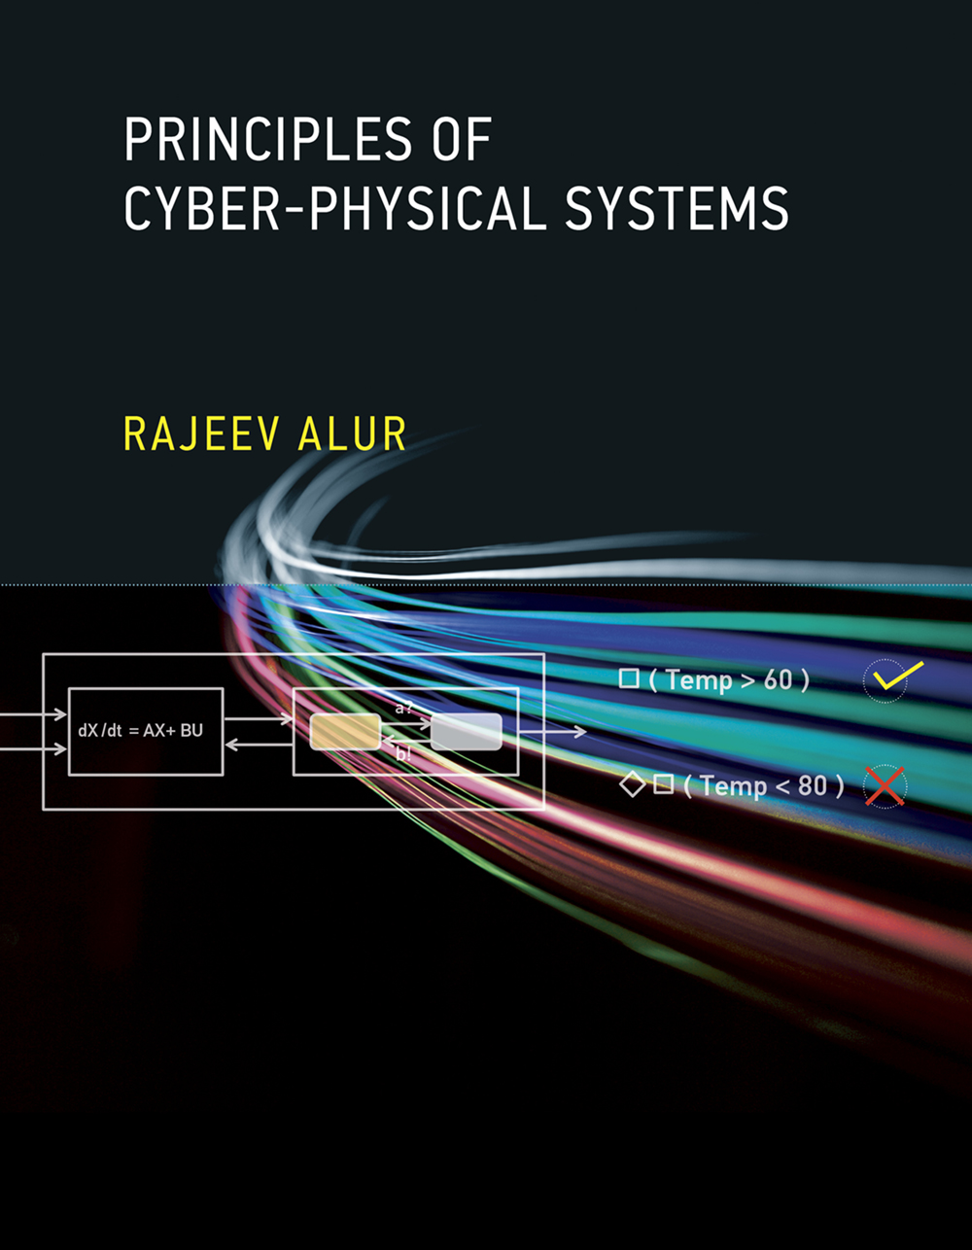
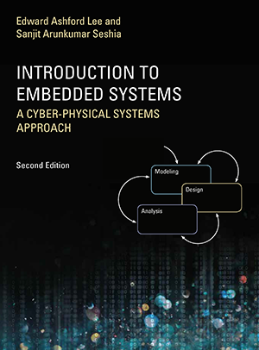
Textbooks: None. Supplementary reading:
Principles of Cyber-Physical Systems by Rajeev Alur
$56-63 on Amazon
Free e-book available on USC libraries
Introduction to Embedded Systems: A CPS approach
- Free at: https://ptolemy.berkeley.edu/books/leeseshia/

Slide 22
Office Hours, Class Timings
Class Timing: 3:30-6:50
First 5 mins: recap of last lecture + outline of this lecture + announcements
Last 20 mins: optional questions, discussions, etc.
Office Hours: Tuesday, 1:00pm-2:00pm (and by appointment)
TAs: Yiqi (Nick) Zhao. yiqizhao@usc.edu
Office Hours: 8-10am, SB5 (GCS LL2)

Slide 23

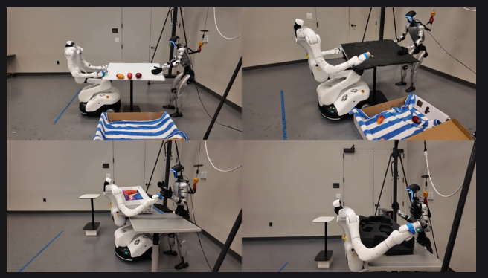
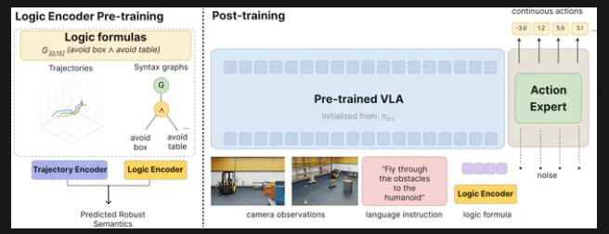
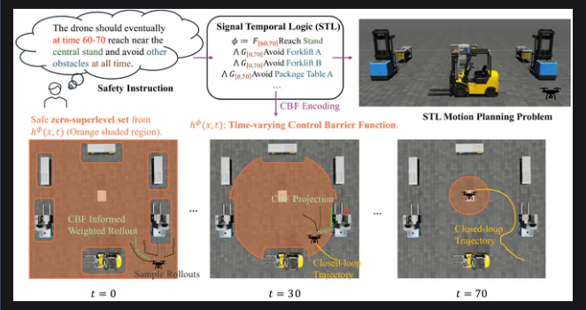
Nick Zhao (Primary TA)
Ph.D. Candidate,
CPS-VIDA Lab
Physical SuperIntelligence Lab (Prof. Yue Wang)
B.S. from Vanderbilt

Slide 24
Logistics
Piazza:
We will be using Piazza for class discussion. The system is highly catered to getting you help fast and efficiently from classmates, the TAs, and myself. Rather than emailing questions to the teaching staff, post your questions on Piazza. Find our class page at: https://piazza.com/usc/fall2026/csci513
Brightspace:
We will be using Brightspace for all homework assignments, mini-project submissions, and final project report submission.
Your grades will also be visible in Brightspace.
Grading:
The grade distribution will be roughly as follows:
A : Top 25-30%
A- : Next ~25%
B+ : Next ~25%
B : Bottom 25%
If you don’t do any one of these, you may get a grade lower than B: (attend class, engage in Piazza/office hours, turn in homeworks, have a reasonable project)

Slide 25
Use of AI
You can use whatever you want!
If AI chatbot makes mistakes, you will lose points!
If AI chatbot hallucinates references, you will lose points!
You can paste your homework assignments in ChatGPT or Claude or Gemini or Qwen
Do declare that you used it
Do explain why you think it gave you the correct or wrong answer
If it gave you the wrong answer, suggest a fix
If you find mistakes in the AI chatbot output, come talk to us
If it is a serious mistake, you can get extra credit
We have gotten pretty good at recognizing the use of AI, so please don’t use it without declaring that you used it.

Slide 26
Questions?

