Slide 1
Autonomous Cyber-Physical Systems: Convolutional Neural Networks
Spring 2018. CS 599.
Instructor: Jyo Deshmukh

Slide 2
Layout
Neural network basics
Convolutional Neural Nets

Slide 3



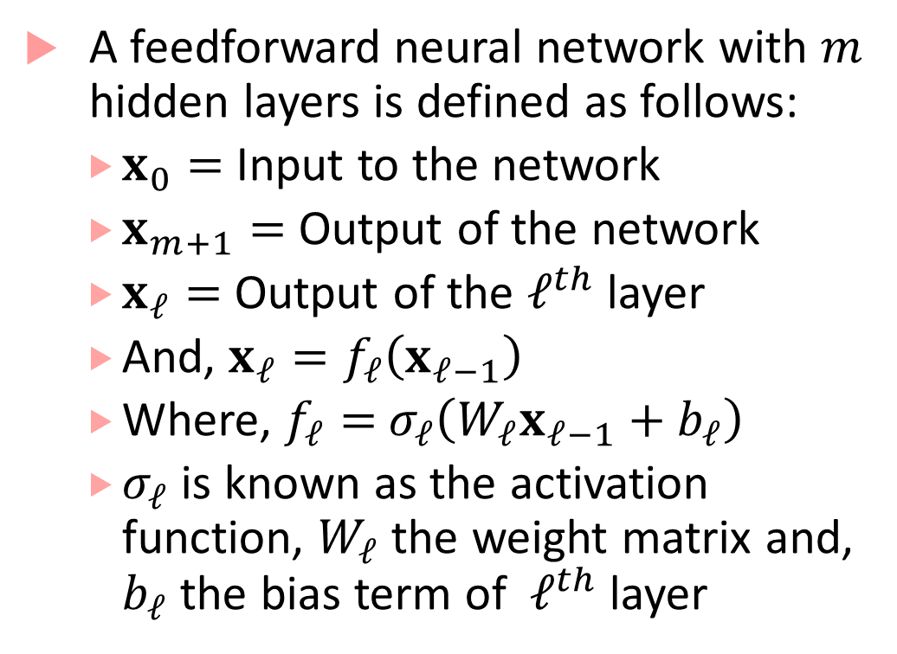


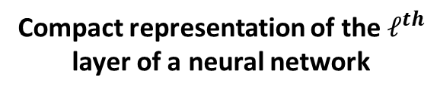
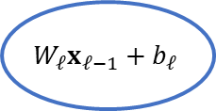

Basics of Neural networks
A feedforward neural network with $m$ hidden layers is defined as follows:
$x_{0}=$Input to the network
$x_{m+1}=$ Output of the network
$x_{ℓ}=$ Output of the $ℓ^{th}$ layer
And, $x_{ℓ}=f_{ℓ}\left(x_{ℓ−1}\right)$
Where, $f_{ℓ}=$ $σ_{ℓ}\left(W_{ℓ}x_{ℓ−1}+b_{ℓ}\right)$
$σ_{ℓ}$ is known as the activation function, $W_{ℓ}$ the weight matrix and, $b_{ℓ}$ the bias term of $ℓ^{th}$ layer
$$x_{ℓ−1}$$
$$W_{ℓ}x_{ℓ−1}+b_{ℓ}$$
$$σ$$
$$x_{ℓ}$$
$$d_{ℓ−1}×1$$
$$d_{ℓ}×d_{ℓ−1}$$
$$d_{ℓ}×1$$
Compact representation of the $ℓ^{th}$ layer of a neural network

Slide 4
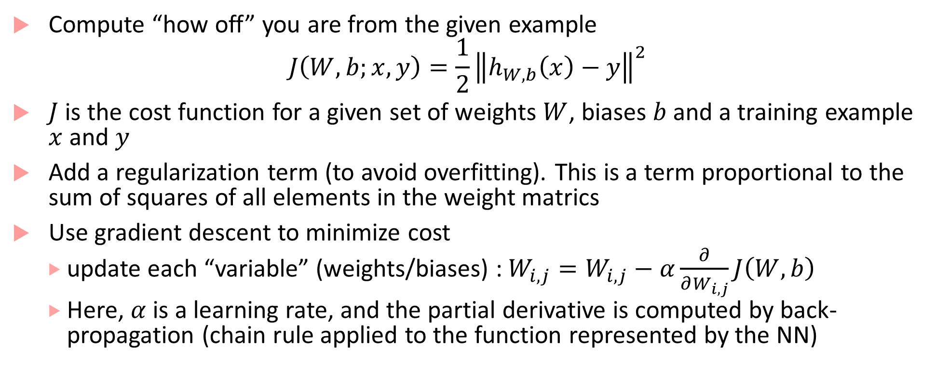
Basics of Training a NN
Compute “how off” you are from the given example
$$J\left(W,b;x,y\right)=\frac{1}{2}{\left\|h_{W,b}\left(x\right)−y\right\|}^{2}$$
$J$ is the cost function for a given set of weights $W$, biases $b$ and a training example $x$ and $y$
Add a regularization term (to avoid overfitting). This is a term proportional to the sum of squares of all elements in the weight matrics
Use gradient descent to minimize cost
update each “variable” (weights/biases) :$W_{i,j}=W_{i,j}−α\frac{∂}{∂W_{i,j}}J\left(W,b\right)$
Here, $α$ is a learning rate, and the partial derivative is computed by back-propagation (chain rule applied to the function represented by the NN)

Slide 5
Convolutional Neural Networks
Inspired by visual cortex in animals
Learns image filters that were previously hand-engineered
Basic intuitions for CNNs:
Images are too large to be monolithically processed by a feedforward neural network (1000x1000 image = 10⁶ inputs, which means the weight matrix for the second layer is proportional to at least 10^{6!})
Data in an image is spatially correlated
CNN divided into several layers with different purposes

Slide 6
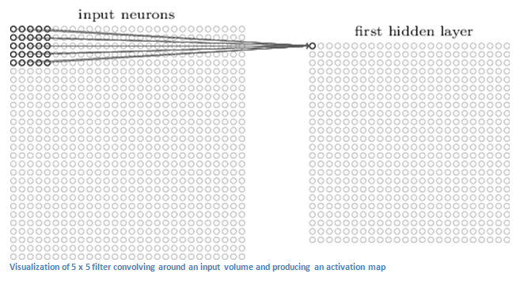
Convolutional layer
Receptive field
First layer is a convolutional layer
Convolutional layer contains neurons associated with sub-regions of the original image
Each sub-region is called receptive field
Convolves the weights of the convolutional layer with each cell in receptive field to obtain activation map or feature map
Image from [1]

Slide 7
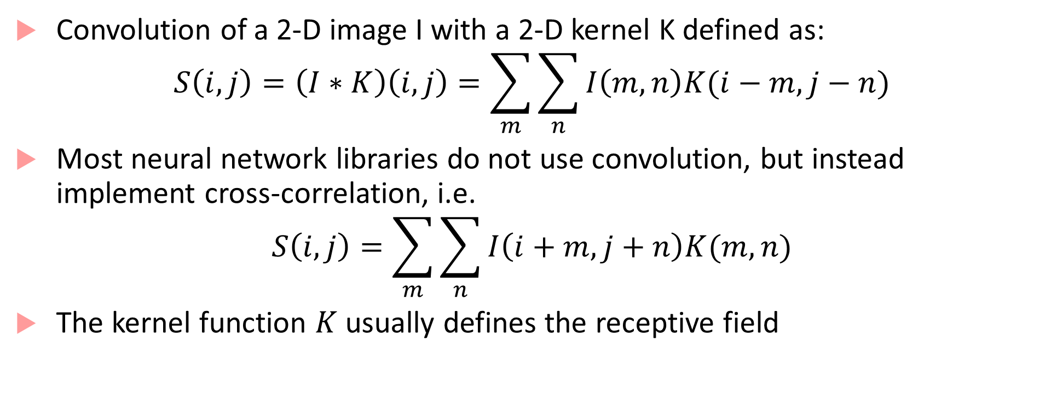
“Convolution”
Convolution of a 2-D image I with a 2-D kernel K defined as:
$$S\left(i,j\right)=\left(I∗K\right)\left(i,j\right)=\sum_{m}{\sum_{n}{I\left(m,n\right)K(i−m,j−n)}}$$
Most neural network libraries do not use convolution, but instead implement cross-correlation, i.e.
$$S\left(i,j\right)=\sum_{m}{\sum_{n}{I\left(i+m,j+n\right)K(m,n)}}$$
The kernel function $K$ usually defines the receptive field

Slide 8
Purpose of convolutional layer
Convolutional layer applies a filter to the pixels within its receptive field
This allows identifying low-level features (curves, straight lines, etc.)
The outputs of the first convolutional layer can be thought of as having a “high value” when a particular feature is detected and a “low value” otherwise
Second convolutional layer allows learning higher-level features (e.g. semi-circles, angles etc.)
Second convolutional layer has a bigger receptive field (as it is able to simultaneously correlate over outputs of first layer)
By “convolving” over the feature map, output of second layer tries to connect higher level features

Slide 9
More insights about convolution
Convolution operation basically helps implement three ideas:
Sparse interactions (between layers)
Parameter sharing
Equivariant representations
Spare interaction:
By using a kernel function that is smaller than input, not all outputs of the first layer interact with all inputs
This reduces the cost of doing matrix multiplication

Slide 10
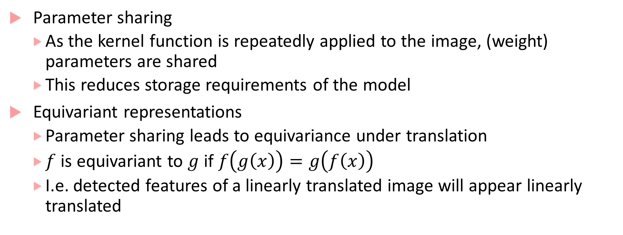
More insights about convolution
Parameter sharing
As the kernel function is repeatedly applied to the image, (weight) parameters are shared
This reduces storage requirements of the model
Equivariant representations
Parameter sharing leads to equivariance under translation
$f$ is equivariant to $g$ if $f\left(g\left(x\right)\right)=g\left(f\left(x\right)\right)$
I.e. detected features of a linearly translated image will appear linearly translated

Slide 11
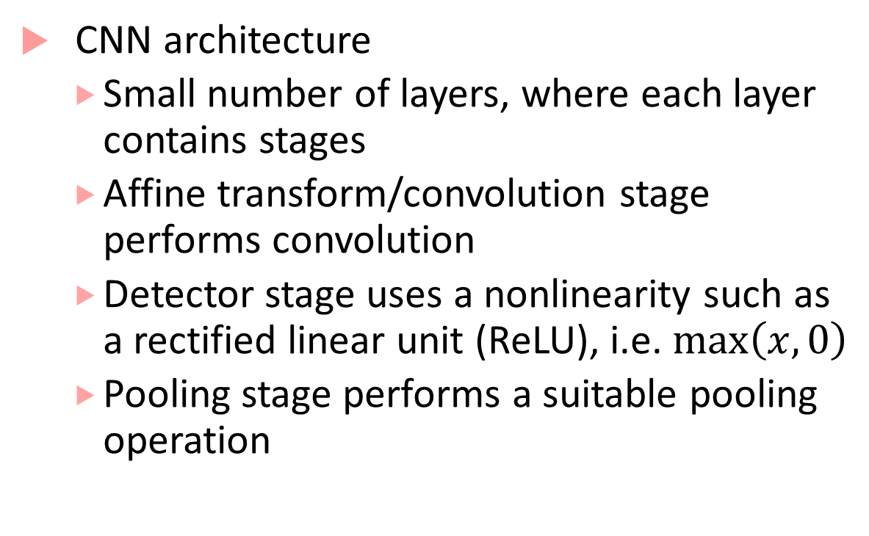
CNN architecture
CNN architecture
Small number of layers, where each layer contains stages
Affine transform/convolution stage performs convolution
Detector stage uses a nonlinearity such as a rectified linear unit (ReLU), i.e. $\max\left(x,0\right)$
Pooling stage performs a suitable pooling operation
Next layer
Convolutional Layer
Pooling stage
Detector stage
Convolution stage (Affine transform)
Picture from [2]
Input to layer

Slide 12
Pooling stage
Pooling function replaces the output of a layer at a certain location with a summary statistic of the nearby outputs
E.g. max pooling reports maximum output within a rectangular neighborhood
Other pooling functions include average, L² norm, weighted average etc.
Pooling helps representation approximately invariant to small translations
By pooling over outputs of different convolutions, features can learn which transformations to become invariant to (e.g. rotation etc.)

Slide 13
Fully connected layers
CNNs may have some fully connected layers before the final output
These layers allows performing higher-level reasoning over different features learned by the previous convolutional layers
Various kind of convolution functions, pooling functions and detection functions are possible, giving rise to many different flavors
Number of convolutional layers can be varied depending on complexity of features to be learned

Slide 14
R-CNN^{[3]}
R-CNN, Fast R-CNN and Faster R-CNN are specific architectures that help with object detection
Objective is to obtain from an image:
A list of bounding boxes
A label assigned to each bounding box
A probability for each label and bounding box
The key idea in R-CNNs is to use region proposals and region of interest pooling
We will briefly discuss the architecture of Faster R-CNN

Slide 15
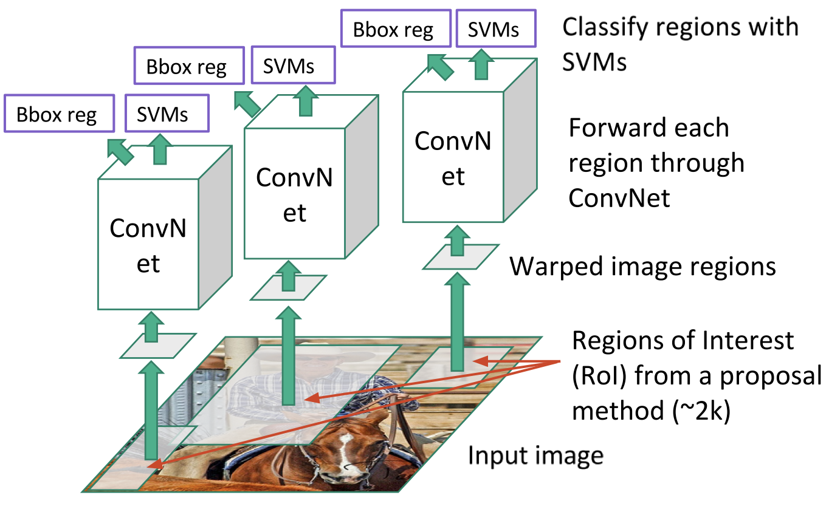
R-CNN
3 main steps:
Scan the input image for possible objects (using an algorithm called Selective Search) generating region proposals (bounding boxes where possible objects may lie)
Run a CNN on top of these region proposals
Take output of each CNN and feed it into a support vector machine to classify the region

Slide 16
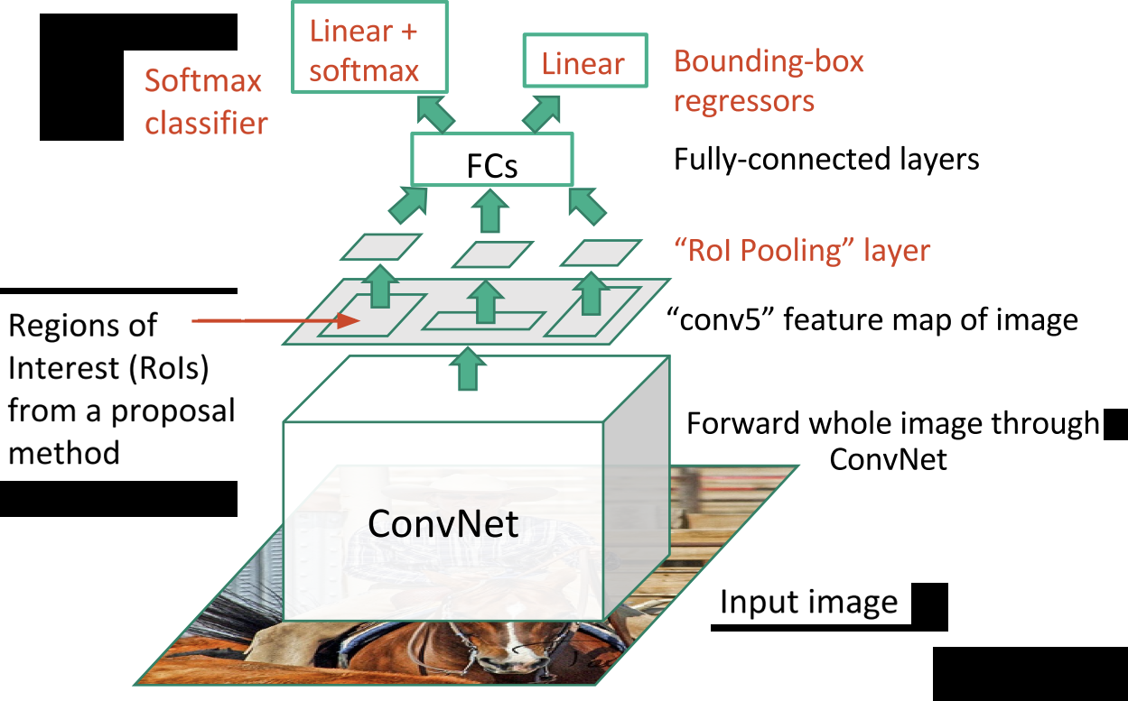
Fast R-CNN
Fast R-CNN performed feature extraction before proposing regions
Replaced SVM with a softmax layer
Fast R-CNN was much faster than R-CNN (hence the name!)
But the bottleneck was still region proposal using selective search
Faster R-CNN changed that

Slide 17
Faster R-CNN
Replaces slow selective search algorithm with a fast neural net
Introduces a region proposal network
Uses an intermediate output of the CNN to generate multiple possible regions based on fixed aspect-ratio anchor boxes, and a score for each region reflecting possibility of containing an object
Matlab 17b uses Faster R-CNN for object detection: you could use this or R-CNN in Homework 3

Slide 18
YOLO algorithm (You Only Look Once)
YOLO is one of the fastest real-time detection algorithms (See [4,5,6])
R-CNN etc. are algorithms that leverage classifiers and localizers to perform detection
YOLO applies a single neural network to the entire image
Network divides image into regions and predicts bounding boxes and probabilities for each region
Bounding boxes are weighted by predicted probabilities

Slide 19
References
[1] Understanding CNNs: https://adeshpande3.github.io/A-Beginner%27s-Guide-To-Understanding-Convolutional-Neural-Networks/
[2] I. Goodfellow, Y. Bengio, A. Courville, Deep Learning, MIT Press.
[3] https://towardsdatascience.com/deep-learning-for-object-detection-a-comprehensive-review-73930816d8d9
[4] https://towardsdatascience.com/yolo-you-only-look-once-real-time-object-detection-explained-492dc9230006
[5] https://pjreddie.com/darknet/yolo/
[6] YOLO algorithm: https://arxiv.org/abs/1506.02640

