Slide 1
Autonomous Cyber-Physical Systems: Perception
Spring 2018. CS 599.
Instructor: Jyo Deshmukh

Slide 2
Overview
Perception from LiDAR & Vision
Localization

Slide 3
Perception from LIDAR and vision
Data representation
Segmentation algorithms from LIDAR data
Object Detection from camera data

Slide 4
Data representation
Following representations for LIDAR data are most popular:
Point-cloud representation in the 3D space
Feature representation
Representation using grids
The choice of representation guides the choice of the algorithms chosen downstream for segmentation/detection
Point-cloud based approaches may need filtering algorithms to reduce number of points
Voxel-grid filtering : cover the space with tiny boxes, and replace each box with the centroid of the box

Slide 5
Data representation
Feature-based approaches
Extract specific features from the point cloud such as lines or surfaces
Most memory-efficient approach, but accuracy subject to nature of the point cloud
Grid-based approaches
Discretize space into small grids and represent the point cloud as a spatial data structure
Discretization-delta is a heuristic choice, and efficacy depends on the chosen delta

Slide 6
Segmentation algorithms
Segmentation: Clustering points into multiple homogenous groups
Broadly divided into:
Edge-based methods: Good when objects have strong artificial edge features (e.g. road curbs)
Region-based methods: Based on region-growing, i.e. pick seed points, and then grow regions based on criteria such as Euclidean distance between points, surface normals etc.
Model-based methods: Fit points into pre-defined categories such as planes, spheres, cones etc.
Attribute-based methods: first compute attributes for each point, and then cluster based on attributes
Graph-based methods: Cast point cloud into graph-based structures
Deep-learning based methods

Slide 7
Some popular segmentation algorithms
RANSAC (random sample and consensus)
Hough Transform
Conditional Random Fields, Markov Random Fields (also used for sensor fusion between LIDAR and vision)

Slide 8
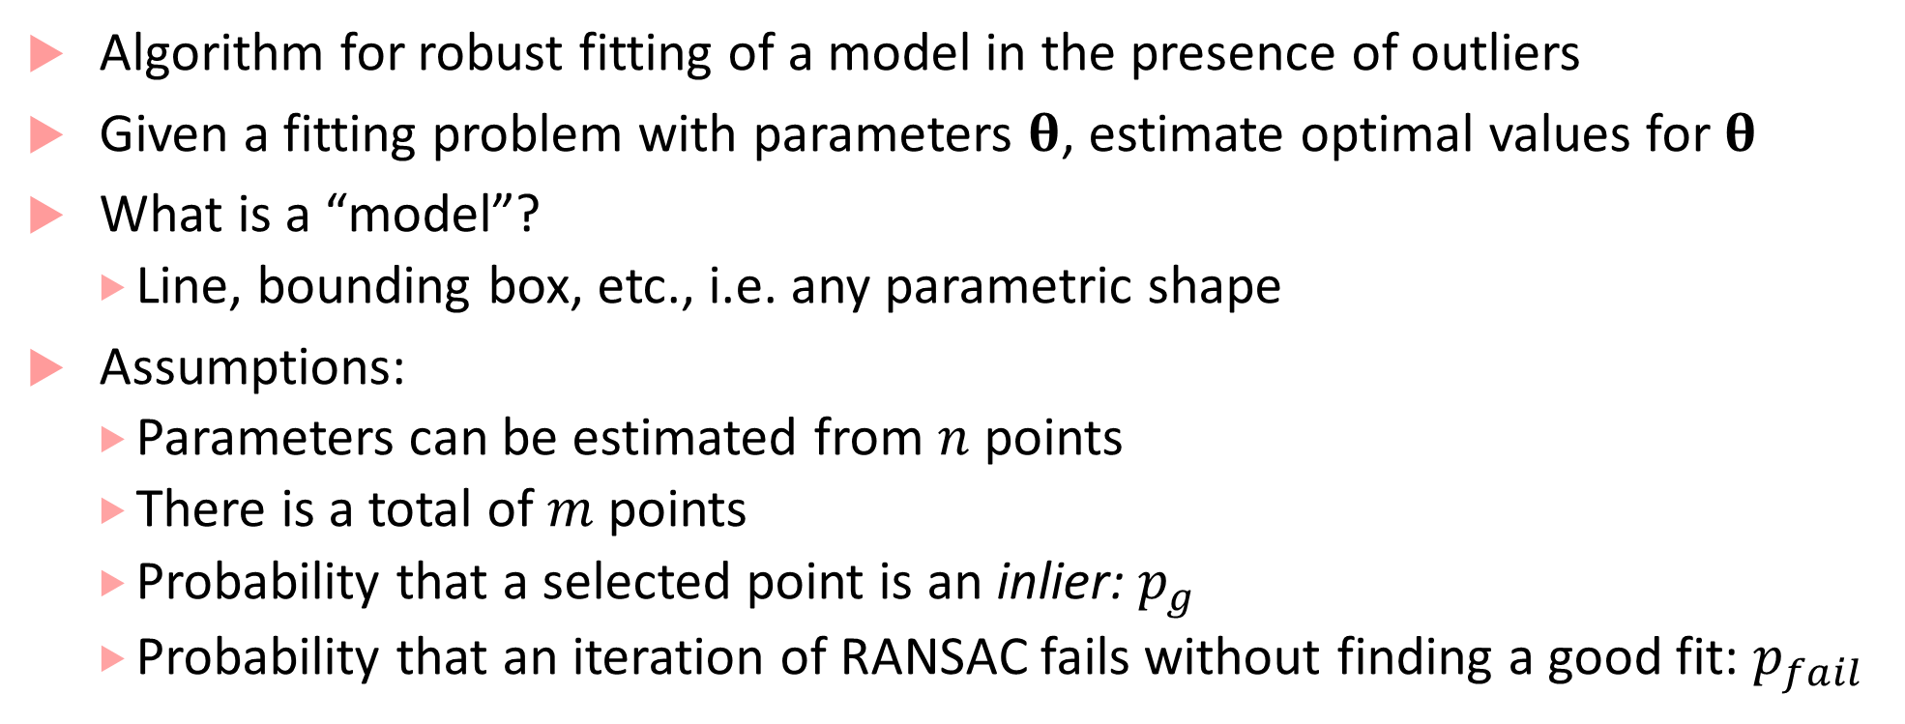
RANSAC
Algorithm for robust fitting of a model in the presence of outliers
Given a fitting problem with parameters $θ$, estimate optimal values for $θ$
What is a “model”?
Line, bounding box, etc., i.e. any parametric shape
Assumptions:
Parameters can be estimated from $n$ points
There is a total of $m$ points
Probability that a selected point is an inlier: $p_{g}$
Probability that an iteration of RANSAC fails without finding a good fit: $p_{fail}$

Slide 9
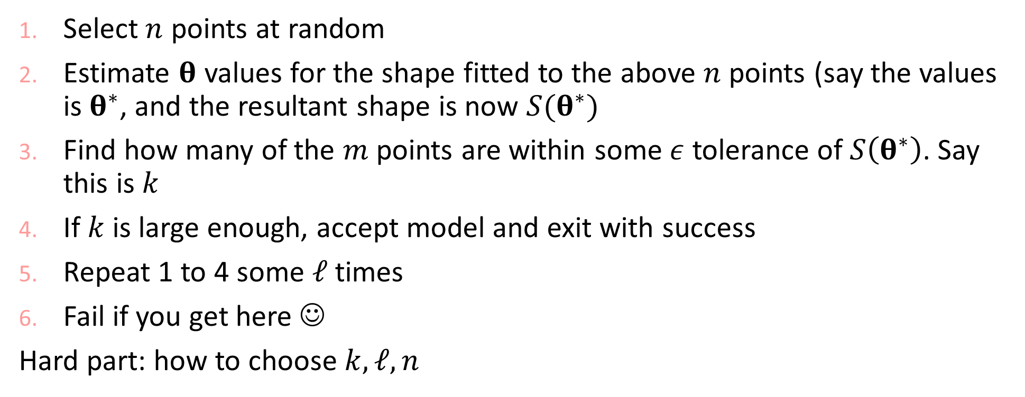
RANSAC continued
Select $n$ points at random
Estimate $θ$ values for the shape fitted to the above $n$ points (say the values is $θ^{∗}$, and the resultant shape is now $S(θ^{∗})$
Find how many of the $m$ points are within some $ε$ tolerance of $S\left(θ^{∗}\right)$. Say this is $k$
If $k$ is large enough, accept model and exit with success
Repeat 1 to 4 some $ℓ$ times
Fail if you get here ☺
Hard part: how to choose $k,ℓ,n$

Slide 10
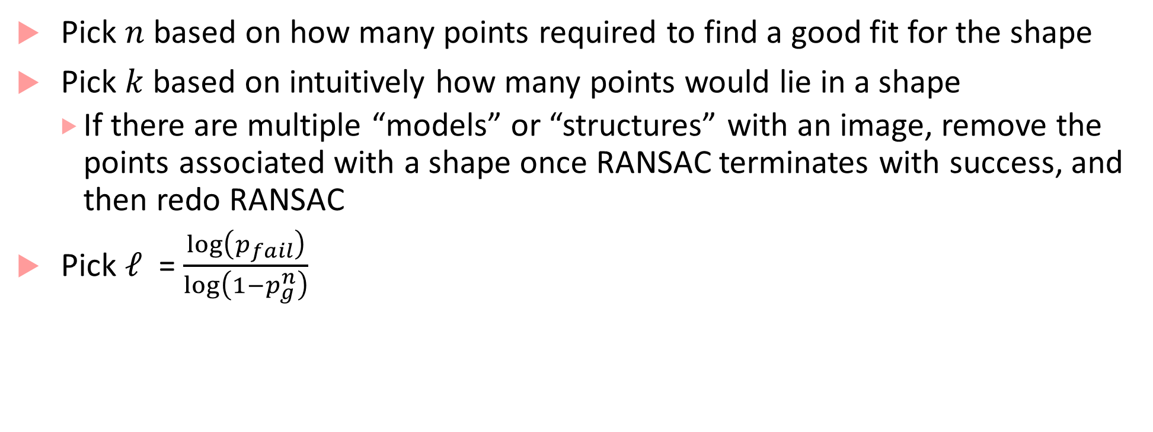
Choosing parameters for RANSAC
Pick $n$ based on how many points required to find a good fit for the shape
Pick $k$ based on intuitively how many points would lie in a shape
If there are multiple “models” or “structures” with an image, remove the points associated with a shape once RANSAC terminates with success, and then redo RANSAC
Pick $ℓ$ = $\frac{\log\left(p_{fail}\right)}{\log\left(1−p_{g}^{n}\right)}$

Slide 11
Hough Transform
A tool to detect lines, circles and more general shapes
One of the tools used for lane marking detection from (pre-processed) images
Operates on sets of points and helps obtain a geometric representation of shapes that points may form
We will see how Hough transform works in 2D

Slide 12





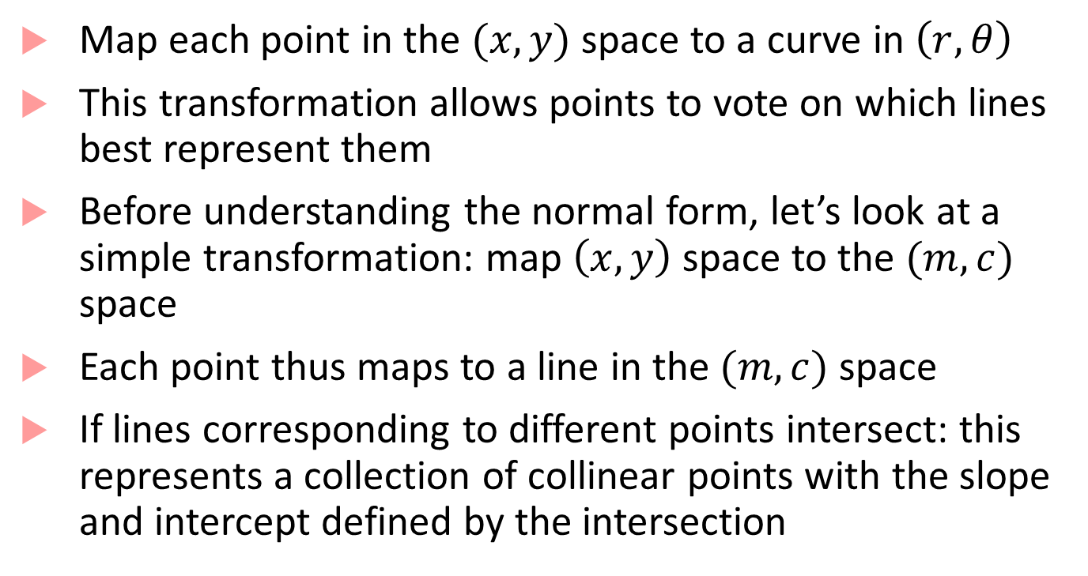







HT basics
$$y$$
$$(x_{1},y_{1})$$
Map each point in the $(x,y)$ space to a curve in $\left(r,θ\right)$
This transformation allows points to vote on which lines best represent them
Before understanding the normal form, let’s look at a simple transformation: map $\left(x,y\right)$ space to the $(m,c)$ space
Each point thus maps to a line in the $(m,c)$ space
If lines corresponding to different points intersect: this represents a collection of collinear points with the slope and intercept defined by the intersection
$$(x_{2},y_{2})$$
$$c$$
$$m$$
$$(x_{3},y_{3})$$
$$x$$
$$c$$
$$2$$
$$3$$
$$1$$
$$m$$

Slide 13
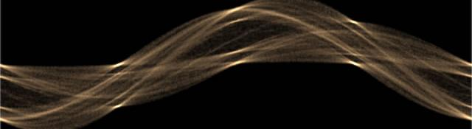

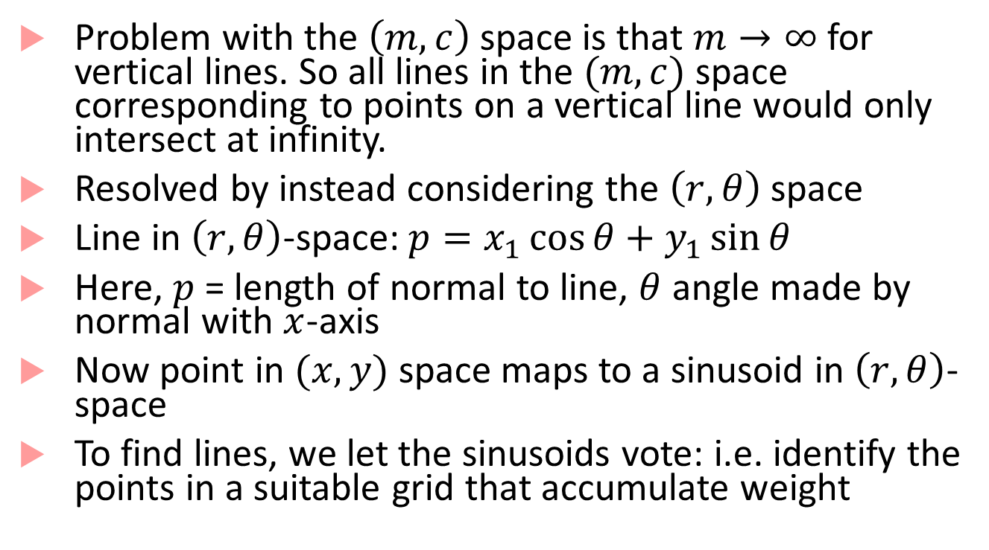

HT in polar coordinates
$$r$$
Problem with the $\left(m,c\right)$ space is that $m→∞$ for vertical lines. So all lines in the $(m,c)$ space corresponding to points on a vertical line would only intersect at infinity.
Resolved by instead considering the $\left(r,θ\right)$ space
Line in $\left(r,θ\right)$-space: $p=x_{1}\cos{θ}+y_{1}\sin{θ}$
Here, $p$ = length of normal to line, $θ$ angle made by normal with $x$-axis
Now point in $(x,y)$ space maps to a sinusoid in $\left(r,θ\right)$-space
To find lines, we let the sinusoids vote: i.e. identify the points in a suitable grid that accumulate weight
$$θ$$

Slide 14
HT discussion
Pros:
Conceptually simple and easy to implement
Robust to noise
Handles missing and occluded data gracefully
Can be adapted to various shapes beyond lines
Cons:
Computationally complex if there are many shapes to look for
Can be fooled by apparent lines
Collinear line segments may be hard to separate

Slide 15
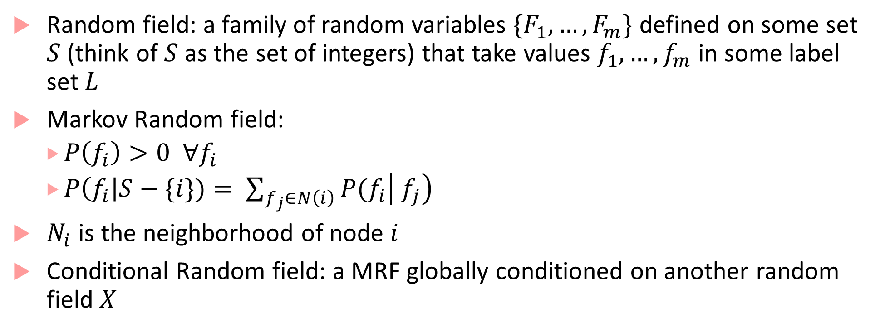
Graph-based algorithms for segmentation
Random field: a family of random variables $\{F_{1},…,F_{m}\}$ defined on some set $S$ (think of $S$ as the set of integers) that take values $f_{1},…, f_{m}$ in some label set $L$
Markov Random field:
$P\left(f_{i}\right)>0 ∀f_{i}$
$P\left(f_{i}\right|S−\{i\})= \sum_{f_{j}∈N\left(i\right)}{P(f_{i}\left| f_{j}\right)}$
$N_{i}$ is the neighborhood of node $i$
Conditional Random field: a MRF globally conditioned on another random field $X$

Slide 16
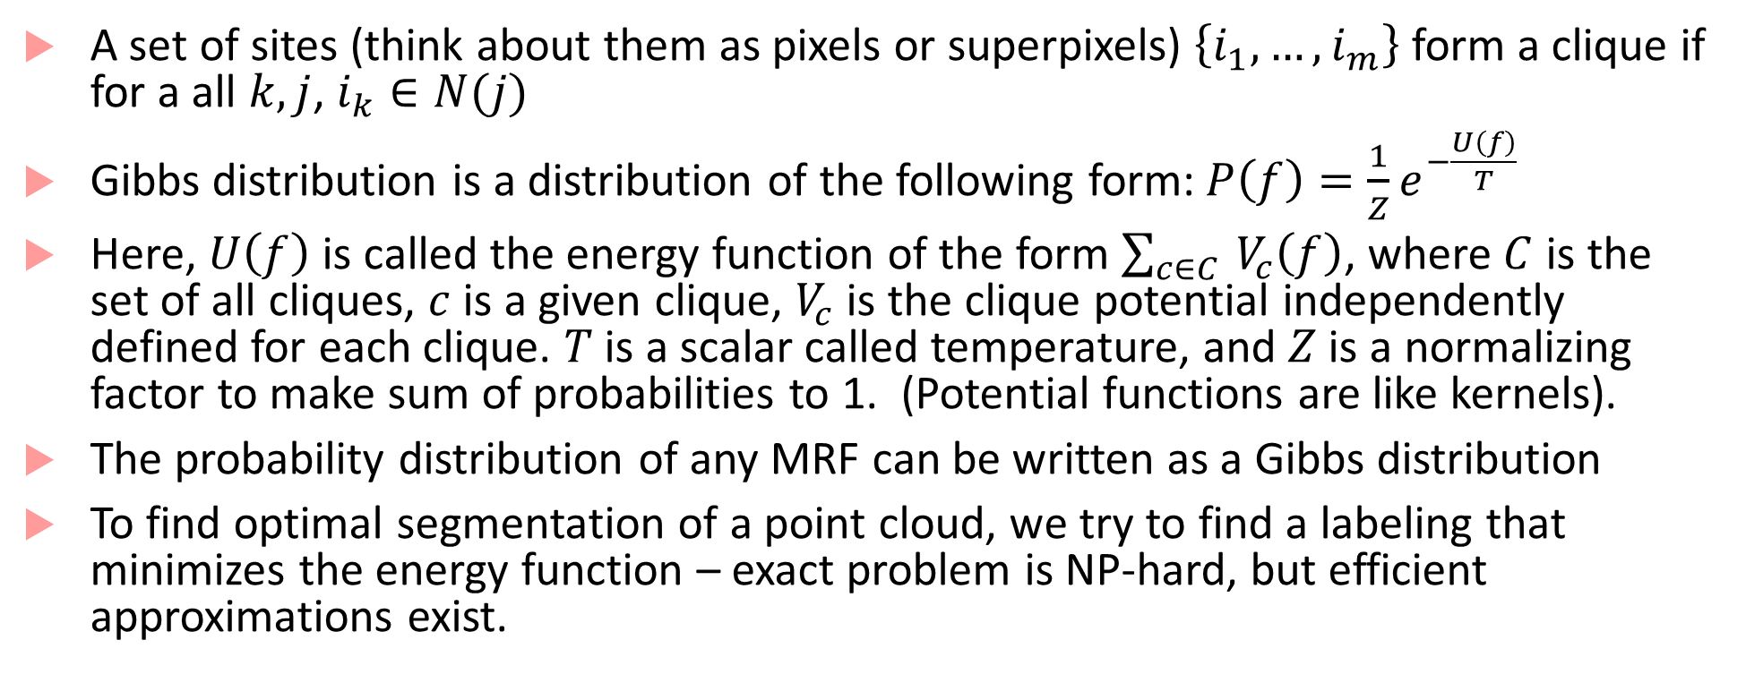
Gibbs distributions and cliques
A set of sites (think about them as pixels or superpixels) $\left\{i_{1},…,i_{m}\right\}$ form a clique if for a all $k,j$, $i_{k}∈N(j)$
Gibbs distribution is a distribution of the following form:$P\left(f\right)=\frac{1}{Z}e^{−\frac{U\left(f\right)}{T}}$
Here, $U\left(f\right)$ is called the energy function of the form $\sum_{c∈C }{V_{c}\left(f\right)}$, where $C$ is the set of all cliques, $c$ is a given clique, $V_{c}$ is the clique potential independently defined for each clique. $T$ is a scalar called temperature, and $Z$ is a normalizing factor to make sum of probabilities to 1. (Potential functions are like kernels).
The probability distribution of any MRF can be written as a Gibbs distribution
To find optimal segmentation of a point cloud, we try to find a labeling that minimizes the energy function – exact problem is NP-hard, but efficient approximations exist.

Slide 17
Detection algorithms for video data
Detection of segmented clusters from LIDAR data is done using traditional machine learning algorithms based on SVMs, Gaussian Mixture Models etc.
More interesting problem is detection from images
Lane line marking detection
Drivable path detection
On-road object detection

Slide 18
Image pre-processing
Typically first step before applying detection algorithms
Remove obstacles (e.g. other vehicles)
Weaken shadows
Normalize images by controlling camera exposure
Limiting region of interest

Slide 19
Lane marking detection
Oldest application of vision in advanced driver-assist systems (ADAS) and critical in the self-driving space
Used as feedback to vehicle control systems (Lane Departure Warning, Lane-Keep Assist, and Lane-Tracking Control)
Several decades of work, but still not fully solved because of uncertainties in traffic conditions, and road-specific issues such as shadows, worn-out markings, directional arrows, warning text, pedestrian zebra crossings etc.
Four/Five common steps:
Lane line feature extraction
Fitting pixels into various models (lines, parabolas, hyperbolas)
Estimating vehicle pose based on fitted model
(optional fourth step: use of temporal continuity)
Image to world coordinates transformation

Slide 20
Model fitting and Pose estimation
Simple case: lane lines are straight lines (straight highway segments)
More complicated case: curvy roads, lane markings may have to be fit with splines, contours etc.
Pose estimation is typically done using Kalman filter or particle filter (typically more reliable)
Requires inverse perspective transformation to go from lane coordinates to world coordinates
Lane-level localization involves estimating vehicle lateral position and moving orientation (again can use vehicle odometry + Kalman filter)

Slide 21
Lane line extraction
Based on lane markings having large contrast with road pavement
Edge detectors followed by Hough Transform to get the complete lane
Basic idea in edge detection:
Edges are discontinuities of intensity in images, correspond to local maxima of the “image gradient”
Naïve image gradients can be affected by noise in the image, so solution is to take “smooth derivatives” i.e. first smooth an image by convolving it with a Gaussian filter, and then take the derivative
Edges correspond to zero-crossings of the second derivative of the Gaussian or LOG (Laplacian of the Gaussian)
Approach used in Canny edge detector (OpenCV) and Matlab
Matlab first transforms image from front-facing view to bird’s eye view and uses a vertically oriented Gaussian filter

Slide 22
Drivable-path detection
Detecting road boundaries where vehicle can drive freely and legally without collisions
Several image-processing based algorithms using feature detection or feature learning : generally deemed to be not robust enough for erratic driving conditions
Deep learning provides the most popular set of techniques based on CNNs (we will look at these in the next lecture)
Other algorithms include exploiting GPS data and OpenStreetMap data

Slide 23
On-road object detection
Detect other vehicles, pedestrians, bicycles etc.
Again, deep learning based methods seem to be clear winners
General pipeline for deep learning approaches:
Set of proposal bounding boxes generated in the input image
Each proposal box is passed through a CNN to obtain a label and fine tune the bounding boxes
We will look at this in some detail in the next lecture

Slide 24
Localization
Most common approach is to use vehicle odometry + GPS + Kalman filter
This becomes unreliable in urban environments, tunnels, tall buildings etc. where GPS signal quality is poor
Map-aided localization:
Use local features to achieve precise localization
SLAM (simultaneous localization and mapping): most popular approach

Slide 25
Main steps in SLAM
Car moves reaching a new point of view of its location
Motion model captures car motion, but could be inaccurate because of actuation errors
Car discovers interesting features in the environment that need to be incorporated into the map
Features are called landmarks; because of sensor errors positions of landmarks will be uncertain.
Mathematical model to determine position of landmarks from observation is called inverse observation model

Slide 26
Main steps in SLAM (continued)
Car observes previously mapped landmarks and uses them to correct its self-localization and positions of landmarks in the map
Localization and landmark uncertainties decrease, and model the predict values of measurement from predicted landmark location and robot localization is called direct observation model
SLAM = above three models + an estimator (Extended Kalman Filter is common)
Another perspective on SLAM is view it as a Bayesian filtering problem

Slide 27
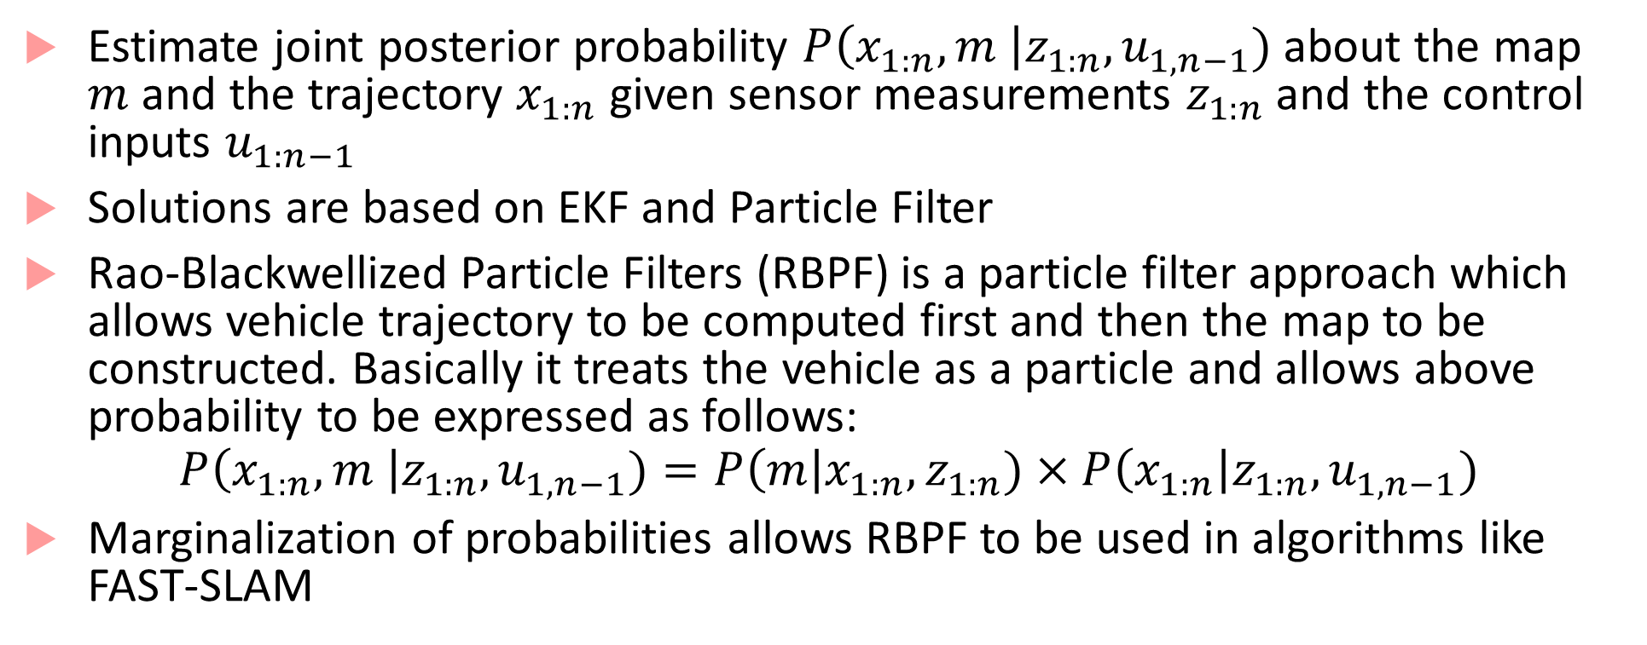
SLAM as Bayesian filtering
Estimate joint posterior probability $P\left(x_{1:n}, m \right|z_{1:n}, u_{1,n−1})$ about the map $m$ and the trajectory $x_{1:n}$ given sensor measurements $z_{1:n}$ and the control inputs $u_{1:n−1}$
Solutions are based on EKF and Particle Filter
Rao-Blackwellized Particle Filters (RBPF) is a particle filter approach which allows vehicle trajectory to be computed first and then the map to be constructed. Basically it treats the vehicle as a particle and allows above probability to be expressed as follows:
$$P\left(x_{1:n}, m \right|z_{1:n}, u_{1,n−1})=P\left(m\right|x_{1:n},z_{1:n})×P\left(x_{1:n}\right|z_{1:n}, u_{1,n−1})$$
Marginalization of probabilities allows RBPF to be used in algorithms like FAST-SLAM

Slide 28
Bibliography
The flow of the material in this lecture is almost entirely based on the following paper:
Pendleton, Scott Drew, Hans Andersen, Xinxin Du, Xiaotong Shen, Malika Meghjani, You Hong Eng, Daniela Rus, and Marcelo H. Ang. "Perception, planning, control, and coordination for autonomous vehicles." Machines 5, no. 1 (2017): 6.
Good introduction to Hough transform and various vision algorithms: http://aishack.in/tutorials/hough-transform-normal/
Hough transform basics: http://web.ipac.caltech.edu/staff/fmasci/home/astro_refs/HoughTrans_review.pdf
Graph-based clustering: http://vision.stanford.edu/teaching/cs231b_spring1213/slides/segmentation.pdf
MRF/CRF fundamentals https://www.cs.umd.edu/~djacobs/CMSC828seg/MRFCRF.pdf
Edge detection: https://www.swarthmore.edu/NatSci/mzucker1/e27_s2016/filter-slides.pdf
SLAM: https://people.eecs.berkeley.edu/~pabbeel/cs287-fa09/readings/Durrant-Whyte_Bailey_SLAM-tutorial-I.pdf

