Slide 1
Autonomous Cyber-Physical Systems: Asynchronous Components
Spring 2018. CS 599.
Instructor: Jyo Deshmukh
Acknowledgment: Some of the material in these slides is based on the lecture slides for CIS 540: Principles of Embedded Computation taught by Rajeev Alur at the University of Pennsylvania. http://www.seas.upenn.edu/~cis540/

Slide 2
Recap
Introduction to MBD
Synchronous Reactive Components
Types of SRC, composing SRCs
Cruise Controller model preview

Slide 3
Asynchrony
Synchrony: All components execute in a sequence of rounds in lock-step
Asynchrony: No lock-step computation!
Natural model for networked, distributed communicating components executing independently and at possibly different speeds
As there is no central, global clock, explicit coordination is required between components
Examples:
Processes in distributed computation, multiple threads in any modern OS
single-threaded computation: interrupts!
[1] Nicolescu, Gabriela; Mosterman, Pieter J., eds. (2010). Model-Based Design for Embedded Systems. Computational Analysis, Synthesis, and Design of Dynamic Systems. 1. Boca Raton: CRC Press.

Slide 4
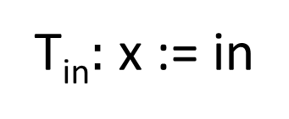
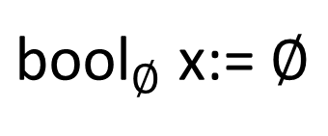
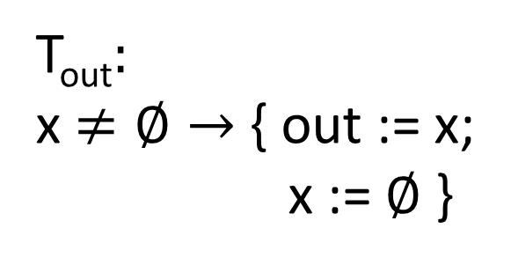
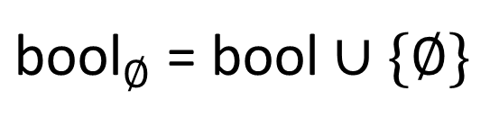
Asynchronous Reactive Component Example
bool in
bool out
${\text{bool}}_{∅}$ x:= $∅$
T_{in}$:$ x := in
${\text{bool}}_{∅}$ = bool $∪\{∅\}$
T_{out}$:$
x$≠∅→$ { out := x;
x := $∅$ }
Guarded Update
Tasks: T_{in},T_{out}

Slide 5
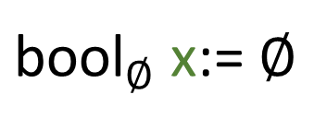
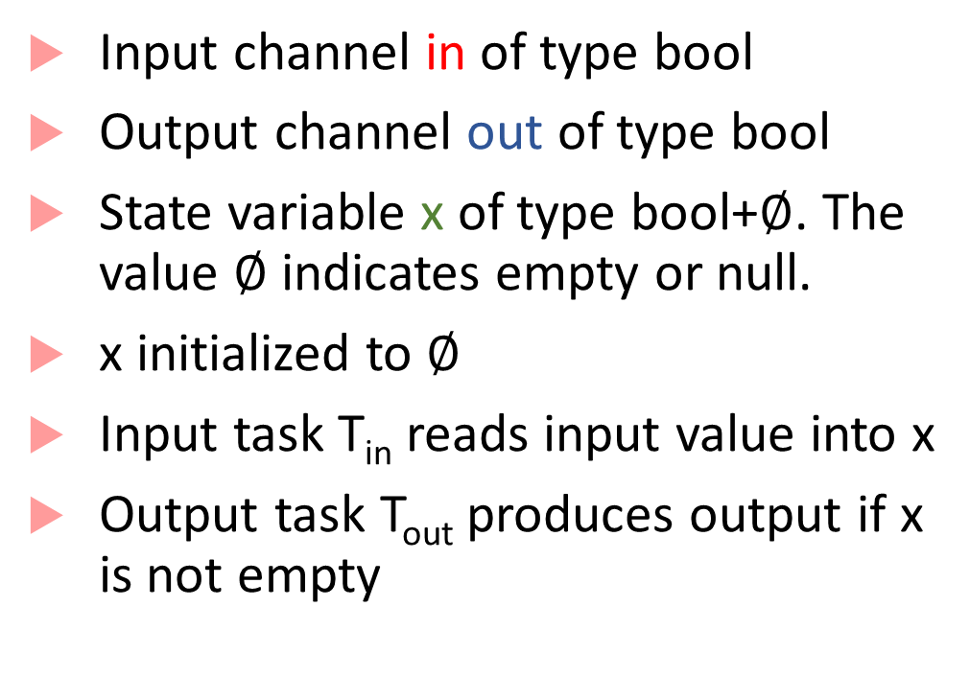
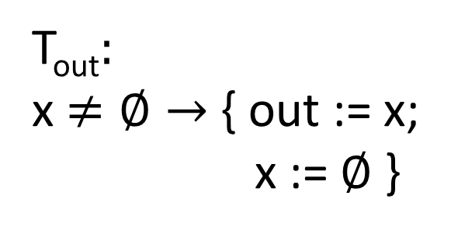
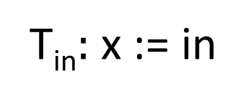
Asynchronous Reactive Component
Input channel in of type bool
Output channel out of type bool
State variable x of type bool+$∅$. The value $∅$ indicates empty or null.
x initialized to $∅$
Input task T_{in} reads input value into x
Output task T_{out} produces output if x is not empty
bool in
${\text{bool}}_{∅}$ x:= $∅$
bool
out
T_{in}$:$ x := in
T_{out}$:$
x$≠∅→$ { out := x;
x := $∅$ }

Slide 6
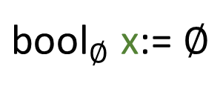
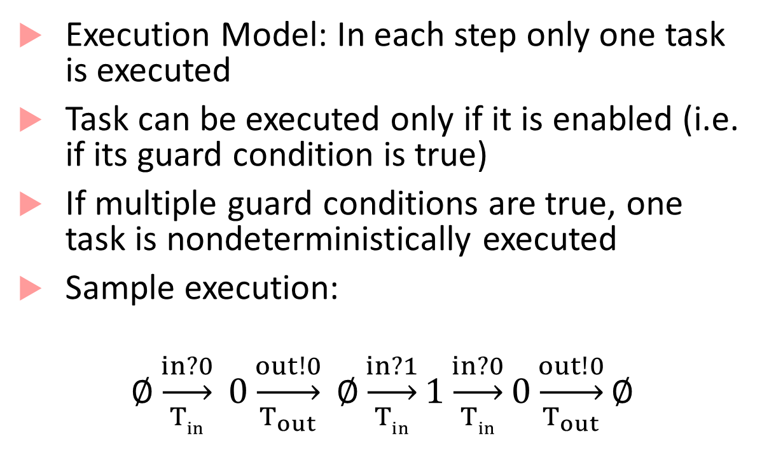
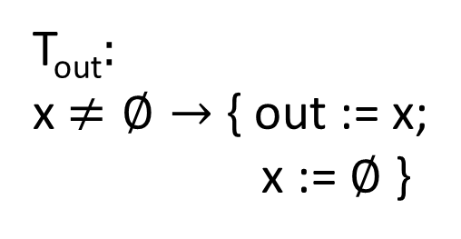
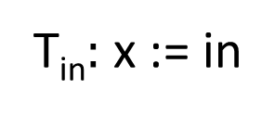
Asynchronous Reactive Component Execution
Execution Model: In each step only one task is executed
Task can be executed only if it is enabled (i.e. if its guard condition is true)
If multiple guard conditions are true, one task is nondeterministically executed
Sample execution:
$$∅\underset{Tin}{\underset{→}{in?0}} 0\underset{T_{out}}{\underset{→}{out!0}} ∅\underset{Tin}{\underset{→}{in?1}}1\underset{Tin}{\underset{→}{in?0}}0\underset{T_{out}}{\underset{→}{out!0}}∅$$
${\text{bool}}_{∅}$ x:= $∅$
bool in
bool
out
T_{in}$:$ x := in
T_{out}$:$
x$≠∅→$ { out := x;
x := $∅$ }
Buffer

Slide 7

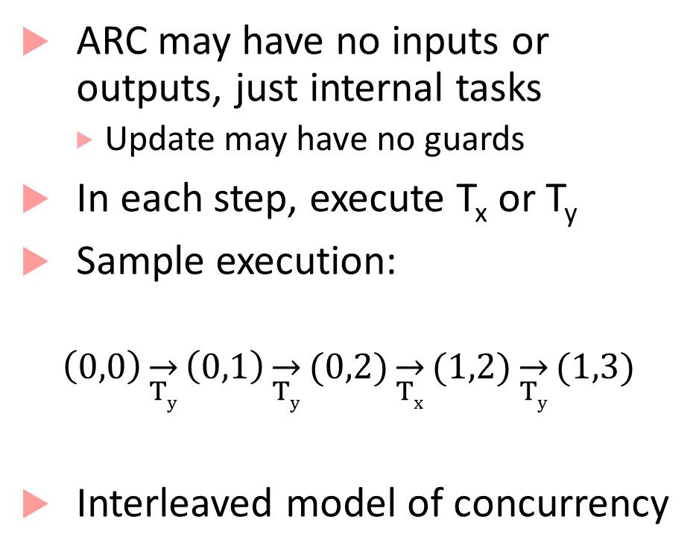

Example: Asynchrony + Nondeterminism
ARC may have no inputs or outputs, just internal tasks
Update may have no guards
In each step, execute T_{x} or T_{y}
Sample execution:
$$\left(0,0\right)\overset{→}{Ty}\left(0,1\right)\overset{→}{Ty}(0,2)\overset{→}{Tx}(1,2)\overset{→}{Ty}(1,3)$$
Interleaved model of concurrency
(0,0)
int x:= 0, y≔ 0
(1,0)
(0,1)
T_{x}$:$ x := x+1
T_{y}$:$ y:= y+1
(2,0)
(1,1)
(0,2)
(1,2)

Slide 8
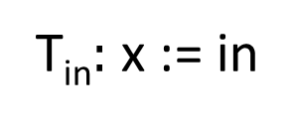
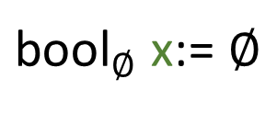
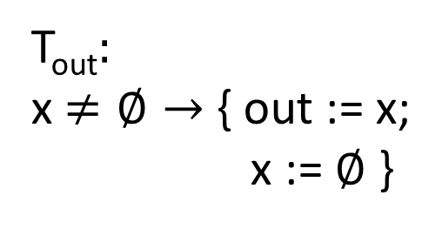
Asynchronous Process/Reactive Component
Set of input channels: I
ESM representation: in?v, where v is the value to be received
Set of output channels: O
ESM representation: out!v, where v is the value to be written
Set of state variables X
Initialization Init which maps state variables to initial values
${\text{bool}}_{∅}$ x:= $∅$
bool in
bool
out
T_{in}$:$ x := in
T_{out}$:$
x$≠∅→$ { out := x;
x := $∅$ }

Slide 9
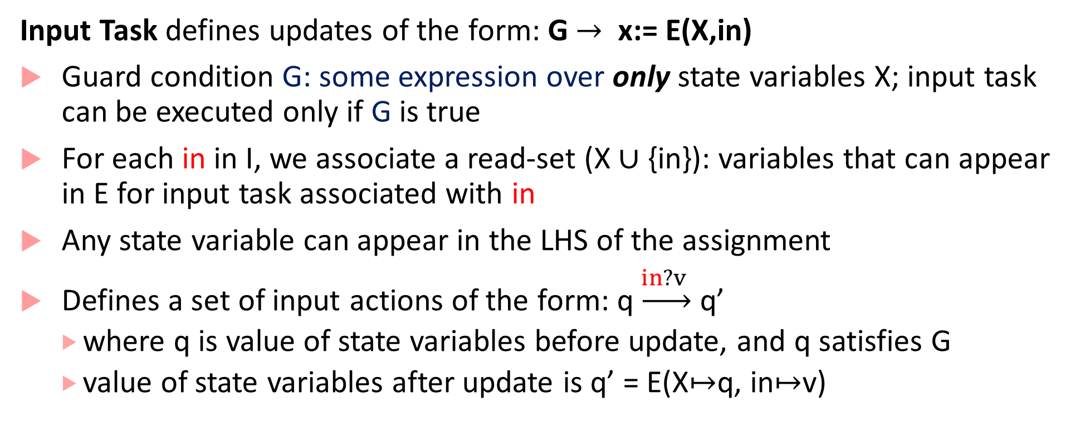
Updates are different from SRCs!
Input Task defines updates of the form: G $→$ x:= E(X,in)
Guard condition G: some expression over only state variables X; input task can be executed only if G is true
For each in in I, we associate a read-set (X $∪$ {in}): variables that can appear in E for input task associated with in
Any state variable can appear in the LHS of the assignment
Defines a set of input actions of the form: q$\underset{→}{in?v }$ q’
where q is value of state variables before update, and q satisfies G
value of state variables after update is q’ = E(X$↦$q, in$↦$v)

Slide 10
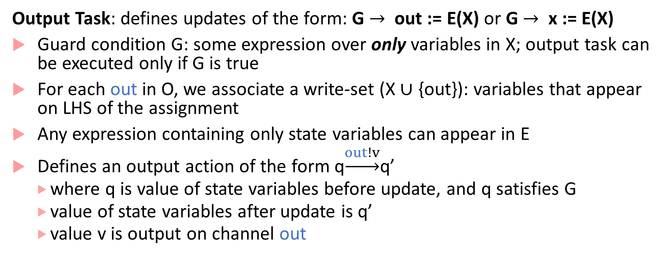
Updates are different from SRCs!
Output Task: defines updates of the form: G $→$ out := E(X) or G $→$ x := E(X)
Guard condition G: some expression over only variables in X; output task can be executed only if G is true
For each out in O, we associate a write-set (X $∪$ {out}): variables that appear on LHS of the assignment
Any expression containing only state variables can appear in E
Defines an output action of the form q$\underset{→}{out!v}$q’
where q is value of state variables before update, and q satisfies G
value of state variables after update is q’
value v is output on channel out

Slide 11
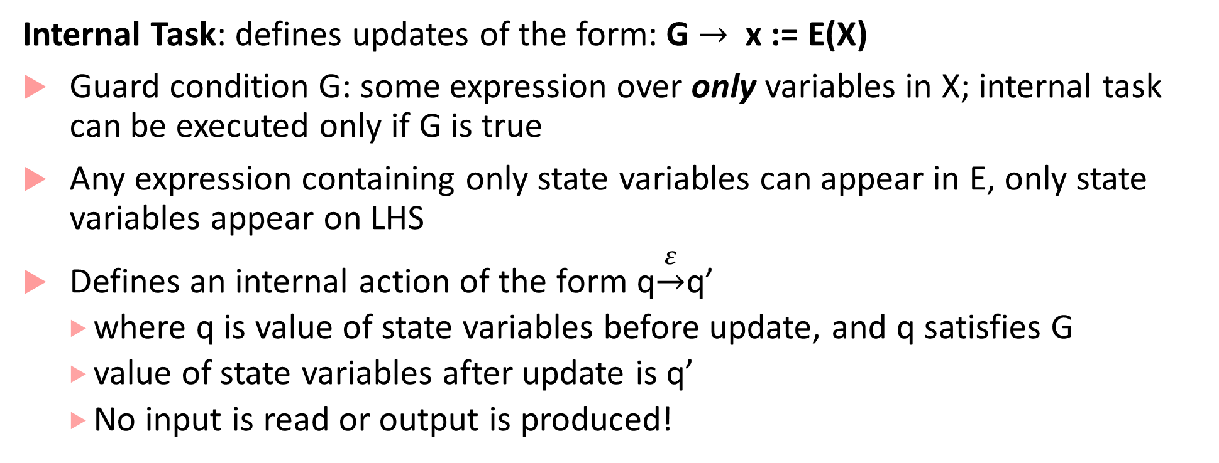
Updates are different from SRCs!
Internal Task: defines updates of the form: G $→$ x := E(X)
Guard condition G: some expression over only variables in X; internal task can be executed only if G is true
Any expression containing only state variables can appear in E, only state variables appear on LHS
Defines an internal action of the form q$\underset{→}{ε}$q’
where q is value of state variables before update, and q satisfies G
value of state variables after update is q’
No input is read or output is produced!

Slide 12
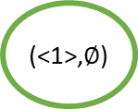

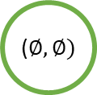




Asynchronous Merge: Sequence of Actions
queue(bool) x₁ $≔∅$, x₂ $≔∅$
($∅,∅)$
bool in₁
bool out
T_{in1}
in1?1
T_{in1}$:$ $¬$Full(x₁) $→$ Enqueue(x₁,in₁)
bool in₂
(<1>,$∅$)
out!1
(<1>,<1>)
T_{in2}$:$ $¬$Full(x₂) $→$ Enqueue(x₂,in₁)
T_{out2}
T_{out1}$:$ $¬$Empty(x₁) $→$ out := Dequeue(x₁)
T_{in2}
in2?0
T_{out2}
out!0
T_{out2}$:$ $¬$Empty(x₂) $→$ out := Dequeue(x₂)
T_{in2}
(<1>,<0>)
(<1>,<0,1>)
in2?1
Asynchronous Processes can also be represented with extended state machines

Slide 13

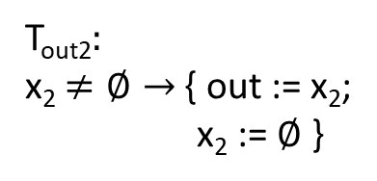




Composing Asynchronous Processes
Parallel composition: Inputs, Outputs, States and Initialization similar to the synchronous case
Input consumption needs to be synchronized with output production for the ‘temp’ variable
${\text{bool}}_{∅}$ x₁ := $∅$
${\text{bool}}_{∅}$x₂:= $∅$
bool in
bool out
T_{in1}$:$ x₁ := in
T_{in2}$:$ x₂ := temp
T_{out1}$:$
x₁$≠∅→$ { temp := x₁;
x := $∅$ }
T_{out2}$:$
x₂$≠∅→$ { out := x₂;
x₂ := $∅$ }
Buffer
Buffer

Slide 14
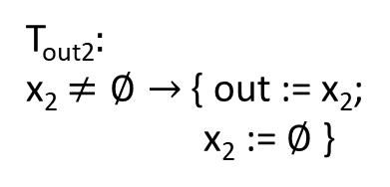


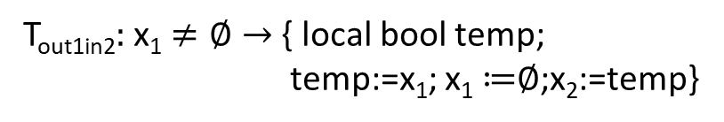
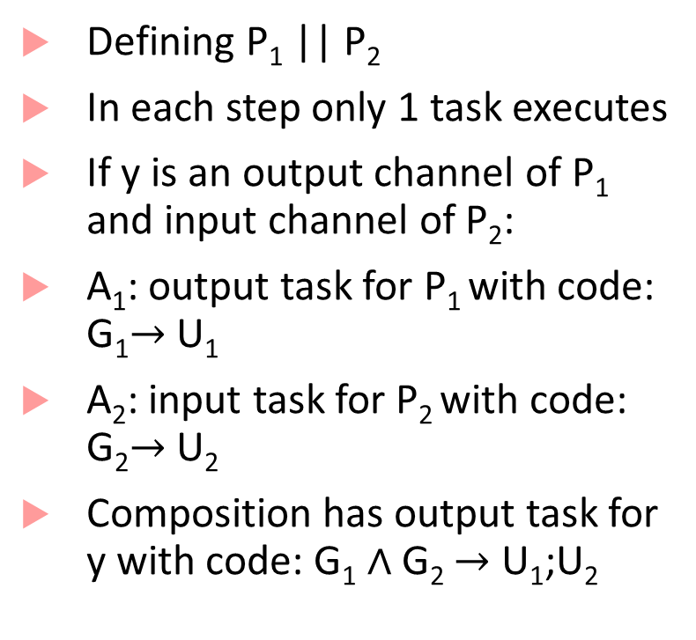






Composed DoubleBuffer
Buffer
Buffer
Defining P₁ || P₂
In each step only 1 task executes
If y is an output channel of P₁ and input channel of P₂:
A₁: output task for P₁ with code: G₁$→$ U₁
A₂: input task for P₂ with code: G₂$→$ U₂
Composition has output task for y with code: G₁ $∧$ G₂ $→$ U₁;U₂
${\text{bool}}_{∅}$ x₁ := $∅$
${\text{bool}}_{∅}$x₂:= $∅$
bool in
bool out
T_{in1}$:$ x₁ := in
T_{in2}$:$ x₂ := temp
T_{out1}$:$
x₁$≠∅→$ { temp := x₁;
x := $∅$ }
T_{out2}$:$
x₂$≠∅→$ { out := x₂;
x₂ := $∅$ }
${\text{bool}}_{∅}$ x₁ := $∅$, x₂ := $∅$
bool in
bool out
T_{in1}$:$ x₁ := in
T_{out2}$:$ x₂ $≠∅→$ { out:=x₂; x₂ ≔$∅$}
Double
Buffer
T_{out1in2}$:$ x₁ $≠∅→$ { local bool temp;
temp:=x₁; x₁ ≔$∅$;x₂:=temp}

Slide 15
Execution model for multiple processes
Execute an internal task of one of the processes
Process input on an input channel in: Execute an input task for every process to which in is an input
Execute an output task for output channel out of some process, followed by an input task for out for every process to which out is an input
If multiple choices enabled, choose nondeterministically

Slide 16
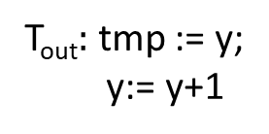
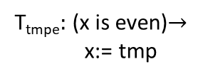
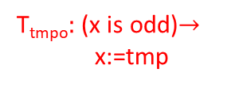
Blocking vs. Non-blocking Synchronization
Task T_{out} of P1 can produce a value on the output only if P2 has an input task that is enabled to consume the value with some input task
In this example, once x becomes odd, P2 cannot consume (no enabled input task) and it blocks communication
Process is non-blocking on channel in if at least one guarded update corresponding to input task for in is enabled
Process is non-blocking if for every input channel, the disjunction of all guards corresponding to input tasks for that channel is valid or the Boolean formula 1 (true).
int y := 0
int x := 0
int tmp
T_{out}$:$ tmp := y;
y:= y+1
T_{tmpe}$:$ (x is even)$→$
x:= tmp
T_{tmpo}$:$ (x is odd)$→$
x:=tmp
P1
P2
How do you make P2 non-blocking?

Slide 17
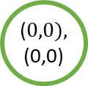

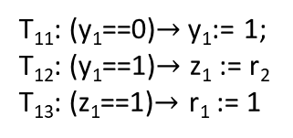
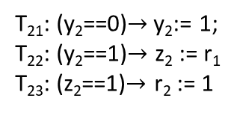

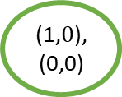
Deadlocks
Common error in asynchronous designs
Caused by each process waiting for another process to execute a task, but no task is enabled
($0,0),$
(0,0)
bool y₁ := 0, z₁ := 0
r₁
bool y₂ := 0, z₂ := 0
T₁₁: (y₁==0)$→$y₁:= 1;
T₁₂: (y₁==1)$→$ z₁ := r₂
T₁₃: (z₁==1)$→$ r₁ := 1
r₂
T₂₁: (y₂==0)$→$y₂:= 1;
T₂₂: (y₂==1)$→$ z₂ := r₁
T₂₃: (z₂==1)$→$ r₂ := 1
T₁₁
$$ε$$
(1,$0$),
(0,0)
P1
P2
T₂₁
$$ε$$
(1,0),
(1,0)

Slide 18
Shared Memory programs are asynch processes
Simple shared memory program:
S
Each statement of a process either:
changes a local variable
reads a shared variable
writes to a shared variable
Execution model: execute one step of either process
int x := 0;
temp1 := x;
temp1 := temp+1;
x:= temp1;
temp2 := x;
temp2 := temp2+1;
x:= temp2;
Process P₁
Process P₂

Slide 19


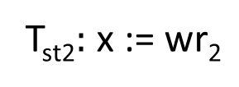

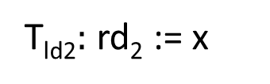
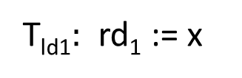
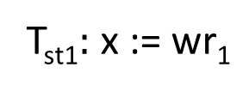

Shared Memory asynch processes
Increment1
Memory
Increment2
bool wr₁
bool wr₂
int temp₁ := 0
int x≔$0$
int temp₂ := $0$
T_{read1}$:$ temp₁ := rd₁
T_{read2}$:$ temp₂ := rd₂
T_{st1}$:$ x := wr₁
bool rd₁
bool rd₂
T_{intern1}: temp₁:= temp₁+1;
T_{st2}$:$ x := wr₂
T_{intern2}: temp₂:= temp₂+1;
T_{ld1}$:$ rd₁ := x
T_{write1}: wr₁:= temp₁;
T_{write2}: wr₂:= temp₂;
T_{ld2}$:$ rd₂ := x

Slide 20


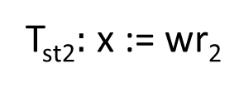

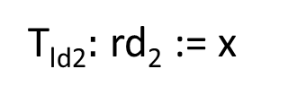
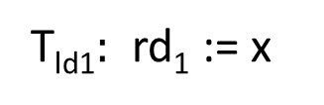
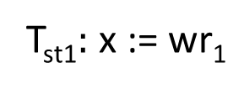
Any enabled task can execute!
Increment1
Memory
Increment2
bool wr₁
bool wr₂
int temp₁ := -1
int x≔$0$
int temp₂ := -1
T_{read1}$:$ temp₁ := rd₁
T_{read2}$:$ temp₂ := rd₂
T_{st1}$:$ x := wr₁
bool rd₁
bool rd₂
T_{intern1}: temp₁:= temp₁+1;
T_{st2}$:$ x := wr₂
T_{intern2}: temp₂:= temp₂+1;
T_{ld1}$:$ rd₁ := x
T_{write1}: wr₁:= temp₁;
T_{write2}: wr₂:= temp₂;
T_{ld2}$:$ rd₂ := x
(-1,0,-1)
(0,0,-1)
(1,0,-1)
(1,0,0)
(1,0,1)
(1,1,1)
(1,1,1)
T_{ld1},
T_{read1}
T_{intern1}
T_{ld2},
T_{read2}
T_{intern2}
T_{st1},
T_{write1}
T_{st2},
T_{write2}

Slide 21
Data Races
Asynchronous processes are subject to data races
Data race: concurrent accesses to shared object where the resulting value of object depends on execution order
Data races are bad because they make program nondeterministic
Nondeterminism is good for abstraction, very bad in programs!
Data races have led to many famous software bugs, number one cause for unpredictability in concurrent shared memory programs

Slide 22
Mutual Exclusion Problem
Process P₁
Process P₂
Entry Code
Entry Code
CS
CS
Critical Section (CS): Part of the code that an asynchronous process should execute without interference from other processes
e.g. updating the database, sending a critical actuator signal
Mutual exclusion problem: design code that guarantees that only one process enters CS at a time
No assumptions about how long a CS can last, process may want CS repeatedly

Slide 23
Mutual exclusion design constraints
Process P₁
Process P₂
Entry Code
Entry Code
CS
CS
Exclusion: Both processes should not be in CS at the same time
Deadlock-Freedom: Any process that wants to enter CS should be able to eventually enter

Slide 24
First attempt: is it correct?
else
idle₁
flag₁:=1
try₁
(flag₂==0)?
cs₁
P1
What happens if both P1 and P2 set their respective flags to 1?
flag₁:=0
else
idle₂
flag₂:=1
try₂
(flag₁==0)?
cs₂
P2
flag₂:=0

Slide 25
Peterson’s Mutex Protocol
(flag₂==0)?
idle₁
flag₁:=1
1try₁
turn:=2
1try₂
1try₃
cs₁
P1
else
(turn==1)?
else
flag₁:=0
(flag₁==0)?
P2
idle₂
flag₂:=1
2try₁
turn:=1
2try₂
2try₃
cs₁
else
(turn==2)?
else
This is a little different from the textbook!
flag₂:=0

Slide 26

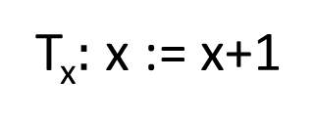
Fairness
(0,0)
int x:= 0, y≔ 0
Covered in 4.2.4, but we will not go into details
Basic idea:
Assumption about underlying platform/scheduler and how tasks are executed
Informally, an infinite execution is unfair to a task if it never gets chance to execute
Fairness restricts set of possible executions to realistic ones without putting bounds on relative speeds of execution
T_{x}$:$ x := x+1
(1,0)
(0,1)
T_{y}$:$ y:= y+1
(2,0)
(1,1)
(0,2)
(3,0)
Unfair to T_{x}: (0,0), (0,1),(0,2),…,(0,10000), …
Unfair to T_{y}: (0,0), (1,0),(2,0),…,(10000,0),…

