Slide 1
Autonomous Cyber-Physical Systems: Reinforcement Learning for Planning
Spring 2018. CS 599.
Instructor: Jyo Deshmukh

Slide 2
Overview
Reinforcement Learning Basics
Neural Networks and Deep Reinforcement Learning

Slide 3
What is Reinforcement Learning
RL is the theoretical model for learning from interaction with an uncertain environment
Inspired by behaviorist psychology
More than 60 years old
Historically, two key threads:
Trial and error learning
Techniques from optimal control
Typically framed using Markov Decision Processes
Environment
Reward/
Penalty
Action
Sense
Agent

Slide 4
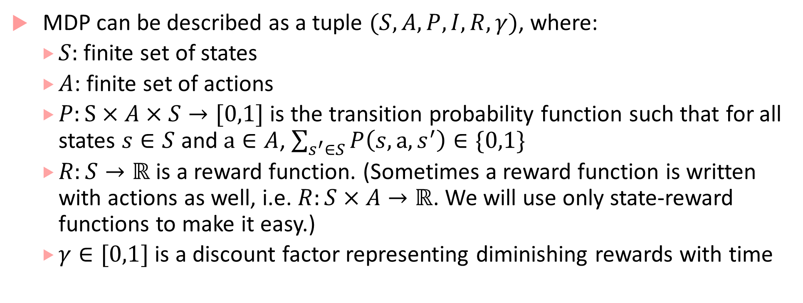
Markov Decision Process
MDP can be described as a tuple $(S,A,P,I, R,γ)$, where:
$S:$ finite set of states
$A$: finite set of actions
$P:S×A×S→[0,1]$ is the transition probability function such that for all states $s∈S$ and $a∈A$, $\sum_{s^{′}∈S}{P\left(s,a,s^{′}\right)}∈\{0,1\}$
$R:S→ℝ$ is a reward function. (Sometimes a reward function is written with actions as well, i.e. $R:S×A→ℝ$. We will use only state-reward functions to make it easy.)
$γ∈[0,1]$ is a discount factor representing diminishing rewards with time

Slide 5
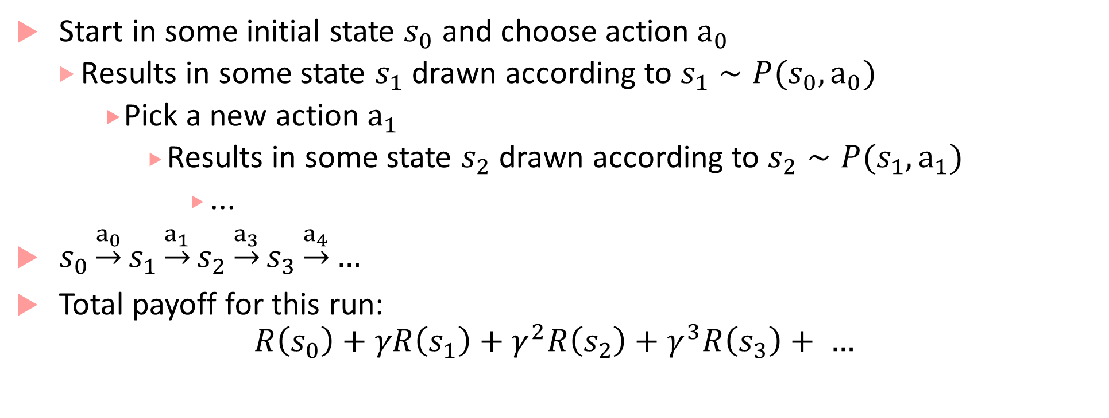
MDP run
Start in some initial state $s_{0}$ and choose action $a_{0}$
Results in some state $s_{1}$ drawn according to $s_{1}∼P(s_{0},a_{0})$
Pick a new action $a_{1}$
Results in some state $s_{2}$ drawn according to $s_{2}∼P(s_{1},a_{1})$
...
$s_{0}\underset{→}{a_{0}}s_{1}\underset{→}{a_{1}}s_{2}\underset{→}{a_{3}}s_{3}\underset{→}{a_{4}}…$
Total payoff for this run:
$$R\left(s_{0}\right)+γR\left(s_{1}\right)+γ^{2}R\left(s_{2}\right)+γ^{3}R\left(s_{3}\right)+ …$$

Slide 6
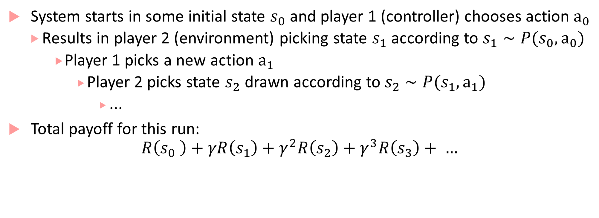
MDP as two-player game
System starts in some initial state $s_{0}$ and player 1 (controller) chooses action $a_{0}$
Results in player 2 (environment) picking state $s_{1}$ according to $s_{1}∼P(s_{0},a_{0})$
Player 1 picks a new action $a_{1}$
Player 2 picks state $s_{2}$ drawn according to $s_{2}∼P(s_{1},a_{1})$
...
Total payoff for this run:
$$R\left(s_{0} \right)+γR\left(s_{1}\right)+γ^{2}R\left(s_{2}\right)+γ^{3}R\left(s_{3}\right)+ …$$

Slide 7
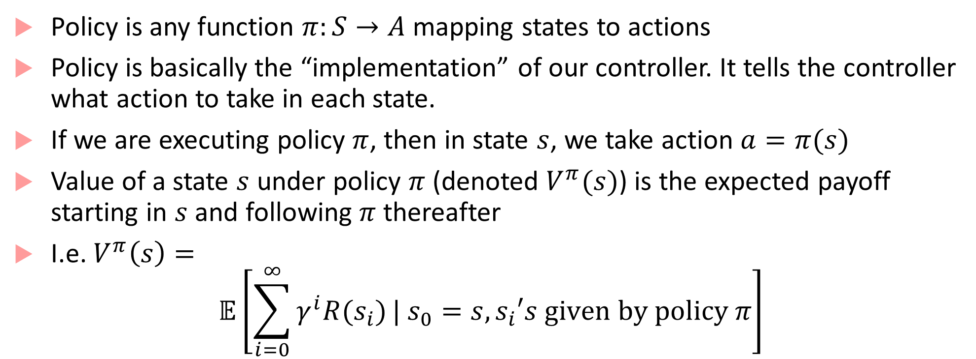
Policies and Value Functions
Policy is any function $π:S→A$ mapping states to actions
Policy is basically the “implementation” of our controller. It tells the controller what action to take in each state.
If we are executing policy $π$, then in state $s$, we take action $a=π(s)$
Value of a state $s$ under policy $π$ (denoted $V^{π}(s)$) is the expected payoff starting in $s$ and following $π$ thereafter
I.e. $V^{π}\left(s\right)=$
$$𝔼\left[\sum_{i=0}^{∞}{γ^{i}R(s_{i})}| s_{0}=s, s_{i}′s given by policy π\right]$$

Slide 8
Bellman Equation
Bellman showed that :
computing optimal reward/cost over several steps of
a dynamic discrete decision problem (i.e. computing the best decision in each discrete step)
can be stated in a recursive step-by-step form
by writing the relationship between the value functions in two successive iterations.
This relationship is called Bellman equation.

Slide 9
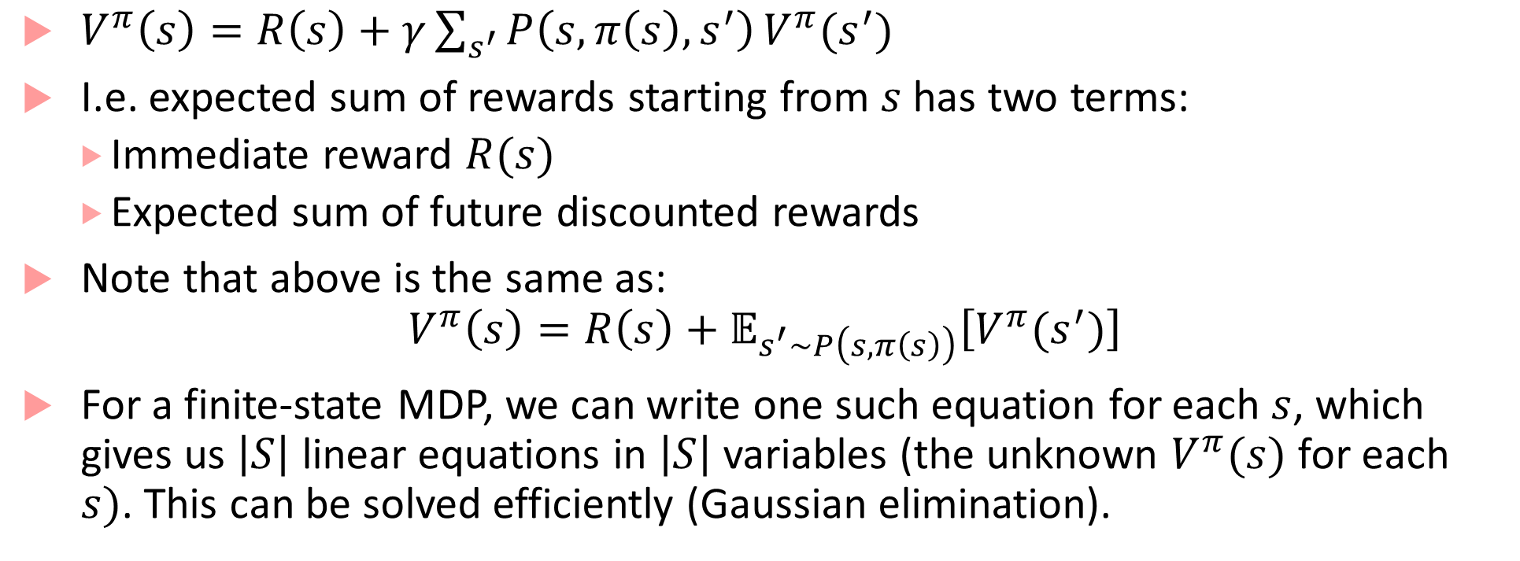
Value function satisfies Bellman equations
$V^{π}\left(s\right)=R\left(s\right)+γ\sum_{s^{′}}{P\left(s,π\left(s\right),s^{′}\right)}V^{π}(s^{′})$
I.e. expected sum of rewards starting from $s$ has two terms:
Immediate reward $R(s)$
Expected sum of future discounted rewards
Note that above is the same as:
$$V^{π}\left(s\right)=R\left(s\right)+𝔼_{s^{′}∼P\left(s,π\left(s\right)\right)}\left[V^{π}(s^{′})\right]$$
For a finite-state MDP, we can write one such equation for each $s$, which gives us $\left|S\right|$ linear equations in $\left|S\right|$ variables (the unknown $V^{π}(s)$ for each $s)$. This can be solved efficiently (Gaussian elimination).

Slide 10
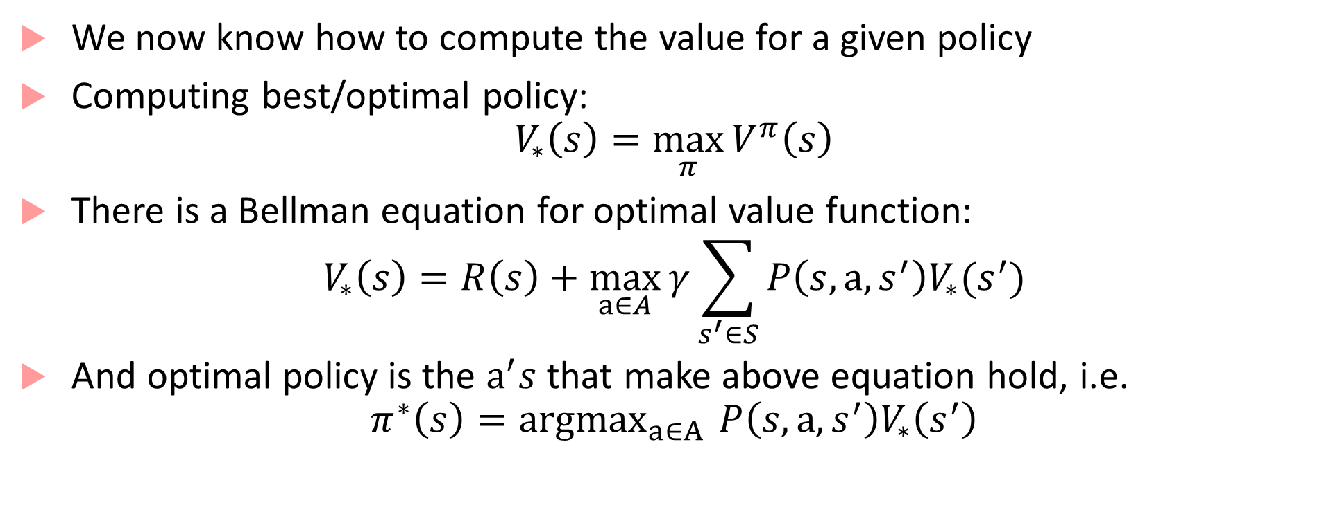
Optimal value function
We now know how to compute the value for a given policy
Computing best/optimal policy:
$$V_{∗}\left(s\right)=\max_{π}{V^{π}\left(s\right)}$$
There is a Bellman equation for optimal value function:
$$V_{∗}\left(s\right)=R\left(s\right)+\max_{a∈A}{γ\sum_{s^{′}∈S}{P\left(s,a,s^{′}\right)V_{∗}(s^{′})}}$$
And optimal policy is the $a^{′}s$ that make above equation hold, i.e.
$$π^{∗}\left(s\right)={argmax}_{a∈A }{P\left(s,a,s^{′}\right)V_{∗}\left(s^{′}\right)}$$

Slide 11
Planning in MDPs
How do we compute the optimal policy?
Two algorithms:
Value iteration
Policy iteration
Value iteration: Repeatedly update estimated value function using Bellman equation
Policy iteration: Use value function of a given policy to improve the policy

Slide 12
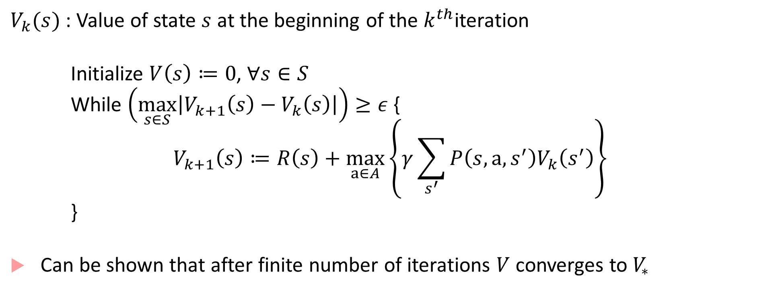
Value iteration
$V_{k}(s)$ : Value of state $s$ at the beginning of the $k^{th}$iteration
Initialize $V\left(s\right)≔0$, $∀s∈S$
While $\left(\max_{s∈S}\left|V_{k+1}\left(s\right)−V_{k}\left(s\right)\right|\right)≥ε$ {
$$V_{k+1}\left(s\right)≔R\left(s\right)+\max_{a∈A}\left\{γ\sum_{s^{′}}{P\left(s,a,s^{′}\right)V_{k}\left(s^{′}\right)}\right\}$$
}
Can be shown that after finite number of iterations $V$ converges to $V_{∗}$

Slide 13
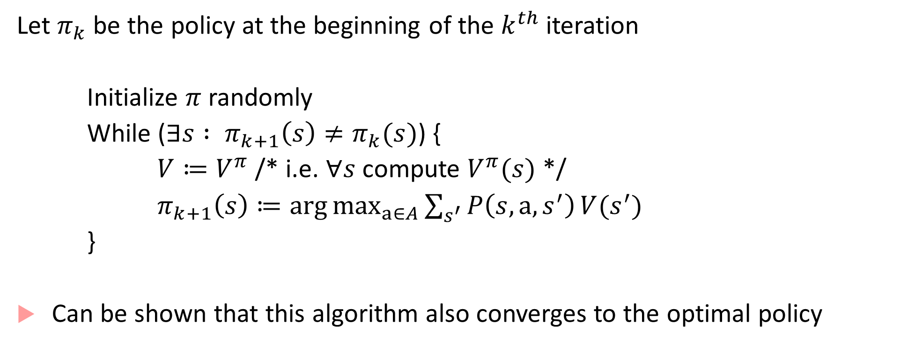
Policy iteration
Let $π_{k}$ be the policy at the beginning of the $k^{th}$ iteration
Initialize $π$ randomly
While ($∃s : π_{k+1}\left(s\right)≠π_{k}(s)$) {
$V≔V^{π}$ /* i.e. $∀s$ compute $V^{π}(s)$ */
$π_{k+1}\left(s\right)≔\arg{\max_{a∈A}{\sum_{s^{′}}{P\left(s,a,s^{′}\right)}V(s^{′})}}$
}
Can be shown that this algorithm also converges to the optimal policy
Can use the LP formulation to solve this, or an iterative algorithm

Slide 14
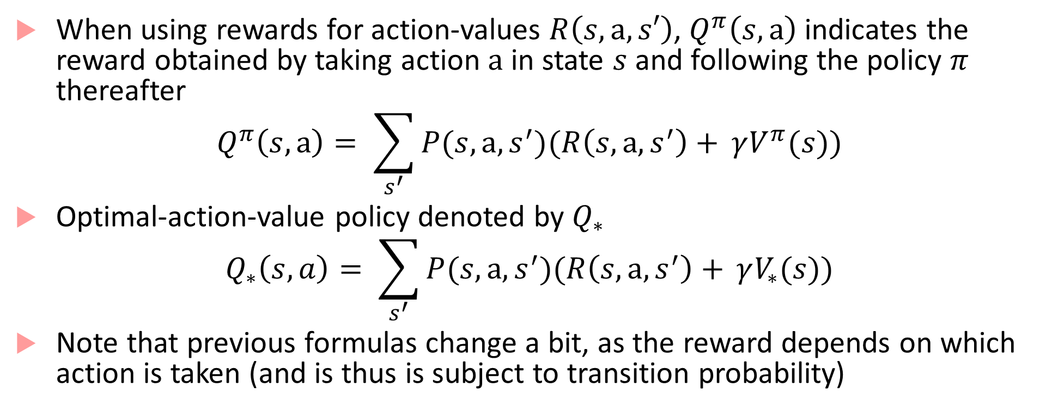
Using state-action pairs for rewards
When using rewards for action-values $R\left(s,a,s′\right)$, $Q^{π}\left(s,a\right)$ indicates the reward obtained by taking action $a$ in state $s$ and following the policy $π$ thereafter
$$Q^{π}\left(s,a\right)= \sum_{s^{′}}{P(s,a,s^{′})(R\left(s,a,s^{′}\right)+ }γV^{π}(s))$$
Optimal-action-value policy denoted by $Q_{∗}$
$$Q_{∗}\left(s,a\right)= \sum_{s^{′}}{P(s,a,s^{′})(R\left(s,a,s^{′}\right)+ }γV_{∗}(s))$$
Note that previous formulas change a bit, as the reward depends on which action is taken (and is thus is subject to transition probability)

Slide 15
Challenges
Value iteration and Policy iteration are both standard, and no agreement on which is better
In practice, value iteration is preferred over policy iteration as the latter requires solving linear equations, which scales ~cubically with the size of the state space
Real-world applications face challenges:
Curse of modeling: Where does the (probabilistic) environment model come from?
Curse of dimensionality: Even if you have a model, computing and storing expectations over large state-spaces is impractical

Slide 16
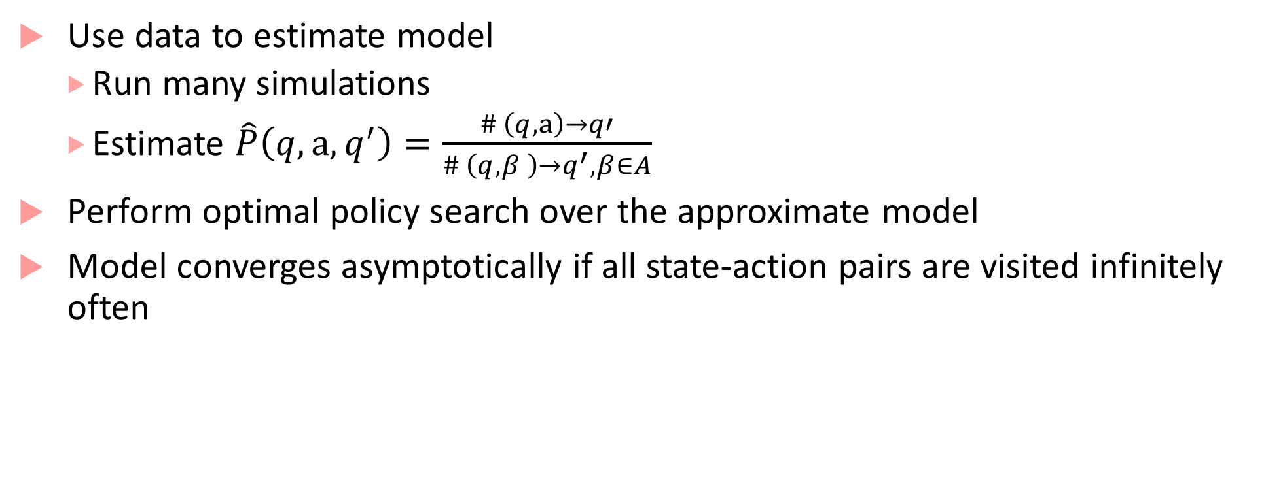
Approximate model (Indirect method)
Use data to estimate model
Run many simulations
Estimate $\hat{P}\left(q,a,q^{′}\right)=\frac{\# \left(q,a\right)→q′}{\# \left(q,β \right)→q^{′}, β∈A}$
Perform optimal policy search over the approximate model
Model converges asymptotically if all state-action pairs are visited infinitely often

Slide 17
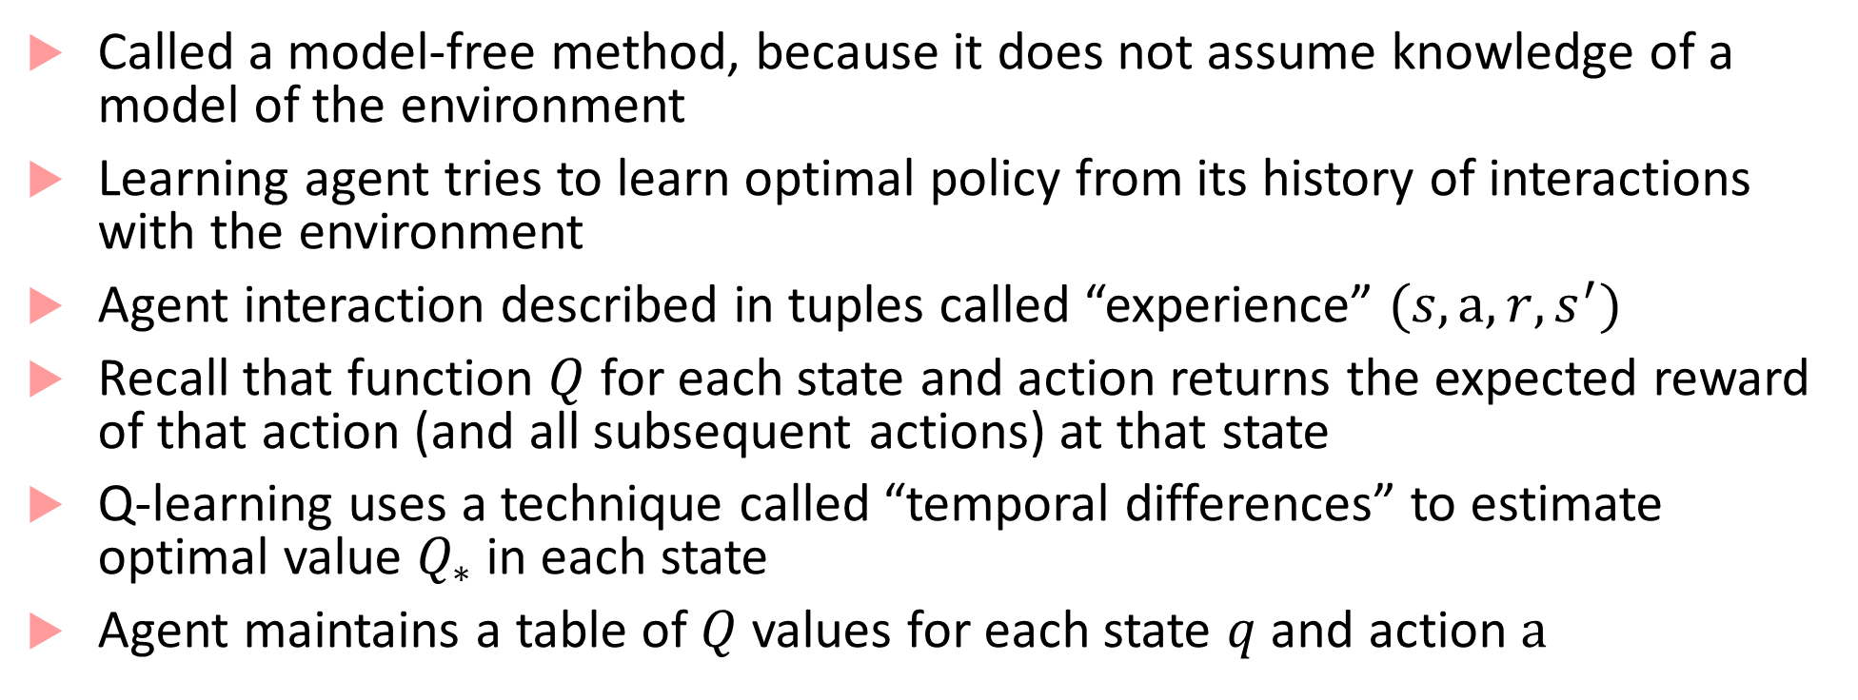
Q-learning: (Model-free method)
Called a model-free method, because it does not assume knowledge of a model of the environment
Learning agent tries to learn optimal policy from its history of interactions with the environment
Agent interaction described in tuples called “experience” $(s,a,r,s^{′})$
Recall that function $Q$ for each state and action returns the expected reward of that action (and all subsequent actions) at that state
Q-learning uses a technique called “temporal differences” to estimate optimal value $Q_{∗}$ in each state
Agent maintains a table of $Q$ values for each state $q$ and action $a$

Slide 18
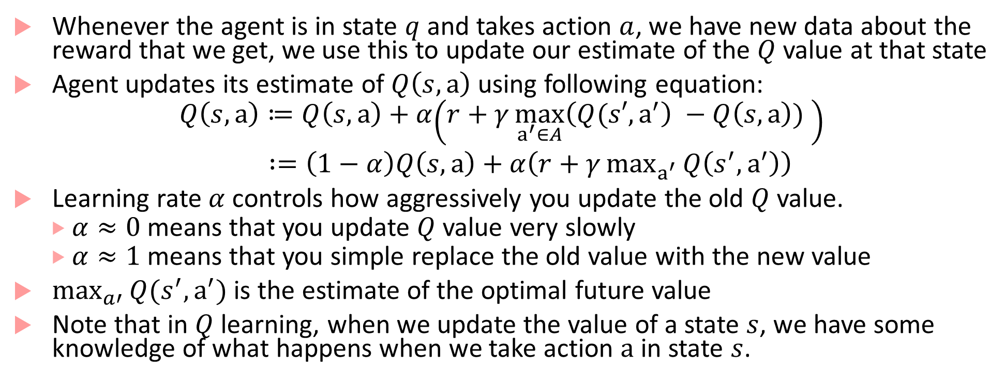
Q-learning
Whenever the agent is in state $q$ and takes action $a$, we have new data about the reward that we get, we use this to update our estimate of the $Q$ value at that state
Agent updates its estimate of $Q\left(s,a\right)$ using following equation:
$$Q\left(s,a\right)≔Q\left(s,a\right)+α\left(r+γ\max_{a^{′}∈A}\left(Q(s′,a^{′}\right) −Q\left(s,a\right)) \right)$$
$:=\left(1−α\right)Q\left(s,a\right)+α\left(r+γ\max_{a^{′}}{Q\left(s^{′},a^{′}\right)}\right)$
Learning rate $α$ controls how aggressively you update the old $Q$ value.
$α≈0$ means that you update $Q$ value very slowly
$α≈1$ means that you simple replace the old value with the new value
$\max_{a′}{Q(s^{′},a^{′})}$is the estimate of the optimal future value
Note that in $Q$ learning, when we update the value of a state $s$, we have some knowledge of what happens when we take action $a$ in state $s$.

Slide 19
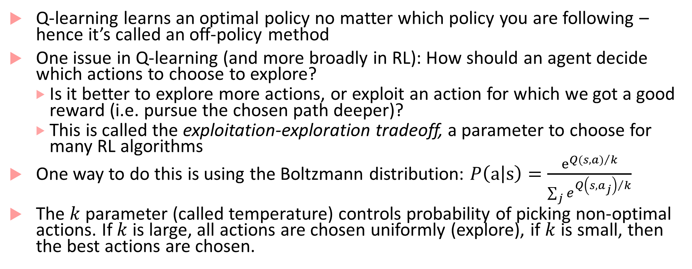
Q-learning
Q-learning learns an optimal policy no matter which policy you are following – hence it’s called an off-policy method
One issue in Q-learning (and more broadly in RL): How should an agent decide which actions to choose to explore?
Is it better to explore more actions, or exploit an action for which we got a good reward (i.e. pursue the chosen path deeper)?
This is called the exploitation-exploration tradeoff, a parameter to choose for many RL algorithms
One way to do this is using the Boltzmann distribution: $P\left(a | s\right)=\frac{e^{{Q(s,a)}/k}}{\sum_{j}{e^{{Q\left(s,a_{j}\right)}/k}}}$
The $k$parameter (called temperature) controls probability of picking non-optimal actions. If $k$is large, all actions are chosen uniformly (explore), if $k$ is small, then the best actions are chosen.

Slide 20
Some more challenges for RL in autonomous CPS
Uncertainty!
In all previous algorithms, we assume that all states are fully visible and precisely estimable
In CPS examples, there is uncertainty in states (sensor/actuation noise, state may not be observable but only estimated, etc.)
The approach is to model the underlying system as a Partially-Observable Markov Decision Process (POMDP) -- pronounced POM-DPs

Slide 21
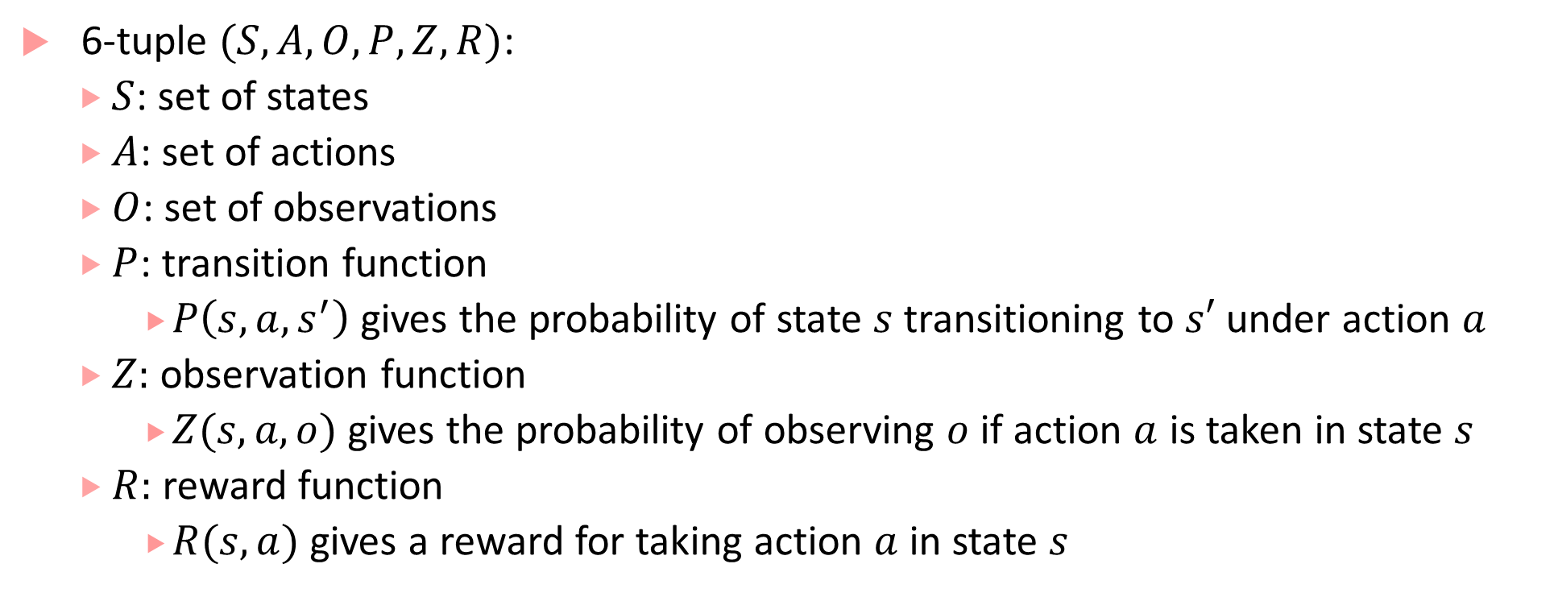
POMDPs
6-tuple $(S,A,O,P,Z,R)$:
$S$: set of states
$A$: set of actions
$O$: set of observations
$P$: transition function
$P\left(s,a,s^{′}\right)$gives the probability of state $s$ transitioning to $s′$ under action $a$
$Z:$ observation function
$Z(s,a,o)$ gives the probability of observing $o$ if action $a$ is taken in state $s$
$R:$ reward function
$R(s,a)$ gives a reward for taking action $a$ in state $s$

Slide 22
RL for POMDPs
Control theory concerns with planning problems for discrete or continuous POMDPs
Strong assumptions required to get theoretical results of optimality
Underlying state-transitions correspond to a linear dynamical system with Gaussian probability distribution
Reward function is a negative quadratic loss
Solving generic discrete POMDP is intractable, finding tractable special cases is a hot topic

Slide 23
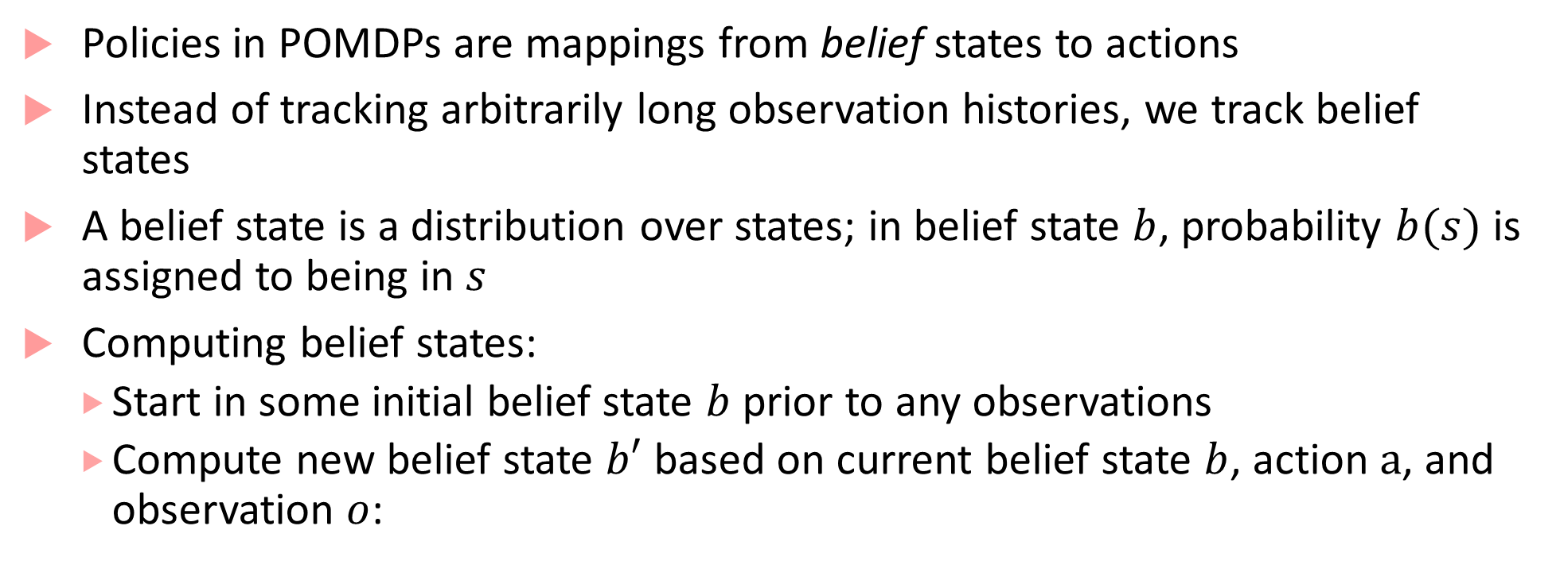
RL for POMDPs
Policies in POMDPs are mappings from belief states to actions
Instead of tracking arbitrarily long observation histories, we track belief states
A belief state is a distribution over states; in belief state $b$, probability $b(s)$ is assigned to being in $s$
Computing belief states:
Start in some initial belief state $b$ prior to any observations
Compute new belief state $b′$ based on current belief state $b$, action $a$, and observation $o$:

Slide 24
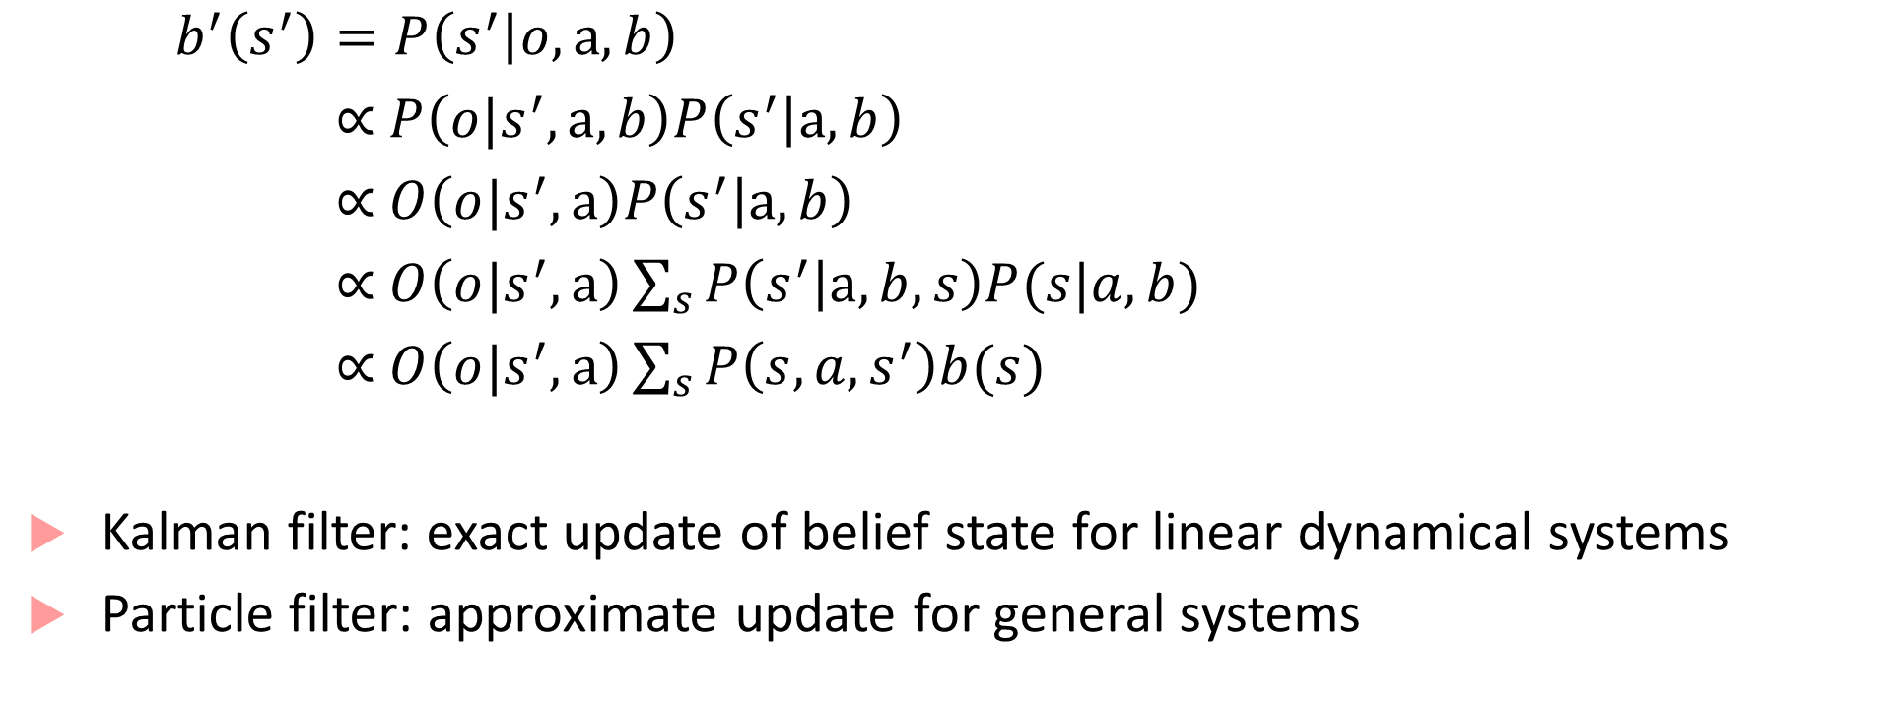
RL for POMDPS
$b^{′}\left(s^{′}\right)=P\left(s^{′} | o,a,b\right)$
$\text{∝} P\left(o|s^{′},a,b\right)P\left(s^{′} | a,b\right)$
$\text{∝} O\left(o|s^{′},a\right)P\left(s^{′} | a,b\right)$
$\text{∝} O\left(o|s^{′},a\right)\sum_{s}{P\left(s^{′} | a,b,s\right)P(s|a,b)}$
$\text{∝ }O\left(o|s^{′},a\right)\sum_{s}{P\left(s,a,s^{′}\right)b(s)}$
Kalman filter: exact update of belief state for linear dynamical systems
Particle filter: approximate update for general systems

Slide 25
Algorithms for planning in POMDPs
Tons of literature, starting in 1960s
Point-based value iteration:
Select a small set of reachable belief points
Perform Bellman updates at those points, keeping value and gradient
Online search for POMDP solutions
Build AND/OR tree of the reachable belief states from current belief
Approaches like branch-and-bound, heuristic search, Monte Carlo Tree search

Slide 26
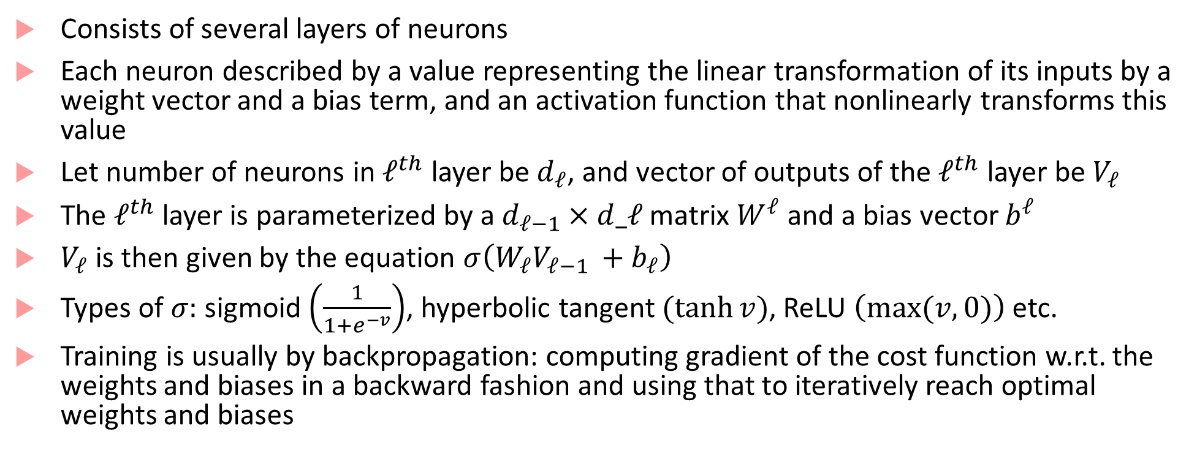
Deep Neural Network: 30 second introduction
Consists of several layers of neurons
Each neuron described by a value representing the linear transformation of its inputs by a weight vector and a bias term, and an activation function that nonlinearly transforms this value
Let number of neurons in $ℓ^{th}$ layer be $d_{ℓ}$, and vector of outputs of the $ℓ^{th}$ layer be $V_{ℓ}$
The $ℓ^{th}$ layer is parameterized by a $d_{ℓ−1}×d_ℓ$ matrix $W^{ℓ}$ and a bias vector $b^{ℓ}$
$V_{ℓ}$ is then given by the equation $σ\left(W_{ℓ}V_{ℓ−1 }+b_{ℓ}\right)$
Types of $σ:$ sigmoid $\left(\frac{1}{1+e^{−v}}\right)$, hyperbolic tangent $(\tanh{v})$, ReLU $\left(max⁡(v,0)\right)$ etc.
Training is usually by backpropagation: computing gradient of the cost function w.r.t. the weights and biases in a backward fashion and using that to iteratively reach optimal weights and biases

Slide 27
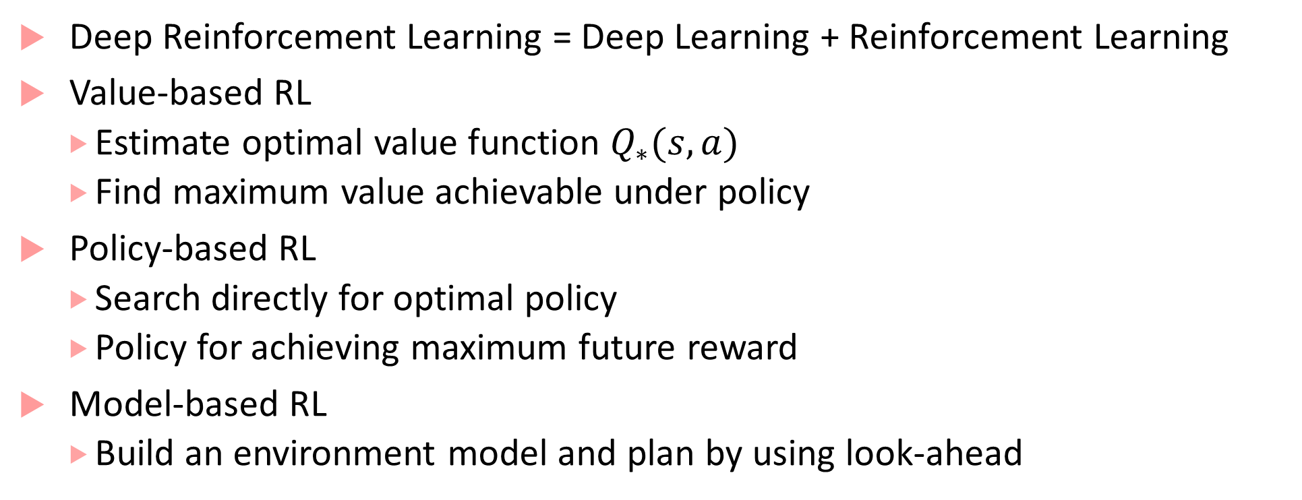
Deep Reinforcement Learning
Deep Reinforcement Learning = Deep Learning + Reinforcement Learning
Value-based RL
Estimate optimal value function $Q_{∗}(s,a)$
Find maximum value achievable under policy
Policy-based RL
Search directly for optimal policy
Policy for achieving maximum future reward
Model-based RL
Build an environment model and plan by using look-ahead

Slide 28
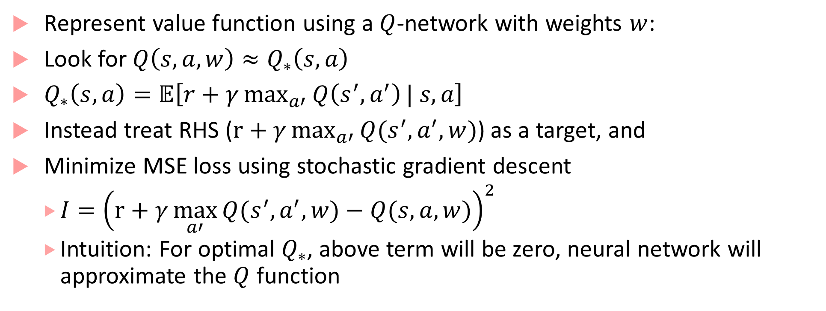
Deep Q-learning
Represent value function using a $Q$-network with weights $w$:
Look for $Q\left(s,a,w\right)≈Q_{∗}\left(s,a\right)$
$Q_{∗}\left(s,a\right)=𝔼\left[r+γ\max_{a′}{Q\left(s^{′},a^{′}\right)}| s,a\right]$
Instead treat RHS ($r+γ\max_{a′}{Q(s^{′},a^{′},w)}$) as a target, and
Minimize MSE loss using stochastic gradient descent
$I={\left(r+γ\max_{a′}{Q(s^{′},a^{′},w)}−Q(s,a,w)\right)}^{2}$
Intuition: For optimal $Q_{∗}$, above term will be zero, neural network will approximate the $Q$ function

Slide 29
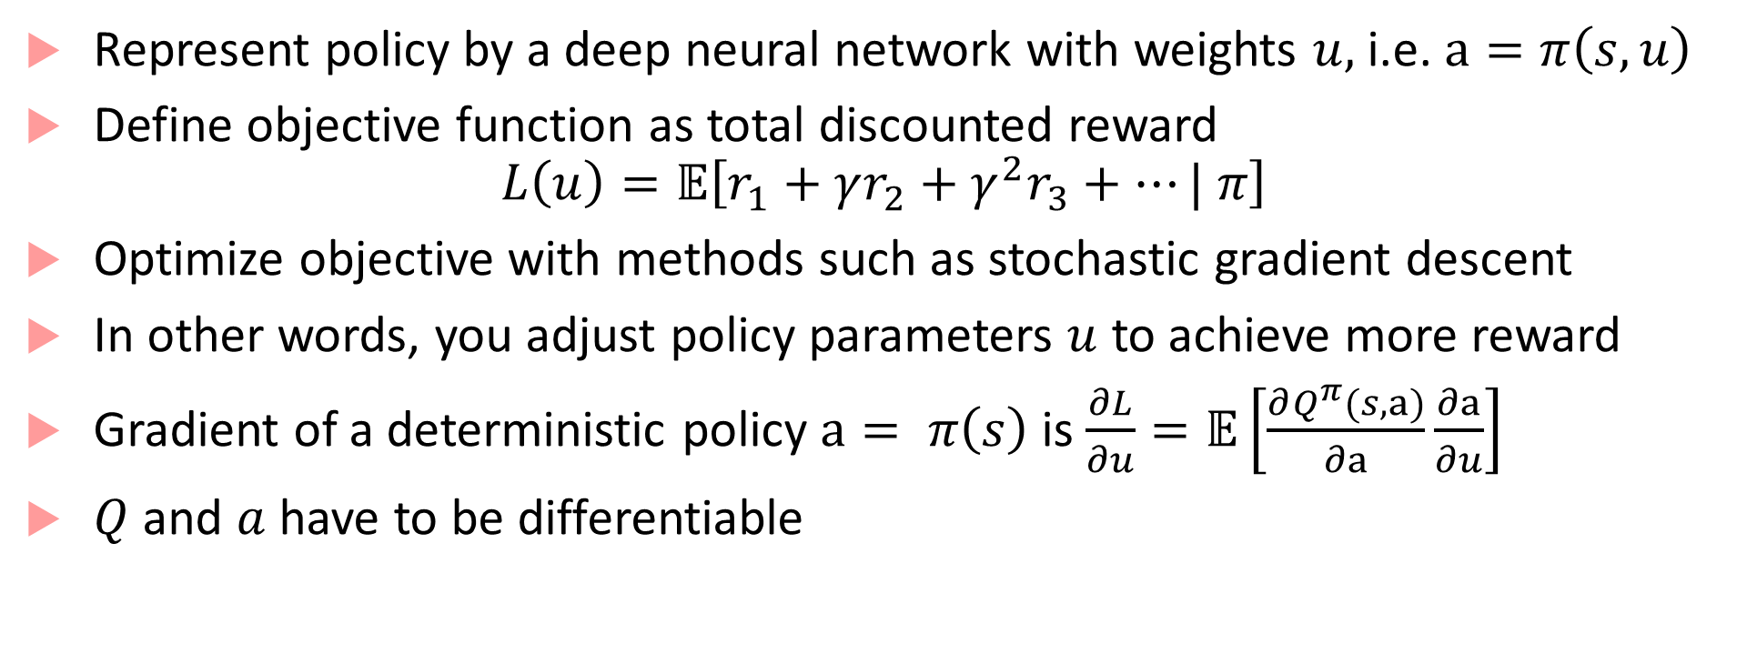
Policy gradients
Represent policy by a deep neural network with weights $u,$ i.e. $a=π\left(s,u\right)$
Define objective function as total discounted reward
$$L\left(u\right)=𝔼\left[r_{1}+γr_{2}+γ^{2}r_{3}+…| π\right]$$
Optimize objective with methods such as stochastic gradient descent
In other words, you adjust policy parameters $u$ to achieve more reward
Gradient of a deterministic policy $a= π\left(s\right)$ is $\frac{∂L}{∂u}=𝔼\left[\frac{∂Q^{π}(s,a)}{∂a}\frac{∂a}{∂u}\right]$
$Q$ and $a$ have to be differentiable

Slide 30
More Deep RL
Many different extensions and improvements to basic algorithms
Lots of existing research
In our context: we need to adapt to deep RL over continuous spaces, or discretize state-space
Continuous-time/space methods follow similar ideas. Policy gradient method extends naturally : DPG is the continuous analog of DQN

Slide 31
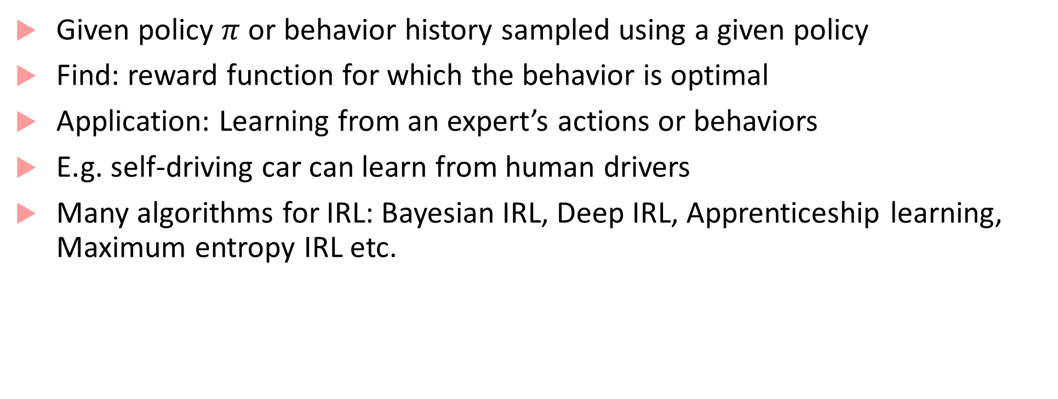
Inverse Reinforcement Learning
Given policy $π$ or behavior history sampled using a given policy
Find: reward function for which the behavior is optimal
Application: Learning from an expert’s actions or behaviors
E.g. self-driving car can learn from human drivers
Many algorithms for IRL: Bayesian IRL, Deep IRL, Apprenticeship learning, Maximum entropy IRL etc.

Slide 32
Bibliography
This is a subset of the sources I used. It is possible I missed something!
Richard S. Sutton and Andrew G. Barto, Reinforcement Learning, MIT Press.
http://ieeecss.org/CSM/library/1992/april1992/w01-ReinforcementLearning.pdf
Decision making under uncertainty: https://web.stanford.edu/~mykel/pomdps.pdf
Satinder Singh’s tutorial: http://web.eecs.umich.edu/~baveja/NIPS05RLTutorial/NIPS05RLMainTutorial.pdf
Great tutorial on Deep Reinforcement Learning: https://icml.cc/2016/tutorials/deep_rl_tutorial.pdf

