Slide 1
Autonomous Cyber-Physical Systems: Probabilistic Models
Spring 2019. CS 599.
Instructor: Jyo Deshmukh
This lecture also some sources other than the textbooks, full bibliography is included at the end of the slides.

Slide 2
Layout
Markov Chains
Continuous-time Markov Chains

Slide 3
Probabilistic Models
Models for components that we studied so far were either deterministic or nondeterministic.
The goal of such models is to represent computation or time-evolution of a physical phenomenon.
These models do not do a great job of capturing uncertainty.
We can usually model uncertainty using probabilities, so probabilistic models allow us to account for likelihood of environment behaviors
Machine learning/AI algorithms also require probabilistic modelling!

Slide 4
Markov chains
Stochastic process: finite or infinite collection of random variables, indexed by time
Represents numeric value of some system changing randomly over time
Value at each time point is random number with some distribution
Distribution at any time may depend on some or all previous times
Markov chain: special case of a stochastic process
Markov property: A process satisfies the Markov property if it can make predictions of the future based only on its current state (i.e. future and past states of the process are independent)
I.e. distribution of future values depends only on the current value/state

Slide 5
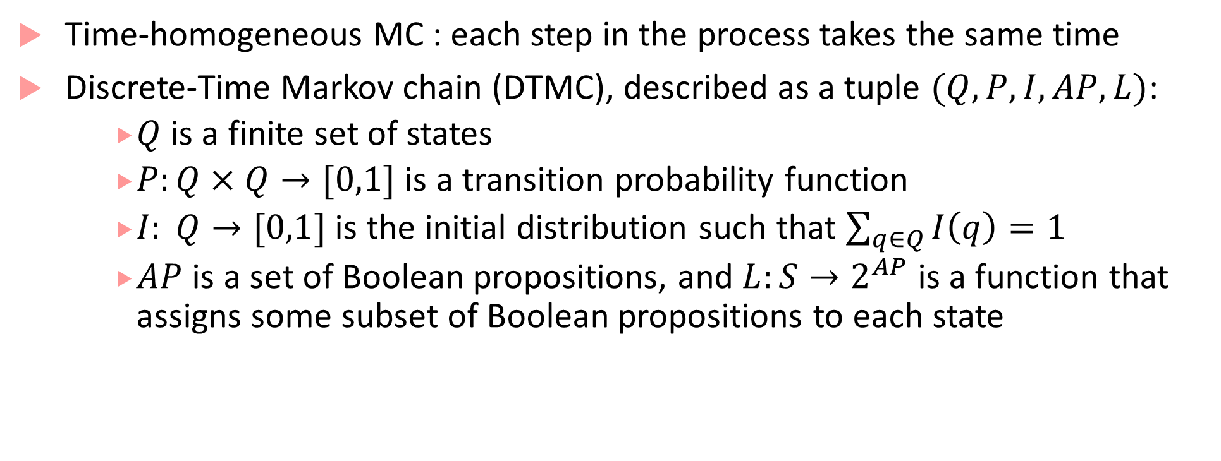
Discrete-time Markov chain (DTMC)
Time-homogeneous MC : each step in the process takes the same time
Discrete-Time Markov chain (DTMC), described as a tuple $(Q, P,I,AP,L)$:
$Q$is a finite set of states
$P:Q×Q→[0,1]$ is a transition probability function
$I: Q→[0,1]$ is the initial distribution such that $\sum_{q∈Q}{I\left(q\right)}=1$
$AP$ is a set of Boolean propositions, and $L:S→2^{AP}$ is a function that assigns some subset of Boolean propositions to each state

Slide 6


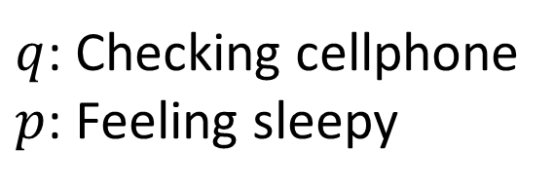


Markov chain example: Driver modeling
0
0
0.3
$$p, q$$
0.1
0.4
$$¬p,¬q$$
Accelerate
Constant Speed
0.2
$q$: Checking cellphone
$p$: Feeling sleepy
0
0.5
0.5
0.8
0.05
0.4
Idling
Brake
$$p,q$$
0.5
$$¬p,q$$
0.05
0.2
1

Slide 7
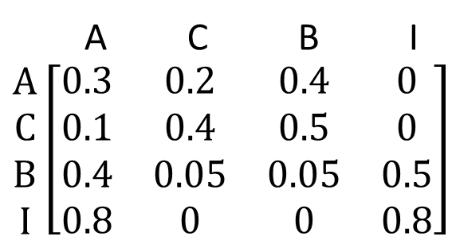
Markov chain: Transition probability matrix
0.3
$$p, q$$
0.1
0.4
A C B I $\begin{matrix}A \\ C \\ B \\ I\end{matrix}\left[\begin{matrix}0.3 & 0.2 & 0.4 & 0 \\ 0.1 & 0.4 & 0.5 & 0 \\ 0.4 & 0.05 & 0.05 & 0.5 \\ 0.8 & 0 & 0 & 0.8\end{matrix}\right]$
$$¬p,¬q$$
Accelerate
Constant Speed
0.2
0
0.5
0.5
0.8
0.05
0.4
Idling
Brake
$$p,q$$
0.5
$$¬p,q$$
0.05
0.2
1

Slide 8
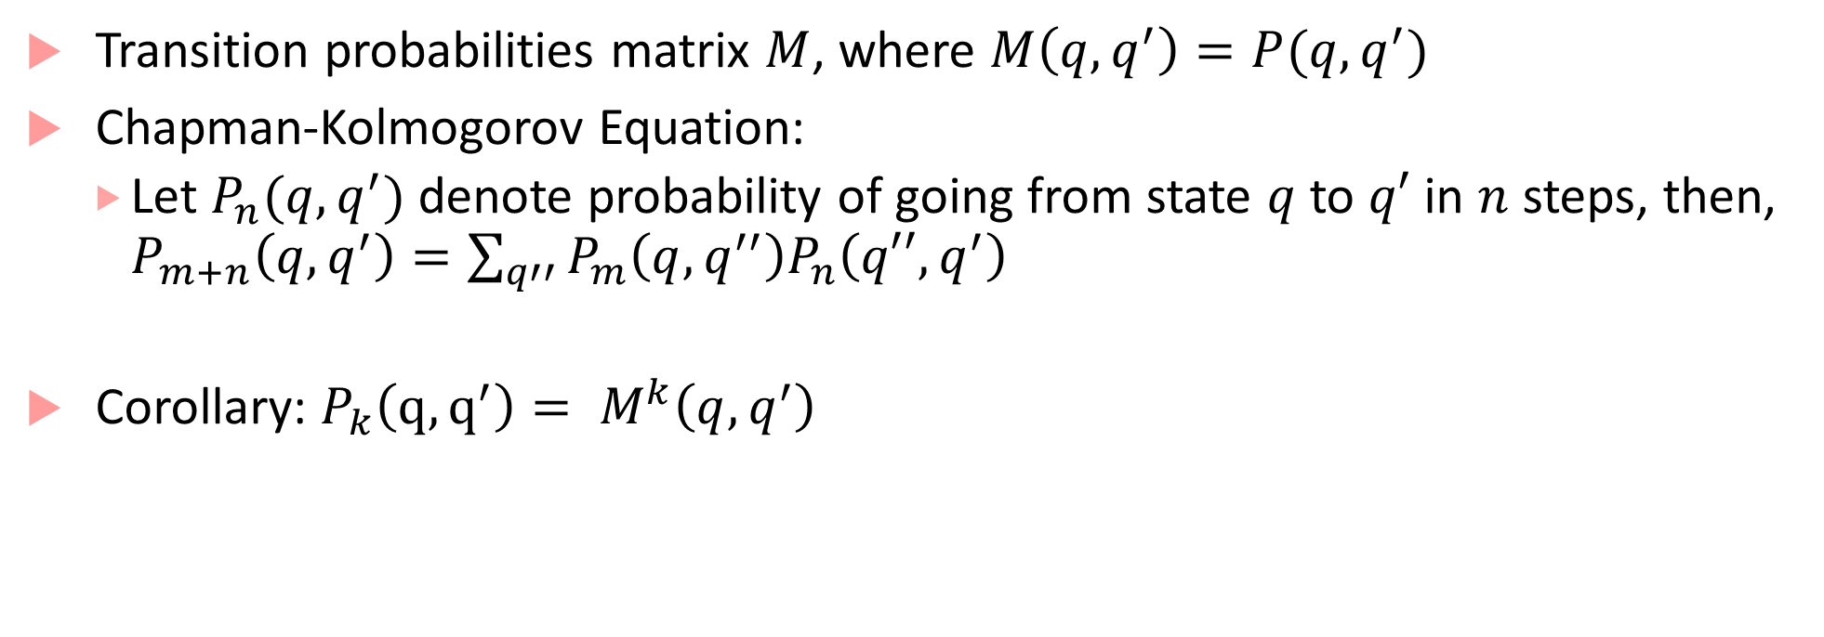
Markov Chain Analysis
Transition probabilities matrix $M$, where $M\left(q,q^{′}\right)=P(q,q^{′})$
Chapman-Kolmogorov Equation:
Let $P_{n}(q,q^{′})$ denote probability of going from state $q$ to $q′$ in $n$ steps, then, $P_{m+n}\left(q,q^{′}\right)=\sum_{q′′}{P_{m}\left(q,q^{′′}\right)P_{n}\left(q′′,q^{′}\right)}$
Corollary: $P_{k}\left(q,q^{′}\right)= M^{k}\left(q,q^{′}\right)$

Slide 9
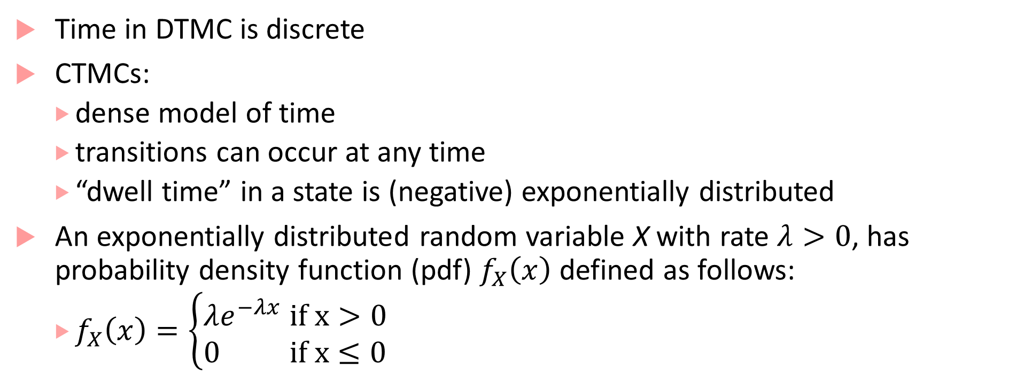
Continuous Time Markov Chains
Time in DTMC is discrete
CTMCs:
dense model of time
transitions can occur at any time
“dwell time” in a state is (negative) exponentially distributed
An exponentially distributed random variable X with rate $λ>0$, has probability density function (pdf) $f_{X}\left(x\right)$ defined as follows:
$f_{X}\left(x\right)=\left\{\begin{matrix}λe^{−λx} if x>0 \\ 0 if x≤0\end{matrix}\right.$

Slide 10
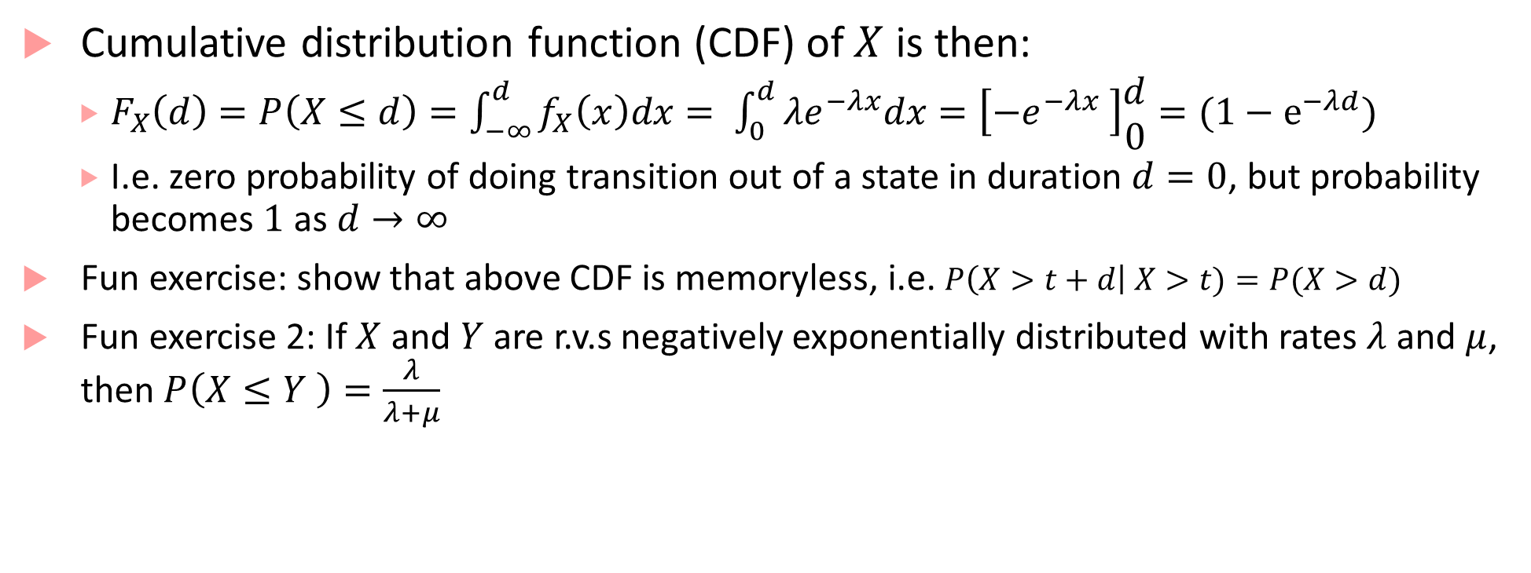
Exponential distribution properties
Cumulative distribution function (CDF) of $X$ is then:
$F_{X}\left(d\right)=P\left(X≤d\right)=\int_{−∞}^{d}{f_{X}\left(x\right)dx}= \int_{0}^{d}{λe^{−λx}dx}=\left[−e^{−λx} \right]\begin{matrix}d \\ 0\end{matrix}=(1−e^{−λd})$
I.e. zero probability of doing transition out of a state in duration $d=0$, but probability becomes $1$ as $d→∞$
Fun exercise: show that above CDF is memoryless, i.e. $P\left(X>t+d\right| X>t)=P(X>d)$
Fun exercise 2: If $X$ and $Y$ are r.v.s negatively exponentially distributed with rates $λ$ and $μ$, then $P\left(X≤Y \right)=\frac{λ}{λ+μ}$

Slide 11
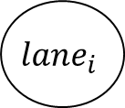
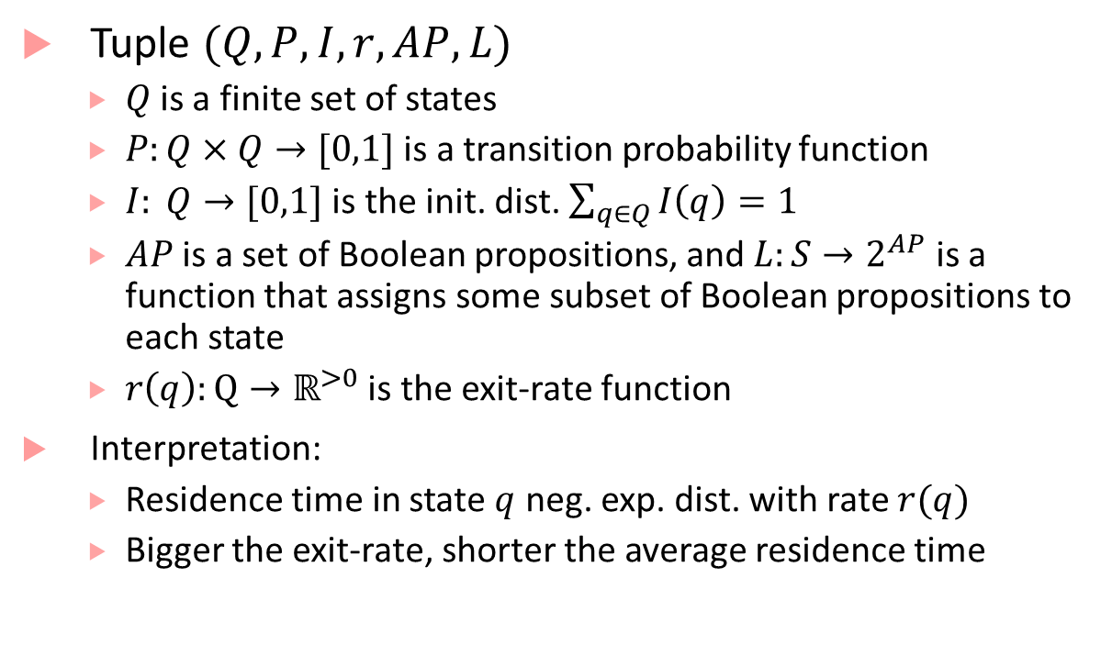
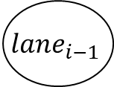
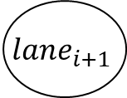
CTMC example
Tuple $(Q,P,I,r,AP,L)$
$Q$is a finite set of states
$P:Q×Q→[0,1]$ is a transition probability function
$I: Q→[0,1]$ is the init. dist. $\sum_{q∈Q}{I\left(q\right)}=1$
$AP$ is a set of Boolean propositions, and $L:S→2^{AP}$ is a function that assigns some subset of Boolean propositions to each state
$r\left(q\right):Q→ℝ^{>0}$ is the exit-rate function
Interpretation:
Residence time in state $q$ neg. exp. dist. with rate $r(q)$
Bigger the exit-rate, shorter the average residence time
0.1
0.6
0.1
$$lane_{i}$$
$$lane_{i+1}$$
0.4
0.3
5
0.6
0.8
$$lane_{i−1}$$
0.2
0.5

Slide 12
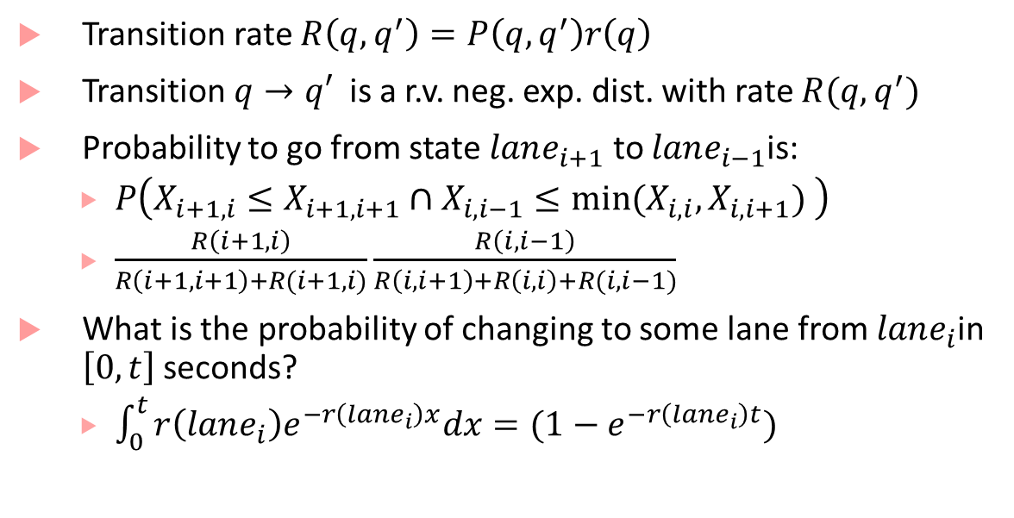
CTMC example
Transition rate $R\left(q,q^{′}\right)=P\left(q,q^{′}\right)r\left(q\right)$
Transition $q→q′$ is a r.v. neg. exp. dist. with rate $R(q,q^{′})$
Probability to go from state $lane_{i+1}$ to $lane_{i−1}$is:
$P\left(X_{i+1,i}≤X_{i+1,i+1}∩X_{i,i−1}≤{min⁡(X}_{i,i},X_{i,i+1}) \right)$
$\frac{R\left(i+1,i\right)}{R\left(i+1,i+1\right)+R(i+1,i)}\frac{R\left(i,i−1\right)}{R\left(i,i+1\right)+R\left(i,i\right)+R(i,i−1)}$
What is the probability of changing to some lane from $lane_{i}$in $\left[0,t\right]$seconds?
$\int_{0}^{t}{r\left(lane_{i}\right)e^{−r\left(lane_{i}\right)x}dx}=(1−e^{−r\left(lane_{i}\right)t})$
0.1
0.6
0.1
$$lane_{i}$$
$$lane_{i+1}$$
0.4
0.3
5
0.6
0.8
$$lane_{i−1}$$
0.2
0.5

Slide 13
Bibliography
Baier, Christel, Joost-Pieter Katoen, and Kim Guldstrand Larsen. Principles of model checking. MIT press, 2008.
Continuous Time Markov Chains: https://resources.mpi-inf.mpg.de/departments/rg1/conferences/vtsa11/slides/katoen/lec01_handout.pdf

