Slide 1
Autonomous Cyber-Physical Systems: Timed Models & Dynamical System Models
Spring 2019. CS 599.
Instructor: Jyo Deshmukh
Acknowledgment: Some of the material in these slides is based on the lecture slides for CIS 540: Principles of Embedded Computation taught by Rajeev Alur at the University of Pennsylvania. http://www.seas.upenn.edu/~cis540/

Slide 2
Timed Models

Slide 3
Summary of Models seen and to be seen
Synchronous Reactive Components
Event-triggered SRCs
Asynchronous Processes
Timed Model
Like Asynchronous models, but with explicit time information
Can make use of global time for coordination
Continuous-time models/Dynamical system models
Like Synchronous, but time evolves continuously
Hybrid Dynamical Models
[1] Nicolescu, Gabriela; Mosterman, Pieter J., eds. (2010). Model-Based Design for Embedded Systems. Computational Analysis, Synthesis, and Design of Dynamic Systems. 1. Boca Raton: CRC Press.

Slide 4
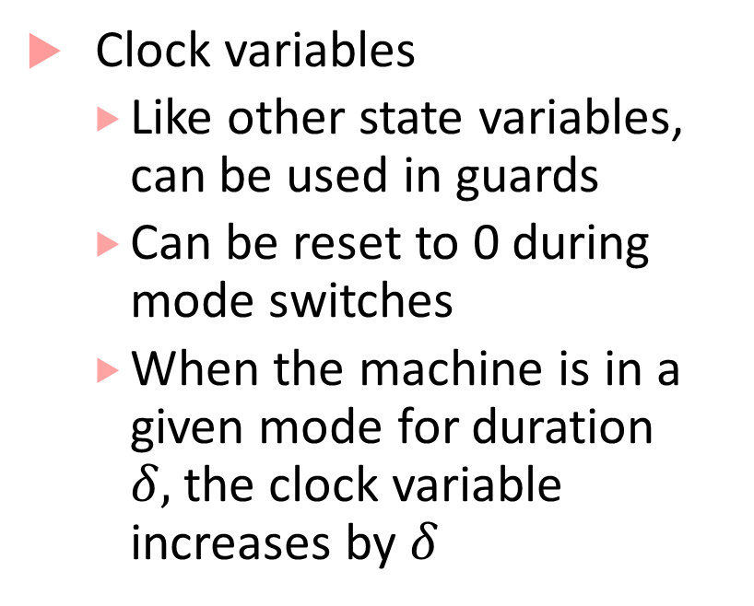


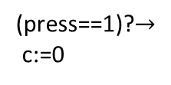
Timed Processes: explicit clock variables
(press==1)? $∧$ (c$≥$1)
Clock variables
Like other state variables, can be used in guards
Can be reset to 0 during mode switches
When the machine is in a given mode for duration $δ,$the clock variable increases by $δ$
clock c:=0
off
dim
(press==1)? $∧$ (c$≤$1)
bright
(press==1)?$→$
c:=0
(press==1)?

Slide 5
Transitions in a timed state machine
(press==1)? $∧$ (c$≥$1)
Mode switch
machine moves from one mode to another
guard on the transition must be true for mode switch to occur
update specified by the transition will update/reset clock variables
clock c:=0
off
dim
(press==1)? $∧$ (c$≤$1)
bright
(press==1)?$→$
c:=0
(press==1)?
(press==1)?
(off,0.5)
(dim,0)

Slide 6
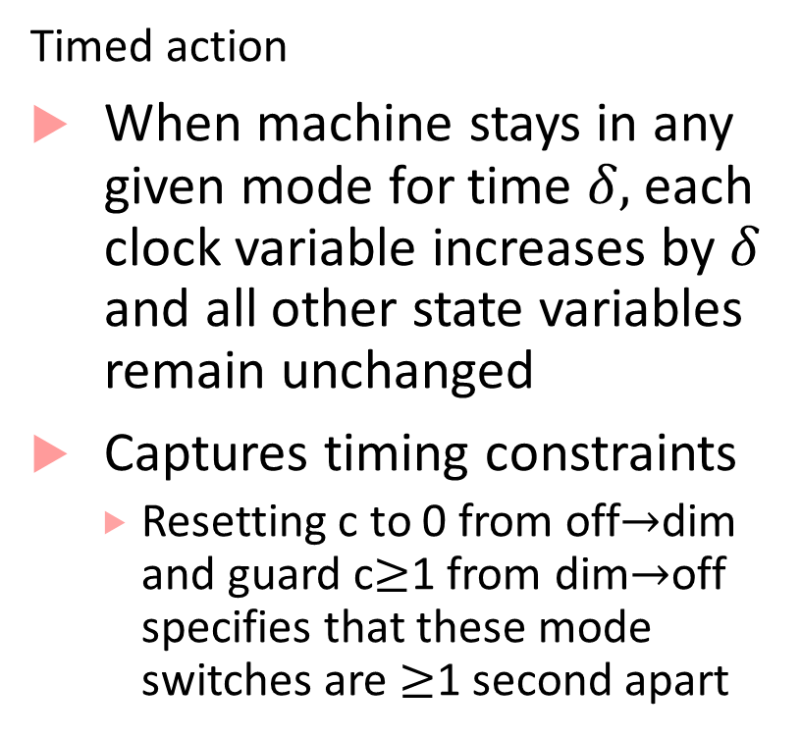
Transitions in a timed state machine
Timed action
When machine stays in any given mode for time $δ,$each clock variable increases by $δ$ and all other state variables remain unchanged
Captures timing constraints
Resetting c to 0 from off$→$dim and guard c$≥$1 from dim$→$off specifies that these mode switches are $≥$1 second apart
(press==1)? $∧$ (c$≥$1)
clock c:=0
off
dim
(press==1)? $∧$ (c$≤$1)
bright
(press==1)?$→$
c:=0
(press==1)?

Slide 7



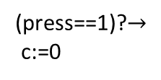

Timed Process Execution
(press==1)? $∧$ (c$≥$1)
Machine execution is through alternating timed transitions and mode switches
clock c:=0
off
dim
(press==1)? $∧$ (c$≤$1)
bright
(press==1)?$→$
c:=0
(press==1)?
(press==1)?
(press==1)?
(off,0)
(off,0.5)
(dim,0)
(dim,0.8)
(bright,0.8)
(press==1)?
(dim,3.8)
(off,3.8)

Slide 8
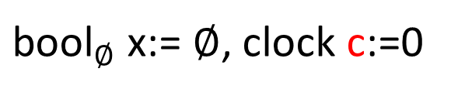
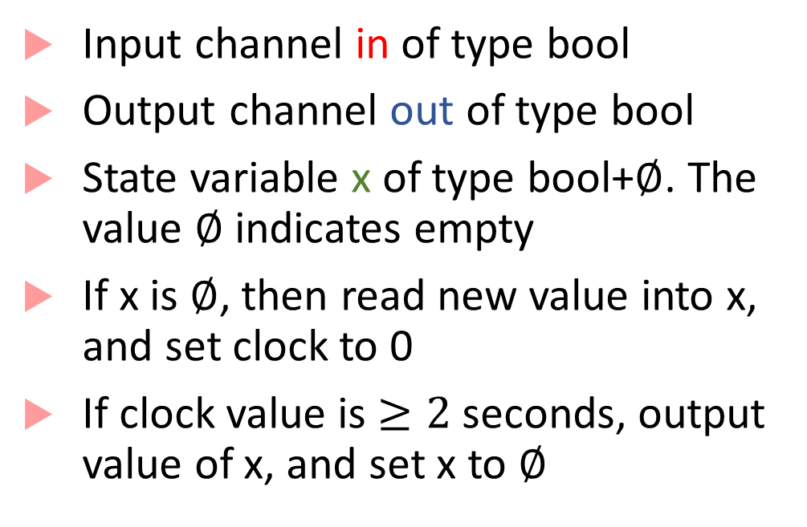
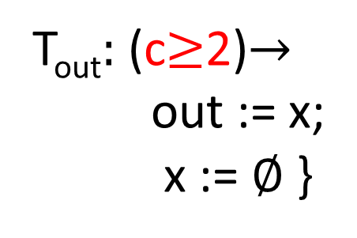
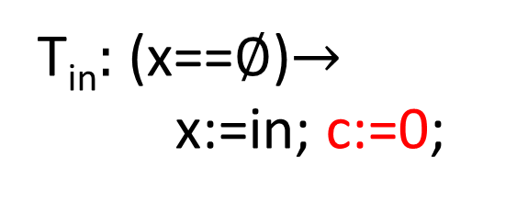
Timed Buffer
bool in
Input channel in of type bool
Output channel out of type bool
State variable x of type bool+$∅$. The value $∅$ indicates empty
If x is $∅$, then read new value into x, and set clock to 0
If clock value is $≥2$ seconds, output value of x, and set x to $∅$
${\text{bool}}_{∅}$ x:= $∅$, clock c:=0
bool
out
T_{in}$:$ (x==$∅$)$→$
x:=in; c:=0;
T_{out}$:$ (c$≥$2)$→$
out := x;
x := $∅$ }

Slide 9

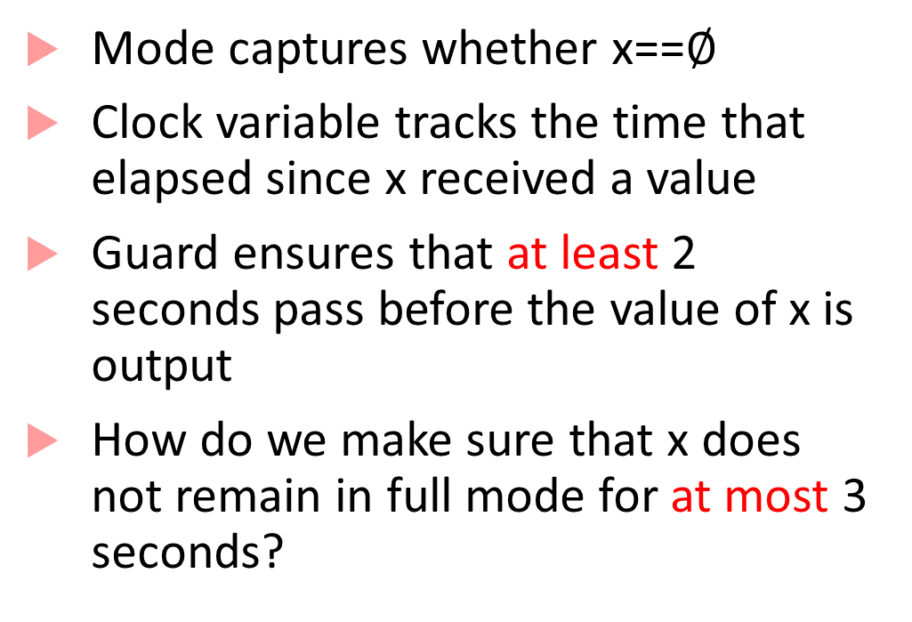

Timed State Machine representation
Mode captures whether x==$∅$
Clock variable tracks the time that elapsed since x received a value
Guard ensures that at least 2 seconds pass before the value of x is output
How do we make sure that x does not remain in full mode for at most 3 seconds?
c$≥2$ $→$ out:=x, x≔$∅$
in?
c:=0
empty
full
in?$→$ x:=in, c:=0

Slide 10
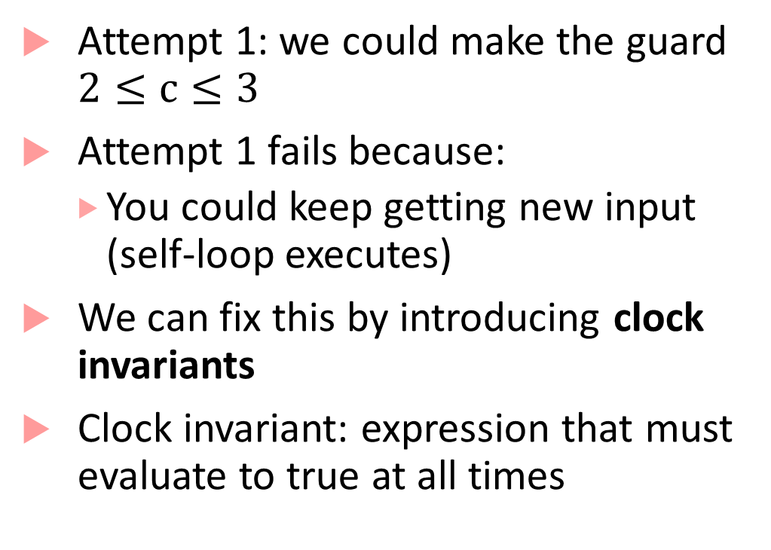
Clock invariants
Attempt 1: we could make the guard $2≤c≤3$
Attempt 1 fails because:
You could keep getting new input (self-loop executes)
We can fix this by introducing clock invariants
Clock invariant: expression that must evaluate to true at all times
c$≥2$ $→$ out:=x, x≔$∅$
in?
c:=0
empty
full
in?$→$ x:=in, c:=0

Slide 11
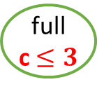
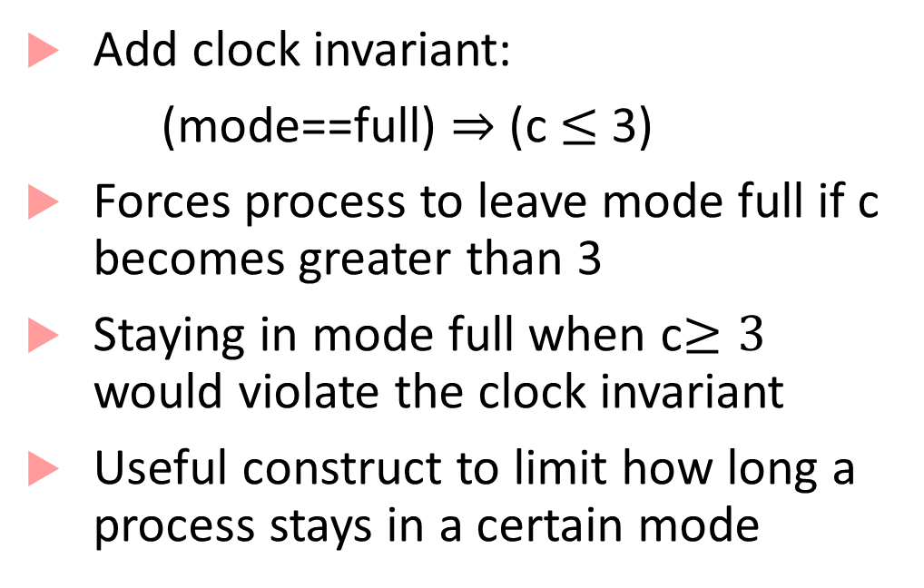
Clock invariants
Add clock invariant:
(mode==full) $⇒$ (c $≤$ 3)
Forces process to leave mode full if c becomes greater than 3
Staying in mode full when c$≥3$ would violate the clock invariant
Useful construct to limit how long a process stays in a certain mode
c$≥2$ $→$ out:=x, x≔$∅$
in?
c:=0
empty
full
c $≤3$
in?$→$ x:=in, c:=0

Slide 12

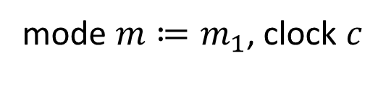
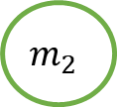
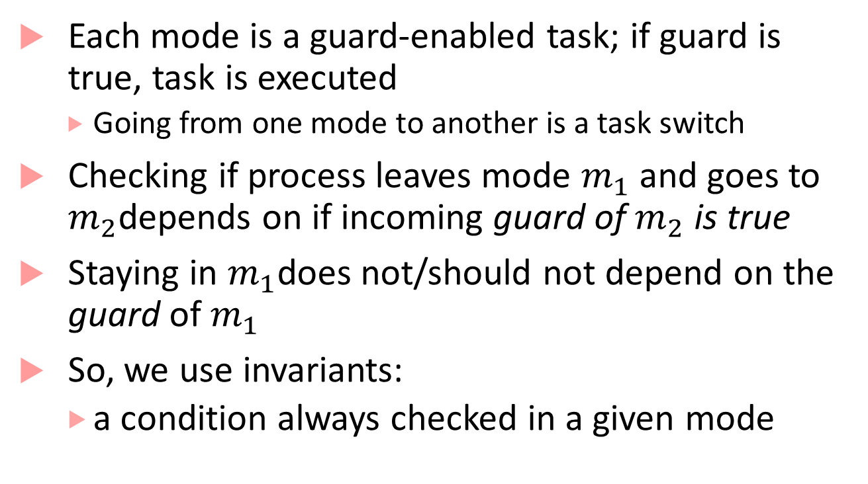

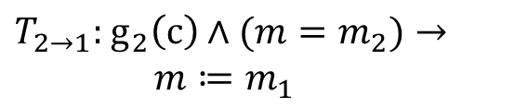
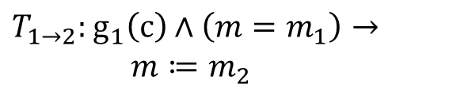

Why model using invariants and guards?
Each mode is a guard-enabled task; if guard is true, task is executed
Going from one mode to another is a task switch
Checking if process leaves mode $m_{1}$ and goes to $m_{2}$depends on if incoming guard of $m_{2}$ is true
Staying in $m_{1}$does not/should not depend on the guard of$m_{1}$
So, we use invariants:
a condition always checked in a given mode
mode $m≔m_{1}$, clock $c$
$T_{1→2}:$ $g_{1}\left(c\right)∧\left(m=m_{1}\right)→$
$m≔m_{2}$
$T_{2→1}:$ $g_{2}\left(c\right)∧(m=m_{2})→$
$m≔m_{1}$
$$m_{1}$$
$$g_{2}$$
$$g_{1}$$
$$m_{2}$$

Slide 13
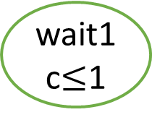
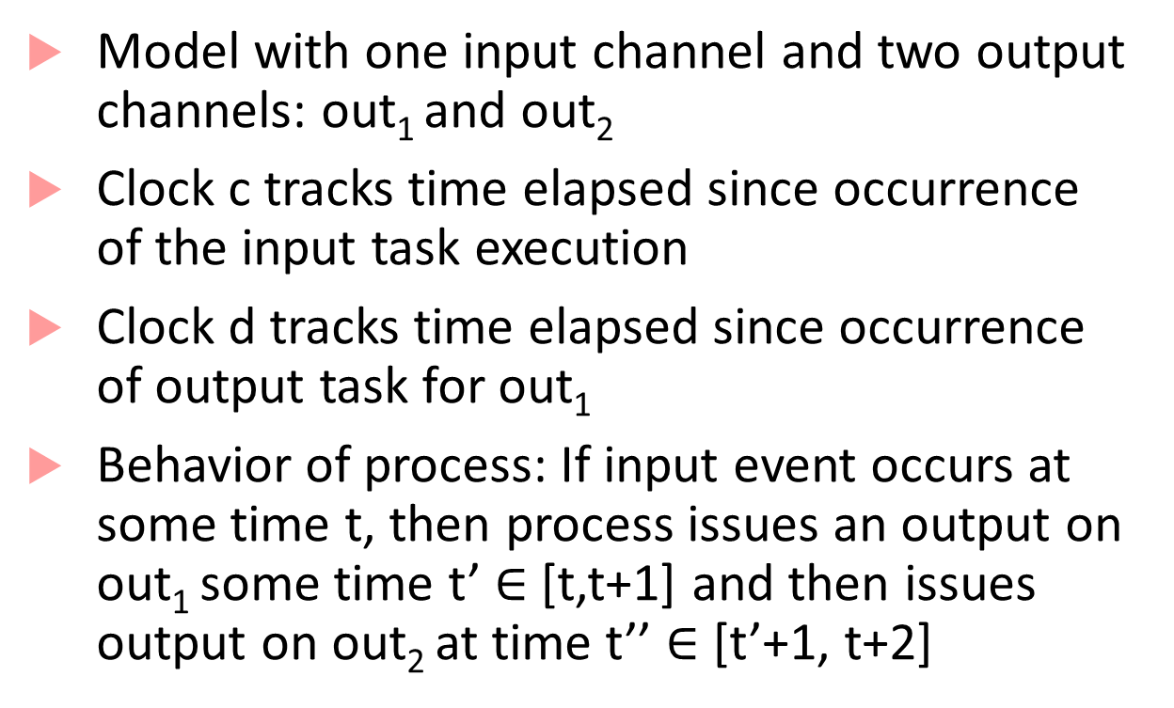
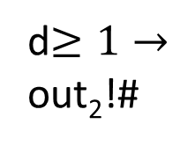
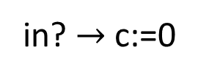
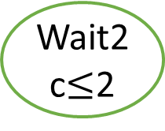
Example with two clocks
clock c,d:=0
Model with one input channel and two output channels: out₁ and out₂
Clock c tracks time elapsed since occurrence of the input task execution
Clock d tracks time elapsed since occurrence of output task for out₁
Behavior of process: If input event occurs at some time t, then process issues an output on out₁ some time t’ $∈$ [t,t+1] and then issues output on out₂ at time t’’ $∈$ [t’+1, t+2]
idle
in? $→$ c:=0
wait1
c$≤$1
out₁!#;d:=0
d$≥1→$
out₂!#
Wait2
c$≤$2

Slide 14
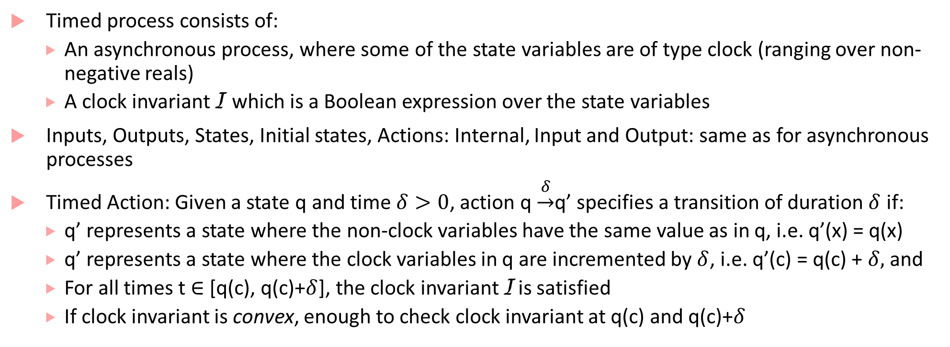
Formal recap of a timed process
Timed process consists of:
An asynchronous process, where some of the state variables are of type clock (ranging over non-negative reals)
A clock invariant I which is a Boolean expression over the state variables
Inputs, Outputs, States, Initial states, Actions: Internal, Input and Output: same as for asynchronous processes
Timed Action: Given a state q and time $δ>0$, action q $\underset{→}{δ}$q’ specifies a transition of duration $δ$ if:
q’ represents a state where the non-clock variables have the same value as in q, i.e. q’(x) = q(x)
q’ represents a state where the clock variables in q are incremented by $δ$, i.e. q’(c) = q(c) + $δ,$ and
For all times t $∈$ [q(c), q(c)+$δ$], the clock invariant I is satisfied
If clock invariant is convex, enough to check clock invariant at q(c) and q(c)+$δ$

Slide 15
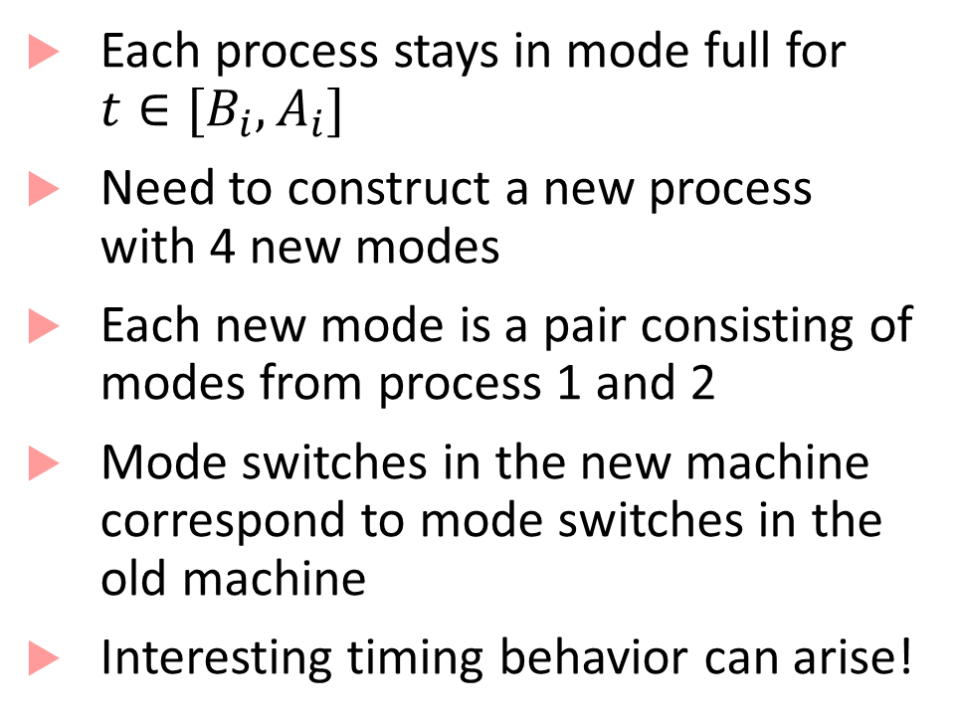


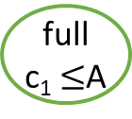

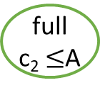

Composing Timed Processes
Each process stays in mode full for $t∈[B_{i}, A_{i}]$
Need to construct a new process with 4 new modes
Each new mode is a pair consisting of modes from process 1 and 2
Mode switches in the new machine correspond to mode switches in the old machine
Interesting timing behavior can arise!
c₁$≥$B₁ $→$ out₁:=x₁, x₁≔$∅$
c₁:=0
empty
full
c₁ $≤$A
in?$→$ x₁:=in, c₁:=0
c₂$≥$B₂ $→$ out₂:=x₂, x₂≔$∅$
c₂:=0
empty
full
c₂ $≤$A
in?$→$ x₂:=in, c₂:=0

Slide 16
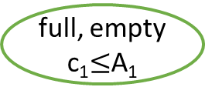
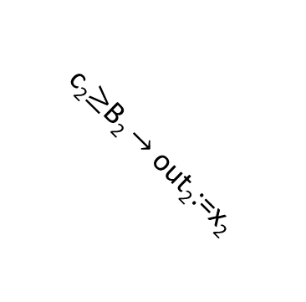


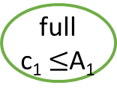
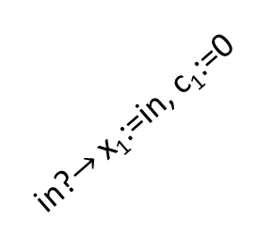

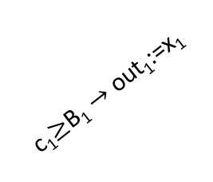
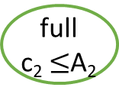

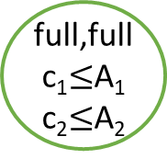
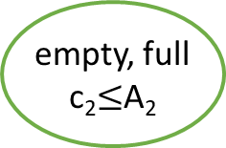

Composing Timed Processes
c₁$≥$B₁ $→$ out₁:=x₁
in?
full, empty
c₁$≤$A₁
c₁:=0
empty
full
c₁ $≤$A₁
c₂$≥$B₂ $→$ out₂:=x₂
c₁$≥$B₁ $→$ out₁:=x₁
in?$→$ x₁:=in, c₁:=0,
x₂:=in, c₂:=0
full,full
c₁$≤$A₁
c₂$≤$A₂
in?$→$ x₁:=in, c₁:=0
empty,
empty
in?
c₂$≥$B₂ $→$ out₂:=x₂
in?
c₁$≥$B₁ $→$ out₁:=x₁
c₂:=0
empty
full
c₂ $≤$A₂
c₂$≥$B₂ $→$ out₂:=x₂
in?$→$ x₁:=in, c₁:=0
empty, full
c₂$≤$A₂
in?$→$ x₂:=in, c₂:=0
in?

Slide 17
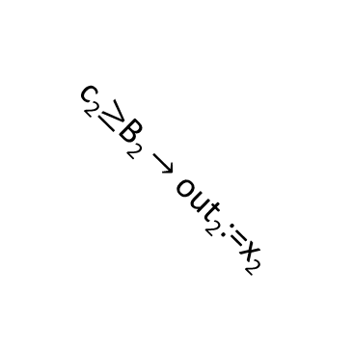
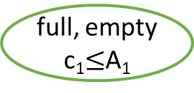

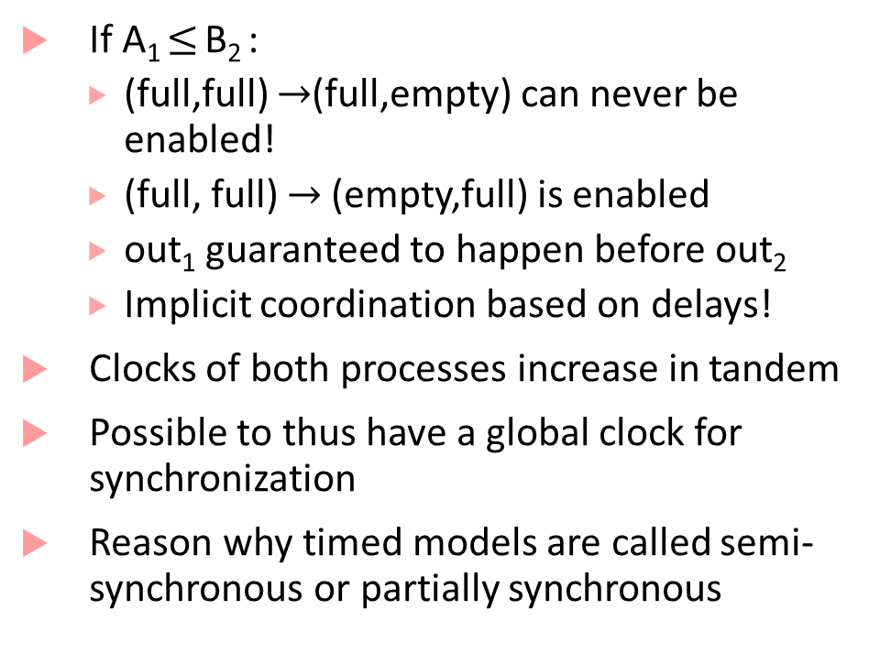
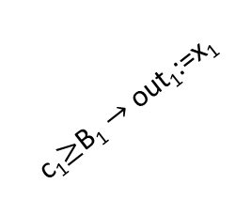
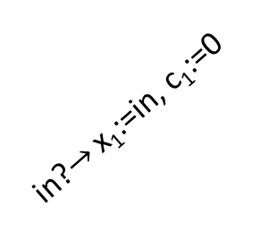
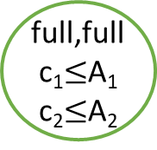


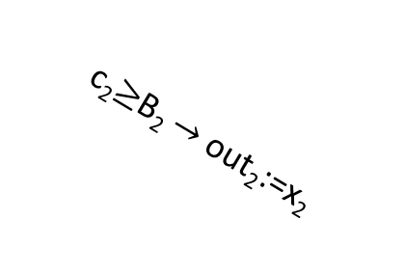
Semi-synchrony
If A₁ $≤$ B₂ :
(full,full) $→$(full,empty) can never be enabled!
(full, full) $→$ (empty,full) is enabled
out₁ guaranteed to happen before out₂
Implicit coordination based on delays!
Clocks of both processes increase in tandem
Possible to thus have a global clock for synchronization
Reason why timed models are called semi-synchronous or partially synchronous
full, empty
c₁$≤$A₁
c₂$≥$B₂ $→$ out₂:=x₂
c₁$≥$B₁ $→$ out₁:=x₁
in?$→$ x₁:=in, c₁:=0,
x₂:=in, c₂:=0
full,full
c₁$≤$A₁
c₂$≤$A₂
empty,
empty
in?
c₁$≥$B₁ $→$ out₁:=x₁
c₂$≥$B₂ $→$ out₂:=x₂
in?$→$ x₁:=in, c₁:=0
empty, full
c₂$≤$A₂
in?

Slide 18
Pacemaker Modeling as a Timed Process
Most material that follows is from this paper:
Z. Jiang, M. Pajic, S. Moarref, R. Alur, R. Mangharam, Modeling and Verification of a Dual Chamber Implantable Pacemaker, In Proceedings of Tools and Algorithms for the Construction and Analysis of Systems (TACAS), 2012.
The textbook has detailed descriptions of some other pacemaker components

Slide 19
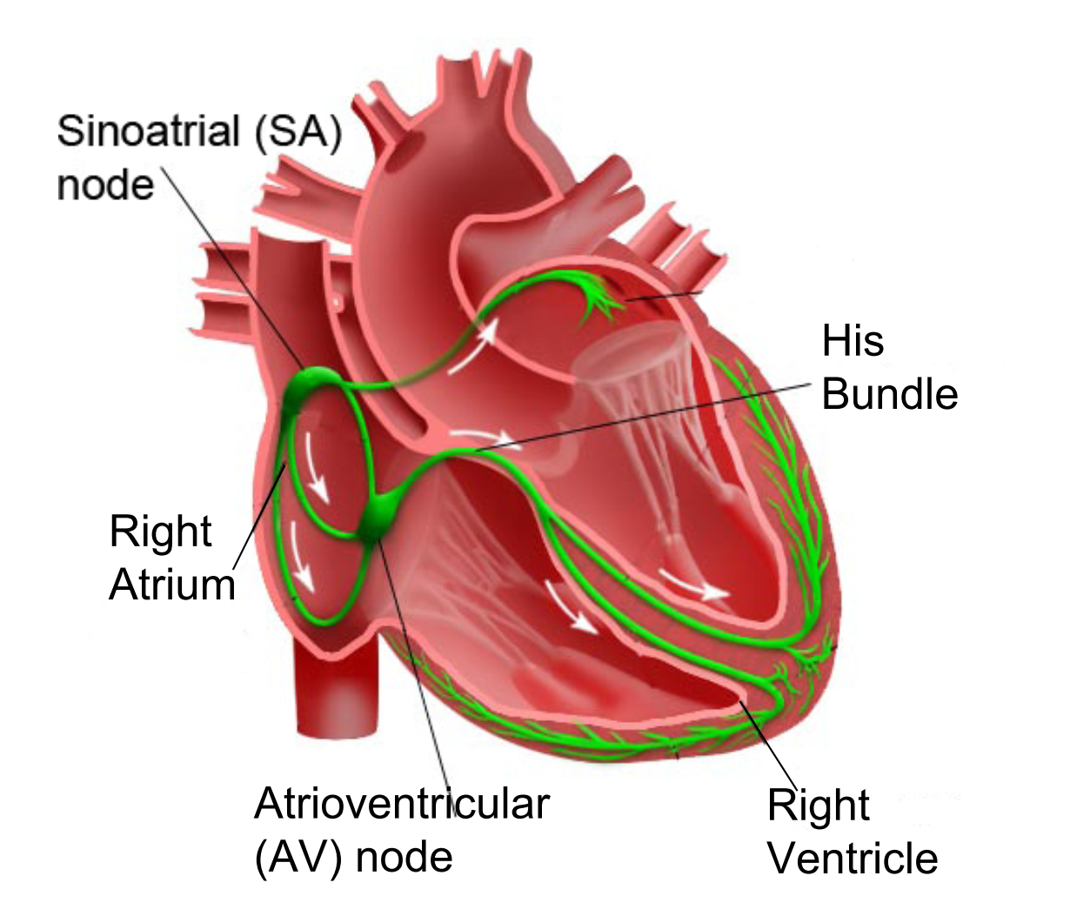
How does a healthy heart work?
SA node (controlled by nervous system) periodically generates an electric pulse
This pulse causes both atria to contract pushing blood into the ventricles
Conduction is delayed at the AV node allowing ventricles to fill
Finally the His-Pukinje system spreads electric activation through ventricles causing them both to contract, pumping blood out of the heart
Electrical Conduction System of the Heart

Slide 20
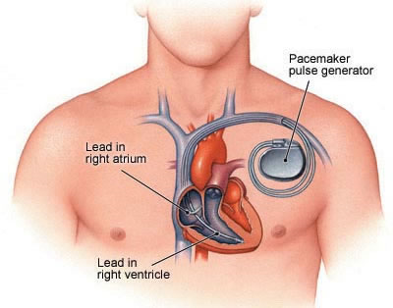
What do pacemakers do?
Aging and/or diseases cause conduction properties of heart tissue to change leading to changes in heart rhythm
Tachycardia: faster than desirable heart rate impairing hemo-dynamics (blood flow dynamics)
Bradycardia: slower heart rate leading to insufficient blood supply
Pacemakers can be used to treat bradycardia by providing pulses when heart rate is low

Slide 21
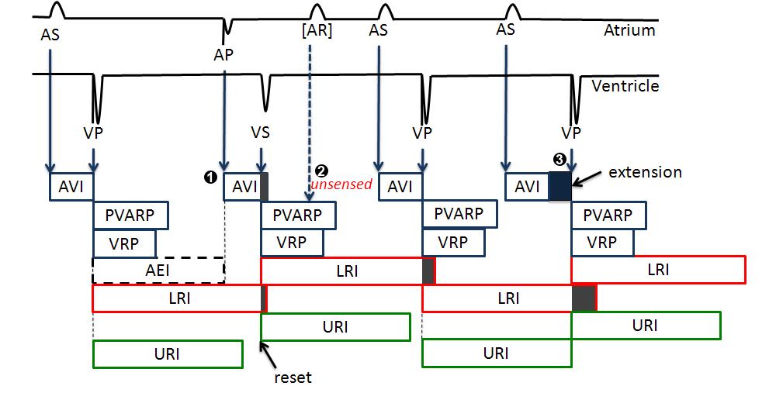
Implantable Pacemaker modeling

Slide 22
How dual-chamber pacemakers work
Two fixed leads on wall of right atrium and ventricle respectively
Activation of local tissue sensed by the leads (giving rise to events Atrial Sense (AS) and Ventricular Sense (VS))
Atrial Pacing (AP) or Ventricular Pacing (VP) are delivered if no sensed events occur within deadlines
Heart
AS
Pacemaker
VS
AP
VP

Slide 23
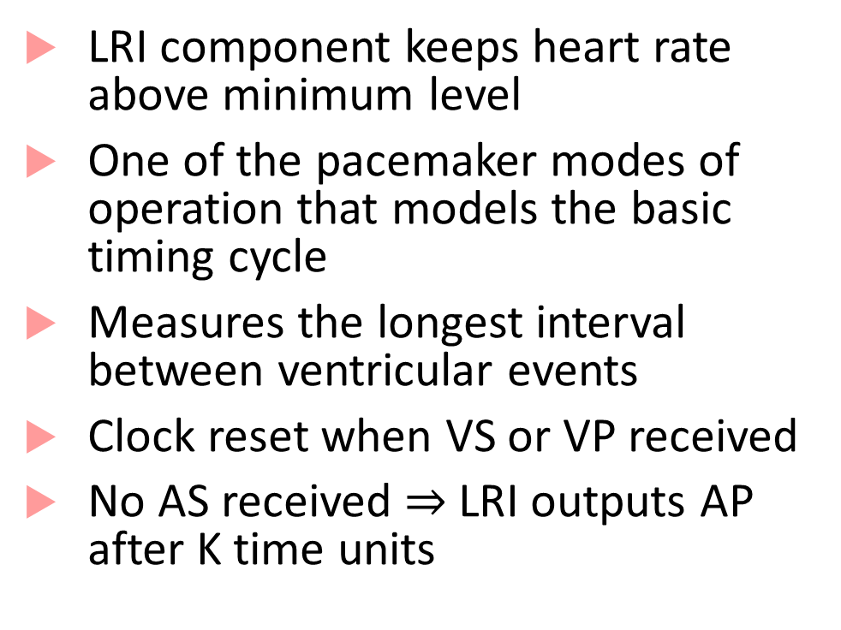


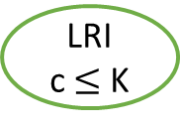



The LRI mode of operation explained
LRI component keeps heart rate above minimum level
One of the pacemaker modes of operation that models the basic timing cycle
Measures the longest interval between ventricular events
Clock reset when VS or VP received
No AS received $⇒$LRI outputs AP after K time units
VP? $→$ c:=0
AS?
ASed
VP? $→$ c:=0
LRI
c $≤$ K
VP? $→$ c:=0
VS? $→$ c:=0
c $≥$ K $→$AP!; c:=0
K= 850ms

Slide 24
Finite State Automata: A 3-slide introduction

Slide 25

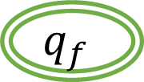







Finite state automata
Famous equivalence between finite state automata and regular expressions
$$A_{1}$$
$$A_{2}$$
$$q_{0}$$
$$q_{f}$$
$$q_{0}$$
$$q_{f}$$
a-z
a-z
a-z,0-9
0-9
a-z
$$q_{1}$$
$$q_{1}$$
$$q_{r}$$
State
0-9
[a-z][a-z 0-9 ]
*
Accepting
state
[a-z][0-9]*[a-z]

Slide 26






How does a finite state automaton work?
Starts at the initial state $q_{0}$
In $q_{0}$, if it receives a letter in a-z, goes to $q_{1}$
else, it goes to $q_{r}$
In $q_{1}$, if it receives a number in 0-9, it stays in $q_{1}$
else, it goes to $q_{f}$ (as it received a-z)
In $q_{r}$, no matter what it gets, it stays in $q_{r}$
$q_{f}$ is an accepting state where computation halts
Any string that takes the machine from $q_{0}$ to $q_{f}$ is accepted by the machine
$$A_{2}$$
$$q_{0}$$
$$q_{f}$$
a-z
0-9
a-z
$$q_{1}$$
$$q_{r}$$
0-9
*

Slide 27

Language of a finite state automaton
What strings are accepted by $A_{2}$?
ab, zy, s2r, q123s, u3123123v, etc.
What strings are not accepted by $A_{2}$?
2b, 334a, etc.
The set of all strings accepted by $A_{2}$ is called its language
The language of a finite state automaton consists of strings, each of which can be arbitrarily long, but finite
$$A_{2}$$
$$q_{0}$$
$$q_{f}$$
a-z
0-9
a-z
$$q_{1}$$
$$q_{r}$$
0-9
*

Slide 28
Timed Automata
Useful tool to do timing analysis and explore properties of timed processes
State-space of timed automata is infinite (clocks can become arbitrarily large!)
But some questions about timed automata behavior can still be answered exactly
Does the automaton accept any string? (also known as emptiness problem)
Reachability of a particular configuration

Slide 29


Timing Analysis
D
(y >= 6)?
Which of D, E, F can be reached?
Needs careful propagation of reachable combinations of x and y
x,y:=0
A
x<=5
x>=3 → y:=0
B
x<=7
(y >= 2)?
C
x$≤$8
y $≤$5
(x <= 4)?
E
(x = 7)?
x $∈\left[3,5\right]$, y $=0$ when we reach B
x $∈\left[3,7\right],$ y $∈[2,∞)$ when we reach C
x $∈[3,8]$, y $∈$ $[2,5]$ when you exit C
OR x $∈\left[3,8\right],$ y $≥5$ and machine stops
F

Slide 30
How is such analysis done?
The key challenge is that if the automata has loops, then how do we know that our procedure for propagation of symbolic clock constraints will terminate?
The key insight by first papers on timed automata was that there is only a finite number of regions in the clock-space that can be visited
This gives a “pumping lemma” style argument*
Allows abstracting a finite timed automaton to an automaton where modes/states represent the regions
This was expensive, and improved by using zone-based constructions
(zones are a uniform representation of constraints that arise during analysis)

Slide 31
Dynamical System Models

Slide 32
Dynamical Systems
Most natural model for describing most physical systems
Continuous/discrete systems that continuously evolve over time
Convenient to model such systems with differential equations
Typically consist of physical quantities modeled as state variables
Pressure, Temperature, Velocity, Acceleration, Current, Voltage, etc.
Could include algebraic relations between state variables
Execution semantics similar to synchronous models, but with continuous-time semantics instead of discrete-time

Slide 33
Continuous-time Component (Algebraic)
real x
real error
error = (x – x_{ref})
real x_{ref}
Input variables: x and x_{ref} of type real, Output variable: error of type real
No state variables
Signals: Assignments of values to variables as a function of time
At each time t, error(t) = x(t) – x_{ref}(t)
Input/Output relation expressed algebraically instead of as an assignment

Slide 34

Model of a simple car
Force $F$
Position $x$
Velocity $v$
Friction $kv$
Newton’s law of motion: $F −kv=m\frac{d^{2}x}{dt^{2}};v=\frac{dx}{dt}$

Slide 35
Continuous-time component (differential)
real $x_{low}≤x≤x_{high}$
$$x$$
Rate of change of each state variable and output variables defined using expressions over inputs and states
$$F$$
real $v_{low}≤v≤v_{high}$
$$v$$
$$m\frac{d^{2}x}{dt^{2}}= F −kv$$
$v=\frac{dx}{dt}$
$$\dot{x}=v$$
$$\dot{v}=\frac{F−kv}{m}$$
Expressions, not assignments!

Slide 36

Executions of Car
Let $𝕋$ represent a set representing time instants, i.e. $𝕋⊆ℝ^{≥0}$
Input Signal: Function $F$ from $𝕋→ℝ$
Input signal is assumed to be continuous or piecewise-continuous
Given an initial state $(x_{0},v_{0})$ and an input signal $F(t)$, the execution of the system is defined by state-trajectories $x\left(t\right)$ and $v\left(t\right)$ (from $𝕋$ to $ℝ$) that satisfy the initial-value problem:
$x\left(0\right)=x_{0}$; $v\left(0\right)=v_{0}$
$\dot{x}=v\left(t\right);\dot{v}=\frac{F\left(t\right)−kv\left(t\right)}{m}$

Slide 37
Sample Execution of Car
Suppose $∀t:F\left(t\right)=0, x_{0}=5 m, v_{0}=20 m/s$. Then, we need to solve:
$x\left(0\right)=5;v\left(0\right)=20$
$\dot{x}=v$;$\dot{v}=−\frac{kv}{m}$
Solution to above differential equation (solve for $v$ first, then $x$):
$v\left(t\right)=v_{0}e^{−\frac{kt}{m}}$; $x\left(t\right)=\frac{mv_{0}}{k}\left(1−e^{−\frac{kt}{m}}\right)$
Note, as $t→∞$, $v\left(t\right)→0$, and $x\left(t\right)→\frac{mv_{0}}{k}$
$$m=1000kg$$
$$k=50Ns/m$$

Slide 38

Simulink and Breach Brief Demo
Plot of Signals vs. Time

Slide 39

Simulink and Breach Demo
Plot in phase-space or state-space.
Shows trajectory of states starting from $x_{0}=5$, $v_{0}=20$

Slide 40
Sample Execution of Car with constant force
Suppose $∀t:F\left(t\right)=500 N, x_{0}=5 m,v_{0}=20 m/s$. Then, we need to solve:
$x\left(0\right)=0;v\left(0\right)=v_{0}$
$\dot{x}=v$;$\dot{v}=−\frac{kv}{m}$
Solution to above differential equation (solve for $v$ first, then $x$):
Compute solution using Simulink/Matlab/Breach
$$m=1000kg$$
$$k=50Ns/m$$

Slide 41


Plots
Phase Plot
Input/Output Signals

Slide 42
Continuous-Time Component Definition
Set $I$ of real-valued input variables
Set $O$ or real-valued output variables
Set $X$ of real-valued (continuous) state variables
Initialization $Init$ specifying a set $X_{0}$of initial values for states
Dynamics: for each state variable, $x$, a real valued expression $f$ over $I$ and $X$
Output Function: for each output variable, $y$, a real valued expression $h$ over $I$ and $X$.

Slide 43
Execution Definition
Convention: $x=\left(x_{1},x_{2},…x_{n}\right), y=(y_{1},y_{2},…,y_{m})$
Given an input signal $u:𝕋→ℝ$, an execution consists of a differentiable state signal $x\left(t\right)$, and an output signal $y\left(t\right),$such that:
$x\left(0\right)∈X_{0}$
For each output variable $y$ and time t, $y\left(t\right)=h\left(u\left(t\right), x\left(t\right)\right)$
For each state variable $x$, $\frac{d}{dt}x\left(t\right)=f(u\left(t\right), x\left(t\right))$
$$\dot{x}=f\left(x,u\right)$$
$$y=h(x,u)$$

Slide 44
Existence and Uniqueness of Solutions
Given an input signal $u(t)$, when are we guaranteed that the system has at least one execution? Is there nondeterminism in continuous-time components?
Input signal should be piecewise-continuous, and additional conditions need to be imposed on the RHS of dynamics $(f)$ and output functions $(h)$
Related to solutions for the initial value problem in the classical theory of ODEs
$$\dot{x}=f\left(x,u\right)$$
$$y=h(x,u)$$

Slide 45
Existence
There exists at least one solution $x(t)$ if the function $f$ is continuous
Definition of continuity uses notion of distance between points
Euclidean distance: $d\left(x,y\right)={\left\|x−y\right\|}_{2}= \sqrt{{\left(x_{1}−y_{1}\right)}^{2}+…+{\left(x_{n}−y_{n}\right)}^{2}}$
$f$ is uniformly continuous if for all $ε>0$, there exists a $δ>0$, such that for all $x,y∈ℝ^{n}$, if ${\left\|x−y\right\|}_{2}<δ$, then ${\left\|f\left(x\right)−f\left(y\right)\right\|}_{2}<ε$.
Example when solution does not globally exist:
$\frac{dx}{dt}= \left\{\begin{aligned}1 if x=0 \\ 0 otherwise\end{aligned}\right.$
$$\dot{x}=f\left(x,u\right)$$
$$y=h(x,u)$$

Slide 46
Uniqueness
Solution to initial value problem is unique if $f$ is Lipschitz continuous
Lipschitz-continuity is a stronger version of continuity: upper bounds how fast a function can change
Function $f$ is Lipschitz-continuous if there exists a constant $L$ (called the Lipschitz constant) such that:
$$∀x,y∈ℝ^{n}:\left\|f\left(x\right)−f\left(y\right)\right\|≤L\left\|x−y\right\|$$
Examples:
Linear functions (e.g. $x_{1}−3x_{2}$) are Lipschitz continuous
Functions: $x^{2}$, $\sqrt{x}$ are not Lipschitz continuous over $ℝ^{n}$
Can restrict $𝕋$ and $X$ to some bounded and closed set such that $f$ is piecewise-continuous and Lipschitz to get unique solutions over such compact domains
$$\dot{x}=f\left(x,u\right)$$
$$y=h(x,u)$$

Slide 47
What do Matlab/Simulink do?
Allow modeling arbitrarily complex functions: even functions with unbounded discontinuities
May not be even possible to check for Lipschitz conditions for what’s implemented in a Matlab function/Simulink model
Rely on numerical integration schemes/solvers to obtain solutions
ode45, ode23, ode15, etc.
We assume that any continuous component model we will use can be numerically simulated by Matlab/Simulink

Slide 48
Linear Systems
Equation of simple car dynamics can be written compactly as:
$\left[\begin{matrix}\dot{x} \\ \dot{v}\end{matrix}\right]=\left[\begin{matrix}0 & 1 \\ 0 & −k/m\end{matrix}\right]\left[\begin{matrix}x \\ v\end{matrix}\right]+\left[\begin{matrix}0 \\ 1\end{matrix}\right][F]$
Letting $A=\left[\begin{matrix}0 & 1 \\ 0 & −k/m\end{matrix}\right], B=\left[\begin{matrix}0 \\ 1\end{matrix}\right]$, we can re-write above equation in the form:
$\dot{x}=Ax+Bu$, where $x=\left[\begin{matrix}x & v\end{matrix}\right]$, and $u=\left[F\right]$

Slide 49
Linear Components
Linear components model linear systems
$f$ is of the form $a_{1}x_{1}+a_{2}x_{2}+…+a_{n}x_{n}$ or compactly, $f=Ax$
$h$ is of the form $b_{1}u_{1}+b_{2}u_{2}+…+b_{m}u_{m}$ or compactly, $h=Bu$
Linear algebra was invented to reason about linear systems!
Linear systems have many nice properties:
Many analysis methods in the frequency domain (using Fourier/Laplace transform methods)
Superposition principle (net response to two or more stimuli is the sum of responses to each stimulus)

Slide 50
Solutions to Linear Systems
Autonomous linear system has no inputs: $\dot{x}=Ax$
Solution of autonomous linear system can be fully characterized:
$x\left(t\right)=e^{At}x_{0}$
$e^{A}$ is a matrix exponential = $I+A+\frac{A^{2}}{2!}+\frac{A^{3}}{3!}+\frac{A^{4}}{4!}+ …$
$e^{A}$ is usually approximated to the first $k$ terms
Computing $e^{A}$ is easy if $A$is a diagonal matrix (non-zero elements are only on the diagonal)
In practice, numerical integration methods outperform matrix exponential
For a linear system with exogenous inputs?
$x\left(t\right)=e^{At}x_{0}+\int_{0}^{t}{e^{A\left(t−τ\right)}Bu\left(τ\right)dτ}$

Slide 51
Stability of Systems
Property capturing the ability of a system to return to a quiescent state after perturbation
Stable systems recover after disturbances, unstable systems may not
Almost always a desirable property for a system design
Fundamental problem in control: design controllers to stabilize a system
Problem: Inverted Pendulum on a moving cart is inherently unstable, aim: keep it upright
Solution Strategy: Move cart in direction in the same direction as the pendulum’s falling direction
Design problem: Design a controller to stabilize the system by computing velocity and direction for cart travel

Slide 52
Lyapunov stability
$$x^{∗}$$
$$x(0)$$
System $\dot{x}=f\left(x\right)$
Equilibrium point when $f\left(x\right)$ is zero (say $x^{∗})$
Equilibrium point $x^{∗}$ is Lyapunov-stable if:
For every $ε>0$,
There exists a $δ>0$, such that
if $\left\|x\left(0\right)−x^{∗}\right\|<δ,$ then,
for every $t≥0,$ we have $\left\|x\left(t\right)−x^{∗}\right\|<ε$
$ε$-ball
$δ$-ball

Slide 53
Asymptotic + Exponential Stability
System $\dot{x}=f\left(x\right)$
Equilibrium point $x^{∗}$ is asymptotically-stable if:
$x^{∗}$ is Lyapunov-stable +
There exists $δ>0$ s.t. if $\left\|x\left(0\right)−x^{∗}\right\|<δ$, then $\lim_{t→∞}{‖x\left(t\right)−x^{∗}‖}=0$
Equilibrium point $x^{∗}$ is exponentially-stable if:
$x^{∗}$is asymptotically stable +
There exist $α>0,β>0$ s.t. if $\left\|x\left(0\right)−x^{∗}\right\|<δ$, then for all $t≥0:$
$$\left\|x\left(t\right)−x^{∗}\right\|≤α\left\|x\left(0\right)−x^{∗}\right\|e^{−βt}$$

Slide 54
What do these definitions all mean?
Lyapunov stable: solutions starting $δ$close from equilibrium point must remain close (within $ε)$ forever
Asymptotically stable: solutions not only remain close, but also converge to the equilibrium
Exponentially stable: solutions not only converge to the equilibrium, but in fact converge at least as fast as a known exponential rate
All stable linear systems are exponentially stable
This need not be true for nonlinear systems!

Slide 55
Analyzing stability for linear systems
Eigenvalues of a matrix $A$:
Value $λ$ satisfying the equation $Av=λv$. $v$ is called the eigenvector
Equivalent to saying: values satisfying $\left|A−λI\right|=0$, where $I$ is the identity matrix
Interesting result for linear systems: System $\dot{x}=Ax$ is asymptotically stable if and only if every eigenvalue of $A$ has a negative real part
Lyapunov stable if and only if every eigenvalue has non-positive real part
Nonlinear systems: no simple analysis technique exists
Next time we will look at Lyapunov’s methods, which allow reasoning about stability of nonlinear systems

Slide 56
Next lecture
Basics of linear control
Nonlinear control

