Slide 1
Autonomous Cyber-Physical Systems: Basics of Control
Fall 2025. CS 513.
Instructor: Jyo Deshmukh

Slide 2


Layout
Introduction to basics of linear control (without any Laplace transforms)
Introduction to nonlinear control and rule-based control
Introduction to observer design
Game 1
Game 2
2

Slide 3
What is control theory?
Engineering techniques and theory for control of dynamical systems
Objective:
Regulate system so that it behaves in desired fashion
Ensure timely action to changes in system behavior
Make sure control action does not cause system to … lose control

Slide 4
Model-based Design
Mathematical and visual method commonly used for design controllers
Development is manifested in four steps:
Create a dynamical system model of the plant
Design/synthesize a controller (model)
Simulate/test the closed-loop system for different environment (exogenous) inputs
Generate code from the controller model and deploy the controller

Slide 5
“Plant”
Terminology inherited from the (chemical) process industry
Can represent any physical component to be controlled, e.g. electrical, electronic, mechanical, etc.
Convenient to model such systems as ordinary differential equations (ODEs)
State variables of ODEs represent physical quantities, e.g. pressure, temperature, Velocity, acceleration, current, voltage, etc.

Slide 6



Open-loop vs. Closed-loop control
Open-loop or feed-forward control
Control action does not depend on plant
Common in many applications!
Pros:
Cheaper, few sensors required, logic pretty straightforward
Cons:
Quality of control poor without human intervention
Not adaptive!
$$i(t)$$
$$u(t)$$
$$y(t)$$
Controller
Plant

Slide 7


Closed-loop or Feedback Control
Controller adjusts controllable inputs in response to observed outputs
Can respond better to variations in disturbances
Performance depends on how well outputs can be sensed, and how quickly controller can track changes in output
Many different flavors of feedback control
$$ref(t)$$
$$u(t)$$
$$y(t)$$
Controller
Plant
$$∑$$

Slide 8
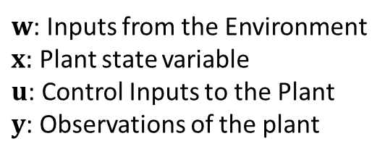
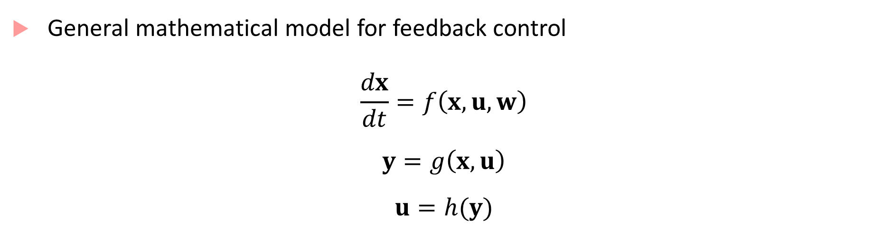
Feedback Control
General mathematical model for feedback control
$$\frac{dx}{dt}=f\left(x,u,w\right)$$
$$y=g\left(x,u\right)$$
$$u=h(y)$$
ODE representing time evolution of plant dynamics
$w$: Inputs from the Environment
$x:$ Plant state variable
$u$: Control Inputs to the Plant
$y$: Observations of the plant
Equation mapping plant states to observed plant
outputs
(Stateless) Feedback Control

Slide 9
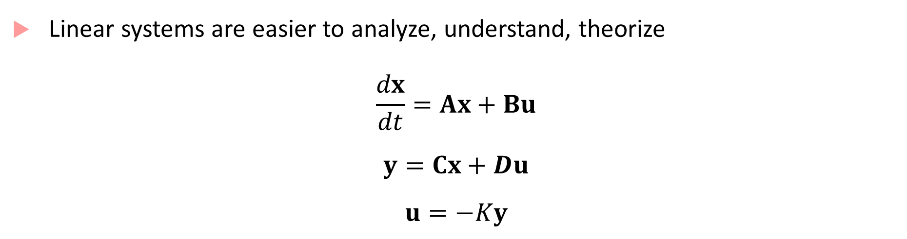
Linear Control
Linear systems are easier to analyze, understand, theorize
$$\frac{dx}{dt}=Ax+Bu$$
$$y=Cx+Du$$
$$u=−Ky$$

Slide 10
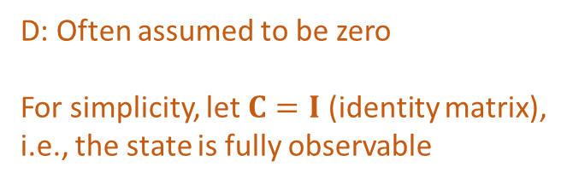

Linear Control
Linear systems are easier to analyze, understand, theorize
$$\frac{dx}{dt}=Ax+Bu$$
$$y=Cx+Du$$
$$u=−Ky$$
Above equations reduce to: $\dot{x}=Ax−BKx$
D: Often assumed to be zero
For simplicity, let $C=I$ (identity matrix),
i.e., the state is fully observable

Slide 11

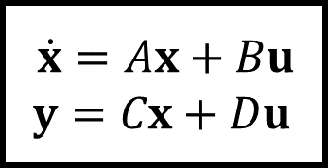



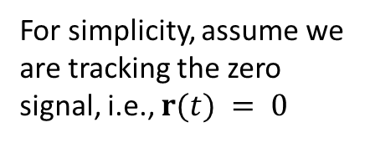

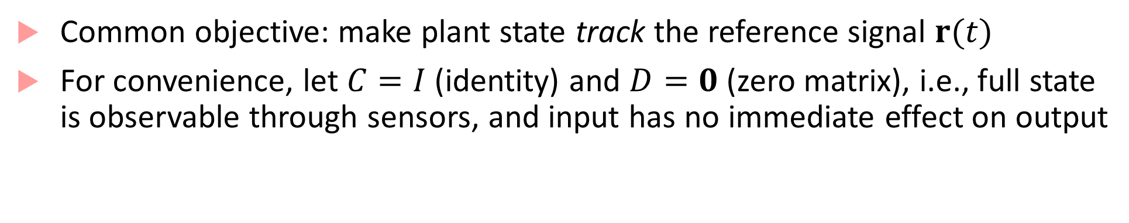
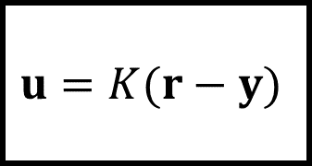

Simple Linear Feedback Control: Reference Tracking
$$r(t)$$
$$u=K(r−y)$$
$$u(t)$$
$\dot{x}=Ax+Bu$
$$y=Cx+Du$$
$$y(t)$$
$$∑$$
$$+$$
$$−$$
Controller
Plant
For simplicity, assume we are tracking the zero signal, i.e., $r(t) = 0$
Common objective: make plant state track the reference signal $r(t)$
For convenience, let $C=I$ (identity) and $D=0$ (zero matrix), i.e., full state is observable through sensors, and input has no immediate effect on output

Slide 12
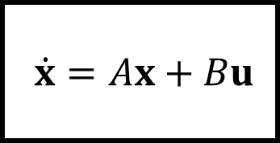

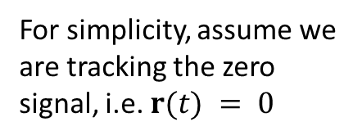
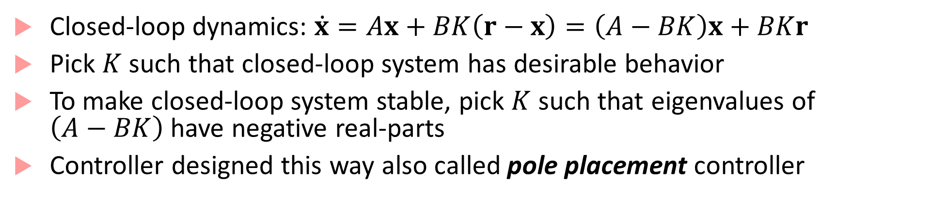
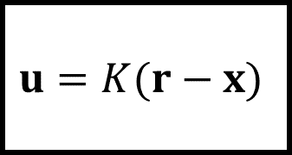
Simple Linear Feedback Control: Reference Tracking
$$r(t)$$
$$u=K(r−x)$$
$$u(t)$$
$\dot{x}=Ax+Bu$
$$x(t)$$
$$∑$$
$$+$$
$$−$$
Controller
Plant
For simplicity, assume we are tracking the zero signal, i.e. $r(t) = 0$
Closed-loop dynamics: $\dot{x}=Ax+BK\left(r−x\right)=\left(A−BK\right)x+BKr$
Pick $K$ such that closed-loop system has desirable behavior
To make closed-loop system stable, pick $K$ such that eigenvalues of $\left(A−BK\right)$ have negative real-parts
Controller designed this way also called pole placement controller

Slide 13



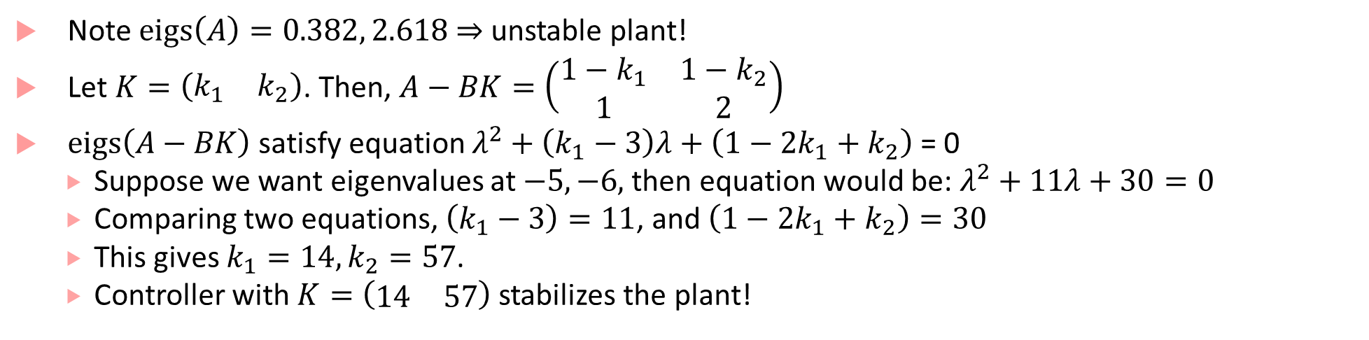

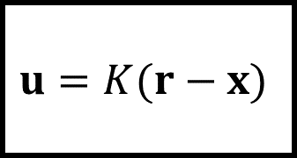

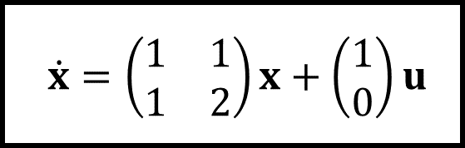

Designing a pole placement controller
$$r(t)$$
$$u=K(r−x)$$
$$u(t)$$
$\dot{x}=\left(\begin{matrix}1 & 1 \\ 1 & 2\end{matrix}\right)x+\left(\begin{matrix}1 \\ 0\end{matrix}\right)u$
$$x(t)$$
$$∑$$
$$+$$
$$−$$
Controller
Plant
Note $eigs\left(A\right)=0.382, 2.618$ $⇒$ unstable plant!
Let $K=\left(\begin{matrix}k_{1} & k_{2}\end{matrix}\right)$. Then, $A−BK=\left(\begin{matrix}1−k_{1} & 1−k_{2} \\ 1 & 2\end{matrix}\right)$
$eigs\left(A−BK\right)$ satisfy equation $λ^{2}+\left(k_{1}−3\right)λ+\left(1−2k_{1}+k_{2}\right)$ = 0
Suppose we want eigenvalues at $−5, −6,$ then equation would be: $λ^{2}+11λ+30=0$
Comparing two equations, $\left(k_{1}−3\right)=11$, and $\left(1−2k_{1}+k_{2}\right)=30$
This gives $k_{1}=14, k_{2}=57$.
Controller with $K=\left(\begin{matrix}14 & 57\end{matrix}\right)$ stabilizes the plant!

Slide 14
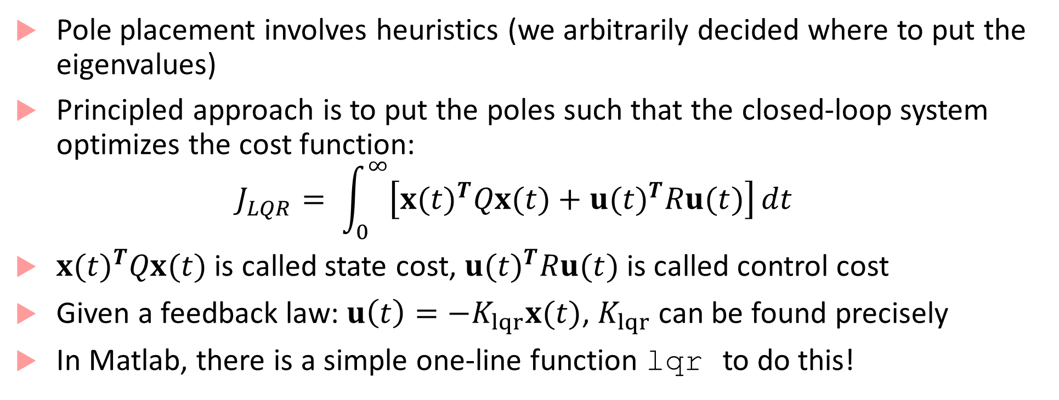
Linear Quadratic Regulator
Pole placement involves heuristics (we arbitrarily decided where to put the eigenvalues)
Principled approach is to put the poles such that the closed-loop system optimizes the cost function:
$$J_{LQR}= \int_{0}^{∞}{\left[{x(t)}^{T}Qx(t)+{u(t)}^{T}Ru(t)\right]}dt$$
${x(t)}^{T}Qx(t)$ is called state cost, ${u(t)}^{T}Ru(t)$ is called control cost
Given a feedback law: $u\left(t\right)=−K_{lqr}x(t)$, $K_{lqr}$ can be found precisely
In Matlab, there is a simple one-line function lqr to do this!

Slide 15
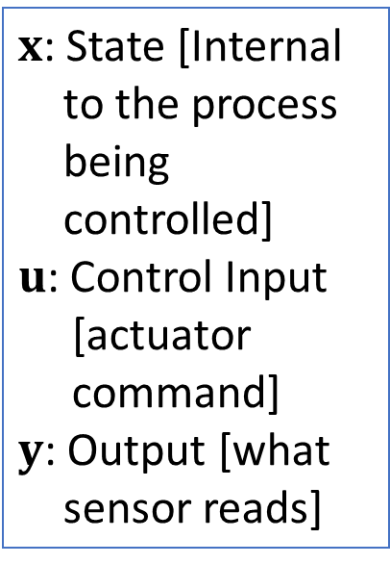
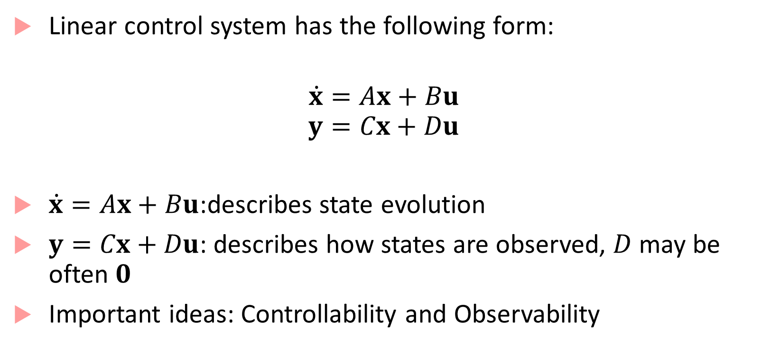
Linear Control System Basics
Linear control system has the following form:
$$\dot{x}=Ax+Bu$$
$$y=Cx+Du$$
$\dot{x}=Ax+Bu$:describes state evolution
$y=Cx+Du$: describes how states are observed, $D$ may be often $0$
Important ideas: Controllability and Observability
$x$: State [Internal to the process being controlled]
$u$: Control Input [actuator command]
$y$: Output [what sensor reads]

Slide 16
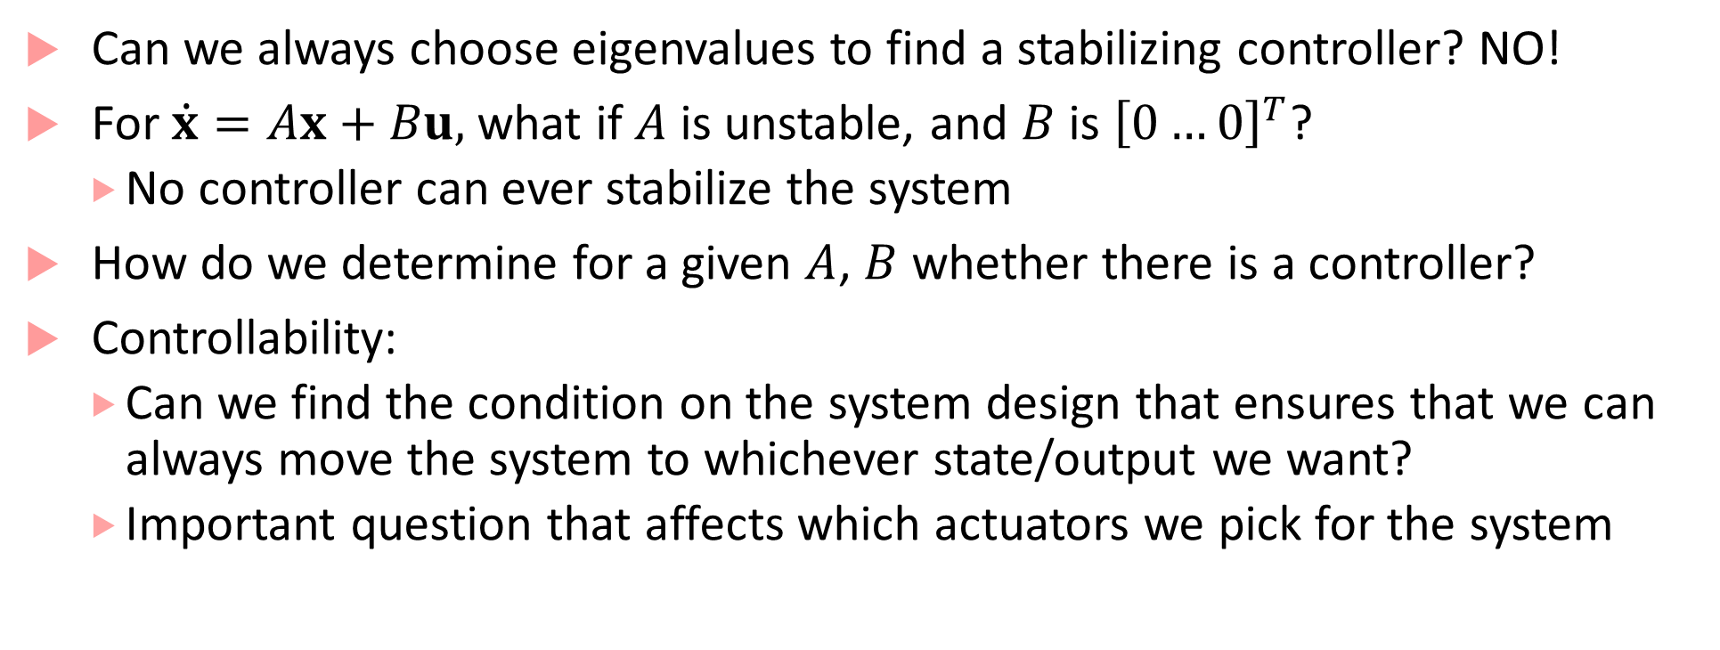
Controllability
Can we always choose eigenvalues to find a stabilizing controller? NO!
For $\dot{x}=Ax+Bu,$ what if $A$ is unstable, and $B$ is ${\left[0…0\right]}^{T}$?
No controller can ever stabilize the system
How do we determine for a given $A$, $B$ whether there is a controller?
Controllability:
Can we find the condition on the system design that ensures that we can always move the system to whichever state/output we want?
Important question that affects which actuators we pick for the system

Slide 17
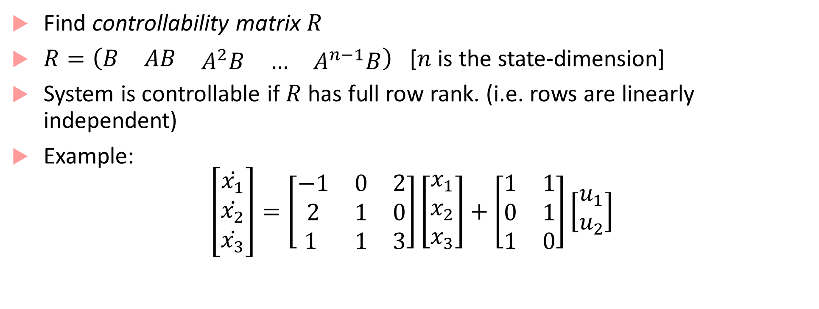
Checking Controllability
Find controllability matrix $R$
$R=\left(\begin{matrix}B & AB & \begin{matrix}A^{2}B & … & A^{n−1}B\end{matrix}\end{matrix}\right)$ [$n$ is the state-dimension]
System is controllable if $R$has full row rank. (i.e. rows are linearly independent)
Example:
$$\left[\begin{matrix}\dot{x_{1}} \\ \dot{x_{2}} \\ \dot{x_{3}}\end{matrix}\right]=\left[\begin{matrix}−1 & 0 & 2 \\ 2 & 1 & 0 \\ 1 & 1 & 3\end{matrix}\right]\left[\begin{matrix}x_{1} \\ x_{2} \\ x_{3}\end{matrix}\right]+\left[\begin{matrix}1 & 1 \\ 0 & 1 \\ 1 & 0\end{matrix}\right]\left[\begin{matrix}u_{1} \\ u_{2}\end{matrix}\right]$$

Slide 18

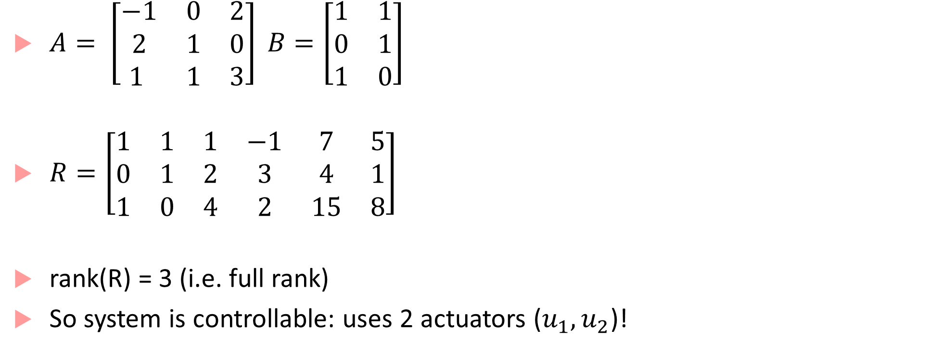


Checking Controllability
$A= \left[\begin{matrix}−1 & 0 & 2 \\ 2 & 1 & 0 \\ 1 & 1 & 3\end{matrix}\right] B=\left[\begin{matrix}1 & 1 \\ 0 & 1 \\ 1 & 0\end{matrix}\right]$
$R=\left[\begin{matrix}1 & 1 & 1 & −1 & 7 & 5 \\ 0 & 1 & 2 & 3 & 4 & 1 \\ 1 & 0 & 4 & 2 & 15 & 8\end{matrix}\right]$
rank(R) = 3 (i.e. full rank)
So system is controllable: uses 2 actuators ($u_{1},u_{2}$)!
$$B$$
$$AB$$
$$A^{2}B$$

Slide 19

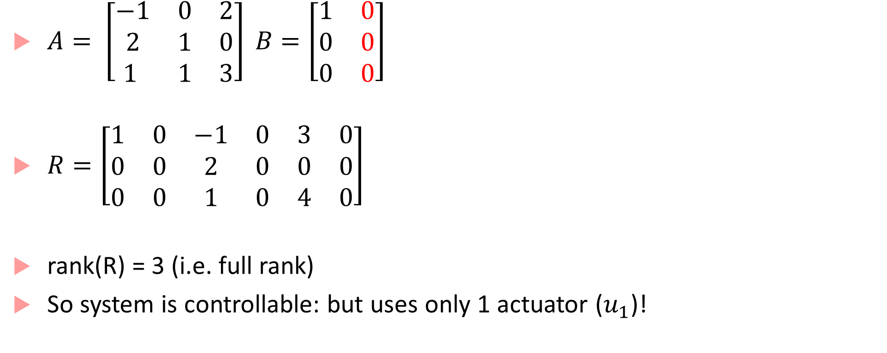
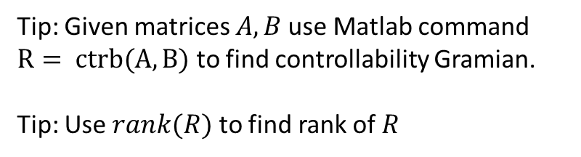


Checking Controllability
$A= \left[\begin{matrix}−1 & 0 & 2 \\ 2 & 1 & 0 \\ 1 & 1 & 3\end{matrix}\right] B=\left[\begin{matrix}1 & 0 \\ 0 & 0 \\ 0 & 0\end{matrix}\right]$
$R=\left[\begin{matrix}1 & 0 & −1 & 0 & 3 & 0 \\ 0 & 0 & 2 & 0 & 0 & 0 \\ 0 & 0 & 1 & 0 & 4 & 0\end{matrix}\right]$
rank(R) = 3 (i.e. full rank)
So system is controllable: but uses only 1 actuator ($u_{1}$)!
Tip: Given matrices $A,B$use Matlab command $R= ctrb(A,B)$ to find controllability Gramian.
Tip: Use $rank(R)$ to find rank of $R$
$$B$$
$$AB$$
$$A^{2}B$$

Slide 20
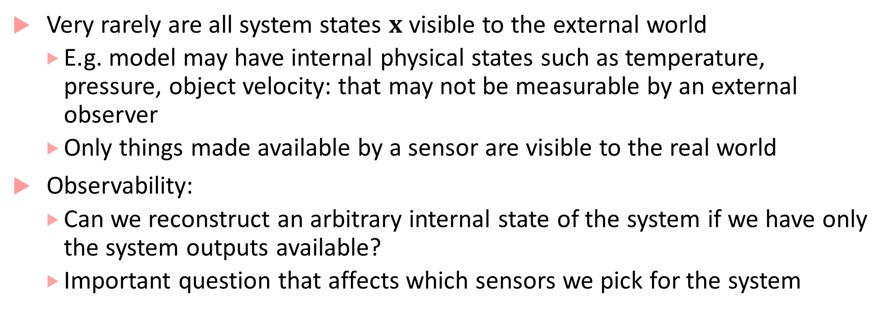
Observability
Very rarely are all system states $x$ visible to the external world
E.g. model may have internal physical states such as temperature, pressure, object velocity: that may not be measurable by an external observer
Only things made available by a sensor are visible to the real world
Observability:
Can we reconstruct an arbitrary internal state of the system if we have only the system outputs available?
Important question that affects which sensors we pick for the system

Slide 21
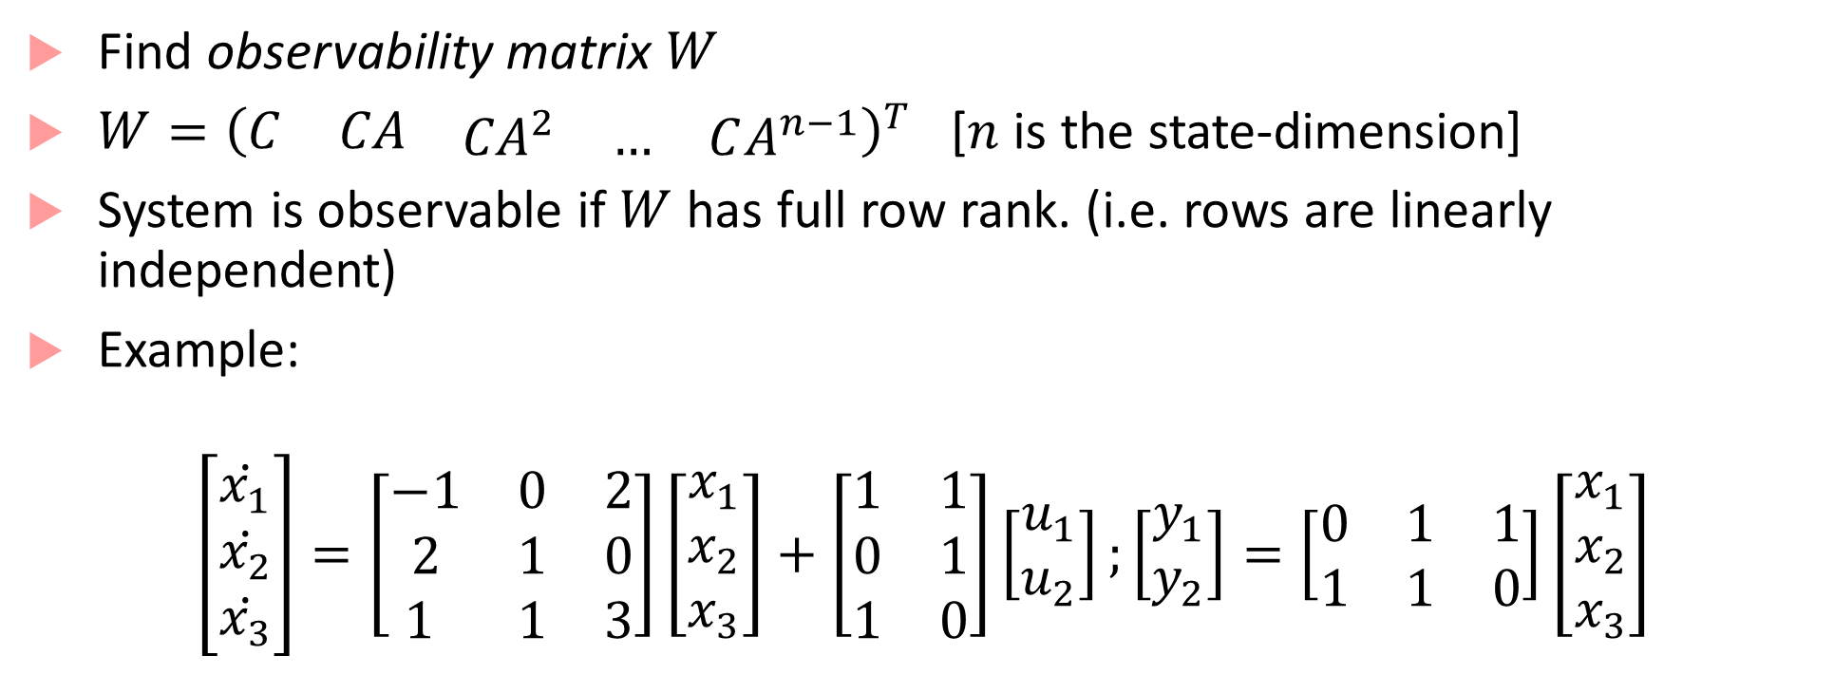
Checking Observability
Find observability matrix $W$
$W={\left(\begin{matrix}C & CA & \begin{matrix}{CA}^{2} & … & CA^{n−1}\end{matrix}\end{matrix}\right)}^{T}$ [$n$ is the state-dimension]
System is observable if $W$has full row rank. (i.e. rows are linearly independent)
Example:
$$\left[\begin{matrix}\dot{x_{1}} \\ \dot{x_{2}} \\ \dot{x_{3}}\end{matrix}\right]=\left[\begin{matrix}−1 & 0 & 2 \\ 2 & 1 & 0 \\ 1 & 1 & 3\end{matrix}\right]\left[\begin{matrix}x_{1} \\ x_{2} \\ x_{3}\end{matrix}\right]+\left[\begin{matrix}1 & 1 \\ 0 & 1 \\ 1 & 0\end{matrix}\right]\left[\begin{matrix}u_{1} \\ u_{2}\end{matrix}\right];\left[\begin{matrix}y_{1} \\ y_{2}\end{matrix}\right]=\left[\begin{matrix}0 & 1 & 1 \\ 1 & 1 & 0\end{matrix}\right]\left[\begin{matrix}x_{1} \\ x_{2} \\ x_{3}\end{matrix}\right]$$

Slide 22
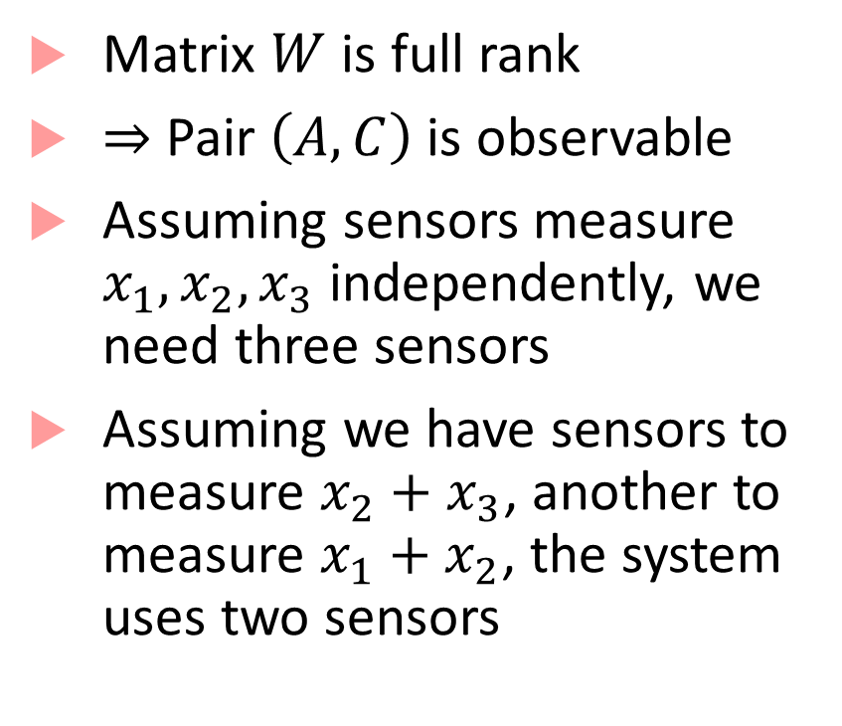
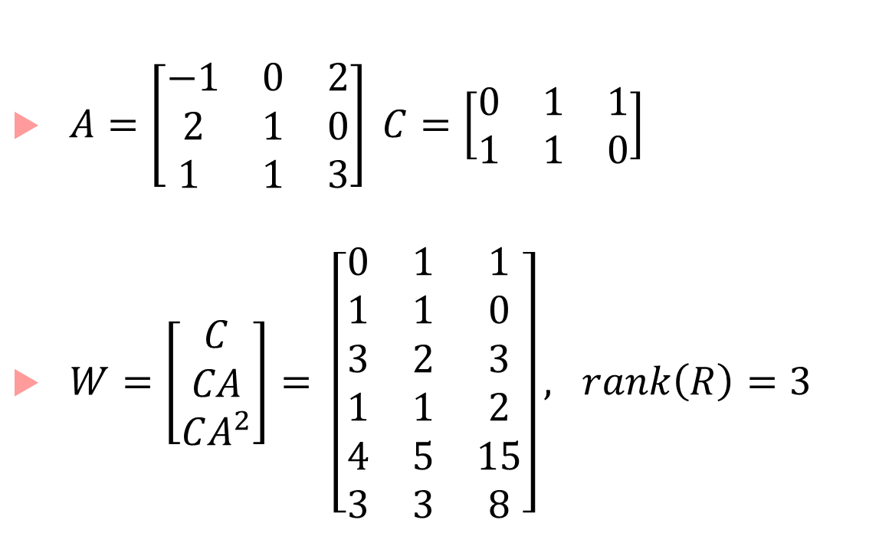
Checking Observability
$A=\left[\begin{matrix}−1 & 0 & 2 \\ 2 & 1 & 0 \\ 1 & 1 & 3\end{matrix}\right] C=\left[\begin{matrix}0 & 1 & 1 \\ 1 & 1 & 0\end{matrix}\right]$
$W=\left[\begin{matrix}C \\ CA \\ CA^{2}\end{matrix}\right]= \left[\begin{matrix}0 & 1 & 1 \\ 1 & 1 & 0 \\ 3 & 2 & 3 \\ 1 & 1 & 2 \\ 4 & 5 & 15 \\ 3 & 3 & 8\end{matrix}\right], rank\left(R\right)=3$
Matrix $W$ is full rank
$⇒$ Pair $\left(A,C\right)$ is observable
Assuming sensors measure $x_{1},x_{2},x_{3}$ independently, we need three sensors
Assuming we have sensors to measure $x_{2}+x_{3}$, another to measure $x_{1}+x_{2}$, the system uses two sensors

Slide 23
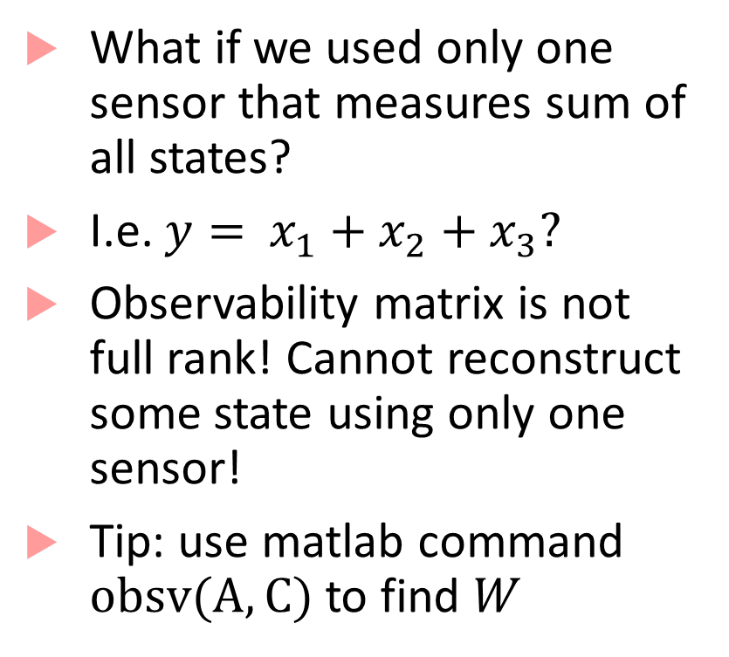
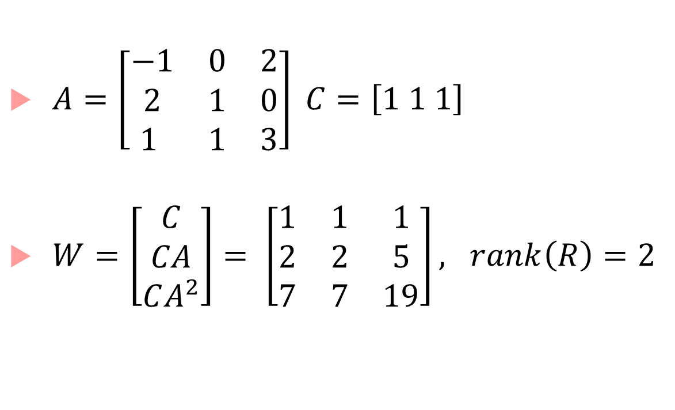
Checking Observability
$A=\left[\begin{matrix}−1 & 0 & 2 \\ 2 & 1 & 0 \\ 1 & 1 & 3\end{matrix}\right] C=\left[1 1 1\right]$
$W=\left[\begin{matrix}C \\ CA \\ CA^{2}\end{matrix}\right]= \left[\begin{matrix}1 & 1 & 1 \\ 2 & 2 & 5 \\ 7 & 7 & 19\end{matrix}\right], rank\left(R\right)=2$
What if we used only one sensor that measures sum of all states?
I.e. $y=$ $x_{1}+x_{2}+x_{3}?$
Observability matrix is not full rank! Cannot reconstruct some state using only one sensor!
Tip: use matlab command $obsv(A,C)$ to find $W$

Slide 24
How do we reconstruct internal state?
For linear systems (with no noise), this is done with the use of state estimators or observers
For linear systems with noisy measurements and possible “process noise” in the system itself we use Kalman filter: introduced later in the course
The most popular control method in the world started without any concerns of controllability, observability etc.
Purpose: Tracking a given reference signal

Slide 25

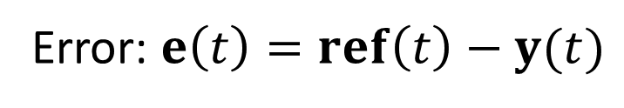

Reference Tracking
“Follow a line” or “Get system to the reference value”
$$ref(t)$$
$$y(t)$$
+
Controller
$$u(t)$$
Plant
$$∑$$
-
Error: $e\left(t\right)=ref\left(t\right)−y(t)$

Slide 26
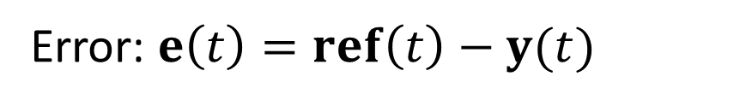
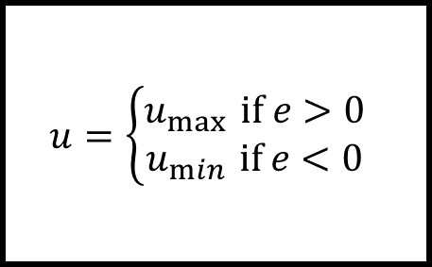




Simplest controller: On/Off
$$ref(t)$$
$$u=\left\{\begin{aligned}u_{\max{ }}if e>0 \\ u_{\min{ }}if e<0\end{aligned}\right.$$
Plant
+
$$u(t)$$
$$y(t)$$
$$∑$$
-
Error: $e\left(t\right)=ref\left(t\right)−y(t)$
Too much energy wasted jostling the system to and fro

Slide 27
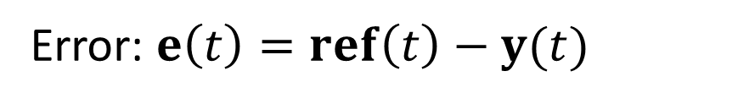
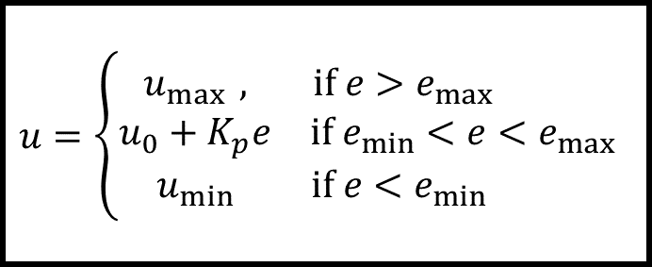


P controller (with control input saturation)
$$ref(t)$$
$$u=\left\{\begin{matrix}u_{\max{ }}, & if e>e_{max} \\ u_{0}+K_{p}e & if e_{min}<e<e_{max} \\ u_{min} & if e<e_{min} \end{matrix}\right.$$
Plant
+
$$u(t)$$
$$y(t)$$
$$∑$$
-
Error: $e\left(t\right)=ref\left(t\right)−y(t)$

Slide 28
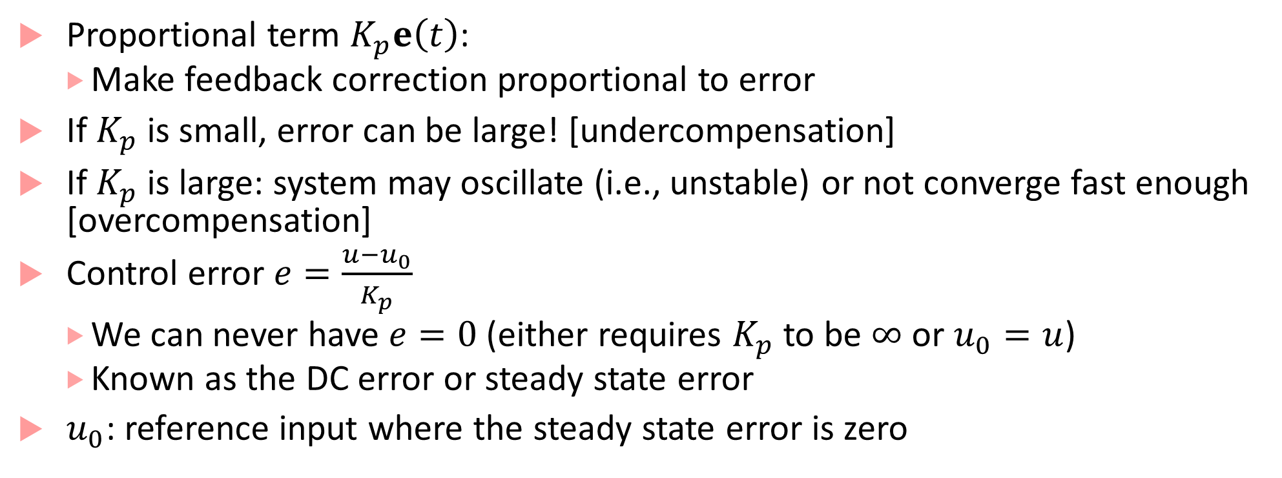
Ignoring saturation: P-only controller
Proportional term $K_{p}e\left(t\right)$:
Make feedback correction proportional to error
If $K_{p}$ is small, error can be large! [undercompensation]
If $K_{p}$ is large: system may oscillate (i.e., unstable) or not converge fast enough [overcompensation]
Control error $e=\frac{u−u_{0}}{K_{p}}$
We can never have $e=0$ (either requires $K_{p}$ to be $∞$ or $u_{0}=u$)
Known as the DC error or steady state error
$u_{0}$: reference input where the steady state error is zero

Slide 29
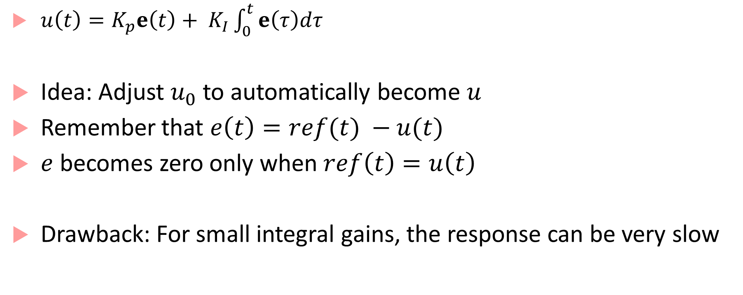
PI controller
$u\left(t\right)={K_{p}e\left(t\right)+ K}_{I}\int_{0}^{t}{e\left(τ\right)dτ}$
Idea: Adjust $u_{0}$ to automatically become $u$
Remember that $e\left(t\right)=ref(t) −u(t)$
$e$ becomes zero only when$ref\left(t\right)=u\left(t\right)$
Drawback: For small integral gains, the response can be very slow

Slide 30
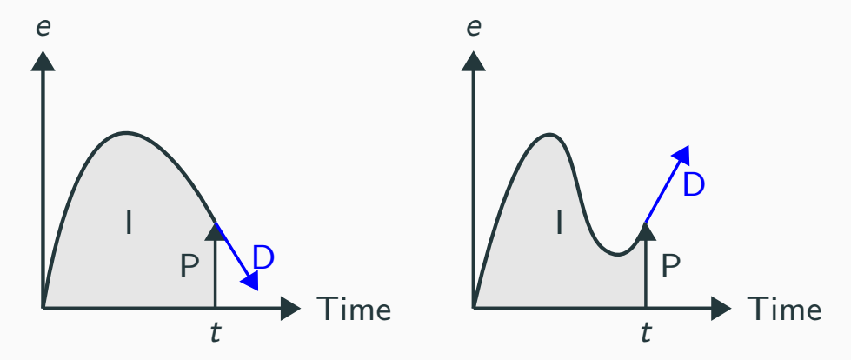
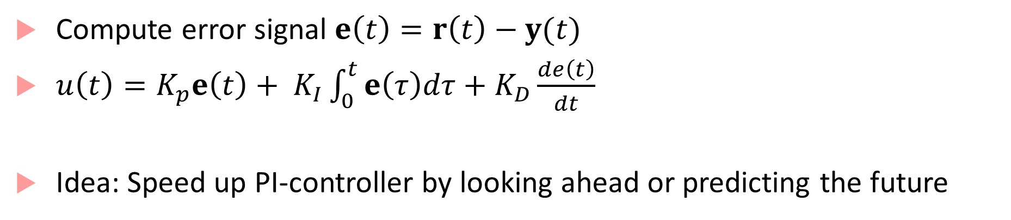
PID-controller
Compute error signal $e\left(t\right)=r\left(t\right)−y(t)$
$u\left(t\right)={K_{p}e\left(t\right)+ K}_{I}\int_{0}^{t}{e\left(τ\right)dτ}+K_{D}\frac{de\left(t\right)}{dt}$
Idea: Speed up PI-controller by looking ahead or predicting the future

Slide 31
PID controller
P part acts on the current error
I part acts on the past error
D part acts on the future or predicted error

Slide 32









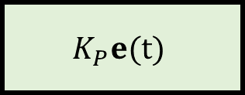
PID controllers
Architecture:
Controller
$$K_{P}e(t)$$
$$r(t)$$
$$y(t)$$
$$K_{I}\int_{0}^{t}{e\left(τ\right)dτ}$$
$$u(t)$$
$\dot{x}=Ax+Bu$
$$y=Cx+Du$$
$$∑$$
$$+$$
$$−$$
$$K_{D}\frac{de(t)}{dt}$$
Plant

Slide 33
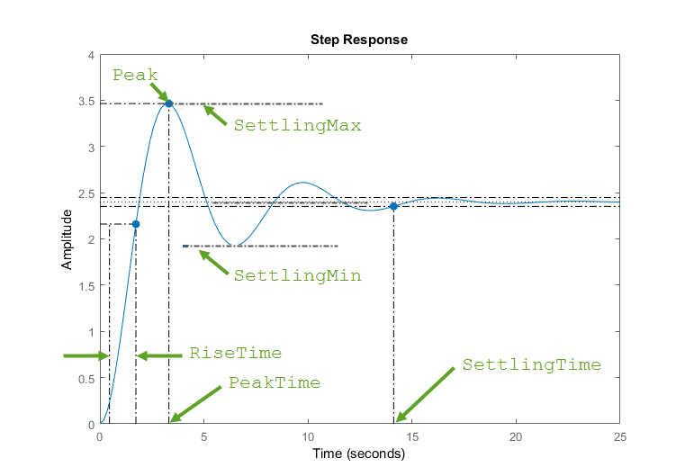
Measuring control performance
Typical to excite closed-loop system with a “step input”
I.e., sudden change in reference set-point
“Step” input of (say) 2.5 at time 0
Step Response in blue
Peak/Overshoot (corr. undershoot)
Settling Time/Settling Region
Rise Time
Peak Time
Steady State Error
Image © from Mathworks

Slide 34
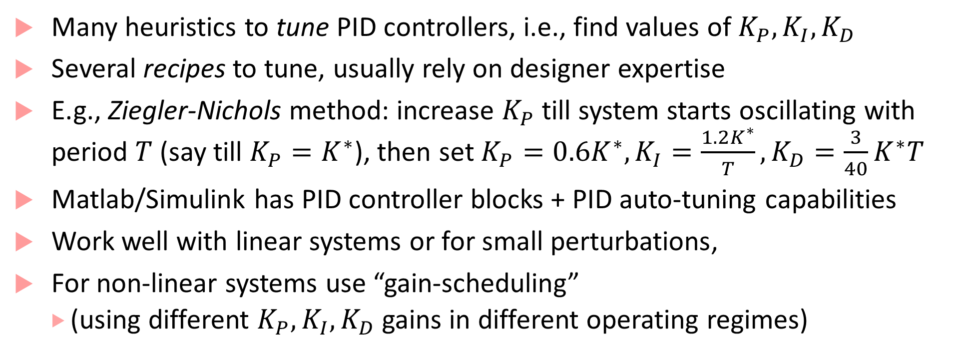
PID controller in practice
Many heuristics to tune PID controllers, i.e., find values of $K_{P},K_{I},K_{D}$
Several recipes to tune, usually rely on designer expertise
E.g., Ziegler-Nichols method: increase $K_{P}$ till system starts oscillating with period $T$ (say till $K_{P}=K^{∗}$), then set $K_{P}=0.6K^{∗}, K_{I}=\frac{1.2K^{∗}}{T},K_{D}=\frac{3}{40}K^{∗}T$
Matlab/Simulink has PID controller blocks + PID auto-tuning capabilities
Work well with linear systems or for small perturbations,
For non-linear systems use “gain-scheduling”
(using different $K_{P},K_{I},K_{D}$ gains in different operating regimes)

Slide 35
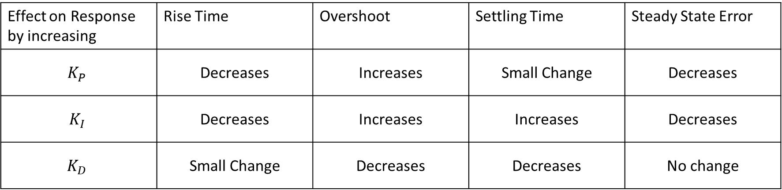
PID characteristics
Effect on Response by increasing | Rise Time | Overshoot | Settling Time | Steady State Error
$$K_{P}$$ | Decreases | Increases | Small Change | Decreases
$$K_{I}$$ | Decreases | Increases | Increases | Decreases
$$K_{D}$$ | Small Change | Decreases | Decreases | No change

Slide 36
Nonlinear Control

Slide 37


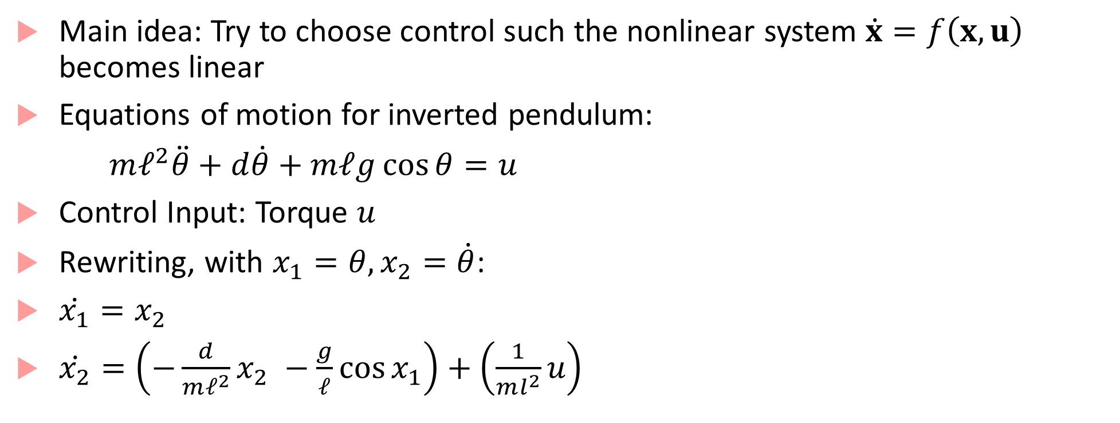



Feedback Linearization
Main idea: Try to choose control such the nonlinear system $\dot{x}=f\left(x,u\right)$ becomes linear
Equations of motion for inverted pendulum:
$mℓ^{2}\ddot{θ}+d\dot{θ}+mℓg\cos{θ}=u$
Control Input: Torque $u$
Rewriting, with $x_{1}=θ, x_{2}=\dot{θ}$:
$\dot{x_{1}}=x_{2}$
$\dot{x_{2}}=\left(−\frac{d}{mℓ^{2}}x_{2} −\frac{g}{ℓ}\cos{x_{1}}\right)+\left(\frac{1}{ml^{2}}u\right)$
$$mg\cos{θ}$$
$$mg$$
$$θ$$
$$ℓ$$
$$u$$

Slide 38
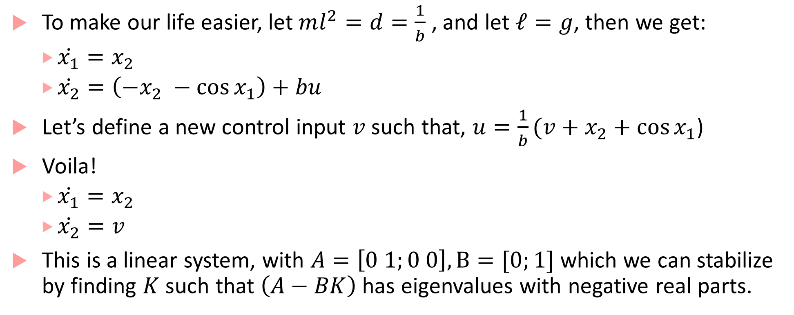
Feedback linearization continued
To make our life easier, let $ml^{2}=d=\frac{1}{b}$ , and let $ℓ=g$, then we get:
$\dot{x_{1}}=x_{2}$
$\dot{x_{2}}=\left(−x_{2} −\cos{x_{1}}\right)+bu$
Let’s define a new control input $v$ such that, $u=\frac{1}{b}(v+x_{2}+\cos{x_{1}}$)
Voila!
$\dot{x_{1}}=x_{2}$
$\dot{x_{2}}=v$
This is a linear system, with $A=\left[0 1;0 0\right], B=[0;1]$ which we can stabilize by finding $K$ such that $\left(A−BK\right)$ has eigenvalues with negative real parts.

Slide 39
Input Transformation
This operation is called input transformation, which leads to exact cancellation of a nonlinearity, giving rise to a linear equation
Also known as exact feedback linearization or dynamic inversion
Note that this is NOT the same as computing the Jacobian of the nonlinear system and trying to stabilize the resulting linear system at the origin (this would make the system stable only locally)
We are using feedback to linearize the system
Unfortunately, we cannot always do this

Slide 40

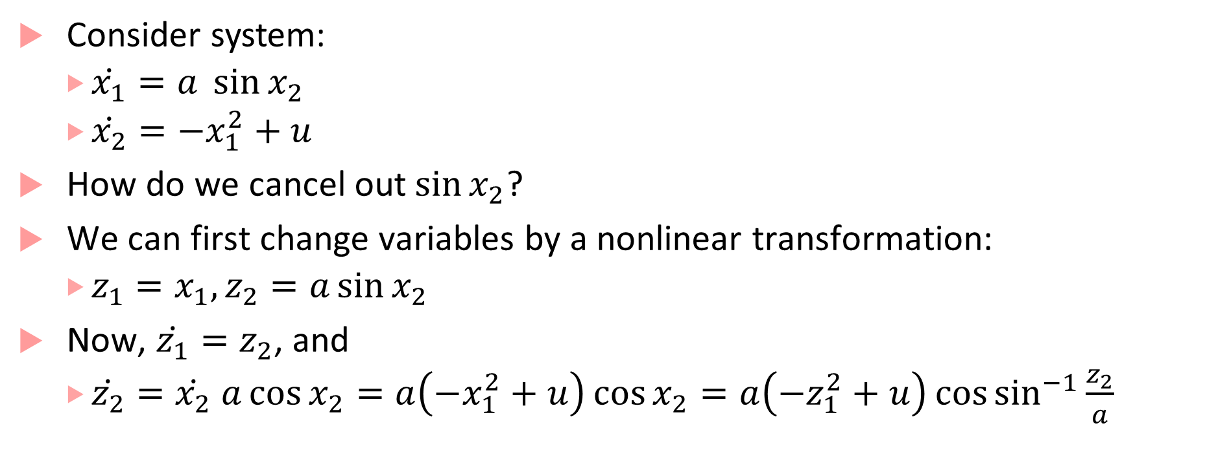
State Transformation
Consider system:
$\dot{x_{1}}=a \sin{x_{2}}$
$\dot{x_{2}}=−x_{1}^{2}+u$
How do we cancel out$\sin{x_{2}}$?
We can first change variables by a nonlinear transformation:
$z_{1}=x_{1}, z_{2}=a\sin{x_{2}}$
Now, $\dot{z_{1}}=z_{2}$, and
$\dot{z_{2}}=\dot{x_{2}} a\cos{x_{2}}=a\left(−x_{1}^{2}+u\right)\cos{x_{2}}=a\left(−z_{1}^{2}+u\right)\cos{\sin^{−1}{\frac{z_{2}}{a}}}$

Slide 41
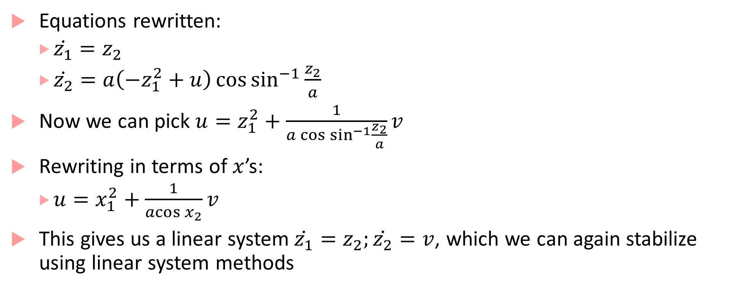
State transformation continued
Equations rewritten:
$\dot{z_{1}}=z_{2}$
$\dot{z_{2}}=a\left(−z_{1}^{2}+u\right)\cos{\sin^{−1}{\frac{z_{2}}{a}}}$
Now we can pick $u=z_{1}^{2}+\frac{1}{a\cos{\sin^{−1}{\frac{z_{2}}{a}}}}v$
Rewriting in terms of $x$’s:
$u=x_{1}^{2}+\frac{1}{\operatorname{acos}{x_{2}}}v$
This gives us a linear system$\dot{z_{1}}=z_{2};\dot{z_{2}}=v$, which we can again stabilize using linear system methods

Slide 42
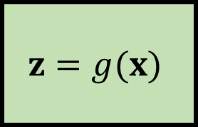









Form of the controller: two “loops”
$$u(t)$$
$$x(t)$$
$$v=−K^{T}z$$
$$u=h(x,v)$$
$\dot{x}=f(x,u)$
$$+$$
$$∑$$
$$0$$
$$−$$
Pole
Placement
Controller
Plant
Linearization Loop
Input
Transformation
$$z=g(x)$$
Feedback Loop
State Transformation

Slide 43

More feedback linearization
What if we only some states are observable? Requires another form of feedback linearization called input to output linearization
$$\dot{x_{1}}=a \sin{x_{2}}$$
$$\dot{x_{2}}=−x_{1}^{2}+u$$
$$y=x_{2}$$
If we use previous substitutions, $z_{1}=x_{1},z_{2}=a\sin{x_{2}},$ then $y=\sin^{−1}{\frac{z_{2}}{a}}$
($y$ is not linear!)
But, we can use $u=x_{1}^{2}+v$. Now, $\dot{x_{2}}=v, y=x_{2}$
(but, oops, $x_{1}$ is now unobservable)

Slide 44

Input-to-output linearization
Differentiate output till input appears in the RHS of output expression
Relative degree: number of times above step needs to be done
Example: ${\dot{x}}_{1}=x_{2} ;\dot{x_{2}}=−x_{1}−x_{1}^{2}+1+u ; y=x_{1}$
Differentiate both sides w.r.t. $t$: $\dot{y}=x_{2}; \ddot{y}=−x_{1}−x_{1}^{2}+1+u$
Relative degree =2
Use nonlinear cancellation to make $d^{p}y/dt^{p}$ linear in new variable $v$
Relative degree $=p$, means $n−p$ states are not observable
Zero dynamics: dynamics of unobservable states
If zero dynamics is unstable, that’s bad news, can’t use feedback linearization
All the math will require a lecture by itself, so we will skip the details

Slide 45

Lyapunov-based Nonlinear Control
Problem:
$\dot{x}=f\left(x,u\right)$
Find $u=k\left(x\right)$ s.t. equilibrium pt. of resulting closed loop system is stable
Approach 1: Fix $u=k\left(x\right)$ based on experience, intuition, trial-and-error and show that the resulting system is stable
Approach 2: Fix a Lyapunov function $V(x,u)$ and compute $u=k(x)$ such that $V\left(x,k\left(x\right)\right)$ certifies that equilibrium point is stable
Examples from: http://sisdin.unipv.it/labsisdin/teaching/courses/ails/files/8-Nonlinear_control_handout.pdf

Slide 46

Example
Problem:
$\dot{x_{1}}=−3x_{1}+2x_{1}x_{2}^{2}+u$
$\dot{x_{2}}=−x_{2}^{3}−x_{2}$
Approach 2: Fix $V\left(x\right)=\frac{1}{2}\left(x_{1}^{2}+x_{2}^{2}\right)$
$\dot{V}\left(x\right)=x_{1}\left(−3x_{1}+2x_{1}x_{2}^{2}+u\right)+x_{2}\left(−x_{2}^{3}−x_{2}\right)$
$=\left(−3x_{1}^{2}−x_{2}^{2}−x_{2}^{4}\right)+\left(2x_{1}^{2}x_{2}^{2}\right)+ux_{1}$
Examples from: http://sisdin.unipv.it/labsisdin/teaching/courses/ails/files/8-Nonlinear_control_handout.pdf

Slide 47

Example
Problem:
$\dot{x_{1}}=−3x_{1}+2x_{1}x_{2}^{2}+u$
$\dot{x_{2}}=−x_{2}^{3}−x_{2}$
Approach 2: Fix $V\left(x\right)=\frac{1}{2}\left(x_{1}^{2}+x_{2}^{2}\right)$
$\dot{V}\left(x\right)=x_{1}\left(−3x_{1}+2x_{1}x_{2}^{2}+u\right)+x_{2}\left(−x_{2}^{3}−x_{2}\right)$
$=\left(−3x_{1}^{2}−x_{2}^{2}−x_{2}^{4}\right)+\left(2x_{1}^{2}x_{2}^{2}\right)+ux_{1}$
Always Negative
Examples from: http://sisdin.unipv.it/labsisdin/teaching/courses/ails/files/8-Nonlinear_control_handout.pdf

Slide 48

Example
$\dot{V}\left(x\right)=x_{1}\left(−3x_{1}+2x_{1}x_{2}^{2}+u\right)+x_{2}\left(−x_{2}^{3}−x_{2}\right)$
$=\left(−3x_{1}^{2}−x_{2}^{2}−x_{2}^{4}\right)+\left(2x_{1}^{2}x_{2}^{2}\right)+ux_{1}$
Find $u=k(x)$ s.t. $2x_{1}^{2}x_{2}^{2}+ux_{1}$ is always negative or zero
One solution: $u=−2x_{1}x_{2}^{2}$
Another solution: $u=−x_{1}^{3}$ [check: does this also make $\dot{V}$ always negative?]
Always Negative
Examples from: http://sisdin.unipv.it/labsisdin/teaching/courses/ails/files/8-Nonlinear_control_handout.pdf

Slide 49

Control Lyapunov Function (CLF)
A function $V :D→ℝ$ s.t.
$V$ is continuously differentiable
Positive-definite: $∀x∈D−\left\{0\right\}:V\left(x\right)>0$
For all $x∈D −\{0\}$ there exists a $u$s.t.$\dot{V}\left(x,u\right)<0$
Last condition is the key: it says that there is a $u$ s.t. the energy of the system is reduced

Slide 50

CLF example
$\dot{x}=ax −bx^{3}+u$ where $a,b>0$
Let $V\left(x\right)=\frac{1}{2}x^{2}$
$\dot{V}\left(x,u\right)=\frac{∂V}{∂x}\dot{x}=x\left(ax−bx^{3}+u\right)=ax^{2}−bx^{4}+u$
Question: does there exist a $u$ s.t. above expression is always negative?

Slide 51

CLF for affine control systems
Affine-control form:
$$\dot{x}=f\left(x\right)+g\left(x\right)u$$
CLFs for affine-control system:
$\left(\frac{∂V}{∂x}g\left(x\right)=0\right)⇒\left(\frac{∂V}{∂x}f\left(x\right)<0\right)$

Slide 52

Model Predictive Control
Main idea: Use a dynamical model of the plant (inside the controller) to predict the plant’s future evolution, and optimize the control signal over possible futures
$$r(t)$$
$$u(t)$$
$$y(t)$$
Model-based Optimizer
Plant
$$∑$$
Sensor readings

Slide 53

Receding Horizon Philosophy
Create difference equation: $x\left[k+1\right]=f\left(x\left[k\right],u\left[k\right]\right)$; $y\left[k\right]=g(x\left[k\right])$
At time t, solve an optimal control problem over next N steps:
$$u^{∗}=arg\min_{u}{\sum_{k=0}^{N−1}{{\left\|y\left[t+k\right]−r\left[t\right]\right\|}^{2}+ }ρ‖u{\left[t+k\right]‖}^{2}}$$
$s.t.$ $x\left[t+k+1\right]=f(x\left[t+k\right],u\left[t+k\right])$
$$y\left[t+k\right]=g\left(x\left[t+k\right]\right)$$
$u_{min}≤u≤u_{max}$, $y_{min}≤y≤y_{max}$
Only apply optimal control input value $u^{∗}$ at time $t$
At time $t+1$: get new measurements, repeat optimization

Slide 54

Receding Horizon or MPC
Image from: https://tinyurl.com/yaej43x5

Slide 55
Observer design

Slide 56



What is state estimation and why is it needed?
$$u$$
Plant
$$y$$
Given a “black box” component, we can try to use a linear or nonlinear system to model it (maybe based on physics, or data-driven)
Model may posit that the plant has $n$ internal states, but we typically have access only to the outputs of the model (whatever we can measure using a sensor)
May need internal states to implement controller: how do we estimate them?
State estimation: Problem of determining internal states of the plant

Slide 57
Deterministic vs. Noisy case
Sensor measurements are noisy (manufacturing imperfections, environment uncertainty, errors introduced in signal processing, etc.)
In the absence of noise, the model is deterministic: for the same input you always get the same output
Can use a simpler form of state estimator called an observer (e.g., a Luenberger observer)
In the presence of noise, we use a state estimator, such as a Kalman Filter
Kalman Filter is one of the most fundamental algorithm that you will see in autonomous systems, robotics, computer graphics, …

Slide 58

Random variables and statistics refresher
For random variable $w$, $𝔼\left[w\right]$ : expected value of $w$, also known as mean
Suppose $𝔼[x]=μ$: then $var(w)$: variance of $w$, is $𝔼\left[{\left(w−μ\right)}^{2}\right]$
For random variables $x$ and $y$, $cov\left(x,y\right)$: covariance of $x$ and $y$
$cov\left(x,y\right)=𝔼\left[\left(x−𝔼\left(x\right)\right)\left(y−𝔼\left(y\right)\right)\right]$
For random vector $x$, $𝔼\left[x\right]$is a vector
For random vectors, $x∈ℝ^{m}$ and $y∈ℝ^{n}$ , cross-covariance matrix is $m×n$ matrix: $cov\left(x,y\right)=𝔼\left[\left(x−𝔼\left[x\right]\right){\left(y−𝔼\left[y\right]\right)}^{T}\right]$
$w∼N\left(μ, σ^{2}\right)$ : $w$ is a normally distributed variable with mean $μ$ and variance $σ$

Slide 59








Data fusion example
Using radar and a camera to estimate the distance to the lead car:
Measurement is never free of noise
Actual distance: $x$
Measurement with radar: $z_{1}=x+v_{1}$ ($v_{1}∼N\left(μ_{1},σ_{1}^{2}\right)$ is radar noise)
With camera: $z_{2}=x+v_{2}$ ($v_{2}∼N(μ_{2},σ_{2}^{2})$ is camera noise)
How do you combine the two estimates?
Use a weighted average of the two estimates, prioritize more likely measurement
$\hat{x}=\frac{{{(z}_{1}}/{σ_{1}^{2})} +{(z_{2}}/{σ_{2}^{2})} }{{(1}/{σ_{1}^{2})}+{(1}/{σ_{2}^{2})}}= kz_{1}+\left(1−k\right)z_{2}$, where $k=\frac{σ_{2}^{2}}{σ_{1}^{2}+σ_{2}^{2}}$
$\hat{μ}=\hat{x}, {\hat{σ}}^{2}=\frac{σ_{1}^{2}σ_{2}^{2}}{σ_{1}^{2}+σ_{2}^{2}}$
Observe: uncertainty reduced, and mean is closer to measurement with lower uncertainty
$$μ_{1}=1,σ_{1}^{2}=1$$
$$μ_{2}=2,σ_{2}^{2}=0.5$$
$$\hat{μ}=1.67,σ_{2}^{2}=0.33$$
$$μ_{1}$$
$$\hat{μ}$$
$$μ_{2}$$

Slide 60

Multi-variate sensor fusion
Instead of estimating one quantity, we want to estimate $n$ quantities, then:
Actual value is some vector $x$
Measurement noise for $i^{th}$ sensor is $v_{i}∼N\left(μ_{i},Σ_{i}\right)$, where $μ_{i}$ is the mean vector, and $Σ_{i}$ is the covariance matrix
$Λ=Σ^{−1}$ is the information matrix
For the two-sensor case:
$\hat{x}={\left(Λ_{1}+Λ_{2}\right)}^{−1}{(Λ}_{1}z_{1}+Λ_{2}z_{2})$, and $\hat{Σ}={\left(Λ_{1}+Λ_{2}\right)}^{−1}$

Slide 61
Motion makes things interesting
What if we have one sensor and making repeated measurements of a moving object?
Measurement differences are not all because of sensor noise, some of it is because of object motion
Kalman filter is a tool that can include a motion model (or in general a dynamical model) to account for changes in internal state of the system
Combines idea of prediction using the system dynamics with correction using weighted average (Bayesian inference)

Slide 62



Stochastic Difference Equation Models
We assume that the plant (whose state we are trying to estimate) is a stochastic discrete dynamical process with the following dynamics:
$x_{k}=Ax_{k−1}+Bu_{k}+w_{k}$ (Process Model)
$z_{k}=Hx_{k}+v_{k}$ (Measurement Model)
$x_{k}$, $x_{k−1}$ | State at time $k$,$k−1$
$$u_{k}$$ | Input at time $k$
$$w_{k}$$ | Random vector representing noise in the plant, $w∼N(0,Q_{k})$
$$v_{k}$$ | Random vector representing sensor noise, $v∼N(0,R_{k})$
$$z_{k}$$ | Output at time $k$
$$n$$ | Number of states
$$m$$ | Number of inputs
$$p$$ | Number of outputs
$$A$$ | $n×n$ matrix
$$B$$ | $n×m$ matrix
$$H$$ | $p×n$ matrix

Slide 63

Step I: Prediction
We assume an estimate of $x$ at time $k−1$, fusing information obtained by measurements till time $k−1$: this is denoted ${\hat{x}}_{k−1|k−1}$
We also assume that the error between the estimate ${\hat{x}}_{k−1|k−1}$ and the actual $x_{k−1}$ has 0 mean, and covariance $P_{k−1|k−1}$
Now, we use these values and the state dynamics to predict the value of $x_{k}$
Because we are still using measurements only up to time $k−1$, we can denote this predicted value as ${\hat{x}}_{k|k−1}$, and compute it as follows:
$${\hat{x}}_{k|k−1}≔A{\hat{x}}_{k−1|k−1}+Bu_{k}$$

Slide 64


Step I: Prediction continued
We also need to update the predicted covariance between the predicted value and the “actual” value of $x_{k}$
$P_{k|k−1}$ | $=cov\left(x_{k}−{\hat{x}}_{k|k−1}\right)$ $=cov\left(Ax_{k−1}+w_{k}−A{\hat{x}}_{k−1|k−1}\right)$
 | $$=Acov\left(x_{k−1}−{\hat{x}}_{k|k−1}\right)A^{T}+cov(w_{k})$$
 | $$=AP_{k−1|k−1}A^{T}+Q_{k}$$
Thus, the a priori estimated state and error covariance are:
$${\hat{x}}_{k|k−1}≔A{\hat{x}}_{k−1|k−1}+Bu_{k}$$
$$P_{k|k−1 }≔AP_{k−1|k−1}A^{T}+Q_{k}$$

Slide 65

Step II: Correction
This is where we basically do data fusion between new measurement and old prediction to obtain new estimate
Note that data fusion is not straightforward like before because we don’t really observe/measure $x_{k}$ directly, but we get measurement $z_{k}$, for an observable output!
Idea remains similar: Do a weighted average of the prediction ${\hat{x}}_{k|k−1}$ and new information
We integrate new information by using the difference between the predicted output and the observation

Slide 66


Step II: Correction continued
Predicted output: $H_{k}{\hat{x}}_{k|k−1}$, and error in predicted output = $z_{k}−H_{k}{\hat{x}}_{k|k−1}$
We denote this expression as the innovation $y_{k} ≔z_{k}−H_{k}{\hat{x}}_{k|k−1}$
Covariance of innovation ($S_{k}$) can be shown to be $R_{k}+H_{k}P_{k|k−1}H_{k}^{T}$
Then to do data fusion, we use a matrix known as (optimal) Kalman gain $K_{k}$
$${\hat{x}}_{k|k} ≔{\hat{x}}_{k|k−1}+K_{k}y_{k}$$
Where, $K_{k}$ is given by $P_{k|k−1}H_{k}^{T}S_{k}^{−1}$
Finally, the updated error covariance estimate is given by:
$$P_{k|k }≔P_{k|k−1}\left(I −K_{k}H_{k}\right)$$

Slide 67

Correction step summary
Innovation | $$y_{k} ≔z_{k}−H_{k}{\hat{x}}_{k|k−1}$$
Innovation Covariance | $$S_{k}≔R_{k}+H_{k}P_{k|k−1}H_{k}^{T}$$
Optimal Kalman Gain | $$K_{k}≔P_{k|k−1}H_{k}^{T}S_{k}^{−1}$$
A posteriori state estimate | $${\hat{x}}_{k|k} ≔{\hat{x}}_{k|k−1}+K_{k}y_{k}$$
A posteriori error covariance estimate | $$P_{k|k }≔P_{k|k−1}\left(I −K_{k}H_{k}\right)$$

Slide 68

What are all these equations? How to make sense?
Let’s take a simple one-dimensional example, with perfect observability (i.e. $z=x$). So, at each step, $x_{k}$ is the measurement.
Then, Kalman filter prediction equations become:
${\hat{x}}_{k|k−1}≔a{\hat{x}}_{k−1|k−1}+bu$ ; $σ_{k|k−1}^{2}≔\underset{\begin{aligned}prior uncertainty \\ in estimate\end{aligned}}{\underbrace{a^{2}σ_{k−1|k−1}^{2}}}+\underset{\begin{aligned}uncertainty \\ in process\end{aligned}}{\underbrace{σ_{q}^{2}}}$
Also, the correction equations become:
Innovation: $y_{k}≔x_{k}−{\hat{x}}_{k|k−1}$, Innovation variance = $σ_{r}^{2}+σ_{k|k−1}^{2}$
Optimal gain: $k= 1/{(σ_{r}^{2}+σ_{k|k−1}^{2}})$,
Updated state estimate: ${\hat{x}}_{k|k}≔{\hat{x}}_{k|k−1}+k(x_{k}−{\hat{x}}_{k|k−1})$
I.e. updated state estimate: ${\hat{x}}_{k|k}≔\left(1−k\right){ \hat{x}}_{k|k−1}+kx_{k}$ (Weighted average!)

Slide 69

Extended Kalman Filter
So far: assumed that the process and measurement model are both linear
Under linear models and Gaussian process/measurement noise, a Kalman filter is an optimal state estimator (minimizes mean square error between estimate and actual state)
In an EKF, state transitions and observations need not be linear functions of the state, but can be any differentiable functions
I.e., the process and measurement models are as follows:
$$x_{k}=f\left(x_{k−1},u_{k}\right)+w_{k}$$
$$z_{k}=h\left(x_{k}\right)+v_{k}$$

Slide 70



EKF updates
Functions $f$ and $h$ can be used directly to compute state-prediction, and predicted measurement, but cannot be directly used to update covariances
So, we instead use the Jacobian of the dynamics at the predicted state
This linearizes the non-linear dynamics around the current estimate
Prediction updates:
$${\hat{x}}_{k|k−1}≔f({\hat{x}}_{k−1|k−1},u_{k})$$
$$P_{k|k−1 }≔F_{k}P_{k−1|k−1}F_{k}^{T}+Q_{k}$$
$$F_{k} ≔{\left.\frac{∂f}{∂x}\right|}_{x={\hat{x}}_{k|k−1},u=u_{k}}$$

Slide 71


EKF updates continued
$$H_{k} ≔{\left.\frac{∂h}{∂x}\right|}_{x={\hat{x}}_{k|k−1} }$$
Correction updates
Innovation | $y_{k} ≔z_{k}−h({\hat{x}}_{k|k−1}$)
Innovation Covariance | $$S_{k}≔R_{k}+H_{k}P_{k|k−1}H_{k}^{T}$$
Near-Optimal Kalman Gain | $$K_{k}≔P_{k|k−1}H_{k}^{T}S_{k}^{−1}$$
A posteriori state estimate | $${\hat{x}}_{k|k} ≔{\hat{x}}_{k|k−1}+K_{k}y_{k}$$
A posteriori error covariance estimate | $$P_{k|k }≔P_{k|k−1}\left(I −K_{k}H_{k}\right)$$

Slide 72
EKF drawbacks
EKF is not in general an optimal estimator
If initial state estimate is wrong filter may diverge quickly : estimates will no longer agree with reality/observations
Estimated covariance matrix tends to underestimate true covariance
Yet, EKF remains widely used! GPS, most navigation systems, Openpilot (for drones), Pixhawk (mobile robots), etc.
EKF in practice requires lot of “expert tuning of parameters”
Most parameters occur in process models, covariance matrices, gains etc.
EKF improvement: Unscented Kalman Filter

Slide 73
End of First Part of the Course
Models of Computation
Synchronous, Asynchronous Models
Timed models and Dynamical System Models
Hybrid Models
Basics of Linear and Nonlinear Control, Observer Design

Slide 74
Bibliography
https://www.control.lth.se/fileadmin/control/Education/EngineeringProgram/FRTF05_China/L1_updated_20181105.pdf
https://www.lehigh.edu/~eus204/teaching/ME450_NSC/lectures/lecture06.pdf
https://en.wikipedia.org/wiki/Feedback_linearization
https://en.wikipedia.org/wiki/Kalman_filter

