Slide 1
Autonomous Cyber-Physical Systems: Vehicle to X Communication
Spring 2018. CS 599.
Instructor: Jyo Deshmukh

Slide 2
Layout
Basic capabilities of V2V and V2I
Co-operative Adaptive Cruise Control
Autonomous Intersection Management
Collaborative Merging
Class Wrap-up and Big-picture story

Slide 3
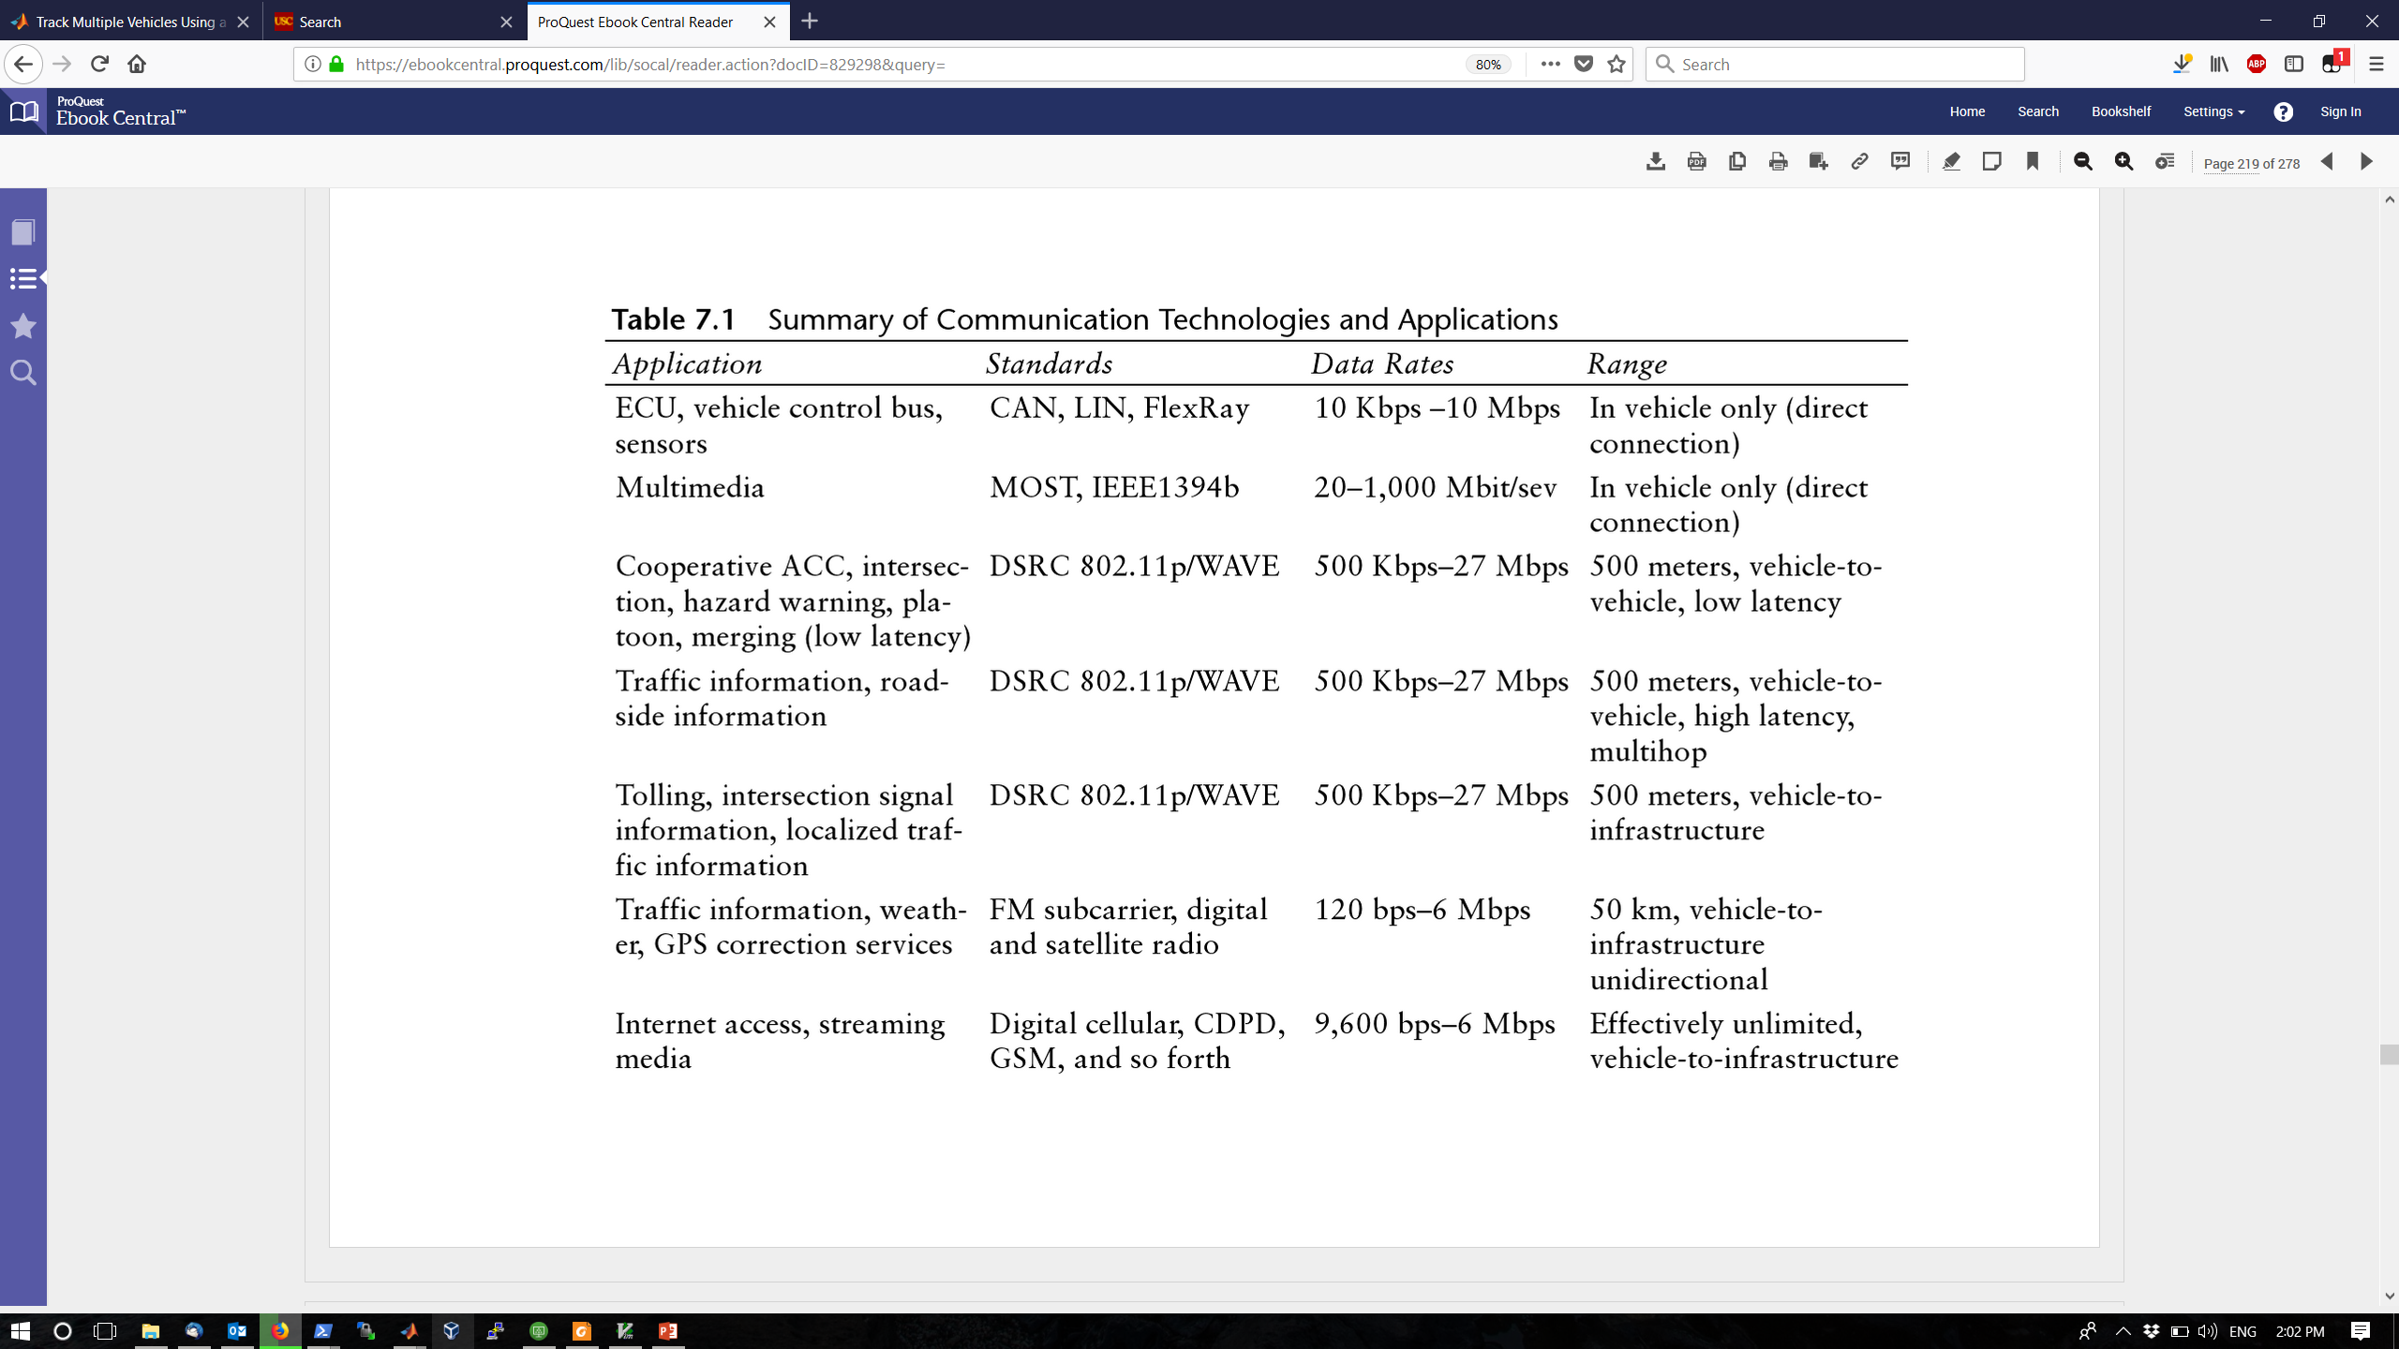
Wireless technologies and their use

Slide 4
V2V communication
Single hop: Vehicle communicates directly with another vehicle
Multi-hop: Vehicle uses intermediate nodes for communication
V2V has been used for safety:
Stopped vehicle or obstacle avoidance on highways
Merging assistance from a slow incoming lane to a crowded road
Intersection safety and collision warning systems
Consensus around DSRC (Dedicated Short-Range Communication) using IEEE 802.11p/WAVE standards
Potential applications:
multi-vehicle sensor fusion for localization, mapping
Platooning and energy management

Slide 5
V2I communication
Vehicle to Infrastructure communication
Applications:
Electronic Toll Collection
Intersection safety with Smart traffic lights
(Cooperative Intersection Collision Avoidance System)
Better route-planning with a traffic-congestion aware cloud system
Computing on the cloud for complex optimization situations

Slide 6
Cooperative Adaptive Cruise Control (CACC)
Used for platoons of vehicles (e.g. trucks)
Several goals:
Improve safety
Improve traffic flow dynamics by damping disturbances (new cars, braking, bumps in the road)
Increasing highway capacity by shorter following gaps
Saving energy and pollution through aerodynamic drafting
Improving driver comfort and convenience

Slide 7
CACC with V2X
Many V2V variants based on where information comes from
Immediate leader or/and follower or/and the overall Platoon Leader or/and any vehicle in range
Simplest scheme: Pairwise sharing between vehicle and immediate leader
V2I schemes: communicate with traffic management center/roadside devices either statically or dynamically
Can help with intersections
Can help with green-driving or eco-driving

Slide 8
CACC uses different gap regulation strategies
Constant clearance or constant distance gap (CDG)
Separation does not change with vehicle velocity
Gives experience of mechanical linkage between vehicles
Requires more formal platoon architecture and tight communication between platoon leader and followers
Communication interruption can cause safety hazards
Need larger gaps to ensure safety of platoon
(Emergency brake by leader can cause domino effect)

Slide 9
Constant Time Gap
Resembles how normal human drivers drive (except on 110 in LA ☺)
Distance between vehicles is proportional to their speed + a small fixed offset distance
E.g. doubling of speed causes doubling of gap between vehicles
Time gap criterion described in terms of time between rear bumper of leading vehicle and front bumper of trailing vehicle pass a fixed point on te roadway
Often described as headway or time headway
Vehicles in CTG CACC are often called a “string of vehicles” rather than platoon

Slide 10
Constant Safety-Factor Criterion
Motivated by guaranteeing that even most severe incidents would involve only one platoon
With small constant-clearance-separations, severe incidents require hard braking
Hardest braking would be by the last vehicle,
Most dangerous condition is when lead vehicle has limited braking ability
Sets minimum distance between platoons such that two platoons do not collide based on above factors
Produces inter-platoon separation proportion to square of cruising speed

Slide 11
CACC String formation in trucks
One or more truck drivers activate CACC and set desired speed and gap
May set preference for leader or follower when forming a new string
CACC local coordination feature searches for additional trucks or existing strings to couple with
Joining driver is displayed list of nearby trucks or strings (graphically or textually)
Once joining driver selects a platoon to couple with, local coordination will confirm with platoon leader and instruct leader to slow down and joining truck to speed up
Lead driver and joining driver are shown a target speed and lane in which to travel
Once joining truck is behind the leader or string, CACC’s vehicle-following mode will engage, and lead truck’s speed will be restored and relayed

Slide 12
CACC steady-state cruising
Steady-state cruising is what hopefully happens most of the time
Drivers still have to actively steer (unless they have lane-tracking-control) and monitor traffic
Steady-state cruising interrupted when trucks join or split strings, or when a non-platoon vehicle intervenes
Cut-ins can be handled by dynamically splitting the string and commanding a new leader and dynamically merging strings when the disturbing vehicle goes away

Slide 13
CACC string splits and faults
CACC needs to handle trucks leaving string
Ideally, departing truck signals intent and remaining string close gaps to maintain platoon structure
In some cases may require string to be split while the truck in the middle departs
As you can see, the above protocols have NUMEROUS fault conditions, errors and abnormal operating conditions (obstacle in the road, accidents, etc.)
Safety: model each truck as an asynchronous process and reason about composition of asynchronous processes!
Specifications: Safety and String stability

Slide 14
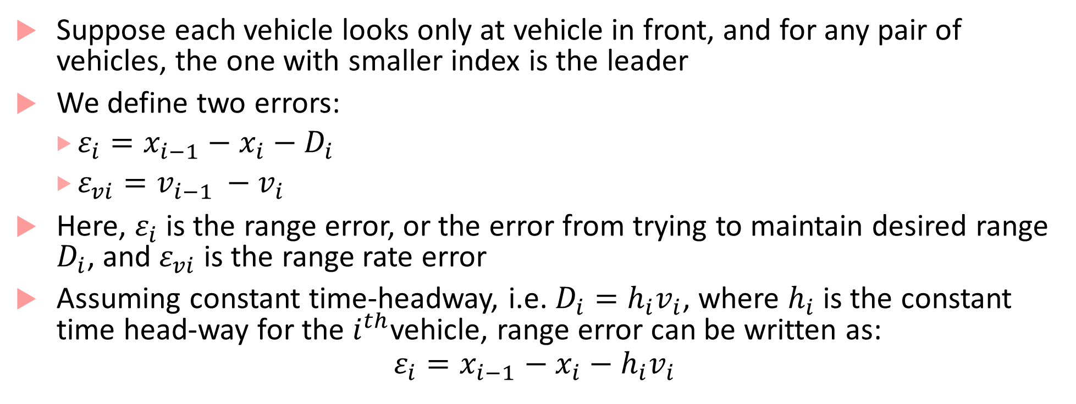
String stability
Suppose each vehicle looks only at vehicle in front, and for any pair of vehicles, the one with smaller index is the leader
We define two errors:
$ε_{i}=x_{i−1}−x_{i}−D_{i}$
$ε_{vi}=v_{i−1 }−v_{i}$
Here, $ε_{i}$ is the range error, or the error from trying to maintain desired range $D_{i}$, and $ε_{vi}$ is the range rate error
Assuming constant time-headway, i.e. $D_{i}=h_{i}v_{i}$, where $h_{i}$ is the constant time head-way for the $i^{th}$vehicle, range error can be written as:
$$ε_{i}=x_{i−1}−x_{i}−h_{i}v_{i}$$

Slide 15
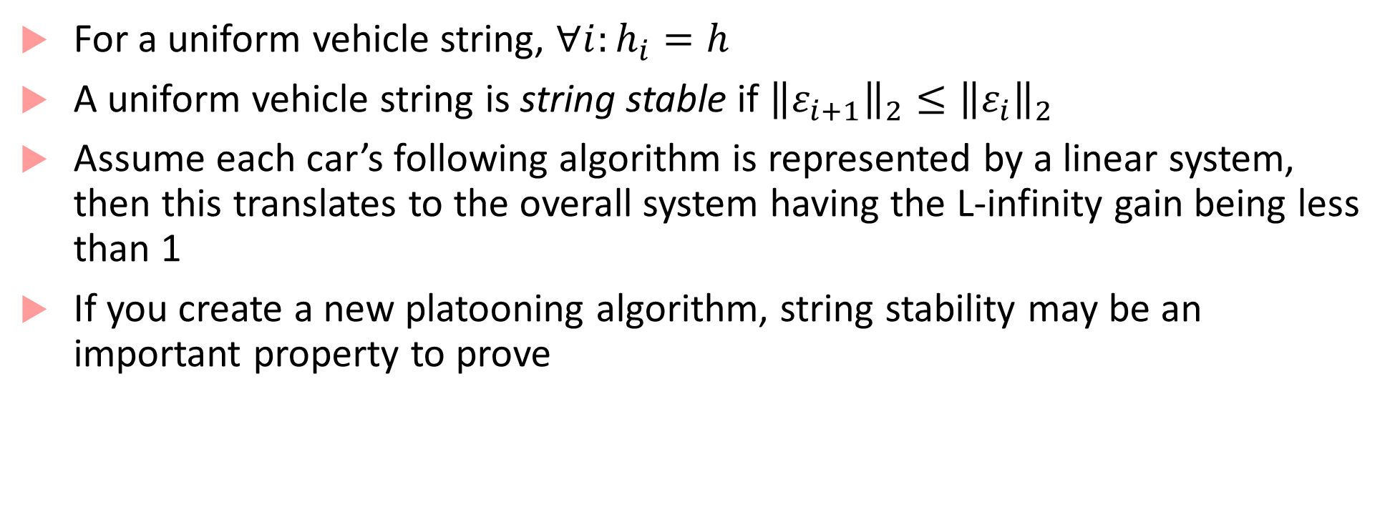
String stability definition
For a uniform vehicle string, $∀i:h_{i}=h$
A uniform vehicle string is string stable if ${\left\|ε_{i+1}\right\|}_{2}≤{\left\|ε_{i}\right\|}_{2}$
Assume each car’s following algorithm is represented by a linear system, then this translates to the overall system having the L-infinity gain being less than 1
If you create a new platooning algorithm, string stability may be an important property to prove

Slide 16
Autonomous Intersection Management
AIM protocol and its variants proposed based on V2I communication
Main idea :
Each car equipped with a driver agent
Each intersection equipped with an intersection manager
Driver agents call ahead to reserve space-time in an intersection
Intersection manager decides to grant or reject reservation requests according to an intersection control policy

Slide 17
AIM protocol⁴
Approach vehicle announces arrival to manager
Vehicle indicates its size, predicted arrival time, velocity, acceleration, arrival and departure lanes
Intersection manager simulates vehicle’s path through the intersection, checking for conflicts with paths of previously processed vehicles
If there are no conflicts, issues a reservation
It is the vehicle’s responsibility to arrive at and travel through the reserved space-time block within some range of error tolerance
In case of conflict, intersection manager suggests an alternate later reservation
Car enters intersection only if reservation successful
Upon leaving intersection, car conveys successful passage to the manager

Slide 18
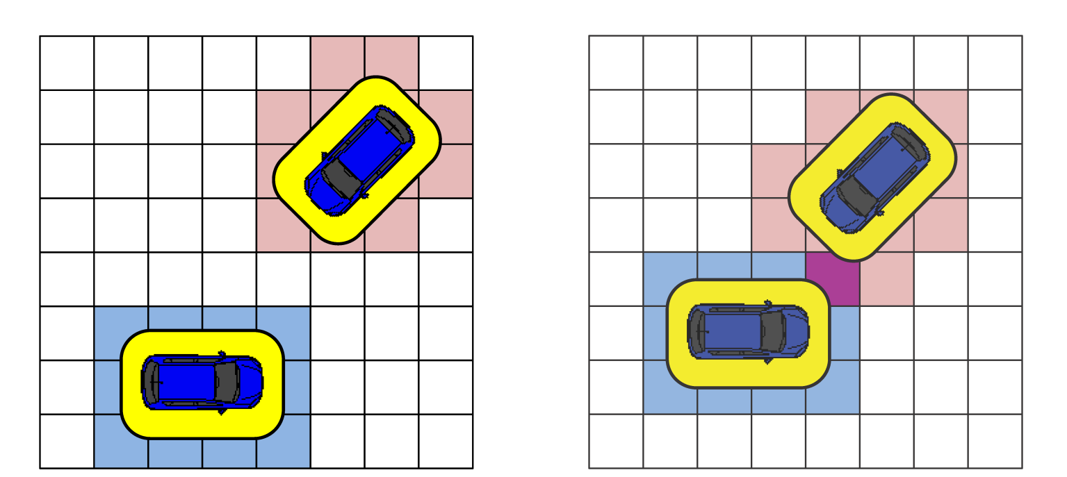
Intersection control policies
Divide intersection into grid of reservation tiles

Slide 19
Many AIM⁵ variants with different concerns
Decentralized (vehicles coordinating among themselves) vs. Centralized (manager)
Deliberative (planning entire trajectories) vs. reactive (planning trajectories in real-time)
Robust (Safety margins) vs. efficient (more throughput at the intersection)
Cooperative (optimizing overall traffic flow) vs. Egoistic (optimizing your own speed/time)
Homogenous (all vehicles treated the same) vs. Heterogeneous
Modeling AIM: asynchronous, timed, & hybrid process models used!

Slide 20
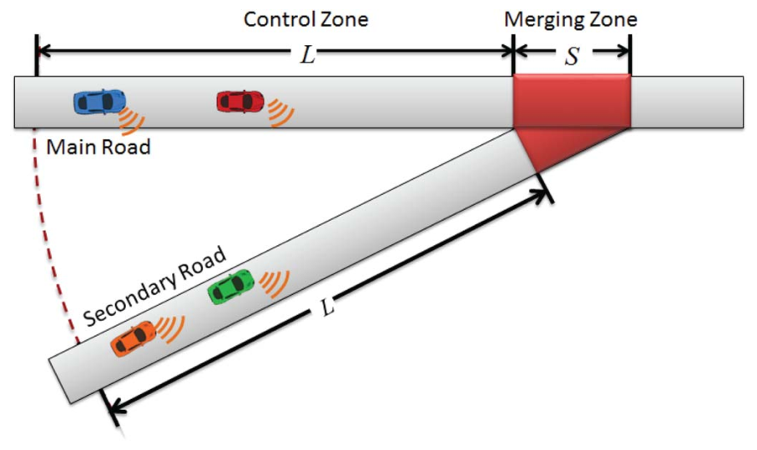
Collaborative merge
Purpose: allow vehicles merging onto a freeway from a ramp to do so in safe fashion
Can be formulated as a specific case in autonomous intersection management
Specialized approaches based on highway ramp metering have existed for some time (these do not utilize V2V capability, and do not guarantee safety)

Slide 21
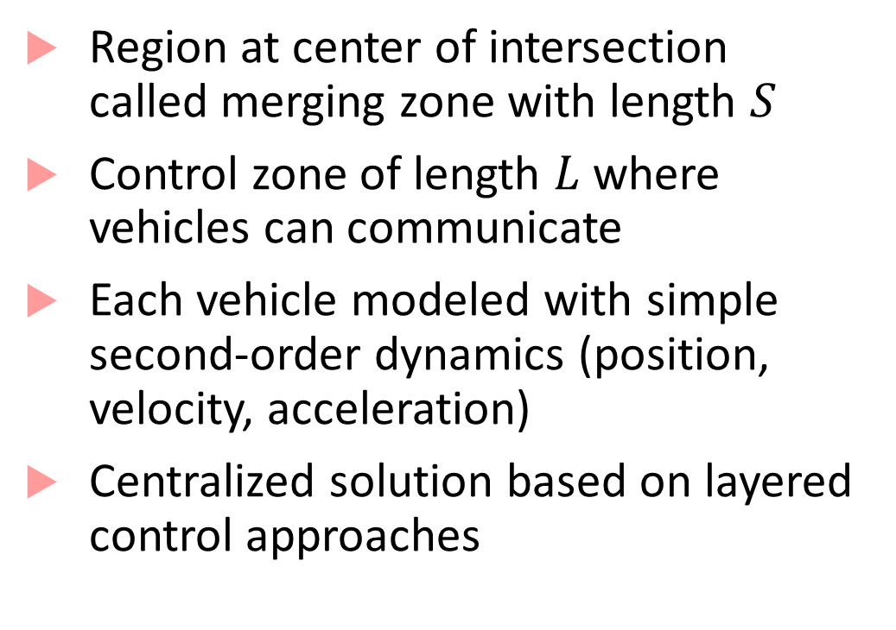
Collaborative merge
Region at center of intersection called merging zone with length $S$
Control zone of length $L$ where vehicles can communicate
Each vehicle modeled with simple second-order dynamics (position, velocity, acceleration)
Centralized solution based on layered control approaches

Slide 22
Two-layered control approach for merging
Centralized approach (V2I only)
First layer
Assumes each vehicle is traveling at constant speed
Computes time for each vehicle to merge into the control zone based on this assumption
Second layer
Determines conflicts in merging sequence
Computes required acceleration value based on heuristic rules
Generalization with different layers of control has been proposed
Optimization: minimizing vehicle overlap (crash!) and travel time

Slide 23
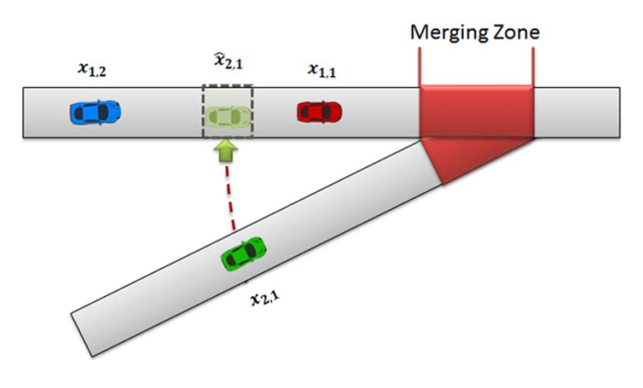
Decentralized approach
Virtual vehicle mapped onto the freeway before actual merging occurs
Allows vehicles to perform smoother and safer control actions
Uses slot-based traffic management (vehicles drive into a virtual slot)
Vehicles use V2V and V2I communication with vehicles in range
Other approaches based on MPC also exist

Slide 24

Design challenges $→$ Course Concepts
Modeling protocols, decision layer components
Synchronous and Asynchronous processes
Understanding system-level safety using synchronous and asynchronous composition
Verification using Model Checking, Inductive Invariants
Liveness properties with LTL, CTL
Model-based and Scenario-based Testing approaches

Slide 25
Design challenges $→$ Course Concepts
Modeling Controllers, Path planning
Timed and Hybrid Processes, Dynamical Systems
Markov Decision Processes & Markov Chains
Verification using Model Checking, Inductive invariants, safety certificates (barrier certificates), Liveness checking with LTL, CTL, STL
Testing using Falsification-based approaches
Software synthesis using Temporal Logic-based approaches, reinforcement learning

Slide 26

Design Challenges $→$ Course Concepts
Reasoning about environments, physical processes to be controlled
Dynamical systems models, hybrid processes
Signal Temporal Logic as a way to express Cyber-Physical systems specifications
Testing and Falsification approaches
Reasoning about safety and security
Models for perception

Slide 27
How does everything fit together?
You want to develop a new CPS/IoT system with autonomy
Analyze its environment: model it as a dynamical system or a stochastic system (e.g. PoMDPs)
Analyze the different components required in the software stack
Perception vs. Decision/Planning vs. Control
Analyze what models to use for the control algorithms
Choices are: Traditional control schemes (PID/MPC), state-machines (synchronous vs. asynchronous based on communication type), AI/planning algorithms, hybrid control algorithms, or combinations of these

Slide 28
Safety is the key!!
Try to specify the closed-loop system as something you can simulate and see its behaviors
Integrative modeling environment such as Simulink (plant models + software models)
Specify requirements of how you expect the system to behave (STL, LTL, or your favorite spec. formalism)
This step is a DO NOT MISS. It will provide documentation of your intent, and also a machine-checkable artifact
Test the system a lot, and then test some more
Apply formal reasoning wherever you can. Proofs are great if you can get them
Safety doesn’t end at modeling stage; continue reasoning about safety after deployment (through monitoring etc.)

Slide 29
It’s been a fun class
Models of computation
Asynchronous, Synchronous, Timed, Hybrid Processes, Dynamical Systems, Probabilistic Models, Simulink
Safe Autonomous CPS
MODELING
Basics of Control
PID, MPC, Nonlinear control, Observer design (Kalman filter)
Basics of Perception
Vision-based systems, CNNs
Basics of Planning
Path planning, Reinforcement learning
Basics of Security and Communicating Autonomous CPS
Basics of Safety-Aware Mindset
Specification Languages (LTL, CTL, STL)
Falsification and Testing
Safety Invariants + Proofs
Reachability, Model Checking
AUTONOMY
SAFETY

Slide 30
References
[1] Shladover, Steven E., et al. "Cooperative adaptive cruise control: Definitions and operating concepts." Transportation Research Record: Journal of the Transportation Research Board 2489 (2015): 145-152.
[2] ibid., https://escholarship.org/uc/item/7jf9n5wm
[3] Liang, Chi-Ying, and Huei Peng. "String stability analysis of adaptive cruise controlled vehicles." JSME International Journal Series C Mechanical Systems, Machine Elements and Manufacturing 43.3 (2000): 671-677.
[4] Stone, Peter, Shun Zhang, and Tsz-Chiu Au. "Autonomous intersection management for semi-autonomous vehicles." Routledge Handbook of Transportation. Routledge, 2015. 116-132.
[5] Qian, Xiangjun, et al. "Autonomous Intersection Management systems: criteria, implementation and evaluation." IET Intelligent Transport Systems 11.3 (2017): 182-189.
[6] de Campos, Gabriel Rodrigues, et al. "Traffic coordination at road intersections: Autonomous decision-making algorithms using model-based heuristics." IEEE Intelligent Transportation Systems Magazine 9.1 (2017): 8-21.
[7] Rios-Torres, Jackeline, and Andreas A. Malikopoulos. "A survey on the coordination of connected and automated vehicles at intersections and merging at highway on-ramps." IEEE Transactions on Intelligent Transportation Systems 18.5 (2017): 1066-1077.

Slide 31
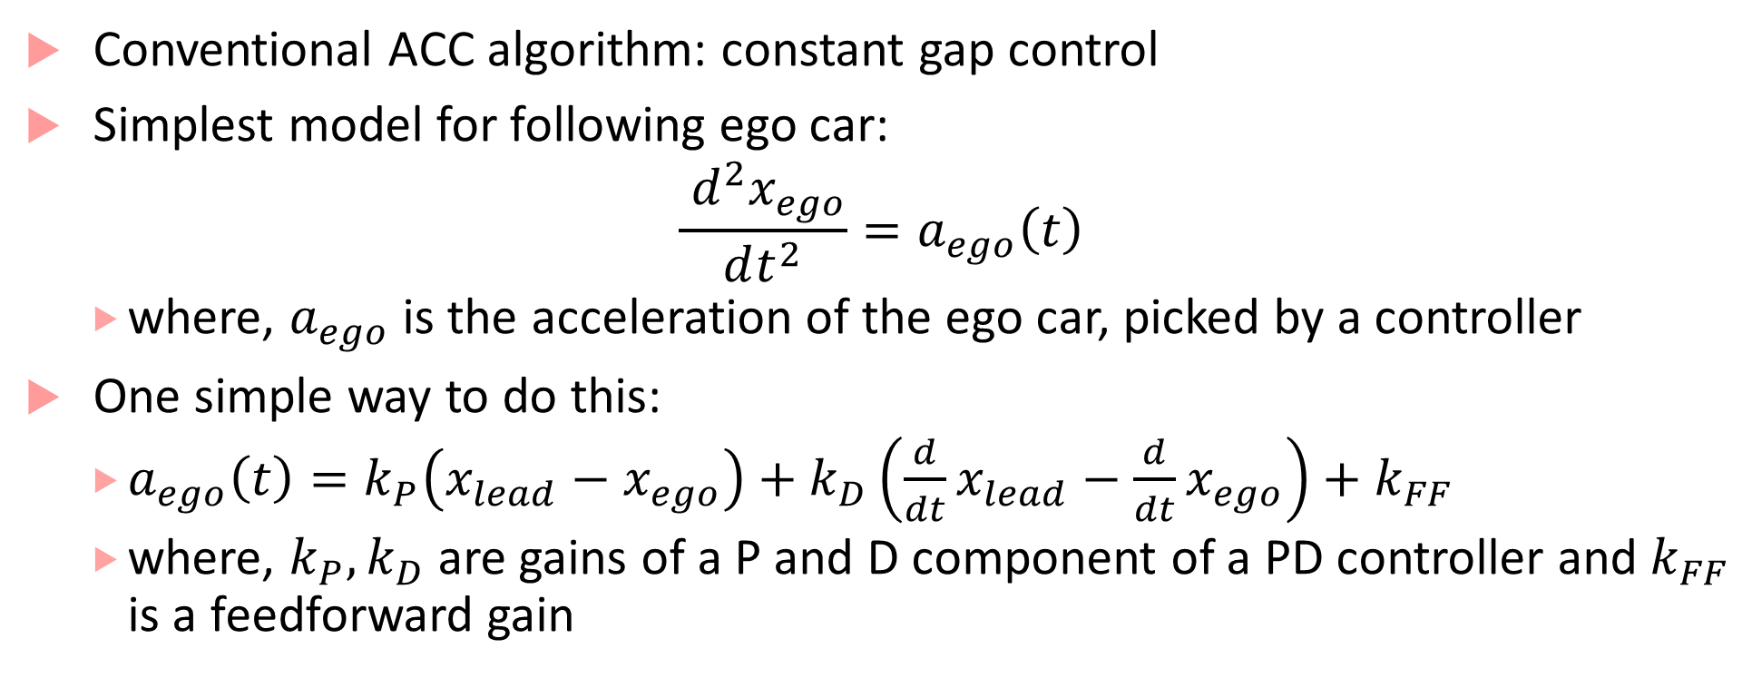
Platooning and Adaptive Cruise Control
Conventional ACC algorithm: constant gap control
Simplest model for following ego car:
$$\frac{ d^{2}x_{ego}}{dt^{2}}=a_{ego}\left(t\right)$$
where, $a_{ego}$ is the acceleration of the ego car, picked by a controller
One simple way to do this:
$a_{ego}\left(t\right)=k_{P}\left(x_{lead}−x_{ego}\right)+k_{D}\left(\frac{d}{dt}x_{lead}−\frac{d}{dt}x_{ego}\right)+k_{FF}$
where, $k_{P}, k_{D}$ are gains of a P and D component of a PD controller and $k_{FF}$ is a feedforward gain

Slide 32
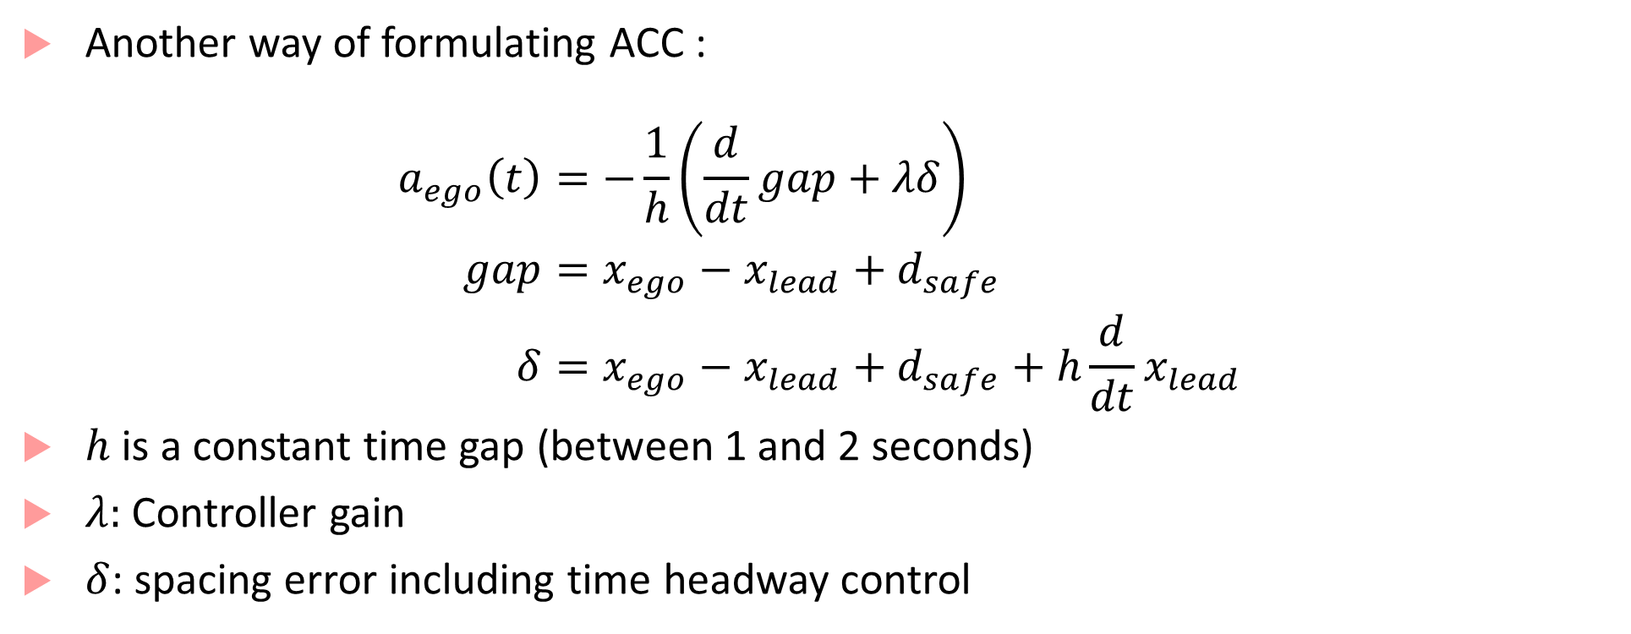
Using communication
Another way of formulating ACC :
$$\begin{aligned}a_{ego}\left(t\right)&=−\frac{1}{h}\left(\frac{d}{dt}gap+λδ\right) \\ gap&=x_{ego}−x_{lead}+d_{safe} \\ δ&=x_{ego}−x_{lead}+d_{safe}+h\frac{d}{dt}x_{lead}\end{aligned}$$
$h$ is a constant time gap (between 1 and 2 seconds)
$λ$: Controller gain
$δ$: spacing error including time headway control

