Slide 1
Autonomous Cyber-Physical Systems: Security and Privacy in Cyber-Physical Systems
Spring 2018. CS 599.
Instructor: Jyo Deshmukh
Acknowledgment: Some of the material in these slides is based on the lecture slides for CIS 540: Principles of Embedded Computation taught by Rajeev Alur at the University of Pennsylvania. http://www.seas.upenn.edu/~cis540/

Slide 2
Now that you know how to design autonomous CPS
Security, Privacy are must-know!

Slide 3
Layout
Basic definitions
Key problems and CPS solutions to these problems

Slide 4
Security/Privacy for Autonomous CPS
Confidentiality: Ability to maintain secrecy from unauthorized users
Eavesdropper should not be able to intercept and read messages sent between an Autonomous CPS agent and another agent, system or human
Integrity: Trustworthiness of received data
If the V2X-enabled car receives a message from the cloud indicating that there is no traffic or obstacle in the next 500 meters, is the message trustworthy?
Availability: Ability of the system to be accessible
Is it possible to make the self-driving car unresponsive by overwhelming its sensors with data?

Slide 5
Security/Privacy for Autonomous CPS
Timeliness: Responsiveness, how recent is the data
If an adversary keeps sending messages to the UAV, can it become unresponsive to the point that its basic control abilities are compromised?
Graceful Degradation: Can the system recover to successively reduced levels of operation in steps?
If a sensor is compromised because of a malicious attack (e.g. an adversary flashing light into the camera, or producing fake ultrasonic pulses), can the system gracefully reach a safe state?
Privacy: Preventing unwanted transfer of information (through inference or correlation)
Can the self-driving car leak information about the driver’s sensitive information to the infrastructure?

Slide 6
Attacks and Attack Models
Attack model: kind of access the adversary has to the system
Autonomous CPS applications offer a diverse set of possible attacks
Attack surface: the sum of all entry points with which the attacker can enter breach the system
Sensors, actuators, communication present different kinds of attack vectors, rendering a large attack surface for an autonomous CPS
CPS systems are liable to:
Cyber attacks
Physical attacks
Cyber-Physical attacks

Slide 7
Taxonomy of attacks
Cyber attacks
Network DDS
Malware
Exploiting software vulnerabilities: buffer overflows, code injection attacks, etc.
Physical attacks
Sensor spoofing
Sensor jamming
Timing attacks
Physical damage
CPS attacks
Replay attacks
State observation/inference
Side-channel attacks
Non-technical attacks (social engineering, phishing, etc.)

Slide 8
Some interesting attacks from a CPS perspective
Sensor spoofing attack: Attacker provides fake sensor data
Spoofing GPS signals
Present a UAV/self-driving car with a doctored image that causes perception/decision layers to behave incorrectly
Physical access to sensors permits masking or subtly changing sensor signals
Replay attack: Attacker intercepts insecure commands and replays them
A malicious adversary could intercept messages sent in a V2X protocol, and replay the message, “safe to merge” when it is not safe to merge.

Slide 9
Relevant attacks in CPS examples
Sensor jamming
Signals sent using DSRC will critically influence autonomous vehicle coordination and cooperation, if these signals are jammed, autonomy will suffer
Timing attacks
Information can be leaked by measuring the time required for a particular operation to be executed
Many CPS applications use online optimization, path planning etc., and the time required to compute a decision may reveal secret information about internal state

Slide 10
Relevant attacks in CPS
Side-channel attacks
These attacks involve monitoring a physical quantity such as the power consumption, electromagnetic leaks, etc. to discover secret information about the system (e.g. can be used to guess a password based on the power profile of the CPU while it is decrypting the string).
Timing attacks are a subclass of side-channel attacks
Information leakage/state inference
By observing a CPS system, the attacker can create a state estimator for internal state of the system, which may be undesirable

Slide 11
Themes in CPS security
Attack detection
Attack monitoring
Secure estimation/control
Privacy

Slide 12
Attack detection
Attack models:
False data/Sensor spoofing attacks
Replay attacks
Fault data injection attacks
Few main ideas:
Design intrusion detection systems that detect anomalous traffic and flag alarms (for mostly cyber attacks)
Construct appropriate observers that can detect and locate an attack
Compute difference between estimated and measured quantities
Using the state estimation Jacobian matrix
Using game theoretic reasoning (attacker is player 2, system is player 1)
In a networked setting: which sensors/nodes to choose for monitoring?

Slide 13
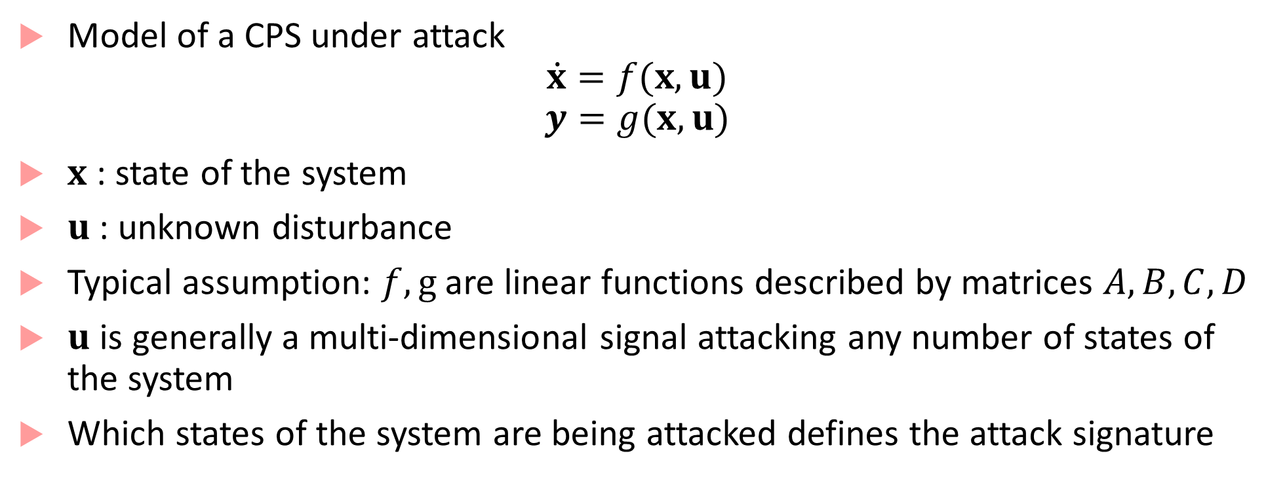
Basic attack detection
Model of a CPS under attack
$$\dot{x}=f(x,u)$$
$$y=g(x,u)$$
$x$ : state of the system
$u$: unknown disturbance
Typical assumption: $f,g$are linear functions described by matrices $A,B,C,D$
$u$ is generally a multi-dimensional signal attacking any number of states of the system
Which states of the system are being attacked defines the attack signature

Slide 14
Attack monitors²
Monitor is a deterministic algorithm that has access to continuous-time measurements and knowledge of system dynamics
Monitor raises a flag/alarm indicating presence or absence of an attack in addition to the set of sensors being attacked
An attack is detectable if the monitor raises an alarm
An attack is identifiable if the monitor is able to accurately identify which states are being attacked
An attack is undetectable if no monitor identifies an attack
Obviously, an undetectable attack is unidentifiable

Slide 15
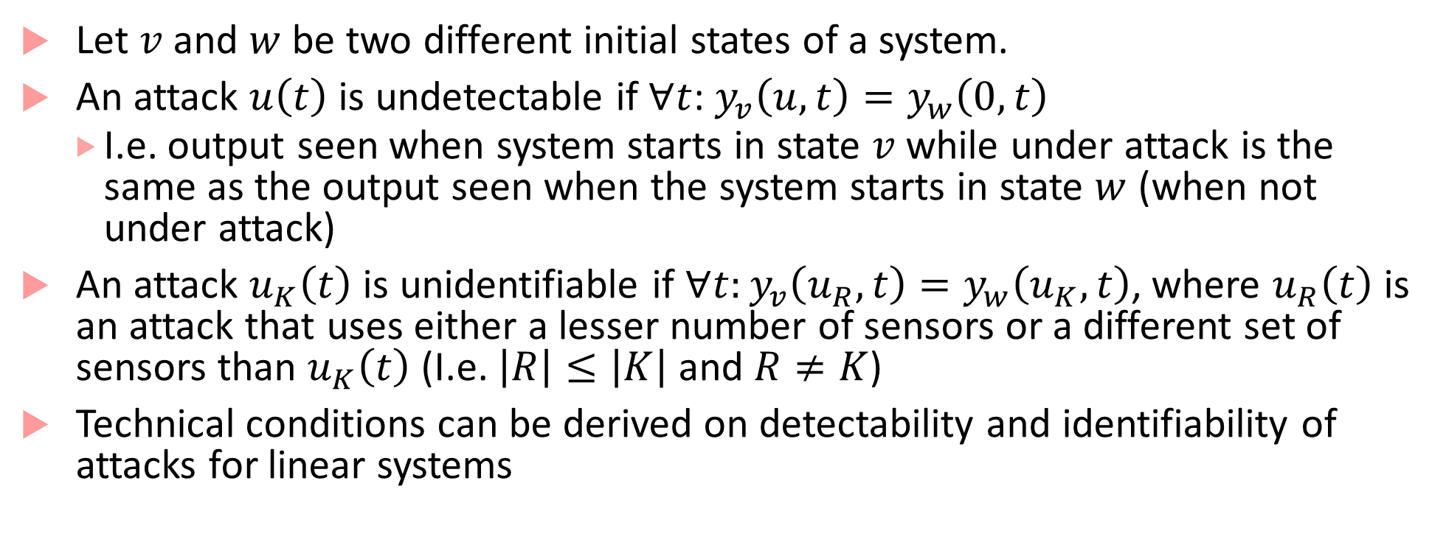
Undetectable & Unidentifiable attacks
Let $v$ and $w$ be two different initial states of a system.
An attack $u\left(t\right)$ is undetectable if $∀t$: $y_{v}\left(u,t\right)=y_{w}\left(0,t\right)$
I.e. output seen when system starts in state $v$ while under attack is the same as the output seen when the system starts in state $w$ (when not under attack)
An attack $u_{K}\left(t\right)$ is unidentifiable if $∀t:y_{v}\left(u_{R},t\right)=y_{w}\left(u_{K},t\right)$, where $u_{R}\left(t\right)$ is an attack that uses either a lesser number of sensors or a different set of sensors than $u_{K}\left(t\right)$ (I.e. $\left|R\right|≤\left|K\right|$ and $R≠K$)
Technical conditions can be derived on detectability and identifiability of attacks for linear systems

Slide 16
Types of monitors
Static monitors: verifies consistency of measurements without utilizing system dynamics or exploiting measurements taken at different times
Dynamic monitors: Make use of the knowledge of system dynamics
Active monitors: Injects an auxiliary input to reveal attacks
Centralized vs. distributed:
In a networked system, a centralized attack detector can see all nodes in the system at once and use that for attack detection (not ideal because of central point of failure)

Slide 17
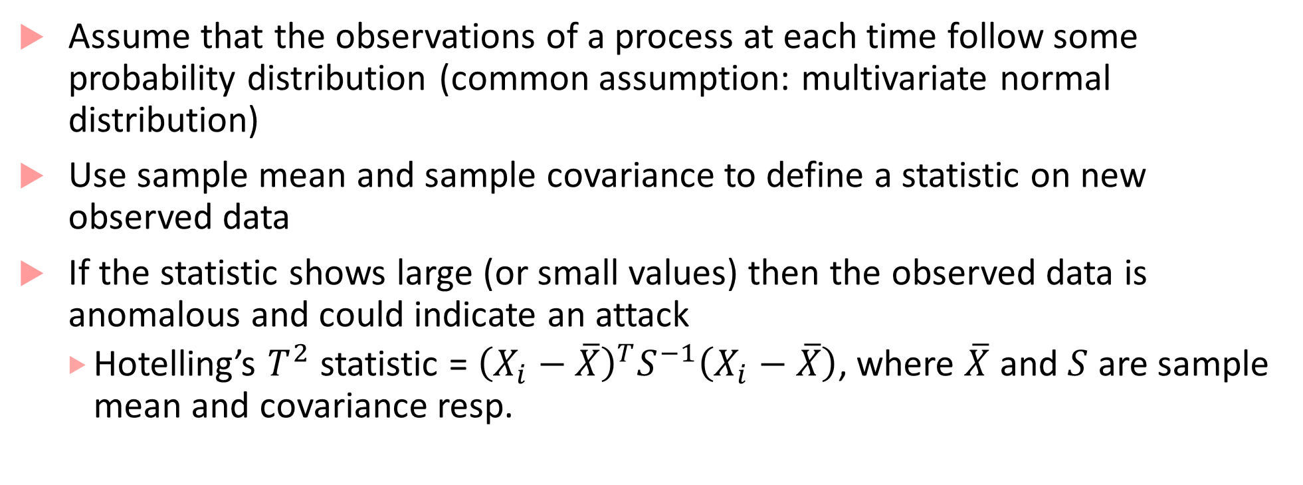
Intrusion detection using statistical techniques
Assume that the observations of a process at each time follow some probability distribution (common assumption: multivariate normal distribution)
Use sample mean and sample covariance to define a statistic on new observed data
If the statistic shows large (or small values) then the observed data is anomalous and could indicate an attack
Hotelling’s $T^{2}$ statistic = ${\left(X_{i}−\overline{X}\right)}^{T}S^{−1}\left(X_{i}−\overline{X}\right)$, where $\overline{X}$ and $S$ are sample mean and covariance resp.

Slide 18
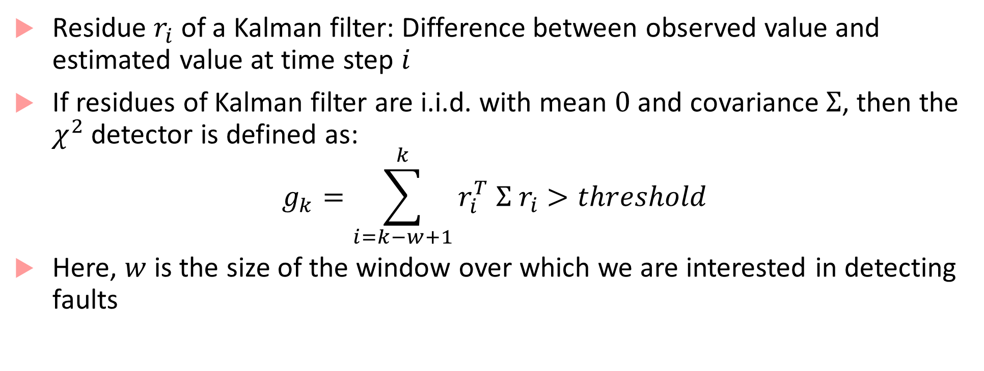
Chi-squared detector
Residue $r_{i}$ of a Kalman filter: Difference between observed value and estimated value at time step $i$
If residues of Kalman filter are i.i.d. with mean $0$ and covariance $Σ$, then the $χ^{2}$ detector is defined as:
$$g_{k}=\sum_{i=k−w+1}^{k}{r_{i}^{T} Σ{ r}_{i}>threshold}$$
Here, $w$ is the size of the window over which we are interested in detecting faults

Slide 19
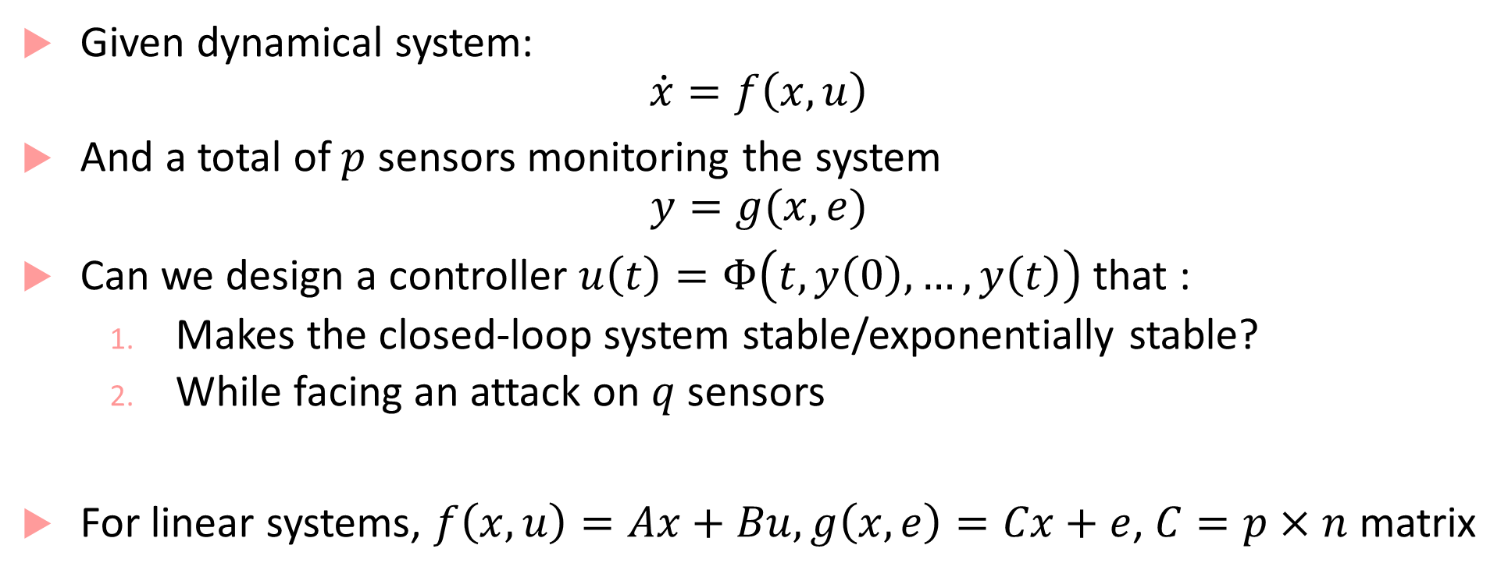
Secure control³
Given dynamical system:
$$\dot{x}=f\left(x,u\right)$$
And a total of $p$ sensors monitoring the system
$$y=g(x,e)$$
Can we design a controller $u\left(t\right)=Φ\left(t,y\left(0\right),…, y\left(t\right)\right)$ that :
Makes the closed-loop system stable/exponentially stable?
While facing an attack on $q$ sensors
For linear systems, $f\left(x,u\right)=Ax+Bu, g\left(x,e\right)=Cx+e$, $C=p×n$ matrix

Slide 20
Accomplishing secure control
For linear systems, you can show that the system can be secured by a controller if there exists a decoder (i.e. observer) that can reconstruct the state within some number of steps
Several Technical conditions for linear systems that characterize when such observers can be constructed, how many sensors can be attacked but the system withstands the attacks, etc.
Several other bodies of work which utilize strategies such as : robust control, falling back to a sub-optimal controller, etc.

Slide 21
Privacy in CPS
Privacy focuses on information flow properties between systems
Can my secret information flow to the adversary?
Can the adversary learn my private information through my public information?
Became a big issue for smart meter systems:
Utility companies can infer presence or absence in the house based on the electricity consumption
But, we want to share data with the utility company so that it can optimize some higher-level resource usage!
CPS privacy is usually a tradeoff between marginal utility gained by sharing information vs. loss of secrecy

Slide 22
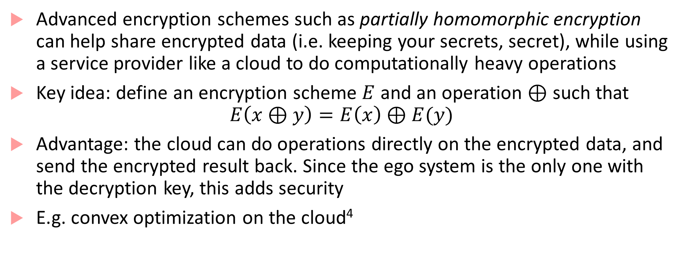
Privacy while using the cloud
Advanced encryption schemes such as partially homomorphic encryption can help share encrypted data (i.e. keeping your secrets, secret), while using a service provider like a cloud to do computationally heavy operations
Key idea: define an encryption scheme $E$ and an operation $⊕$ such that
$$E\left(x⊕y\right)=E\left(x\right)⊕E(y)$$
Advantage: the cloud can do operations directly on the encrypted data, and send the encrypted result back. Since the ego system is the only one with the decryption key, this adds security
E.g. convex optimization on the cloud⁴

Slide 23
Using logics to analyze information flow
New logics such as HyperLTL and its invariants
LTL: property of single traces
HyperLTL: properties of sets of traces

Slide 24
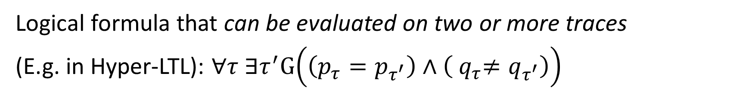
What is a hyperproperty?
Logical formula that can be evaluated on two or more traces
(E.g. in Hyper-LTL): $∀τ ∃τ^{′}G\left(\left(p_{τ}=p_{τ^{′}}\right)∧\left({ q}_{τ}≠q_{τ^{′}}\right)\right)$
$$p,q$$
$$p,\overline{q}$$
$$\overline{p},q$$
$$\overline{p},\overline{q}$$
$$p,\overline{q}$$
Satisfying Set 1
$$p,\overline{q}$$
$$p,q$$
$$\overline{p},\overline{q}$$
$$\overline{p},q$$
$$p,q$$
$$p,\overline{q}$$
$$p,\overline{q}$$
$$p,\overline{q}$$
$$p,\overline{q}$$
$$p,\overline{q}$$
Satisfying Set 2
$$p,q$$
$$p,q$$
$$\overline{p},q$$
$$\overline{p},q$$
$$p,q$$

Slide 25
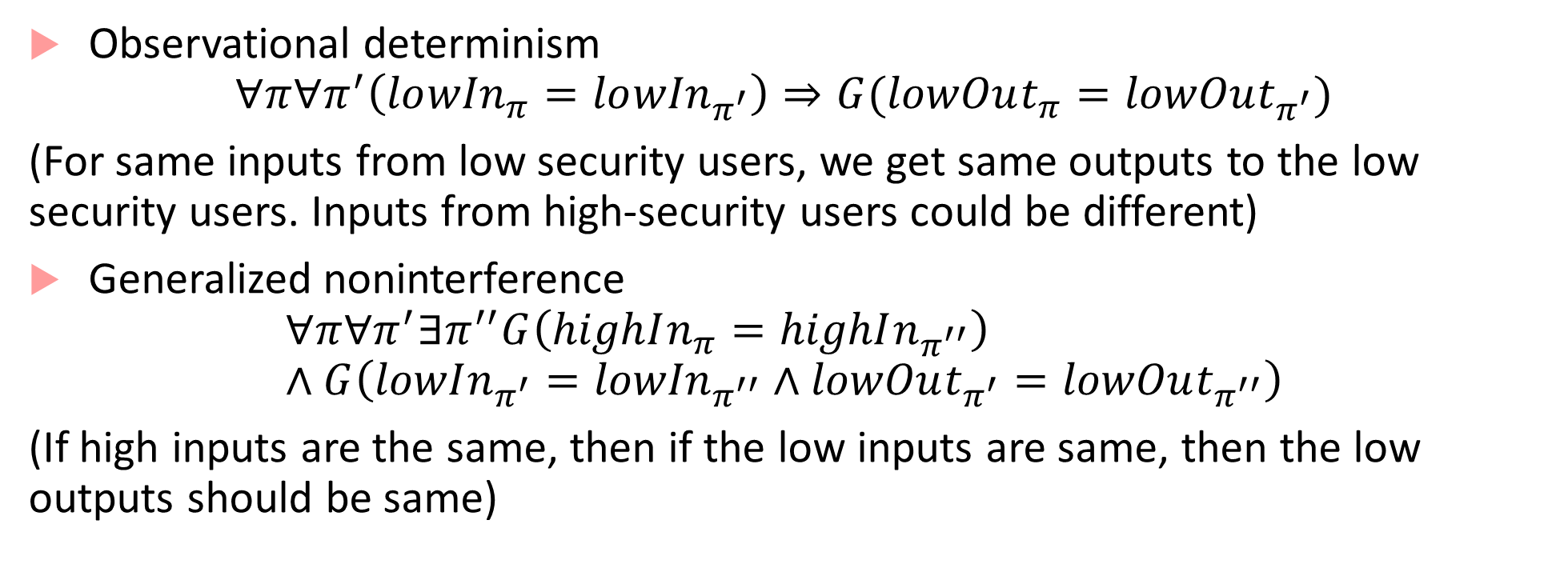
Examples of HyperLTL properties
Observational determinism
$$∀π∀π^{′}\left(lo{wIn}_{π}=lo{wIn}_{π^{′}}\right)⇒G(lowOut_{π}=lowOut_{π^{′}})$$
(For same inputs from low security users, we get same outputs to the low security users. Inputs from high-security users could be different)
Generalized noninterference
$$∀π∀π^{′}∃π^{′′}G\left(highIn_{π}=highIn_{π^{′′}}\right)∧G\left(lowIn_{π^{′}}={lowIn}_{π^{′′}}∧lowOut_{π^{′}}=lowOut_{π^{′′}}\right)$$
(If high inputs are the same, then if the low inputs are same, then the low outputs should be same)

Slide 26
Applying Hyperproperties to CPS context
HyperSTL!
We can make predicates over signals leaking private information of a CPS to the external world
In contrast to HyperLTL where decisions are Boolean, in HyperSTL, we can have any functions of the internal state of the CPS application
Very new, evolving area

Slide 27
References
T. McDermott, et al., Technical Report on Human Capital Development – Resilient Cyber Physical Systems, Available at: http://www.sercuarc.org/publications-papers/technical-report-human-capital-development-resilient-cyber-physical-systems/
Pasqualetti, F., Dörfler, F., & Bullo, F. (2013). Attack detection and identification in cyber-physical systems. IEEE Transactions on Automatic Control, 58(11), 2715-2729.
Paulo Tabuada’s talk on science of security: http://publish.illinois.edu/science-of-security-lablet/files/2015/.../SoSCPSWeek_Tabuada.pdf
Shoukry, Yasser, et al. "Privacy-aware quadratic optimization using partially homomorphic encryption." Decision and Control (CDC), 2016 IEEE 55th Conference on. IEEE, 2016.

