Slide 1
Autonomous Cyber-Physical Systems: Stability Analysis for Linear & Nonlinear Dynamical Systems
Fall 2026. CS 513.
Instructor: Jyo Deshmukh
Acknowledgment: Some of the material in these slides is based on the lecture slides for CIS 540: Principles of Embedded Computation taught by Rajeev Alur at the University of Pennsylvania. http://www.seas.upenn.edu/~cis540/
This lecture also uses some other sources, full bibliography is included at the end of the slides.

Slide 2
Stability of Systems
Property capturing the ability of a system to return to a quiescent state after perturbation
Stable systems recover after disturbances, unstable systems may not
Almost always a desirable property for a system design
Fundamental problem in control: design controllers to stabilize a system
Problem: Cart-pole is inherently unstable, aim: keep it upright
Solution Strategy: Move cart in direction in the same direction as the pendulum’s falling direction
Design problem: Design a controller to stabilize the system by computing velocity and direction for cart travel

Slide 3
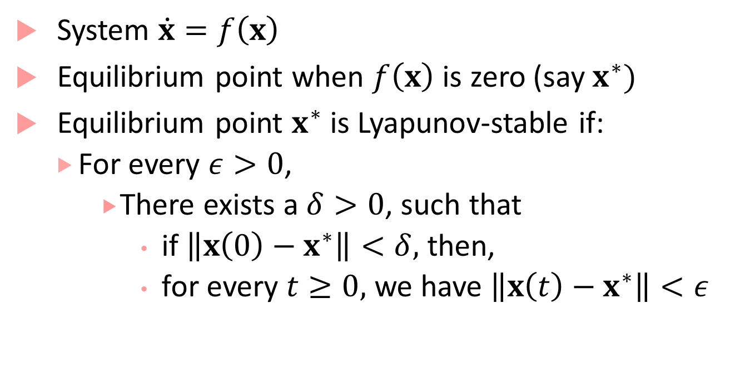
Lyapunov stability
$$x^{∗}$$
$$x(0)$$
System $\dot{x}=f\left(x\right)$
Equilibrium point when $f\left(x\right)$ is zero (say $x^{∗})$
Equilibrium point $x^{∗}$ is Lyapunov-stable if:
For every $ε>0$,
There exists a $δ>0$, such that
if $\left\|x\left(0\right)−x^{∗}\right\|<δ,$ then,
for every $t≥0,$ we have $\left\|x\left(t\right)−x^{∗}\right\|<ε$
$ε$-ball
$δ$-ball

Slide 4
Asymptotic + Exponential Stability
System $\dot{x}=f\left(x\right)$
Equilibrium point $x^{∗}$ is asymptotically-stable if:
$x^{∗}$ is Lyapunov-stable +
There exists $δ>0$ s.t. if $\left\|x\left(0\right)−x^{∗}\right\|<δ$, then $\lim_{t→∞}{‖x\left(t\right)−x^{∗}‖}=0$
Equilibrium point $x^{∗}$ is exponentially-stable if:
$x^{∗}$is asymptotically stable +
There exist $α>0,β>0$ s.t. if $\left\|x\left(0\right)−x^{∗}\right\|<δ$, then for all $t≥0:$
$$\left\|x\left(t\right)−x^{∗}\right\|≤α\left\|x\left(0\right)−x^{∗}\right\|e^{−βt}$$

Slide 5
What do these definitions all mean?
Lyapunov stable: solutions starting $δ$close from equilibrium point must remain close (within $ε)$ forever
Asymptotically stable: solutions not only remain close, but also converge to the equilibrium
Exponentially stable: solutions not only converge to the equilibrium, but in fact converge at least as fast as a known exponential rate
All stable linear systems are exponentially stable
This need not be true for nonlinear systems!

Slide 6
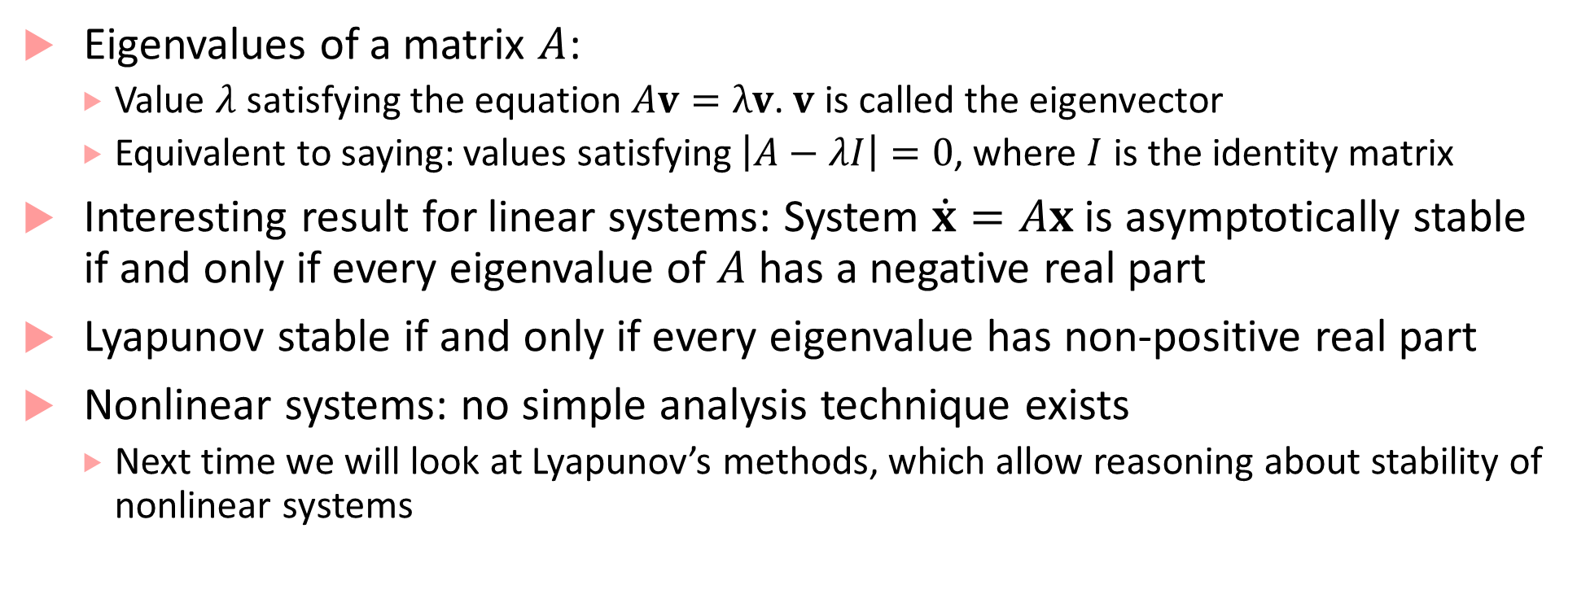
Analyzing stability for linear systems
Eigenvalues of a matrix $A$:
Value $λ$ satisfying the equation $Av=λv$. $v$ is called the eigenvector
Equivalent to saying: values satisfying $\left|A−λI\right|=0$, where $I$ is the identity matrix
Interesting result for linear systems: System $\dot{x}=Ax$ is asymptotically stable if and only if every eigenvalue of $A$ has a negative real part
Lyapunov stable if and only if every eigenvalue has non-positive real part
Nonlinear systems: no simple analysis technique exists
Next time we will look at Lyapunov’s methods, which allow reasoning about stability of nonlinear systems

Slide 7
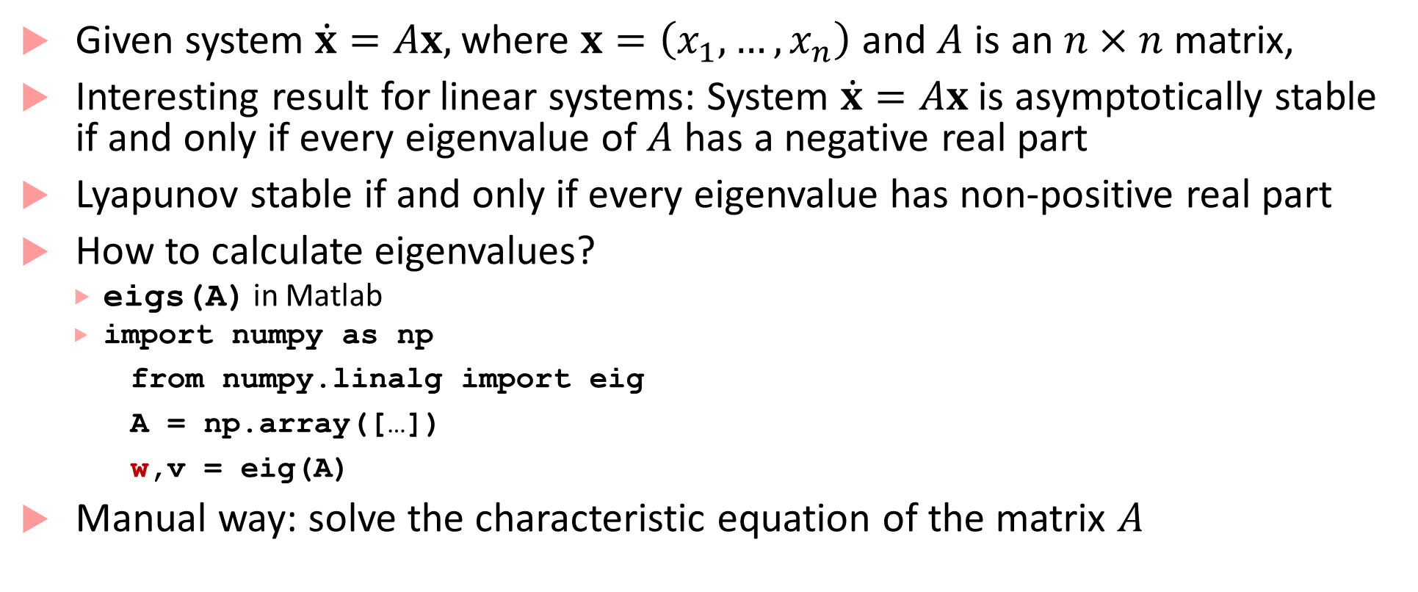
Stability Analysis for Linear Systems
Given system $\dot{x}=Ax,$where $x=\left(x_{1},…, x_{n}\right)$ and $A$ is an $n×n$matrix,
Interesting result for linear systems: System $\dot{x}=Ax$ is asymptotically stable if and only if every eigenvalue of $A$ has a negative real part
Lyapunov stable if and only if every eigenvalue has non-positive real part
How to calculate eigenvalues?
eigs(A) in Matlab
import numpy as np
from numpy.linalg import eig
A = np.array([…])
w,v = eig(A)
Manual way: solve the characteristic equation of the matrix $A$

Slide 8
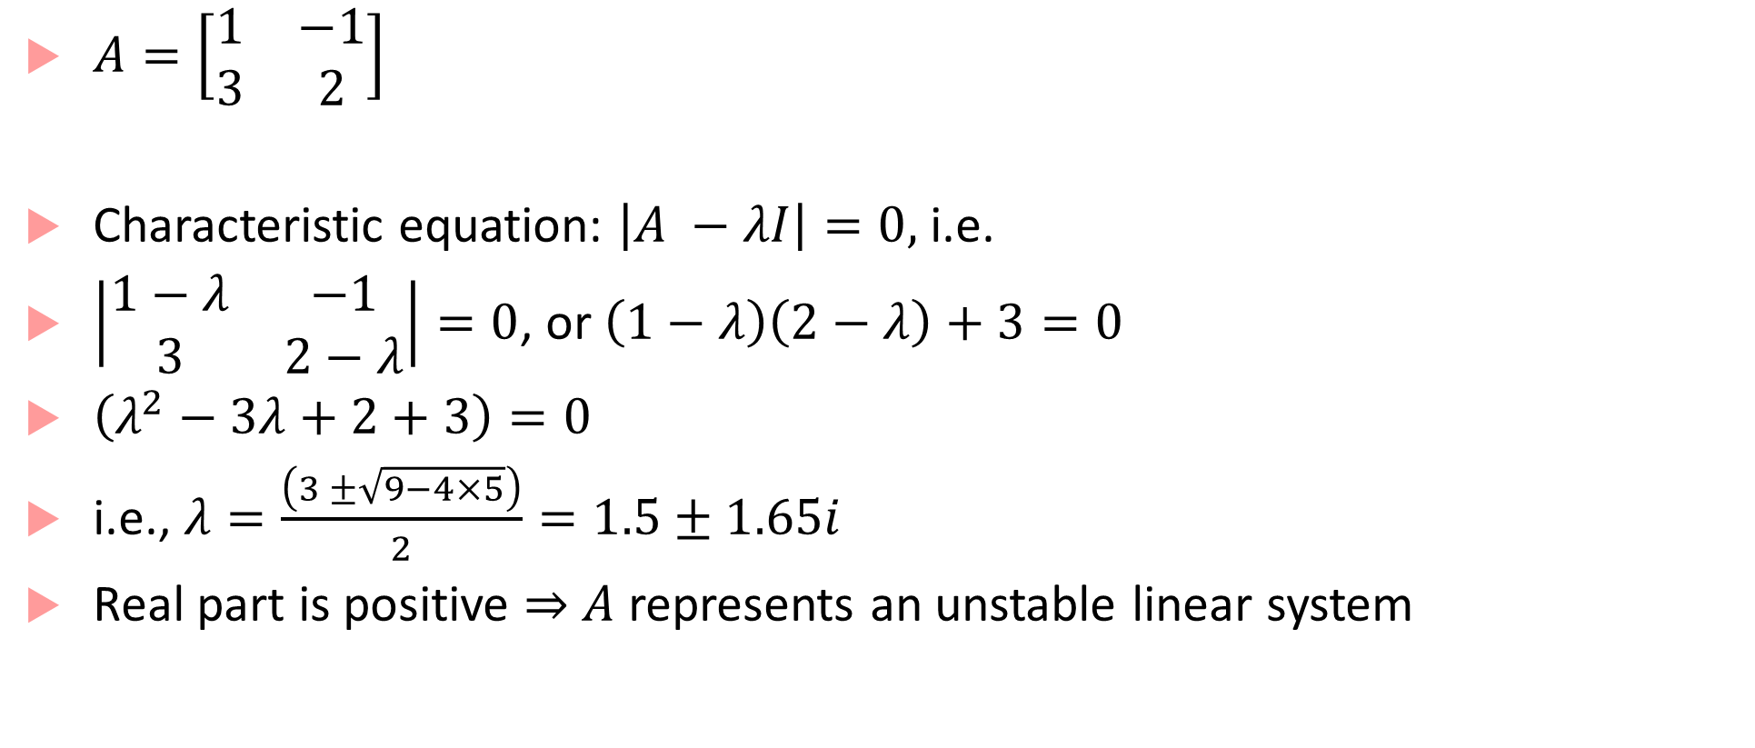
Stability analysis example for linear systems
$A=\left[\begin{matrix}1 & −1 \\ 3 & 2\end{matrix}\right]$
Characteristic equation: $\left|A −λI\right|=0,$ i.e.
$\left|\begin{matrix}1−λ & −1 \\ 3 & 2−λ\end{matrix}\right|=0$, or $\left(1−λ\right)\left(2−λ\right)+3=0$
$\left(λ^{2}−3λ+2+3\right)=0$
i.e., $λ=\frac{\left(3 ±\sqrt{9−4×5}\right)}{2}=1.5±1.65i$
Real part is positive $⇒$ $A$ represents an unstable linear system

Slide 9
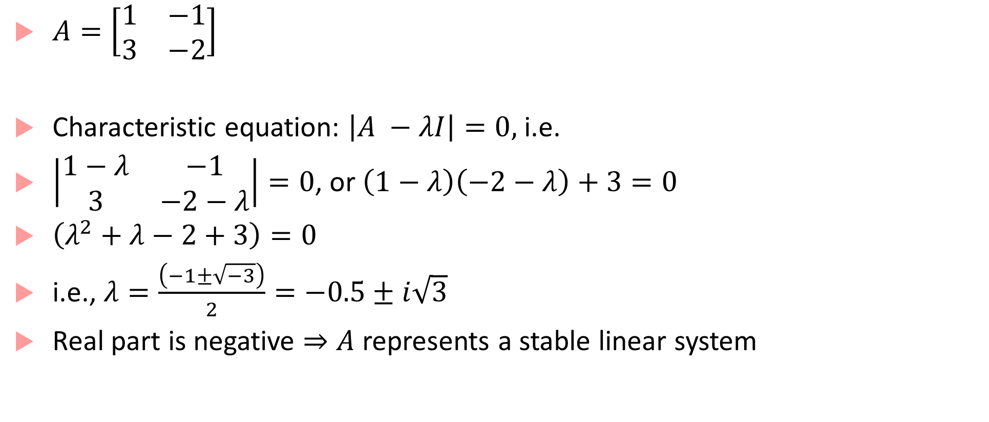
Stability analysis example for linear systems
$A=\left[\begin{matrix}1 & −1 \\ 3 & −2\end{matrix}\right]$
Characteristic equation: $\left|A −λI\right|=0,$ i.e.
$\left|\begin{matrix}1−λ & −1 \\ 3 & −2−λ\end{matrix}\right|=0$, or $\left(1−λ\right)\left(−2−λ\right)+3=0$
$\left(λ^{2}+λ−2+3\right)=0$
i.e., $λ=\frac{\left(−1±\sqrt{−3}\right)}{2}=−0.5±i\sqrt{3}$
Real part is negative $⇒$ $A$ represents a stable linear system

Slide 10


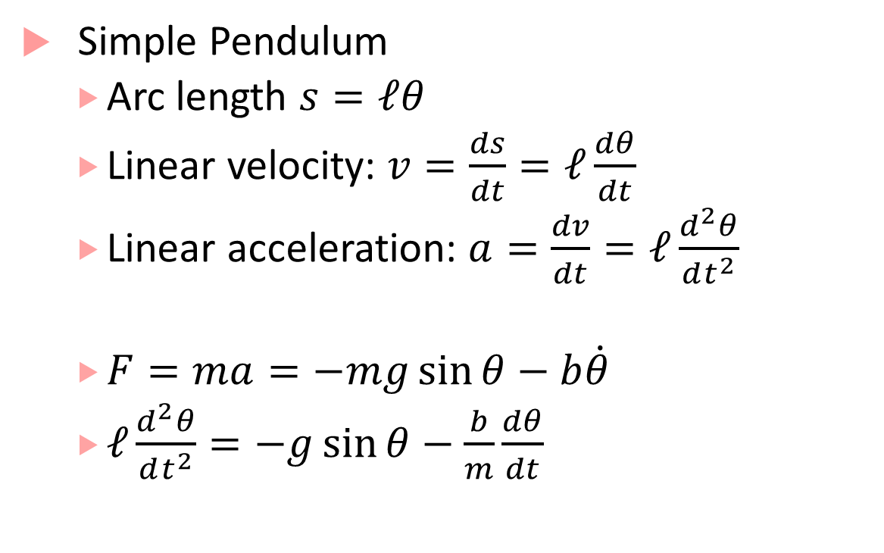



Nonlinear Dynamical System
Simple Pendulum
Arc length $s=ℓθ$
Linear velocity: $v=\frac{ds}{dt}=ℓ\frac{dθ}{dt}$
Linear acceleration: $a=\frac{dv}{dt}=ℓ\frac{d^{2}θ}{dt^{2}}$
$F=ma=−mg\sin{θ}−b\dot{θ}$
$ℓ\frac{d^{2}θ}{dt^{2}}=−g\sin{θ}−\frac{b}{m}\frac{dθ}{dt}$
$$θ$$
$$ℓ$$
$$mg\sin{θ}$$
Friction
$$mg\cos{θ}$$
$$mg$$

Slide 11
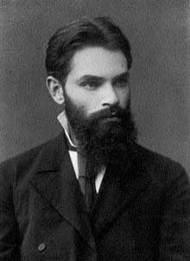
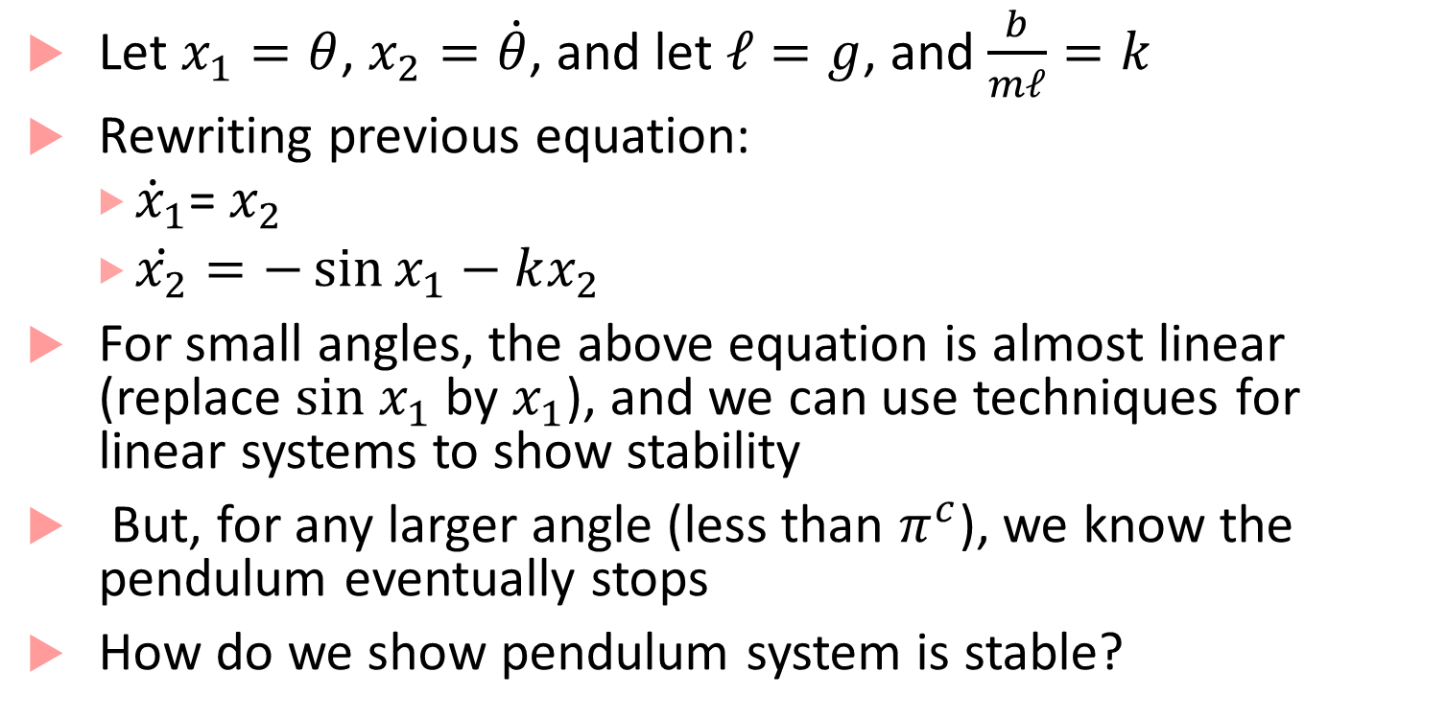
Simple Pendulum Dynamics
Aleksandr Lyapunov
Russian mathematician
Let $x_{1}=θ$, $x_{2}=\dot{θ}$, and let $ℓ=g$, and $\frac{b}{mℓ}=k$
Rewriting previous equation:
${\dot{x}}_{1}$= $x_{2}$
$\dot{x_{2}}=−\sin{x_{1}}−kx_{2}$
For small angles, the above equation is almost linear (replace $sin x_{1}$ by $x_{1}$), and we can use techniques for linear systems to show stability
But, for any larger angle (less than $π^{c}$), we know the pendulum eventually stops
How do we show pendulum system is stable?
Use my method!!

Slide 12
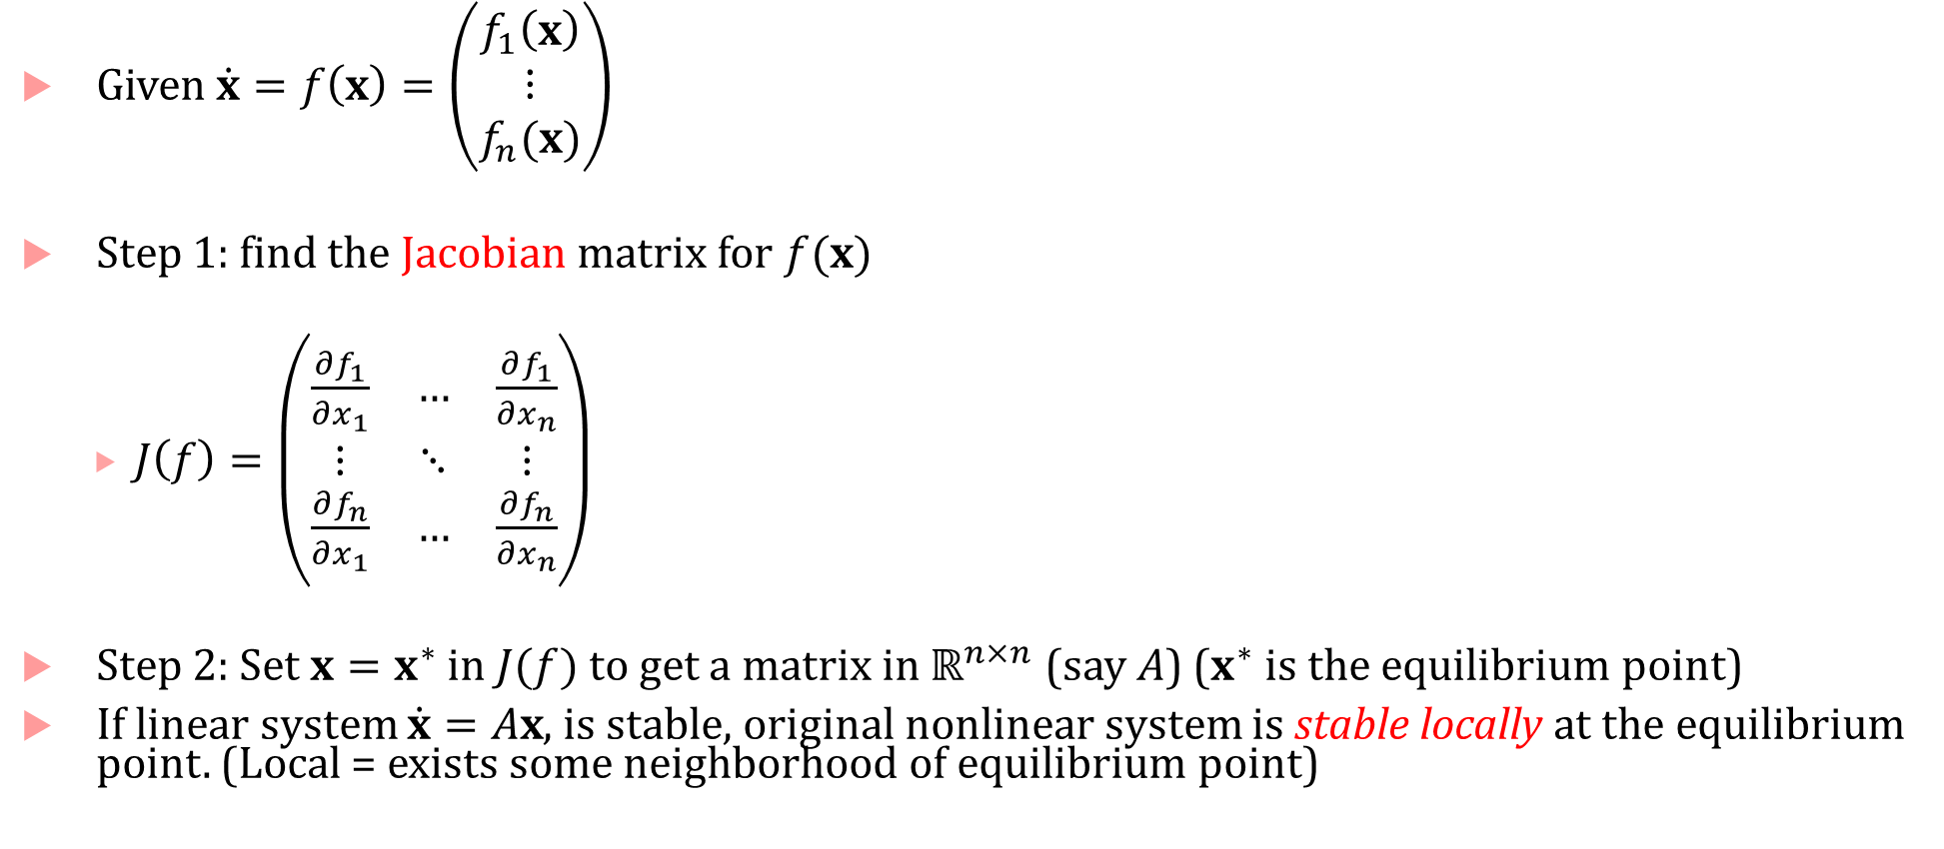
Lyapunov’s first method
Given $\dot{x}=f\left(x\right)=\left(\begin{matrix}f_{1}\left(x\right) \\ \begin{matrix}⋮ \\ f_{n}(x)\end{matrix}\end{matrix}\right)$
Step 1: find the Jacobian matrix for $f(x)$
$J\left(f\right)=\left(\begin{matrix}\frac{∂f_{1}}{∂x_{1}} & … & \frac{∂f_{1}}{∂x_{n}} \\ ⋮ & ⋱ & ⋮ \\ \frac{∂f_{n}}{∂x_{1}} & … & \frac{∂f_{n}}{∂x_{n}}\end{matrix}\right)$
Step 2: Set $x=x^{∗}$ in $J(f)$ to get a matrix in $ℝ^{n×n}$ (say $A$) ($x^{∗}$ is the equilibrium point)
If linear system $\dot{x}=Ax$, is stable, original nonlinear system is stable locally at the equilibrium point. (Local = exists some neighborhood of equilibrium point)

Slide 13
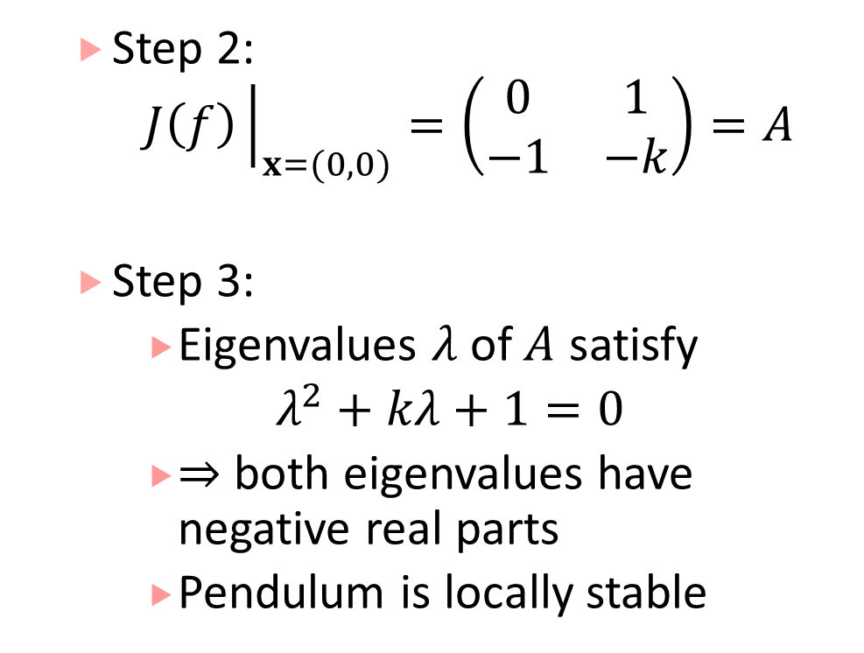
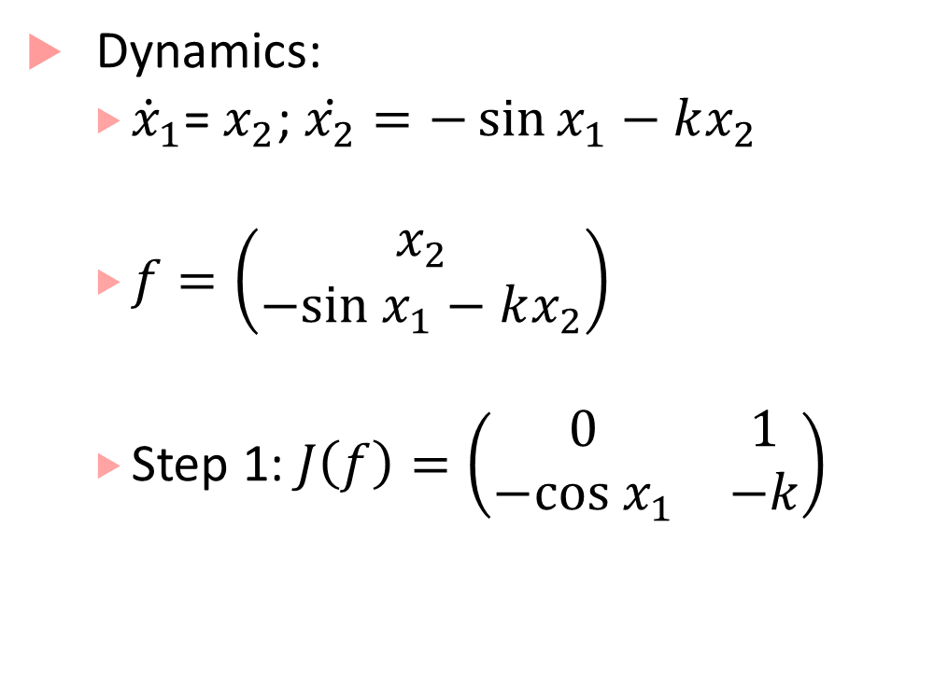
Lyapunov’s first method for pendulum
Dynamics:
${\dot{x}}_{1}$= $x_{2}$; $\dot{x_{2}}=−\sin{x_{1}}−kx_{2}$
$f=\left(\begin{matrix}x_{2} \\ −sin x_{1}−kx_{2}\end{matrix}\right)$
Step 1: $J\left(f\right)=\left(\begin{matrix}0 & 1 \\ −cos x_{1} & −k\end{matrix}\right)$
Step 2:
$$J\left(f\right){\left.​\right|}_{x=(0,0)}=\left(\begin{matrix}0 & 1 \\ −1 & −k\end{matrix}\right)=A$$
Step 3:
Eigenvalues $λ$of $A$ satisfy
$λ^{2}+kλ+1=0$
$⇒$ both eigenvalues have negative real parts
Pendulum is locally stable

Slide 14
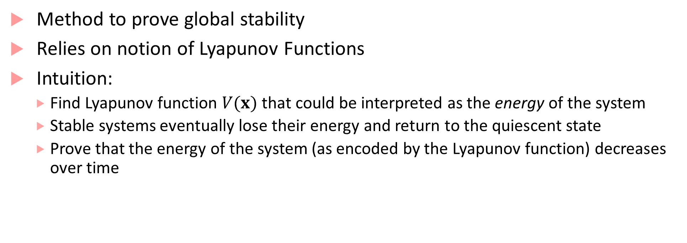
Lyapunov’s second method
Method to prove global stability
Relies on notion of Lyapunov Functions
Intuition:
Find Lyapunov function $V(x)$ that could be interpreted as the energy of the system
Stable systems eventually lose their energy and return to the quiescent state
Prove that the energy of the system (as encoded by the Lyapunov function) decreases over time

Slide 15
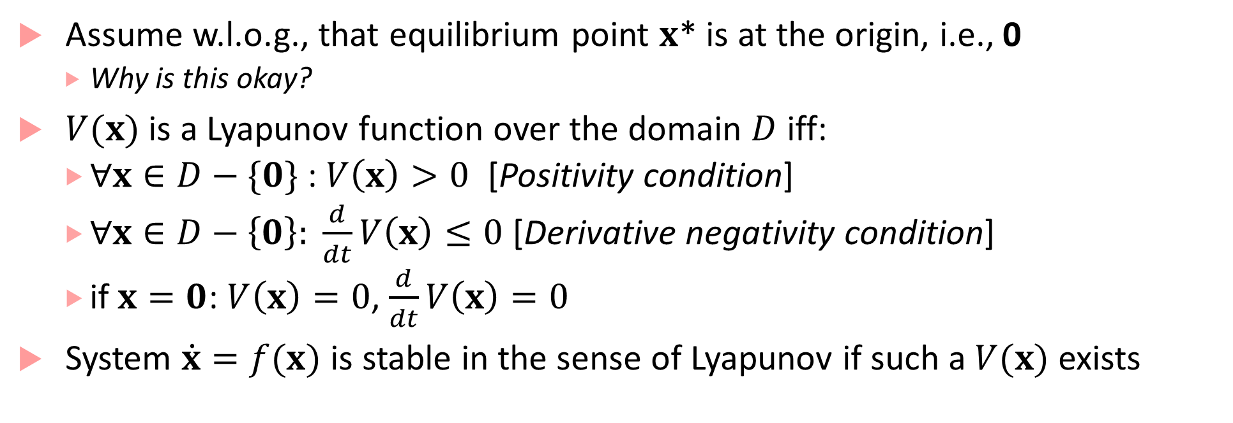
Lyapunov’s Second Method: the math
Assume w.l.o.g., that equilibrium point $x$* is at the origin, i.e., 0
Why is this okay?
$V(x)$ is a Lyapunov function over the domain $D$ iff:
$∀x∈D−\{0\}$ : $V\left(x\right)>0$ [Positivity condition]
$∀x∈D−\left\{0\right\}: \frac{d}{dt}V\left(x\right)≤0$ [Derivative negativity condition]
if $x=0$: $V\left(x\right)=0$, $\frac{d}{dt}V\left(x\right)=0$
System $\dot{x}=f(x)$ is stable in the sense of Lyapunov if such a $V(x)$ exists

Slide 16






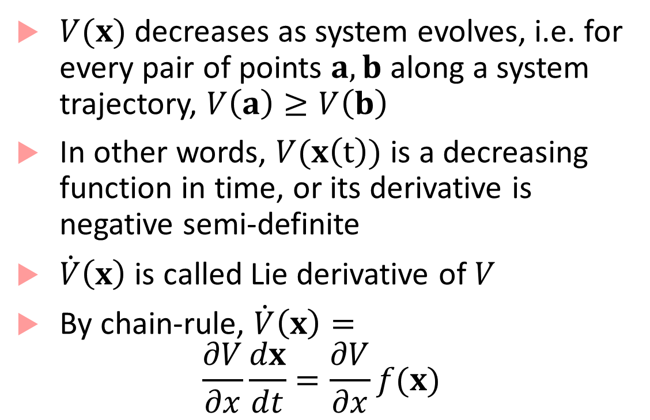



Illustration and Lie-derivative
$$x_{2}$$
$V(x)$ decreases as system evolves, i.e. for every pair of points $a,b$ along a system trajectory, $V\left(a\right)≥V\left(b\right)$
In other words, $V(x\left(t\right))$ is a decreasing function in time, or its derivative is negative semi-definite
$\dot{V}\left(x\right)$ is called Lie derivative of $V$
By chain-rule, $\dot{V}\left(x\right)=$
$$\frac{∂V}{∂x}\frac{dx}{dt}=\frac{∂V}{∂x}f(x)$$
$$x(0)$$
$$0$$
$$x_{1}$$
$$a$$
$$V(a)$$
$$≥$$
$$b$$
$$V(b)$$

Slide 17
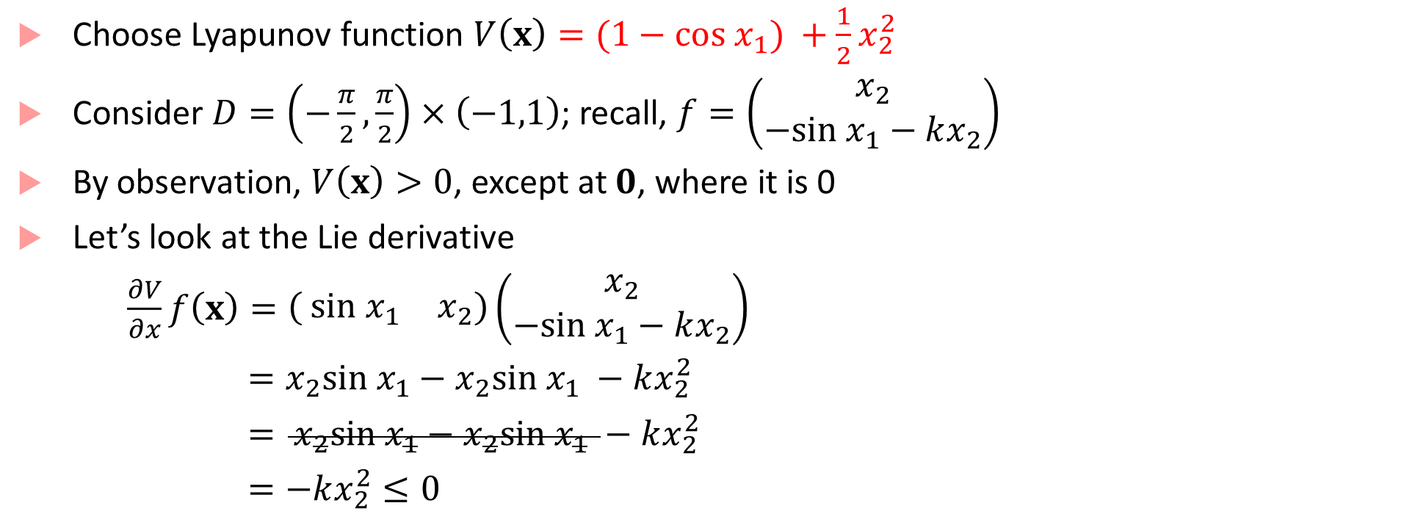
Lyapunov’s second method for pendulum
Choose Lyapunov function $V\left(x\right)=(1−cos x_{1}) +\frac{1}{2}x_{2}^{2}$
Consider $D=\left(−\frac{π}{2},\frac{π}{2}\right)×\left(−1,1\right)$; recall, $f=\left(\begin{matrix}x_{2} \\ −sin x_{1}−kx_{2}\end{matrix}\right)$
By observation, $V\left(x\right)>0$, except at $0$, where it is 0
Let’s look at the Lie derivative
$\frac{∂V}{∂x}f\left(x\right)=\left( \begin{matrix}{sin x}_{1} & x_{2}\end{matrix}\right)\left(\begin{matrix}x_{2} \\ −sin x_{1}−kx_{2}\end{matrix}\right)$
$=x_{2}sin x_{1}−x_{2}sin x_{1} −kx_{2}^{2}$
$= x_{2}sin x_{1}−x_{2}sin x_{1} −kx_{2}^{2}$
$=−kx_{2}^{2}≤0$

Slide 18
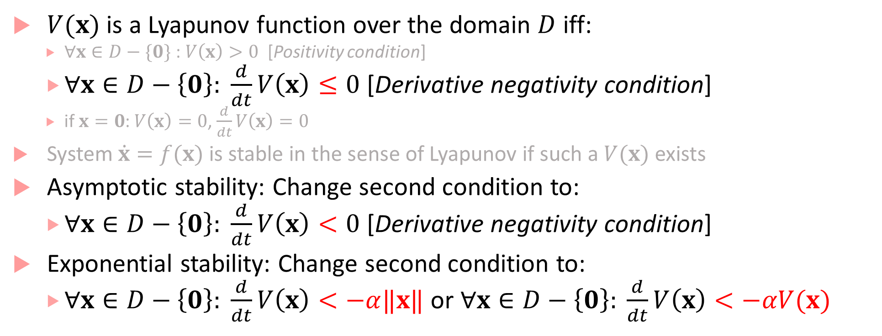
Second method for asymptotic/exponential stability
$V(x)$ is a Lyapunov function over the domain $D$ iff:
$∀x∈D−\{0\}$ : $V\left(x\right)>0$ [Positivity condition]
$∀x∈D−\left\{0\right\}: \frac{d}{dt}V\left(x\right)≤0$ [Derivative negativity condition]
if $x=0$: $V\left(x\right)=0$, $\frac{d}{dt}V\left(x\right)=0$
System $\dot{x}=f(x)$ is stable in the sense of Lyapunov if such a $V(x)$ exists
Asymptotic stability: Change second condition to:
$∀x∈D−\left\{0\right\}: \frac{d}{dt}V\left(x\right)<0$ [Derivative negativity condition]
Exponential stability: Change second condition to:
$∀x∈D−\left\{0\right\}: \frac{d}{dt}V\left(x\right)<−α‖x‖$ or $∀x∈D−\left\{0\right\}: \frac{d}{dt}V\left(x\right)<−αV(x)$

Slide 19
Challenges with Lyapunov’s second method
How do we find a Lyapunov function?
Maybe use the physics of the system to understand what encodes “energy”
For certain nonlinear systems (those with polynomial dynamics), can some algorithmic methods
In general a hard problem
Yet, is a powerful approach to prove global stability

Slide 20
Stability of hybrid systems
Hybrid systems can have surprising results with respect to stability
No uniform method like Lyapunov analysis for analyzing all hybrid systems
Example: Piecewise Linear (PWL) Dynamical System
Special class of hybrid system, in which each mode has linear dynamics, guards, resets are all linear/affine
Each mode in the PWL system can have stable dynamics (by doing eigen-value analysis), but resulting hybrid system may be unstable!

Slide 21
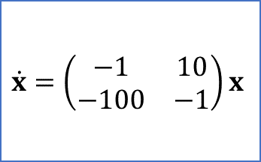
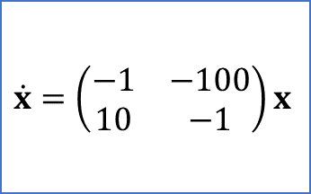


Example
$$x_{2}=−0.2x_{1} ?$$
$$\dot{x}=\left(\begin{matrix}−1 & −100 \\ 10 & −1\end{matrix}\right)x$$
$$\dot{x}=\left(\begin{matrix}−1 & 10 \\ −100 & −1\end{matrix}\right)x$$
$$x_{2}=5x_{1} ?$$
Dynamics in each mode are stable!

Slide 22




Simulation results
$$x_{2}$$
$$x_{2}=5x_{1}$$
$$x_{2}=−0.2x_{1}$$
Initial State
$$x_{1}$$

Slide 23
What are the implications of this?
Most controllers/actuators operate at discrete-time intervals or are event-triggered
Could have multiple controllers/actuators that act at different time-steps
Stability becomes challenging to prove!

Slide 24
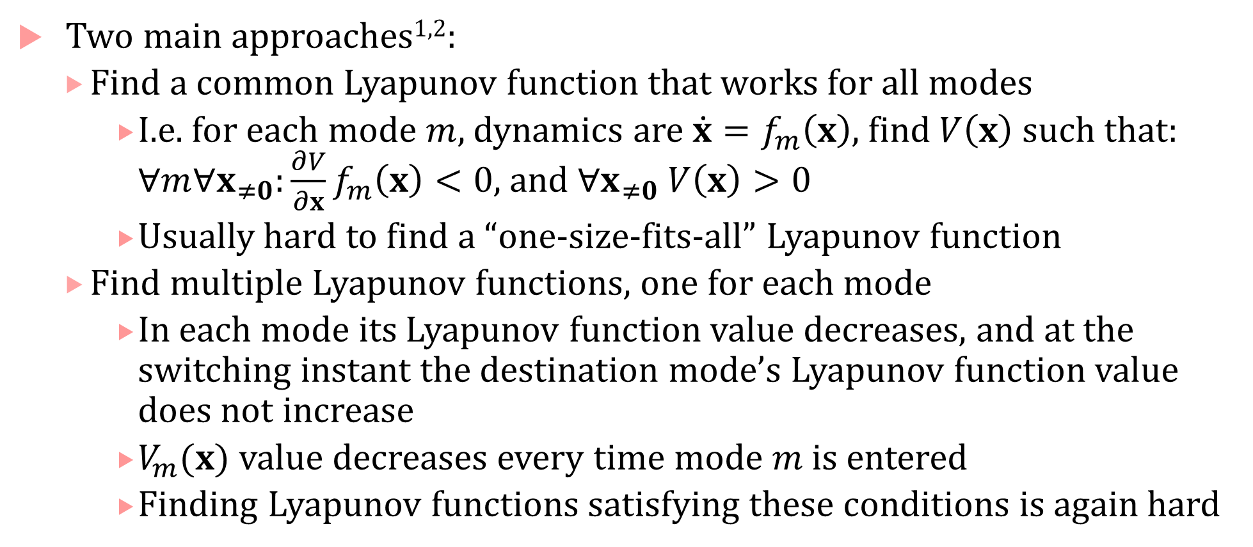
Stability analysis for hybrid systems
Two main approaches^{1,2}:
Find a common Lyapunov function that works for all modes
I.e. for each mode $m$, dynamics are $\dot{x}=f_{m}\left(x\right)$, find $V\left(x\right)$ such that: $∀m∀x_{≠0}:\frac{∂V}{∂x}f_{m}\left(x\right)<0$, and $∀x_{≠0} V\left(x\right)>0$
Usually hard to find a “one-size-fits-all” Lyapunov function
Find multiple Lyapunov functions, one for each mode
In each mode its Lyapunov function value decreases, and at the switching instant the destination mode’s Lyapunov function value does not increase
$V_{m}(x)$ value decreases every time mode $m$ is entered
Finding Lyapunov functions satisfying these conditions is again hard

Slide 25

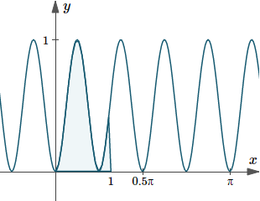

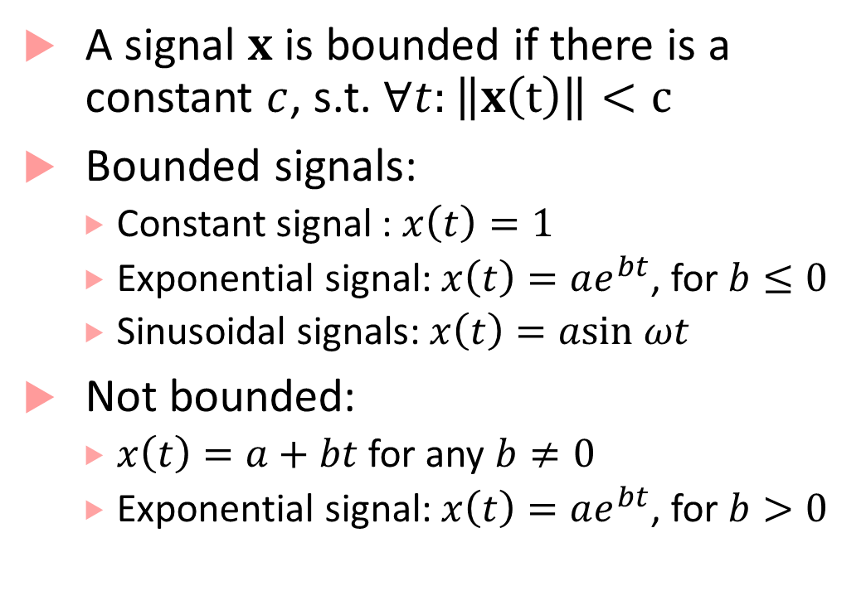









Bounded signals
A signal $x$ is bounded if there is a constant $c$, s.t. $∀t:\left\|x\left(t\right)\right\|<c$
Bounded signals:
Constant signal : $x\left(t\right)=1$
Exponential signal: $x\left(t\right)=ae^{bt}$, for $b≤0$
Sinusoidal signals: $x\left(t\right)=asin ωt$
Not bounded:
$x\left(t\right)=a+bt$ for any $b≠0$
Exponential signal: $x\left(t\right)=ae^{bt}$, for $b>0$
$$‖x‖$$
$$‖x‖$$
$$t$$
$$t$$
$$‖x‖$$
$$‖x‖$$
$$t$$
$$‖x‖$$
$$t$$
$$t$$
This Photo by Unknown Author is licensed under CC BY-SA

Slide 26
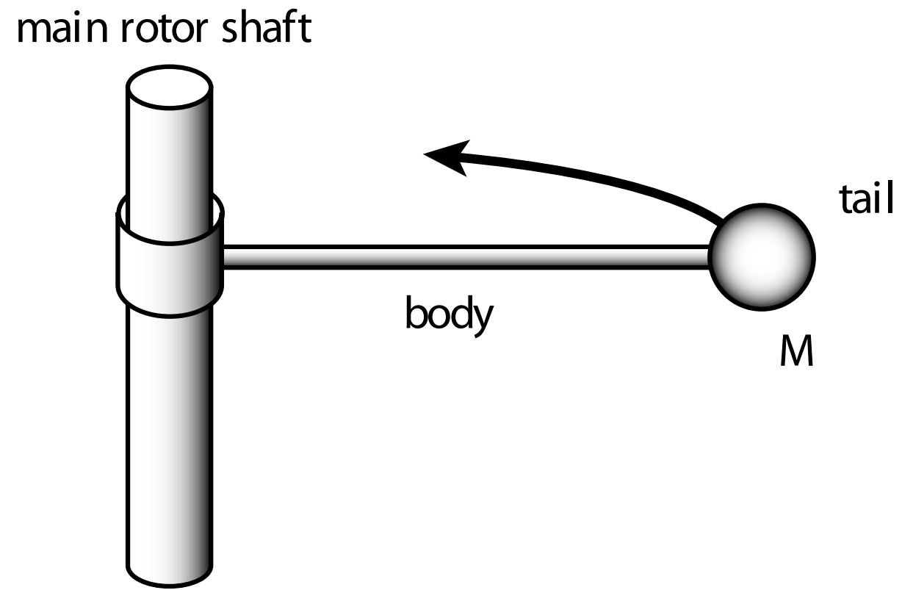
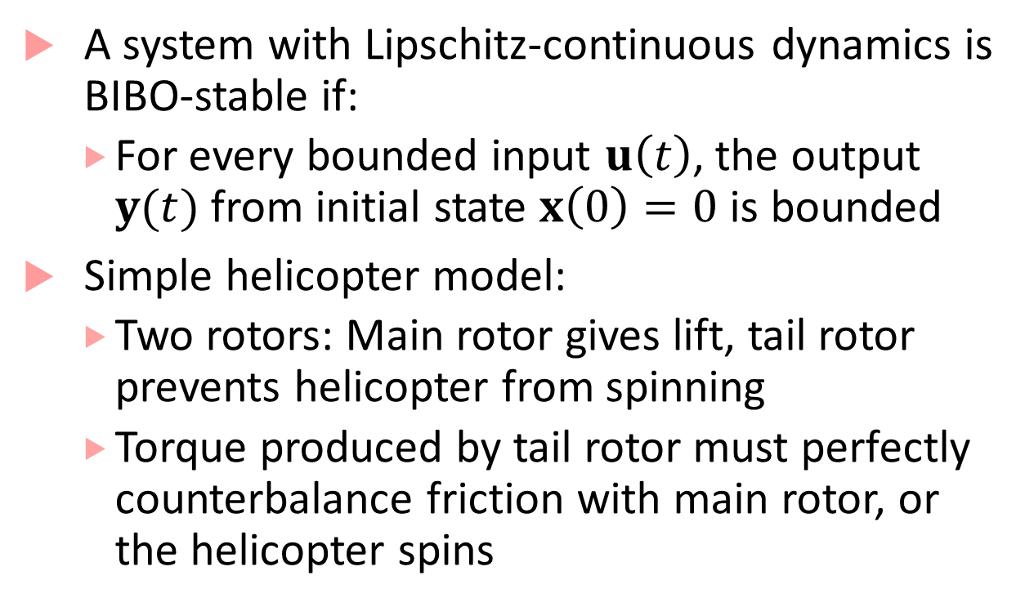
BIBO stability
A system with Lipschitz-continuous dynamics is BIBO-stable if:
For every bounded input $u\left(t\right)$, the output $y(t)$ from initial state $x\left(0\right)=0$ is bounded
Simple helicopter model:
Two rotors: Main rotor gives lift, tail rotor prevents helicopter from spinning
Torque produced by tail rotor must perfectly counterbalance friction with main rotor, or the helicopter spins
Image credit: From Lee & Seshia: Introduction to Embedded Systems - A Cyber-Physical Systems Approach, http://leeseshia.org/

Slide 27
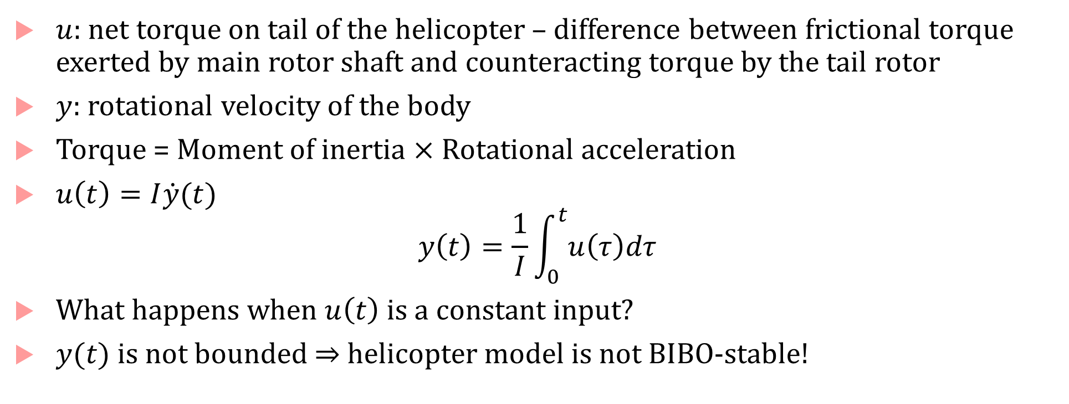
Helicopter Model continued
$u$: net torque on tail of the helicopter – difference between frictional torque exerted by main rotor shaft and counteracting torque by the tail rotor
$y$: rotational velocity of the body
Torque = Moment of inertia $×$ Rotational acceleration
$u\left(t\right)=I\dot{y}(t)$
$$y\left(t\right)=\frac{1}{I}\int_{0}^{t}{u\left(τ\right)dτ}$$
What happens when $u\left(t\right)$ is a constant input?
$y(t)$ is not bounded $⇒$ helicopter model is not BIBO-stable!

