Slide 1
Autonomous Cyber-Physical Systems: Timed & Hybrid Dynamical Systems
Fall 2026. CSCI 513.
Instructor: Jyo Deshmukh
Acknowledgment: Some of the material in these slides is based on the lecture slides for CIS 540: Principles of Embedded Computation taught by Rajeev Alur at the University of Pennsylvania. http://www.seas.upenn.edu/~cis540/

Slide 2
Models of Computation
Synchronous Process Models
Asynchronous Process Models
Continuous-time models/Dynamical system models
Like Synchronous, but time evolves continuously
Timed & Hybrid Dynamical Models
[1] Nicolescu, Gabriela; Mosterman, Pieter J., eds. (2010). Model-Based Design for Embedded Systems. Computational Analysis, Synthesis, and Design of Dynamic Systems. 1. Boca Raton: CRC Press.

Slide 3


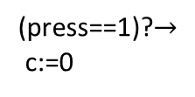
Timed ESMs
Like asynchronous ESMs, have input, output channels, state variables
Special type of state variable called “clock”
Clock variables evolve continuously in time
ESM can “stay” in a mode with clock increasing monotonically from the start value
(press==1)? $∧$ (c$≥$1)
clock c:=0
off
dim
(press==1)? $∧$ (c$≤$1)
bright
(press==1)?$→$
c:=0
(press==1)?

Slide 4
Transitions of a timed ESM
(press==1)? $∧$ (c$≥$1)
Mode switch: discrete action
machine moves from one mode to another
guard on the transition must be true for mode switch to occur
update specified by the transition will update/reset clock variables
clock c:=0
off
dim
(press==1)? $∧$ (c$≤$1)
bright
(press==1)?$→$
c:=0
(press==1)?
(press==1)?
(off,0.5)
(dim,0)

Slide 5
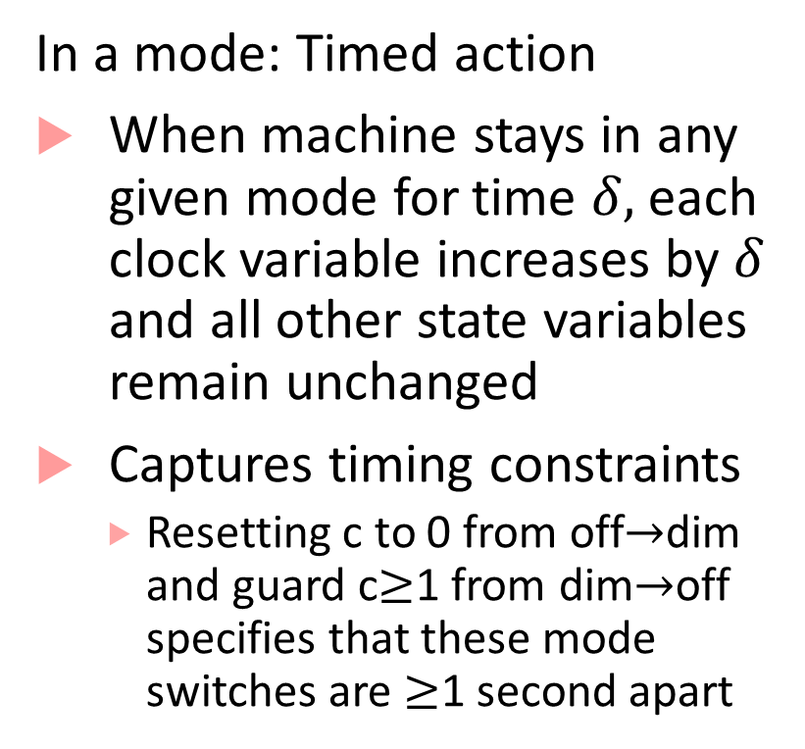
Transitions of a timed ESM
In a mode: Timed action
When machine stays in any given mode for time $δ,$each clock variable increases by $δ$ and all other state variables remain unchanged
Captures timing constraints
Resetting c to 0 from off$→$dim and guard c$≥$1 from dim$→$off specifies that these mode switches are $≥$1 second apart
(press==1)? $∧$ (c$≥$1)
clock c:=0
off
dim
(press==1)? $∧$ (c$≤$1)
bright
(press==1)?$→$
c:=0
(press==1)?

Slide 6
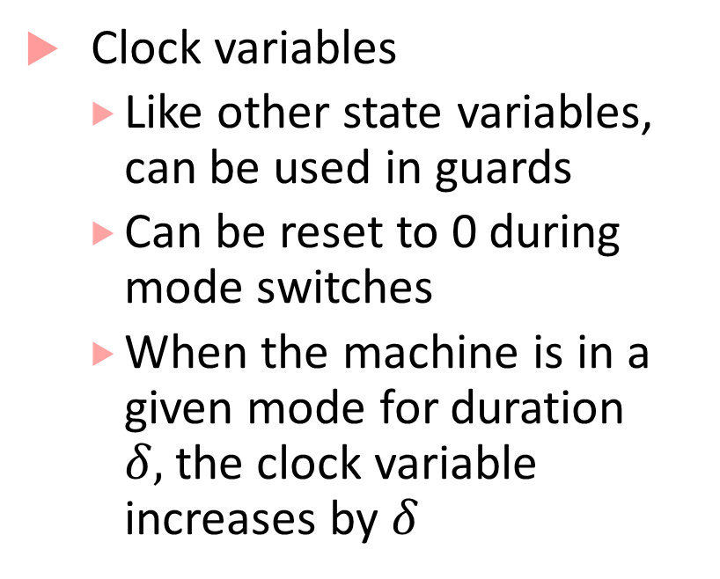
Timed Processes: explicit clock variables
(press==1)? $∧$ (c$≥$1)
Clock variables
Like other state variables, can be used in guards
Can be reset to 0 during mode switches
When the machine is in a given mode for duration $δ,$the clock variable increases by $δ$
clock c:=0
off
dim
(press==1)? $∧$ (c$≤$1)
bright
(press==1)?$→$
c:=0
(press==1)?

Slide 7

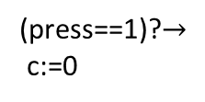

Timed Process Execution
(press==1)? $∧$ (c$≥$1)
Machine execution is through alternating timed transitions and mode switches
clock c:=0
off
dim
(press==1)? $∧$ (c$≤$1)
bright
(press==1)?$→$
c:=0
(press==1)?
(press==1)?
(press==1)?
(off,0)
(off,0.5)
(dim,0)
(dim,0.8)
(bright,0.8)

Slide 8
Timed Process Execution
(press==1)? $∧$ (c$≥$1)
Machine execution is through alternating timed transitions and mode switches
clock c:=0
off
dim
(press==1)? $∧$ (c$≤$1)
bright
(press==1)?$→$
c:=0
(press==1)?
(press==1)?
(off,0)
(off,0.5)
(dim,0)
(press==1)?
(dim,3.8)
(off,3.8)

Slide 9

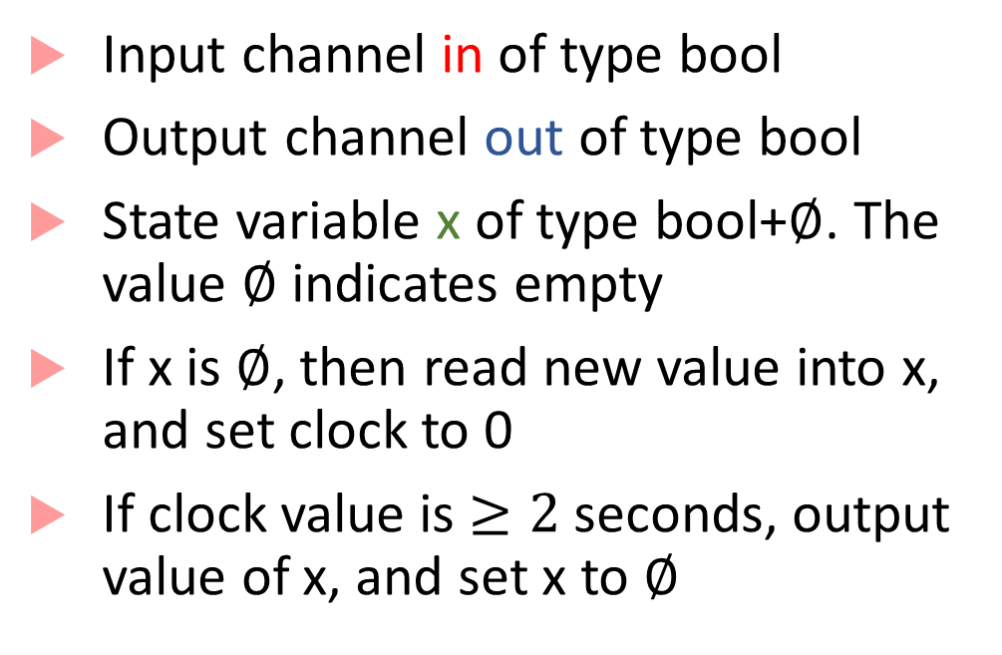

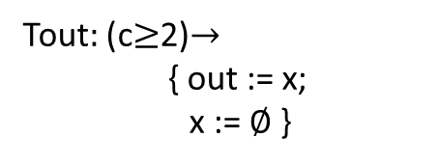
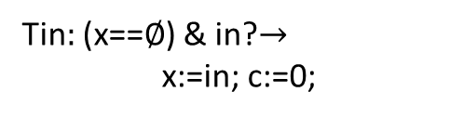
Timed Buffer
Input channel in of type bool
Output channel out of type bool
State variable x of type bool+$∅$. The value $∅$ indicates empty
If x is $∅$, then read new value into x, and set clock to 0
If clock value is $≥2$ seconds, output value of x, and set x to $∅$
bool in
${\text{bool}}_{∅}$ x:= $∅$, clock c:=0
bool
out
Tin$:$ (x==$∅$) & in?$→$
x:=in; c:=0;
Tout$:$ (c$≥$2)$→$
{ out := x;
x := $∅$ }
T_{infull}$:$ in? $→$

Slide 10

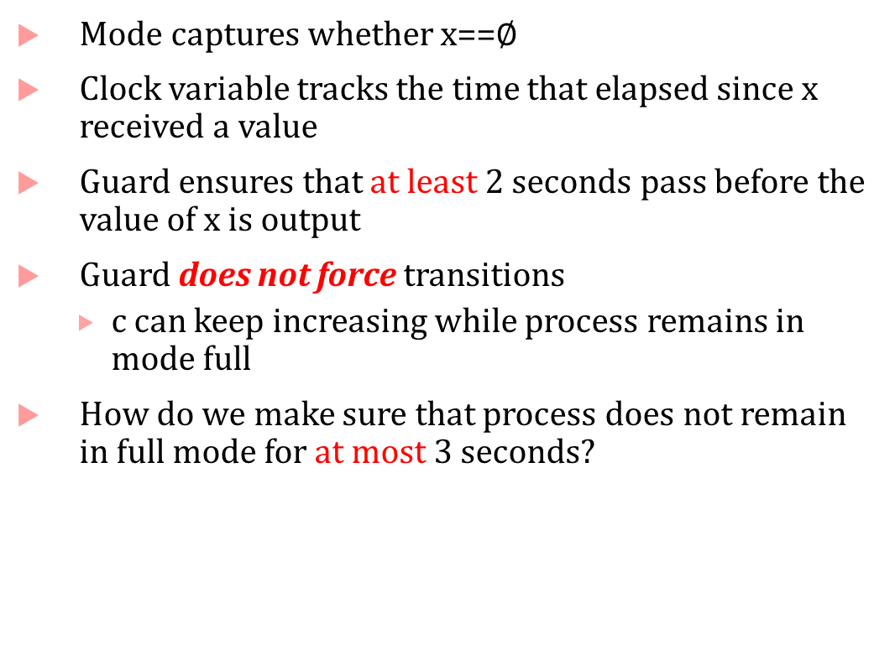

Timed State Machine representation
Mode captures whether x==$∅$
Clock variable tracks the time that elapsed since x received a value
Guard ensures that at least 2 seconds pass before the value of x is output
Guard does not force transitions
$c$ can keep increasing while process remains in mode full
How do we make sure that process does not remain in full mode for at most 3 seconds?
c$≥2$ $→$ out:=x, x≔$∅$
in?
c:=0
empty
full
in?$→$ x:=in, c:=0

Slide 11
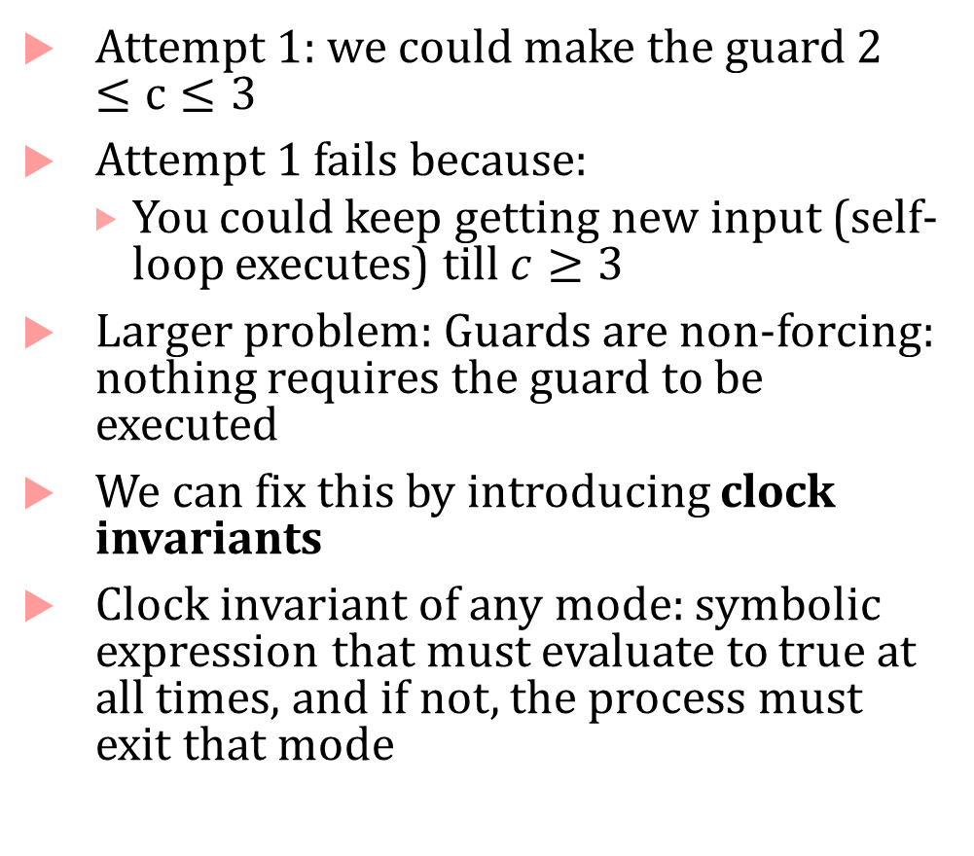

Clock invariants
Attempt 1: we could make the guard $2≤c≤3$
Attempt 1 fails because:
You could keep getting new input (self-loop executes) till $c≥3$
Larger problem: Guards are non-forcing: nothing requires the guard to be executed
We can fix this by introducing clock invariants
Clock invariant of any mode: symbolic expression that must evaluate to true at all times, and if not, the process must exit that mode
c$≥2$ $→$ out:=x, x≔$∅$
in?
c:=0
empty
full
in?$→$ x:=in, c:=0

Slide 12
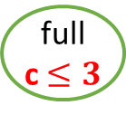
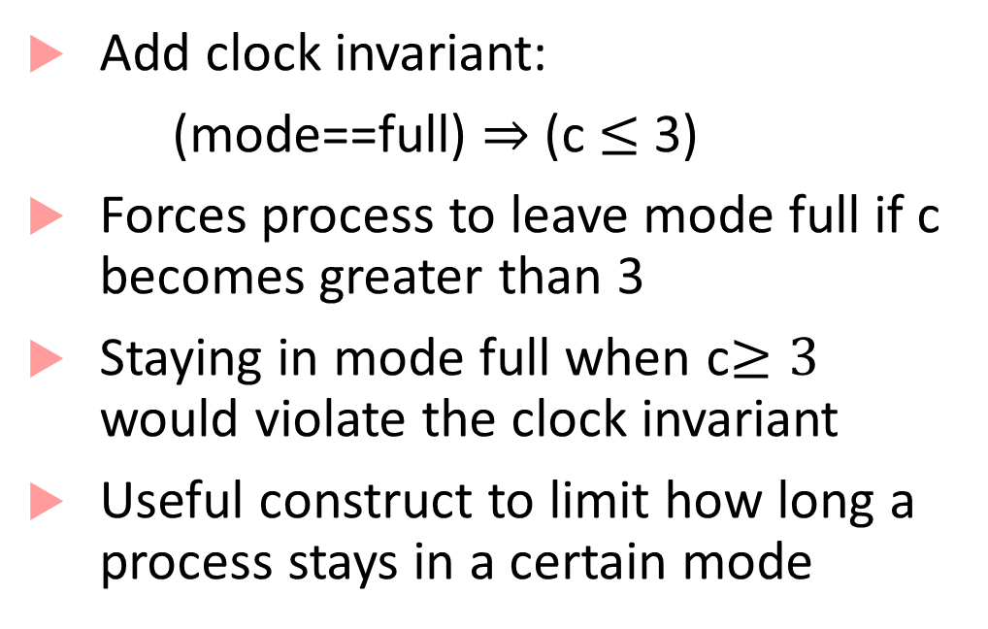
Clock invariants
Add clock invariant:
(mode==full) $⇒$ (c $≤$ 3)
Forces process to leave mode full if c becomes greater than 3
Staying in mode full when c$≥3$ would violate the clock invariant
Useful construct to limit how long a process stays in a certain mode
c$≥2$ $→$ out:=x, x≔$∅$
in?
c:=0
empty
full
c $≤3$
in?$→$ x:=in, c:=0

Slide 13

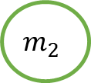
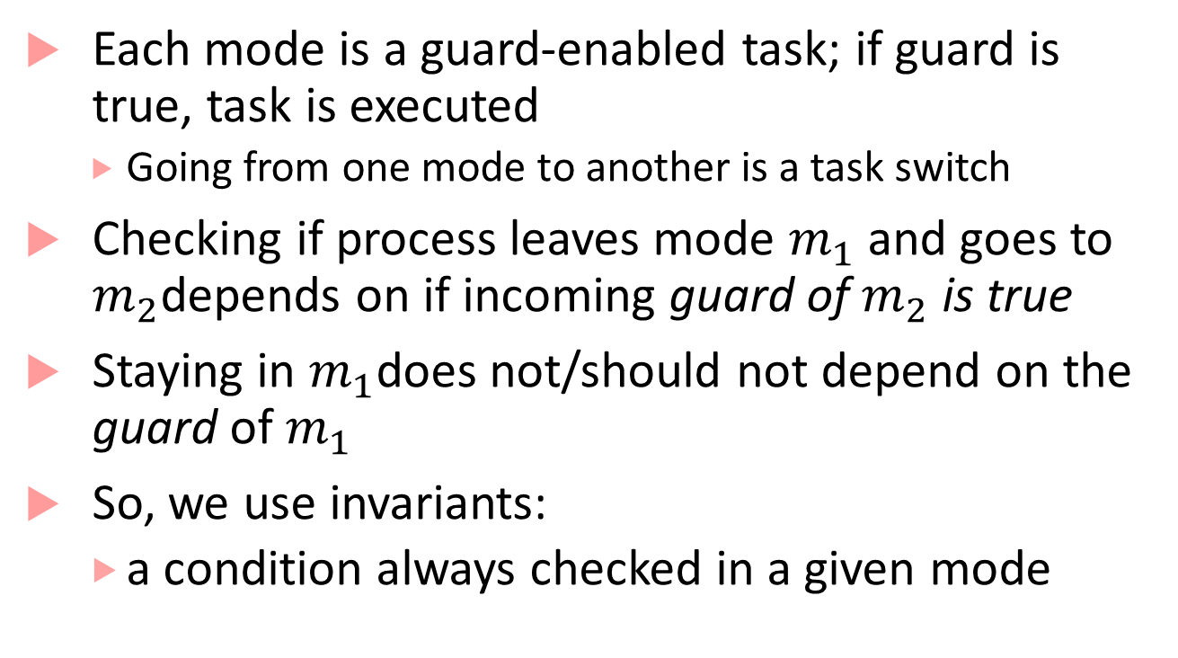


Why model using invariants and guards?
Each mode is a guard-enabled task; if guard is true, task is executed
Going from one mode to another is a task switch
Checking if process leaves mode $m_{1}$ and goes to $m_{2}$depends on if incoming guard of $m_{2}$ is true
Staying in $m_{1}$does not/should not depend on the guard of$m_{1}$
So, we use invariants:
a condition always checked in a given mode
$$m_{1}$$
$$g_{2}$$
$$g_{1}$$
$$m_{2}$$

Slide 14
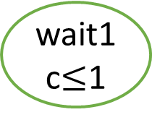
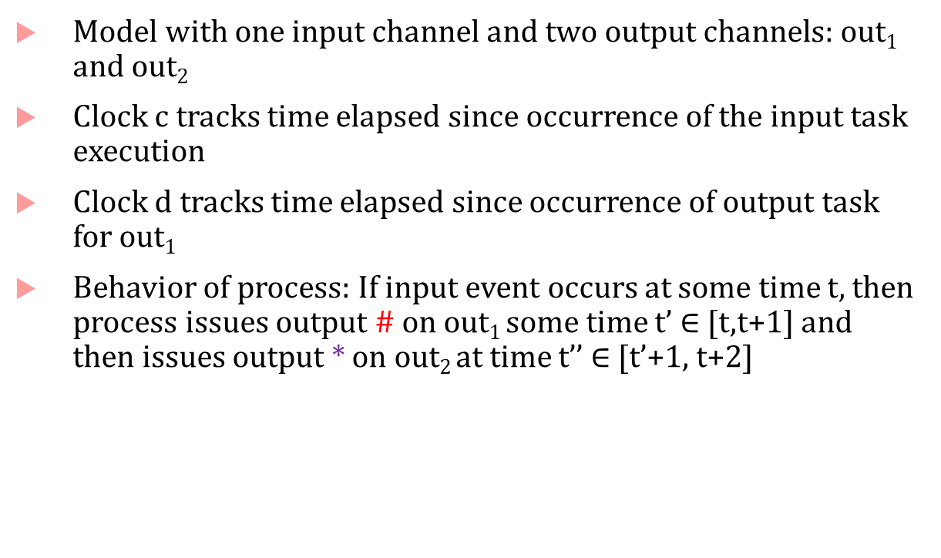
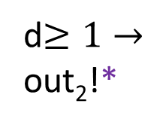
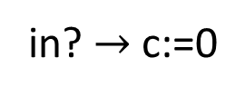
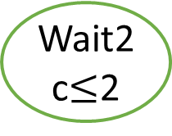
Example with two clocks
clock c,d:=0
Model with one input channel and two output channels: out₁ and out₂
Clock c tracks time elapsed since occurrence of the input task execution
Clock d tracks time elapsed since occurrence of output task for out₁
Behavior of process: If input event occurs at some time t, then process issues output # on out₁ some time t’ $∈$ [t,t+1] and then issues output * on out₂ at time t’’ $∈$ [t’+1, t+2]
idle
in? $→$ c:=0
wait1
c$≤$1
out₁!#;d:=0
d$≥1→$
out₂!*
Wait2
c$≤$2

Slide 15
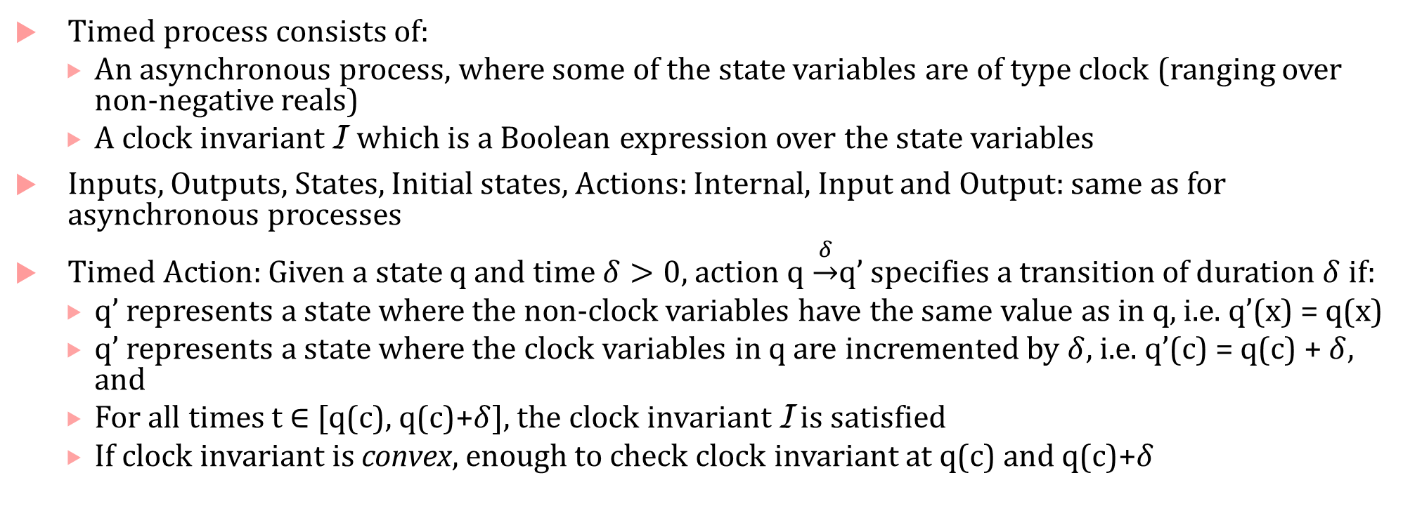
Formal recap of a timed process
Timed process consists of:
An asynchronous process, where some of the state variables are of type clock (ranging over non-negative reals)
A clock invariant I which is a Boolean expression over the state variables
Inputs, Outputs, States, Initial states, Actions: Internal, Input and Output: same as for asynchronous processes
Timed Action: Given a state q and time $δ>0$, action q $\underset{→}{δ}$q’ specifies a transition of duration $δ$ if:
q’ represents a state where the non-clock variables have the same value as in q, i.e. q’(x) = q(x)
q’ represents a state where the clock variables in q are incremented by $δ$, i.e. q’(c) = q(c) + $δ,$ and
For all times t $∈$ [q(c), q(c)+$δ$], the clock invariant I is satisfied
If clock invariant is convex, enough to check clock invariant at q(c) and q(c)+$δ$

Slide 16
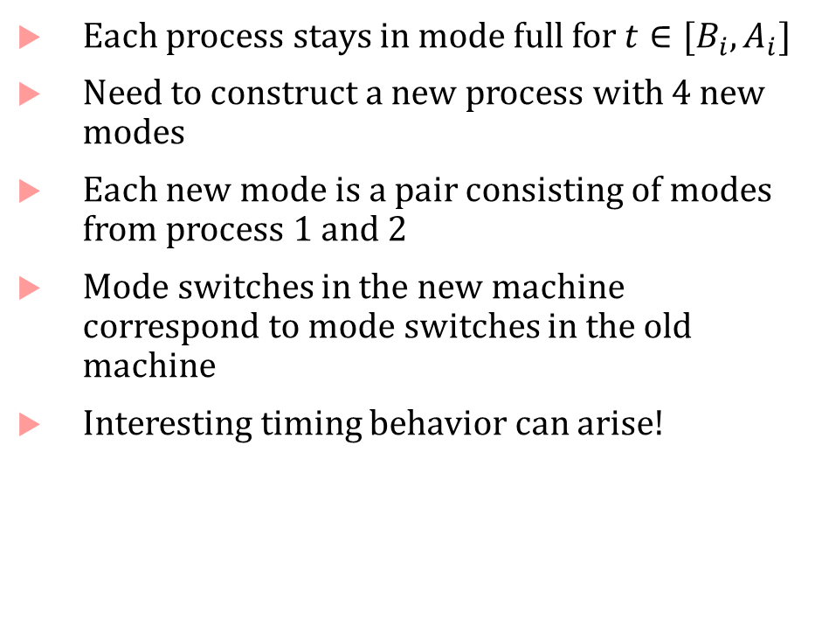


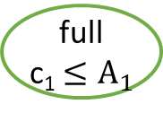

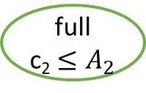

Composing Timed Processes
Each process stays in mode full for $t∈[B_{i}, A_{i}]$
Need to construct a new process with 4 new modes
Each new mode is a pair consisting of modes from process 1 and 2
Mode switches in the new machine correspond to mode switches in the old machine
Interesting timing behavior can arise!
c₁$≥$B₁ $→$ out₁:=x₁, x₁≔$∅$
c₁:=0
empty
full
c₁ $≤A_{1}$
in?$→$ x₁:=in, c₁:=0
c₂$≥$B₂ $→$ out₂:=x₂, x₂≔$∅$
c₂:=0
empty
full
c₂ $≤A_{2}$
in?$→$ x₂:=in, c₂:=0

Slide 17
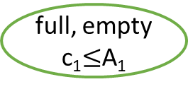
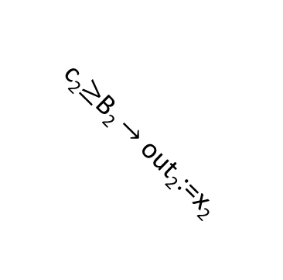


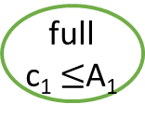
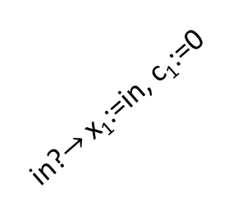

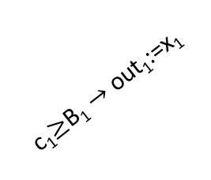
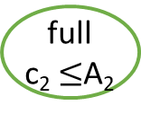

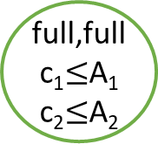
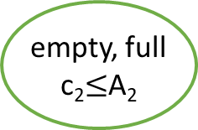

Composing Timed Processes
c₁$≥$B₁ $→$ out₁:=x₁
in?
full, empty
c₁$≤$A₁
c₁:=0
empty
full
c₁ $≤$A₁
c₂$≥$B₂ $→$ out₂:=x₂
c₁$≥$B₁ $→$ out₁:=x₁
in?$→$ x₁:=in, c₁:=0,
x₂:=in, c₂:=0
full,full
c₁$≤$A₁
c₂$≤$A₂
in?$→$ x₁:=in, c₁:=0
empty,
empty
in?
c₂$≥$B₂ $→$ out₂:=x₂
in?
c₁$≥$B₁ $→$ out₁:=x₁
c₂:=0
empty
full
c₂ $≤$A₂
c₂$≥$B₂ $→$ out₂:=x₂
in?$→$ x₁:=in, c₁:=0
empty, full
c₂$≤$A₂
in?$→$ x₂:=in, c₂:=0
in?

Slide 18
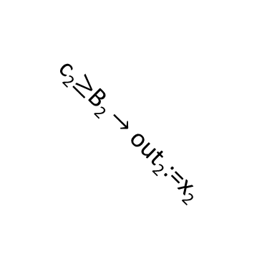
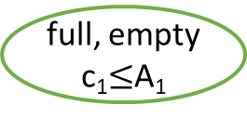

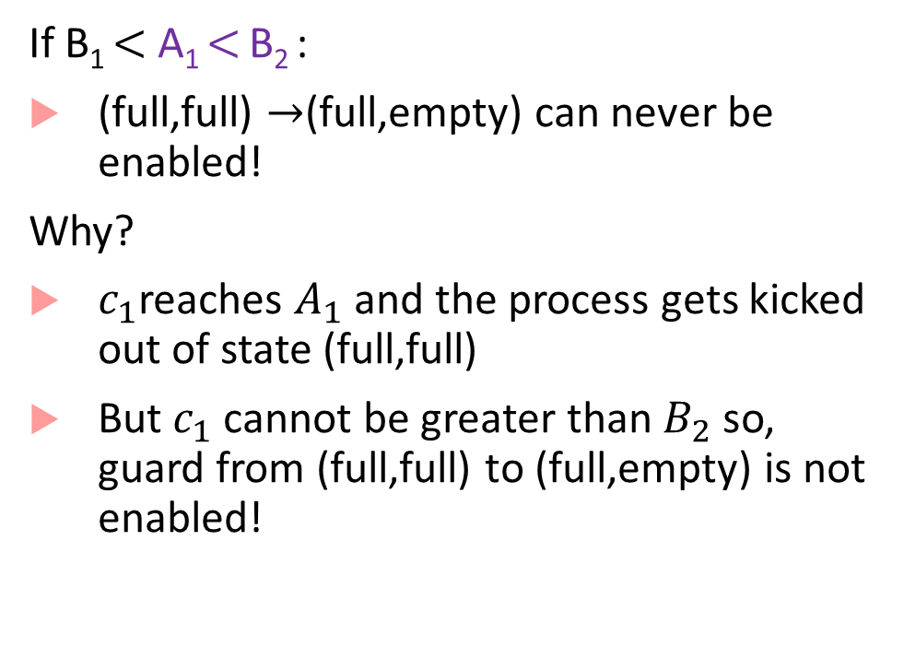
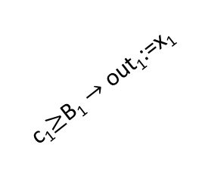
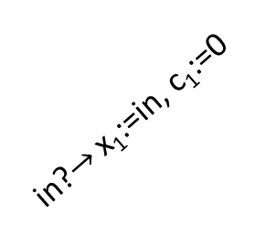
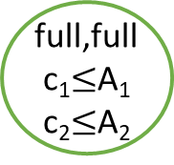


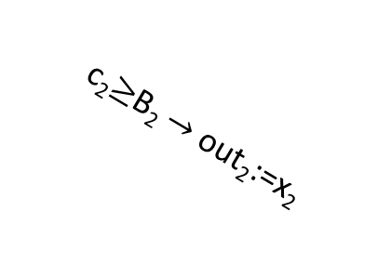
Semi-synchrony
If B₁ $<$ A₁ $<$ B₂ :
(full,full) $→$(full,empty) can never be enabled!
Why?
$c_{1}$reaches $A_{1}$ and the process gets kicked out of state (full,full)
But $c_{1}$ cannot be greater than $B_{2}$ so, guard from (full,full) to (full,empty) is not enabled!
full, empty
c₁$≤$A₁
c₂$≥$B₂ $→$ out₂:=x₂
c₁$≥$B₁ $→$ out₁:=x₁
in?$→$ x₁:=in, c₁:=0,
x₂:=in, c₂:=0
full,full
c₁$≤$A₁
c₂$≤$A₂
empty,
empty
in?
c₁$≥$B₁ $→$ out₁:=x₁
c₂$≥$B₂ $→$ out₂:=x₂
in?$→$ x₁:=in, c₁:=0
empty, full
c₂$≤$A₂
in?

Slide 19
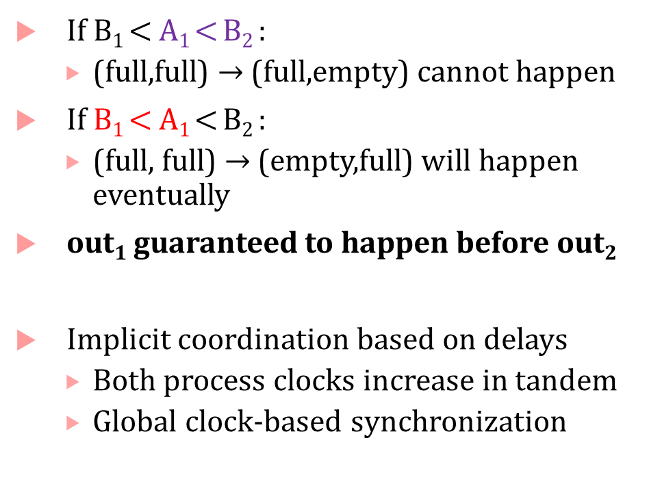
Semi-synchrony
If B₁ $<$ A₁ $<$ B₂ :
(full,full) $→$ (full,empty) cannot happen
If B₁ $<$ A₁ $<$ B₂ :
(full, full) $→$ (empty,full) will happen eventually
out₁ guaranteed to happen before out₂
Implicit coordination based on delays
Both process clocks increase in tandem
Global clock-based synchronization
full, empty
c₁$≤$A₁
c₂$≥$B₂ $→$ out₂:=x₂
c₁$≥$B₁ $→$ out₁:=x₁
in?$→$ x₁:=in, c₁:=0,
x₂:=in, c₂:=0
full,full
c₁$≤$A₁
c₂$≤$A₂
empty,
empty
in?
c₁$≥$B₁ $→$ out₁:=x₁
c₂$≥$B₂ $→$ out₂:=x₂
in?$→$ x₁:=in, c₁:=0
empty, full
c₂$≤$A₂
in?

Slide 20
Pacemaker Modeling as a Timed Process
Most material that follows is from this paper:
Z. Jiang, M. Pajic, S. Moarref, R. Alur, R. Mangharam, Modeling and Verification of a Dual Chamber Implantable Pacemaker, In Proceedings of Tools and Algorithms for the Construction and Analysis of Systems (TACAS), 2012.
Alur’s textbook has detailed descriptions of some other pacemaker components

Slide 21
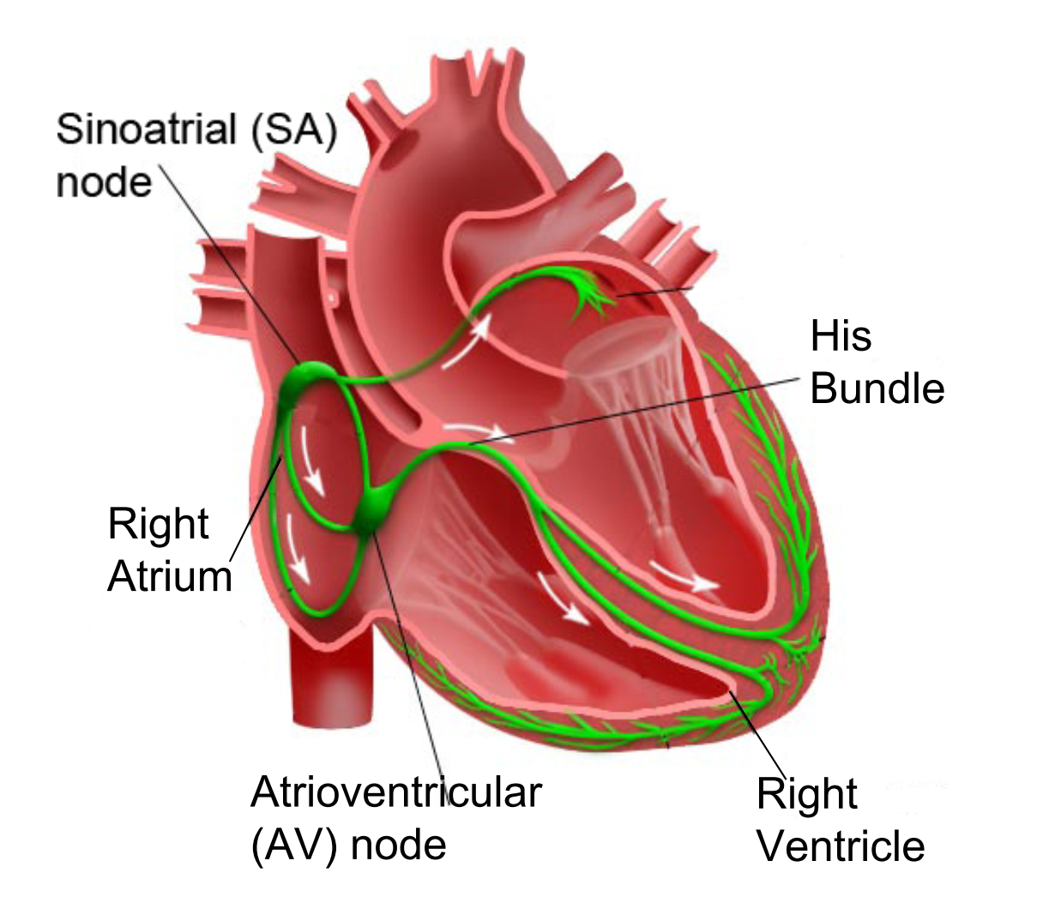
How does a healthy heart work?
SA node (controlled by nervous system) periodically generates an electric pulse
This pulse causes both atria to contract pushing blood into the ventricles
Conduction is delayed at the AV node allowing ventricles to fill
Finally the His-Purkinje system spreads electric activation through ventricles causing them both to contract, pumping blood out of the heart
Electrical Conduction System of the Heart

Slide 22
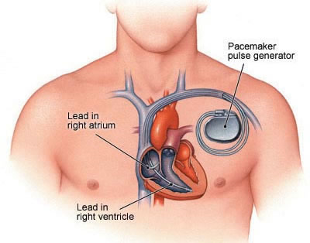
What do pacemakers do?
Aging and/or diseases cause conduction properties of heart tissue to change leading to changes in heart rhythm
Tachycardia: faster than desirable heart rate impairing hemo-dynamics (blood flow dynamics)
Bradycardia: slower heart rate leading to insufficient blood supply
Pacemakers can be used to treat bradycardia by providing pulses when heart rate is low

Slide 23
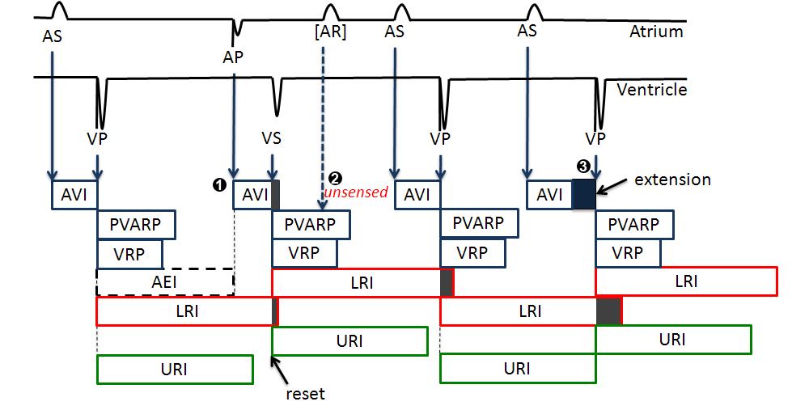
Implantable Pacemaker modeling

Slide 24
How dual-chamber pacemakers work
Two fixed leads on wall of right atrium and ventricle respectively
Activation of local tissue sensed by the leads (giving rise to events Atrial Sense (AS) and Ventricular Sense (VS))
Atrial Pacing (AP) or Ventricular Pacing (VP) are delivered if no sensed events occur within deadlines
Heart
AS
Pacemaker
VS
AP
VP

Slide 25
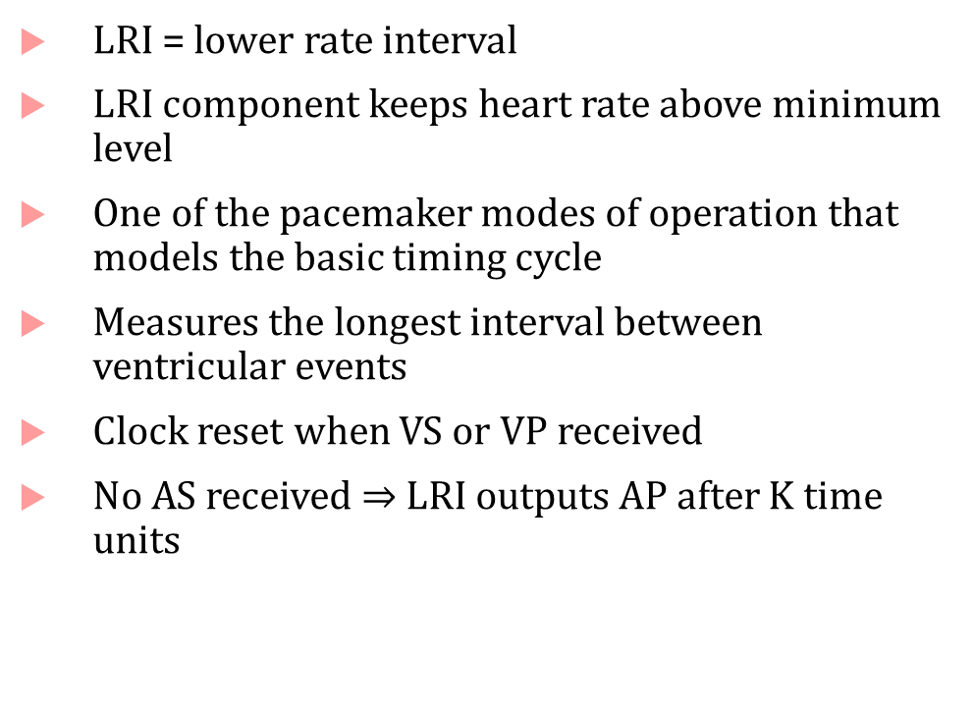


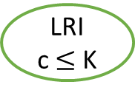



The LRI mode of operation explained
LRI = lower rate interval
LRI component keeps heart rate above minimum level
One of the pacemaker modes of operation that models the basic timing cycle
Measures the longest interval between ventricular events
Clock reset when VS or VP received
No AS received $⇒$LRI outputs AP after K time units
VS? $→$ c:=0
AS?
ASed
VP? $→$ c:=0
LRI
c $≤$ K
VP? $→$ c:=0
VS? $→$ c:=0
c $≥$ K $→$AP!; c:=0
K= 850ms

Slide 26
Finite State Automata: A 3-slide introduction

Slide 27









Finite state automata
Famous equivalence between finite state automata and regular expressions
$$A_{1}$$
$$A_{2}$$
$$q_{0}$$
$$q_{f}$$
$$q_{0}$$
$$q_{f}$$
a-z
a-z
a-z,0-9
0-9
a-z
$$q_{1}$$
$$q_{1}$$
$$q_{r}$$
State
0-9
[a-z][a-z 0-9 ]
*
Accepting
state
[a-z][0-9]*[a-z]

Slide 28


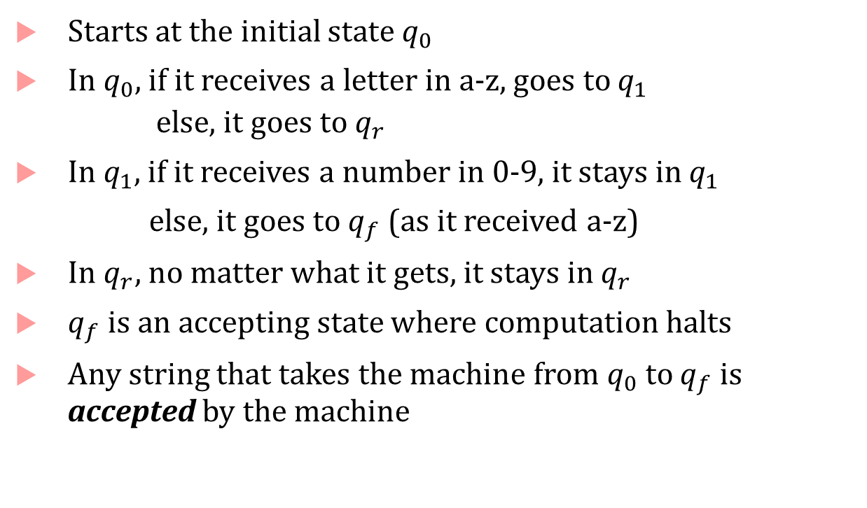



How does a finite state automaton work?
Starts at the initial state $q_{0}$
In $q_{0}$, if it receives a letter in a-z, goes to $q_{1}$
else, it goes to $q_{r}$
In $q_{1}$, if it receives a number in 0-9, it stays in $q_{1}$
else, it goes to $q_{f}$ (as it received a-z)
In $q_{r}$, no matter what it gets, it stays in $q_{r}$
$q_{f}$ is an accepting state where computation halts
Any string that takes the machine from $q_{0}$ to $q_{f}$ is accepted by the machine
$$A_{2}$$
$$q_{0}$$
$$q_{f}$$
a-z
0-9
a-z
$$q_{1}$$
$$q_{r}$$
0-9
*

Slide 29
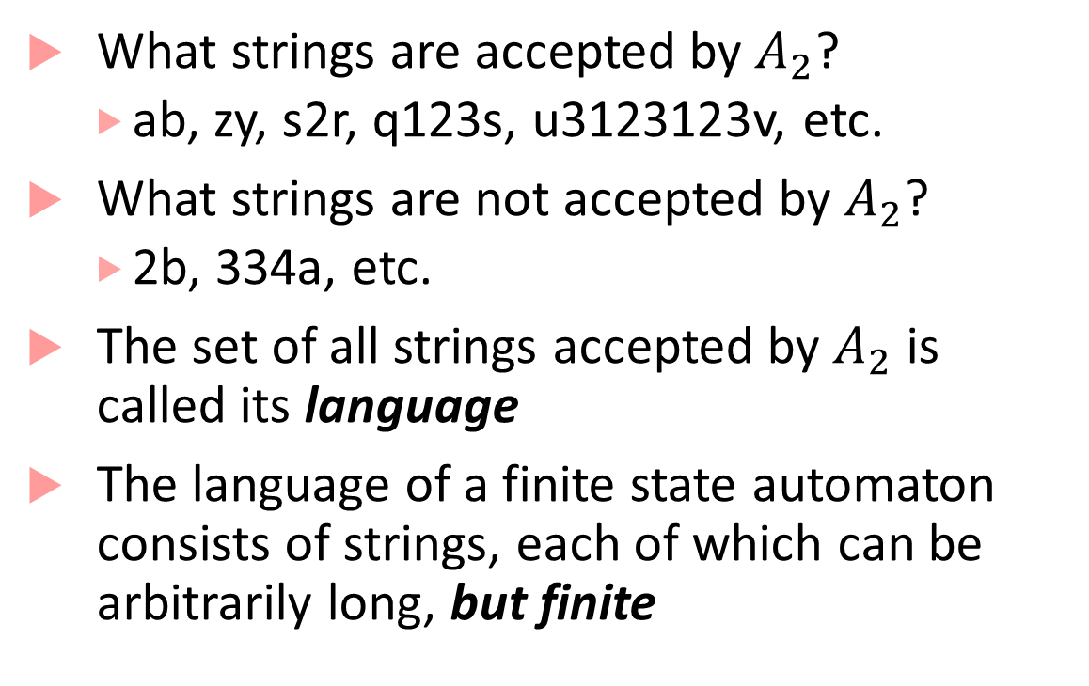
Language of a finite state automaton
What strings are accepted by $A_{2}$?
ab, zy, s2r, q123s, u3123123v, etc.
What strings are not accepted by $A_{2}$?
2b, 334a, etc.
The set of all strings accepted by $A_{2}$ is called its language
The language of a finite state automaton consists of strings, each of which can be arbitrarily long, but finite
$$A_{2}$$
$$q_{0}$$
$$q_{f}$$
a-z
0-9
a-z
$$q_{1}$$
$$q_{r}$$
0-9
*

Slide 30
Timed Automata
Useful tool to do timing analysis and explore properties of timed processes
State-space of timed automata is infinite (clocks can become arbitrarily large!)
But some questions about timed automata behavior can still be answered exactly
Does the automaton accept any string? (also known as emptiness problem)
Reachability of a particular configuration
We will revisit this later in the course

Slide 31
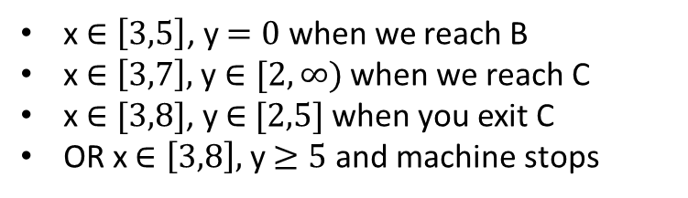
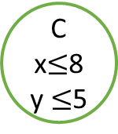
Timing Analysis
D
(y >= 6)?
Which of D, E, F can be reached?
Needs careful propagation of reachable combinations of x and y
x,y:=0
A
x<=5
x>=3 → y:=0
B
x<=7
(y >= 2)?
C
x$≤$8
y $≤$5
(x <= 4)?
E
(x = 7)?
x $∈\left[3,5\right]$, y $=0$ when we reach B
x $∈\left[3,7\right],$ y $∈[2,∞)$ when we reach C
x $∈[3,8]$, y $∈$ $[2,5]$ when you exit C
OR x $∈\left[3,8\right],$ y $≥5$ and machine stops
F

Slide 32
How is such analysis done?
The key challenge is that if the automata has loops, then how do we know that our procedure for propagation of symbolic clock constraints will terminate?
The key insight by first papers on timed automata was that there is only a finite number of regions in the clock-space that can be visited
This gives a “pumping lemma” style argument*
Allows abstracting a finite timed automaton to an automaton where modes/states represent the regions
This was expensive, and improved by using zone-based constructions
(zones are a uniform representation of constraints that arise during analysis)

Slide 33
Hybrid Dynamical Systems

Slide 34





Hybrid Process
Generalization of a timed process
Instead of timed transitions, we can have arbitrary evolution of state/output variables, typically specified using differential equations
off
on
$θ≤70$?
$$\frac{dθ}{dt}=−kθ$$
$$θ≥70$$
$$\frac{dθ}{dt}=kh−kθ$$
$$θ≤75$$
$θ≥75$?
$$70≤θ_{init}≤75$$

Slide 35
Bang-bang control (thermostat) hybrid automaton
off
on
$θ≤70$?
$$\frac{dθ}{dt}=−kθ$$
$$θ≥70$$
$$\frac{dθ}{dt}=kh−kθ$$
$$θ≤75$$
$θ≥75$?
$$70≤θ_{init}≤75$$

Slide 36






Executions of Thermostat
Initial state : (off, $θ_{0}$), $θ_{0}∈[70,75]$
If thermostat enters mode off with $θ=θ_{in}$, then $θ\left(t\right) ={θ_{in}e}^{−kt}$
Mode switch enabled when $θ≤70$, and must happen before $θ<70$, i.e. at$θ=70$
In mode on, it heats the room according to:
$$θ\left(t\right)=h−\left(h−70\right)e^{−kt}$$
Mode switch enabled when $θ≥75$, and must happen before $θ>75$, i.e. at $θ=75$
$$70≤θ_{init}≤75$$
off
$$\dot{θ}=−kθ$$
$$θ≥70$$
$θ≥75$?
$θ≤70$?
$$\dot{θ}=kh−kθ$$
$$θ≤75$$
on

Slide 37

Behavior of thermostat
temperature
mode
time
time

Slide 38




Hybrid Automata: State machines for hybrid processes
Mode: Vertical travel subject to gravity
$$\frac{dh}{dt}=v$$
$$\frac{dv}{dt}=−g$$
Standard coordinate system
Down is negative, Up is positive
$\frac{dv}{dt}$ is negative because the velocity is becoming more negative (magnitude is increasing)
Sign of $v$ as the ball approaches ground is negative
$$h$$
$$v$$
USC Viterbi
School of Engineering
Department of Computer Science

Slide 39


Hybrid Automata: State machines for hybrid processes
When does vertical travel end? $h=0$
Discrete transition!
Ball goes from vertical travel to impact and back to vertical travel
$v$goes from downward to upward!
I.e. $h=0 / v :=−av 0<a<1$
$a=$restitution coefficient measures fraction of speed retained after bounce
$h$ = 0
USC Viterbi
School of Engineering
Department of Computer Science

Slide 40




Hybrid Automata: State machines for hybrid processes
Mode: Vertical travel subject to $g$
$$\frac{dh}{dt}=v$$
$$\frac{dv}{dt}=−g$$
Vertical travel mode resumed
Initially some positive upward velocity
$g$ makes this velocity decrease
Eventually, $v$ will be zero, and then negative
But it is still the same “mode” : vertical travel subject to gravity
$$h$$
$$v$$
USC Viterbi
School of Engineering
Department of Computer Science

Slide 41







Hybrid automaton for bouncing ball
$$h∈\left[10,20\right],$$
$$v∈[0,5]$$
This is not a cartoon of a ball bouncing and traveling horizontally, just $h$ vs. $t$
$$h$$
$$\dot{v}=−g, \dot{h}=v$$
$$h≥0$$
$$h=0→sound!boink$$
$$v≔−av$$
$$t$$
What happens as $h→0$?

Slide 42





Hybrid Process
$$u(t)/y(t)$$
$$(m,x_{ τ})$$
$$\left(m,x\left(t+δ\right)\right)$$
Continuous action/transition:
$$δ$$
Discrete mode $m$does not change
$x(0)$ = $x_{τ}$
$\frac{dx\left(t\right)}{dt}$ satisfies the given dynamical equation for mode $m$
At all times $t∈\left[0,δ\right]$, the state $x\left(t\right)$ satisfies the invariant for mode $m$

Slide 43




Hybrid Process
$g(x)$/$x≔r\left(x\right)$
Discrete action/transition:
Happens instantaneously
Changes discrete mode $m$ to $m^{′}$
Can execute only if $g(x_{τ})$ evaluates to true
Changes state variable value from $x_{τ}$ to $r\left(x_{τ}\right)$
$r\left(x_{τ}\right)$ should satisfy mode invariant of $m′$
$$(m,x_{ τ})$$
$$\left(m′,r\left(x_{τ}\right)\right)$$

Slide 44




















Executions of a hybrid process
At each cell boundary, assume that the guard is the equation of the boundary, and the reset is $x≔x+ε, y≔y+ε,$ where $ε=0.01$
Invariant for each cell/mode is the open set enclosed by its boundaries
Suppose initial state is $(0,0.9)$
(0,3)
$$m_{3}$$
$$m_{4}$$
$$m_{9}$$
$$\dot{x}=1$$ $$\dot{y}=0.5$$ | $$\dot{x}=1$$ $$\dot{y}=−1$$ | $$\dot{x}=0$$ $$\dot{y}=0$$
$$\dot{x}=0$$ $$\dot{y}=1$$ | $$\dot{x}=−1$$ $$\dot{y}=−1$$ | $$\dot{x}=0.5$$ $$\dot{y}=1$$
$$\dot{x}=1$$ $$\dot{y}=1$$ | $$\dot{x}=1$$ $$\dot{y}=0.5$$ | $$\dot{x}=0.5$$ $$\dot{y}=1$$
(0,2)
$$m_{2}$$
$$m_{5}$$
$$m_{8}$$
(0,1)
$$m_{1}$$
$$m_{6}$$
$$m_{7}$$
$$y=1?$$
$$\left(x,y\right)+=ε$$
$$(m_{1},0,0.9)$$
$$\left(m_{1},0.1,1\right)$$
$$\left(m_{2},0.11,1.01\right)$$
$$0.1\sqrt{2}$$
$$y=2?$$
$$\left(x,y\right)+=ε$$
(0,0)
(1,0)
(2,0)
(3,0)
$$0.99$$
$$\left(m_{3},0.12,2.01\right)$$
$$\left(m_{2},0.11,2\right)$$

Slide 45


Zeno’s Paradox
Greek philosopher Zeno’s race between Achilles and a tortoise
Tortoise has a head start over Achilles, but is much slower
If Achilles is d meters behind at the beginning of a round
and during the round, suppose Achilles runs d meters
but by then, tortoise has moved a little bit further
At the beginning of the next round, Achilles is still behind, by $a×d$ meters [0<$a$<1]
By induction, if we repeat this for infinitely many rounds, Achilles will never catch up!
What is the mistake made by Zeno?
If sum of durations between successive discrete actions converges to constant$K$, then an execution with infinitely many discrete actions describes behavior only up to time $K$ (and does not tell us the state of the system at time $K$and beyond
Zeno assumes that if there are infinitely many points Achilles must “check off,” then it must take infinite time. But in fact, the times shrink and form a convergent series.

Slide 46

Hybrid automaton for bouncing ball
$$h∈\left[10,20\right],$$
$$v∈[0,5]$$
$$x$$
$$\dot{v}=−g, \dot{h}=v$$
$$h≥0$$
$$h=0→sound!boink$$
$$v≔−av$$
$$t$$
As the ball approaches the ground, the number of discrete transitions occurring in any time interval tends to infinity: in the limit, there will be only discrete transitions and time will stop!

Slide 47
How to deal with Zeno behavior
An infinite execution is called Zeno if infinite sum of all the durations is bounded by a constant, and non-Zeno if the sum diverges
Any state in a hybrid process is called Zeno if:
If every execution starting in state is Zeno
Non-Zeno if there exists some non-Zeno starting in that state
Hybrid process is non-Zeno if any state that you can reach from the initial state is non-Zeno
Thermostat: non-Zeno, Bouncing ball: Zeno
Dealing with Zeno: remove Zeno-ness through better modeling

Slide 48





Non-Zeno hybrid process for bouncing ball
$$\dot{v}=−g, \dot{h}=v$$
$$h≥0$$
bounce
$$h=0→sound!boink ;v≔−av$$
$$h∈\left[10,20\right], v∈[0,5]$$
$$h=0∧v<ε→sound!splat ;v≔0$$
$$\dot{v}=0, \dot{h}=0$$
$$h≥0$$
halt

Slide 49



Reachability analysis
Suppose the grid world represents the configuration space of a robot
How do we analyze: Does the robot reach the error cell?
Easy if we have only one initial state: just simulate!
What if the initial position of the robot is not certain (could be a set)?
What if the dynamics are not certain?
(0,3)
$$m_{3}$$
$$m_{4}$$
$$error$$
$$\dot{x}=1$$ $$\dot{y}=0.5$$ | $$\dot{x}=1$$ $$\dot{y}=−1$$ | $$\dot{x}=0$$ $$\dot{y}=0$$
$$\dot{x}=0$$ $$\dot{y}=1$$ | $$\dot{x}=−1$$ $$\dot{y}=−1$$ | $$\dot{x}=0.5$$ $$\dot{y}=1$$
$$\dot{x}=1$$ $$\dot{y}=1$$ | $$\dot{x}=1$$ $$\dot{y}=0.5$$ | $$\dot{x}=0.5$$ $$\dot{y}=1$$
(0,2)
$$m_{2}$$
$$m_{5}$$
$$m_{8}$$
(0,1)
$$m_{1}$$
$$m_{6}$$
$$m_{7}$$
(0,0)
(1,0)
(2,0)
(3,0)
Initial states

Slide 50

Time-bounded Reachability Analysis
Fundamental problem for dynamical systems
Simulation:
Given an initial condition $x\left(0\right)=x_{0}$, compute solution $x(t)$ such that $\frac{dx\left(t\right)}{dt}=f(x\left(t\right))$
Time-bounded Reachability:
Given a set of initial conditions $x\left(0\right)∈X_{0}$, and a time T, compute the set $X_{reach,T}$ such that $∀t∈\left[0,T\right]:x\left(t\right)∈X_{reach,T}$
A useless (but correct) answer is $X_{reach,T}=ℝ^{n}$
How do we find a “tight” reachable set?

Slide 51

Computing Reachable Sets³
Main idea: compute successor states
For a given set of states$Y$,
$$postd\left(Y\right)=\left\{\left(m^{′},x_{τ^{′}}\right) | \left(m,x_{τ}\right)\underset{→}{{g\left(x\right)}/{x≔r\left(x\right)}}\left(m^{′},x_{τ^{′}}\right)\right\}$$
For a given set $Y$,
$$post_{c}\left(Y\right)=\left\{(m,x_{τ^{′}}) | \left(m,x_{τ}\right){\text{⇝}}_{δ} (m,x_{τ^{′}})\right\}$$
For a given set $Y$, compute $post_{d}(Y)$ and $post_{c}\left(Y\right)$
Use a recurrence relation to do fixpoint computation

Slide 52

Fixpoint computation of reachable states
Computation:
Initialize $Y_{0}≔X_{0}$ (initial set of states)
Recur: $Y_{k+1}≔Y_{k}∪post_{d}\left(Y_{k}\right)∪post_{c}(Y_{k})$
Terminate if: $Y_{k+1 }=Y_{k}$
Time-bounded: when the sum of time elapsed on all continuous transitions is $≥T$
Problems:
Termination not guaranteed for general case
$post_{c}\left(Y_{k}\right)$ is not easy to compute in general
Error in computing $post_{c}\left(Y_{k}\right)$ can blow-up leading to answers that are too conservative
Many Tools: SpaceEx, Flow*, C2E2, dReach, CORA (and a few others)

Slide 53
Stability of hybrid systems
Hybrid systems can have surprising results with respect to stability
No uniform method like Lyapunov analysis for analyzing all hybrid systems
Example: Piecewise Linear (PWL) Dynamical System
Special class of hybrid system, in which each mode has linear dynamics, guards, resets are all linear/affine
Each mode in the PWL system can have stable dynamics (by doing eigen-value analysis), but resulting hybrid system may be unstable!

Slide 54




Example
$$x_{2}=−0.2x_{1} ?$$
$$\dot{x}=\left(\begin{matrix}−1 & −100 \\ 10 & −1\end{matrix}\right)x$$
$$\dot{x}=\left(\begin{matrix}−1 & 10 \\ −100 & −1\end{matrix}\right)x$$
$$x_{2}=5x_{1} ?$$
Dynamics in each mode are stable!

Slide 55




Simulation results
$$x_{2}$$
$$x_{2}=5x_{1}$$
$$x_{2}=−0.2x_{1}$$
Initial State
$$x_{1}$$

Slide 56

Stability analysis for hybrid systems
Two main approaches^{1,2}:
Find a common Lyapunov function that works for all modes
I.e. for each mode $m$, dynamics are $\dot{x}=f_{m}\left(x\right)$, find $V\left(x\right)$ such that: $∀m∀x_{≠0}:\frac{∂V}{∂x}f_{m}\left(x\right)<0$, and $∀x_{≠0} V\left(x\right)>0$
Usually hard to find a “one-size-fits-all” Lyapunov function
Find multiple Lyapunov functions, one for each mode
In each mode its Lyapunov function value decreases, and at the switching instant the destination mode’s Lyapunov function value does not increase
$V_{m}(x)$ value decreases every time mode $m$ is entered
Finding Lyapunov functions satisfying these conditions is again hard

Slide 57

Design Application: Autonomous Guided Vehicle
Objective: Steer vehicle to follow a given track
Control inputs: linear vehicle speed $\left(v\right)$, vehicle angular velocity $(ω)$, start/stop
Constraints on control inputs:
$v∈\left\{v_{max}, v_{max}/2,0\right\}$
$ω∈\{−π,0,π\}$
Designer choice: $v=v_{max}$ only if $ω=0$, otherwise $v=\frac{v_{max}}{2}$

Slide 58





















On/Off control for Path following
$$y$$
Turn right
Go straight
$$\dot{x}=(v_{max}/2)\cos{θ}$$
$$\dot{y}=\left({v_{max}}/2\right)\sin{θ}$$
$$\dot{θ}=−π$$
$$d≥ε$$
$$d≤ε?$$
$$\dot{x}=v_{max}\cos{θ}$$
$$\dot{y}=v_{max}\sin{θ}$$
$$\dot{θ}=0$$
$$−ε≤d≤ε$$
$$θ$$
$$x$$
$$d≥ε?$$
$$d$$
$$ss?start∧$$
$$d≥ε?$$
$$ss?stop$$
Track
$$ss?stop$$
$$d≤−ε?$$
$$d≥−ε?$$
$$ss?start∧$$
$$−ε≤d≤ε?$$
$$\dot{x}=0$$
$$\dot{y}=0$$
$$\dot{θ}=0$$
$$\dot{x}=(v_{max}/2)\cos{θ}$$
$$\dot{y}=\left({v_{max}}/2\right)\sin{θ}$$
$$\dot{θ}=π$$
$$d≤−ε$$
When $d∈\left[−ε,+ε\right]$, controller decides that vehicle goes straight, otherwise executes a turn command to bring error back in the interval
$$ss?stop$$
$$x≔x_{0}$$
$$y≔y_{0}$$
$$θ≔θ_{0}$$
$$ss?start∧$$
$$d≤−ε?$$
Stationary
Turn left

Slide 59
Design Application: Robot Coordination
Autonomous mobile robots in a room, goal for each robot:
Reach a target at a known location
Avoid obstacles (positions not known in advance)
Minimize distance travelled
Design Problems:
Cameras/vision systems can provide estimates of obstacle positions
When should a robot update its estimate of the obstacle position?
Robots can communicate with each other
How often and what information can they communicate?
High-level motion planning
What path in the speed/direction-space should the robots traverse?

Slide 60












Path planning with obstacle avoidance
$$y$$
Assumptions:
Two-dimensional world
Robots are just points
Each robot travels with a fixed speed
Dynamics for Robot $R_{i}$:
$\dot{x_{i}}=v \cos{θ_{i}}$; $\dot{y_{i}}=v \sin{θ_{i}}$
Design objectives:
Eventually reach $\left(x_{f},y_{f}\right)$
Always avoid Obstacle1 and Obstacle 2
Minimize distance travelled
$$R_{2}$$
$$\left(v,θ_{2}\right)$$
Obstacle 2
$$p_{o2}=\left(x_{o2},y_{o2}\right)$$
$$p_{2}=\left(x_{2},y_{2}\right)$$
$$\left(x_{f},y_{f}\right)$$
Goal
Obstacle 1
$$R_{1}$$
$$p_{o1}=\left(x_{o1},y_{o1}\right)$$
$$\left(v,θ_{1}\right)$$
$$p_{1}=\left(x_{1},y_{1}\right)$$
$$x$$

Slide 61
Divide path/motion planning into two parts
Computer vision tasks
Actual path planning task
Assume: vision algorithm identifies obstacles, and labels them with some easy-to-represent geometric shape (such as a bounding boxes)
In this example, assume a sonar-based sensor, so we will use circles
Assuming the vision algorithm is correct, do path planning based on the estimated shapes of obstacles
Design challenge:
obstacle shape estimate not the smallest shape containing the obstacle
estimate varies based on distance from obstacle

Slide 62








Estimation error
$$p_{o1}=\left(x_{o1},y_{o1}\right)$$
Robot $R_{1}$ maintains radii $e_{1}$ and $e_{2}$ that are estimates of obstacle sizes
Every $τ$ seconds, $R_{1}$ executes following update to get estimates of shapes of each obstacle
$$e_{1}≔\min\left(e_{1}, r_{1}+a\left(\left\|p_{1}−p_{o1}\right\|−r_{1}\right)\right)$$
We don’t know $r_{1}$, but we are guaranteed that we get a radius of an estimated shape of the obstacle $r$ that is exactly: $r_{1}+a\left(d\left(p_{1},p_{o_{1}}\right)−r_{1}\right)$
$p_{1}$ is actual position of $R_{1},$ $p_{o_{1}}$is actual (unknown) position of $o_{1}$
Computation of $R_{2}$ is symmetric $e_{2}≔\min\left(e_{2}, r_{2}+a\left(\left\|p_{1}−p_{o2}\right\|−r_{2}\right)\right)$
Estimated shape
from distance $d′$
$$r_{1}$$
Estimated shape
from distance $d$
$$e^{′}$$
$$e$$
Smallest shape
bounding obstacle
Estimated radius $e=r+a(d−r)$,
where $a∈[0,1]$ is a constant

Slide 63











Path planning
$$y$$
Choose shortest path $ρ_{3}$ to target (to minimize time)
If estimate of obstacle 1 intersects $ρ_{3}$, calculate two paths that are tangent to obstacle 1 estimate
If estimate of obstacle 2 intersects $ρ_{3}$, or obstacle 1, calculate tangent paths
Plausible paths: $ρ_{1}$ and $ρ_{2}$
Calculate shorter one as the planned path
$$ρ_{1}$$
$$(x_{f},y_{f})$$
$$p_{o1}$$
$$ρ_{4}$$
$$ρ_{3}$$
$$p_{o2}$$
$$ρ_{2}$$
$$p_{1}$$
$$x$$

Slide 64

Dynamic path planning
Path planning inputs:
Current position of robot
Target position
Position of obstacles and estimates
Output:
Direction for motion assuming obstacle estimates are correct
May be useful to execute planning algorithm again as robot moves!
Because estimates will improve closer to the obstacles
Invoke planning algorithm every$τ$ seconds

Slide 65

Communication improves planning
Every robot has its own estimate of the obstacle
$R_{2}$’s estimate of obstacle might be better than $R_{1}$’s
Strategy: every $τ$ seconds, send estimates to other robot, and receive estimates
For estimate $e_{i}$, use final estimate = $\min\left(e_{i},e_{i}^{recv}\right)$
Re-run path planner

Slide 66




















Improved path planning through communication
$$y$$
$$y$$
New path available
because estimate of obstacle 1 improved after receiving estimate from $R_{2}$
$$ρ_{1}$$
$$ρ_{1}$$
$$(x_{f},y_{f})$$
$$(x_{f},y_{f})$$
$$p_{o1}$$
$$ρ_{4}$$
$$p_{o1}$$
$$ρ_{4}^{′}$$
$$ρ_{3}$$
$$p_{1}(0)$$
$$ρ_{3}$$
$$ρ_{2}$$
$$ρ_{2}$$
$$p_{o2}$$
$$p_{o2}$$
$$p_{1}$$
$$p_{1}(τ)$$
Old path
$$x$$
$$x$$

Slide 67

Hybrid State Machine for Communicating Robot

Slide 68
Advantage of using hybrid processes
Hybrid models combine computation, communication and control
Most real-world controllers are digital/discrete-time controllers: hybrid process/automata models describe underlying mathematical model for most CPS applications!
We can perform design-space exploration through simulations and check safety/correctness (later in the course)

Slide 69
Bibliography
H. Lin and P. J. Antsaklis, "Stability and Stabilizability of Switched Linear Systems: A Survey of Recent Results," in IEEE Transactions on Automatic Control, vol. 54, no. 2, pp. 308-322, Feb. 2009.
Branicky, Michael S. "Multiple Lyapunov functions and other analysis tools for switched and hybrid systems." IEEE Transactions on automatic control 43.4 (1998): 475-482.
Talk by Goran Frehse, pdf of slides here: http://qmc.cs.aau.dk/slides/slides-frehse.pdf
SpaceEx: http://spaceex.imag.fr/
Flow*: https://flowstar.org/
dReach: http://dreal.github.io/dReach/
CORA: http://www.i6.in.tum.de/Main/SoftwareCORA

