Slide 1
Autonomous Cyber-Physical Systems: Sensing and Perception
Fall 2021 CS 513.
Instructor: Jyo Deshmukh

Slide 2
Autonomous systems software architecture
Software architecture describes key software components and their inter-relationships.
A very general software architecture will give you insight about all the software that goes into making the autonomous system; this will include:
A single real-time operating system or a hypervisor that controls several operating systems
Libraries and components for interfacing with specialized components like GPUs/NPUs, memory, I/O etc.
Application-layer software (the interesting part that makes the autonomous system, autonomous)
We will focus only on the application layer software architecture

Slide 3
Self-driving car architecture
Sensing
Perception
Decision
Control
Actuation
Operating System/Hypervisor

Slide 4
Sensing
Primary purpose is to know everything about the environment
Most of the software modules in the sensing modules deal with:
Sensor fusion: (using KFs, EKFs, UKFs, etc.)
Data preprocessing: e.g. converting LiDAR data into point-cloud representation, sampling video signals, compressing data
GPS
IMU
LiDAR
Radar
Camera

Slide 5
Perception
Many things fall under the vague category of perception, list to the left is not complete
Localization:
Strongly connected to sensor fusion
May use algorithms such as particle filters in addition to Kalman filter
Could further sub-divide into road-level localization in a map, or lane-level localization on a road, or localizing within a lane
Localization
Object Detection
Object Tracking
Traffic recognition
Road topology identification

Slide 6
Perception
Object detection
Use vision or deep learning algorithms to detect various kinds of objects
Pedestrians, Bicyclists, other vehicles, traffic signs, lane markings, obstacles
Objects could be static or dynamic, and detection algorithms may vary accordingly
Object tracking
Tracking trajectories of moving objects
Could be based on deep learning or algorithms like optical flow
Localization
Object Detection
Object Tracking
Traffic recognition
Road topology identification

Slide 7
Decision
Prediction: Generate most probable trajectories of vehicles, pedestrians, obstacles in the environment
Mission/Route planning: Generate very high-level route plan based on way-points, maps
Reference planning: Generate trajectories for vehicle + Behavioral planning (traffic-aware): modify according to environment models
Motion planning: Synthesizing inputs for low-level actuators to match a higher-level plan
Obstacle avoidance: Stopping or maneuvering around an obstacle
Prediction
Mission planning
Behavioral Planning
Obstacle avoidance
Motion Planning

Slide 8
Decision
Decision layer is the most software-intensive layer
Several algorithms have been proposed in the robotics and automotive community based on optimization, search-based planning, discrete decision-making (with state machines).
Current trend is to investigate application of AI/control techniques such as reinforcement learning/deep reinforcement learning
Prediction
Mission planning
Behavioral Planning
Obstacle avoidance
Motion Planning

Slide 9
Control (Low-level control)
These algorithms have been typically deployed to cars before self-driving cars took off
Also, researchers are interested in knowing if existing algorithms can be made more efficient with data (models of the environment)
Drive-by-wire controlled by AI software
Techniques like model-predictive control are gathering momentum
Steering Control
Torque control
Lateral stability control
Energy management
Emissions control

Slide 10
Sensors
“Transducers” that convert one physical property into another
In our context, a sensor convers a physical quantity into a numeric value
Choosing sensors is a hard design problem, as sensors can have many factors that need tuning
Accuracy: Error between true value and its measurement (noise values, rejection of external interference)
Resolution: Minimum difference between two measurements (usually much smaller number than actual accuracy of the sensor)
Sensitivity: Smallest change in value that can be detected

Slide 11
Sensor selection
Factors affecting sensor selection (continued)
Dynamic Range: Minimum and maximum values that can be accurately detected
Time-scale/Responsiveness: How often the sensor produces output and frequency bandwidth of the measurement output over time
Interface technology: analog, digital or serial or network streams
Perspective: Which portion of the environment can the sensor measure (e.g. the field of vision for a camera, orientation for an ultrasonic module)

Slide 12
Some important sensors for autonomy
Inertial Measurement Units
GPS
Vision-based (Camera) sensors
LiDAR
RADAR

Slide 13
Basics of IMUs
Inertial Measurement Units or IMUs: part of an Inertial Navigation System
Use accelerometers and gyroscopes to track position and orientation of an object relative to start position, orientation and velocity
Typically: 3 orthogonal rate-gyroscopes measuring angular velocities, and 3 accelerometers measuring linear accelerations (along the 3 axes)
Stable-platform IMUs: a platform is used to mount the inertial sensors, and the platform is isolated from external rotational motion
Strapdown IMUs: Inertial sensors mounted rigidly (more common due to smaller size)

Slide 14
Basics of IMUs
Inertial Measurement Units or IMUs: part of an Inertial Navigation System
Use accelerometers and gyroscopes to track position and orientation of an object relative to start position, orientation and velocity
Typically: 3 orthogonal rate-gyroscopes measuring angular velocities, and 3 accelerometers measuring linear accelerations (along the 3 axes)

Slide 15
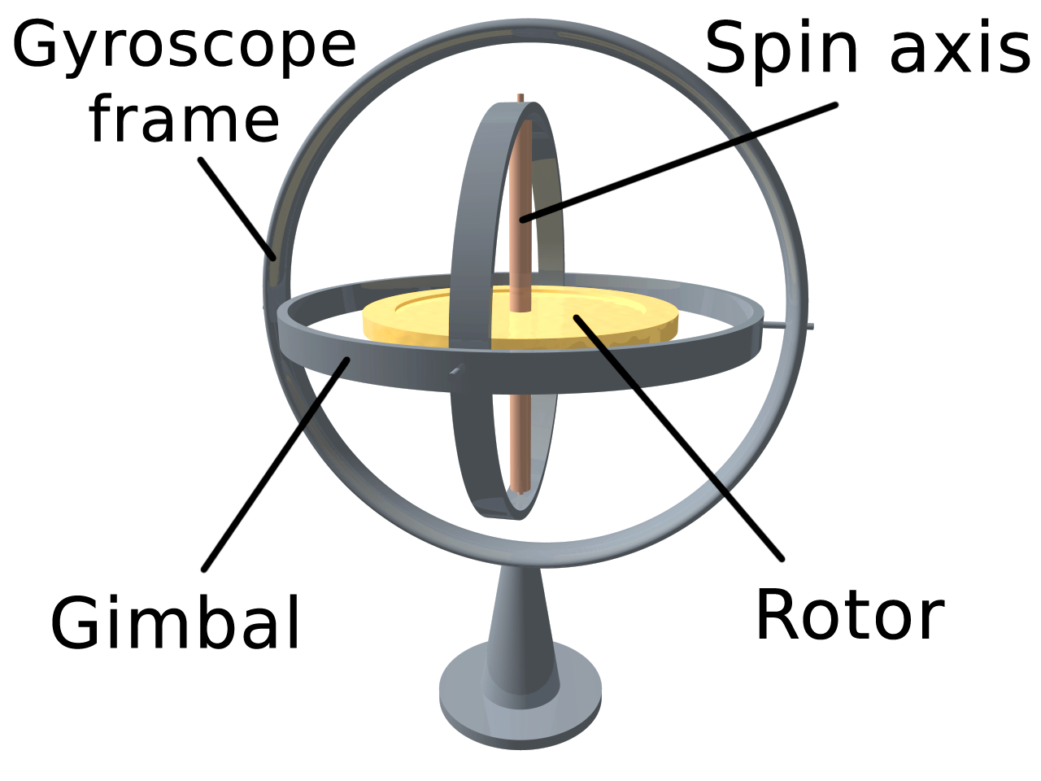
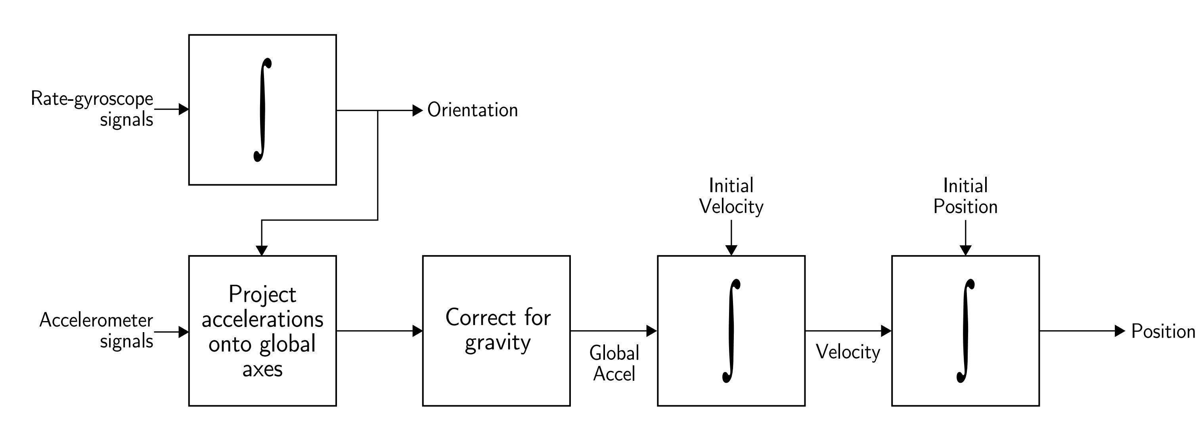
Inertial navigation algorithm (for strapdown IMUs)

Slide 16
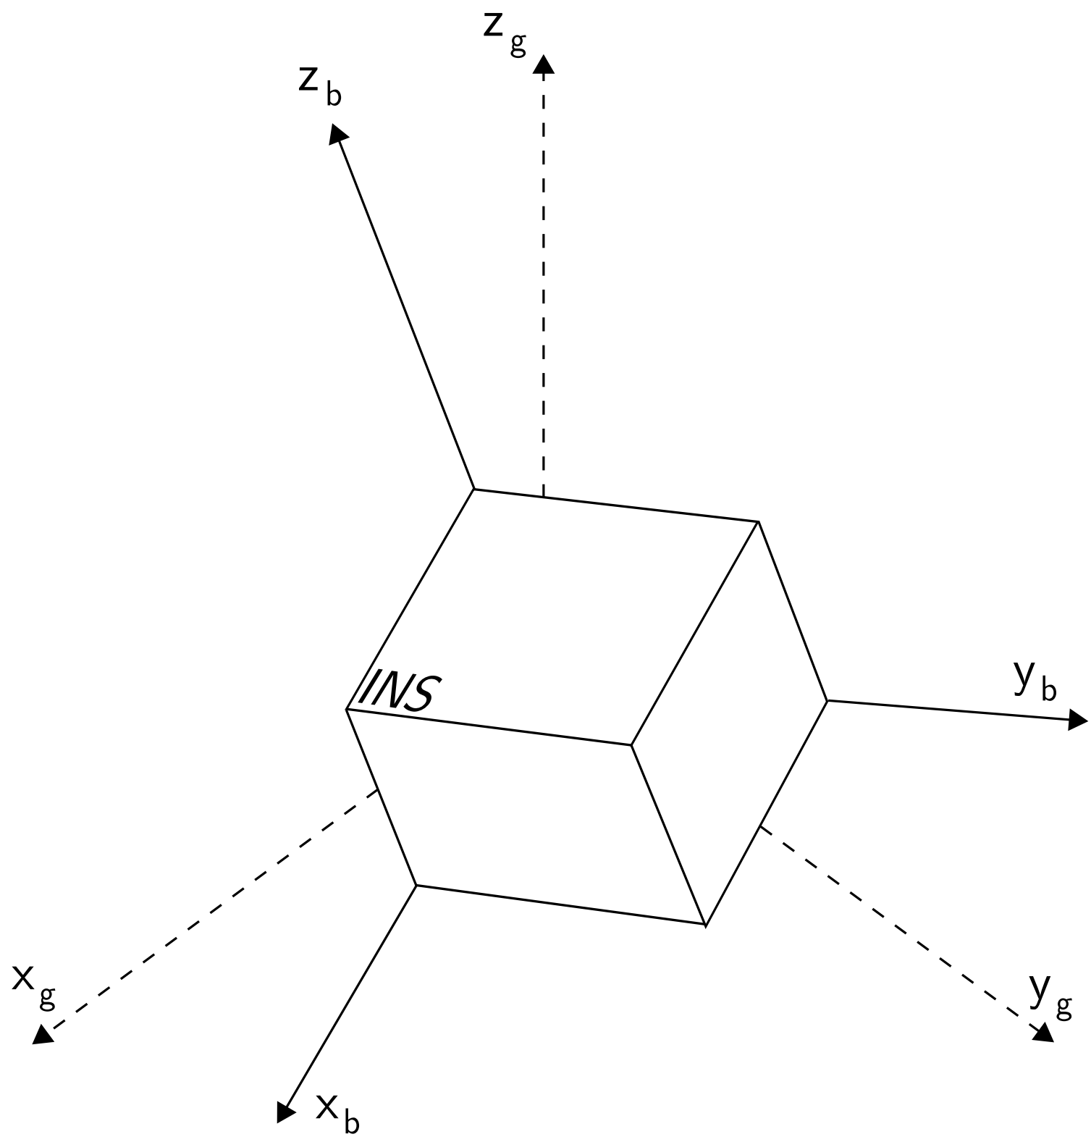
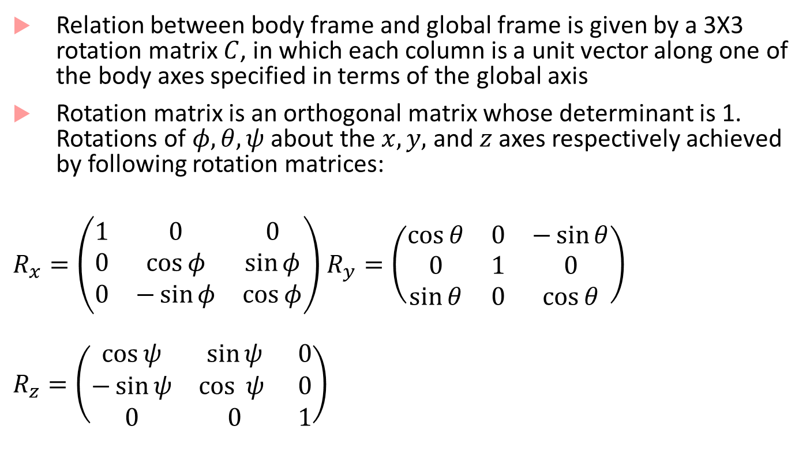
IMU equations
Relation between body frame and global frame is given by a 3X3 rotation matrix $C$, in which each column is a unit vector along one of the body axes specified in terms of the global axis
Rotation matrix is an orthogonal matrix whose determinant is 1. Rotations of $φ, θ, ψ$ about the $x,y,$ and $z$ axes respectively achieved by following rotation matrices:
$R_{x}=\left(\begin{matrix}1 & 0 & 0 \\ 0 & \cos{φ} & \sin{φ} \\ 0 & −\sin{φ} & \cos{φ}\end{matrix}\right)$ $R_{y}=\left(\begin{matrix}\cos{θ} & 0 & −\sin{θ} \\ 0 & 1 & 0 \\ \sin{θ} & 0 & \cos{θ}\end{matrix}\right)$
$$R_{z}=\left(\begin{matrix}\cos{ψ} & \sin{ψ} & 0 \\ −\sin{ψ} & \cos{ ψ } & 0 \\ 0 & 0 & 1\end{matrix}\right)$$
Body Frame vs. Global Frame
Image from [1]

Slide 17
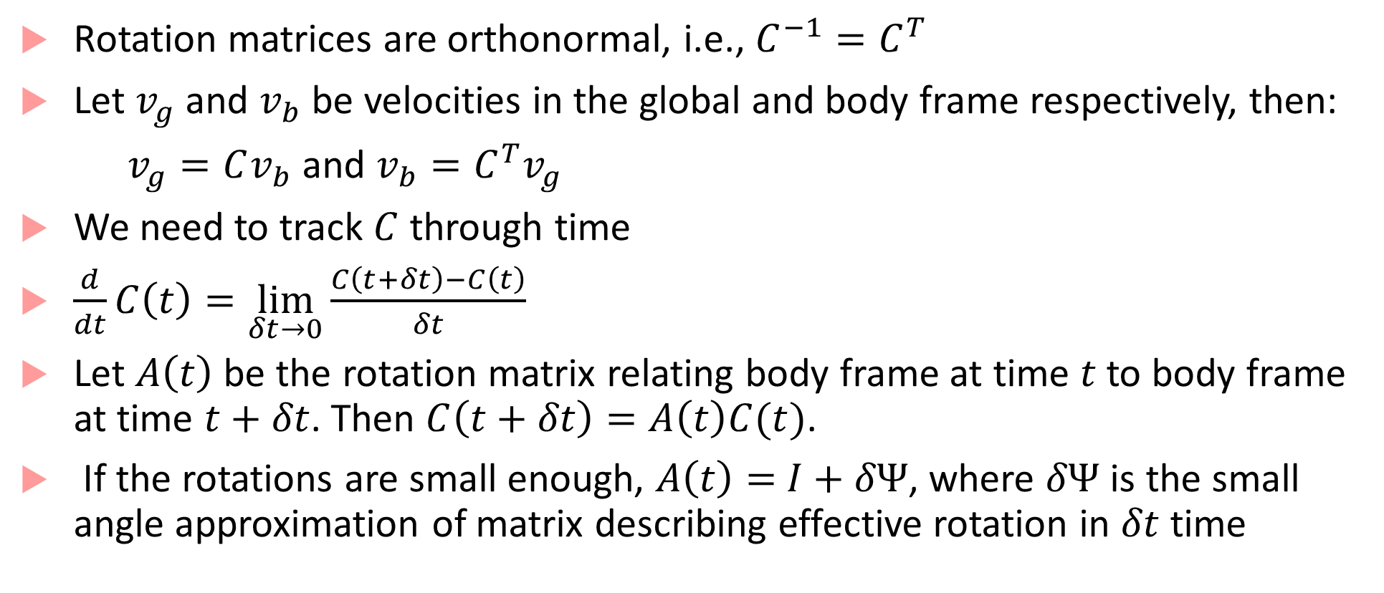
IMU equations continued
Rotation matrices are orthonormal, i.e., $C^{−1}=C^{T}$
Let $v_{g}$ and $v_{b}$ be velocities in the global and body frame respectively, then:
$v_{g}=Cv_{b}$ and $v_{b}=C^{T}v_{g}$
We need to track $C$ through time
$\frac{d}{dt}C\left(t\right)=\lim_{δt→0}{\frac{C\left(t+δt\right)−C\left(t\right)}{δt}}$
Let $A\left(t\right)$ be the rotation matrix relating body frame at time $t$to body frame at time $t+δt$. Then $C\left(t+δt\right)=A\left(t\right)C(t)$.
If the rotations are small enough, $A\left(t\right)=$ $I+δΨ$, where $δΨ$ is the small angle approximation of matrix describing effective rotation in $δt$ time

Slide 18
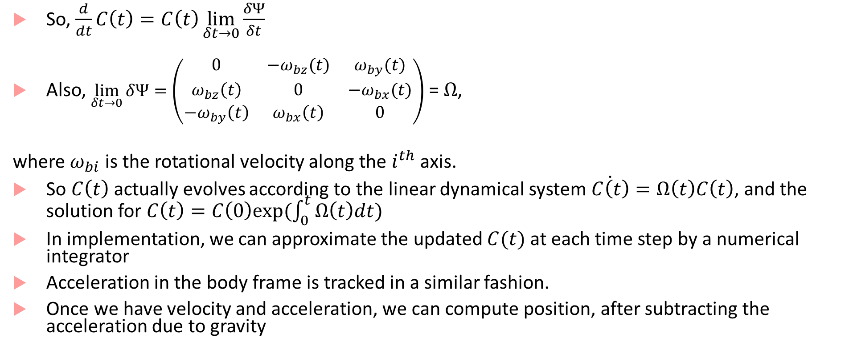
IMU equations
So, $\frac{d}{dt}C\left(t\right)=C\left(t\right)\lim_{δt→0}{\frac{δΨ}{δt}}$
Also, $\lim_{δt→0}{δΨ}=\left(\begin{matrix}0 & −ω_{bz}(t) & ω_{by}(t) \\ ω_{bz}\left(t\right) & 0 & −ω_{bx}(t) \\ −ω_{by}\left(t\right) & ω_{bx}\left(t\right) & 0\end{matrix}\right)$ = $Ω$,
where $ω_{bi}$ is the rotational velocity along the $i^{th}$ axis.
So $C\left(t\right)$ actually evolves according to the linear dynamical system $\dot{C\left(t\right)}=Ω\left(t\right)C\left(t\right)$, and the solution for $C\left(t\right)=C\left(0\right)exp⁡(\int_{0}^{t}{Ω\left(t\right)dt})$
In implementation, we can approximate the updated $C(t)$ at each time step by a numerical integrator
Acceleration in the body frame is tracked in a similar fashion.
Once we have velocity and acceleration, we can compute position, after subtracting the acceleration due to gravity

Slide 19
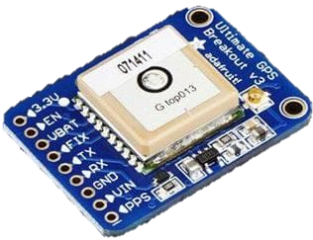
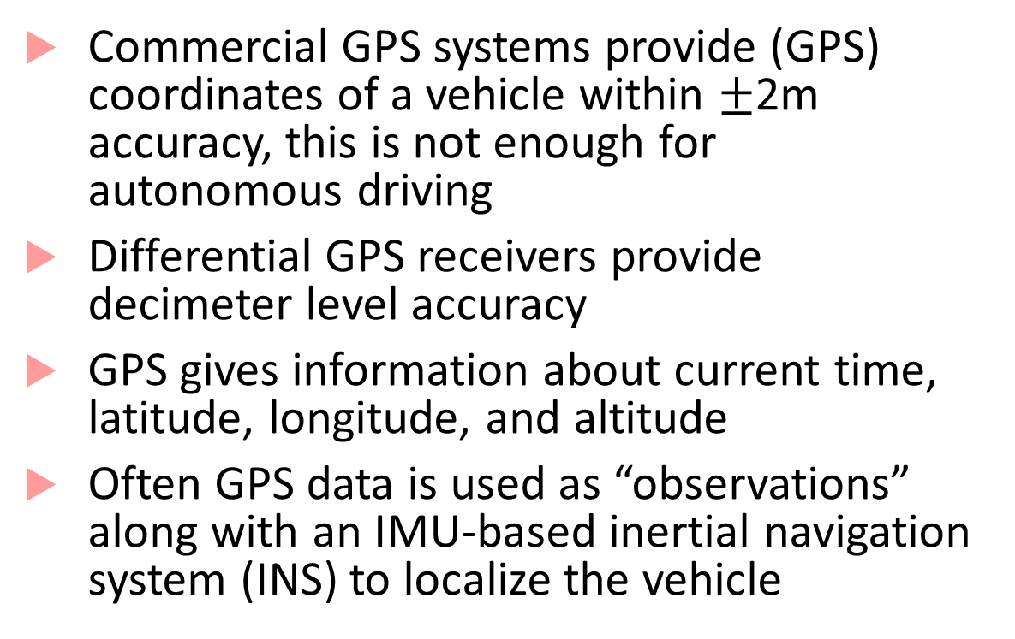
Basics of GPS
Commercial GPS systems provide (GPS) coordinates of a vehicle within $±$2m accuracy, this is not enough for autonomous driving
Differential GPS receivers provide decimeter level accuracy
GPS gives information about current time, latitude, longitude, and altitude
Often GPS data is used as “observations” along with an IMU-based inertial navigation system (INS) to localize the vehicle
Kalman Filter/EKF
Predict
Update

Slide 20
Basics of Radar
Main idea is to compute the distance to the obstacle in a given direction by comparing transmitted and received signals
Allows estimating both distance and relative velocity
Radars may require additional signal processing to give precise answers when the environment is dusty, rainy, or foggy.
Forward-facing radars estimate relative position/velocity of lead vehicle
Surround ultrasonic sensors can help create environment models (Tesla approach)

Slide 21
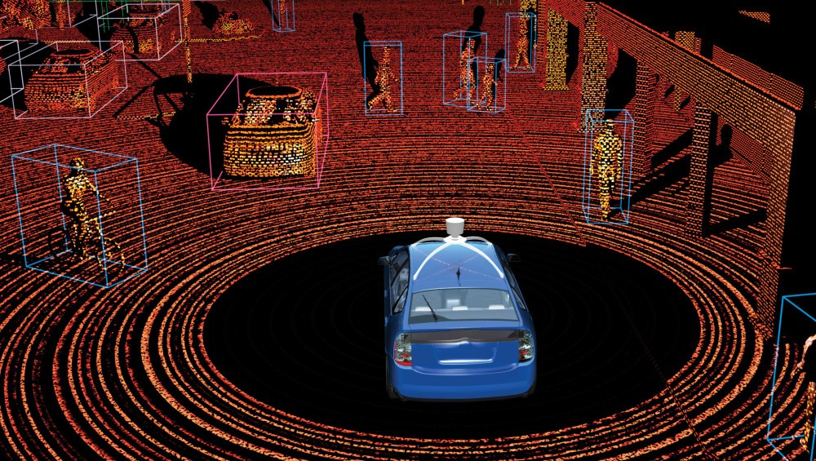
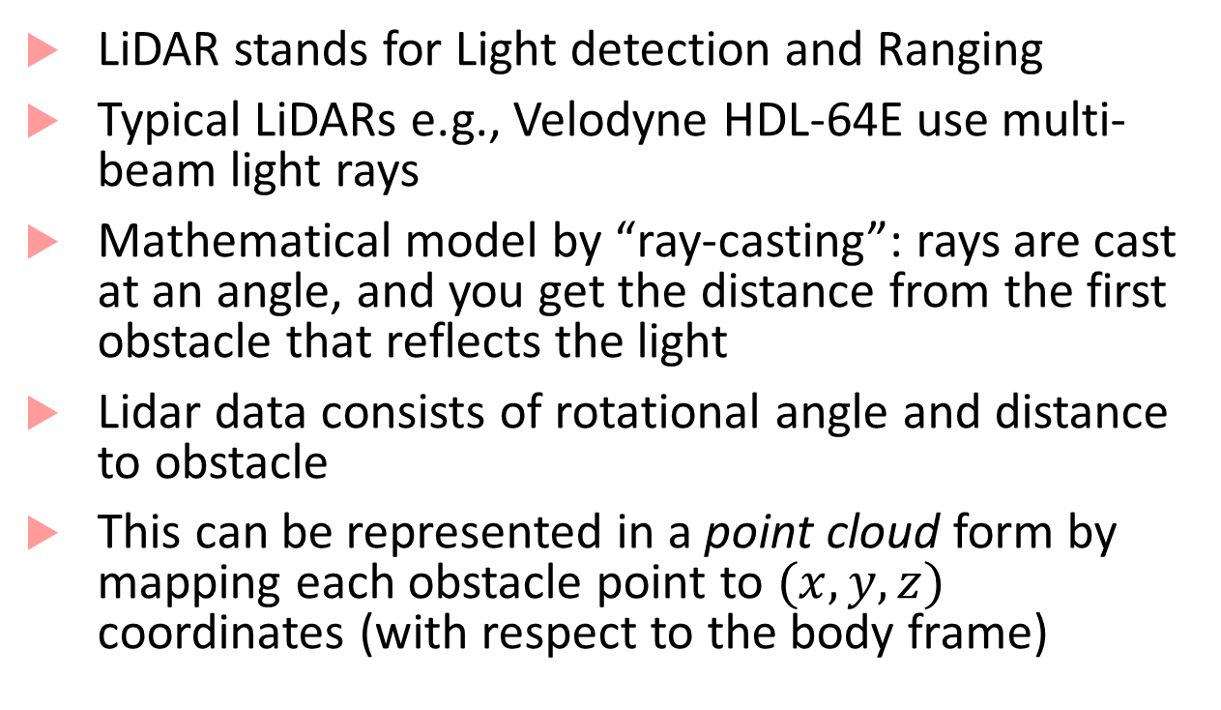
Basics of LiDAR
LiDAR stands for Light detection and Ranging
Typical LiDARs e.g., Velodyne HDL-64E use multi-beam light rays
Mathematical model by “ray-casting”: rays are cast at an angle, and you get the distance from the first obstacle that reflects the light
Lidar data consists of rotational angle and distance to obstacle
This can be represented in a point cloud form by mapping each obstacle point to $(x,y,z)$ coordinates (with respect to the body frame)

Slide 22
Data representation
Following representations for LIDAR data are most popular:
Point-cloud representation in the 3D space
Feature representation
Representation using grids
Choice of representation guides the choice of the algorithms chosen downstream for segmentation/detection
Point-cloud based approaches may need filtering algorithms to reduce number of points
Voxel-grid filtering : cover the space with tiny boxes, and replace each box with the centroid of the box

Slide 23
Data representation
Feature-based approaches
Extract specific features from the point cloud such as lines or surfaces
Most memory-efficient approach, but accuracy subject to nature of the point cloud
Grid-based approaches
Discretize space into small grids and represent the point cloud as a spatial data structure
Discretization-delta is a heuristic choice, and efficacy depends on the chosen delta

Slide 24
Segmentation algorithms
Segmentation: Clustering points into multiple homogenous groups
Broadly divided into:
Edge-based methods: When objects have strong edge features (e.g., road curbs)
Region-based methods: Based on region-growing, i.e., pick seed points, grow regions based on Euclidean distance between points.
Model-based methods: Fit points into pre-defined categories such as planes, spheres, cones, etc.
Attribute-based methods: first compute attributes for each point, and then cluster based on attributes
Graph-based methods: Cast point cloud into graph-based structures
Deep-learning based methods

Slide 25
Some popular segmentation algorithms
RANSAC (random sample and consensus)
Hough Transform
Conditional Random Fields, Markov Random Fields (also used for sensor fusion between LIDAR and vision)

Slide 26
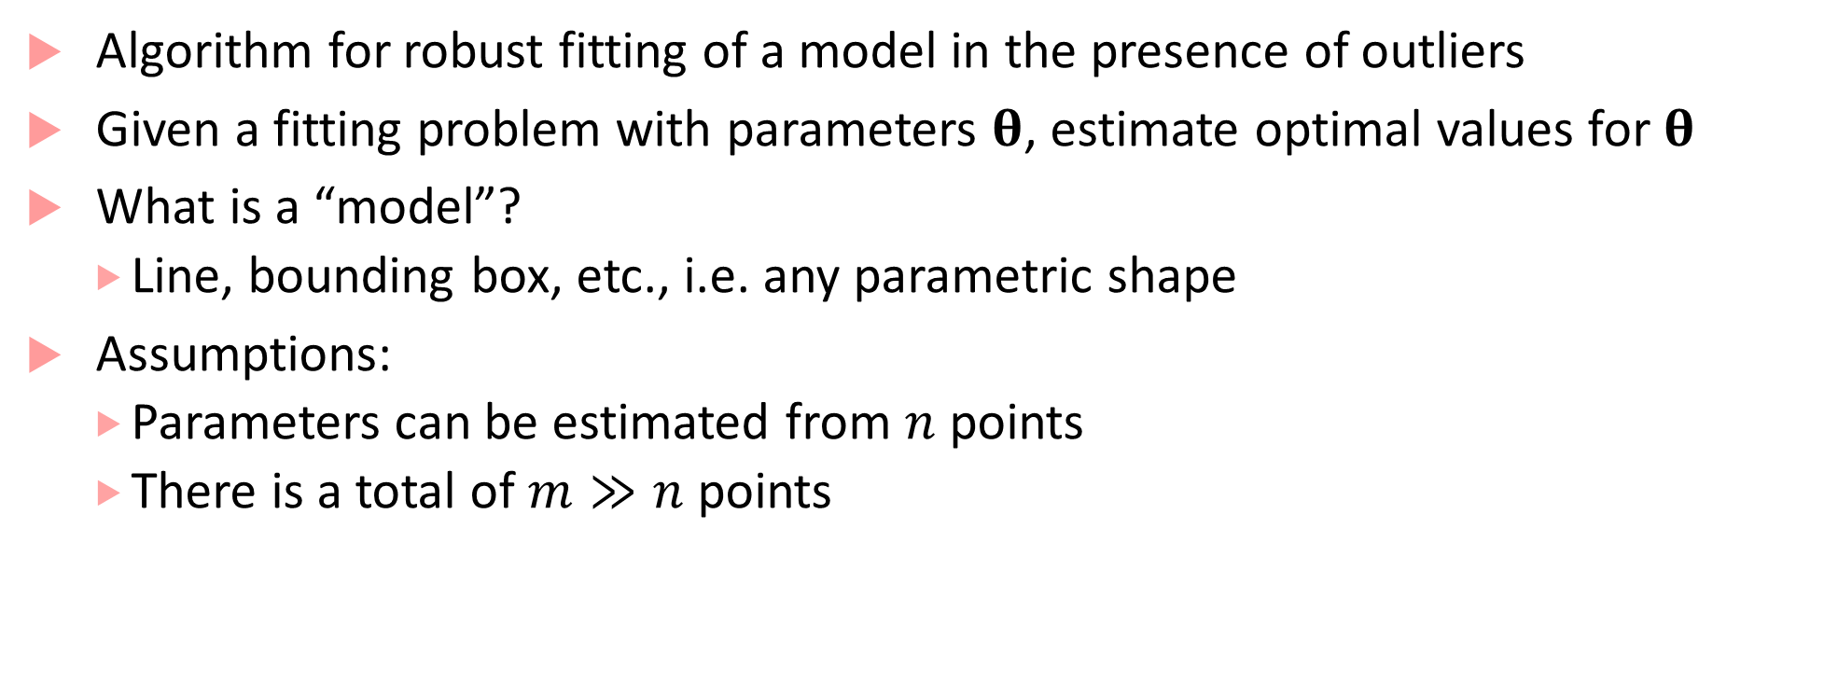
RANSAC
Algorithm for robust fitting of a model in the presence of outliers
Given a fitting problem with parameters $θ$, estimate optimal values for $θ$
What is a “model”?
Line, bounding box, etc., i.e. any parametric shape
Assumptions:
Parameters can be estimated from $n$ points
There is a total of $m≫n$ points

Slide 27
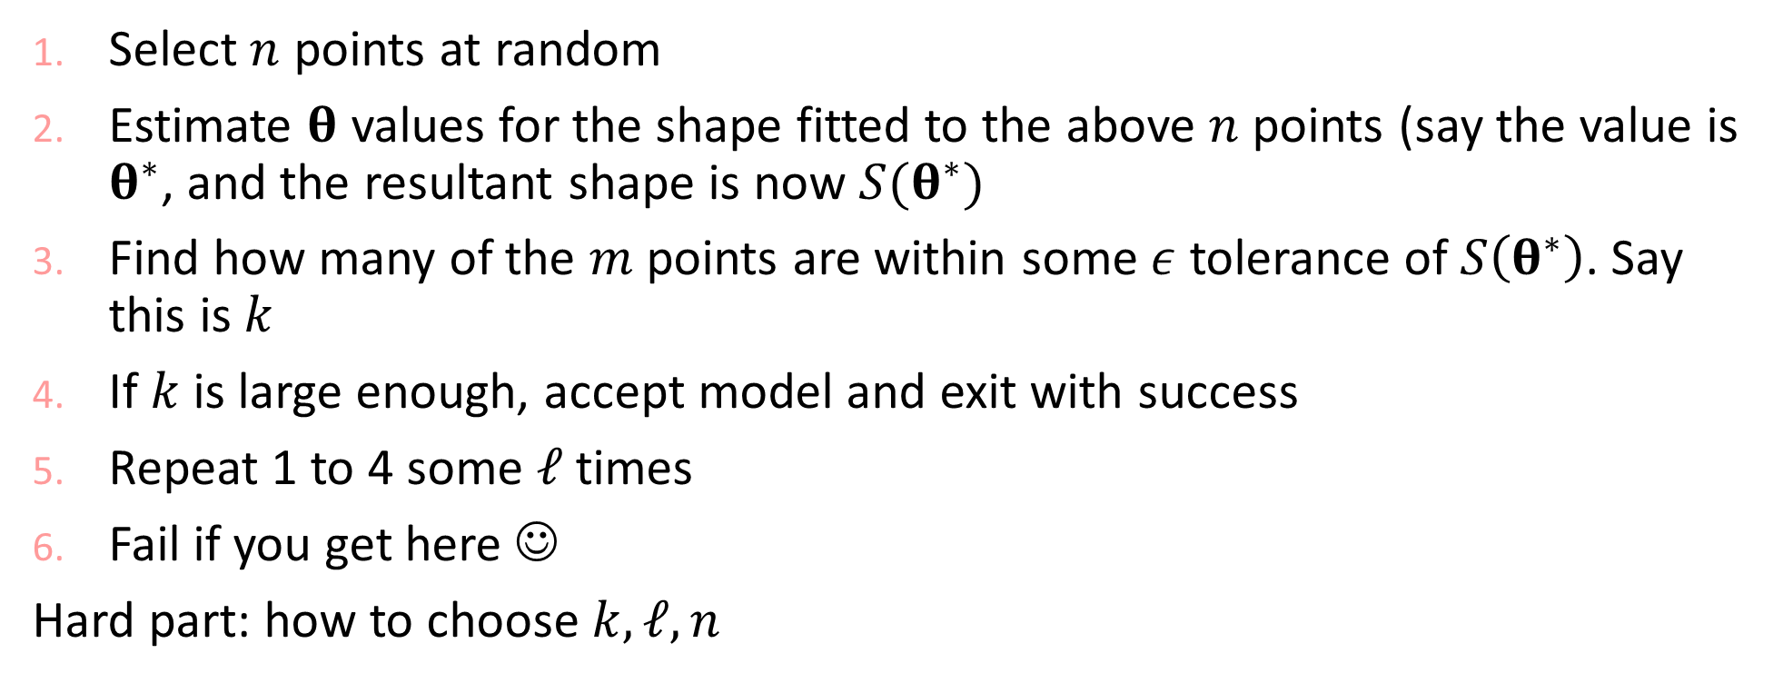
RANSAC continued
Select $n$ points at random
Estimate $θ$ values for the shape fitted to the above $n$ points (say the value is $θ^{∗}$, and the resultant shape is now $S(θ^{∗})$
Find how many of the $m$ points are within some $ε$ tolerance of $S\left(θ^{∗}\right)$. Say this is $k$
If $k$ is large enough, accept model and exit with success
Repeat 1 to 4 some $ℓ$ times
Fail if you get here ☺
Hard part: how to choose $k,ℓ,n$

Slide 28
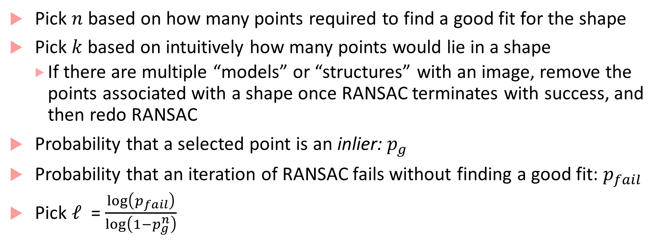
Choosing parameters for RANSAC
Pick $n$ based on how many points required to find a good fit for the shape
Pick $k$ based on intuitively how many points would lie in a shape
If there are multiple “models” or “structures” with an image, remove the points associated with a shape once RANSAC terminates with success, and then redo RANSAC
Probability that a selected point is an inlier: $p_{g}$
Probability that an iteration of RANSAC fails without finding a good fit: $p_{fail}$
Pick $ℓ$ = $\frac{\log\left(p_{fail}\right)}{\log\left(1−p_{g}^{n}\right)}$

Slide 29
Hough Transform
A tool to detect lines, circles and more general shapes
One of the tools used for lane marking detection from (pre-processed) images
Operates on sets of points and helps obtain a geometric representation of shapes that points may form
We will see how Hough transform works in 2D

Slide 30





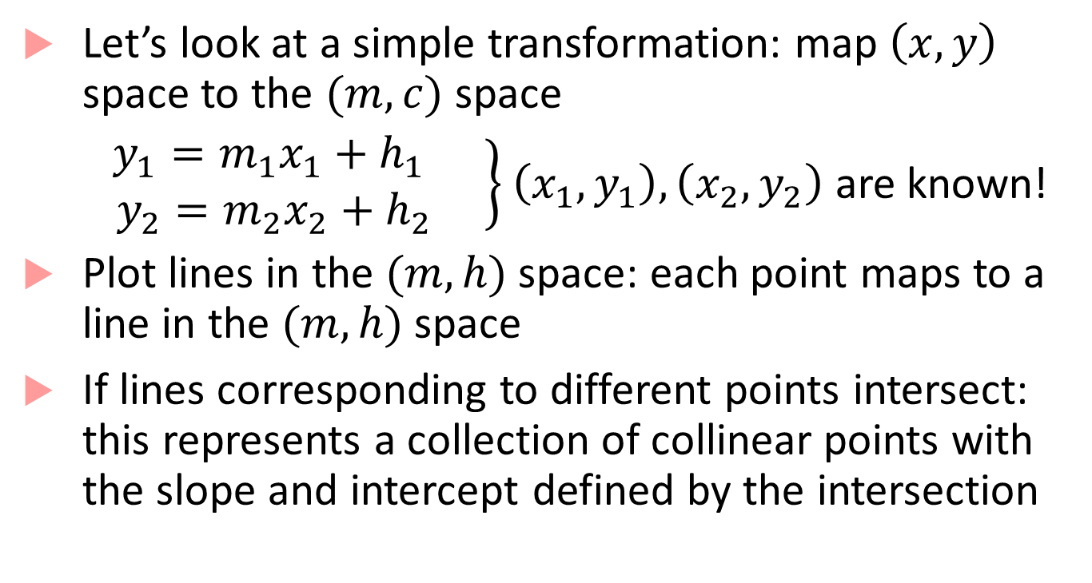







HT basics
$$y$$
$$(x_{1},y_{1})$$
Let’s look at a simple transformation: map $\left(x,y\right)$ space to the $(m,c)$ space
$\left.\begin{aligned}y_{1}=m_{1}x_{1}+h_{1} \\ { y}_{2}=m_{2}x_{2}+h_{2} \end{aligned}\right\}$ $\left(x_{1},y_{1}\right), \left(x_{2},y_{2}\right)$ are known!
Plot lines in the $(m,h)$ space: each point maps to a line in the $(m,h)$ space
If lines corresponding to different points intersect: this represents a collection of collinear points with the slope and intercept defined by the intersection
$$(x_{2},y_{2})$$
$$c$$
$$m$$
$$(x_{3},y_{3})$$
$$x$$
$$c$$
$$2$$
$$3$$
$$1$$
$$m$$

Slide 31
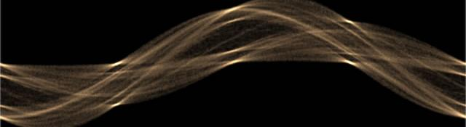

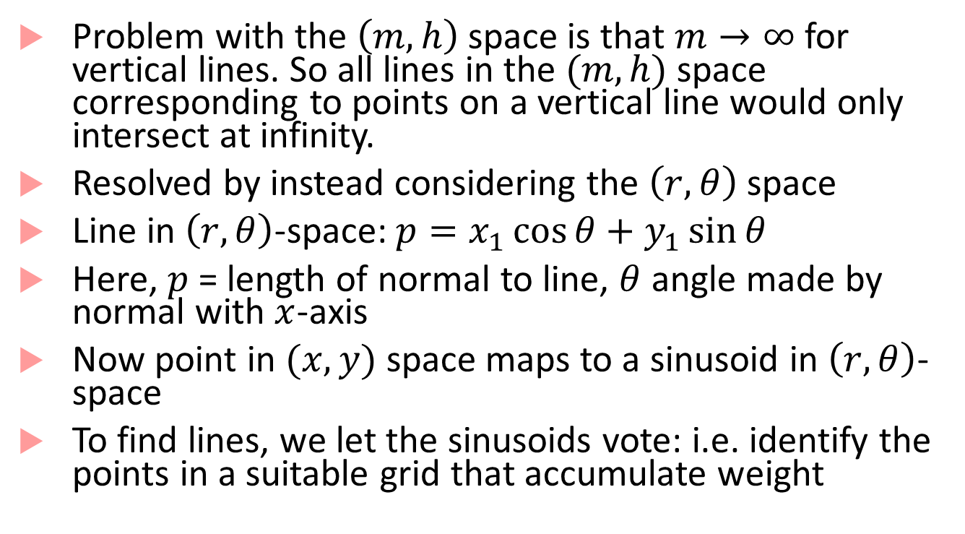

HT in polar coordinates
$$r$$
Problem with the $\left(m,h\right)$ space is that $m→∞$ for vertical lines. So all lines in the $(m,h)$ space corresponding to points on a vertical line would only intersect at infinity.
Resolved by instead considering the $\left(r,θ\right)$ space
Line in $\left(r,θ\right)$-space: $p=x_{1}\cos{θ}+y_{1}\sin{θ}$
Here, $p$ = length of normal to line, $θ$ angle made by normal with $x$-axis
Now point in $(x,y)$ space maps to a sinusoid in $\left(r,θ\right)$-space
To find lines, we let the sinusoids vote: i.e. identify the points in a suitable grid that accumulate weight
$$θ$$

Slide 32
HT discussion
Pros:
Conceptually simple and easy to implement
Robust to noise
Handles missing and occluded data gracefully
Can be adapted to various shapes beyond lines
Cons:
Computationally complex if there are many shapes to look for
Can be fooled by apparent lines
Collinear line segments may be hard to separate

Slide 33
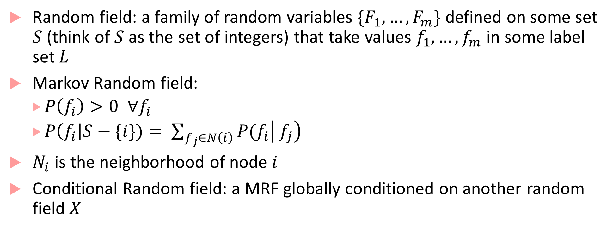
Graph-based algorithms for segmentation
Random field: a family of random variables $\{F_{1},…,F_{m}\}$ defined on some set $S$ (think of $S$ as the set of integers) that take values $f_{1},…, f_{m}$ in some label set $L$
Markov Random field:
$P\left(f_{i}\right)>0 ∀f_{i}$
$P\left(f_{i}\right|S−\{i\})= \sum_{f_{j}∈N\left(i\right)}{P(f_{i}\left| f_{j}\right)}$
$N_{i}$ is the neighborhood of node $i$
Conditional Random field: a MRF globally conditioned on another random field $X$

Slide 34
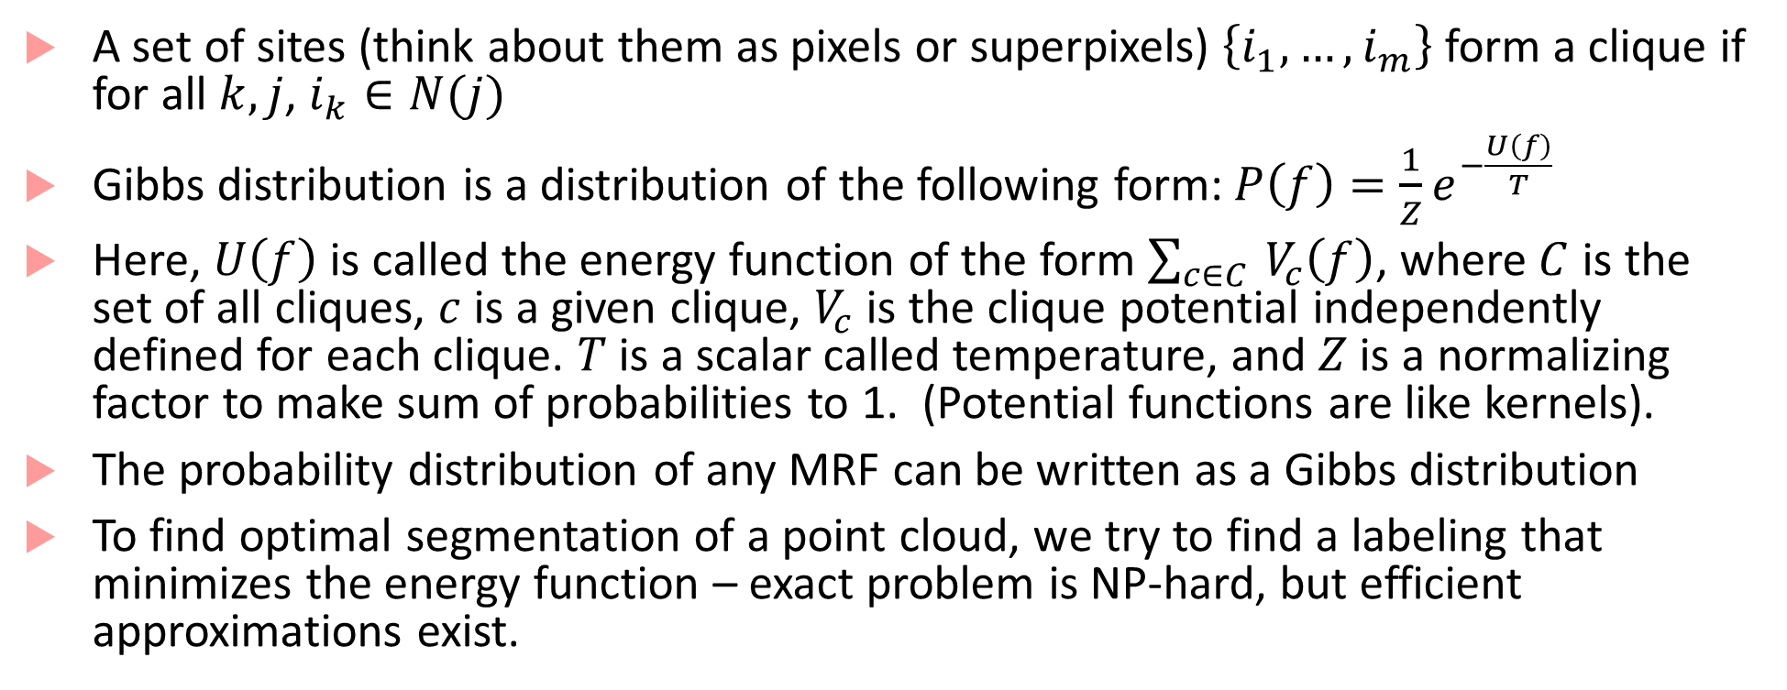
Gibbs distributions and cliques
A set of sites (think about them as pixels or superpixels) $\left\{i_{1},…,i_{m}\right\}$ form a clique if for all $k,j$, $i_{k}∈N(j)$
Gibbs distribution is a distribution of the following form:$P\left(f\right)=\frac{1}{Z}e^{−\frac{U\left(f\right)}{T}}$
Here, $U\left(f\right)$ is called the energy function of the form $\sum_{c∈C }{V_{c}\left(f\right)}$, where $C$ is the set of all cliques, $c$ is a given clique, $V_{c}$ is the clique potential independently defined for each clique. $T$ is a scalar called temperature, and $Z$ is a normalizing factor to make sum of probabilities to 1. (Potential functions are like kernels).
The probability distribution of any MRF can be written as a Gibbs distribution
To find optimal segmentation of a point cloud, we try to find a labeling that minimizes the energy function – exact problem is NP-hard, but efficient approximations exist.

Slide 35
Detection algorithms for video data
Detection of segmented clusters from LIDAR data is done using traditional machine learning algorithms as well as deep learning
Detection from images (camera data)
Lane line marking detection
Drivable path detection
Object detection
Distances to obstacles
Semantic segmentation
Scenario identification

Slide 36
Lane marking detection
Used as feedback to vehicle control systems (Lane Departure Warning, Lane-Keep Assist, and Lane-Tracking Control)
Several decades of work, but still not fully solved because of uncertainties in traffic conditions, and road-specific issues such as shadows, worn-out markings, directional arrows, warning text, pedestrian zebra-crossings, etc.
Four/Five common steps:
Lane line feature extraction
Fitting pixels into various models (lines, parabolas, hyperbolas)
Estimating vehicle pose based on fitted model
(optional fourth step: use of temporal continuity)
Image to world coordinates transformation

Slide 37
Model fitting and Pose estimation
Simple case: lane lines are straight lines (straight highway segments)
More complicated case: curvy roads, lane markings may have to be fit with splines, contours etc.
Pose estimation is typically done using Kalman filter or particle filter (typically more reliable)
Requires inverse perspective transformation to go from lane coordinates to world coordinates
Lane-level localization involves estimating vehicle lateral position and moving orientation (again can use vehicle odometry + Kalman filter)

Slide 38
Lane line extraction
Based on lane markings having large contrast with road pavement
Edge detectors followed by Hough Transform to get the complete lane
Basic idea in edge detection:
Edges are discontinuities of intensity in images, correspond to local maxima of the “image gradient”
Naïve image gradients can be affected by noise in the image, so solution is to take “smooth derivatives” i.e. first smooth an image by convolving it with a Gaussian filter, and then take the derivative
Edges correspond to zero-crossings of the second derivative of the Gaussian or LOG (Laplacian of the Gaussian)
Approach used in Canny edge detector (OpenCV) and Matlab

Slide 39
Drivable-path detection
Detecting road boundaries where vehicle can drive freely and legally without collisions
Several image-processing based algorithms using feature detection or feature learning : generally deemed to be not robust enough for erratic driving conditions
Deep learning provides the most popular set of techniques based on CNNs
Other algorithms include exploiting GPS data and OpenStreetMap data

Slide 40
On-road object detection
Detect other vehicles, pedestrians, bicycles etc.
Again, deep learning-based methods seem to be clear winners
General pipeline for deep learning approaches:
Set of proposal bounding boxes generated in the input image
Each proposal box is passed through a CNN to obtain a label and fine tune the bounding boxes

Slide 41
Basics of Neural networks
A feedforward neural network with $m$ hidden layers is defined as follows:
$x_{0}=$Input to the network
$x_{m+1}=$ Output of the network
$x_{ℓ}=$ Output of the $ℓ^{th}$ layer
And, $x_{ℓ}=f_{ℓ}\left(x_{ℓ−1}\right)$
Where, $f_{ℓ}=$ $σ_{ℓ}\left(W_{ℓ}x_{ℓ−1}+b_{ℓ}\right)$
$σ_{ℓ}$ is known as the activation function, $W_{ℓ}$ the weight matrix and, $b_{ℓ}$ the bias term of $ℓ^{th}$ layer
$$x_{ℓ−1}$$
$$W_{ℓ}x_{ℓ−1}+b_{ℓ}$$
$$σ$$
$$x_{ℓ}$$
$$d_{ℓ−1}×1$$
$$d_{ℓ}×d_{ℓ−1}$$
$$d_{ℓ}×1$$
Compact representation of the $ℓ^{th}$ layer of a neural network

Slide 42
Basics of Training a NN
Compute “how off” you are from the given example
$$J\left(W,b;x,y\right)=\frac{1}{2}{\left\|h_{W,b}\left(x\right)−y\right\|}^{2}$$
$J$ is the cost function for a given set of weights $W$, biases $b$ and a training example $x$ and $y$
Add a regularization term (to avoid overfitting). This is a term proportional to the sum of squares of all elements in the weight matrics
Use gradient descent to minimize cost
update each “variable” (weights/biases) :$W_{i,j}=W_{i,j}−α\frac{∂}{∂W_{i,j}}J\left(W,b\right)$
Here, $α$ is a learning rate, and the partial derivative is computed by back-propagation (chain rule applied to the function represented by the NN)

Slide 43
Convolutional Neural Networks
Inspired by visual cortex in animals
Learns image filters that were previously hand-engineered
Basic intuitions for CNNs:
Images are too large to be monolithically processed by a feedforward neural network (1000x1000 image = 10⁶ inputs, which means the weight matrix for the second layer is proportional to at least 10^{6!})
Data in an image is spatially correlated
CNN divided into several layers with different purposes

Slide 44
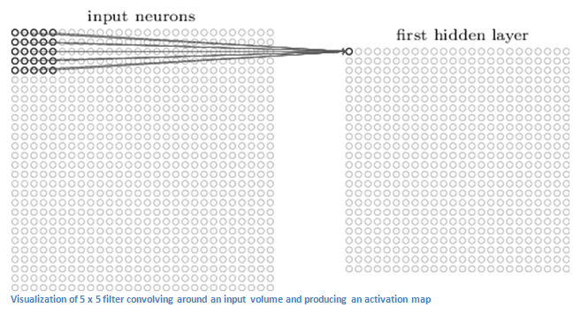
Convolutional layer
Receptive field
First layer is a convolutional layer
Convolutional layer contains neurons associated with sub-regions of the original image
Each sub-region is called receptive field
Convolves the weights of the convolutional layer with each cell in receptive field to obtain activation map or feature map
Image from [1]

Slide 45
“Convolution”
Convolution of a 2-D image I with a 2-D kernel K defined as:
$$S\left(i,j\right)=\left(I∗K\right)\left(i,j\right)=\sum_{m}{\sum_{n}{I\left(m,n\right)K(i−m,j−n)}}$$
Most neural network libraries do not use convolution, but instead implement cross-correlation, i.e.
$$S\left(i,j\right)=\sum_{m}{\sum_{n}{I\left(i+m,j+n\right)K(m,n)}}$$
The kernel function $K$ usually defines the receptive field

Slide 46
Purpose of convolutional layer
Convolutional layer applies a filter to the pixels within its receptive field
This allows identifying low-level features (curves, straight lines, etc.)
The outputs of the first convolutional layer can be thought of as having a “high value” when a particular feature is detected and a “low value” otherwise
Second convolutional layer allows learning higher-level features (e.g. semi-circles, angles etc.)
Second convolutional layer has a bigger receptive field (as it is able to simultaneously correlate over outputs of first layer)
By “convolving” over the feature map, output of second layer tries to connect higher level features

Slide 47
More insights about convolution
Convolution operation basically helps implement three ideas:
Sparse interactions (between layers)
Parameter sharing
Equivariant representations
Sparse interaction:
By using a kernel function that is smaller than input, not all outputs of the first layer interact with all inputs
This reduces the cost of doing matrix multiplication

Slide 48
More insights about convolution
Parameter sharing
As the kernel function is repeatedly applied to the image, (weight) parameters are shared
This reduces storage requirements of the model
Equivariant representations
Parameter sharing leads to equivariance under translation
$f$ is equivariant to $g$ if $f\left(g\left(x\right)\right)=g\left(f\left(x\right)\right)$
I.e. detected features of a linearly translated image will appear linearly translated

Slide 49
CNN architecture
CNN architecture
Small number of layers, where each layer contains stages
Affine transform/convolution stage performs convolution
Detector stage uses a nonlinearity such as a rectified linear unit (ReLU), i.e. $\max\left(x,0\right)$
Pooling stage performs a suitable pooling operation
Next layer
Convolutional Layer
Pooling stage
Detector stage
Convolution stage (Affine transform)
Picture from [2]
Input to layer

Slide 50
Pooling stage
Pooling function replaces the output of a layer at a certain location with a summary statistic of the nearby outputs
E.g., max pooling reports maximum output within a rectangular neighborhood
Other pooling functions include average, L² norm, weighted average etc.
Pooling helps representation be approximately invariant to small translations
By pooling over outputs of different convolutions, features can learn which transformations to become invariant to (e.g., rotation etc.)

Slide 51
Fully connected layers
CNNs may have some fully connected layers before the final output
These layers allows performing higher-level reasoning over different features learned by the previous convolutional layers
Various kind of convolution functions, pooling functions and detection functions are possible, giving rise to many different flavors
Number of convolutional layers can be varied depending on complexity of features to be learned

Slide 52
R-CNN^{[3]}
R-CNN, Fast R-CNN and Faster R-CNN are specific architectures that help with object detection
Objective is to obtain from an image:
A list of bounding boxes
A label assigned to each bounding box
A probability for each label and bounding box
The key idea in R-CNNs is to use region proposals and region of interest pooling
We will briefly discuss the architecture of Faster R-CNN

Slide 53
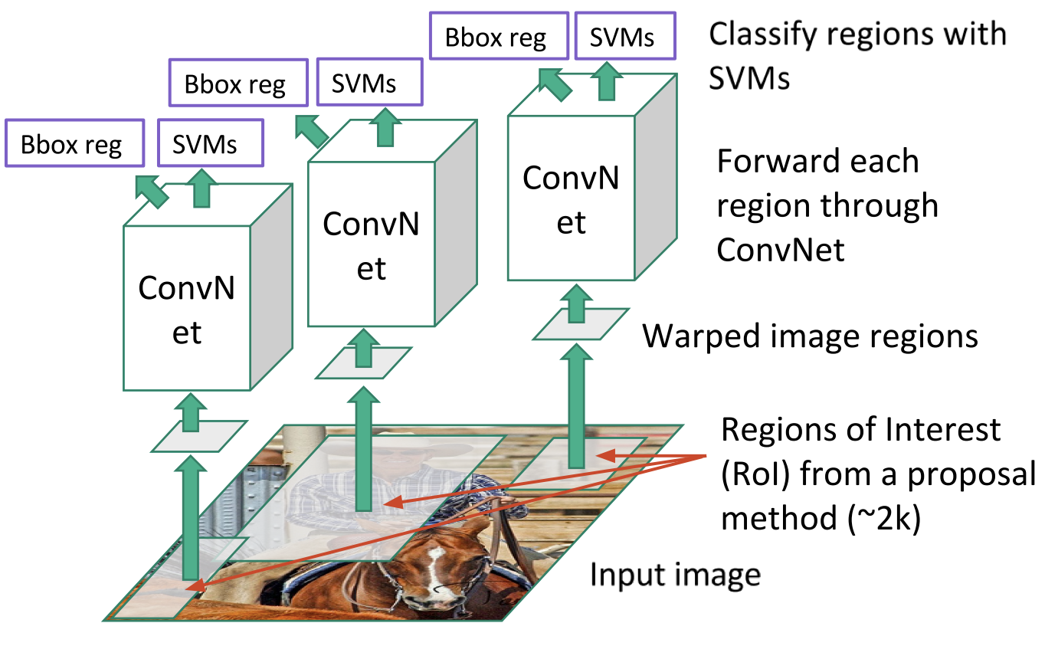
R-CNN
3 main steps:
Scan the input image for possible objects (using an algorithm called Selective Search) generating region proposals (bounding boxes where possible objects may lie)
Run a CNN on top of these region proposals
Take output of each CNN and feed it into a support vector machine to classify the region

Slide 54
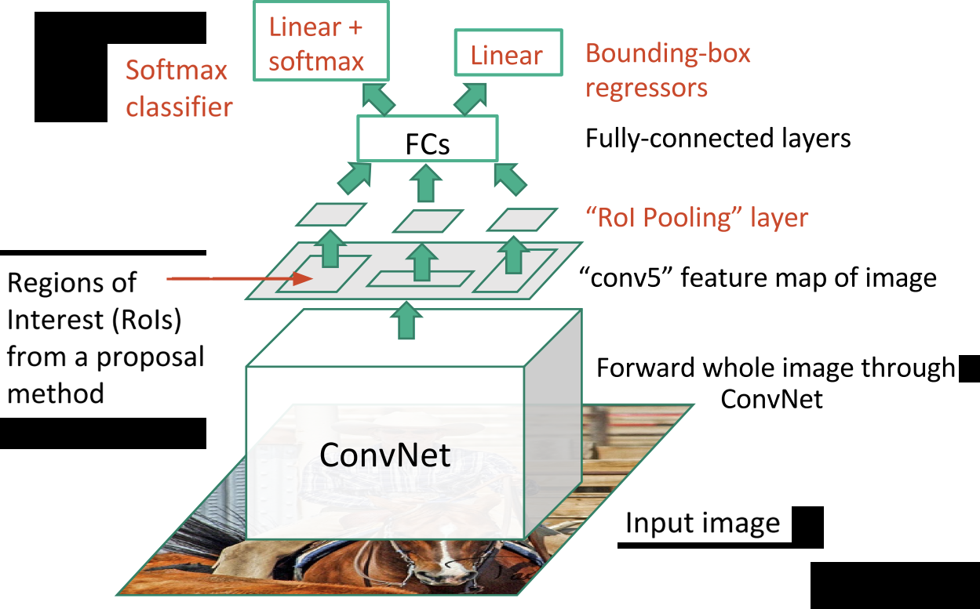
Fast R-CNN
Fast R-CNN performed feature extraction before proposing regions
Replaced SVM with a softmax layer
Fast R-CNN was much faster than R-CNN (hence the name!)
But the bottleneck was still region proposal using selective search
Faster R-CNN changed that

Slide 55
Faster R-CNN
Replaces slow selective search algorithm with a fast neural net
Introduces a region proposal network
Uses an intermediate output of the CNN to generate multiple possible regions and a score for each region reflecting possibility of containing an object
Matlab 17b+ uses Faster R-CNN for object detection

Slide 56
YOLO algorithm (You Only Look Once)
YOLO is one of the fastest real-time detection algorithms (See [4,5,6])
R-CNN etc. are algorithms that leverage classifiers and localizers to perform detection
YOLO applies a single neural network to the entire image
Network divides image into regions and predicts bounding boxes and probabilities for each region
Bounding boxes are weighted by predicted probabilities

Slide 57
Localization
Most common approach is to use vehicle odometry + GPS + Kalman filter
This becomes unreliable in urban environments, tunnels, tall buildings etc. where GPS signal quality is poor
Map-aided localization:
Use local features to achieve precise localization
SLAM (simultaneous localization and mapping): most popular approach

Slide 58
Main steps in SLAM
Car moves reaching a new point of view of its location
Motion model captures car motion, but could be inaccurate because of actuation errors
Car discovers interesting features in the environment that need to be incorporated into the map
Features are called landmarks; because of sensor errors, positions of landmarks will be uncertain.
Mathematical model to determine position of landmarks from observation is called inverse observation model

Slide 59
Main steps in SLAM (continued)
Car observes previously mapped landmarks and uses them to correct its self-localization and positions of landmarks in the map
Localization and landmark uncertainties decrease
Predict values of measurement from predicted landmark location and robot localization is called direct observation model
SLAM = above three models + an estimator (Extended Kalman Filter is common)
Another perspective on SLAM is view it as a Bayesian filtering problem

Slide 60
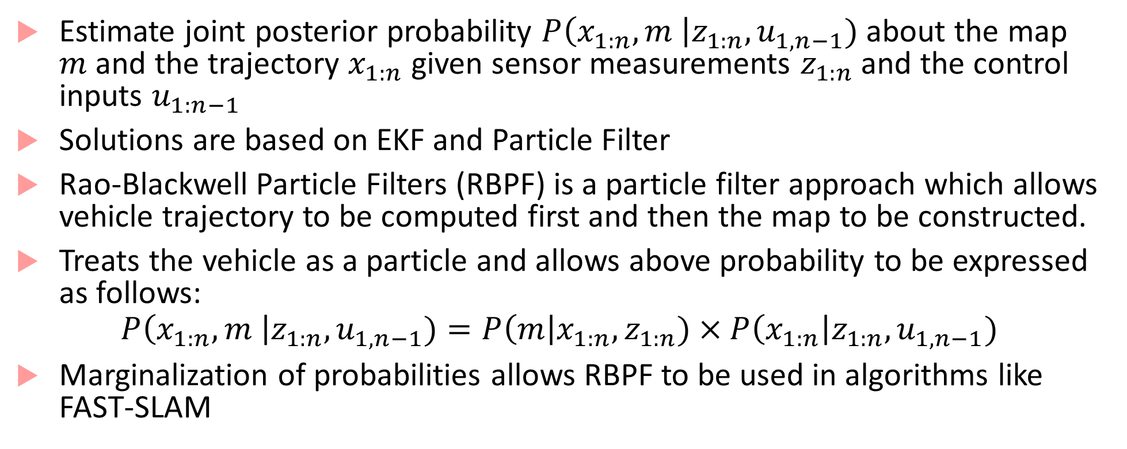
SLAM as Bayesian filtering
Estimate joint posterior probability $P\left(x_{1:n}, m \right|z_{1:n}, u_{1,n−1})$ about the map $m$ and the trajectory $x_{1:n}$ given sensor measurements $z_{1:n}$ and the control inputs $u_{1:n−1}$
Solutions are based on EKF and Particle Filter
Rao-Blackwell Particle Filters (RBPF) is a particle filter approach which allows vehicle trajectory to be computed first and then the map to be constructed.
Treats the vehicle as a particle and allows above probability to be expressed as follows:
$$P\left(x_{1:n}, m \right|z_{1:n}, u_{1,n−1})=P\left(m\right|x_{1:n},z_{1:n})×P\left(x_{1:n}\right|z_{1:n}, u_{1,n−1})$$
Marginalization of probabilities allows RBPF to be used in algorithms like FAST-SLAM

Slide 61
Sensor Fusion
We already learned about Kalman filter that can help do sensor fusion for localization using INS and GPU
Sensor fusion for camera and LiDAR data requires new algorithms
Centralized algorithms based on conditional random fields, Markov random fields, and decentralized algorithms based on boosting and Gaussian mixture models have been explored
Deep learning is also being explored for doing sensor fusion
Note: these approaches are exploratory, and there is no standard algorithm accepted by all

Slide 62
References
[1] Understanding CNNs: https://adeshpande3.github.io/A-Beginner%27s-Guide-To-Understanding-Convolutional-Neural-Networks/
[2] I. Goodfellow, Y. Bengio, A. Courville, Deep Learning, MIT Press.
[3] https://towardsdatascience.com/deep-learning-for-object-detection-a-comprehensive-review-73930816d8d9
[4] https://towardsdatascience.com/yolo-you-only-look-once-real-time-object-detection-explained-492dc9230006
[5] https://pjreddie.com/darknet/yolo/
[6] YOLO algorithm: https://arxiv.org/abs/1506.02640

Slide 63
Bibliography
O. J. Woodman, An introduction to inertial navigation - Cambridge Computer Laboratory, https://www.cl.cam.ac.uk/techreports/UCAM-CL-TR-696.pdf
Pendleton, Scott Drew, Hans Andersen, Xinxin Du, Xiaotong Shen, Malika Meghjani, You Hong Eng, Daniela Rus, and Marcelo H. Ang. "Perception, planning, control, and coordination for autonomous vehicles." Machines 5, no. 1 (2017): 6.
S. Liu, L. Li, J. Tang, S. Wu, Jean-Luc Gaudiot, Creating Autonomous Vehicle Systems, Morgan & Claypool 2018.

Slide 64
Bibliography
Pendleton, Scott Drew, Hans Andersen, Xinxin Du, Xiaotong Shen, Malika Meghjani, You Hong Eng, Daniela Rus, and Marcelo H. Ang. "Perception, planning, control, and coordination for autonomous vehicles." Machines 5, no. 1 (2017): 6.
Good introduction to Hough transform and various vision algorithms: http://aishack.in/tutorials/hough-transform-normal/
Hough transform basics: http://web.ipac.caltech.edu/staff/fmasci/home/astro_refs/HoughTrans_review.pdf
Graph-based clustering: http://vision.stanford.edu/teaching/cs231b_spring1213/slides/segmentation.pdf
MRF/CRF fundamentals https://www.cs.umd.edu/~djacobs/CMSC828seg/MRFCRF.pdf
Edge detection: https://www.swarthmore.edu/NatSci/mzucker1/e27_s2016/filter-slides.pdf
SLAM: https://people.eecs.berkeley.edu/~pabbeel/cs287-fa09/readings/Durrant-Whyte_Bailey_SLAM-tutorial-I.pdf

