Slide 1
Autonomous Cyber-Physical Systems: Probabilistic Models
Fall 2020. CS 513
Instructor: Jyo Deshmukh
This lecture also some sources other than the textbooks, full bibliography is included at the end of the slides.

Slide 2
Layout
Markov Chains
Continuous-time Markov Chains

Slide 3
Probabilistic Models
Models for components that we studied so far were either deterministic or nondeterministic.
The goal of such models is to represent computation or time-evolution of a physical phenomenon.
These models do not do a great job of capturing uncertainty.
We can usually model uncertainty using probabilities, so probabilistic models allow us to account for likelihood of environment behaviors
Machine learning/AI algorithms also require probabilistic modelling!

Slide 4
Markov chains
Stochastic process: finite or infinite collection of random variables, indexed by time
Represents numeric value of some system changing randomly over time
Value at each time point is random number with some distribution
Distribution at any time may depend on some or all previous times
Markov chain: special case of a stochastic process
Markov property: A process satisfies the Markov property if it can make predictions of the future based only on its current state (i.e. future and past states of the process are independent)
I.e. distribution of future values depends only on the current value/state

Slide 5
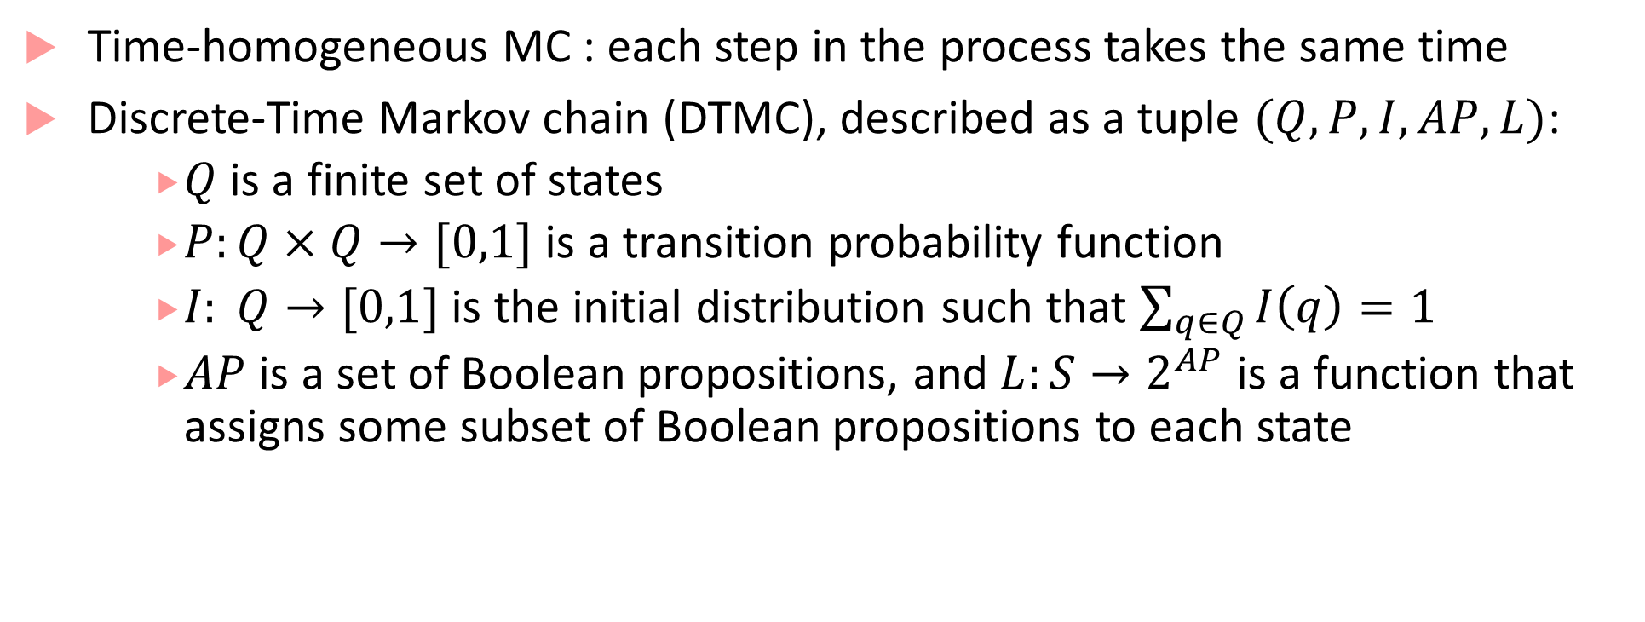
Discrete-time Markov chain (DTMC)
Time-homogeneous MC : each step in the process takes the same time
Discrete-Time Markov chain (DTMC), described as a tuple $(Q, P,I,AP,L)$:
$Q$is a finite set of states
$P:Q×Q→[0,1]$ is a transition probability function
$I: Q→[0,1]$ is the initial distribution such that $\sum_{q∈Q}{I\left(q\right)}=1$
$AP$ is a set of Boolean propositions, and $L:S→2^{AP}$ is a function that assigns some subset of Boolean propositions to each state

Slide 6


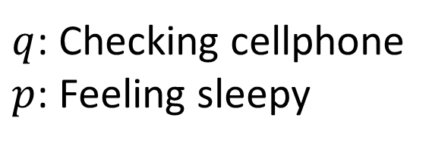


Markov chain example: Driver modeling
0
0
0.3
$$p, q$$
0.1
0.4
$$¬p,¬q$$
Accelerate
Constant Speed
0.2
$q$: Checking cellphone
$p$: Feeling sleepy
0
0.5
0.5
0.8
0.05
0.4
Idling
Brake
$$p,q$$
0.5
$$¬p,q$$
0.05
0.2
1

Slide 7
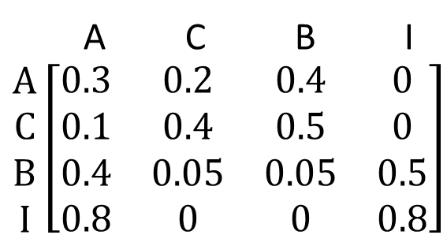
Markov chain: Transition probability matrix
0.3
$$p, q$$
0.1
0.4
A C B I $\begin{matrix}A \\ C \\ B \\ I\end{matrix}\left[\begin{matrix}0.3 & 0.2 & 0.4 & 0 \\ 0.1 & 0.4 & 0.5 & 0 \\ 0.4 & 0.05 & 0.05 & 0.5 \\ 0.8 & 0 & 0 & 0.8\end{matrix}\right]$
$$¬p,¬q$$
Accelerate
Constant Speed
0.2
0
0.5
0.5
0.8
0.05
0.4
Idling
Brake
$$p,q$$
0.5
$$¬p,q$$
0.05
0.2
1

Slide 8
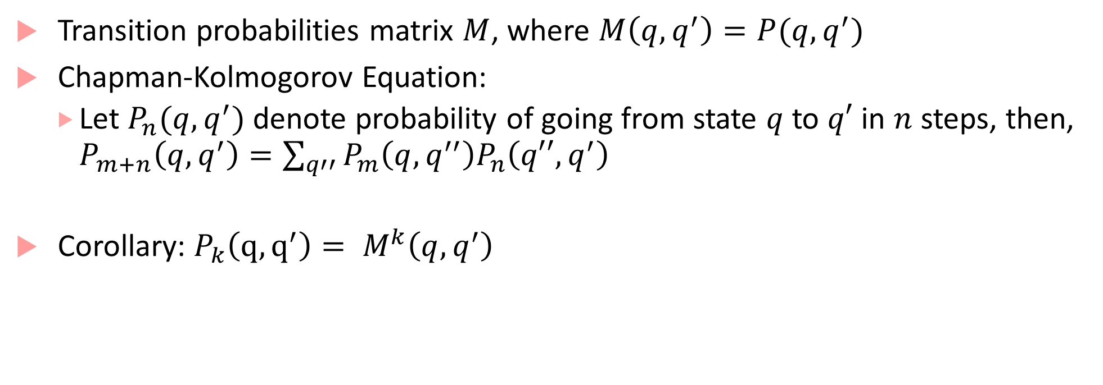
Markov Chain Analysis
Transition probabilities matrix $M$, where $M\left(q,q^{′}\right)=P(q,q^{′})$
Chapman-Kolmogorov Equation:
Let $P_{n}(q,q^{′})$ denote probability of going from state $q$ to $q′$ in $n$ steps, then, $P_{m+n}\left(q,q^{′}\right)=\sum_{q′′}{P_{m}\left(q,q^{′′}\right)P_{n}\left(q′′,q^{′}\right)}$
Corollary: $P_{k}\left(q,q^{′}\right)= M^{k}\left(q,q^{′}\right)$

Slide 9
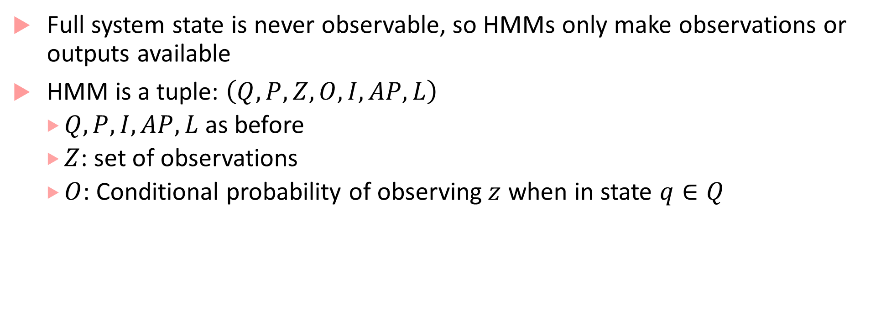
Hidden Markov Models
Full system state is never observable, so HMMs only make observations or outputs available
HMM is a tuple: $\left(Q,P,Z,O,I,AP,L\right)$
$Q, P, I, AP, L$ as before
$Z$: set of observations
$O$: Conditional probability of observing$z$ when in state $q∈Q$

Slide 10
Robot trying to reach moving target example
What is the expected time before robot reaches target?
What’s the probability that robot reaches target within the next 2 steps?
What’s the probability that the robot hits a wall before getting to the target
3 |  |  |  | G
2
1 |  | R
 |  | 1 | 2 | 3 | 4 | 5 | 6 | 7
Rules of the Game
Each timestep the target and robot move randomly to an adjacent cell or stay in the same cell (with some probability, possibly different for each cell)
When the robot and target occupy the same cell, robot declares victory

Slide 11
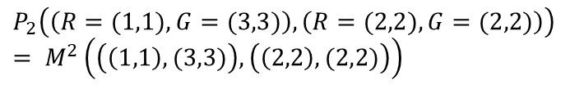
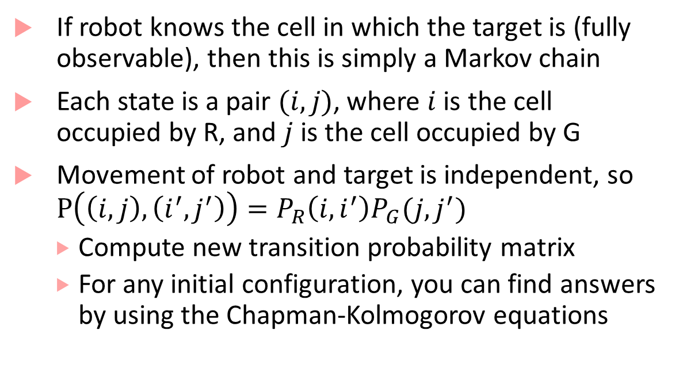
Robot trying to reach moving target example
3 |  |  |  | G
2
1 |  | R
 |  | 1 | 2 | 3 | 4 | 5 | 6 | 7
If robot knows the cell in which the target is (fully observable), then this is simply a Markov chain
Each state is a pair $(i,j)$, where $i$is the cell occupied by R, and $j$ is the cell occupied by G
Movement of robot and target is independent, so $P\left(\left(i,j\right),\left(i^{′},j^{′}\right)\right)=P_{R}\left(i,i^{′}\right)P_{G}(j,j^{′})$
Compute new transition probability matrix
For any initial configuration, you can find answers by using the Chapman-Kolmogorov equations
$$P_{2}\left(\left(R=(1,1),G=(3,3)\right),\left(R=(2,2),G=(2,2)\right)\right)$$
$$= M^{2}\left(\left(\left(1,1\right),(3,3)\right),\left(\left(2,2\right),(2,2)\right)\right)$$

Slide 12
What if robot cannot see all the state?
Robot with noisy proximity sensors:
W | W | W
 | R
G
W | W | W
 | R
G | G
True state
Observed noisy state
Target state is hidden : if it is not proximal, robot does not know where the target is, and if it is proximal, robot only has noisy estimates
We can assume robot knows how the target moves (left, right, top, down), and the uncertainty (as captured by the transition probability matrix): this is like the process model in KF
The robot’s sensors are noisy, this is like the measurement model in KF
Question: Given a series of (noisy) observations, can the robot estimate where the target is?
Problem very similar to KF! In fact, HMM can be viewed as a discrete-variable version of KF

Slide 13
Interesting Problems for HMMs
[Decoding] Given a sequence of observations, can you estimate the hidden state sequence? [Solution with the Viterbi Algorithm]
[Likelihood] Given an HMM and an observation sequence, what is the likelihood of that observation sequence [Dynamic Programming based Forward Algorithm]
[Learning] Given an observation sequence (or sequences), learn the HMM that maximizes the likelihood of that sequence [Baum-Welch or forward-backward algorithm]

Slide 14
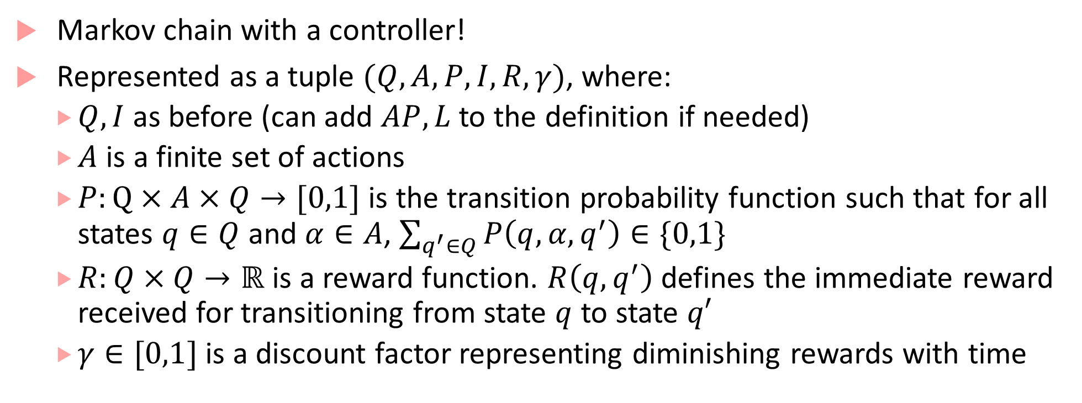
Markov Decision Process
Markov chain with a controller!
Represented as a tuple $(Q,A,P,I, R,γ)$, where:
$Q, I$ as before (can add $AP, L$ to the definition if needed)
$A$ is a finite set of actions
$P:Q×A×Q→[0,1]$ is the transition probability function such that for all states $q∈Q$ and $α∈A$, $\sum_{q^{′}∈Q}{P\left(q,α,q^{′}\right)}∈\{0,1\}$
$R:Q×Q→ℝ$ is a reward function. $R\left(q,q^{′}\right)$ defines the immediate reward received for transitioning from state $q$ to state $q′$
$γ∈[0,1]$ is a discount factor representing diminishing rewards with time

Slide 15





Autonomous Robot controlling its actions
Assume fixed target location
Reward for transitions going to target cell = 1, otherwise 0
Just part of the robot MDP showing two different actions, each action leading to next states with some probability
Which action to choose from each cell?
How do we find an optimal policy (that maximizes rewards)?
We will revisit this when we do reinforcement learning
0.9
$$(i,j+1)$$
up
$$(i,j)$$
0.1
$$(i,j)$$
0.9
dn
$$(i,j−1)$$
0.1
$$(i−1,j)$$

Slide 16
Detour to Branching-Time Logics

Slide 17
Computation Tree Logic
LTL was a linear-time logic where we reason about traces
CTL is a logic where we reason over the tree of executions generated by a program, also known as the computation tree
We care about CTL because:
There are some properties that cannot be expressed in LTL, but can be expressed in CTL: From every system state, there is a system execution that takes it back to the initial state (also known as the reset property)
To understand pCTL (Probabilistic CTL), it’s good if you understand CTL ☺
Can express interesting properties for multi-agent systems

Slide 18


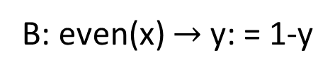


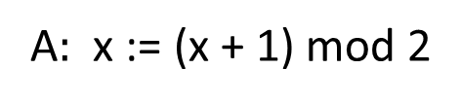






Computation Tree
nat x := 0; bool y:= 0
$$(0,0)$$
We saw computation trees when understanding semantics of asynchronous processes
Basically a tree that considers “all possibilities” in a reactive program
A$:$ x := (x + 1) mod 2
B: even(x) $→$ y: = 1-y
Process
$$(1,0)$$
$$(0,1)$$
$$(0,0)$$
$$(0,1)$$
$$(0,0)$$
$$(0,0)$$
$$(1,1)$$
$$(1,0)$$
$$(1,1)$$
Finite State machine

Slide 19
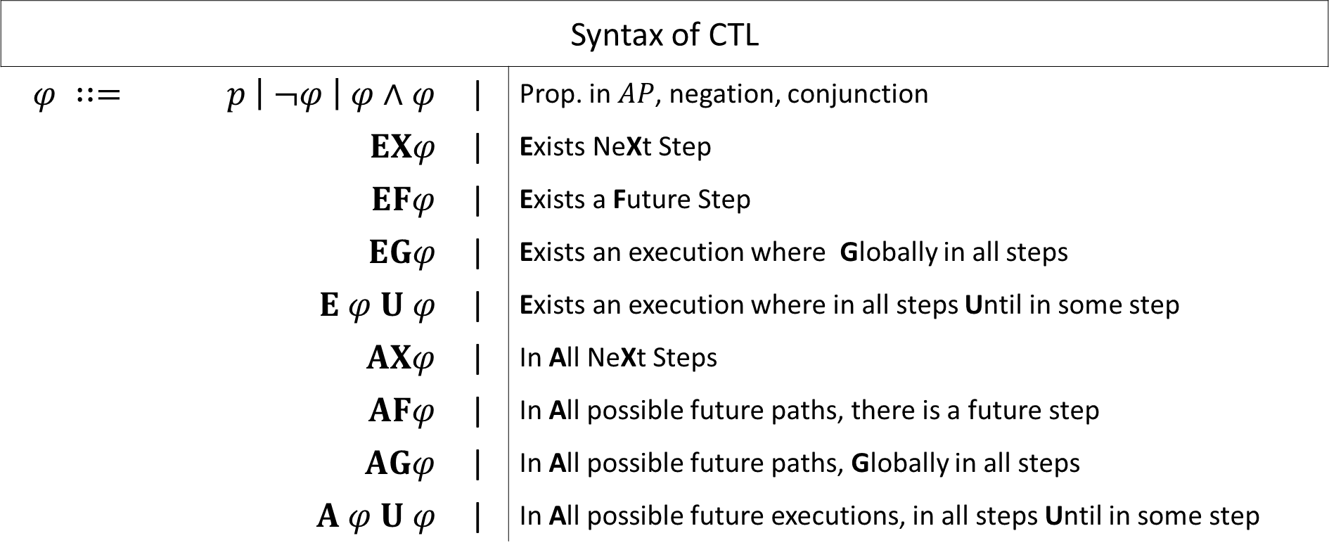
CTL Syntax
Syntax of CTL
$$φ ∷=$$ | $p \left| ¬φ \right| φ∧φ$ | | | Prop. in $AP$, negation, conjunction
 | $$EXφ$$ | | | Exists NeXt Step
 | $$EFφ$$ | | | Exists a Future Step
 | $$EGφ$$ | | | Exists an execution where Globally in all steps
 | $$E φ U φ$$ | | | Exists an execution where in all steps Until in some step
 | $$AXφ$$ | | | In All NeXt Steps
 | $$AFφ$$ | | | In All possible future paths, there is a future step
 | $$AGφ$$ | | | In All possible future paths, Globally in all steps
 | $$A φ U φ$$ | | | In All possible future executions, in all steps Until in some step

Slide 20
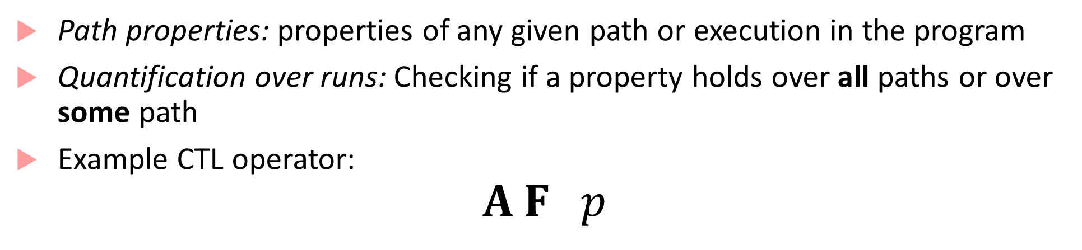
CTL semantics
Path properties: properties of any given path or execution in the program
Quantification over runs: Checking if a property holds over all paths or over some path
Example CTL operator:
$$A F p$$
For All executions
Eventually/In Some Future step

Slide 21

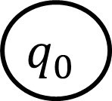


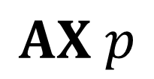
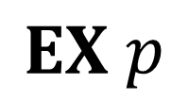
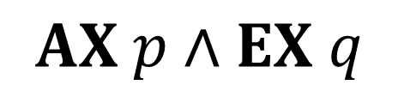





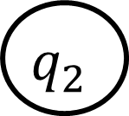
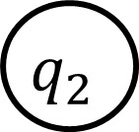

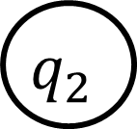
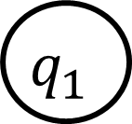
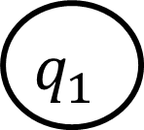
CTL Semantics through examples
$$q_{0}$$
$$q_{0}$$
$$q_{0}$$
$$p$$
$$p$$
$$q_{2}$$
$$q_{1}$$
$$p$$
$$q_{2}$$
$$q_{1}$$
$$p$$
$$q_{1}$$
$$p$$
$$q_{2}$$
$$q$$
$$EX p$$
$$AX p∧EX q$$
$$AX p$$

Slide 22



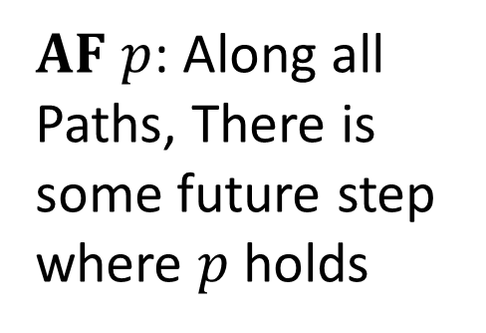


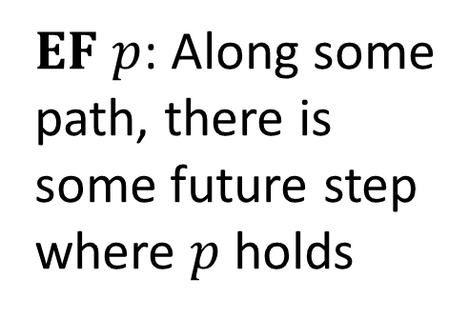


CTL semantics through examples
$$q_{0}$$
$AF p$: Along all
Paths, There is some future step where $p$ holds
$$q_{0}$$
$$p$$
$EF p$: Along some
path, there is some future step where $p$ holds
$$p$$
$$p$$
$$p$$
$$p$$

Slide 23
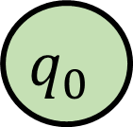



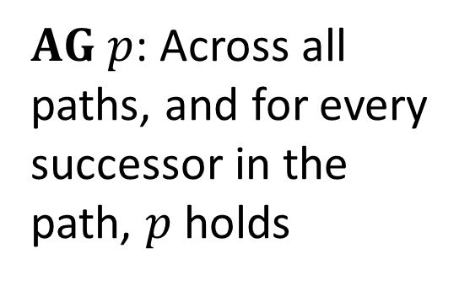




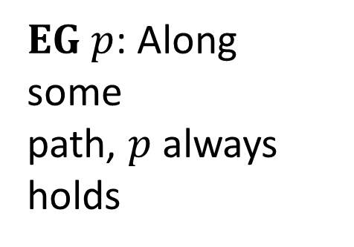



CTL semantics through examples
$AG p$: Across all
paths, and for every successor in the path, $p$ holds
$$q_{0}$$
$$p$$
$$q_{0}$$
$$p$$
$$p$$
$$p$$
$$p$$
$$p$$
$$p$$
$EG p$: Along some
path, $p$ always holds
$$p$$
$$p$$
$$p$$

Slide 24
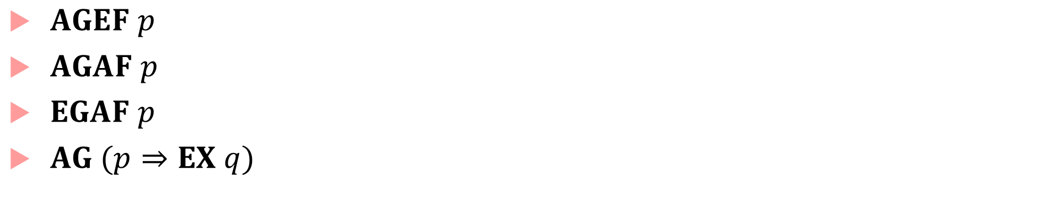
CTL Operator fun
$AGEF$ $p$
$AGAF p$
$EGAF p$
$AG (p⇒EX q)$

Slide 25
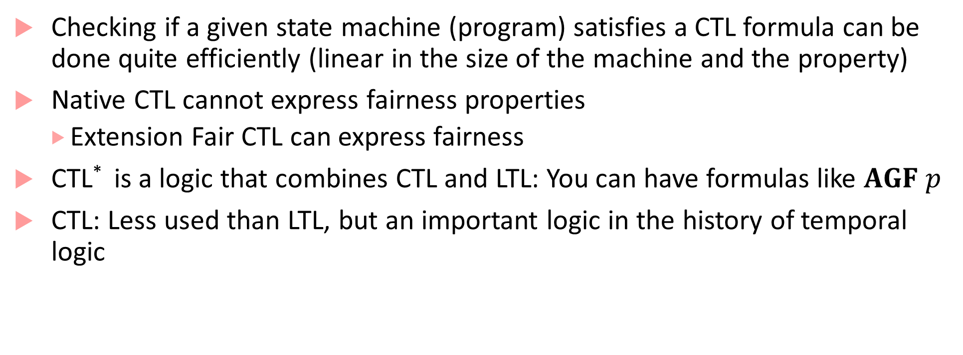
CTL advantages and limitations
Checking if a given state machine (program) satisfies a CTL formula can be done quite efficiently (linear in the size of the machine and the property)
Native CTL cannot express fairness properties
Extension Fair CTL can express fairness
CTL* is a logic that combines CTL and LTL: You can have formulas like $AGF p$
CTL: Less used than LTL, but an important logic in the history of temporal logic

Slide 26
Probabilistic CTL
LTL
Can be interpreted over individual executions
Can be interpreted over a state machine: do all paths satisfy property
CTL
Is interpreted over a computation tree
PCTL
Is interpreted over a discrete-time Markov chain
Encodes uncertainties in computation due to environment etc.

Slide 27
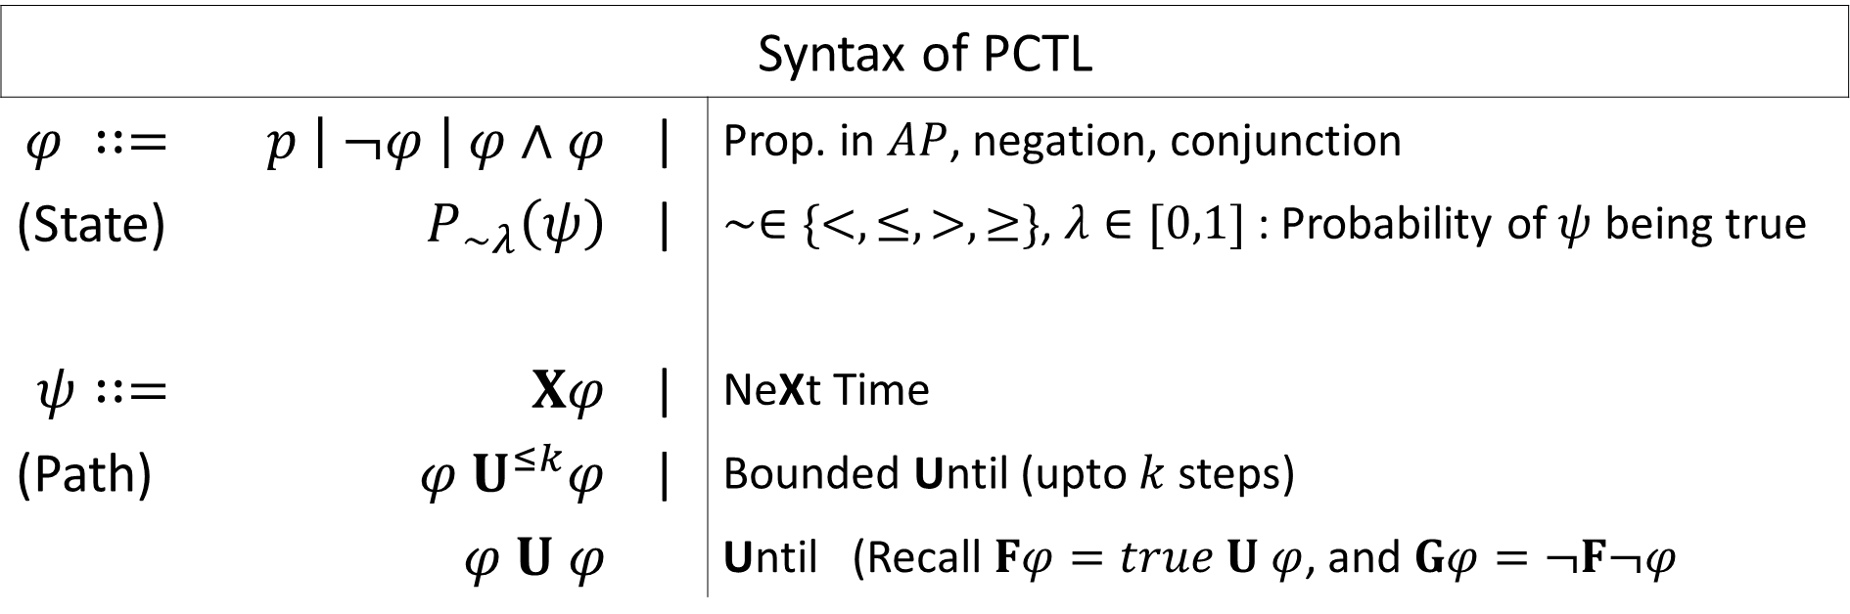
Probabilistic CTL
Syntax of PCTL
$$φ ∷=$$ | $p \left| ¬φ \right| φ∧φ$ | | | Prop. in $AP$, negation, conjunction
(State) | $$P_{∼λ}\left(ψ\right)$$ | | | $∼∈\{<,≤,>,≥\}$, $λ∈[0,1]$ : Probability of $ψ$ being true
$$ψ∷=$$ | $$Xφ$$ | | | NeXt Time
(Path) | $$φ U^{≤k}φ$$ | | | Bounded Until (upto $k$ steps)
 | $$φ U φ$$ |  | Until (Recall $Fφ=true U φ$, and $Gφ=¬F¬φ$
PCTL formulas are state formulas, path formulas used to define how to build a PCTL formula

Slide 28



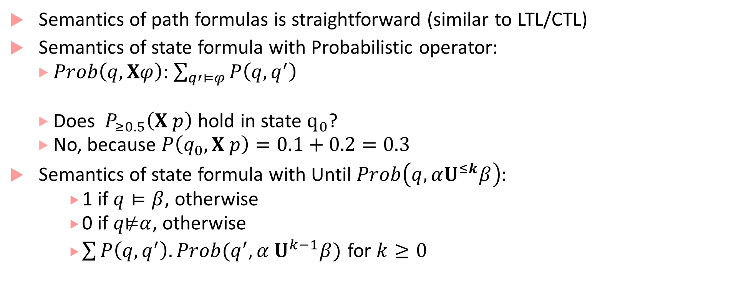




Semantics
Semantics of path formulas is straightforward (similar to LTL/CTL)
Semantics of state formula with Probabilistic operator:
$Prob\left(q,Xφ\right)$: $\sum_{q′⊨φ}{P\left(q,q^{′}\right)}$
Does ${ P}_{≥0.5}\left(X p\right)$ hold in state $q_{0}$?
No, because $P\left(q_{0},X p\right)=0.1+0.2=0.3$
Semantics of state formula with Until $Prob\left(q,αU^{≤k}β\right)$:
1 if $q⊨β$, otherwise
0 if $q\text{⊭}α$, otherwise
$\sum{P\left(q,q^{′}\right).Prob(q^{′},α U^{k−1}β})$ for $k≥0$
$$q_{0}$$
0.4
$$¬p$$
$$p$$
$$q_{2}$$
0.2
0.1
$$q_{3}$$
$$q_{1}$$
$$p$$

Slide 29

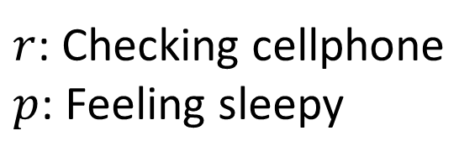
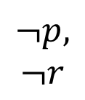
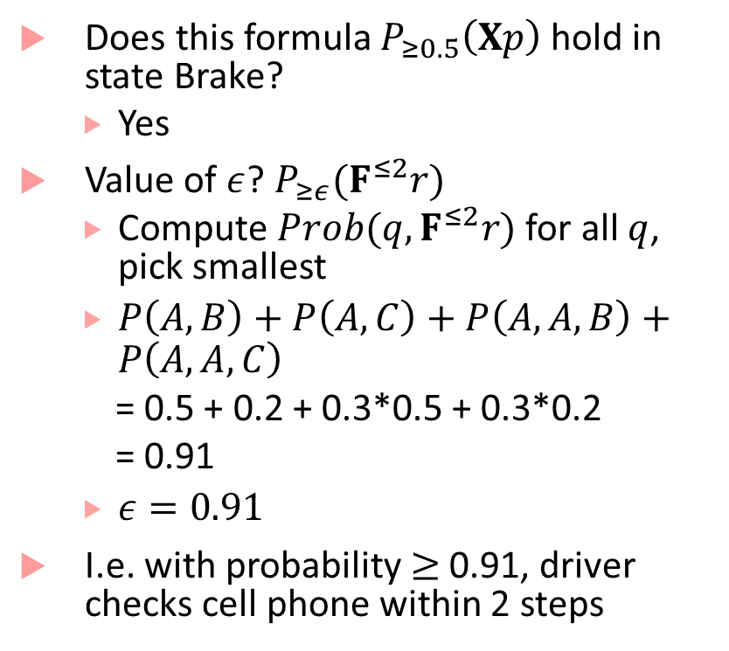


PCTL
$r$: Checking cellphone
$p$: Feeling sleepy
Does this formula $P_{≥0.5}\left(Xp\right)$ hold in state Brake?
Yes
Value of $ε$? $P_{≥ε}(F^{≤2}r)$
Compute $Prob(q, F^{≤2}r)$ for all $q$, pick smallest
$P\left(A,B\right)+P\left(A,C\right)+P\left(A,A,B\right)+P\left(A,A,C\right)$
= 0.5 + 0.2 + 0.3*0.5 + 0.3*0.2
= 0.91
$ε=0.91$
I.e. with probability$≥$ 0.91, driver checks cell phone within 2 steps
0
0.3
0
$$p, r$$
$$¬p,$$
$$¬r$$
0.1
0.4
Accelerate
Constant Speed
0.2
0
0.5
0.5
0.8
0.05
0.4
Idling
Brake
$$p,r$$
0.5
$$¬p,r$$
0.05
0.2
1

Slide 30
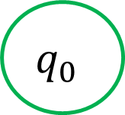

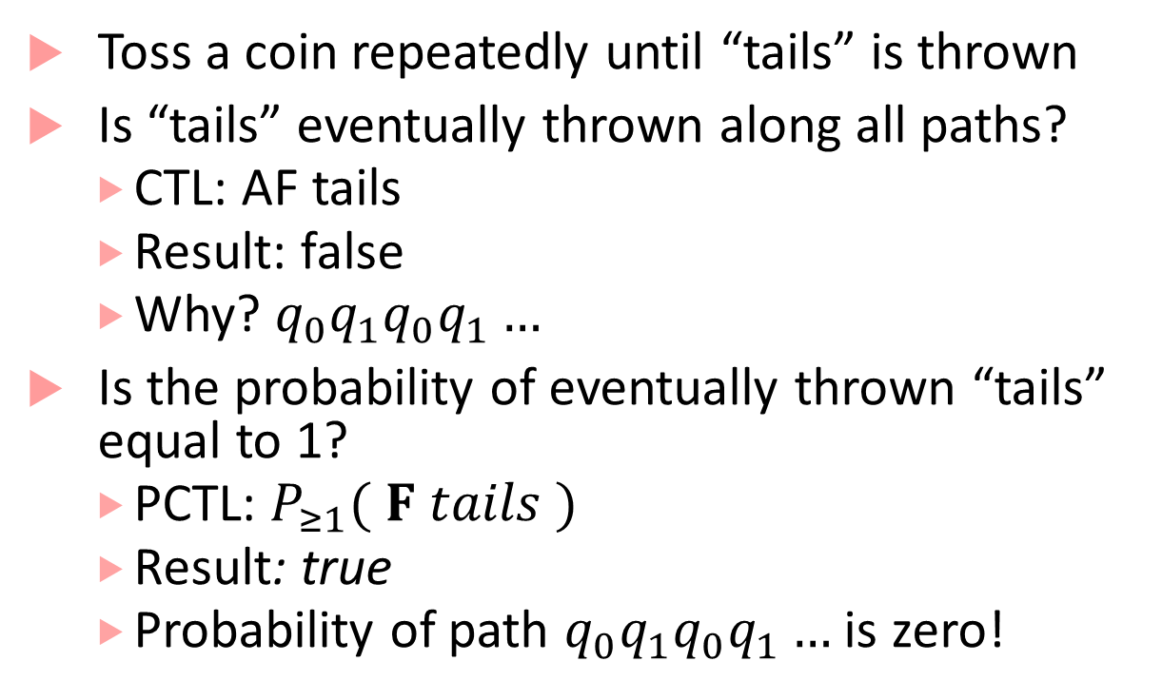

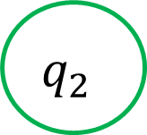
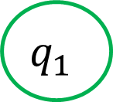
Quantitative in PCTL vs. Qualitative in CTL
Toss a coin repeatedly until “tails” is thrown
Is “tails” eventually thrown along all paths?
CTL: AF tails
Result: false
Why? $q_{0}q_{1}q_{0}q_{1}…$
Is the probability of eventually thrown “tails” equal to 1?
PCTL: $P_{≥1}( F tails )$
Result: true
Probability of path $q_{0}q_{1}q_{0}q_{1}…$ is zero!
1
$$q_{1}$$
$$heads$$
0.5
$$q_{0}$$
0.5
1
$$q_{2}$$
$$tails$$

Slide 31
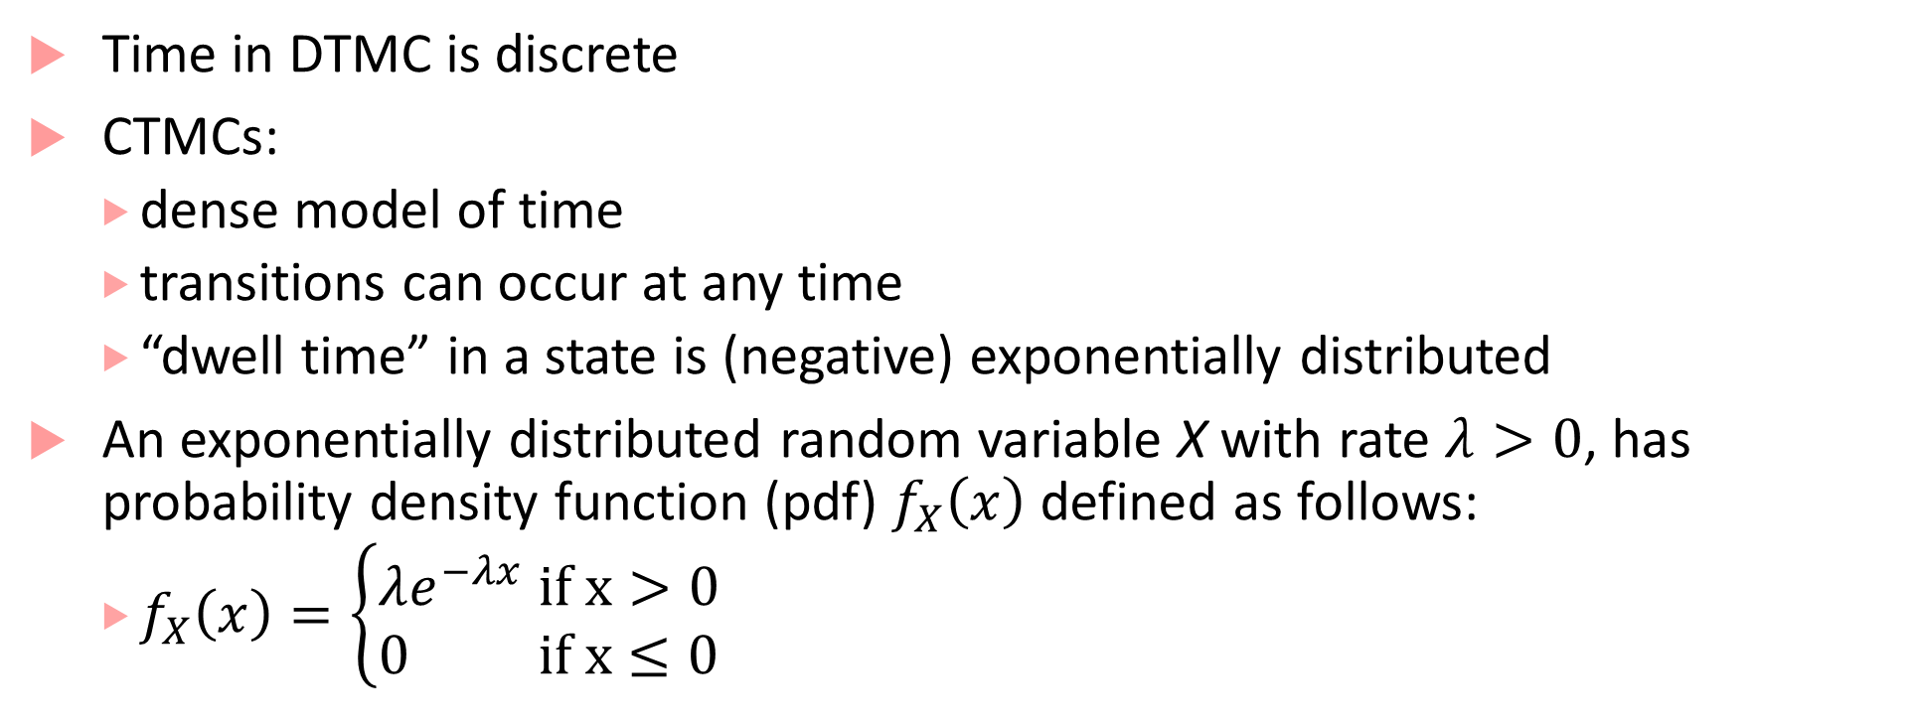
Continuous Time Markov Chains
Time in DTMC is discrete
CTMCs:
dense model of time
transitions can occur at any time
“dwell time” in a state is (negative) exponentially distributed
An exponentially distributed random variable X with rate $λ>0$, has probability density function (pdf) $f_{X}\left(x\right)$ defined as follows:
$f_{X}\left(x\right)=\left\{\begin{matrix}λe^{−λx} if x>0 \\ 0 if x≤0\end{matrix}\right.$

Slide 32
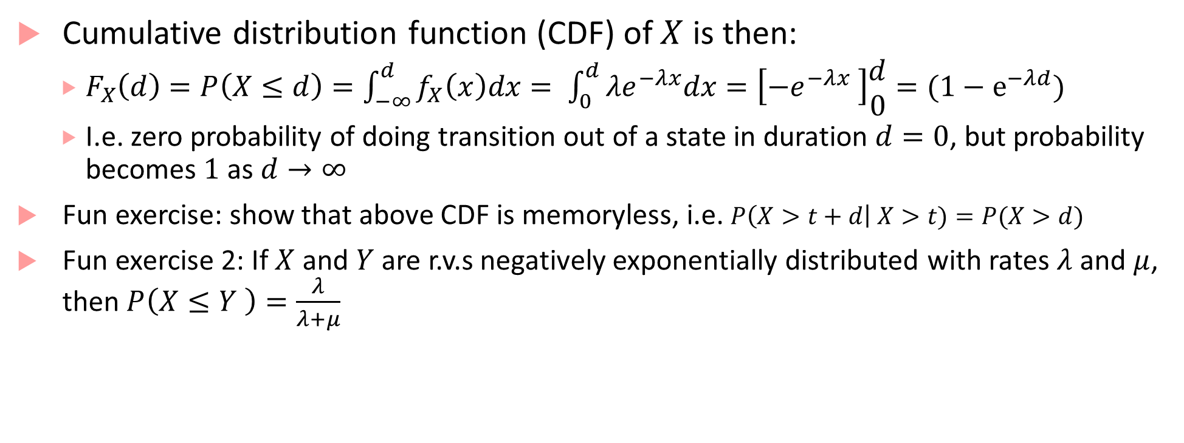
Exponential distribution properties
Cumulative distribution function (CDF) of $X$ is then:
$F_{X}\left(d\right)=P\left(X≤d\right)=\int_{−∞}^{d}{f_{X}\left(x\right)dx}= \int_{0}^{d}{λe^{−λx}dx}=\left[−e^{−λx} \right]\begin{matrix}d \\ 0\end{matrix}=(1−e^{−λd})$
I.e. zero probability of doing transition out of a state in duration $d=0$, but probability becomes $1$ as $d→∞$
Fun exercise: show that above CDF is memoryless, i.e. $P\left(X>t+d\right| X>t)=P(X>d)$
Fun exercise 2: If $X$ and $Y$ are r.v.s negatively exponentially distributed with rates $λ$ and $μ$, then $P\left(X≤Y \right)=\frac{λ}{λ+μ}$

Slide 33
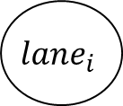
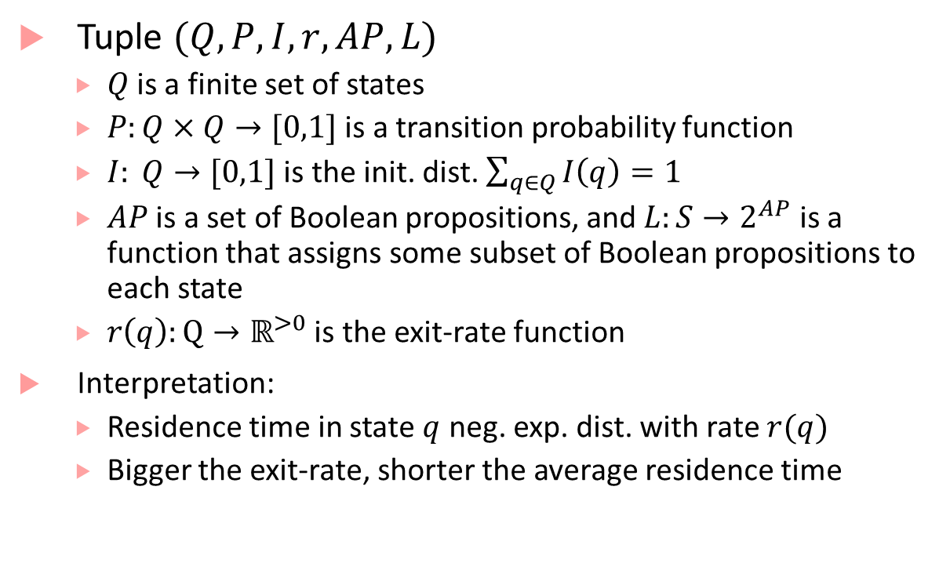
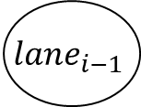
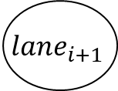
CTMC example
Tuple $(Q,P,I,r,AP,L)$
$Q$is a finite set of states
$P:Q×Q→[0,1]$ is a transition probability function
$I: Q→[0,1]$ is the init. dist. $\sum_{q∈Q}{I\left(q\right)}=1$
$AP$ is a set of Boolean propositions, and $L:S→2^{AP}$ is a function that assigns some subset of Boolean propositions to each state
$r\left(q\right):Q→ℝ^{>0}$ is the exit-rate function
Interpretation:
Residence time in state $q$ neg. exp. dist. with rate $r(q)$
Bigger the exit-rate, shorter the average residence time
0.1
0.6
0.1
$$lane_{i}$$
$$lane_{i+1}$$
0.4
0.3
5
0.6
0.8
$$lane_{i−1}$$
0.2
0.5

Slide 34
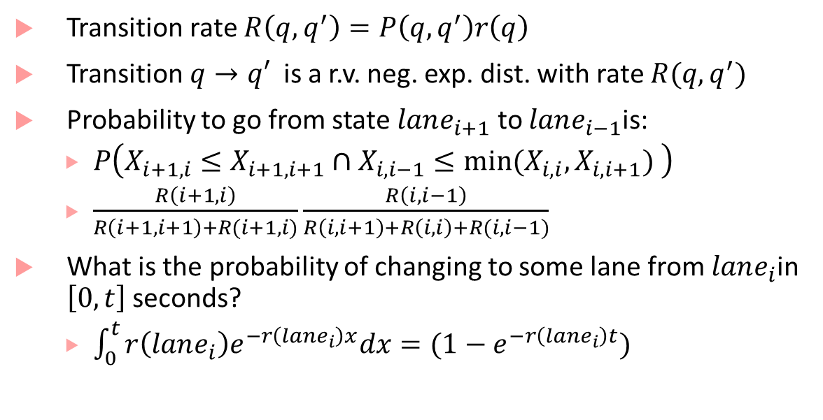
CTMC example
Transition rate $R\left(q,q^{′}\right)=P\left(q,q^{′}\right)r\left(q\right)$
Transition $q→q′$ is a r.v. neg. exp. dist. with rate $R(q,q^{′})$
Probability to go from state $lane_{i+1}$ to $lane_{i−1}$is:
$P\left(X_{i+1,i}≤X_{i+1,i+1}∩X_{i,i−1}≤{min⁡(X}_{i,i},X_{i,i+1}) \right)$
$\frac{R\left(i+1,i\right)}{R\left(i+1,i+1\right)+R(i+1,i)}\frac{R\left(i,i−1\right)}{R\left(i,i+1\right)+R\left(i,i\right)+R(i,i−1)}$
What is the probability of changing to some lane from $lane_{i}$in $\left[0,t\right]$seconds?
$\int_{0}^{t}{r\left(lane_{i}\right)e^{−r\left(lane_{i}\right)x}dx}=(1−e^{−r\left(lane_{i}\right)t})$
0.1
0.6
0.1
$$lane_{i}$$
$$lane_{i+1}$$
0.4
0.3
5
0.6
0.8
$$lane_{i−1}$$
0.2
0.5

Slide 35



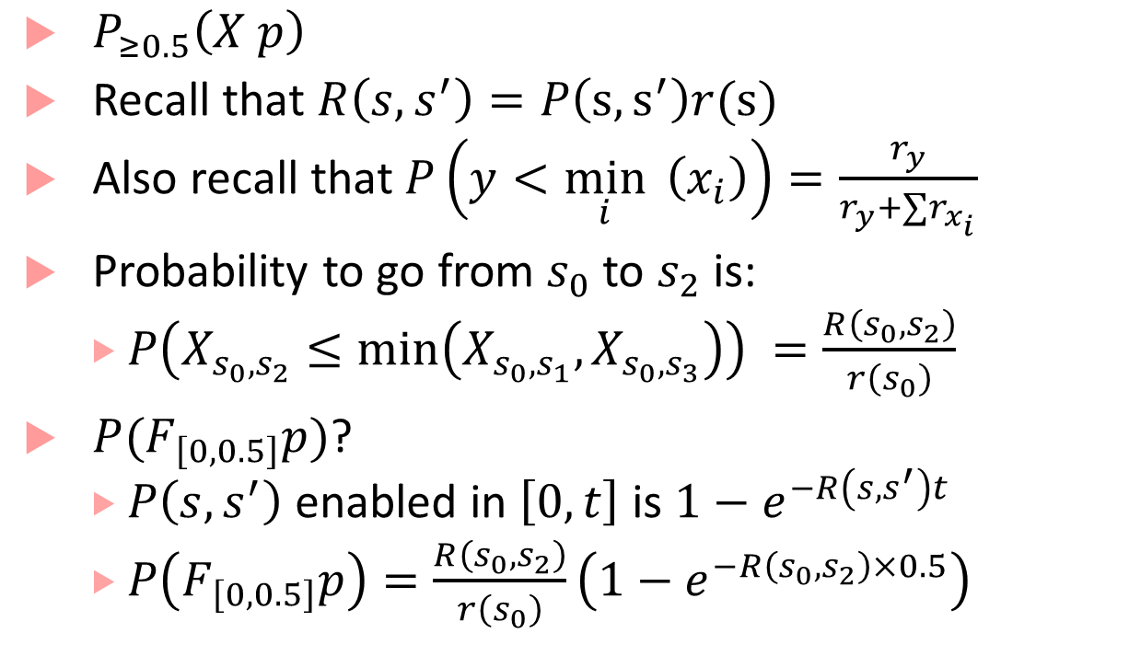





CTMC + PCTL
$P_{≥0.5}\left(X p\right)$
Recall that $R\left(s,s^{′}\right)=P\left(s,s^{′}\right)r(s)$
Also recall that $P\left(y<\min_{i}{ \left(x_{i}\right)}\right)=\frac{r_{y}}{r_{y}+∑r_{x_{i}}}$
Probability to go from $s_{0}$ to $s_{2}$ is:
$P\left(X_{s_{0},s_{2}}≤\min\left(X_{s_{0},s_{1}},X_{s_{0},s_{3}}\right)\right) =\frac{R\left(s_{0},s_{2}\right)}{r\left(s_{0}\right)}$
$P(F_{\left[0,0.5\right]}p)$?
$P\left(s,s^{′}\right)$enabled in $\left[0,t\right]$ is $1−e^{−R\left(s,s^{′}\right)t}$
$P\left(F_{\left[0,0.5\right]}p\right)=\frac{R\left(s_{0},s_{2}\right)}{r\left(s_{0}\right)}\left(1−e^{−R\left(s_{0},s_{2}\right)×0.5}\right)$
$$s_{1}$$
$$¬p$$
0.5
$$s_{0}$$
$$s_{2}$$
$$p$$
0.3
$$r\left(s_{0}\right)=2$$
0.2
$$s_{3}$$
$$¬p$$

Slide 36
Bibliography
Baier, Christel, Joost-Pieter Katoen, and Kim Guldstrand Larsen. Principles of model checking. MIT press, 2008.
Continuous Time Markov Chains: https://resources.mpi-inf.mpg.de/departments/rg1/conferences/vtsa11/slides/katoen/lec01_handout.pdf

