Slide 1
Autonomous Cyber-Physical Systems: Dynamical Systems
Spring 2018. CS 599.
Instructor: Jyo Deshmukh
Acknowledgment: Some of the material in these slides is based on the lecture slides for CIS 540: Principles of Embedded Computation taught by Rajeev Alur at the University of Pennsylvania. http://www.seas.upenn.edu/~cis540/

Slide 2
Dynamical Systems
Most natural model for describing most physical systems
Continuous/discrete systems that continuously evolve over time
Convenient to model such systems with differential equations
Typically consist of physical quantities modeled as state variables
Pressure, Temperature, Velocity, Acceleration, Current, Voltage, etc.
Could include algebraic relations between state variables
Execution semantics similar to synchronous models, but with continuous-time semantics instead of discrete-time

Slide 3
Continuous-time Component (Algebraic)
real x
real error
error = (x – x_{ref})
real x_{ref}
Input variables: x and x_{ref} of type real, Output variable: error of type real
No state variables
Signals: Assignments of values to variables as a function of time
At each time t, error(t) = x(t) – x_{ref}(t)
Input/Output relation expressed algebraically instead of as an assignment

Slide 4
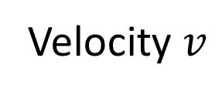
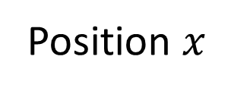
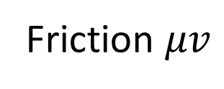
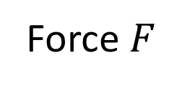
Model of a simple car
Force $F$
Position $x$
Velocity $v$
Friction $μv$
Newton’s law of motion: $F −kv=m\frac{d^{2}x}{dt^{2}};v=\frac{dx}{dt}$

Slide 5



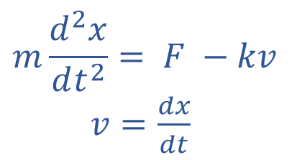
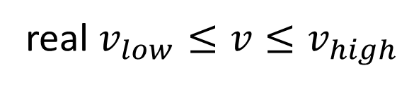

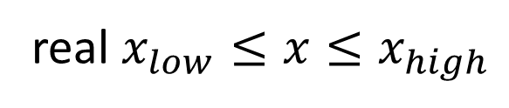

Continuous-time component (differential)
real $x_{low}≤x≤x_{high}$
$$x$$
Rate of change of each state variable and output variables defined using expressions over inputs and states
$$F$$
real $v_{low}≤v≤v_{high}$
$$v$$
$$m\frac{d^{2}x}{dt^{2}}= F −kv$$
$v=\frac{dx}{dt}$
$$\dot{x}=v$$
$$\dot{v}=\frac{F−kv}{m}$$
Expressions, not assignments!

Slide 6
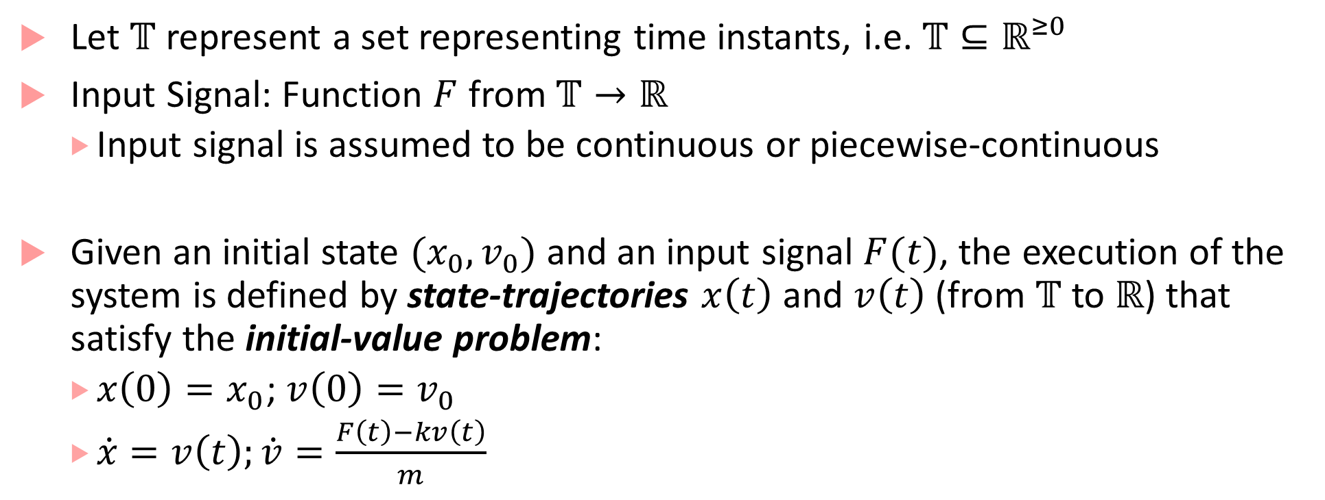
Executions of Car
Let $𝕋$ represent a set representing time instants, i.e. $𝕋⊆ℝ^{≥0}$
Input Signal: Function $F$ from $𝕋→ℝ$
Input signal is assumed to be continuous or piecewise-continuous
Given an initial state $(x_{0},v_{0})$ and an input signal $F(t)$, the execution of the system is defined by state-trajectories $x\left(t\right)$ and $v\left(t\right)$ (from $𝕋$ to $ℝ$) that satisfy the initial-value problem:
$x\left(0\right)=x_{0}$; $v\left(0\right)=v_{0}$
$\dot{x}=v\left(t\right);\dot{v}=\frac{F\left(t\right)−kv\left(t\right)}{m}$

Slide 7
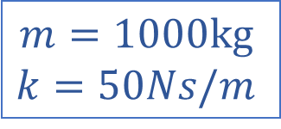
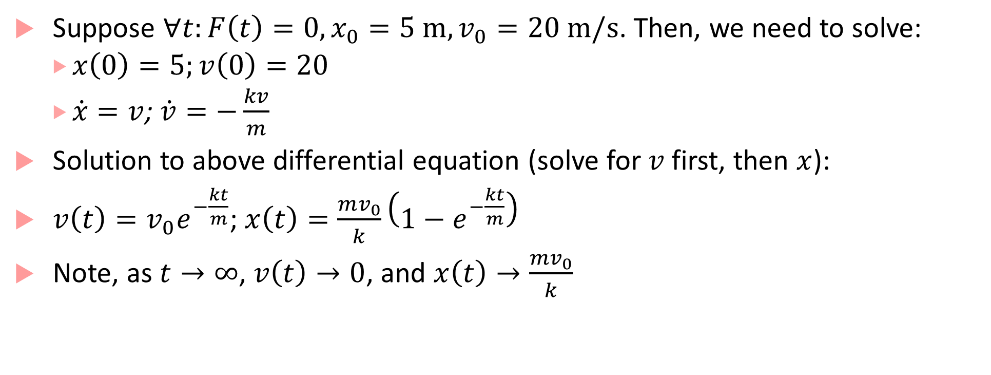
Sample Execution of Car
Suppose $∀t:F\left(t\right)=0, x_{0}=5 m, v_{0}=20 m/s$. Then, we need to solve:
$x\left(0\right)=5;v\left(0\right)=20$
$\dot{x}=v$;$\dot{v}=−\frac{kv}{m}$
Solution to above differential equation (solve for $v$ first, then $x$):
$v\left(t\right)=v_{0}e^{−\frac{kt}{m}}$; $x\left(t\right)=\frac{mv_{0}}{k}\left(1−e^{−\frac{kt}{m}}\right)$
Note, as $t→∞$, $v\left(t\right)→0$, and $x\left(t\right)→\frac{mv_{0}}{k}$
$$m=1000kg$$
$$k=50Ns/m$$

Slide 8
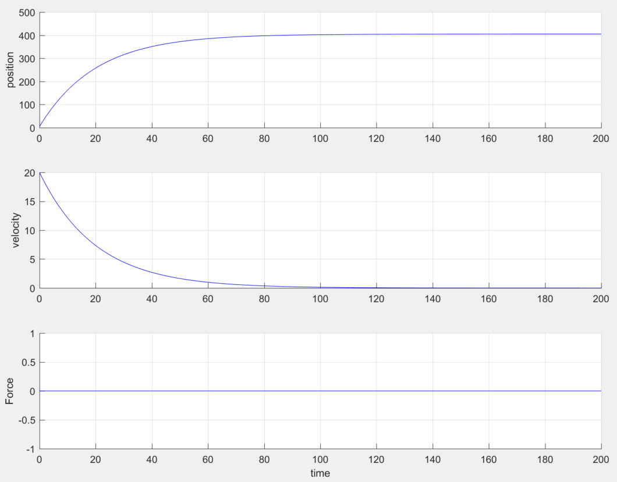
Simulink and Breach Brief Demo
Plot of Signals vs. Time

Slide 9
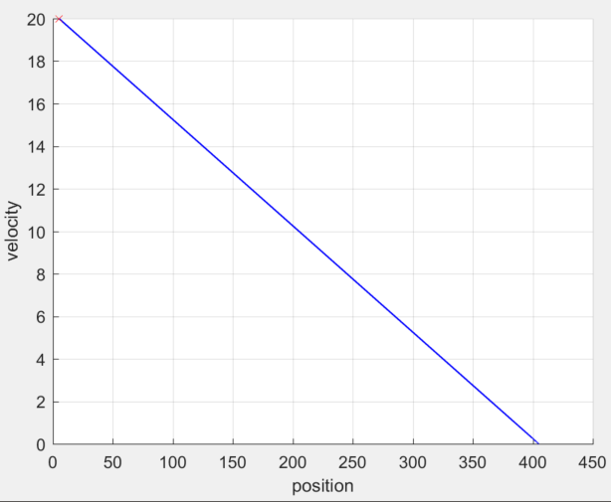
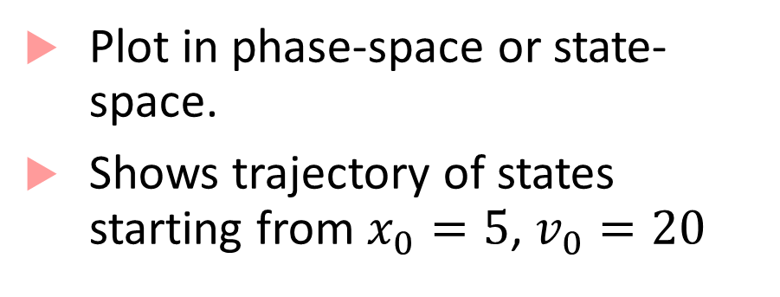
Simulink and Breach Demo
Plot in phase-space or state-space.
Shows trajectory of states starting from $x_{0}=5$, $v_{0}=20$

Slide 10
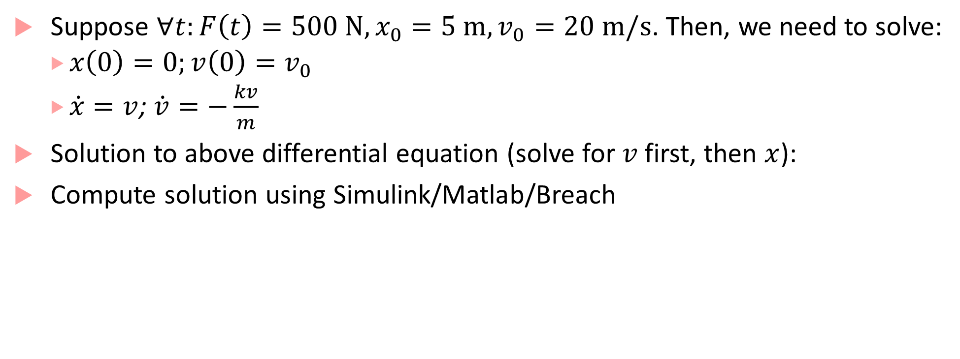
Sample Execution of Car with constant force
Suppose $∀t:F\left(t\right)=500 N, x_{0}=5 m,v_{0}=20 m/s$. Then, we need to solve:
$x\left(0\right)=0;v\left(0\right)=v_{0}$
$\dot{x}=v$;$\dot{v}=−\frac{kv}{m}$
Solution to above differential equation (solve for $v$ first, then $x$):
Compute solution using Simulink/Matlab/Breach
$$m=1000kg$$
$$k=50Ns/m$$

Slide 11
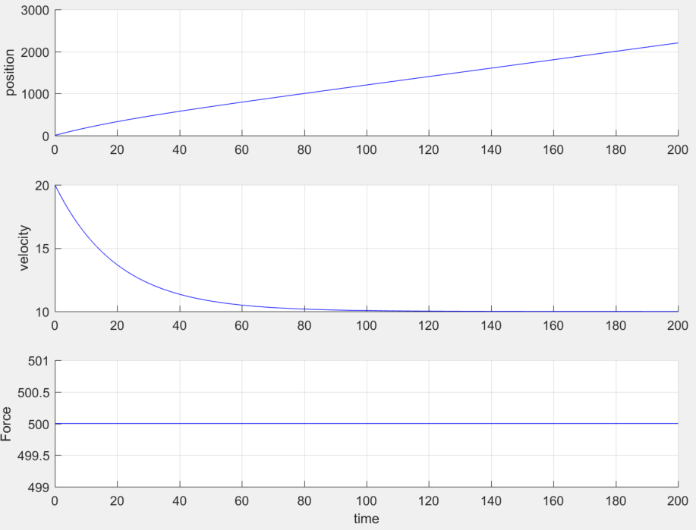
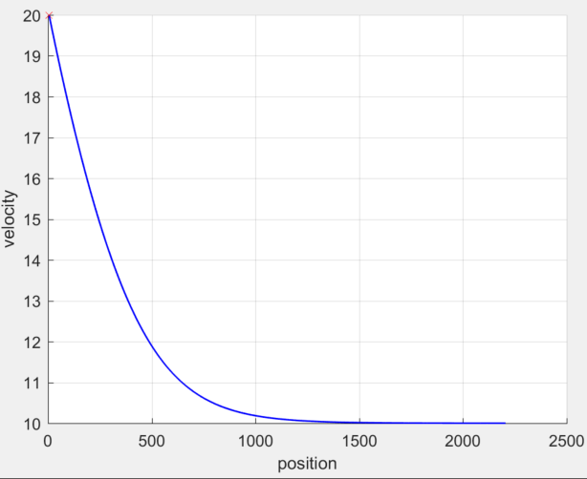
Plots
Phase Plot
Input/Output Signals

Slide 12
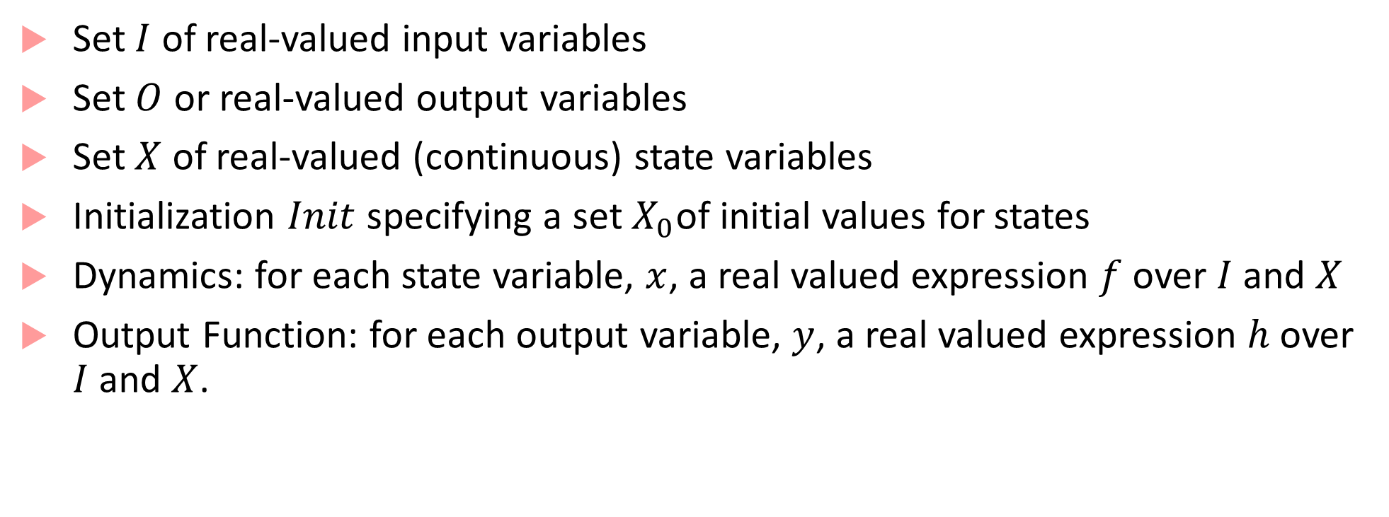
Continuous-Time Component Definition
Set $I$ of real-valued input variables
Set $O$ or real-valued output variables
Set $X$ of real-valued (continuous) state variables
Initialization $Init$ specifying a set $X_{0}$of initial values for states
Dynamics: for each state variable, $x$, a real valued expression $f$ over $I$ and $X$
Output Function: for each output variable, $y$, a real valued expression $h$ over $I$ and $X$.

Slide 13
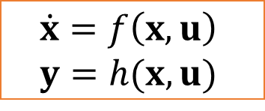
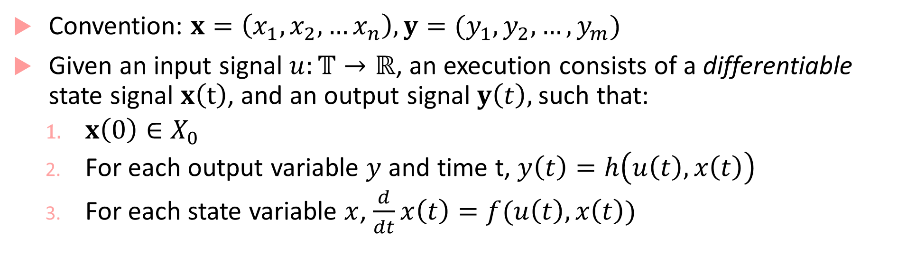
Execution Definition
Convention: $x=\left(x_{1},x_{2},…x_{n}\right), y=(y_{1},y_{2},…,y_{m})$
Given an input signal $u:𝕋→ℝ$, an execution consists of a differentiable state signal $x\left(t\right)$, and an output signal $y\left(t\right),$such that:
$x\left(0\right)∈X_{0}$
For each output variable $y$ and time t, $y\left(t\right)=h\left(u\left(t\right), x\left(t\right)\right)$
For each state variable $x$, $\frac{d}{dt}x\left(t\right)=f(u\left(t\right), x\left(t\right))$
$$\dot{x}=f\left(x,u\right)$$
$$y=h(x,u)$$

Slide 14

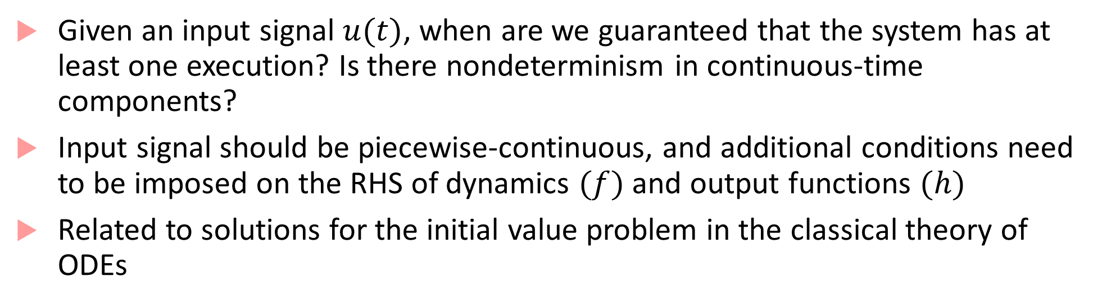
Existence and Uniqueness of Solutions
Given an input signal $u(t)$, when are we guaranteed that the system has at least one execution? Is there nondeterminism in continuous-time components?
Input signal should be piecewise-continuous, and additional conditions need to be imposed on the RHS of dynamics $(f)$ and output functions $(h)$
Related to solutions for the initial value problem in the classical theory of ODEs
$$\dot{x}=f\left(x,u\right)$$
$$y=h(x,u)$$

Slide 15
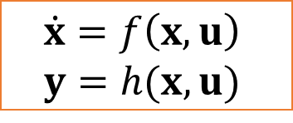
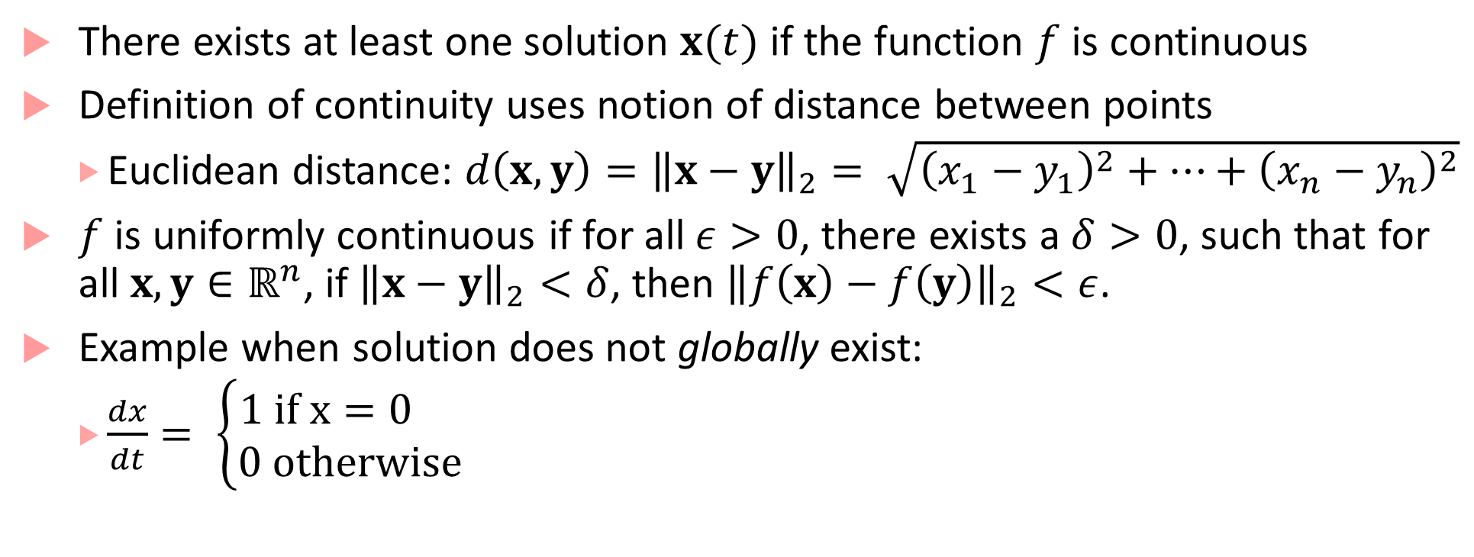
Existence
There exists at least one solution $x(t)$ if the function $f$ is continuous
Definition of continuity uses notion of distance between points
Euclidean distance: $d\left(x,y\right)={\left\|x−y\right\|}_{2}= \sqrt{{\left(x_{1}−y_{1}\right)}^{2}+…+{\left(x_{n}−y_{n}\right)}^{2}}$
$f$ is uniformly continuous if for all $ε>0$, there exists a $δ>0$, such that for all $x,y∈ℝ^{n}$, if ${\left\|x−y\right\|}_{2}<δ$, then ${\left\|f\left(x\right)−f\left(y\right)\right\|}_{2}<ε$.
Example when solution does not globally exist:
$\frac{dx}{dt}= \left\{\begin{aligned}1 if x=0 \\ 0 otherwise\end{aligned}\right.$
$$\dot{x}=f\left(x,u\right)$$
$$y=h(x,u)$$

Slide 16

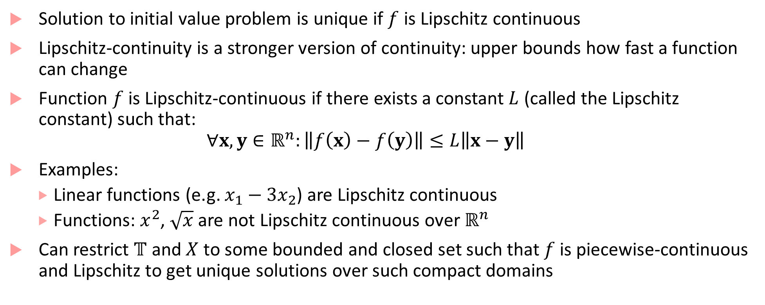
Uniqueness
Solution to initial value problem is unique if $f$ is Lipschitz continuous
Lipschitz-continuity is a stronger version of continuity: upper bounds how fast a function can change
Function $f$ is Lipschitz-continuous if there exists a constant $L$ (called the Lipschitz constant) such that:
$$∀x,y∈ℝ^{n}:\left\|f\left(x\right)−f\left(y\right)\right\|≤L\left\|x−y\right\|$$
Examples:
Linear functions (e.g. $x_{1}−3x_{2}$) are Lipschitz continuous
Functions: $x^{2}$, $\sqrt{x}$ are not Lipschitz continuous over $ℝ^{n}$
Can restrict $𝕋$ and $X$ to some bounded and closed set such that $f$ is piecewise-continuous and Lipschitz to get unique solutions over such compact domains
$$\dot{x}=f\left(x,u\right)$$
$$y=h(x,u)$$

Slide 17
What do Matlab/Simulink do?
Allow modeling arbitrarily complex functions: even functions with unbounded discontinuities
May not be even possible to check for Lipschitz conditions for what’s implemented in a Matlab function/Simulink model
Rely on numerical integration schemes/solvers to obtain solutions
ode45, ode23, ode15, etc.
We assume that any continuous component model we will use can be numerically simulated by Matlab/Simulink

Slide 18
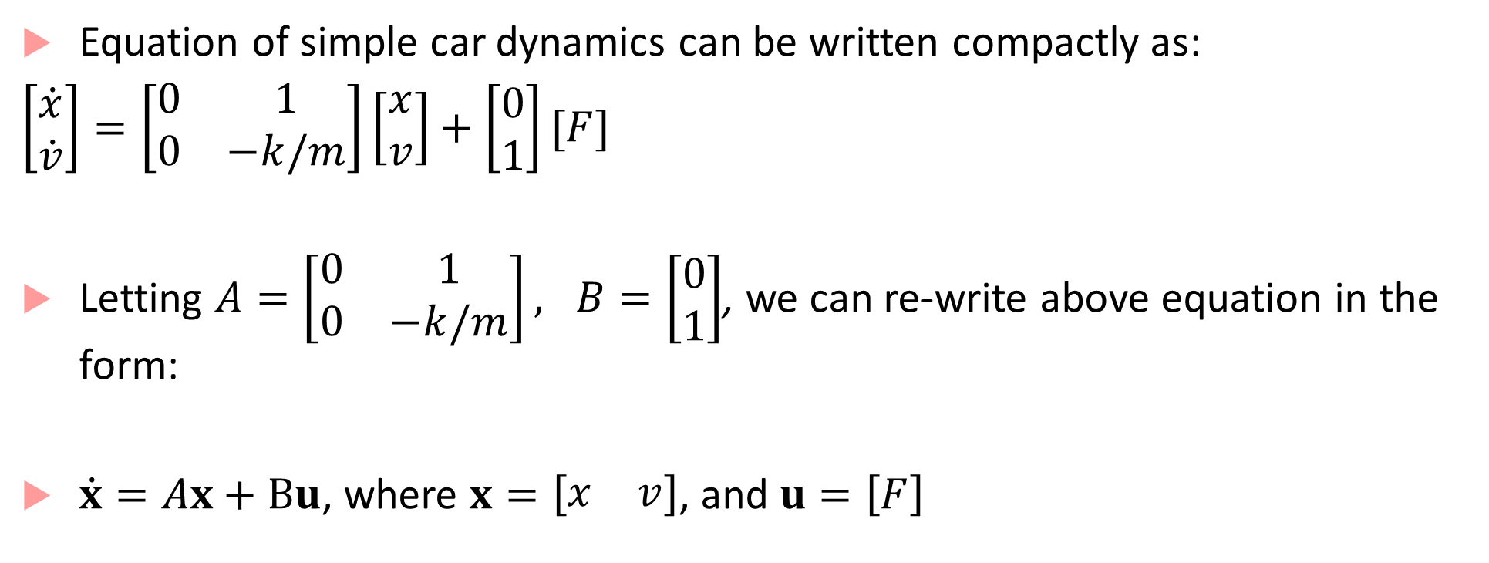
Linear Systems
Equation of simple car dynamics can be written compactly as:
$\left[\begin{matrix}\dot{x} \\ \dot{v}\end{matrix}\right]=\left[\begin{matrix}0 & 1 \\ 0 & −k/m\end{matrix}\right]\left[\begin{matrix}x \\ v\end{matrix}\right]+\left[\begin{matrix}0 \\ 1\end{matrix}\right][F]$
Letting $A=\left[\begin{matrix}0 & 1 \\ 0 & −k/m\end{matrix}\right], B=\left[\begin{matrix}0 \\ 1\end{matrix}\right]$, we can re-write above equation in the form:
$\dot{x}=Ax+Bu$, where $x=\left[\begin{matrix}x & v\end{matrix}\right]$, and $u=\left[F\right]$

Slide 19
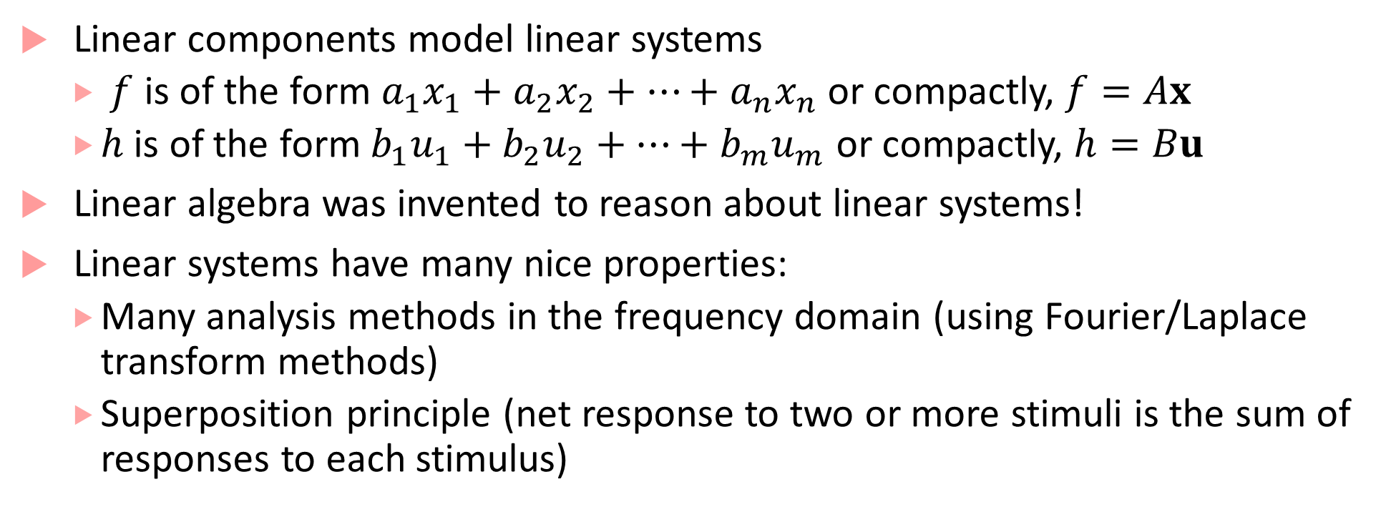
Linear Components
Linear components model linear systems
$f$ is of the form $a_{1}x_{1}+a_{2}x_{2}+…+a_{n}x_{n}$ or compactly, $f=Ax$
$h$ is of the form $b_{1}u_{1}+b_{2}u_{2}+…+b_{m}u_{m}$ or compactly, $h=Bu$
Linear algebra was invented to reason about linear systems!
Linear systems have many nice properties:
Many analysis methods in the frequency domain (using Fourier/Laplace transform methods)
Superposition principle (net response to two or more stimuli is the sum of responses to each stimulus)

Slide 20
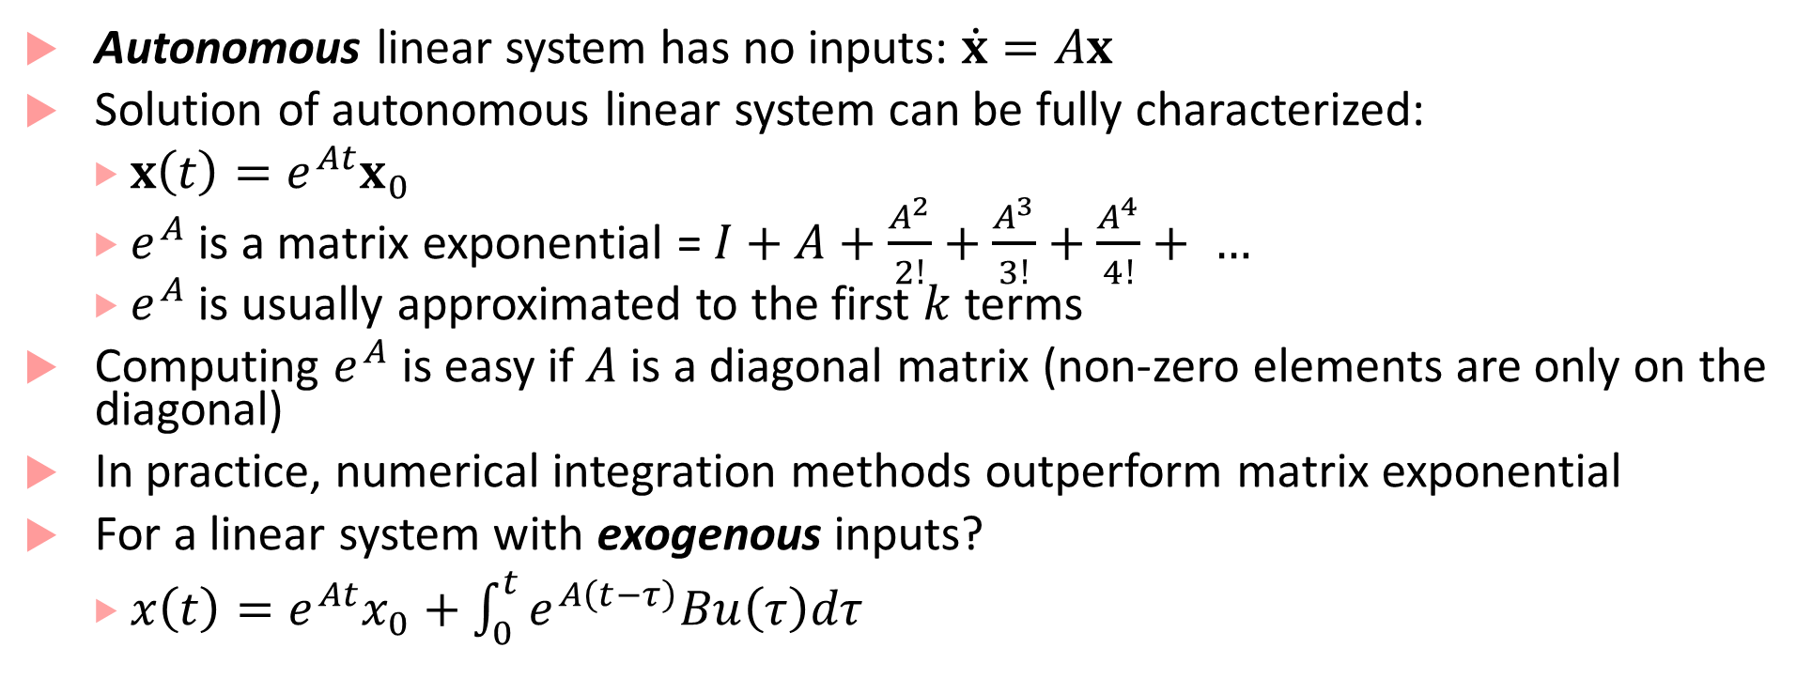
Solutions to Linear Systems
Autonomous linear system has no inputs: $\dot{x}=Ax$
Solution of autonomous linear system can be fully characterized:
$x\left(t\right)=e^{At}x_{0}$
$e^{A}$ is a matrix exponential = $I+A+\frac{A^{2}}{2!}+\frac{A^{3}}{3!}+\frac{A^{4}}{4!}+ …$
$e^{A}$ is usually approximated to the first $k$ terms
Computing $e^{A}$ is easy if $A$is a diagonal matrix (non-zero elements are only on the diagonal)
In practice, numerical integration methods outperform matrix exponential
For a linear system with exogenous inputs?
$x\left(t\right)=e^{At}x_{0}+\int_{0}^{t}{e^{A\left(t−τ\right)}Bu\left(τ\right)dτ}$

Slide 21
Stability of Systems
Property capturing the ability of a system to return to a quiescent state after perturbation
Stable systems recover after disturbances, unstable systems may not
Almost always a desirable property for a system design
Fundamental problem in control: design controllers to stabilize a system
Problem: Inverted Pendulum on a moving cart is inherently unstable, aim: keep it upright
Solution Strategy: Move cart in direction in the same direction as the pendulum’s falling direction
Design problem: Design a controller to stabilize the system by computing velocity and direction for cart travel

Slide 22
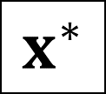
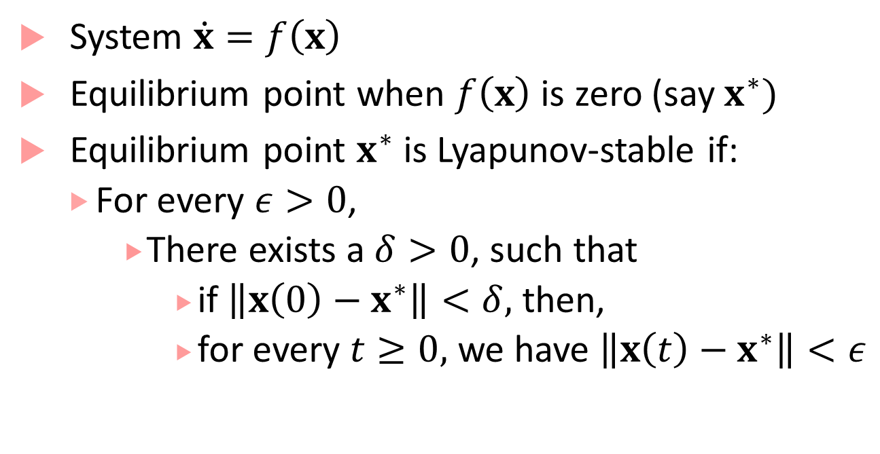
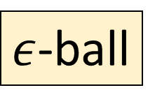
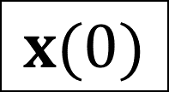
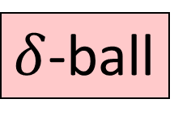
Lyapunov stability
$$x^{∗}$$
$$x(0)$$
System $\dot{x}=f\left(x\right)$
Equilibrium point when $f\left(x\right)$ is zero (say $x^{∗})$
Equilibrium point $x^{∗}$ is Lyapunov-stable if:
For every $ε>0$,
There exists a $δ>0$, such that
if $\left\|x\left(0\right)−x^{∗}\right\|<δ,$ then,
for every $t≥0,$ we have $\left\|x\left(t\right)−x^{∗}\right\|<ε$
$ε$-ball
$δ$-ball

Slide 23
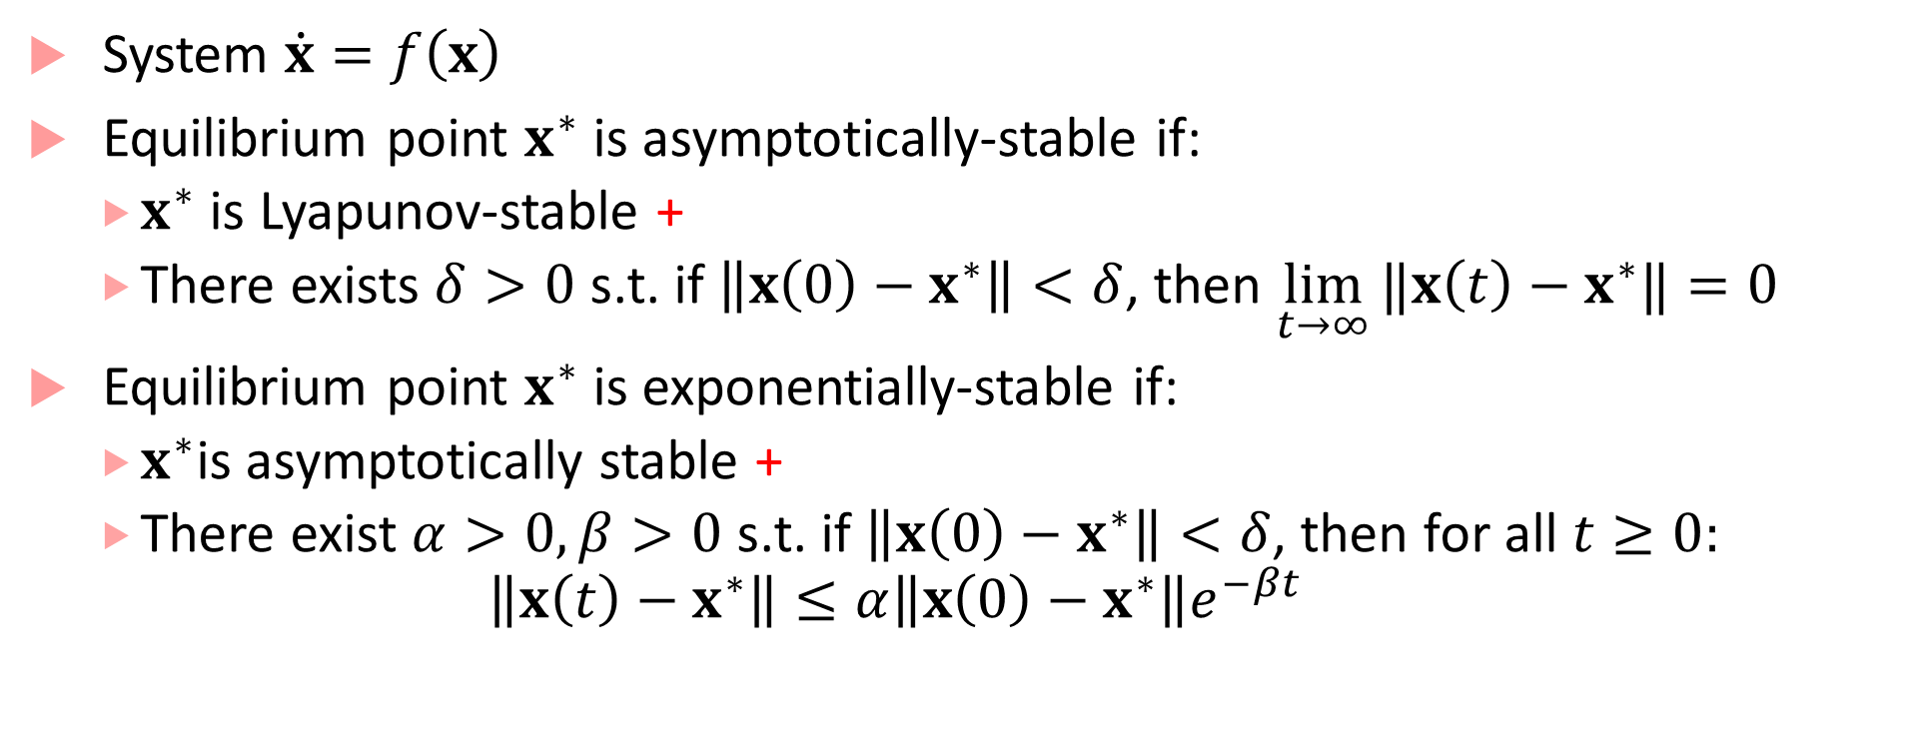
Asymptotic + Exponential Stability
System $\dot{x}=f\left(x\right)$
Equilibrium point $x^{∗}$ is asymptotically-stable if:
$x^{∗}$ is Lyapunov-stable +
There exists $δ>0$ s.t. if $\left\|x\left(0\right)−x^{∗}\right\|<δ$, then $\lim_{t→∞}{‖x\left(t\right)−x^{∗}‖}=0$
Equilibrium point $x^{∗}$ is exponentially-stable if:
$x^{∗}$is asymptotically stable +
There exist $α>0,β>0$ s.t. if $\left\|x\left(0\right)−x^{∗}\right\|<δ$, then for all $t≥0:$
$$\left\|x\left(t\right)−x^{∗}\right\|≤α\left\|x\left(0\right)−x^{∗}\right\|e^{−βt}$$

Slide 24
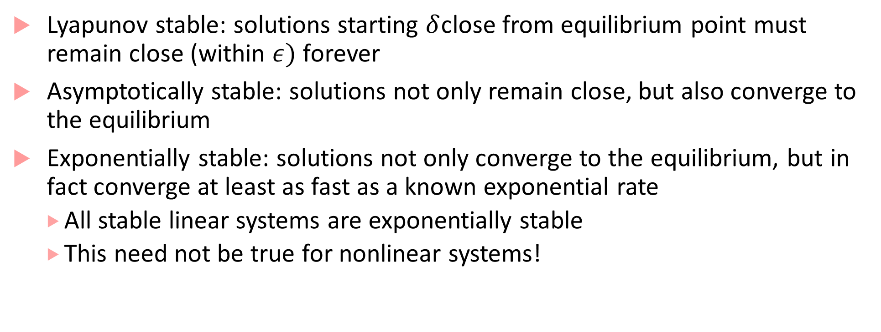
What do these definitions all mean?
Lyapunov stable: solutions starting $δ$close from equilibrium point must remain close (within $ε)$ forever
Asymptotically stable: solutions not only remain close, but also converge to the equilibrium
Exponentially stable: solutions not only converge to the equilibrium, but in fact converge at least as fast as a known exponential rate
All stable linear systems are exponentially stable
This need not be true for nonlinear systems!

Slide 25
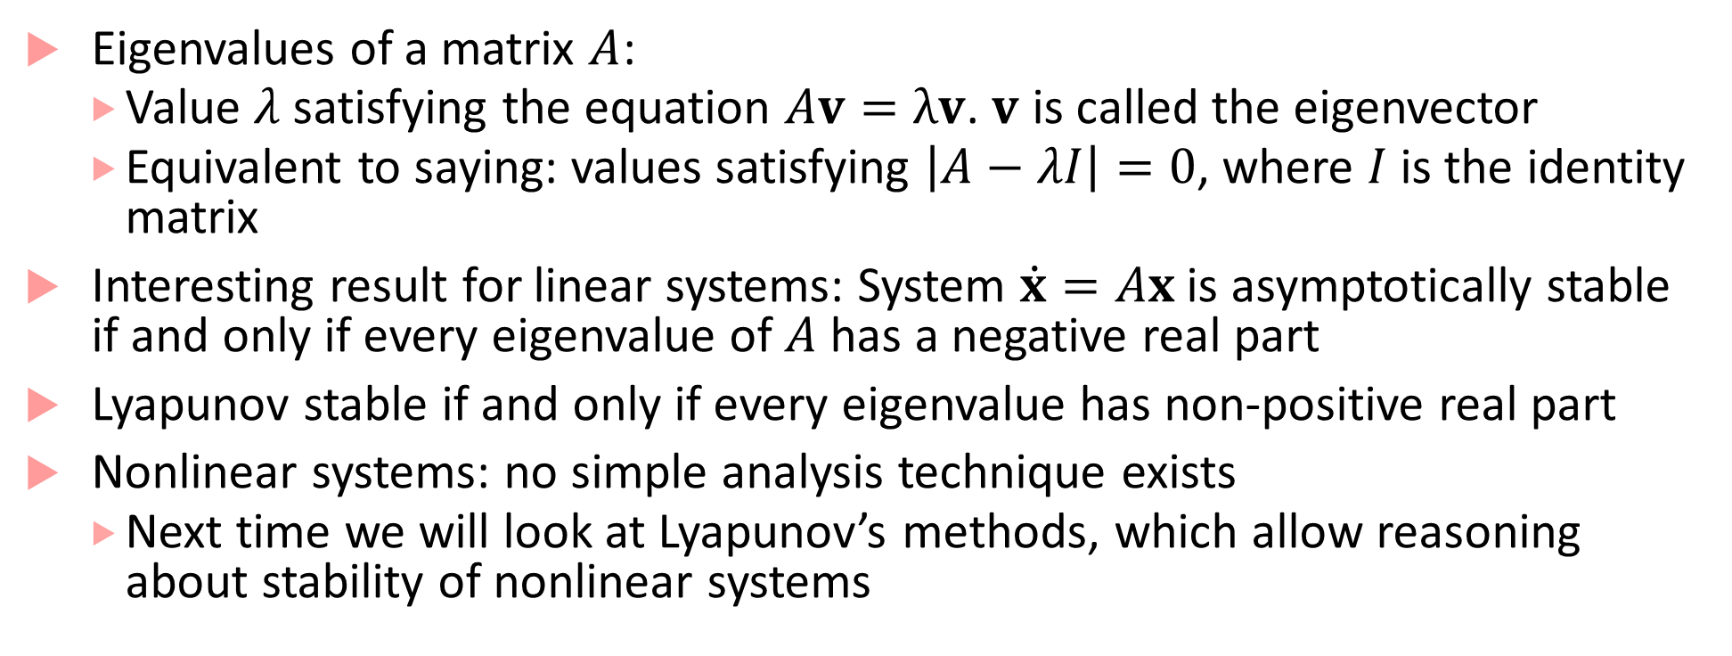
Analyzing stability for linear systems
Eigenvalues of a matrix $A$:
Value $λ$ satisfying the equation $Av=λv$. $v$ is called the eigenvector
Equivalent to saying: values satisfying $\left|A−λI\right|=0$, where $I$ is the identity matrix
Interesting result for linear systems: System $\dot{x}=Ax$ is asymptotically stable if and only if every eigenvalue of $A$ has a negative real part
Lyapunov stable if and only if every eigenvalue has non-positive real part
Nonlinear systems: no simple analysis technique exists
Next time we will look at Lyapunov’s methods, which allow reasoning about stability of nonlinear systems

