Slide 1
Autonomous Cyber-Physical Systems: Nonlinear Control and Intro to Hybrid Systems
Spring 2018. CS 599.
Instructor: Jyo Deshmukh
Acknowledgment: Some of the material in these slides is based on the lecture slides for CIS 540: Principles of Embedded Computation taught by Rajeev Alur at the University of Pennsylvania. http://www.seas.upenn.edu/~cis540/
This lecture also uses some other sources, full bibliography is included at the end of the slides.

Slide 2
Layout
Nonlinear Control
Feedback Linearization
Model-predictive control
Hybrid Systems

Slide 3
Nonlinear Control Design Techniques
Feedback Linearization
Backstepping Control
Robust Control (e.g. Sliding control)
Optimal Control
Model-Predictive Control (MPC) or Receding Horizon Control

Slide 4


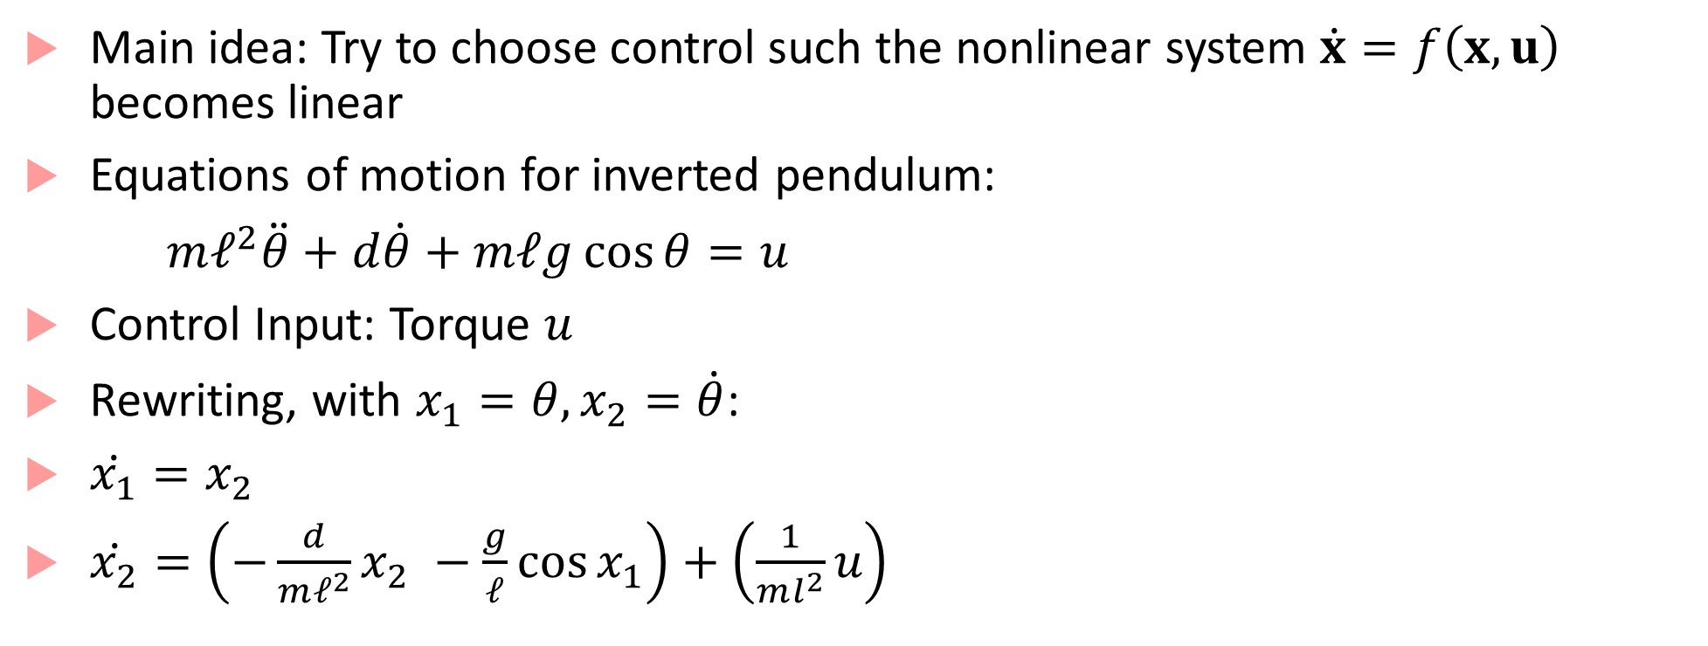



Feedback Linearization
Main idea: Try to choose control such the nonlinear system $\dot{x}=f\left(x,u\right)$ becomes linear
Equations of motion for inverted pendulum:
$mℓ^{2}\ddot{θ}+d\dot{θ}+mℓg\cos{θ}=u$
Control Input: Torque $u$
Rewriting, with $x_{1}=θ, x_{2}=\dot{θ}$:
$\dot{x_{1}}=x_{2}$
$\dot{x_{2}}=\left(−\frac{d}{mℓ^{2}}x_{2} −\frac{g}{ℓ}\cos{x_{1}}\right)+\left(\frac{1}{ml^{2}}u\right)$
$$mg\cos{θ}$$
$$mg$$
$$θ$$
$$ℓ$$
$$u$$

Slide 5
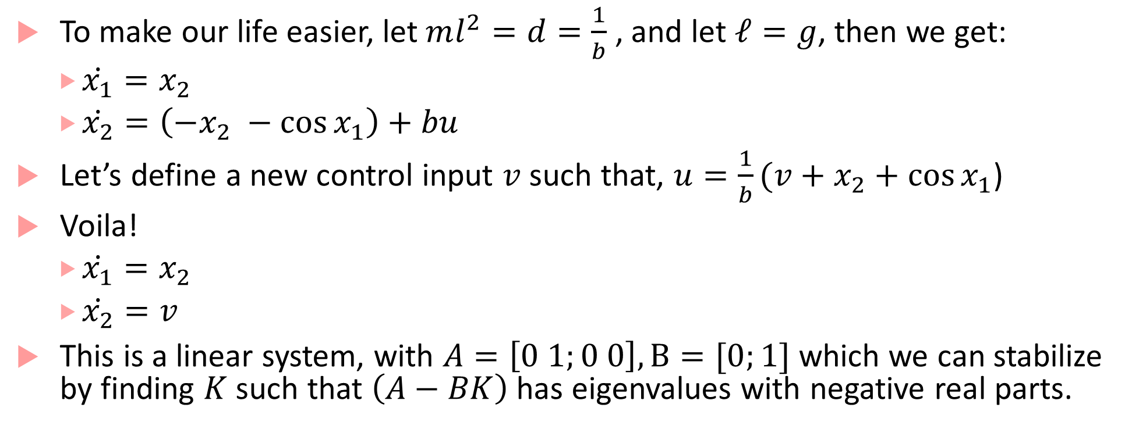
Feedback linearization continued
To make our life easier, let $ml^{2}=d=\frac{1}{b}$ , and let $ℓ=g$, then we get:
$\dot{x_{1}}=x_{2}$
$\dot{x_{2}}=\left(−x_{2} −\cos{x_{1}}\right)+bu$
Let’s define a new control input $v$ such that, $u=\frac{1}{b}(v+x_{2}+\cos{x_{1}}$)
Voila!
$\dot{x_{1}}=x_{2}$
$\dot{x_{2}}=v$
This is a linear system, with $A=\left[0 1;0 0\right], B=[0;1]$ which we can stabilize by finding $K$ such that $\left(A−BK\right)$ has eigenvalues with negative real parts.

Slide 6
Input Transformation
This operation is called input transformation, which leads to exact cancellation of a nonlinearity, giving rise to a linear equation
Also known as exact feedback linearization or dynamic inversion
Note that this is NOT the same as computing the Jacobian of the nonlinear system and trying to stabilize the resulting linear system at the origin (this would make the system stable only locally)
We are using feedback to linearize the system
Unfortunately, we cannot always do this

Slide 7

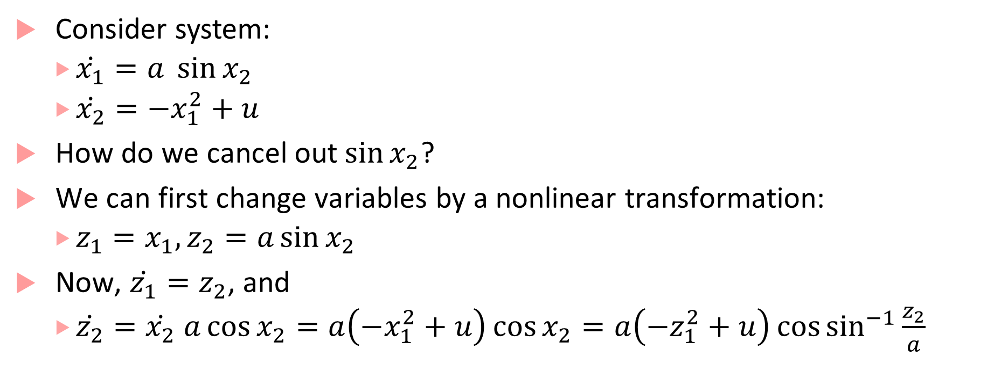
State Transformation
Consider system:
$\dot{x_{1}}=a \sin{x_{2}}$
$\dot{x_{2}}=−x_{1}^{2}+u$
How do we cancel out$\sin{x_{2}}$?
We can first change variables by a nonlinear transformation:
$z_{1}=x_{1}, z_{2}=a\sin{x_{2}}$
Now, $\dot{z_{1}}=z_{2}$, and
$\dot{z_{2}}=\dot{x_{2}} a\cos{x_{2}}=a\left(−x_{1}^{2}+u\right)\cos{x_{2}}=a\left(−z_{1}^{2}+u\right)\cos{\sin^{−1}{\frac{z_{2}}{a}}}$

Slide 8
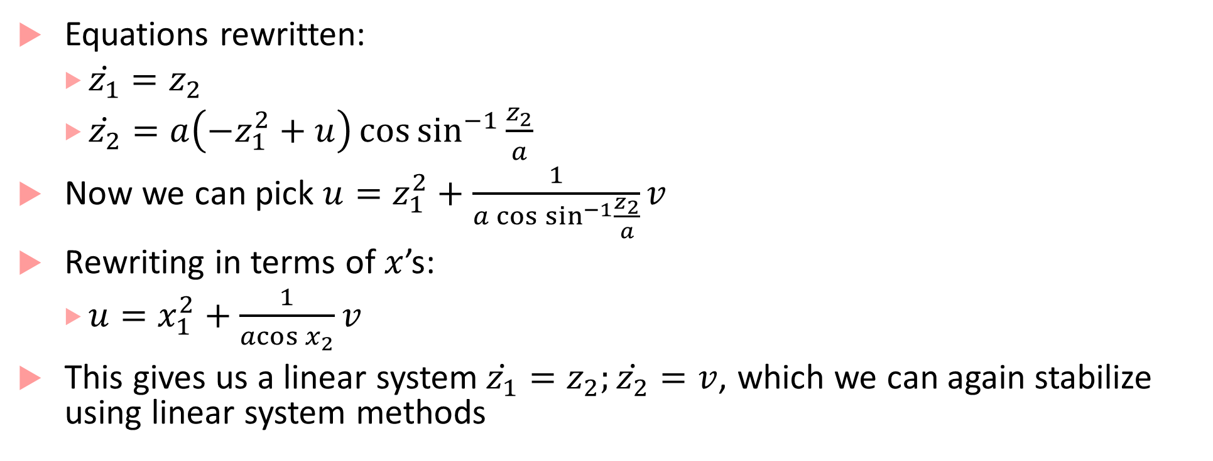
State transformation continued
Equations rewritten:
$\dot{z_{1}}=z_{2}$
$\dot{z_{2}}=a\left(−z_{1}^{2}+u\right)\cos{\sin^{−1}{\frac{z_{2}}{a}}}$
Now we can pick $u=z_{1}^{2}+\frac{1}{a\cos{\sin^{−1}{\frac{z_{2}}{a}}}}v$
Rewriting in terms of $x$’s:
$u=x_{1}^{2}+\frac{1}{\operatorname{acos}{x_{2}}}v$
This gives us a linear system$\dot{z_{1}}=z_{2};\dot{z_{2}}=v$, which we can again stabilize using linear system methods

Slide 9
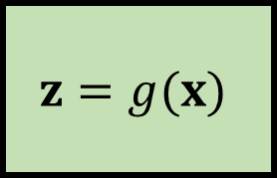
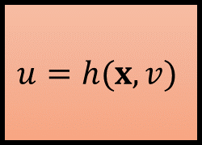
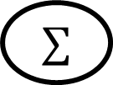
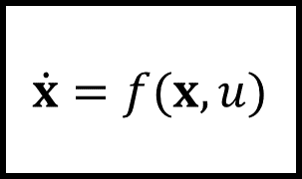

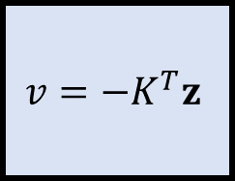




Form of the controller: two “loops”
$$u(t)$$
$$x(t)$$
$$v=−K^{T}z$$
$$u=h(x,v)$$
$\dot{x}=f(x,u)$
$$+$$
$$∑$$
$$0$$
$$−$$
Pole
Placement
Controller
Plant
Linearization Loop
Input
Transformation
$$z=g(x)$$
Feedback Loop
State Transformation

Slide 10
More feedback linearization
What we looked at is the simple case of feedback linearization called input to state linearization
Typically, you can’t assume full state is observable; also, you may want to the output to track a reference or have a certain shape
Requires another form of feedback linearization called input to output linearization
Understanding this fully would require an entire lecture (or two), and a whole lot of control theory and math, so we will skip it ☺

Slide 11




Model Predictive Control
Main idea: Use a dynamical model of the plant (inside the controller) to predict the plant’s future evolution, and optimize the control signal over possible futures
$$r(t)$$
$$u(t)$$
$$y(t)$$
Model-based Optimizer
Plant
$$∑$$
Sensor readings

Slide 12
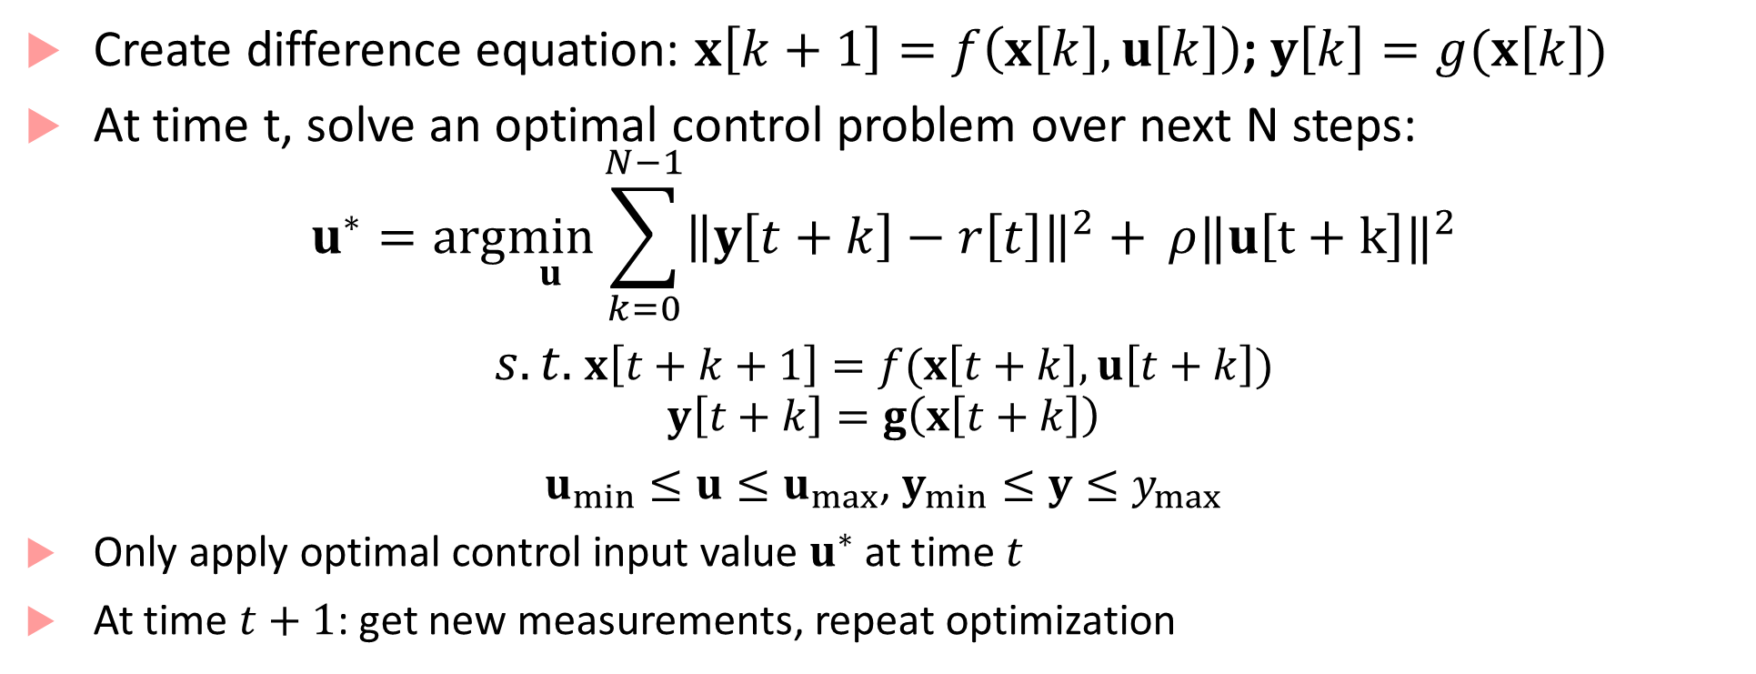
Receding Horizon Philosophy
Create difference equation: $x\left[k+1\right]=f\left(x\left[k\right],u\left[k\right]\right)$; $y\left[k\right]=g(x\left[k\right])$
At time t, solve an optimal control problem over next N steps:
$$u^{∗}=arg\min_{u}{\sum_{k=0}^{N−1}{{\left\|y\left[t+k\right]−r\left[t\right]\right\|}^{2}+ }ρ‖u{\left[t+k\right]‖}^{2}}$$
$s.t.$ $x\left[t+k+1\right]=f(x\left[t+k\right],u\left[t+k\right])$
$$y\left[t+k\right]=g\left(x\left[t+k\right]\right)$$
$u_{min}≤u≤u_{max}$, $y_{min}≤y≤y_{max}$
Only apply optimal control input value $u^{∗}$ at time $t$
At time $t+1$: get new measurements, repeat optimization

Slide 13
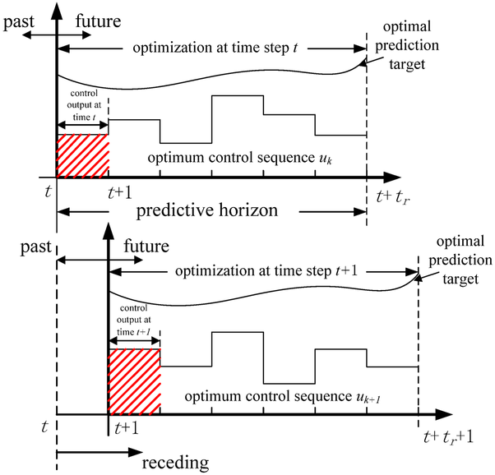
Receding Horizon or MPC
Image from: https://tinyurl.com/yaej43x5

Slide 14
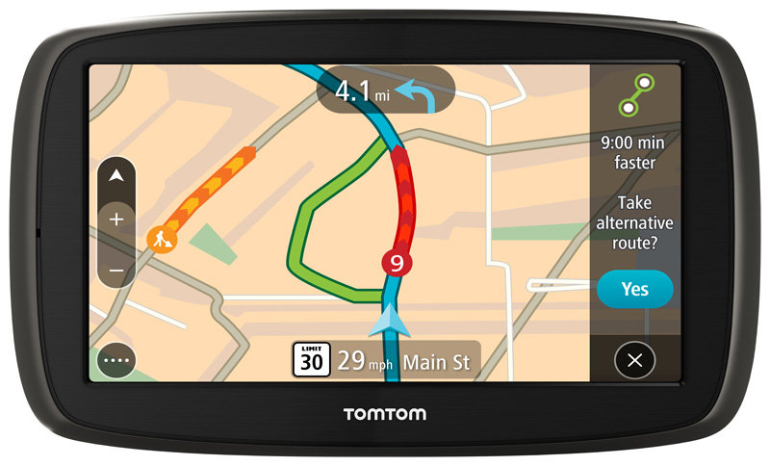
Receding Horizon Control Application
Prediction model: Vehicle’s movements on map
Constraints: Follow traffic rules (speed, direction, lights)
Disturbances: Driver’s inattention
Set point: Desired destination
Cost function: Minimum Time/Minimum Fuel-Cost/Minimum distance etc.
Receding horizon philosophy:
Compute optimal route at each time-point
Event-based: When vehicle detected to be not on optimal path

Slide 15
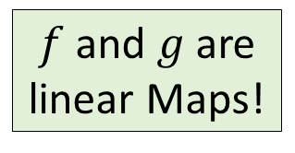
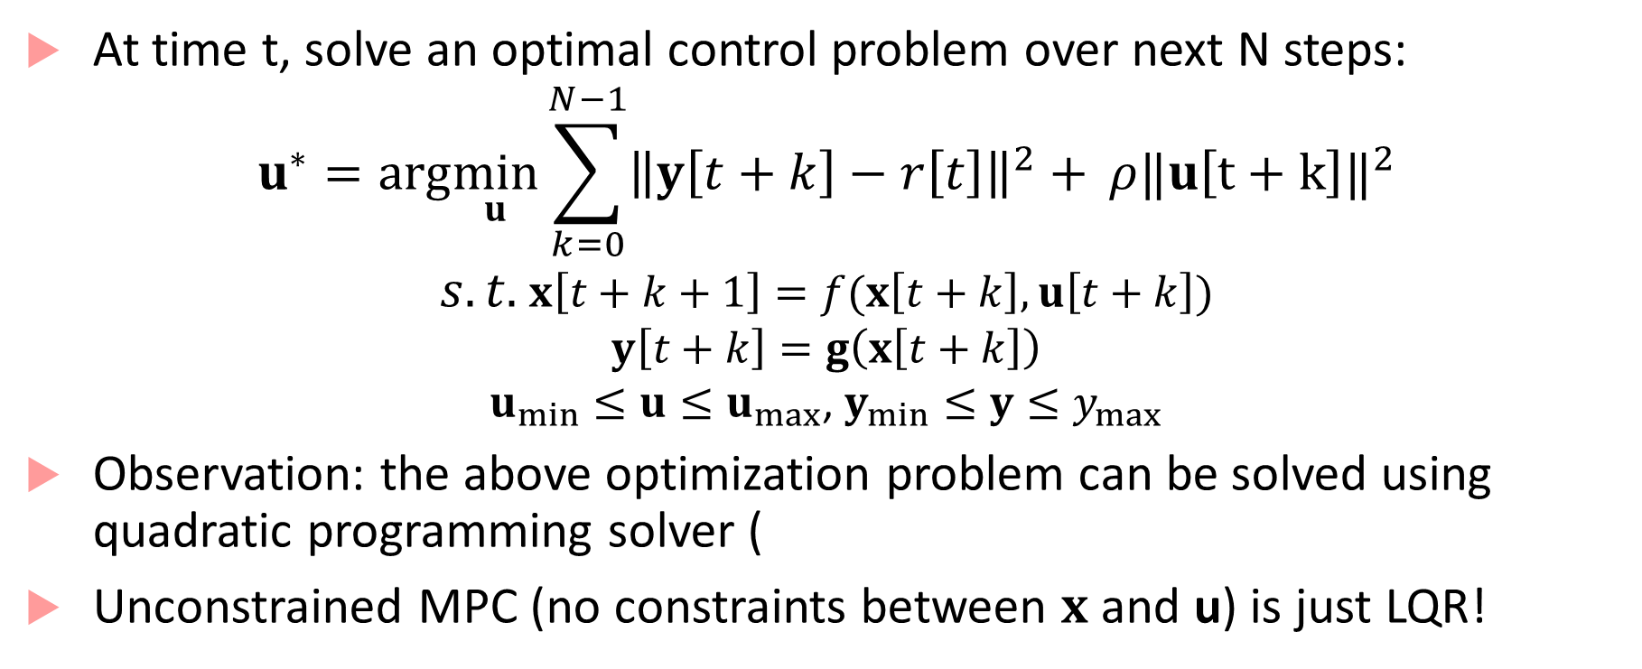
Linear MPC algorithm
At time t, solve an optimal control problem over next N steps:
$$u^{∗}=arg\min_{u}{\sum_{k=0}^{N−1}{{\left\|y\left[t+k\right]−r\left[t\right]\right\|}^{2}+ }ρ‖u{\left[t+k\right]‖}^{2}}$$
$s.t.$ $x\left[t+k+1\right]=f(x\left[t+k\right],u\left[t+k\right])$
$$y\left[t+k\right]=g\left(x\left[t+k\right]\right)$$
$u_{min}≤u≤u_{max}$, $y_{min}≤y≤y_{max}$
Observation: the above optimization problem can be solved using quadratic programming solver (
Unconstrained MPC (no constraints between $x$ and u) is just LQR!
$f$ and $g$are linear Maps!

Slide 16
More about MPC
Linear MPC: optimization problem is convex (thus solving optimization online is fast and gives robust answers)
Nonlinear MPC:
optimization is not convex!
solution strategies include numerical methods, and methods based on control-Lyapunov functions
Explicit MPC:
divide state-space into piecewise-affine regions (convex polytopes)
precompute the optimal solution for each region, and apply at runtime
good for systems with fast dynamics

Slide 17
Why MPC is important in autonomous CPS
Many autonomous applications need to have a model of the environment
You cannot do lane-tracking control, if you don’t know what a lane is!
You cannot avoid pedestrians without a pedestrian model
Early applications show a lot of promise (see bibliography)
MPC assumes symbolic plant models, and the use of an online/offline optimization problem for predictive control
Related idea: use data (and data-driven models, e.g. neural networks) to do the prediction (data-predictive control)

Slide 18
Controllers in Practice
In everything we have talked about so far, our controllers were continuous-time components
In reality, our controllers will get mapped to software instructions on some hardware platform
Most digital controllers operate on a sense-compute-actuate loop at a fixed or variable frequency
E.g. every 10ms, read the sensor outputs, compute the control command based on the control law, and send the actuator commands
This is not a continuous-time system any more!
What about stability, tracking, etc.?

Slide 19
Digital Control Issues
Controllers will quantize sensor readings and actuator commands
Fixed-precision or floating-point precision computation
Many industrial controllers are fixed-point precision, as floating-point is deemed expensive, and can have unreliable computation times
Controllers will discretize time (because of the periodic sampling)
Sampling infrequently can cause severe loss of performance
Sampling a stabilizing controller at the wrong frequency can even cause instability!
Reasoning about combined discrete and continuous dynamics: hybrid systems

Slide 20
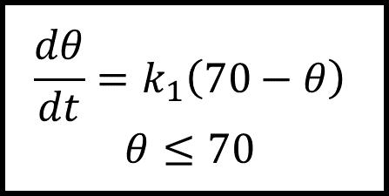
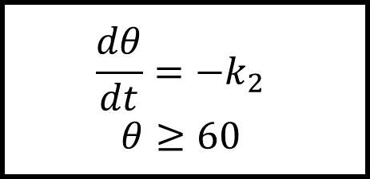

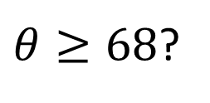
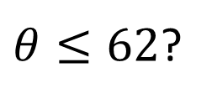
Hybrid System
Generalization of a timed process
Instead of timed transitions, we can have arbitrary evolution of state/output variables, typically specified using differential equations
off
on
$θ≤62$?
$$\frac{dθ}{dt}=−k_{2}$$
$$θ≥60$$
$$\frac{dθ}{dt}=k_{1}\left(70−θ\right)$$
$$θ≤70$$
$θ≥68$?
$$60≤θ_{init}≤70$$

Slide 21
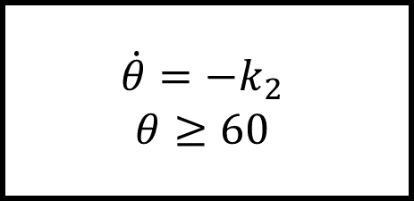

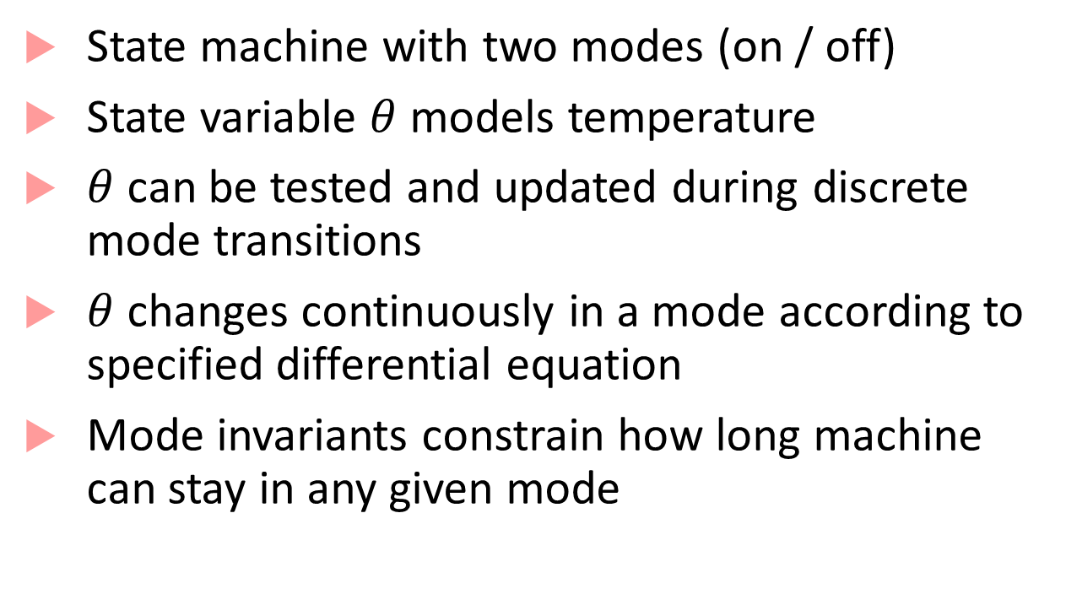
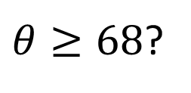
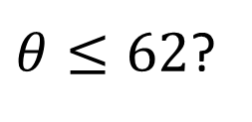
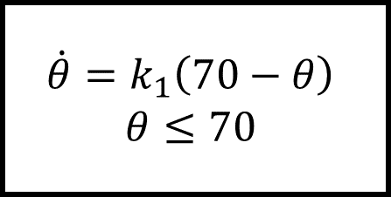
Hybrid System: Thermostat
$$60≤θ_{init}≤70$$
State machine with two modes (on / off)
State variable $θ$ models temperature
$θ$ can be tested and updated during discrete mode transitions
$θ$ changes continuously in a mode according to specified differential equation
Mode invariants constrain how long machine can stay in any given mode
off
$$\dot{θ}=−k_{2}$$
$$θ≥60$$
$θ≥68$?
$θ≤62$?
$$\dot{θ}=k_{1}\left(70−θ\right)$$
$$θ≤70$$
on

Slide 22


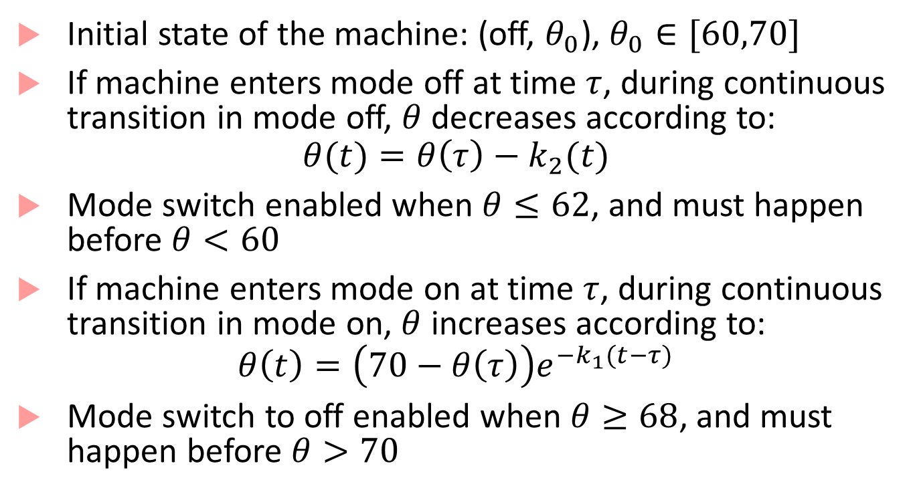
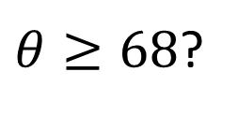
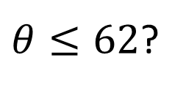
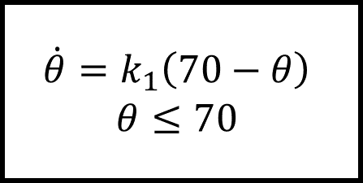
Executions of Thermostat
Initial state of the machine: (off, $θ_{0}$), $θ_{0}∈[60,70]$
If machine enters mode off at time $τ$, during continuous transition in mode off, $θ$ decreases according to:
$$θ(t)=θ\left(τ\right)−k_{2}(t)$$
Mode switch enabled when $θ≤62$, and must happen before $θ<60$
If machine enters mode on at time $τ$, during continuous transition in mode on, $θ$ increases according to:
$$θ\left(t\right)=\left(70−θ\left(τ\right)\right)e^{−k_{1}(t−τ)}$$
Mode switch to off enabled when $θ≥68$, and must happen before $θ>70$
$$60≤θ_{init}≤70$$
off
$$\dot{θ}=−k_{2}$$
$$θ≥60$$
$θ≥68$?
$θ≤62$?
$$\dot{θ}=k_{1}\left(70−θ\right)$$
$$θ≤70$$
on

Slide 23
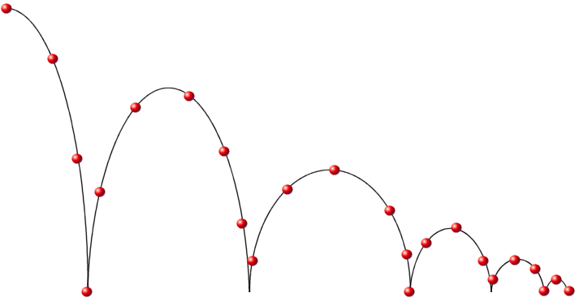
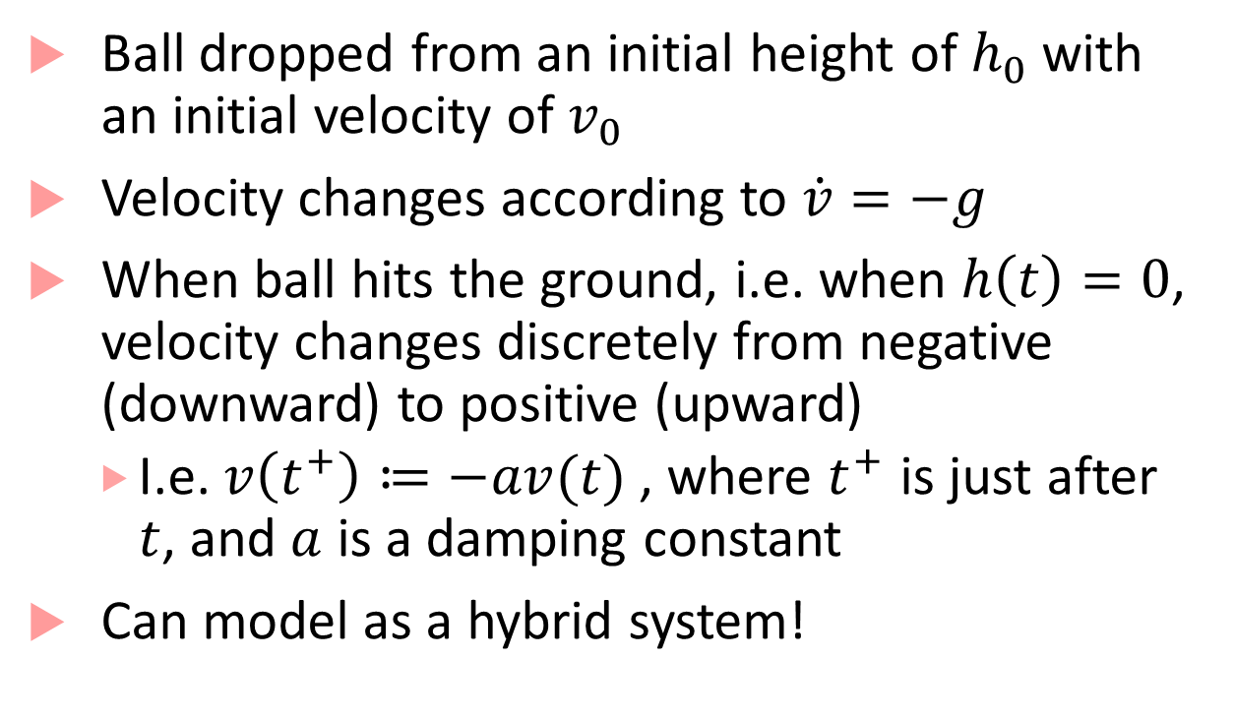
Modeling a bouncing ball
Ball dropped from an initial height of $h_{0}$ with an initial velocity of $v_{0}$
Velocity changes according to $\dot{v}=−g$
When ball hits the ground, i.e. when $h\left(t\right)=0$, velocity changes discretely from negative (downward) to positive (upward)
I.e. $v\left(t^{+}\right)≔−av(t)$, where $t^{+}$ is just after $t$, and $a$ is a damping constant
Can model as a hybrid system!

Slide 24

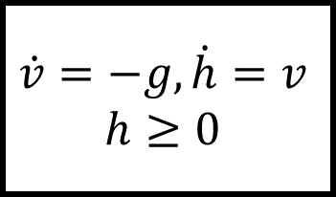


Hybrid Process for Bouncing ball
$$\dot{v}=−g, \dot{h}=v$$
$$h≥0$$
$$h=0→sound!boink ;v≔−av$$
$$h∈\left[10,20\right], v∈[0,5]$$
What happens as $h→0$?

Slide 25
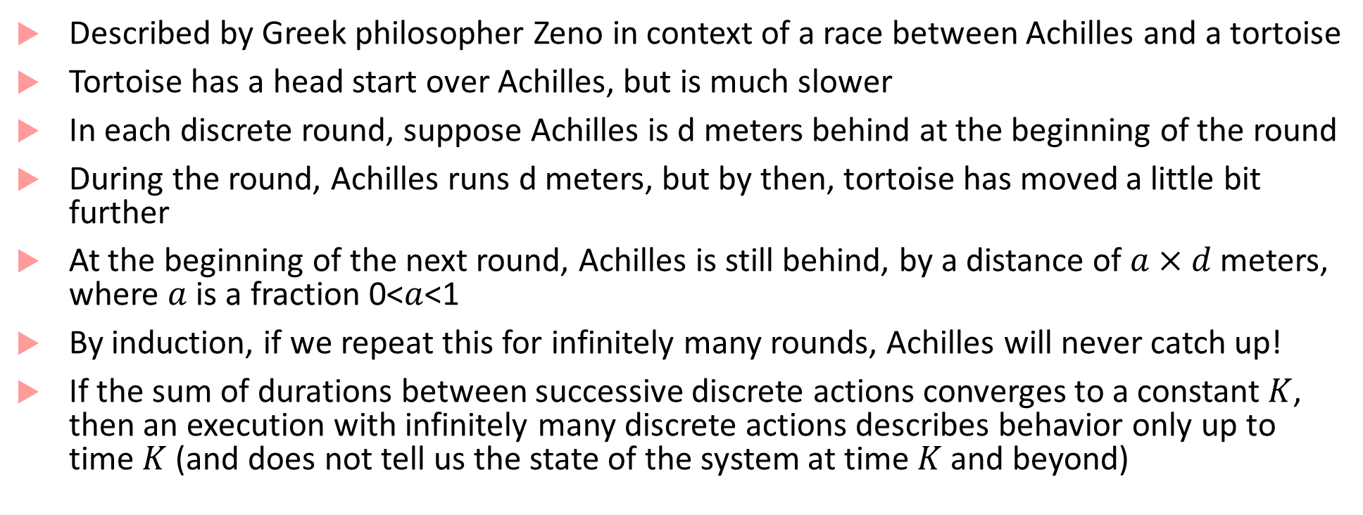
Zeno’s Paradox
Described by Greek philosopher Zeno in context of a race between Achilles and a tortoise
Tortoise has a head start over Achilles, but is much slower
In each discrete round, suppose Achilles is d meters behind at the beginning of the round
During the round, Achilles runs d meters, but by then, tortoise has moved a little bit further
At the beginning of the next round, Achilles is still behind, by a distance of $a×d$ meters, where $a$ is a fraction 0<$a$<1
By induction, if we repeat this for infinitely many rounds, Achilles will never catch up!
If the sum of durations between successive discrete actions converges to a constant$K$, then an execution with infinitely many discrete actions describes behavior only up to time $K$ (and does not tell us the state of the system at time $K$and beyond)

Slide 26
How to deal with Zeno
An infinite execution is called Zeno if infinite sum of all the durations is bounded by a constant, and non-Zeno if the sum diverges
Any state in a hybrid process is called Zeno if:
If every execution starting in state is Zeno
Non-Zeno if there exists some non-Zeno starting in that state
Hybrid process is non-Zeno if any state that you can reach from the initial state is non-Zeno
Thermostat: non-Zeno, Bouncing ball: Zeno
Dealing with Zeno: remove Zeno-ness through better modeling

Slide 27



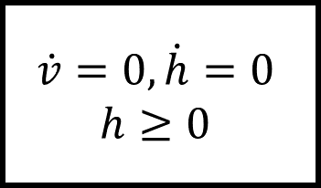

Non-Zeno hybrid process for bouncing ball
$$\dot{v}=−g, \dot{h}=v$$
$$h≥0$$
bounce
$$h=0→sound!boink ;v≔−av$$
$$h∈\left[10,20\right], v∈[0,5]$$
$$h=0∧v<ε→sound!splat ;v≔0$$
$$\dot{v}=0, \dot{h}=0$$
$$h≥0$$
halt

Slide 28
Bibliography
Slotine, J. J. E., & Li, W. (1991). Applied nonlinear control (Vol. 199, No. 1). Englewood Cliffs, NJ: Prentice hall.
Slide 4 example: http://www.control.lth.se/media/Education/EngineeringProgram/FRTN05/2014/lec09_2014eight.pdf
Slide 7 example: http://control.ee.ethz.ch/~apnoco/Lectures2009/16-Feedback%20Linearization%20v2.pdf
MPC: http://cse.lab.imtlucca.it/~bemporad/teaching/ac/pdf/AC2-10-MPC.pdf
MPC in autonomous vehicles: http://ieeexplore.ieee.org/abstract/document/4162483/
MPC in autonomous vehicles: Shim, David H., H. Jin Kim, and Shankar Sastry. "Decentralized nonlinear model predictive control of multiple flying robots." Decision and control, 2003. Proceedings. 42nd IEEE conference on. Vol. 4. IEEE, 2003.
MPC in autonomous vehicles: Rosolia, Ugo, Ashwin Carvalho, and Francesco Borrelli. "Autonomous racing using learning model predictive control." American Control Conference (ACC), 2017. IEEE, 2017.

