Slide 1
Autonomous Cyber-Physical Systems: Basics of Verification
Spring 2018. CS 599.
Instructor: Jyo Deshmukh
Acknowledgment: Some of the material in these slides is based on the lecture slides for CIS 540: Principles of Embedded Computation taught by Rajeev Alur at the University of Pennsylvania. http://www.seas.upenn.edu/~cis540/

Slide 2
Where we are in the course
Done with Module 1!
Module 1: How you can create virtual models for your autonomous CPS designs
Models for Software: Synchronous Components, Asynchronous and Timed Processes
Models for Physical systems and Environment: Dynamical Systems, Probabilistic Models
CPS Models: Hybrid Processes/Systems, Closed-loop control for linear and nonlinear systems, Stability Analysis, State Estimation
Module 2: What you can do with these virtual CPS models that you now know how to construct

Slide 3
Module 2 : Analyzing closed-loop models
Basics of Verification
Formal Requirements/Specifications
Requirements-based Testing
Some Formal Verification Techniques

Slide 4
Requirements
Sounds like a boring topic about documentation, is anything but that!
A requirement describes a desirable property of the system behaviors.
High assurance/safety-critical, or mission-critical systems should use formal requirements.
A system design meets its requirements if all system executions satisfy all the requirements.
There should ideally be clear separation between requirements (what needs to be implemented) and the design (how should it be implemented).
Unfortunately, this simple philosophy is often not followed by designers.

Slide 5
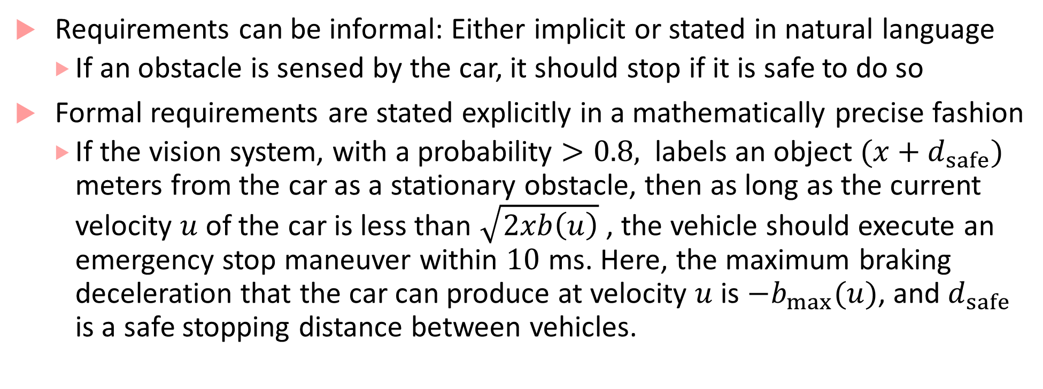
Rigor in Requirements
Requirements can be informal: Either implicit or stated in natural language
If an obstacle is sensed by the car, it should stop if it is safe to do so
Formal requirements are stated explicitly in a mathematically precise fashion
If the vision system, with a probability $>0.8,$ labels an object $(x+d_{safe})$ meters from the car as a stationary obstacle, then as long as the current velocity $u$of the car is less than $\sqrt{2xb\left(u\right)}$ , the vehicle should execute an emergency stop maneuver within $10$ ms. Here, the maximum braking deceleration that the car can produce at velocity $u$is ${−b}_{max}(u)$, and $d_{safe}$ is a safe stopping distance between vehicles.

Slide 6
Granularity
Granularity of requirements
System-level: UAV is able to maintain a given desired altitude in presence of acceptable disturbances.
Subsystem-level: Upon receiving a ‘turn right’ command, flight control subsystem (FCS) produces the correct actuator commands that cause the UAV to turn right.
Function-level: For the position controller module, the maximum error between the estimated position and the position setpoint is less than 5%.
Hardware/Timing-level: The MPC algorithm for attitude control has a worst-case execution time of 4 ms.

Slide 7
Types of Requirements
Hard Requirements: Violation leads to endangering safety-criticality or mission-criticality
Safety Requirements: system never does something bad
Liveness Requirements: from any point of time, system eventually does something good
Soft Requirements: Violations lead to inefficiency, but are not critical
(Absolute) Performance Requirements: system performance is not worst than a certain level
(Average) Performance Requirements: average system performance is at a certain level

Slide 8
Other kind of requirements
Security Requirements: system should protect against modifications in its behavior by an adversarial actor
Failure to satisfy security requirements may lead to a hard requirement violation
Privacy Requirements: the data revealed by the system to the external world should not leak sensitive information
These requirements will become increasingly important for autonomous CPS, especially as IoT technologies and smart transportation initiatives are deployed!

Slide 9
Safety Requirements
A safety requirement states that a system always stays within the set of good states (i.e. nothing bad every happens)
Examples:
Collision avoidance: the distance between a car and a pedestrian is always greater than a threshold
Patient’s blood glucose never drops below 80 mg/dL
Maximum temperature specification on the battery is not exceeded
Safety requirements can be formalized using transition systems

Slide 10
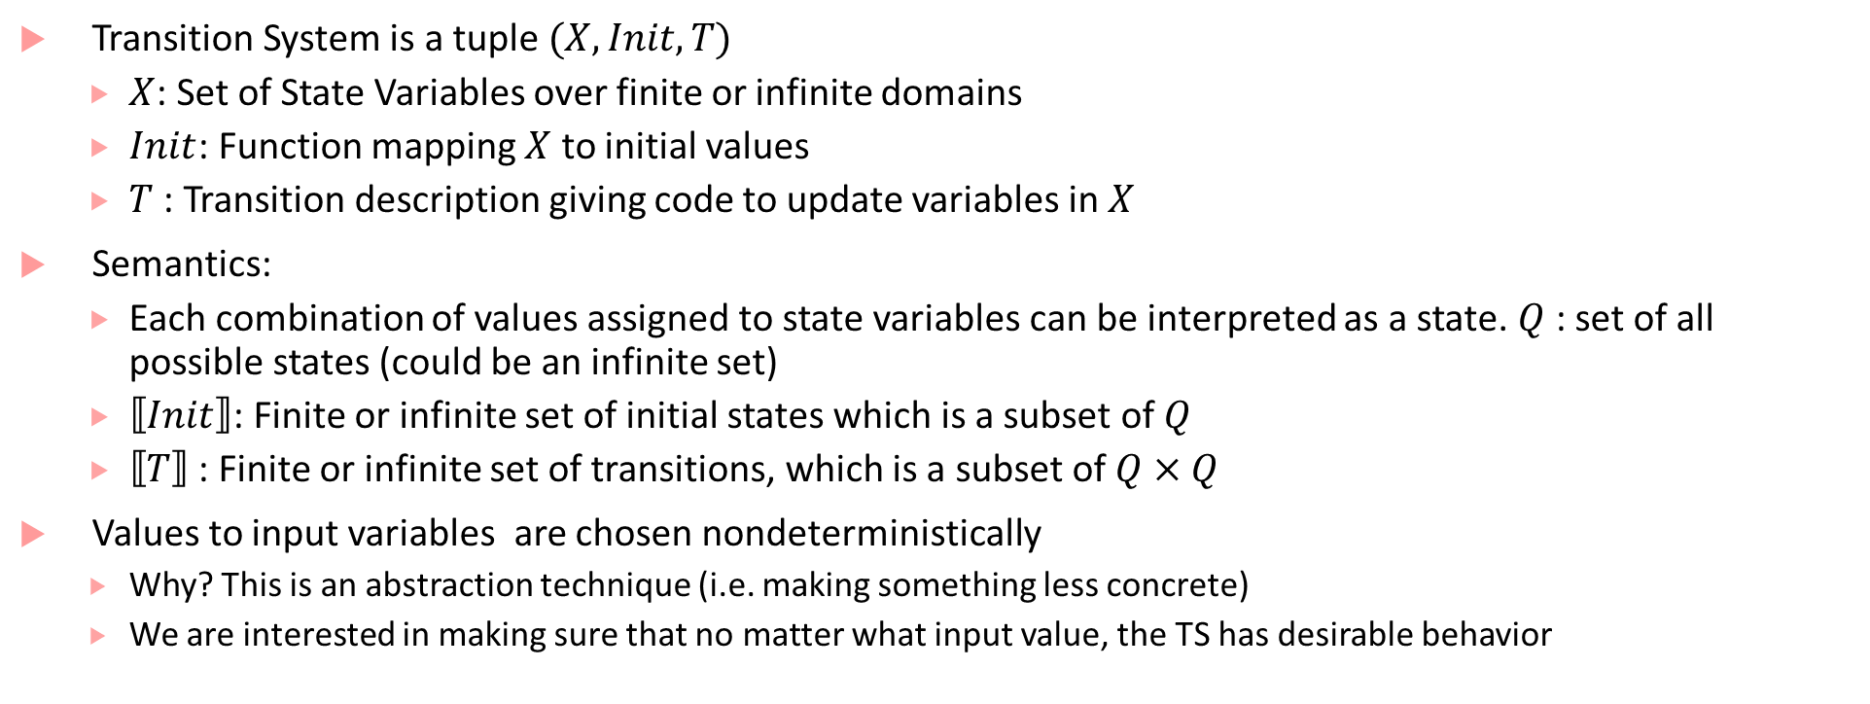
Transition System
Transition System is a tuple $(X,Init,T)$
$X$: Set of State Variables over finite or infinite domains
$Init$: Function mapping $X$ to initial values
$T$ : Transition description giving code to update variables in $X$
Semantics:
Each combination of values assigned to state variables can be interpreted as a state. $Q$ : set of all possible states (could be an infinite set)
$⟦Init⟧$: Finite or infinite set of initial states which is a subset of $Q$
$⟦T⟧$ : Finite or infinite set of transitions, which is a subset of $Q×Q$
Values to input variables are chosen nondeterministically
Why? This is an abstraction technique (i.e. making something less concrete)
We are interested in making sure that no matter what input value, the TS has desirable behavior

Slide 11
Transition Systems and state
All kinds of components (synchronous, asynchronous, timed, hybrid, continuous components have an underlying transition system
Caution: the word “state” can be confusing, as it is overloaded
State is used to represent modes in an ESM
State in the transition system underlying a component captures any given runtime configuration of the component
If a synchronous component has finite input/output types and a finite number of “states” in its ESM, then it has a finite-state transition system
Continuous components, Timed Processes, Hybrid Processes in general, have infinite number of states

Slide 12
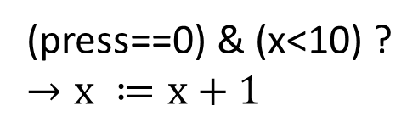
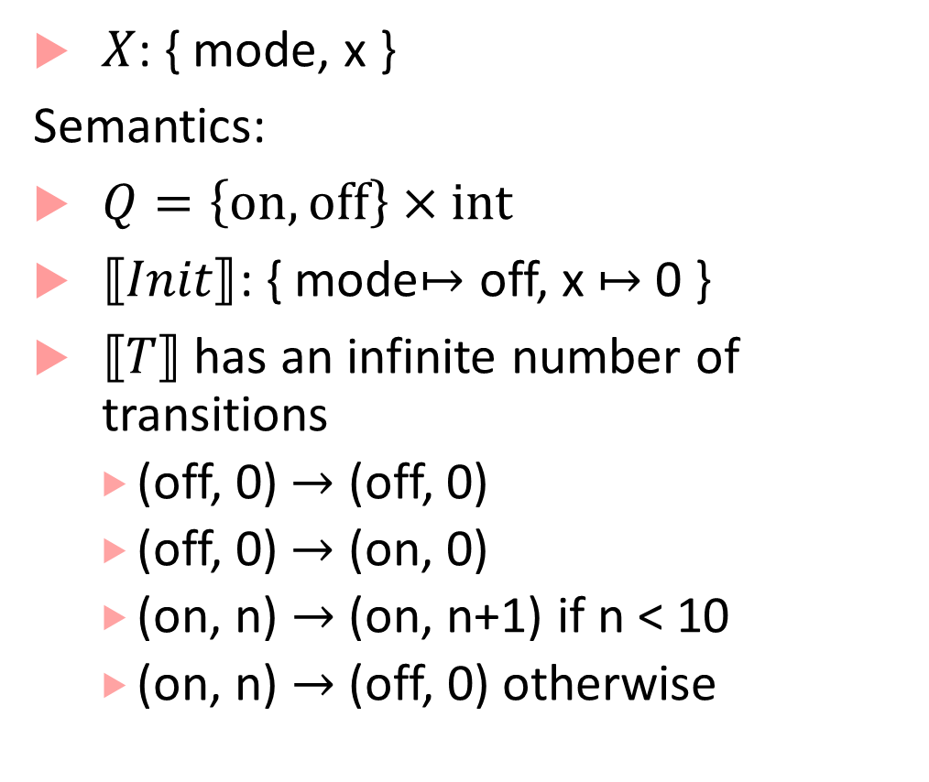
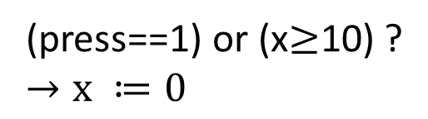

Example of a TS
$X$: { mode, x }
Semantics:
$Q=\left\{on, off\right\}×int$
$⟦Init⟧$: { mode$↦$ off, x $↦$ 0 }
$⟦T⟧$ has an infinite number of transitions
(off, 0) $→$ (off, 0)
(off, 0) $→$ (on, 0)
(on, n) $→$ (on, n+1) if n < 10
(on, n) $→$ (off, 0) otherwise
$int x≔$0
off
(press==1)?
(press==0)?
on
(press==1) or (x$≥$10) ?
$$→x ≔0$$
(press==0) & (x<10) ?
$$→x ≔x+1$$

Slide 13
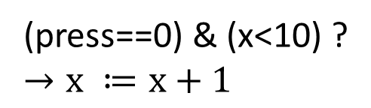
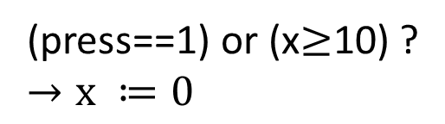

Example transitions for TS
$int x≔$0
(off,0)
(on,100)
off
(press==1)?
(press==0)?
(on,0)
(on,1)
on
(press==1) or (x$≥$10) ?
$$→x ≔0$$
(off,42)
(on,2)
(press==0) & (x<10) ?
$$→x ≔x+1$$
(on,42)

Slide 14

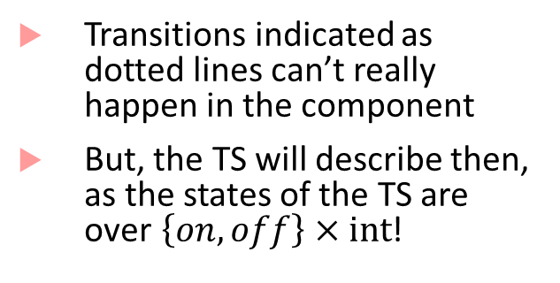


TS describes all possible transitions
(off,0)
(on,100)
$int x≔$0
Transitions indicated as dotted lines can’t really happen in the component
But, the TS will describe then, as the states of the TS are over$\left\{on,off\right\}×int$!
off
(press==1)?
(on,0)
(on,1)
(press==0)?
on
(press==1) or (x$≥$10) ?
$$→x ≔0$$
(off,42)
(on,2)
(press==0) & (x<10) ?
$$→x ≔x+1$$
(on,42)

Slide 15



Reachable states of a modified switch TS
(off,0)
(on,100)
$int x≔$0
off
(press==1)?
(press==0)?
(on,0)
(on,1)
on
(press==1) or (x$≥$ 2) ?
$$→x ≔0$$
(press==0) & (x<2) ?
$$→x ≔x+1$$
Reachable states and transitions
(on,2)
(off,42)
(on,42)

Slide 16
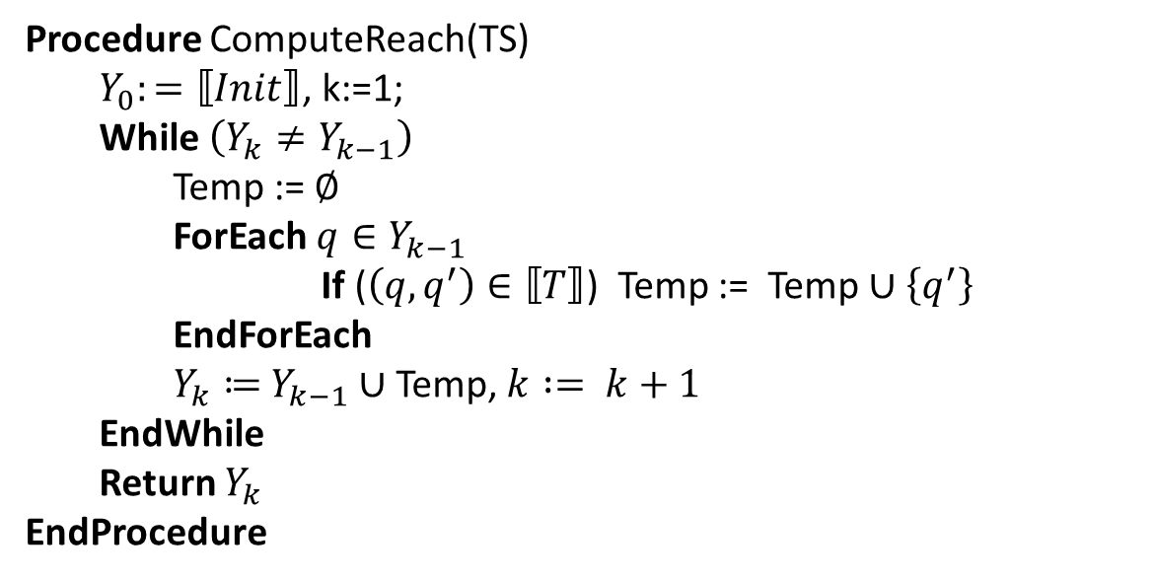
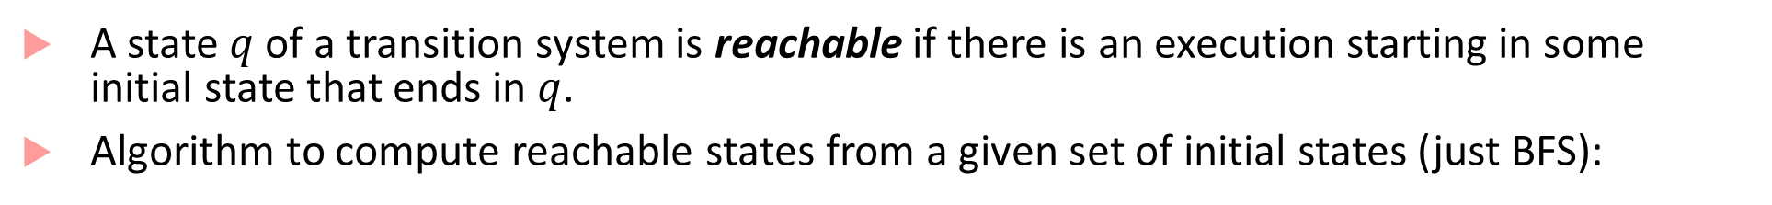
Reachability
A state $q$ of a transition system is reachable if there is an execution starting in some initial state that ends in $q$.
Algorithm to compute reachable states from a given set of initial states (just BFS):
Procedure ComputeReach(TS)
$Y_{0}:=⟦Init⟧$, k:=1;
While $\left(Y_{k}≠Y_{k−1}\right)$
Temp := $∅$
ForEach $q∈Y_{k−1}$
If ($\left(q,q^{′}\right)∈⟦T⟧$) Temp := Temp $∪$ $\left\{q^{′}\right\}$
EndForEach
$Y_{k}≔$ $Y_{k−1}∪$ Temp, $k := k+1$
EndWhile
Return $Y_{k}$
EndProcedure

Slide 17
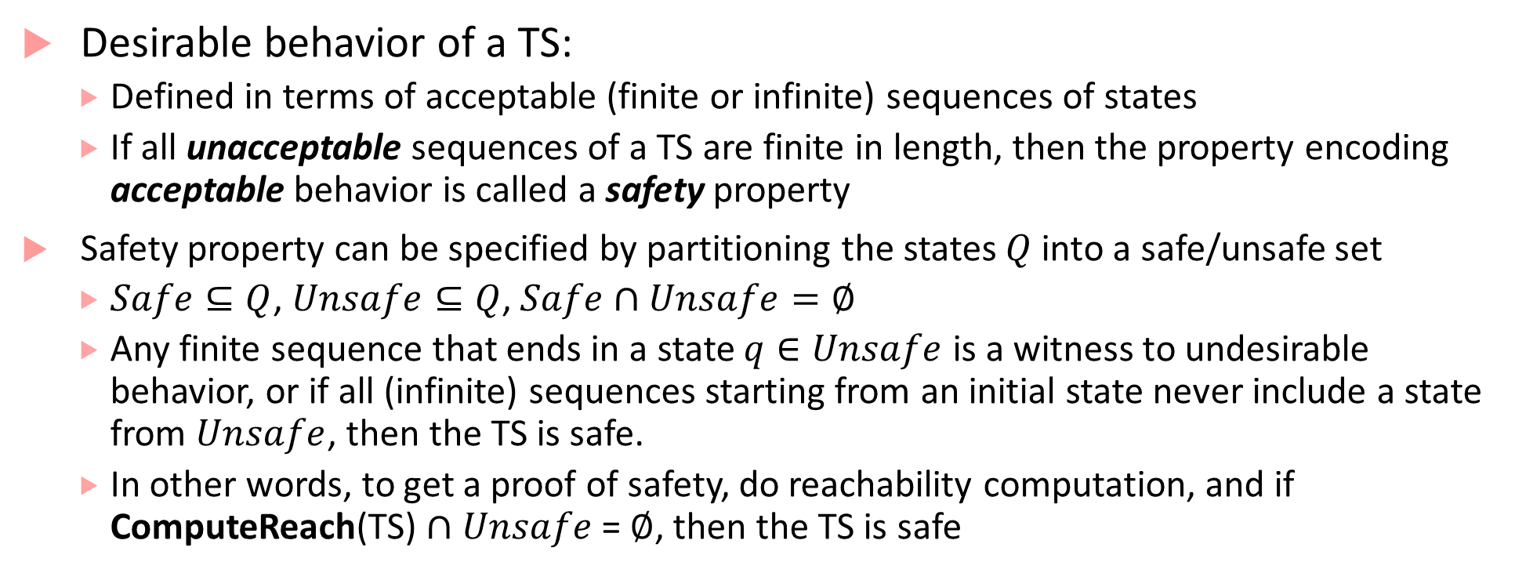
Desirable behaviors of a TS
Desirable behavior of a TS:
Defined in terms of acceptable (finite or infinite) sequences of states
If all unacceptable sequences of a TS are finite in length, then the property encoding acceptable behavior is called a safety property
Safety property can be specified by partitioning the states $Q$ into a safe/unsafe set
$Safe⊆Q$, $Unsafe⊆Q$, $Safe∩Unsafe=∅$
Any finite sequence that ends in a state $q∈Unsafe$ is a witness to undesirable behavior, or if all (infinite) sequences starting from an initial state never include a state from $Unsafe$, then the TS is safe.
In other words, to get a proof of safety, do reachability computation, and if ComputeReach(TS) $∩$ $Unsafe$= $∅$, then the TS is safe

Slide 18

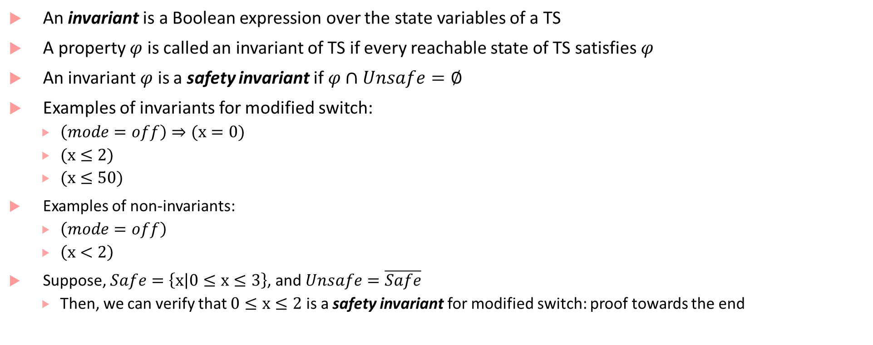

Safety invariants
An invariant is a Boolean expression over the state variables of a TS
A property $φ$ is called an invariant of TS if every reachable state of TS satisfies $φ$
An invariant $φ$ is a safety invariant if $φ∩Unsafe=∅$
Examples of invariants for modified switch:
$\left(mode=off\right)⇒(x=0)$
$(x≤2)$
$(x≤50)$
Examples of non-invariants:
$\left(mode=off\right)$
$\left(x<2\right)$
Suppose, $Safe=\left\{\left.x\right|0≤x≤3\right\}$, and $Unsafe=\overline{Safe}$
Then, we can verify that $0≤x≤2$ is a safety invariant for modified switch: proof towards the end
$int x≔$0
off
(press==1)?
(press==0)?
on
(press==1) or (x$≥$ 2) ?
$$→x ≔0$$
(press==0) & (x<2) ?
$$→x ≔x+1$$

Slide 19
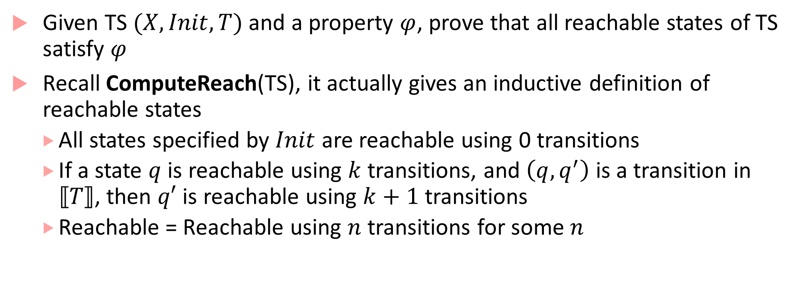
Proving that something is an invariant
Given TS $(X,Init,T)$ and a property $φ$, prove that all reachable states of TS satisfy $φ$
Recall ComputeReach(TS), it actually gives an inductive definition of reachable states
All states specified by $Init$ are reachable using 0 transitions
If a state $q$ is reachable using $k$ transitions, and $\left(q,q^{′}\right)$ is a transition in $⟦T⟧$, then $q′$ is reachable using $k+1$ transitions
Reachable = Reachable using $n$ transitions for some $n$

Slide 20

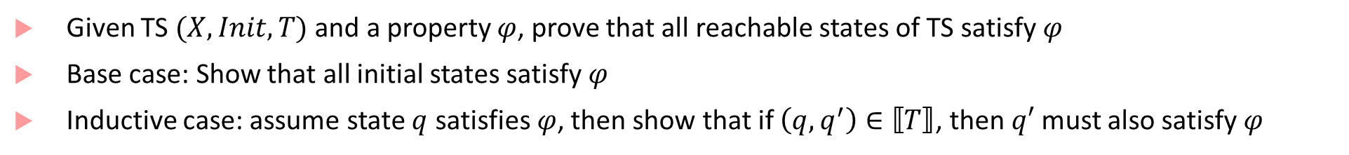


Inductive Safety Proof
Given TS $(X,Init,T)$ and a property $φ$, prove that all reachable states of TS satisfy $φ$
Base case: Show that all initial states satisfy $φ$
Inductive case: assume state $q$ satisfies $φ$, then show that if $\left(q,q^{′}\right)∈⟦T⟧$, then $q′$ must also satisfy $φ$
$int x≔$0
off
(press==1)?
(press==0)?
on
(press==1) or (x$≥$ 2) ?
$$→x ≔0$$
(press==0) & (x<2) ?
$$→x ≔x+1$$

Slide 21
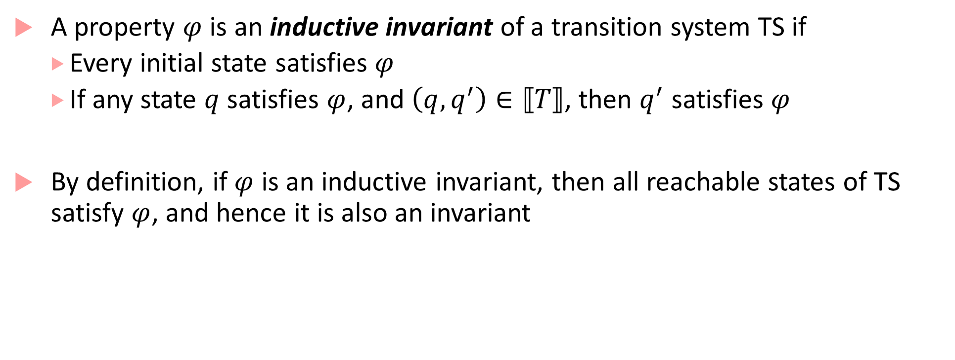
Inductive Invariant
A property $φ$ is an inductive invariant of a transition system TS if
Every initial state satisfies $φ$
If any state $q$ satisfies $φ$, and $\left(q,q^{′}\right)∈⟦T⟧$, then $q^{′}$ satisfies $φ$
By definition, if $φ$ is an inductive invariant, then all reachable states of TS satisfy $φ$, and hence it is also an invariant

Slide 22
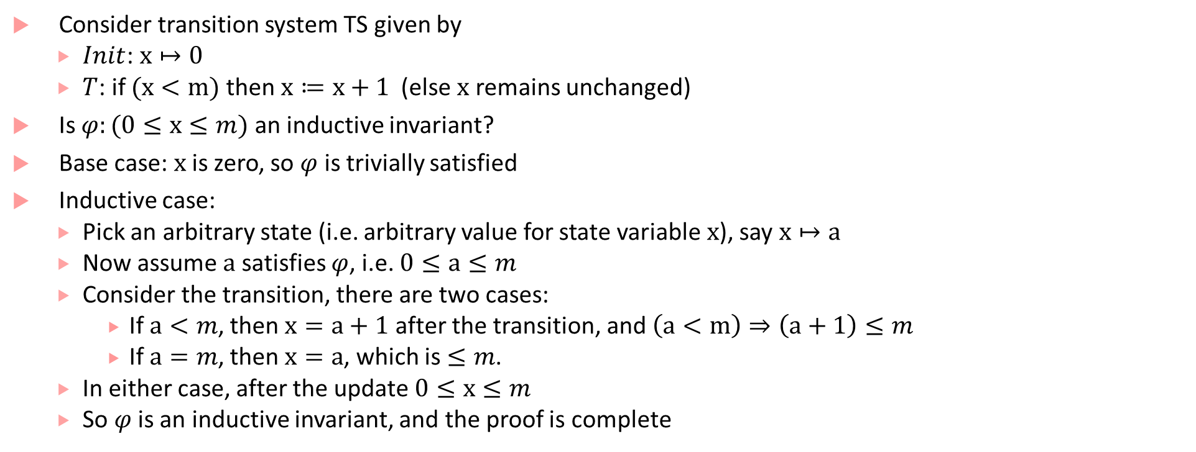
Proving inductive invariants: I
Consider transition system TS given by
$Init$: $x↦0$
$T$: if $(x<m)$ then $x≔x+1$ (else $x$ remains unchanged)
Is $φ:(0≤x≤m)$ an inductive invariant?
Base case: $x$ is zero, so $φ$ is trivially satisfied
Inductive case:
Pick an arbitrary state (i.e. arbitrary value for state variable $x$), say $x↦a$
Now assume $a$ satisfies $φ$, i.e. $0≤a≤m$
Consider the transition, there are two cases:
If $a<m$, then $x=a+1$ after the transition, and $\left(a<m\right)⇒\left(a+1\right)≤m$
If $a=m$, then $x=a$, which is $≤m$.
In either case, after the update $0≤x≤m$
So $φ$ is an inductive invariant, and the proof is complete

Slide 23
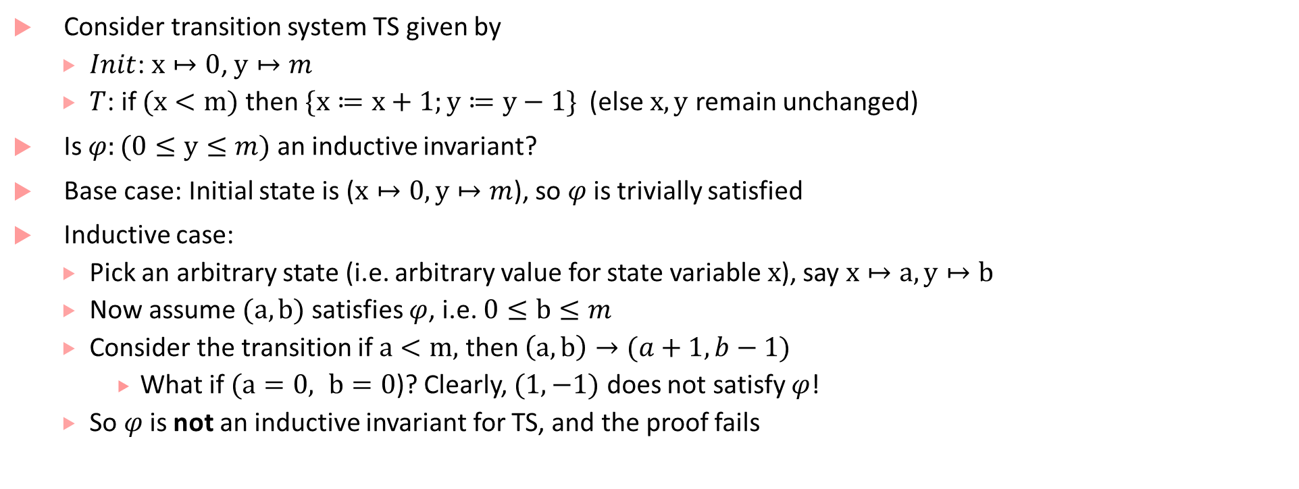
Proving inductive invariants: II
Consider transition system TS given by
$Init$: $x↦0$, $y↦m$
$T$: if $(x<m)$ then $\{x≔x+1;y≔y−1\}$ (else $x,y$ remain unchanged)
Is $φ:(0≤y≤m)$ an inductive invariant?
Base case: Initial state is ($x↦0, y↦m$), so $φ$ is trivially satisfied
Inductive case:
Pick an arbitrary state (i.e. arbitrary value for state variable $x$), say $x↦a, y↦b$
Now assume $(a,b)$ satisfies $φ$, i.e. $0≤b≤m$
Consider the transition if $a<m,$ then $\left(a,b\right)→(a+1,b−1)$
What if $(a=0, b=0$)? Clearly, $(1,−1)$ does not satisfy $φ$!
So $φ$ is not an inductive invariant for TS, and the proof fails

Slide 24
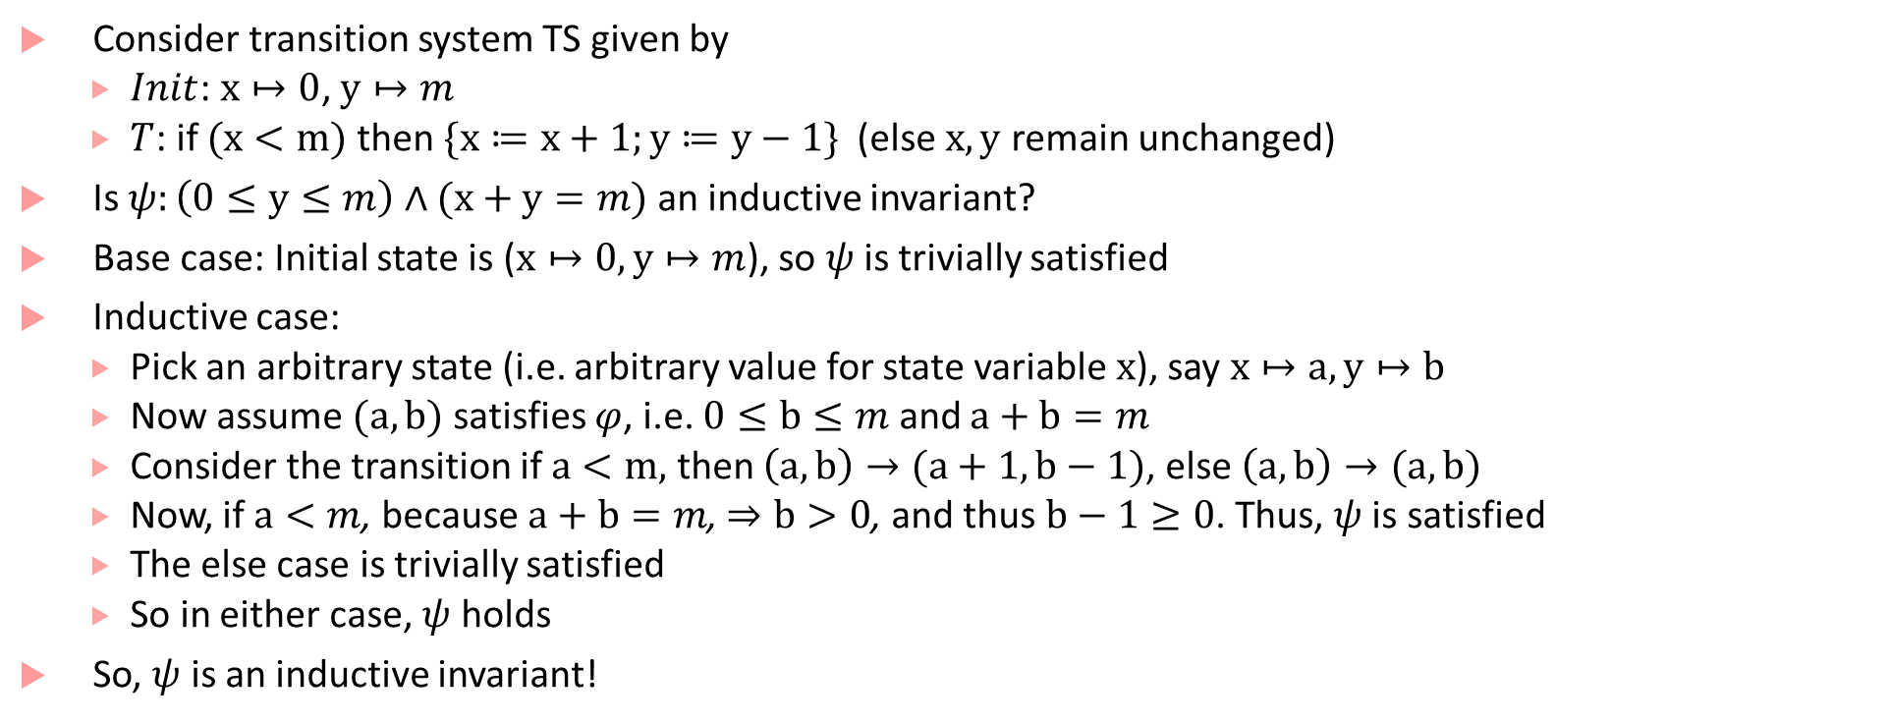
Proving inductive invariants: III
Consider transition system TS given by
$Init$: $x↦0$, $y↦m$
$T$: if $(x<m)$ then $\{x≔x+1;y≔y−1\}$ (else $x,y$ remain unchanged)
Is $ψ:\left(0≤y≤m\right)∧(x+y=m)$ an inductive invariant?
Base case: Initial state is ($x↦0, y↦m$), so $ψ$ is trivially satisfied
Inductive case:
Pick an arbitrary state (i.e. arbitrary value for state variable $x$), say $x↦a, y↦b$
Now assume $(a,b)$ satisfies $φ$, i.e. $0≤b≤m$ and $a+b=m$
Consider the transition if $a<m,$ then $\left(a,b\right)→(a+1,b−1)$, else $\left(a,b\right)→(a,b)$
Now, if $a<m$, because $a+b=m$, $⇒b>0$, and thus $b−1≥0$. Thus, $ψ$ is satisfied
The else case is trivially satisfied
So in either case, $ψ$ holds
So, $ψ$ is an inductive invariant!

Slide 25
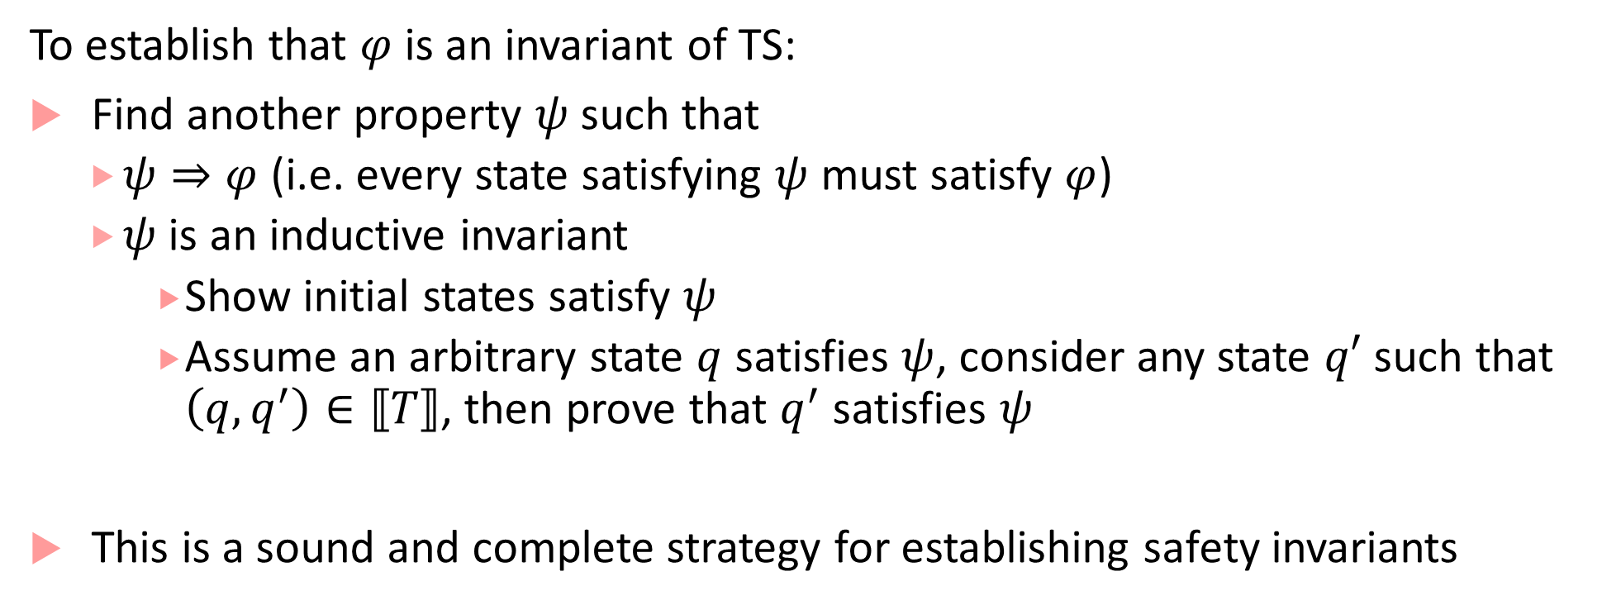
How do we prove safety invariants?
To establish that $φ$ is an invariant of TS:
Find another property $ψ$ such that
$ψ⇒φ$ (i.e. every state satisfying $ψ$ must satisfy $φ$)
$ψ$ is an inductive invariant
Show initial states satisfy $ψ$
Assume an arbitrary state $q$ satisfies $ψ$, consider any state $q′$ such that $\left(q,q^{′}\right)∈⟦T⟧$, then prove that $q^{′}$ satisfies $ψ$
This is a sound and complete strategy for establishing safety invariants

Slide 26
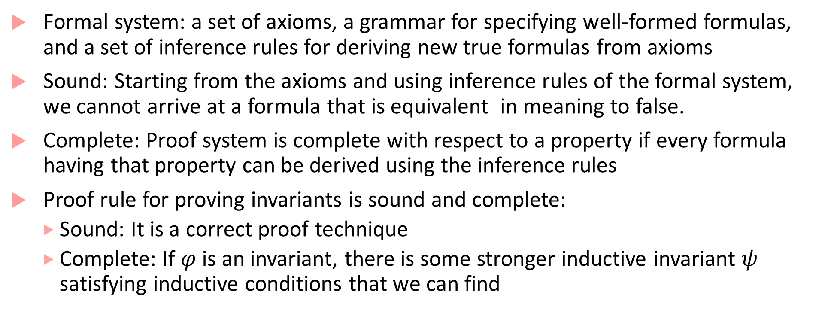
Soundness and Completeness
Formal system: a set of axioms, a grammar for specifying well-formed formulas, and a set of inference rules for deriving new true formulas from axioms
Sound: Starting from the axioms and using inference rules of the formal system, we cannot arrive at a formula that is equivalent in meaning to false.
Complete: Proof system is complete with respect to a property if every formula having that property can be derived using the inference rules
Proof rule for proving invariants is sound and complete:
Sound: It is a correct proof technique
Complete: If $φ$ is an invariant, there is some stronger inductive invariant $ψ$ satisfying inductive conditions that we can find

Slide 27
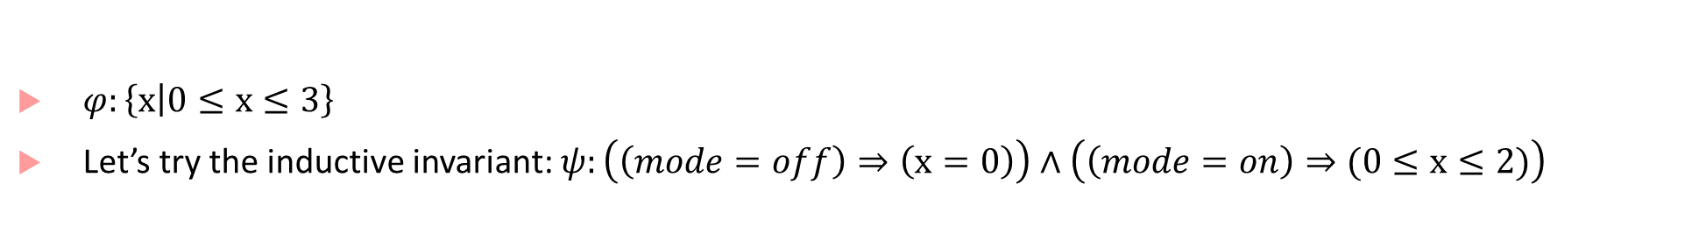
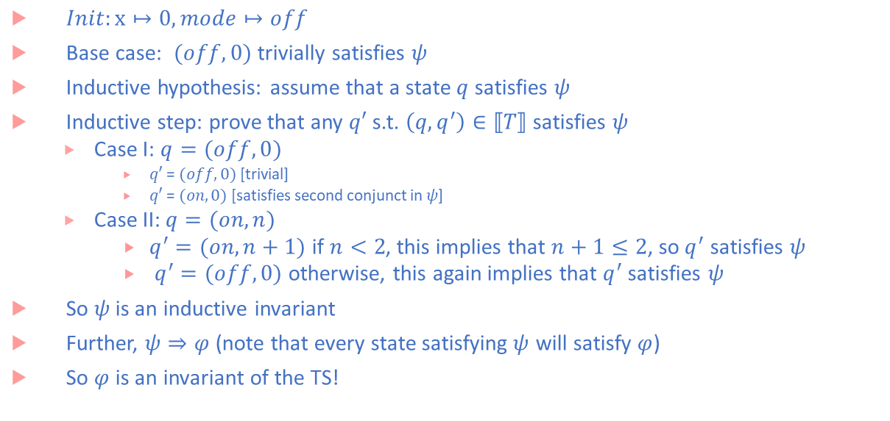
Safety Proof for Switch
$φ:\left\{\left.x\right|0≤x≤3\right\}$
Let’s try the inductive invariant: $ψ:\left(\left(mode=off\right)⇒\left(x=0\right)\right)∧\left(\left(mode=on\right)⇒(0≤x≤2)\right)$
$Init:x↦0, mode↦off$
Base case: $(off,0)$ trivially satisfies $ψ$
Inductive hypothesis: assume that a state $q$ satisfies $ψ$
Inductive step: prove that any $q′$ s.t. $\left(q,q^{′}\right)∈⟦T⟧$ satisfies $ψ$
Case I: $q=(off,0)$
$q′$ = $(off,0)$ [trivial]
$q′$ = $(on, 0)$ [satisfies second conjunct in $ψ$]
Case II: $q=(on,n)$
$q^{′}=(on,n+1)$ if $n<2$, this implies that $n+1≤2$, so$q^{′}$ satisfies $ψ$
$q^{′}=(off,0)$ otherwise, this again implies that $q^{′}$ satisfies $ψ$
So $ψ$ is an inductive invariant
Further, $ψ⇒φ$ (note that every state satisfying$ψ$ will satisfy $φ$)
So $φ$ is an invariant of the TS!
$int x≔$0
off
(press==1)?
(press==0)?
on
(press==1) or (x$≥$ 2) ?
$$→x ≔0$$
(press==0) & (x<2) ?
$$→x ≔x+1$$

Slide 28
Next time
Wrap-up of verification basics
Temporal Logic

