Slide 1
How can CPS education provide what the industry needs?
Jyotirmoy Deshmukh
Toyota Technical Center, Los Angeles

Slide 2
What do “CPS people” in automotive industry do?
Research and Advanced Development
Design control software for new hardware
Model hardware, environment for software
Exhaustively test and worry about correctness
Research/ Advanced Development
Advanced Production Development
Production

Slide 3
What do “CPS people” in automotive industry do?
Advanced Production Development
Map software to a particular platform
Integrate their software with legacy software
Exhaustively test and worry about correctness
Research/ Advanced Development
Advanced Production Development
Production

Slide 4
What do “CPS people” in automotive industry do?
Production
Calibration and Tuning
Occasionally fix logic issues
Exhaustively test and worry about correctness
Research/ Advanced Development
Advanced Production Development
Production

Slide 5
Research & Advanced Development Needs
Control Design Theory
Linear systems theory: Basic linear algebra, PID control, Frequency domain analysis, Gain/Phase margin, Bode plots, etc.
Nonlinear systems: Lyapunov theory, Feedback linearization, etc.
Control algorithms: MPC, Sliding-mode, State-Observation and Estimation
Implementing control algorithms
Control Design Tools
Matlab®
Simulink® and its toolboxes
LabView™, and related tools
Optimization tools and packages

Slide 6
Research & Advanced Development Needs
Modeling Theory
Causal versus acausal modeling
ODEs vs DAEs
Model order reduction (Rigorous transformations vs. approximations)
System identification
Making models fast
Modeling Tools
Modelica language: Dymola, OpenModelica
Maplesoft tools
Simscape from The MathWorks

Slide 7
Research & Advanced Development Needs
Verification/Validation/Testing Theory
Software testing: Test-case generation, code coverage.
Real-time computing
Formal Requirements in Logic
Hybrid & Continuous dynamical systems theory: Reachability analysis, Stability theory, Invariants
Verification/Validation/Testing Tools
Not many standard tools
Current state-of-the-art:
Open-loop : Simulink Design Verifier, Reactis, EmbeddedTester, LabView™ and related tools, dSpace, Model checkers, ….
Closed-loop: (Testing) S-TaLiRo, Breach; (Verification) SpaceEx, Flow*, Model checkers

Slide 8
Advanced Dev + Production Dev Needs
Real-time Software Theory
Models of Computation: Asynchronous Message-passing vs. Synchronous Dataflow vs. Discrete-Event Systems
Schedulability, Worst-case Execution Time Analysis
Software/Hardware architectures
Real-time Deadline-driven Concurrency Analysis
Skills: Knowledge of standards such as AUTOSAR, MISRA-C, DO-178B, ISO 26262

Slide 9
What will an ideal CPS engineer look like?
Three Masters degrees, Two PhDs, plus 10years experience?
Let’s look at what we can add:
How could we CPS up a CS major?
How could we CPS up an EE/ME (controls) major?

Slide 10
Switch from CS to CPS is generally harder
Control software development is different:
You don’t write code, you “draw” specs, generate code (e.g. Simulink, Ptolemy, TargetLink etc.)
Memory management is simplistic: shared memory organized in global variables
No object-oriented-ness, no functional languages
Very few pointers, dynamic typing, etc.
Formal Methodists often cringe at qualitative requirements

Slide 11
Switch from CS to CPS is generally harder
CS curricula generally:
Avoid ODEs, real numbers
Rarely include real analysis, Laplace transforms, etc.
Give students strong skill-set to be successful at traditional “software engineer” positions at Google, Facebook, Microsoft, Amazon, making apps, etc.
Big challenge: How to generate excitement about the CPS challenges in mainstream CS?

Slide 12
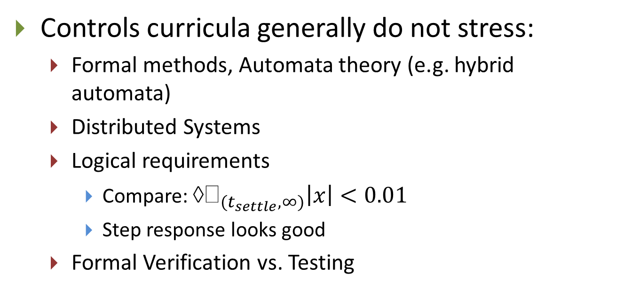
Controls to CPS easier, but need upgrades
Controls curricula generally do not stress:
Formal methods, Automata theory (e.g. hybrid automata)
Distributed Systems
Logical requirements
Compare: $→_{(t_{settle},∞)}\left|x\right|<0.01$
Step response looks good
Formal Verification vs. Testing

Slide 13
Controls to CPS easier, but need upgrades
Multi-core platforms are coming!
Need training in concurrency theory, synchronization, memory models, schedulability, etc.
Hardware and software architectures
V2V communication, active safety, driver assistance systems are already here
Big data is coming
Machine learning, Data mining techniques will become prevalent
Abstraction/Refinement, logical foundations for sound reasoning, Compositional reasoning

Slide 14
What the industry should also need (but is currently not)
Very little focus on correct-by-construction design
Enormous strides in program synthesis, SMT, SAT can be leveraged
Design by abstractions and refinements
Hardware (mechanical components) and Software evolve independently and simultaneously
Makes verification, testing, calibration arduous and difficult: the shifting target problem
Formal Requirements
Even “as-is” requirements are not common
How do I design “improve gas-mileage?”

Slide 15
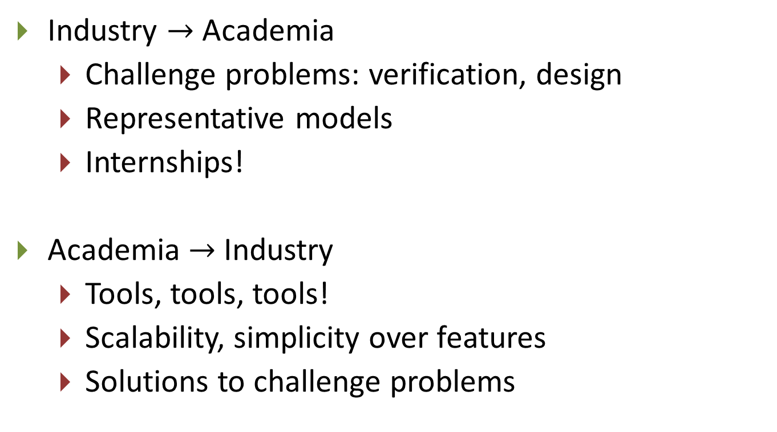
CPS academia and industrial CPS: Symbiosis?
Industry $→$ Academia
Challenge problems: verification, design
Representative models
Internships!
Academia $→$ Industry
Tools, tools, tools!
Scalability, simplicity over features
Solutions to challenge problems
E.g. Berkeley’s MOOC course:
Partnership of UCB with NI,
excellent example of cross-pollination

Slide 16
Thank You!

