Slide 1


Mining Requirements from Closed Loop Control Models
Jyotirmoy V. Deshmukh
Joint work with:
Xiaoqing Jin
Alexander Donzé
Sanjit A. Seshia
TexPoint fonts used in EMF.
Read the TexPoint manual before you delete this box.: AAAAAAAAAA

Slide 2
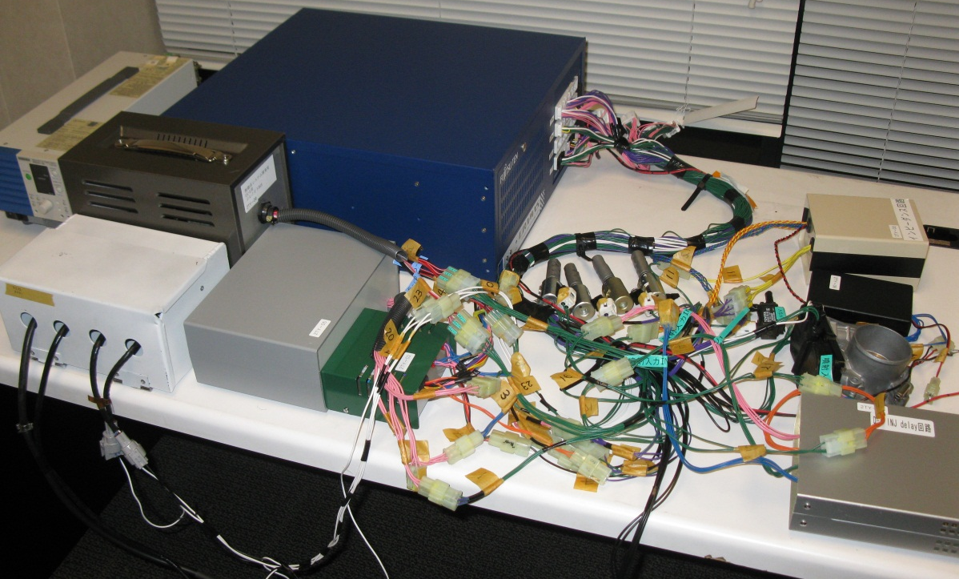
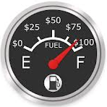
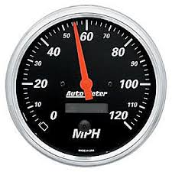

But, you are doing it all wrong!
Aren’t you supposed to check if design satisfies requirements/specifications/properties?
Design
Requirements

Slide 3
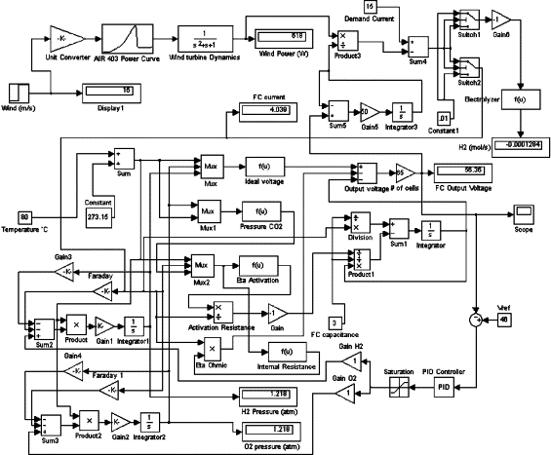
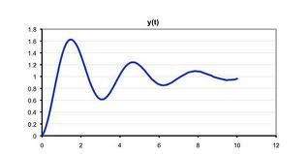

Challenges
Closed-loop models very complex:
nonlinear dynamics
look-up tables
large amounts of switching
components with no models
unclear semantics
Requirements too vague, high-level:
intake manifold pressure should settle
increase fuel efficiency
improve ride quality

Slide 4
What this work is all about …
How we could use formal reasoning when all we have is:
Ability to simulate and test system
Vague idea of what system should satisfy
(Possibly limited) ability to check if system satisfies property
Requirement Mining!

Slide 5
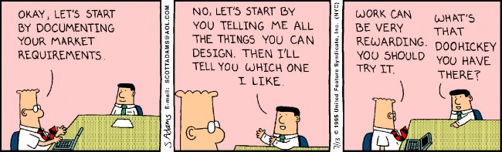
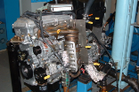


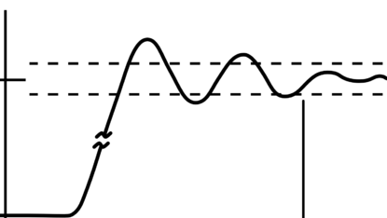
Mining in Action
‘As-is’ properties of closed-loop design
Ask designer if mined requirements are OK
“Settling time is 6.25 ms”
“Overshoot is 100 units”
100
6.25ms

Slide 6
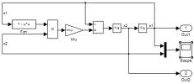
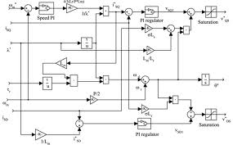
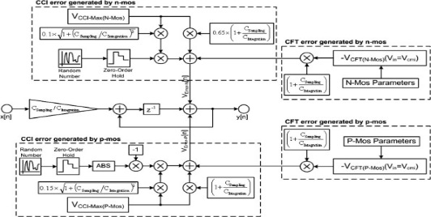
Mine for one version, get many free
Version 0
Requirement 1
Requirement 2
Requirement 3
Mine Requirements
Use for
V & V
Use for
V & V
Use for
V & V
Version 1
Version 2

Slide 7

Legacy code
Value added by mining:
Mined Requirements become useful documentation
Useful for code maintenance and revision
Use requirements during tuning and testing
It’s working, but I don’t understand why!

Slide 8
Outline
Expressing Requirements in Signal Temporal Logic
Mining Algorithm
Experimental Results

Slide 9
Expressing Requirements in
Signal Temporal Logic

Slide 10


Signal Temporal Logic (STL)
Extension of Metric Temporal Logic (MTL)
Allows tests over continuous-valued signal variables
Examples:
3
1
0
50
100
1
+0.1
-0.1
60
0
100

Slide 11
Quantitative Semantics of STL
Function ρ that maps STL formula ϕ to a numeric value
Quantifies “how much” a trace satisfies a property
Large positive value : trace easily satisfies ϕ
Small positive value: trace close to violating ϕ
Negative value: trace does not satisfy ϕ

Slide 12
Mining Algorithm

Slide 13
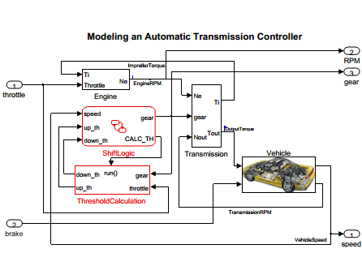
CounterExample Guided Inductive Synthesis
Are there behaviors that do NOT satisfy these
requirements?
YES
1.
m.
1.
Find “Tightest” Answers
Settling Time is 5 ms
Overshoot is 5 KPa
Upper Bound on x is 3.6
Settling Time is ??
Overshoot is ??
Upper Bound on x is ??

Slide 14
CounterExample Guided Inductive Synthesis
Are there behaviors that do NOT satisfy these
requirements?
YES
1.
1.
m.
n.
Counterexamples
Find “Tightest” Answers
Settling Time is 5.3 ms
Overshoot is 5.1 KPa
Upper Bound on x is 3.8
Settling Time is … ms
Overshoot is … KPa
Upper Bound on x is …
Settling Time is ??
Overshoot is ??
Upper Bound on x is ??

Slide 15
CounterExample Guided Inductive Synthesis
Are there behaviors that do NOT satisfy these
requirements?
1.
1.
m.
n.
Counterexamples
Find “Tightest” Answers
Settling Time is 6.3 ms
Overshoot is 5.6 KPa
Upper Bound on x is 4.1
NO
Mined Requirement
Settling Time is ??
Overshoot is ??
Upper Bound on x is ??
Settling Time is 6.3 ms
Overshoot is 5.6 KPa
Upper Bound on x is 4.1

Slide 16

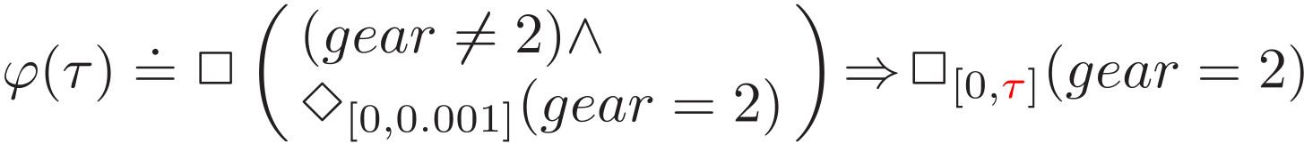
Parametric STL
Constants in STL formula replaced with parameters
Scale parameters
Time parameters
Examples:
Between some time and 10seconds,
x remains greater than some value
After transmission
shifts to gear 2, it
remains in gear 2
for at least secs

Slide 17
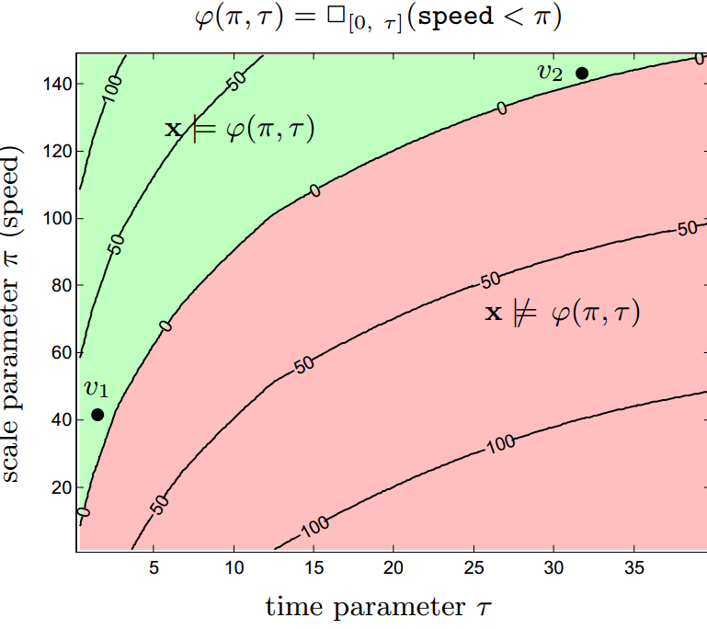
Semantics of PSTL formula ϕ(p)
p = ( )
Valuation function v assigns values to parameters in p
ϕ(v(p)) is an STL formula
Validity domain:
{v(p) | ∀i: (x_{i}, t) ϕ(v(p))}
{x_{i}} : set of traces

Slide 18



Parameter Synthesis
(I.e. Find the “tightest” value)
x δ-satisfies property ϕ if for some i:
(x,t) ϕ(v(p)) v(p) = (v₁,…v_{i},…)
(x,t) ϕ(v(p)) v’(p) = (v₁,…v’_{i},…)
|v_{i} −v’_{i}| < δ
Find δ-tight valuation v such that ∀i: (x_{i},0) ϕ(v(p))
Multi-criteria, nonlinear optimization problem
Solution not unique, need to find Pareto-optimal solution

Slide 19
Parameter Synthesis
Naïve approach:
grid parameter space
evaluate satisfaction value at each point
pick valuation with smallest satisfaction value
Exponential number of points in parameter space
Could miss optimal values

Slide 20


Satisfaction Monotonicity
Sat. value monotonically increasing in i^{th} parameter:
x ϕ(v(p)) and v(p_{i}) ≤ v’(p_{i}) and ∀j≠i v(p_{j}) =v’(p_{j})
⇒ x ϕ(v’(p))
Monotonic if either decreasing or increasing
4
If upper bound of all signals is 3, any number > 3 is also an upper bound
3
0
50
100
Binary-search in monotonic parameter dimensions
Now implemented in tool Breach

Slide 21
Checking Monotonicity
Checking monotonicity is undecidable
Encode monotonicity check as SMT query
F.O. Logic with quantifiers + uninterpreted functions + real arithmetic
Return “yes”/ “no” / “unknown”
If “yes” – proof of monotonicity
If “no” – fall back to naïve procedure

Slide 22
Falsification: any violating behaviors?
u
S(u)
\
\
Falsification Tool
ϕ(v(p))

Slide 23
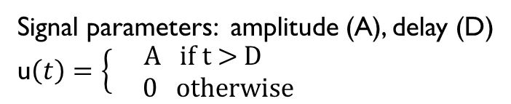
Falsification as Optimization
Solve
If < 0, found falsifying trace!
Use stochastic optimization such as in S-Taliro
Need clever “parameterization” of input signal space
Implemented parameterization in Breach-based falsifier
Run-time worsens with more signal parameters
Nonlinear Optimization Problem, No exact solution, Limited formal guarantees
Signal parameters: amplitude (A), delay (D)
u$\left(t\right)=\left\{\begin{aligned}\text{A} \text{if} \text{t}\text{ > }\text{D} \\ 0 \text{otherwise}\end{aligned}\right.$

Slide 24
Mining in a nutshell
S-Taliro/
Breach
falsified Requirement?
YES
1.
1.
m.
n.
Counterexamples
Breach
Candidate Requirement
NO
Template PSTL property
Mined STL Requirement

Slide 25
Experimental Results

Slide 26
Experimental Results
 | S-Taliro for Falsification* |  | Breach for Falsification
 | Time taken | # Simulations | Time Taken | # Simulations
Upper bounds on speed & rpm | 55 s | 255 | 197 s | 496
Cannot reach 100mph in τ seconds with rpm < π | 6422 s | 9519 | 267 s | 709
Cannot reach 100mph in τ seconds with rpm < π | 8554 s | 18284 | 147 s | 411
Minimum Dwell time in Gear 2 | 18886 s | 130 | 1015 s | 431
* We ran S-Taliro with default options and did not explore signal parameterization

Slide 27

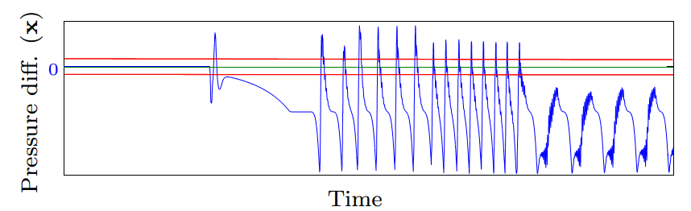
Experimental Results
Experimental Engine
Control Model
Found max overshoot with 7000 simulations in 13 hours
Attempt to mine max settling time:
Stops after 4 iterations with t_{settle} = total time for simulation

Slide 28

Mining can lead to deep bugs
Experimental Engine
Control Model
Each iteration produced intermediate requirements
Forced falsification to explore trajectories more likely to altogether violate requirement
Discussion with control designer revealed it to be a real bug
Root cause identified as wrong value in a look-up table, bug was fixed
Why mining could be useful for bug-finding:
Mining provides better “direction” information to optimizer
Looking for bugs ≈ Mine for negation of bug

Slide 29
References
Breach & STL: http://www.eecs.berkeley.edu/~donze/breach_page.html
Alexander Donzé, Oded Maler. Robust satisfaction of temporal logic over real-valued signals. Formal Modeling and Analysis of Timed Systems, 2010.
Alexander Donzé. Breach: A Toolbox for Verification and Parameter Synthesis of Hybrid Systems. CAV, 2010.
Eugene Asarin, Alexander Donzé, Oded Maler and D. Nickovic. Parametric identification of temporal properties. Runtime Verification, 2011.
S-Taliro: https://sites.google.com/a/asu.edu/s-taliro/s-taliro
Sriram Sankaranarayanan and Georgios Fainekos. Falsification of temporal properties of hybrid systems using the cross-entropy method. HSCC 2012.
Y. Annpureddy. C. Liu, G. E. Fainekos, and S. Sankaranarayanan. S-TaLiRo: A tool for Temporal Logic Falsification for Hybrid Systems: TACAS 2011.

Slide 30
Thank You!

Slide 31
Backup Slides

Slide 32
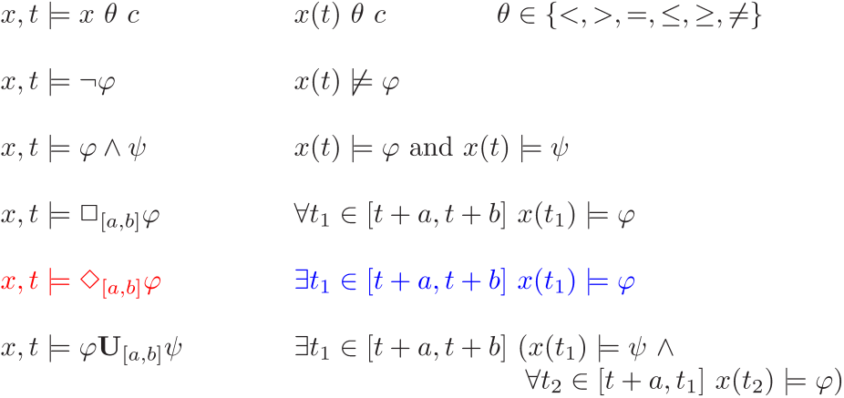
Syntax & Semantics
Syntax
Semantics

Slide 33
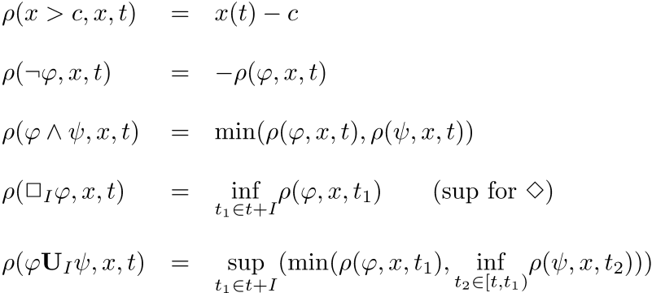
Quantitative Semantics of STL
Following (satisfaction value) does the trick

Slide 34




Quantitative Semantics Demystified
2
1
0.1
0.2
0.3
0.4
0.5
0.6
0.7
0
1
0.5
-0.5
0.5
-1
0
0.5
1
1
sup over each interval
0.5
0.5
0.5
0.5
0.5

Slide 35



Quantitative Semantics Demystified
= 0.5
2
1
0.1
0.2
0.3
0.4
0.5
0.6
0.7
0
1
0.5
-0.5
0.5
-1
0
0.5
1
1
0.5
0.5
0.5
0.5
0.5
0.5
inf over result from previous step

