Slide 1
Autonomous Cyber-Physical Systems: Course Introduction
Spring 2018: CS 599
Instructor: Jyo Deshmukh
Course materials: http://www-bcf.usc.edu/~jdeshmuk/teaching/cs599-autocps/

Slide 2
What is a Cyber-Physical System?
Different ways to answer this question!
Wikipedia: A Cyber-Physical system (CPS) is a mechanism controlled or monitored by software algorithms.
NSF: engineered systems built from, and depending upon, the seamless integration of algorithms and physical components
From a historical perspective CPS combines elements of cybernetics, mechatronics, control theory, process science, embedded systems, distributed control, and more recently communication.
One common saying: CPS = Control + Computation + Communication

Slide 3
Our focus on CPS in this course
Control
Systems where the behavior of the physical components is strongly influenced by the software components
Systems where there the communication between the physical component and the software component may be direct or through a network
Systems in which the primary role played by software is control (in contrast to passive monitoring).
Communication
Computation
CPS

Slide 4
One view of a CPS
Actuators
Physical component
Sensors
Environment/Plant
Communication Network
Controller
(Some embedded code)

Slide 5
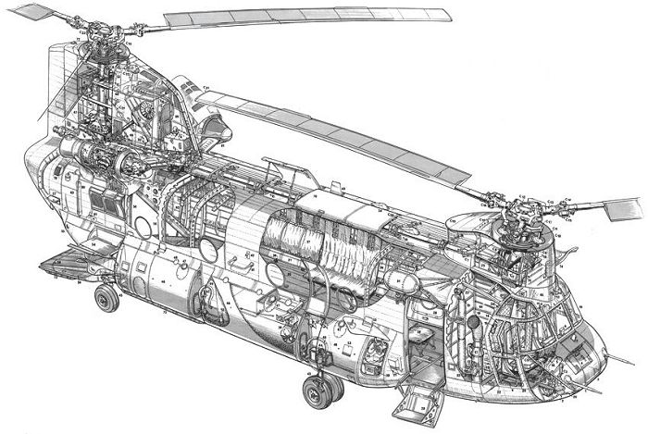
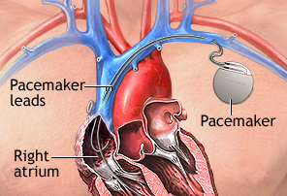
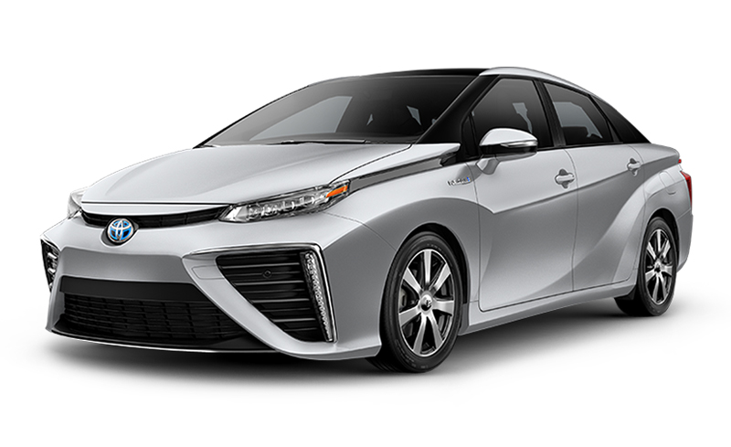
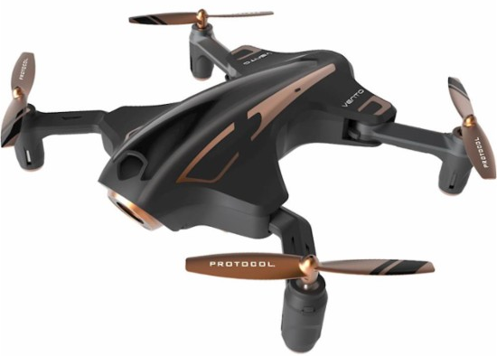
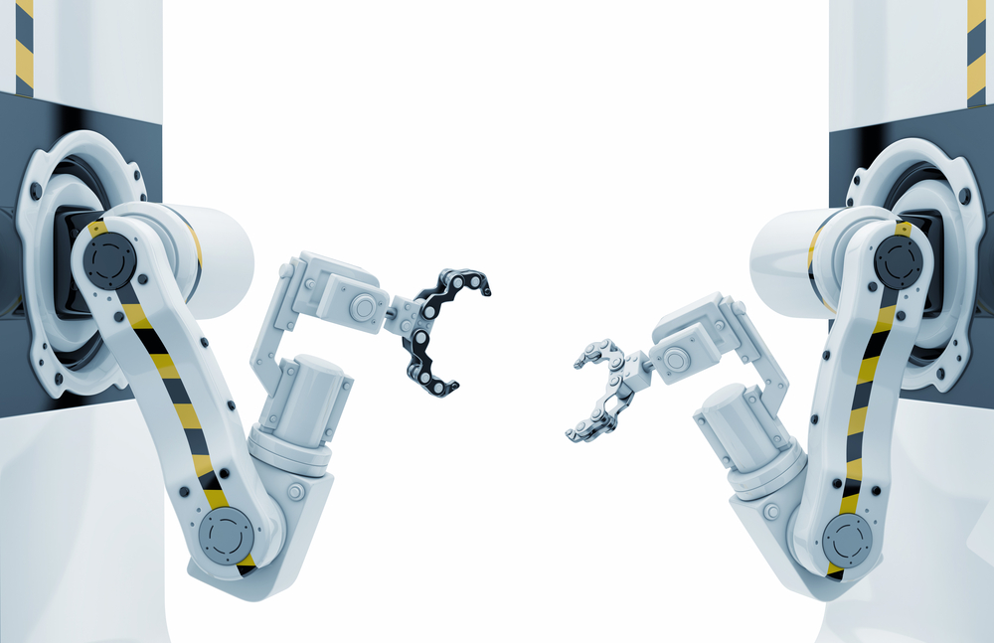
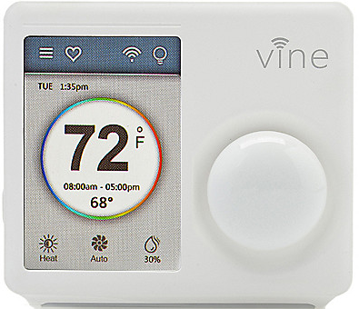
Examples
[All images from Google image search]

Slide 6
What’s an autonomous CPS?
Autonomous: without the need for human intervention or control
Autonomous CPS = CPS with no human operator!
Semi-autonomous: CPS with autonomy under specific conditions, but requiring a human operator otherwise.
Today, several CPS examples are semi-autonomous, and getting to fully autonomous

Slide 7
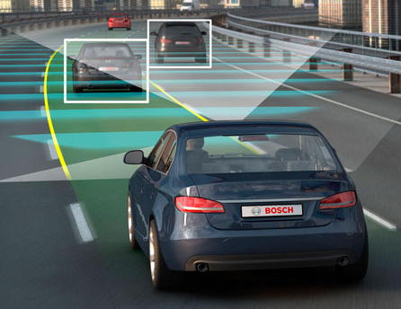
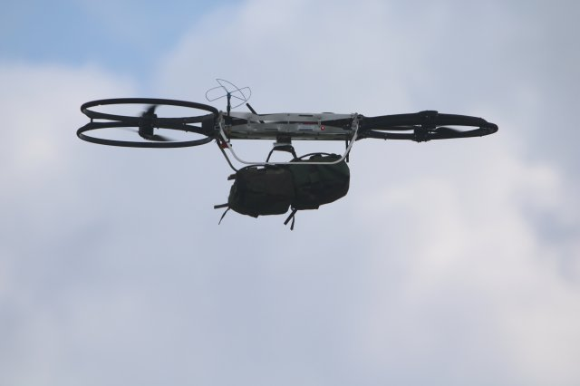
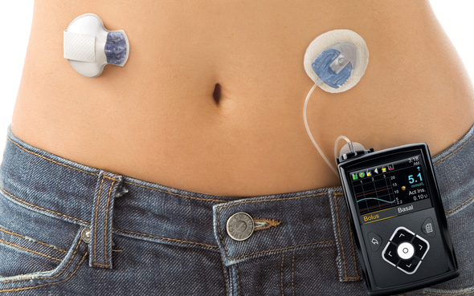
Autonomous/Semi-autonomous CPS
Image credit: Motor Authority
Image credit: army.mil
Image credit: Google images

Slide 8
Course Objectives
Gain basic familiarity with CPS topics
Computational models
Control algorithms
Software Architectures
Challenge Problems/Case studies
“Model-Based” Software Development Paradigm for CPS
Developing models for physical components + software + communication
Software Engineering: Writing checkable requirements and tests
Software testing for CPS
Learn autonomous software stack through case studies in autonomy

Slide 9
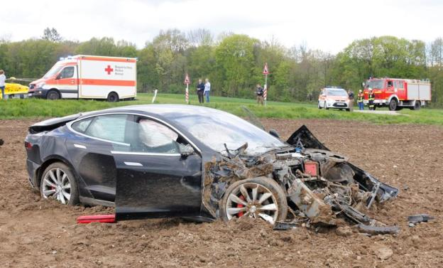
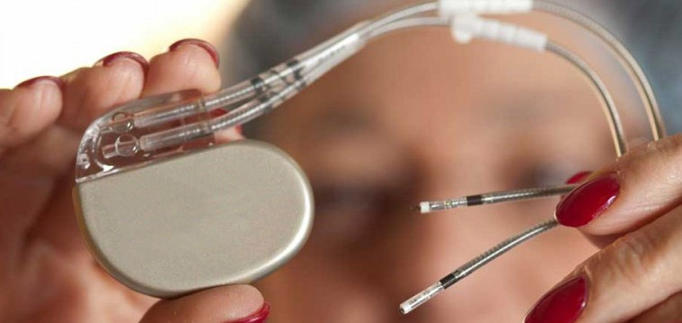
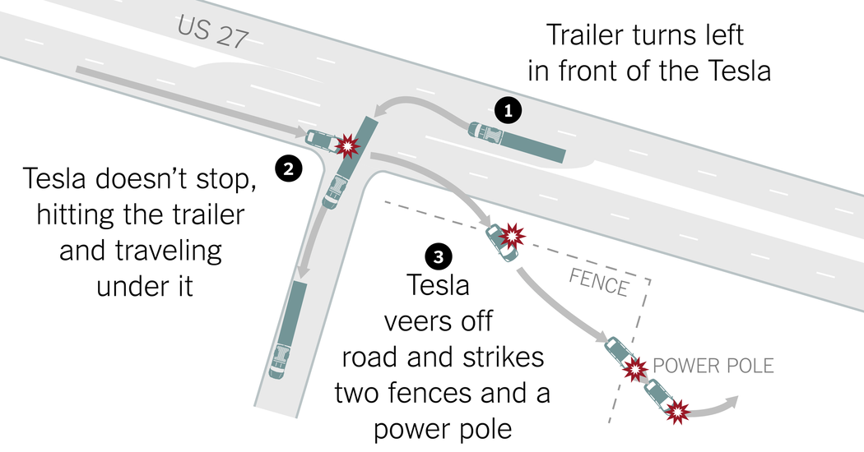

Key Theme of the course: Formal Reasoning
Formal Reasoning is required because we are dealing with systems that are safety-critical, and/or mission-critical with huge implications on human health, well-being, economy, etc.
The FDA has issued 23 recalls of defective devices during the first half of 2010, all of which are categorized as “Class I,” meaning there is “reasonable probability that use of these products will cause serious adverse health consequences or death.”

Slide 10
Course Overview
Part I: Basic Models of Computation
Synchronous, Asynchronous, Timed, Dynamical System Model, Hybrid Models, Probabilistic Models
Part II: Writing Safety Requirements and Monitors
Temporal Logics, Barrier Certificates, Introduction to the Breach Toolbox
Part III: Testing, Verification, Validation
Part IV: Autonomous CPS software stack
Basics of control, perception, decision-making, examples from self-driving, UAVs and medical devices

Slide 11
How will we evaluate ourselves?
3 Homework Assignments
Think of them as three parts of one course-long project
First will be a written assignment
Second and third will involve coding
2 simple exams
Will test basic understanding of what we cover in the course
Class Project

Slide 12
Class Project
Research Project: Write a research paper on a fundamental question and identify possible solutions. Instructor will give some topics if needed
Survey Project: Pick a sub-area of CPS and write a thorough survey on that area
Programming Project: Build an autonomous CPS example, or a tool to analyze autonomous CPS models. [can include hardware implementations if self-motivated]
Will have two presentations: project proposal + final

Slide 13
Learning curve will be sharper if:
You have no knowledge of Matlab
Matlab is easy to learn, with several online resources and tutorials, but it may take you some time if you have never used it!
You have no knowledge of automata
You are expected to know at least how finite-state automata work
You do not remember basics of calculus
You should remember simple basics of differential equations

Slide 14
Grading and Evaluation Breakdown
Assignments: 35% (10+10+15)
Tests: 30% (15+15)
Project: 25% (Proposal talk: 5, Final Paper: 15, Final Talk: 5)
Attendance + Class participation: 5%
Please ask questions in class or at office hours!

Slide 15
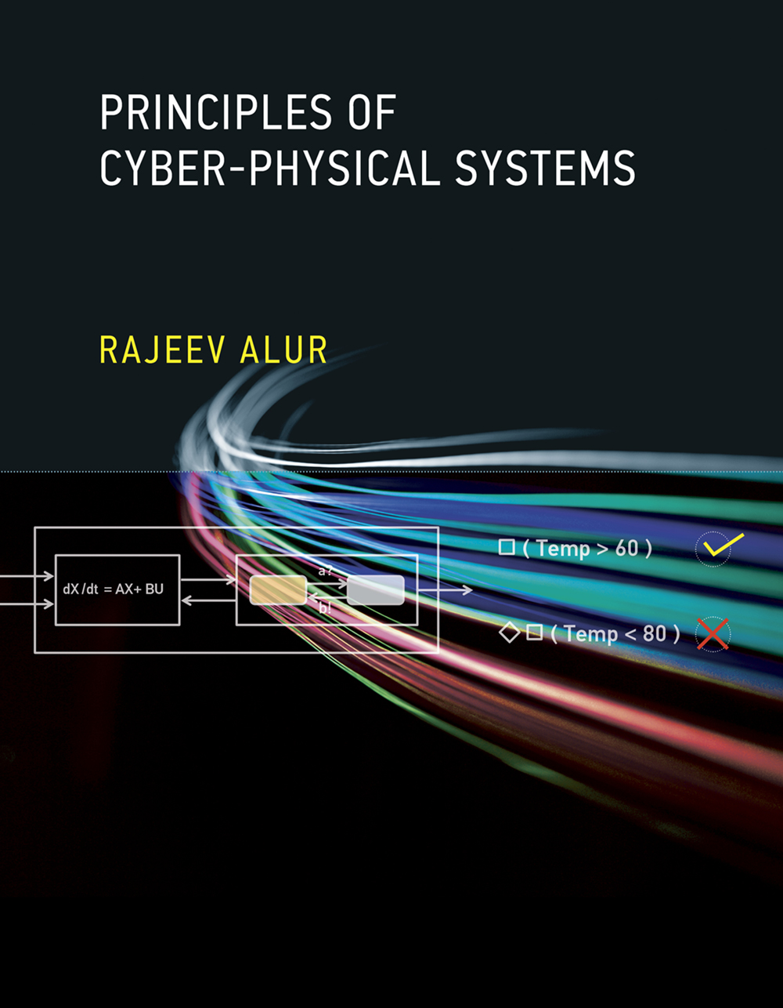
Textbook
Principles of Cyber-Physical Systems by Rajeev Alur
$56-63 on Amazon
Free e-book available on USC libraries

Slide 16
Office Hours, Class Timings
Class Timing: 3:30-5:20
First 5 mins: recap of last lecture + outline of this lecture + announcements
Last 10 mins: optional questions, discussions, etc.
Let’s take a 5 min break at 4:30!
Office Hours: Tuesday, Thursday, 11:00am-1:00pm, SAL 340, or by appointment.
TA: Probably none, but I will keep you posted

Slide 17
Introductions …
What’s your background?
Why did you feel like taking this course?
What do you expect to get out of it?
Exposure to Matlab/Simulink/Control Theory?
One fun fact about you.

Slide 18
Questions?

