Slide 1
Autonomous Cyber-Physical Systems: Design and Analysis of Hybrid Systems
Spring 2018. CS 599.
Instructor: Jyo Deshmukh
Acknowledgment: Some of the material in these slides is based on the lecture slides for CIS 540: Principles of Embedded Computation taught by Rajeev Alur at the University of Pennsylvania. http://www.seas.upenn.edu/~cis540/
This lecture also uses some other sources, full bibliography is included at the end of the slides.

Slide 2
Layout
Hybrid Systems Background
Hybrid Process Formalization
Stability analysis for hybrid systems
Reachability analysis for hybrid systems
Hybrid Systems applications
Model-based Design V
Obstacle-avoidance for robots

Slide 3

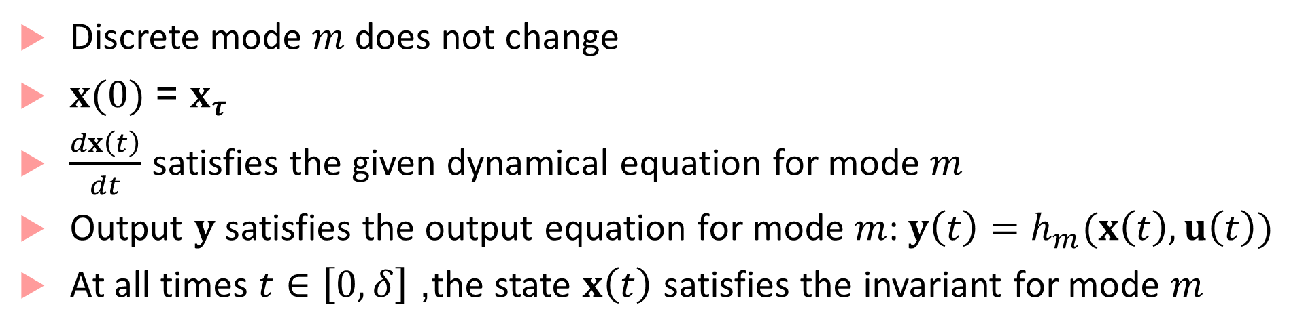



Hybrid Process
Inputs, Outputs, States (both continuous and discrete), Internal actions, input and output actions exactly like the asynchronous model
Continuous action/transition:
$$u(t)/y(t)$$
$$(m,x_{ τ})$$
$$\left(m,x\left(t+δ\right)\right)$$
Discrete mode $m$does not change
$x(0)$ = $x_{τ}$
$\frac{dx\left(t\right)}{dt}$ satisfies the given dynamical equation for mode $m$
Output $y$ satisfies the output equation for mode $m$: $y\left(t\right)=h_{m}(x\left(t\right),u\left(t\right))$
At all times $t∈\left[0,δ\right]$, the state $x\left(t\right)$ satisfies the invariant for mode $m$
$$δ$$

Slide 4

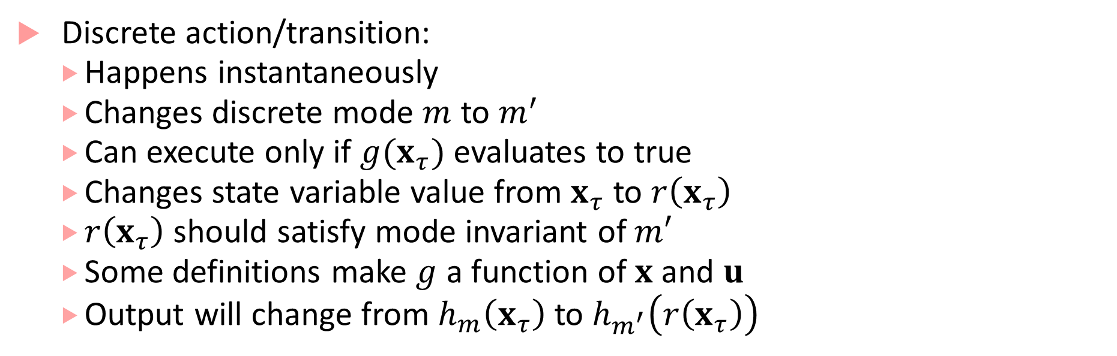
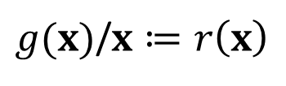

Hybrid Process
$g(x)$/$x≔r\left(x\right)$
Discrete action/transition:
Happens instantaneously
Changes discrete mode $m$ to $m^{′}$
Can execute only if $g(x_{τ})$ evaluates to true
Changes state variable value from $x_{τ}$ to $r\left(x_{τ}\right)$
$r\left(x_{τ}\right)$ should satisfy mode invariant of $m′$
Some definitions make $g$ a function of $x$ and $u$
Output will change from $h_{m}\left(x_{τ}\right)$ to $h_{m^{′}}\left(r\left(x_{τ}\right)\right)$
$$(m,x_{ τ})$$
$$\left(m′,r\left(x_{τ}\right)\right)$$

Slide 5



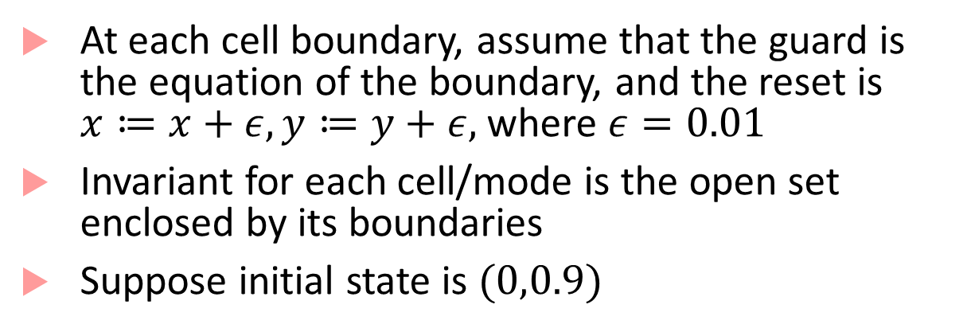



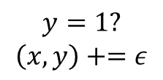


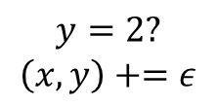









Executions of a hybrid process
At each cell boundary, assume that the guard is the equation of the boundary, and the reset is $x≔x+ε, y≔y+ε,$ where $ε=0.01$
Invariant for each cell/mode is the open set enclosed by its boundaries
Suppose initial state is $(0,0.9)$
(0,3)
$$m_{3}$$
$$m_{4}$$
$$m_{9}$$
$$\dot{x}=1$$ $$\dot{y}=0.5$$ | $$\dot{x}=1$$ $$\dot{y}=−1$$ | $$\dot{x}=0$$ $$\dot{y}=0$$
$$\dot{x}=0$$ $$\dot{y}=1$$ | $$\dot{x}=−1$$ $$\dot{y}=−1$$ | $$\dot{x}=0.5$$ $$\dot{y}=1$$
$$\dot{x}=1$$ $$\dot{y}=1$$ | $$\dot{x}=1$$ $$\dot{y}=0.5$$ | $$\dot{x}=0.5$$ $$\dot{y}=1$$
(0,2)
$$m_{2}$$
$$m_{5}$$
$$m_{8}$$
(0,1)
$$m_{1}$$
$$m_{6}$$
$$m_{7}$$
$$y=1?$$
$$\left(x,y\right)+=ε$$
$$(m_{1},0,0.9)$$
$$\left(m_{1},0.1,1\right)$$
$$\left(m_{2},0.11,1.01\right)$$
$$0.1\sqrt{2}$$
$$y=2?$$
$$\left(x,y\right)+=ε$$
(0,0)
(1,0)
(2,0)
(3,0)
$$0.99$$
$$\left(m_{3},0.12,2.01\right)$$
$$\left(m_{2},0.11,2\right)$$

Slide 6
Stability of hybrid systems
Hybrid systems can have surprising results with respect to stability
No uniform method like Lyapunov analysis for analyzing all hybrid systems
Example: Piecewise Linear (PWL) Dynamical System
Special class of hybrid system, in which each mode has linear dynamics, guards, resets are all linear/affine
Each mode in the PWL system can have stable dynamics (by doing eigen-value analysis), but resulting hybrid system may be unstable!

Slide 7
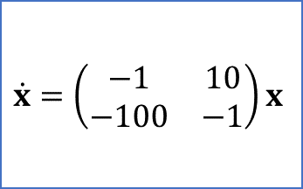
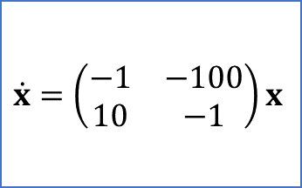


Example
$$x_{2}=−0.2x_{1} ?$$
$$\dot{x}=\left(\begin{matrix}−1 & −100 \\ 10 & −1\end{matrix}\right)x$$
$$\dot{x}=\left(\begin{matrix}−1 & 10 \\ −100 & −1\end{matrix}\right)x$$
$$x_{2}=5x_{1} ?$$
Dynamics in each mode are stable!

Slide 8




Simulation results
$$x_{2}$$
$$x_{2}=5x_{1}$$
$$x_{2}=−0.2x_{1}$$
Initial State
$$x_{1}$$

Slide 9
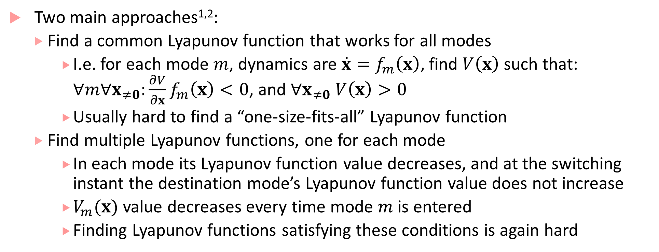
Stability analysis for hybrid systems
Two main approaches^{1,2}:
Find a common Lyapunov function that works for all modes
I.e. for each mode $m$, dynamics are $\dot{x}=f_{m}\left(x\right)$, find $V\left(x\right)$ such that: $∀m∀x_{≠0}:\frac{∂V}{∂x}f_{m}\left(x\right)<0$, and $∀x_{≠0} V\left(x\right)>0$
Usually hard to find a “one-size-fits-all” Lyapunov function
Find multiple Lyapunov functions, one for each mode
In each mode its Lyapunov function value decreases, and at the switching instant the destination mode’s Lyapunov function value does not increase
$V_{m}(x)$ value decreases every time mode $m$ is entered
Finding Lyapunov functions satisfying these conditions is again hard

Slide 10

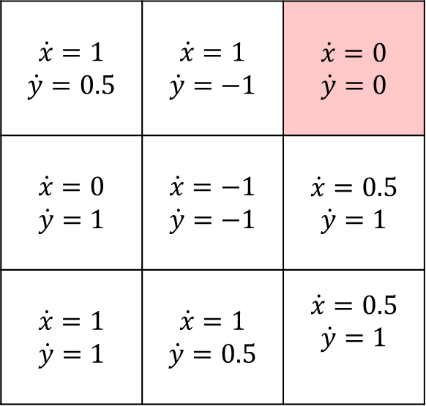

Reachability analysis
Suppose the grid world represents the configuration space of a robot
How do we analyze: Does the robot reach the error cell?
Easy if we have only one initial state: just simulate!
What if the initial position of the robot is not certain (could be a set)?
What if the dynamics are not certain?
(0,3)
$$m_{3}$$
$$m_{4}$$
$$error$$
$$\dot{x}=1$$ $$\dot{y}=0.5$$ | $$\dot{x}=1$$ $$\dot{y}=−1$$ | $$\dot{x}=0$$ $$\dot{y}=0$$
$$\dot{x}=0$$ $$\dot{y}=1$$ | $$\dot{x}=−1$$ $$\dot{y}=−1$$ | $$\dot{x}=0.5$$ $$\dot{y}=1$$
$$\dot{x}=1$$ $$\dot{y}=1$$ | $$\dot{x}=1$$ $$\dot{y}=0.5$$ | $$\dot{x}=0.5$$ $$\dot{y}=1$$
(0,2)
$$m_{2}$$
$$m_{5}$$
$$m_{8}$$
(0,1)
$$m_{1}$$
$$m_{6}$$
$$m_{7}$$
(0,0)
(1,0)
(2,0)
(3,0)
Initial states

Slide 11
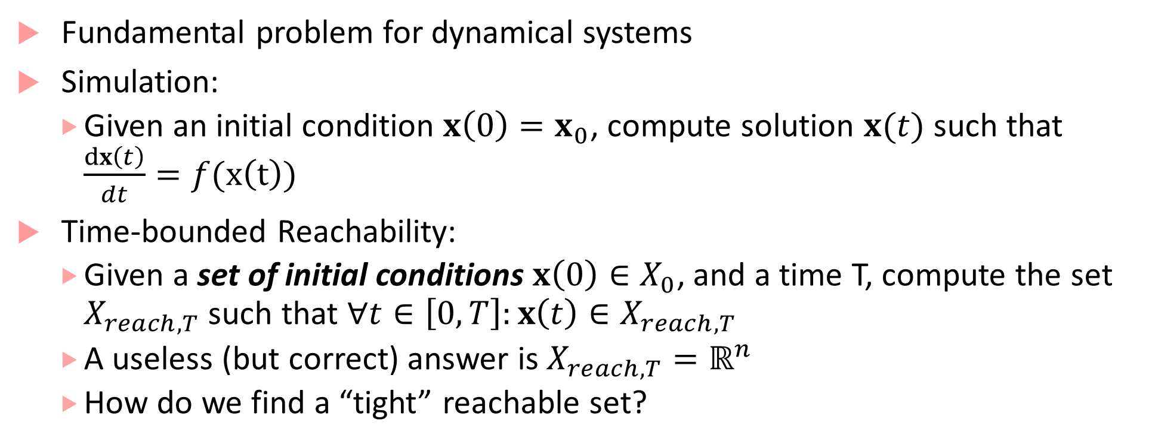
Time-bounded Reachability Analysis
Fundamental problem for dynamical systems
Simulation:
Given an initial condition $x\left(0\right)=x_{0}$, compute solution $x(t)$ such that $\frac{dx\left(t\right)}{dt}=f(x\left(t\right))$
Time-bounded Reachability:
Given a set of initial conditions $x\left(0\right)∈X_{0}$, and a time T, compute the set $X_{reach,T}$ such that $∀t∈\left[0,T\right]:x\left(t\right)∈X_{reach,T}$
A useless (but correct) answer is $X_{reach,T}=ℝ^{n}$
How do we find a “tight” reachable set?

Slide 12
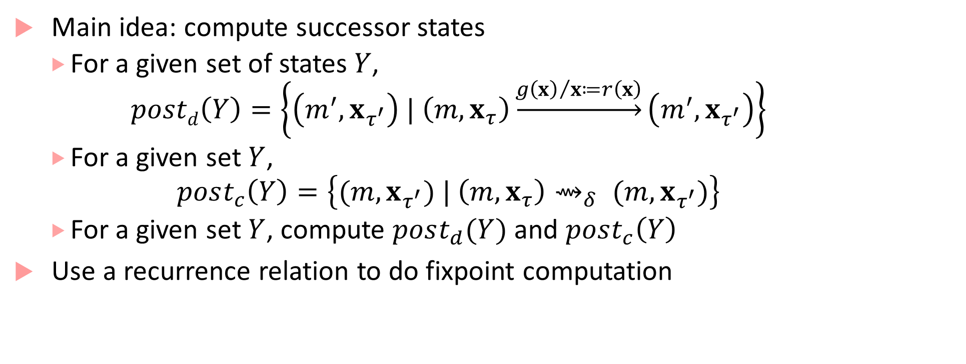
Computing Reachable Sets³
Main idea: compute successor states
For a given set of states$Y$,
$$postd\left(Y\right)=\left\{\left(m^{′},x_{τ^{′}}\right) | \left(m,x_{τ}\right)\underset{→}{{g\left(x\right)}/{x≔r\left(x\right)}}\left(m^{′},x_{τ^{′}}\right)\right\}$$
For a given set $Y$,
$$post_{c}\left(Y\right)=\left\{(m,x_{τ^{′}}) | \left(m,x_{τ}\right){\text{⇝}}_{δ} (m,x_{τ^{′}})\right\}$$
For a given set $Y$, compute $post_{d}(Y)$ and $post_{c}\left(Y\right)$
Use a recurrence relation to do fixpoint computation

Slide 13
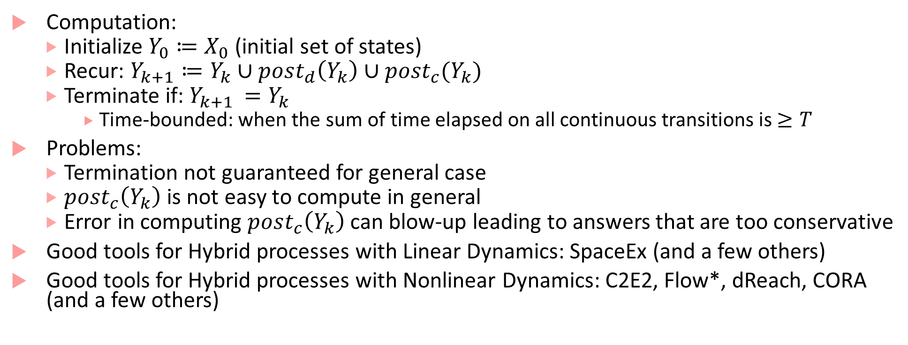
Fixpoint computation of reachable states
Computation:
Initialize $Y_{0}≔X_{0}$ (initial set of states)
Recur: $Y_{k+1}≔Y_{k}∪post_{d}\left(Y_{k}\right)∪post_{c}(Y_{k})$
Terminate if: $Y_{k+1 }=Y_{k}$
Time-bounded: when the sum of time elapsed on all continuous transitions is $≥T$
Problems:
Termination not guaranteed for general case
$post_{c}\left(Y_{k}\right)$ is not easy to compute in general
Error in computing $post_{c}\left(Y_{k}\right)$ can blow-up leading to answers that are too conservative
Good tools for Hybrid processes with Linear Dynamics: SpaceEx (and a few others)
Good tools for Hybrid processes with Nonlinear Dynamics: C2E2, Flow*, dReach, CORA (and a few others)

Slide 14
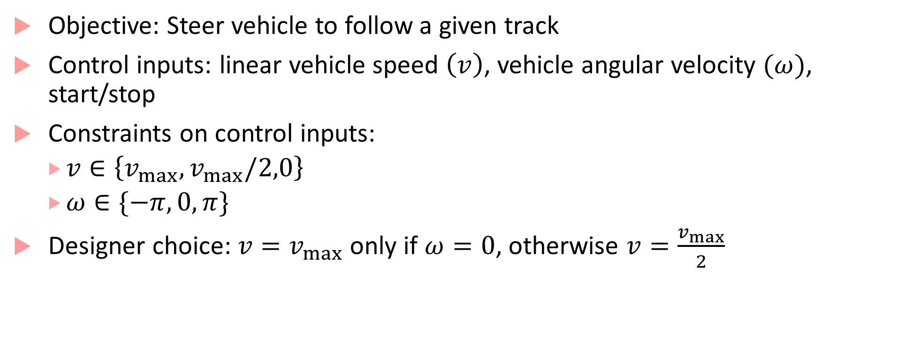
Design Application: Autonomous Guided Vehicle
Objective: Steer vehicle to follow a given track
Control inputs: linear vehicle speed $\left(v\right)$, vehicle angular velocity $(ω)$, start/stop
Constraints on control inputs:
$v∈\left\{v_{max}, v_{max}/2,0\right\}$
$ω∈\{−π,0,π\}$
Designer choice: $v=v_{max}$ only if $ω=0$, otherwise $v=\frac{v_{max}}{2}$

Slide 15
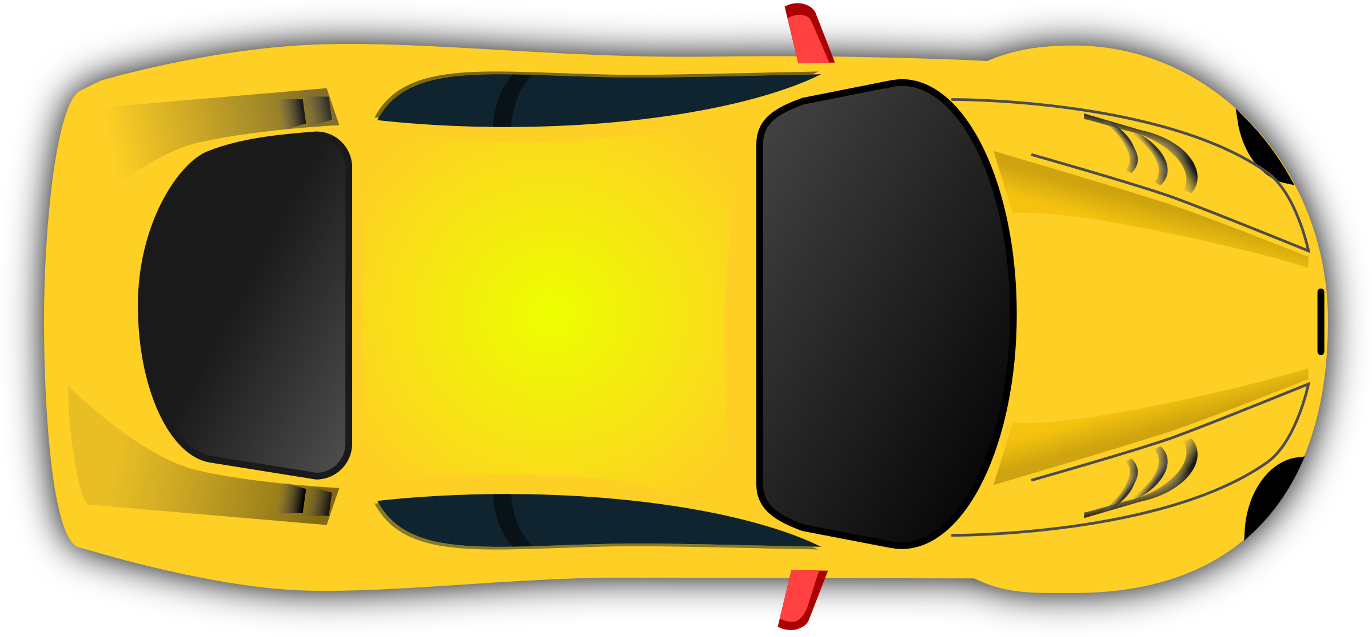
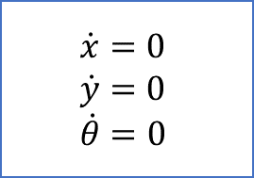

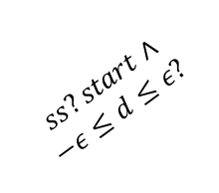

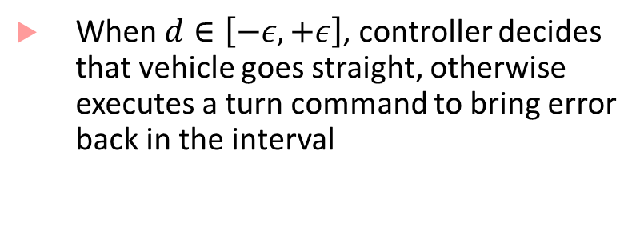
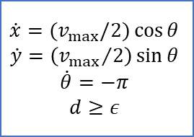

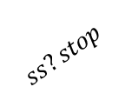






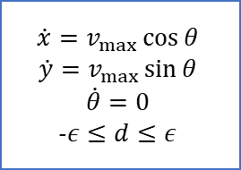


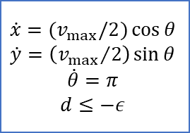

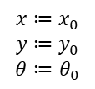
On/Off control for Path following
$$y$$
Turn right
Go straight
$$\dot{x}=(v_{max}/2)\cos{θ}$$
$$\dot{y}=\left({v_{max}}/2\right)\sin{θ}$$
$$\dot{θ}=−π$$
$$d≥ε$$
$$d≤ε?$$
$$\dot{x}=v_{max}\cos{θ}$$
$$\dot{y}=v_{max}\sin{θ}$$
$$\dot{θ}=0$$
$$-ε≤d≤ε$$
$$θ$$
$$x$$
$$d≥ε?$$
$$d$$
$$ss?start∧$$
$$d≥ε?$$
$$ss?stop$$
Track
$$ss?stop$$
$$d≤−ε?$$
$$d≥−ε?$$
$$ss?start∧$$
$$−ε≤d≤ε?$$
$$\dot{x}=0$$
$$\dot{y}=0$$
$$\dot{θ}=0$$
$$\dot{x}=(v_{max}/2)\cos{θ}$$
$$\dot{y}=\left({v_{max}}/2\right)\sin{θ}$$
$$\dot{θ}=π$$
$$d≤−ε$$
When $d∈\left[−ε,+ε\right]$, controller decides that vehicle goes straight, otherwise executes a turn command to bring error back in the interval
$$ss?stop$$
$$x≔x_{0}$$
$$y≔y_{0}$$
$$θ≔θ_{0}$$
$$ss?start∧$$
$$d≤−ε?$$
Stationary
Turn left

Slide 16
Design Application: Robot Coordination
Autonomous mobile robots in a room, goal for each robot:
Reach a target at a known location
Avoid obstacles (positions not known in advance)
Minimize distance travelled
Design Problems:
Cameras/vision systems can provide estimates of obstacle positions
When should a robot update its estimate of the obstacle position?
Robots can communicate with each other
How often and what information can they communicate?
High-level motion planning
What path in the speed/direction-space should the robots traverse?

Slide 17








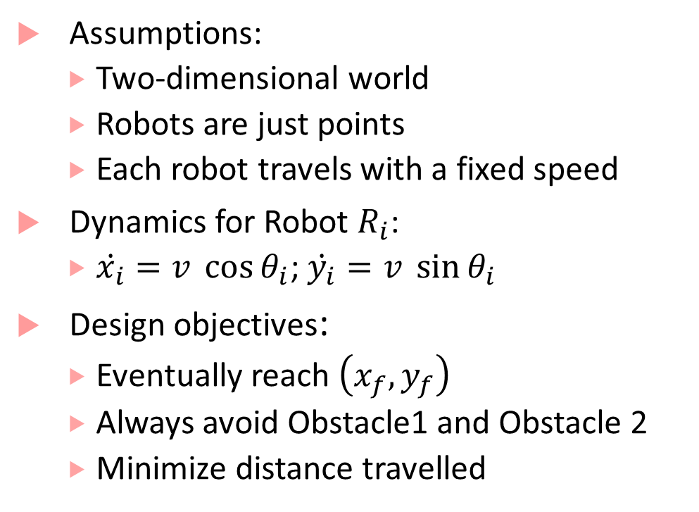



Path planning with obstacle avoidance
$$y$$
Assumptions:
Two-dimensional world
Robots are just points
Each robot travels with a fixed speed
Dynamics for Robot $R_{i}$:
$\dot{x_{i}}=v \cos{θ_{i}}$; $\dot{y_{i}}=v \sin{θ_{i}}$
Design objectives:
Eventually reach $\left(x_{f},y_{f}\right)$
Always avoid Obstacle1 and Obstacle 2
Minimize distance travelled
$$R_{2}$$
$$\left(v,θ_{2}\right)$$
Obstacle 2
$$p_{o2}=\left(x_{o2},y_{o2}\right)$$
$$p_{2}=\left(x_{2},y_{2}\right)$$
$$\left(x_{f},y_{f}\right)$$
Goal
Obstacle 1
$$R_{1}$$
$$p_{o1}=\left(x_{o1},y_{o1}\right)$$
$$\left(v,θ_{1}\right)$$
$$p_{1}=\left(x_{1},y_{1}\right)$$
$$x$$

Slide 18
Divide path/motion planning into two parts
Computer vision tasks
Actual path planning task
Assume computer vision algorithm identifies obstacles, and labels them with some easy-to-represent geometric shape (such as a bounding boxes)
In this example, we will assume a sonar-based sensor, so we will use circles
Assuming the vision algorithm is correct, do path planning based on the estimated shapes of obstacles
Design challenge:
Estimate of obstacle shape is not the smallest shape containing the obstacle
Shape estimate varies based on distance from obstacle

Slide 19
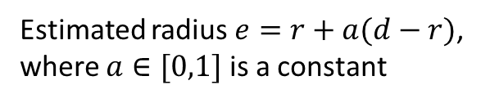


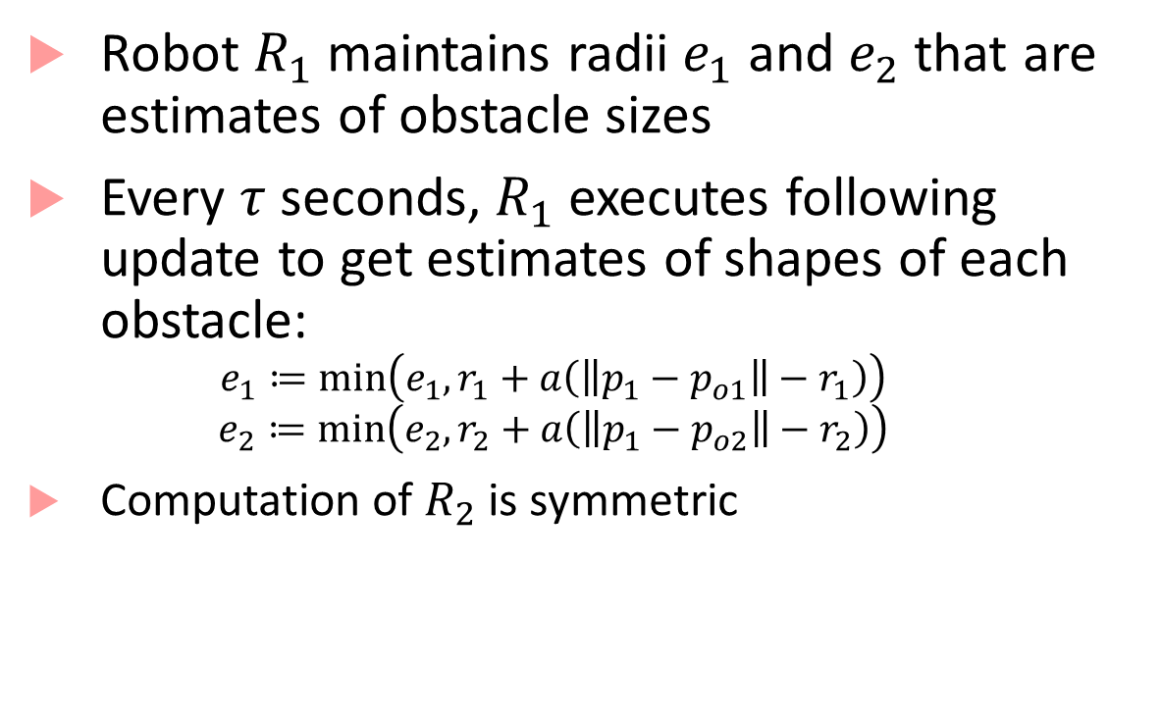




Estimation error
$$p_{o1}=\left(x_{o1},y_{o1}\right)$$
Robot $R_{1}$ maintains radii $e_{1}$ and $e_{2}$ that are estimates of obstacle sizes
Every $τ$ seconds, $R_{1}$ executes following update to get estimates of shapes of each obstacle:
$$e_{1}≔\min\left(e_{1}, r_{1}+a\left(\left\|p_{1}−p_{o1}\right\|−r_{1}\right)\right)$$
$$e_{2}≔\min\left(e_{2}, r_{2}+a\left(\left\|p_{1}−p_{o2}\right\|−r_{2}\right)\right)$$
Computation of $R_{2}$ is symmetric
Estimated shape
from distance $d′$
$$r_{1}$$
Estimated shape
from distance $d$
$$e^{′}$$
$$e$$
Smallest shape
bounding obstacle
Estimated radius $e=r+a(d−r)$,
where $a∈[0,1]$ is a constant

Slide 20




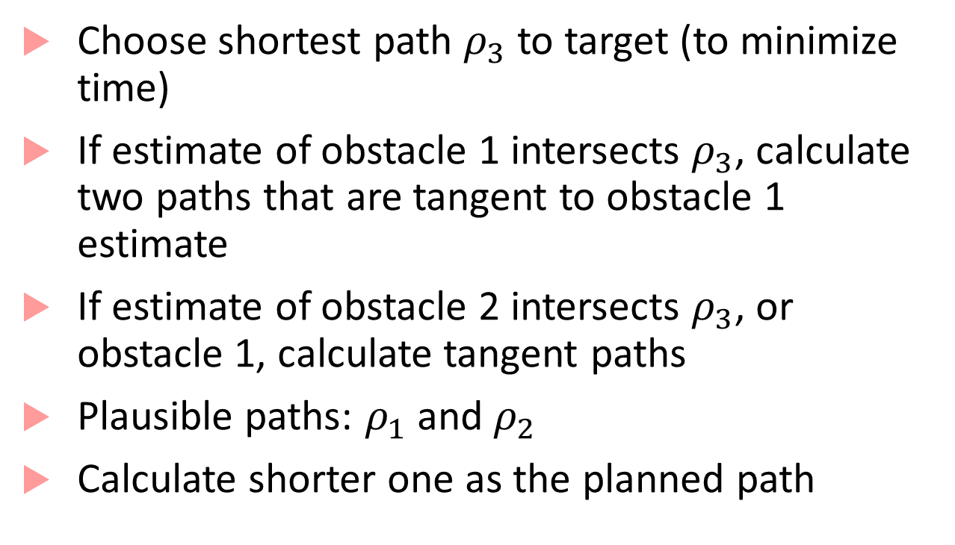






Path planning
$$y$$
Choose shortest path $ρ_{3}$ to target (to minimize time)
If estimate of obstacle 1 intersects $ρ_{3}$, calculate two paths that are tangent to obstacle 1 estimate
If estimate of obstacle 2 intersects $ρ_{3}$, or obstacle 1, calculate tangent paths
Plausible paths: $ρ_{1}$ and $ρ_{2}$
Calculate shorter one as the planned path
$$ρ_{1}$$
$$(x_{f},y_{f})$$
$$p_{o1}$$
$$ρ_{4}$$
$$ρ_{3}$$
$$p_{o2}$$
$$ρ_{2}$$
$$p_{1}$$
$$x$$

Slide 21
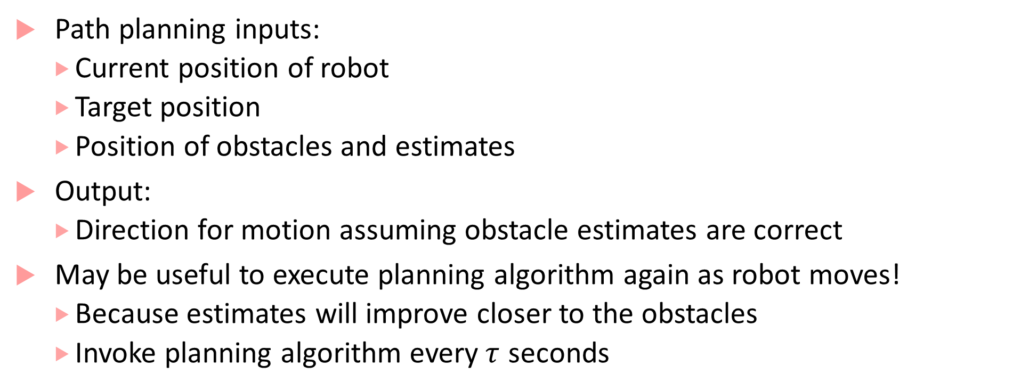
Dynamic path planning
Path planning inputs:
Current position of robot
Target position
Position of obstacles and estimates
Output:
Direction for motion assuming obstacle estimates are correct
May be useful to execute planning algorithm again as robot moves!
Because estimates will improve closer to the obstacles
Invoke planning algorithm every$τ$ seconds

Slide 22
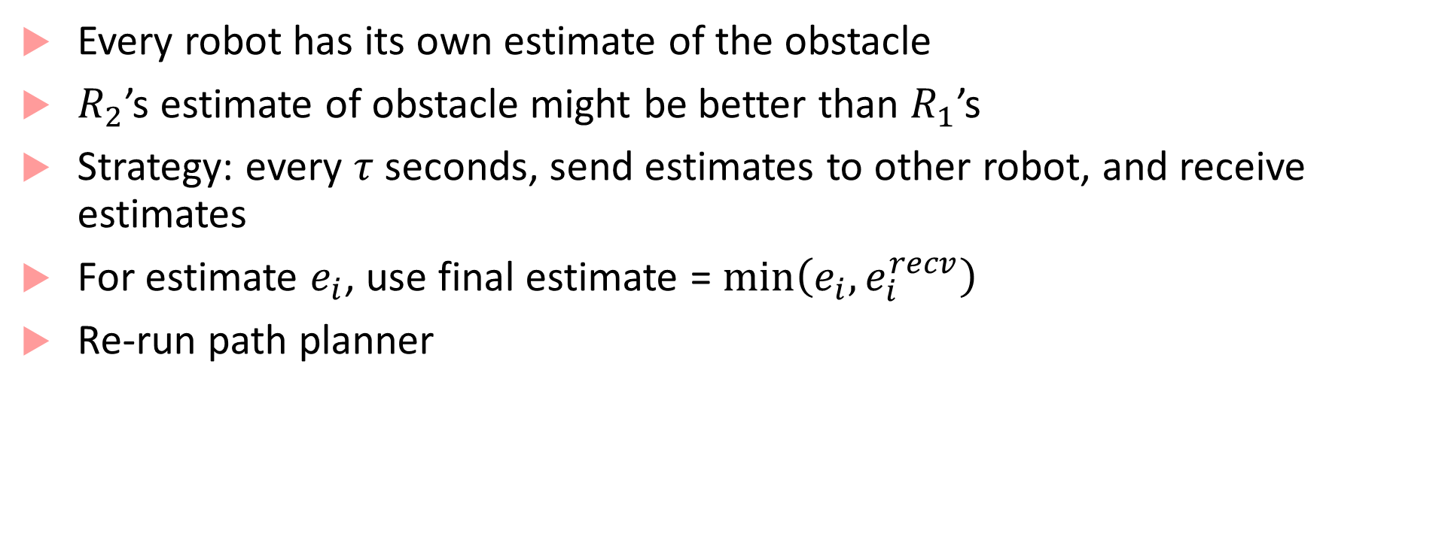
Communication improves planning
Every robot has its own estimate of the obstacle
$R_{2}$’s estimate of obstacle might be better than $R_{1}$’s
Strategy: every $τ$ seconds, send estimates to other robot, and receive estimates
For estimate $e_{i}$, use final estimate = $\min\left(e_{i},e_{i}^{recv}\right)$
Re-run path planner

Slide 23




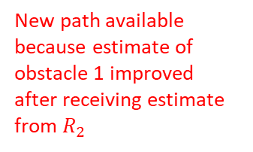















Improved path planning through communication
$$y$$
$$y$$
New path available
because estimate of obstacle 1 improved after receiving estimate from $R_{2}$
$$ρ_{1}$$
$$ρ_{1}$$
$$(x_{f},y_{f})$$
$$(x_{f},y_{f})$$
$$p_{o1}$$
$$ρ_{4}$$
$$p_{o1}$$
$$ρ_{4}^{′}$$
$$ρ_{3}$$
$$p_{1}(0)$$
$$ρ_{3}$$
$$ρ_{2}$$
$$ρ_{2}$$
$$p_{o2}$$
$$p_{o2}$$
$$p_{1}$$
$$p_{1}(τ)$$
Old path
$$x$$
$$x$$

Slide 24
Advantage of using hybrid processes
See Fig. 9.19 in book for hybrid process for a robot
Hybrid process combines computation, communication and control
Elegant machine that exemplifies the basic operation of a cyber-physical system
Allows design-space exploration through simulations and reachability analysis
We can check effect of parameter choices on the behavior of the system

Slide 25
Bibliography
H. Lin and P. J. Antsaklis, "Stability and Stabilizability of Switched Linear Systems: A Survey of Recent Results," in IEEE Transactions on Automatic Control, vol. 54, no. 2, pp. 308-322, Feb. 2009.
Branicky, Michael S. "Multiple Lyapunov functions and other analysis tools for switched and hybrid systems." IEEE Transactions on automatic control 43.4 (1998): 475-482.
Talk by Goran Frehse, pdf of slides here: http://qmc.cs.aau.dk/slides/slides-frehse.pdf
SpaceEx: http://spaceex.imag.fr/
Flow*: https://flowstar.org/
dReach: http://dreal.github.io/dReach/
CORA: http://www.i6.in.tum.de/Main/SoftwareCORA

