Slide 1
Autonomous Cyber-Physical Systems: State Estimation and Probabilistic Models
Spring 2018. CS 599.
Instructor: Jyo Deshmukh
This lecture also some sources other than the textbooks, full bibliography is included at the end of the slides.

Slide 2
Layout
Kalman Filter
Probabilistic Models
Markov Chains
Hidden Markov Models
Markov Decision Processes

Slide 3


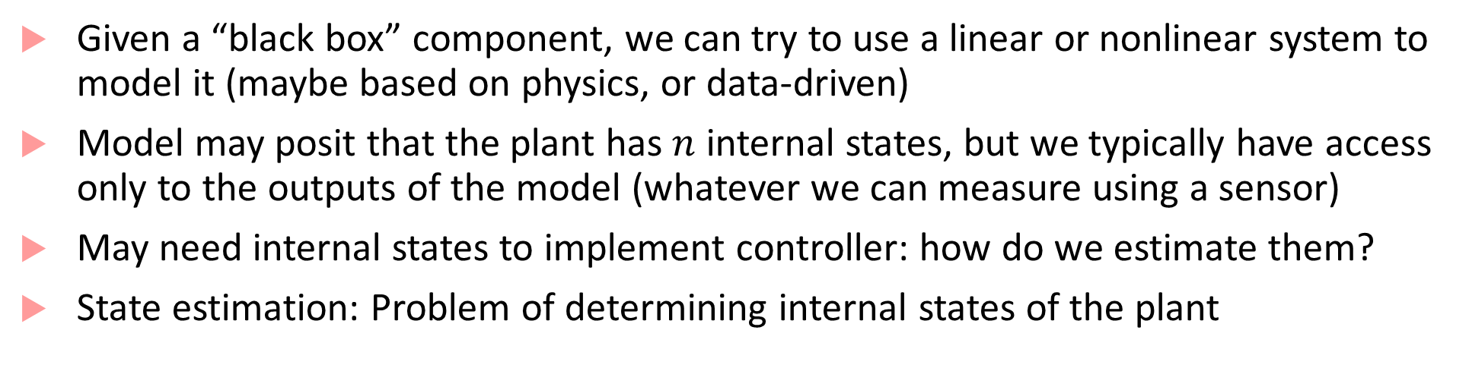
What is state estimation and why is it needed?
$$u$$
Plant
$$y$$
Given a “black box” component, we can try to use a linear or nonlinear system to model it (maybe based on physics, or data-driven)
Model may posit that the plant has $n$ internal states, but we typically have access only to the outputs of the model (whatever we can measure using a sensor)
May need internal states to implement controller: how do we estimate them?
State estimation: Problem of determining internal states of the plant

Slide 4
Deterministic vs. Noisy case
Typically sensor measurements are noisy (manufacturing imperfections, environment uncertainty, errors introduced in signal processing, etc.)
In the absence of noise, the model is deterministic: for the same input you always get the same output
Can use a simpler form of state estimator called an observer (e.g. a Luenberger observer)
In the presence of noise, we use a state estimator, such as a Kalman Filter
Kalman Filter is one of the most fundamental algorithm that you will see in autonomous systems, robotics, computer graphics, …

Slide 5
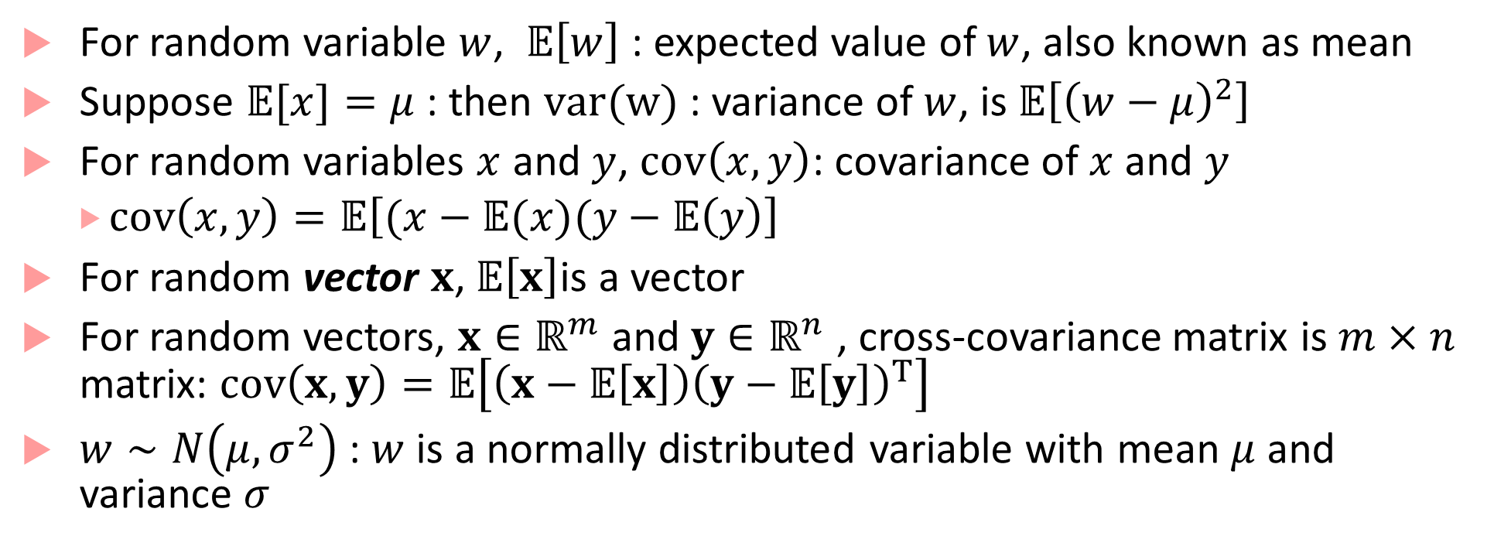
Random variables and statistics refresher
For random variable $w$, $𝔼\left[w\right]$ : expected value of $w$, also known as mean
Suppose $𝔼[x]=μ$: then $var(w)$: variance of $w$, is $𝔼\left[{\left(w−μ\right)}^{2}\right]$
For random variables $x$ and $y$, $cov\left(x,y\right)$: covariance of $x$ and $y$
$cov\left(x,y\right)=𝔼\left[(x−𝔼(x)(y−𝔼\left(y\right)\right]$
For random vector $x$, $𝔼\left[x\right]$is a vector
For random vectors, $x∈ℝ^{m}$ and $y∈ℝ^{n}$ , cross-covariance matrix is $m×n$ matrix: $cov\left(x,y\right)=𝔼\left[\left(x−𝔼\left[x\right]\right){\left(y−𝔼\left[y\right]\right)}^{T}\right]$
$w∼N\left(μ, σ^{2}\right)$ : $w$ is a normally distributed variable with mean $μ$ and variance $σ$

Slide 6
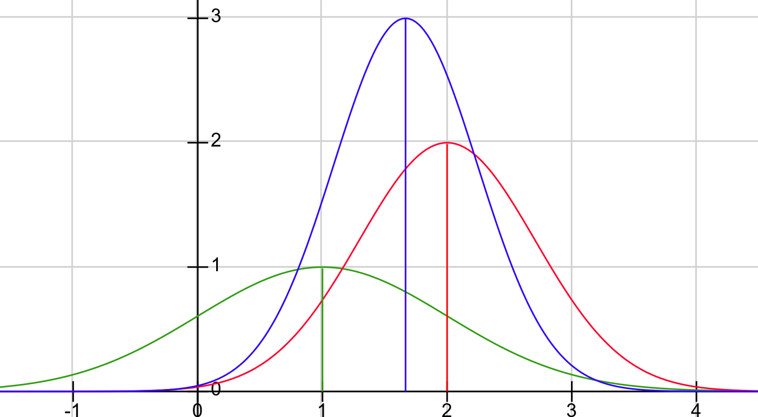


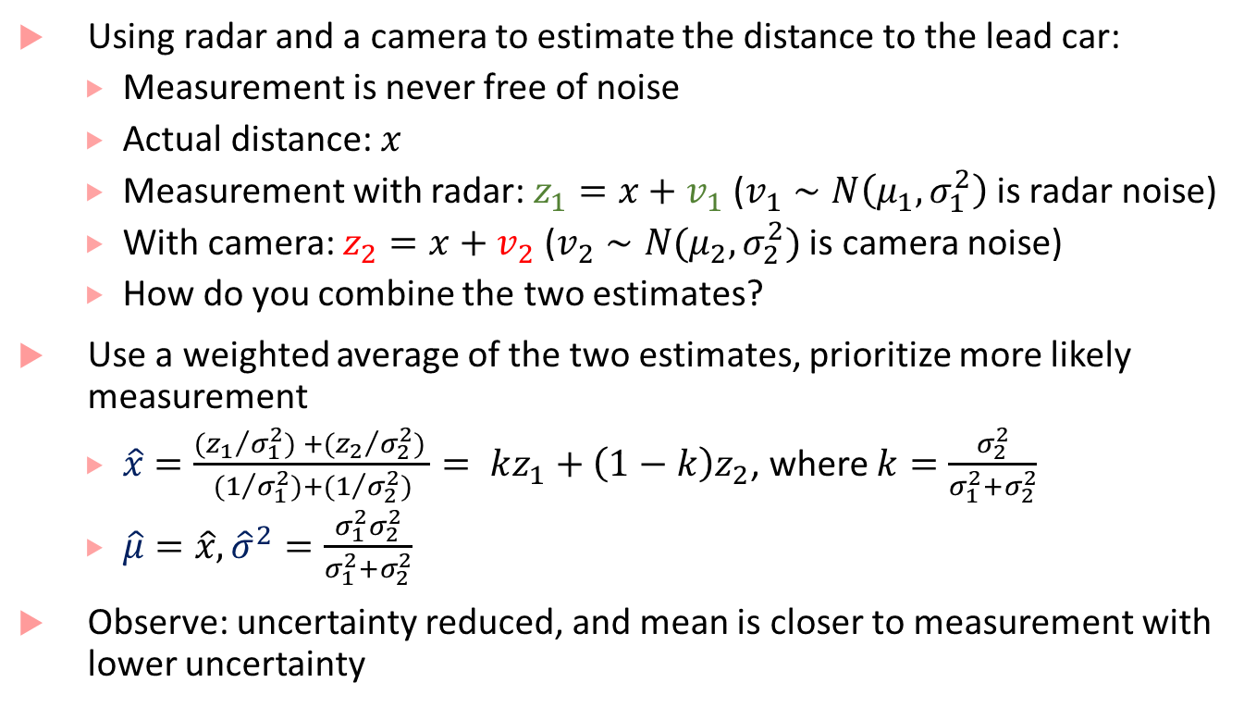




Data fusion example
Using radar and a camera to estimate the distance to the lead car:
Measurement is never free of noise
Actual distance: $x$
Measurement with radar: $z_{1}=x+v_{1}$ ($v_{1}∼N\left(μ_{1},σ_{1}^{2}\right)$ is radar noise)
With camera: $z_{2}=x+v_{2}$ ($v_{2}∼N(μ_{2},σ_{2}^{2})$ is camera noise)
How do you combine the two estimates?
Use a weighted average of the two estimates, prioritize more likely measurement
$\hat{x}=\frac{{{(z}_{1}}/{σ_{1}^{2})} +{(z_{2}}/{σ_{2}^{2})} }{{(1}/{σ_{1}^{2})}+{(1}/{σ_{2}^{2})}}= kz_{1}+\left(1−k\right)z_{2}$, where $k=\frac{σ_{2}^{2}}{σ_{1}^{2}+σ_{2}^{2}}$
$\hat{μ}=\hat{x}, {\hat{σ}}^{2}=\frac{σ_{1}^{2}σ_{2}^{2}}{σ_{1}^{2}+σ_{2}^{2}}$
Observe: uncertainty reduced, and mean is closer to measurement with lower uncertainty
$$μ_{1}=1,σ_{1}^{2}=1$$
$$μ_{2}=2,σ_{2}^{2}=0.5$$
$$\hat{μ}=1.67,σ_{2}^{2}=0.33$$
$$μ_{1}$$
$$\hat{μ}$$
$$μ_{2}$$

Slide 7
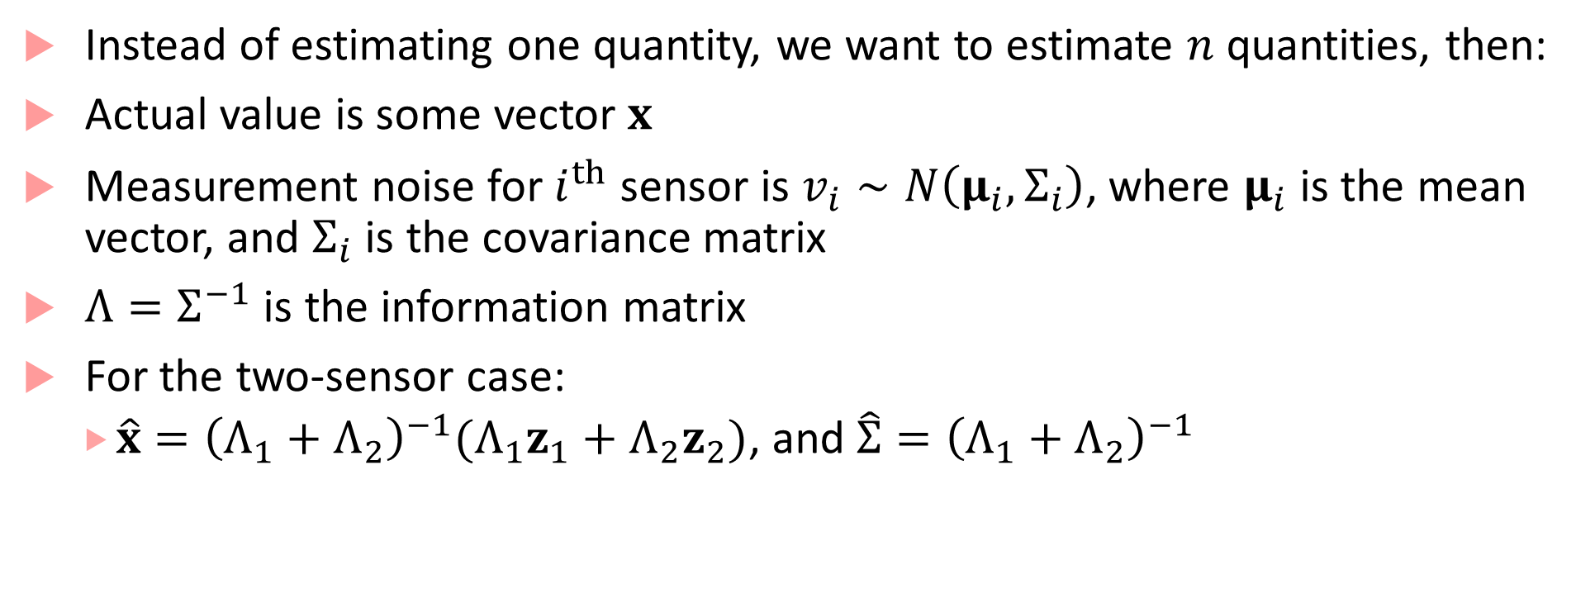
Multi-variate sensor fusion
Instead of estimating one quantity, we want to estimate $n$ quantities, then:
Actual value is some vector $x$
Measurement noise for $i^{th}$ sensor is $v_{i}∼N\left(μ_{i},Σ_{i}\right)$, where $μ_{i}$ is the mean vector, and $Σ_{i}$ is the covariance matrix
$Λ=Σ^{−1}$ is the information matrix
For the two-sensor case:
$\hat{x}={\left(Λ_{1}+Λ_{2}\right)}^{−1}{(Λ}_{1}z_{1}+Λ_{2}z_{2})$, and $\hat{Σ}={\left(Λ_{1}+Λ_{2}\right)}^{−1}$

Slide 8
Motion makes things interesting
What if we have one sensor and making repeated measurements of a moving object?
Measurement differences are not all because of sensor noise, some of it is because of object motion
Kalman filter is a tool that can include a motion model (or in general a dynamical model) to account for changes in internal state of the system
Combines idea of prediction using the system dynamics with correction using weighted average (Bayesian inference)

Slide 9
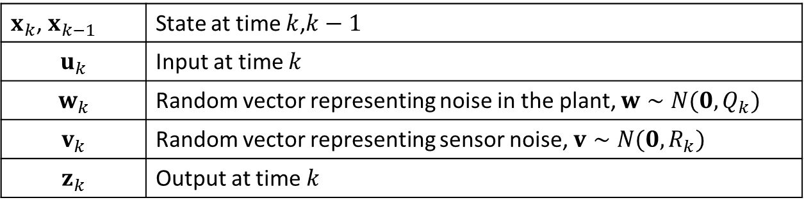
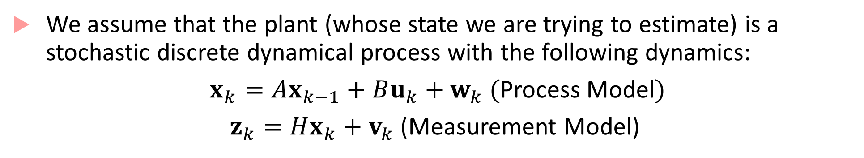
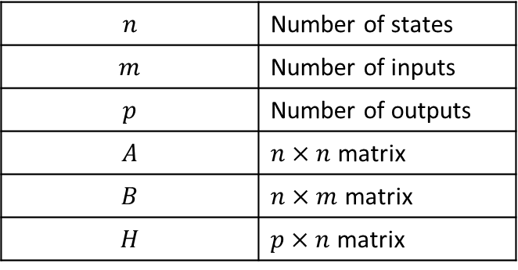
Stochastic Difference Equation Models
We assume that the plant (whose state we are trying to estimate) is a stochastic discrete dynamical process with the following dynamics:
$x_{k}=Ax_{k−1}+Bu_{k}+w_{k}$ (Process Model)
$z_{k}=Hx_{k}+v_{k}$ (Measurement Model)
$x_{k}$, $x_{k−1}$ | State at time $k$,$k−1$
$$u_{k}$$ | Input at time $k$
$$w_{k}$$ | Random vector representing noise in the plant, $w∼N(0,Q_{k})$
$$v_{k}$$ | Random vector representing sensor noise, $v∼N(0,R_{k})$
$$z_{k}$$ | Output at time $k$
$$n$$ | Number of states
$$m$$ | Number of inputs
$$p$$ | Number of outputs
$$A$$ | $n×n$ matrix
$$B$$ | $n×m$ matrix
$$H$$ | $p×n$ matrix

Slide 10
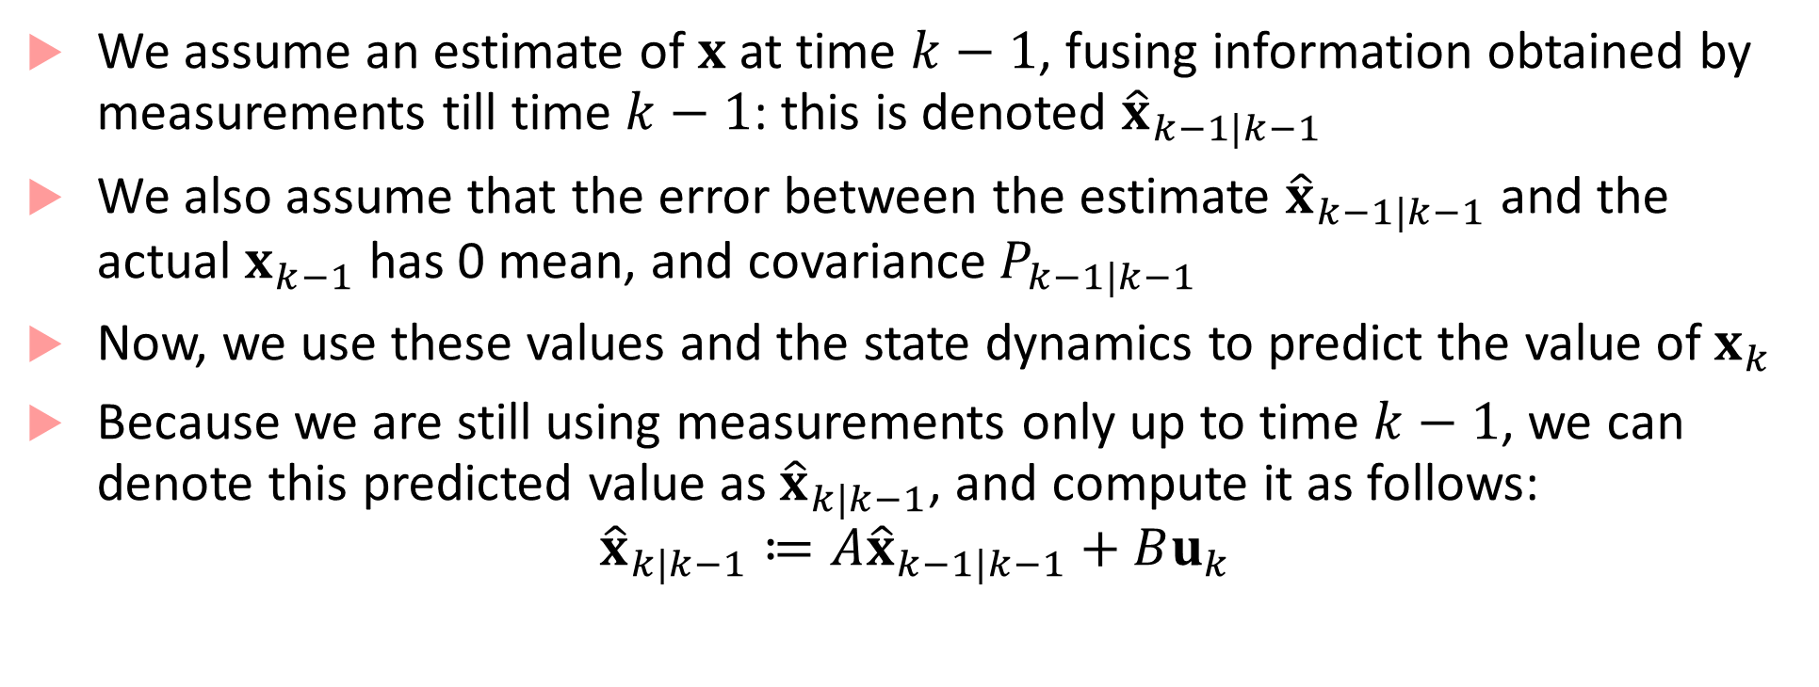
Step I: Prediction
We assume an estimate of $x$ at time $k−1$, fusing information obtained by measurements till time $k−1$: this is denoted ${\hat{x}}_{k−1|k−1}$
We also assume that the error between the estimate ${\hat{x}}_{k−1|k−1}$ and the actual $x_{k−1}$ has 0 mean, and covariance $P_{k−1|k−1}$
Now, we use these values and the state dynamics to predict the value of $x_{k}$
Because we are still using measurements only up to time $k−1$, we can denote this predicted value as ${\hat{x}}_{k|k−1}$, and compute it as follows:
$${\hat{x}}_{k|k−1}≔A{\hat{x}}_{k−1|k−1}+Bu_{k}$$

Slide 11
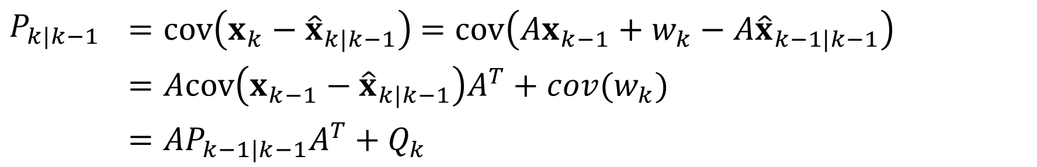
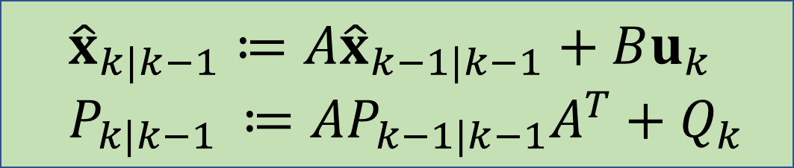
Step I: Prediction continued
We also need to update the predicted covariance between the predicted value and the “actual” value of $x_{k}$
$P_{k|k−1}$ | $=cov\left(x_{k}−{\hat{x}}_{k|k−1}\right)$ $=cov\left(Ax_{k−1}+w_{k}−A{\hat{x}}_{k−1|k−1}\right)$
 | $$=Acov\left(x_{k−1}−{\hat{x}}_{k|k−1}\right)A^{T}+cov(w_{k})$$
 | $$=AP_{k−1|k−1}A^{T}+Q_{k}$$
Thus, the a priori estimated state and error covariance are:
$${\hat{x}}_{k|k−1}≔A{\hat{x}}_{k−1|k−1}+Bu_{k}$$
$$P_{k|k−1 }≔AP_{k−1|k−1}A^{T}+Q_{k}$$

Slide 12
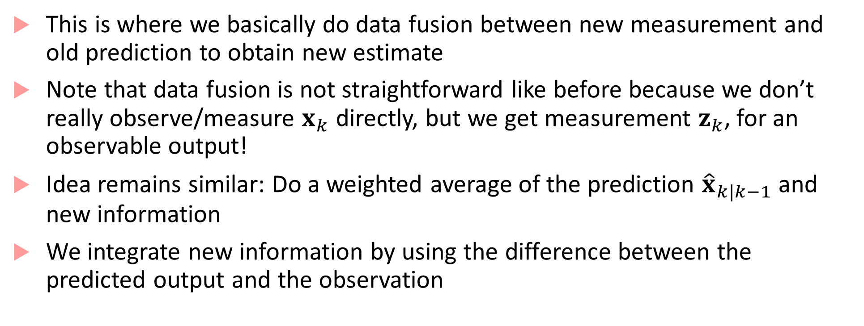
Step II: Correction
This is where we basically do data fusion between new measurement and old prediction to obtain new estimate
Note that data fusion is not straightforward like before because we don’t really observe/measure $x_{k}$ directly, but we get measurement $z_{k}$, for an observable output!
Idea remains similar: Do a weighted average of the prediction ${\hat{x}}_{k|k−1}$ and new information
We integrate new information by using the difference between the predicted output and the observation

Slide 13
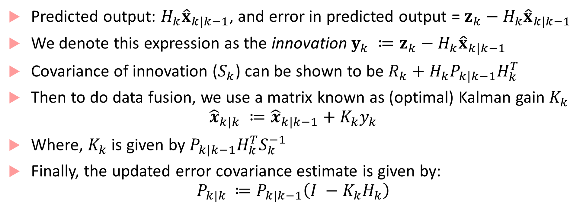
Step II: Correction continued
Predicted output: $H_{k}{\hat{x}}_{k|k−1}$, and error in predicted output = $z_{k}−H_{k}{\hat{x}}_{k|k−1}$
We denote this expression as the innovation $y_{k} ≔z_{k}−H_{k}{\hat{x}}_{k|k−1}$
Covariance of innovation ($S_{k}$) can be shown to be $R_{k}+H_{k}P_{k|k−1}H_{k}^{T}$
Then to do data fusion, we use a matrix known as (optimal) Kalman gain $K_{k}$
$${\hat{x}}_{k|k} ≔{\hat{x}}_{k|k−1}+K_{k}y_{k}$$
Where, $K_{k}$ is given by $P_{k|k−1}H_{k}^{T}S_{k}^{−1}$
Finally, the updated error covariance estimate is given by:
$$P_{k|k }≔P_{k|k−1}\left(I −K_{k}H_{k}\right)$$

Slide 14
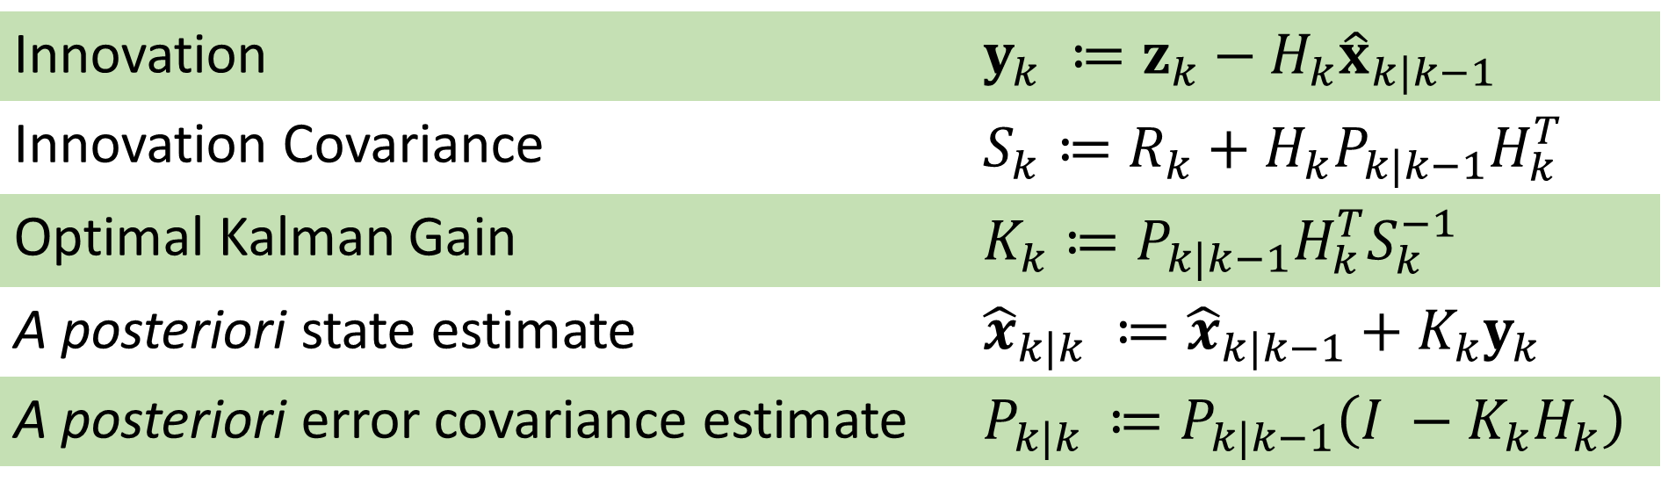
Correction step summary
Innovation | $$y_{k} ≔z_{k}−H_{k}{\hat{x}}_{k|k−1}$$
Innovation Covariance | $$S_{k}≔R_{k}+H_{k}P_{k|k−1}H_{k}^{T}$$
Optimal Kalman Gain | $$K_{k}≔P_{k|k−1}H_{k}^{T}S_{k}^{−1}$$
A posteriori state estimate | $${\hat{x}}_{k|k} ≔{\hat{x}}_{k|k−1}+K_{k}y_{k}$$
A posteriori error covariance estimate | $$P_{k|k }≔P_{k|k−1}\left(I −K_{k}H_{k}\right)$$

Slide 15
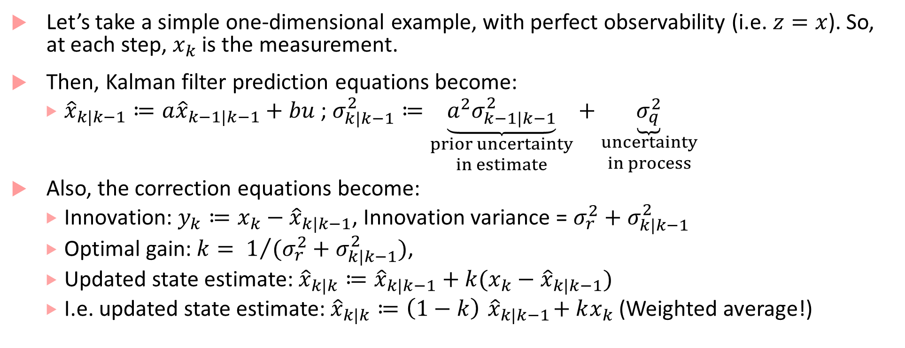
What are all these equations? How to make sense?
Let’s take a simple one-dimensional example, with perfect observability (i.e. $z=x$). So, at each step, $x_{k}$ is the measurement.
Then, Kalman filter prediction equations become:
${\hat{x}}_{k|k−1}≔a{\hat{x}}_{k−1|k−1}+bu$ ; $σ_{k|k−1}^{2}≔\underset{\begin{aligned}prior uncertainty \\ in estimate\end{aligned}}{\underbrace{a^{2}σ_{k−1|k−1}^{2}}}+\underset{\begin{aligned}uncertainty \\ in process\end{aligned}}{\underbrace{σ_{q}^{2}}}$
Also, the correction equations become:
Innovation: $y_{k}≔x_{k}−{\hat{x}}_{k|k−1}$, Innovation variance = $σ_{r}^{2}+σ_{k|k−1}^{2}$
Optimal gain: $k= 1/{(σ_{r}^{2}+σ_{k|k−1}^{2}})$,
Updated state estimate: ${\hat{x}}_{k|k}≔{\hat{x}}_{k|k−1}+k(x_{k}−{\hat{x}}_{k|k−1})$
I.e. updated state estimate: ${\hat{x}}_{k|k}≔\left(1−k\right){ \hat{x}}_{k|k−1}+kx_{k}$ (Weighted average!)

Slide 16
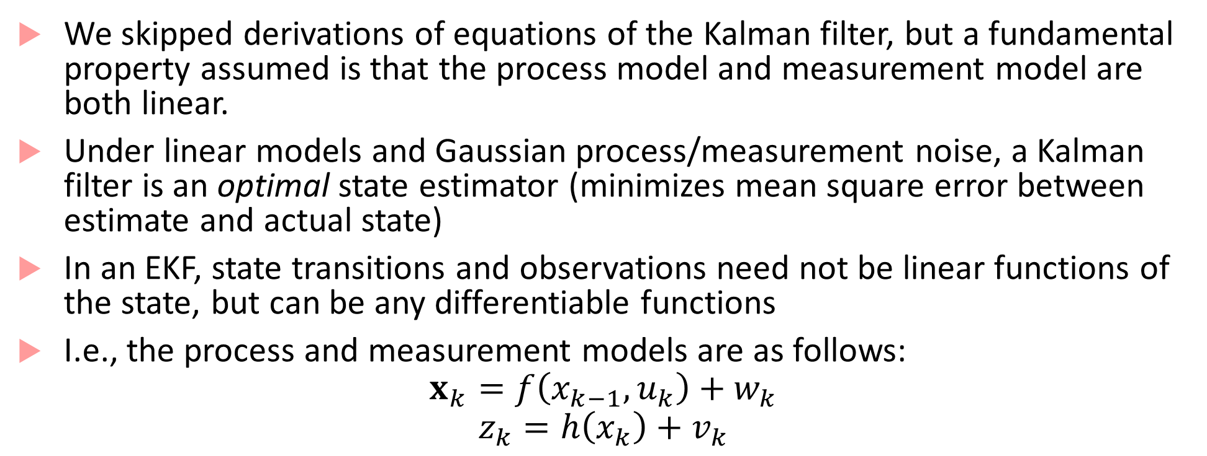
Extended Kalman Filter
We skipped derivations of equations of the Kalman filter, but a fundamental property assumed is that the process model and measurement model are both linear.
Under linear models and Gaussian process/measurement noise, a Kalman filter is an optimal state estimator (minimizes mean square error between estimate and actual state)
In an EKF, state transitions and observations need not be linear functions of the state, but can be any differentiable functions
I.e., the process and measurement models are as follows:
$$x_{k}=f\left(x_{k−1},u_{k}\right)+w_{k}$$
$$z_{k}=h\left(x_{k}\right)+v_{k}$$

Slide 17
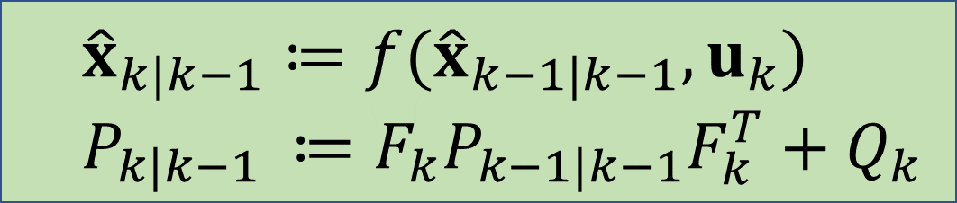
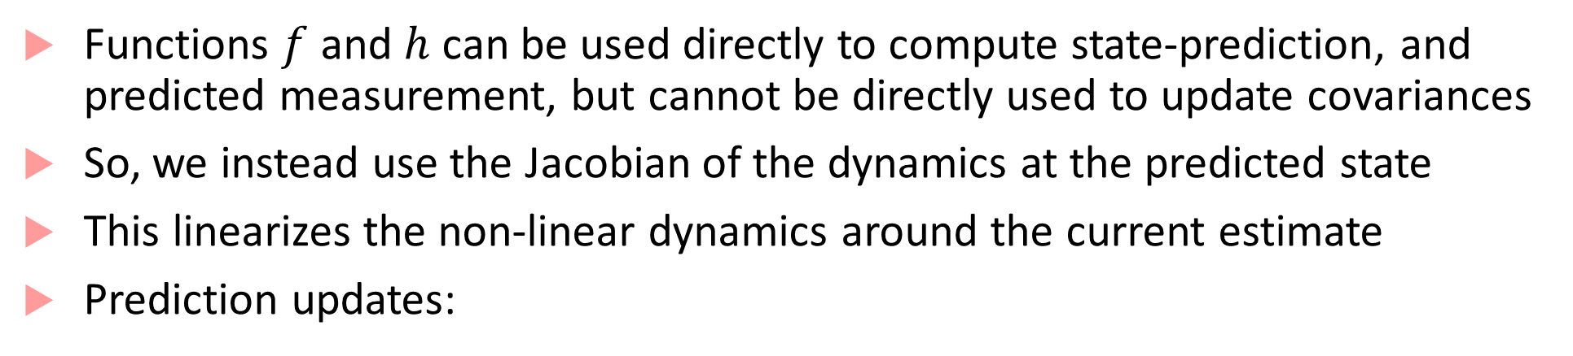
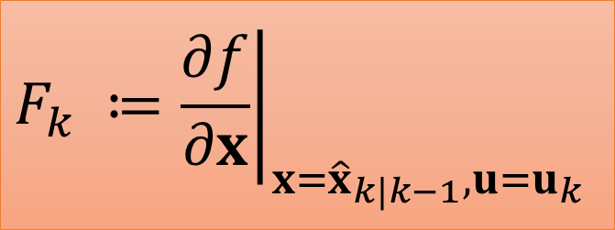
EKF updates
Functions $f$ and $h$ can be used directly to compute state-prediction, and predicted measurement, but cannot be directly used to update covariances
So, we instead use the Jacobian of the dynamics at the predicted state
This linearizes the non-linear dynamics around the current estimate
Prediction updates:
$${\hat{x}}_{k|k−1}≔f({\hat{x}}_{k−1|k−1},u_{k})$$
$$P_{k|k−1 }≔F_{k}P_{k−1|k−1}F_{k}^{T}+Q_{k}$$
$$F_{k} ≔{\left.\frac{∂f}{∂x}\right|}_{x={\hat{x}}_{k|k−1},u=u_{k}}$$

Slide 18

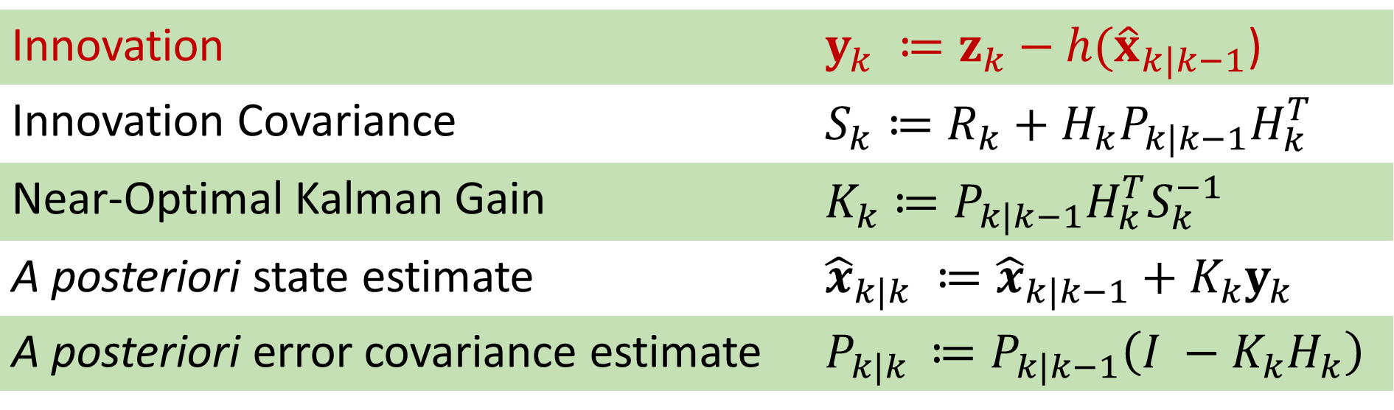
EKF updates continued
$$H_{k} ≔{\left.\frac{∂h}{∂x}\right|}_{x={\hat{x}}_{k|k−1} }$$
Correction updates
Innovation | $y_{k} ≔z_{k}−h({\hat{x}}_{k|k−1}$)
Innovation Covariance | $$S_{k}≔R_{k}+H_{k}P_{k|k−1}H_{k}^{T}$$
Near-Optimal Kalman Gain | $$K_{k}≔P_{k|k−1}H_{k}^{T}S_{k}^{−1}$$
A posteriori state estimate | $${\hat{x}}_{k|k} ≔{\hat{x}}_{k|k−1}+K_{k}y_{k}$$
A posteriori error covariance estimate | $$P_{k|k }≔P_{k|k−1}\left(I −K_{k}H_{k}\right)$$

Slide 19
EKF drawbacks
EKF is not in general an optimal estimator
If initial state estimate is wrong filter may diverge quickly : estimates will no longer agree with reality/observations
Estimated covariance matrix tends to underestimate true covariance
Yet, EKF remains widely used! GPS, most navigation systems, Openpilot (for drones), Pixhawk (mobile robots), etc.
EKF in practice requires lot of “expert tuning of parameters”
Most parameters occur in process models, covariance matrices, gains etc.
EKF improvement: Unscented Kalman Filter

Slide 20
Probabilistic Models
Models for components that we studied so far were either deterministic or nondeterministic.
The goal of such models is to represent computation or time-evolution of a physical phenomenon.
These models do not do a great job of capturing uncertainty.
We can usually model uncertainty using probabilities, so probabilistic models allow us to account for likelihood of environment behaviors
Machine learning/AI algorithms also require probabilistic modelling!

Slide 21
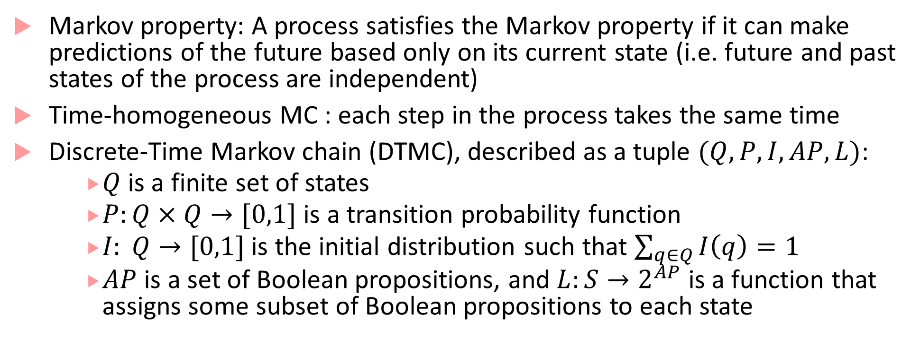
Markov chains
Markov property: A process satisfies the Markov property if it can make predictions of the future based only on its current state (i.e. future and past states of the process are independent)
Time-homogeneous MC : each step in the process takes the same time
Discrete-Time Markov chain (DTMC), described as a tuple $(Q, P,I,AP,L)$:
$Q$is a finite set of states
$P:Q×Q→[0,1]$ is a transition probability function
$I: Q→[0,1]$ is the initial distribution such that $\sum_{q∈Q}{I\left(q\right)}=1$
$AP$ is a set of Boolean propositions, and $L:S→2^{AP}$ is a function that assigns some subset of Boolean propositions to each state

Slide 22


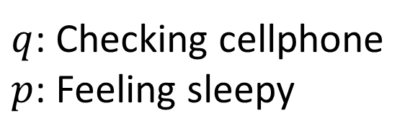


Example of a Markov chain
0
0
0.3
$$p, q$$
0.1
0.4
$$¬p,¬q$$
Accelerate
Constant Speed
0.2
$q$: Checking cellphone
$p$: Feeling sleepy
0
0.5
0.5
0.8
0.05
0.4
Idling
Brake
$$p,q$$
0.5
$$¬p,q$$
0.05
0.2
1

Slide 23
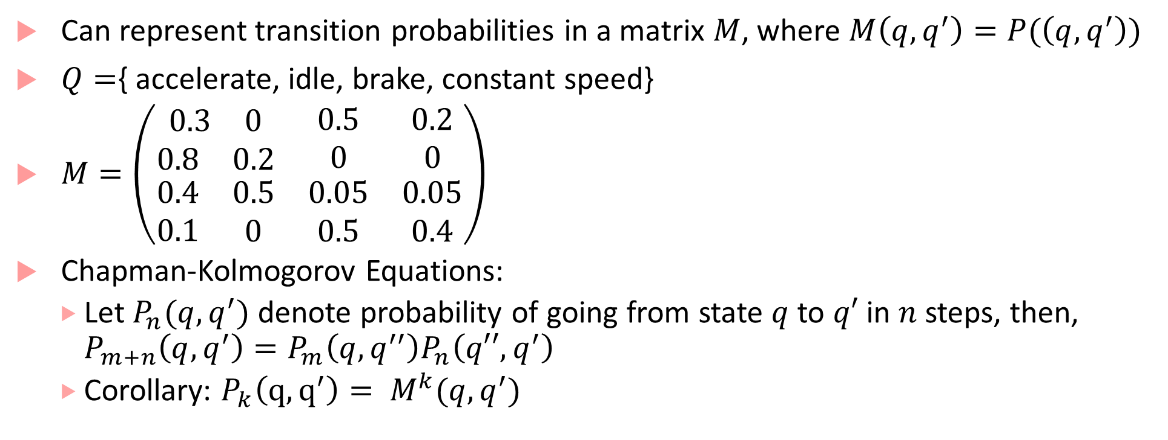
Markov Chain Analysis
Can represent transition probabilities in a matrix $M$, where $M\left(q,q^{′}\right)=P(\left(q,q^{′}\right))$
$Q=${ accelerate, idle, brake, constant speed}
$M=\left(\begin{matrix}\begin{matrix}0.3 & 0\end{matrix} & 0.5 & 0.2 \\ \begin{matrix}0.8 & 0.2\end{matrix} & 0 & 0 \\ \begin{matrix}\begin{matrix}0.4 \\ 0.1\end{matrix} & \begin{matrix}0.5 \\ 0\end{matrix}\end{matrix} & \begin{matrix}0.05 \\ 0.5\end{matrix} & \begin{matrix}0.05 \\ 0.4\end{matrix}\end{matrix}\right)$
Chapman-Kolmogorov Equations:
Let $P_{n}(q,q^{′})$ denote probability of going from state $q$ to $q′$ in $n$ steps, then, $P_{m+n}\left(q,q^{′}\right)=P_{m}\left(q,q^{′′}\right)P_{n}\left(q′′,q^{′}\right)$
Corollary: $P_{k}\left(q,q^{′}\right)= M^{k}(q,q^{′})$

Slide 24
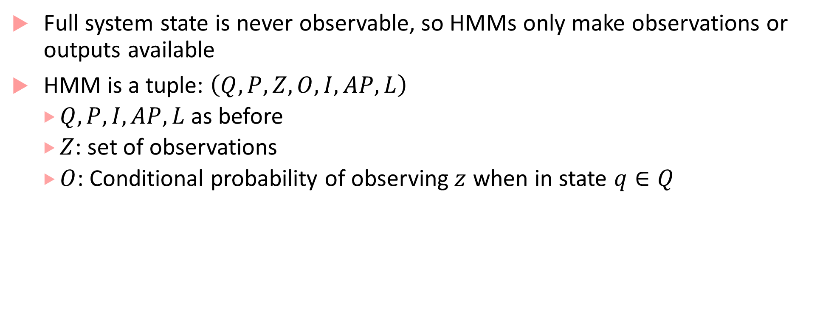
Hidden Markov Models
Full system state is never observable, so HMMs only make observations or outputs available
HMM is a tuple: $\left(Q,P,Z,O,I,AP,L\right)$
$Q, P, I, AP, L$ as before
$Z$: set of observations
$O$: Conditional probability of observing$z$ when in state $q∈Q$

Slide 25
Robot trying to reach moving target example
What is the expected time before robot reaches target?
What’s the probability that robot reaches target within the next 2 steps?
What’s the probability that the robot hits a wall before getting to the target
3 |  |  |  | G
2
1 |  | R
 |  | 1 | 2 | 3 | 4 | 5 | 6 | 7
Rules of the Game
Each timestep the target and robot move randomly to an adjacent cell or stay in the same cell (with some probability, possibly different for each cell)
When the robot and target occupy the same cell, robot declares victory

Slide 26
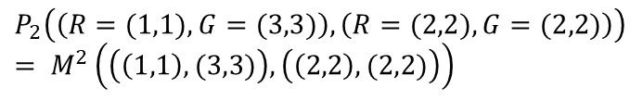
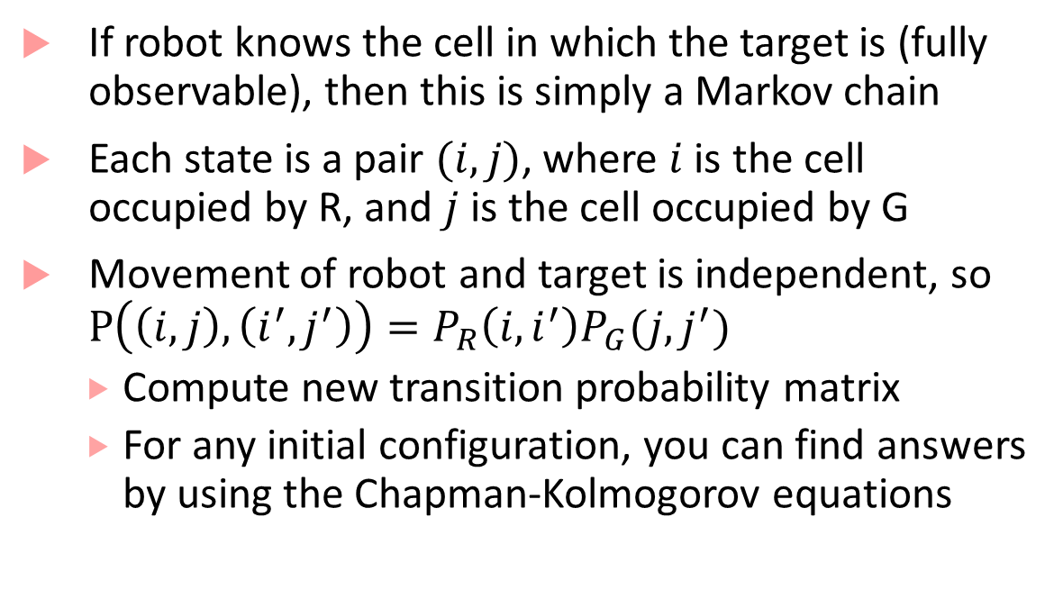
Robot trying to reach moving target example
3 |  |  |  | G
2
1 |  | R
 |  | 1 | 2 | 3 | 4 | 5 | 6 | 7
If robot knows the cell in which the target is (fully observable), then this is simply a Markov chain
Each state is a pair $(i,j)$, where $i$is the cell occupied by R, and $j$ is the cell occupied by G
Movement of robot and target is independent, so $P\left(\left(i,j\right),\left(i^{′},j^{′}\right)\right)=P_{R}\left(i,i^{′}\right)P_{G}(j,j^{′})$
Compute new transition probability matrix
For any initial configuration, you can find answers by using the Chapman-Kolmogorov equations
$$P_{2}\left(\left(R=(1,1),G=(3,3)\right),\left(R=(2,2),G=(2,2)\right)\right)$$
$$= M^{2}\left(\left(\left(1,1\right),(3,3)\right),\left(\left(2,2\right),(2,2)\right)\right)$$

Slide 27
What if robot cannot see all the state?
Robot with noisy proximity sensors:
W | W | W
 | R
G
W | W | W
 | R
G | G
True state
Observed noisy state
Target state is hidden : if it is not proximal, robot does not know where the target is, and if it is proximal, robot only has noisy estimates
We can assume robot knows how the target moves (left, right, top, down), and the uncertainty (as captured by the transition probability matrix): this is like the process model in KF
The robot’s sensors are noisy, this is like the measurement model in KF
Question: Given a series of (noisy) observations, can the robot estimate where the target is?
Problem very similar to KF! In fact, HMM can be viewed as a discrete-variable version of KF

Slide 28
Interesting Problems for HMMs
[Decoding] Given a sequence of observations, can you estimate the hidden state sequence? [Solution with the Viterbi Algorithm]
[Likelihood] Given an HMM and an observation sequence, what is the likelihood of that observation sequence [Dynamic Programming based Forward Algorithm]
[Learning] Given an observation sequence (or sequences), learn the HMM that maximizes the likelihood of that sequence [Baum-Welch or forward-backward algorithm]
We will revisit this when we do sensing/localization

Slide 29
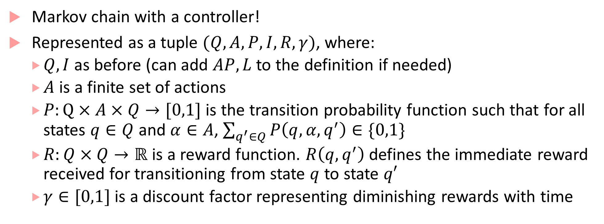
Markov Decision Process
Markov chain with a controller!
Represented as a tuple $(Q,A,P,I, R,γ)$, where:
$Q, I$ as before (can add $AP, L$ to the definition if needed)
$A$ is a finite set of actions
$P:Q×A×Q→[0,1]$ is the transition probability function such that for all states $q∈Q$ and $α∈A$, $\sum_{q^{′}∈Q}{P\left(q,α,q^{′}\right)}∈\{0,1\}$
$R:Q×Q→ℝ$ is a reward function. $R\left(q,q^{′}\right)$ defines the immediate reward received for transitioning from state $q$ to state $q′$
$γ∈[0,1]$ is a discount factor representing diminishing rewards with time

Slide 30





Autonomous Robot controlling its actions
Assume fixed target location
Reward for transitions going to target cell = 1, otherwise 0
Just part of the robot MDP showing two different actions, each action leading to next states with some probability
Which action to choose from each cell?
How do we find an optimal policy (that maximizes rewards)?
We will revisit this when we do reinforcement learning
0.9
$$(i,j+1)$$
up
$$(i,j)$$
0.1
$$(i,j)$$
0.9
dn
$$(i,j−1)$$
0.1
$$(i−1,j)$$

Slide 31
Bibliography
Kalman Filter presentation motivated by Georgia Tech Professor Frank Dellaert’s lecture notes on Sensor Fusion as Weighted Averaging, notes available from Piazza.
Lecture notes on HMMs, MDPs and Markov Chains
http://research.cs.tamu.edu/prism/lectures/pr/pr_l23.pdf
https://web.stanford.edu/~jurafsky/slp3/9.pdf
http://www.robots.ox.ac.uk/~mobile/Theses/ondruska_thesis.pdf
www.cs.cornell.edu/courses/cs4758/2012sp/materials/cs4758_hmm.pdf (Robot - Target example from here)
https://people.eecs.berkeley.edu/~pabbeel/cs287-fa11/slides/mdps-intro-value-iteration.pdf (Robot-Fixed Target example from here)
Wikipedia entries on Kalman Filter, MDPs and Markov chains are very good.
Also used this book for its discussion on probabilistic systems: Baier, Christel, Joost-Pieter Katoen, and Kim Guldstrand Larsen. Principles of model checking. MIT press, 2008.

