Slide 1
Autonomous Cyber-Physical Systems: Signal Temporal Logic
Spring 2019. CS 599.
Instructor: Jyo Deshmukh

Slide 2
Overview
Last lecture
LTL, CTL, pCTL
This lecture
STL: A requirements language for Cyber-Physical Systems

Slide 3



Typical day in a control designer’s life
$x$,
$$x_{ref}$$
Uh Oh!
time
$x$,
$$x_{ref}$$
… should be okay
time
Looks good
$x$,
$$x_{ref}$$
time

Slide 4
Signal Temporal Logic (STL)
STL can be used as a logic to formalize many control-theoretic properties, properties of path-planning algorithms, express timing constraints and causality relations
LTL/CTL: languages to express properties of discrete-timed, discrete-valued reactive systems
Operating systems, Distributed systems, shared-memory programs, device drivers etc.
STL: started as a logic to express properties of mixed-signal and analog circuits
Invented by Dejan Nickovic and Oded Maler from Verimag

Slide 5
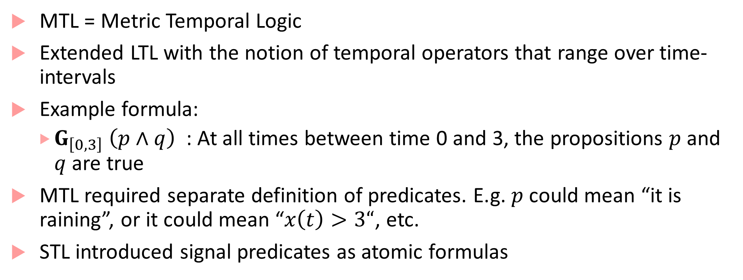
Before STL, there was MTL
MTL = Metric Temporal Logic
Extended LTL with the notion of temporal operators that range over time-intervals
Example formula:
$G_{\left[0,3\right]} \left(p∧q\right)$ : At all times between time 0 and 3, the propositions $p$ and $q$ are true
MTL required separate definition of predicates. E.g. $p$ could mean “it is raining”, or it could mean “$x\left(t\right)>3“$, etc.
STL introduced signal predicates as atomic formulas

Slide 6




Expressing specifications in STL
$${Always}_{[0,100]} \left(1≤x\left(t\right)≤3\right)$$
3
1
$$t$$
Always between time 0 and 100
0
50
100
$$x$$
1
$$t$$
$${Eventually}_{\left[20,60\right]}\left(Always \left(\left|x(t)\right|<0.1\right) \right)$$
+0.1
-0.1
60
0
100
Eventually at some time t between time 20 and 60
From that time t, always till the end of the signal trace

Slide 7


Can we express our engineer’s requirements?
$x$,
$$x_{ref}$$
Uh Oh!
time
$x$,
$$x_{ref}$$
… should be okay
time
Looks good
$x$,
$$x_{ref}$$
time
$$φ≡{Alw}_{\left[0,10\right]}\left(step⇒{Alw}_{\left[0,2\right]}\left(\left|x−x_{ref}\right|<0.05x_{ref}\right) \right)$$

Slide 8
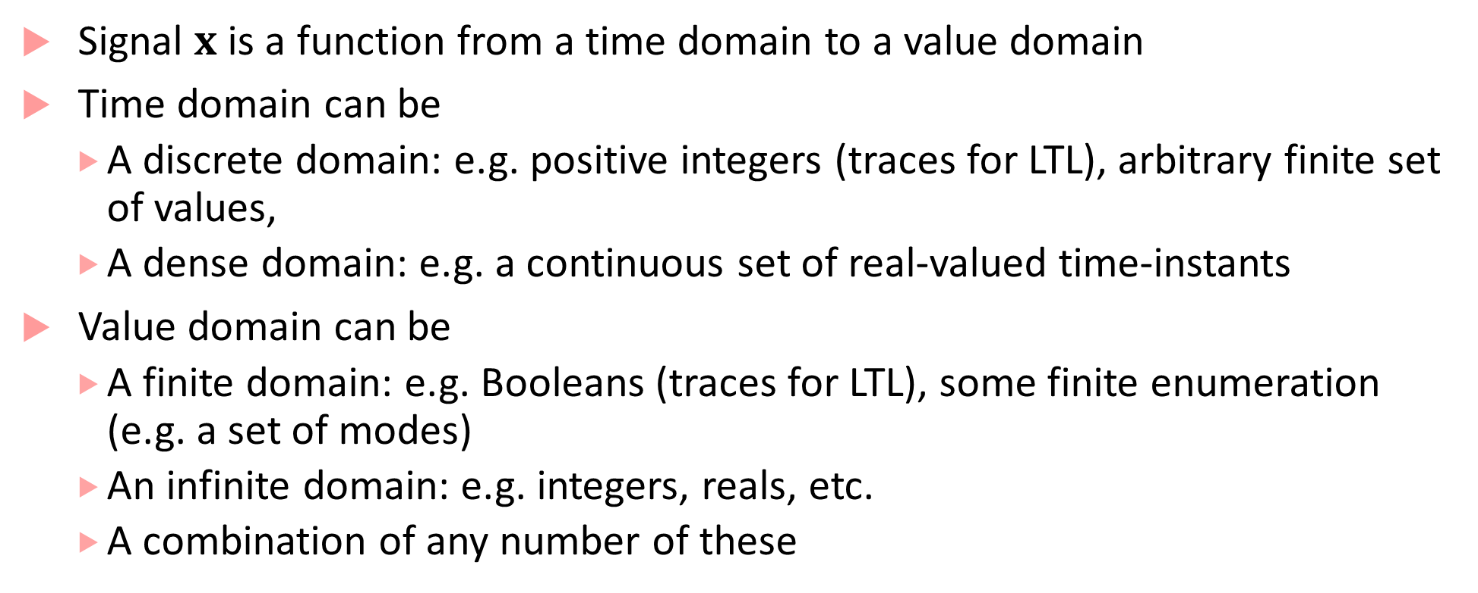
STL is interpreted over Signals
Signal $x$ is a function from a time domain to a value domain
Time domain can be
A discrete domain: e.g. positive integers (traces for LTL), arbitrary finite set of values,
A dense domain: e.g. a continuous set of real-valued time-instants
Value domain can be
A finite domain: e.g. Booleans (traces for LTL), some finite enumeration (e.g. a set of modes)
An infinite domain: e.g. integers, reals, etc.
A combination of any number of these

Slide 9
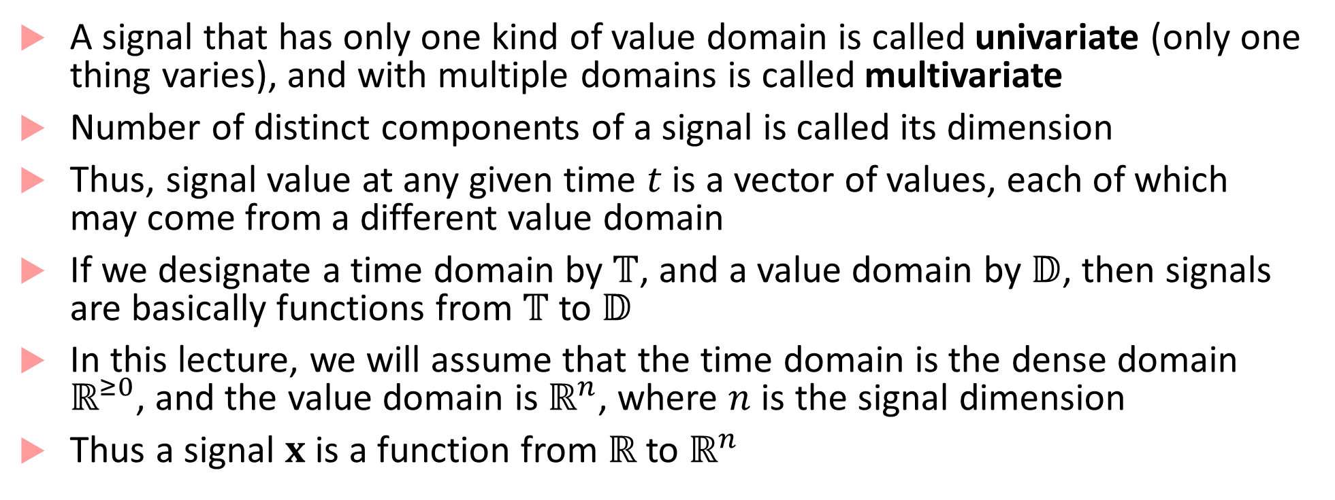
More about Signals
A signal that has only one kind of value domain is called univariate (only one thing varies), and with multiple domains is called multivariate
Number of distinct components of a signal is called its dimension
Thus, signal value at any given time $t$ is a vector of values, each of which may come from a different value domain
If we designate a time domain by $𝕋$, and a value domain by $𝔻$, then signals are basically functions from $𝕋$ to $𝔻$
In this lecture, we will assume that the time domain is the dense domain $ℝ^{≥0}$, and the value domain is $ℝ^{n}$, where $n$ is the signal dimension
Thus a signal $x$ is a function from $ℝ$ to $ℝ^{n}$

Slide 10
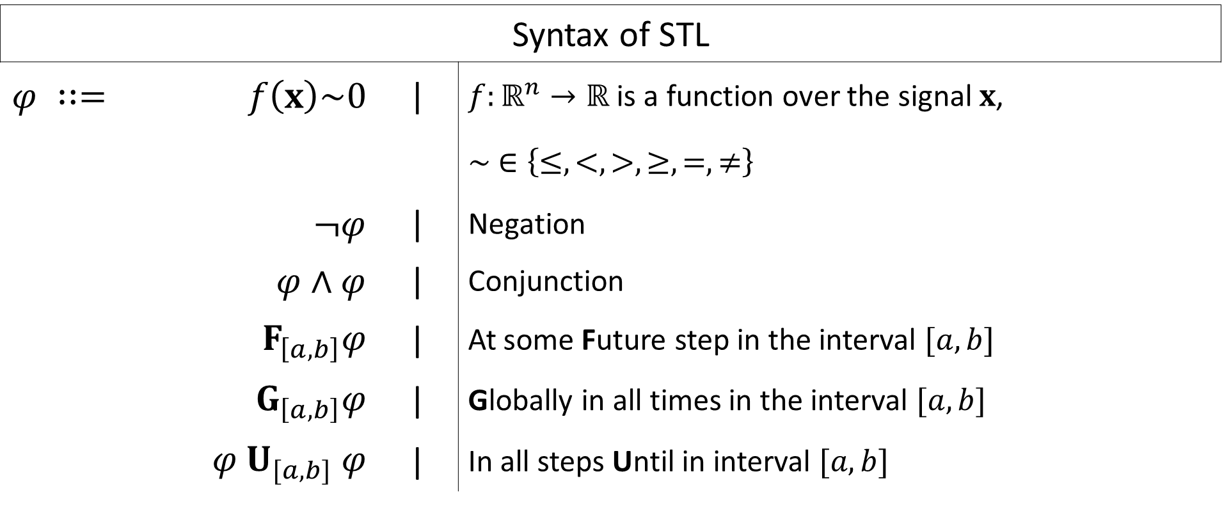
STL Syntax
Syntax of STL
$$φ ∷=$$ | $$f\left(x\right)\sim 0$$ | | | $f:ℝ^{n}→ℝ$ is a function over the signal $x$,
 |  |  | $$∼ ∈\left\{≤,<,>,≥,=,≠\right\}$$
 | $¬φ$ | | | Negation
 | $φ∧φ$ | | | Conjunction
 | $$F_{\left[a,b\right]}φ$$ | | | At some Future step in the interval $[a,b]$
 | $$G_{\left[a,b\right]}φ$$ | | | Globally in all times in the interval $[a,b]$
 | $$φ U_{[a,b]} φ$$ | | | In all steps Until in interval $[a,b]$

Slide 11

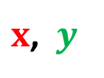
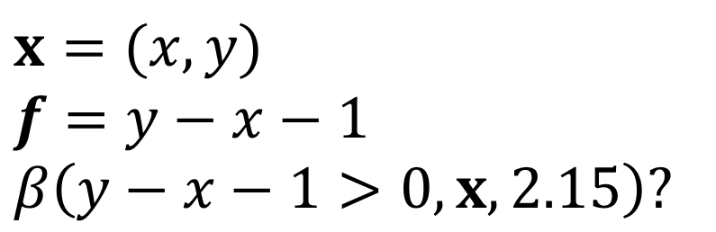




STL semantics
Semantics of STL specified recursively over a signal at each time
For each STL formula $φ$, here’s how we define it’s semantics:
If $φ$ is the signal predicate $f\left(x\right)>0$, then $β\left(φ, x,t\right)=true$iff $f\left(x\left(t\right)\right)>0$
$x$, $y$
$$x=(x,y)$$
$$f=y−x−1$$
$$β\left(y−x−1>0, x, 2.15\right)?$$
$$2$$
$$1$$
$$2.15$$
$$t$$

Slide 12
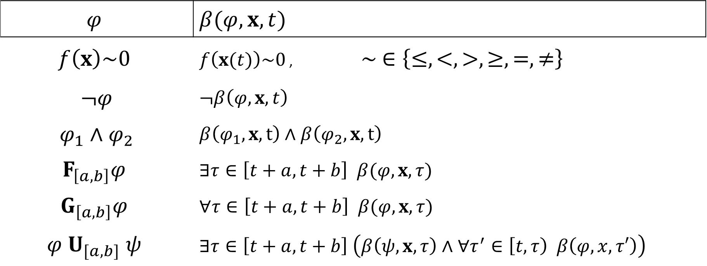
Recursive Boolean Semantics of STL
$$φ$$ | $$β(φ,x,t)$$
$f\left(x\right)\sim 0$ | $f\left(x(t)\right)\sim 0$ , $∼ ∈\left\{≤,<,>,≥,=,≠\right\}$
$¬φ$ | $$¬β\left(φ, x,t\right)$$
$φ_{1}∧φ_{2}$ | $$β\left(φ_{1},x,t\right)∧β\left(φ_{2},x,t\right)$$
$$F_{\left[a,b\right]}φ$$ | $$∃τ∈\left[t+a,t+b\right] β(φ,x, τ)$$
$$G_{\left[a,b\right]}φ$$ | $$∀τ∈\left[t+a,t+b\right] β(φ,x, τ)$$
$$φ U_{[a,b]} ψ$$ | $$∃τ∈\left[t+a,t+b\right] \left(β\left(ψ, x, τ\right)∧∀τ^{′}∈\left[t, τ\right) β\left(φ,x,τ′\right)\right)$$

Slide 13
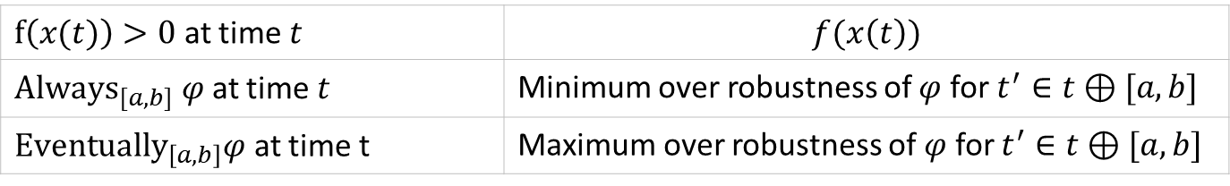
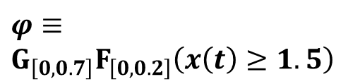
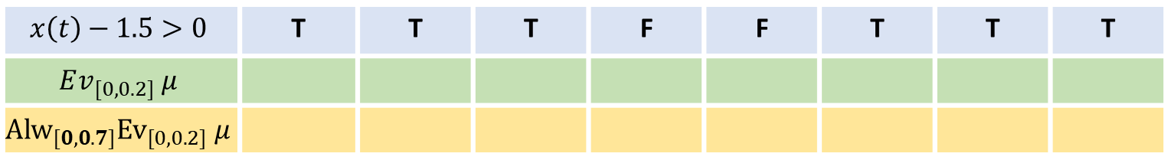
Recursive Boolean Semantics of STL
3
$$φ≡$$
$$G_{\left[0,0.7\right]}F_{\left[0,0.2\right]}\left(x\left(t\right)≥1.5\right)$$
2
1
0,0
0.1
0.2
0.3
0.4
0.5
0.6
0.7
$$x\left(t\right)−1.5>0$$ | T | T | T | F | F | T | T | T
$$Ev_{[0,0.2]} μ$$
$${Alw}_{[0,0.7]}{Ev}_{[0,0.2]} μ$$
T
T
T
T
T
T
T
$f\left(x(t)\right)>0$ at time $t$ | $$f(x\left(t\right))$$
${Always}_{[a,b]} φ$ at time $t$ | Minimum over robustness of $φ$ for $t^{′}∈t⊕[a,b]$
${Eventually}_{\left[a,b\right]}φ$ at time t | Maximum over robustness of $φ$ for $t^{′}∈t⊕[a,b]$

Slide 14

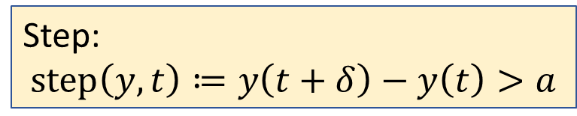

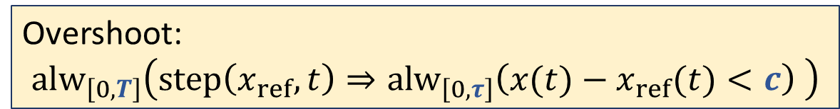





Example STL formulas: Overshoot
$$x$$
$$x_{ref}$$
$$c$$
Step:
$$step\left(y,t\right)≔y\left(t+δ\right)−y\left(t\right)>a$$
$$δ$$
$$a$$
Overshoot:
$${alw}_{\left[0,T\right]}\left(step\left(x_{ref},t\right)⇒{alw}_{\left[0,τ\right]}\left(x(t)−x_{ref}(t)<c\right) \right)$$
$$τ$$
$$T$$
time

Slide 15

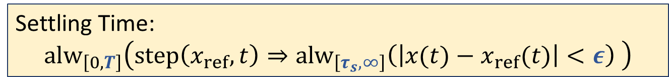



Example STL formulas: Settling Time
$$x$$
$$x_{ref}$$
Step:
$$step\left(y,t\right)≔y\left(t+δ\right)−y\left(t\right)>a$$
$$ε$$
$$a$$
Settling Time:
$${alw}_{\left[0,T\right]}\left(step\left(x_{ref},t\right)⇒{alw}_{\left[τ_{s},∞\right]}\left(\left|x(t)−x_{ref}(t)\right|<ε\right) \right)$$
$$τ_{s}$$
$$T$$
time

Slide 16

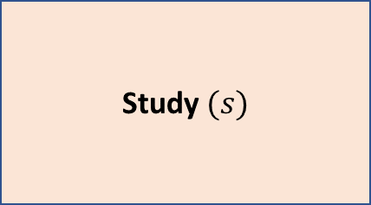
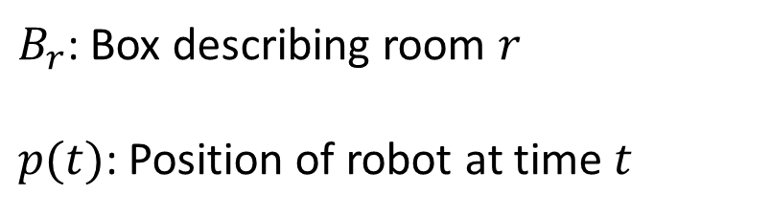

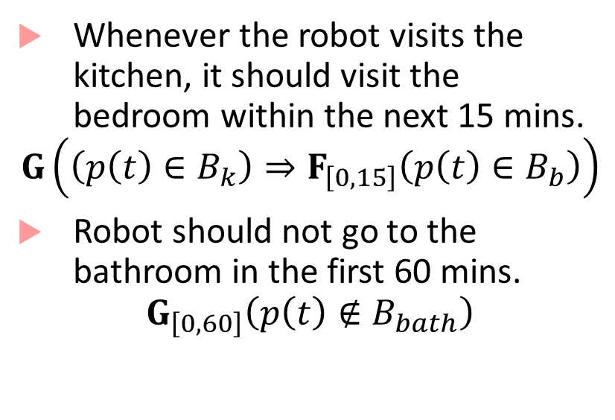

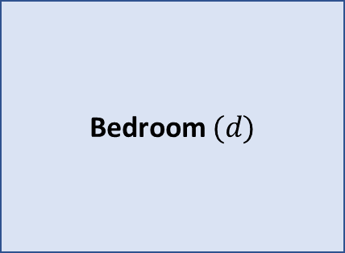

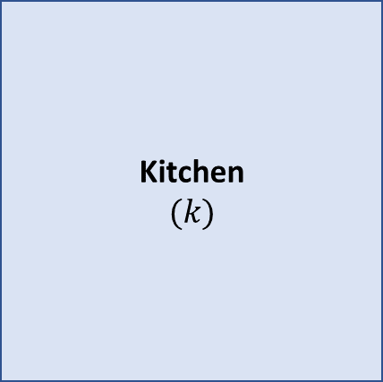
Robot Path Specification
(15,25)
Kitchen
$$(k)$$
Living Room $(ℓ)$
Study $(s)$
Whenever the robot visits the kitchen, it should visit the bedroom within the next 15 mins.
$$G\left(\left(p\left(t\right)∈B_{k}\right)⇒F_{\left[0,15\right]}\left(p\left(t\right)∈B_{b}\right)\right)$$
Robot should not go to the bathroom in the first 60 mins.
$$G_{\left[0,60\right]}\left(p\left(t\right)∉B_{bath}\right)$$
Passage $(p)$
Bedroom $(d)$
(0,5)
Bathroom $(b)$
$B_{r}$: Box describing room $r$
$p(t)$: Position of robot at time $t$
TV
${p\left(t\right)∈B}_{k} :\left(0<p_{x}\left(t\right)<15\right)∧\left(5 <p_{y}\left(t\right)<25\right)$

Slide 17

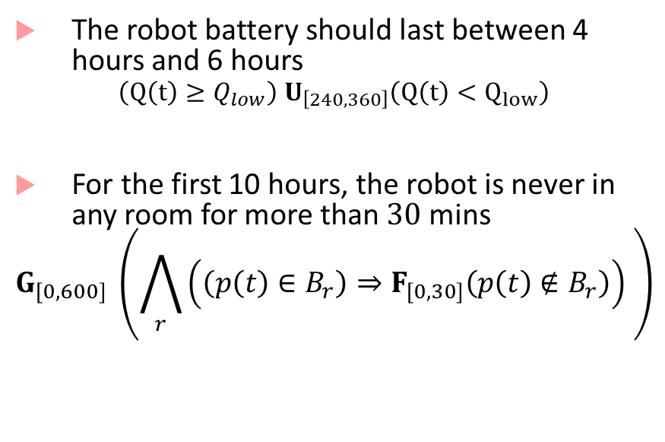
Robot Path Specification
Kitchen
$$(k)$$
Living Room $(ℓ)$
Study $(s)$
Passage $(p)$
The robot battery should last between 4 hours and 6 hours
$$\left(Q\left(t\right)≥Q_{low}\right) U_{\left[240,360\right]}\left(Q\left(t\right)<Q_{low}\right)$$
For the first 10 hours, the robot is never in any room for more than $30$ mins
$$G_{[0,600]} \left(\bigwedge_{r}{\left(\left(p\left(t\right)∈B_{r}\right)⇒F_{\left[0,30\right]}\left(p\left(t\right)∉B_{r}\right)\right)} \right)$$
Bedroom $(d)$
Bathroom $(b)$

Slide 18
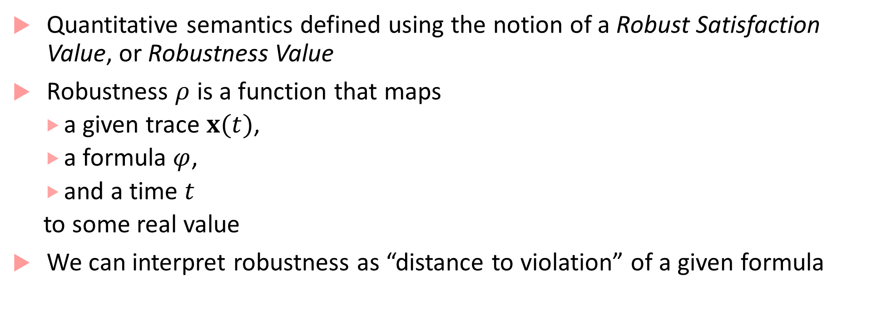
STL has quantitative semantics
Quantitative semantics defined using the notion of a Robust Satisfaction Value, or Robustness Value
Robustness $ρ$ is a function that maps
a given trace $x(t)$,
a formula $φ$,
and a time $t$
to some real value
We can interpret robustness as “distance to violation” of a given formula

Slide 19

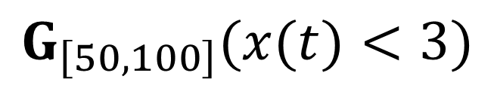



Distance to violation/satisfaction
GOOD
BAD
GOOD
BAD
$$x$$
$$x$$
3
3
How far is
bad?
How bad is the violation?
$$t$$
$$t$$
0
100
0
50
100
50
$$G_{\left[50,100\right]}(x(t)<3)$$

Slide 20



How do quantitative semantics help our engineer?
$x$,
$$x_{ref}$$
$$f_{φ}$$
= -0.2
Uh Oh!
time
$x$,
$$x_{ref}$$
… should be okay
$$f_{φ}$$
time
= 0.01
Looks good
$x$,
$$x_{ref}$$
$$f_{φ}$$
= 0.2
time
$$φ≡{Alw}_{\left[0,10\right]}\left(step⇒{Alw}_{\left[0,2\right]}\left(\left|x−x_{ref}\right|<0.05x_{ref}\right) \right)$$

Slide 21
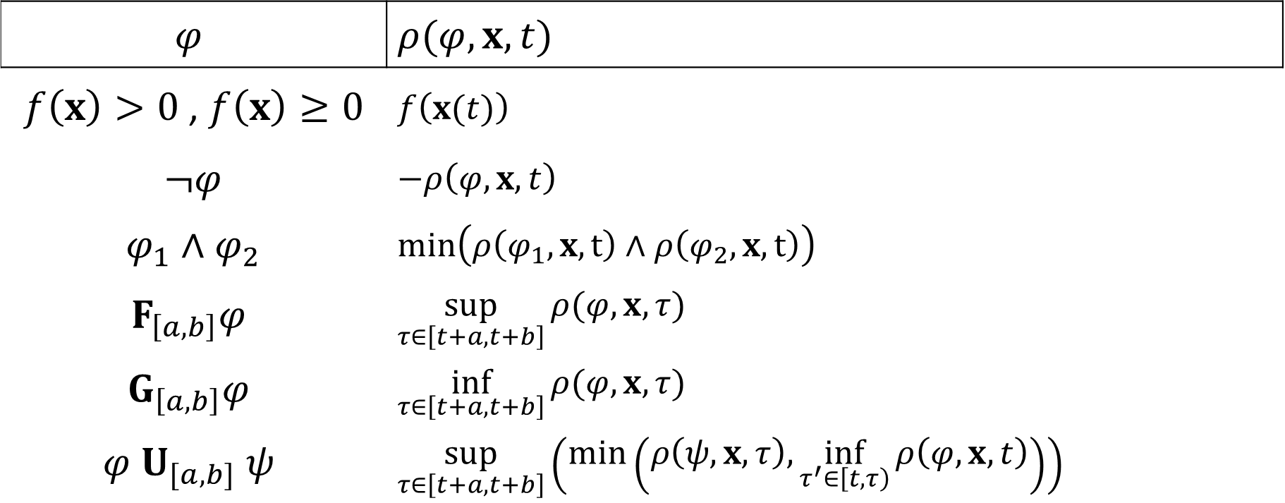
Recursive Quantitative Semantics
$$φ$$ | $$ρ(φ,x,t)$$
$f\left(x\right)>0$, $f\left(x\right)≥0$ | $f\left(x(t)\right)$
$¬φ$ | $$−ρ\left(φ,x,t\right)$$
$φ_{1}∧φ_{2}$ | $$min\left(ρ\left(φ_{1},x,t\right)∧ρ\left(φ_{2},x,t\right)\right)$$
$$F_{\left[a,b\right]}φ$$ | $$\sup_{τ∈\left[t+a,t+b\right]}{ρ(φ,x, τ)}$$
$$G_{\left[a,b\right]}φ$$ | $$\inf_{τ∈\left[t+a,t+b\right]}{ρ(φ,x, τ)}$$
$$φ U_{[a,b]} ψ$$ | $$\sup_{τ∈\left[t+a,t+b\right]}\left(\min\left(ρ\left(ψ,x, τ\right),\inf_{τ^{′}∈\left[t,τ\right)}{ρ\left(φ,x,t\right)}\right)\right)$$

Slide 22

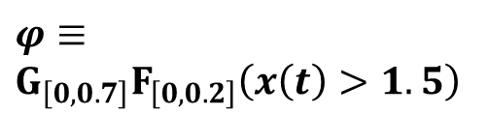
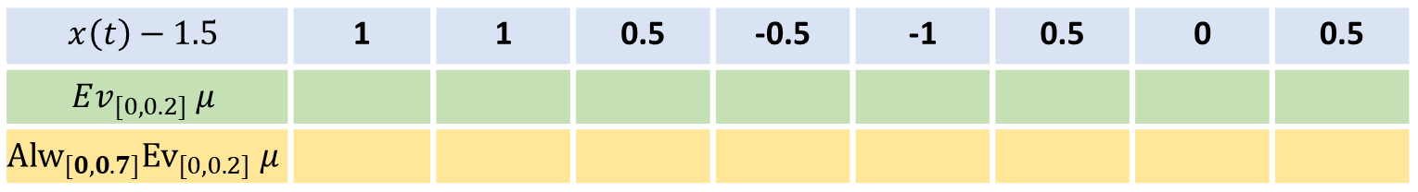
Robustness computation example
3
$$φ≡$$
$$G_{\left[0,0.7\right]}F_{\left[0,0.2\right]}\left(x\left(t\right)>1.5\right)$$
2
1
0,0
0.1
0.2
0.3
0.4
0.5
0.6
0.7
$$x\left(t\right)−1.5$$ | 1 | 1 | 0.5 | -0.5 | -1 | 0.5 | 0 | 0.5
$$Ev_{[0,0.2]} μ$$
$${Alw}_{[0,0.7]}{Ev}_{[0,0.2]} μ$$
$$μ≡x\left(t\right)>1.5$$
1
1
0.5
0.5
0.5
0.5
0.5
$f\left(x(t)\right)>0$ at time $t$ | $$f(x\left(t\right))$$
${Always}_{[a,b]} φ$ at time $t$ | Minimum over robustness of $φ$ for $t^{′}∈t⊕[a,b]$
${Eventually}_{\left[a,b\right]}φ$ at time t | Maximum over robustness of $φ$ for $t^{′}∈t⊕[a,b]$

Slide 23
The many uses of STL
Requirement-based testing for closed-loop control models
Requirement Falsification
Mining Specifications/Requirements from Models
…

Slide 24
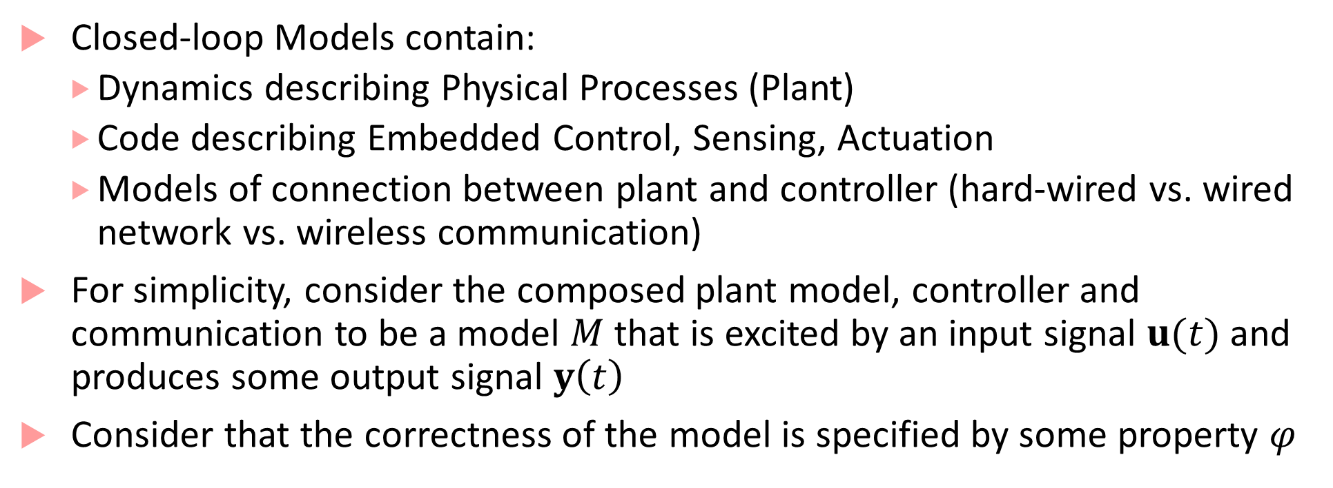
Closed-loop Models
Closed-loop Models contain:
Dynamics describing Physical Processes (Plant)
Code describing Embedded Control, Sensing, Actuation
Models of connection between plant and controller (hard-wired vs. wired network vs. wireless communication)
For simplicity, consider the composed plant model, controller and communication to be a model $M$ that is excited by an input signal $u(t)$ and produces some output signal $y\left(t\right)$
Consider that the correctness of the model is specified by some property $φ$

Slide 25
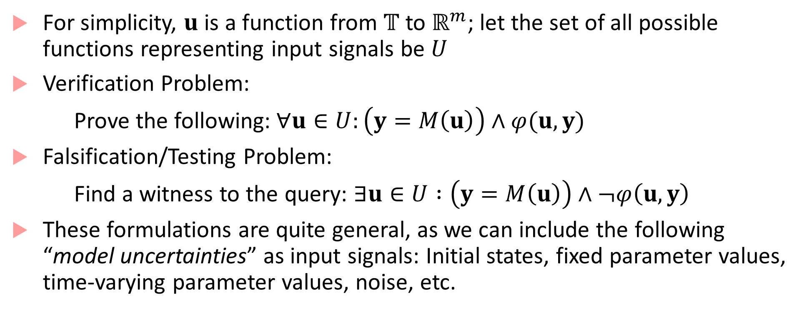
Verification vs. Testing
For simplicity, $u$ is a function from $𝕋$ to $ℝ^{m}$; let the set of all possible functions representing input signals be $U$
Verification Problem:
Prove the following:$∀u∈U:\left(y=M\left(u\right)\right)∧φ(u,y)$
Falsification/Testing Problem:
Find a witness to the query: $∃u∈U :\left(y=M\left(u\right)\right)∧¬φ\left(u,y\right)$
These formulations are quite general, as we can include the following “model uncertainties” as input signals: Initial states, fixed parameter values, time-varying parameter values, noise, etc.

Slide 26
Challenges with real-world systems
If plant model, software and communication is simple (e.g. linear models), then we can do formal analysis
Most real-world examples have very complex plants, controllers and communication!
Verification problem, in the most general case is undecidable
It can be mathematically proven that there is no algorithm which will take the description of an arbitrary closed-loop model and a property, and give a yes/no answer to the verification problem.

Slide 27
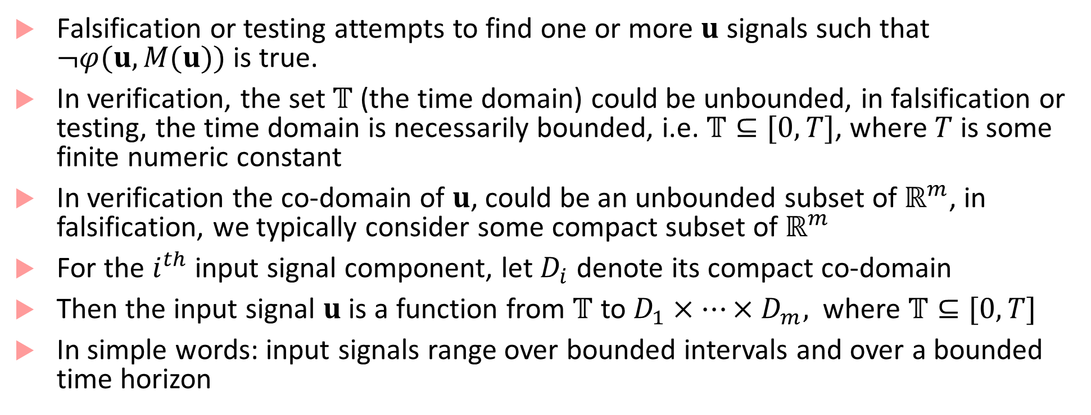
Falsification/Testing
Falsification or testing attempts to find one or more $u$ signals such that $¬φ(u,M(u))$ is true.
In verification, the set $𝕋$ (the time domain) could be unbounded, in falsification or testing, the time domain is necessarily bounded, i.e. $𝕋⊆[0,T]$, where $T$ is some finite numeric constant
In verification the co-domain of $u$, could be an unbounded subset of $ℝ^{m}$, in falsification, we typically consider some compact subset of $ℝ^{m}$
For the $i^{th}$ input signal component, let $D_{i}$ denote its compact co-domain
Then the input signal $u$ is a function from $𝕋$ to $D_{1}×…×D_{m},$ where $𝕋⊆[0,T]$
In simple words: input signals range over bounded intervals and over a bounded time horizon

Slide 28
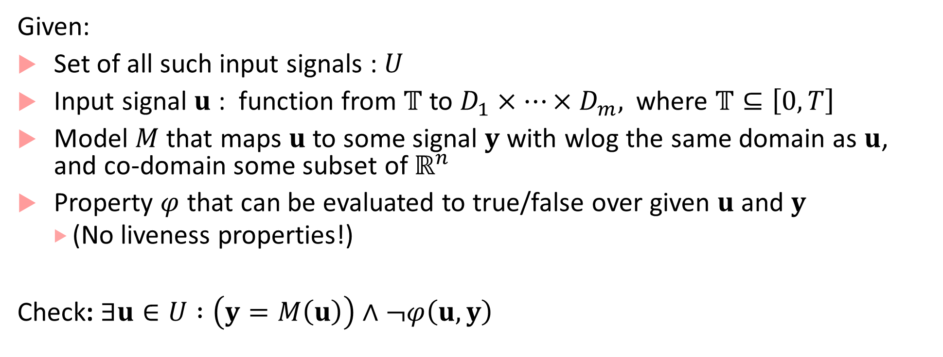
Falsification re-framed
Given:
Set of all such input signals : $U$
Input signal $u$ : function from $𝕋$ to $D_{1}×…×D_{m},$ where $𝕋⊆\left[0,T\right]$
Model $M$ that maps $u$ to some signal $y$ with wlog the same domain as $u$, and co-domain some subset of $ℝ^{n}$
Property $φ$ that can be evaluated to true/false over given $u$ and $y$
(No liveness properties!)
Check: $∃u∈U :\left(y=M\left(u\right)\right)∧¬φ\left(u,y\right)$

Slide 29
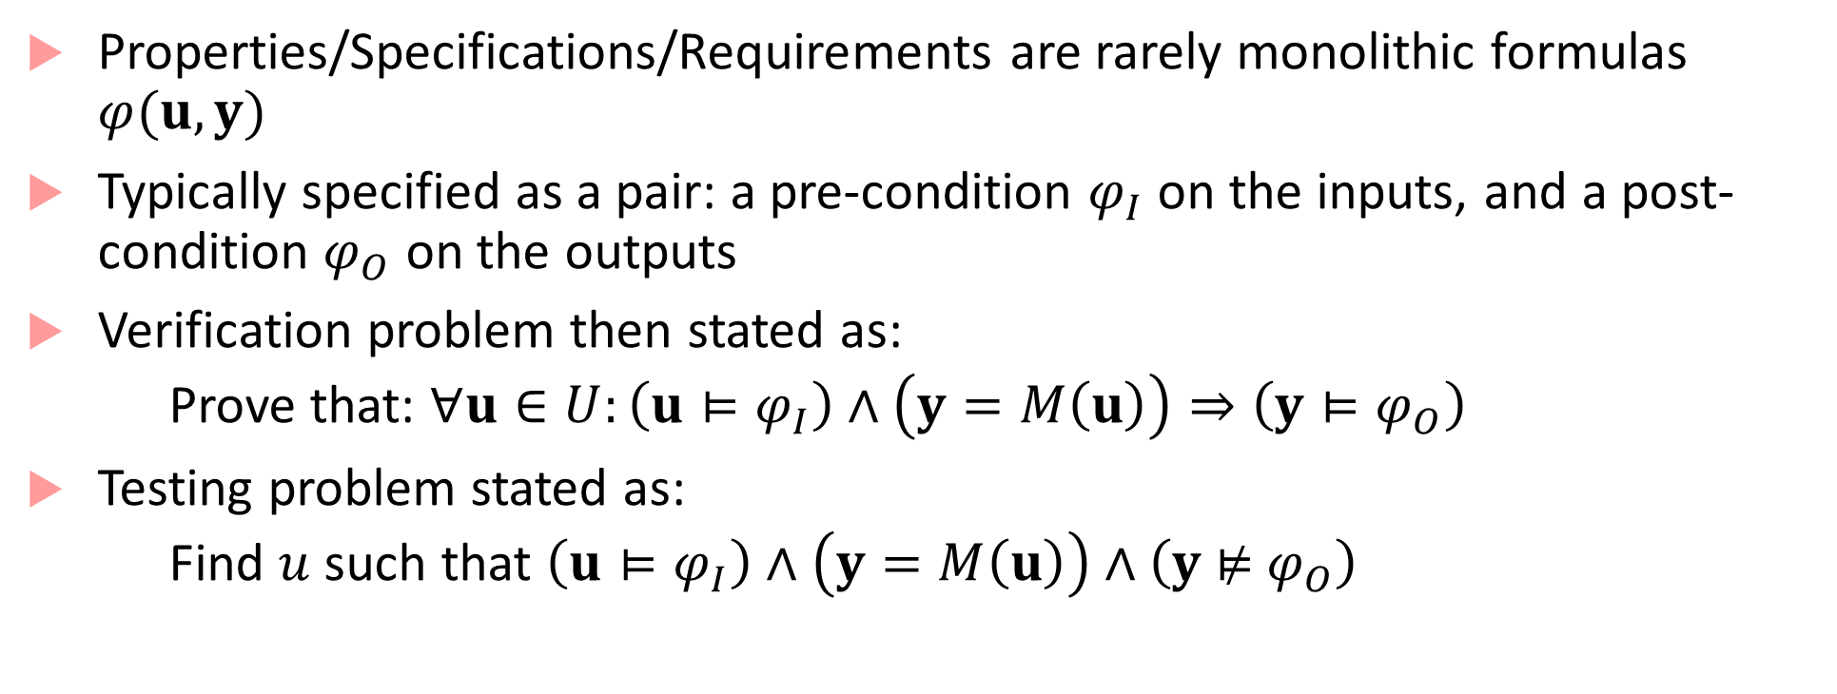
Input/Output Properties for Closed-loop Models
Properties/Specifications/Requirements are rarely monolithic formulas $φ(u,y)$
Typically specified as a pair: a pre-condition $φ_{I}$ on the inputs, and a post-condition $φ_{O}$ on the outputs
Verification problem then stated as:
Prove that: $∀u∈U:\left(u⊨φ_{I}\right)∧\left(y=M\left(u\right)\right)⇒\left(y⊨φ_{O}\right)$
Testing problem stated as:
Find $u$ such that $\left(u⊨φ_{I}\right)∧\left(y=M\left(u\right)\right)∧\left(y \text{⊭}{ φ}_{O}\right)$

Slide 30
Input Properties/Pre-conditions
Common practice in control theory to excite closed-loop models with input signals of certain special shapes
Motivation comes from theory of linear systems, where a step-response or impulse-response are enough to characterize all behaviors of the system
Such special shapes do not provide comprehensive information for nonlinear closed-loop systems, yet, it is still common to excite these systems with a few common patterns
Frequently, input signal patterns come from engineering insights or application-specific domain expertise

Slide 31












Common input patterns used for testing
Step
$$u$$
Impulse
$$u$$
Multiple Steps
$$u$$
$$t$$
$$t$$
$$t$$
$$u$$
Ramp
$$u$$
Pulse Train
$$u$$
Sinusoid
$$t$$
$$t$$
$$t$$

Slide 32
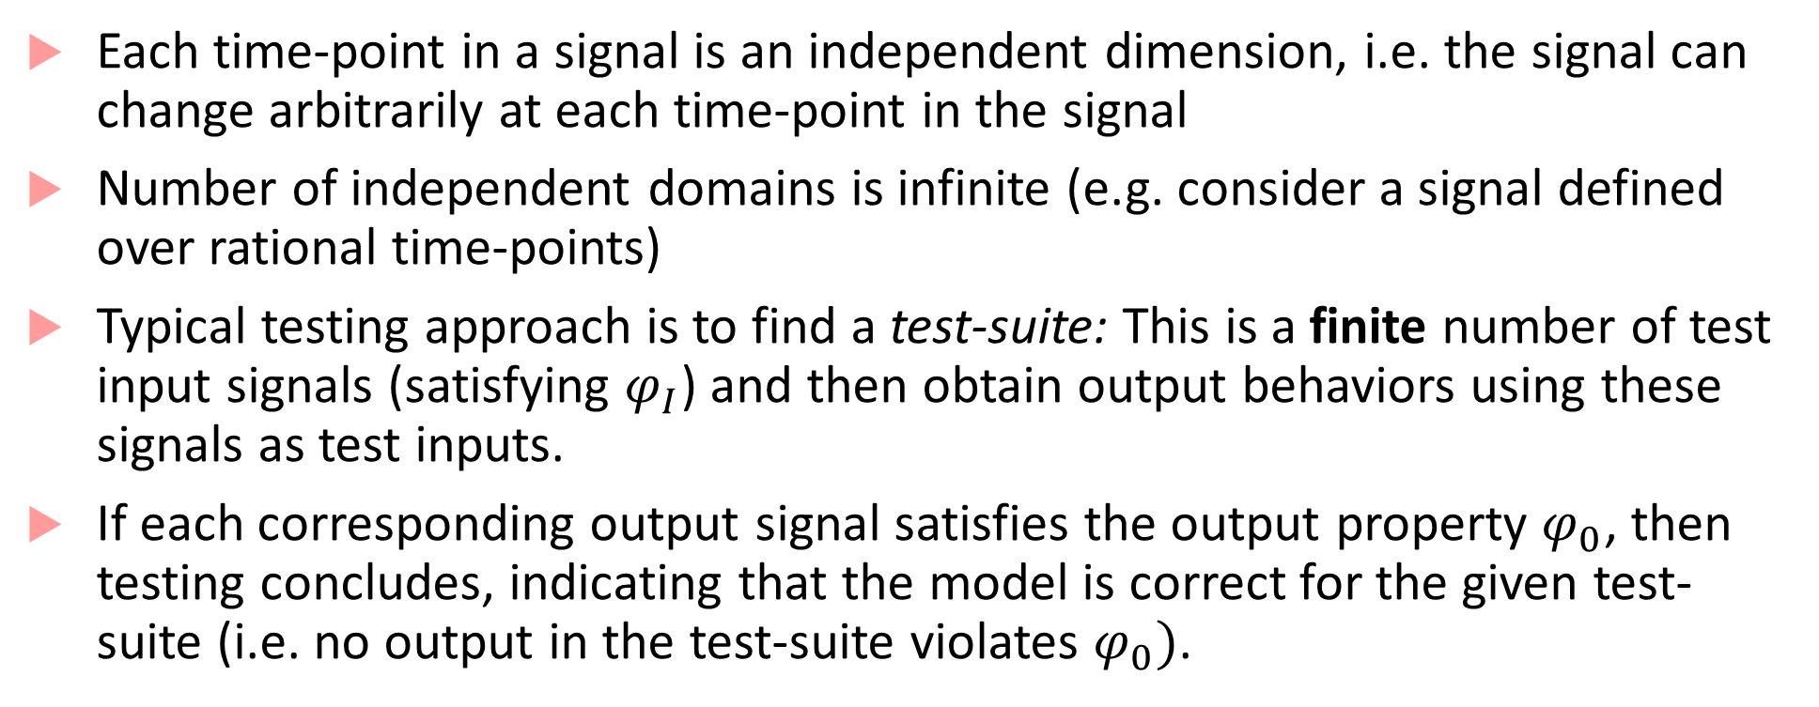
Testing in practice
Each time-point in a signal is an independent dimension, i.e. the signal can change arbitrarily at each time-point in the signal
Number of independent domains is infinite (e.g. consider a signal defined over rational time-points)
Typical testing approach is to find a test-suite: This is a finite number of test input signals (satisfying $φ_{I}$) and then obtain output behaviors using these signals as test inputs.
If each corresponding output signal satisfies the output property $φ_{0}$, then testing concludes, indicating that the model is correct for the given test-suite (i.e. no output in the test-suite violates $φ_{0})$.

Slide 33
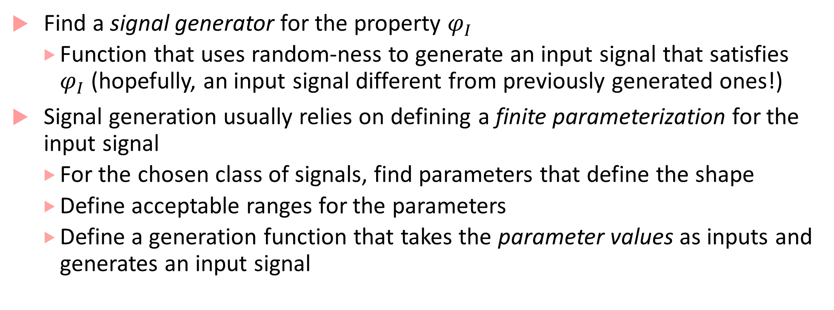
Signal Generation
Find a signal generator for the property $φ_{I}$
Function that uses random-ness to generate an input signal that satisfies $φ_{I}$ (hopefully, an input signal different from previously generated ones!)
Signal generation usually relies on defining a finite parameterization for the input signal
For the chosen class of signals, find parameters that define the shape
Define acceptable ranges for the parameters
Define a generation function that takes the parameter values as inputs and generates an input signal

Slide 34








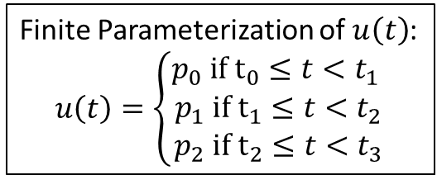





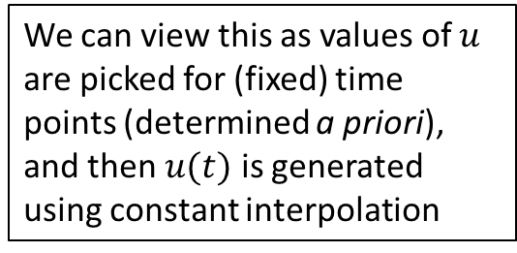






Finite parameterization using control points
$$u$$
$$h$$
Finite Parameterization of $u\left(t\right)$:
$$u\left(t\right)=\left\{\begin{matrix}p_{0} if t_{0}≤t<t_{1} \\ p_{1} if t_{1}≤t<t_{2} \\ p_{2} if t_{2}≤t<t_{3}\end{matrix}\right.$$
Acceptable ranges on parameters (control points)
$$p_{0}$$
Control points
$$p_{1}$$
$$p_{1}$$
$$(ℓ,h,ℓ)$$
We can view this as values of $u$ are picked for (fixed) time points (determined a priori), and then $u(t)$ is generated using constant interpolation
$$t_{0}$$
$$t_{1}$$
$$t_{2}$$
$$t_{3}$$
$t$
$$(h,h,h)$$
$$p_{2}$$
$$p_{0}$$
$$(ℓ,ℓ,ℓ)$$
$$(h,ℓ,ℓ)$$
$$(ℓ,ℓ,h)$$
$$ℓ$$
$$p_{2}$$

Slide 35


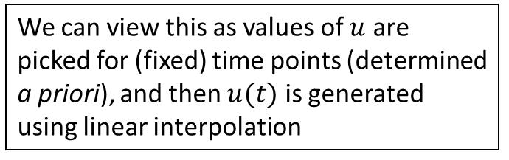


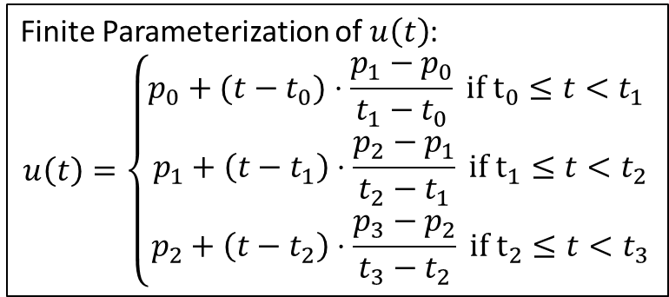






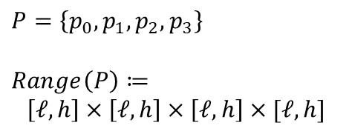


Finite parameterization using linear interpolation
$$u$$
$$P=\left\{p_{0},p_{1},p_{2},p_{3}\right\}$$
$$Range\left(P\right)≔$$
$$\left[ℓ,h\right]×\left[ℓ,h\right]×\left[ℓ,h\right]×[ℓ,h]$$
$$h$$
Finite Parameterization of $u\left(t\right)$:
$$u\left(t\right)=\left\{\begin{matrix}p_{0}+(t−t_{0})⋅\frac{p_{1}−p_{0}}{t_{1}−t_{0}} if t_{0}≤t<t_{1} \\ p_{1}+\left(t−t_{1}\right)⋅\frac{p_{2}−p_{1}}{t_{2}−t_{1}} if t_{1}≤t<t_{2} \\ p_{2}+\left(t−t_{2}\right)⋅\frac{p_{3}−p_{2}}{t_{3}−t_{2}} if t_{2}≤t<t_{3}\end{matrix}\right.$$
$$p_{0}$$
Control points
Acceptable ranges on parameters (control points)
$$p_{1}$$
$$t_{0}$$
$$t_{1}$$
$$t_{2}$$
$$t_{3}$$
$t$
We can view this as values of $u$ are picked for (fixed) time points (determined a priori), and then $u(t)$ is generated using linear interpolation
$$p_{3}$$
$$p_{2}$$
$$ℓ$$

Slide 36
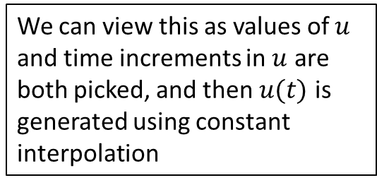
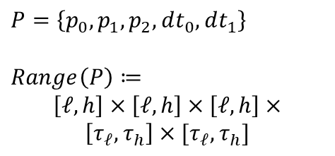
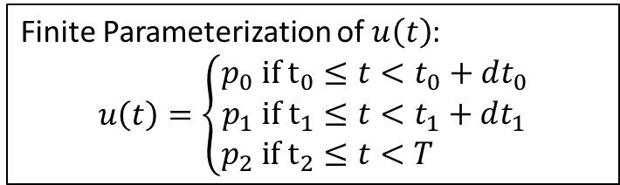



Finite parameterization variable control point times
$$u$$
$$h$$
Finite Parameterization of $u\left(t\right)$:
$$u\left(t\right)=\left\{\begin{matrix}p_{0} if t_{0}≤t<t_{0}+dt_{0} \\ p_{1} if t_{1}≤t<t_{1}+dt_{1} \\ p_{2} if t_{2}≤t<T \end{matrix}\right.$$
Acceptable ranges on parameter values
$$p_{0}$$
Control points
$$p_{1}$$
We can view this as values of $u$ and time increments in $u$ are both picked, and then $u(t)$ is generated using constant interpolation
$$t_{0}$$
$$t_{1}$$
$$t_{2}$$
$$T$$
$t$
$${dt}_{0}$$
$${dt}_{1}$$
$$P=\left\{p_{0},p_{1},p_{2},dt_{0},dt_{1}\right\}$$
$$Range\left(P\right)≔$$
$$\left[ℓ,h\right]×\left[ℓ,h\right]×\left[ℓ,h\right]×$$
$$\left[τ_{ℓ},τ_{h}\right]×[τ_{ℓ},τ_{h}]$$
$$p_{2}$$
Acceptable ranges on time increments
$$ℓ$$

Slide 37

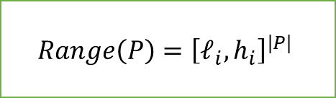

Signal Generator
$$u$$
$$Range\left(P\right)={\left[ℓ_{i},h_{i}\right]}^{|P|}$$
Sample Parameter Space
Generate Signal
$$t$$
Signal Generation controlled by the testing algorithm
Parameter space could be sampled all at once
Parameter space could be sampled in a sequential fashion, e.g. using a method such as Markov Chain Monte Carlo
Sampling scheme could be application-specific: uniform random, quasi-random (more evenly spread out), truncated normal, grid-based sampling (points from a fixed grid), etc.

Slide 38
Checking output properties
Output properties could be simple static bounds check, dynamic bounds check, or any other function returning yes/no answers (e.g. any Matlab function that maps a signal to a yes/no answer)
More systematic approach is to use properties specified in STL
Properties could be over just output signals or specify some relation between input and output signals
Tool Breach provides both Boolean/Quantitative monitoring approaches to check if a given set of signals satisfies an STL property

Slide 39
Falsification or Automated Test Generation
In most industrial settings, test generation is still quite manual
Engineer knows the input patterns of interest from technical insights
Regulatory or other external agencies may provide test input signals
Companies may build a library of interesting test input signals
Random sampling to generate a test-suite of input signals is one method for automatic input test-generation
Falsification takes automatic test generation to the next level by directing test generation to focus on input signals that are likelier to cause violations of correctness properties

Slide 40
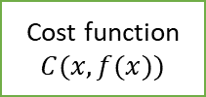

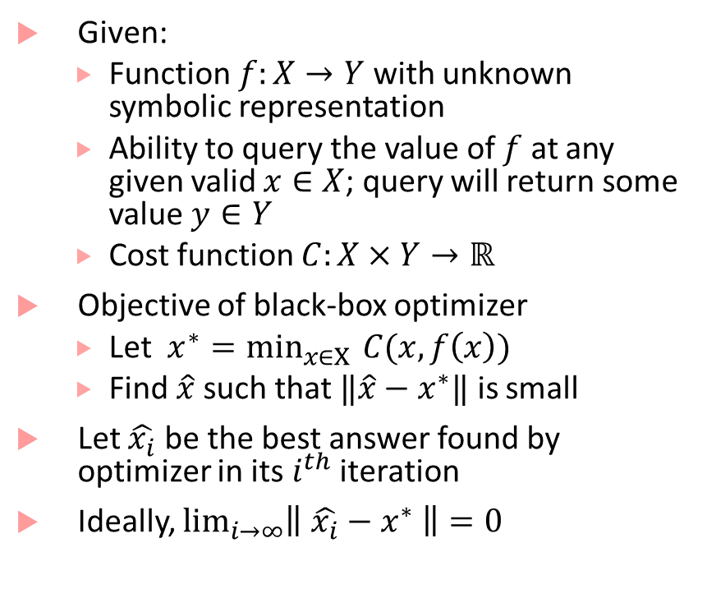
Quick Introduction to Black-box Optimization
Given:
Function $f:X→Y$ with unknown symbolic representation
Ability to query the value of $f$ at any given valid $x∈X$; query will return some value $y∈Y$
Cost function $C:X×Y→ℝ$
Objective of black-box optimizer
Let $x^{∗}=\min_{x∈X }{C(x,f\left(x\right))}$
Find $\hat{x}$ such that $‖\hat{x}−x^{∗}‖$ is small
Let $\hat{x_{i}}$ be the best answer found by optimizer in its $i^{th}$ iteration
Ideally, $\lim_{i→∞}\left\| \hat{x_{i}}−x^{∗} \right\|=0$
$$f$$
Black-box Optimizer
Cost function $C(x,f(x))$

Slide 41
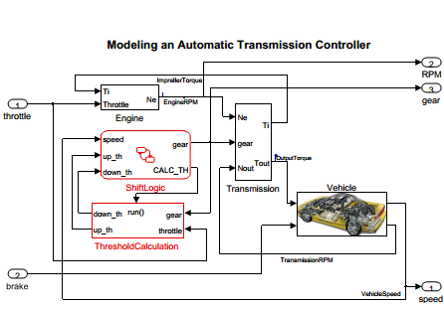
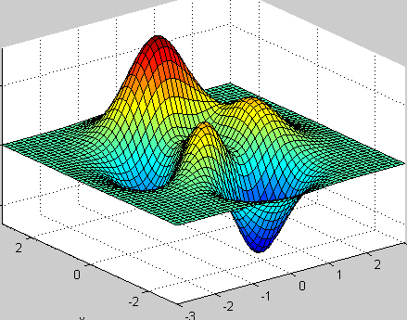


Falsification using Optimization
$$y(t)$$
$$u(t)$$
\
\
Minimize robustness
Compute Robustness
ϕ

Slide 42
Step-by-step of how falsification works
Given: a finite parameterization for input signals, a model that can be simulated and an STL property
While the number of allowed iterations is not exhausted do:
pick values for the signal parameters
generate an input signal
run simulation with generated input signal to get output signal
compute robustness value of given property w.r.t. the input/output signals
if robustness value is negative, HALT
pick a new set of values for the signal parameters based on certain heuristics

Slide 43
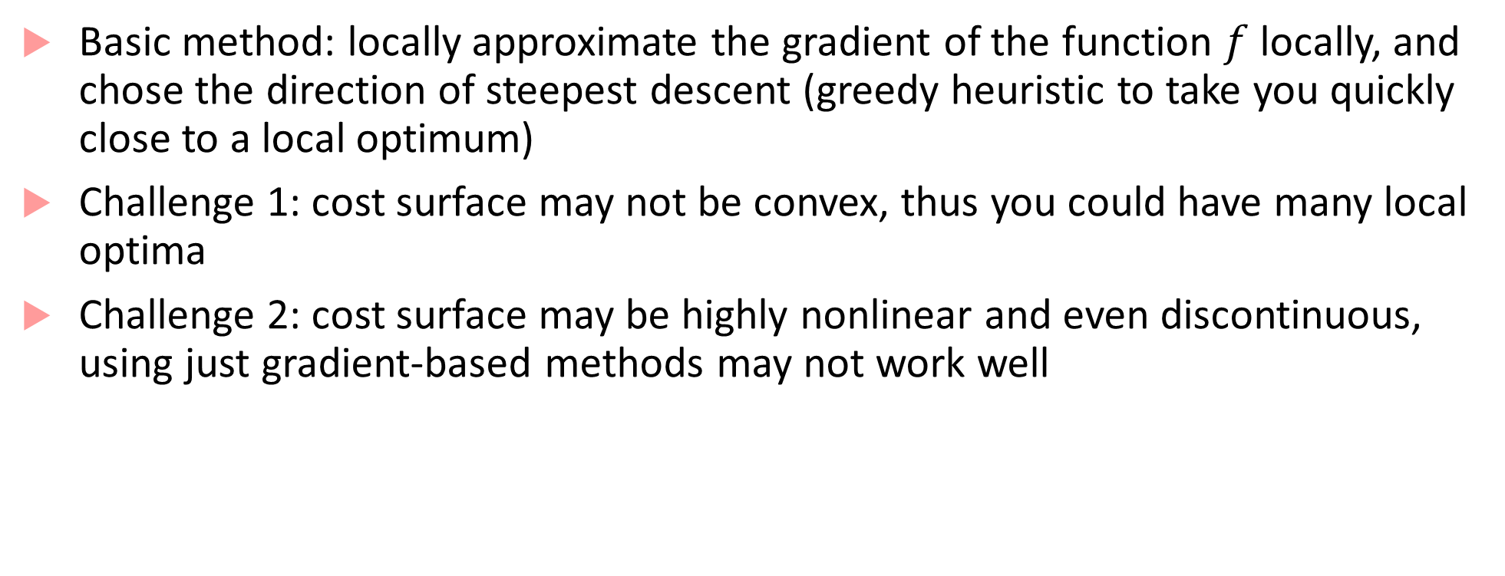
Picking new parameter values to explore
Basic method: locally approximate the gradient of the function $f$ locally, and chose the direction of steepest descent (greedy heuristic to take you quickly close to a local optimum)
Challenge 1: cost surface may not be convex, thus you could have many local optima
Challenge 2: cost surface may be highly nonlinear and even discontinuous, using just gradient-based methods may not work well

Slide 44
Exploring parameter space using heuristic search
Heuristics rely on:
combining gradient-based methods with perturbing the search strategy (e.g. simulated annealing, stochastic local search with random restarts)
evolutionary strategies: Covariance Matrix Adaptation Evolution Strategy (CMA-ES), genetic algorithms etc.
probabilistic techniques: Ant Colony Optimization, Cross-Entropy optimization, Bayesian optimization
Can also pick random sampling as a (not very good) strategy!

Slide 45






Stochastic Tabu-Search and Refinement
3
$$u$$
$$u$$
$$(+, +, −)$$
$$w_{1}$$
3
1
time
3
1
-2
Neighbor 1: (3,1,-2)
1
time
time
-3
-2
3
-3
$$w_{2}$$
Ego point: (1,-2,1)
$$(−, −, +)$$
1
time
-2
-3
-2
Neighbor 2: (-2,-3,-2)
Tabu List
-3
Point | Robustness
(1, -2, 1) | 30
(3, 1, -2) | 40
(-2, -3, -2) | 10
(-3, -2, -3) | 5
(1, -3, 1) | 10
Key Idea: Make input signal space finite (even further simplification than finite parameterization)
Stochastically estimate least cost neighbor and descend to it
Use Tabu-list to avoid revisiting points
Use random restarts to escape local optima
Refine search space in promising regions

Slide 46
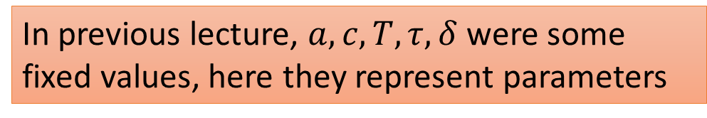
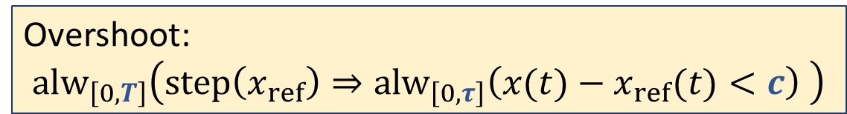
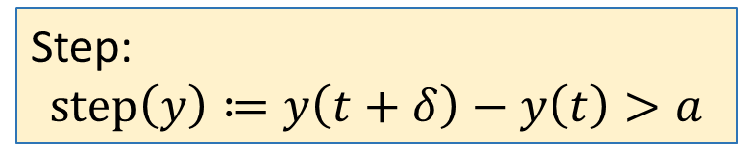
Specification Templates using PSTL
If we convert all values in an STL formula to parameters, then we get a specification template, or a Parametric STL (PSTL) formula
PSTL = Parametric Signal Temporal Logic
In previous lecture, $a,c,T,τ, δ$ were some fixed values, here they represent parameters
$$x$$
$$x_{ref}$$
$$c$$
Step:
$$step\left(y\right)≔y\left(t+δ\right)−y\left(t\right)>a$$
$$δ$$
$$a$$
Overshoot:
$${alw}_{\left[0,T\right]}\left(step\left(x_{ref}\right)⇒{alw}_{\left[0,τ\right]}\left(x(t)−x_{ref}(t)<c\right) \right)$$
$$τ$$
$$T$$
time

Slide 47
Specification Mining
Specification Mining: Try to find values of parameters of a PSTL formula from a given model
Why?
Good to know “as-is” properties of the model
Finds worst-case behaviors of the model
Can be used to do design-space exploration

Slide 48
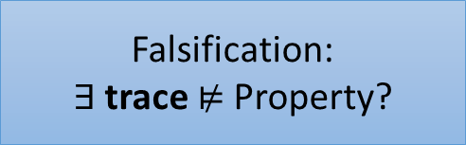
Specification Mining
Falsification:
$∃$ trace ⊭ Property?
YES
1.
1.
Counterexamples
YES
m.
n.
1.
NO
Parameter Inference:
Find “Tightest” Answers
Settling Time is 5 ms
Overshoot is 5 KPa
Upper Bound on x is 3.6
Settling Time is 6 ms
Overshoot is 5.5 KPa
Upper Bound on x is 5
Settling Time is ??
Overshoot is ??
Bounds on x are ??
Settling Time is 6 ms
Overshoot is 5.5 KPa
Upper Bound on x is 5

Slide 49
Specification Mining
Falsification:
$∃$ trace ⊭ Property?
YES
1.
1.
YES
Secret Sauce:
Infer parameters for a given PSTL formula from traces
Falsify given STL formula
Counterexamples
m.
n.
1.
NO
Parameter Inference:
Find “Tightest” Answers
Settling Time is 5 ms
Overshoot is 5 KPa
Upper Bound on x is 3.6
Settling Time is 6 ms
Overshoot is 5.5 KPa
Upper Bound on x is 5
Settling Time is ??
Overshoot is ??
Bounds on x are ??
Settling Time is 6 ms
Overshoot is 5.5 KPa
Upper Bound on x is 5

Slide 50







Parameter inference for PSTL
$$x$$
Given:
PSTL formula $φ\left(p\right)$, [$p=$ $\left(p_{1},p_{2},…, p_{m}\right)$]
Traces $x_{1},…,x_{n}$
Find:
Valuation $ν(p)$ such that: $∀i :x_{i}⊨φ\left(ν\left(p\right)\right)$
c= 1000
Problem: Could find very conservative valuations!!
c = 1.5
$δ$-tight valuation
$$Alw(x<c)$$
and $∃i:x_{i}\text{⊭}φ\left(ν\left(p\right)±δ\right)$ :
i.e. small perturbation in $ν(p)$ makes some trace not satisfy formula
time
formula sat for given valuation $⇒$ $∀$ greater (or lesser) valuations sat
Finding $δ$-tight valuations hard in general, but efficient for Monotonic PSTL
Binary search on parameter space

Slide 51
Bibliography
G. Fainekos, and G. J. Pappas. Robustness of temporal logic specifications for continuous-time signals. Theoretical Computer Science 2009.
Maler, Oded, and Dejan Nickovic. "Monitoring temporal properties of continuous signals." Formal Techniques, Modelling and Analysis of Timed and Fault-Tolerant Systems. Springer, Berlin, Heidelberg, 2004. 152-166.
Donzé, Alexandre, and Oded Maler. "Robust satisfaction of temporal logic over real-valued signals." International Conference on Formal Modeling and Analysis of Timed Systems. Springer, Berlin, Heidelberg, 2010.
Kapinski, James, et al. ST-Lib: A library for specifying and classifying model behaviors. No. 2016-01-0621. SAE Technical Paper, 2016.

Slide 52
Bibliography
Several excellent papers on the first development of falsification technology can be found on the web-site of S-TaLiRo : https://sites.google.com/a/asu.edu/s-taliro/references
Breach : https://link.springer.com/chapter/10.1007/978-3-642-14295-6_17
Jyotirmoy Deshmukh, Marko Horvat, Xiaoqing Jin, Rupak Majumdar, and Vinayak S. Prabhu. 2017. Testing Cyber-Physical Systems through Bayesian Optimization. ACM Trans. Embed. Comput. Syst. 16, 5s, Article 170 (September 2017)
Deshmukh, Jyotirmoy, Xiaoqing Jin, James Kapinski, and Oded Maler. Stochastic Local Search for Falsification of Hybrid Systems. In International Symposium on Automated Technology for Verification and Analysis, pp. 500-517.
Jin, Deshmukh et al. Mining Requirements from Closed-loop Control Models (HSCC ’13, IEEE Trans. On Computer Aided Design ’15)

