Slide 1
Autonomous Cyber-Physical Systems: Signal Temporal Logic
Spring 2018. CS 599.
Instructor: Jyo Deshmukh

Slide 2
Overview
Last lecture
CTL, pCTL
This lecture
STL: A requirements language for Cyber-Physical Systems

Slide 3
Let’s reduce the engine size and add a turbocharger
Sure, how does the turbocharger behave? How can I model it?
How does CPS software design actually happen in reality?
It’s still being designed
Let me assume a textbook model..
Here’s some hardware spec data
I enhanced the physics-based model and tuned it to match your data, and have a controller that works!
Actually, here’s some new data, the hardware specs changed
The new specs need to have X,Y,Z characteristics
Here’s my final controller specification model
Here’s my final hardware design
Closed-Loop System Model

Slide 4



What are closed-loop models used for?
Testing design quality!
Control Designer
Check transient response of x when driving with highway 73 pattern with temperature below freezing
Chief Engineer

Slide 5


Typical day in a control designer’s life
$x$,
$$x_{ref}$$
Uh Oh!
time
$x$,
$$x_{ref}$$
… should be okay
time
Looks good
$x$,
$$x_{ref}$$
time

Slide 6
Signal Temporal Logic (STL)
STL can be used as a logic to formalize many control-theoretic properties, properties of path-planning algorithms, express timing constraints and causality relations
LTL/CTL: languages to express properties of discrete-timed, discrete-valued reactive systems
Operating systems, Distributed systems, shared-memory programs, device drivers etc.
STL: started as a logic to express properties of mixed-signal and analog circuits
Invented by Dejan Nickovic and Oded Maler from Verimag

Slide 7
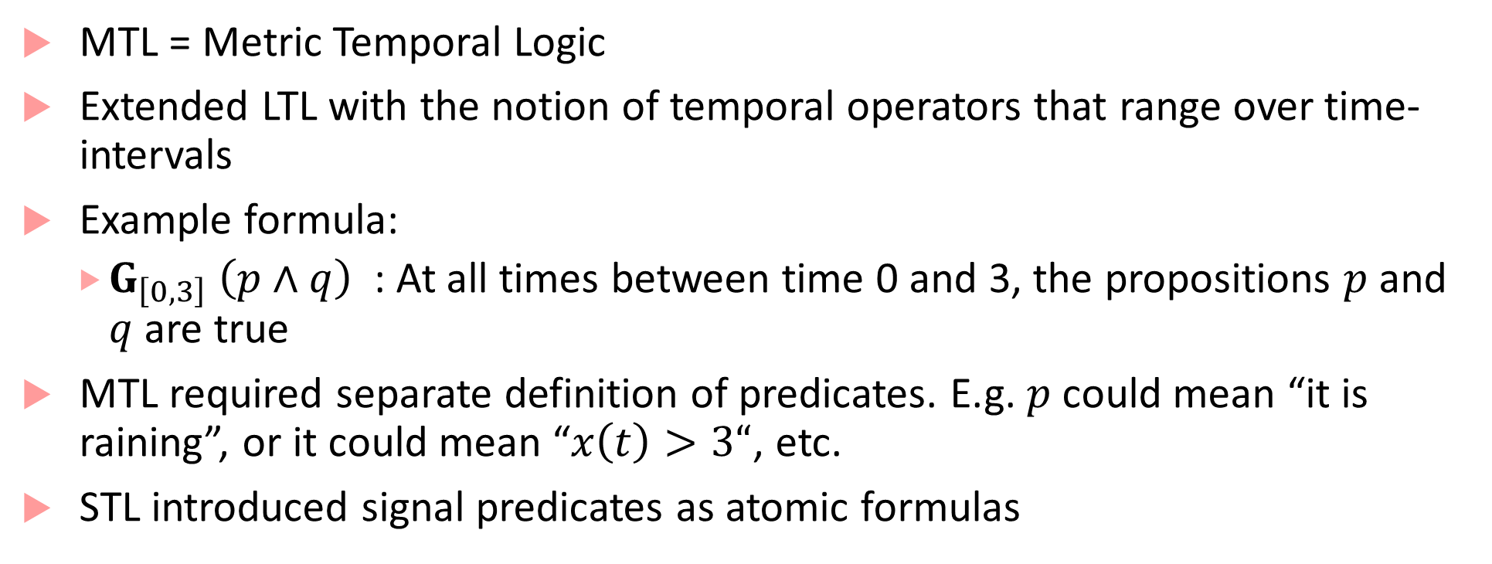
Before STL, there was MTL
MTL = Metric Temporal Logic
Extended LTL with the notion of temporal operators that range over time-intervals
Example formula:
$G_{\left[0,3\right]} \left(p∧q\right)$ : At all times between time 0 and 3, the propositions $p$ and $q$ are true
MTL required separate definition of predicates. E.g. $p$ could mean “it is raining”, or it could mean “$x\left(t\right)>3“$, etc.
STL introduced signal predicates as atomic formulas

Slide 8




Expressing specifications in STL
$${Always}_{[0,100]} \left(1≤x\left(t\right)≤3\right)$$
3
1
$$t$$
Always between time 0 and 100
0
50
100
$$x$$
1
$$t$$
$${Eventually}_{\left[20,60\right]}\left(Always \left(\left|x(t)\right|<0.1\right) \right)$$
+0.1
-0.1
60
0
100
Eventually at some time t between time 20 and 60
From that time t, always till the end of the signal trace

Slide 9


Can we express our engineer’s requirements?
$x$,
$$x_{ref}$$
Uh Oh!
time
$x$,
$$x_{ref}$$
… should be okay
time
Looks good
$x$,
$$x_{ref}$$
time
$$φ≡{Alw}_{\left[0,10\right]}\left(step⇒{Alw}_{\left[0,2\right]}\left(\left|x−x_{ref}\right|<0.05x_{ref}\right) \right)$$

Slide 10
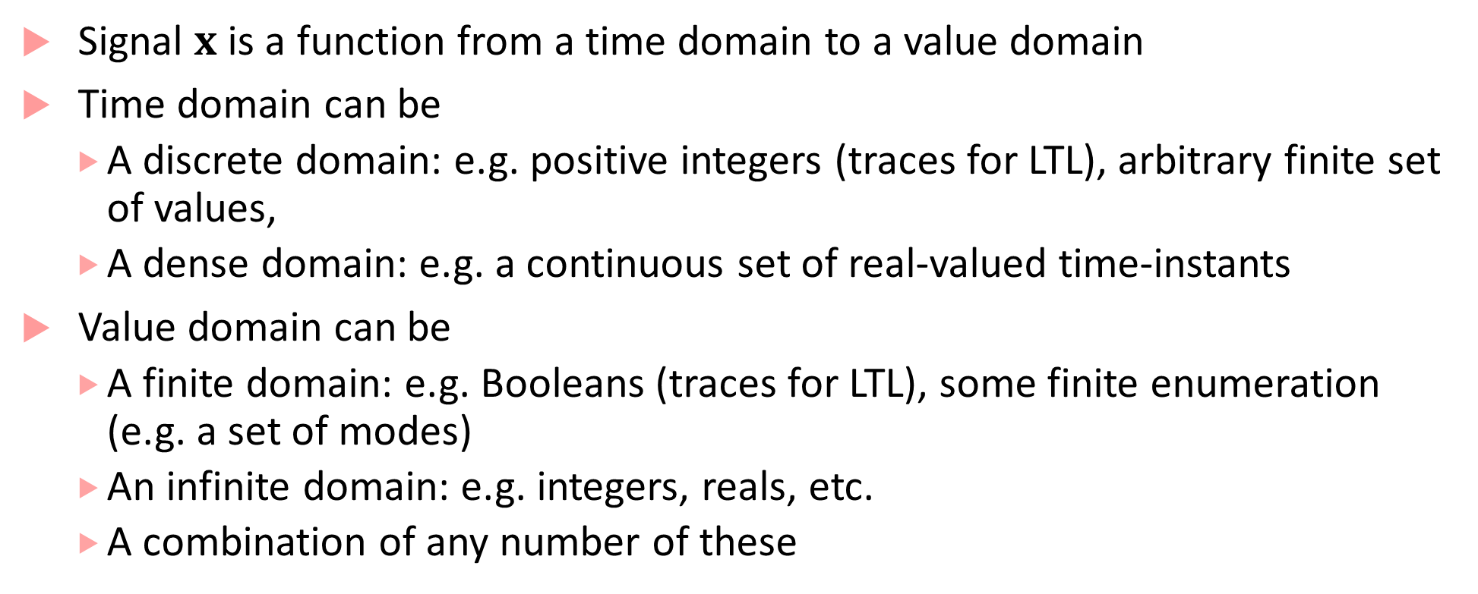
STL is interpreted over Signals
Signal $x$ is a function from a time domain to a value domain
Time domain can be
A discrete domain: e.g. positive integers (traces for LTL), arbitrary finite set of values,
A dense domain: e.g. a continuous set of real-valued time-instants
Value domain can be
A finite domain: e.g. Booleans (traces for LTL), some finite enumeration (e.g. a set of modes)
An infinite domain: e.g. integers, reals, etc.
A combination of any number of these

Slide 11
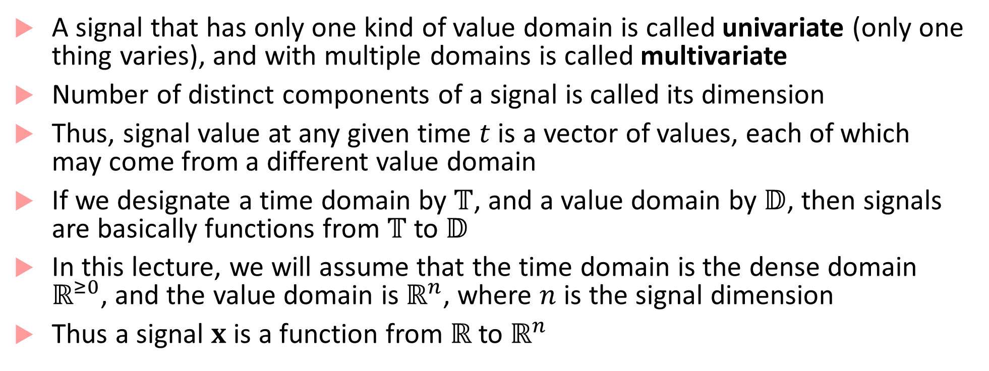
More about Signals
A signal that has only one kind of value domain is called univariate (only one thing varies), and with multiple domains is called multivariate
Number of distinct components of a signal is called its dimension
Thus, signal value at any given time $t$ is a vector of values, each of which may come from a different value domain
If we designate a time domain by $𝕋$, and a value domain by $𝔻$, then signals are basically functions from $𝕋$ to $𝔻$
In this lecture, we will assume that the time domain is the dense domain $ℝ^{≥0}$, and the value domain is $ℝ^{n}$, where $n$ is the signal dimension
Thus a signal $x$ is a function from $ℝ$ to $ℝ^{n}$

Slide 12
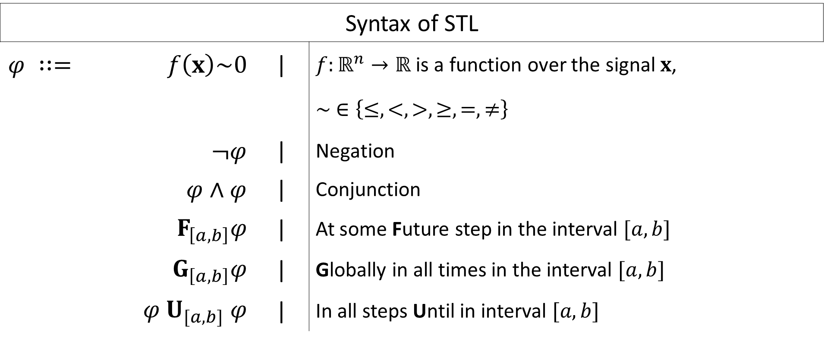
STL Syntax
Syntax of STL
$$φ ∷=$$ | $$f\left(x\right)\sim 0$$ | | | $f:ℝ^{n}→ℝ$ is a function over the signal $x$,
 |  |  | $$∼ ∈\left\{≤,<,>,≥,=,≠\right\}$$
 | $¬φ$ | | | Negation
 | $φ∧φ$ | | | Conjunction
 | $$F_{\left[a,b\right]}φ$$ | | | At some Future step in the interval $[a,b]$
 | $$G_{\left[a,b\right]}φ$$ | | | Globally in all times in the interval $[a,b]$
 | $$φ U_{[a,b]} φ$$ | | | In all steps Until in interval $[a,b]$

Slide 13

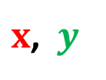
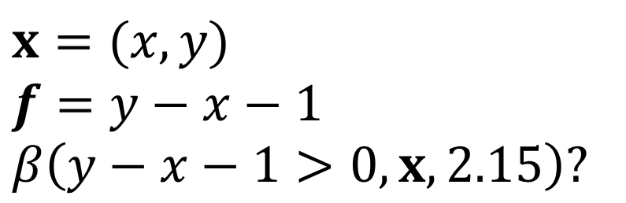




STL semantics
Semantics of STL specified recursively over a signal at each time
For each STL formula $φ$, here’s how we define it’s semantics:
If $φ$ is the signal predicate $f\left(x\right)>0$, then $β\left(φ, x,t\right)=true$iff $f\left(x\left(t\right)\right)>0$
$x$, $y$
$$x=(x,y)$$
$$f=y−x−1$$
$$β\left(y−x−1>0, x, 2.15\right)?$$
$$2$$
$$1$$
$$2.15$$
$$t$$

Slide 14
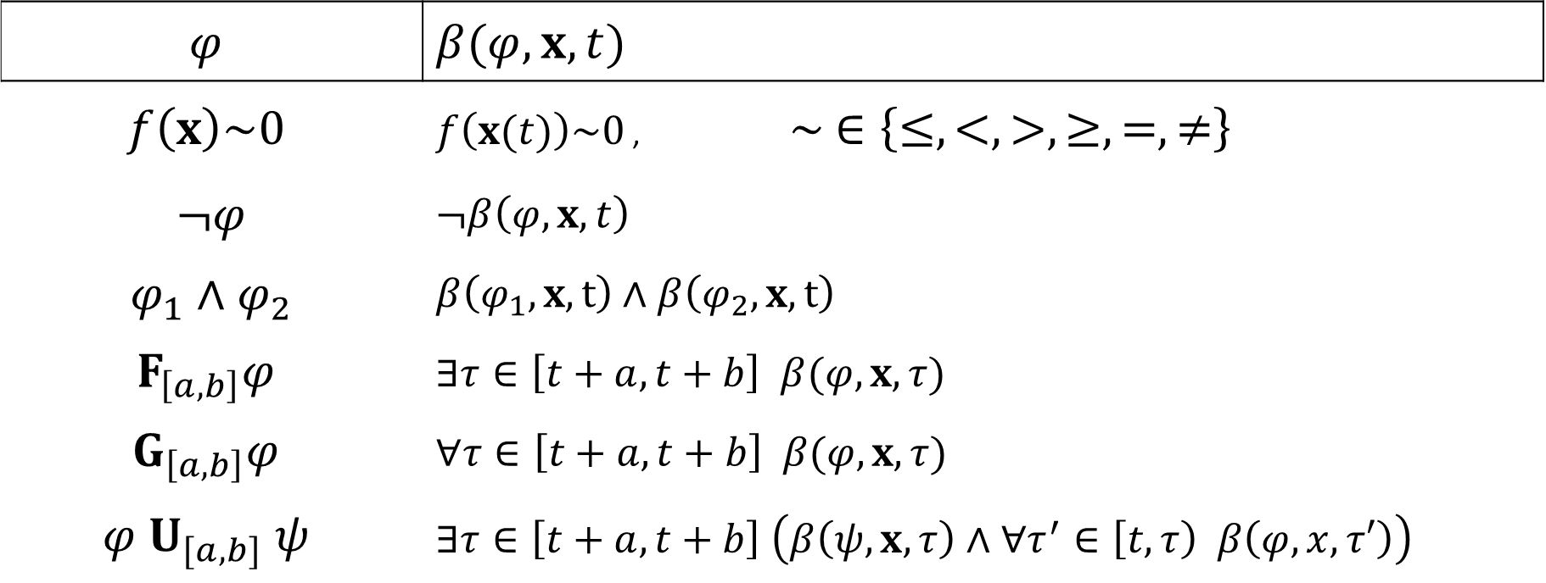
Recursive Boolean Semantics of STL
$$φ$$ | $$β(φ,x,t)$$
$f\left(x\right)\sim 0$ | $f\left(x(t)\right)\sim 0$ , $∼ ∈\left\{≤,<,>,≥,=,≠\right\}$
$¬φ$ | $$¬β\left(φ, x,t\right)$$
$φ_{1}∧φ_{2}$ | $$β\left(φ_{1},x,t\right)∧β\left(φ_{2},x,t\right)$$
$$F_{\left[a,b\right]}φ$$ | $$∃τ∈\left[t+a,t+b\right] β(φ,x, τ)$$
$$G_{\left[a,b\right]}φ$$ | $$∀τ∈\left[t+a,t+b\right] β(φ,x, τ)$$
$$φ U_{[a,b]} ψ$$ | $$∃τ∈\left[t+a,t+b\right] \left(β\left(ψ, x, τ\right)∧∀τ^{′}∈\left[t, τ\right) β\left(φ,x,τ′\right)\right)$$

Slide 15
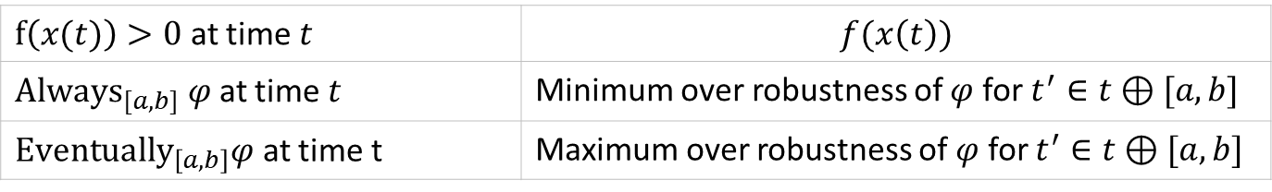
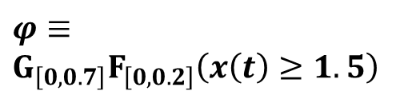
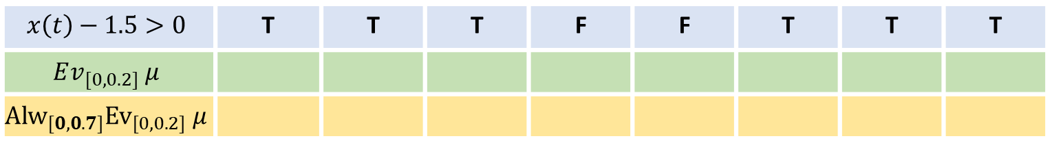
Recursive Boolean Semantics of STL
3
$$φ≡$$
$$G_{\left[0,0.7\right]}F_{\left[0,0.2\right]}\left(x\left(t\right)≥1.5\right)$$
2
1
0,0
0.1
0.2
0.3
0.4
0.5
0.6
0.7
$$x\left(t\right)−1.5>0$$ | T | T | T | F | F | T | T | T
$$Ev_{[0,0.2]} μ$$
$${Alw}_{[0,0.7]}{Ev}_{[0,0.2]} μ$$
T
T
T
T
T
T
T
$f\left(x(t)\right)>0$ at time $t$ | $$f(x\left(t\right))$$
${Always}_{[a,b]} φ$ at time $t$ | Minimum over robustness of $φ$ for $t^{′}∈t⊕[a,b]$
${Eventually}_{\left[a,b\right]}φ$ at time t | Maximum over robustness of $φ$ for $t^{′}∈t⊕[a,b]$

Slide 16

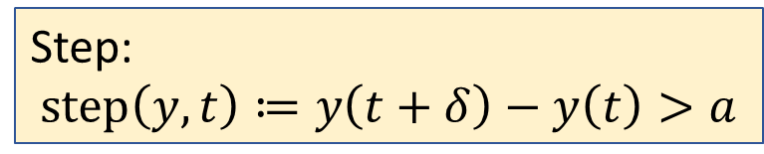

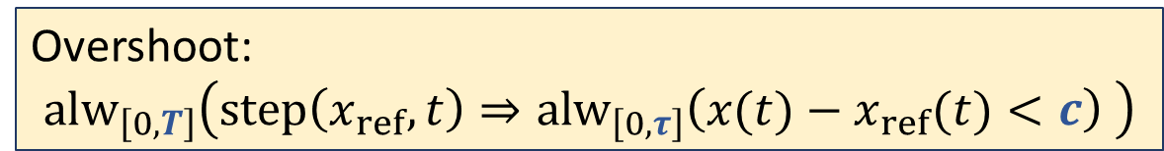





Example STL formulas: Overshoot
$$x$$
$$x_{ref}$$
$$c$$
Step:
$$step\left(y,t\right)≔y\left(t+δ\right)−y\left(t\right)>a$$
$$δ$$
$$a$$
Overshoot:
$${alw}_{\left[0,T\right]}\left(step\left(x_{ref},t\right)⇒{alw}_{\left[0,τ\right]}\left(x(t)−x_{ref}(t)<c\right) \right)$$
$$τ$$
$$T$$
time

Slide 17

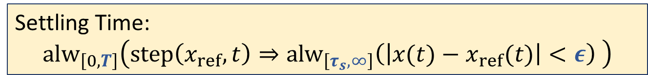



Example STL formulas: Settling Time
$$x$$
$$x_{ref}$$
Step:
$$step\left(y,t\right)≔y\left(t+δ\right)−y\left(t\right)>a$$
$$ε$$
$$a$$
Settling Time:
$${alw}_{\left[0,T\right]}\left(step\left(x_{ref},t\right)⇒{alw}_{\left[τ_{s},∞\right]}\left(\left|x(t)−x_{ref}(t)\right|<ε\right) \right)$$
$$τ_{s}$$
$$T$$
time

Slide 18

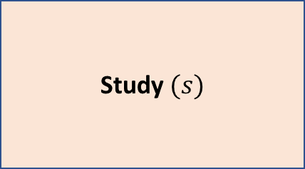
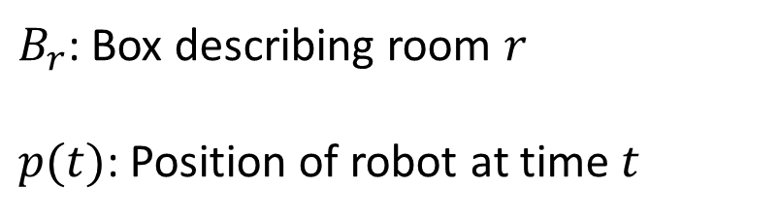

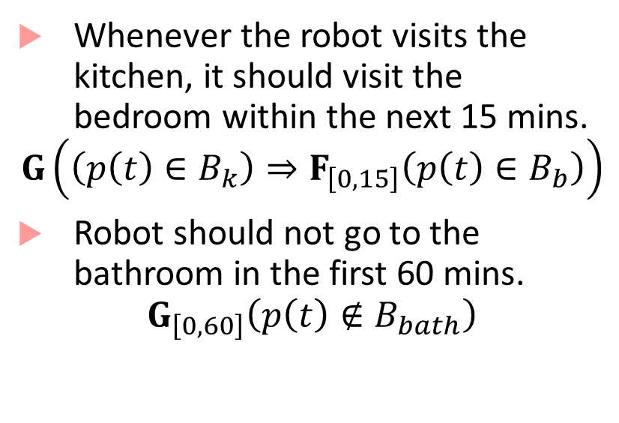
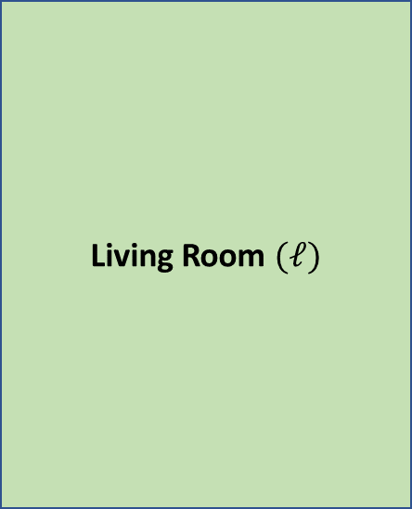
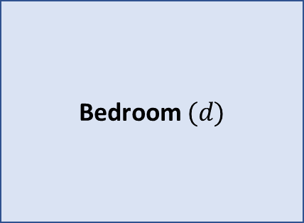

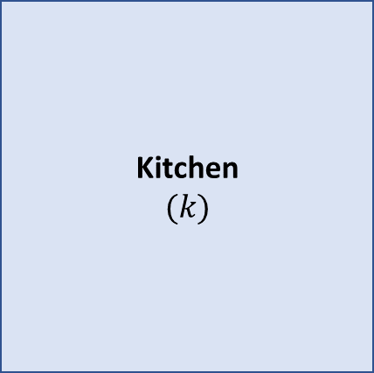
Robot Path Specification
(15,25)
Kitchen
$$(k)$$
Living Room $(ℓ)$
Study $(s)$
Whenever the robot visits the kitchen, it should visit the bedroom within the next 15 mins.
$$G\left(\left(p\left(t\right)∈B_{k}\right)⇒F_{\left[0,15\right]}\left(p\left(t\right)∈B_{b}\right)\right)$$
Robot should not go to the bathroom in the first 60 mins.
$$G_{\left[0,60\right]}\left(p\left(t\right)∉B_{bath}\right)$$
Passage $(p)$
Bedroom $(d)$
(0,5)
Bathroom $(b)$
$B_{r}$: Box describing room $r$
$p(t)$: Position of robot at time $t$
TV
${p\left(t\right)∈B}_{k} :\left(0<p_{x}\left(t\right)<15\right)∧\left(5 <p_{y}\left(t\right)<25\right)$

Slide 19

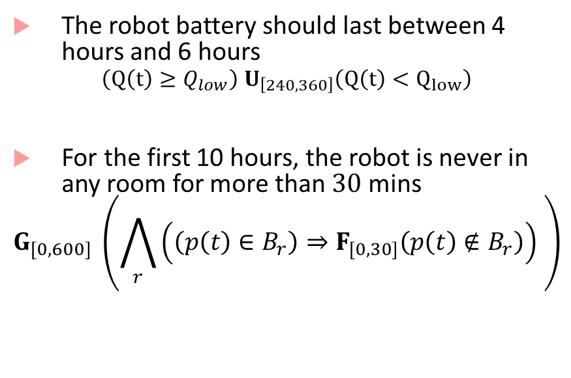
Robot Path Specification
Kitchen
$$(k)$$
Living Room $(ℓ)$
Study $(s)$
Passage $(p)$
The robot battery should last between 4 hours and 6 hours
$$\left(Q\left(t\right)≥Q_{low}\right) U_{\left[240,360\right]}\left(Q\left(t\right)<Q_{low}\right)$$
For the first 10 hours, the robot is never in any room for more than $30$ mins
$$G_{[0,600]} \left(\bigwedge_{r}{\left(\left(p\left(t\right)∈B_{r}\right)⇒F_{\left[0,30\right]}\left(p\left(t\right)∉B_{r}\right)\right)} \right)$$
Bedroom $(d)$
Bathroom $(b)$

Slide 20
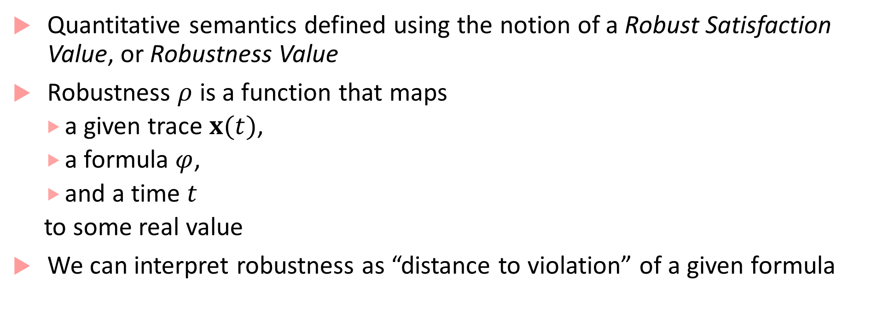
STL has quantitative semantics
Quantitative semantics defined using the notion of a Robust Satisfaction Value, or Robustness Value
Robustness $ρ$ is a function that maps
a given trace $x(t)$,
a formula $φ$,
and a time $t$
to some real value
We can interpret robustness as “distance to violation” of a given formula

Slide 21

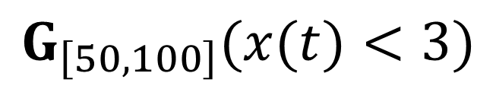



Distance to violation/satisfaction
GOOD
BAD
GOOD
BAD
$$x$$
$$x$$
3
3
How far is
bad?
How bad is the violation?
$$t$$
$$t$$
0
100
0
50
100
50
$$G_{\left[50,100\right]}(x(t)<3)$$

Slide 22



How do quantitative semantics help our engineer?
$x$,
$$x_{ref}$$
$$f_{φ}$$
= -0.2
Uh Oh!
time
$x$,
$$x_{ref}$$
… should be okay
$$f_{φ}$$
time
= 0.01
Looks good
$x$,
$$x_{ref}$$
$$f_{φ}$$
= 0.2
time
$$φ≡{Alw}_{\left[0,10\right]}\left(step⇒{Alw}_{\left[0,2\right]}\left(\left|x−x_{ref}\right|<0.05x_{ref}\right) \right)$$

Slide 23
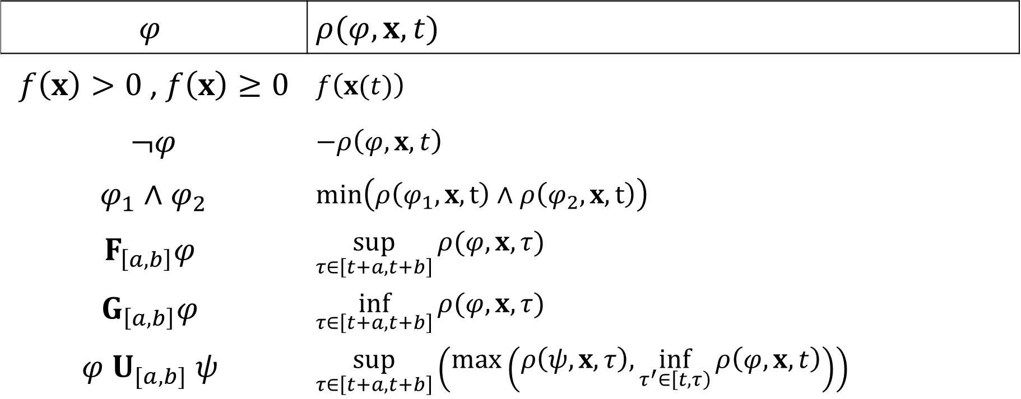
Recursive Quantitative Semantics
$$φ$$ | $$ρ(φ,x,t)$$
$f\left(x\right)>0$, $f\left(x\right)≥0$ | $f\left(x(t)\right)$
$¬φ$ | $$−ρ\left(φ,x,t\right)$$
$φ_{1}∧φ_{2}$ | $$min\left(ρ\left(φ_{1},x,t\right)∧ρ\left(φ_{2},x,t\right)\right)$$
$$F_{\left[a,b\right]}φ$$ | $$\sup_{τ∈\left[t+a,t+b\right]}{ρ(φ,x, τ)}$$
$$G_{\left[a,b\right]}φ$$ | $$\inf_{τ∈\left[t+a,t+b\right]}{ρ(φ,x, τ)}$$
$$φ U_{[a,b]} ψ$$ | $$\sup_{τ∈\left[t+a,t+b\right]}\left(\max\left(ρ\left(ψ,x, τ\right),\inf_{τ^{′}∈\left[t,τ\right)}{ρ\left(φ,x,t\right)}\right)\right)$$

Slide 24

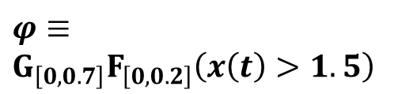
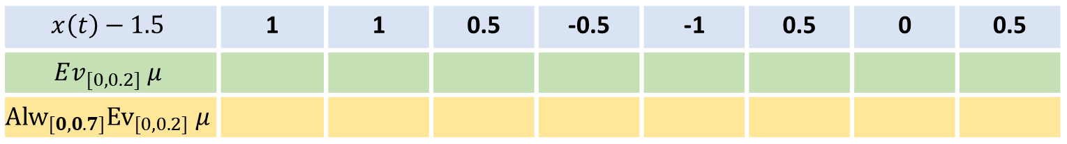
Robustness computation example
3
$$φ≡$$
$$G_{\left[0,0.7\right]}F_{\left[0,0.2\right]}\left(x\left(t\right)>1.5\right)$$
2
1
0,0
0.1
0.2
0.3
0.4
0.5
0.6
0.7
$$x\left(t\right)−1.5$$ | 1 | 1 | 0.5 | -0.5 | -1 | 0.5 | 0 | 0.5
$$Ev_{[0,0.2]} μ$$
$${Alw}_{[0,0.7]}{Ev}_{[0,0.2]} μ$$
$$μ≡x\left(t\right)>1.5$$
1
1
0.5
0.5
0.5
0.5
0.5
$f\left(x(t)\right)>0$ at time $t$ | $$f(x\left(t\right))$$
${Always}_{[a,b]} φ$ at time $t$ | Minimum over robustness of $φ$ for $t^{′}∈t⊕[a,b]$
${Eventually}_{\left[a,b\right]}φ$ at time t | Maximum over robustness of $φ$ for $t^{′}∈t⊕[a,b]$

Slide 25
Next lecture
How do we use STL for testing, falsification
How can we infer STL requirements from a model

Slide 26
Bibliography
G. Fainekos, and G. J. Pappas. Robustness of temporal logic specifications for continuous-time signals. Theoretical Computer Science 2009.
Maler, Oded, and Dejan Nickovic. "Monitoring temporal properties of continuous signals." Formal Techniques, Modelling and Analysis of Timed and Fault-Tolerant Systems. Springer, Berlin, Heidelberg, 2004. 152-166.
Donzé, Alexandre, and Oded Maler. "Robust satisfaction of temporal logic over real-valued signals." International Conference on Formal Modeling and Analysis of Timed Systems. Springer, Berlin, Heidelberg, 2010.
Kapinski, James, et al. ST-Lib: A library for specifying and classifying model behaviors. No. 2016-01-0621. SAE Technical Paper, 2016.

