Slide 1
Autonomous Cyber-Physical Systems: Model-based Design & Synchronous Components
Spring 2018. CS 599.
Instructor: Jyo Deshmukh
Acknowledgment: Some of the material in these slides is based on the lecture slides for CIS 540: Principles of Embedded Computation taught by Rajeev Alur at the University of Pennsylvania. http://www.seas.upenn.edu/~cis540/

Slide 2
Model-based Development (MBD) or design
Most popular paradigm in CPS software development
We will learn various aspects of MBD through this course
MBD when used for designing embedded software¹ has 4 main steps
Model the physical components/environment (also known as a plant model)
Analyze the plant, and synthesize/design the control-software at a high-level
Co-Simulate the plant and control-software
Automatically generate code from the control-software model for deployment
Popular MBD frameworks such as Simulink®, LabView™, RationalRose, DyMola, TargetLink, Scade, etc.
[1] Nicolescu, Gabriela; Mosterman, Pieter J., eds. (2010). Model-Based Design for Embedded Systems. Computational Analysis, Synthesis, and Design of Dynamic Systems. 1. Boca Raton: CRC Press.

Slide 3
Our programs will be MBD models
MBD languages are often visual and block-diagram based, e.g. Simulink
We know how to interpret a file containing C, Java, Python, Haskell, Ocaml, or any other imperative/functional program
How do we interpret MBD programs? What are their execution semantics?

Slide 4
Most convenient model of computation for an Autonomous CPS is a
reactive and concurrent model of computation.
An autonomous CPS can be viewed as a network of components that communicate
either synchronously or asynchronously.

Slide 5
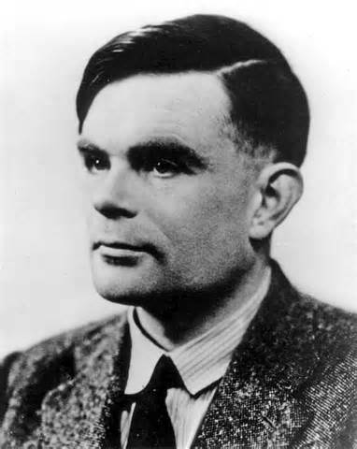
Models of Computation: Functional
Classical model of computation: Functional or Transformational Programs
Start from a given input,
Produce a certain output and then terminate
Desired functionality can be described by a mathematical function
Emphasis is on data computation
Canonical model: Turing machines e.g. compute square-root, encrypt some text, etc.

Slide 6
Models of Computation: Reactive/Interactive
Interactive Programs:
Interact with the user in their own time, i.e. react to user’s commands, but with no real-time constraints
Emphasis is on user-interaction; e.g. a web browsers, word processors, etc.
Reactive Programs:
Continuously interact with the environment at a rate decided by the environment
Emphasis is on system-environment interaction; e.g. airline autopilot, mail-servers, etc.

Slide 7
Sequential vs. Concurrent Processing
Classical model: Sequential
Entire computation is a linear sequence of instructions executed one at a time
Program execution is deterministic
Concurrent computation
Multiple “threads” of execution, possibly exchanging information and evolving concurrently
Key distinction imposed by regime in which threads exchange information:
Synchronous: under a global “clocking” mechanism that forces lock-step computation
Asynchronous: No central coordination

Slide 8
Synchronous Models
All components execute in a sequence of rounds in lock-step
Example:
Components in a digital hardware circuit with a central global clock
Fixed-step Simulation Models of Discrete Components in Simulink

Slide 9
Synchronous languages
Rich class of languages called “synchronous dataflow”
Benefit: system design is simpler if we use a simple round-based computation
Challenge: How do we ensure synchronous execution when components may execute on different hardware?

Slide 10
Basic Layout of a Synchronous Component
State Variables Declaration and initialization
Update action that happens in each round
Input Names and Types
Output Names and Types
Component

Slide 11
Simplest synchronous component: delay
(Boolean = { 0, 1})
Input variable: in of type Boolean
Output variable: out of type Boolean
State variable: x of type Boolean, initialized to 0
In each round, component updates output from the state and state from input
bool in
bool out
bool x := 0
out:=x ; x:= in

Slide 12
Execution of “Delay”
Initialize state to 0
Repeatedly execute rounds
In each round:
Choose value for input (provided from environment, e.g. by user)
Execute update code
bool in
bool out
bool x := 0
out:=x ; x:= in
1 / 0
1 / 1
0 / 1
0 / 0
1 / 0
0
1
1
0
0
1

Slide 13
Synchrony hypothesis
Time needed to execute update is negligible compared to arrival times between consecutive inputs
Synchronous execution is a logical abstraction
Execution time of update code is 0
Production of outputs, updates to state and arrival of inputs happen instantaneously
With multiple components, assume all execute synchronously and simultaneously
Burden on design-time to validate hypothesis

Slide 14
Composition of Synchronous Components
bool in₁
bool out₁
bool in₂
bool out₂
bool x₁ := 0
bool x₂ := 1
out₁:=x₁ ; x₁:= in₁
out₂:=x₂ ; x₂:= in₂
Delay sequentially composed with Delay

Slide 15
Composition of Synchronous Components
bool in₁
bool out₁
bool in₂
bool out₂
bool x₁ := 1
bool x₂ := 0
Observe:
in₂ is the same as out₁ in every round
Ignoring first 2 rounds, outputs of d2 are the inputs to d1 delayed by 2 rounds
out₁:=x₁ ; x₁:= in₁
out₂:=x₂ ; x₂:= in₂
1 / 1
0 / 1
0 / 0
1 / 0
1 / 1
1
1
0
0
1
1
Delay 1
1 / 0
1 / 1
0 / 1
0 / 0
1 / 0
Delay 2
0
1
1
0
0
1

Slide 16
What does this model achieve?
bool in
int y:= 0
int c
bool d := 0
int out
bool warn
if (c > 0)
if (d != 0)
warn:=1;
else
d := 1;
end
else
d := 0;
end
out:=y ;
if (in==0)
y:= y + 1
else
y:= y-1

Slide 17
Next class:
More on Synchronous Components and a preview of a simple semi-autonomous CPS model

