Slide 1
Autonomous Cyber-Physical Systems: Verification Basics + V2X + Wrap-up
Spring 2019. CS 599.
Instructor: Jyo Deshmukh

Slide 2
Safety Requirements
A safety requirement states that a system always stays within the set of good states (i.e. nothing bad every happens)
Examples:
Collision avoidance: the distance between a car and a pedestrian is always greater than a threshold
Patient’s blood glucose never drops below 80 mg/dL
Maximum temperature specification on the battery is not exceeded
Safety requirements can be formalized using transition systems

Slide 3
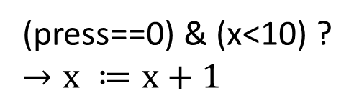
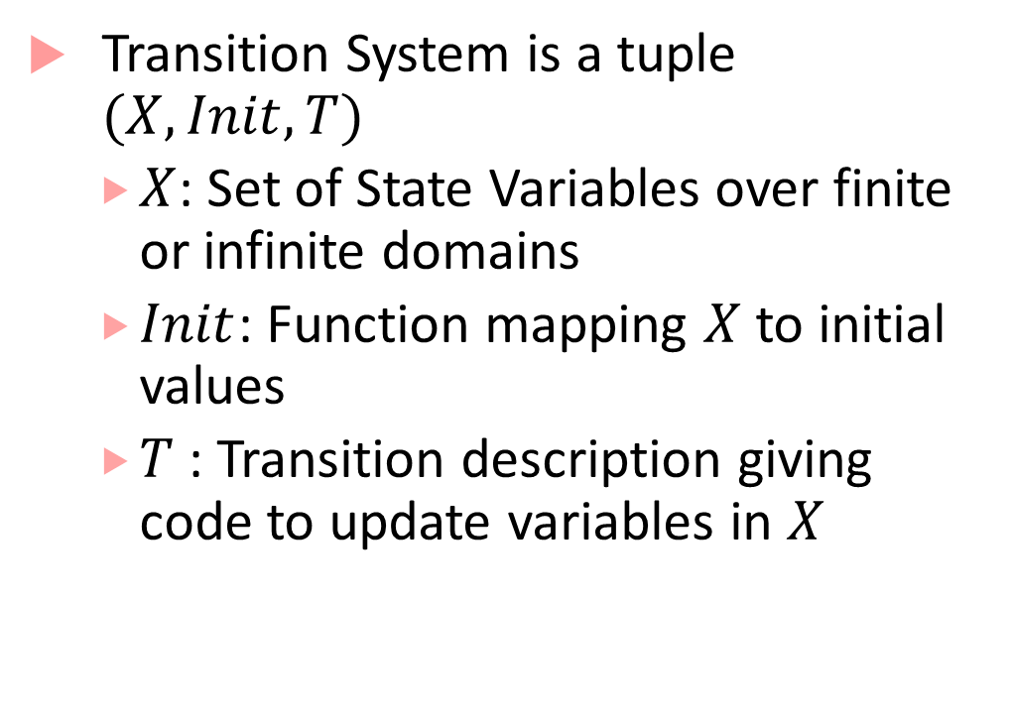
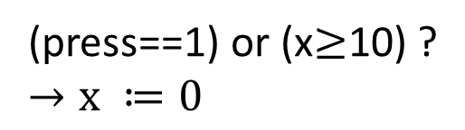

Transition System
$int x≔$0
Transition System is a tuple $(X,Init,T)$
$X$: Set of State Variables over finite or infinite domains
$Init$: Function mapping $X$ to initial values
$T$ : Transition description giving code to update variables in $X$
off
(press==1)?
(press==0)?
on
(press==1) or (x$≥$10) ?
$$→x ≔0$$
(press==0) & (x<10) ?
$$→x ≔x+1$$

Slide 4
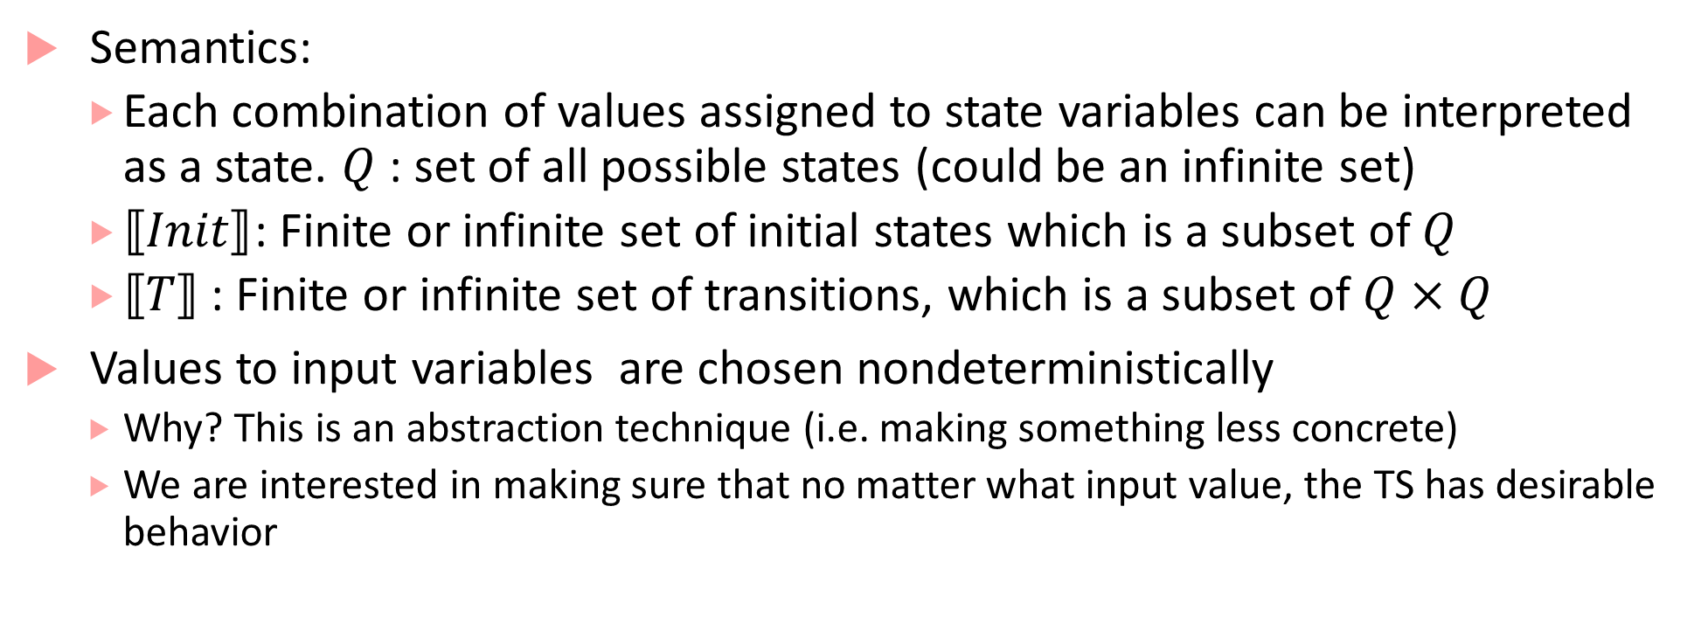
Transition System
Semantics:
Each combination of values assigned to state variables can be interpreted as a state. $Q$ : set of all possible states (could be an infinite set)
$⟦Init⟧$: Finite or infinite set of initial states which is a subset of $Q$
$⟦T⟧$ : Finite or infinite set of transitions, which is a subset of $Q×Q$
Values to input variables are chosen nondeterministically
Why? This is an abstraction technique (i.e. making something less concrete)
We are interested in making sure that no matter what input value, the TS has desirable behavior

Slide 5
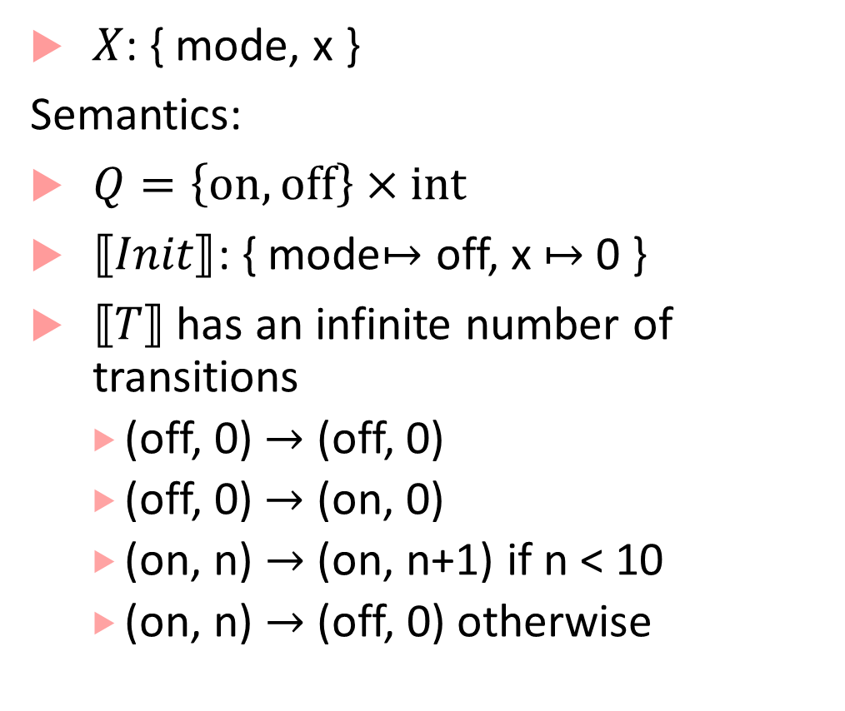
Example of a TS
$X$: { mode, x }
Semantics:
$Q=\left\{on, off\right\}×int$
$⟦Init⟧$: { mode$↦$ off, x $↦$ 0 }
$⟦T⟧$ has an infinite number of transitions
(off, 0) $→$ (off, 0)
(off, 0) $→$ (on, 0)
(on, n) $→$ (on, n+1) if n < 10
(on, n) $→$ (off, 0) otherwise
$int x≔$0
off
(press==1)?
(press==0)?
on
(press==1) or (x$≥$10) ?
$$→x ≔0$$
(press==0) & (x<10) ?
$$→x ≔x+1$$

Slide 6
Transition Systems and state
All kinds of components (synchronous, asynchronous, timed, hybrid, continuous components have an underlying transition system
State in the transition system underlying a component captures any given runtime configuration of the component
Continuous components, Timed Processes, Hybrid Processes in general, have infinite number of states

Slide 7
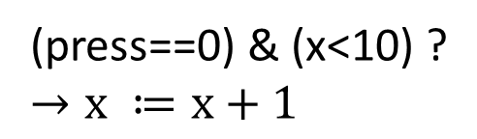
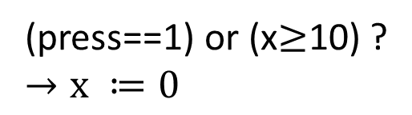

Example transitions for TS
$int x≔$0
(off,0)
(on,100)
off
(press==1)?
(press==0)?
(on,0)
(on,1)
on
(press==1) or (x$≥$10) ?
$$→x ≔0$$
(off,42)
(on,2)
(press==0) & (x<10) ?
$$→x ≔x+1$$
(on,42)

Slide 8

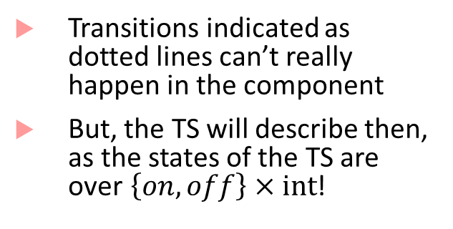


TS describes all possible transitions
(off,0)
(on,100)
$int x≔$0
Transitions indicated as dotted lines can’t really happen in the component
But, the TS will describe then, as the states of the TS are over$\left\{on,off\right\}×int$!
off
(press==1)?
(on,0)
(on,1)
(press==0)?
on
(press==1) or (x$≥$10) ?
$$→x ≔0$$
(off,42)
(on,2)
(press==0) & (x<10) ?
$$→x ≔x+1$$
(on,42)

Slide 9



Reachable states of a modified switch TS
(off,0)
(on,100)
$int x≔$0
off
(press==1)?
(press==0)?
(on,0)
(on,1)
on
(press==1) or (x$≥$ 2) ?
$$→x ≔0$$
(press==0) & (x<2) ?
$$→x ≔x+1$$
Reachable states and transitions
(on,2)
(off,42)
(on,42)

Slide 10
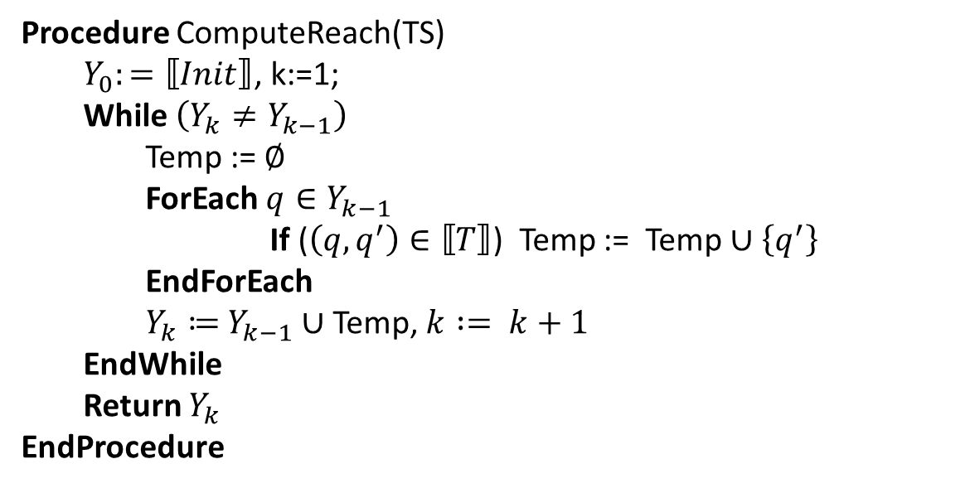
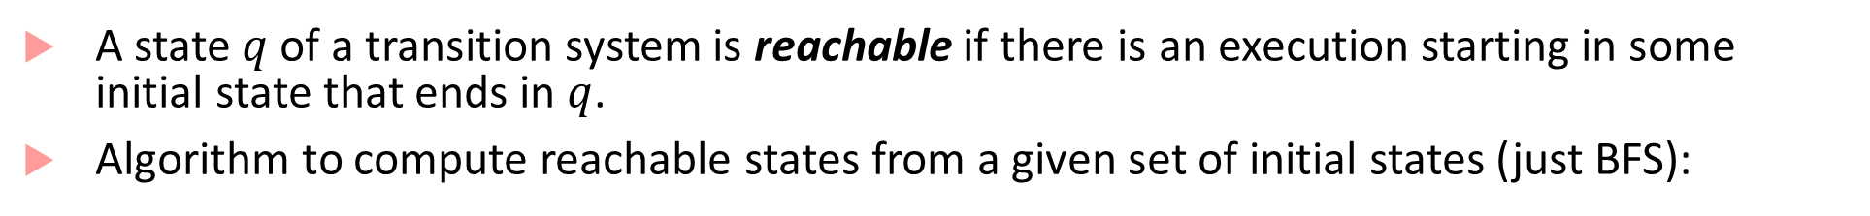
Reachability
A state $q$ of a transition system is reachable if there is an execution starting in some initial state that ends in $q$.
Algorithm to compute reachable states from a given set of initial states (just BFS):
Procedure ComputeReach(TS)
$Y_{0}:=⟦Init⟧$, k:=1;
While $\left(Y_{k}≠Y_{k−1}\right)$
Temp := $∅$
ForEach $q∈Y_{k−1}$
If ($\left(q,q^{′}\right)∈⟦T⟧$) Temp := Temp $∪$ $\left\{q^{′}\right\}$
EndForEach
$Y_{k}≔$ $Y_{k−1}∪$ Temp, $k := k+1$
EndWhile
Return $Y_{k}$
EndProcedure

Slide 11
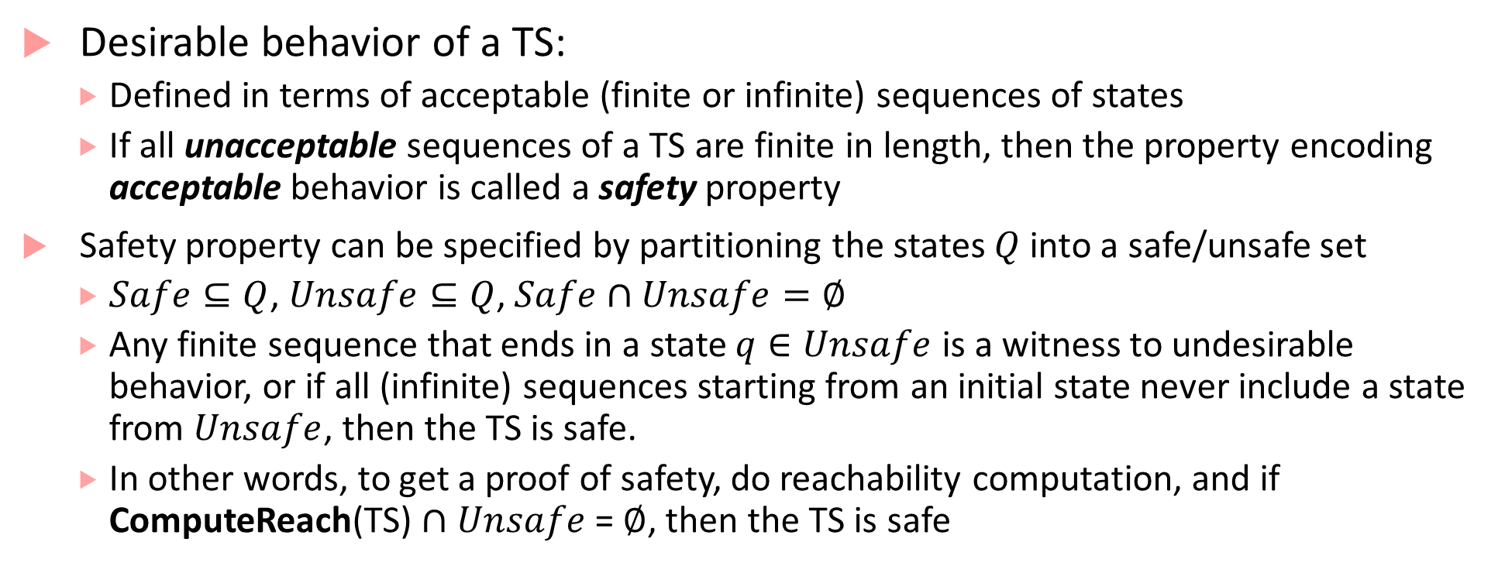
Desirable behaviors of a TS
Desirable behavior of a TS:
Defined in terms of acceptable (finite or infinite) sequences of states
If all unacceptable sequences of a TS are finite in length, then the property encoding acceptable behavior is called a safety property
Safety property can be specified by partitioning the states $Q$ into a safe/unsafe set
$Safe⊆Q$, $Unsafe⊆Q$, $Safe∩Unsafe=∅$
Any finite sequence that ends in a state $q∈Unsafe$ is a witness to undesirable behavior, or if all (infinite) sequences starting from an initial state never include a state from $Unsafe$, then the TS is safe.
In other words, to get a proof of safety, do reachability computation, and if ComputeReach(TS) $∩$ $Unsafe$= $∅$, then the TS is safe

Slide 12

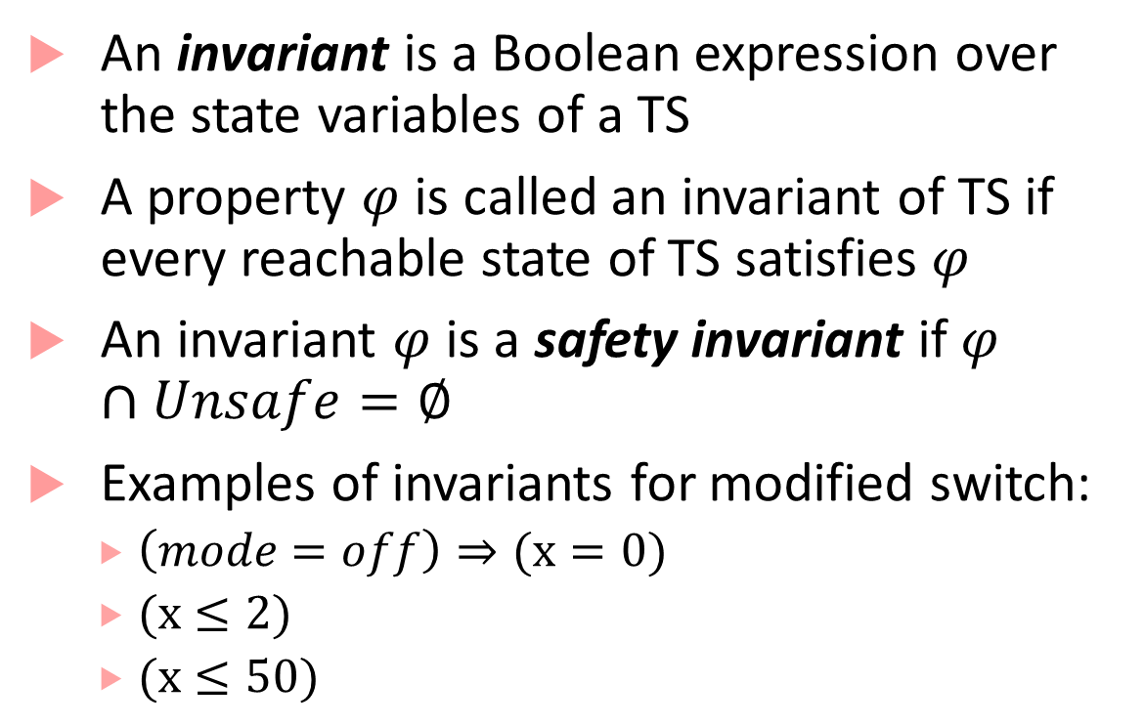

Safety invariants
An invariant is a Boolean expression over the state variables of a TS
A property $φ$ is called an invariant of TS if every reachable state of TS satisfies $φ$
An invariant $φ$ is a safety invariant if $φ∩Unsafe=∅$
Examples of invariants for modified switch:
$\left(mode=off\right)⇒(x=0)$
$(x≤2)$
$(x≤50)$
$int x≔$0
off
(press==1)?
(press==0)?
on
(press==1) or (x$≥$ 2) ?
$$→x ≔0$$
(press==0) & (x<2) ?
$$→x ≔x+1$$

Slide 13
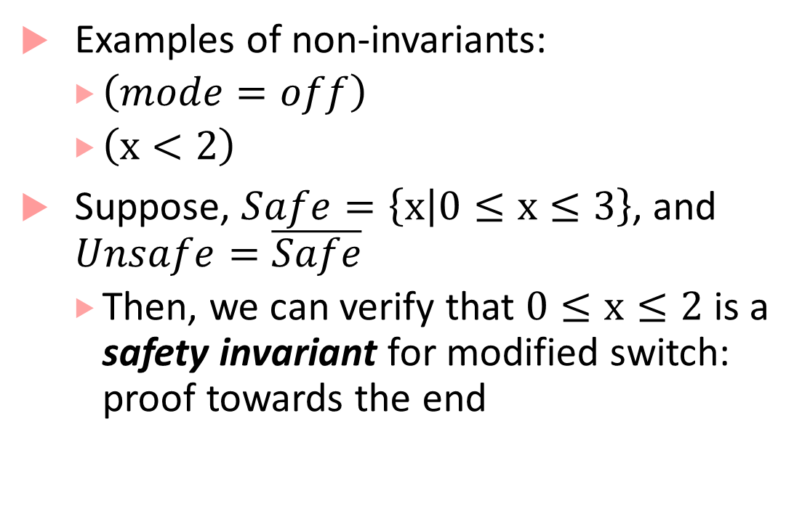
Safety invariants
Examples of non-invariants:
$\left(mode=off\right)$
$\left(x<2\right)$
Suppose, $Safe=\left\{\left.x\right|0≤x≤3\right\}$, and $Unsafe=\overline{Safe}$
Then, we can verify that $0≤x≤2$ is a safety invariant for modified switch: proof towards the end
$int x≔$0
off
(press==1)?
(press==0)?
on
(press==1) or (x$≥$ 2) ?
$$→x ≔0$$
(press==0) & (x<2) ?
$$→x ≔x+1$$

Slide 14
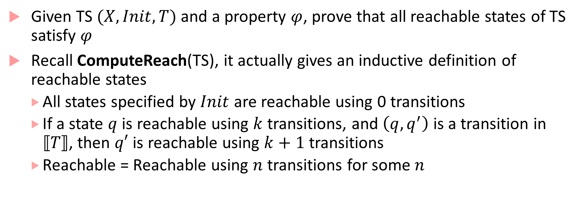
Proving that something is an invariant
Given TS $(X,Init,T)$ and a property $φ$, prove that all reachable states of TS satisfy $φ$
Recall ComputeReach(TS), it actually gives an inductive definition of reachable states
All states specified by $Init$ are reachable using 0 transitions
If a state $q$ is reachable using $k$ transitions, and $\left(q,q^{′}\right)$ is a transition in $⟦T⟧$, then $q′$ is reachable using $k+1$ transitions
Reachable = Reachable using $n$ transitions for some $n$

Slide 15

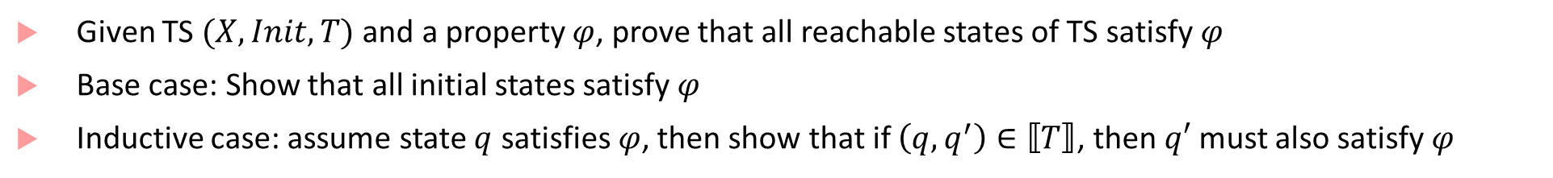


Inductive Safety Proof
Given TS $(X,Init,T)$ and a property $φ$, prove that all reachable states of TS satisfy $φ$
Base case: Show that all initial states satisfy $φ$
Inductive case: assume state $q$ satisfies $φ$, then show that if $\left(q,q^{′}\right)∈⟦T⟧$, then $q′$ must also satisfy $φ$
$int x≔$0
off
(press==1)?
(press==0)?
on
(press==1) or (x$≥$ 2) ?
$$→x ≔0$$
(press==0) & (x<2) ?
$$→x ≔x+1$$

Slide 16
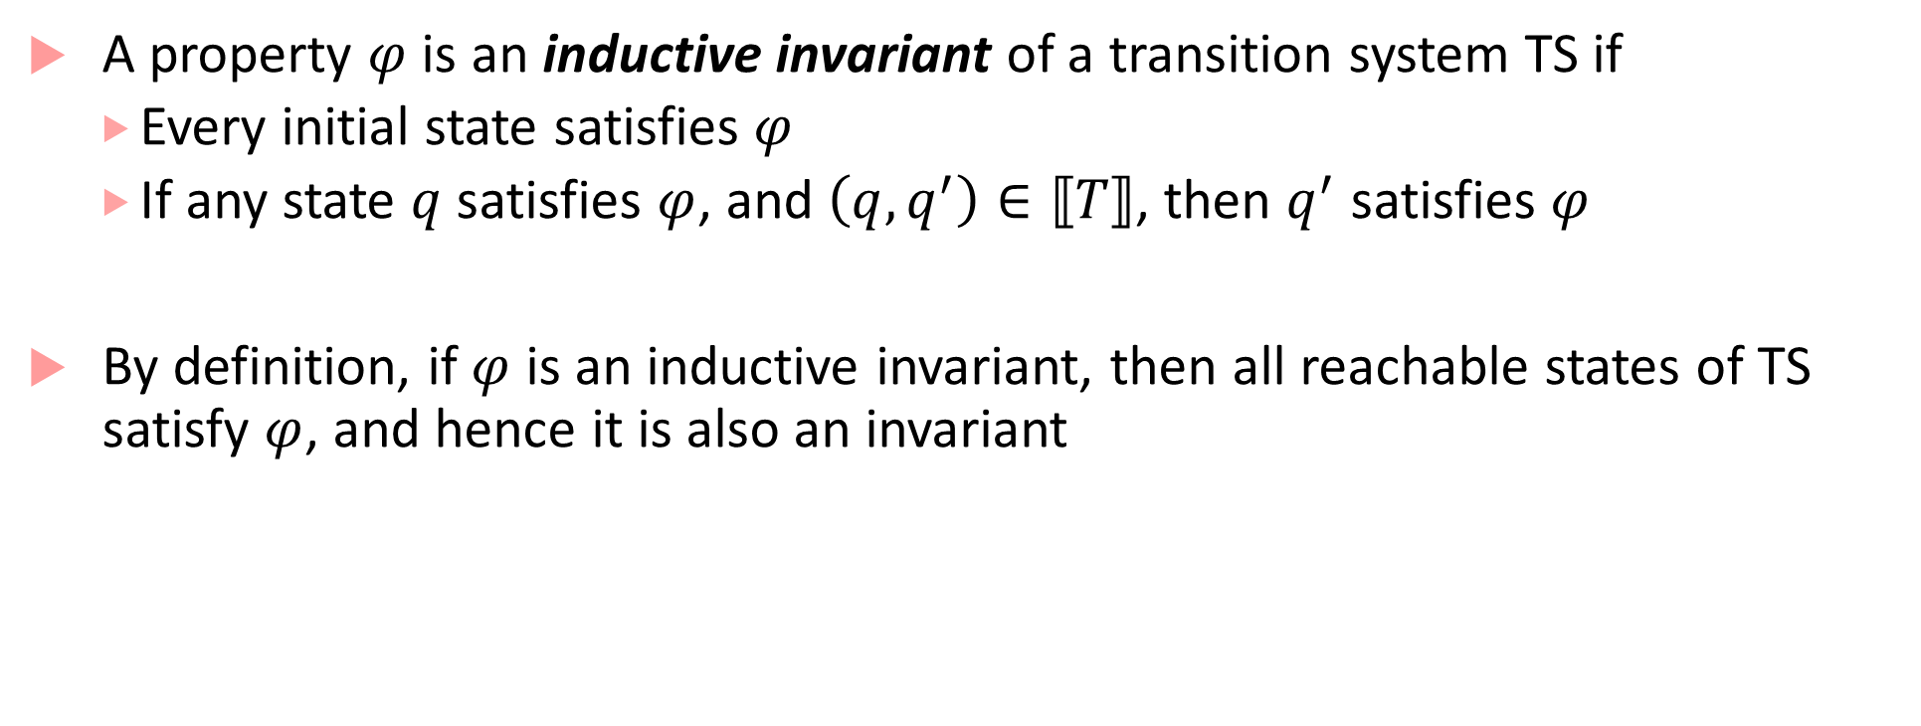
Inductive Invariant
A property $φ$ is an inductive invariant of a transition system TS if
Every initial state satisfies $φ$
If any state $q$ satisfies $φ$, and $\left(q,q^{′}\right)∈⟦T⟧$, then $q^{′}$ satisfies $φ$
By definition, if $φ$ is an inductive invariant, then all reachable states of TS satisfy $φ$, and hence it is also an invariant

Slide 17
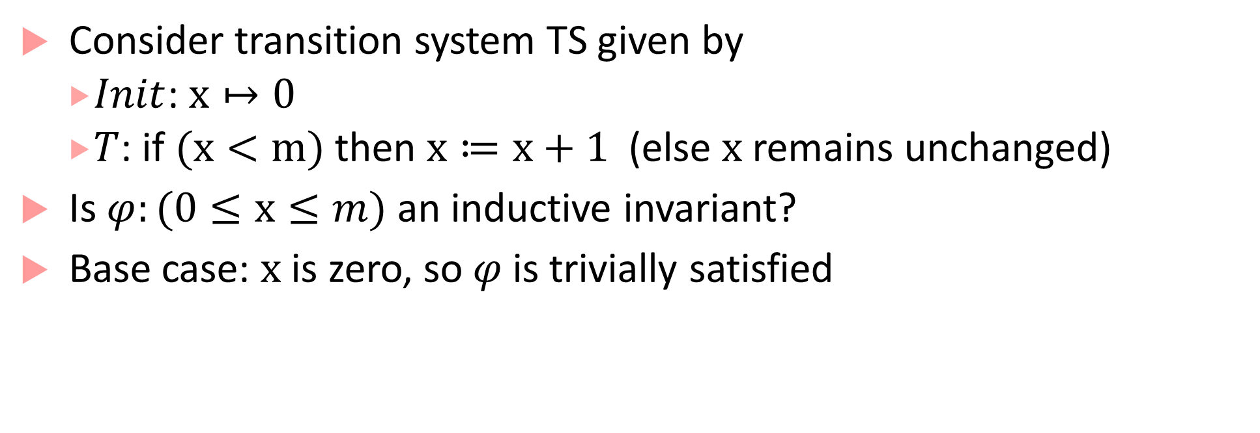
Proving inductive invariants: I
Consider transition system TS given by
$Init$: $x↦0$
$T$: if $(x<m)$ then $x≔x+1$ (else $x$ remains unchanged)
Is $φ:(0≤x≤m)$ an inductive invariant?
Base case: $x$ is zero, so $φ$ is trivially satisfied

Slide 18
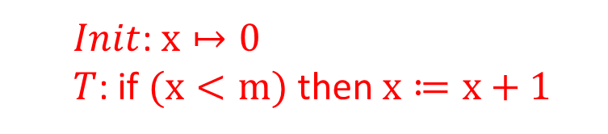
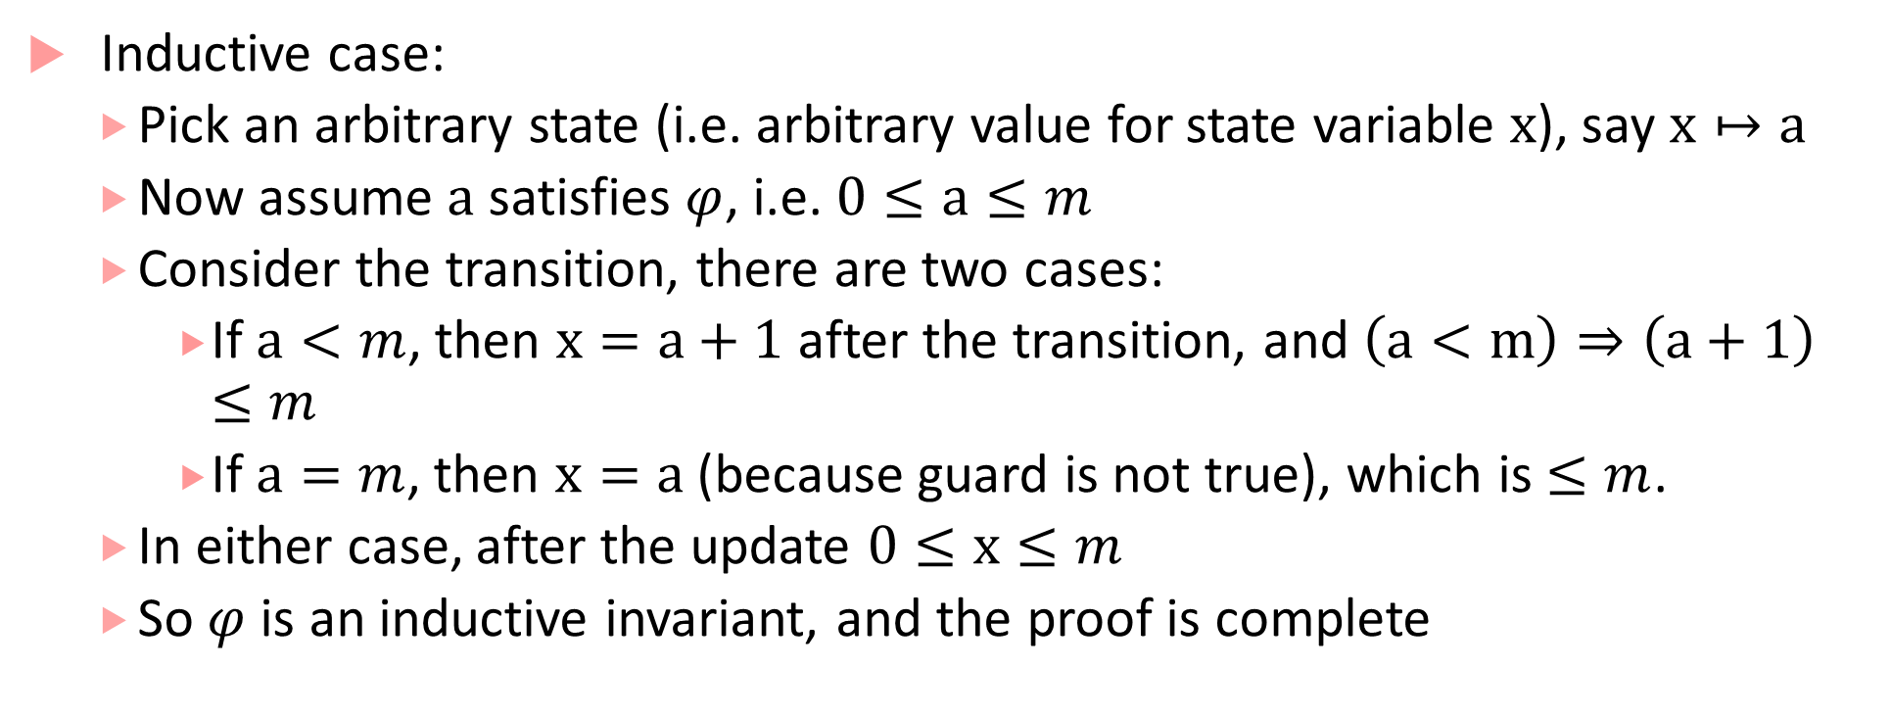
Proving inductive invariants: I
$Init$: $x↦0$
$T$: if $(x<m)$ then $x≔x+1$
Inductive case:
Pick an arbitrary state (i.e. arbitrary value for state variable $x$), say $x↦a$
Now assume $a$ satisfies $φ$, i.e. $0≤a≤m$
Consider the transition, there are two cases:
If $a<m$, then $x=a+1$ after the transition, and $\left(a<m\right)⇒\left(a+1\right)≤m$
If $a=m$, then $x=a$ (because guard is not true), which is $≤m$.
In either case, after the update $0≤x≤m$
So $φ$ is an inductive invariant, and the proof is complete

Slide 19
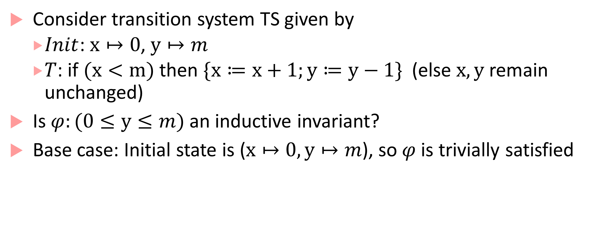
Proving inductive invariants: II
Consider transition system TS given by
$Init$: $x↦0$, $y↦m$
$T$: if $(x<m)$ then $\{x≔x+1;y≔y−1\}$ (else $x,y$ remain unchanged)
Is $φ:(0≤y≤m)$ an inductive invariant?
Base case: Initial state is ($x↦0, y↦m$), so $φ$ is trivially satisfied

Slide 20
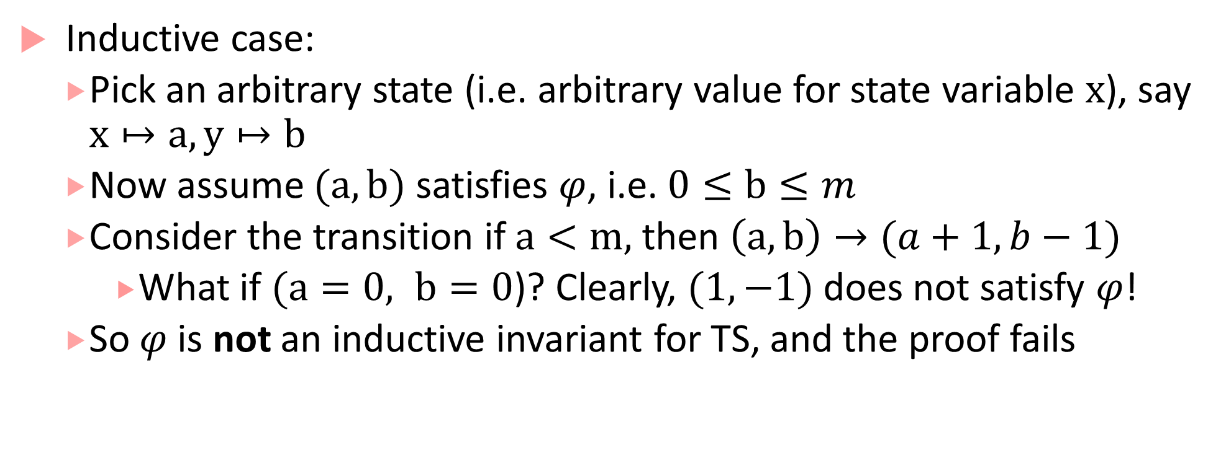
Proving inductive invariants: II
Inductive case:
Pick an arbitrary state (i.e. arbitrary value for state variable $x$), say $x↦a, y↦b$
Now assume $(a,b)$ satisfies $φ$, i.e. $0≤b≤m$
Consider the transition if $a<m,$ then $\left(a,b\right)→(a+1,b−1)$
What if $(a=0, b=0$)? Clearly, $(1,−1)$ does not satisfy $φ$!
So $φ$ is not an inductive invariant for TS, and the proof fails

Slide 21
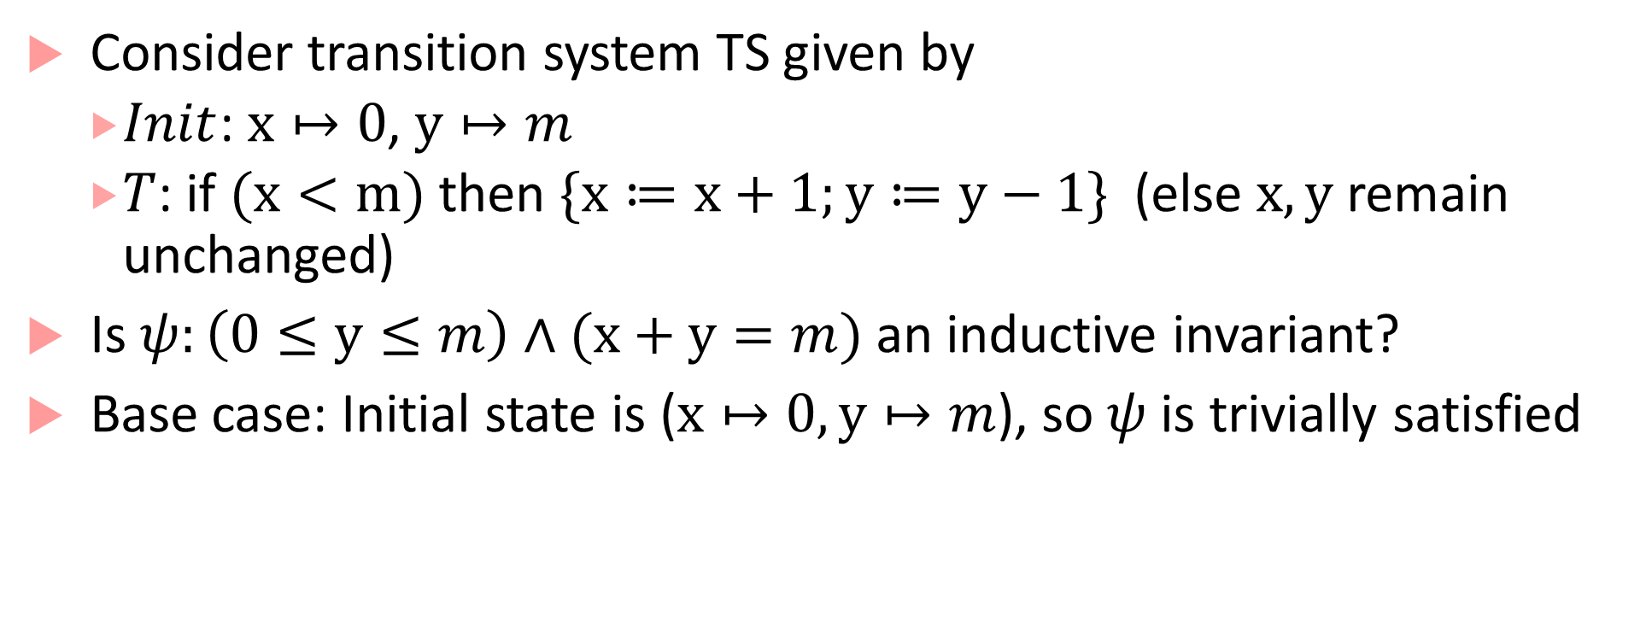
Proving inductive invariants: III
Consider transition system TS given by
$Init$: $x↦0$, $y↦m$
$T$: if $(x<m)$ then $\{x≔x+1;y≔y−1\}$ (else $x,y$ remain unchanged)
Is $ψ:\left(0≤y≤m\right)∧(x+y=m)$ an inductive invariant?
Base case: Initial state is ($x↦0, y↦m$), so $ψ$ is trivially satisfied

Slide 22
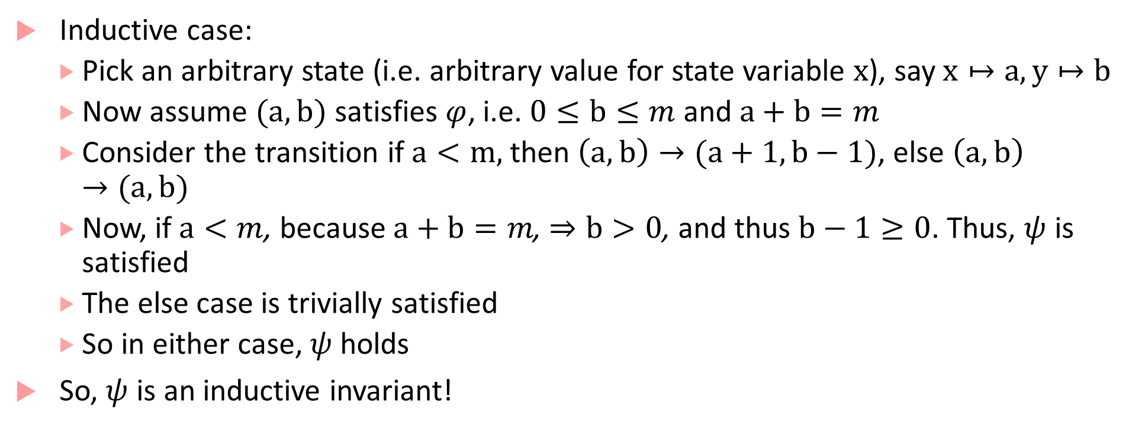
Proving inductive invariants: III
Inductive case:
Pick an arbitrary state (i.e. arbitrary value for state variable $x$), say $x↦a, y↦b$
Now assume $(a,b)$ satisfies $φ$, i.e. $0≤b≤m$ and $a+b=m$
Consider the transition if $a<m,$ then $\left(a,b\right)→(a+1,b−1)$, else $\left(a,b\right)→(a,b)$
Now, if $a<m$, because $a+b=m$, $⇒b>0$, and thus $b−1≥0$. Thus, $ψ$ is satisfied
The else case is trivially satisfied
So in either case, $ψ$ holds
So, $ψ$ is an inductive invariant!

Slide 23
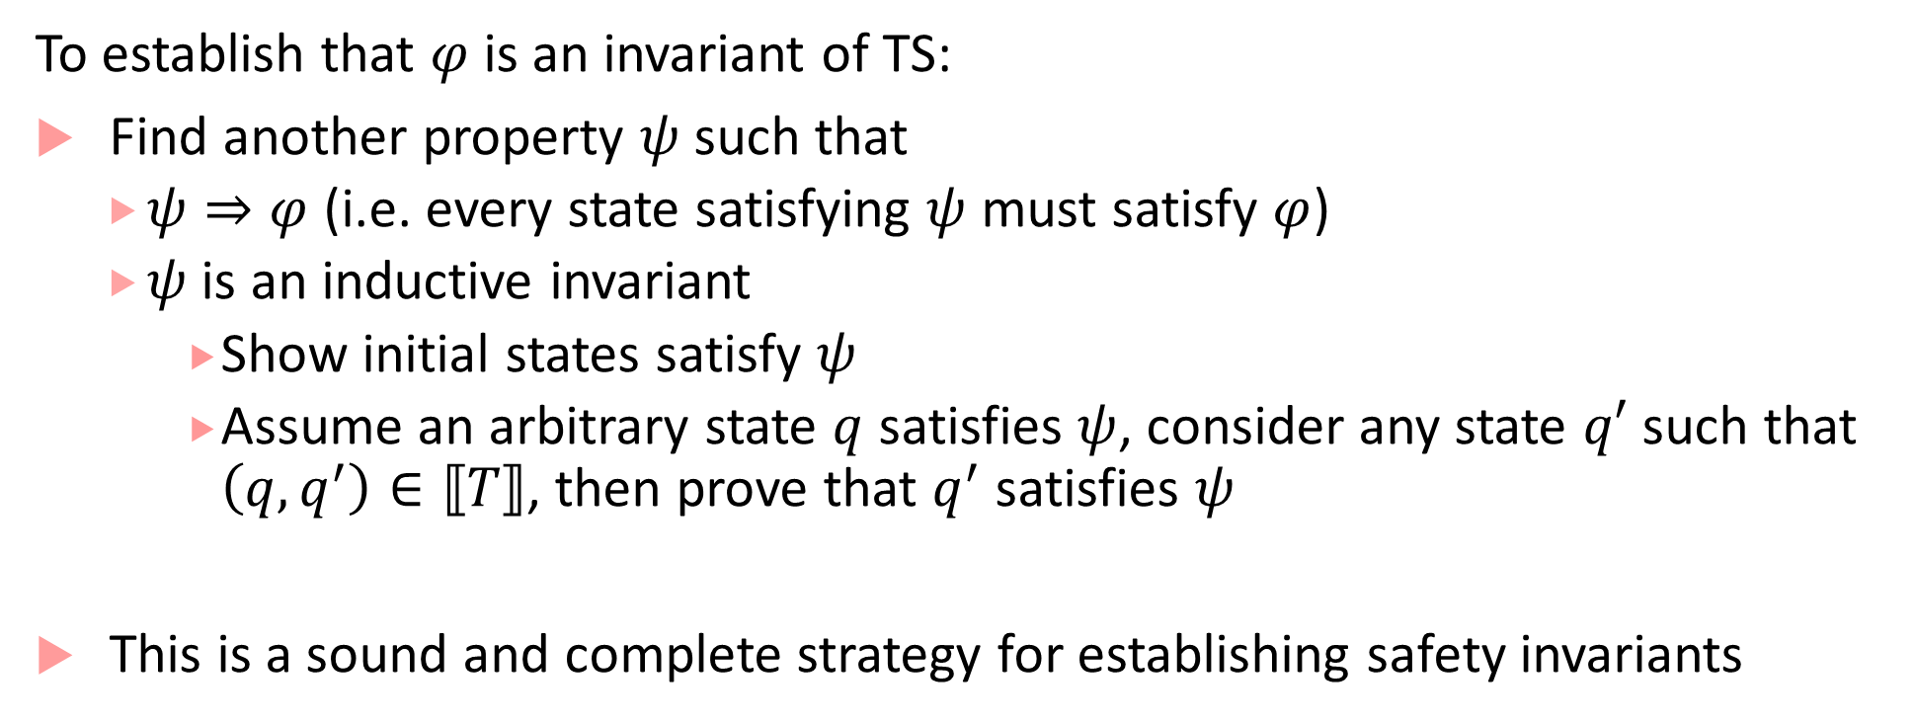
How do we prove safety invariants?
To establish that $φ$ is an invariant of TS:
Find another property $ψ$ such that
$ψ⇒φ$ (i.e. every state satisfying $ψ$ must satisfy $φ$)
$ψ$ is an inductive invariant
Show initial states satisfy $ψ$
Assume an arbitrary state $q$ satisfies $ψ$, consider any state $q′$ such that $\left(q,q^{′}\right)∈⟦T⟧$, then prove that $q^{′}$ satisfies $ψ$
This is a sound and complete strategy for establishing safety invariants

Slide 24
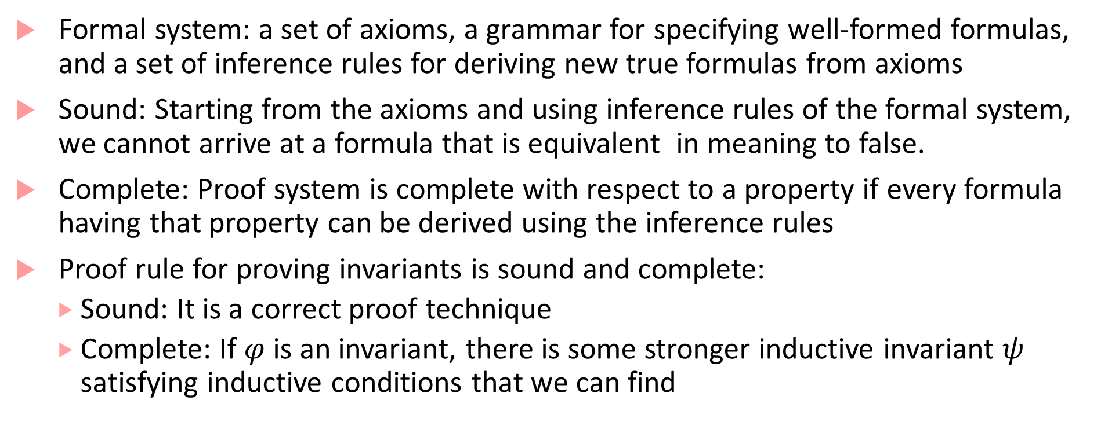
Soundness and Completeness
Formal system: a set of axioms, a grammar for specifying well-formed formulas, and a set of inference rules for deriving new true formulas from axioms
Sound: Starting from the axioms and using inference rules of the formal system, we cannot arrive at a formula that is equivalent in meaning to false.
Complete: Proof system is complete with respect to a property if every formula having that property can be derived using the inference rules
Proof rule for proving invariants is sound and complete:
Sound: It is a correct proof technique
Complete: If $φ$ is an invariant, there is some stronger inductive invariant $ψ$ satisfying inductive conditions that we can find

Slide 25
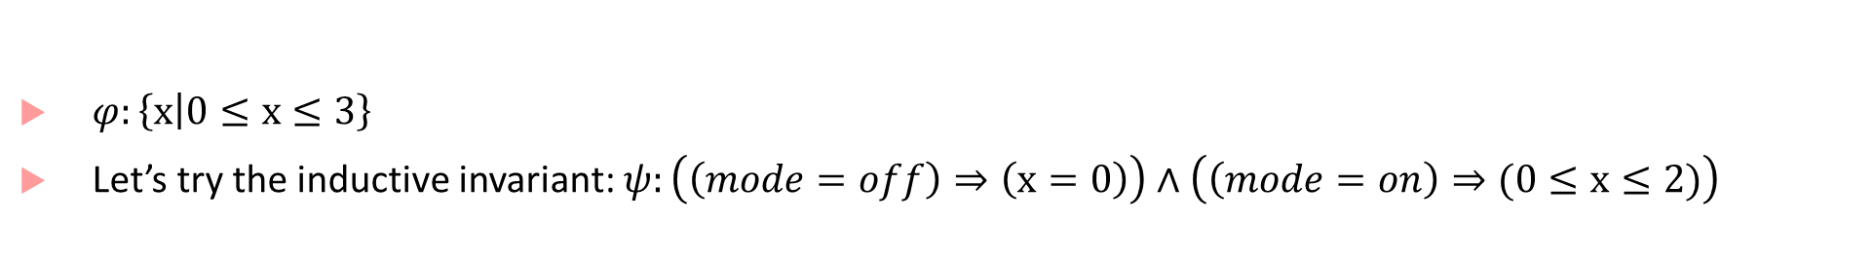
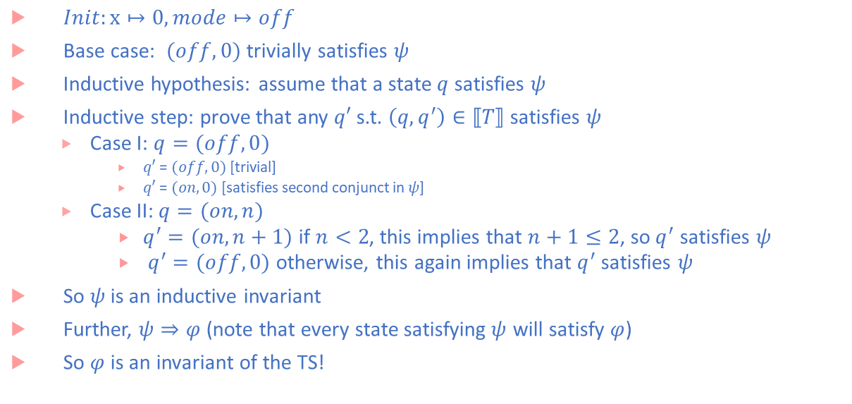
Safety Proof for Switch
$φ:\left\{\left.x\right|0≤x≤3\right\}$
Let’s try the inductive invariant: $ψ:\left(\left(mode=off\right)⇒\left(x=0\right)\right)∧\left(\left(mode=on\right)⇒(0≤x≤2)\right)$
$Init:x↦0, mode↦off$
Base case: $(off,0)$ trivially satisfies $ψ$
Inductive hypothesis: assume that a state $q$ satisfies $ψ$
Inductive step: prove that any $q′$ s.t. $\left(q,q^{′}\right)∈⟦T⟧$ satisfies $ψ$
Case I: $q=(off,0)$
$q′$ = $(off,0)$ [trivial]
$q′$ = $(on, 0)$ [satisfies second conjunct in $ψ$]
Case II: $q=(on,n)$
$q^{′}=(on,n+1)$ if $n<2$, this implies that $n+1≤2$, so$q^{′}$ satisfies $ψ$
$q^{′}=(off,0)$ otherwise, this again implies that $q^{′}$ satisfies $ψ$
So $ψ$ is an inductive invariant
Further, $ψ⇒φ$ (note that every state satisfying$ψ$ will satisfy $φ$)
So $φ$ is an invariant of the TS!
$int x≔$0
off
(press==1)?
(press==0)?
on
(press==1) or (x$≥$ 2) ?
$$→x ≔0$$
(press==0) & (x<2) ?
$$→x ≔x+1$$

Slide 26
Safety verification using barrier certificates
Barrier certificate: safety invariant for a continuous dynamical system
It establishes an invisible barrier that trajectories of a system cannot cross
(think of it as a force-field)
Reasoning very similar to that of an inductive invariant
Establish that the initial states all lie within the barrier
Establish that the unsafe states are all outside the barrier
Show that the next states for all states on the barrier are inside the barrier

Slide 27
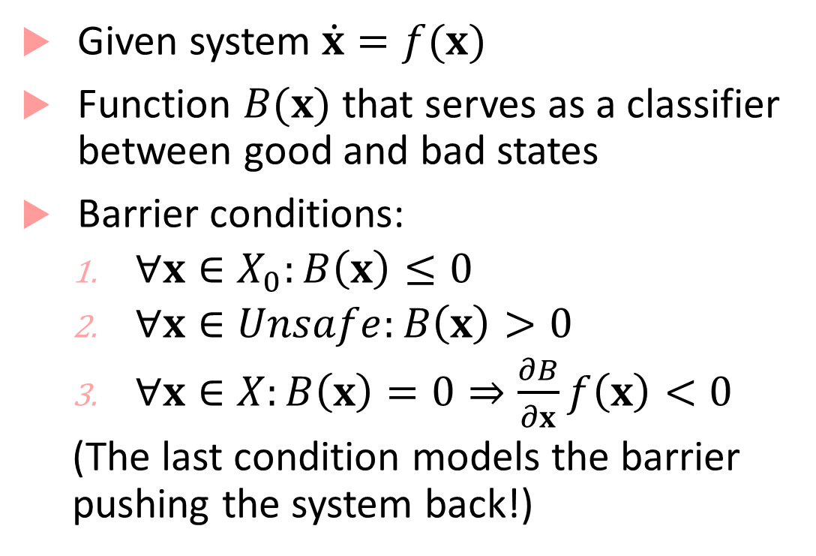
Strict barrier certificate
Given system $\dot{x}=f(x)$
Function $B(x)$ that serves as a classifier between good and bad states
Barrier conditions:
$∀x∈X_{0}:B\left(x\right)≤0$
$∀x∈Unsafe:B\left(x\right)>0$
$∀x∈X:B\left(x\right)=0⇒\frac{∂B}{∂x}f\left(x\right)<0$
(The last condition models the barrier pushing the system back!)
Unsafe
Initial

Slide 28
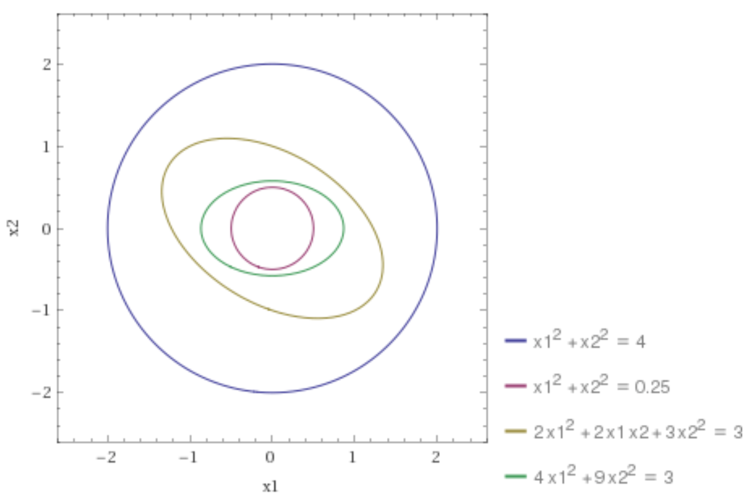

Example
Unsafe
$\dot{x_{1}}={−x}_{1};\dot{x_{2}}=x_{1}−x_{2}$
Initial state set: $x_{1}^{2}+x_{2}^{2}<1/4$
Unsafe set: $x_{1}^{2}+x_{2}^{2}>4$
Barrier: $B\left(x_{1},x_{2}\right)= {2x}_{1}^{2}+{2x_{1}x_{2}+3x}_{2}^{2}−3$
From plot:
for initial states, $B\left(x\right)<0$,
for unsafe states, $B\left(x\right)>0$
Barrier
Initial

Slide 29
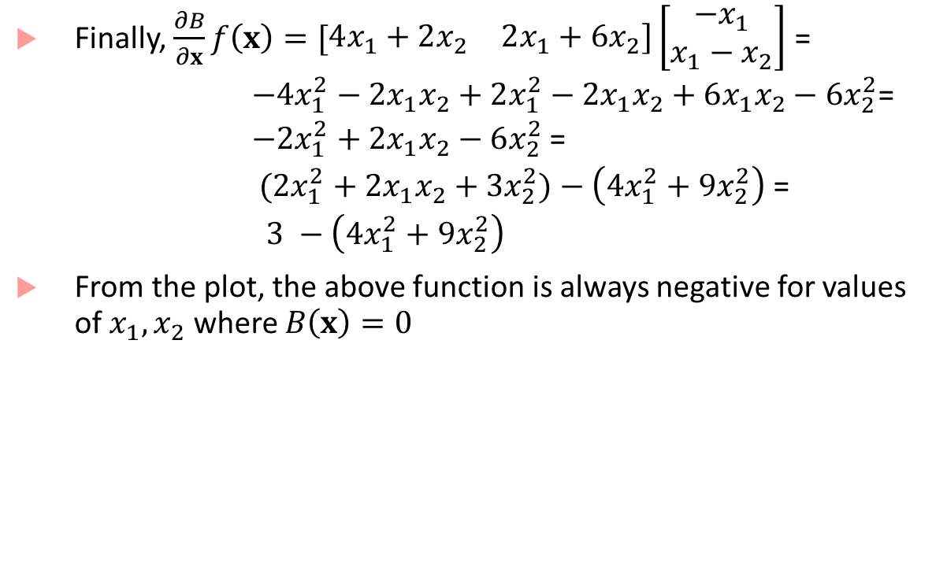
Example
Barrier
Finally, $\frac{∂B}{∂x}f\left(x\right)=[\begin{matrix}4x_{1}+2x_{2} & 2x_{1}+6x_{2}]\end{matrix}\left[\begin{matrix}−x_{1} \\ x_{1}−x_{2}\end{matrix}\right]$ =
$−4x_{1}^{2}−2x_{1}x_{2}+2x_{1}^{2}−2x_{1}x_{2}+6x_{1}x_{2}−6x_{2}^{2}$=
$−2x_{1}^{2}+2x_{1}x_{2}−6x_{2}^{2}$ =
$({2x}_{1}^{2}+{2x_{1}x_{2}+3x}_{2}^{2})−\left(4x_{1}^{2}+9x_{2}^{2}\right)$ =
$3 −\left(4x_{1}^{2}+9x_{2}^{2}\right)$
From the plot, the above function is always negative for values of $x_{1},x_{2}$ where $B\left(x\right)=0$

Slide 30
Time-bounded Reachability
Verification basics and Hybrid Systems lecture: reachability analysis using a “fix-point based algorithm”
uses a breadth-first approach to compute reachable states over an infinite time-horizon
Barrier certificates: also provide infinite time safety results, but require manual ingenuity in coming up with a barrier; difficult to do for hybrid/nonlinear systems
Time-bounded reachability: Starting from some initial state in a given set of initial states, does the system behavior ever reach an unsafe state within a given time bound?

Slide 31



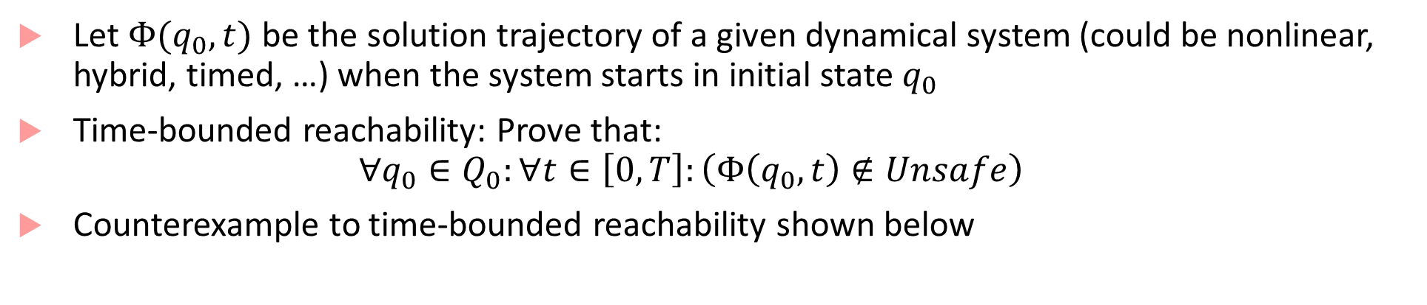



Problem definition
Let $Φ(q_{0},t)$ be the solution trajectory of a given dynamical system (could be nonlinear, hybrid, timed, …) when the system starts in initial state $q_{0}$
Time-bounded reachability: Prove that:
$$∀q_{0}∈Q_{0}:∀t∈\left[0,T\right]:\left(Φ\left(q_{0},t\right)∉Unsafe\right)$$
Counterexample to time-bounded reachability shown below
Trajectory segment with safe states
$$Q_{0}$$
$${Φ(q}_{0},0)$$
Trajectory segment with unsafe states
Unsafe
$${Φ(q}_{0},\hat{t})$$
$${Φ(q}_{0},t)$$
$$q_{0}$$
?
$$\hat{t}∈[0,T]$$

Slide 32
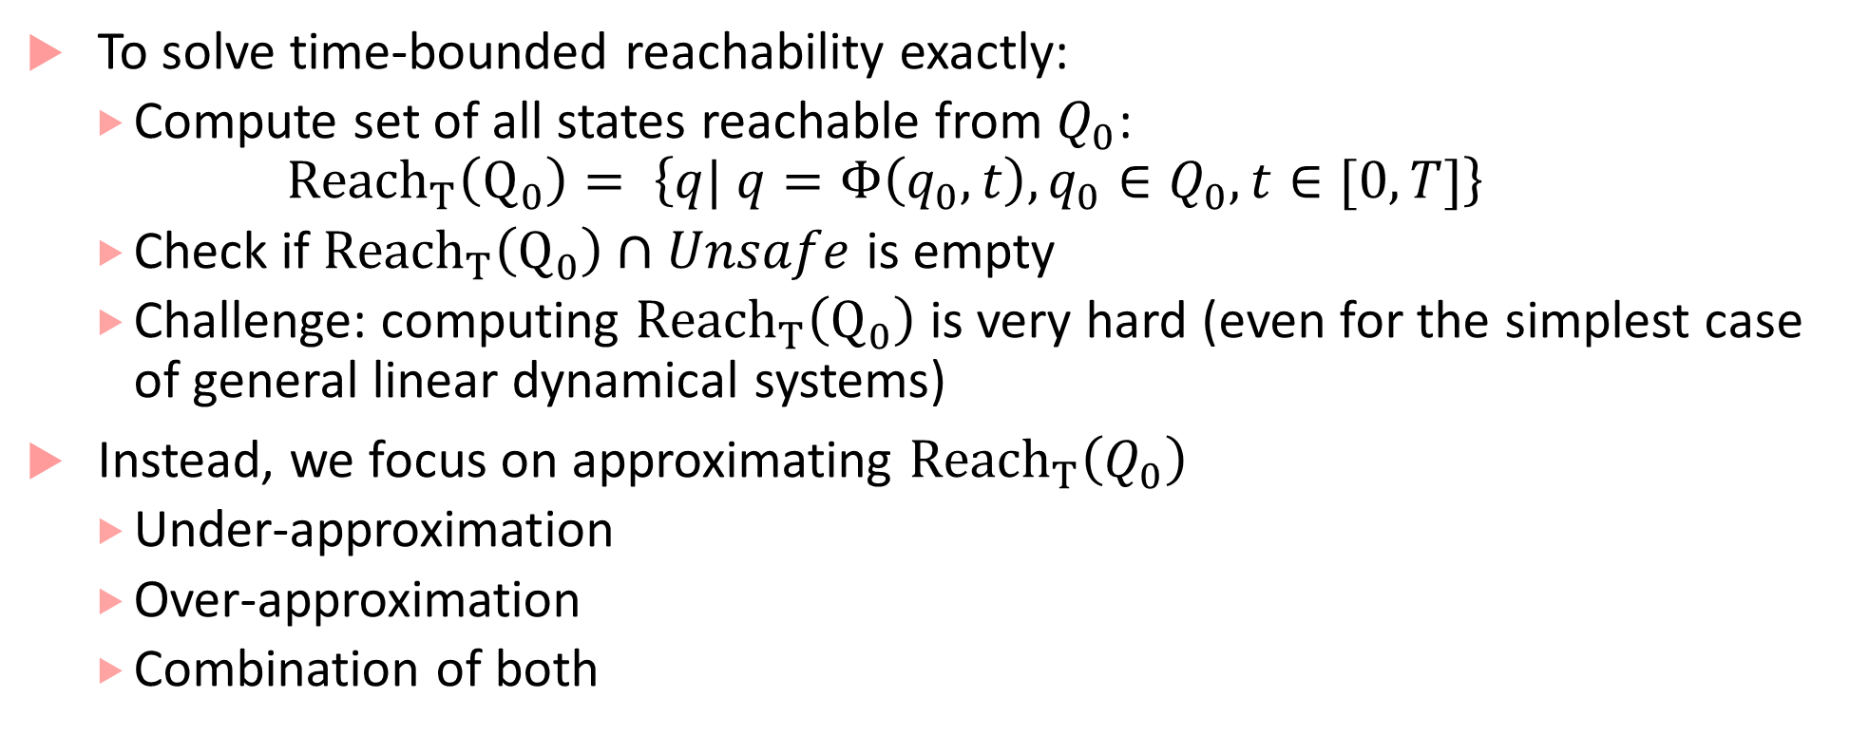
Solutions to time-bounded reachability
To solve time-bounded reachability exactly:
Compute set of all states reachable from $Q_{0}$:
$${Reach}_{T}\left(Q_{0}\right)= \left\{q| q=Φ\left(q_{0},t\right), q_{0}∈Q_{0}, t∈[0,T]\right\}$$
Check if ${Reach}_{T}\left(Q_{0}\right)∩Unsafe$ is empty
Challenge: computing ${Reach}_{T}\left(Q_{0}\right)$ is very hard (even for the simplest case of general linear dynamical systems)
Instead, we focus on approximating ${Reach}_{T}\left(Q_{0}\right)$
Under-approximation
Over-approximation
Combination of both

Slide 33
Under-approximation
When we under-approximate the set of initial states, at each time, the set of reachable states that we compute is a subset of the actual set of reachable states
Best example of under-approximation is (guaranteed) numerical simulation
Guaranteed numerical simulation: better than numerical integration schemes as it gives bounds on error in numerical integration (e.g. VNODE)
Under-approximation is:
Sound for bug-finding: if we find a bug, then it is really a bug
Unsound for verification: if we do not find a bug, does not mean the system is safe

Slide 34


Under-approximation: sound for bug-finding
The good case: under-approximation found a trace that contained unsafe states – we found a bug in the system!
$$Unsafe$$
$$Q_{0}$$

Slide 35
Under-approximation: unsound for verification
The bad case: under-approximation did not find a trace that contained unsafe states – we cannot conclude anything.
$$Unsafe$$
$$Q_{0}$$

Slide 36
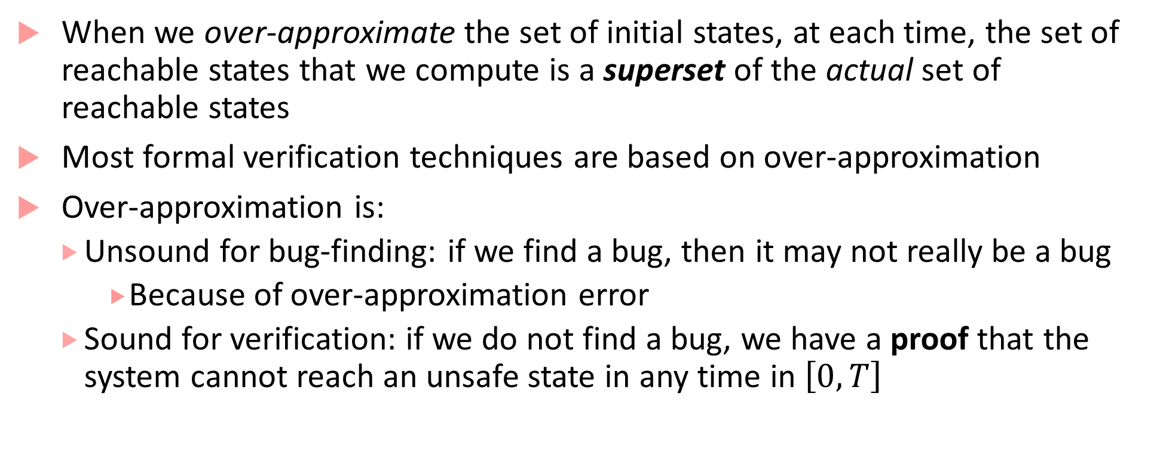
Over-approximation
When we over-approximate the set of initial states, at each time, the set of reachable states that we compute is a superset of the actual set of reachable states
Most formal verification techniques are based on over-approximation
Over-approximation is:
Unsound for bug-finding: if we find a bug, then it may not really be a bug
Because of over-approximation error
Sound for verification: if we do not find a bug, we have a proof that the system cannot reach an unsafe state in any time in $\left[0,T\right]$

Slide 37
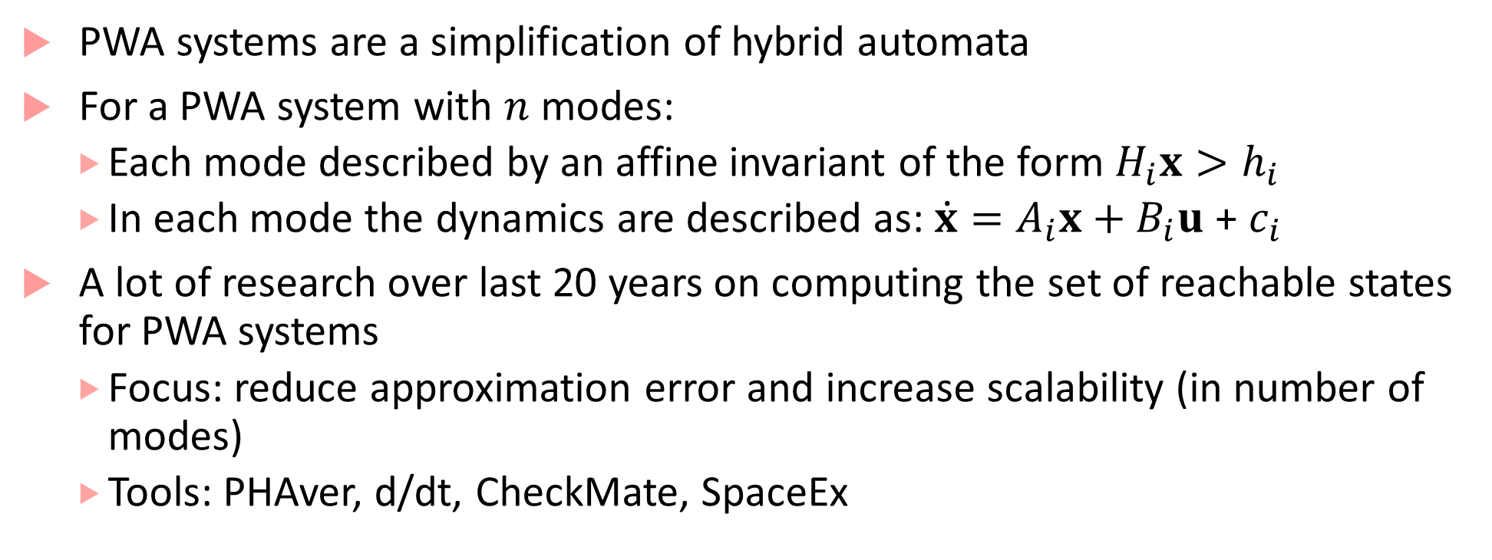
Reachability for piecewise affine (PWA) systems
PWA systems are a simplification of hybrid automata
For a PWA system with $n$ modes:
Each mode described by an affine invariant of the form $H_{i}x>h_{i}$
In each mode the dynamics are described as: $\dot{x}=A_{i}x+B_{i}u$ + $c_{i}$
A lot of research over last 20 years on computing the set of reachable states for PWA systems
Focus: reduce approximation error and increase scalability (in number of modes)
Tools: PHAver, d/dt, CheckMate, SpaceEx

Slide 38


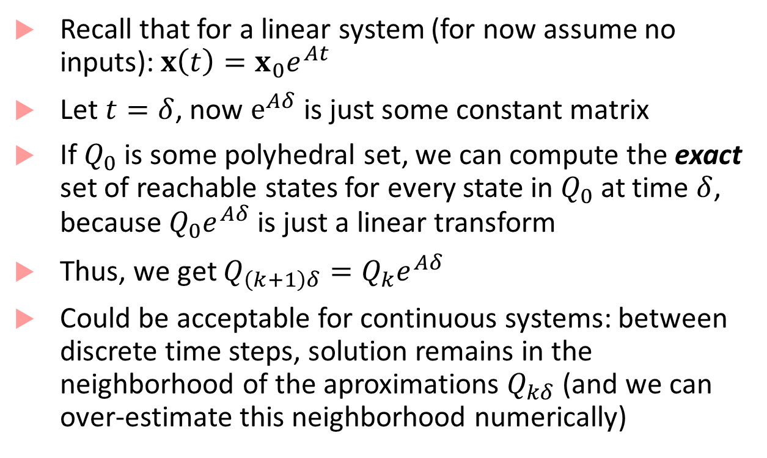




Reachability for affine systems
$$Q_{3δ}$$
Recall that for a linear system (for now assume no inputs):$x\left(t\right)=x_{0}e^{At}$
Let $t=δ$, now $e^{Aδ}$ is just some constant matrix
If $Q_{0}$ is some polyhedral set, we can compute the exact set of reachable states for every state in $Q_{0}$ at time $δ$, because $Q_{0}e^{Aδ}$ is just a linear transform
Thus, we get $Q_{\left(k+1\right)δ}=Q_{k}e^{Aδ}$
Could be acceptable for continuous systems: between discrete time steps, solution remains in the neighborhood of the aproximations $Q_{kδ}$ (and we can over-estimate this neighborhood numerically)
$$x$$
$$Q_{2δ}$$
$$Q_{δ}$$
$$Q_{0}$$
$$t$$

Slide 39
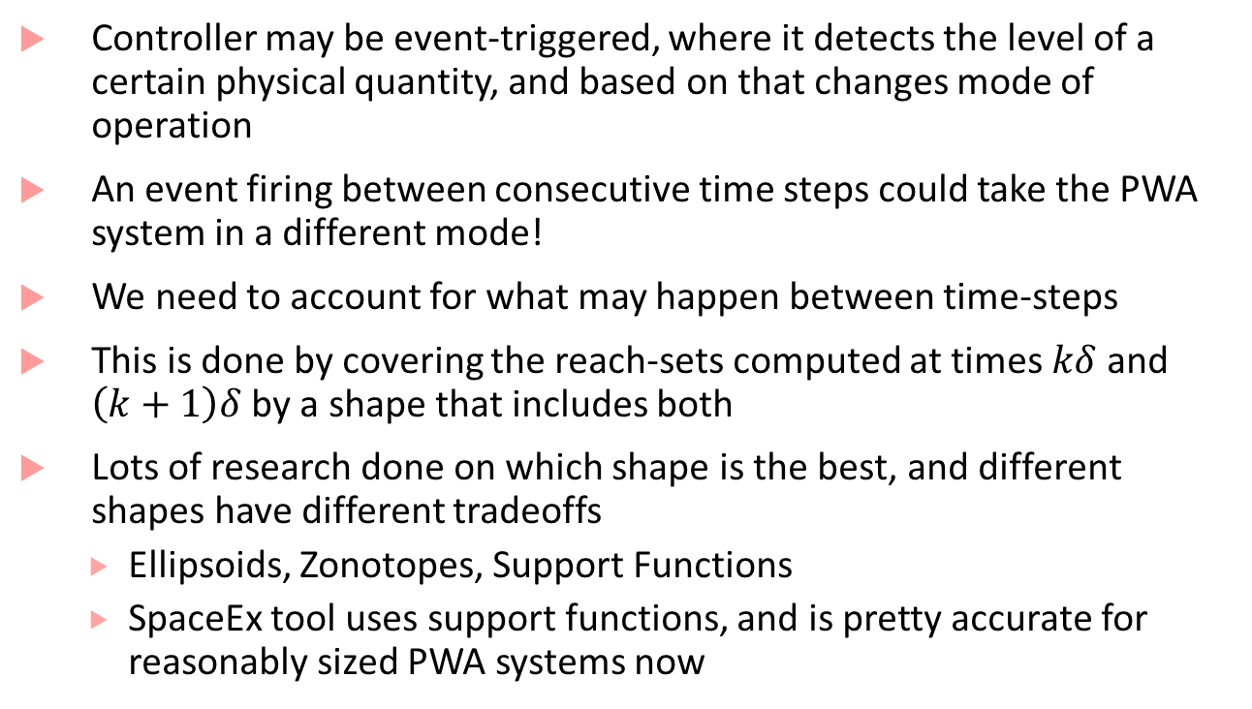

Problem for CPS (hybrid systems)
Controller may be event-triggered, where it detects the level of a certain physical quantity, and based on that changes mode of operation
An event firing between consecutive time steps could take the PWA system in a different mode!
We need to account for what may happen between time-steps
This is done by covering the reach-sets computed at times $kδ$ and $\left(k+1\right)δ$ by a shape that includes both
Lots of research done on which shape is the best, and different shapes have different tradeoffs
Ellipsoids, Zonotopes, Support Functions
SpaceEx tool uses support functions, and is pretty accurate for reasonably sized PWA systems now
$$Q_{2δ}$$
$$x$$
$$Q_{δ}$$
Wrong!
$$Q_{0}$$
$$t$$

Slide 40
Reachability for nonlinear systems
Not all systems can be modeled as PWA!
Nonlinear systems:
Approach I: first PWA-ize the system, then do reachability. Drawback: Error encountered during PWA-ization accumulates
Approach 2: use more interesting models such as Taylor models (based on Taylor series representations): used in tool Flow*
Approach 3: throw the problem at a powerful nonlinear SMT solver: used in tool dReach

Slide 41
Combining under and over-approximations
Also known as simulation-guided reachability analysis
Main idea:
Sample some initial states, perform simulations starting from these states
Use “continuity”-like arguments to bloat the trajectories in a sound manner
If bloated trajectories cover initial state space, go to step 4, if not go back to step 1
If bloated trajectories do not intersect unsafe set, conclude system is safe. If bloated trajectories intersect unsafe set, try to refine bloated trajectories to check if there is a true counterexample

Slide 42
Simlulation-guided reachability depiction
Initial
Simulation Trace up to time T
Reach-Tube up to time T
Unsafe

Slide 43
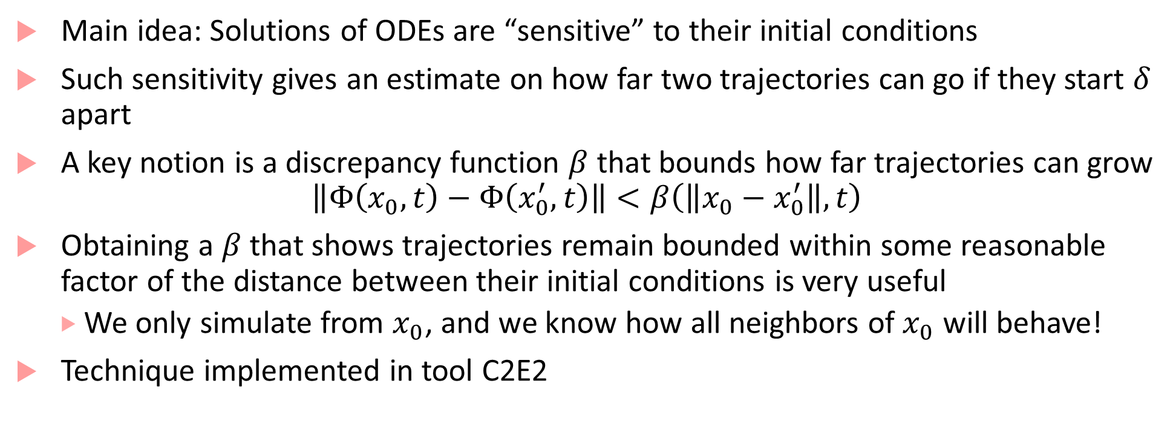
Secret sauce: how to bloat
Main idea: Solutions of ODEs are “sensitive” to their initial conditions
Such sensitivity gives an estimate on how far two trajectories can go if they start $δ$ apart
A key notion is a discrepancy function $β$ that bounds how far trajectories can grow
$$\left\|Φ\left(x_{0},t\right)−Φ\left(x_{0}^{′},t\right)\right\|<β\left(\left\|x_{0}−x_{0}^{′}\right\|,t\right)$$
Obtaining a $β$ that shows trajectories remain bounded within some reasonable factor of the distance between their initial conditions is very useful
We only simulate from $x_{0}$, and we know how all neighbors of $x_{0}$ will behave!
Technique implemented in tool C2E2

Slide 44
Bibliography
Breach : https://link.springer.com/chapter/10.1007/978-3-642-14295-6_17
Prajna, S., & Jadbabaie, A. (2004, March). Safety verification of hybrid systems using barrier certificates. In International Workshop on Hybrid Systems: Computation and Control (pp. 477-492).
Duggirala, Parasara Sridhar, et al. "C2E2: a verification tool for stateflow models." International Conference on Tools and Algorithms for the Construction and Analysis of Systems.
Frehse, Goran, Colas Le Guernic, Alexandre Donzé, Scott Cotton, Rajarshi Ray, Olivier Lebeltel, Rodolfo Ripado, Antoine Girard, Thao Dang, and Oded Maler. "SpaceEx: Scalable verification of hybrid systems." In International Conference on Computer Aided Verification, pp. 379-395. Springer, Berlin, Heidelberg, 2011.
Chen, Xin, Erika Ábrahám, and Sriram Sankaranarayanan. "Flow*: An analyzer for non-linear hybrid systems." In International Conference on Computer Aided Verification, pp. 258-263. Springer, Berlin, Heidelberg, 2013.
Frehse, Goran. "PHAVer: Algorithmic verification of hybrid systems past HyTech." International workshop on hybrid systems: computation and control. Springer, Berlin, Heidelberg, 2005
Asarin, E., Dang, T., & Maler, O. (2002, July). The d/dt tool for verification of hybrid systems. In International Conference on Computer Aided Verification (pp. 365-370). Springer, Berlin, Heidelberg.
Fan, Chuchu, Bolun Qi, Sayan Mitra, Mahesh Viswanathan, and Parasara Sridhar Duggirala. "Automatic reachability analysis for nonlinear hybrid models with C2E2." In International Conference on Computer Aided Verification, pp. 531-538. Springer, Cham, 2016.
Donzé, Alexandre, and Oded Maler. "Systematic simulation using sensitivity analysis." In International Workshop on Hybrid Systems: Computation and Control, pp. 174-189. Springer, Berlin, Heidelberg, 2007

Slide 45
V2V communication
Single hop: Vehicle communicates directly with another vehicle
Multi-hop: Vehicle uses intermediate nodes for communication
V2V has been used for safety:
Stopped vehicle or obstacle avoidance on highways
Merging assistance from a slow incoming lane to a crowded road
Intersection safety and collision warning systems
Consensus around DSRC (Dedicated Short-Range Communication) using IEEE 802.11p/WAVE standards
Potential applications:
multi-vehicle sensor fusion for localization, mapping
Platooning and energy management

Slide 46
V2I communication
Vehicle to Infrastructure communication
Applications:
Electronic Toll Collection
Intersection safety with Smart traffic lights
(Cooperative Intersection Collision Avoidance System)
Better route-planning with a traffic-congestion aware cloud system
Computing on the cloud for complex optimization situations

Slide 47
Cooperative Adaptive Cruise Control (CACC)
Used for platoons of vehicles (e.g. trucks)
Several goals:
Improve safety
Improve traffic flow dynamics by damping disturbances (new cars, braking, bumps in the road)
Increasing highway capacity by shorter following gaps
Saving energy and pollution through aerodynamic drafting
Improving driver comfort and convenience

Slide 48
CACC with V2X
Many V2V variants based on where information comes from
Immediate leader or/and follower or/and the overall Platoon Leader or/and any vehicle in range
Simplest scheme: Pairwise sharing between vehicle and immediate leader
V2I schemes: communicate with traffic management center/roadside devices either statically or dynamically
Can help with intersections
Can help with green-driving or eco-driving

Slide 49
CACC uses different gap regulation strategies
Constant clearance or constant distance gap (CDG)
Separation does not change with vehicle velocity
Gives experience of mechanical linkage between vehicles
Requires more formal platoon architecture and tight communication between platoon leader and followers
Communication interruption can cause safety hazards
Need larger gaps to ensure safety of platoon
(Emergency brake by leader can cause domino effect)

Slide 50
Constant Time Gap
Resembles how normal human drivers drive (except on 110 in LA ☺)
Distance between vehicles is proportional to their speed + a small fixed offset distance
E.g. doubling of speed causes doubling of gap between vehicles
Time gap criterion described in terms of time between rear bumper of leading vehicle and front bumper of trailing vehicle pass a fixed point on te roadway
Often described as headway or time headway
Vehicles in CTG CACC are often called a “string of vehicles” rather than platoon

Slide 51
Autonomous Intersection Management
AIM protocol and its variants proposed based on V2I communication
Main idea :
Each car equipped with a driver agent
Each intersection equipped with an intersection manager
Driver agents call ahead to reserve space-time in an intersection
Intersection manager decides to grant or reject reservation requests according to an intersection control policy

Slide 52
AIM protocol⁴
Approach vehicle announces arrival to manager
Vehicle indicates its size, predicted arrival time, velocity, acceleration, arrival and departure lanes
Intersection manager simulates vehicle’s path through the intersection, checking for conflicts with paths of previously processed vehicles
If there are no conflicts, issues a reservation
It is the vehicle’s responsibility to arrive at and travel through the reserved space-time block within some range of error tolerance
In case of conflict, intersection manager suggests an alternate later reservation
Car enters intersection only if reservation successful
Upon leaving intersection, car conveys successful passage to the manager

Slide 53
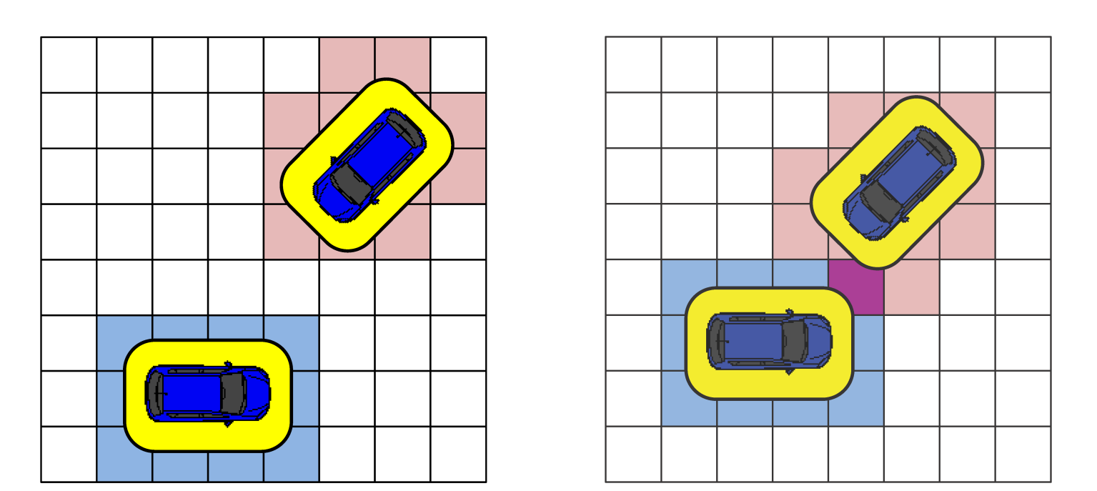
Intersection control policies
Divide intersection into grid of reservation tiles

Slide 54
Many AIM⁵ variants with different concerns
Decentralized (vehicles coordinating among themselves) vs. Centralized (manager)
Deliberative (planning entire trajectories) vs. reactive (planning trajectories in real-time)
Robust (Safety margins) vs. efficient (more throughput at the intersection)
Cooperative (optimizing overall traffic flow) vs. Egoistic (optimizing your own speed/time)
Homogenous (all vehicles treated the same) vs. Heterogeneous
Modeling AIM: asynchronous, timed, & hybrid process models used!

Slide 55
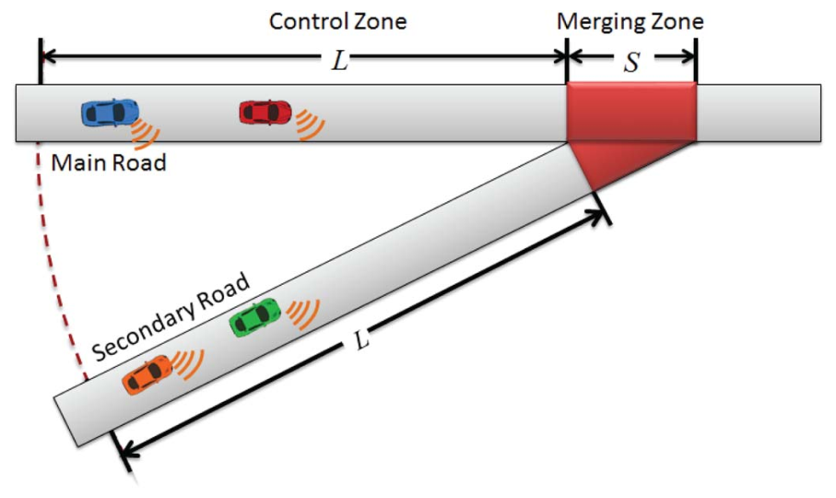
Collaborative merge
Purpose: allow vehicles merging onto a freeway from a ramp to do so in safe fashion
Can be formulated as a specific case in autonomous intersection management
Specialized approaches based on highway ramp metering have existed for some time (these do not utilize V2V capability, and do not guarantee safety)

Slide 56
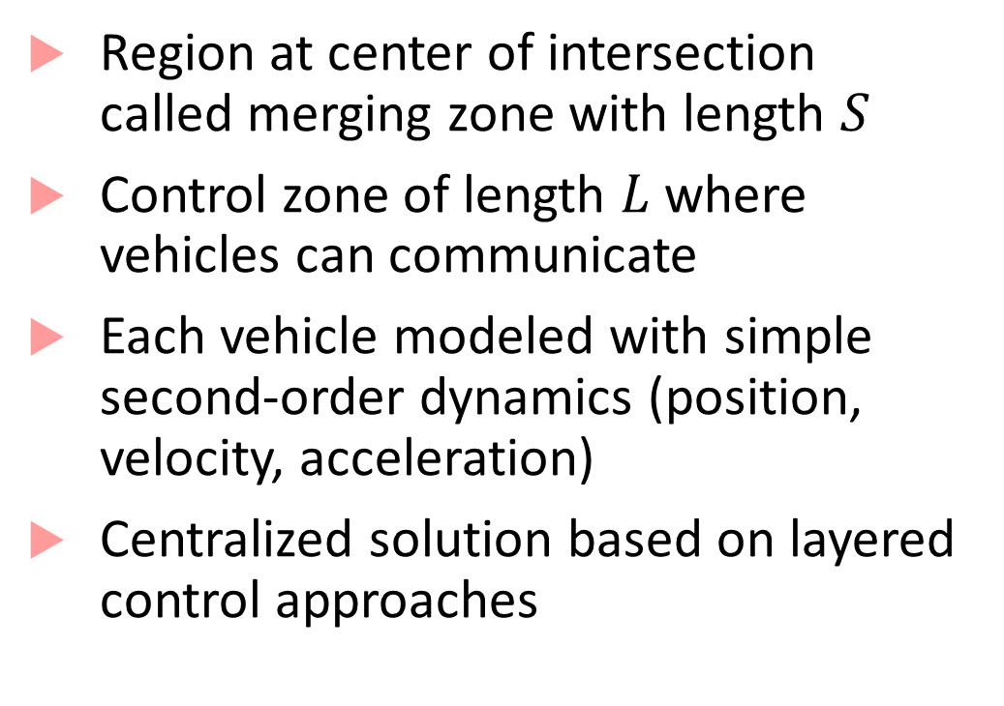
Collaborative merge
Region at center of intersection called merging zone with length $S$
Control zone of length $L$ where vehicles can communicate
Each vehicle modeled with simple second-order dynamics (position, velocity, acceleration)
Centralized solution based on layered control approaches

Slide 57
Two-layered control approach for merging
Centralized approach (V2I only)
First layer
Assumes each vehicle is traveling at constant speed
Computes time for each vehicle to merge into the control zone based on this assumption
Second layer
Determines conflicts in merging sequence
Computes required acceleration value based on heuristic rules
Generalization with different layers of control has been proposed
Optimization: minimizing vehicle overlap (crash!) and travel time

Slide 58
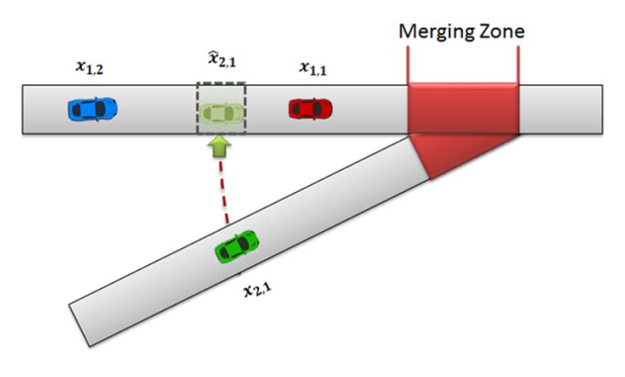
Decentralized approach
Virtual vehicle mapped onto the freeway before actual merging occurs
Allows vehicles to perform smoother and safer control actions
Uses slot-based traffic management (vehicles drive into a virtual slot)
Vehicles use V2V and V2I communication with vehicles in range
Other approaches based on MPC also exist

Slide 59

Design challenges $→$ Course Concepts
Modeling protocols, decision layer components
Synchronous and Asynchronous processes
Understanding system-level safety using synchronous and asynchronous composition
Verification using Model Checking, Inductive Invariants
Liveness properties with LTL, CTL
Model-based and Scenario-based Testing approaches

Slide 60
Design challenges $→$ Course Concepts
Modeling Controllers, Path planning
Timed and Hybrid Processes, Dynamical Systems
Markov Decision Processes & Markov Chains
Verification using Model Checking, Inductive invariants, safety certificates (barrier certificates), Liveness checking with LTL, CTL, STL
Testing using Falsification-based approaches
Software synthesis using Temporal Logic-based approaches, reinforcement learning

Slide 61

Design Challenges $→$ Course Concepts
Reasoning about environments, physical processes to be controlled
Dynamical systems models, hybrid processes
Signal Temporal Logic as a way to express Cyber-Physical systems specifications
Testing and Falsification approaches
Reasoning about safety and security
Models for perception

Slide 62
How does everything fit together?
You want to develop a new CPS/IoT system with autonomy
Analyze its environment: model it as a dynamical system or a stochastic system (e.g. PoMDPs)
Analyze the different components required in the software stack
Perception vs. Decision/Planning vs. Control
Analyze what models to use for the control algorithms
Choices are: Traditional control schemes (PID/MPC), state-machines (synchronous vs. asynchronous based on communication type), AI/planning algorithms, hybrid control algorithms, or combinations of these

Slide 63
Safety is the key!!
Try to specify the closed-loop system as something you can simulate and see its behaviors
Integrative modeling environment such as Simulink (plant models + software models)
Specify requirements of how you expect the system to behave (STL, LTL, or your favorite spec. formalism)
This step is a DO NOT MISS. It will provide documentation of your intent, and also a machine-checkable artifact
Test the system a lot, and then test some more
Apply formal reasoning wherever you can. Proofs are great if you can get them
Safety doesn’t end at modeling stage; continue reasoning about safety after deployment (through monitoring etc.)

Slide 64
It’s been a fun class
Models of computation
Asynchronous, Synchronous, Timed, Hybrid Processes, Dynamical Systems, Probabilistic Models, Simulink
Safe Autonomous CPS
MODELING
Basics of Control
PID, MPC, Nonlinear control, Observer design (Kalman filter)
Basics of Perception
Vision-based systems, CNNs
Basics of Planning
Path planning, Reinforcement learning
Basics of Security and Communicating Autonomous CPS
Basics of Safety-Aware Mindset
Specification Languages (LTL, CTL, STL)
Falsification and Testing
Safety Invariants + Proofs
Reachability, Model Checking
AUTONOMY
SAFETY

Slide 65
References
[1] Shladover, Steven E., et al. "Cooperative adaptive cruise control: Definitions and operating concepts." Transportation Research Record: Journal of the Transportation Research Board 2489 (2015): 145-152.
[2] ibid., https://escholarship.org/uc/item/7jf9n5wm
[3] Liang, Chi-Ying, and Huei Peng. "String stability analysis of adaptive cruise controlled vehicles." JSME International Journal Series C Mechanical Systems, Machine Elements and Manufacturing 43.3 (2000): 671-677.
[4] Stone, Peter, Shun Zhang, and Tsz-Chiu Au. "Autonomous intersection management for semi-autonomous vehicles." Routledge Handbook of Transportation. Routledge, 2015. 116-132.
[5] Qian, Xiangjun, et al. "Autonomous Intersection Management systems: criteria, implementation and evaluation." IET Intelligent Transport Systems 11.3 (2017): 182-189.
[6] de Campos, Gabriel Rodrigues, et al. "Traffic coordination at road intersections: Autonomous decision-making algorithms using model-based heuristics." IEEE Intelligent Transportation Systems Magazine 9.1 (2017): 8-21.
[7] Rios-Torres, Jackeline, and Andreas A. Malikopoulos. "A survey on the coordination of connected and automated vehicles at intersections and merging at highway on-ramps." IEEE Transactions on Intelligent Transportation Systems 18.5 (2017): 1066-1077.

