Slide 1
Autonomous Cyber-Physical Systems: Sensing and Perception
Fall 2024 CS 513.
Instructor: Jyo Deshmukh

Slide 2
Some important sensors for autonomy
Inertial Measurement Units
Vision-based (Camera) sensors
LiDAR
Not discussed:
GPS
RADAR
SONAR
Audio

Slide 3
Basics of IMUs
Inertial Measurement Units or IMUs: part of an Inertial Navigation System
Use accelerometers and gyroscopes to track position and orientation of an object relative to start position, orientation and velocity
Typically: 3 orthogonal rate-gyroscopes measuring angular velocities, and 3 accelerometers measuring linear accelerations (along the 3 axes)

Slide 4
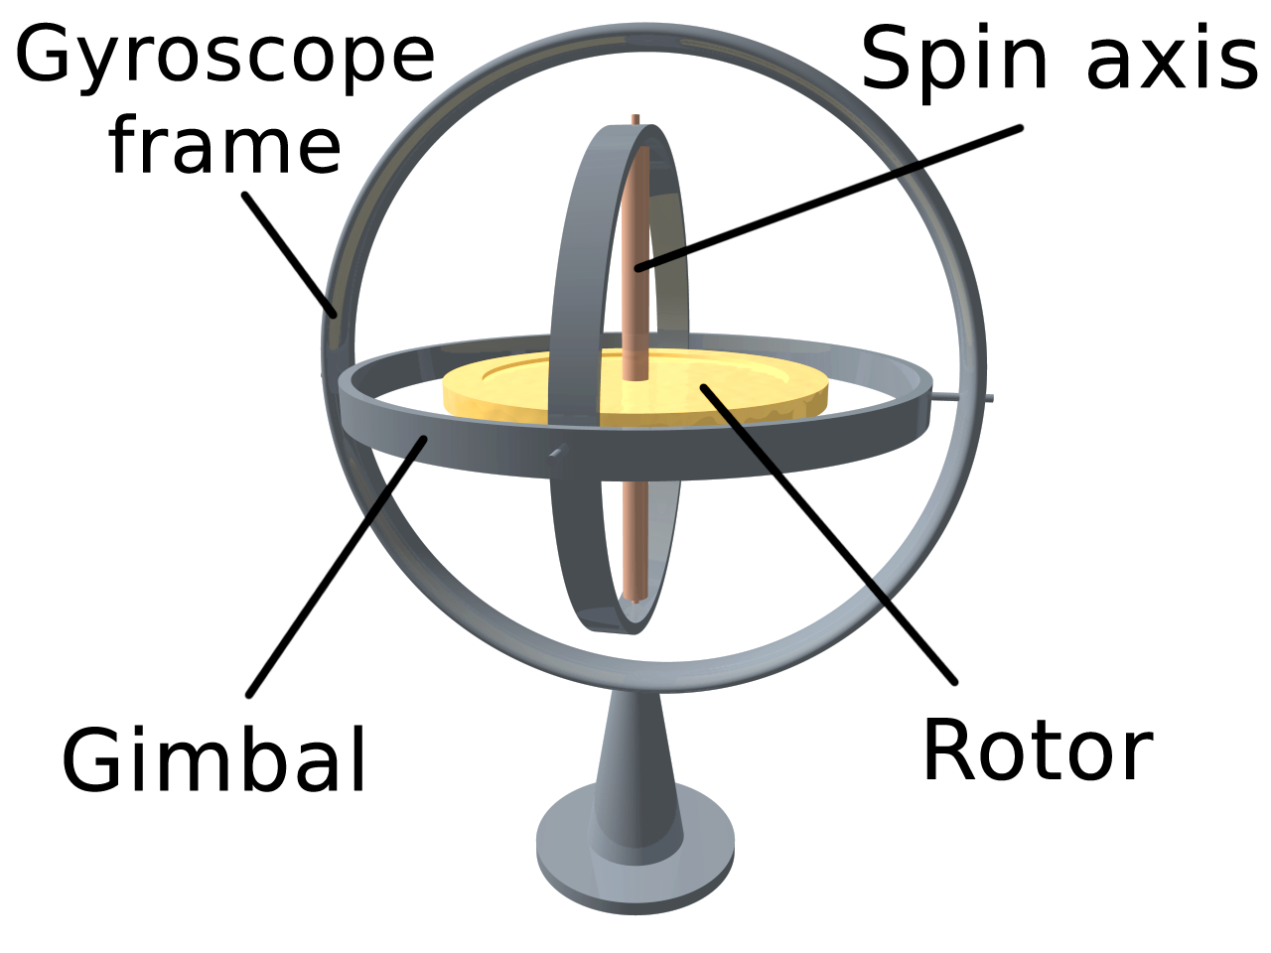
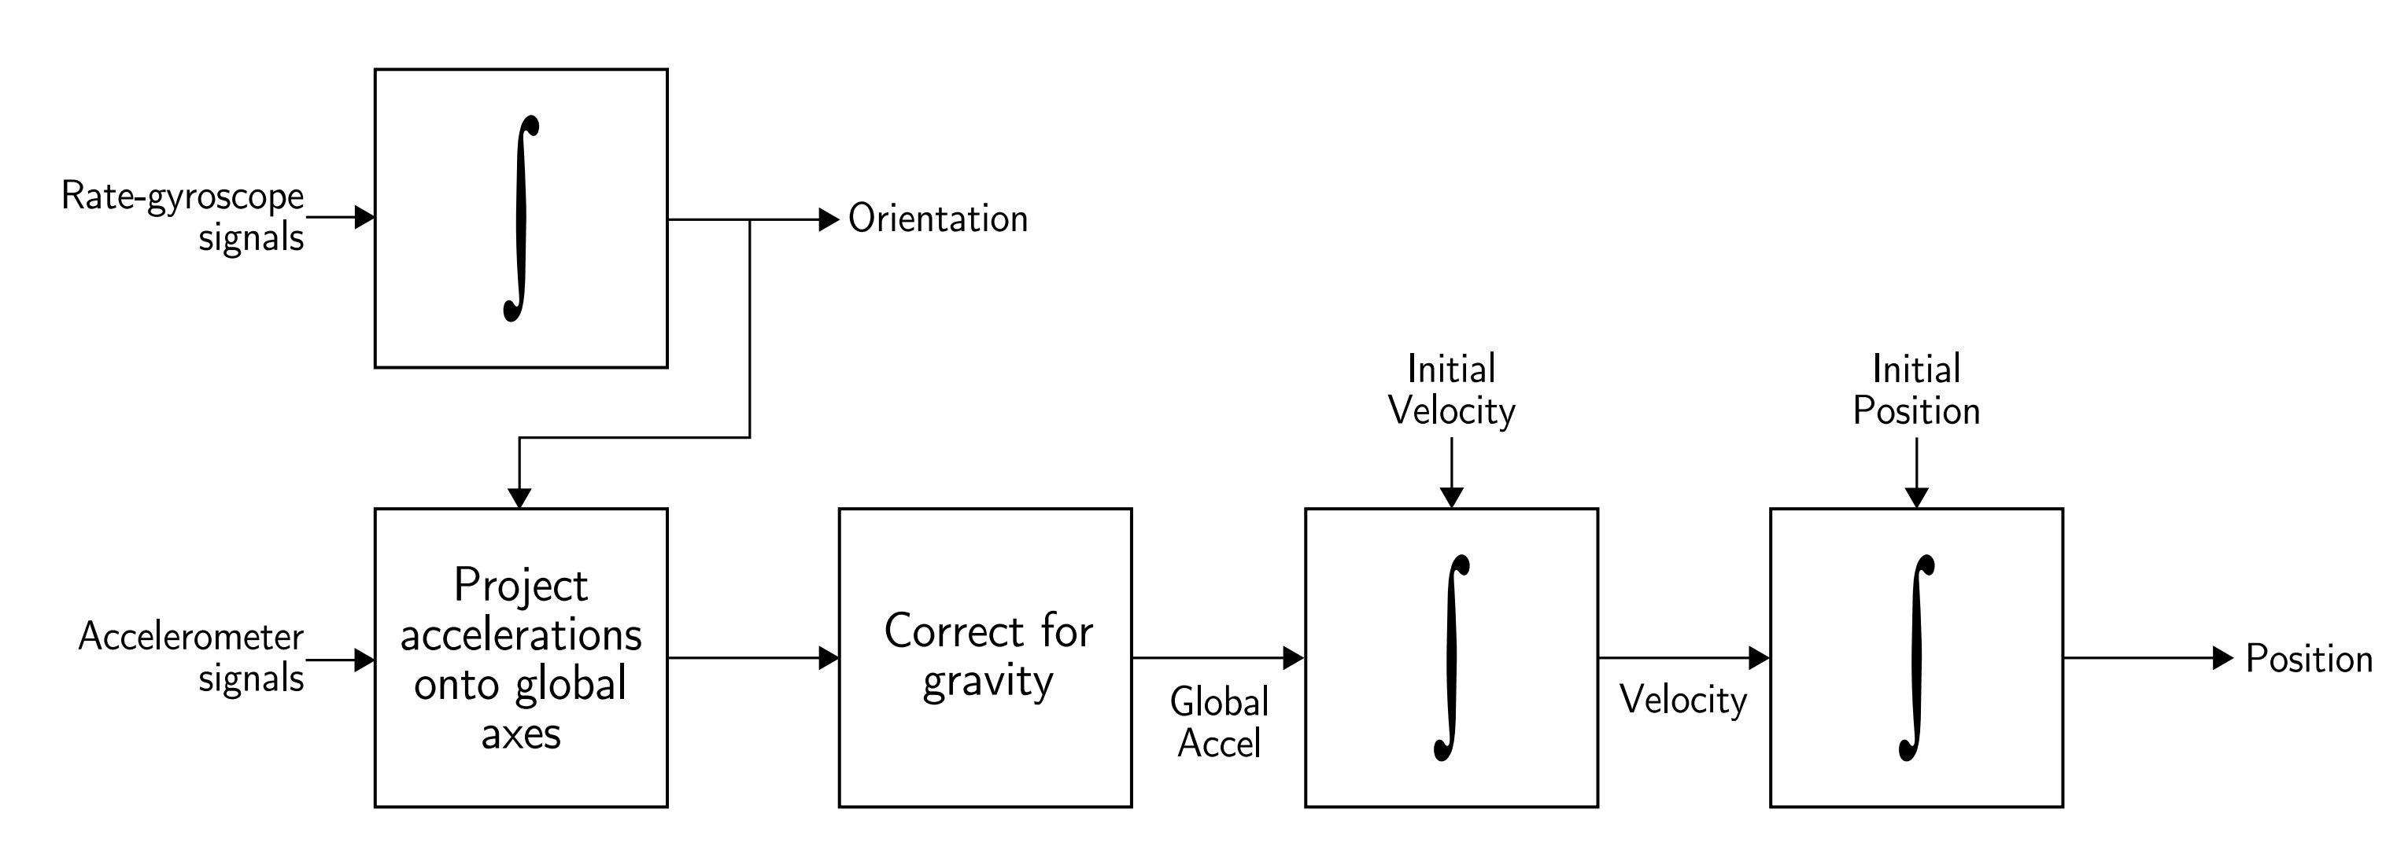
Inertial navigation

Slide 5
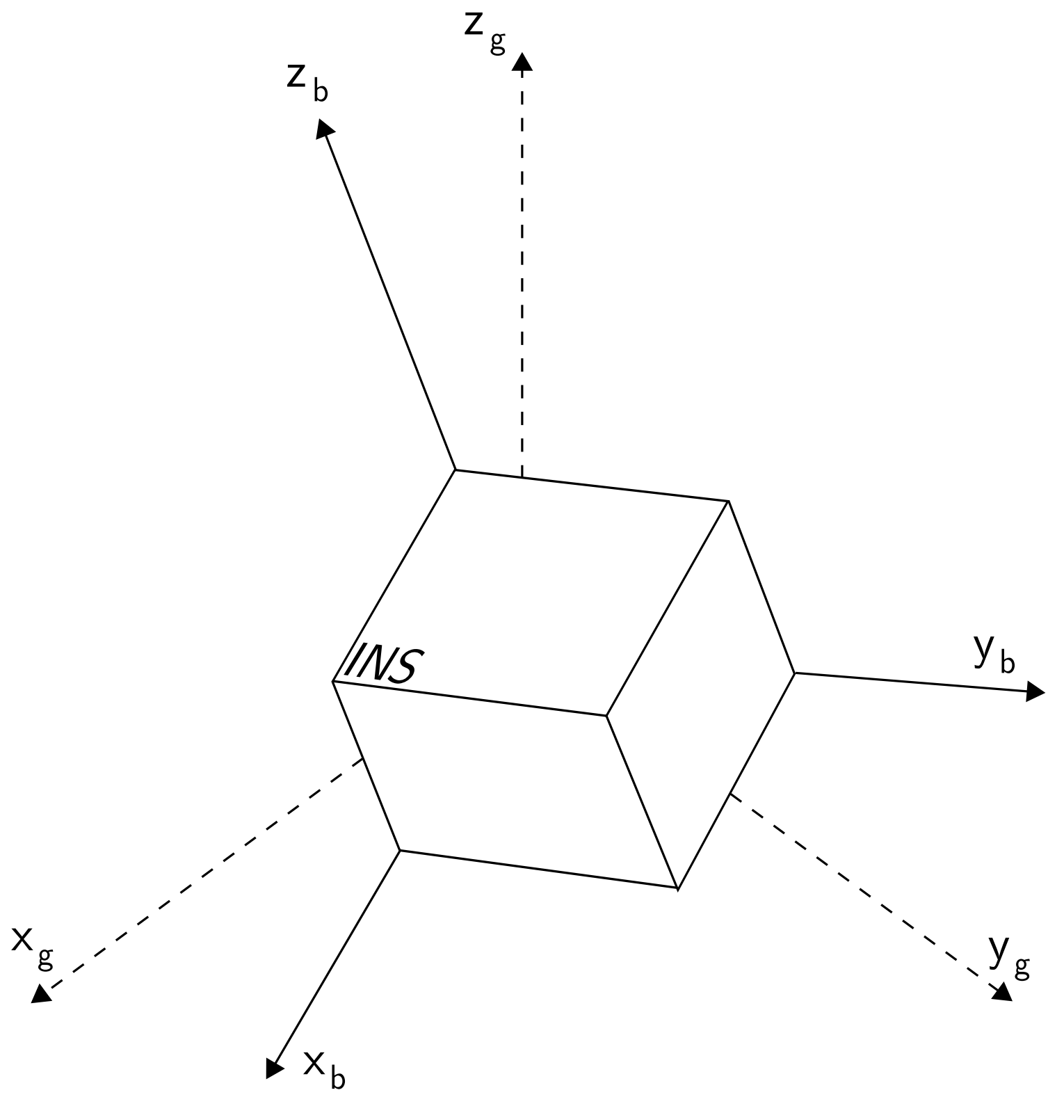
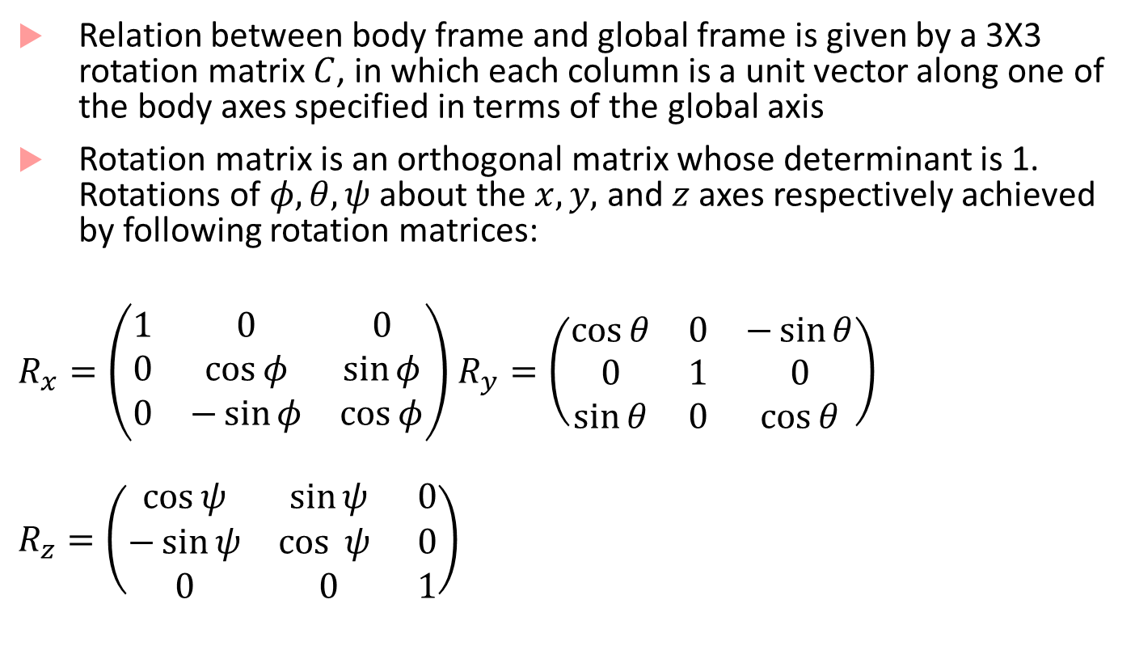
IMU equations
Relation between body frame and global frame is given by a 3X3 rotation matrix $C$, in which each column is a unit vector along one of the body axes specified in terms of the global axis
Rotation matrix is an orthogonal matrix whose determinant is 1. Rotations of $φ, θ, ψ$ about the $x,y,$ and $z$ axes respectively achieved by following rotation matrices:
$R_{x}=\left(\begin{matrix}1 & 0 & 0 \\ 0 & \cos{φ} & \sin{φ} \\ 0 & −\sin{φ} & \cos{φ}\end{matrix}\right)$ $R_{y}=\left(\begin{matrix}\cos{θ} & 0 & −\sin{θ} \\ 0 & 1 & 0 \\ \sin{θ} & 0 & \cos{θ}\end{matrix}\right)$
$$R_{z}=\left(\begin{matrix}\cos{ψ} & \sin{ψ} & 0 \\ −\sin{ψ} & \cos{ ψ } & 0 \\ 0 & 0 & 1\end{matrix}\right)$$
Body Frame vs. Global Frame
Image from [1]

Slide 6
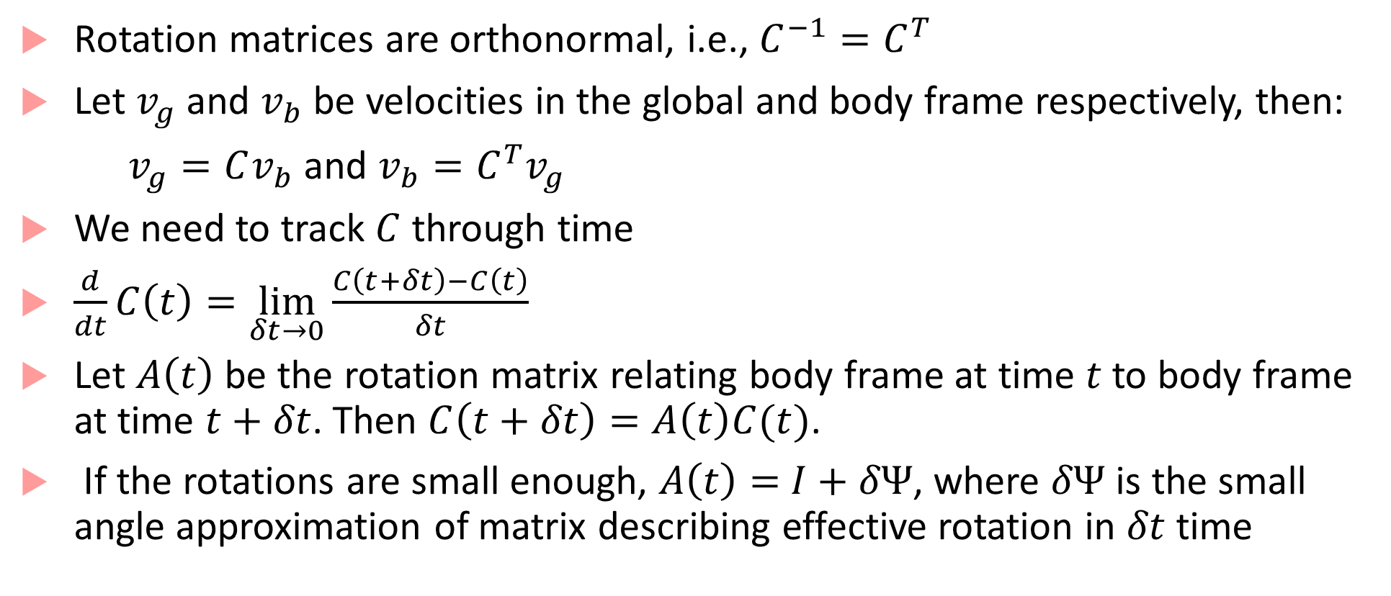
IMU equations continued
Rotation matrices are orthonormal, i.e., $C^{−1}=C^{T}$
Let $v_{g}$ and $v_{b}$ be velocities in the global and body frame respectively, then:
$v_{g}=Cv_{b}$ and $v_{b}=C^{T}v_{g}$
We need to track $C$ through time
$\frac{d}{dt}C\left(t\right)=\lim_{δt→0}{\frac{C\left(t+δt\right)−C\left(t\right)}{δt}}$
Let $A\left(t\right)$ be the rotation matrix relating body frame at time $t$to body frame at time $t+δt$. Then $C\left(t+δt\right)=A\left(t\right)C(t)$.
If the rotations are small enough, $A\left(t\right)=$ $I+δΨ$, where $δΨ$ is the small angle approximation of matrix describing effective rotation in $δt$ time

Slide 7
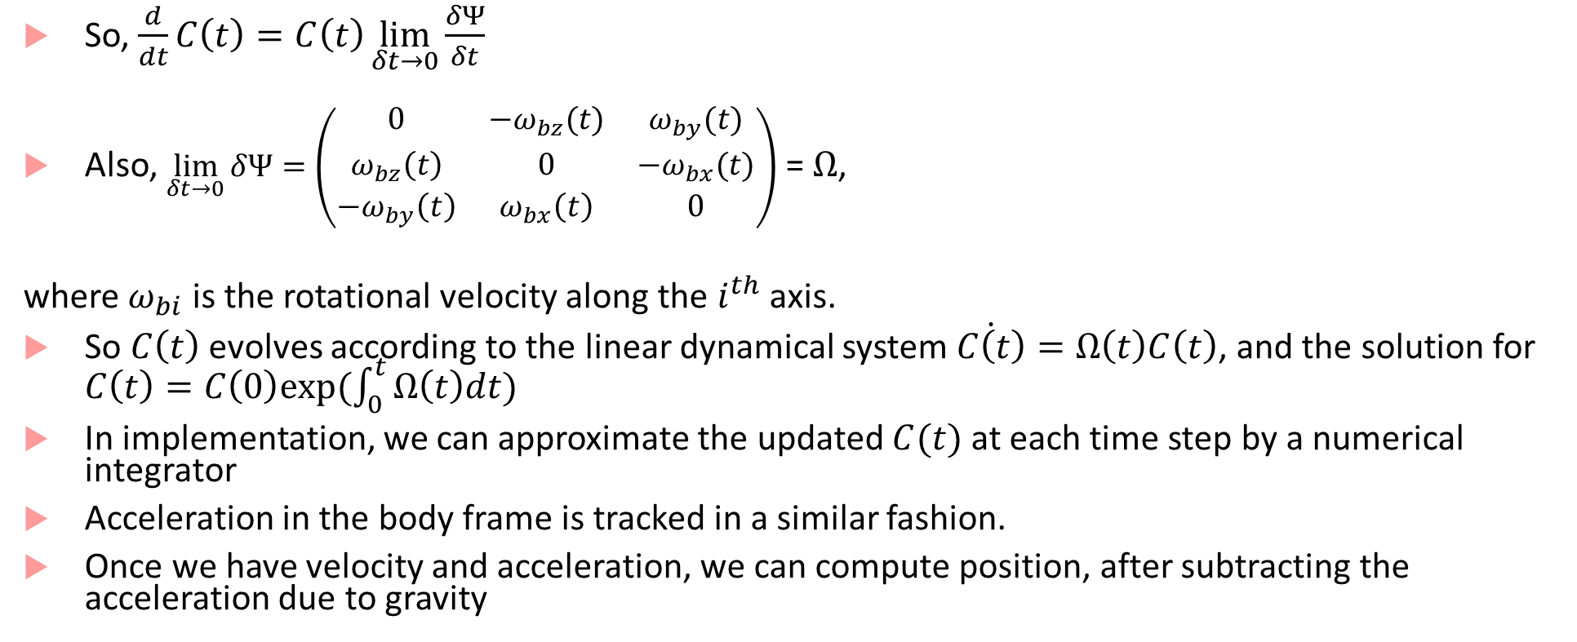
IMU equations
So, $\frac{d}{dt}C\left(t\right)=C\left(t\right)\lim_{δt→0}{\frac{δΨ}{δt}}$
Also, $\lim_{δt→0}{δΨ}=\left(\begin{matrix}0 & −ω_{bz}(t) & ω_{by}(t) \\ ω_{bz}\left(t\right) & 0 & −ω_{bx}(t) \\ −ω_{by}\left(t\right) & ω_{bx}\left(t\right) & 0\end{matrix}\right)$ = $Ω$,
where $ω_{bi}$ is the rotational velocity along the $i^{th}$ axis.
So $C\left(t\right)$ evolves according to the linear dynamical system $\dot{C\left(t\right)}=Ω\left(t\right)C\left(t\right)$, and the solution for $C\left(t\right)=C\left(0\right)exp⁡(\int_{0}^{t}{Ω\left(t\right)dt})$
In implementation, we can approximate the updated $C(t)$ at each time step by a numerical integrator
Acceleration in the body frame is tracked in a similar fashion.
Once we have velocity and acceleration, we can compute position, after subtracting the acceleration due to gravity

Slide 8
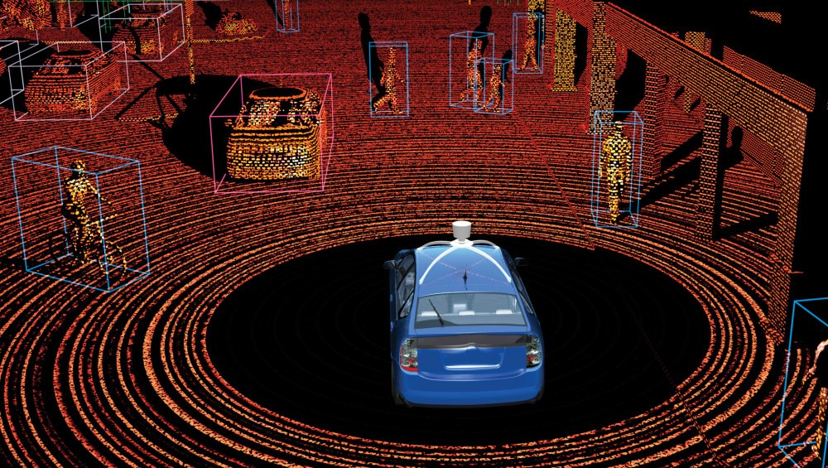
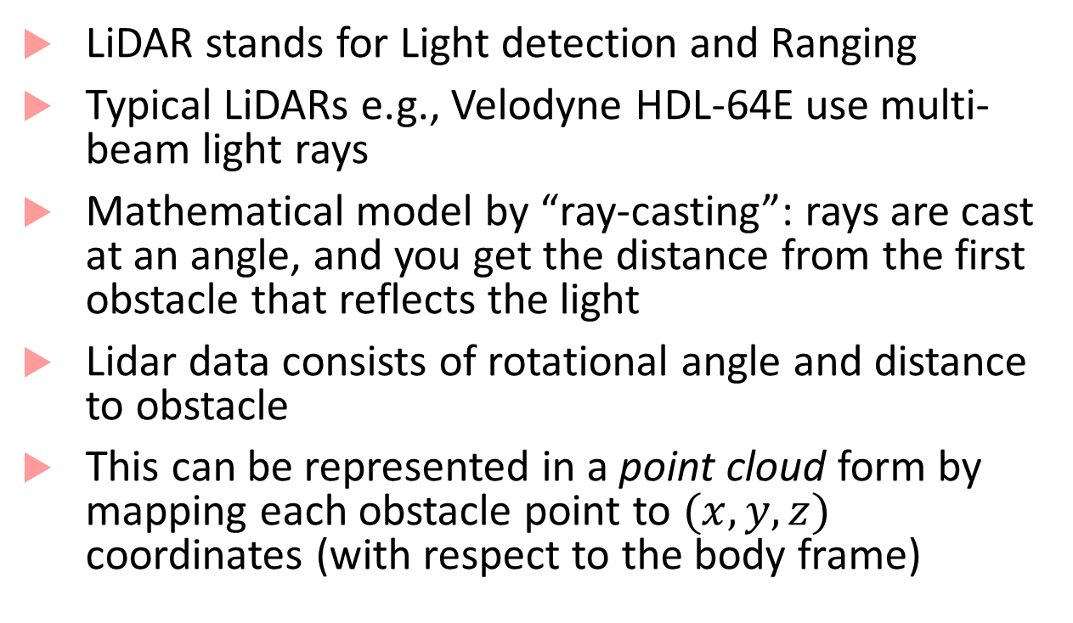
Basics of LiDAR
LiDAR stands for Light detection and Ranging
Typical LiDARs e.g., Velodyne HDL-64E use multi-beam light rays
Mathematical model by “ray-casting”: rays are cast at an angle, and you get the distance from the first obstacle that reflects the light
Lidar data consists of rotational angle and distance to obstacle
This can be represented in a point cloud form by mapping each obstacle point to $(x,y,z)$ coordinates (with respect to the body frame)

Slide 9
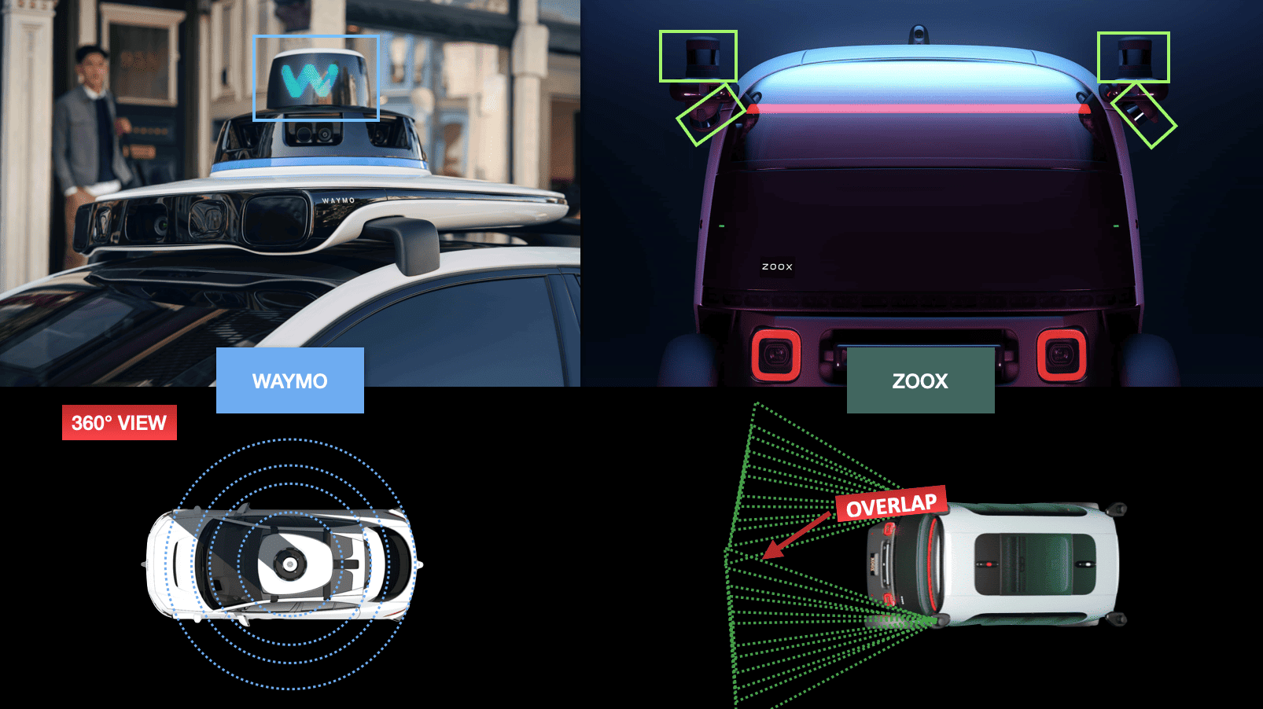
Shift to solid-state LiDAR
Solid-state LiDAR : cheaper/smaller than mechanical LiDAR

Slide 10
Point cloud alignment
Given two different point clouds, how do we “fuse” them to have a uniform view?
Two main steps:
Correspondence: figure out which points correspond to each other
Transformation: map one point cloud to the other’s coordinate frame
Rigid (translation/rotation) or Non-rigid (Scaling/shear mapping)
Algorithms for doing point cloud alignment?
Iterative closest point (ICP) [Chen & Medioni, Besl & McKay]
Feature-based matching (color, intensity, reflectance, etc.)
Deep Learning-based techniques

Slide 11
Detection algorithms for video/spatial data
Detection of segmented clusters from LIDAR data is done using traditional machine learning algorithms as well as deep learning
Detection from images (camera data)
Lane line marking detection
Drivable path detection
Object detection
Distances to obstacles
Semantic segmentation
Scenario identification

Slide 12
Convolutional Neural Networks
Inspired by visual cortex in animals
Learns image filters that were previously hand-engineered
Basic intuitions for CNNs:
Images are too large to be monolithically processed by a feedforward neural network (1000x1000 image = 10⁶ inputs, which means the weight matrix for the second layer is proportional to at least 10^{6!})
Data in an image is spatially correlated
CNN divided into several layers with different purposes

Slide 13
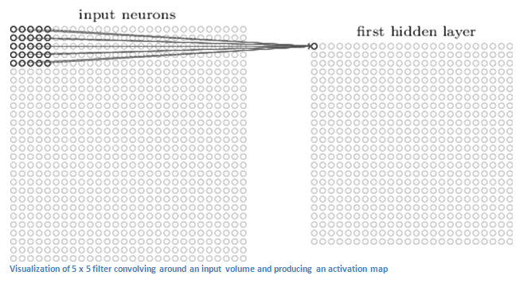
Convolutional layer
Receptive field
First layer is a convolutional layer
Convolutional layer contains neurons associated with sub-regions of the original image
Each sub-region is called receptive field
Convolves the weights of the convolutional layer with each cell in receptive field to obtain activation map or feature map
Image from [1]

Slide 14
“Convolution”
Convolution of a 2-D image I with a 2-D kernel K defined as:
$$S\left(i,j\right)=\left(I∗K\right)\left(i,j\right)=\sum_{m}{\sum_{n}{I\left(m,n\right)K(i−m,j−n)}}$$
Most neural network libraries do not use convolution, but instead implement cross-correlation, i.e.
$$S\left(i,j\right)=\sum_{m}{\sum_{n}{I\left(i+m,j+n\right)K(m,n)}}$$
The kernel function $K$ usually defines the receptive field

Slide 15
Purpose of convolutional layer
Convolutional layer applies a filter to the pixels within its receptive field
This allows identifying low-level features (curves, straight lines, etc.)
The outputs of the first convolutional layer can be thought of as having a “high value” when a particular feature is detected and a “low value” otherwise
Second convolutional layer allows learning higher-level features (e.g. semi-circles, angles etc.)
Second convolutional layer has a bigger receptive field (as it is able to simultaneously correlate over outputs of first layer)
By “convolving” over the feature map, output of second layer tries to connect higher level features

Slide 16
More insights about convolution
Convolution operation basically helps implement three ideas:
Sparse interactions (between layers)
Parameter sharing
Equivariant representations
Sparse interaction:
By using a kernel function that is smaller than input, not all outputs of the first layer interact with all inputs
This reduces the cost of doing matrix multiplication

Slide 17
More insights about convolution
Parameter sharing
As the kernel function is repeatedly applied to the image, (weight) parameters are shared
This reduces storage requirements of the model
Equivariant representations
Parameter sharing leads to equivariance under translation
$f$ is equivariant to $g$ if $f\left(g\left(x\right)\right)=g\left(f\left(x\right)\right)$
I.e. detected features of a linearly translated image will appear linearly translated

Slide 18
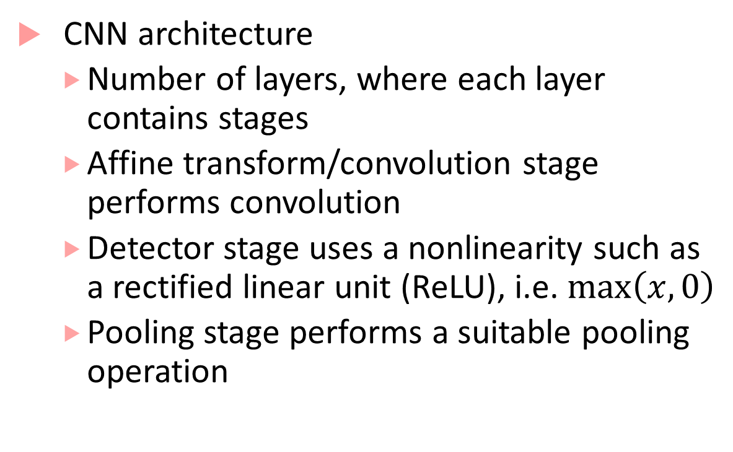
CNN architecture
CNN architecture
Number of layers, where each layer contains stages
Affine transform/convolution stage performs convolution
Detector stage uses a nonlinearity such as a rectified linear unit (ReLU), i.e. $\max\left(x,0\right)$
Pooling stage performs a suitable pooling operation
Next layer
Convolutional Layer
Pooling stage
Detector stage
Convolution stage (Affine transform)
Picture from [2]
Input to layer

Slide 19
Pooling stage
Pooling function replaces the output of a layer at a certain location with a summary statistic of the nearby outputs
E.g., max pooling reports maximum output within a rectangular neighborhood
Other pooling functions include average, L² norm, weighted average etc.
Pooling helps representation be approximately invariant to small translations
By pooling over outputs of different convolutions, features can learn which transformations to become invariant to (e.g., rotation etc.)

Slide 20
Fully connected layers
CNNs may have some fully connected layers before the final output
These layers allows performing higher-level reasoning over different features learned by the previous convolutional layers
Various kind of convolution functions, pooling functions and detection functions are possible, giving rise to many different flavors
Number of convolutional layers can be varied depending on complexity of features to be learned

Slide 21
R-CNN^{[3]}
R-CNN, Fast R-CNN and Faster R-CNN are specific architectures that help with object detection
Objective is to obtain from an image:
A list of bounding boxes
A label assigned to each bounding box
A probability for each label and bounding box
The key idea in R-CNNs is to use region proposals and region of interest pooling

Slide 22
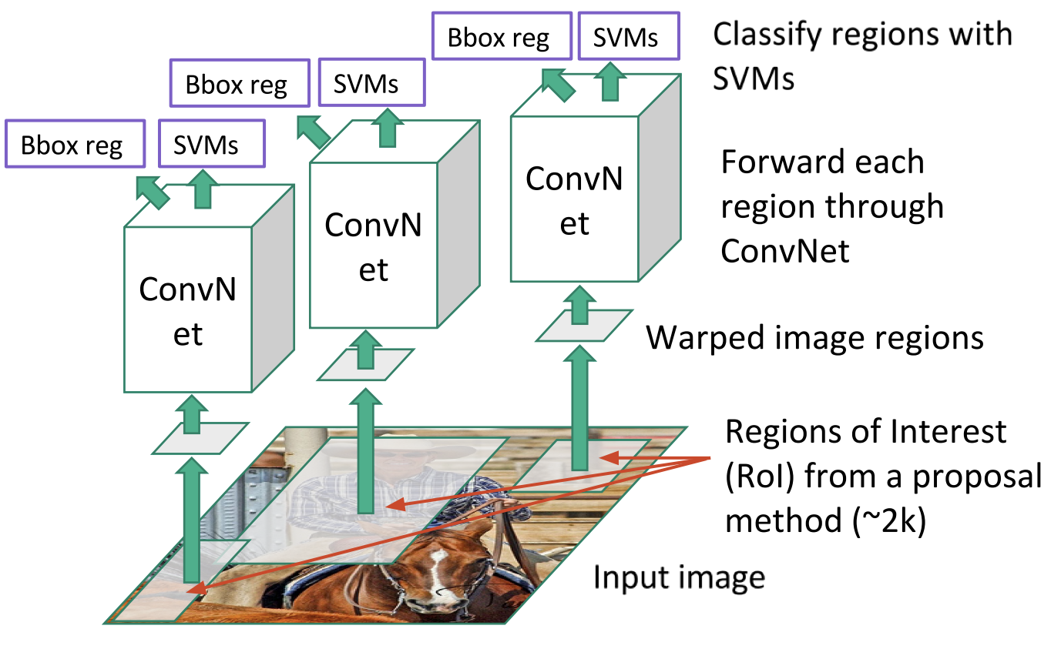
R-CNN, Fast-RCNN, Faster-RCNN
R-CNN
Scan image for possible objects (using selective search)
Generating region proposals (bounding boxes where possible objects may lie)
Run a CNN on region proposals
Take output of each CNN and feed it to an SVM to classify the region
Fast-RCNN
Replace SVM with a softmax layer
Faster-RCNN
Replaces slow selective search algorithm with a fast neural net

Slide 23
YOLO algorithm (You Only Look Once)
YOLO is one of the fastest real-time detection algorithms (See [4,5,6])
R-CNN etc. are algorithms that leverage classifiers and localizers to perform detection
YOLO applies a single neural network to the entire image
Network divides image into regions and predicts bounding boxes and probabilities for each region
Bounding boxes are weighted by predicted probabilities

Slide 24
Localization
Most common approach is to use odometry + GPS + Kalman filter
This becomes unreliable in urban environments, tunnels, tall buildings etc. where GPS signal quality is poor
Map-aided localization:
Use local features to achieve precise localization
SLAM (simultaneous localization and mapping): most popular approach

Slide 25
Main steps in SLAM
ACPS moves reaching a new point of view of its location
Motion model captures car motion, but could be inaccurate because of actuation errors
ACPS discovers interesting features in the environment that need to be incorporated into the map
Features are called landmarks; because of sensor errors, positions of landmarks will be uncertain.
Mathematical model to determine position of landmarks from observation is called inverse observation model

Slide 26
Main steps in SLAM (continued)
ACPS observes previously mapped landmarks and uses them to correct its self-localization and positions of landmarks in the map
Localization and landmark uncertainties decrease
Predict values of measurement from predicted landmark location and robot localization is called direct observation model
SLAM = above three models + an estimator (EKF is common)
SLAM viewed as a Bayesian filtering problem

Slide 27
Sensor Fusion
We already learned about Kalman filter that can help do sensor fusion for localization using INS and GPU
Sensor fusion for camera and LiDAR data requires new algorithms
Centralized algorithms based on conditional random fields, Markov random fields, and decentralized algorithms based on boosting and Gaussian mixture models have been explored
Deep learning is also being explored for doing sensor fusion
Note: these approaches are exploratory, and there is no standard algorithm accepted by all

Slide 28
References
[1] Understanding CNNs: https://adeshpande3.github.io/A-Beginner%27s-Guide-To-Understanding-Convolutional-Neural-Networks/
[2] I. Goodfellow, Y. Bengio, A. Courville, Deep Learning, MIT Press.
[3] https://towardsdatascience.com/deep-learning-for-object-detection-a-comprehensive-review-73930816d8d9
[4] https://towardsdatascience.com/yolo-you-only-look-once-real-time-object-detection-explained-492dc9230006
[5] https://pjreddie.com/darknet/yolo/
[6] YOLO algorithm: https://arxiv.org/abs/1506.02640

Slide 29
Bibliography
O. J. Woodman, An introduction to inertial navigation - Cambridge Computer Laboratory, https://www.cl.cam.ac.uk/techreports/UCAM-CL-TR-696.pdf
Pendleton, Scott Drew, Hans Andersen, Xinxin Du, Xiaotong Shen, Malika Meghjani, You Hong Eng, Daniela Rus, and Marcelo H. Ang. "Perception, planning, control, and coordination for autonomous vehicles." Machines 5, no. 1 (2017): 6.
S. Liu, L. Li, J. Tang, S. Wu, Jean-Luc Gaudiot, Creating Autonomous Vehicle Systems, Morgan & Claypool 2018.

Slide 30
Bibliography
Pendleton, Scott Drew, Hans Andersen, Xinxin Du, Xiaotong Shen, Malika Meghjani, You Hong Eng, Daniela Rus, and Marcelo H. Ang. "Perception, planning, control, and coordination for autonomous vehicles." Machines 5, no. 1 (2017): 6.
Good introduction to Hough transform and various vision algorithms: http://aishack.in/tutorials/hough-transform-normal/
Hough transform basics: http://web.ipac.caltech.edu/staff/fmasci/home/astro_refs/HoughTrans_review.pdf
Graph-based clustering: http://vision.stanford.edu/teaching/cs231b_spring1213/slides/segmentation.pdf
MRF/CRF fundamentals https://www.cs.umd.edu/~djacobs/CMSC828seg/MRFCRF.pdf
Edge detection: https://www.swarthmore.edu/NatSci/mzucker1/e27_s2016/filter-slides.pdf
SLAM: https://people.eecs.berkeley.edu/~pabbeel/cs287-fa09/readings/Durrant-Whyte_Bailey_SLAM-tutorial-I.pdf

