Slide 1
Autonomous Cyber-Physical Systems: Safety Verification
Spring 2018. CS 599.
Instructor: Jyo Deshmukh
Acknowledgment: Some of the material in these slides is based on the lecture slides for CIS 540: Principles of Embedded Computation taught by Rajeev Alur at the University of Pennsylvania. http://www.seas.upenn.edu/~cis540/
Also, part of the material here is from Goran Frehse’s slides presented at the CPS summer school in 2014: https://persyval-lab.org/sites/default/files/summer-schools/CPS14/slides/Frehse.pdf

Slide 2
Overview
Last lecture
Falsification (Requirements-driven Testing)
Requirement Mining
This lecture
Safety Verification using Barrier Certificates
Safety Verification using Reachability Analysis
Simulation-guided Reachability Analysis

Slide 3
Safety verification using barrier certificates
Barrier certificate: safety invariant for a continuous dynamical system
It establishes an invisible barrier that trajectories of a system cannot cross
(think of it as a force-field)
Reasoning very similar to that of an inductive invariant
Establish that the initial states all lie within the barrier
Establish that the unsafe states are all outside the barrier
Show that the next states for all states on the barrier are inside the barrier

Slide 4
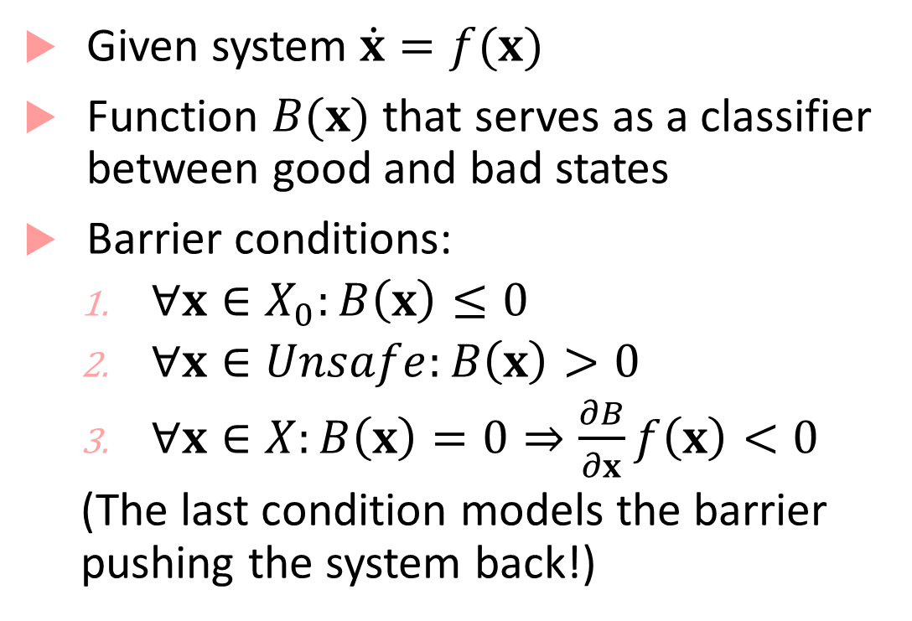
Strict barrier certificate
Given system $\dot{x}=f(x)$
Function $B(x)$ that serves as a classifier between good and bad states
Barrier conditions:
$∀x∈X_{0}:B\left(x\right)≤0$
$∀x∈Unsafe:B\left(x\right)>0$
$∀x∈X:B\left(x\right)=0⇒\frac{∂B}{∂x}f\left(x\right)<0$
(The last condition models the barrier pushing the system back!)
Unsafe
Initial

Slide 5
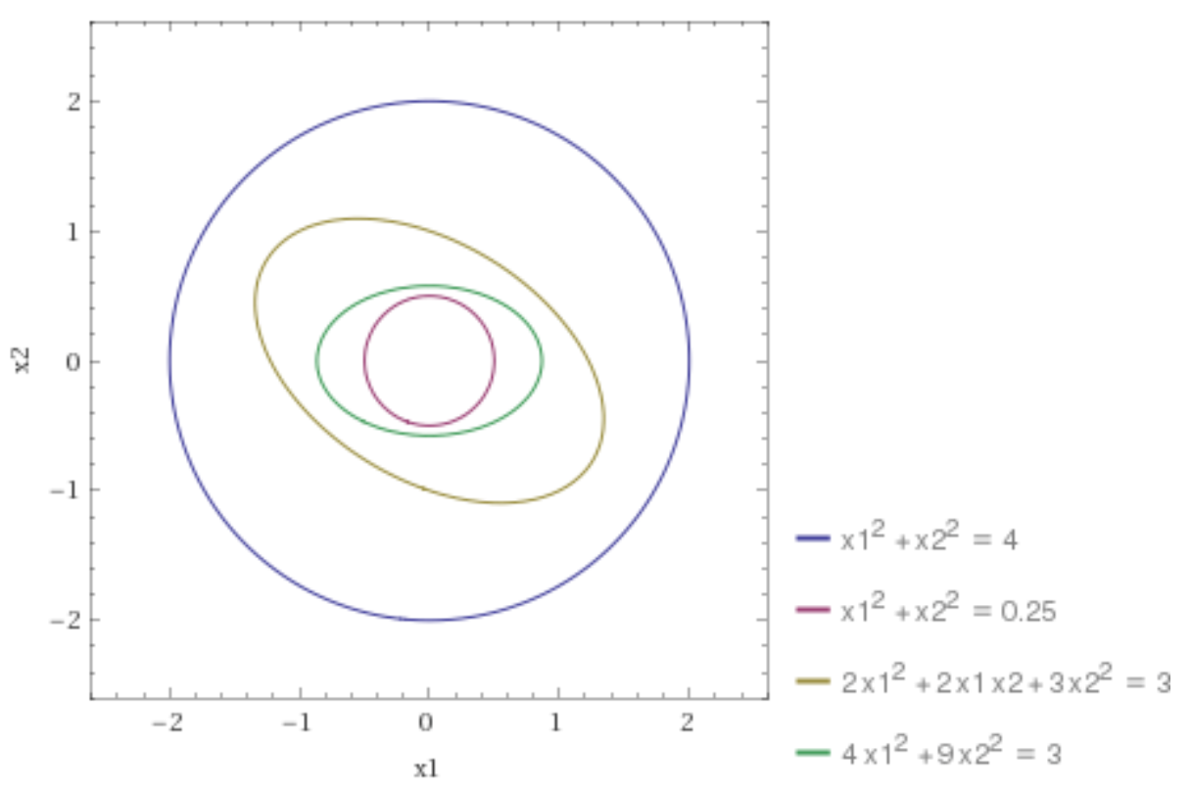

Example
Unsafe
$\dot{x_{1}}={−x}_{1};\dot{x_{2}}=x_{1}−x_{2}$
Initial state set: $x_{1}^{2}+x_{2}^{2}<1/4$
Unsafe set: $x_{1}^{2}+x_{2}^{2}>4$
Barrier: $B\left(x_{1},x_{2}\right)= {2x}_{1}^{2}+{2x_{1}x_{2}+3x}_{2}^{2}−3$
From plot:
for initial states, $B\left(x\right)<0$,
for unsafe states, $B\left(x\right)>0$
Barrier
Initial

Slide 6
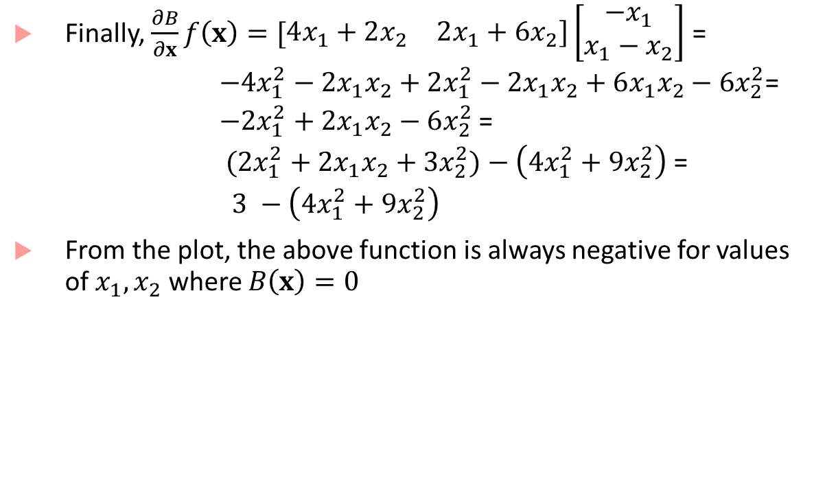
Example
Barrier
Finally, $\frac{∂B}{∂x}f\left(x\right)=[\begin{matrix}4x_{1}+2x_{2} & 2x_{1}+6x_{2}]\end{matrix}\left[\begin{matrix}−x_{1} \\ x_{1}−x_{2}\end{matrix}\right]$ =
$−4x_{1}^{2}−2x_{1}x_{2}+2x_{1}^{2}−2x_{1}x_{2}+6x_{1}x_{2}−6x_{2}^{2}$=
$−2x_{1}^{2}+2x_{1}x_{2}−6x_{2}^{2}$ =
$({2x}_{1}^{2}+{2x_{1}x_{2}+3x}_{2}^{2})−\left(4x_{1}^{2}+9x_{2}^{2}\right)$ =
$3 −\left(4x_{1}^{2}+9x_{2}^{2}\right)$
From the plot, the above function is always negative for values of $x_{1},x_{2}$ where $B\left(x\right)=0$

Slide 7
Time-bounded Reachability
Verification basics and Hybrid Systems lecture: reachability analysis using a “fix-point based algorithm”
uses a breadth-first approach to compute reachable states over an infinite time-horizon
Barrier certificates: also provide infinite time safety results, but require manual ingenuity in coming up with a barrier; difficult to do for hybrid/nonlinear systems
Time-bounded reachability: Starting from some initial state in a given set of initial states, does the system behavior ever reach an unsafe state within a given time bound?

Slide 8



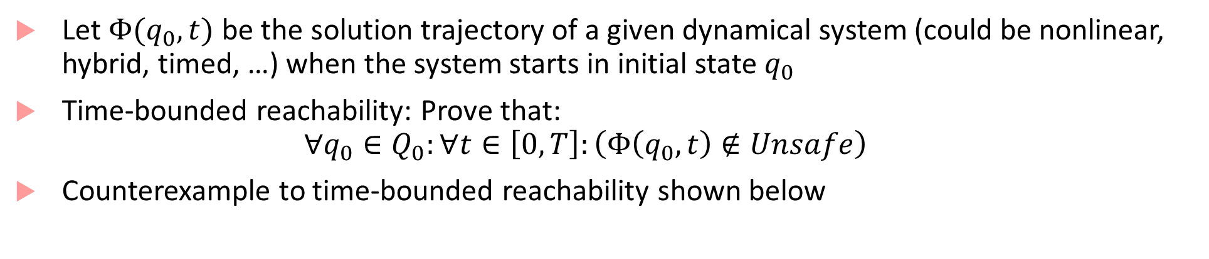



Problem definition
Let $Φ(q_{0},t)$ be the solution trajectory of a given dynamical system (could be nonlinear, hybrid, timed, …) when the system starts in initial state $q_{0}$
Time-bounded reachability: Prove that:
$$∀q_{0}∈Q_{0}:∀t∈\left[0,T\right]:\left(Φ\left(q_{0},t\right)∉Unsafe\right)$$
Counterexample to time-bounded reachability shown below
Trajectory segment with safe states
$$Q_{0}$$
$${Φ(q}_{0},0)$$
Trajectory segment with unsafe states
Unsafe
$${Φ(q}_{0},\hat{t})$$
$${Φ(q}_{0},t)$$
$$q_{0}$$
?
$$\hat{t}∈[0,T]$$

Slide 9
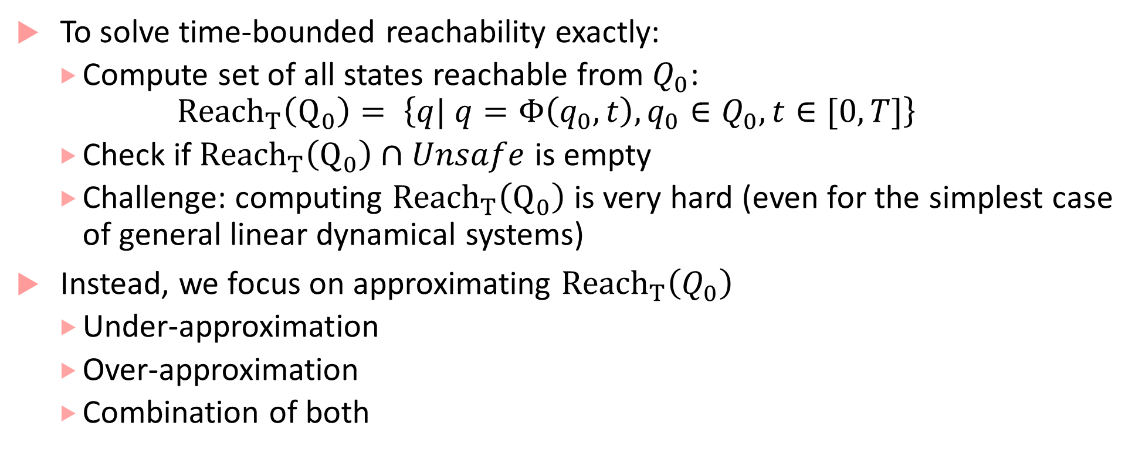
Solutions to time-bounded reachability
To solve time-bounded reachability exactly:
Compute set of all states reachable from $Q_{0}$:
$${Reach}_{T}\left(Q_{0}\right)= \left\{q| q=Φ\left(q_{0},t\right), q_{0}∈Q_{0}, t∈[0,T]\right\}$$
Check if ${Reach}_{T}\left(Q_{0}\right)∩Unsafe$ is empty
Challenge: computing ${Reach}_{T}\left(Q_{0}\right)$ is very hard (even for the simplest case of general linear dynamical systems)
Instead, we focus on approximating ${Reach}_{T}\left(Q_{0}\right)$
Under-approximation
Over-approximation
Combination of both

Slide 10
Under-approximation
When we under-approximate the set of initial states, at each time, the set of reachable states that we compute is a subset of the actual set of reachable states
Best example of under-approximation is (guaranteed) numerical simulation
Guaranteed numerical simulation: better than numerical integration schemes as it gives bounds on error in numerical integration (e.g. VNODE)
Under-approximation is:
Sound for bug-finding: if we find a bug, then it is really a bug
Unsound for verification: if we do not find a bug, does not mean the system is safe

Slide 11


Under-approximation: sound for bug-finding
The good case: under-approximation found a trace that contained unsafe states – we found a bug in the system!
$$Unsafe$$
$$Q_{0}$$

Slide 12
Under-approximation: unsound for verification
The bad case: under-approximation did not find a trace that contained unsafe states – we cannot conclude anything.
$$Unsafe$$
$$Q_{0}$$

Slide 13
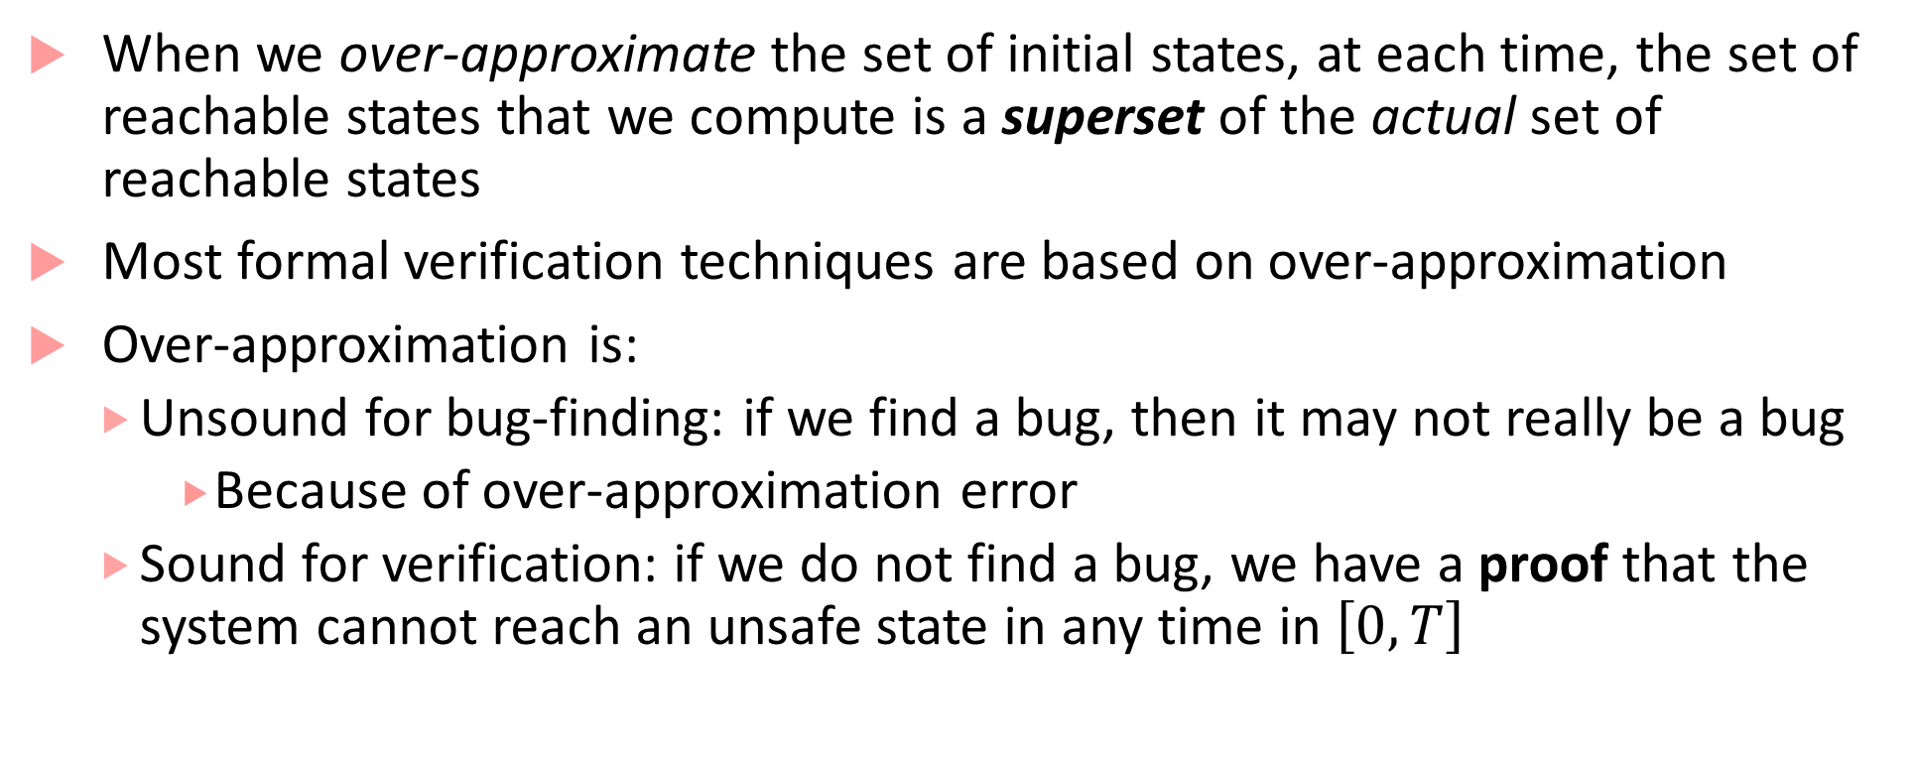
Over-approximation
When we over-approximate the set of initial states, at each time, the set of reachable states that we compute is a superset of the actual set of reachable states
Most formal verification techniques are based on over-approximation
Over-approximation is:
Unsound for bug-finding: if we find a bug, then it may not really be a bug
Because of over-approximation error
Sound for verification: if we do not find a bug, we have a proof that the system cannot reach an unsafe state in any time in $\left[0,T\right]$

Slide 14
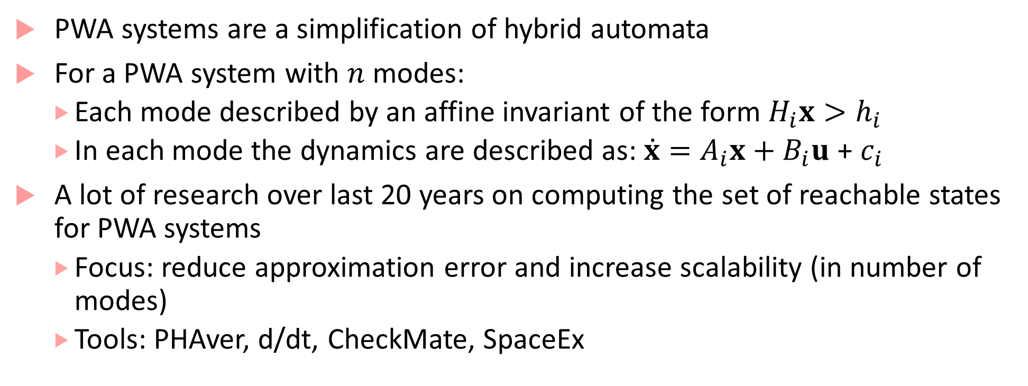
Reachability for piecewise affine (PWA) systems
PWA systems are a simplification of hybrid automata
For a PWA system with $n$ modes:
Each mode described by an affine invariant of the form $H_{i}x>h_{i}$
In each mode the dynamics are described as: $\dot{x}=A_{i}x+B_{i}u$ + $c_{i}$
A lot of research over last 20 years on computing the set of reachable states for PWA systems
Focus: reduce approximation error and increase scalability (in number of modes)
Tools: PHAver, d/dt, CheckMate, SpaceEx

Slide 15


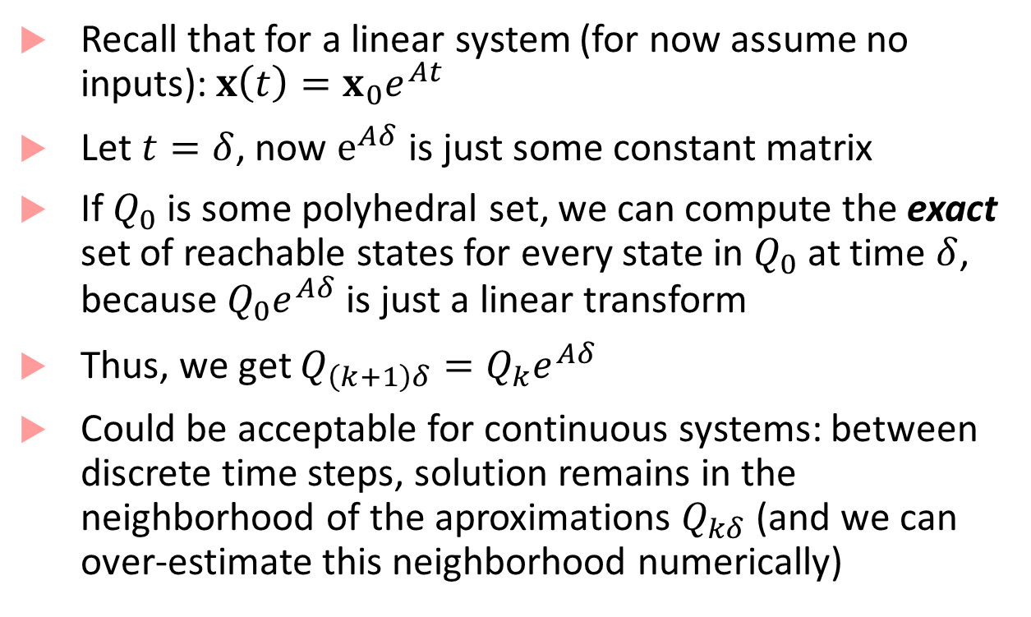




Reachability for affine systems
$$Q_{3δ}$$
Recall that for a linear system (for now assume no inputs):$x\left(t\right)=x_{0}e^{At}$
Let $t=δ$, now $e^{Aδ}$ is just some constant matrix
If $Q_{0}$ is some polyhedral set, we can compute the exact set of reachable states for every state in $Q_{0}$ at time $δ$, because $Q_{0}e^{Aδ}$ is just a linear transform
Thus, we get $Q_{\left(k+1\right)δ}=Q_{k}e^{Aδ}$
Could be acceptable for continuous systems: between discrete time steps, solution remains in the neighborhood of the aproximations $Q_{kδ}$ (and we can over-estimate this neighborhood numerically)
$$x$$
$$Q_{2δ}$$
$$Q_{δ}$$
$$Q_{0}$$
$$t$$

Slide 16
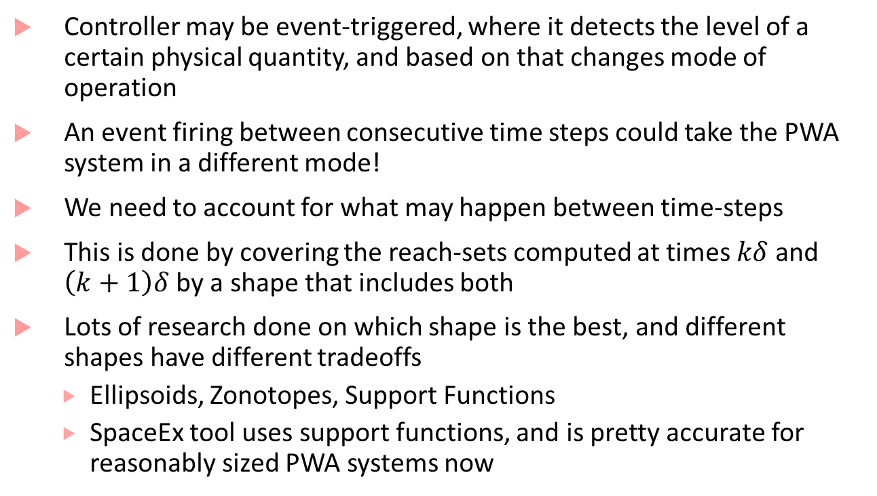

Problem for CPS (hybrid systems)
Controller may be event-triggered, where it detects the level of a certain physical quantity, and based on that changes mode of operation
An event firing between consecutive time steps could take the PWA system in a different mode!
We need to account for what may happen between time-steps
This is done by covering the reach-sets computed at times $kδ$ and $\left(k+1\right)δ$ by a shape that includes both
Lots of research done on which shape is the best, and different shapes have different tradeoffs
Ellipsoids, Zonotopes, Support Functions
SpaceEx tool uses support functions, and is pretty accurate for reasonably sized PWA systems now
$$Q_{2δ}$$
$$x$$
$$Q_{δ}$$
Wrong!
$$Q_{0}$$
$$t$$

Slide 17
Reachability for nonlinear systems
Not all systems can be modeled as PWA!
Nonlinear systems:
Approach I: first PWA-ize the system, then do reachability. Drawback: Error encountered during PWA-ization accumulates
Approach 2: use more interesting models such as Taylor models (based on Taylor series representations): used in tool Flow*
Approach 3: throw the problem at a powerful nonlinear SMT solver: used in tool dReach

Slide 18
Combining under and over-approximations
Also known as simulation-guided reachability analysis
Main idea:
Sample some initial states, perform simulations starting from these states
Use “continuity”-like arguments to bloat the trajectories in a sound manner
If bloated trajectories cover initial state space, go to step 4, if not go back to step 1
If bloated trajectories do not intersect unsafe set, conclude system is safe. If bloated trajectories intersect unsafe set, try to refine bloated trajectories to check if there is a true counterexample

Slide 19
Simlulation-guided reachability depiction
Initial
Simulation Trace up to time T
Reach-Tube up to time T
Unsafe

Slide 20
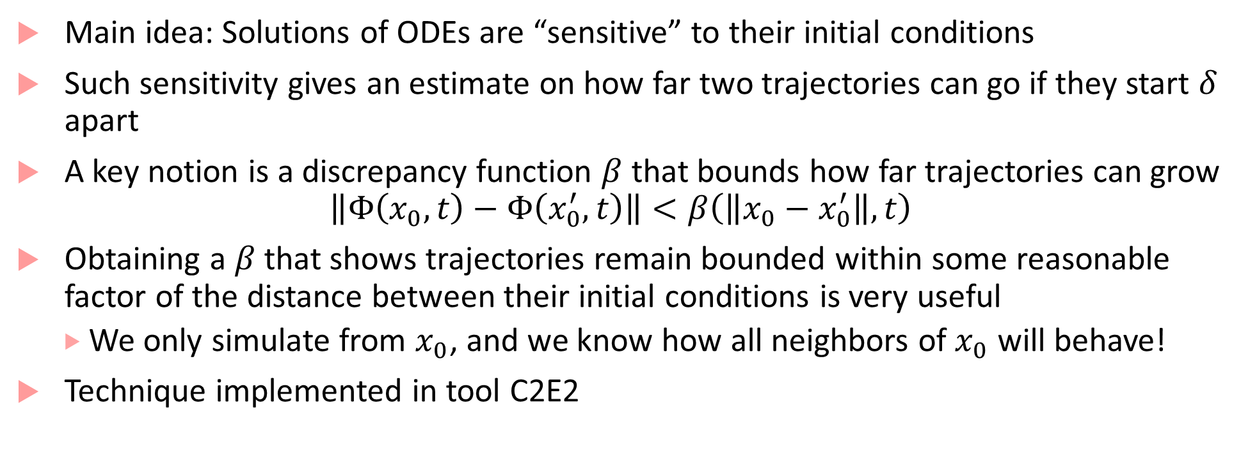
Secret sauce: how to bloat
Main idea: Solutions of ODEs are “sensitive” to their initial conditions
Such sensitivity gives an estimate on how far two trajectories can go if they start $δ$ apart
A key notion is a discrepancy function $β$ that bounds how far trajectories can grow
$$\left\|Φ\left(x_{0},t\right)−Φ\left(x_{0}^{′},t\right)\right\|<β\left(\left\|x_{0}−x_{0}^{′}\right\|,t\right)$$
Obtaining a $β$ that shows trajectories remain bounded within some reasonable factor of the distance between their initial conditions is very useful
We only simulate from $x_{0}$, and we know how all neighbors of $x_{0}$ will behave!
Technique implemented in tool C2E2

Slide 21
Bibliography
Breach : https://link.springer.com/chapter/10.1007/978-3-642-14295-6_17
Prajna, S., & Jadbabaie, A. (2004, March). Safety verification of hybrid systems using barrier certificates. In International Workshop on Hybrid Systems: Computation and Control (pp. 477-492).
Duggirala, Parasara Sridhar, et al. "C2E2: a verification tool for stateflow models." International Conference on Tools and Algorithms for the Construction and Analysis of Systems.
Frehse, Goran, Colas Le Guernic, Alexandre Donzé, Scott Cotton, Rajarshi Ray, Olivier Lebeltel, Rodolfo Ripado, Antoine Girard, Thao Dang, and Oded Maler. "SpaceEx: Scalable verification of hybrid systems." In International Conference on Computer Aided Verification, pp. 379-395. Springer, Berlin, Heidelberg, 2011.
Chen, Xin, Erika Ábrahám, and Sriram Sankaranarayanan. "Flow*: An analyzer for non-linear hybrid systems." In International Conference on Computer Aided Verification, pp. 258-263. Springer, Berlin, Heidelberg, 2013.
Frehse, Goran. "PHAVer: Algorithmic verification of hybrid systems past HyTech." International workshop on hybrid systems: computation and control. Springer, Berlin, Heidelberg, 2005
Asarin, E., Dang, T., & Maler, O. (2002, July). The d/dt tool for verification of hybrid systems. In International Conference on Computer Aided Verification (pp. 365-370). Springer, Berlin, Heidelberg.
Fan, Chuchu, Bolun Qi, Sayan Mitra, Mahesh Viswanathan, and Parasara Sridhar Duggirala. "Automatic reachability analysis for nonlinear hybrid models with C2E2." In International Conference on Computer Aided Verification, pp. 531-538. Springer, Cham, 2016.
Donzé, Alexandre, and Oded Maler. "Systematic simulation using sensitivity analysis." In International Workshop on Hybrid Systems: Computation and Control, pp. 174-189. Springer, Berlin, Heidelberg, 2007

