Slide 1
Topics in Formal Reasoning for Cyber-Physical Systems
Fall 2018: CSCI 699
Instructor: Jyo Deshmukh
Course materials: http://www-bcf.usc.edu/~jdeshmuk/teaching/cs699-fm-for-cps/index.html

Slide 2
What is a Cyber-Physical System?
Different ways to answer this question!
Wikipedia: A Cyber-Physical system (CPS) is a mechanism controlled or monitored by software algorithms.
NSF: engineered systems built from, and depending upon, the seamless integration of algorithms and physical components
From a historical perspective CPS combines elements of cybernetics, mechatronics, control theory, process science, embedded systems, distributed control, and more recently communication.
One common saying: CPS = Control + Computation + Communication

Slide 3
Our focus on CPS in this course
Control
Systems where the behavior of the physical components is strongly influenced by the software components
Systems where there the communication between the physical component and the software component may be direct or through a network
Systems in which the primary role played by software is control (in contrast to passive monitoring).
Communication
Computation
CPS

Slide 4
One view of a CPS
Actuators
Physical component
Sensors
Environment/Plant
Communication Network
Controller
(Some embedded code)

Slide 5
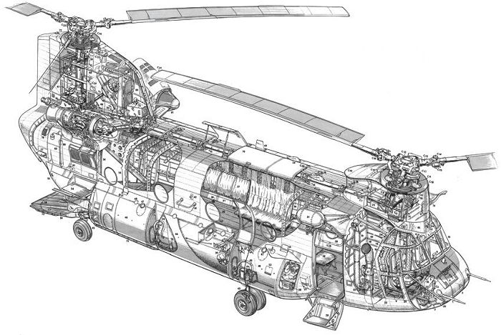
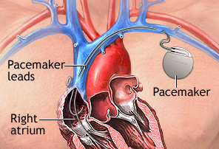
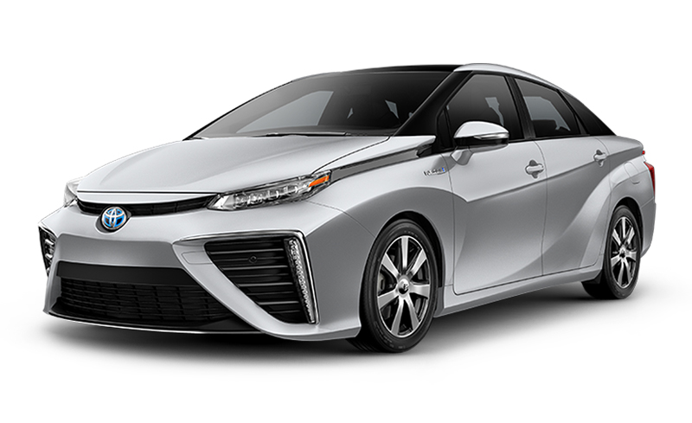
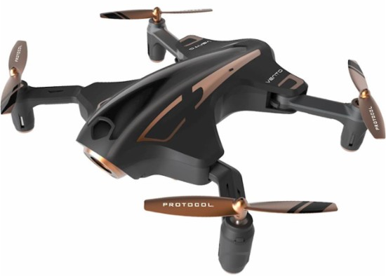
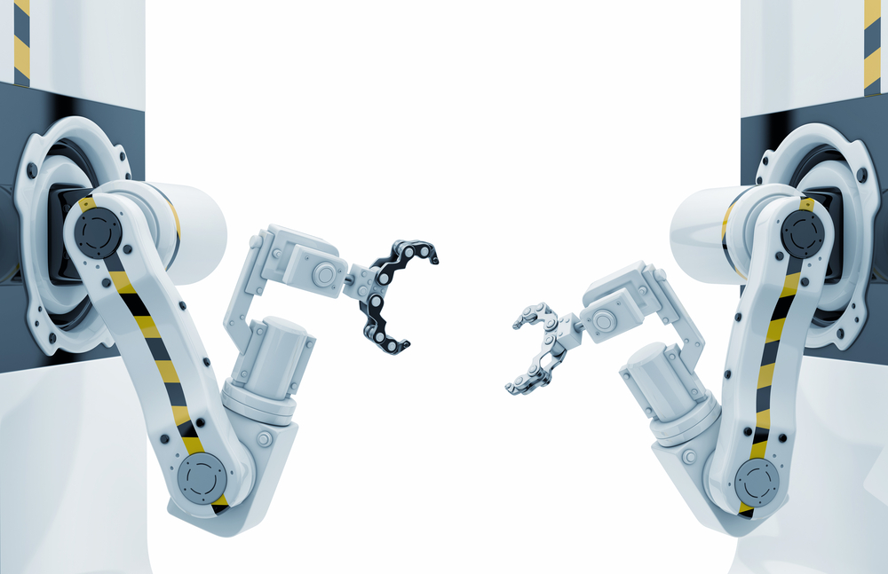
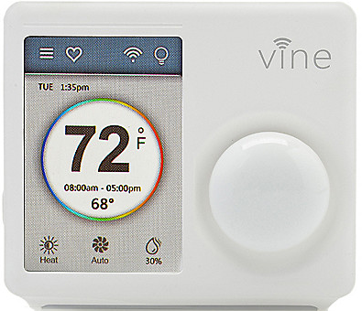
Examples
[All images from Google image search]

Slide 6
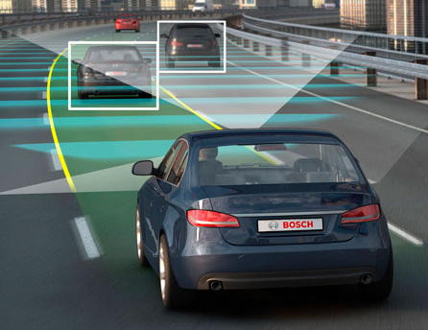
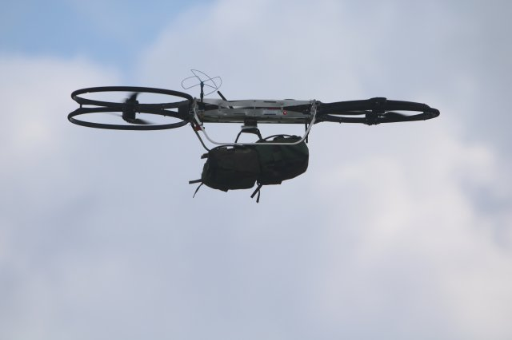
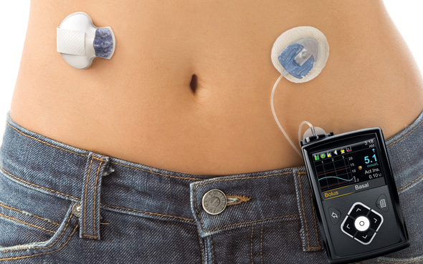
Autonomous/Semi-autonomous CPS
Image credit: Motor Authority
Image credit: army.mil
Image credit: Google images

Slide 7
Course Objectives
Gain familiarity with topics in formal reasoning for CPS
Verification Approaches
Requirement Formalisms
Reasoning about Autonomy in CPS
Reading papers in CPS without feeling overwhelmed by continuous math
Gaining familiarity with favorite notation used by CPS people
Making connections between software verification and CPS verification

Slide 8
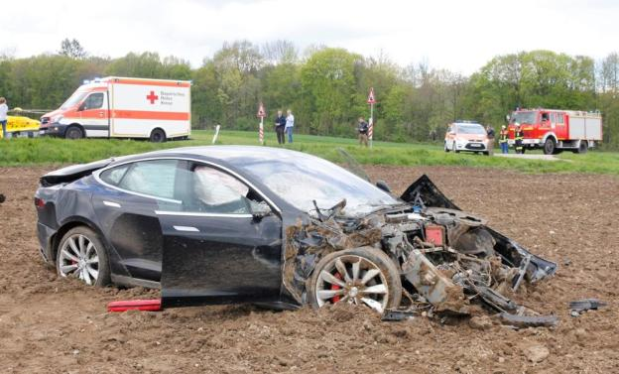
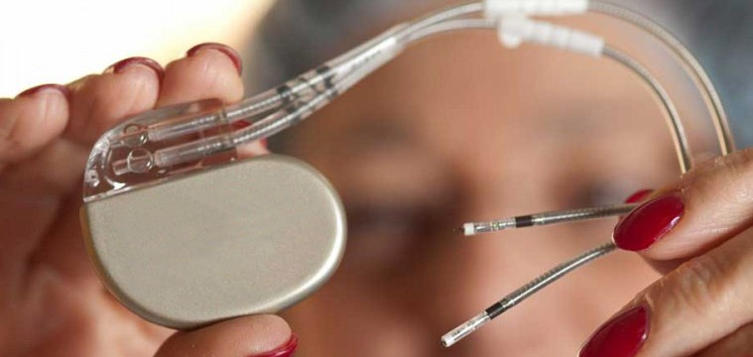
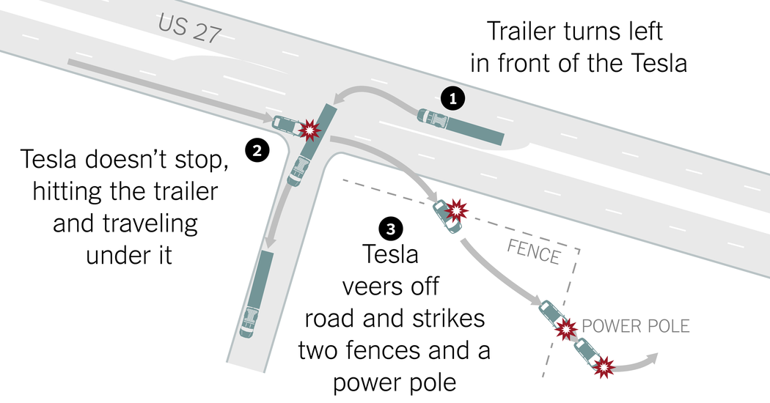

Key Theme of the course: Formal Reasoning
Formal Reasoning is required because we are dealing with systems that are safety-critical, and/or mission-critical with huge implications on human health, well-being, economy, etc.
The FDA has issued 23 recalls of defective devices during the first half of 2010, all of which are categorized as “Class I,” meaning there is “reasonable probability that use of these products will cause serious adverse health consequences or death.”

Slide 9
Course Overview
Divided into 3 atoms
Atom A
Formal Verification
Hybrid Systems Models
Deductive techniques
Atom B
Temporal Logic Requirements
Verification and Testing
Verification for Stochastic systems
Atom C
CPS + AI verification

Slide 10
Course structure: Focus on reading papers
Every week read one, two or three papers
Turn in a 1 or 2-page summary of reading material before class
Presentation-style summary, address 5 questions for each paper
What is the main problem addressed by the paper?
What was done before, and how does this paper improve on it? OR What are the pros/cons of different techniques addressed in this paper?
What is the one cool mathematical factoid or proof technique that was learned from this paper?
What part of the paper was difficult to understand?
What generalization or extension of the paper could be done? OR What are the open problems?

Slide 11
Course structure: Class discussion
During class, we will discuss the paper
One or two lead presenters per paper
Every person has to speak!
Ask questions
Scribing
One or two scribes per class
Scribe responsible for creating at most 10 slide summary of discussion (to be posted on course webpage)

Slide 12
Class Project: options
Project types:
Research Project: Write a research paper on a fundamental question and identify possible solutions. Instructor will give some topics if needed
Survey Project: Pick a sub-area of formal methods for CPS and write a thorough survey on that area
Programming Project: Build a tool to formally analyze CPS models.
Format
Proposal due mid-term
Final paper (15 page LNCS style)
Must use LaTeX, or give very good reason for using any other typesetting system

Slide 13
Grading and Evaluation Breakdown
Assignments: 45% (5 x 9)
Scribing + Participation: 25% (10+15)
Project: 30% (Proposal + Final talk: 5, Final Paper: 25)

Slide 14
Introductions …
What’s your background?
Why did you feel like taking this course?
What do you expect to get out of it?
One fun fact about you

