Slide 1
Autonomous Cyber-Physical Systems: Timed Models
Fall 2024. CSCI 513.
Instructor: Jyo Deshmukh
Acknowledgment: Some of the material in these slides is based on the lecture slides for CIS 540: Principles of Embedded Computation taught by Rajeev Alur at the University of Pennsylvania. http://www.seas.upenn.edu/~cis540/

Slide 2
Models of Computation
Synchronous Process Models
Asynchronous Process Models
Timed Models
Like Asynchronous models, but with explicit time information
Can make use of global time for coordination
Continuous-time models/Dynamical system models
Like Synchronous, but time evolves continuously
Hybrid Dynamical Models
[1] Nicolescu, Gabriela; Mosterman, Pieter J., eds. (2010). Model-Based Design for Embedded Systems. Computational Analysis, Synthesis, and Design of Dynamic Systems. 1. Boca Raton: CRC Press.

Slide 3


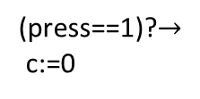
Timed ESMs
Like asynchronous ESMs, have input, output channels, state variables
Special type of state variable called “clock”
Clock variables evolve continuously in time
ESM can “stay” in a mode with clock increasing monotonically from the start value
(press==1)? $∧$ (c$≥$1)
clock c:=0
off
dim
(press==1)? $∧$ (c$≤$1)
bright
(press==1)?$→$
c:=0
(press==1)?

Slide 4
Transitions of a timed ESM
(press==1)? $∧$ (c$≥$1)
Mode switch: discrete action
machine moves from one mode to another
guard on the transition must be true for mode switch to occur
update specified by the transition will update/reset clock variables
clock c:=0
off
dim
(press==1)? $∧$ (c$≤$1)
bright
(press==1)?$→$
c:=0
(press==1)?
(press==1)?
(off,0.5)
(dim,0)

Slide 5
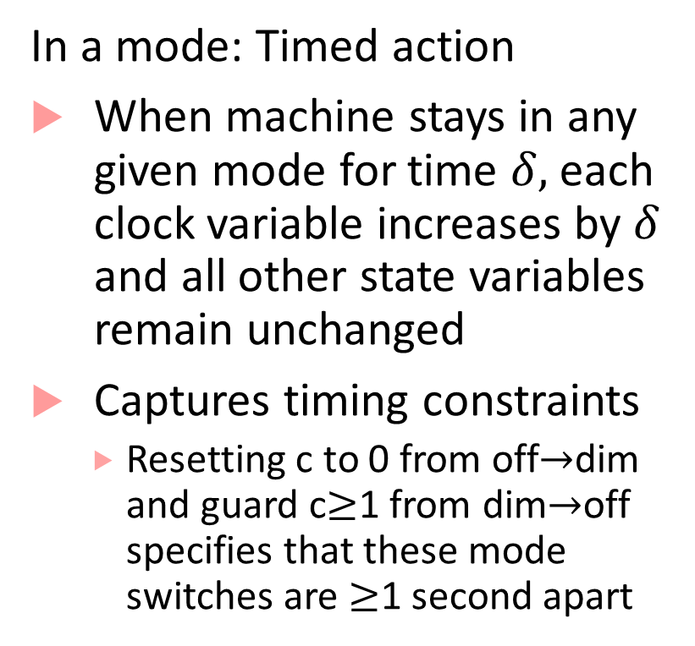
Transitions of a timed ESM
In a mode: Timed action
When machine stays in any given mode for time $δ,$each clock variable increases by $δ$ and all other state variables remain unchanged
Captures timing constraints
Resetting c to 0 from off$→$dim and guard c$≥$1 from dim$→$off specifies that these mode switches are $≥$1 second apart
(press==1)? $∧$ (c$≥$1)
clock c:=0
off
dim
(press==1)? $∧$ (c$≤$1)
bright
(press==1)?$→$
c:=0
(press==1)?

Slide 6
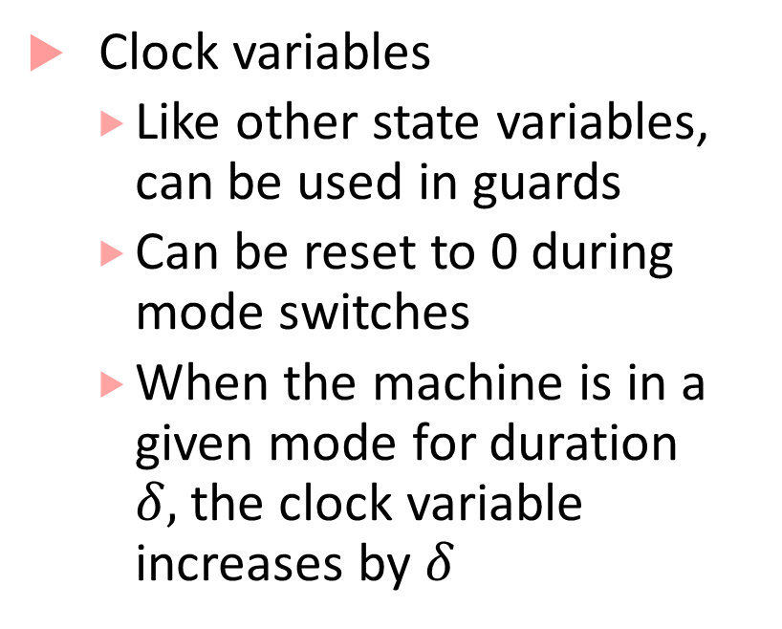
Timed Processes: explicit clock variables
(press==1)? $∧$ (c$≥$1)
Clock variables
Like other state variables, can be used in guards
Can be reset to 0 during mode switches
When the machine is in a given mode for duration $δ,$the clock variable increases by $δ$
clock c:=0
off
dim
(press==1)? $∧$ (c$≤$1)
bright
(press==1)?$→$
c:=0
(press==1)?

Slide 7


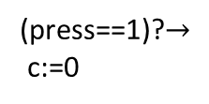

Timed Process Execution
(press==1)? $∧$ (c$≥$1)
Machine execution is through alternating timed transitions and mode switches
clock c:=0
off
dim
(press==1)? $∧$ (c$≤$1)
bright
(press==1)?$→$
c:=0
(press==1)?
(press==1)?
(press==1)?
(off,0)
(off,0.5)
(dim,0)
(dim,0.8)
(bright,0.8)

Slide 8

Timed Process Execution
(press==1)? $∧$ (c$≥$1)
Machine execution is through alternating timed transitions and mode switches
clock c:=0
off
dim
(press==1)? $∧$ (c$≤$1)
bright
(press==1)?$→$
c:=0
(press==1)?
(press==1)?
(off,0)
(off,0.5)
(dim,0)
(press==1)?
(dim,3.8)
(off,3.8)

Slide 9

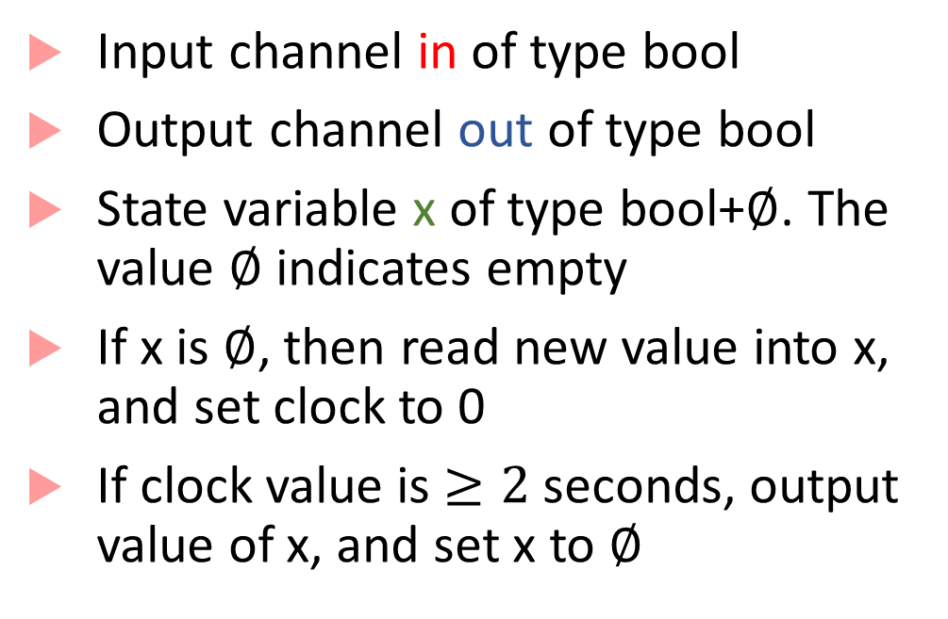

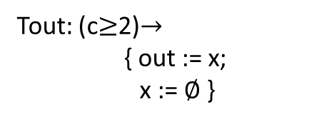
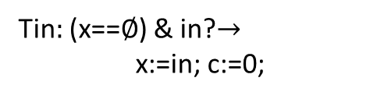
Timed Buffer
Input channel in of type bool
Output channel out of type bool
State variable x of type bool+$∅$. The value $∅$ indicates empty
If x is $∅$, then read new value into x, and set clock to 0
If clock value is $≥2$ seconds, output value of x, and set x to $∅$
bool in
${\text{bool}}_{∅}$ x:= $∅$, clock c:=0
bool
out
Tin$:$ (x==$∅$) & in?$→$
x:=in; c:=0;
Tout$:$ (c$≥$2)$→$
{ out := x;
x := $∅$ }
T_{infull}$:$ in? $→$

Slide 10

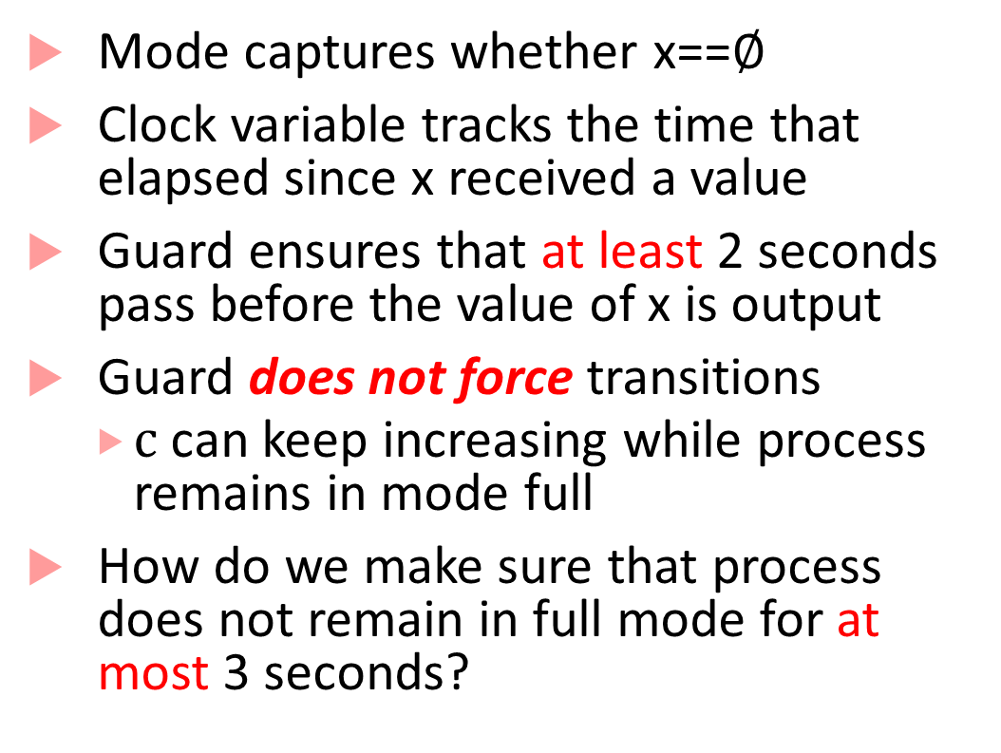

Timed State Machine representation
Mode captures whether x==$∅$
Clock variable tracks the time that elapsed since x received a value
Guard ensures that at least 2 seconds pass before the value of x is output
Guard does not force transitions
$c$ can keep increasing while process remains in mode full
How do we make sure that process does not remain in full mode for at most 3 seconds?
c$≥2$ $→$ out:=x, x≔$∅$
in?
c:=0
empty
full
in?$→$ x:=in, c:=0

Slide 11
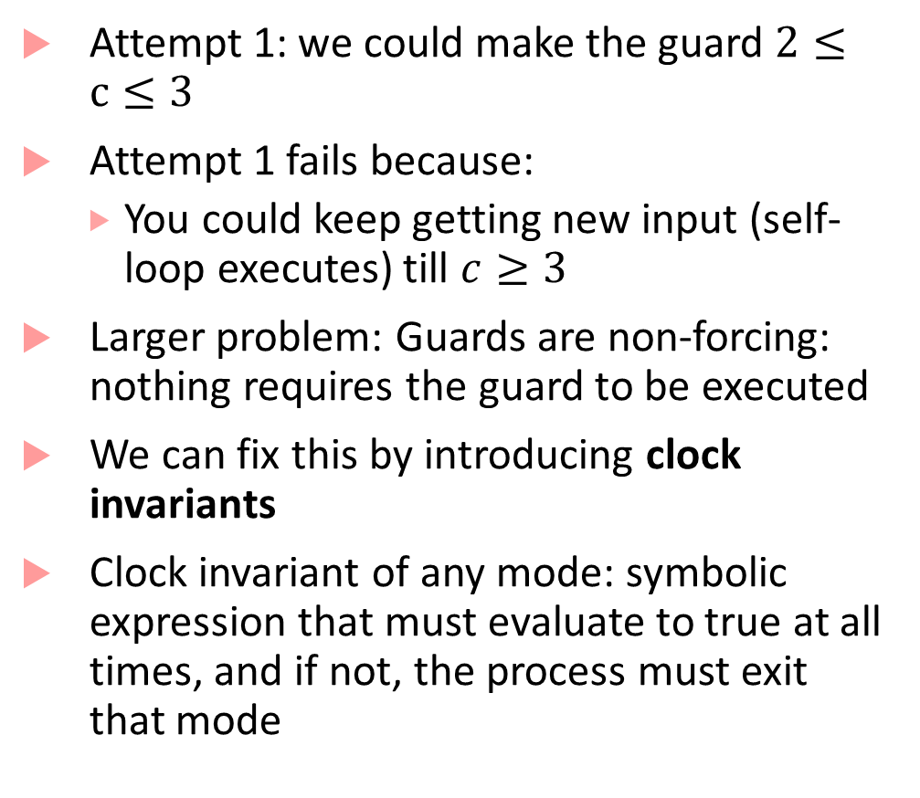

Clock invariants
Attempt 1: we could make the guard $2≤c≤3$
Attempt 1 fails because:
You could keep getting new input (self-loop executes) till $c≥3$
Larger problem: Guards are non-forcing: nothing requires the guard to be executed
We can fix this by introducing clock invariants
Clock invariant of any mode: symbolic expression that must evaluate to true at all times, and if not, the process must exit that mode
c$≥2$ $→$ out:=x, x≔$∅$
in?
c:=0
empty
full
in?$→$ x:=in, c:=0

Slide 12
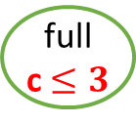
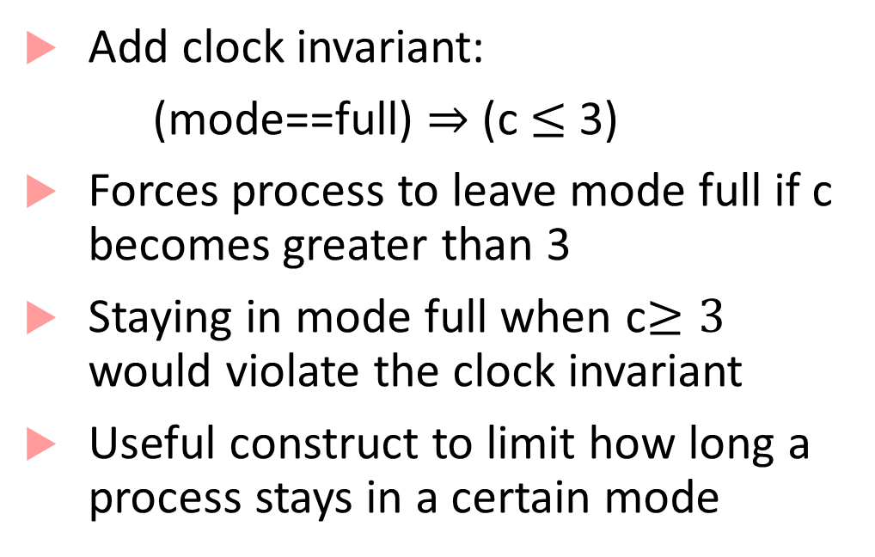
Clock invariants
Add clock invariant:
(mode==full) $⇒$ (c $≤$ 3)
Forces process to leave mode full if c becomes greater than 3
Staying in mode full when c$≥3$ would violate the clock invariant
Useful construct to limit how long a process stays in a certain mode
c$≥2$ $→$ out:=x, x≔$∅$
in?
c:=0
empty
full
c $≤3$
in?$→$ x:=in, c:=0

Slide 13


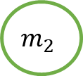
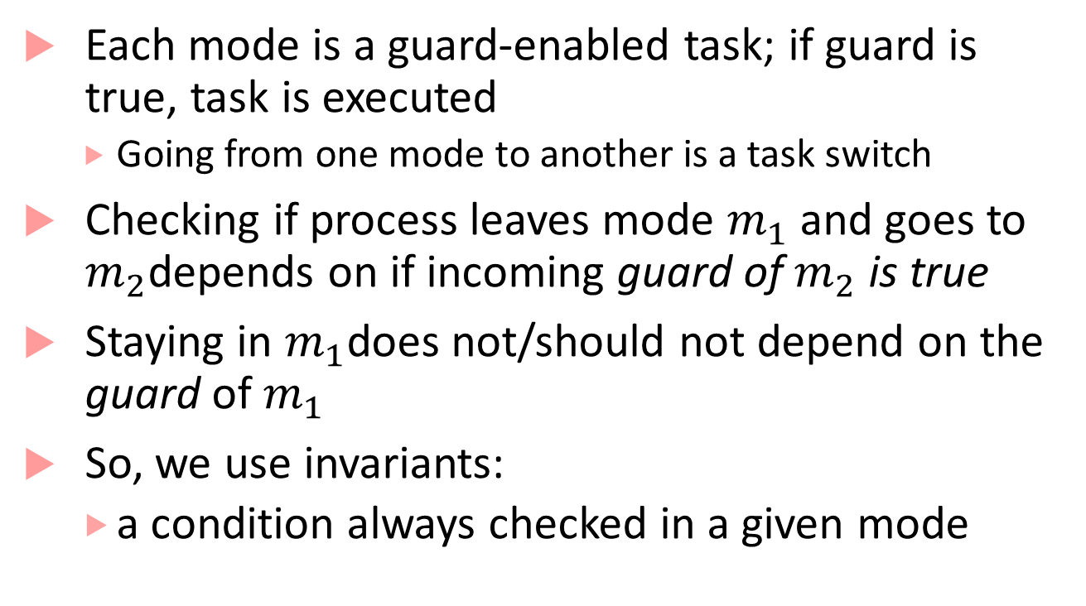

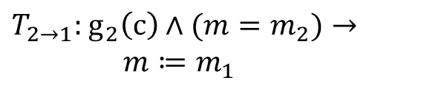
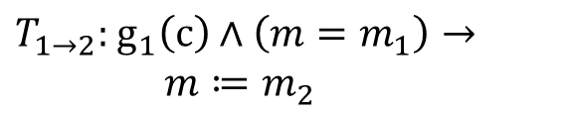

Why model using invariants and guards?
Each mode is a guard-enabled task; if guard is true, task is executed
Going from one mode to another is a task switch
Checking if process leaves mode $m_{1}$ and goes to $m_{2}$depends on if incoming guard of $m_{2}$ is true
Staying in $m_{1}$does not/should not depend on the guard of$m_{1}$
So, we use invariants:
a condition always checked in a given mode
mode $m≔m_{1}$, clock $c$
$T_{1→2}:$ $g_{1}\left(c\right)∧\left(m=m_{1}\right)→$
$m≔m_{2}$
$T_{2→1}:$ $g_{2}\left(c\right)∧(m=m_{2})→$
$m≔m_{1}$
$$m_{1}$$
$$g_{2}$$
$$g_{1}$$
$$m_{2}$$

Slide 14
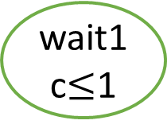
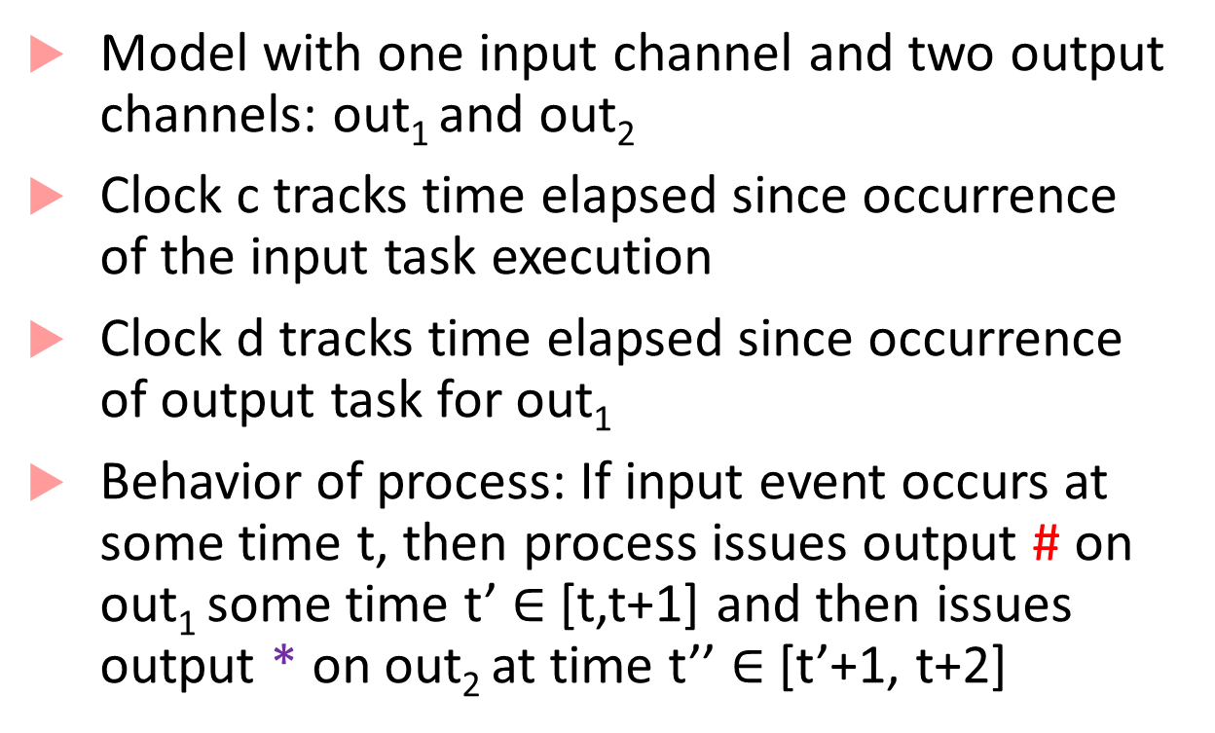
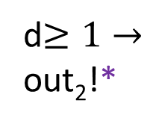
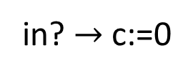
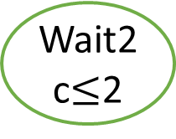
Example with two clocks
clock c,d:=0
Model with one input channel and two output channels: out₁ and out₂
Clock c tracks time elapsed since occurrence of the input task execution
Clock d tracks time elapsed since occurrence of output task for out₁
Behavior of process: If input event occurs at some time t, then process issues output # on out₁ some time t’ $∈$ [t,t+1] and then issues output * on out₂ at time t’’ $∈$ [t’+1, t+2]
idle
in? $→$ c:=0
wait1
c$≤$1
out₁!#;d:=0
d$≥1→$
out₂!*
Wait2
c$≤$2

Slide 15
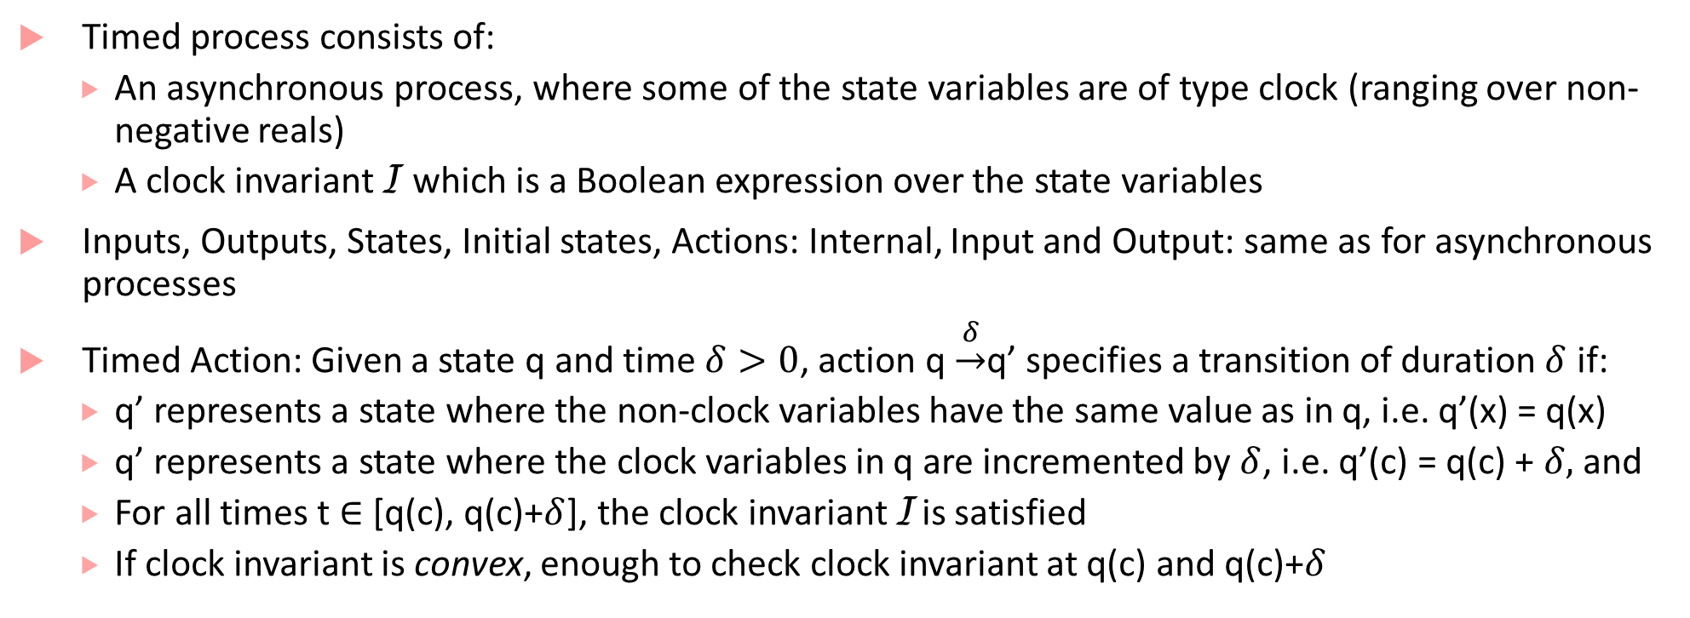
Formal recap of a timed process
Timed process consists of:
An asynchronous process, where some of the state variables are of type clock (ranging over non-negative reals)
A clock invariant I which is a Boolean expression over the state variables
Inputs, Outputs, States, Initial states, Actions: Internal, Input and Output: same as for asynchronous processes
Timed Action: Given a state q and time $δ>0$, action q $\underset{→}{δ}$q’ specifies a transition of duration $δ$ if:
q’ represents a state where the non-clock variables have the same value as in q, i.e. q’(x) = q(x)
q’ represents a state where the clock variables in q are incremented by $δ$, i.e. q’(c) = q(c) + $δ,$ and
For all times t $∈$ [q(c), q(c)+$δ$], the clock invariant I is satisfied
If clock invariant is convex, enough to check clock invariant at q(c) and q(c)+$δ$

Slide 16
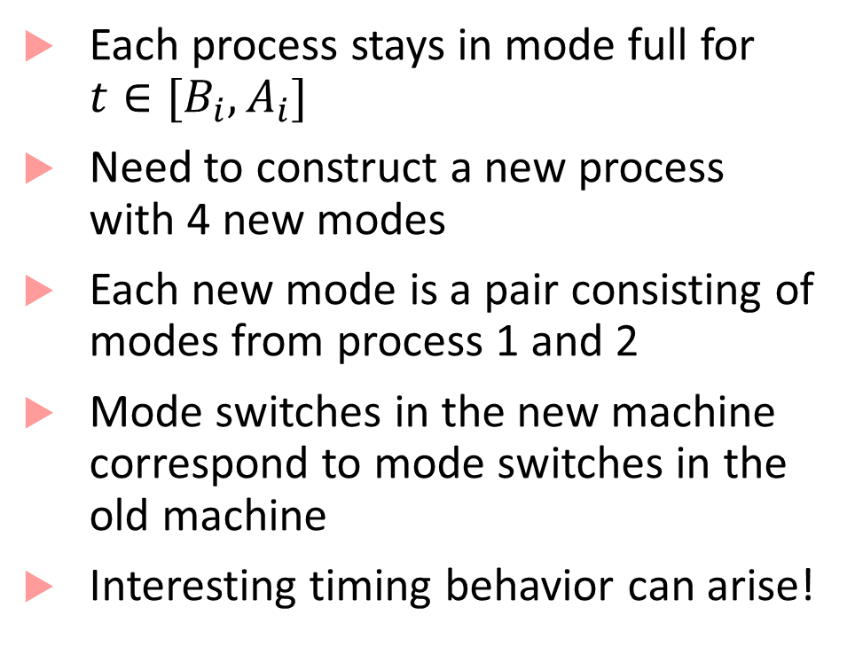


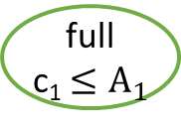

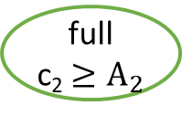

Composing Timed Processes
Each process stays in mode full for $t∈[B_{i}, A_{i}]$
Need to construct a new process with 4 new modes
Each new mode is a pair consisting of modes from process 1 and 2
Mode switches in the new machine correspond to mode switches in the old machine
Interesting timing behavior can arise!
c₁$≥$B₁ $→$ out₁:=x₁, x₁≔$∅$
c₁:=0
empty
full
c₁ $≤A_{1}$
in?$→$ x₁:=in, c₁:=0
c₂$≥$B₂ $→$ out₂:=x₂, x₂≔$∅$
c₂:=0
empty
full
c₂ ${≥A}_{2}$
in?$→$ x₂:=in, c₂:=0

Slide 17
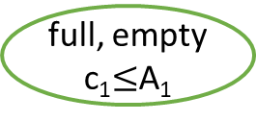
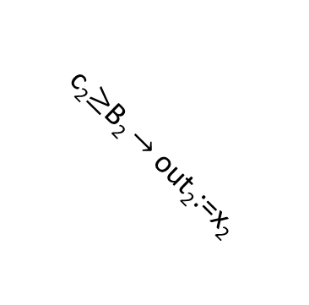


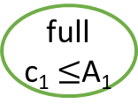
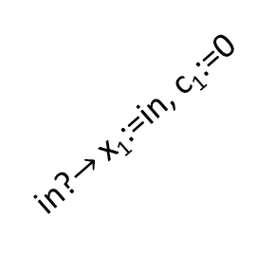

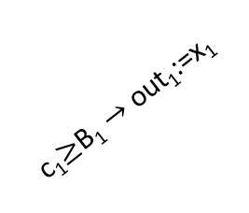
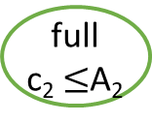

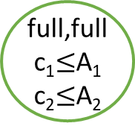
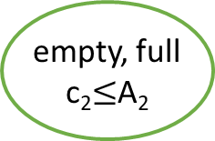

Composing Timed Processes
c₁$≥$B₁ $→$ out₁:=x₁
in?
full, empty
c₁$≤$A₁
c₁:=0
empty
full
c₁ $≤$A₁
c₂$≥$B₂ $→$ out₂:=x₂
c₁$≥$B₁ $→$ out₁:=x₁
in?$→$ x₁:=in, c₁:=0,
x₂:=in, c₂:=0
full,full
c₁$≤$A₁
c₂$≤$A₂
in?$→$ x₁:=in, c₁:=0
empty,
empty
in?
c₂$≥$B₂ $→$ out₂:=x₂
in?
c₁$≥$B₁ $→$ out₁:=x₁
c₂:=0
empty
full
c₂ $≤$A₂
c₂$≥$B₂ $→$ out₂:=x₂
in?$→$ x₁:=in, c₁:=0
empty, full
c₂$≤$A₂
in?$→$ x₂:=in, c₂:=0
in?

Slide 18
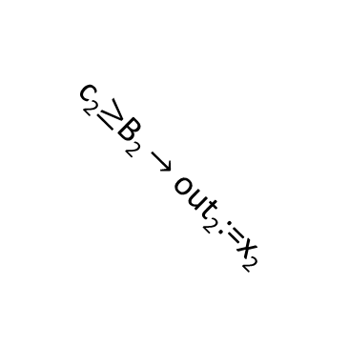
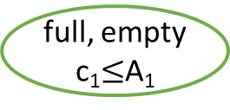

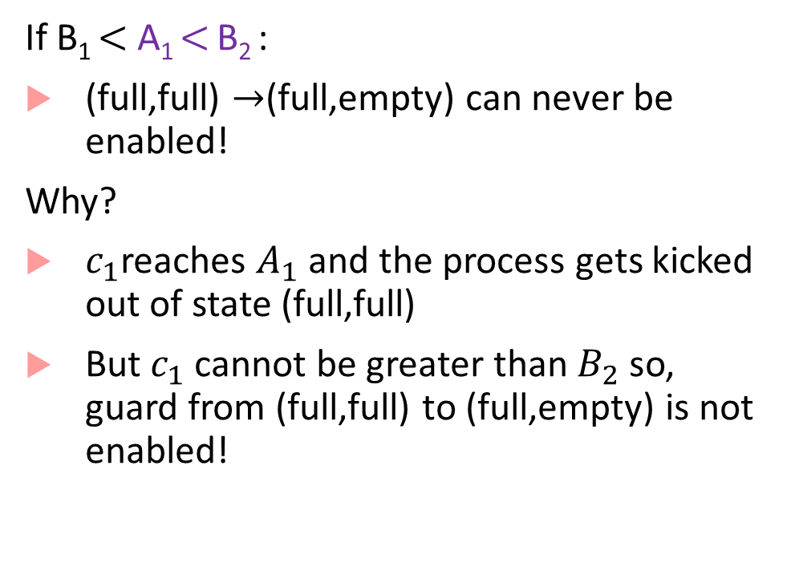
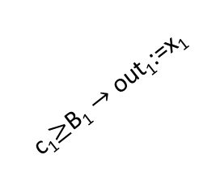
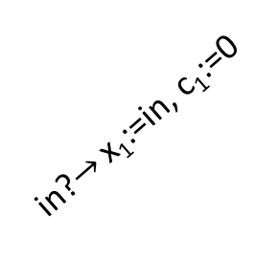
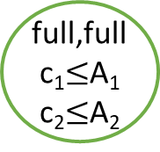


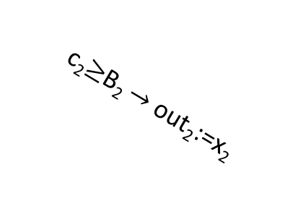
Semi-synchrony
If B₁ $<$ A₁ $<$ B₂ :
(full,full) $→$(full,empty) can never be enabled!
Why?
$c_{1}$reaches $A_{1}$ and the process gets kicked out of state (full,full)
But $c_{1}$ cannot be greater than $B_{2}$ so, guard from (full,full) to (full,empty) is not enabled!
full, empty
c₁$≤$A₁
c₂$≥$B₂ $→$ out₂:=x₂
c₁$≥$B₁ $→$ out₁:=x₁
in?$→$ x₁:=in, c₁:=0,
x₂:=in, c₂:=0
full,full
c₁$≤$A₁
c₂$≤$A₂
empty,
empty
in?
c₁$≥$B₁ $→$ out₁:=x₁
c₂$≥$B₂ $→$ out₂:=x₂
in?$→$ x₁:=in, c₁:=0
empty, full
c₂$≤$A₂
in?

Slide 19
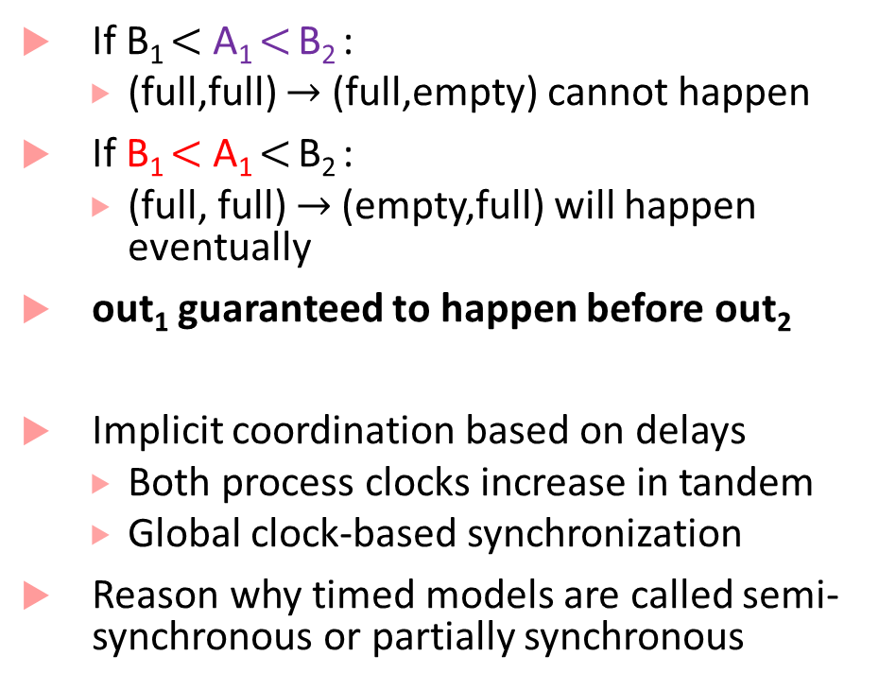
Semi-synchrony
If B₁ $<$ A₁ $<$ B₂ :
(full,full) $→$ (full,empty) cannot happen
If B₁ $<$ A₁ $<$ B₂ :
(full, full) $→$ (empty,full) will happen eventually
out₁ guaranteed to happen before out₂
Implicit coordination based on delays
Both process clocks increase in tandem
Global clock-based synchronization
Reason why timed models are called semi-synchronous or partially synchronous
full, empty
c₁$≤$A₁
c₂$≥$B₂ $→$ out₂:=x₂
c₁$≥$B₁ $→$ out₁:=x₁
in?$→$ x₁:=in, c₁:=0,
x₂:=in, c₂:=0
full,full
c₁$≤$A₁
c₂$≤$A₂
empty,
empty
in?
c₁$≥$B₁ $→$ out₁:=x₁
c₂$≥$B₂ $→$ out₂:=x₂
in?$→$ x₁:=in, c₁:=0
empty, full
c₂$≤$A₂
in?

Slide 20
Pacemaker Modeling as a Timed Process
Most material that follows is from this paper:
Z. Jiang, M. Pajic, S. Moarref, R. Alur, R. Mangharam, Modeling and Verification of a Dual Chamber Implantable Pacemaker, In Proceedings of Tools and Algorithms for the Construction and Analysis of Systems (TACAS), 2012.
Alur’s textbook has detailed descriptions of some other pacemaker components

Slide 21
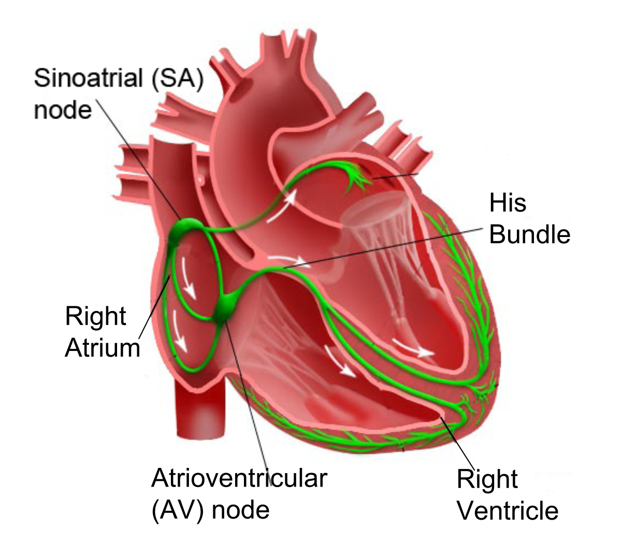
How does a healthy heart work?
SA node (controlled by nervous system) periodically generates an electric pulse
This pulse causes both atria to contract pushing blood into the ventricles
Conduction is delayed at the AV node allowing ventricles to fill
Finally the His-Purkinje system spreads electric activation through ventricles causing them both to contract, pumping blood out of the heart
Electrical Conduction System of the Heart

Slide 22
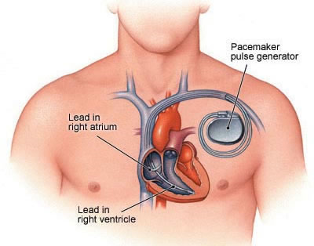
What do pacemakers do?
Aging and/or diseases cause conduction properties of heart tissue to change leading to changes in heart rhythm
Tachycardia: faster than desirable heart rate impairing hemo-dynamics (blood flow dynamics)
Bradycardia: slower heart rate leading to insufficient blood supply
Pacemakers can be used to treat bradycardia by providing pulses when heart rate is low

Slide 23
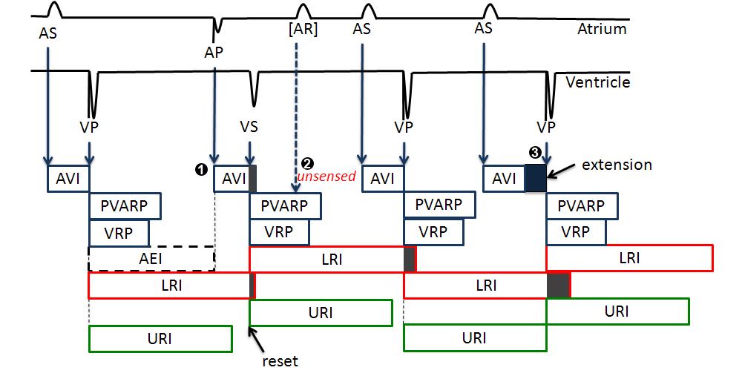
Implantable Pacemaker modeling

Slide 24
How dual-chamber pacemakers work
Two fixed leads on wall of right atrium and ventricle respectively
Activation of local tissue sensed by the leads (giving rise to events Atrial Sense (AS) and Ventricular Sense (VS))
Atrial Pacing (AP) or Ventricular Pacing (VP) are delivered if no sensed events occur within deadlines
Heart
AS
Pacemaker
VS
AP
VP

Slide 25
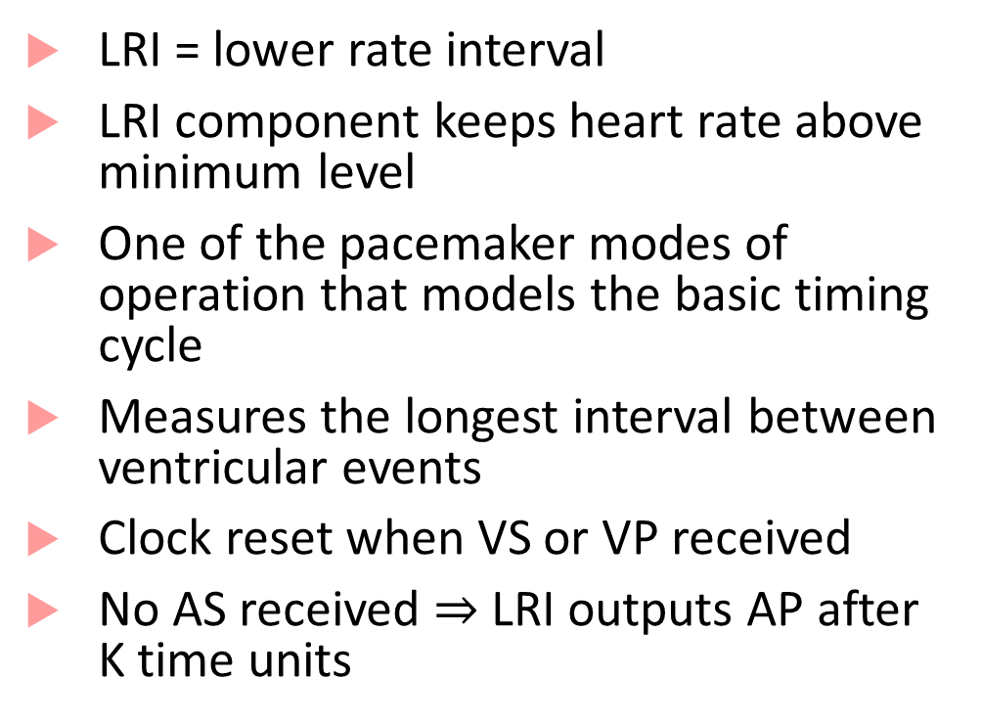


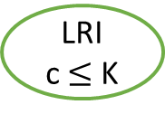



The LRI mode of operation explained
LRI = lower rate interval
LRI component keeps heart rate above minimum level
One of the pacemaker modes of operation that models the basic timing cycle
Measures the longest interval between ventricular events
Clock reset when VS or VP received
No AS received $⇒$LRI outputs AP after K time units
VS? $→$ c:=0
AS?
ASed
VP? $→$ c:=0
LRI
c $≤$ K
VP? $→$ c:=0
VS? $→$ c:=0
c $≥$ K $→$AP!; c:=0
K= 850ms

Slide 26
Finite State Automata: A 3-slide introduction

Slide 27









Finite state automata
Famous equivalence between finite state automata and regular expressions
$$A_{1}$$
$$A_{2}$$
$$q_{0}$$
$$q_{f}$$
$$q_{0}$$
$$q_{f}$$
a-z
a-z
a-z,0-9
0-9
a-z
$$q_{1}$$
$$q_{1}$$
$$q_{r}$$
State
0-9
[a-z][a-z 0-9 ]
*
Accepting
state
[a-z][0-9]*[a-z]

Slide 28


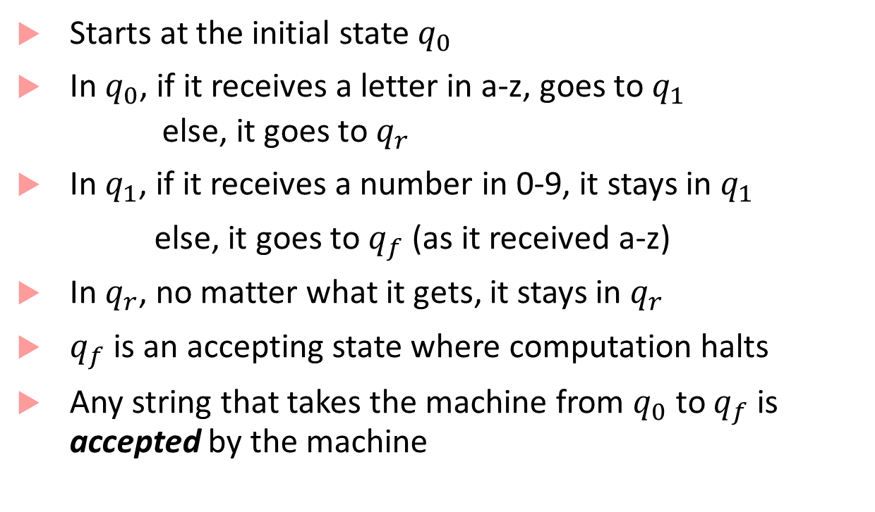



How does a finite state automaton work?
Starts at the initial state $q_{0}$
In $q_{0}$, if it receives a letter in a-z, goes to $q_{1}$
else, it goes to $q_{r}$
In $q_{1}$, if it receives a number in 0-9, it stays in $q_{1}$
else, it goes to $q_{f}$ (as it received a-z)
In $q_{r}$, no matter what it gets, it stays in $q_{r}$
$q_{f}$ is an accepting state where computation halts
Any string that takes the machine from $q_{0}$ to $q_{f}$ is accepted by the machine
$$A_{2}$$
$$q_{0}$$
$$q_{f}$$
a-z
0-9
a-z
$$q_{1}$$
$$q_{r}$$
0-9
*

Slide 29
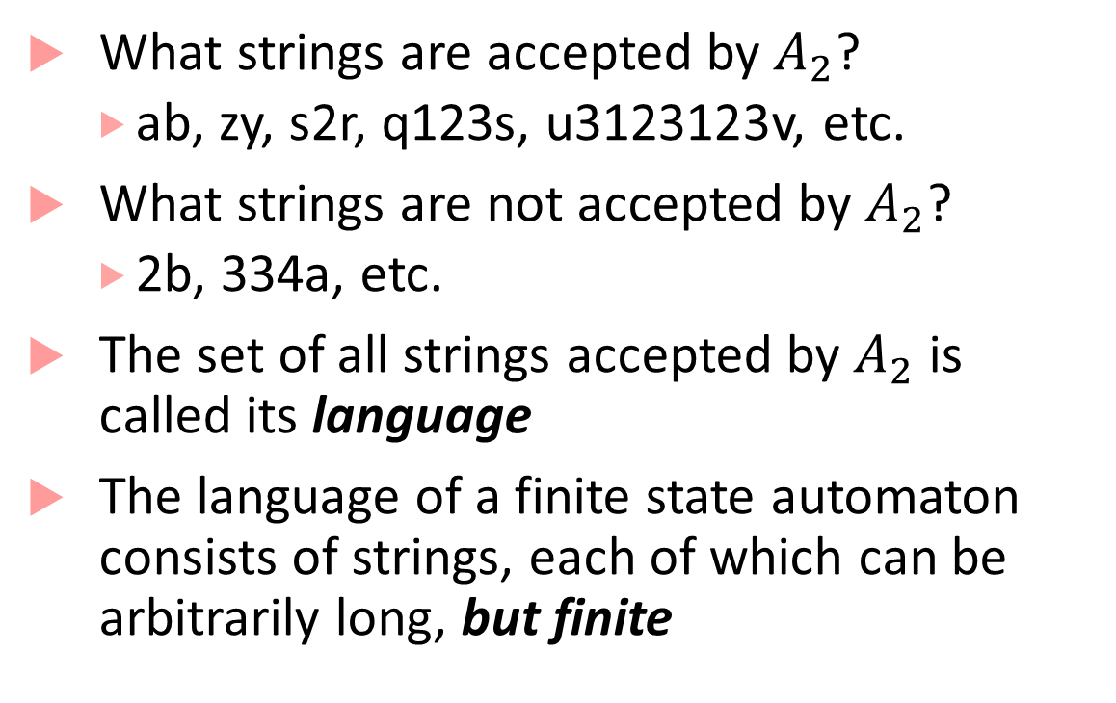
Language of a finite state automaton
What strings are accepted by $A_{2}$?
ab, zy, s2r, q123s, u3123123v, etc.
What strings are not accepted by $A_{2}$?
2b, 334a, etc.
The set of all strings accepted by $A_{2}$ is called its language
The language of a finite state automaton consists of strings, each of which can be arbitrarily long, but finite
$$A_{2}$$
$$q_{0}$$
$$q_{f}$$
a-z
0-9
a-z
$$q_{1}$$
$$q_{r}$$
0-9
*

Slide 30
Timed Automata
Useful tool to do timing analysis and explore properties of timed processes
State-space of timed automata is infinite (clocks can become arbitrarily large!)
But some questions about timed automata behavior can still be answered exactly
Does the automaton accept any string? (also known as emptiness problem)
Reachability of a particular configuration
We will revisit this later in the course

Slide 31


Timing Analysis
D
(y >= 6)?
Which of D, E, F can be reached?
Needs careful propagation of reachable combinations of x and y
x,y:=0
A
x<=5
x>=3 → y:=0
B
x<=7
(y >= 2)?
C
x$≤$8
y $≤$5
(x <= 4)?
E
(x = 7)?
x $∈\left[3,5\right]$, y $=0$ when we reach B
x $∈\left[3,7\right],$ y $∈[2,∞)$ when we reach C
x $∈[3,8]$, y $∈$ $[2,5]$ when you exit C
OR x $∈\left[3,8\right],$ y $≥5$ and machine stops
F

Slide 32
How is such analysis done?
The key challenge is that if the automata has loops, then how do we know that our procedure for propagation of symbolic clock constraints will terminate?
The key insight by first papers on timed automata was that there is only a finite number of regions in the clock-space that can be visited
This gives a “pumping lemma” style argument*
Allows abstracting a finite timed automaton to an automaton where modes/states represent the regions
This was expensive, and improved by using zone-based constructions
(zones are a uniform representation of constraints that arise during analysis)

