Slide 1
Autonomous Cyber-Physical Systems: Course Introduction
Fall 2020: CS 513
Instructor: Jyo Deshmukh
Course materials: http://jdeshmukh.github.io/teaching/cs513-autocps-fall-2020/

Slide 2
What is a Cyber-Physical System?
Different ways to answer this question!
Wikipedia: A Cyber-Physical system (CPS) is a mechanism controlled or monitored by software algorithms.
NSF: engineered systems built from, and depending upon, the seamless integration of algorithms and physical components
From a historical perspective CPS combines elements of cybernetics, mechatronics, control theory, process science, embedded systems, distributed control, and more recently communication.
One common saying: CPS = Control + Computation + Communication

Slide 3
Our focus on CPS in this course
Control
Systems where the behavior of the physical components is strongly influenced by the software components
Systems where there the communication between the physical component and the software component may be direct or through a network
Systems in which the primary role played by software is control (in contrast to passive monitoring)
Communication
Computation
CPS

Slide 4
One view of a CPS
Actuators
Physical component
Sensors
Environment/Plant
Communication Network
Controller
(Some embedded code)

Slide 5
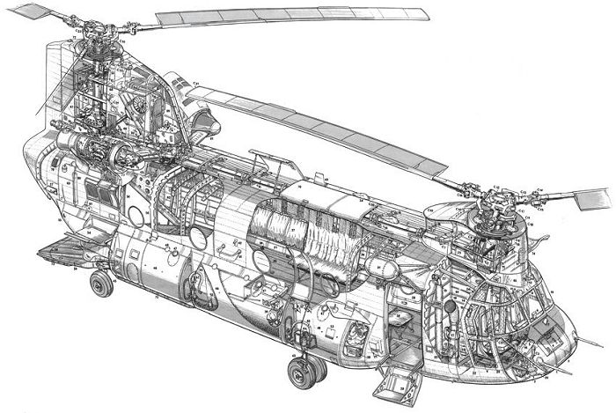
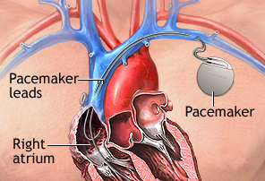
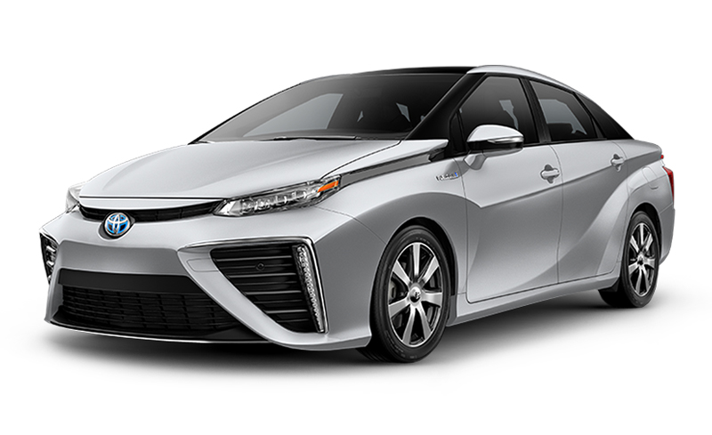
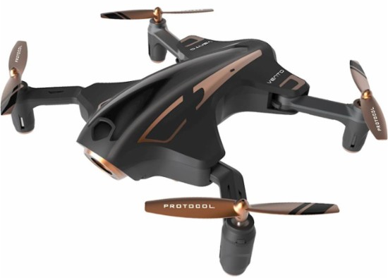
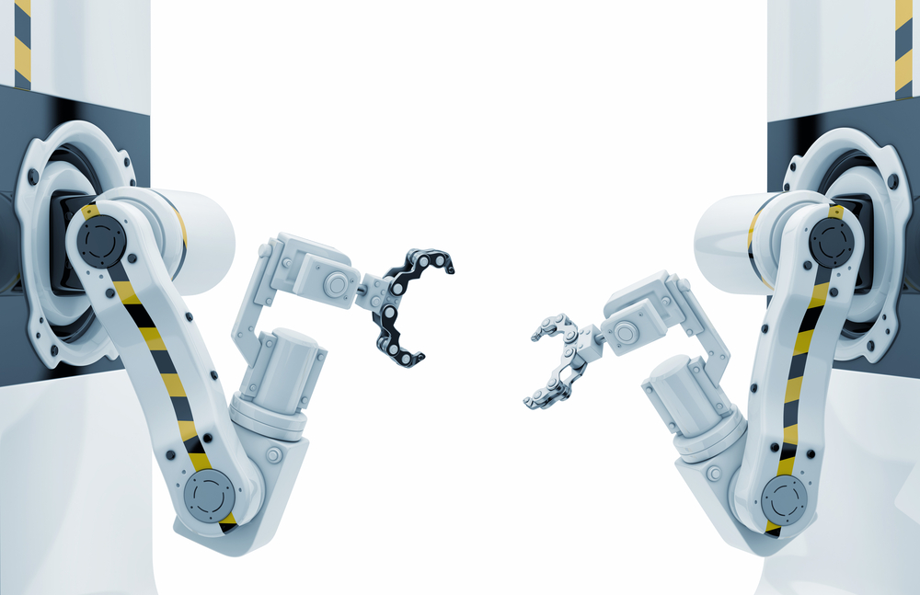
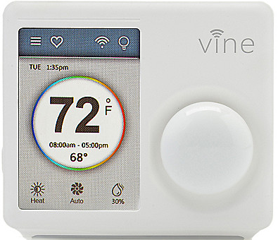
Examples
[All images from Google image search]

Slide 6
What’s an autonomous CPS?
Autonomous: without the need for human intervention or control
Autonomous CPS = CPS with no human operator!
Semi-autonomous: CPS with autonomy under specific conditions, but requiring a human operator otherwise.
Today, several CPS examples are semi-autonomous, and getting to fully autonomous

Slide 7
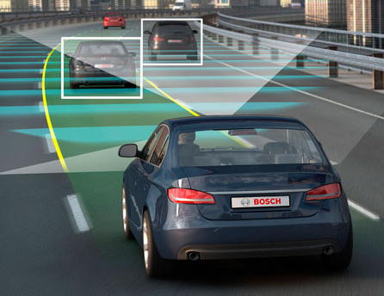
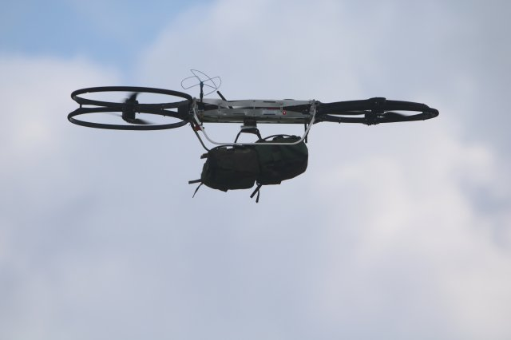
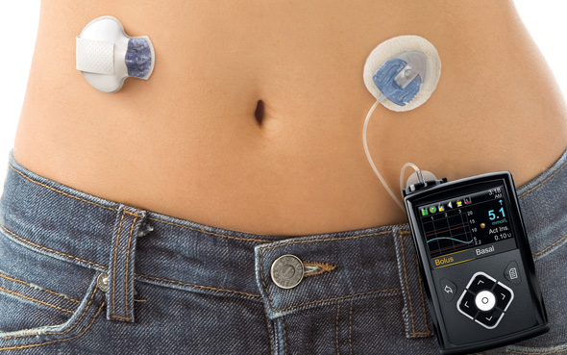
Autonomous/Semi-autonomous CPS
Image credit: Motor Authority
Image credit: army.mil
Image credit: Google images

Slide 8
Course Objectives
Gain basic familiarity with CPS topics
Computational models
Control algorithms
Software Architecture
Ingredients for autonomy
Challenge Problems/Case studies
“Model-Based” Software Development Paradigm for CPS
Developing models for physical components + software + communication
Software Engineering: Writing checkable requirements and tests
Software testing for CPS
Learn autonomous software stack through case studies in autonomy

Slide 9
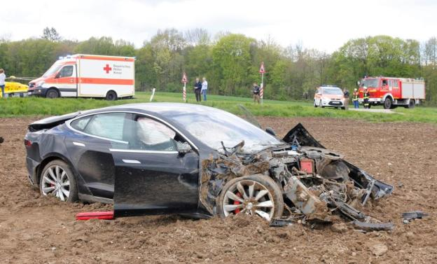
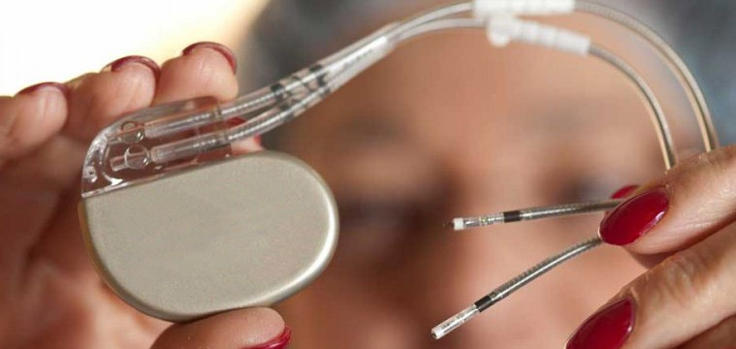
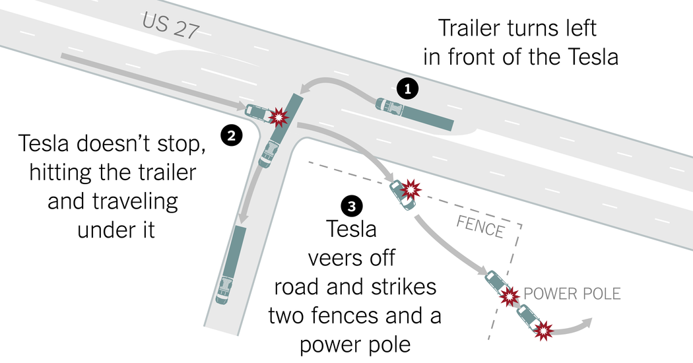

Key theme of the course: Formal Reasoning
Formal Reasoning is required because we are dealing with systems that are safety-critical, and/or mission-critical with huge implications on human health, well-being, economy, etc.
The FDA has issued 23 recalls of defective devices during the first half of 2010, all of which are categorized as “Class I,” meaning there is “reasonable probability that use of these products will cause serious adverse health consequences or death.”

Slide 10
Course Overview
Part I: Model-based Development
Synchronous & Asynchronous Models, Timed Models, Dynamical System Models, Hybrid Models, Basics of Control
Part II: Expressing Requirements, Monitoring, Test Generation, Verification
Temporal Logic, Test Generation, Falsification
Part III: Ingredients of Autonomous CPS software
Basics of perception, decision-making, reinforcement learning, sensing, examples from self-driving, UAVs and medical devices

Slide 11
How will we evaluate ourselves?
2 Homework Assignments
written assignments focusing on theory
2 Mini-Projects
Learn how to code a self-driving car subsystem
Learn how to code for a mini-drone
1 take-home final
Will test basic understanding of what we cover in the course
Class Project

Slide 12
Class Project
Purpose:
Freedom to choose your own advanced application
Write formal requirements
Generate tests/proofs using verification/falsification/test generation
Show the application of formal reasoning
Expected outcome:
Matlab/Simulink (simulation) model of a CPS application
Can also develop model in Python if that is the preferred language
If motivated, you can try to deploy it on the chosen hardware platform
I have a few that I can give you to play with – first-come-first-serve, ask me about these!

Slide 13
Example Projects
Design a UAV to follow a plan specified using formal specifications
Create a vehicle model and design a controller that can change lanes
Explore multi-vehicle simulators for collaborative merging, autonomous intersection control
Train a vehicle for stop-sign detection
Train a vehicle for pedestrian/bicycle detection and avoidance
Explore a traffic simulator for exploring platooning
Create a model of the human heart and design a pacemaker
Create a blood-glucose dynamics model and design an automatic insulin infusion pump
Train a ground robot that uses LIDAR/Cameras and train it using reinforcement learning
Some fun past projects: automated pet feeder, automatic race-car training from human players

Slide 14
Project Timeline
Project teams of 2 or 3 : unless there is some extreme circumstance, we don’t want solo projects.
Team of 3 = More expectation!
Use slack for forming teams
Identify team members by third week
Project Proposal due by early October
will give more details on proposal format next week
Final Project Deliverable
Demo + 5-page Report / 15-page Report
Final Project Presentation in Finals Week

Slide 15
Grading and Evaluation Breakdown
Assignments: 50% (2x10 + 2x15)
Final: 20%
Project: 25% (Proposal: 5, Final Report: 15, Final Talk: 5)
Class participation: 5%
Participation in Slack
Q&A during live Zoom sessions

Slide 16
Learning curve will be sharper if:
You have no knowledge of Matlab
Matlab is easy to learn, with several online resources and tutorials, but it may take you some time if you have never used it!
You have no knowledge of automata
Knowledge of finite-state automata will help, but I will go over the basics
You do not remember elementary calculus
Basics of differential equations

Slide 17
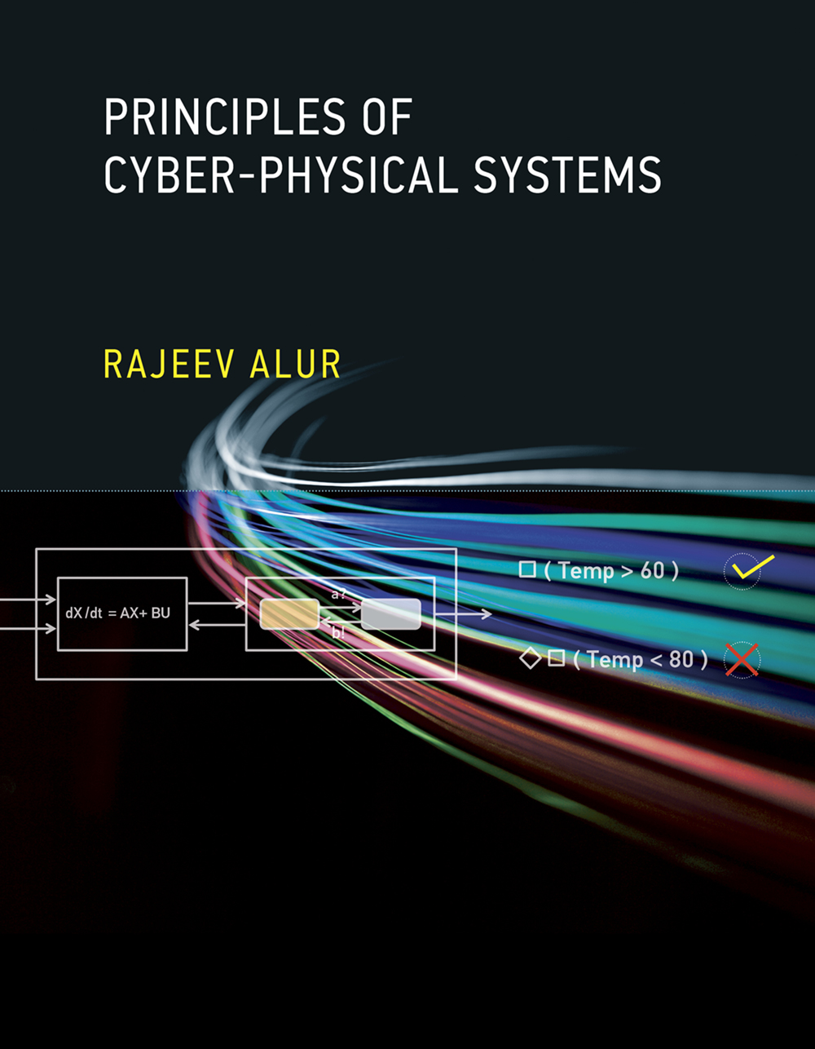
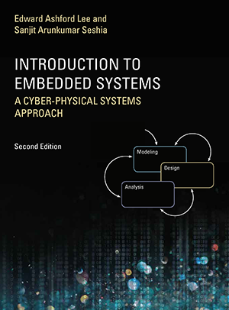
Textbooks: Optional
Principles of Cyber-Physical Systems by Rajeev Alur
$56-63 on Amazon
Free e-book available on USC libraries
Introduction to Embedded Systems: A CPS approach
- Free at: https://ptolemy.berkeley.edu/books/leeseshia/

Slide 18
Office Hours, Class Timings
Class Timing: 2:00-5:20
First 5 mins: recap of last lecture + outline of this lecture + announcements
Last 20 mins: optional questions, discussions, etc.
Office Hours: Tuesday, 11:00am-12:00pm over Zoom (or by appointment)
TA: Aniruddh Puranic
Office Hours: Thursday, 11:00am-12:00pm over Zoom (or by appointment)

Slide 19
Introductions …
Name
What’s your background?
Why did you feel like taking this course?
One fun fact about you

Slide 20
Questions?

