Slide 1
Autonomous Cyber-Physical Systems: Intro to Models of Computation Synchronous & Asynchronous Process Models
Fall 2022. CSCI 513.
Instructor: Jyo Deshmukh
Acknowledgment: Some of the material in these slides is based on the lecture slides for CIS 540: Principles of Embedded Computation taught by Rajeev Alur at the University of Pennsylvania. http://www.seas.upenn.edu/~cis540/

Slide 2
Model-based Development (MBD) or design
Most popular paradigm for principled software development in CPS
We will learn various aspects of MBD through this course
MBD when used for designing embedded software¹ has 4 main steps
Model the physical components/environment (also known as a plant model)
Analyze the plant, and synthesize/design the control-software at a high-level
Co-Simulate the plant and control-software for testing/analysis
Automatically generate code from the control-software model for deployment
Popular MBD frameworks such as Simulink®, LabView™, RationalRose, DyMola, TargetLink, Scade, Python etc.
[1] Nicolescu, Gabriela; Mosterman, Pieter J., eds. (2010). Model-Based Design for Embedded Systems. Computational Analysis, Synthesis, and Design of Dynamic Systems. 1. Boca Raton: CRC Press.

Slide 3
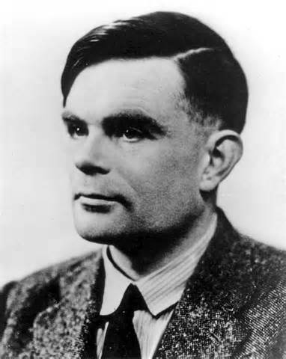
Models of Computation: Functional
Classical model of computation: Programs as Functions
Start from a given input,
Produce a certain output and then terminate
Desired functionality can be described by a mathematical function
Emphasis is on data computation
Canonical model: Turing machines e.g. compute square-root, encrypt some text, etc.

Slide 4
Models of Computation: Reactive/Interactive
Interactive Programs:
Interact with the user in their own time, i.e. react to user’s commands, but with no real-time constraints
Emphasis is on user-interaction; e.g. a web browsers, word processors, etc.
Reactive Programs:
Continuously interact with the environment at a rate decided by the environment
Emphasis is on system-environment interaction; e.g. airline autopilot, mail-servers, etc.

Slide 5
Models of Computation: Timing
What’s the notion of time in the model?
Real-time or Logical time-steps of execution?
What time do different components in the model use?
Single global clock for full synchronization?
Different clocks in each component?
What level of granularity do we need in time?
Discrete time-steps or Continuous dense time?

Slide 6
Interpreting models
We know how to interpret imperative/functional programs
How do we interpret models? What are their execution semantics?

Slide 7
Most convenient model of computation for an Autonomous CPS is a
reactive and concurrent model of computation.
An autonomous CPS can be viewed as a network of components that communicate
either synchronously or asynchronously.

Slide 8
Models of Computation
Synchronous Model of Computation
Asynchronous Model of Computation
Timed Models
Like Asynchronous models, but with explicit time information
Can make use of global time for coordination
Continuous-time models/Dynamical system models
Like Synchronous, but time evolves continuously
Hybrid Dynamical Models

Slide 9
Models of Computation: this lecture
Synchronous Model of Computation
Asynchronous Model of Computation
Timed Model
Like Asynchronous models, but with explicit time information
Can make use of global time for coordination
Continuous-time models/Dynamical system models
Like Synchronous, but time evolves continuously
Hybrid Dynamical Models
[1] Nicolescu, Gabriela; Mosterman, Pieter J., eds. (2010). Model-Based Design for Embedded Systems. Computational Analysis, Synthesis, and Design of Dynamic Systems. 1. Boca Raton: CRC Press.

Slide 10
Synchronous Models

Slide 11
Synchronous Models
All components execute in a sequence of rounds in lock-step
Example:
Components in a digital hardware circuit with a central global clock
Fixed-step Simulation Models of Discrete Components in Simulink

Slide 12
Synchronous languages
Rich class of languages called “synchronous dataflow”
Scade-suite from Esterel Technologies: used in many avionics applications
Benefit: system design is simpler if we use a simple round-based computation
Challenge: How do we ensure synchronous execution when components may execute on different hardware?

Slide 13
Simple Representation of a Synchronous Component
State Variables Declaration and initialization
Update action that happens in each round
Input Names and Types
Output Names and Types
Component

Slide 14

Simplest synchronous component: delay
(Boolean = {0, 1})
Input variable: in of type Boolean
Output variable: out of type Boolean
State variable: x of type Boolean, initialized to 0
In each round, component updates output from the state and state from input
bool in
bool out
bool x := 0
out:=x ; x:= in

Slide 15
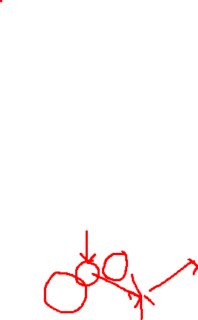
Execution of “Delay”
Initialize state to 0
Repeatedly execute rounds
In each round:
Choose value for input (provided from environment, e.g. by user)
Execute update code
bool in
bool out
bool x := 0
out:=x ; x:= in
1 / 0
1 / 1
0 / 1
0 / 0
1 / 0
0
1
1
0
0
1

Slide 16
Synchrony hypothesis
Time needed to execute update is negligible compared to arrival times between consecutive inputs
Synchronous execution is a logical abstraction
Execution time of update code is 0
Production of outputs, updates to state and arrival of inputs happen instantaneously
With multiple components, assume all execute synchronously and simultaneously
Design-time burden: validate synchrony hypothesis

Slide 17
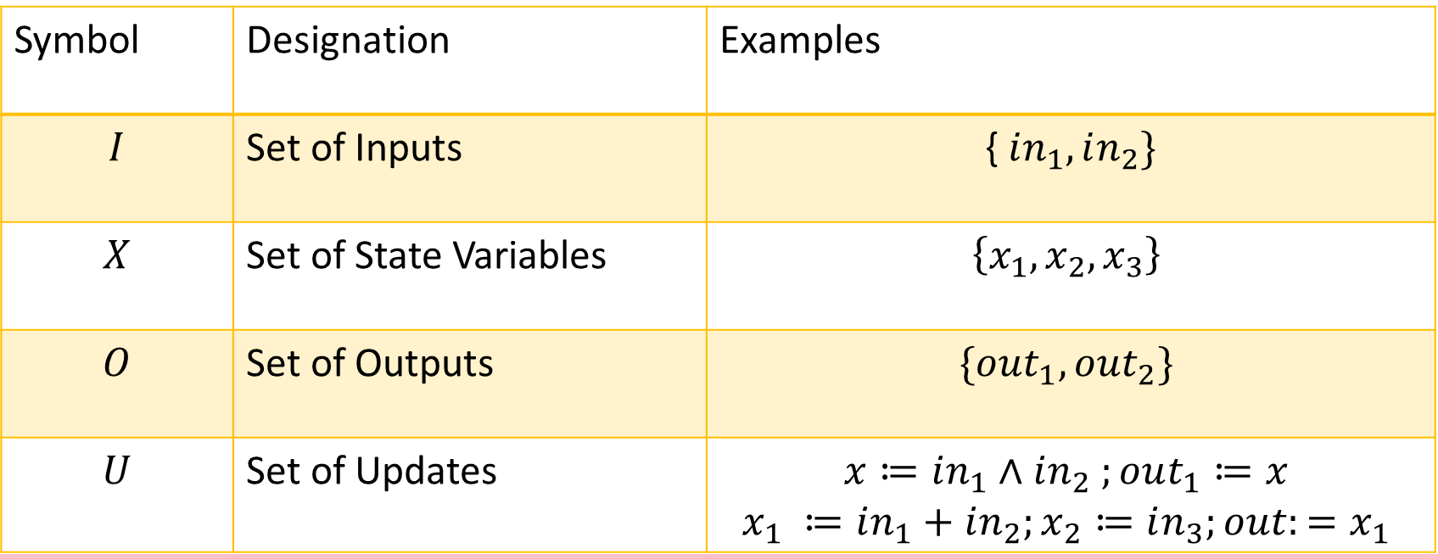
Formalization of synchronous comp.
State Variables Declaration and initialization
Input Names and Types
Update action that happens in each round
Output Names and Types
Synch. comp. is a tuple: $(I,O,X,U)$, where:
Component
Symbol | Designation | Examples
$$I$$ | Set of Inputs | { $in_{1}, in_{2}\}$
$$X$$ | Set of State Variables | $$\left\{x_{1},x_{2},x_{3}\right\}$$
$$O$$ | Set of Outputs | $$\{out_{1},out_{2}\}$$
$$U$$ | Set of Updates | $$x≔in_{1}∧in_{2} ;out_{1}≔x$$ $$x_{1} ≔in_{1}+in_{2};x_{2}≔in_{3};out:=x_{1}$$

Slide 18
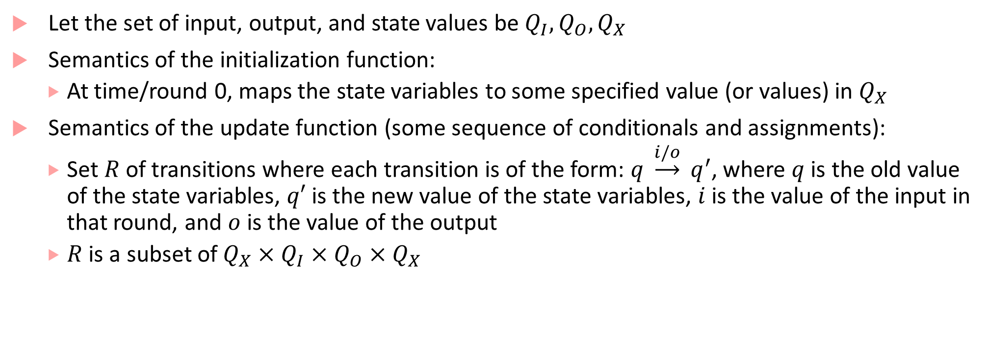
Semantics of updates & initialization
Let the set of input, output, and state values be $Q_{I}, Q_{O}, Q_{X}$
Semantics of the initialization function:
At time/round 0, maps the state variables to some specified value (or values) in $Q_{X}$
Semantics of the update function (some sequence of conditionals and assignments):
Set $R$of transitions where each transition is of the form: $q \underset{→}{i/o} q^{′}$, where $q$ is the old value of the state variables, $q′$ is the new value of the state variables, $i$ is the value of the input in that round, and $o$ is the value of the output
$R$ is a subset of $Q_{X}×Q_{I}×Q_{O}×Q_{X}$

Slide 19



What are the $Q_{I}, Q_{O}, Q_{X}$ for these components?
bool in
bool out
bool in
int y:= 0
bool z:= 0
bool x := 0
int out
out:=y ;
if (z==0)
y:= y + 1
else
y:= y-1
z := in
out:=x ; x:= in
$$Q_{I}=\left\{0,1\right\}, Q_{X}=\left\{0,1\right\}, Q_{O}=\{0,1\}$$
$Q_{I}=\left\{0,1\right\}, Q_{X}=int×\{0,1\}$ $, Q_{O}=int$
Notes:
int = {int_min,..,-1,0,1,..int_max}
Q_I = {0, 1}, Q_O = {0, 1}, Q_X = {0,1}
Q_I = {0,1}, Q_X = int x {0,1}, Q_O = int

Slide 20

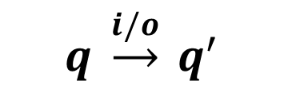




Transitions for Delay
$$0\underset{→}{0/0} 0$$
$$0\underset{→}{1/0} 1$$
$$1\underset{→}{0/1} 0$$
$$1\underset{→}{1/1} 1$$
bool in
bool out
bool x := 0
$$q \underset{→}{i/o} q^{′}$$
out:=x ; x:= in

Slide 21
Composition of Synchronous Components
bool in₁
bool out₁
bool in₂
bool out₂
bool x₁ := 0
bool x₂ := 1
out₁:=x₁ ; x₁:= in₁
out₂:=x₂ ; x₂:= in₂
Delay sequentially composed with Delay

Slide 22
Composition of Synchronous Components
bool in₁
bool out₁
bool in₂
bool out₂
bool x₁ := 1
bool x₂ := 0
Observe:
in₂ is the same as out₁ in every round
Ignoring first 2 rounds, outputs of d2 are the inputs to d1 delayed by 2 rounds
out₁:=x₁ ; x₁:= in₁
out₂:=x₂ ; x₂:= in₂
1 / 1
0 / 1
0 / 0
1 / 0
1 / 1
1
1
0
0
1
1
Delay 1
1 / 0
1 / 1
0 / 1
0 / 0
1 / 0
Delay 2
0
1
1
0
0
1

Slide 23

What does this model achieve?
bool in
int y:= 0
int c
bool warn := 0
int out
bool error := 0
bool warn
out:=y ;
if (in==0)
y:= y + 1
else
y:= y-1
if (c $≥$ 2)
if (warn == 1)
error := 1;
else
warn := 1;
end
end
bool error
10101010
11111111
10001111
001100

Slide 24
What does this model achieve?
bool in
int y:= 0
int c
bool warn := 0
int out
bool warn
out:=y ;
if (in==0)
y:= y + 1
else
y:= y-1
if (c $≥$ 2)
if (warn == 1)
error := 1;
else
warn := 1;
end
end
bool error
If number of ‘0’ inputs seen by the first component exceeds the number of ‘1’ inputs it has seen by 2, at any point in its execution, then the ‘warn’ light becomes high
If this happens again, the ‘error’ light becomes high

Slide 25
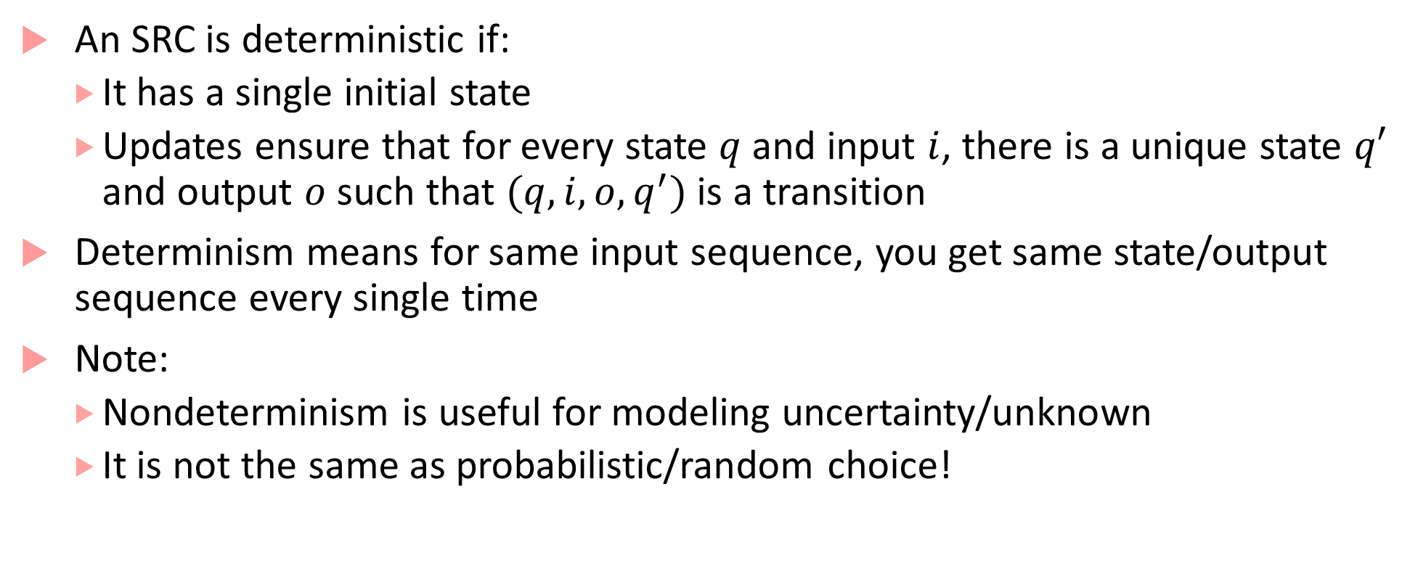
Deterministic Component
An SRC is deterministic if:
It has a single initial state
Updates ensure that for every state $q$and input $i$, there is a unique state $q′$ and output $o$ such that $(q,i,o,q^{′})$ is a transition
Determinism means for same input sequence, you get same state/output sequence every single time
Note:
Nondeterminism is useful for modeling uncertainty/unknown
It is not the same as probabilistic/random choice!

Slide 26
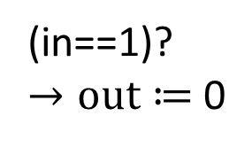
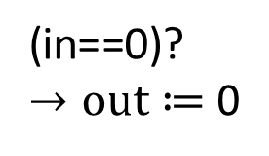
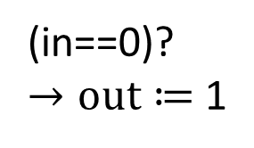
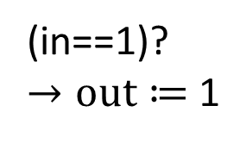
Extended State Machines
Commonly used to describe behavior of MBD models
Does this ESM remind you of something?
0
(in==1)?
$→out≔$0
(in==0)?
$→out≔$0
(in==0)?
$→out≔$1
1
(in==1)?
$→out≔$1

Slide 27
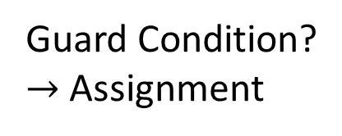
Anatomy of an ESM
Commonly used to describe behavior of MBD models
Initial state
From state
Guard Condition?
$→$Assignment
To state

Slide 28
Component Switch: What does this do?
bool press
bool out
int x := 0
bool q := 0
switch (q)
case 0: if (press==1) q:= 1
case 1: if (press==0) & (x < 10)
q:=1; x:= x+1
elseif (press==1) or ( x >= 10)
q:=0; x:= 0; out:= 1
end
end

Slide 29

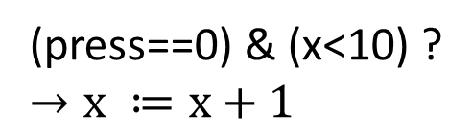
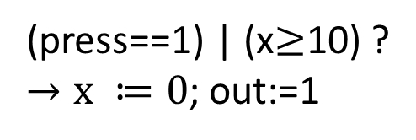
ESM corresponding to Switch SRC
q = 0 : off
= 1 : on
$int x≔$0
Off
(q==0)
(press==1)?
(press==0)?
on
(q==1)
(press==1) | (x$≥$10) ?
$→x ≔0$; out:=1
(press==0) & (x<10) ?
$$→x ≔x+1$$

Slide 30

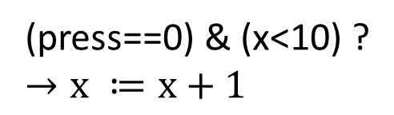
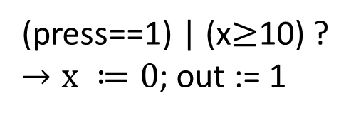
ESM notation
$int x≔$0
Implicit variable called “mode” that is a discrete state variable over some finite enumeration. Here: {on, off}
SRC transition may correspond to mode-switch
Each mode-switch has guard/update. Example:
Guard: (press==0) & (x<10) and
Update: x:= x+1
off
(press==0)?
(press==1)?
on
(press==0) & (x<10) ?
$$→x ≔x+1$$
(press==1) | (x$≥$10) ?
$→x ≔0$; out := 1

Slide 31
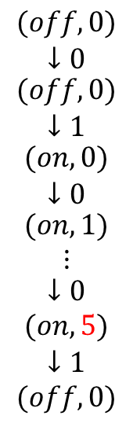
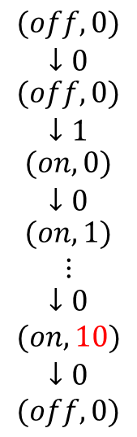
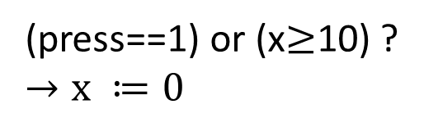
ESM execution
Start in mode off; initial state = (off,0)
Sample executions:
$int x≔$0
off
(press==0)?
$$\begin{matrix}(off,0) \\ ↓0 \\ \begin{matrix}(off,0) \\ ↓1 \\ \begin{matrix}(on,0) \\ ↓0 \\ \begin{matrix}(on,1) \\ ⋮ \\ \begin{matrix}↓0 \\ (on,10) \\ \begin{aligned}↓0 \\ (off,0)\end{aligned}\end{matrix}\end{matrix}\end{matrix}\end{matrix}\end{matrix}$$
$$\begin{matrix}(off,0) \\ ↓0 \\ \begin{matrix}(off,0) \\ ↓1 \\ \begin{matrix}(on,0) \\ ↓0 \\ \begin{matrix}(on,1) \\ ⋮ \\ \begin{matrix}↓0 \\ (on,5) \\ \begin{aligned}↓1 \\ (off,0)\end{aligned}\end{matrix}\end{matrix}\end{matrix}\end{matrix}\end{matrix}$$
(press==1)?
on
(press==0) & (x<10) ?
$$→x ≔x+1$$
(press==1) or (x$≥$10) ?
$$→x ≔0$$

Slide 32

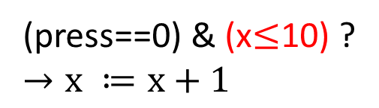
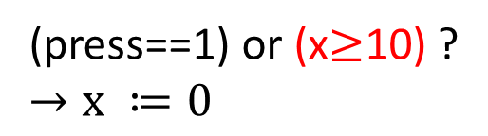
ESM transitions could be nondeterministic!
$int x≔$0
off
(press==0)?
(press==1)?
on
(press==0) & (x$≤$10) ?
$$→x ≔x+1$$
(press==1) or (x$≥$10) ?
$$→x ≔0$$

Slide 33
SRC: Finite-state Components
Component is finite state if all variables are over finite types
bool in
int y:= 0
bool z:= 0
bool in
bool out
int out
bool x := 0
out:=y ;
if (z==0)
y:= y + 1
else
y:= y-1
z := in
out:=x ; x:= in
FS
Not FS!

Slide 34
Cruise Controller Example
ThrottleController
event(real) F
event second
event cruise
Clock
event inc
CruiseController
Sensor
event rotate
event dec
Driver Inputs
nat speed
event(nat) cruiseSpeed
Display

Slide 35
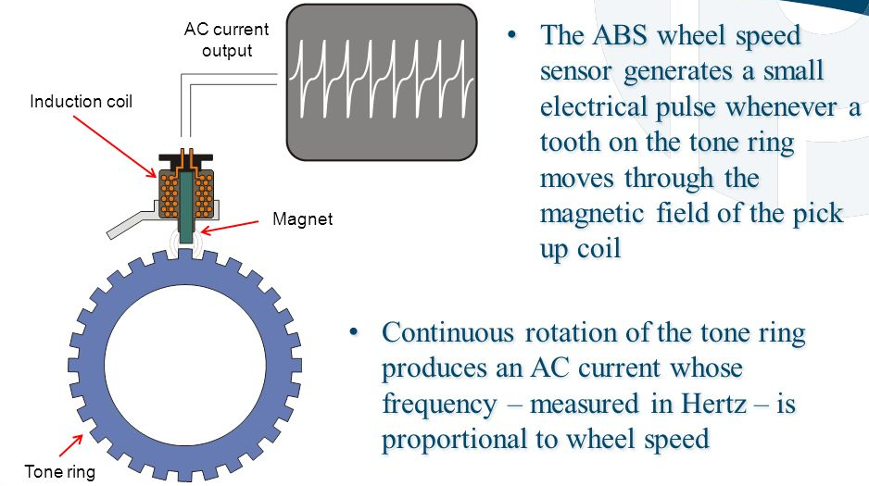
Sensors
Rotation Sensor: Wheel speed sensor or vehicle speed sensor
Type of a tachometer
Counts number of rotations per second and as the wheel radius is known, can compute the linear speed of the car
(From Porter and Chester Institute slides on Google Image Search)

Slide 36
Actuator
ThrottleController
ThrottleController is an actuator that gets a force/torque required to adjust the throttle plate which leads to tracking the desired speed
event(real) F
event second
event cruise
Clock
event inc
CruiseController
Sensor
event rotate
event dec
nat speed
event(nat) cruiseSpeed
Display

Slide 37
Decomposing CruiseController further

Slide 38
MeasureSpeed Component
event rotate
nat speed
nat count := 0, s:=0
event second
if rotate?
count:=count + 1;
if second?
s:= round( K* count);
count:=0;
speed:=s
MeasureSpeed SRC

Slide 39
Asynchronous Components

Slide 40
Logistics
Slack channel: uscviterbiclass.slack.com
You should see something like fall22-csci-513-30161
If you are not subscribed to this channel, please contact Viterbi IT
Blackboard:
I am still in the process of setting this up
They keep changing the interface to the point that I have to relearn it ☹
We will be using Blackboard for:
Submitting homework assignments
Posting grades

Slide 41
Asynchrony
Synchrony: All components execute in a sequence of rounds in lock-step
Asynchrony: No lock-step computation!
Natural model for networked, distributed communicating components executing independently and at possibly different speeds
As there is no central, global clock, explicit coordination is required between components
Examples:
Processes in distributed computation, multiple threads in any modern OS
Interrupt-driven processing

Slide 42
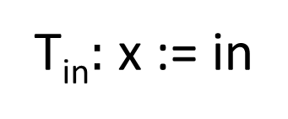
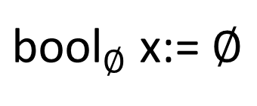
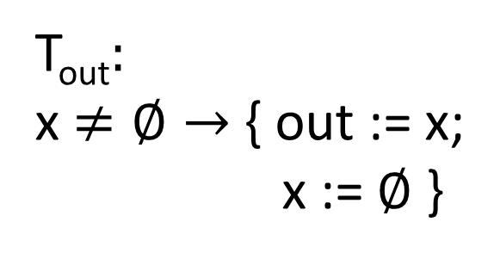
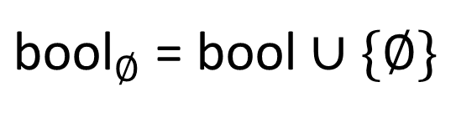
Asynchronous Reactive Component Example
bool in
bool out
${\text{bool}}_{∅}$ x:= $∅$
T_{in}$:$ x := in
${\text{bool}}_{∅}$ = bool $∪\{∅\}$
T_{out}$:$
x$≠∅→$ { out := x;
x := $∅$ }
Guarded Update
Tasks: T_{in},T_{out}

Slide 43
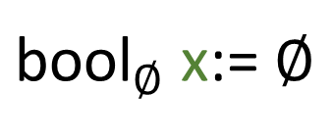
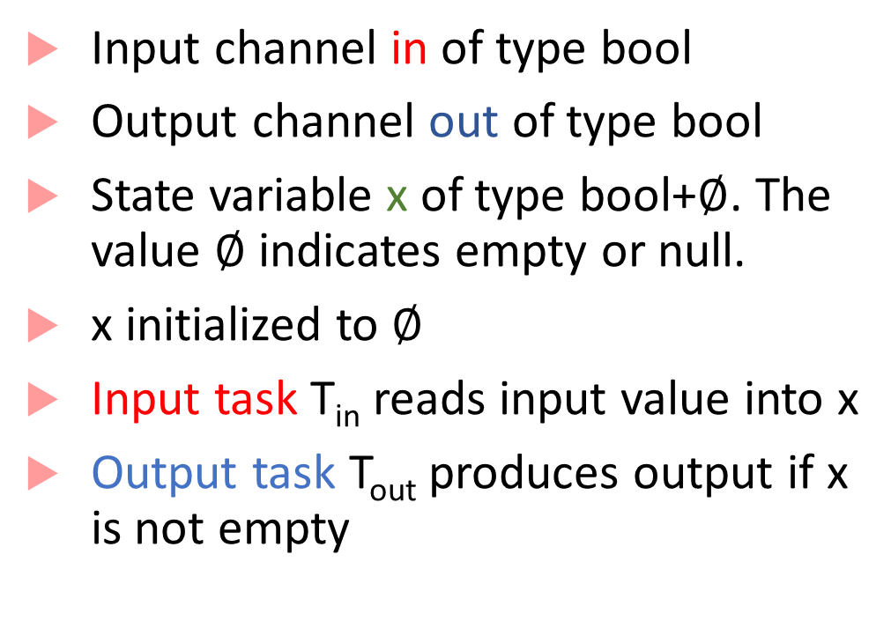
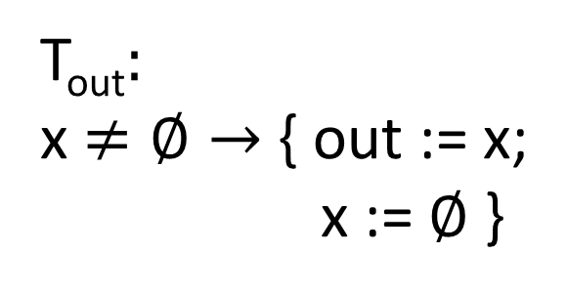
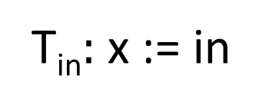
Asynchronous Reactive Component
Input channel in of type bool
Output channel out of type bool
State variable x of type bool+$∅$. The value $∅$ indicates empty or null.
x initialized to $∅$
Input task T_{in} reads input value into x
Output task T_{out} produces output if x is not empty
bool in
${\text{bool}}_{∅}$ x:= $∅$
bool
out
T_{in}$:$ x := in
T_{out}$:$
x$≠∅→$ { out := x;
x := $∅$ }

Slide 44
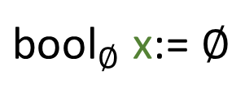
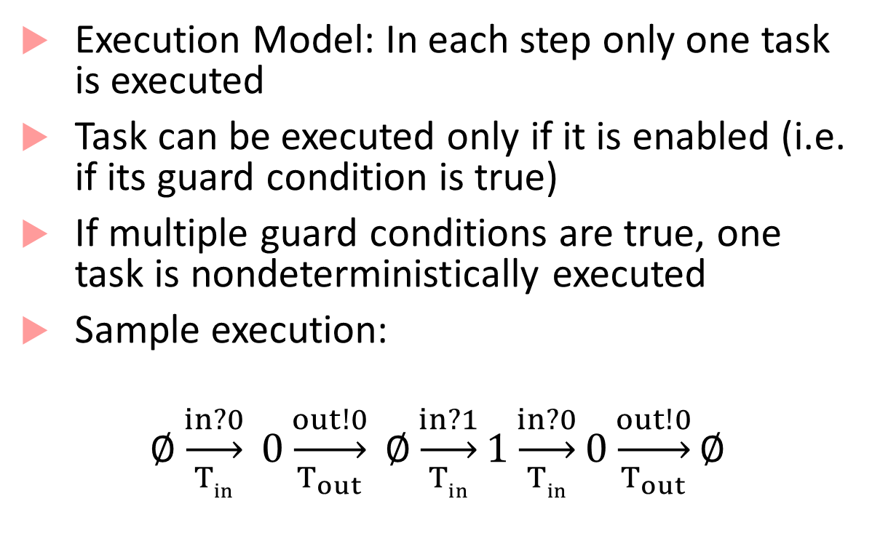
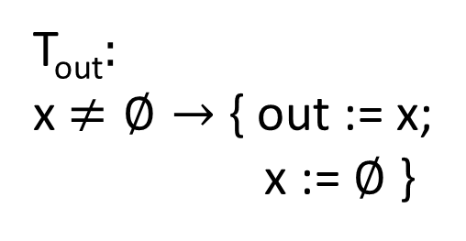
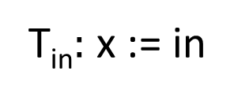
Asynchronous Reactive Component Execution
Execution Model: In each step only one task is executed
Task can be executed only if it is enabled (i.e. if its guard condition is true)
If multiple guard conditions are true, one task is nondeterministically executed
Sample execution:
$$∅\underset{Tin}{\underset{→}{in?0}} 0\underset{T_{out}}{\underset{→}{out!0}} ∅\underset{Tin}{\underset{→}{in?1}}1\underset{Tin}{\underset{→}{in?0}}0\underset{T_{out}}{\underset{→}{out!0}}∅$$
${\text{bool}}_{∅}$ x:= $∅$
bool in
bool
out
T_{in}$:$ x := in
T_{out}$:$
x$≠∅→$ { out := x;
x := $∅$ }
Buffer

Slide 45

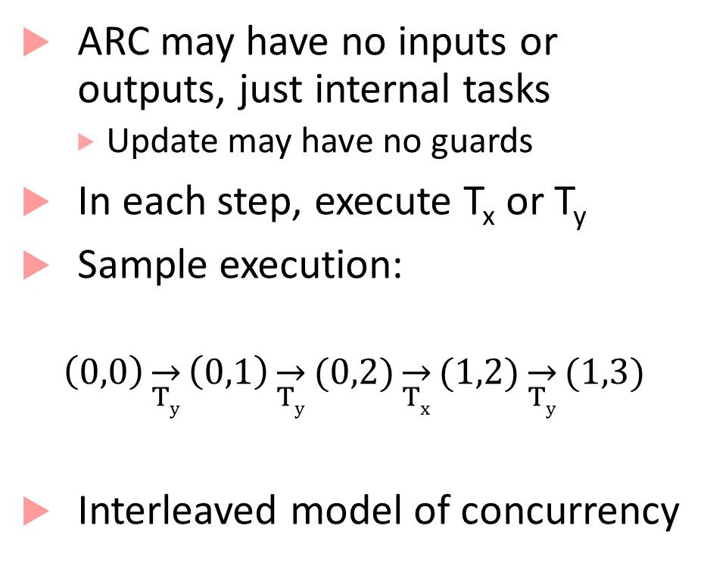

Example: Asynchrony + Nondeterminism
ARC may have no inputs or outputs, just internal tasks
Update may have no guards
In each step, execute T_{x} or T_{y}
Sample execution:
$$\left(0,0\right)\overset{→}{Ty}\left(0,1\right)\overset{→}{Ty}(0,2)\overset{→}{Tx}(1,2)\overset{→}{Ty}(1,3)$$
Interleaved model of concurrency
(0,0)
int x:= 0, y≔ 0
(1,0)
(0,1)
T_{x}$:$ x := x+1
T_{y}$:$ y:= y+1
(2,0)
(1,1)
(0,2)
(1,2)

Slide 46
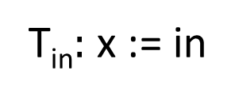
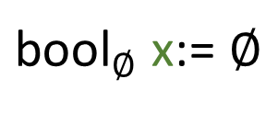
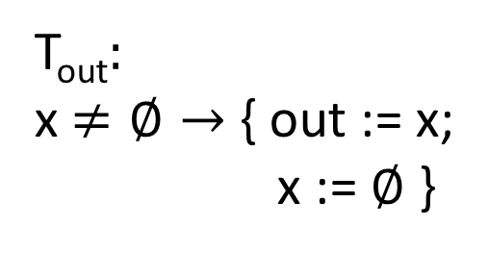
Asynchronous Process/Reactive Component
Set of input channels: I
ESM representation: in?v, where v is the value to be received
Set of output channels: O
ESM representation: out!v, where v is the value to be written
Set of state variables X
Initialization Init which maps state variables to initial values
${\text{bool}}_{∅}$ x:= $∅$
bool in
bool
out
T_{in}$:$ x := in
T_{out}$:$
x$≠∅→$ { out := x;
x := $∅$ }

Slide 47
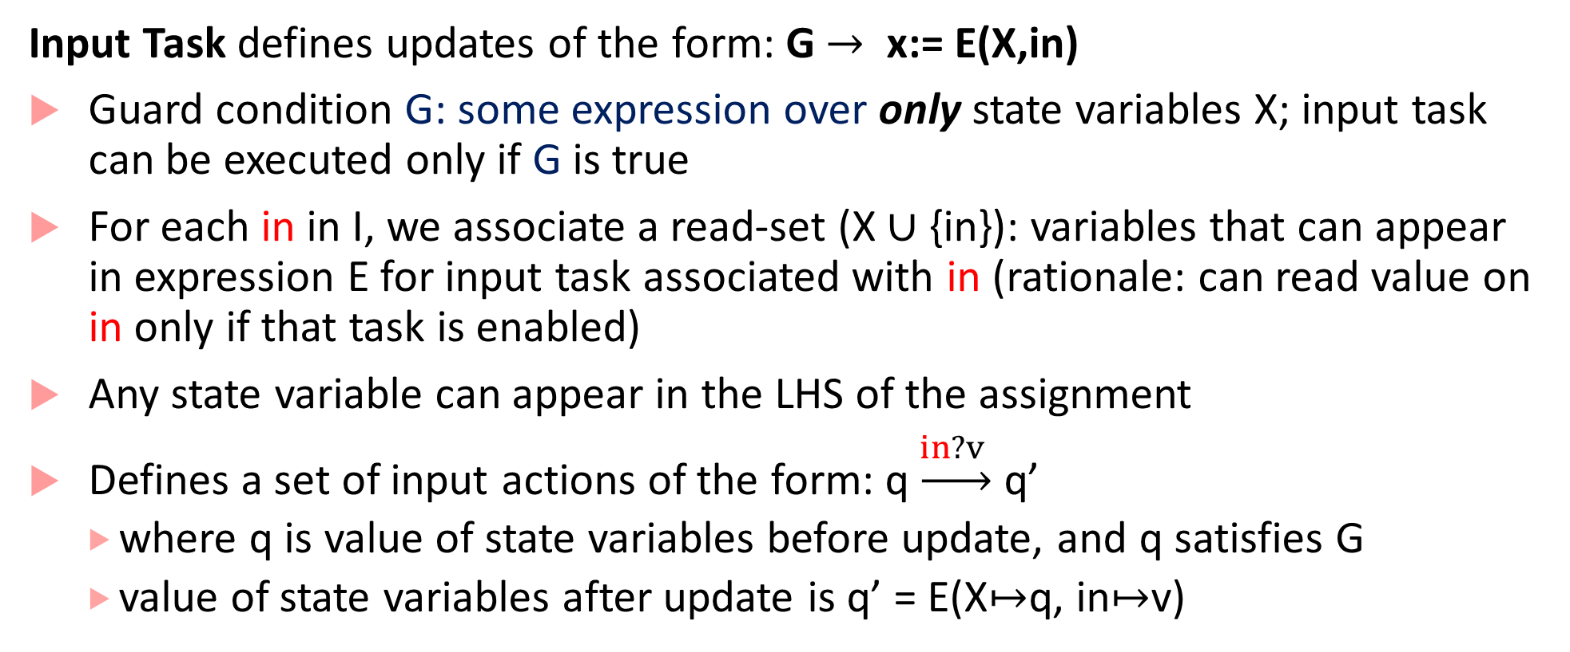
Updates are different from SRCs!
Input Task defines updates of the form: G $→$ x:= E(X,in)
Guard condition G: some expression over only state variables X; input task can be executed only if G is true
For each in in I, we associate a read-set (X $∪$ {in}): variables that can appear in expression E for input task associated with in (rationale: can read value on in only if that task is enabled)
Any state variable can appear in the LHS of the assignment
Defines a set of input actions of the form: q$\underset{→}{in?v }$ q’
where q is value of state variables before update, and q satisfies G
value of state variables after update is q’ = E(X$↦$q, in$↦$v)

Slide 48
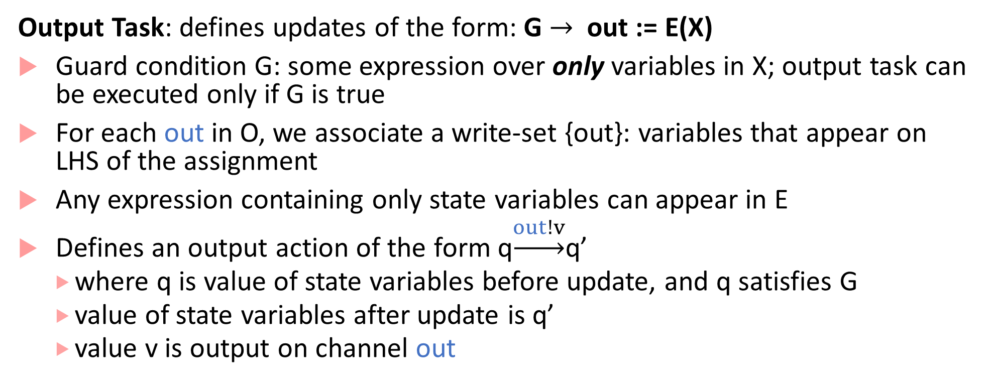
Updates are different from SRCs!
Output Task: defines updates of the form: G $→$ out := E(X)
Guard condition G: some expression over only variables in X; output task can be executed only if G is true
For each out in O, we associate a write-set {out}: variables that appear on LHS of the assignment
Any expression containing only state variables can appear in E
Defines an output action of the form q$\underset{→}{out!v}$q’
where q is value of state variables before update, and q satisfies G
value of state variables after update is q’
value v is output on channel out

Slide 49
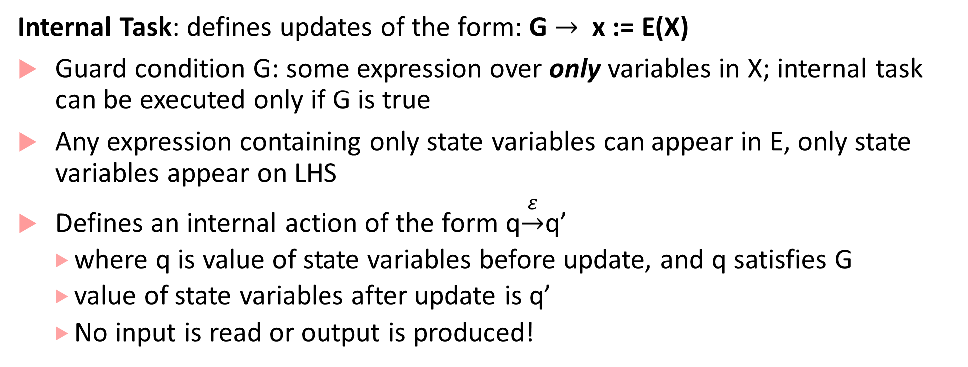
Updates are different from SRCs!
Internal Task: defines updates of the form: G $→$ x := E(X)
Guard condition G: some expression over only variables in X; internal task can be executed only if G is true
Any expression containing only state variables can appear in E, only state variables appear on LHS
Defines an internal action of the form q$\underset{→}{ε}$q’
where q is value of state variables before update, and q satisfies G
value of state variables after update is q’
No input is read or output is produced!

Slide 50
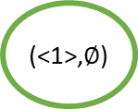

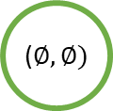




Asynchronous Merge: Sequence of Actions
queue(bool) x₁ $≔∅$, x₂ $≔∅$
($∅,∅)$
bool in₁
bool out
T_{in1}
in1?1
T_{in1}$:$ $¬$Full(x₁) $→$ Enqueue(x₁,in₁)
bool in₂
(<1>,$∅$)
out!1
(<1>,<1>)
T_{in2}$:$ $¬$Full(x₂) $→$ Enqueue(x₂,in₂)
T_{out2}
T_{out1}$:$ $¬$Empty(x₁) $→$ out := Dequeue(x₁)
T_{in2}
in2?0
T_{out2}
out!0
T_{out2}$:$ $¬$Empty(x₂) $→$ out := Dequeue(x₂)
T_{in2}
(<1>,<0>)
(<1>,<0,1>)
in2?1
Asynchronous Processes can also be represented with extended state machines

Slide 51

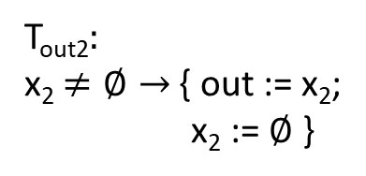




Composing Asynchronous Processes
Parallel composition: Inputs, Outputs, States and Initialization similar to the synchronous case
Input consumption needs to be synchronized with output production for the ‘temp’ variable
bool temp
${\text{bool}}_{∅}$ x₁ := $∅$
${\text{bool}}_{∅}$x₂:= $∅$
bool in
bool out
T_{in1}$:$ x₁ := in
T_{in2}$:$ x₂ := temp
T_{out1}$:$
x₁$≠∅→$ { temp := x₁;
x := $∅$ }
T_{out2}$:$
x₂$≠∅→$ { out := x₂;
x₂ := $∅$ }
Buffer
Buffer

Slide 52
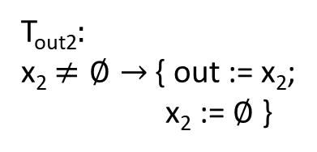


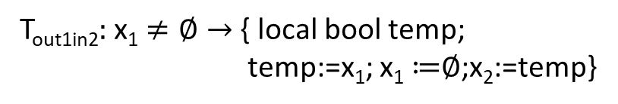







Composed DoubleBuffer
Buffer
Buffer
Defining P₁ || P₂
In each step only 1 task executes
If y is an output channel of P₁ and input channel of P₂:
A₁: output task for P₁ with code: G₁$→$ U₁
A₂: input task for P₂ with code: G₂$→$ U₂
Composition has output task for y with code: G₁ $∧$ G₂ $→$ U₁;U₂
${\text{bool}}_{∅}$ x₁ := $∅$
${\text{bool}}_{∅}$x₂:= $∅$
bool in
bool out
T_{in1}$:$ x₁ := in
T_{in2}$:$ x₂ := temp
T_{out1}$:$
x₁$≠∅→$ { temp := x₁;
x := $∅$ }
T_{out2}$:$
x₂$≠∅→$ { out := x₂;
x₂ := $∅$ }
${\text{bool}}_{∅}$ x₁ := $∅$, x₂ := $∅$
bool in
bool out
T_{in1}$:$ x₁ := in
T_{out2}$:$ x₂ $≠∅→$ { out:=x₂; x₂ ≔$∅$}
Double
Buffer
T_{out1in2}$:$ x₁ $≠∅→$ { local bool temp;
temp:=x₁; x₁ ≔$∅$;x₂:=temp}

Slide 53



Blocking vs. Non-blocking Synchronization
Task T_{out} of P1 can produce a value on the output only if P2 has an input task that is enabled to consume the value with some input task
In this example, once x becomes odd, P2 cannot consume (no enabled input task) and it blocks communication
Process is non-blocking on channel in if at least one guarded update corresponding to input task for in is enabled
Process is non-blocking if for every input channel, the disjunction of all guards corresponding to input tasks for that channel is valid or the Boolean formula 1 (true).
int y := 0
int x := 0
int tmp
T_{out}$:$ tmp := y;
y:= y+1
T_{tmpe}$:$ (x is even)$→$
x:= tmp
T_{tmpo}$:$ (x is odd)$→$
x:=tmp
P1
P2
How do you make P2 non-blocking?

Slide 54






Deadlocks
Common error in asynchronous designs
Caused by each process waiting for another process to execute a task, but no task is enabled
($0,0),$
(0,0)
bool y₁ := 0, z₁ := 0
r₁
bool y₂ := 0, z₂ := 0
T₁₁: (y₁==0)$→$y₁:= 1;
T₁₂: (y₁==1)$→$ z₁ := r₂
T₁₃: (z₁==1)$→$ r₁ := 1
r₂
T₂₁: (y₂==0)$→$y₂:= 1;
T₂₂: (y₂==1)$→$ z₂ := r₁
T₂₃: (z₂==1)$→$ r₂ := 1
T₁₁
$$ε$$
(1,$0$),
(0,0)
P1
P2
T₂₁
$$ε$$
(1,0),
(1,0)

Slide 55
Wrapping it all up
Synchronous components/processes:
Good abstraction if you have a common shared clock at which each component in your software executes
Asynchronous components/processes
Good abstraction if you have interrupts, user-driven actions
Next time:
Continuous-time models

