Slide 1
Theory and Algorithms for Formal Verification Course Introduction
Spring 2022: CSCI 699
Instructor: Jyo Deshmukh

Slide 2
What are formal methods?
Mathematically rigorous techniques for reasoning about computer systems
Computer systems can include a broad variety of systems:
software programs (terminating functional programs, scientific computing, scripts to train your favorite ML model, simulators, etc.)
reactive systems (distributed and concurrent software for operating systems, email servers, databases, logging, monitoring, etc.)
interactive systems (web browsers, human-machine interfaces)
hardware circuits/descriptions (VHDL/Verilog descriptions, SPICE programs, etc.)
cyber-physical systems (service robots, self-driving cars, airplanes, human-piloted and autonomous drones, medical devices, industrial systems, power grids, etc.)

Slide 3
Some key ideas in formal methods
Specification
We should be able to describe our expectations on the behavior of the system-under-design (SUD) using a high-level (formal) language
Verification
Given a computer-interpretable description of the SUD, we should be able to algorithmically decide if the SUD satisfies its specification
Synthesis
Given a set of high-level (complete or incomplete) specifications of the SUD, and some partial (possibly empty) implementation of the SUD, we should be able to algorithmically synthesize the complete implementation of the SUD (that is guaranteed to satisfy the given specifications)

Slide 4
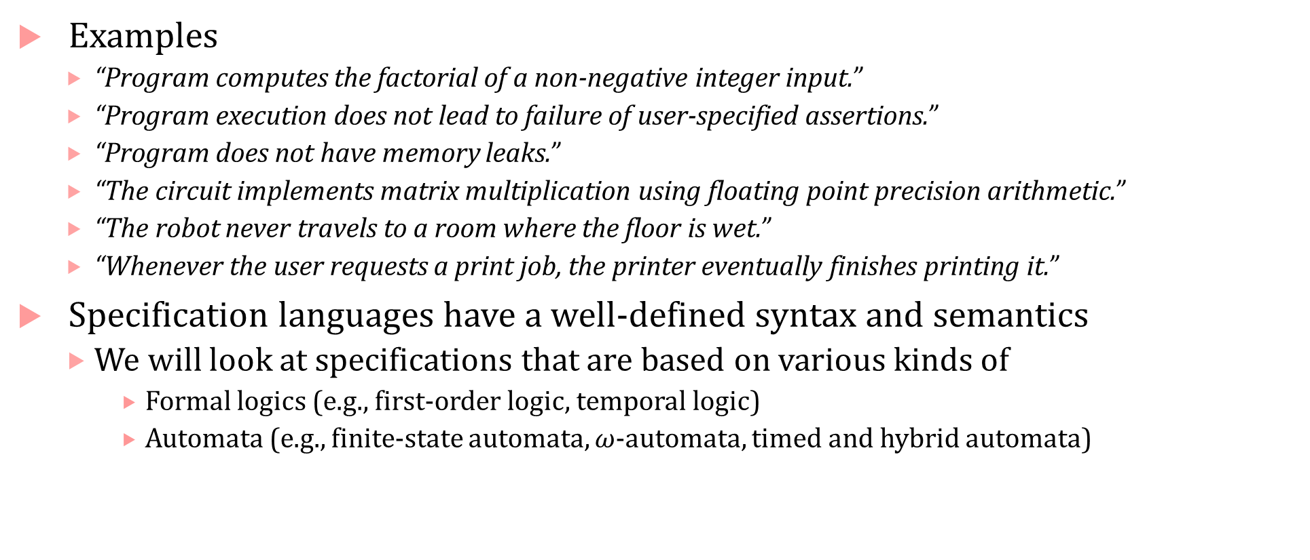
Specifications
Examples
“Program computes the factorial of a non-negative integer input.”
“Program execution does not lead to failure of user-specified assertions.”
“Program does not have memory leaks.”
“The circuit implements matrix multiplication using floating point precision arithmetic.”
“The robot never travels to a room where the floor is wet.”
“Whenever the user requests a print job, the printer eventually finishes printing it.”
Specification languages have a well-defined syntax and semantics
We will look at specifications that are based on various kinds of
Formal logics (e.g., first-order logic, temporal logic)
Automata (e.g., finite-state automata, $ω$-automata, timed and hybrid automata)

Slide 5
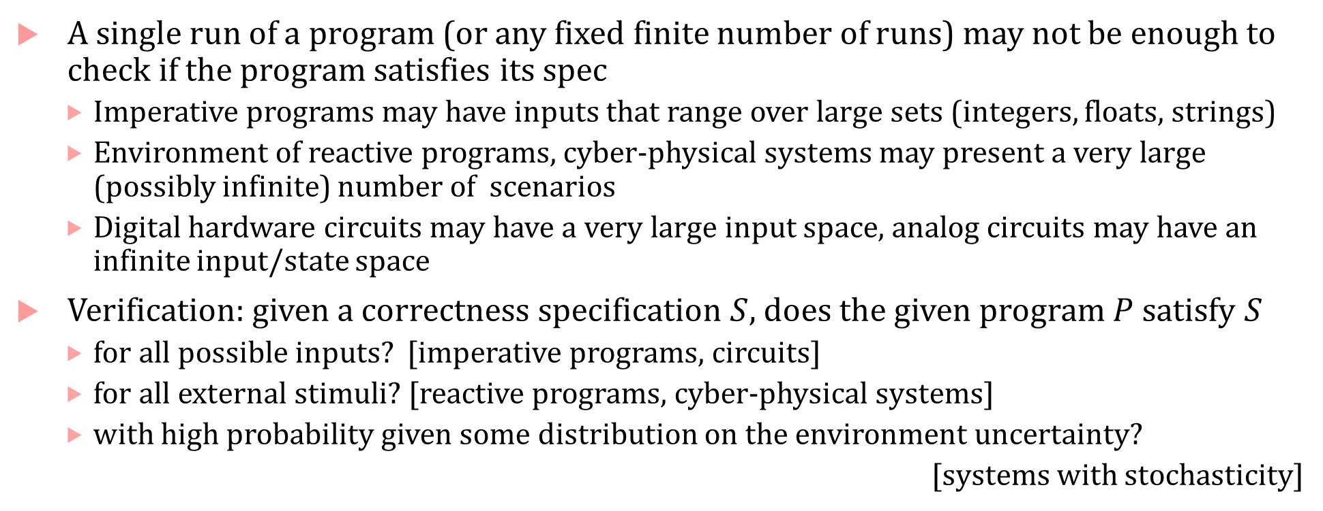
Verification
A single run of a program (or any fixed finite number of runs) may not be enough to check if the program satisfies its spec
Imperative programs may have inputs that range over large sets (integers, floats, strings)
Environment of reactive programs, cyber-physical systems may present a very large (possibly infinite) number of scenarios
Digital hardware circuits may have a very large input space, analog circuits may have an infinite input/state space
Verification: given a correctness specification $S$, does the given program $P$satisfy $S$
for all possible inputs? [imperative programs, circuits]
for all external stimuli? [reactive programs, cyber-physical systems]
with high probability given some distribution on the environment uncertainty?
[systems with stochasticity]

Slide 6
Verification vs. Testing
Testing: Pick some set of inputs and execute the program on this set. Program is buggy if it violates its specification on any of the test inputs.
Testing can show the presence of bugs, but not the absence of bugs.
The one test input that causes the bug may be missing from your test-suite
Verification tries to establish the absence of bugs by proving that the program cannot violate its specification under all possible inputs/stimuli etc.

Slide 7
Verification vs. Program Analysis
Static/Program analysis: Learn properties of the program by just inspecting the source code
Static analysis is one way to perform verification for certain kinds of specifications; static analysis is generally fully automatic.
CSCI 610 is a great course to learn all about static analysis
Verification is a general approach that consist of various techniques with different levels of automation: (theorem proving, model checking, static and dynamic analysis, runtime verification, etc.)

Slide 8
Verification for Cyber-physical systems
Formal Verification is not limited to software programs
Suppose you are developing software for controlling a train, and the correctness is specified as, “if the train sees a red signal, it must come to rest within 120 seconds.” You cannot verify this specification on the software alone, but you need to know the time-evolution of the train’s behavior in response to the software commands it receives.
We can model the physical components being controlled by software using dynamical equations (ODEs, PDEs, DAEs, difference equations), and use CPS verification techniques to check the above specification.

Slide 9
Verification for Probabilistic Systems
Many real-world cyber-physical systems (e.g., robots, cars, medical devices), networking software face stochastic uncertainty from their operating environment
For such systems, absolute guarantees are generally difficult to obtain
For example, “self-driving car should not collide with other cars” is a specification that we may never be able to prove because the self-driving car is designed with certain rational assumptions on other cars. What guarantees can we give if other cars are homicidal?
We can give guarantees modulo assumptions on the environment: if environment assumptions are stochastic, we get probabilistic guarantees

Slide 10
New frontiers: Neural network verification/robustness
Neural networks are a very special kind of a program
Machine learning typically focuses on improving the accuracy of neural networks, verification typically has not been a concern
Many problems for neural networks could be addressed using formal verification approaches:
Robustness: Do small perturbations in the input to the NN cause large changes in its output (or output labels)?
Compression: Is a reduced size NN functionally similar to the original NN?
Safety: Is an NN-controlled dynamical system safe?

Slide 11
Synthesis
Given a set of high-level specifications* generate the correct-by-construction program that is guaranteed to satisfy the specs
* = we also provide some assumptions about the program (e.g., some program skeleton, assumptions about platform on which program will run, assumptions on communication topology, etc.)
Logic synthesis: produce circuit implementations from high-level descriptions (mature area with several active EDA companies)
Program synthesis: imperative programs, functional programs
Reactive synthesis: reactive programs that are not intended to terminate
Controller synthesis: cyber-physical systems
Controller/Policy Learning: general decision-making systems
Synthesis is a harder problem than verification, but verification can be used as a step within a broader synthesis framework

Slide 12
What will we learn?
Algorithms for deductive verification
Modeling programs as transition systems
Automatic verification approaches such as model checking
Specification languages such as temporal logic and automata over infinite words and trees
Techniques to make verification scalable
Models, Specification formalisms and Verification algorithms for Probabilistic Systems
Modeling, Specifying and Verifying Cyber-Physical Systems
New research on neural network verification

Slide 13
Why should people care about formal verification?
History of software development is also a history of software blunders, often those that have catastrophic results
Ariane 5 rocket explosion (integer overflow), Therac-25 radiation treatment killing patients with radiation overdose (race condition), $475M FDIV bug for Intel (missing entries in lookup table used for floating point division), Patriot missile fails to intercept Scud missile (rounding error), software error led to recall of a neonatal ventilator, … several others
More recently: Tesla car misidentifies a truck as the sky, Uber car fails to act in time to avoid fatal collision with pedestrian walking a bike, Boeing 787 MAX errors

Slide 14
Who cares about formal verification today?
Hardware/EDA industry: has embraced FV for almost two decades
Avionics industry:
FAA requires software on commercial airplanes to be certified before they can fly
Rigorous standards for certification, changing even one line of code can trigger multi-year-long certification process (important to do it right!)
Medical devices:
FDA requires medical device software to be certified
Software industry [a very incomplete list]
Amazon has a world class formal verification group that uses TLA+ model checker and other tools to verify various distributed systems aspects (esp. in AWS)
Microsoft Research has a strong rigorous software engineering group responsible for fundamental advances in theory and tools for formal verification
Increasingly: the automotive industry [Toyota, Robert Bosch GmbH, Ford, GM, Volvo, and several others have teams doing research/practice of verification]

Slide 15
About the course

Slide 16
This is a theory course!
There will be no programming assignments!
The course will require you to exercise your mathematical and logical skills
I will give guidance and help with proof techniques, formalizing problems, etc.
That said …
You are encouraged to download and play with formal verification tools such as model checkers, theorem provers, SMT solvers, monitoring and specification tools
My personal conviction is that formal methods/verification can advance as a field only through well-engineered tools: it is important to build tools.
The purpose of this course: understanding the technology behind the tools.

Slide 17
Course structure
Lecture-oriented + supplementary reading from textbooks if necessary
Three textbooks will cover most of the material for the course
(should be available through libraries.usc.edu as ebooks)
Principles of Model Checking by Christel Baier and Joost Pieter Katoen, MIT Press
Verifying Cyber-Physical Systems by Sayan Mitra, MIT Press
Principles of Cyber-Physical Systems by Rajeev Alur, MIT Press
4 homework assignments
Can work on homework in teams: collaborate if you desire
Homework content: design algorithms, write proofs
1 take-home final exam
Everyone takes their own exam

Slide 18
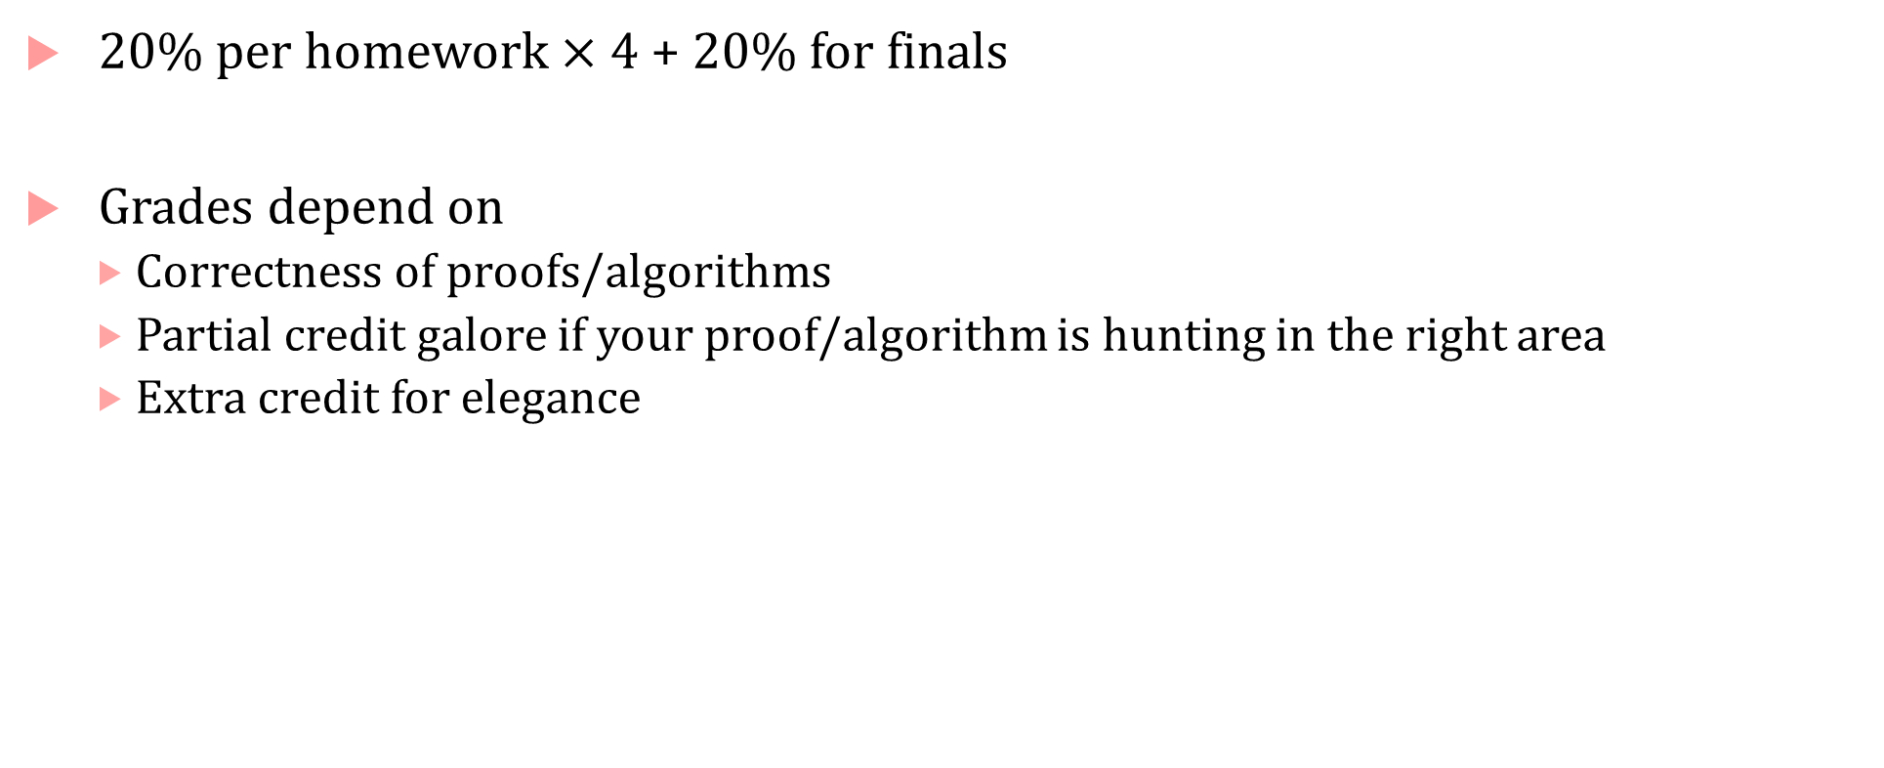
Grade and Grading
20% per homework $×$ 4 + 20% for finals
Grades depend on
Correctness of proofs/algorithms
Partial credit galore if your proof/algorithm is hunting in the right area
Extra credit for elegance

Slide 19
Office hours
Fridays 11am-12pm + by appointment
Jyo’s office: SAL 340

Slide 20
Introductions…

