Slide 1
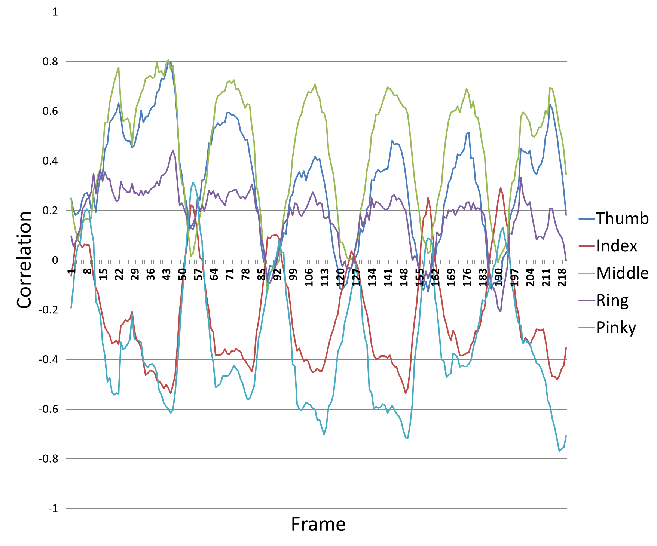
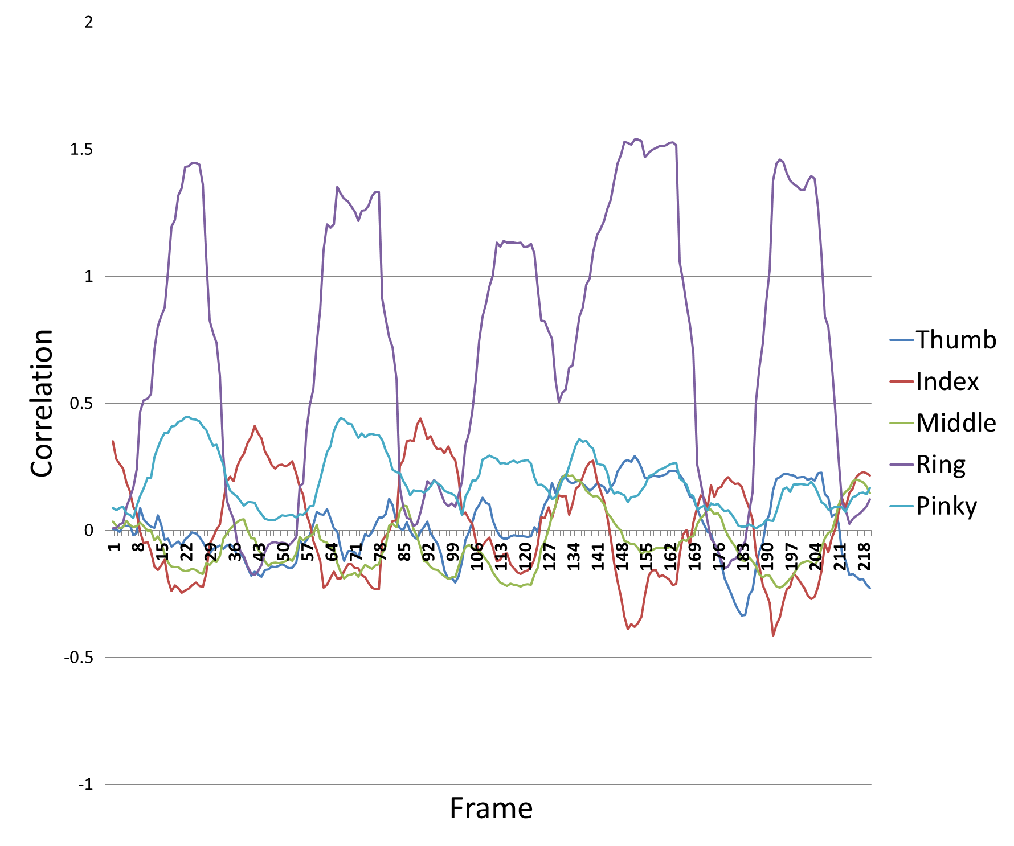
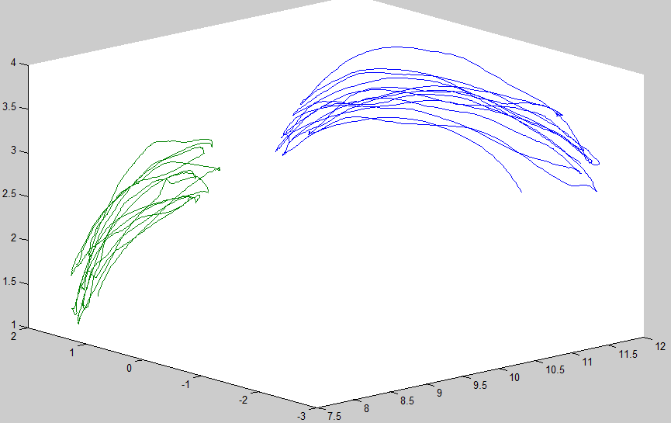
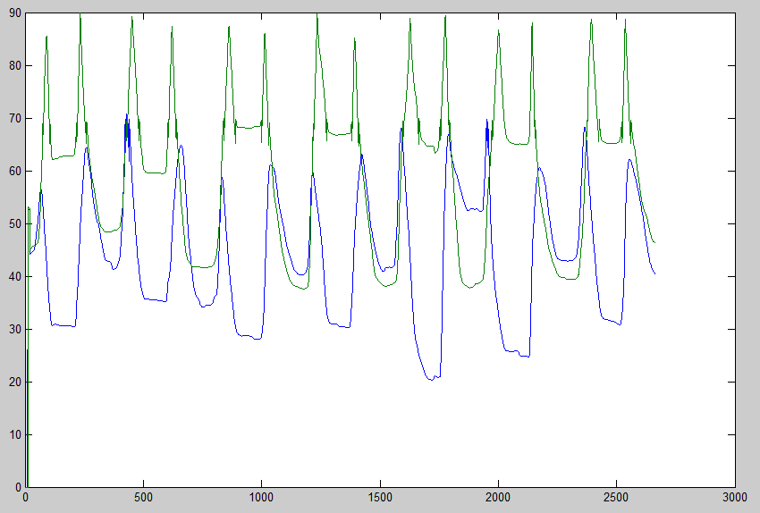
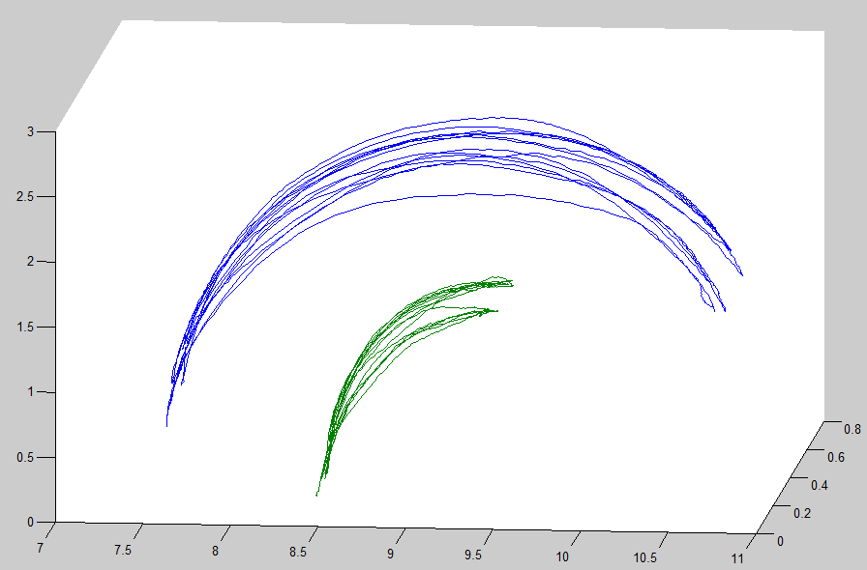
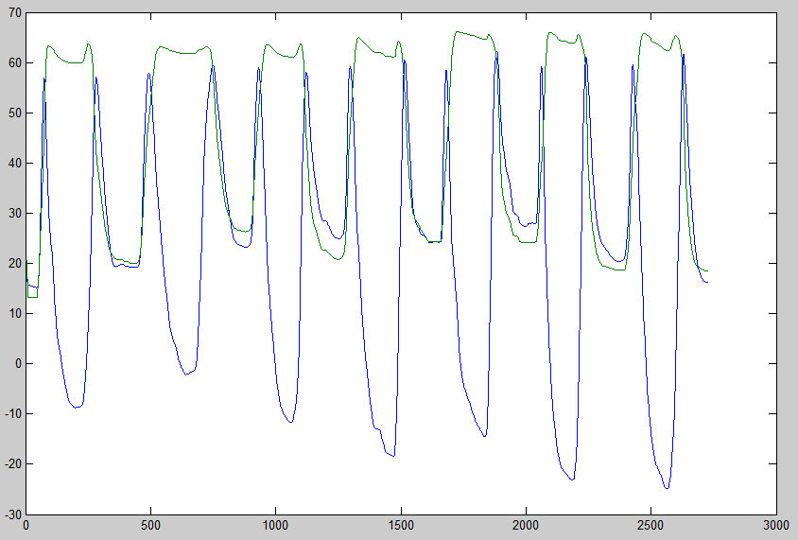
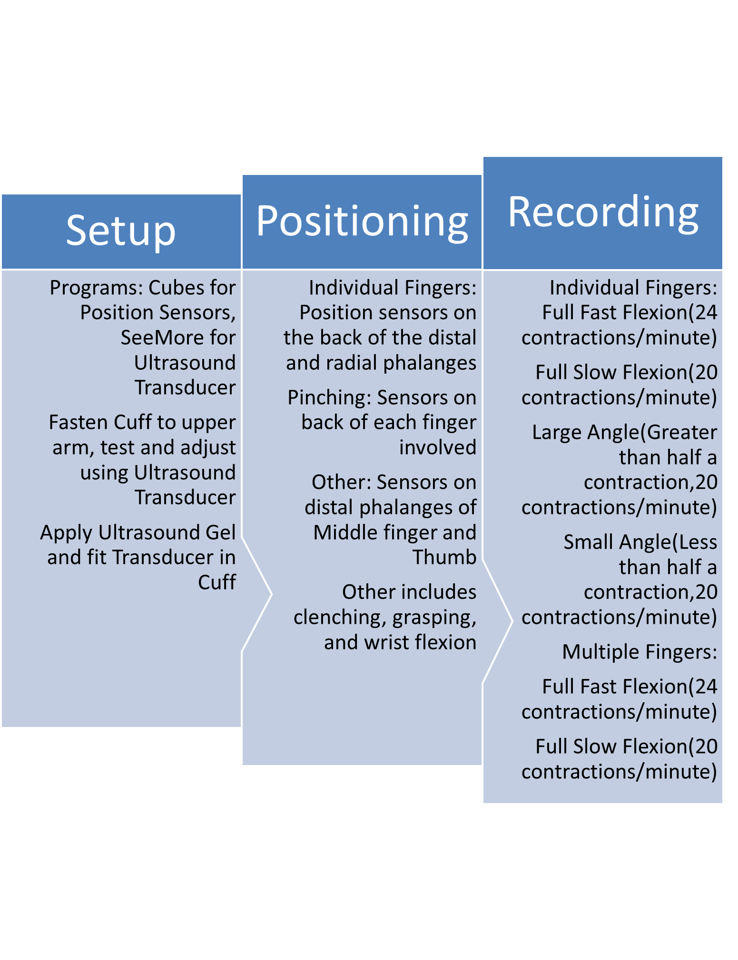
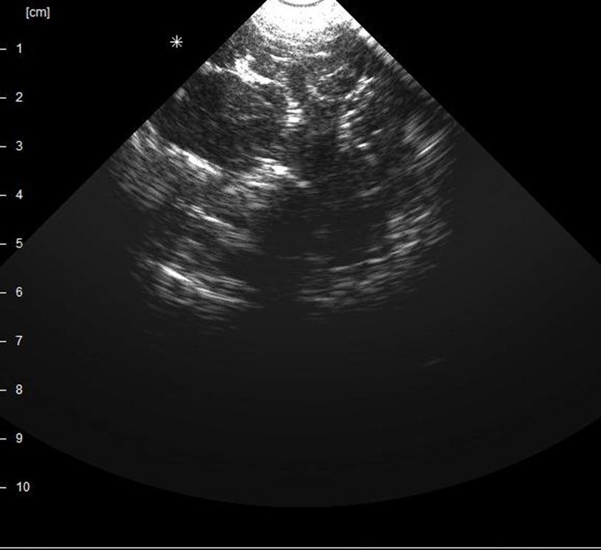
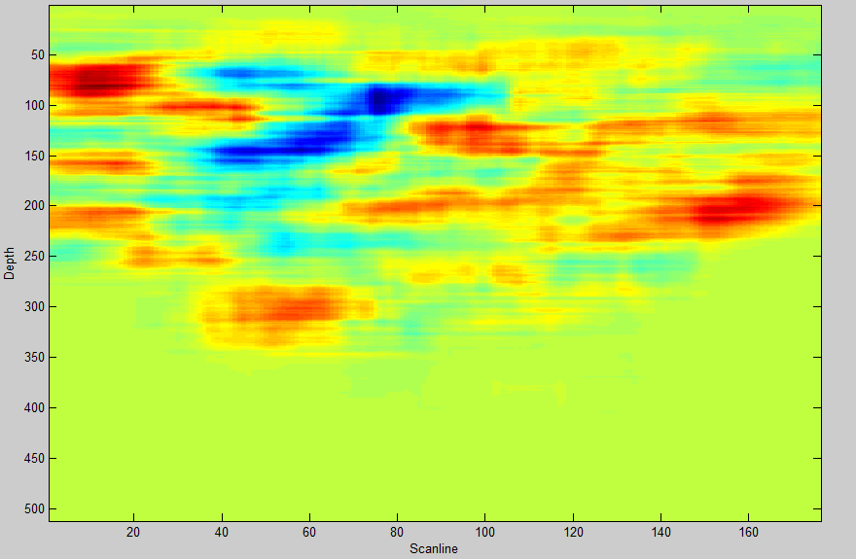
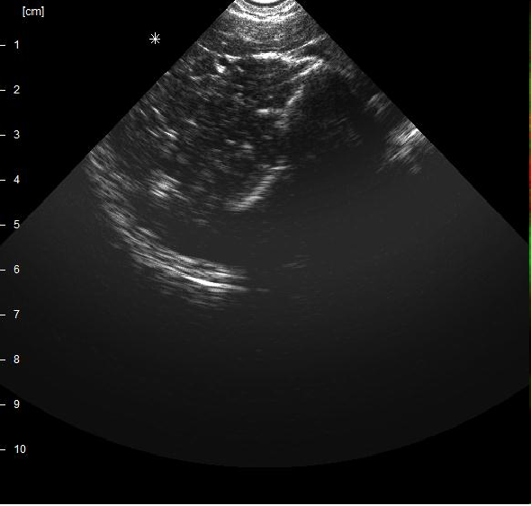
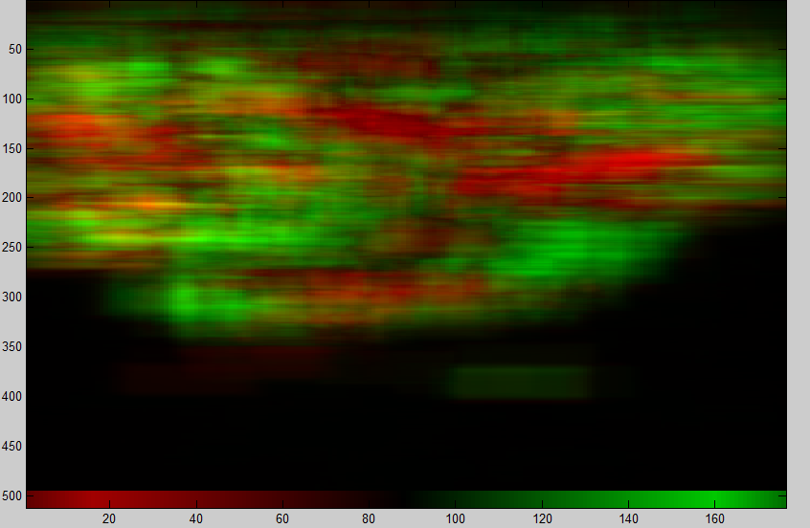
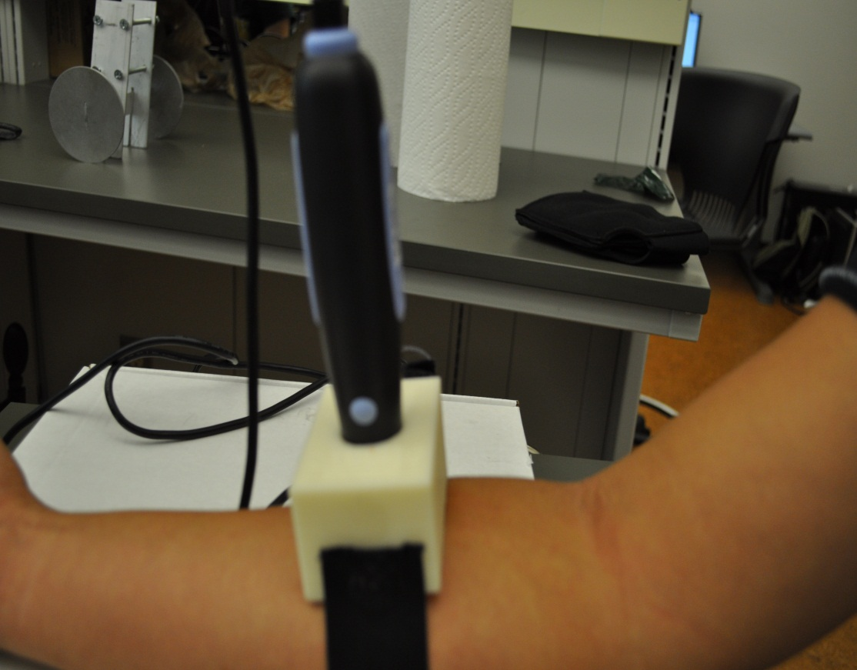
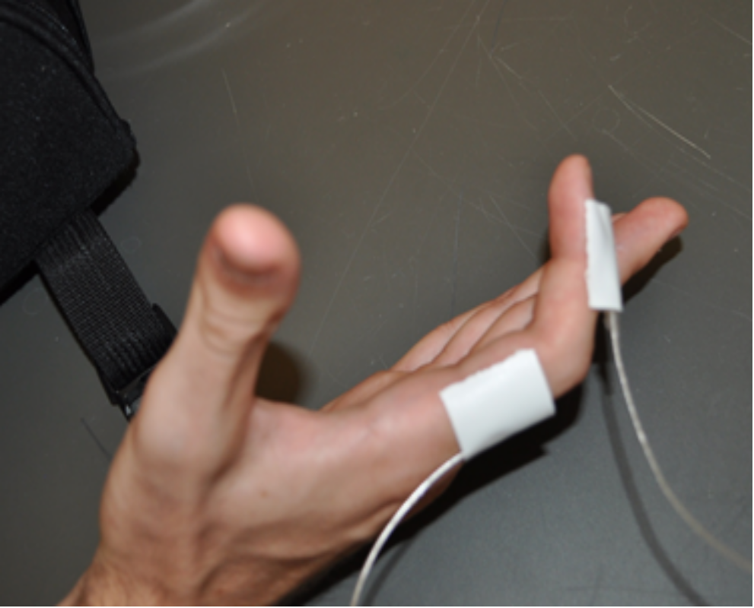
Decoding Finger Movements using Ultrasound Imaging of Muscle Activity
Jayanth Devanathan
Background
T9 min
T11min
T15min
T30min
T60min
T3hr
Results
Approximately 40,000 individuals in the United States have upper extremity amputations. Recently there have been major advances in the electromechanical design of upper extremity prosthetics, however the control strategies have lagged far behind. Kushaba,Kodagoda, Maen,&Gamini looked into electromyogram(EMG) signals from an individual's muscles. They used two EMG electrodes to test muscle movements on human forearms for a variety of subjects. Ten movements were tested for each subject; singular finger movements, all the pinches, and a hand clench motion. Data was analyzed using a sliding window approach with an overlapping window scheme, which was classified and tested with Bayesian Fusion and kNN classifier(Nearest Neighbor Algorithm). The process used had a 90% accuracy .
Li et al. also researched arm prosthetics using EMG signals. Transradial amputees were tested on as well as regular limbed people. 12 electrodes were placed on intact arms and 8 were placed on amputated arms. Machine learning was the method used for classification, which garnered a 90% accuracy for people with intact arms and a bit lower for amputees.
Another study conducted by Daley,Englehart,Hargrove,&Kuruganti did a similar project where electrodes were placed on human test subjects and were required to perform different tasks. This time, tasks were divided into fine, medium, and gross tasks. For data analysis, machine learning categorized each task, and Linear Discriminant Analysis pinpointed each movement.. Accuracies ranged from 81% to 98%. Gross tasks generally had stronger classification accuracies than fine data.
Sikdar,Nelson,Hunt,& Imran also looked at ultrasound images, specifically in the arm., using machine learning to identify singular finger movements. Data was collected using an ultrasound probe, and a cuff was made to keep it in place during data collection. A root - mean -squared analysis was used with reference files and the correlation was accurate for singular fingers. The steepness of the correlations and the wavelength of each was used to determine velocity and angle of contraction.
Overall, previous methods, though informative, have not been very accurate at detecting complex finger movements; a new method, using ultrasound, may prove more helpful.
T0 min
T1 min
T3 min
T5 min
T7 min
Ring
Thumb
Ring
Thumb
Pinky Distal Phalanx
Figure 3. Correlation Graph for fast pinch of Thumb and Middle fingers.
Figure 4. Correlation Graph for slow flexion of ring finger.
Pinky Radial Phalanx
Pinky Distal Phalanx
Pinky Radial Phalanx
Methods
Correlation Process
Import Ultrasound Reference Files (Individual Finger Small Angle Movements, Figure 5)
Find the best “Block” of data to use
Perform subtraction between all frames of the video and a baseline reference frame.
Use Convolution to find highest and lowest muscle movements (Figure 6)
Import Ultrasound Video to Correlate (Figure 3)
Split video into separate contractions
Perform Subtraction again
Convolute each frame of video (Figure 4)
Compare each contraction to each of the reference files and tally the highest correlations
Display Correlations in Confusion Matrix
Figure 9,10(Upper Graphs) – Thumb-Ring slow pinch position graph and elevation angle graph.
Figure 11,12 (Lower Graphs) – Pinky flexion position graph and elevation angle graph.
Conclusions and Further Research
After the ultrasound data was collected from the patients, the correlation process with a kNN-classifier was used to determine whether complex finger movements could be decoded given simple movements as training data. The test was run for all the patients data using each of their finger small angle data as reference data. The algorithm had a 91.9% accuracy in calculating pinching movements.
For further research, a tighter cuff is suggested, as some data was discarded because of its movement during experimentation; in the results, many later contractions were not correlated properly, probably because of the slight movement of the cuff throughout the data collection period. Also, implementation of the trakSTAR data into the program is reccomended, as this would allow a prosthetic device to not only identify a contraction but identify how fast an appendage is moving.
Figure 5. Frame of an Ultrasound file, Index Full Flexion Slow
Figure 6. Figure 3 after convolution
Figure 1(Left): Situation of Cuff and ultrasound transducer during testing
Figure 2(Right): Situation of sensors for index
Bibliography
Banker,C.J.,Pedersen,P.C.,Szabo,T.L. (2008). Interactive Training System for Medical Ultrasound. IEEE International Ultrasonics Symposium Proceedings. 1350-1354. 10.1109/ULTSYM.2008.0327
Daley,H.,Englehart,K.,Hargrove,L.,Kuruganti,U. (2012). High density electromyography data of normally limbed and transradial amputee subjects for multifunction prosthetic control. Journal of Electromyography and Kinesiology.
Khushaba,R.N.,Kodagoda,S.,Takruri,M.,Dissanayake,G., (2012).Toward improved control of prosthetic fingers using surface electromyogram(EMG) signals. Expert Systems with Applications,Vol 39, 10731-10738.
Li, G., Schultz, A. E., & Kuiken, T. A. (April 2010). Quantifying Pattern Recognition- Based Myoelectric Control of Multifunctional Transradial Prostheses. IEEE Transactions on Nerual Systems and Rehabilitation Engineering, Vol. 18, 185-191.
"U.S. Patent Application No. 61,513,789, Unpublished (filing date Dec. 04, 2011) (Sikdar ,Nelson, Hunt,Imran,John Smith, applicant)."
Figure 7. Frame of an Ultrasound Reference file, Index Small Angle
Figure 8. Min and Max points after convolution

