Slide 1
Scalable Multirotor UAV Trajectory Planning using Mixed-Integer Linear Programming
Master’s Thesis defense
Jorik De Waen

Slide 2
Overview
Introduction
MILP Trajectory Planning
Segmentation of the MILP problem
Results
Conclusion

Slide 3


Introduction

Slide 4
Problem Statement (1)
Online/Realtime <-> Offline
Trajectory speed <-> Performance
UAV Trajectory Planning
Flexibility?
Short Term <-> Long Term
Known <-> Unknown Environment
2D <-> 3D
Fixed Wing <-> Multirotor <-> General Vehicle
Notes:
UAV Trajectory planning -> Many options
Online, short term planning well explored
Accurate, offline, long term planning poorly explored for multirotor UAVs
Optimality not required, wish to make it as flexible as possible
Known environments to limit scope

Slide 5
Problem Statement (1)
Online/Realtime <-> Offline
Trajectory speed <-> Performance
UAV Trajectory Planning
Flexibility?
Short Term <-> Long Term
Known <-> Unknown Environment
2D <-> 3D
Fixed Wing <-> Multirotor <-> General Vehicle
Notes:
UAV Trajectory planning -> Many options
Online, short term planning well explored
Accurate, offline, long term planning poorly explored for multirotor UAVs
Optimality not required, wish to make it as flexible as possible
Known environments to limit scope

Slide 6
Problem Statement (2)
Decision: use Mixed-Integer Linear Programming (MILP)
Advantages
UAV properties and movement can be modelled accurately
General solver finds optimal solution to problem
Constraint programming: flexible by design
Main Disadvantage
Performance!!!

Slide 7
Alternative approaches
Modified Path Planning algorithms
extended with kinematic constraints, post-smoothing, etc.
No (or limited) use of UAV constraints → conservative and slow trajectory
No flexibility
Very fast
Randomized approaches
Rapidly-Exploring Random Trees, Probabilistic Roadmaps
Take UAV dynamics into account
Random factor adds artifacts
Performance challenges due to many degrees of freedom of UAV

Slide 8
MILP Trajectory Planning

Slide 9
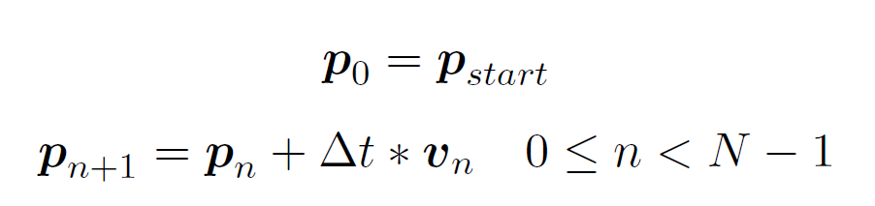
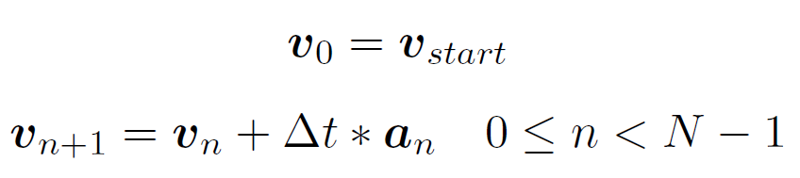
Time and UAV State
Based on work by Bellingham
Discretized time: N distinct time steps
UAV position, velocity, acceleration determined at each time step
John Saunders Bellingham. Coordination and control of uav fleets using mixed-integer linear programming.
PhD thesis, Massachusetts Institute of Technology, 2002.

Slide 10
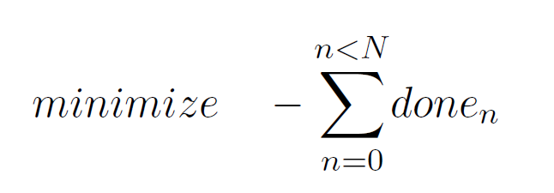


Objective Function
Objective function: minimize amount of time steps before goal is reached
UAV must reach the goal eventually
State Transition Axiom: Leslie Lamport. A simple approach to specifying concurrent systems.
Communications of the ACM, 32(1):32–45, 1989.

Slide 11
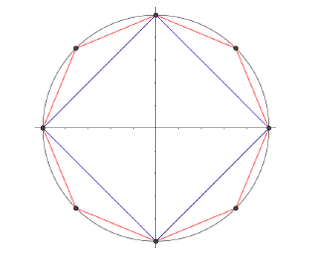
UAV State limits
Maximum velocity: limits 2-norm of velocity vector
→ Use linear approximation of 2-norm
John Saunders Bellingham.
Coordination and control of uav fleets using mixed-integer linear programming.
PhD thesis, Massachusetts Institute of Technology, 2002.

Slide 12
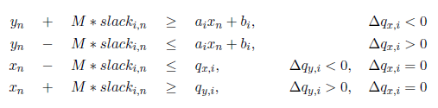

Obstacle Avoidance
Assume obstacles are stationary polygons, known in advance
Using Big M method:
Tom Schouwenaars, Bart De Moor, Eric Feron, and Jonathan How. Mixed integer programming for multi-vehicle path planning.
In Control Conference (ECC), 2001 European, pages 2603–2608. IEEE, 2001.

Slide 13
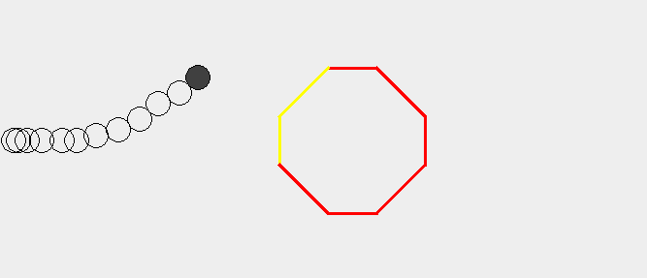

Slide 14


Slide 21
Scalability issues

Slide 22
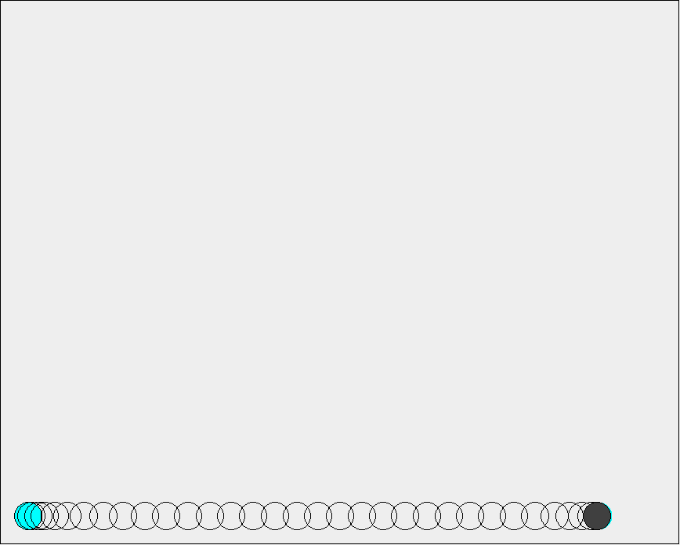
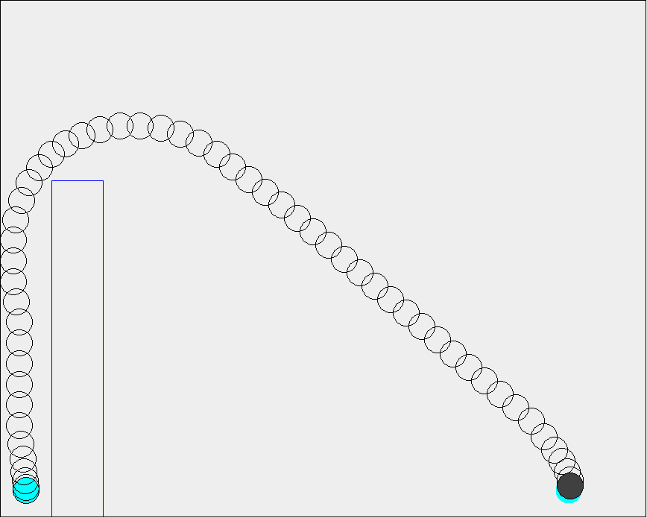
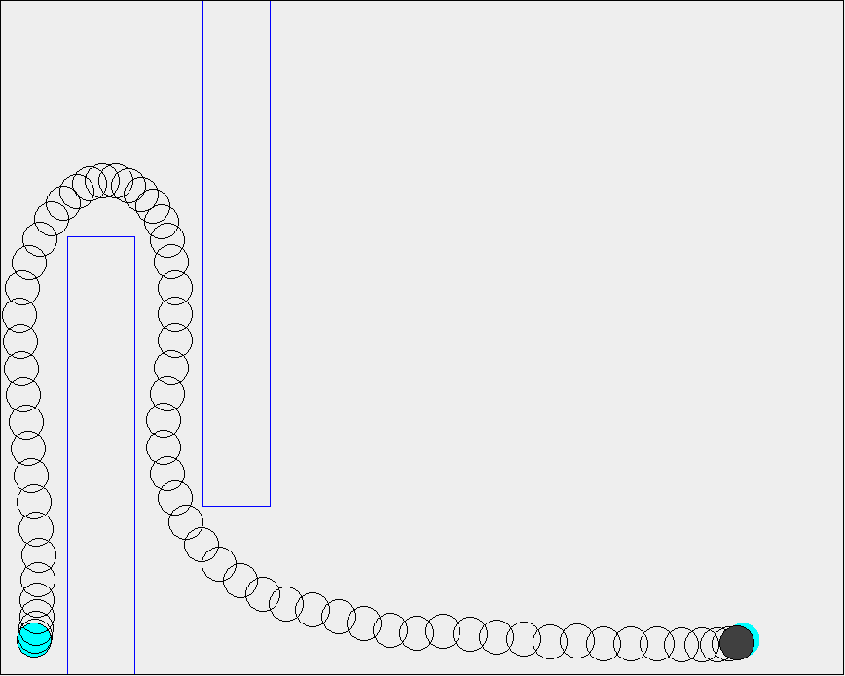
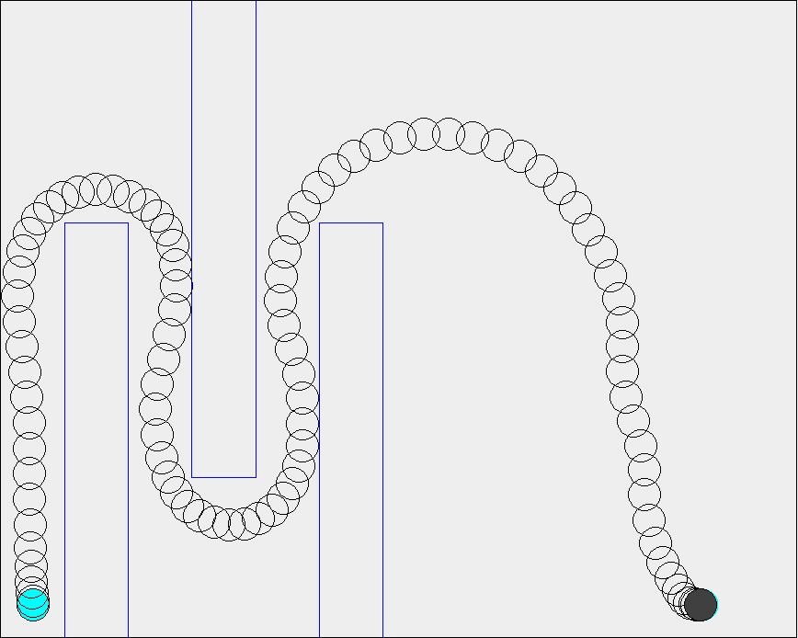
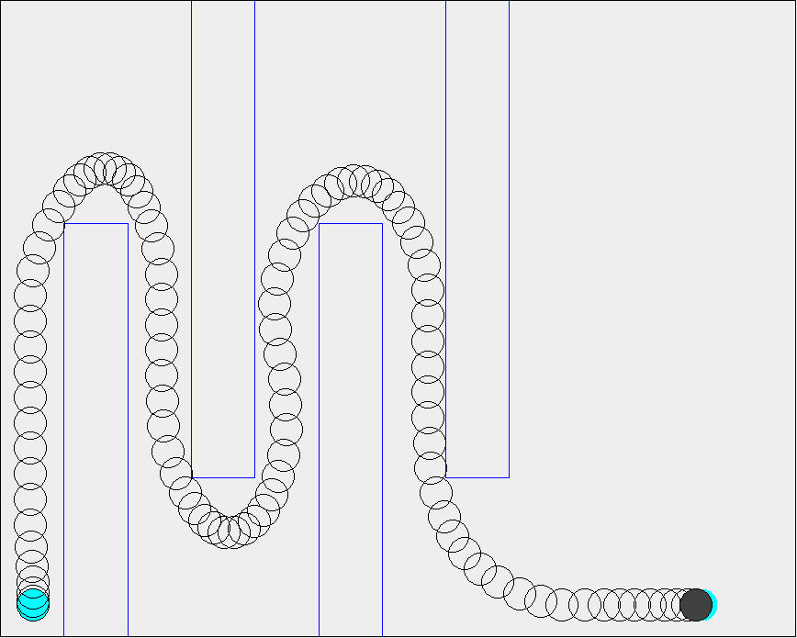
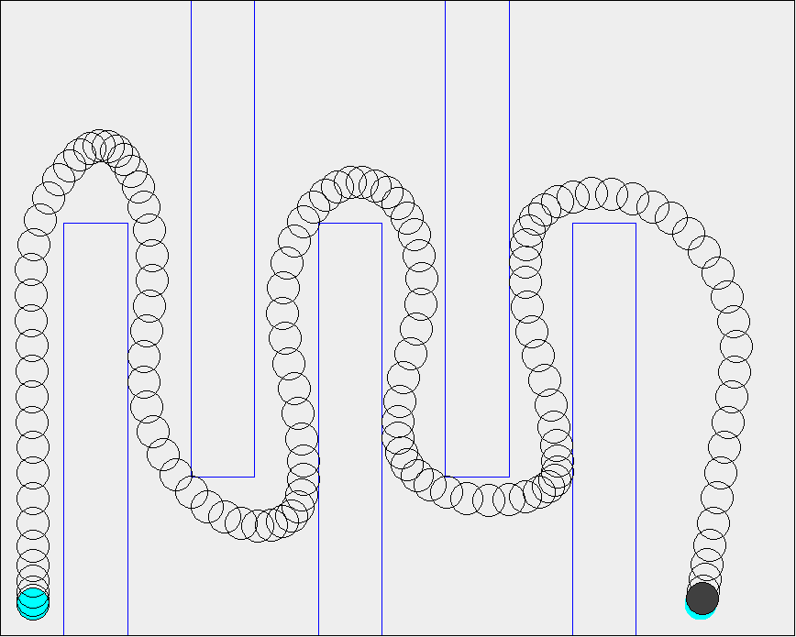
Test Scenarios

Slide 23
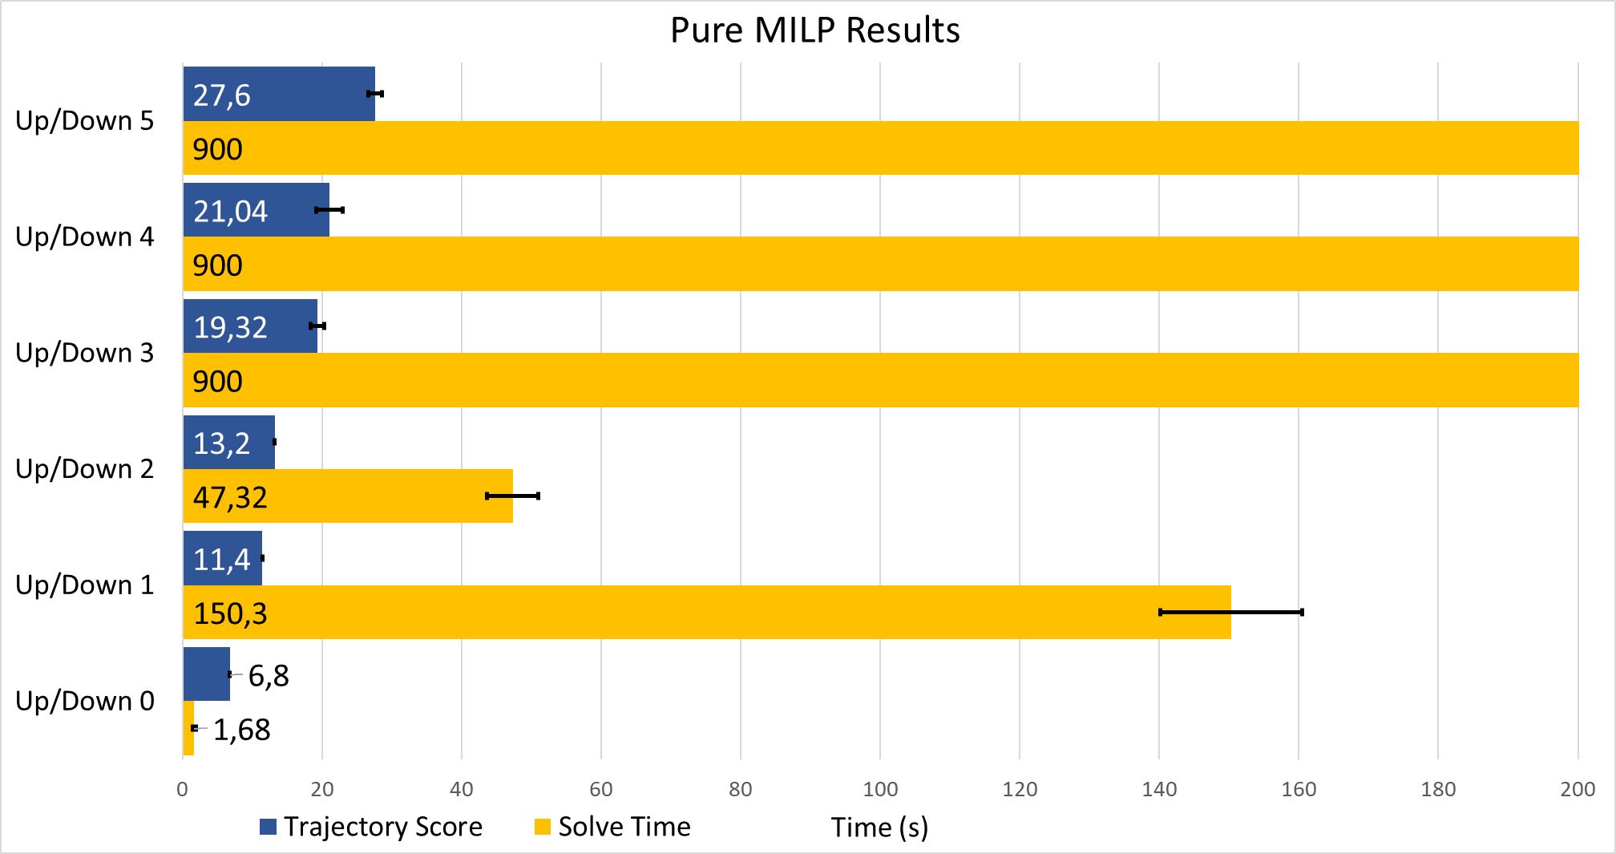
Pure MILP Performance Results
Dramatic increases in solve time as amount of obstacles increases
Starting at three obstacles: cannot find optimal trajectory in less than 900s

Slide 24
Segmentation of the MILP problem

Slide 25

Algorithm Approach
MILP: NP-Complete problem, $O(2^{n})$ for n oolean variables
Obstacles need Boolean variable for every edge for every time step
Many obstacles and/or many time steps cause bad performance
Goal of algorithm: reduce amount of obstacles and time steps
Divide trajectory planning problem into MILP subproblems: “segmentation”
Build trajectory gradually by solving subproblems in sequence
Tradeoff: Optimal trajectory will probably not be found

Slide 26
Algorithm Outline
Find Theta* path
Find turn events on Theta* path
Generate segments around turn events
Generate safe region for each segment and solve MILP subproblem sequentially
Combine sub-trajectories into final trajectory

Slide 27
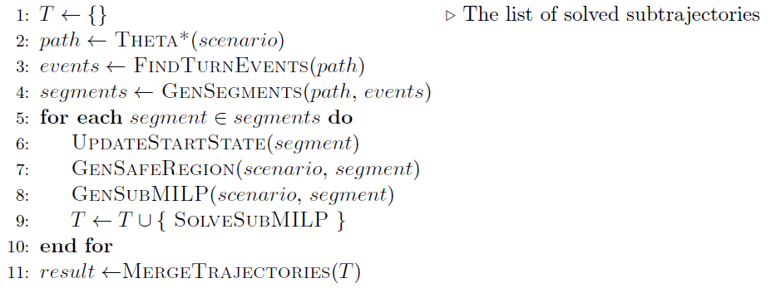
Algorithm Outline
Notes:
TODO: rewrite

Slide 28
Importance of Convexity
Integer variables determine worst case complexity
However: Solvers are smart, some problems can be solved much faster
Integer variables are needed to model non-convex search space
Working hypothesis: non-convexity of search space is “real” cause of poor performance
→ Focus on keeping search space as convex as possible, instead of minimizing integer variables

Slide 29
1) Finding The Initial Path
Theta* Extension of A* to allow path at any angle
Finds an initial path from start to goal position
Multirotor UAV can always reach goal by following this path exactly
Ensures a feasible trajectory can always be found
Initial path is used to find turn events, generate segments
Kenny Daniel, Alex Nash, Sven Koenig, and Ariel Felner. Theta*: Any-angle path planning on grids.
Journal of Artificial Intelligence Research, 39:533–579, 2010.

Slide 30
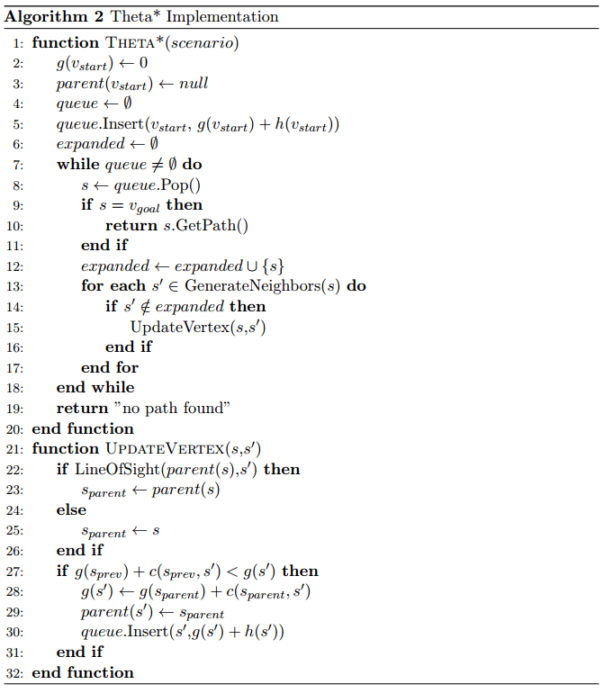
Theta* Algorithm

Slide 31
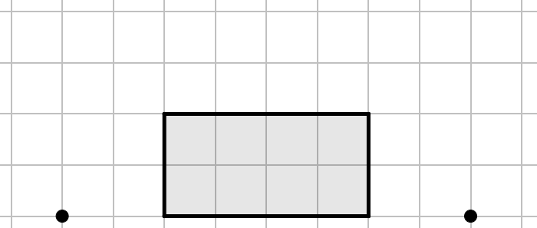
Theta* Demonstration
A
B

Slide 32
Theta* Demonstration
A
B

Slide 33
Theta* Demonstration
A
B

Slide 34
Theta* Demonstration
A
B

Slide 35
Theta* Demonstration
A
B

Slide 36
Theta* Demonstration
A
B

Slide 37
Theta* Demonstration
A
B

Slide 38
Theta* Demonstration
A
B

Slide 39
Theta* Demonstration
A
B

Slide 40
2) Detecting Turn Events
Segments are generated around turns in Theta* path for two reasons:
Safety/Stability
Allows for construction of segments such that UAV can always safely navigate turns
→ By starting segment well before the turn, the UAV can slow down in time
Performance
Turns show where non-convex parts of search space are
→ Max one turn per segment minimizes performance impact

Slide 41
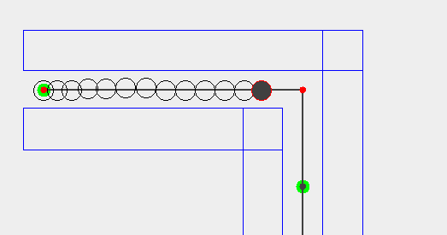
Safety/Stability

Slide 42
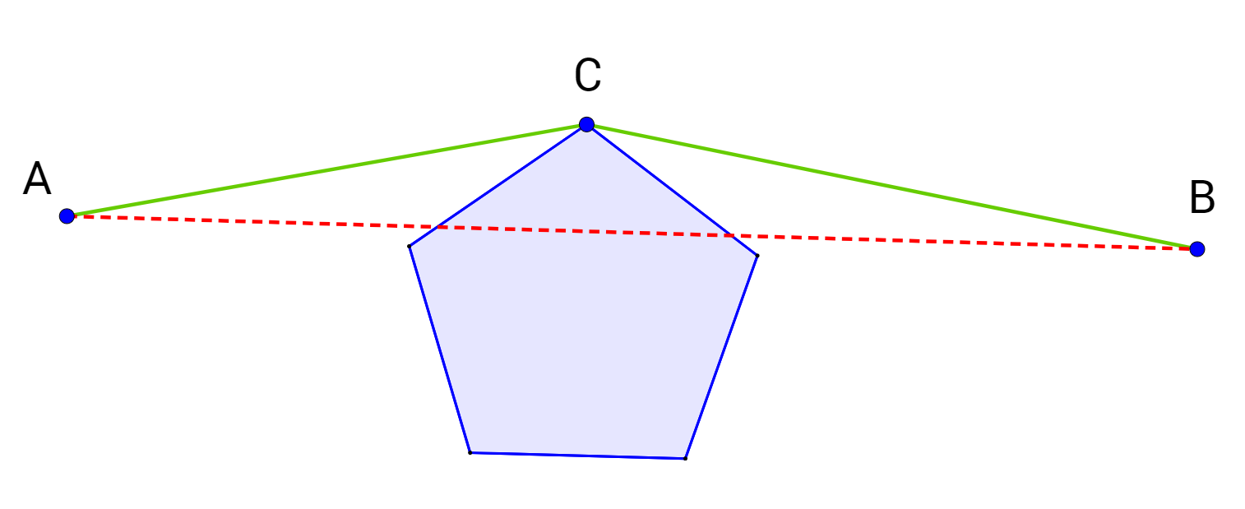
Performance
Theta*: Node on path “survives”
→ line of sight check failed
Obstacle on inside of turn
Line between two valid positions is not entirely in search space
Non-convex search space by definition
Turns are manifestations of non-convex search space
Goal: Keep search space as convex as possible in each segment
→ Minimize amount of turns in each segment (at most one)

Slide 43
Turn Events Algorithm
Sometimes: multiple nodes for single turn → group into turn events
Nodes in same turn event must:
turn in the same direction
be close enough to each other

Slide 44
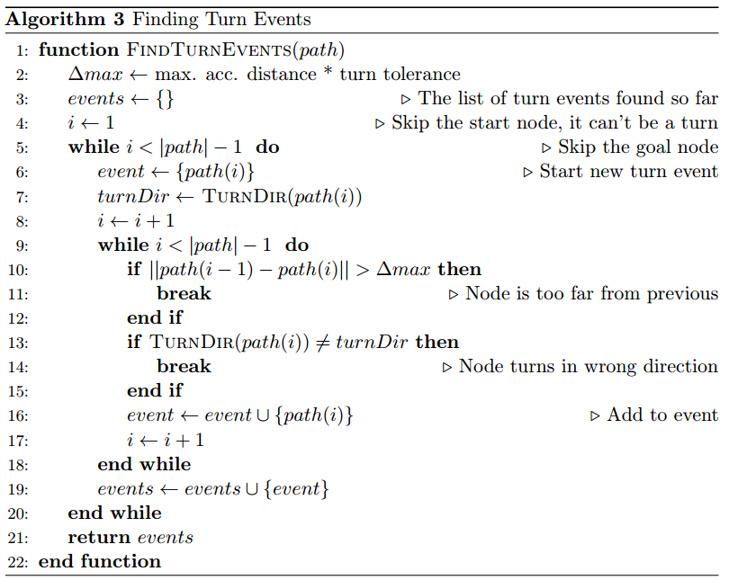
Turn Events Algorithm

Slide 45
Turn Events Demonstration
Start of new Turn Event:
Turns clockwise

Slide 46
Turn Events Demonstration
Next node:
Close enough
Turns clockwise
→ Add to current event

Slide 47
Turn Events Demonstration
Next node:
Too far away
Turns clockwise
→ Do not add to current event

Slide 48
Turn Events Demonstration
Start of new Turn Event:
Turns clockwise

Slide 49
Turn Events Demonstration
Next node:
Close enough
Turns counter-clockwise
→ Do not add to current event

Slide 50
Turn Events Demonstration
Start of new Turn Event:
Turns counter-clockwise

Slide 51
Turn Events Demonstration

Slide 52
3) Generating Segments
Segments should be as small as possible, while ensuring safety
→ Expand turn events outwards by using MAD
MAD: Maximum Acceleration Distance
If segment starts 1*MAD before the turn, the UAV can always stop
If segment starts even earlier: more room to maneuver
Should allow for a more efficient approach
Algorithm generates 1 segment per turn event
When turn events are far apart: generate straight segments between them

Slide 53
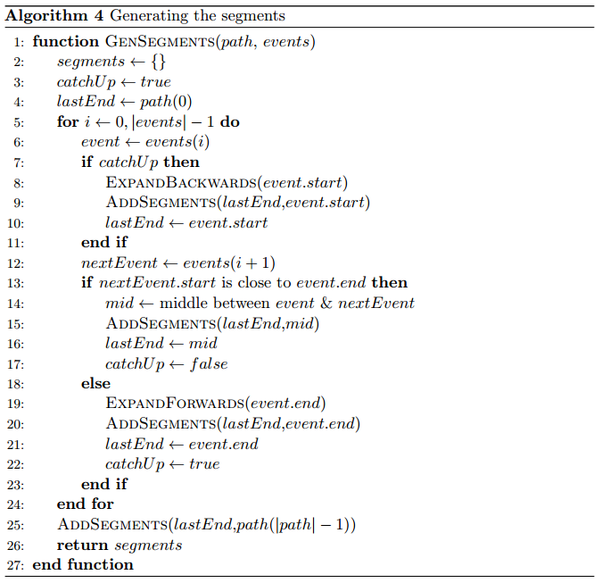
Segmentation Algorithm

Slide 54
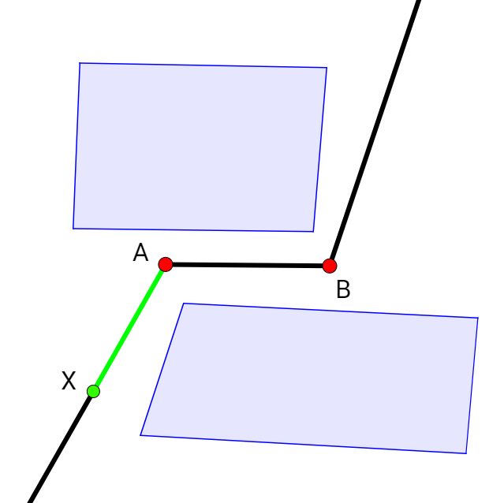
Segment Generation Demo

Slide 55
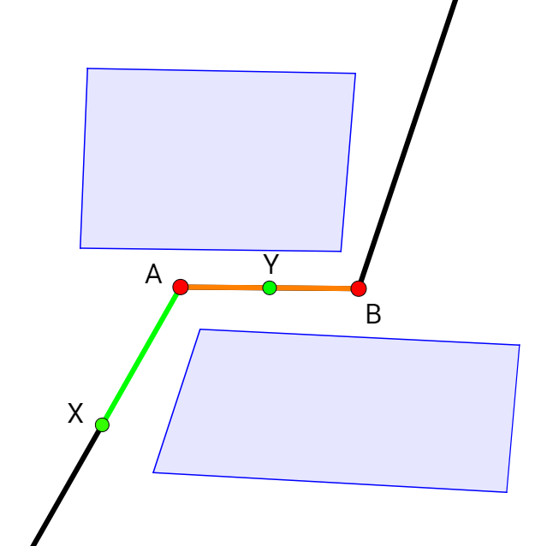
Segment Generation Demo

Slide 56
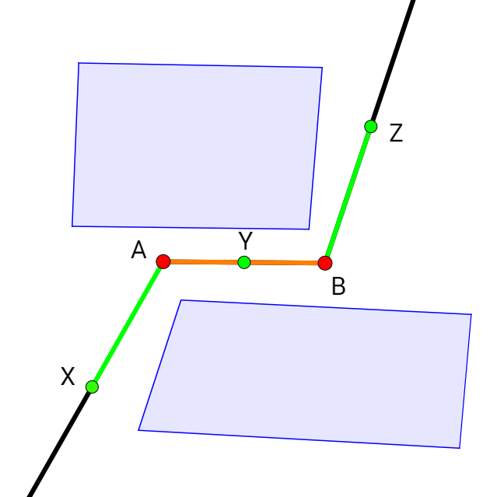
Segment Generation Demo

Slide 57
4) Generating the Safe Region
Not all obstacles need to be modelled in a segment
Reducing amount of obstacles improves performance
If segment has a turn: at least on obstacles prevent straight path from start to end of segment
Those obstacles make search space non-convex
The “important” obstacles
All other obstacles can be represented using convex constraints only
Concept of “Safe Region”

Slide 58
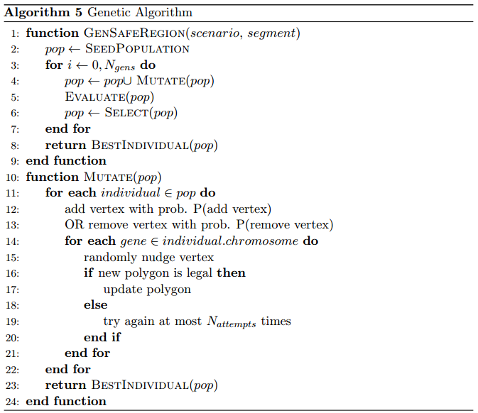
Genetic Algorithm Implementation

Slide 59
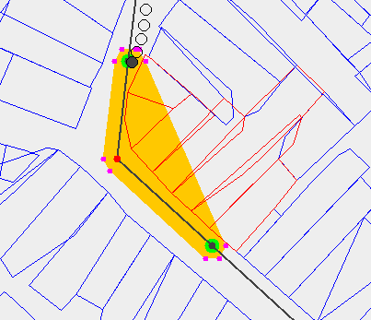
Initial Safe Region
Orange area: convex hull of nodes in segment
Red obstacles: overlap convex hull → make search space non-convex
These are selected to be modelled in MILP problem
If UAV stays inside orange safe regions and the selected obstacles are modelled: no collisions possible
Safe region is overly restrictive

Slide 60
Genetic Algorithm
Use genetic algorithm to grow safe region
Each individual has one chromosome with multiple genes
Each gene represents the position of a vertex of the safe region
Genetic Algorithm uses only one genetic operator:
Can add/remove vertices
Can “nudge” a vertex.
Tournament Selection is used, fitness function measures area of safe region

Slide 61
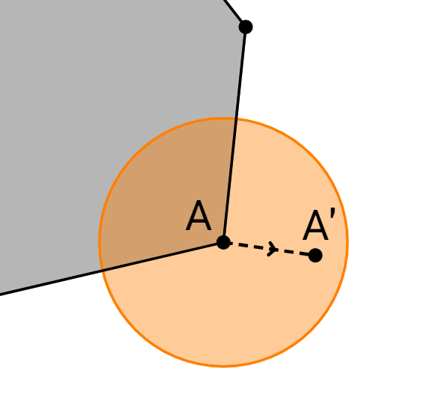
Nudge operation
Attempts to move a vertex from the safe region to a new, random position nearby
The safe region…
must stay convex
may not self-intersect
must contain initial safe region
may only overlap selected obstacles

Slide 62
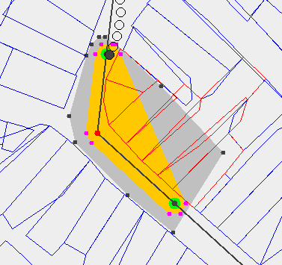
Expanded Safe Region
Still only overlaps red obstacles
UAV has more room to maneuver

Slide 63
Results

Slide 64
Testing Scenarios
Algorithm was tested on three categories of scenarios
Synthetic
Small, hand-made, obstacles laid out to be as challenging as possible
San Francisco
Uses real data, city grid with grid-aligned rectangles as obstacles
Leuven
Uses real data, dense and irregular layout of polygonal obstacles

Slide 65
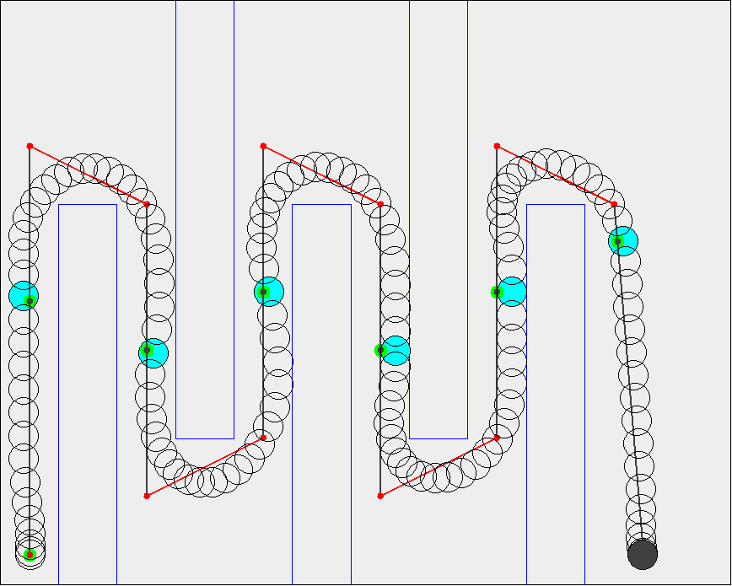
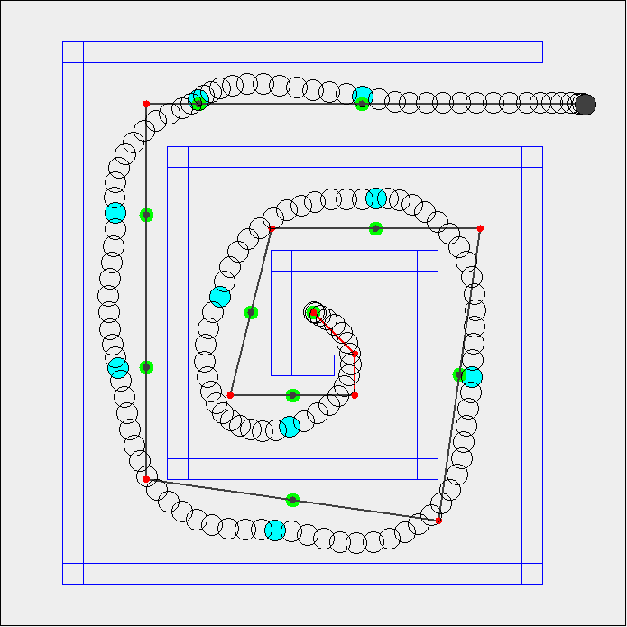
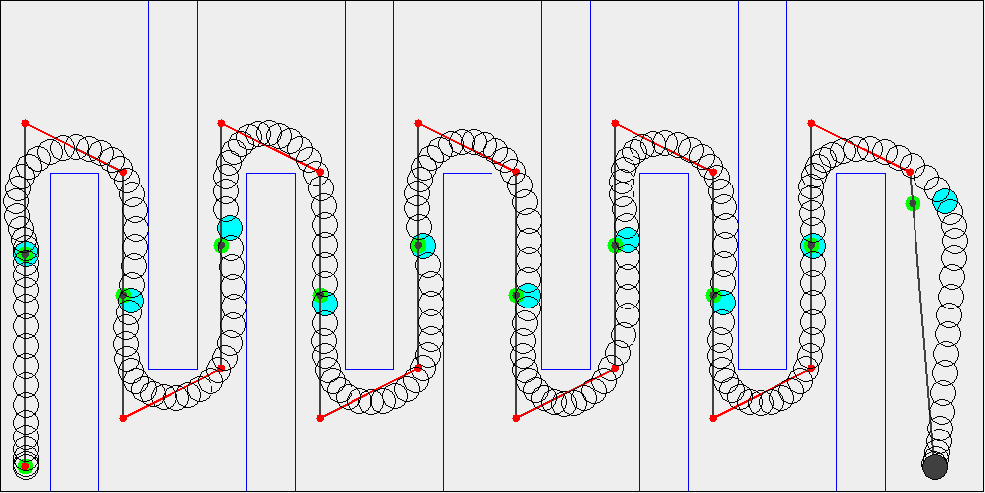
Synthetic Scenarios
Up/Down Small
Up/Down Large
Spiral

Slide 66
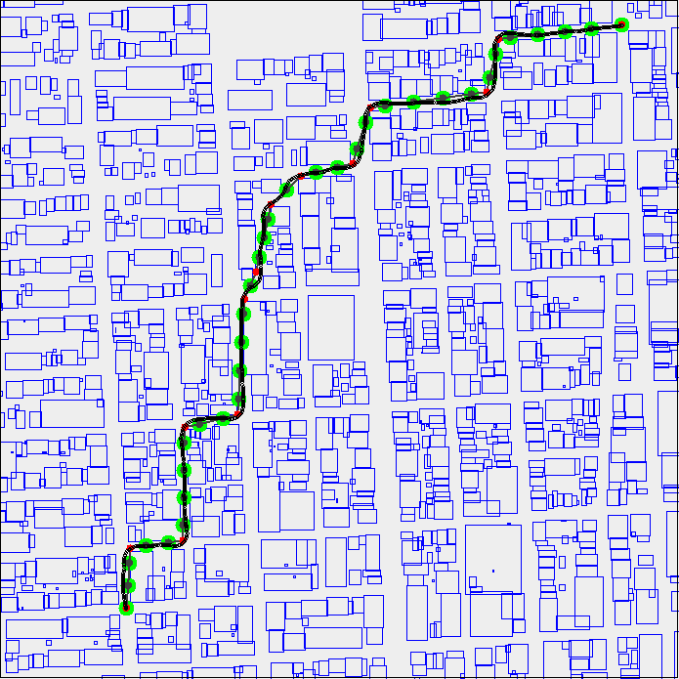
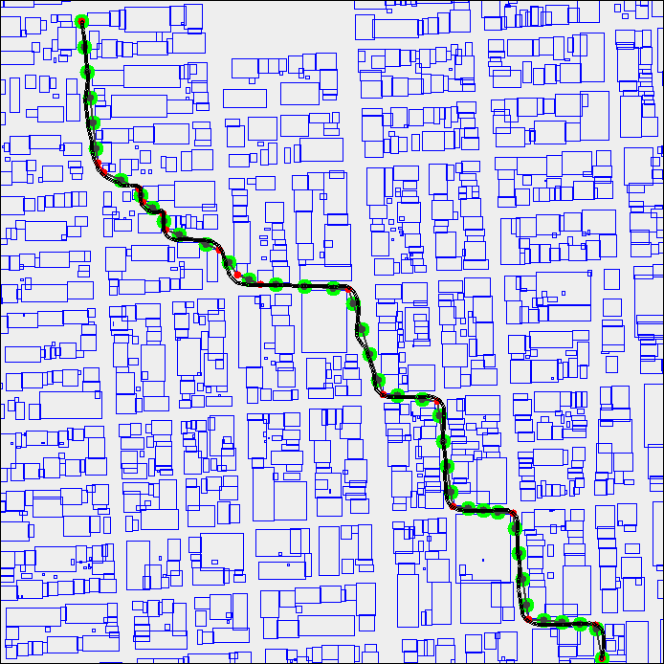
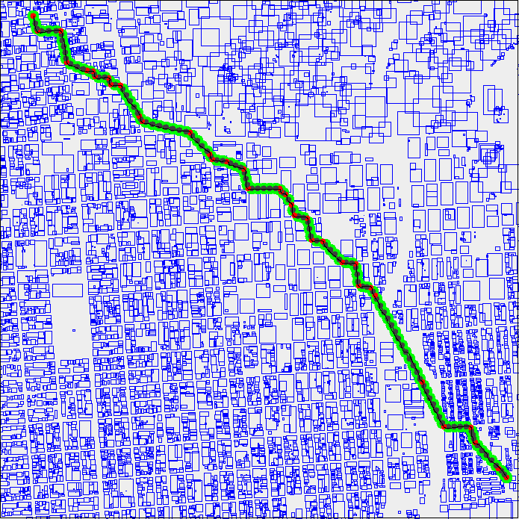
San Francisco Scenarios
San Francisco Small 1
San Francisco Small 2
San Francisco Large

Slide 67
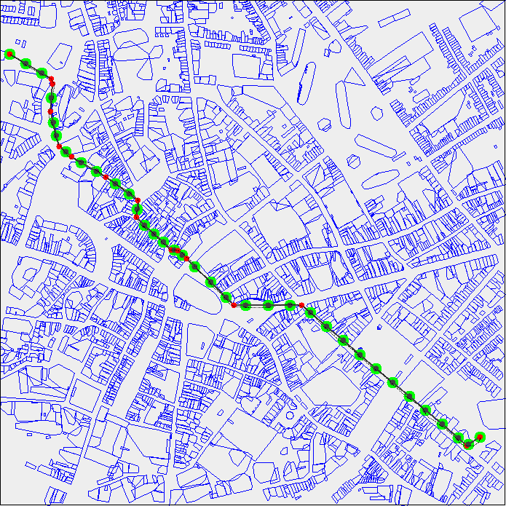
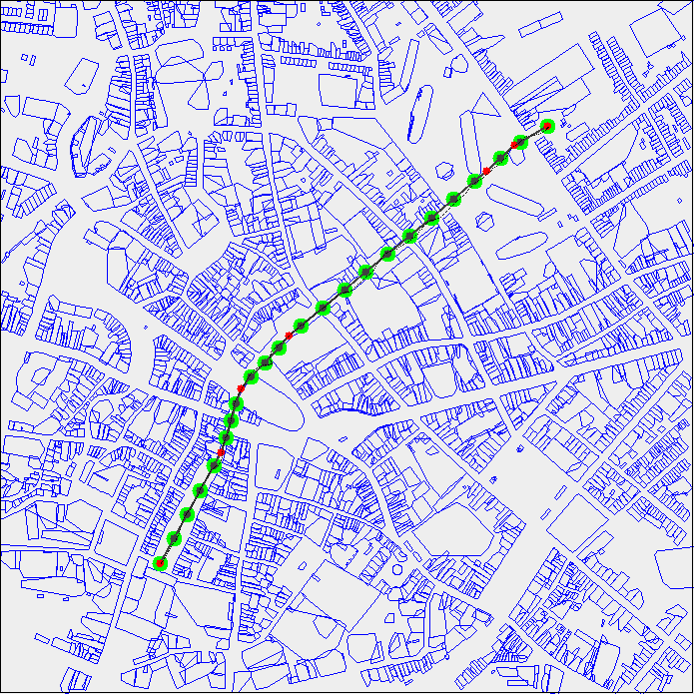
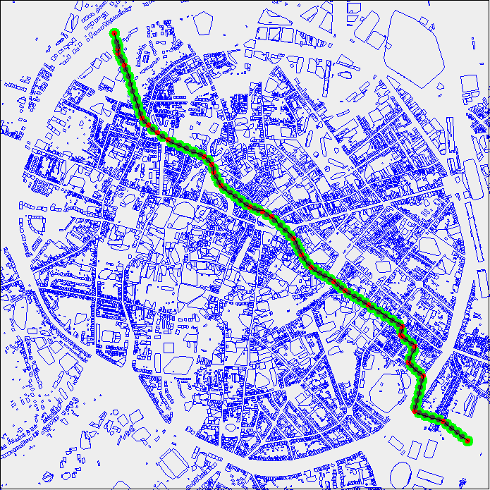
Leuven Scenarios
Leuven Small 1
Leuven Small 2
Leuven Large

Slide 68
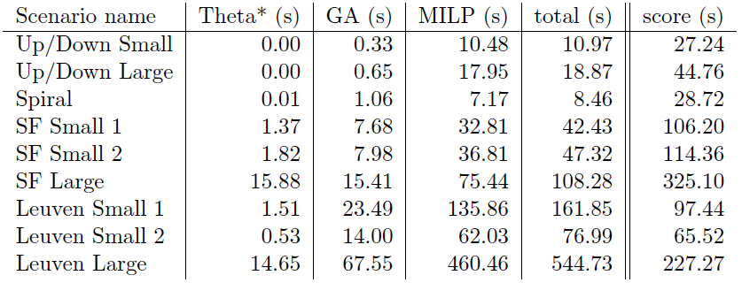
Total Performance results

Slide 69
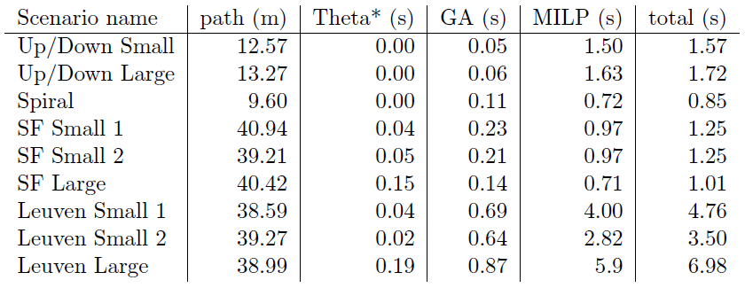
Performance per segment

Slide 70
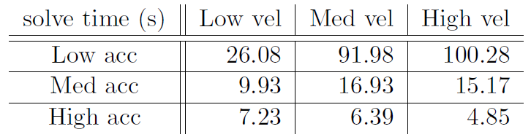
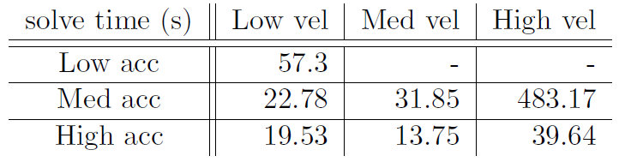
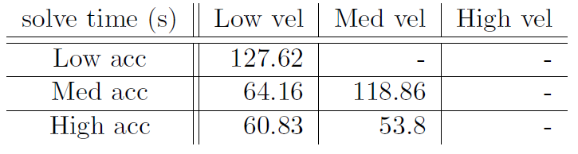
UAV Agility
Up/Down
San Francisco
Leuven

Slide 71
Performance discussion
MILP solve time scales linearly with path length
Theta* is still exponential, but much easier to solve
“routing” aspect separated from trajectory planning aspect
MILP solve time scales exponentially with obstacle density
Compared to total amount of obstacles for pure MILP
Leuven scenario: just barely possible, denser than necessary
Higher UAV agility reduces solve times
Algorithm assumes high agility of UAV
→ assumption only holds for multirotor UAV

Slide 72
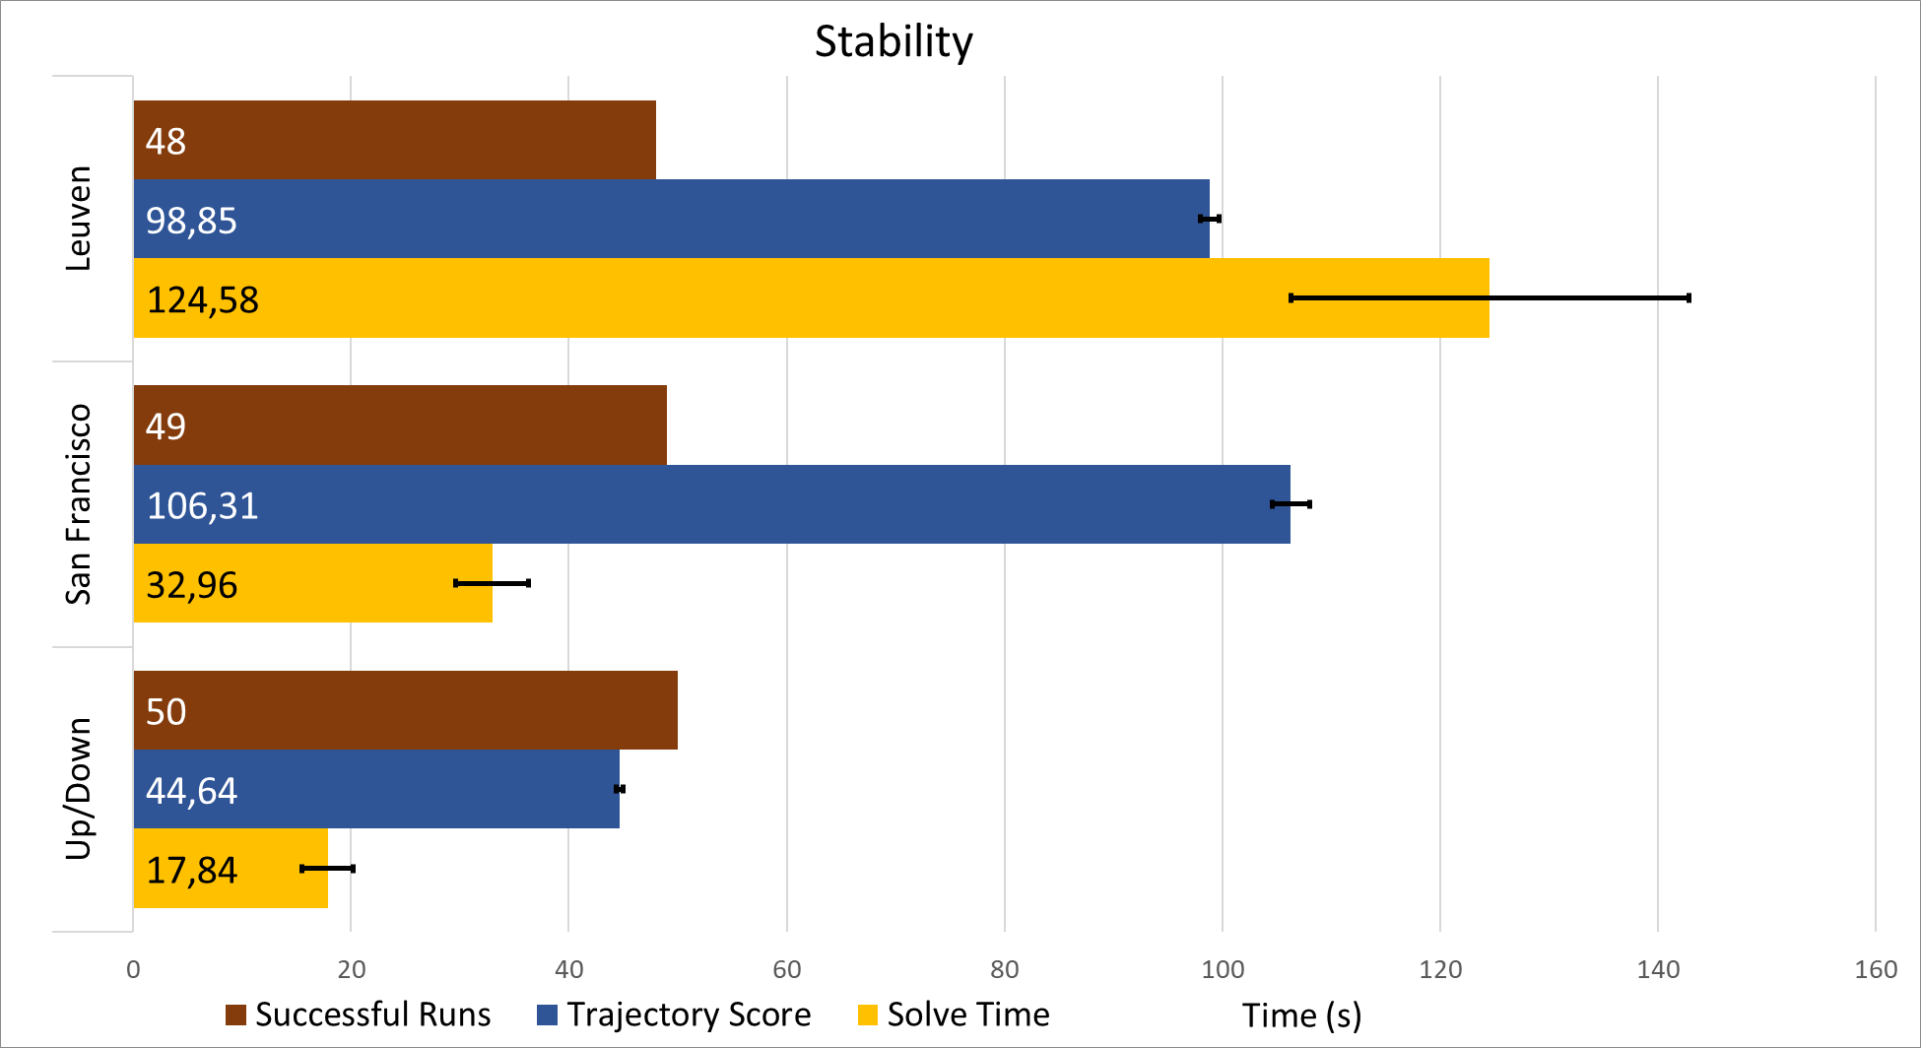
Stability

Slide 73
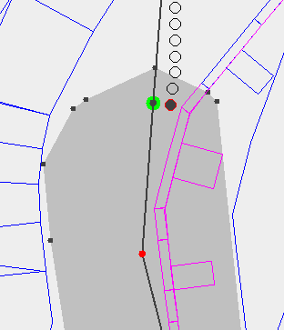
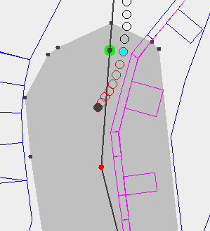
Stability Issues

Slide 74
Stability discussion
Algorithm is mostly stable
Sometimes transition between segments fails… bug, bad assumption ??
Should be possible to fix edge cases where it fails
When trajectory is found: very similar between runs
Theta* is deterministic → trajectory always roughly the same path
Execution time varies by 10-15% between runs

Slide 75
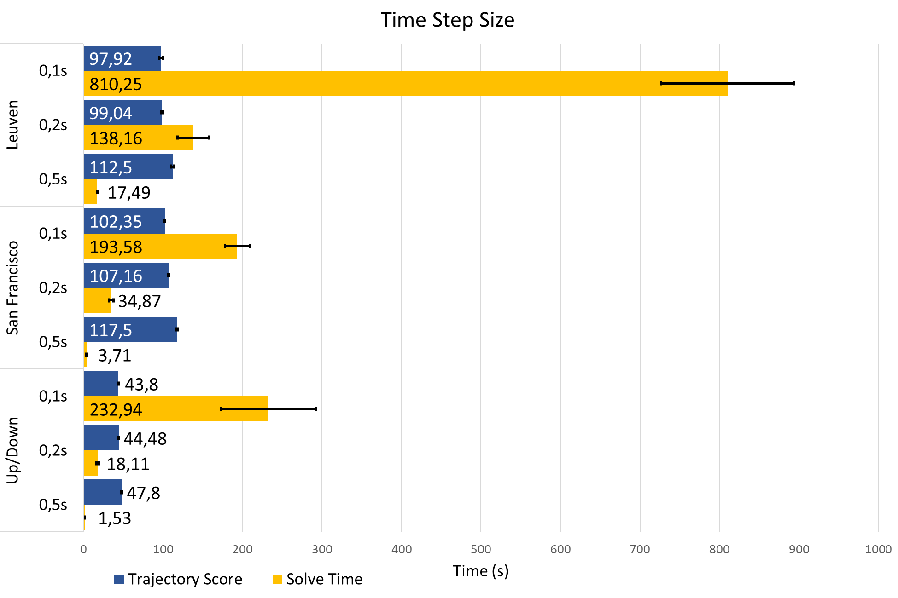
Time Step Size

Slide 76
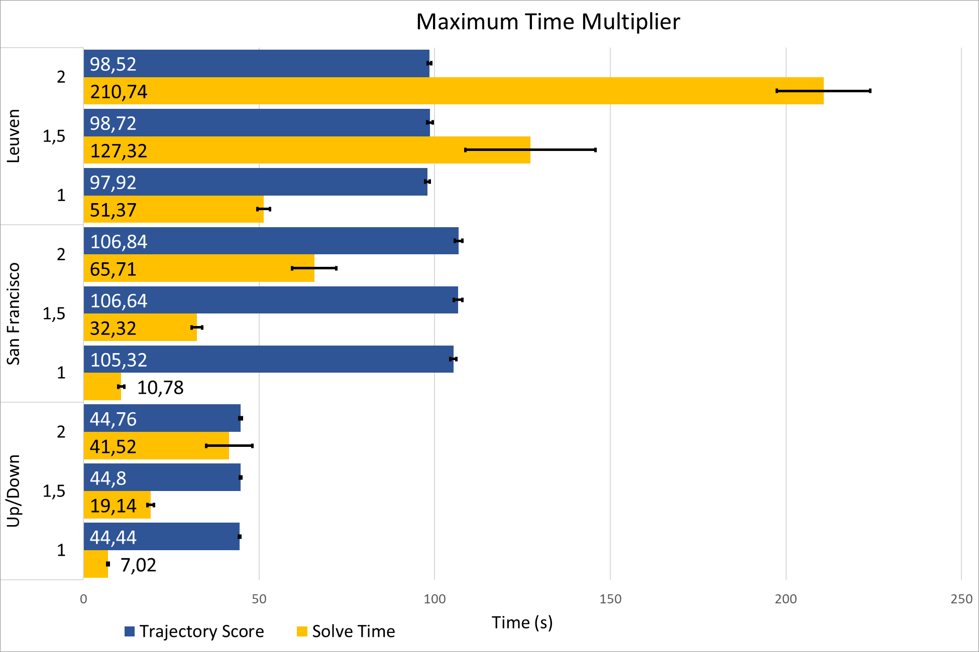
Maximum Time

Slide 77
Important parameters: Time Step Size & Maximum Time
Dramatic effect on performance
Coarser time step size can be solved much faster
Solve rough trajectory first to gather info to solve fine trajectory faster?
Quick test: Pre-solve with 0,5s time step to estimate maximum time: 3x faster total solve time
Should be explored further!
Use rough trajectory to find important edges?
Use rough trajectory to improve transitions between segments?
…

Slide 78
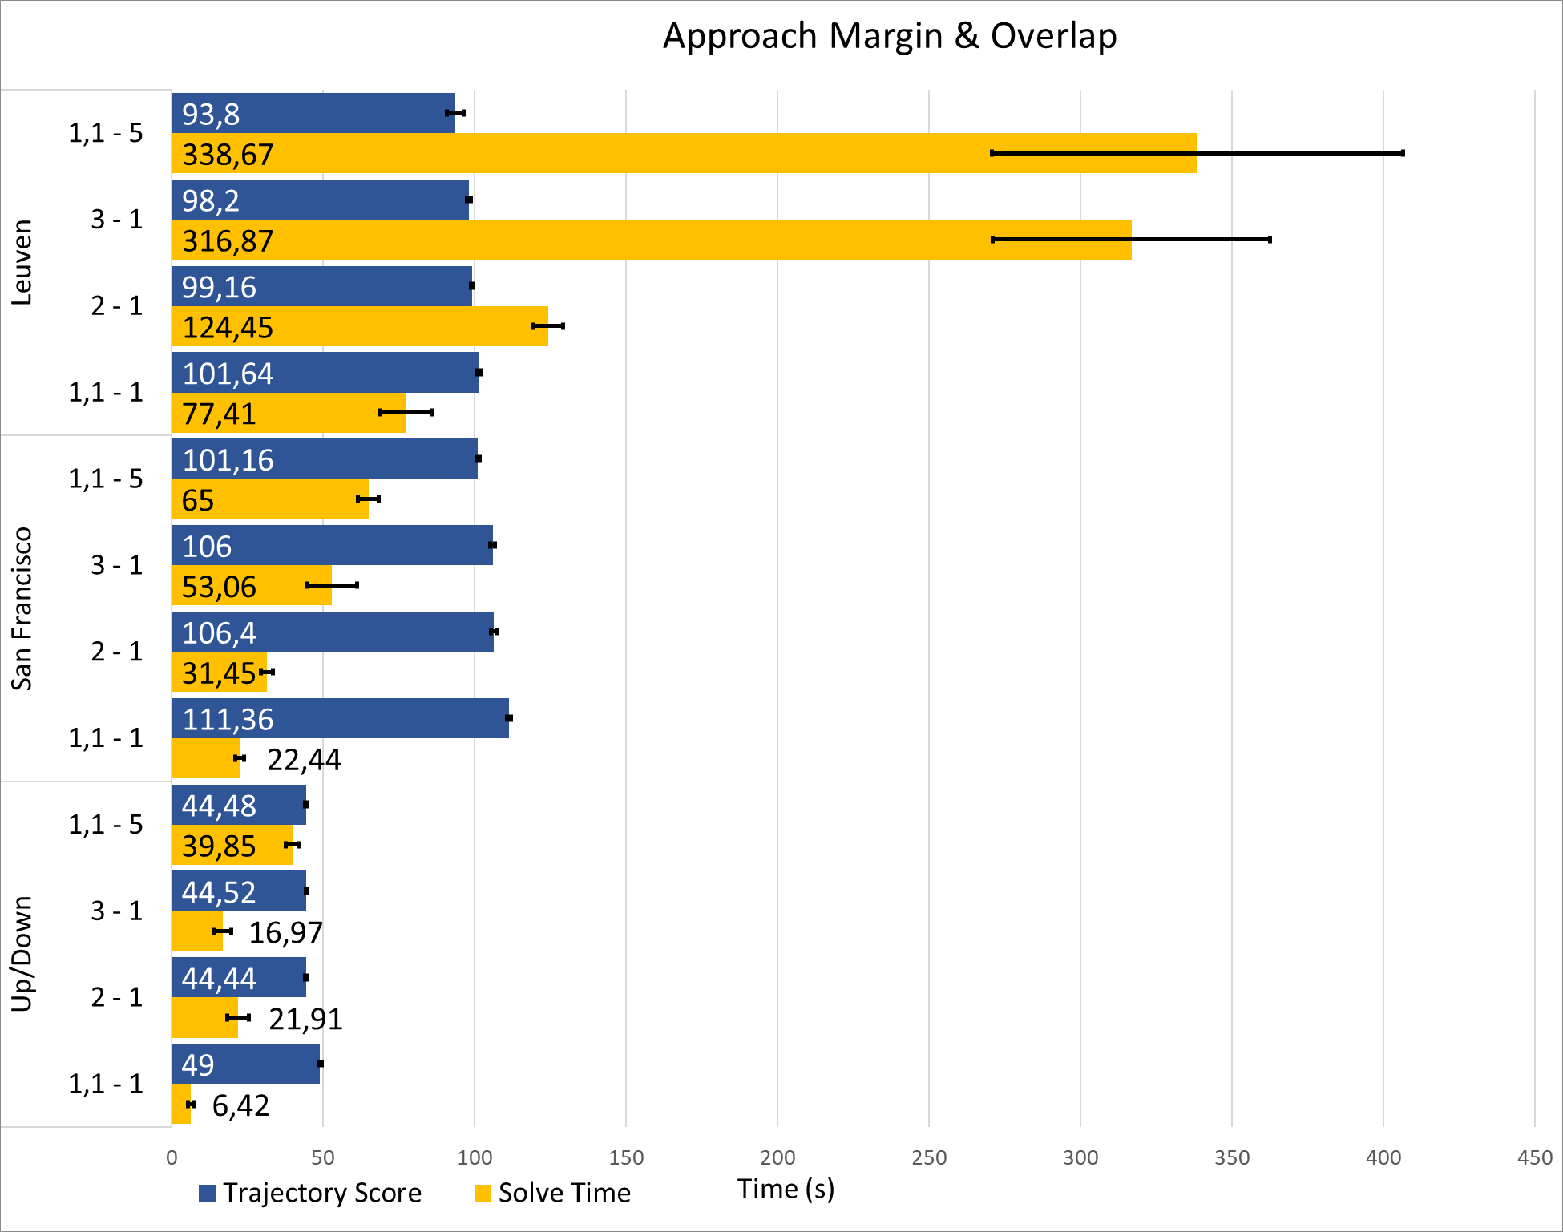
Approach Margin and Overlap

Slide 79
Important parameters: Approach Margin
Some approach margin is beneficial. Larger margin: small gains
Overlapping segments:
Significantly better trajectory
Large performance penalty
Original idea: larger approach margin → more efficient trajectory
Seems to be wrong. Overlapping works much better
Should be explored further!
Why does a small overlap cause a large performance penalty?
How can this performance penalty be minimized?
Is there a better way to generate segments?

Slide 80
Safe Region Generation
Genetic Algorithm was not thoroughly tested
Works well enough to not be the limiting part of the algorithm
However: probably not the best way to solve the problem
Improvements/alternatives should be explored…

Slide 81
Conclusions

Slide 82
Reflection
Goal of thesis: Build a UAV trajectory planning algorithm that scales to large and complex environments
This goal has been reached
Some weaknesses remain (segment transition bug)
Algorithm presented is just a first iteration
experiments show several ways the algorithm could be improved
Principles used in algorithm may be applied in other algorithms

Slide 83
Future work
Explore leads from experiments
Extend algorithm to 3D
Try Mixed-Integer Quadratic Programming so 2-norm can be modelled directly. Performance penalty or improvement?
Make complimentary online/realtime algorithm
Necessary to use algorithm on actual physical UAV
Further performance improvements may allow for online long-term planning?

Slide 84
Demo

Slide 85
Questions?

