Slide 1
Scalable Multirotor UAV Trajectory Planning using Mixed-Integer Linear Programming
Master’s Thesis defense
Jorik De Waen

Slide 2
Problem Statement (1)
Online/Realtime <-> Offline
Trajectory speed <-> Performance
UAV Trajectory Planning
Flexibility?
Short Term <-> Long Term
2D <-> 3D
Fixed Wing <-> Multirotor <-> General Vehicle
Known <-> Unknown Environment
Notes:
UAV Trajectory planning -> Many options
Online, short term planning well explored
Accurate, offline, long term planning poorly explored for multirotor UAVs
Optimality not required, wish to make it as flexible as possible
Known environments to limit scope

Slide 3
Problem Statement (2)
Decision: use Mixed-Integer Linear Programming (MILP)
Advantages
UAV properties and movement can be modelled accurately
Solver finds optimal solution to problem
Constraint programming: flexible by design
Main Disadvantage
Performance!!!

Slide 4
Alternative approaches
Trajectory Speed <-> Performance: main differentiator
Modified Pathplanning algorithms
extended with kinematic constraints, post-smoothing, etc
No (or limited) use of UAV constraints → conservative and slow trajectory
No flexibility
Randomized approaches
Rapidly-Exploring Random Trees, Probabilistic Roadmaps
Take UAV dynamics into account
Random factor adds artifacts
TODO!!

Slide 5
MILP Trajectory Planning

Slide 6
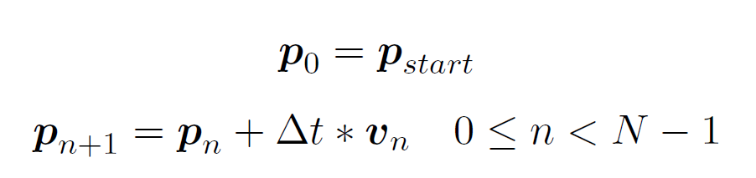
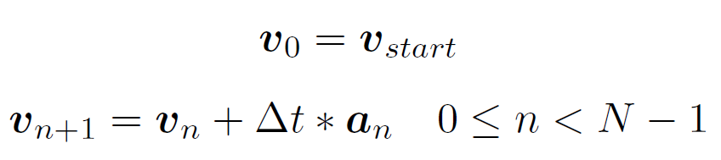
Time and UAV State
Based on work by Bellingham TODO: cite everywhere!
Discretized time: N distinct time steps
UAV position, velocity, acceleration determined at each time step
John Saunders Bellingham. Coordination and control of uav fleets using mixed-integer linear programming.
PhD thesis, Massachusetts Institute of Technology, 2002.

Slide 7
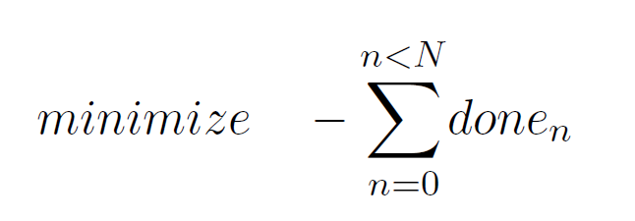


Objective Function
Objective function: minimize amount of time steps before goal is reached
UAV must reach the goal eventually
State Transition Axiom: Leslie Lamport. A simple approach to specifying concurrent systems.
Communications of the ACM, 32(1):32–45, 1989.

Slide 8
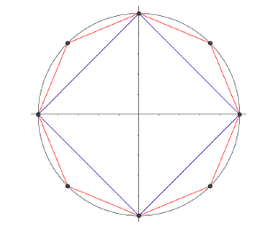
UAV State limits
Maximum velocity: limits 2-norm of velocity vector
→ Use linear approximation of 2-norm
John Saunders Bellingham. Coordination and control of uav fleets using mixed-integer linear programming.
PhD thesis, Massachusetts Institute of Technology, 2002.

Slide 9
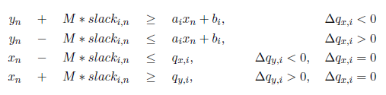

Obstacle Avoidance
Assume obstacles are stationary polygons, known in advance
Using Big M method:
Tom Schouwenaars, Bart De Moor, Eric Feron, and Jonathan How. Mixed integer programming for multi-vehicle path planning.
In Control Conference (ECC), 2001 European, pages 2603–2608. IEEE, 2001.

Slide 10
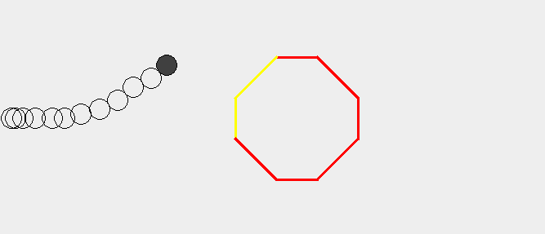

Slide 18
Scalability issues

Slide 19
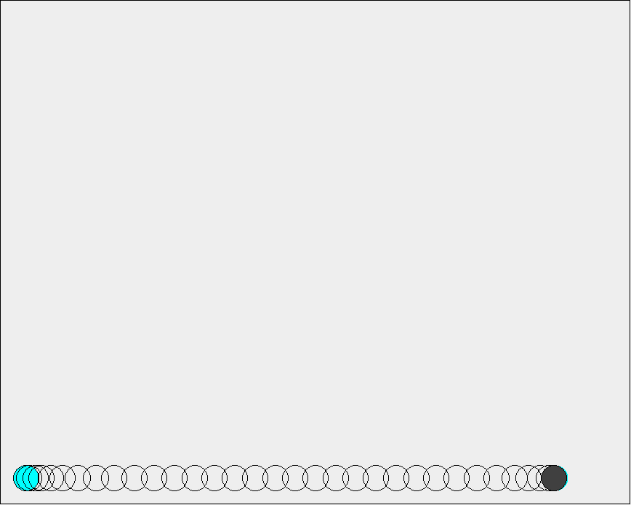
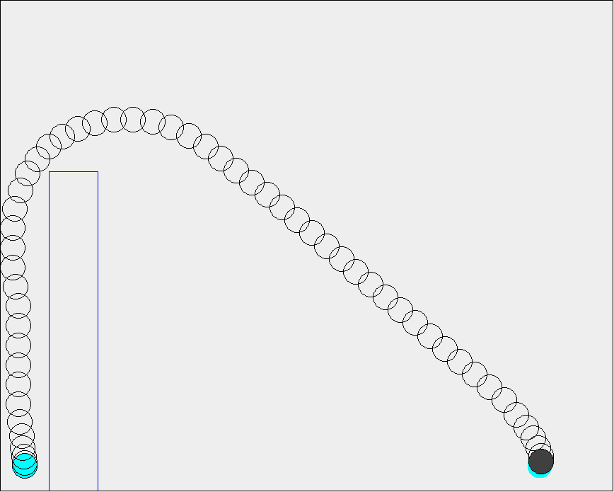
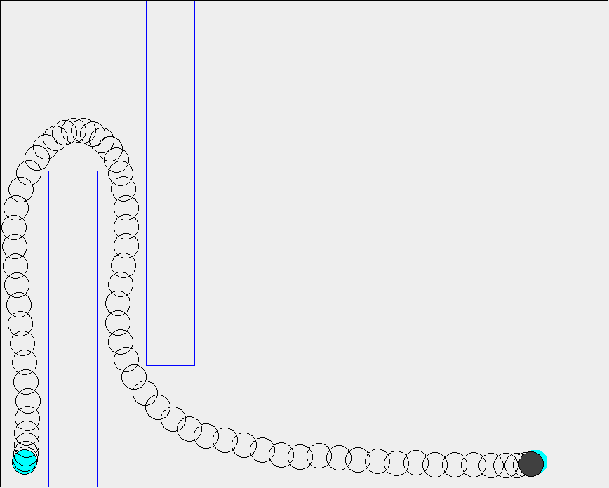
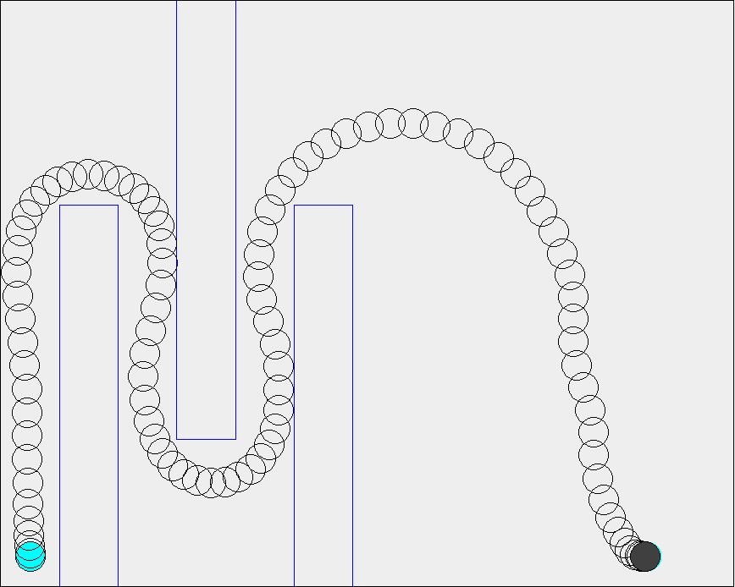
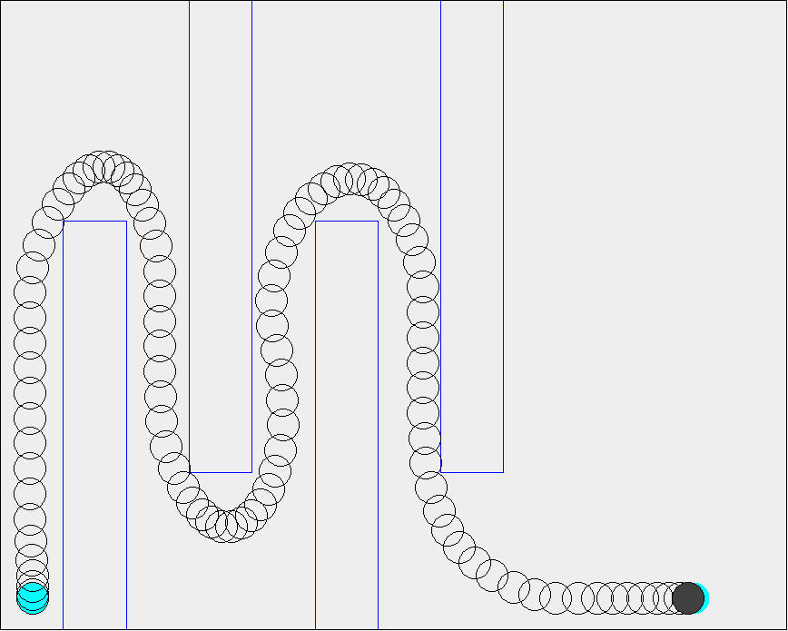
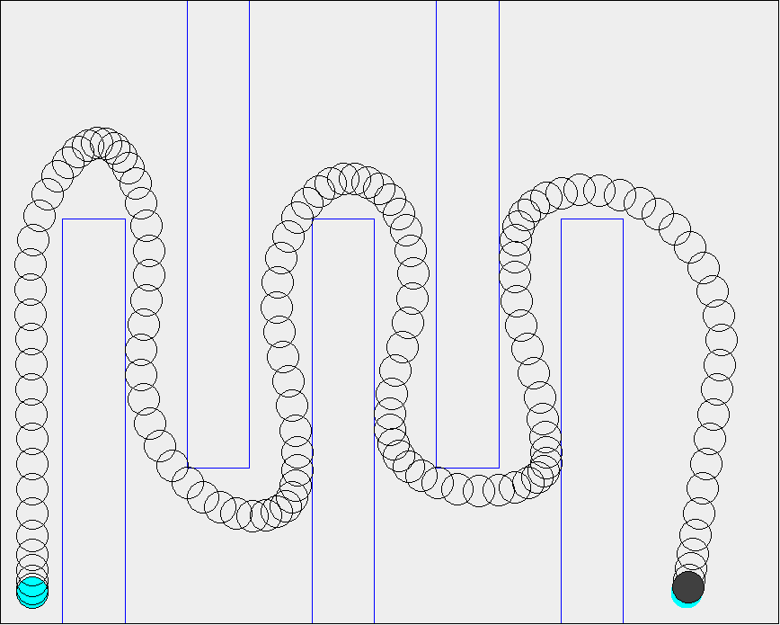
Scenarios

Slide 20
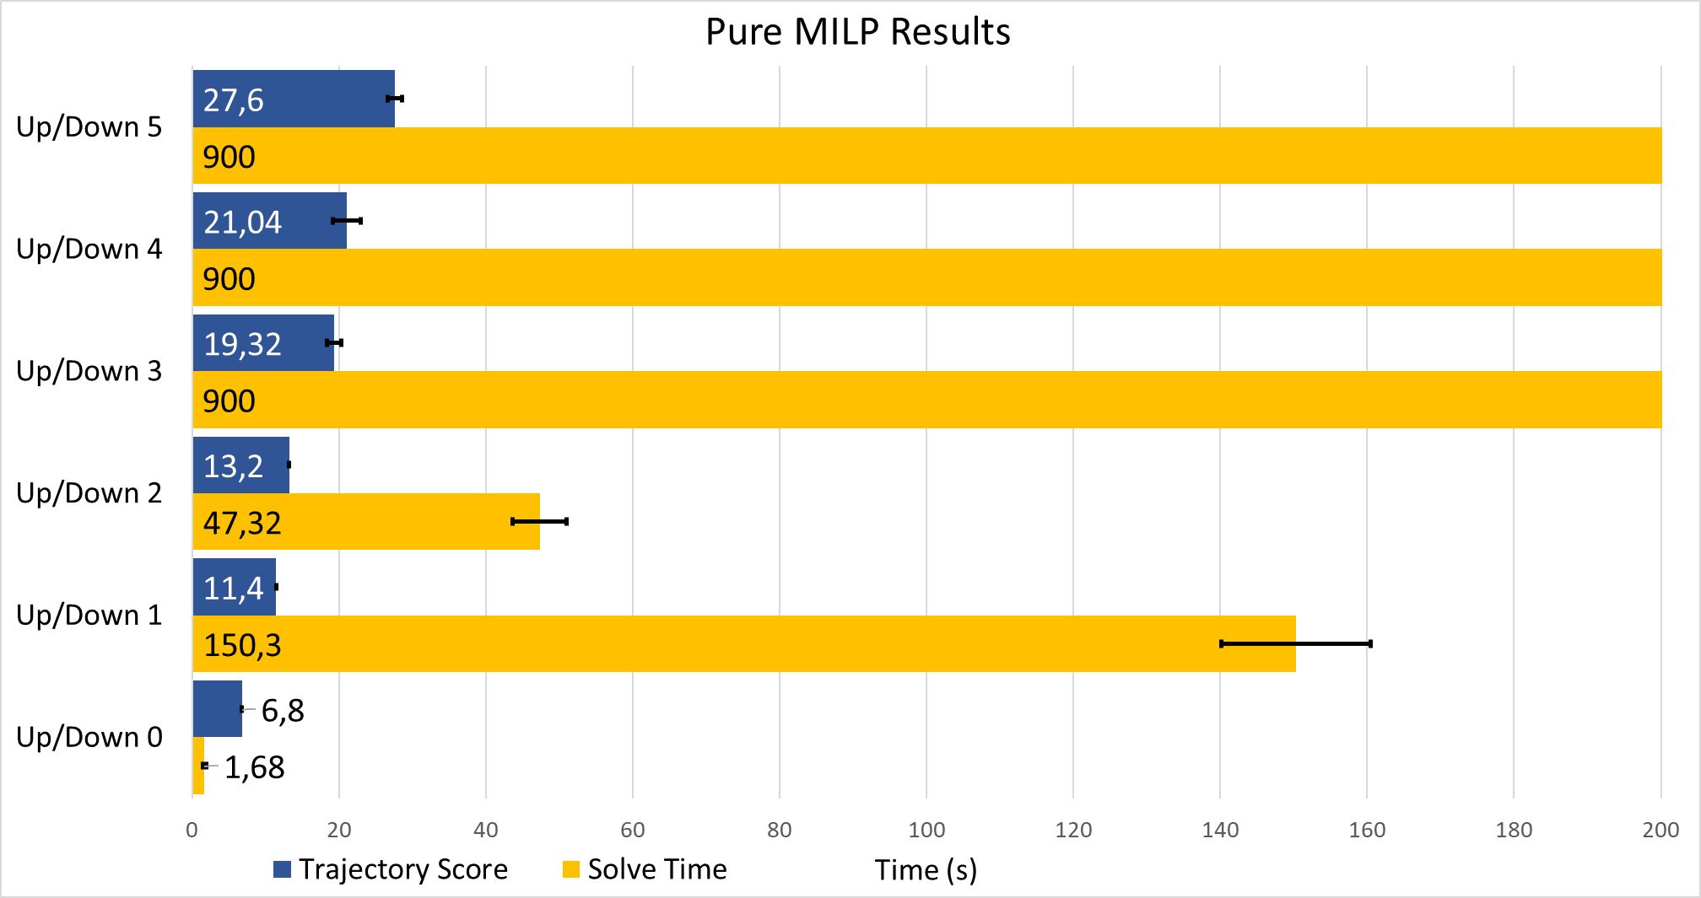
Pure MILP Performance Results

Slide 21
Segmentation of the MILP problem

Slide 22
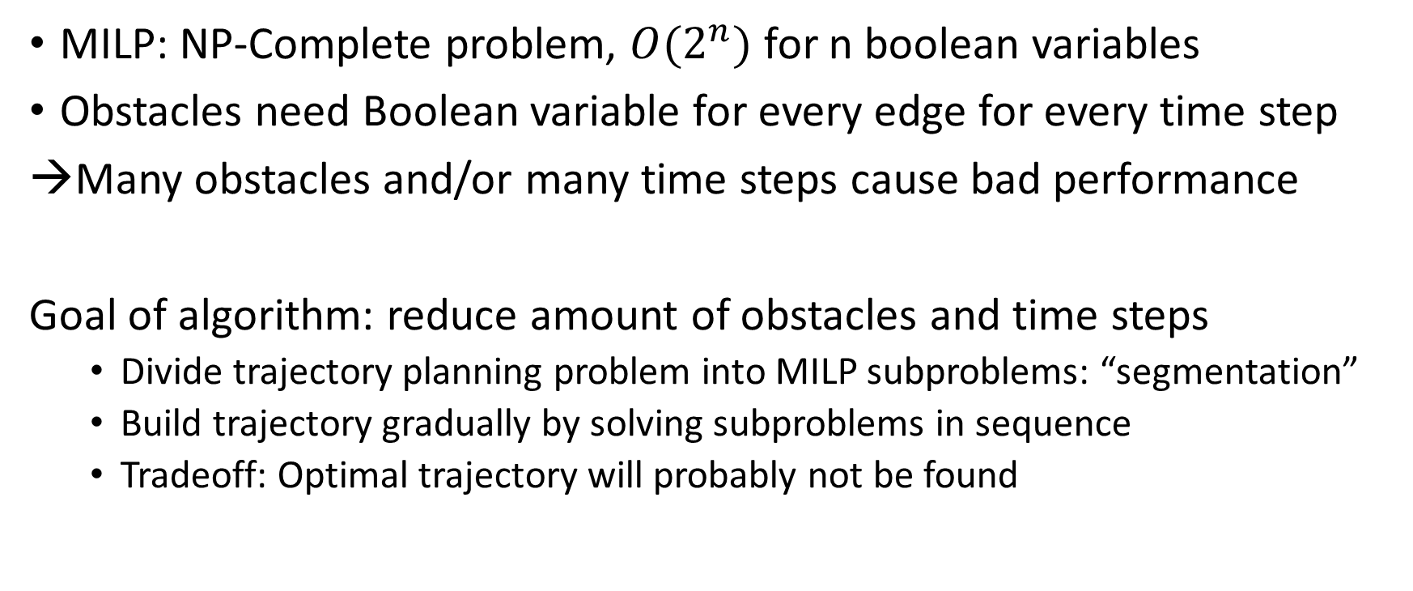
Algorithm Approach
MILP: NP-Complete problem, $O(2^{n})$ for n boolean variables
Obstacles need Boolean variable for every edge for every time step
Many obstacles and/or many time steps cause bad performance
Goal of algorithm: reduce amount of obstacles and time steps
Divide trajectory planning problem into MILP subproblems: “segmentation”
Build trajectory gradually by solving subproblems in sequence
Tradeoff: Optimal trajectory will probably not be found

Slide 23
Algorithm Outline
Find Theta* path
Find turn events on Theta* path
Generate segments around turn events
Generate safe region for each segment and solve MILP subproblem sequentially
Combine sub-trajectories into final trajectory

Slide 24
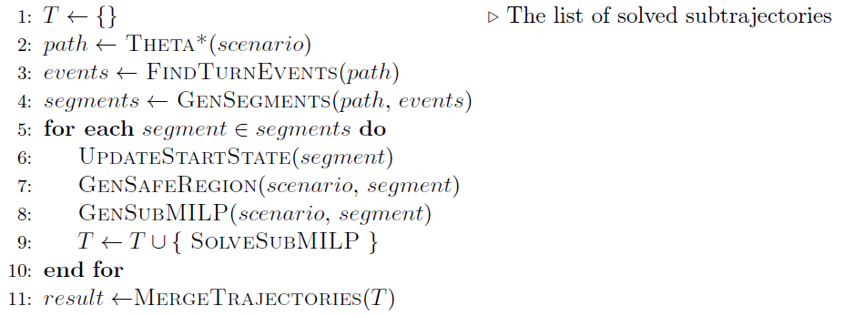
Algorithm Outline
Notes:
TODO: rewrite

Slide 25
Importance of Convexity
Integer variables determine worst case complexity
However: Solvers are smart, some problems can be solved much faster
Integer variables are needed to model non-convex search space
Working hypothesis: non-convexity of search space is “real” cause of poor performance
→ Focus on keeping search space as convex as possible, instead of minimizing integer variables

Slide 26
1) Theta*
Extension of A* to allow path at any angle
Finds an initial path from start to goal position
Multirotor UAV can always reach goal by following this path exactly
Ensures a feasible trajectory can always be found
Initial path is used to find turn events, generate segments
Kenny Daniel, Alex Nash, Sven Koenig, and Ariel Felner. Theta*: Any-angle path planning on grids.
Journal of Artificial Intelligence Research, 39:533–579, 2010.

Slide 27
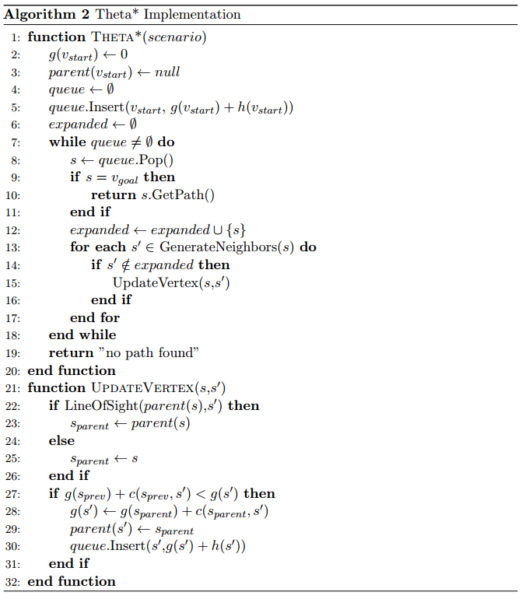
Theta* Algorithm

Slide 28
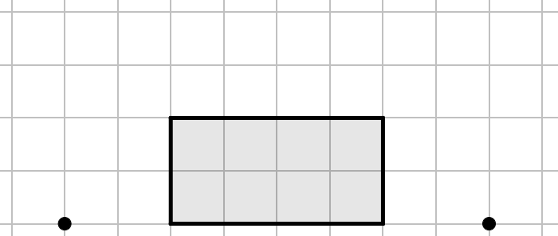
Theta* Demonstration
A
B

Slide 29
Theta* Demonstration
A
B

Slide 30
Theta* Demonstration
A
B

Slide 31
Theta* Demonstration
A
B

Slide 32
Theta* Demonstration
A
B

Slide 33
Theta* Demonstration
A
B

Slide 34
Theta* Demonstration
A
B

Slide 35
Theta* Demonstration
A
B

Slide 36
Theta* Demonstration
A
B

Slide 37
2) Detecting Turn Events
Segments are generated around turns in Theta* path for two reasons:
Safety/Stability
Allows for construction of segments such that UAV can always safely navigate turns
→ By starting segment well before the turn, the UAV can slow down in time
Performance
Turns show where non-convex parts of search space are
→ Max one turn per segment minimizes performance impact

Slide 38
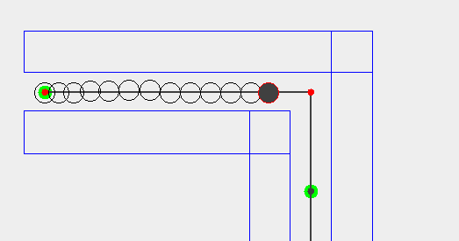
Safety/Stability

Slide 39
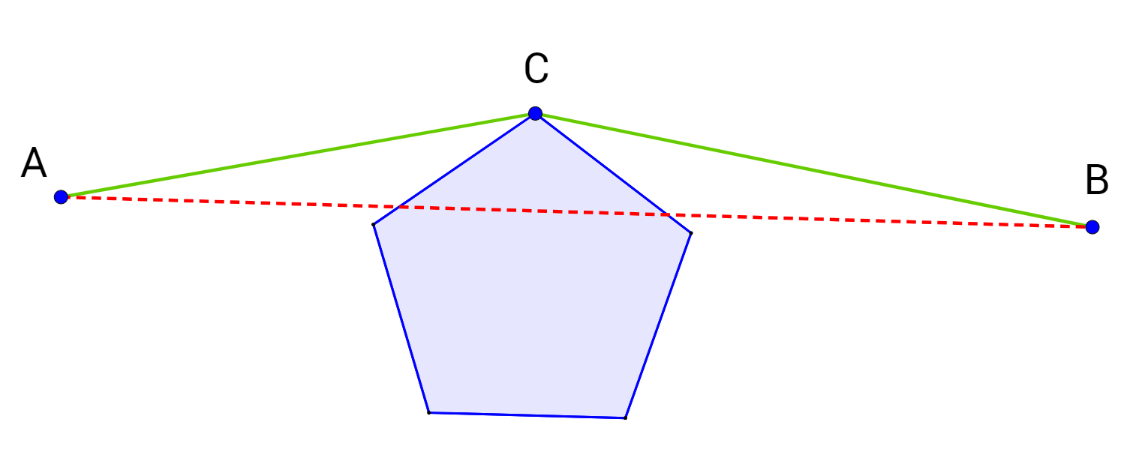
Performance
Theta*: Node on path “survives”
→ line of sight check failed
Obstacle on inside of turn
Line between two valid positions is not entirely in search space
Non-convex search space by definition
Turns are manifestations of non-convex search space
Goal: Keep search space as convex as possible in each segment
→ Minimize amount of turns in each segment (at most one)

Slide 40
Turn Events Algorithm
Sometimes: multiple nodes for single turn → group into turn events
Nodes in same turn event must:
turn in the same direction
be close enough to each other

Slide 41
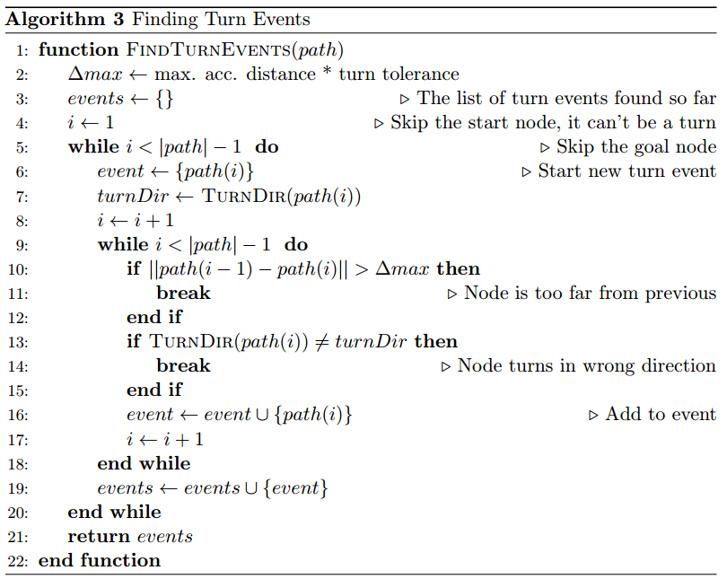
Turn Events Algorithm

Slide 42
Turn Events Demonstration
Start of new Turn Event:
Turns clockwise

Slide 43
Turn Events Demonstration
Next node:
Close enough
Turns clockwise
→ Add to current event

Slide 44
Turn Events Demonstration
Next node:
Too far away
Turns clockwise
→ Do not add to current event

Slide 45
Turn Events Demonstration
Start of new Turn Event:
Turns clockwise

Slide 46
Turn Events Demonstration
Next node:
Close enough
Turns counter-clockwise
→ Do not add to current event

Slide 47
Turn Events Demonstration
Start of new Turn Event:
Turns counter-clockwise

Slide 48
Turn Events Demonstration

Slide 49
3) Generating Segments
Segments should be as small as possible, while ensuring safety
MAD: Maximum Acceleration Distance
If segment starts 1*MAD before the turn, the UAV can always stop
If segment starts even earlier: more room to maneuver
Should allow for a more efficient approach
Algorithm generates 1 segment per turn event
When turn events are far apart: generate straight segments between them

Slide 50
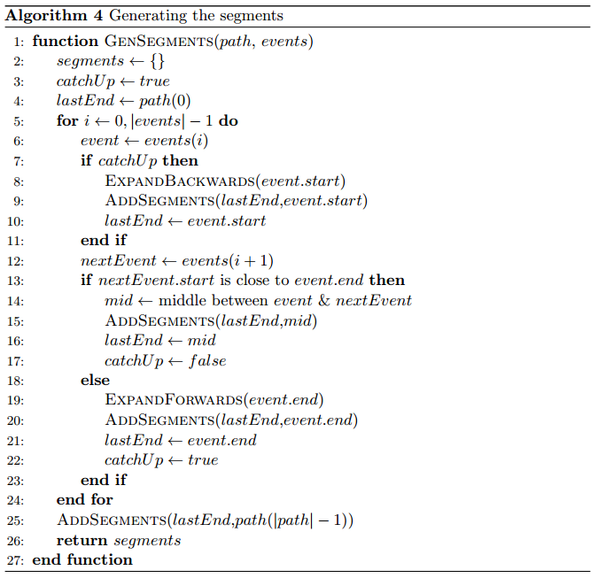
Segmentation Algorithm

Slide 51
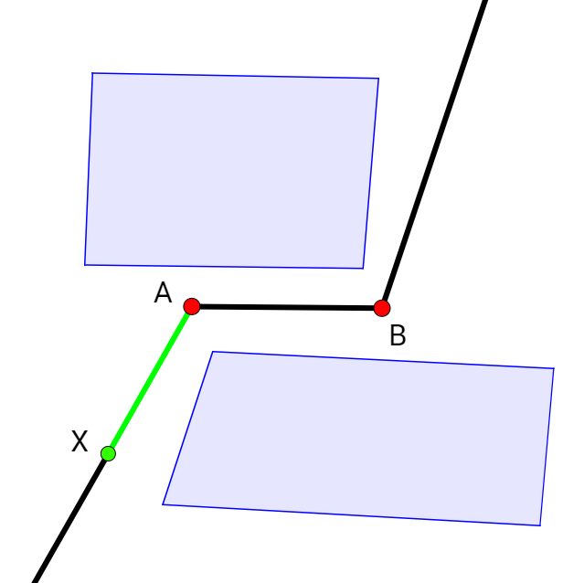

Slide 52
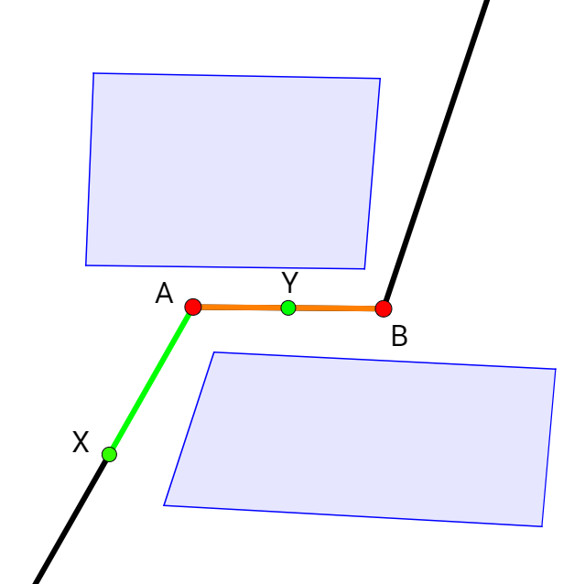

Slide 53
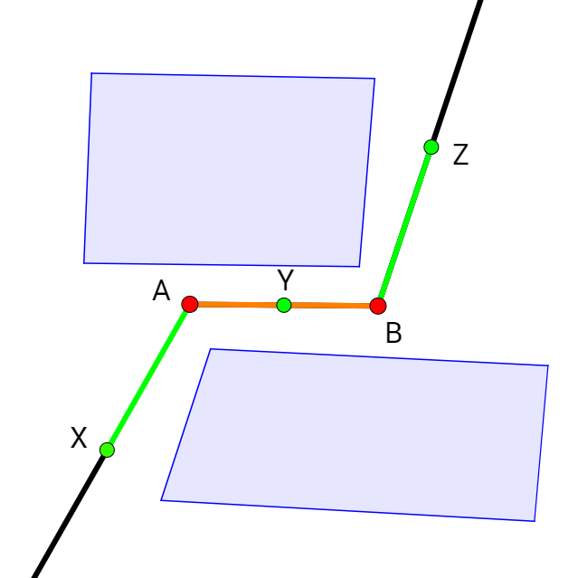

Slide 54
4) Generating the Safe Region
Not all obstacles need to be modelled in a segment
Reducing amount of obstacles improves performance
If segment has a turn: at least on obstacles prevent straight path from start to end of segment
Those obstacles make search space non-convex
The “important” obstacles
All other obstacles can be represented using convex constraints only
Concept of “Safe Region”

Slide 55
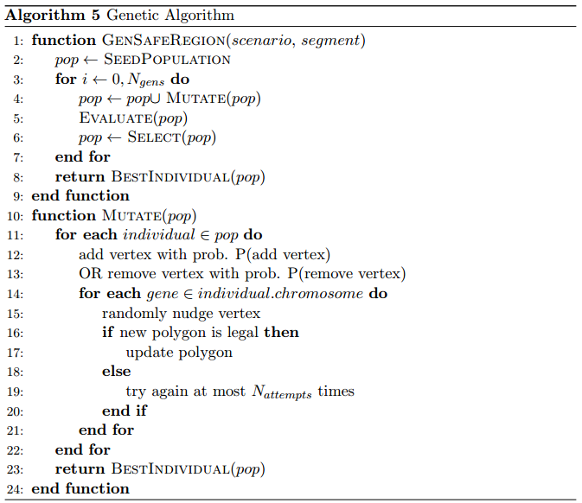
Genetic Algorithm Implementation

Slide 56
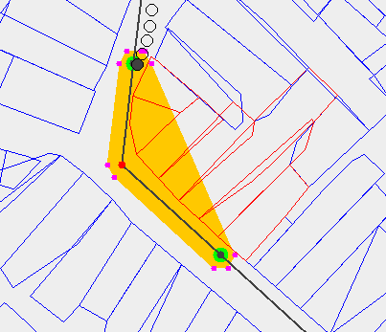
Initial Safe Region
Orange area: convex hull of nodes in segment
Red obstacles: overlap convex hull → make search space non-convex
These are selected to be modelled in MILP problem
If UAV stays inside orange safe regions and the selected obstacles are modelled: no collisions possible
Safe region is overly restrictive

Slide 57
Genetic Algorithm
Use genetic algorithm to grow safe region
Each individual has one chromosome with multiple genes
Each gene represents the position of a vertex of the safe region
Genetic Algorithm uses only one genetic operator:
Can add/remove vertices
Can “nudge” a vertex.
Tournament Selection is used, fitness function measures area of safe region

Slide 58
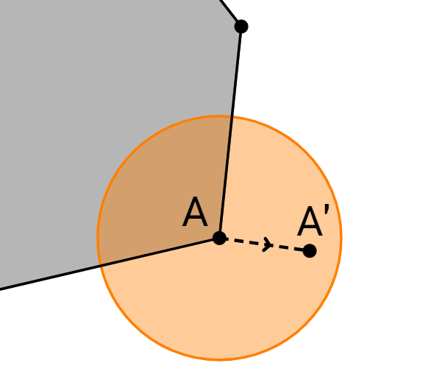
Nudge operation
The safe region…
must stay convex
may not self-intersect
must contain initial safe region
may only overlap selected obstacles

Slide 59
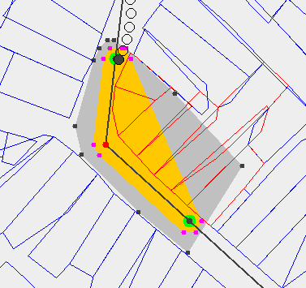
Expanded Safe Region
Still only overlaps red obstacles
UAV has more room to maneuver

Slide 60
Results

Slide 61
Testing Scenarios
Algorithm was tested on three categories of scenarios
Synthetic
Small, hand-made, obstacles laid out to be as challenging as possible
San Francisco
Uses real data, city grid with grid-aligned rectangles as obstacles
Leuven
Uses real data, dense and irregular layout of polygonal obstacles

Slide 62
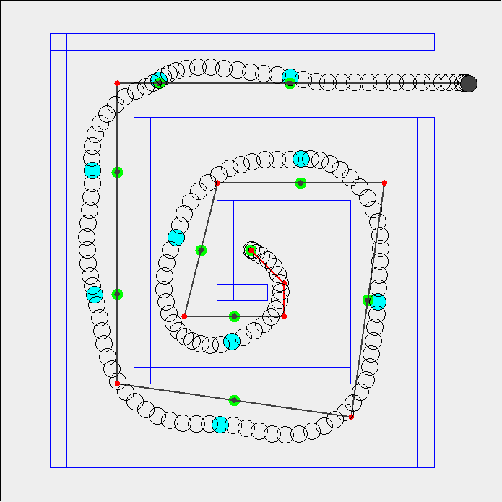
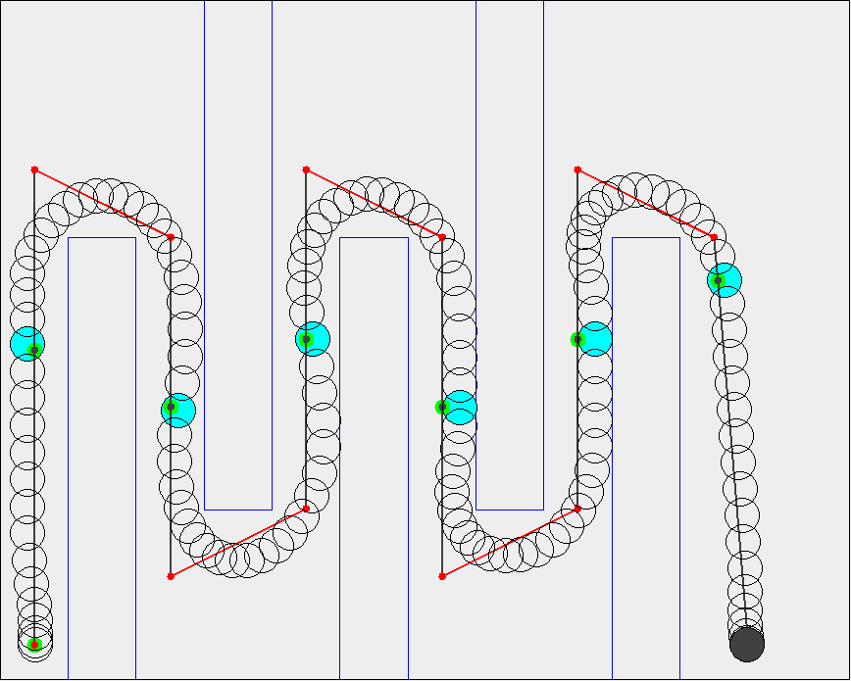
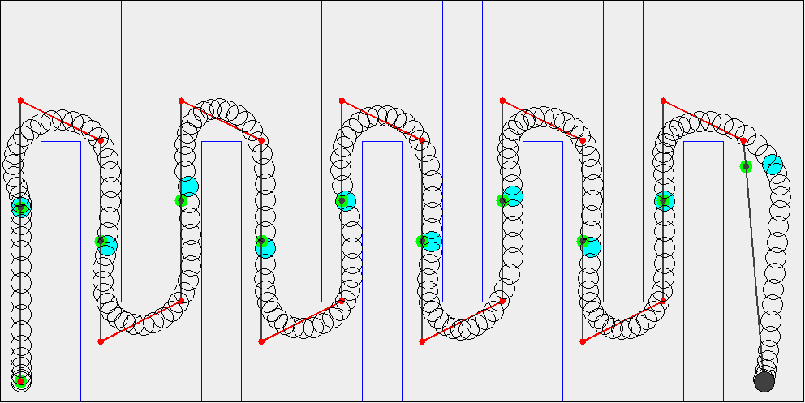
Synthetic Scenarios
Up/Down Small
Up/Down Large
Spiral

Slide 63
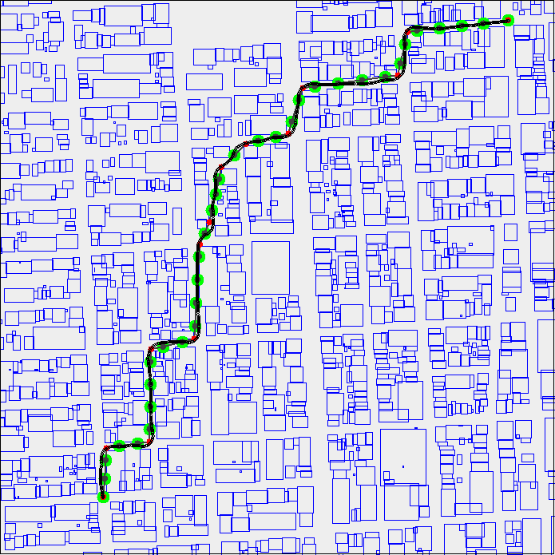
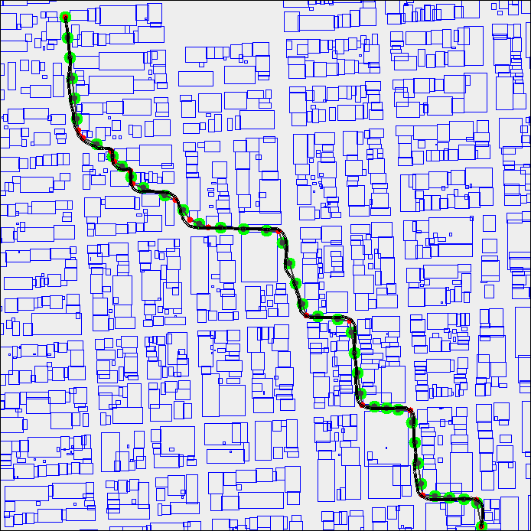
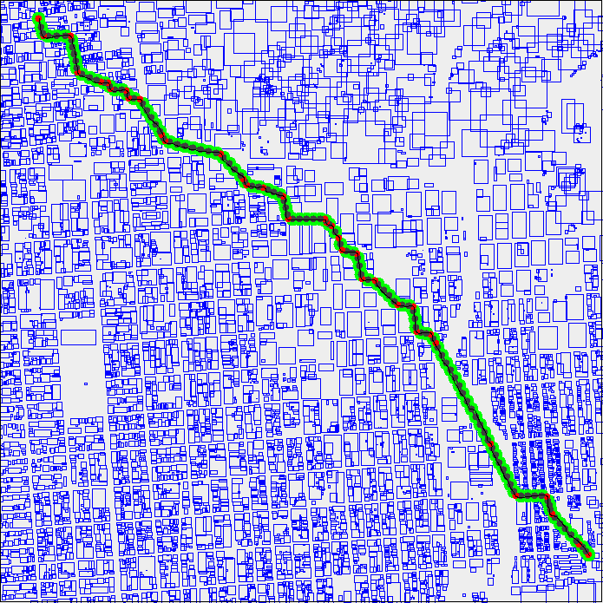
San Francisco Scenarios
San Francisco Small 1
San Francisco Small 2
San Francisco Large

Slide 64
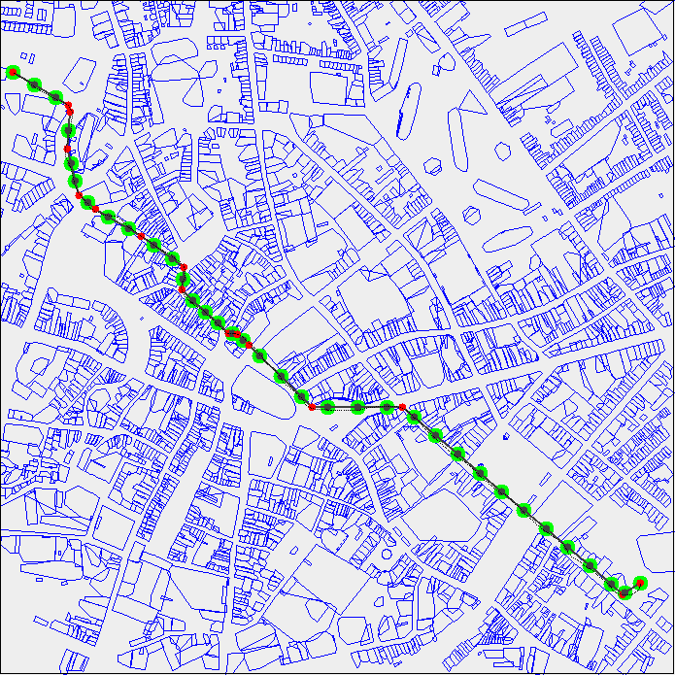
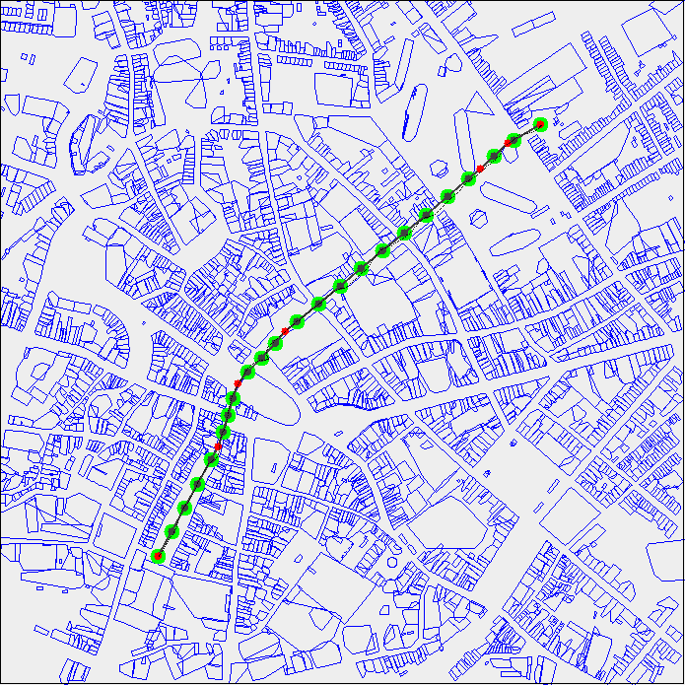
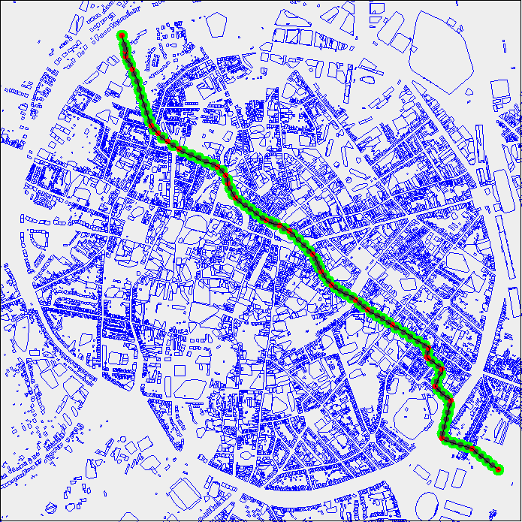
Leuven Scenarios
Leuven Small 1
Leuven Small 2
Leuven Large

Slide 65
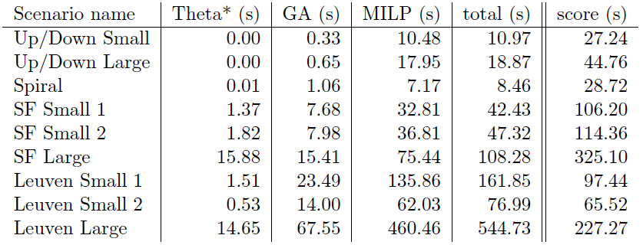
General Performance

Slide 66
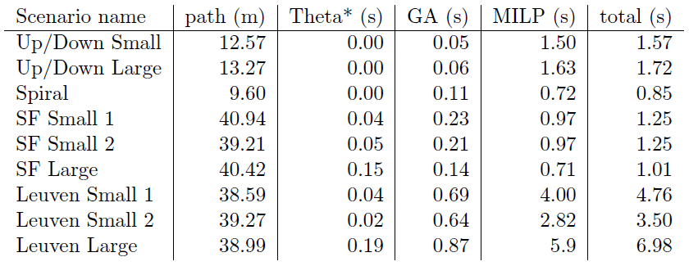
General Performance

Slide 67
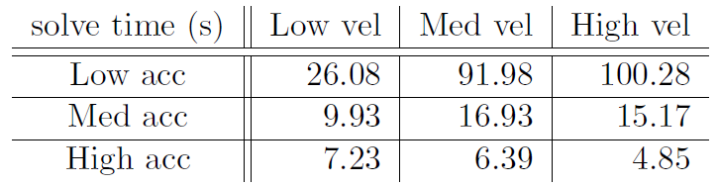
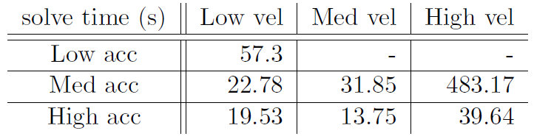
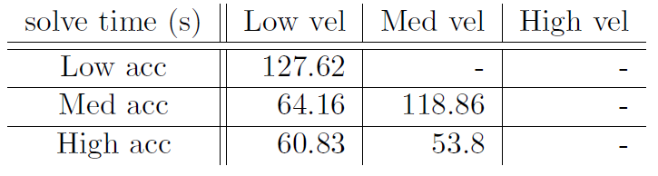
UAV Agility

Slide 68
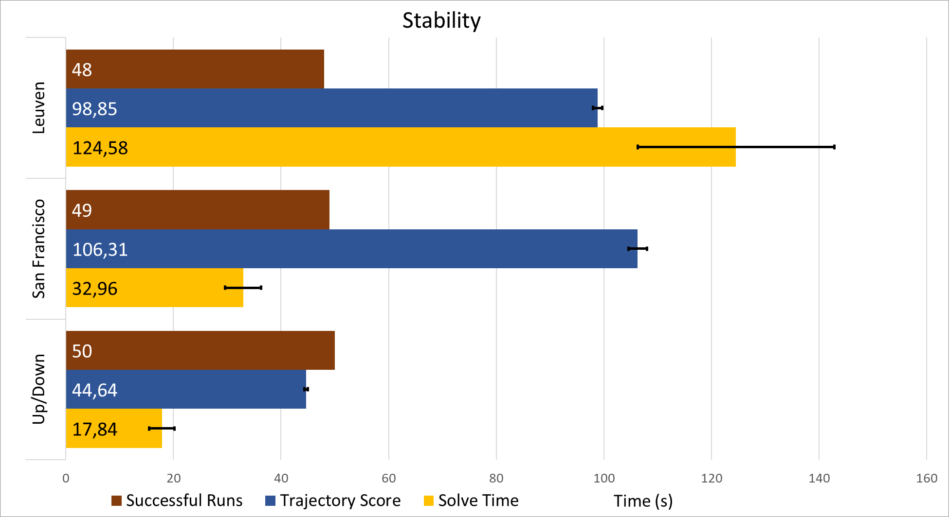
Stability

Slide 69
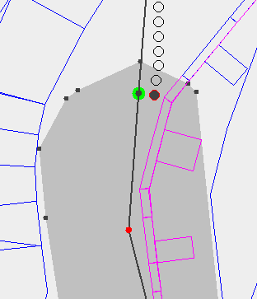
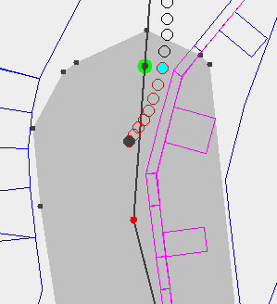
Stability Issues

Slide 70
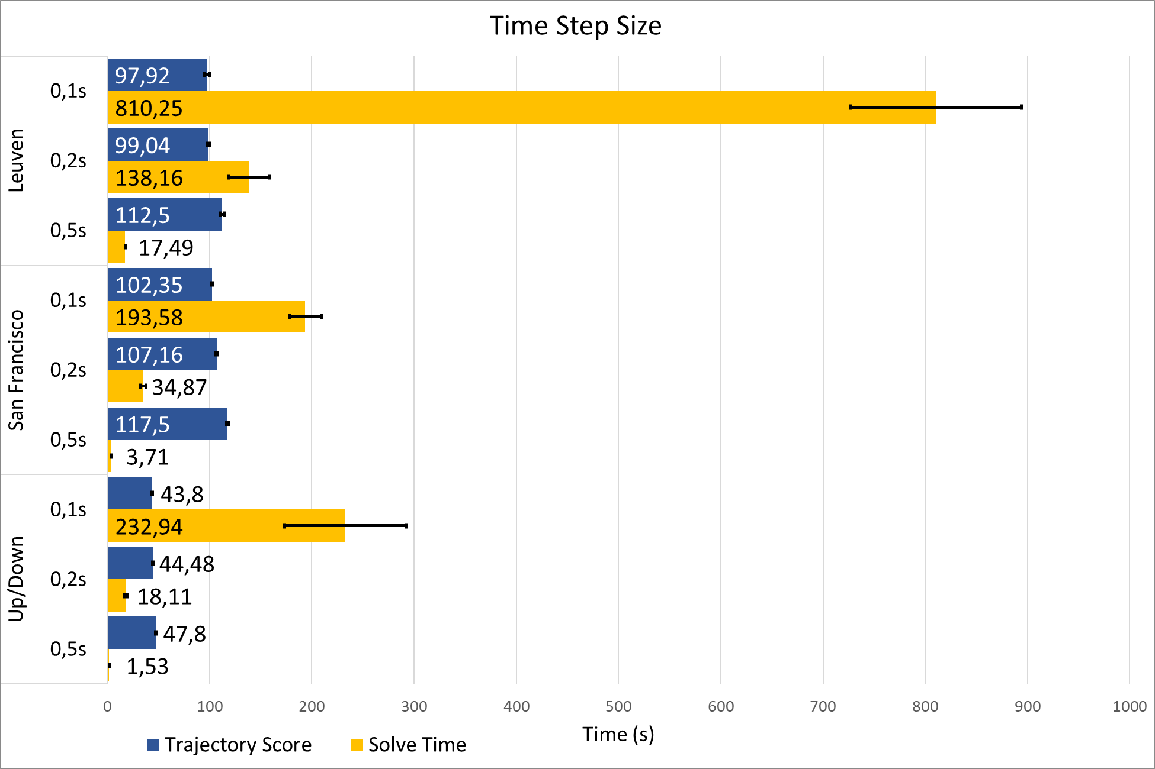
Time Step Size

Slide 71
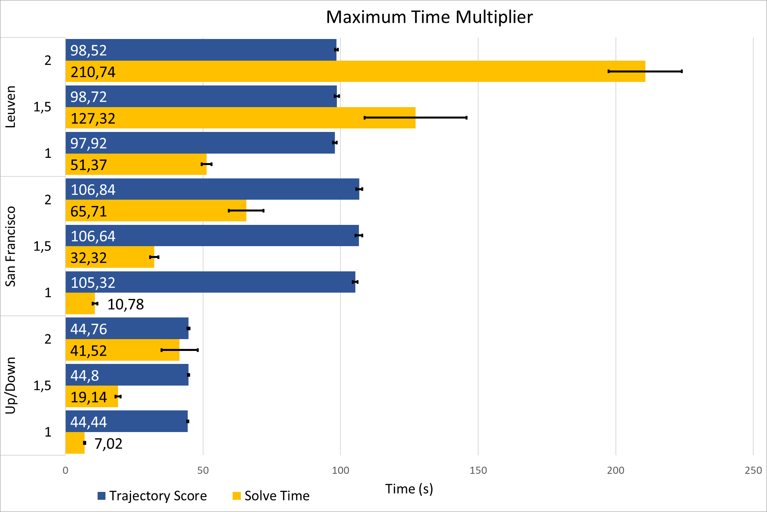
Maximum Time

Slide 72
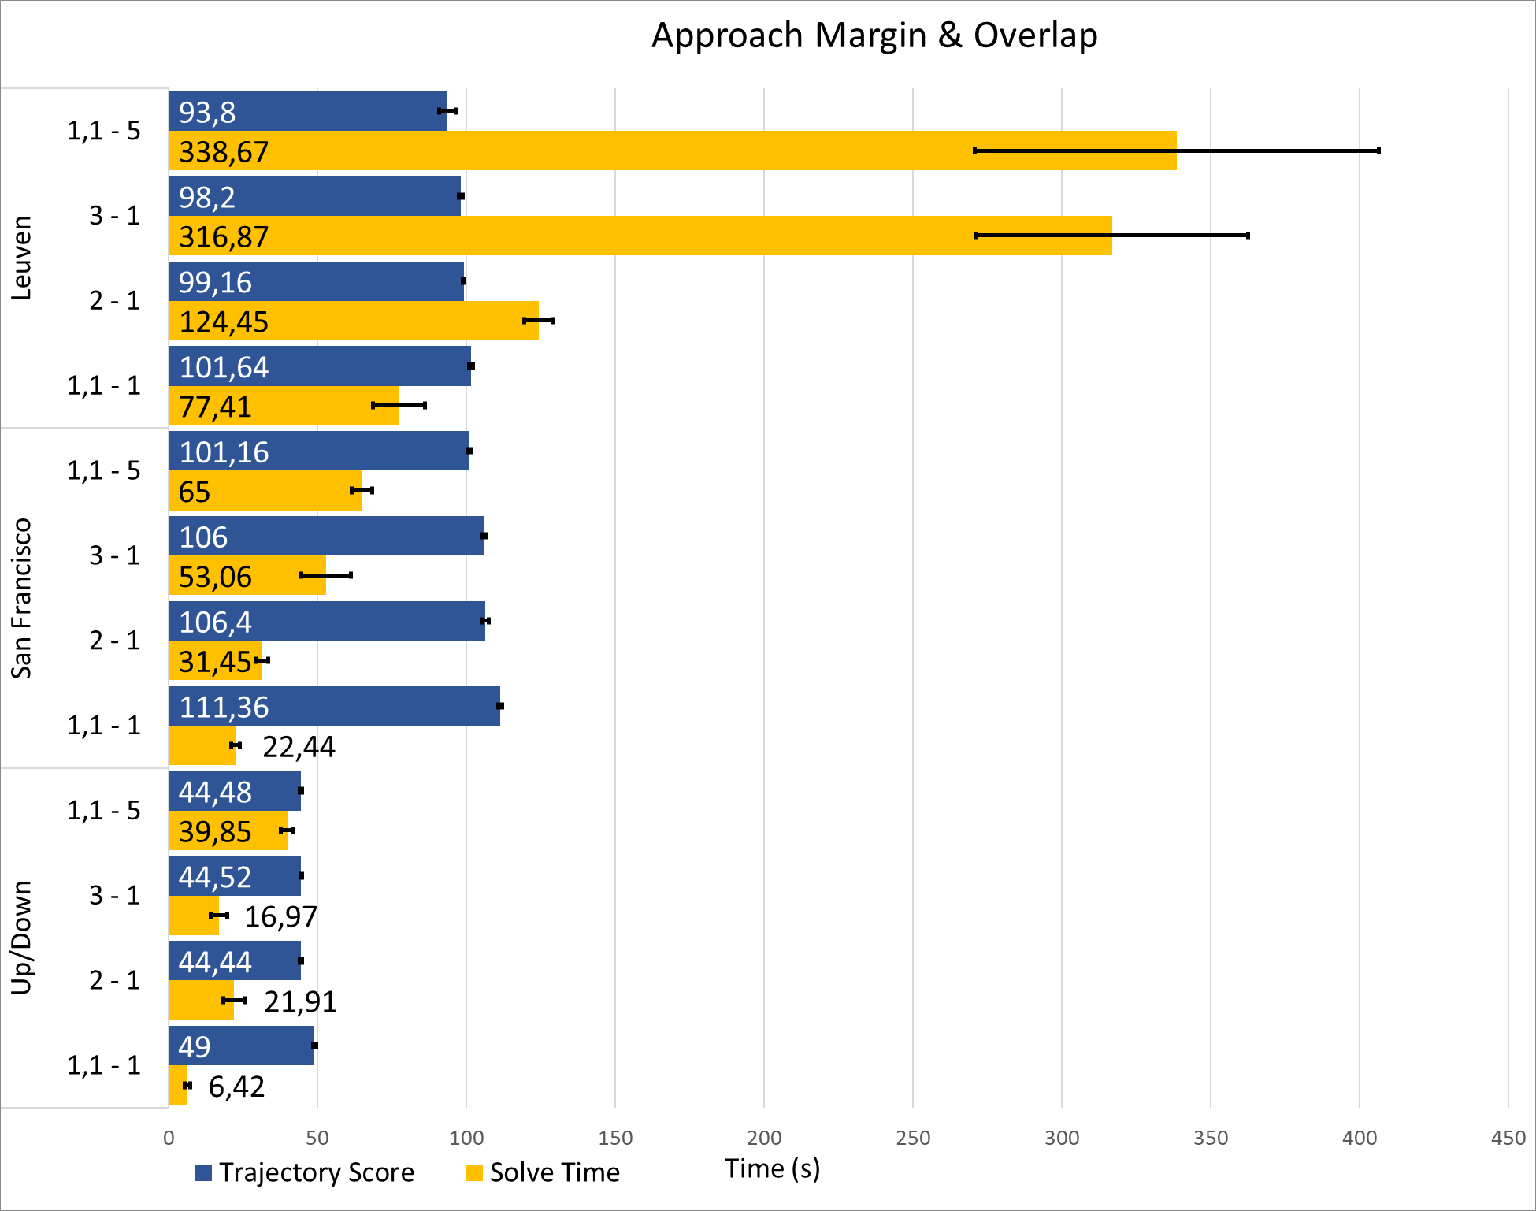
Approach Margin and Overlap

Slide 73
Performance
MILP solve time scales linearly with path length
Theta* is still exponential, but much easier to solve
“routing” aspect separated from trajectory planning aspect
MILP solve time scales exponentially with obstacle density
Compared to total amount of obstacles for pure MILP
Leuven scenario: just barely possible, denser than necessary
Higher UAV agility reduces solve times
Algorithm assumes high agility of UAV
→ assumption only holds for multirotor UAV

Slide 74
Stability
Algorithm is mostly stable
Sometimes transition between segments fails… bug, bad assumption ??
Should be possible to fix edge cases where it fails
When trajectory is found: very similar between runs
Theta* is deterministic → trajectory always roughly the same path
Execution time varies by 10-15% between runs

Slide 75
Important parameters: Time Step Size & Maximum Time
Dramatic effect on performance
Coarser time step size can be solved much faster
Solve rough trajectory first to gather info to solve fine trajectory faster?
Quick test: Pre-solve with 0,5s time step to estimate maximum time: 3x faster total solve time
Should be explored further!
Use rough trajectory to find important edges?
Use rough trajectory to improve transitions between segments?
…

Slide 76
Important parameters: Approach Margin
Some approach margin is beneficial. Larger margin: small gains
Overlapping segments:
Significantly better trajectory
Large performance penalty
Original idea: larger approach margin → more efficient trajectory
Seems to be wrong. Overlapping works much better
Should be explored further!
Why does a small overlap cause a large performance penalty?
How can this performance penalty be minimized?
Is there a better way to generate segments?

Slide 77
Safe Region Generation
Genetic Algorithm was not thoroughly tested
Works well enough to not be the limiting part of the algorithm
However: probably not the best way to solve the problem
Improvements/Alternatives should be explored…

Slide 78
Future work
Explore leads from experiments
Extend algorithm to 3D
Try Mixed-Integer Quadratic Programming so 2-norm can be modelled directly. Performance penalty or improvement?
Make complimentary online/realtime algorithm
Necessary to use algorithm on actual physical UAV
Further performance improvements may allow for online long-term planning?

Slide 79
Conclusions
Goal of thesis: Build a UAV trajectory planning algorithm that scales to large and complex environments
This goal has been reached
Some weaknesses remain (segment transition bug)
Algorithm presented is just a first iteration
experiments show several ways the algorithm could be improved
Principles used in algorithm may be applied in other algorithms

Slide 80
Demo

Slide 81
Questions?

