Slide 2
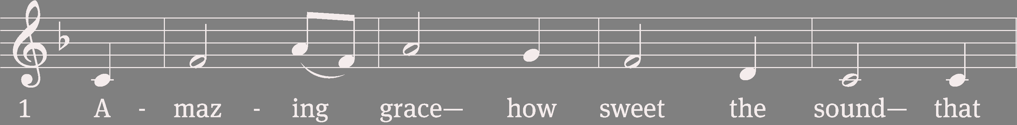
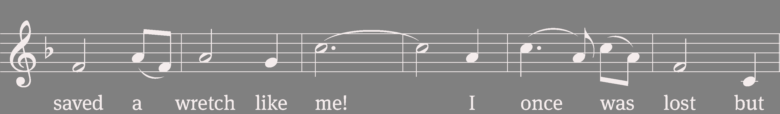
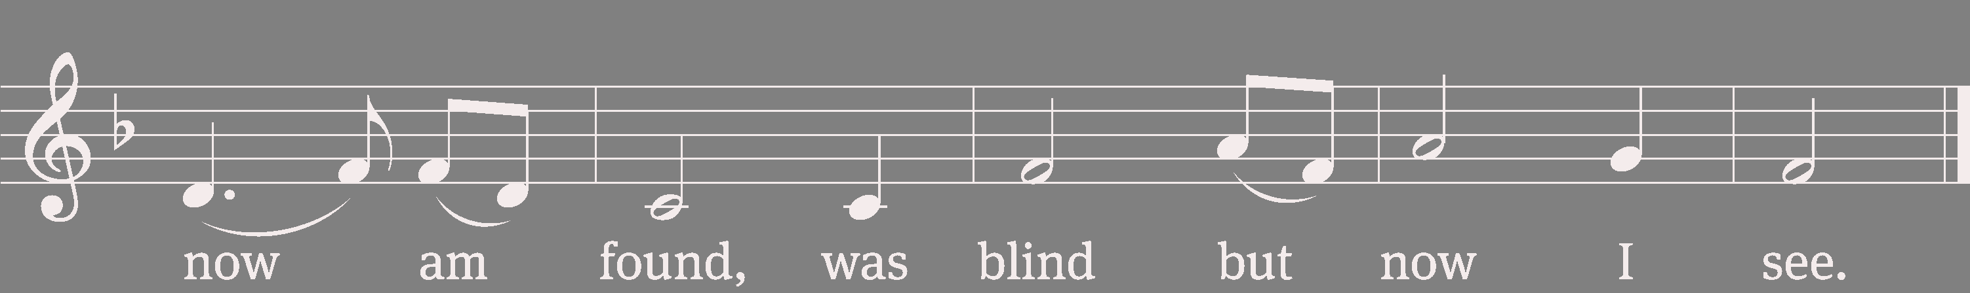
576 Amazing Grace

Slide 3
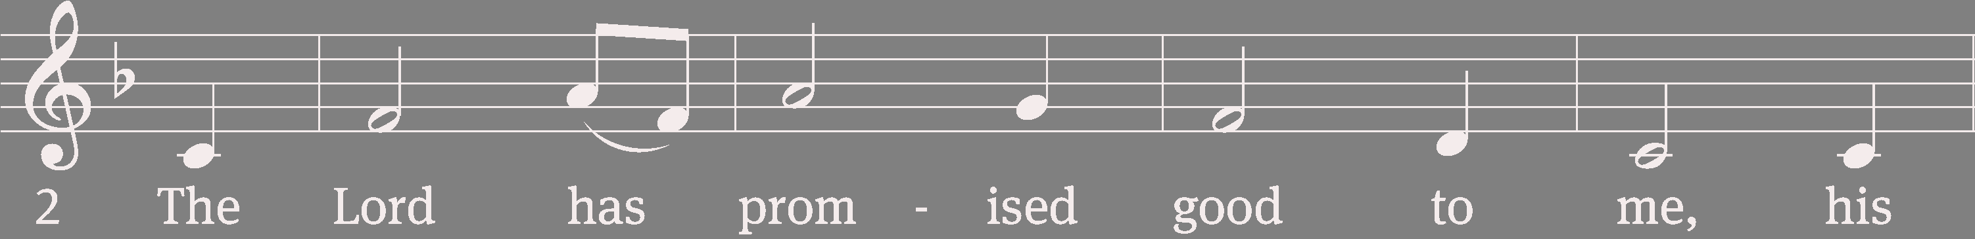
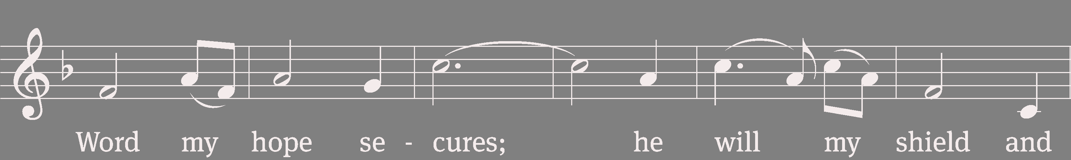
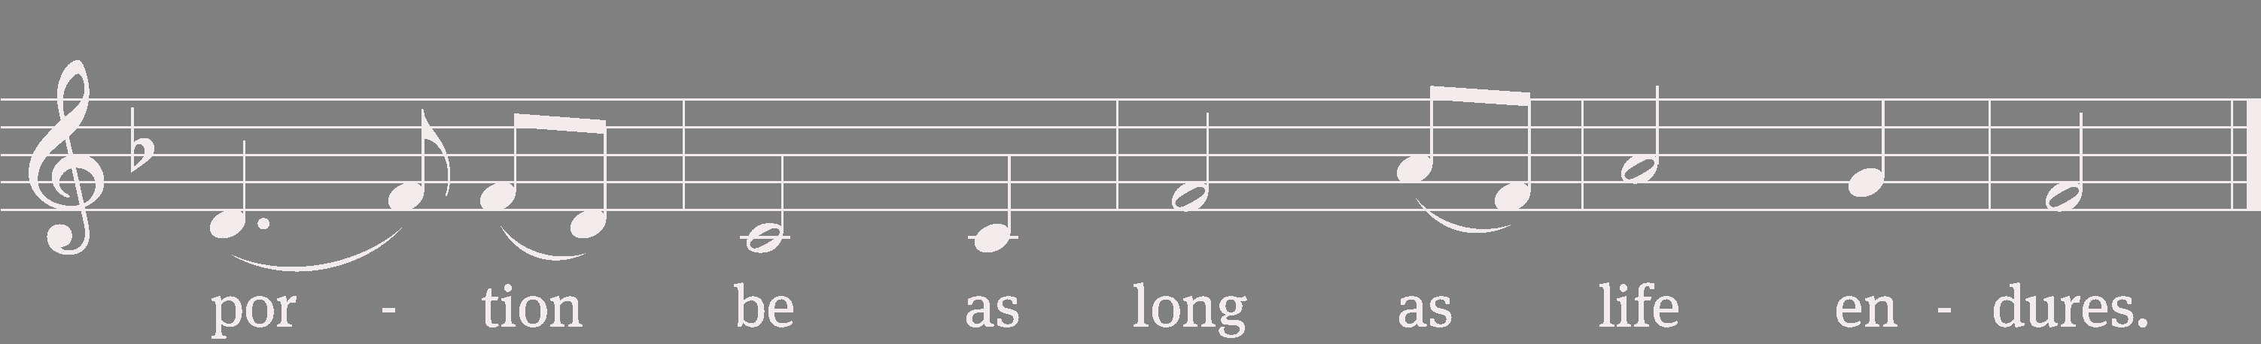
576 Amazing Grace

Slide 4
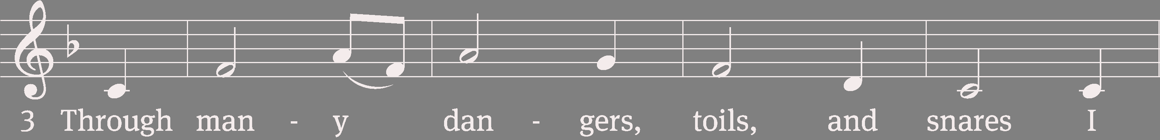
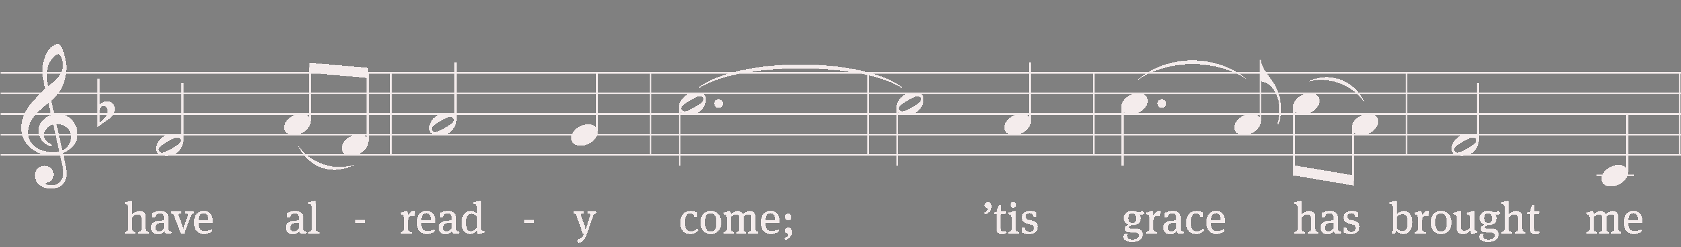
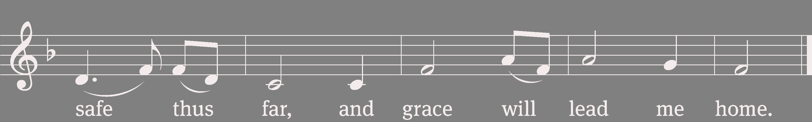
576 Amazing Grace

Slide 5
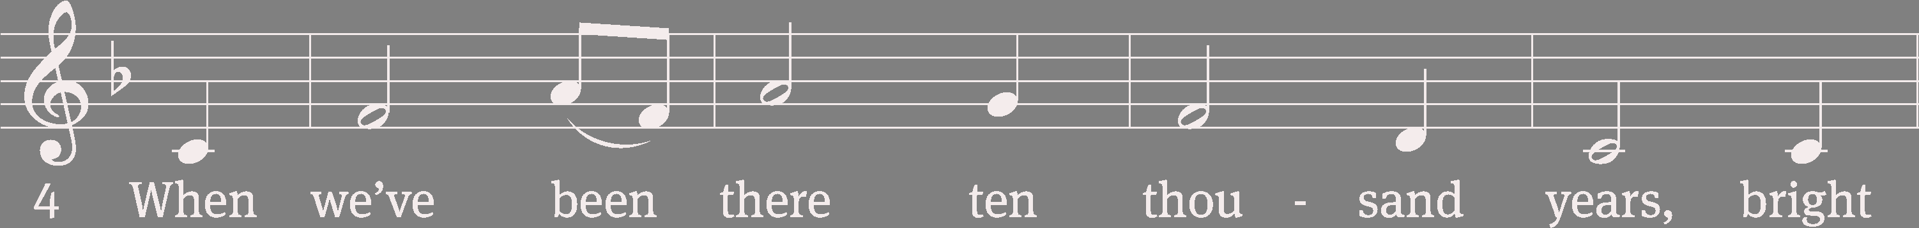
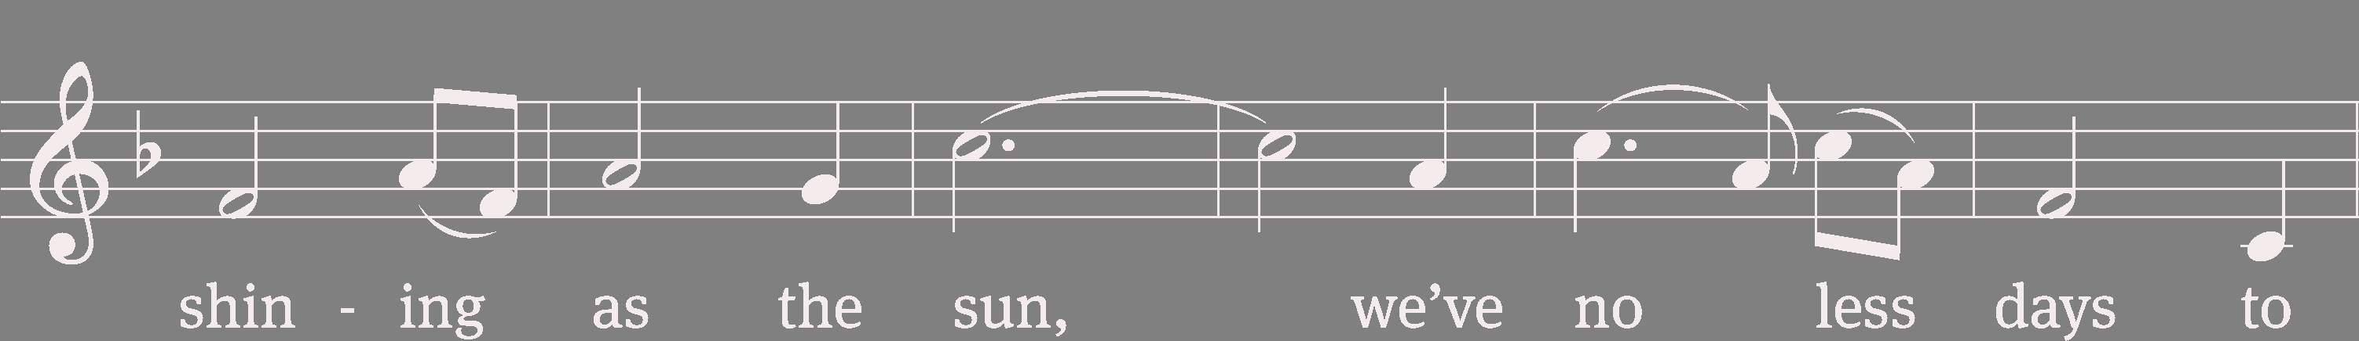
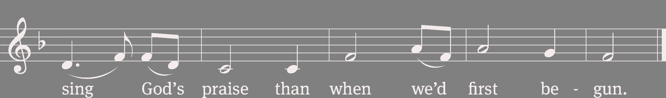
576 Amazing Grace
Text (sts. 1–3): John Newton, 1725–1807, alt.; (st. 4): A Collection of Sacred Ballads, Richmond, 1790
Tune: Columbian Harmony, Cincinnati, 1829, ed. Benjamin Shaw; ed. Charles H. Spilman
Text and tune: Public domain

Slide 6
Invocation
In the name of the Father and of the (+) Son and of the Holy Spirit.
Amen.

Slide 7
Confession
If we claim to be without sin, we deceive ourselves and the truth is not in us.
If we confess our sins, God is faithful and just
and will forgive us our sins
and purify us from all unrighteousness.
Let us confess our sins to the Lord.
Holy God, gracious Father,
I am sinful by nature
and have sinned against you in my thoughts, words, and actions.

Slide 8
Confession (cont)
I have not loved you with my whole heart;
I have not loved others as I should.
I deserve your punishment both now and forever.
But Jesus, my Savior, paid for my sins
with his innocent suffering and death.
Trusting in him, I pray: God, have mercy on me, a sinner.

Slide 9
Absolution
Our gracious Father in heaven has been merciful to us. He sent his only Son, Jesus Christ, who gave his life as the atoning sacrifice for the sins of the whole world. Therefore, as a called servant of Christ and by his authority, I forgive you all your sins in the name of the Father and of the (+) Son and of the Holy Spirit.
Amen.

Slide 10
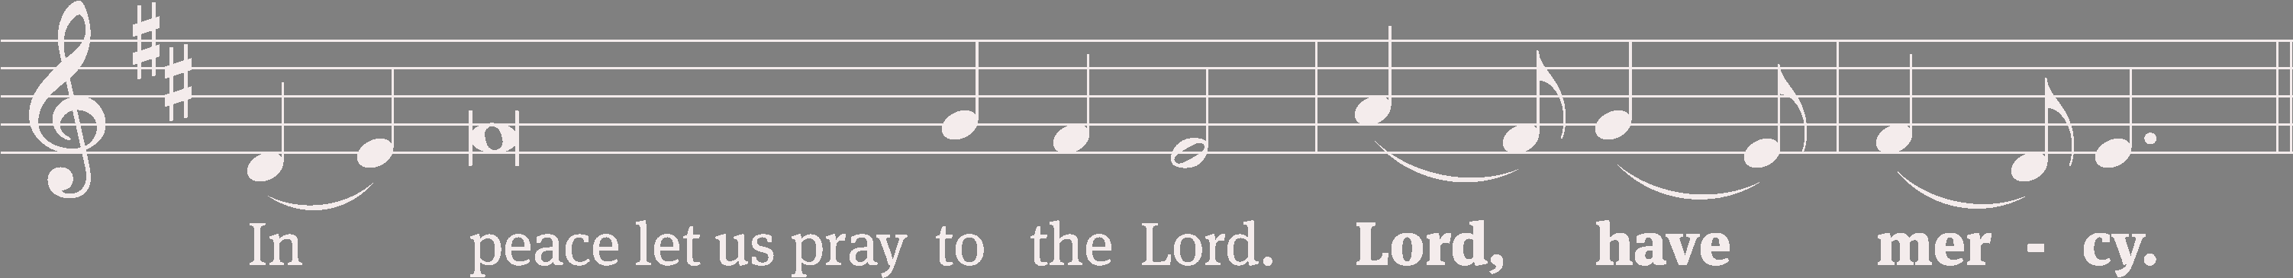
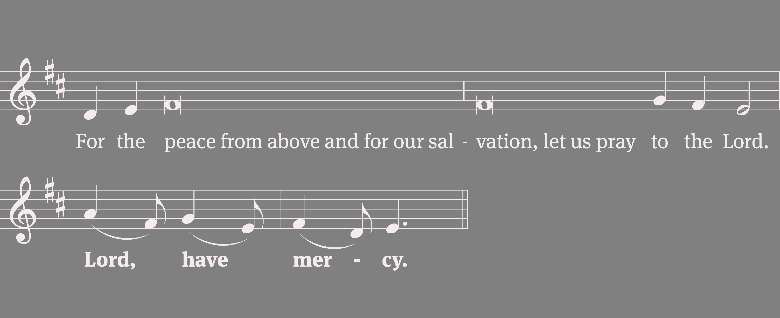
Lord, Have Mercy

Slide 11
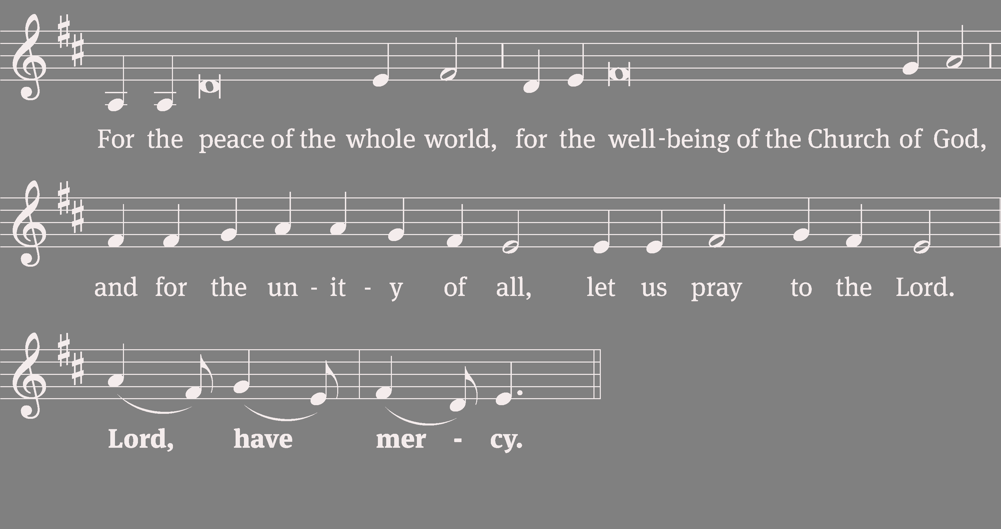
Lord, Have Mercy

Slide 12
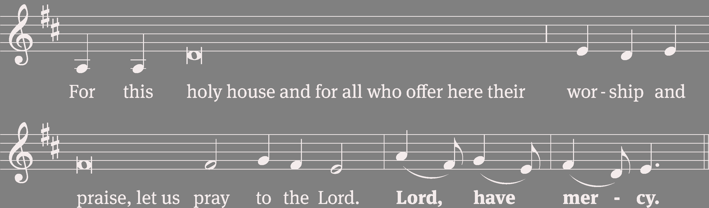
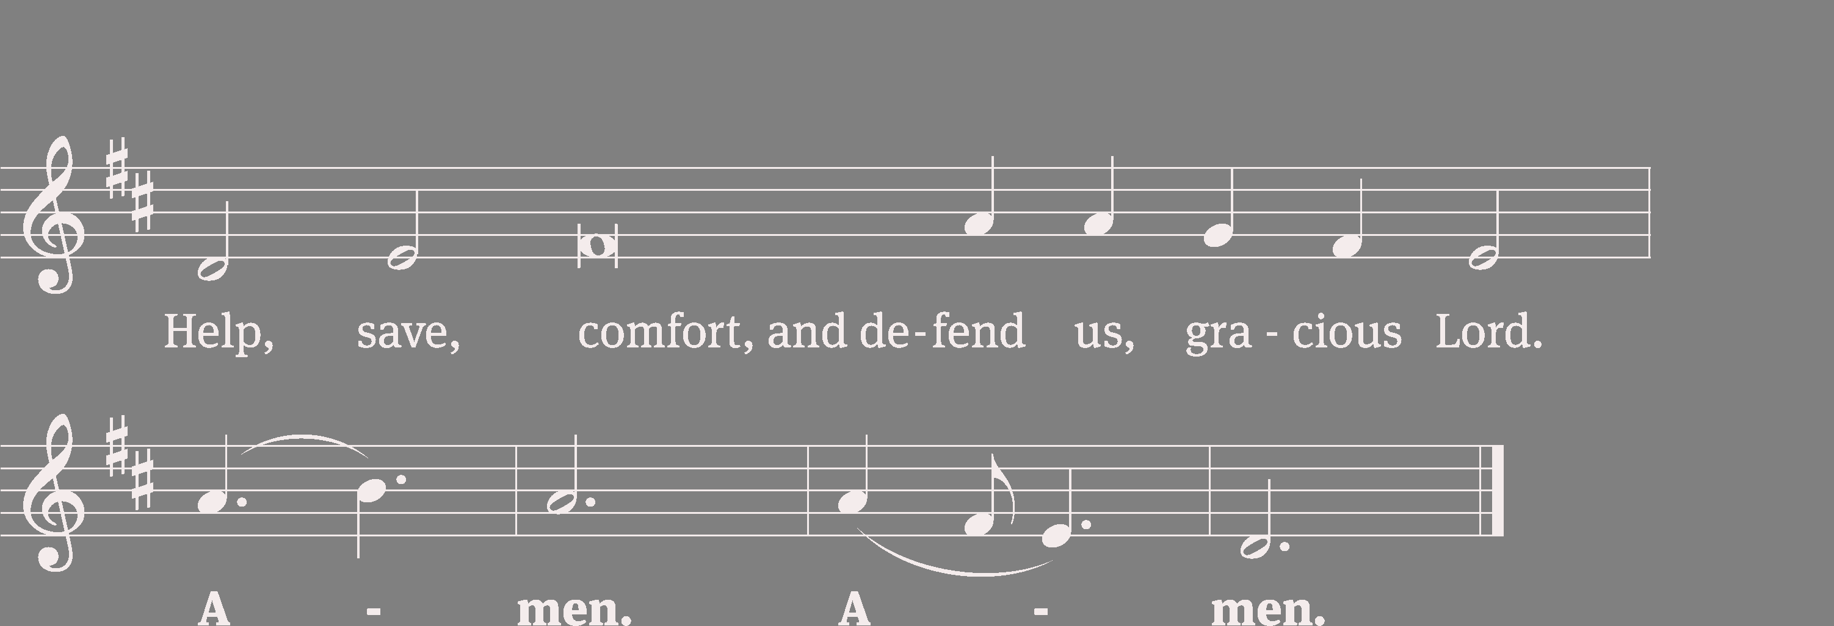
Lord, Have Mercy
Tune: William Gokelman; David Kauffman
Tune: © 2021 GFTSMUSIC Publishing Company, Inc., admin. Music Services. Used by permission: OneLicense no. 707551

Slide 13
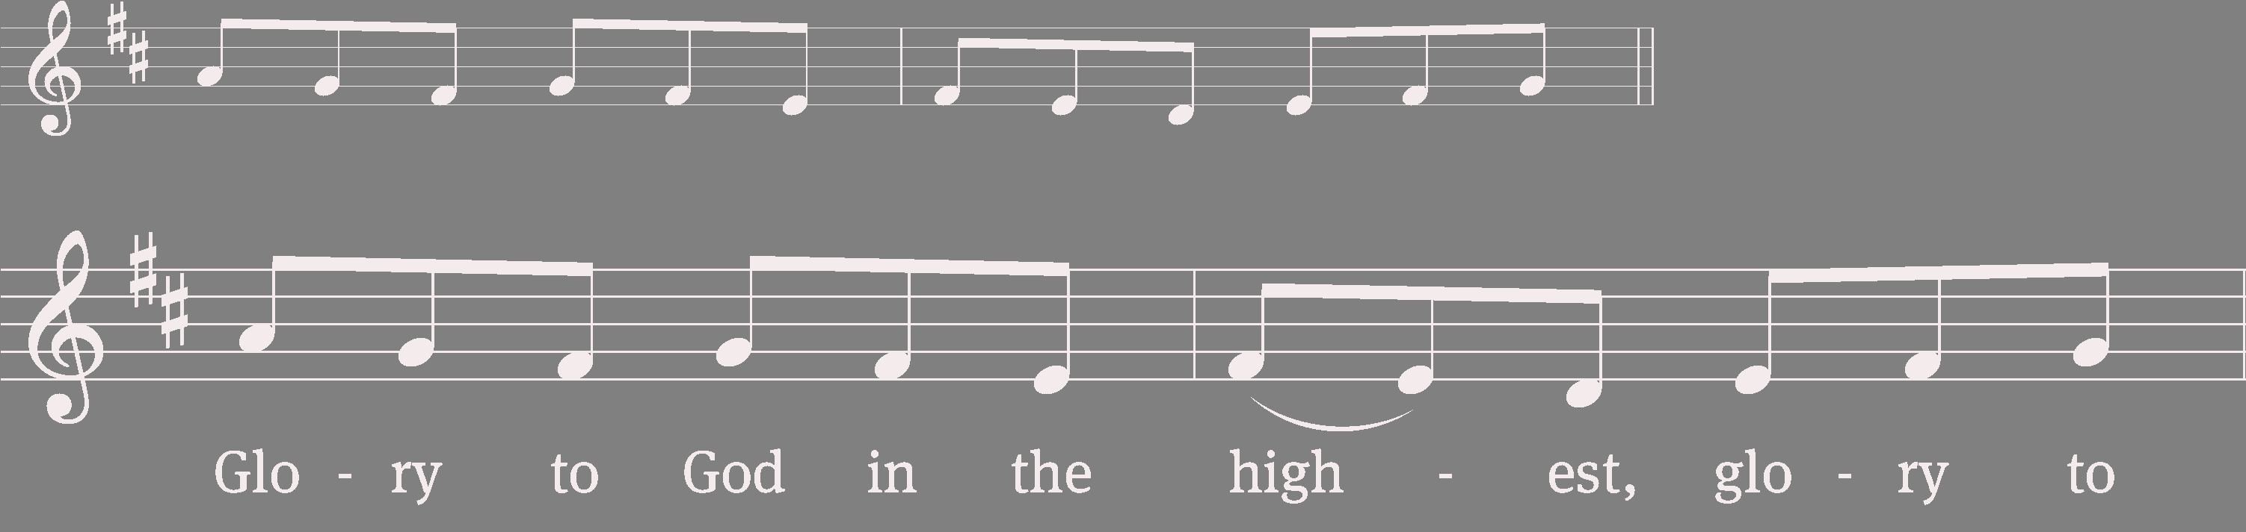
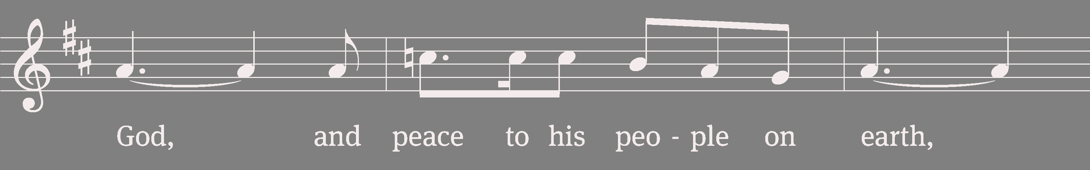
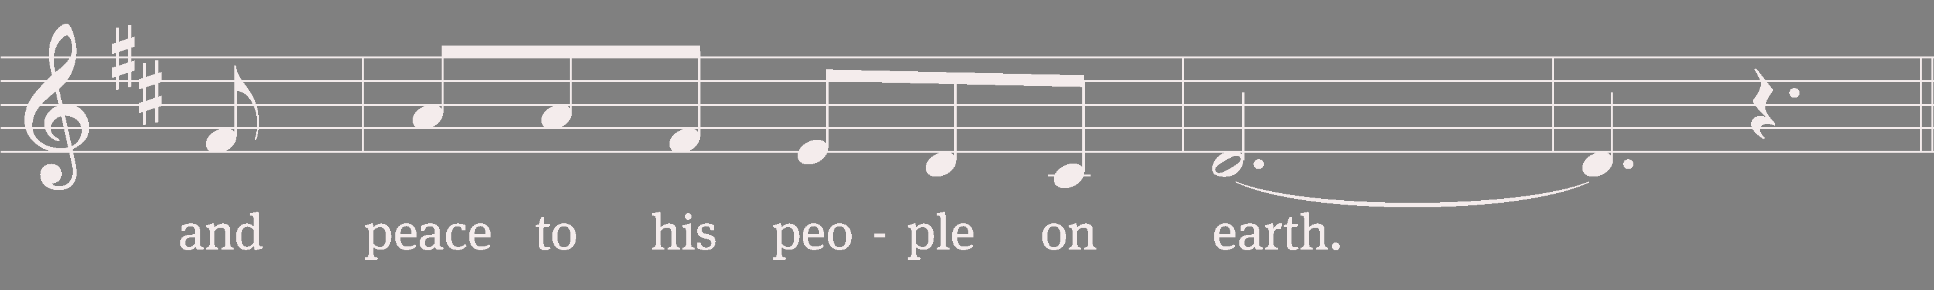
Glory to God in the Highest

Slide 14
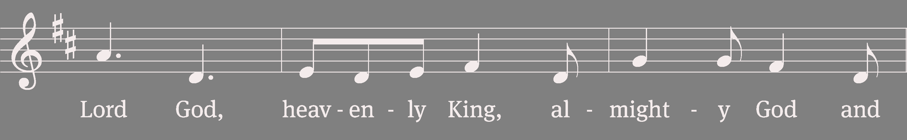
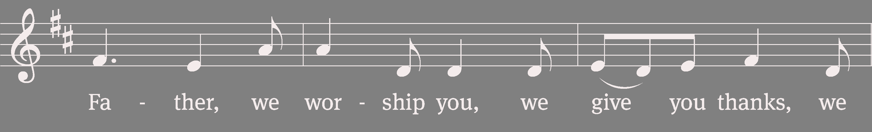
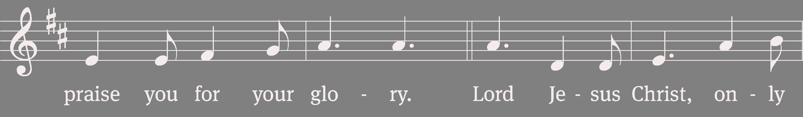
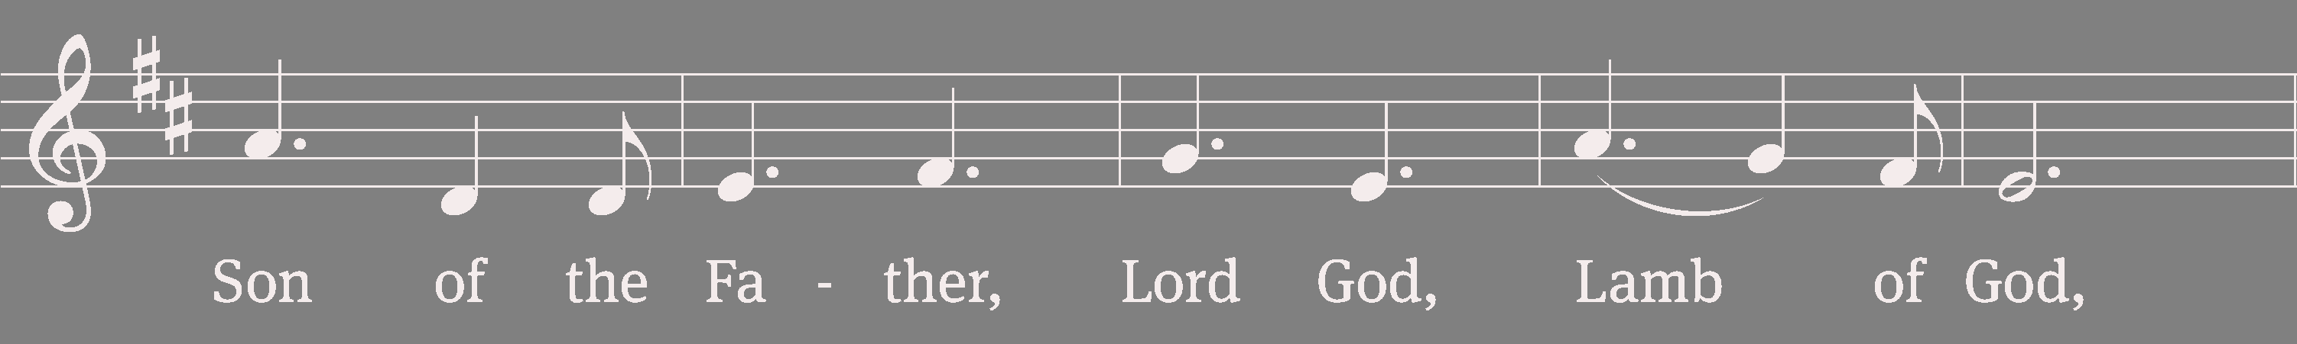
Glory to God in the Highest

Slide 15
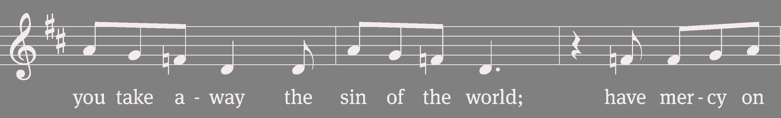
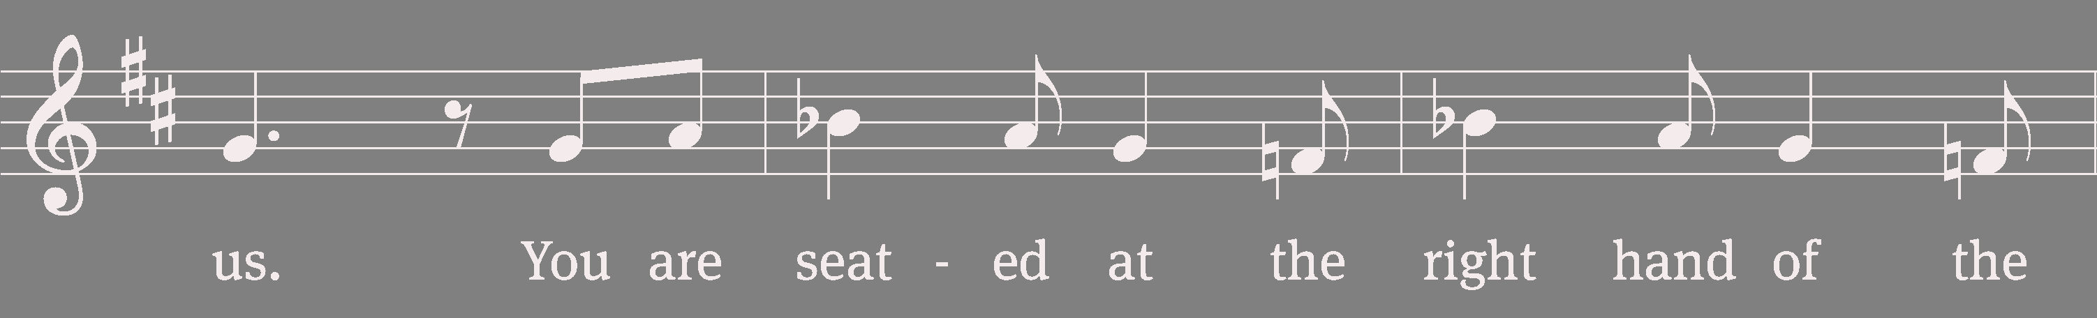
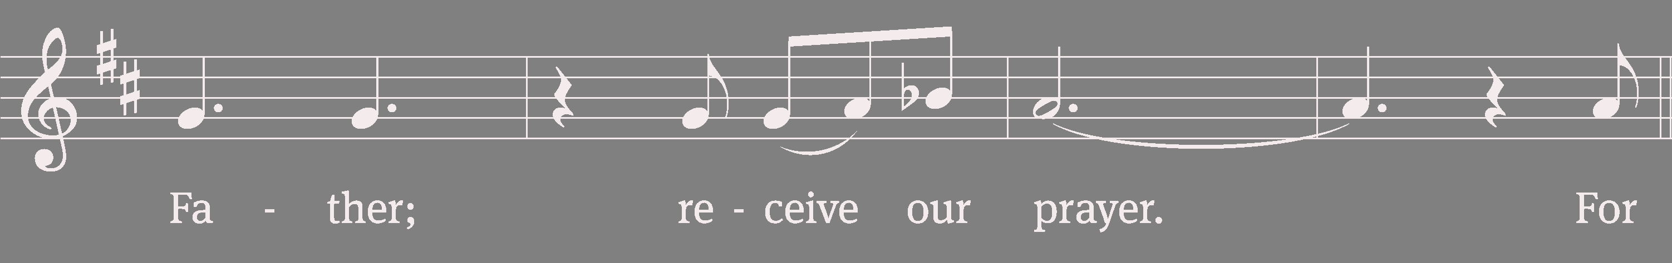
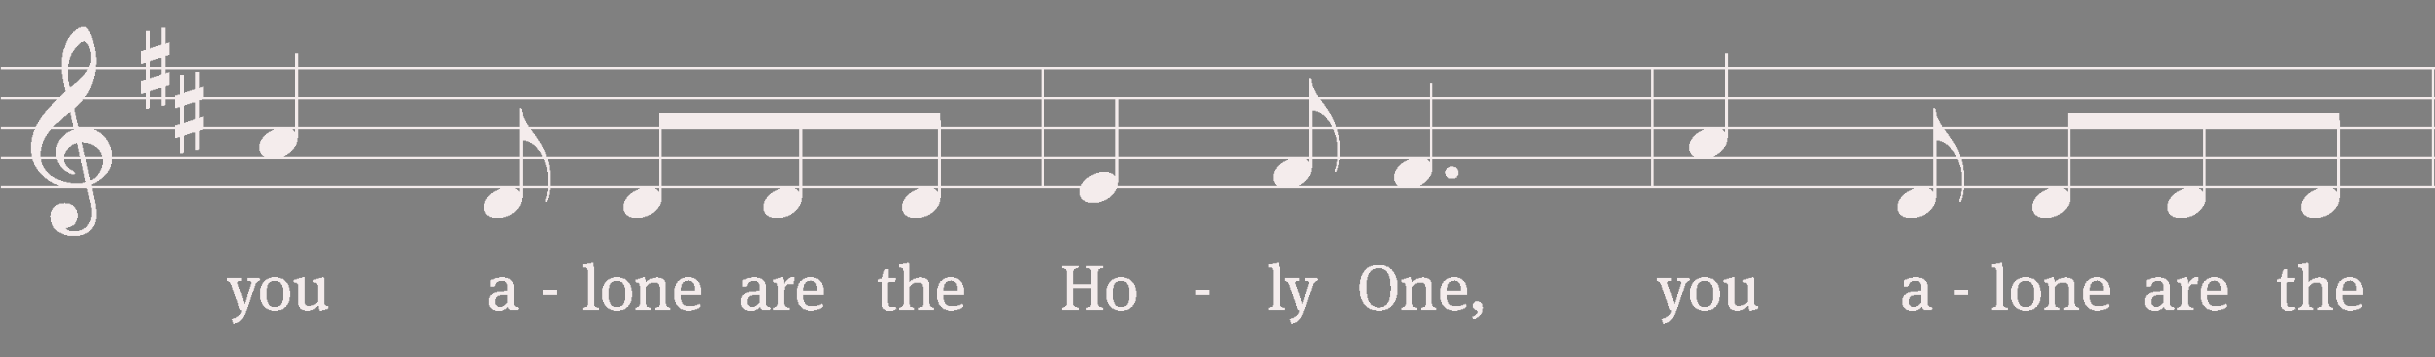
Glory to God in the Highest

Slide 16
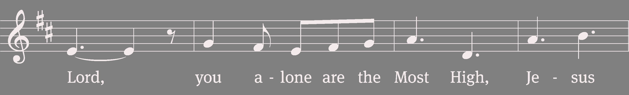
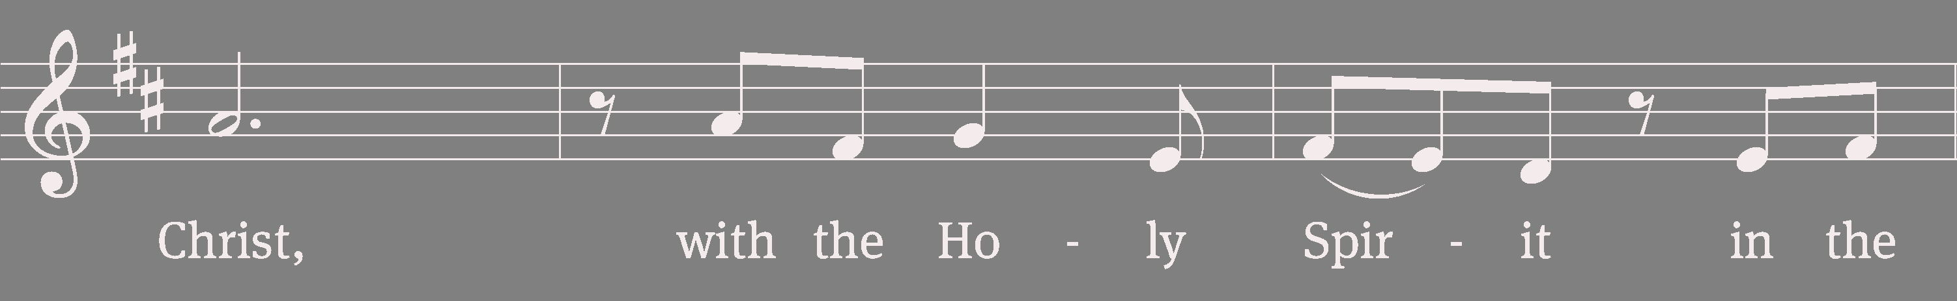
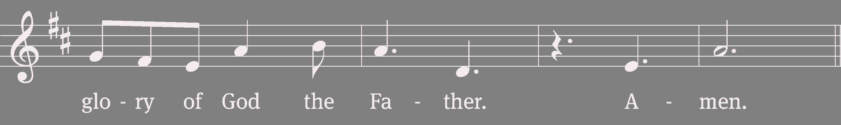
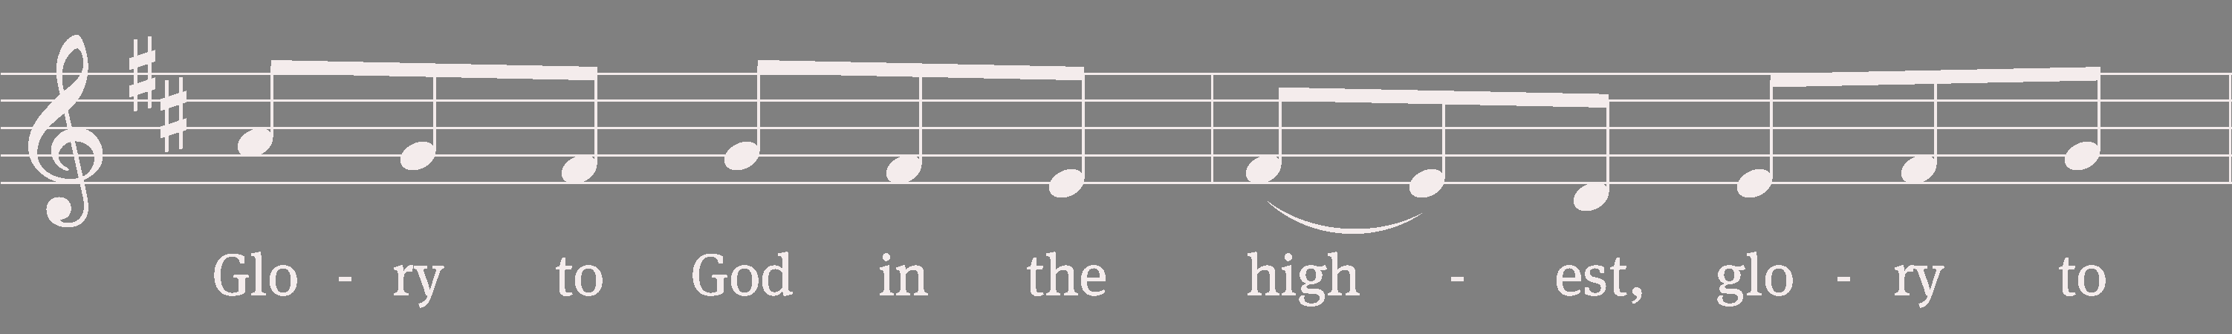
Glory to God in the Highest

Slide 17
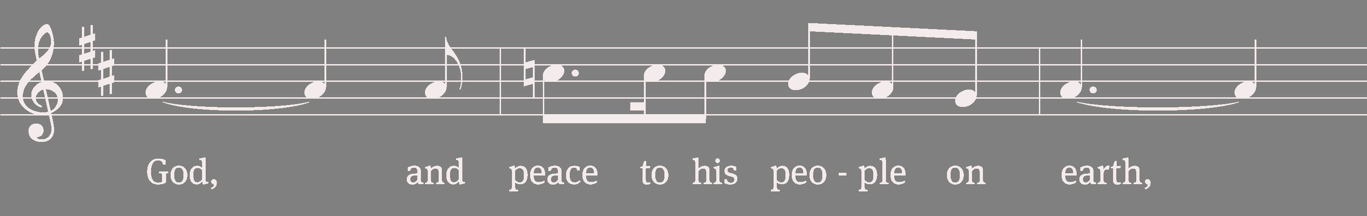
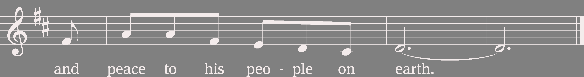
Glory to God in the Highest
Tune: William Gokelman; David Kauffman
Tune: © 2010, 2021 GFTSMUSIC Publishing Company, Inc., admin. Music Services. Used by permission: OneLicense no. 707551

Slide 18
Salutation
The Lord be with you.
And also with you.

Slide 19
Prayer of the Day
We pray.
Lord God, you call us to work in your kingdom and promise to reward us according to your grace. Help us to rid our minds of worldly expectations and rejoice that you freely pour out the blessings of salvation to all people; through the merits of Jesus Christ our Lord, who lives and reigns with you and the Holy Spirit, one God, now and forever.
Amen.

Slide 20
1st Reading Romans 9:6–8, 16, EHV
⁶This does not mean that God's word has failed, because not all who are descended from Israel are really Israel, ⁷and not all who are descended from Abraham are really his children. On the contrary, “Your line of descent will be traced through Isaac.” ⁸This means that it is not the children of the flesh who are God's children, but it is the children of the promise who are counted as his descendants.
¹⁶So then, it does not depend on human desire or effort, but on God's mercy.
The Word of the Lord.
Thanks be to God.

Slide 21
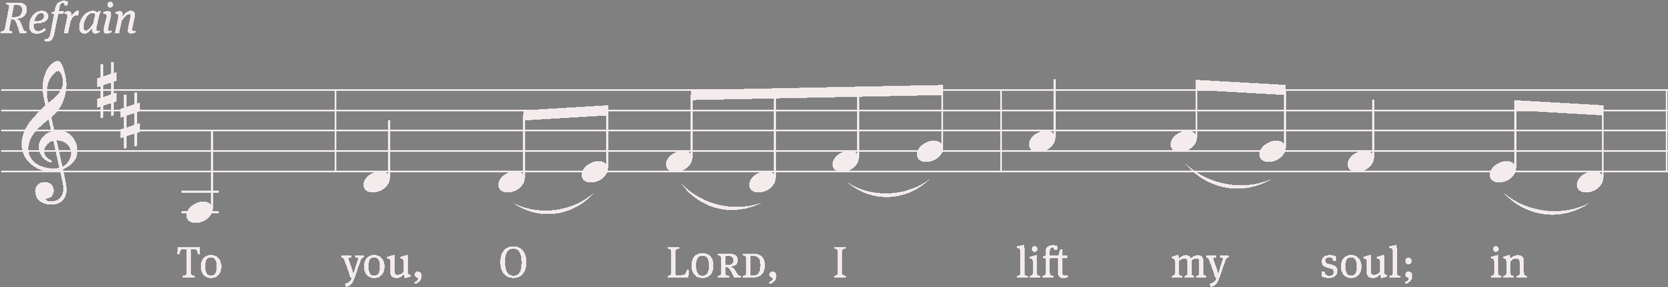
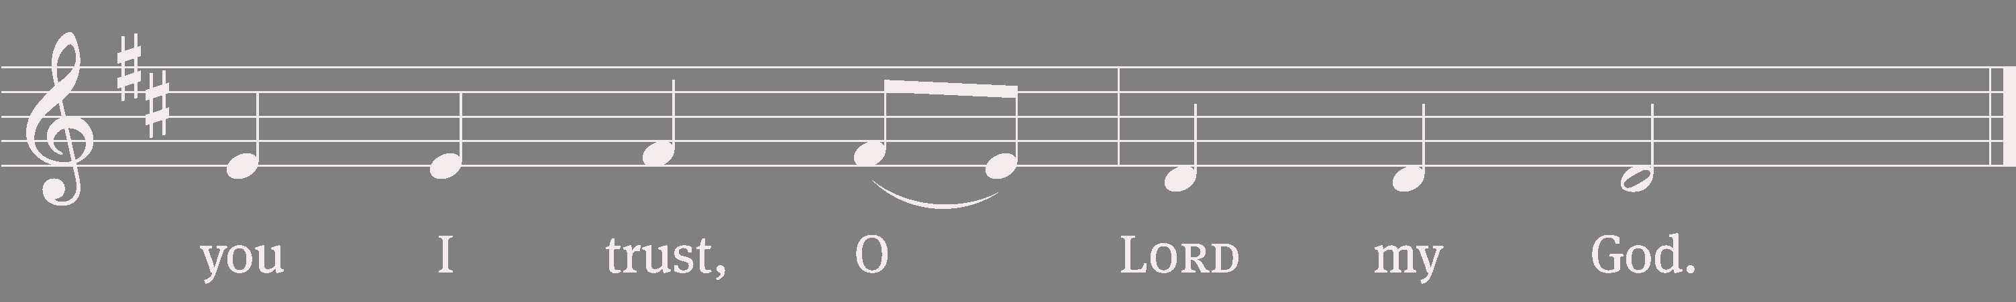
25A To You, O LORD, I Lift My Soul

Slide 22
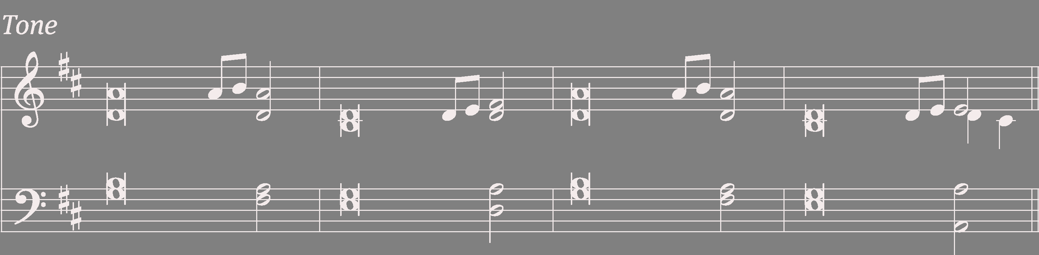
25A To You, O LORD, I Lift My Soul
In you, Lord my God, I / put my trust.
I trust in you; do not let me be / put to shame.
Show me your ways, Lord, teach me / your paths.
Guide me in your truth and teach me, for you are
God my / Savior.

Slide 23
25A To You, O LORD, I Lift My Soul
Remember, Lord, your great mer- / cy and love,
for they are / from of old.
Do not remember the sins of my youth and my
re- / bellious ways;
according to your love remember me, for you,
Lord, / are good.
Refrain on next slide

Slide 24
25A To You, O LORD, I Lift My Soul

Slide 25
25A To You, O LORD, I Lift My Soul
Lord, forgive my iniquity, though / it is great.
Turn to me and be gracious to me, for I am lonely
and af- / flicted.
Look on my affliction and / my distress
and take away / all my sins.

Slide 26
25A To You, O LORD, I Lift My Soul
Glory be to the Father and / to the Son
and to the Holy / Spirit,
as it was in the be- / ginning,
is now, and will be forever. / Amen.
Refrain on next slide

Slide 27
25A To You, O LORD, I Lift My Soul
Tune: Mark Haas
Setting: Mark Haas
Music: © 2014 Mark Haas. Used by permission: OneLicense no. 707551

Slide 28
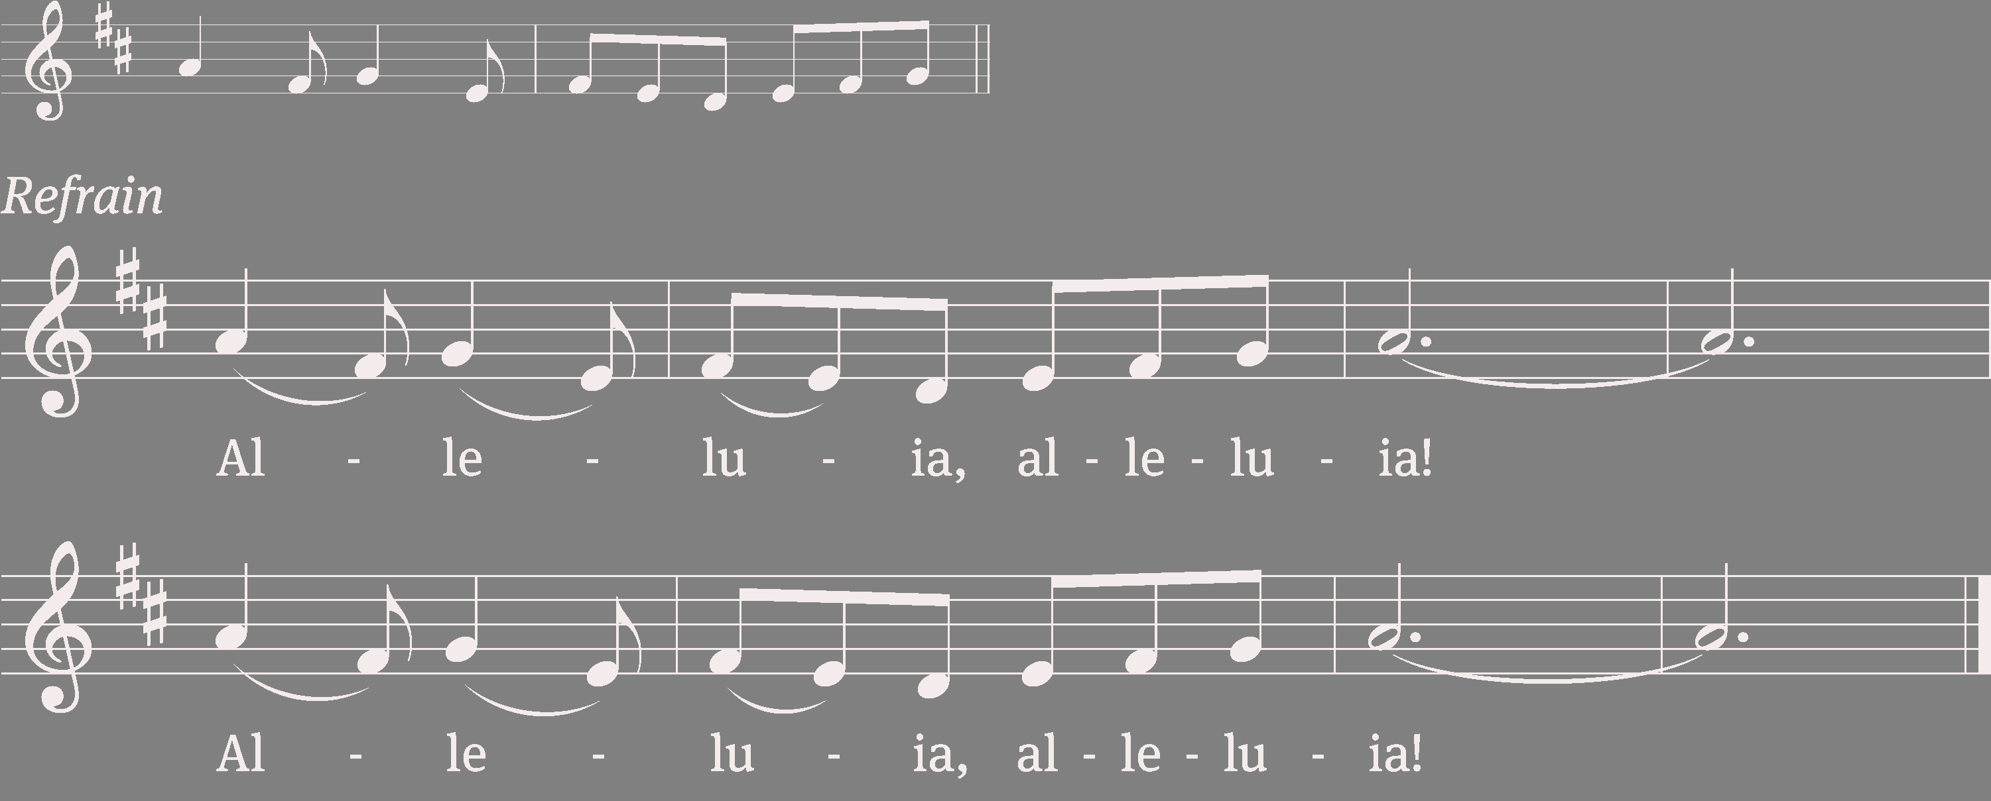
Gospel Acclamation Ephesians 2:8

Slide 29
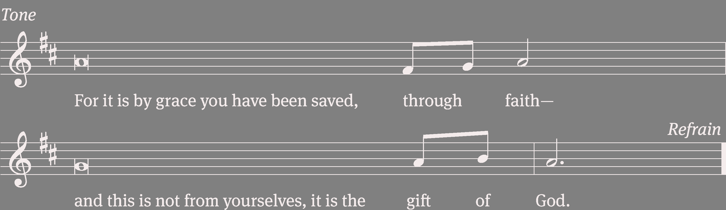
Gospel Acclamation - Setting 3
Tune: © 2010, 2021 GFTSMUSIC Publishing Company, Inc., admin. Music Services. Used by permission: OneLicense no. 707551

Slide 30
Gospel Acclamation
Tune: © 2010, 2021 GFTSMUSIC Publishing Company, Inc., admin. Music Services. Used by permission: OneLicense no. 707551

Slide 31
2nd Reading Matthew 20:1–16, EHV
¹“Indeed the kingdom of heaven is like a landowner who went out early in the morning to hire workers for his vineyard. ²After agreeing to pay the workers a denarius for the day, he sent them into his vineyard. ³He also went out about the third hour and saw others standing unemployed in the marketplace. ⁴To these he said, ‘You also go into the vineyard, and I will give you whatever is right.’ So they went. ⁵Again he went out about the sixth and the ninth hour and did the same thing. ⁶When he went out about the eleventh hour, he found others standing unemployed. He said to them, ‘Why have you stood here all day unemployed?’

Slide 32
2nd Reading Matthew 20:1–16, EHV
⁷“They said to him, ‘Because no one hired us.’
“He told them, ‘You also go into the vineyard.’ ⁸When it was evening, the owner of the vineyard said to his foreman, ‘Call the workers and pay them their wages, starting with the last group and ending with the first.’
⁹“When those who were hired around the eleventh hour came, they each received a denarius. ¹⁰When those who were hired first came, they thought they would receive more. But they each received a denarius too. ¹¹After they received it, they began to grumble against the landowner: ¹²‘Those who were last worked one hour, and you made them equal to us who have endured the

Slide 33
2nd Reading Matthew 20:1–16, EHV
burden of the day and the scorching heat!’
¹³“But he answered one of them, ‘Friend, I am doing you no wrong. Did you not make an agreement with me for a denarius? ¹⁴Take what is yours and go. I want to give to the last one hired the same as I also gave to you. ¹⁵Can't I do what I want with my own money? Or are you envious because I am generous?’ ¹⁶In the same way, the last will be first, and the first, last.”
The Gospel of the Lord.
Praise be to you, O Christ!

Slide 34
Children’s Message

Slide 35
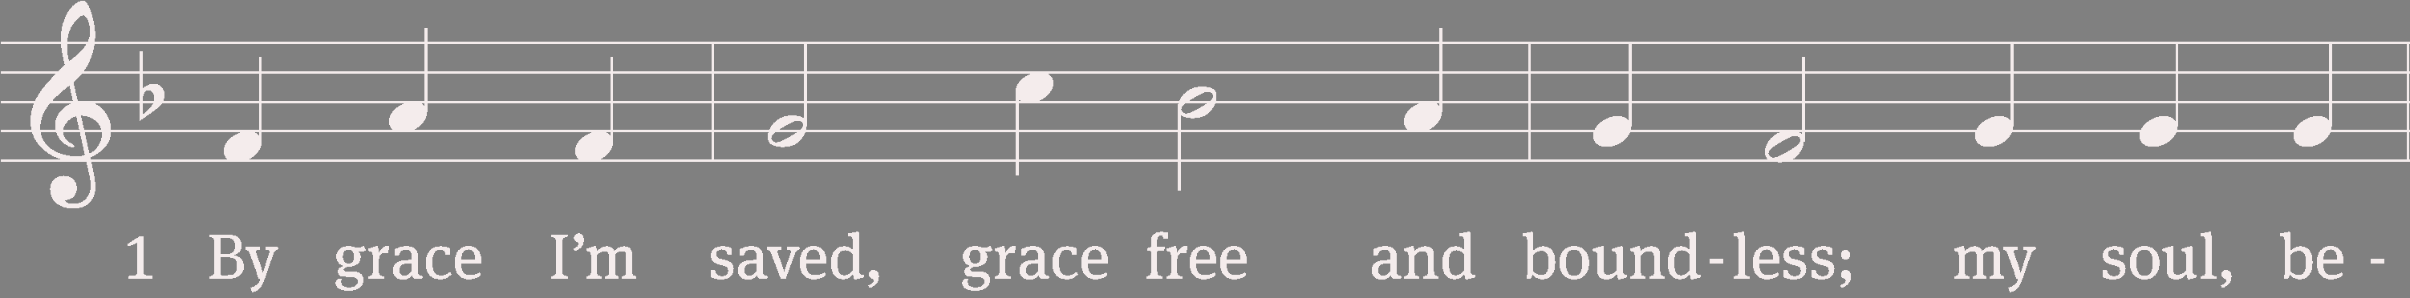
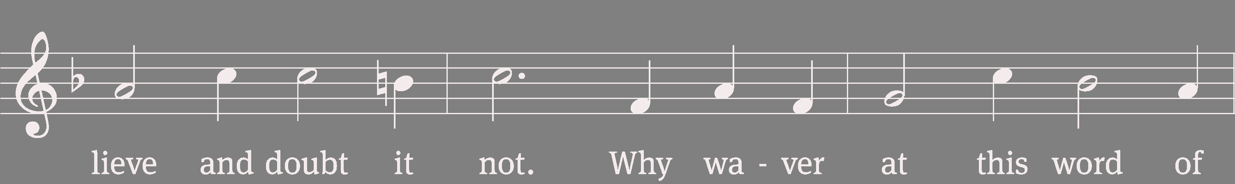
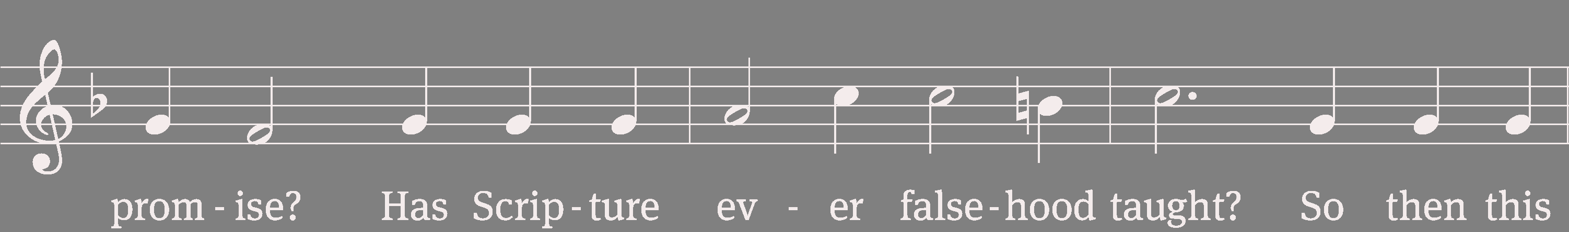
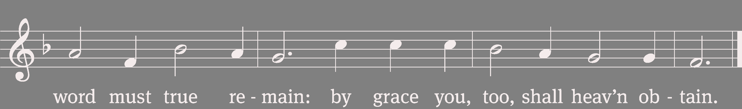
575 By Grace I’m Saved

Slide 36
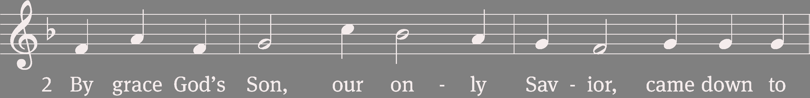
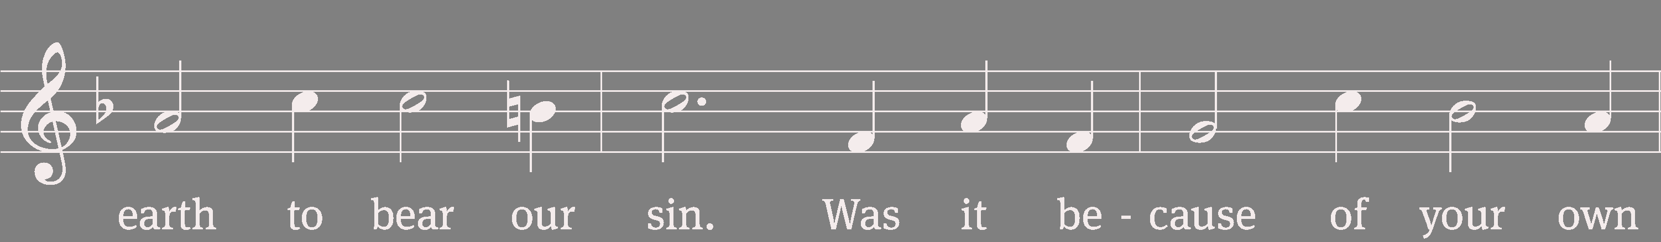
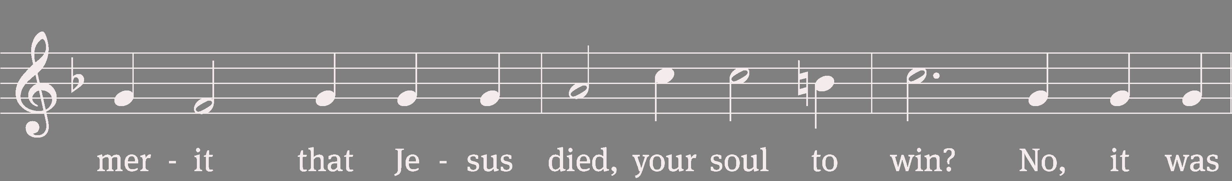
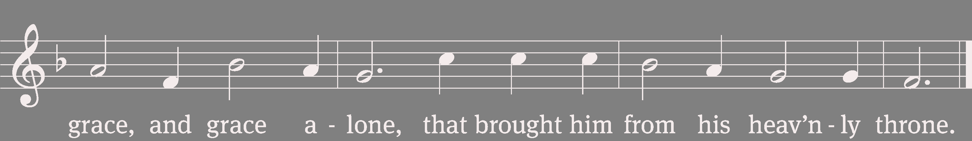
575 By Grace I’m Saved

Slide 37
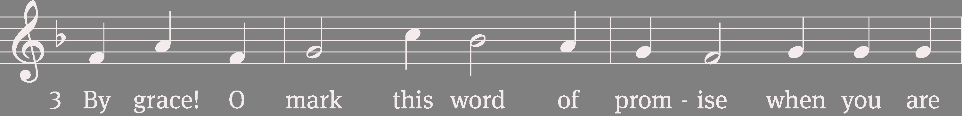
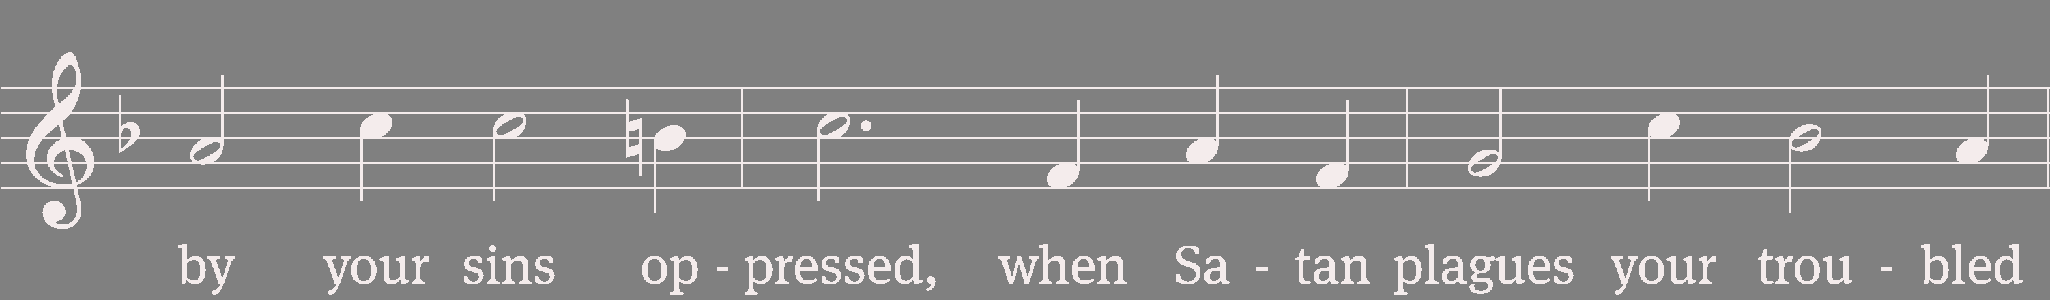
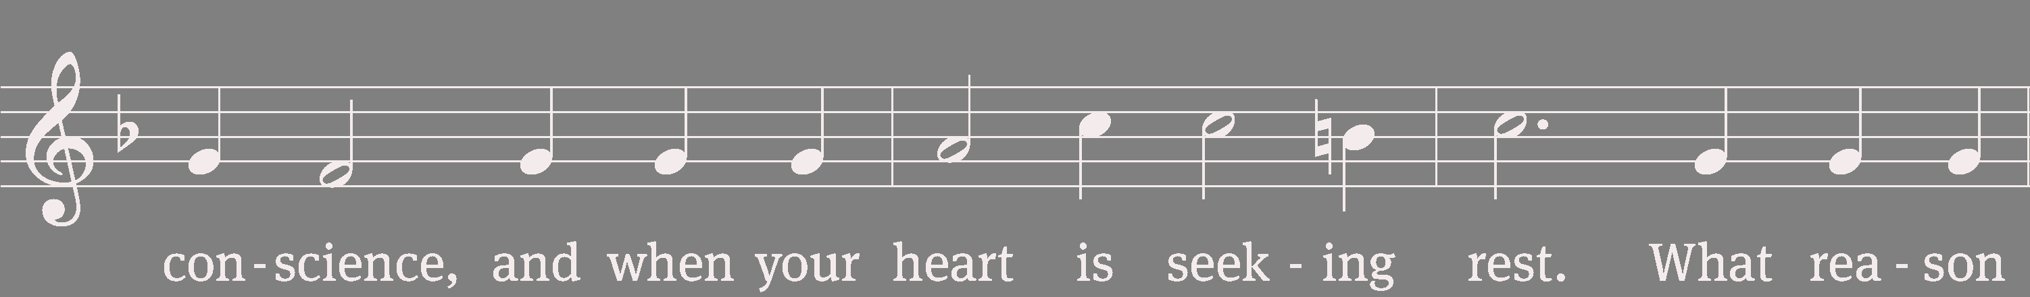

575 By Grace I’m Saved

Slide 39




575 By Grace I’m Saved

Slide 40




575 By Grace I’m Saved
Text: Christian L. Scheidt, 1709–1761, abr.; tr. The Lutheran Hymnal, 1941, alt.
Tune: Cornelius H. Dretzel, 1697–1775
Text and tune: Public domain

Slide 41
Nicene Creed
We believe in one God, the Father, the Almighty,
maker of heaven and earth,
of all that is, seen and unseen.
We believe in one Lord, Jesus Christ, the only Son of God,
eternally begotten of the Father,
God from God, Light from Light,
true God from true God,
begotten, not made,
of one being with the Father.
Through him all things were made.

Slide 42
Nicene Creed
For us and for our salvation, he came
down from heaven,
was incarnate of the Holy Spirit and the
Virgin Mary, and became truly human.
For our sake he was crucified under
Pontius Pilate.
He suffered death and was buried.
On the third day he rose again in
accordance with the Scriptures.
He ascended into heaven
and is seated at the right hand of
the Father.
He will come again in glory to judge
the living and the dead,

Slide 43
Nicene Creed
and his kingdom will have no end.
We believe in the Holy Spirit,
the Lord, the giver of life,
who proceeds from the Father
and the Son,
who in unity with the Father
and the Son is worshiped
and glorified,
who has spoken through the prophets.
We believe in one holy Christian
and apostolic Church.
We acknowledge one baptism for the
forgiveness of sins.

Slide 44
Nicene Creed
We look for the resurrection of the
dead and the life of the world to come.
Amen.

Slide 45
Prayer of the Church
We pray that we would learn to become like our divine Master, who wants all to be saved and to come to the knowledge of the truth, let us pray to the Lord:
Lord, have mercy.
We pray for this nation, that the Lord would bless all authorities, that they would serve on behalf of the defenseless, let us pray to the Lord:
Lord, have mercy.

Slide 46
Prayer of the Church (cont.)
We pray for those who are in any need, that God would keep them in the certainty that to live is Christ and to die is gain, let us pray to the Lord:
Lord, have mercy.
We pray for those still being instructed, that they may be nourished in hope and come soon to the Lord’s table, let us pray to the Lord:
Lord, have mercy.

Slide 47
Prayer of the Church (cont.)
We pray for all who commune this day, that they may receive our Savior’s body and blood in faith for the forgiveness of their sins. Let us pray to the Lord.
Lord, have mercy. Amen

Slide 48
Offering
Online giving options: 1) http://stpeterwels.com; or 2) the QR code at the end of the bulletin.

Slide 49


750 We Give Thee but Thine Own v.1

Slide 50


750 We Give Thee but Thine Own v. 2
Text: William W. How, 1823–1897, abr.
Tune: William H. Monk, 1823–1889
Text and tune: Public domain

Slide 51
Sacrament Announcement

Slide 52


Preface

Slide 53

Preface
Tune: David Kauffman; William Gokelman
Tune: © 2021 GFTSMUSIC Publishing Company, Inc., admin. Music Services. Used by permission: OneLicense no. 707551

Slide 54
Prayer of Thanksgiving
Blessed are you, Lord God, eternal King and gracious Father. In love you made us the crown of your creation. In mercy you planned our salvation. In grace you sent your Son to redeem us from sin.
We remember and give you thanks that your eternal Son, Jesus Christ, became flesh and made his dwelling among us, that he willingly placed himself under law to redeem those under law, that he humbled himself by becoming obedient to death on a cross, that he has destroyed death and has brought life and immortality to light through the gospel.

Slide 55
Prayer of Thanksgiving (cont)
Bless us as we receive your Son’s body and blood in this Sacrament. Forgive our sins, increase our faith, strengthen our fellowship, and deepen our longing for the day when Christ will welcome us to his eternal feast. Praise and thanks and honor and glory be to you, O God our Father, and to your Son and to the Holy Spirit, one God, now and forever.
Amen.

Slide 56
Lord’s Prayer
Our Father in heaven,
hallowed be your name,
your kingdom come,
your will be done on earth as in heaven.
Give us today our daily bread.
Forgive us our sins,
as we forgive those
who sin against us.
Lead us not into temptation,
but deliver us from evil.
For the kingdom, the power,
and the glory are yours
now and forever. Amen.

Slide 57
Words of Institution
Our Lord Jesus Christ, on the night he was betrayed, took bread; and when he had given thanks, he broke it and gave it to his disciples, saying, “Take and eat; this is my (+) body, which is given for you. Do this in remembrance of me.”
Then he took the cup, gave thanks, and gave it to them, saying, “Drink from it, all of you; this is my (+) blood of the new covenant, which is poured out for you for the forgiveness of sins. Do this, whenever you drink it, in remembrance of me.”

Slide 58
Pax Domini
The peace of the Lord be with you always.
Amen.

Slide 59




Lamb of God

Slide 60


Lamb of God
Tune: William Gokelman; David Kauffman
Tune: © 2010 GFTSMUSIC Publishing Company, Inc., admin. Music Services. Used by permission: OneLicense no. 707551

Slide 62


662 Draw Near

Slide 63




662 Draw Near

Slide 64
662 Draw Near

Slide 65




662 Draw Near

Slide 66
662 Draw Near

Slide 67




662 Draw Near

Slide 68
662 Draw Near

Slide 69




662 Draw Near

Slide 70
662 Draw Near
Text: Latin, 7th cent., abr.; tr. John Mason Neale, 1818–1866, alt.
Tune: Steven R. Janco, b. 1961
Text: Public domain
Tune: © 1992 World Library Publications, a division of GIA Publications, Inc. Used by permission: OneLicense no. 707551

Slide 72




582 Not unto Us

Slide 73




582 Not unto Us

Slide 74




582 Not unto Us

Slide 75




582 Not unto Us
Text: Kurt J. Eggert, 1923–1993, alt.
Tune: Kurt J. Eggert, 1923–1993
Text and tune: © 1975 Kurt J. Eggert, admin. Northwestern Publishing House. Used by permission: OneLicense no. 707551

Slide 77
Thanksgiving
Give thanks to the Lord, for he is good;
his mercy endures forever.

Slide 78
Proclamation
Whenever we eat this bread and drink this cup,
we proclaim the Lord’s death until he comes.

Slide 79
Post-Communion Prayer
O God the Father, source of all goodness, in your loving-kindness you sent your Son to share our humanity. We thank you that through him you have given us pardon and peace in this Sacrament. We also pray that you will not forsake us but will rule our hearts and minds by your Holy Spirit so that we willingly serve you day after day; through Jesus Christ our Lord, who lives and reigns with you and the Holy Spirit, one God, now and forever.
Amen.

Slide 80
Blessing
The Lord bless you and keep you.
The Lord make his face shine on you and be gracious to you.
The Lord look on you with favor and (+) give you peace.
Amen.

Slide 81


584 Jesus Loves Me

Slide 82


584 Jesus Loves Me

Slide 83


584 Jesus Loves Me

Slide 84
584 Jesus Loves Me
Text: Anna B. Warner, 1820–1915, abr.; Spanish tr. unknown
Tune: William B. Bradbury, 1816–1868
Text and tune: Public domain

Slide 85
Acknowledgments
Unless otherwise noted, Scripture quotations are from the Holy Bible, Evangelical Heritage Version® (EHV®) © 2017 Wartburg Project. All rights reserved. Used by permission. Liturgical and musical settings of Scripture based on text from The Holy Bible, New International Version®, NIV®. Copyright © 1973, 1978, 1984, 2011 by Biblica, Inc.TM Used by permission of Zondervan. All rights reserved worldwide. Software distributed in partnership with Northwestern Publishing House.
Created by Christian Worship: Service Builder © 2026 Concordia Publishing House.

