Slide 1

LABEL designer

Slide 2
Team Members
Rohan Sunil
Sana Fathima
Jayadev G

Slide 3
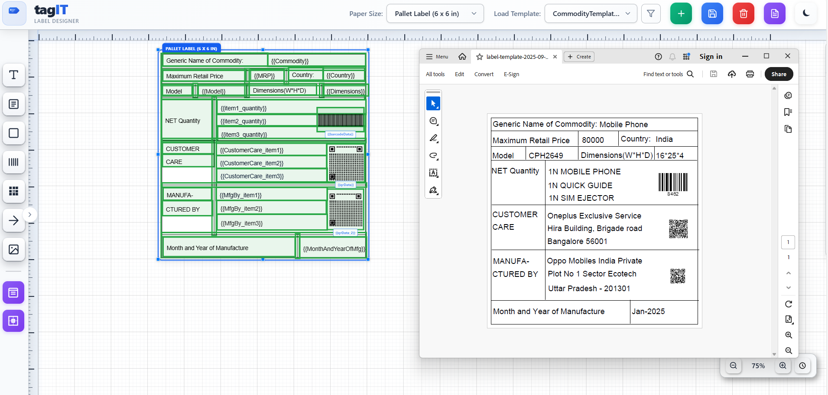

Slide 4
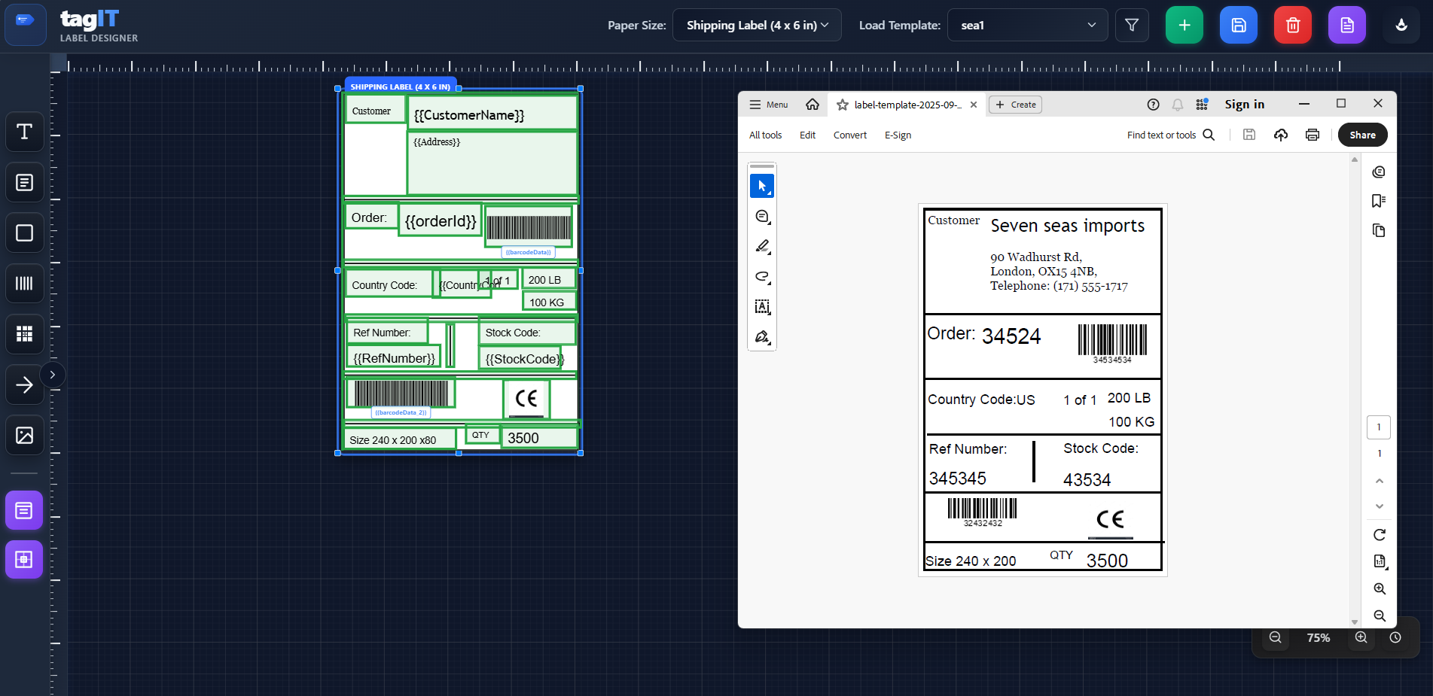

Slide 5
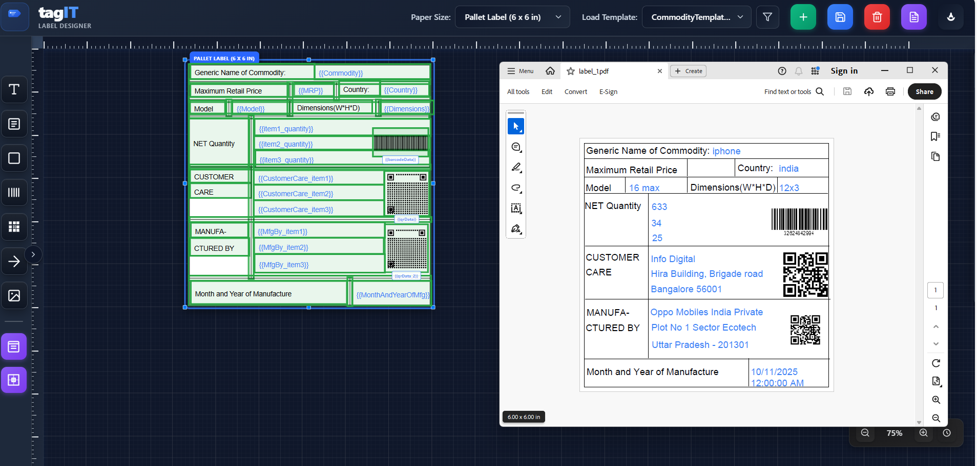

Slide 6
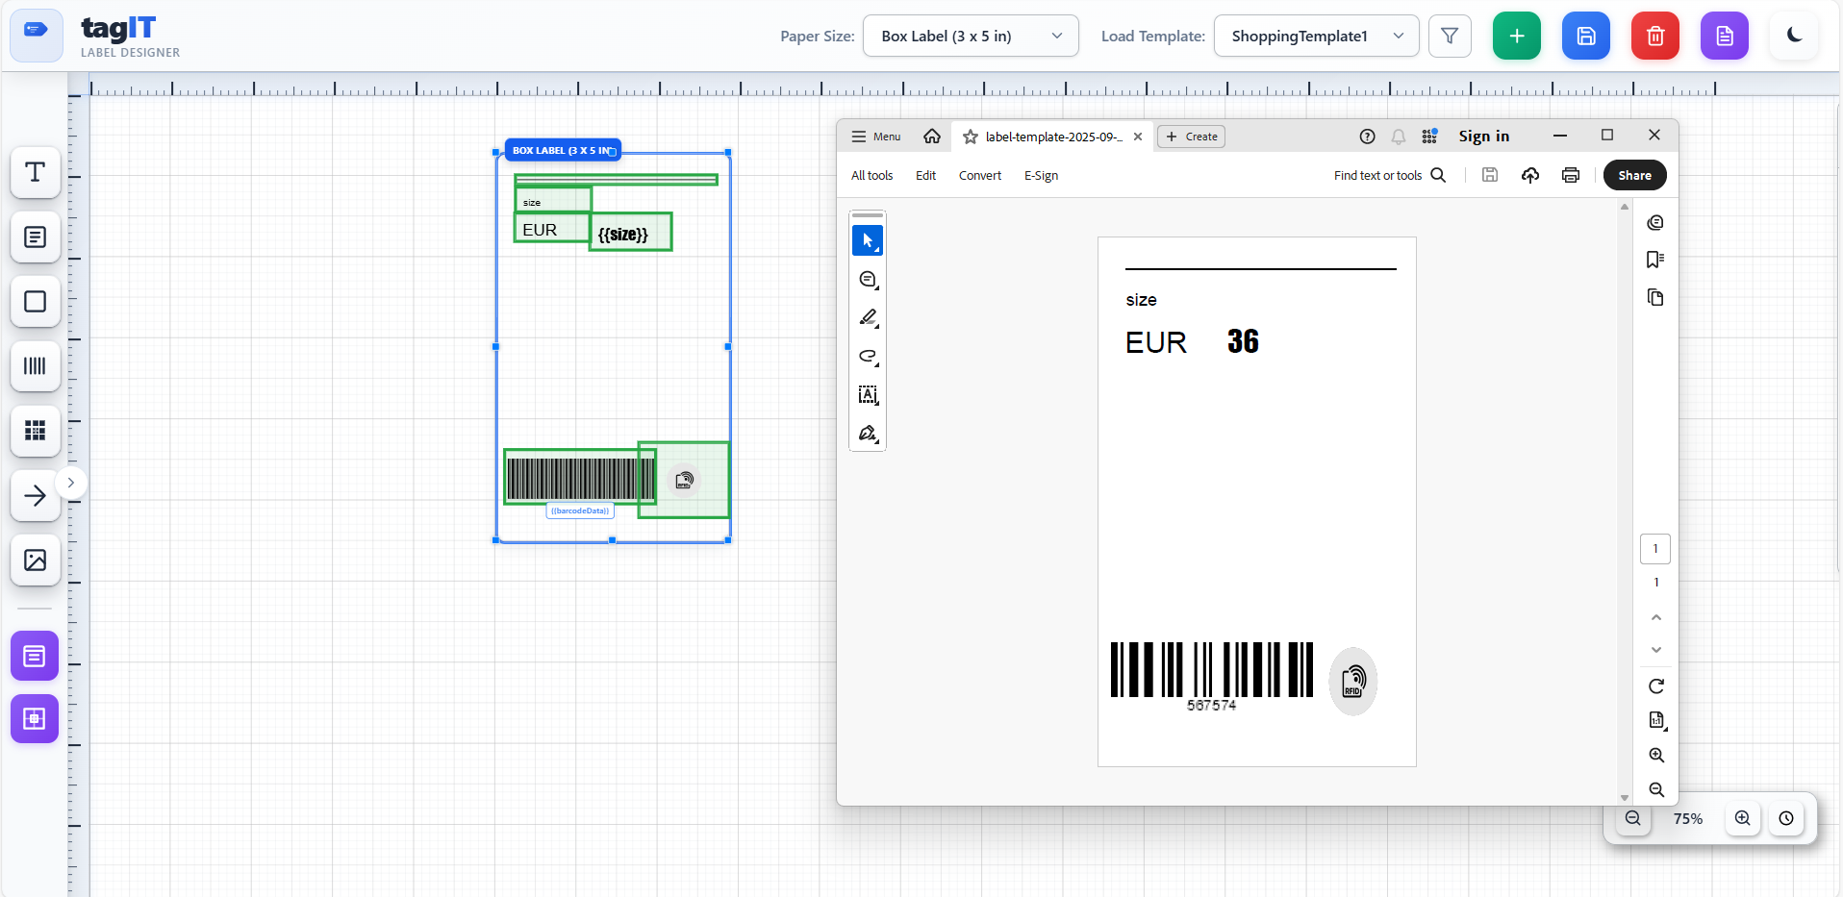

Slide 7
