Slide 1
Maps, Iterators and Comparisons

Slide 2
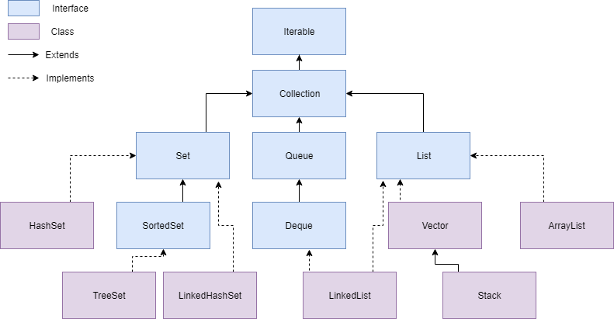
Collection Hierarchy (recap)

Slide 3
Collection Interface (recap)
Iterable – Everything can be “iterated through”. i.e. you can look at data within these items, one by one.
Collection – An Interface in Java that provides an architecture to store and manipulate objects
Set – A collection which cannot contain duplicate elements.
HashSet, LinkedHashSet, SortedSet
Queue – An ordered collection of objects which utilizes a First-in-first-out principle.
Priority Queue, Deque
List – An ordered collection of objects which utilizes indexes.
ArrayList, Vector, LinkedList

Slide 4
Generics
All Java Collections use “Generics”: <Type>
Generics act as a specifier (and limiter) for a type of data to be used within a class or interface.
Generics can be used when writing classes, interfaces and methods*.
*To use generics in a method, the containing class or interface must use generics
Generic types must be an object, primitives are not allowed. ‘Generic primitives’ are achieved using wrapper classes.
Generics are a way of saying, “I don’t know what type this will be right now, but when this class is instantiated into an object, a type will be provided”
ArrayList<String> strList = new ArrayList<String>();

Slide 5
Iterable
The Iterable interface specifies the behavior for being able to return an Iterator.
Implementing classes must define the .iterator() method that returns an Iterator type object.
Implementing Iterable is mandatory for using an “enhanced for” loop
The Collection interface extends the Iterable interface. All Java collections are iterable/have iterators

Slide 6
Iterators
How do you traverse (retrieve each element in) a collection?
Lists: you can use the size() element to get the total number of elements, and get(int index) from 0 … size()
Sets and Queues don’t use an index though…
An Iterator is an interface that specifies the behavior of blindly moving through each element in a collection
Calling the iterator() method of a Collection returns an Iterator object capable of unidirectional “blind” navigation
Unidirectional: Can only move to the “next” element
Blind: no sorting is guaranteed, no telling what the “next” element is going to be

Slide 7
Iterator/Enhanced For Loop Example
public void iterate(HashSet someSet) {
Iterator iter = someSet.iterator();
while (iter.hasNext()) {
System.out.println(iter.next());
}
}
public void enhancedFor(HashSet<String> stringSet) {
for(String s : stringSet)
System.out.println(s);
}

Slide 8
Comparing Collection Elements
When you need to sort a collection, you need to compare two elements at a time to evaluate which comes before or after the other.
Java has two interfaces for this: Comparable, and Comparator
Comparing two objects, A and B produces an int…
If A comes before B, the result should be less than 0
If A has the same place as B, the result should be 0
If A comes after B, the result should be greater than 0.
The specific output value is never guaranteed!

Slide 9
Comparable vs Comparator
Comparable is implemented by the object itself. It defines a single method for comparing an object against another
public interface Comparable<T> { int compareTo(T other); }
Comparator is implemented by a 3rd party class, and can define a single method for comparing two objects.
public interface Comparator<T> { int compare(T objectA, T objectB); }
Comparable defines a default comparison behavior for an object. Comparator defines custom behavior.

Slide 10
Comparable Example
public class Student implements Comparable<Student> {
int studentID;
String fist;
String last;
// The natural ordering of students is by
// Student ID.
public int compareTo(Student other) {
return this.studentID – other.studentID;
}
}

Slide 11
Comparator Example
public class Student implements Comparable<Student> {
int studentID;
String first;
String last;
}
public class NameComparator implements Comparator<Student> {
// Comparing students by their name involves sorting by
// last name, then first name. This is equivalent to
// reversing the full names and sorting alphabetically.
public int compare(Student stud_A, Student stud_B) {
String fullA = stud_A.last + “ “ + stud_A.first;
String fullB = stud_B.last + “ “ + stud_B.first;
return fullA.compareTo(fullB);
}
}

Slide 12
Collection vs Collections
Collection is an interface that declares mandatory behavior for collections
Collections is a utility class filled with static methods that can be run with Collection subclasses.
Be sure to review the documentation for more detailed information on any of the methods within the Collections class.

Slide 13
Collections
Some of these static methods inlcude:
reverse()
A method that takes a list and reverses the order of elements in that specified list.
shuffle()
A method that randomly places elements within a list.
sort()
An overloaded method that takes a list (byte, char, double, float, int, long, short or object) and potentially a comparator, placing the elements in specified order according to natural ordering (if no comparator is given and a natural ordering exists in the jvm) or the order specified by the comparator.

Slide 14
Arrays
Arrays is a utility class that can be used on array objects, such as sorting, index, etc…
Some of these static methods include:
toString()
An overloaded toString methods which takes a boolean, byte, char, double, float, int, long, short or object array, and prints a string representation of the contents within the array.
binarySearch()
An overloaded method that takes two parameters an array (byte, char, double, float, int, long, short or object) and a value with a matching datatype. It then performs a binary search on the given array for the given value.
This method assumes that the array provided is sorted.
sort()
An overloaded method that takes an array (byte, char, double, float, int, long, short or object) and sorts the values in ascending numerical order. When given an Object array, the ordering of the objects can only be performed if the object implements the comparable interface and provides an implementation for the compareTo method

Slide 15
Java Maps
Maps in Java do not implement the Collection interface or the Iterable interface
Map<String, Integer> mp = new Hashmap<> ();
You can insert new key:value pairs using the put() method.
mp.put(“a”,1)
However, the keySet() and values() methods both return Iterable collections of all the keys and values in the Map, respectively.
You can iterate over a keyset to facilitate iterating through a map intuitively.

Slide 16
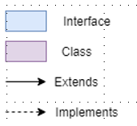
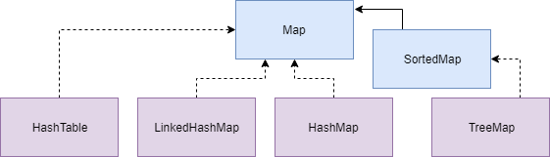
Map

Slide 17
Maps
HashMap
A collection that stores algorithmically data in Key-Value pairs, in which the value is linked to a key, and the key is then hashed and used as the index of the value.
Hashtable
Similar to a HashMap, however, a HashTable is synchronized (thread safe).
SortedMap
A collection that stores data in Key-Value pairs and holds the keys in sorted order based on natural ordering or based on the implementation of the Comparator interface for the elements in the collection

