Slide 1
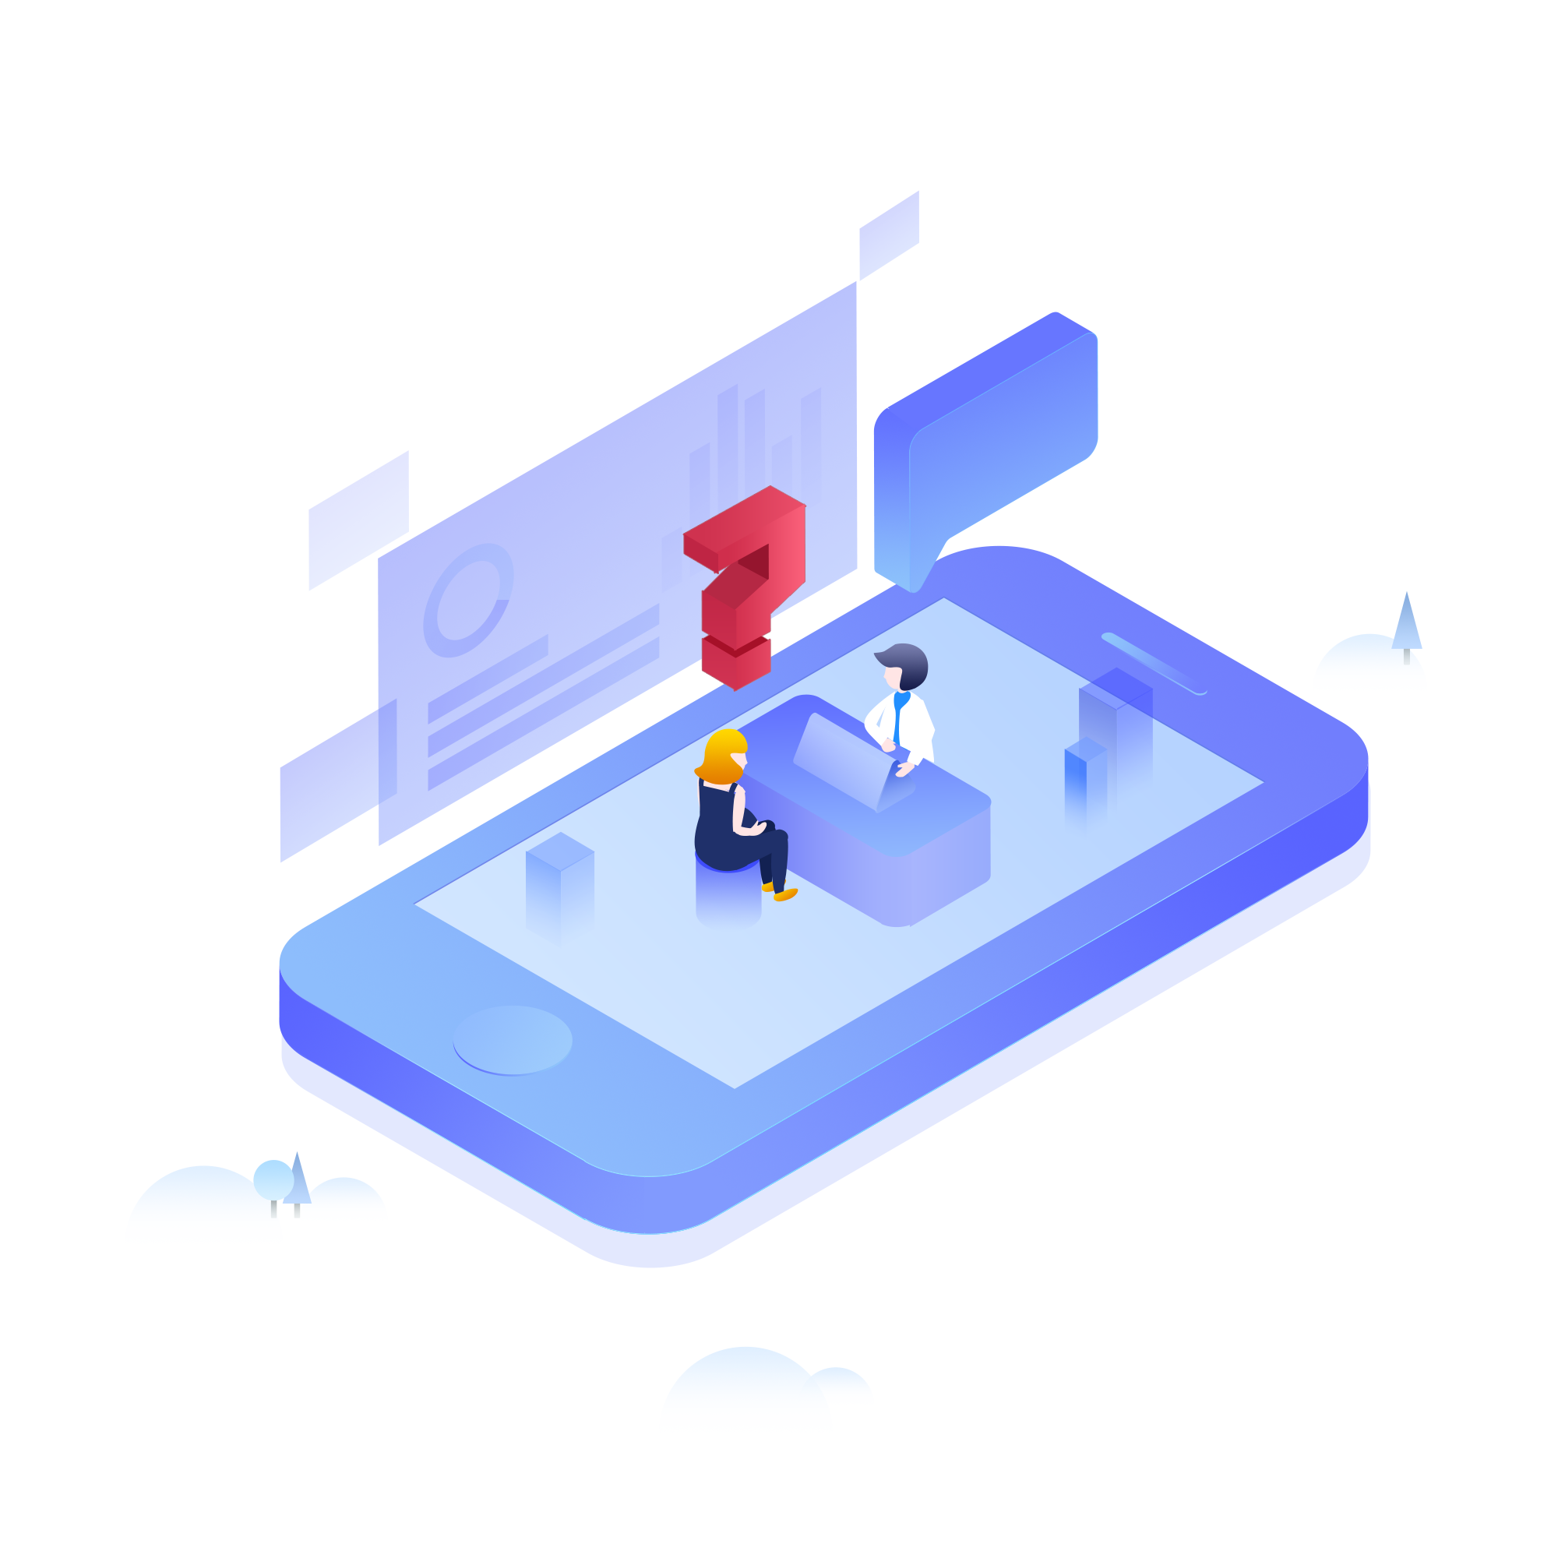
JDHAcks Doctor@Fingertip Social ImpaCt
By : Jaimini Dave [ jd hacks]

Slide 2
contents
Idea
Approach of my Project
Innovation & Scalability of the projects.
The business approach towards the project.
Tech Stacks & Azure Services Used.
Sample Screens
By : Jaimini Dave [ jd hacks]

Slide 3
Idea
My main objective of developing doctor@fingertip app is to bridge gap between doctors & patients in addition to this when we have any kind of viral or bacterial infection or such kind of diseases which spreads very fast through simple general notification kind of thing we can just alert the users across the globe as well as we can provide them authenticate information.
By : Jaimini Dave [ jd hacks]

Slide 4
Requirements & Implementation of idea
We can implement this idea by studying present doctors &patients system
There are two modules of the projects (Doctors, Patients).
There is one module for medical representative which becomes bridge between patients & doctors
Doctors directly answers the questions asks by patients and patients asks questions to doctors.
I have used Android platform for mobile app development and for back end api development we can use Azure Virtual Machines, AZURE SQL DB for db storage other Azure technologies as per needs.
By : Jaimini Dave [ jd hacks]

Slide 5
Innovation & scalability
As per my knowledge there is no any app or kind of solution available in the market which connects patients & doctors globally.
As every country and origin of the world has different medical rules & regulations in addition to that peoples food habits are also different.
In terms of innovation in my app there are lots of areas we can innovate by using other AI & ML technology like forwarding queries to the correct doctors, suggesting diet based on age & medical reports
My app can useful for small region small city as well as whole country or whole state and I can design app accordingly.
By : Jaimini Dave [ jd hacks]

Slide 6
Business approach
My app can be useful for small village doctors to chief medical officer who runs his own hospital.
By this app same subjects or panel of doctors can discuss and share their knowledge with each other as well as they can share their experience of healing critical medical patients
They can able to recommend exact medicine to the patients by addressing specific medical stores in their region which enable business opportunities for medical stores representatives and also for pharma companies
By : Jaimini Dave [ jd hacks]

Slide 7
Tech stacks
Android
Azure SQL Database
Azure Virtual Machine
Azure Functions
Azure DevOps
Azure Blob Storage
Azure Functions
Azure Container Services
By : Jaimini Dave [ jd hacks]

Slide 8
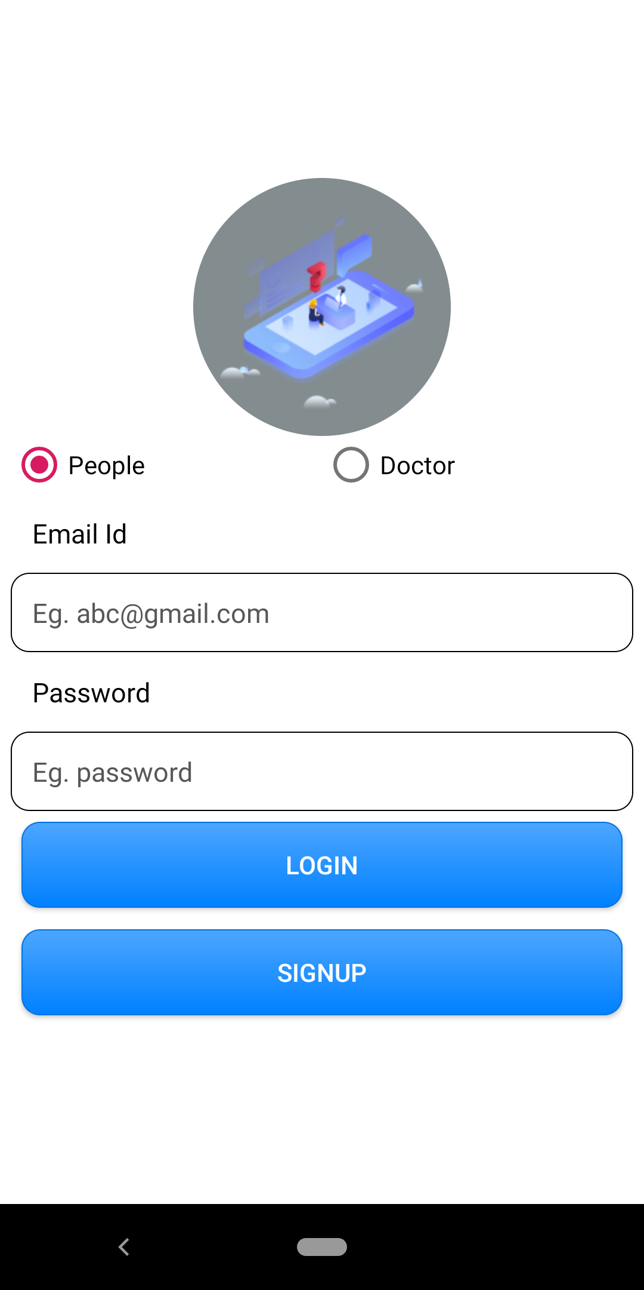
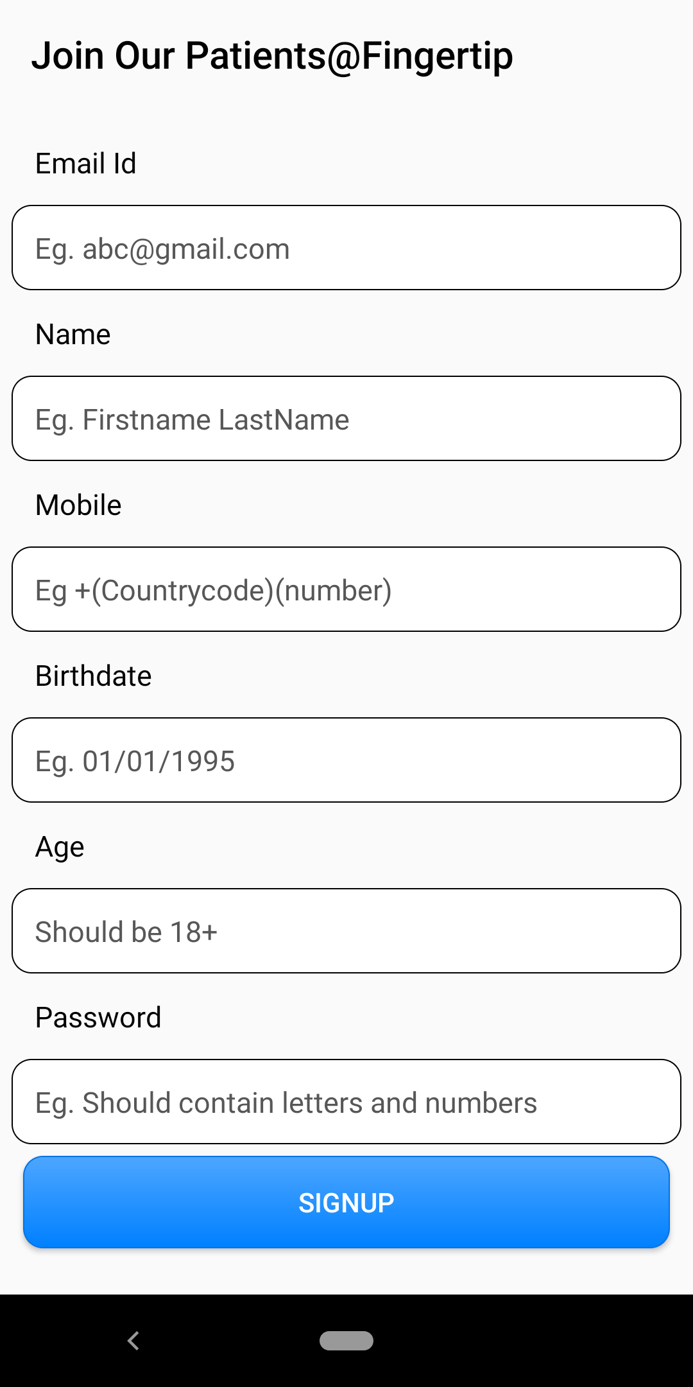
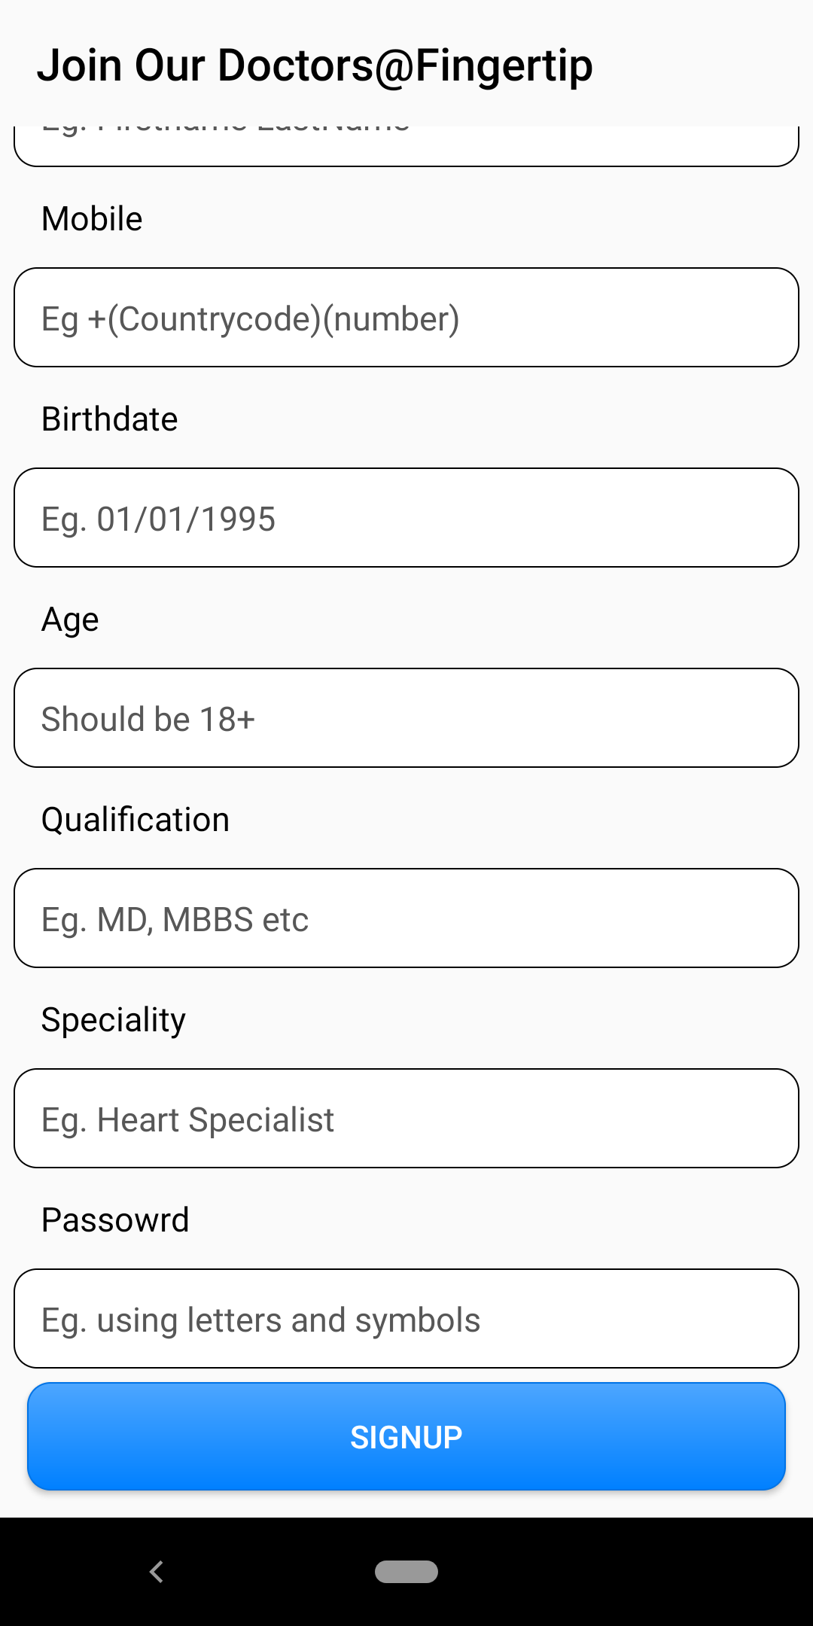
Sample screens

Slide 9
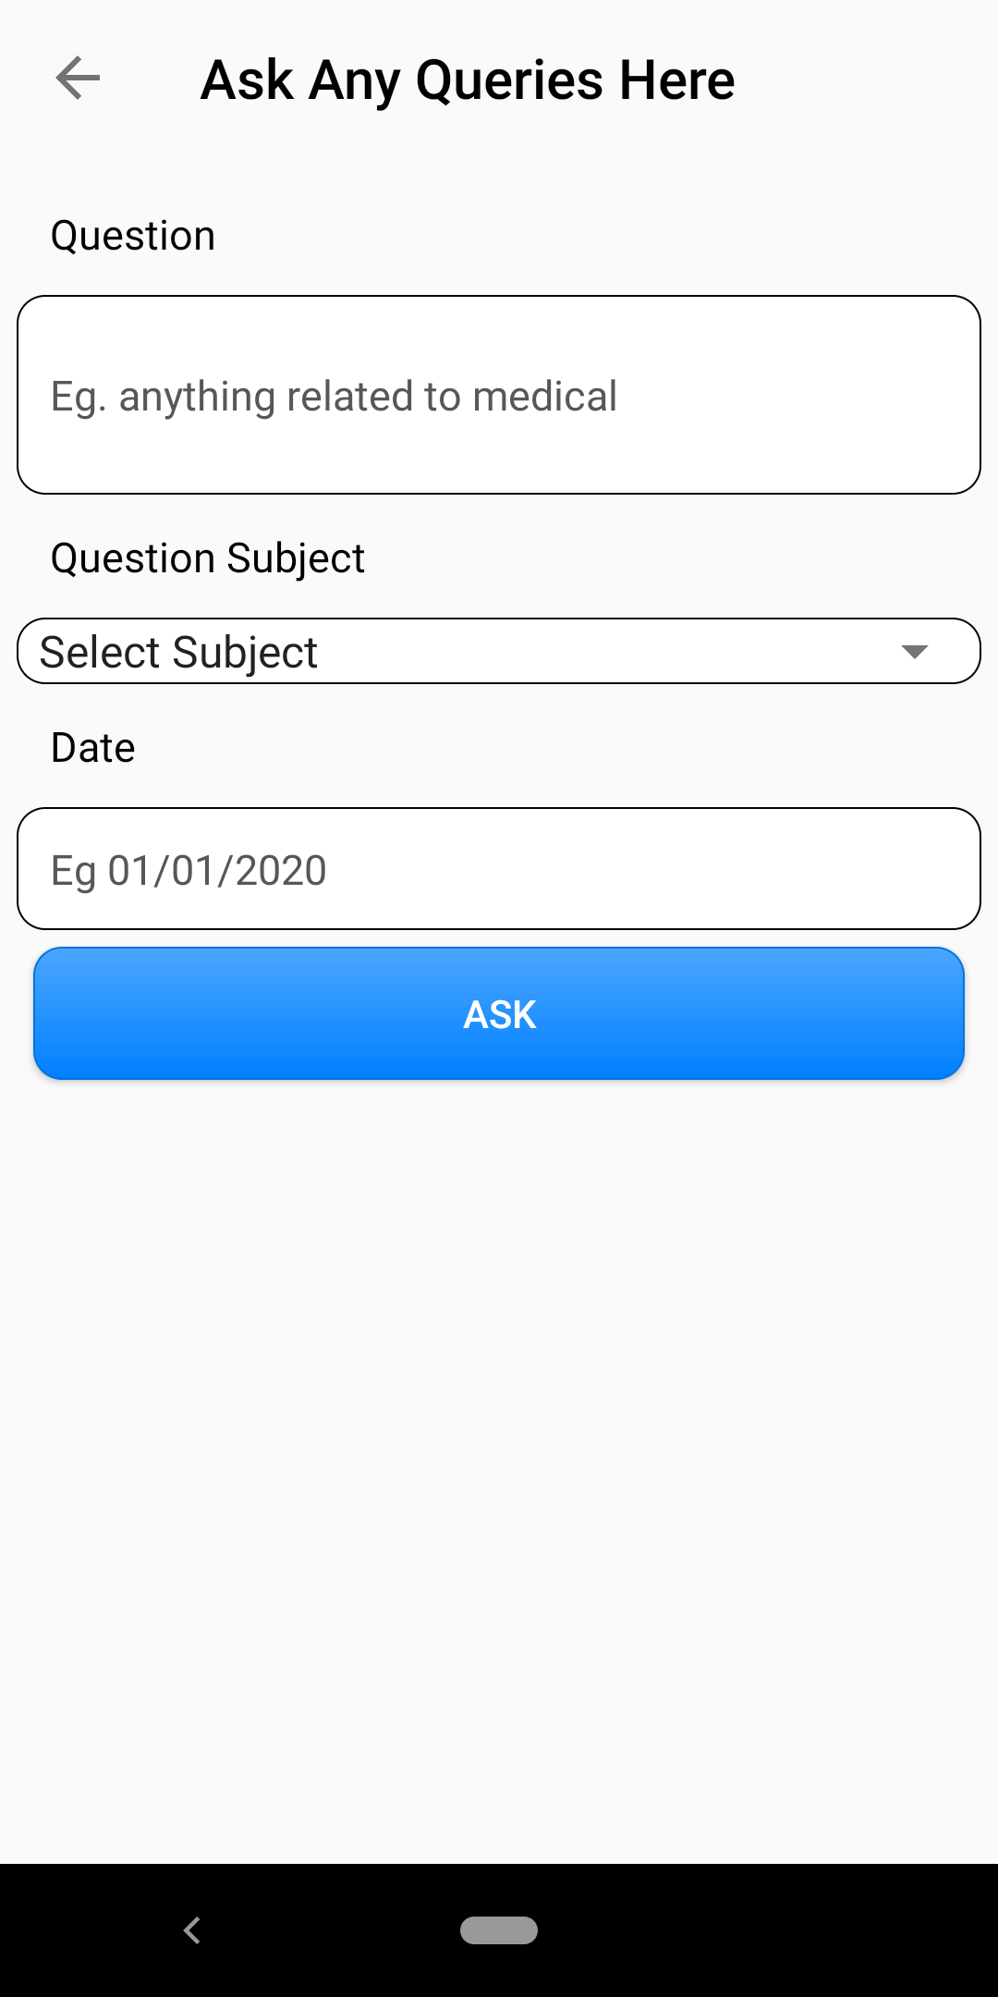
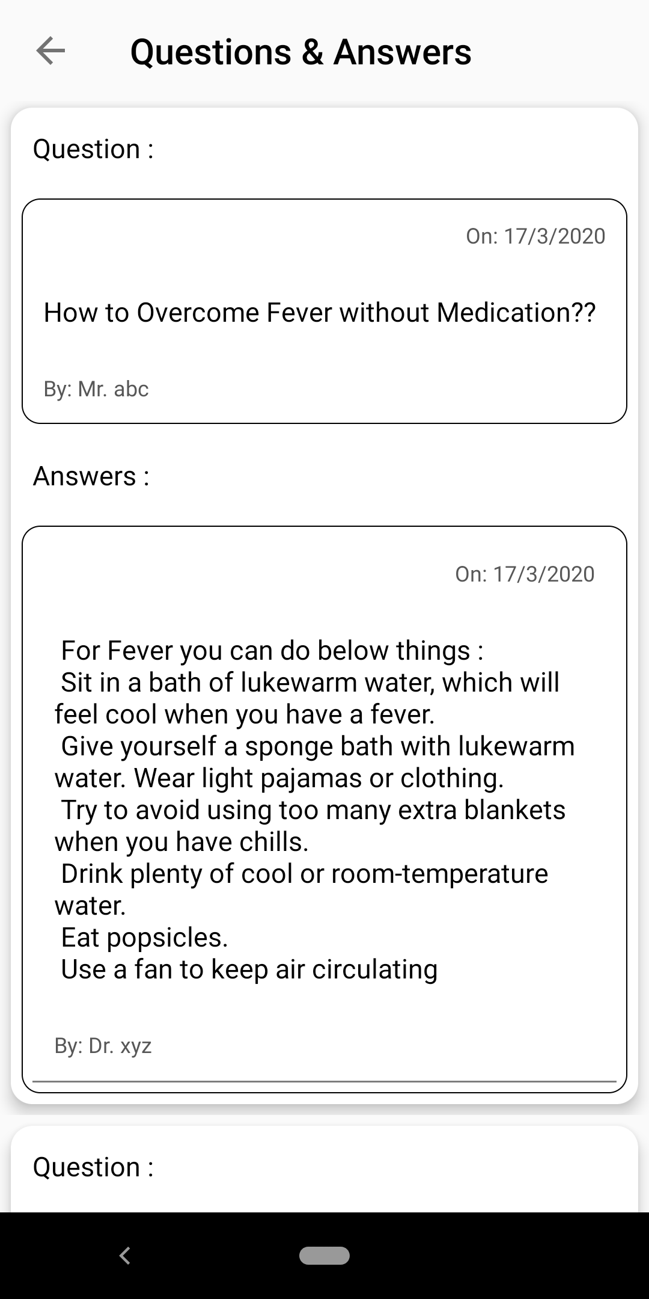
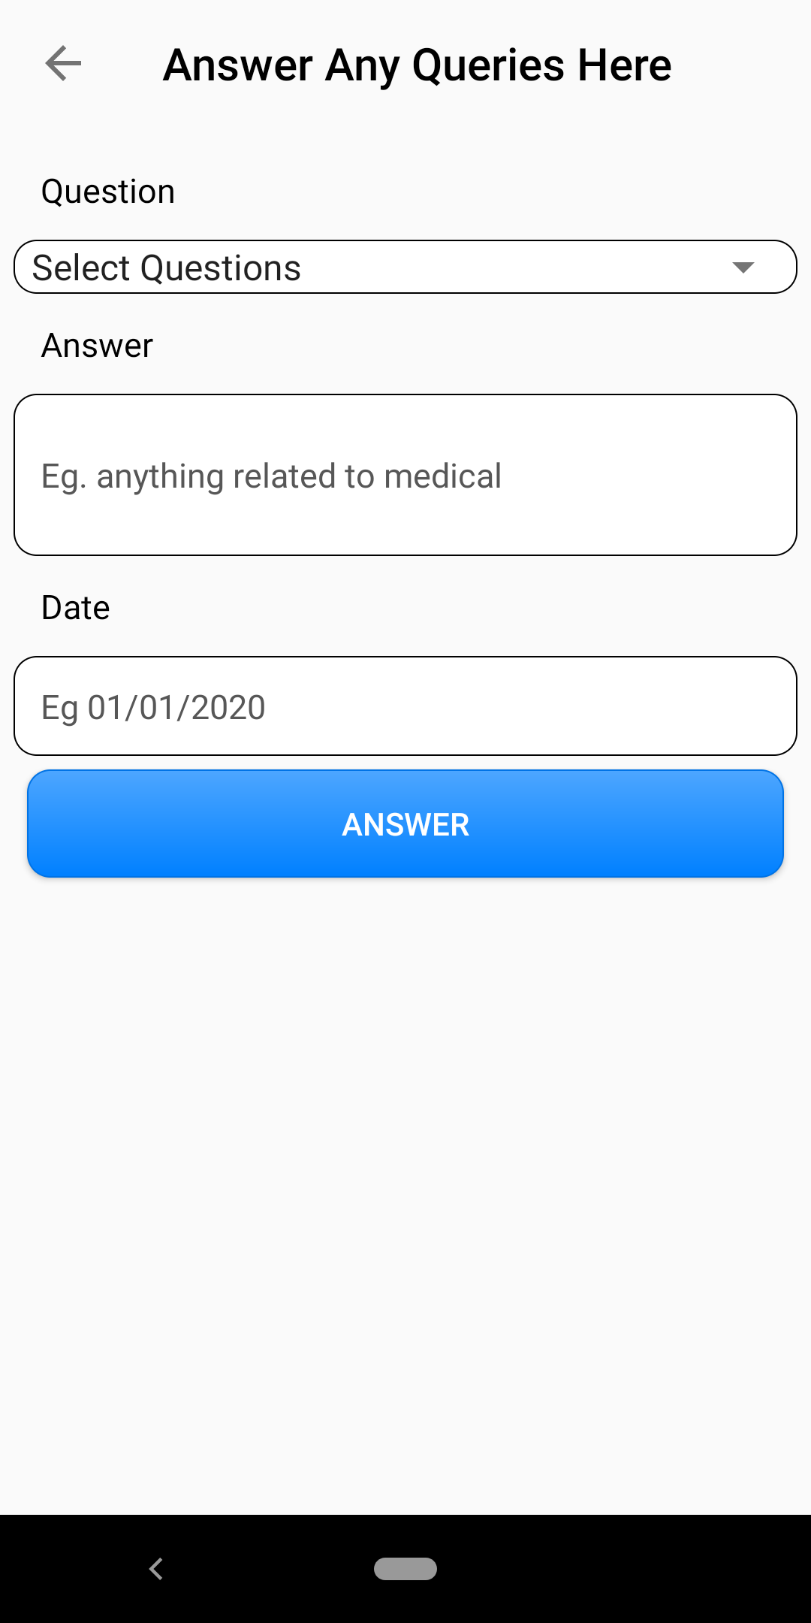
Sample Screens

